Slide 1
Management of T2D in People with HIV
Claudia E. Ramirez Bustamante
Baylor College of Medicine
Notes:
Include version date:_March 2023

Slide 2
Presenter Profile
Dr. Claudia Ramirez Bustamante, MD, obtained her medical degree from Universidad Peruana Cayetano Heredia (Peru). After completing medical school she joined the Lab of Nancy J. Brown at VUMC (TN, USA) where she studied the effect of sildenafil on glucose homeostasis. After this post-doctoral experience, she continued her clinical training in Internal Medicine and Endocrinology with the goal of becoming a translational researcher. Her clinical and research interest focus on HIV-associated lipid dysfunction and transgender medicine.
(Photo)

Slide 3
Conflict of Interest Disclosure Statement
Speaker has nothing to disclose
This program is supported by the Health Resources and Services Administration (HRSA) of the U.S. Department of Health and Human Services (HHS) as part of an award totaling $3,132,205, with 0% financed with non-governmental sources. The contents are those of the author(s) and do not necessarily represent the official views of, nor does mention of trade names, commercial practices, or organizations imply an endorsement by HRSA, HHS, or the U.S. Government. For more information, please visit HRSA.gov. Any trade/brand names for products mentioned during this presentation are for training and identification purposes only.

Slide 4
Learning Objectives
Recognize the strategies for screening and diagnosis of Type 2 Diabetes (T2D) in people with HIV (PWH).
Recognize the importance of person-centered diabetes management.
Identify the main drug-drug interaction between antidiabetic medications and Antiretroviral Therapy (ART).

Slide 5
Outline
Risk factors for T2D in PWH
Screening and diagnosis
Person-centered diabetes management
Therapeutic treatment plans/Dedicated Drug Interactions (DDI’s)
Summary

Slide 6
Diabetes: an HIV-associated comorbidity
As PWH live longer, their risk for developing diabetes has increased along with their lifespans
The prevalence of diabetes in a cohort in the United States of PWH on stable ART ranges between 12.2% (men) and 19.3% (women)
Centers for Disease Control and Prevention. “HIV Among People Aged 50 and Over.” Buchacz et al. Antivir Ther. 2013;18(1):65–75

Slide 7
Determinants of cardiometabolic comorbidities
Warriner et al. Infectious disease clinics of North America 2014.

Slide 8
Screening and diagnosis
PWH should be screened for diabetes before starting ART, followed by 4-6 weeks after therapy initiation, and every 12 months thereafter with fasting blood glucose (BG) (ADA)
Diagnosis should be based on:
fasting glucose ≥ 126 mg/dl
2-hour BG ≥ 200 mg/dl after a 75-gram glucose challenge
HgA1c underestimates glycemia in PWH
Abacavir is associated with greater discordance between A1c and BG levels
American Diabetes Association (ADA) Diabetes care guidelines. 2022.
Sarkar et al. Curr Diab Rep. ; 21(5): 13.

Slide 9
Person-centered diabetes management
People living with chronic diseases must be treated differently depending on which one they acquired first
Traditional risk factors for T2D in the general population apply equally to people with and without HIV → early patient encounters should document the presence of any risk factors
Additional risk factors should also be recognized:
Weight gain after ART initiation “return to health” → specially with Integrase Strand Transfer Inhibitors (INSTIs)

Slide 10
Person-centered diabetes management (cont’d)
Diabetes Care – ADA. January 2023
Notes:
For reference

Slide 11
Diabetes Care – ADA. January 2023
Notes:
Person-centered diabetes management (cont’d²)

Slide 12
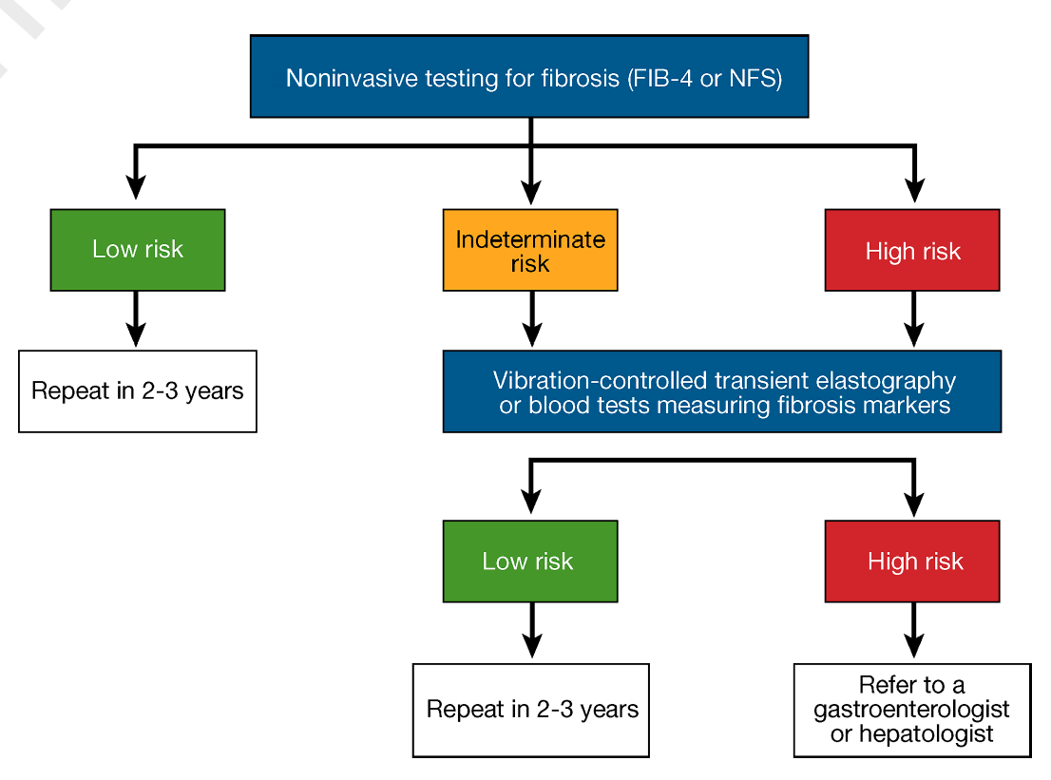
https://www.mdcalc.com/calc/2200/fibrosis-4-fib-4-index-liver-fibrosis
FIB4<1.3 →low risk
FIB4>2.6 → high probability of liver fibrosis
Diabetes Care – ADA. January 2023
Notes:
Person-centered diabetes management (cont’d³)

Slide 13
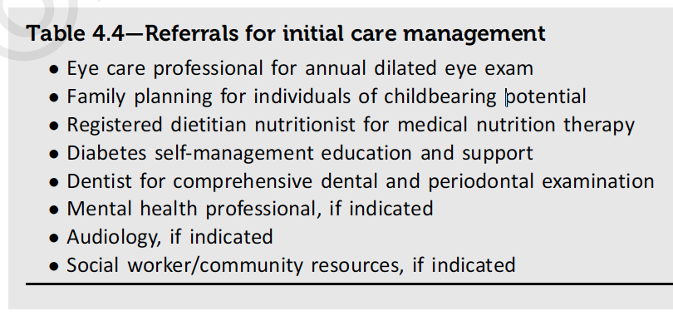
Person-centered diabetes management (cont’d)
Diabetes Care – ADA. January 2023
Notes:
Person-centered diabetes management (cont’d⁴)

Slide 14
Diabetes Care – ADA. January 2023
Notes:
Person-centered diabetes management (cont’d⁵)

Slide 15
Diabetes Care – ADA. January 2023
Notes:
For reference

Slide 16
Cardiorenal risk reduction in high-risk patients
Diabetes Care – ADA. January 2023
Notes:
For reference

Slide 17
Glycemic and weight management goals
Diabetes Care – ADA. January 2023
Notes:
For reference

Slide 18
Achieving and maintaining glycemic and weight management goals
Diabetes Care – ADA. January 2023
Notes:
Diabetes self-management education and support (DSMES)
CGM= continuous glucose monitoring
SDOH= social determinants of health

Slide 19
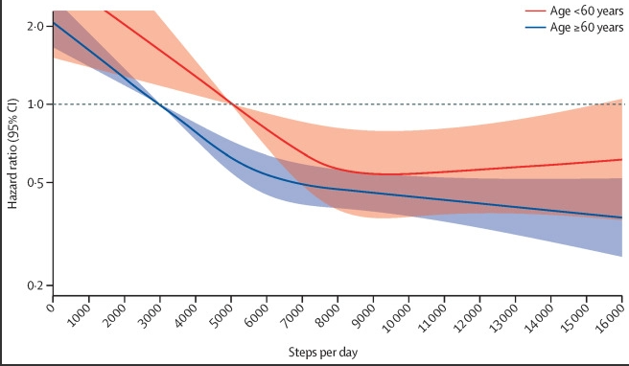
Life-style changes
Steps per day vs all-cause mortality
Lancet Public Health 2022; 7: e219–28

Slide 20
GLP-1 receptor agonist
Increases glucose-dependant insulin secretion, decreases inappropriate glucagon secretion, and slows gastric emptying
Examples: liraglutide, semaglutide, exenatide once weekly, tirzepatide
Liraglutide is associated with a reduction in the composite primary endpoint of non-fatal myocardial infarction, non-fatal stroke, and Cardiovascular (CV)-related death
Notes:
Examples: liraglutide, semaglutide, exenatide once weekly, tirzepatide

Slide 21
GLP-1 receptor agonist
Contraindications
Personal or family history of medullary thyroid cancer or multiple endocrine neoplasia type 2 (MEN2)
Side effects
Weight loss***
GI side effects
Worsening diabetic retinopathy

Slide 22
SGLT2 inhibitors
Inhibits sodium-glucose cotransporter 2 (SGLT2) in the proximal renal tubules
Examples: canagliflozin, dapagliflozin, empagliflozin, ertugliflozin, and bexagliflozin
Empagliflozin is associated with a reduced risk of the composite primary outcome of non-fatal MI, non-fatal stroke, and CV-related death. Similar results were noted with dapagliflozin and canagliflozin
Notes:
Examples:

Slide 23
SGLT2 inhibitors
Contraindications:
Ketosis-prone diabetes (risk of euglycemic DKA, relative)
Diabetic foot (2-fold increase in risk of amputation with Canagliflozin)
Side effects:
UTI/GI fungal infections
Increased urinary frequency***

Slide 24
Pioglitazone
Insulin sensitizer
Potent PPARg agonist
Side effects:
Lower extremity edema
hypoglycemia
Contraindications:
Any stage of heart failure
Severe hepatic impairment
Active/history bladder cancer
Uninvestigated macroscopic hematuria
Pregnancy

Slide 25
Metformin
Decreases hepatic glucose production, decreases intestinal absorption of glucose and improves insulin sensitivity
Side effects
GI side effects → consider XR formulation
Contraindications:
eGFR<30
Drug-Drug Interactions (DDI): a maximum dose of metformin 1000 mg daily is recommended for use with dolutegravir. Side effects should be monitored with bictegravir.
Notes:
DDI- drug drug interactions
XR=extended release
eGFR=estimated glomerular filtration rate
Dolutegravir and bictegravir are integrase strand transfer inhibitors (INSTI)

Slide 26
Insulin
Recommended for A1c>10% and/or End Stage Renal Disease (ESRD)
Requires self-monitoring BG 1-4 times daily
Basal insulin can be initiated at a dose of 10 units daily or 0.1–0.2 units/Kg daily
Insulin resistant individuals might need 0.5-1 units/kg daily
Notes:
HHS= harris health system

Slide 27
Insulin
Prandial insulin sometimes needed to achieve glycemic control
Recommend referral to clinical pharmacist and/or endocrinologist
Side effect: weight gain

Slide 28
Treatment goal for LDL in PWH
European AIDS Clinical Society Guidelines 2021, Low Density Lipoprotein = LDL

Slide 29
Summary
T2D is an important HIV comorbidity. Independently both are risk factors for CVD, thus it is paramount to treat T2D in PWH to prevent complications.
T2D treatment should be tailored to each patient based on their socio-economical resources and comorbidities.
Management of T2D takes a toll on patients and caregivers. It is important to have a multidisciplinary approach that includes PCP, diabetes educators, clinical pharmacists, endocrinologists, case managers, and mental health providers.
Notes:
CVD= cardiovascular disease

Slide 31
SCAETC Social Media

Slide 32
Resources
National Clinician Consultation Center http://nccc.ucsf.edu/
HIV Management
Perinatal HIV
HIV PrEP
HIV PEP line
HCV Management
Substance Use Management
Present case on ECHO https://hsc.unm.edu/scaetc/programs-services/echo.html
AETC National HIV Curriculum https://aidsetc.org/nhc
AETC National Coordinating Resource Center https://targethiv.org/library/aetc-national-coordinating-resource-center-0
Additional trainings scaetcecho@salud.unm.edu
www.scaetc.org
Notes:
Find an HIV-related topic TeleECHO in your area: https://echo.unm.edu/locations-2/echo-hubs-superhubs-united-states/
IDEA Platform: Infectious Diseases Education & Assessment. https://idea.medicine.uw.edu/
AETC National HIV Curriculum: 6 core modules for self study; regularly updated; CME, CNE
Hepatitis C Online Curriculum: https://www.hepatitisc.uw.edu/
Hepatitis B Online Curriculum: https://www.hepatitisb.uw.edu/
National STD Curriculum: https://www.std.uw.edu/
Clinical apps for HIV care https://aidsetc.org/resource/clinician-mobile-apps-hiv-related-care

