Slide 1
Oh The Things We Can Do!
ALICE C. THORNTON, MD, FIDSA​
CHIEF, INFECTIOUS DISEASES​
UNIVERSITY OF KENTUCKY

Slide 2
Disclosures
PI KY AETC, Vanderbilt SE-AETC
HRSA Grants: PI : RW B,C
PI Non-ACTG –REPRIEVE (A5332) Massachusetts General Hospital
PI KORE, WRAP
State of KY: Director, KIRP (KY Income Reinvestment Program)

Slide 3
Disclosures
This program is supported by the Health Resources and Services Administration (HRSA) of the U.S. Department of Health and Human Services (HHS) under grant number U1OHA30535 as part of an award totaling $4.2m. The contents are those of the author(s) and do not necessarily represent the official views of, nor an endorsement, by HRSA, HHS, or the U.S. Government. For more information, please visit HRSA.gov.
“Funding for this presentation was made possible by cooperative agreement U1OHA30535 from the Health Resources and Services Administration HIV/AIDS Bureau. The views expressed do not necessarily reflect the official policies of the Department of Health and Human Services nor does mention of trade names, commercial practices, or organizations imply endorsement by the U.S. Government. Any trade/brand names for products mentioned during this presentation are for training and identification purposes only.”
This content is owned by the AETC, and is protected by copyright laws. Reproduction or distribution of the content without written permission of the sponsor is prohibited, and may result in legal action.

Slide 4
Learning Objectives
Each participant will be able to define various forms of harm reduction as it relates to Substance Use Disorder
Each participant will be able to identify current and future harm reduction responses in people who have Substance Use Disorder

Slide 5
PRINCIPLES OF HARM REDUCTION
Spectrum of strategies that includes safer use, managed use, abstinence
Meet people “where they’re at”
No universal definition/formula for implementing harm reduction
Non-judgmental, non-coercive provision of services/resources to people who use drugs
https://harmreduction.org/about-us/principles-of-harm-reduction
Drug use is a complex and multi-faceted continuum ranging from severe use to total abstinence
Some ways of using drugs are safer than others
Not necessarily cessation of all drug use as criteria for success

Slide 6
Case for Thought
27 year old, history of depression
Painful outbreak of genital herpes
During exam, provider notices track marks on feet
Provider expresses concern and patient admits to daily heroin and meth injections with their partner
Referral for treatment is offered, patient declines
Frank, Morrison . Am Fam Physician. 2022;105(1):90-92

Slide 7
Harm Reduction - is there a role for the ID Provider?
What is harm reduction?
Harm Reduction –
Focuses on limiting harm
Embraces evidence based interventions
Respects personal autonomy
Not contingent on abstaining from substance use
Frank, Morrison . Am Fam Physician. 2022;105(1):90-92

Slide 8
Who is that person
You might be surprised
Might have been the team lead on a military canine training program
Might have gone to college and majored in literature
Might feel insecure when well dressed comes into their room
Might feel ashamed of their very bad teeth
Might be an amazing landscaper who shared great tips
Might be a talented mechanic
Might be a mother who desperately misses her children
Might be someone who was prostituted by their family member
Might be a talented mason who misses his dead son

Slide 9
People who use drugs are Often referred to AS untrustworthy
{
incarceration
unemployment
department of child services
loss of benefits
loss of housing
labeled
vulnerability
of disclosure
Christopher Abert, Executive Director, Southwest Recovery Alliance, modified
Notes:
Because there is vulnerability in being honest.
Consequences of being honest about drug use are
-incarceration
-unemployment
-department of child services
-loss of benefits
-loss of housing
-red flagged on medical records

Slide 10
It was in His EyES
It was his eyes that called me……scared, troubled, sad
We finished our work and walked out of the room. As I walked down the hall, his eyes haunted me
I stopped, the eyes were calling me back
Did we test him for “this”? Yes, what is our plan? Ok, I’ll see him back
We saw him days later, scared, troubled, confused
Chaos seemed to follow him everywhere he went
We “cured” one illness but not the other – He struggled
“He looks odd, don’t you think?”
We looked and found another problem – he had an extra X with his Y– no one had ever taken time to look
Now years later, he still struggles, but the eyes have changed. I see trust, peace and sometimes happiness
The biggest thing? – his eyes are still open – he is still alive

Slide 11
See the Person – Not just the Patient
This is someone’s son, daughter, mother, friend, sister, brother, neighbor
Sometimes people are just looking for kindness
Patients with high-risk behaviors are often stigmatized and not treated kindly in the medical setting
Patients that are treated poorly, often have worse outcomes and behavioral change is harder to occur

Slide 12
ID Providers and source control
Drain an abscess
Treat Pneumocystis and underlying HIV
Adherence is often contingent on food and housing
We have to start to treat the true problem – SUD

Slide 13
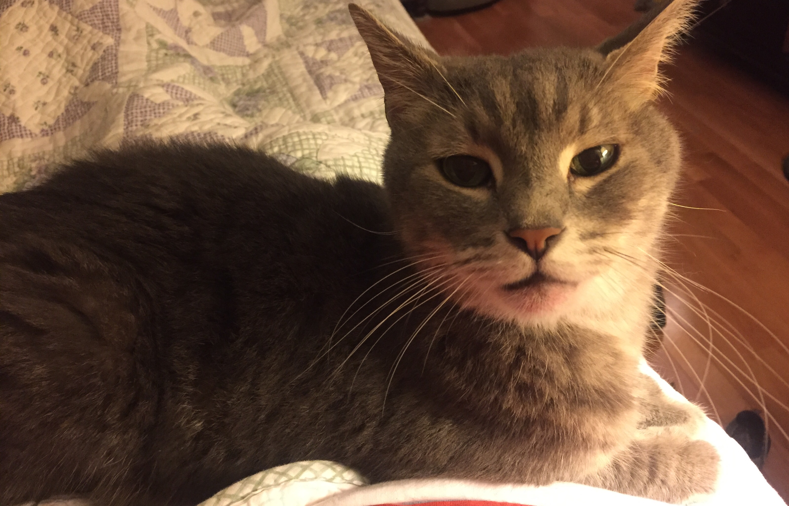
What is one thing you can do
Infection?
Adult Screenings?
Vaccinations?
Reproduction/HIV Prevention
Link to Social Services
Harm Reduction ( SSP, etc.)
Treatment of SUD
Look for partners
Advocacy

Slide 14
Screenings for PWID admitted with Serious injection-related infections
** HAV /Trich in F/Latent TB
Marks, LR, et al. Open Forum Infectious Diseases, Volume 8, Issue 11, November 2021, ofab489, https://doi.org/10.1093/ofid/ofab489

Slide 15
Vaccinations
vaccinations
Don’t forget to assess for HPV, Influenza, COVID-19, and Tetanus vaccination status!
https://www.cdc.gov/hepatitis/populations/idu.htm

Slide 16
PrEP
CDC 2021 Update Clinical Practice Guideline – PrEP for the Prevention of HIV Infection in the US.

Slide 17
reproduction
45% of all pregnancies are unintended
The rate is doubled in women with substance use disorders
Women with SUD are 25% less likely to use contraception
60% report using condoms
American college of Obstetricians and Gynecologists
Recommend long-acting reversible contraceptives as first-line contraception for all women
Discuss reproductive goals!
Frank, Morrison . Am Fam Physician. 2022;105(1):90-92

Slide 18
Harm Reduction

Slide 19
Open Forum Infect Dis, Volume 9, Issue 2, February 2022, ofab631, https://doi.org/10.1093/ofid/ofab631

Slide 20
safety plan
housing first
stages of change
Naloxone
change mode of use
fentanyl strips
designated driver
HIV/HCV education
sterile syringes
housing first
therapy while using
use reduction
change form of drug
buprenorphine
methadone
abstinence
the
fertile ground
of harm reduction
chaotic use
no use
safer use
Christopher Abert, Executive Director, Southwest Recovery Alliance, modified
Notes:
Implement a Harm Reduction approaches to drastically increase the options available for people looking to make positive changes in their lives.
Remember that 80% of people living with SUD in the US are past prevention and not engaged in treatment. This is where the "vast, fertile ground of harm reduction“ allows for a flourishing of positive changes, including but not limited to those listed on this slide. We have an almost infinite amount of opportunities for positive change when we embrace harm reduction as a recovery strategy. Most programs and policies are geared towards long term abstinence. Notice abstinence is included among the Harm Reduction options. When we present abstinence as the only option, or ultimate goal, we lose the ability to offer all of these other opportunities for change. And to celebrate when people achieve them! These seemingly small changes can be the foothold people need to make more. And they add up. Taken as a whole, thousands of people making small changes will have an impact not just on their personal health, but in public health as a whole.

Slide 21
MOUD to Prevent & Treat Infection
Buprenorphine Naloxone, Methadone – opioid agonists
Reduce opioid use, reduce overdose death by 50%
Reduce HIV and HCV acquisition by reducing injection drug use
Improve HIV, HCV treatment outcomes
Reduce bacterial infections by reducing injection
Decrease in incomplete discharge
Extended-Release Naltrexone (IM monthly) – Competitive mu-opioid antagonist
No waiver required
7 days of opioid abstinence
Westlake AA. Eisenberg MP. Open Forum Infectious Diseases. Infectious Disease (ID) Learning Unit: What the ID Clinician Needs to Know about Buprenorphine Treatment of Opioid Use Disorder.2018; Sevel et.al Open Forum Infectious Diseases. Beyond Antibiotics: A practical Guide for the Infectious Disease Physician to Treat Opioid Use Disorder in the Setting of Associated Infectious Diseases.2019.​
Notes:
Sordo.BMJ.2017
Altice.JAIDS.2011
Mattick. Cochrane.2014
Nance et al. CID.2019

Slide 22
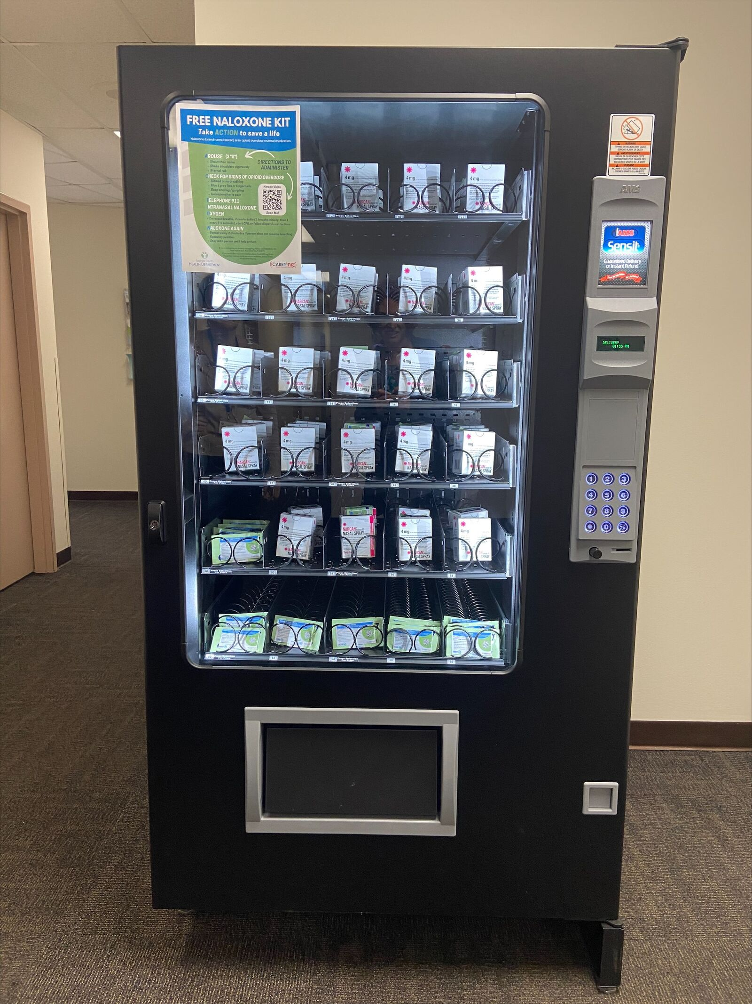
Overdose Education and Naloxone Distribution
Overdose is the leading cause of death among people who use nonprescribed opioids
Naloxone
It is an opioid antagonist
Rapidly reverses an opioid overdose
Decreases overdose related deaths
No waiver needed to prescribe
First Narcan vending machine in Kentucky emptied out one day after opening
Frank, Morrison . Am Fam Physician. 2022;105(1):90-92; https://abcnews4.com/news/nation-world/first-narcan-vending-machine-in-ky-emptied-out-just-one-day-after-opening-kentucky-nalaoxone-overdose-vine-grove-opioid​

Slide 23
Look for partners
Look for a “coalition of the willing“
Social services are key – but if you don’t have them what can you do?
Is there a local church or charity you can partner with?
Ensure patients have access to transportation for follow ups

Slide 24
Case for Thought
27 year old, history of depression
Painful outbreak of genital herpes
During exam, provider notices track marks on feet
Provider expresses concern and patient admits to daily heroin and meth injections with their partner
Referral for treatment is offered, patient declines
Frank, Morrison . Am Fam Physician. 2022;105(1):90-92

Slide 25
Discussion of Case
“I want you to know that I care and I hear that you are not ready to stop using heroin or meth”
“ I will continue to be here for you as a physician whether you stop or not”
What else can be done to reduce risk?
Contraception, screening, vaccinations, referral to SSP,
Prescribe naloxone
Talk about safe injection practices
Does she have a place to sleep/ food
Frank, Morrison . Am Fam Physician. 2022;105(1):90-92
.

Slide 26
UK Infectious Disease Initiatives
Addiction Consult and Education Service (ACES)
Multidisciplinary team: Inpatient Addiction Consults
4,000 patients since inception
~100 new consults/ month
WRAP – Wrap Around Recovery for Addiction and Infectious Disease Program ( KORE-KY Opioid Response Effort) – 2018
Multidisciplinary team: Focuses on transition to outpatient -324 enrolled
MDET –Multidisciplinary Endocarditis Team
Stand-alone Infectious Diseases Consult Service focusing on patients with endocarditis and cardiac device infections
Weekly case conference with colleagues – 215 cases discussed at 1 year anniversary

Slide 27
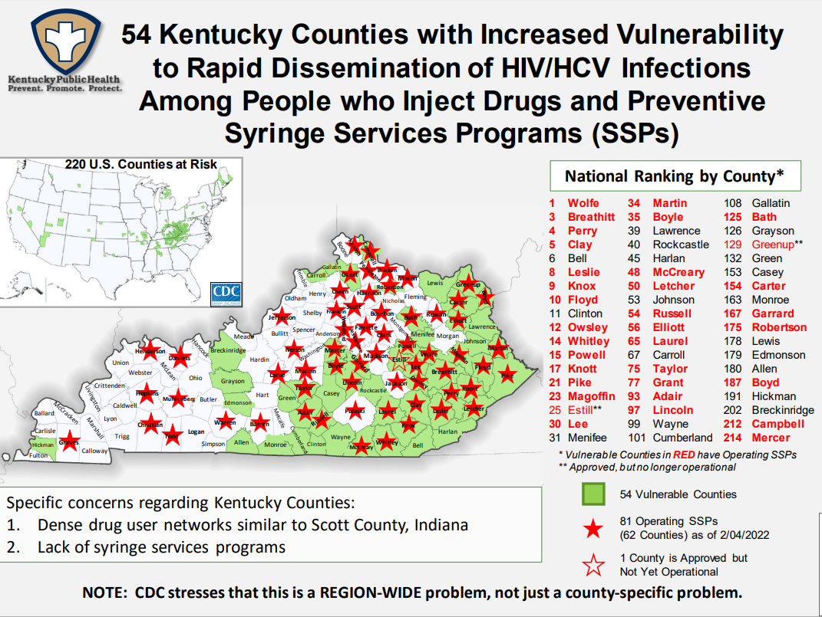
KY Income Reinvestment Program

Slide 28
Advocacy
Physicians/medical providers are uniquely positioned
Can observe and see links between social factors and health
Public trust of physicians is high/credible source of information
Individual Advocacy
Concentrates on one 1 or 2 individuals
Can be formal or informal
System Advocacy
Changing policies, laws or rules that impact lives

Slide 29
Last Conversation
“You may be the last medical person to see that person alive” the speaker said. Months later, the words still rang in my ear.
I remembered thinking of that challenge, the day I chose to care.
My patient struggled. He was so young. The age of my children –my oldest son.
It wasn’t until he was leaving that day that I realized what a special person he was. He had worked with animals. He showed me a picture of when he was strong.
He had fought for us – our country.
He had a wounded heart. A broken soul.
That day, he spoke of hope, of an imagined future, he had a plan.
The next day, I spoke with his loved one.
She was broken as she told me that his story had ended.
How did it happen … He was so hopeful but now he was gone… gone.

Slide 30
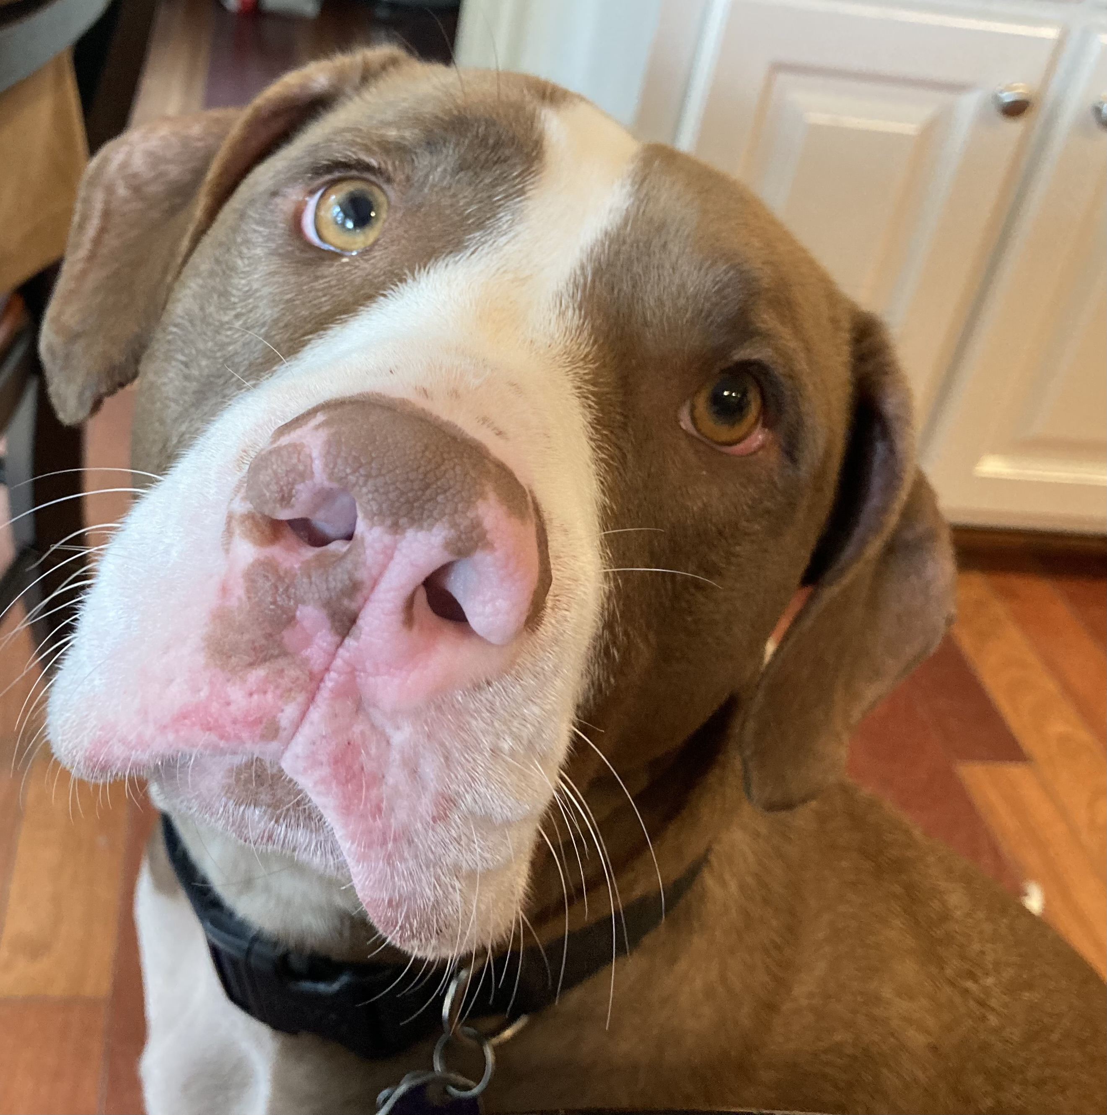
What is success
Success may look different than expected
How do you eat an elephant? One bite at a time
Will they manipulate you? Maybe
Will they fail? Perhaps
Will they die if their life doesn’t turn in a different direction? Possibly
Success may come in little steps – celebrate the small wins
Can you make a difference?

Slide 31
Thank you
Session Organizers
Chris Abert
Grant Laugherty
Crystal Stover
Tiffany Stivers
Frank Romanelli
Laura Fanucchi
James Thacker
Sami El-Dalati
Jana Collins

Slide 32
AETC Program National Centers and HIV Curriculum
National Coordinating Resource Center – serves as the central web –based repository for AETC Program training and capacity building resources; its website includes a free virtual library with training and technical assistance materials, a program directory, and a calendar of trainings and other events. Learn more: https://aidsetc.org/
National Clinician Consultation Center – provides free, peer-to-peer, expert advice for health professionals on HIV prevention, care, and treatment and related topics. Learn more: https://nccc/ucsf.edu
National HIV Curriculum – provides ongoing, up –to-date HIV training and information for health professionals through a free, web –based curriculum; also provides free CME credits, CNE contact hours, CE contact hours, and maintenance of certification credits. Learn more: www.hiv.uw.edu

