Slide 1
Ending the HIV Epidemic: PrEP/PEP and HIV Prevention
Bonnie Ruth Fruge, FNP
LSU SCAETC Clinical Director
Notes:
Version date_07 2023
Target participants: prescribing providers, pharmacists

Slide 2
Conflict of Interest Disclosure Statement
Speaker has nothing to disclose
This program is supported by the Health Resources and Services Administration (HRSA) of the U.S. Department of Health and Human Services (HHS) as part of an award totaling $4,205,743 with 0% financed with non-governmental sources. The contents are those of the author(s) and do not necessarily represent the official views of, nor does mention of trade names, commercial practices, or organizations imply an endorsement by HRSA, HHS, or the U.S. Government. For more information, please visit HRSA.gov. Any trade/brand names for products mentioned during this presentation are for training and identification purposes only.
Notes:
Please add presenter disclosures here if any exist.

Slide 3
Unconscious Bias Disclosure
SCAETC recognizes that language is constantly evolving, and while we make every effort to avoid bias and stigmatizing terms, we acknowledge that unintentional lapses may occur in our presentations.
We value your feedback and encourage you to share any concerns related to language, images, or concepts that may be offensive or stigmatizing.
Your input will help us refine and improve our presentations, ensuring they remain inclusive and respectful to participants.

Slide 4
Learning Objectives
By the end of this session, you should be able to:
Recognize current trends of HIV in the U.S and State.
Describe the guidelines regarding the administration of Pre-Exposure Prophylaxis (PrEP) and Post-Exposure Prophylaxis (PEP), including targeted populations, monitoring and prescribing.
Identify strategies to overcome barriers to appropriate use of PrEP and PEP.
Review guidelines and strategies to the Rapid Start of Antiretroviral Therapy (ART).

Slide 5
Fast-Track Cities Initiative (FTCI) is a global partnership between the city of PaTheris, Joint United Nations Program on HIV/AIDS, United Nations Settlement Program, and the International Association of Providers of AIDS Care, in collaboration with the local, national, regional, and international partners and stakeholders.
Strengthening HIV Programs
and Leveraging Resources
to End AIDS by 2030

Slide 6
ENDING THE HIV EPIDEMIC: A PLAN FOR AMERICA
Phase 1: Reduce new infections by 75% in 5 years
Phase 2: Widely disseminate effort to reduce by 90% in the following 5 years
Phase 3: Intense case management to maintain the number of new infections at <3,000 per year
Ending the HIV Epidemic in the U.S. (EHE) is a plan announced in 2019 that aims to end the HIV epidemic in the United States by 2030
www.hiv.gov
Notes:
Ending the HIV Epidemic in the U.S. (EHE) is a bold plan announced in 2019 that aims to end the HIV epidemic in the United States by 2030.
There are 3 phases in the plan:
In its first phase, the initiative is focusing on areas where HIV transmission occurs most frequently, providing 57 geographic focus areas with an infusion of additional resources, expertise, and technology to develop and implement locally tailored EHE plans.
Phase 2: then expands the efforts to other parts of the US
Phase 3: includes efforts to help maintain the number of new infections at <3000 per year.
Over all GOAL:
The initiative seeks to reduce the number of new HIV infections in the United States by 75 percent by 2025, and then by at least 90 percent by 2030, for an estimated 250,000 total HIV infections averted.
https://www.hiv.gov/federal-response/ending-the-hiv-epidemic/overview

Slide 7
ENDING the HIV EPIDEMIC? The Right Data and Right Tools
Antiretroviral Therapy (ART)
Highly effective, save lives, prevents sexual transmission, and therapies are simpler and safer
Pre-Exposure Prophylaxis (PrEP)
FDA-approved, highly effective drugs to prevent HIV infections
Proven Models of Care and Prevention
>25 years of experience engaging and retaining patients in care
Notes:
Basically, the time is now - We have the right data, tools, and leadership support to move towards ending the hiv epidemic.
We can leverage much of what we know and the tools we have to help make this happen.

Slide 8
Ending the Epidemic
Ending the Epidemic: DHHS 2019
https://www.hhs.gov/sites/default/files/ending-the-hiv-epidemic-fact-sheet.pdf?language=es

Slide 9
Pillar 1: Diagnose All people with HIV as early as possible
Data: More than 160,000 Americans are unaware they have HIV
Tools: improved, accessible, and routine testing
Goals:
Optimize early detection and rapid linkage to care
Connect those who test negative to appropriate prevention services
www.hiv.gov
Notes:
More than 160,000 Americans are unaware they are living with HIV. Early detection coupled with rapid linkage to care is critical and can lead to improved individual and community health outcomes. Improved, more accessible, and routine HIV testing, immediately connecting people with HIV to care services, and connecting those who test negative to appropriate prevention services are important activities supporting this strategy. CDC, HRSA, IHS, SAMHSA and other agencies are working in collaboration with communities to increase local capacity to expand the availability of HIV testing in health centers, emergency departments, substance abuse prevention and treatment programs, mobile units, as well as community-based organizations and non-traditional settings such as bars, parks, and during community festivals.

Slide 10
Pillar 2: Treat People with HIV rapidly and effectively to reach sustained viral suppression
Data:
Viral suppression rate in the US is 53% (CDC)
250,000 individuals aware of HIV infection, but not in care and on treatment
Undetectable = Untransmissible (U=U); Treatment as Prevention (TasP)
Tools: effective, simpler, and safer medications
Goals:
Optimize programs for prompt linking of newly diagnosed (i.e. Rapid Start programs)
Re-engagement strategies for those out of care
Increase viral suppression to 90 percent nationally by 2030
www.hiv.gov
Notes:
Centers for Disease Control (CDC)

Slide 11
Pillar 3: Prevent New HIV transmission by using proven interventions
Data:
>37,000 new infections nationally in 2018
Decline in new infections is stalled
Tools:
Pre-exposure prophylaxis (PrEP)
Syringe services programs (SSPs)
Goals:
Reduce new infections by 75 percent nationally by 2025
www.hiv.gov

Slide 12
Pillar 4: Respond Quickly to potential HIV outbreaks to get needed prevention and treatment services to people who need them
Tools: New laboratory methods and epidemiological techniques
Goals:
Quickly develop and implement strategies to stop ongoing transmission
www.hiv.gov

Slide 13
HIV Global Epidemiology
Globally there is an estimated 36.7 million people living with HIV infection (PWH)
34.9 million adults
1.8 million children under the age of 15 years old
In the U.S., the CDC estimates that more than 1.2 million people in the United States are living with HIV infection
https://www.cdc.gov/hiv/statistics/overview/index.html

Slide 16
HIV Epidemic in the United States
37,000 new cases in 2019
53% of new Diagnoses occurred in South
57% occurred among those 13-34 years of age
42% new Diagnoses among Black Americans & 29% among Hispanics/Latinos
17% were 50 or older
19% were females ( gender assigned at birth)

Slide 18
HIV Epidemic in the U.S.
37,000 new cases in 2019
53% of new diagnoses occurred in the South
57% occurred among those 13-34yo
42% new diagnoses among Black Americans & 29% among Hispanics/Latinos
17% 50yo or older
19% were female (gender assigned at birth)
https://www.cdc.gov/hiv/statistics/overview/index.html

Slide 19
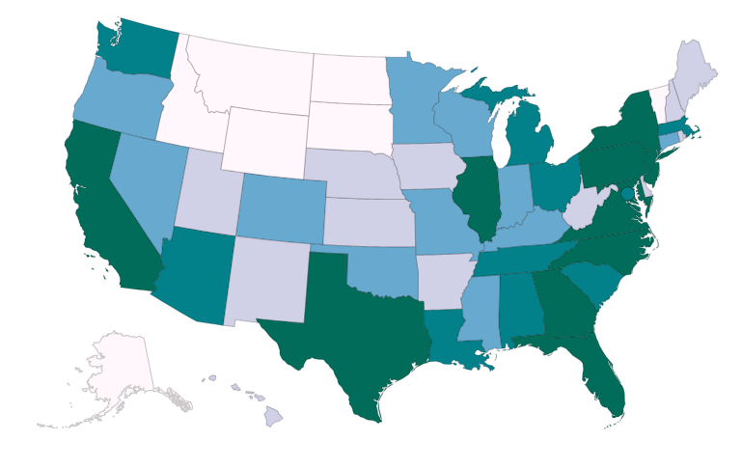
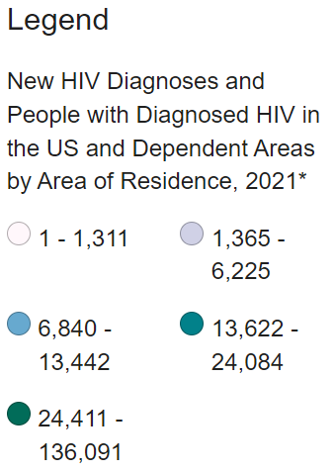
HIV Epidemic in the U.S.
https://www.cdc.gov/hiv/basics/statistics.html
Notes:
In 2021, 36,136 people received an HIV diagnosis in the United States and dependent areas.^{a,b} The annual number of new diagnoses decreased 7% from 2017 to 2021
An estimated 1.2 million people in the United States^{c} had HIV at the end of 2021, the most recent year for which this information is available. Of those people, about 87% knew they had HIV.
In 2021, male-to-male sexual contact^{d} accounted for 67% (24,107) of all new HIV diagnoses in the United States and dependent areas. In the same year, heterosexual contact accounted for 22% (8,059) of all HIV diagnoses.
Black/African American people are most affected by HIV. In 2021, Black/African American people accounted for 40% (14,528) of all new HIV diagnoses. Additionally, Hispanic/Latino people are also strongly affected. They accounted for 29% (10,467) of all new HIV diagnoses.
The most affected subpopulation is Black/African American gay and bisexual men.
Most cases of HIV occur in metropolitan areas with 500,000 or more people. The South has the highest number of people living with HIV, but if population size is taken into account, the Northeast has the highest rate of people living with HIV. (Rates are the number of cases of disease per 100,000 people. Rates allow number comparisons between groups of different sizes.)

Slide 20
Epidemiology in Louisiana (LA)
As of 2020, a total of 21,380 persons with HIV infection (PWH) in Louisiana
Of these 10,966 persons (50%) have Stage 3 HIV (AIDS)
In 2020, 722 new HIV cases were diagnosed in Louisiana
553 per 100,000
71.1% male, 28.9% female
Louisiana Department of Health. LA HIV, AIDS, and Early Syphilis Surveillance Quarterly Report 2019. September 30, 2019
Notes:
In 2020, 722 new HIV cases were diagnosed in Louisiana.(down from 880 in 2019 ?covid related)

Slide 21
Epidemiology in Louisiana cont’d
Men who have Sex with Men (MSM) is the primary identified risk factor for new HIV diagnoses
In 2020 total PWH in LA
Black 67.6% (LA general Black pop 32%)
Latino 5.7%
White 24%
17 parishes prevalence > 400 per 100K
Parishes with corrections had higher prevalence
Louisiana Department of Health. LA HIV, AIDS, and Early Syphilis Surveillance Quarterly Report 2019. September 30, 2019

Slide 22
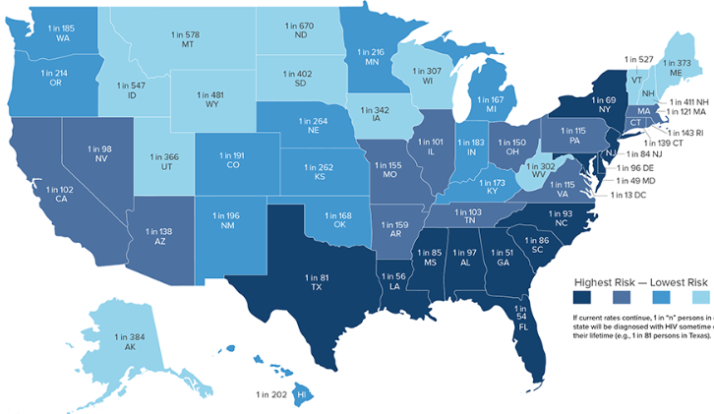
Lifetime Risk of HIV Diagnosis, by State
1:56
Hess KL, Hu X, Lansky A, Mermin J, Hall HI. Lifetime Risk of a Diagnosis of HIV Infection in the United States. Annals of epidemiology. 2017;27(4):238-243.

Slide 23
Lifetime Risk of HIV Diagnosis 2016
2016 Lifetime Risk of Diagnosis Among MSM by Race/Ethnicity
https://www.cdc.gov/nchhstp/newsroom/2016/croi-2016.html
Notes:
Hess, KL et al. Lifetime Risk of a diagnosis of HIV infection in the US. Ann Epidemiol. 2017;27(4):238-243.
Females account for 27% (1 in 4) of all new HIV/AIDS diagnoses. While African American and Hispanic Women represent 77% of these new infections.
African American/black females diagnosis rate of HIV was almost 12x greater than the rate for white females and was more than 2x the rate for Hispanic/Latino females.
https://www.cdc.gov/nchhstp/newsroom/images/2016/croi_lifetime_risk_race_ethnicity.jpg
Where you live can affect your risk of getting HIV:
-high rate of HIV in your community
-lack of access to healthcare
-poverty

Slide 24
HIV Screening Guidelines
Screening As Prevention
CDC 2006
USPSTF 2013
Test all pts 13-64 yo
Test all pregnant women
Test all pts with TB or STI
Test high risk patients at least annually
Test all 15-65 yo
Test all pregnant women
Test <15 & >65 yo if at risk
Grade A recommendation
USPSTF=United States Preventative Services Task Force, TB = tuberculosis; STI = sexually transmitted infection, Branson, Bernard, et al. MMWR 2006;55(RR14):1-17. Moyer, Virginia et al. Annals of Internal Medicine. 2013
Notes:
Branson BM, et al. MMWR Recomm Rep. 2006;55(RR-14):1-17.
Thought that those who don’t know their status account for 50% of new infections (Marks, et al. 2006)
Verbal consent for testing (written consent no longer needed)
Repeat at least yearly screening for those at high risk
Person who inject drugs and their sex partners
Persons who exchange sex for money or drugs
Persons who themselves or whose sex partners have had more than one sex partner since their most recent HIV test
Sex partners of those with uncontrolled HIV or those with unknown virologic control should be screened regularly
Sex partners of those with well controlled HIV (undetectable viral load) are not at increased risk of HIV transmission through sexual exposure (See CDC U=U campaign)

Slide 25
HIV Screening for Prevention
Knowing if one has HIV allows people to
Protect others from becoming infected
Make safer decisions about sex, needle use, & health care
People with HIV (PWH) who know their status avoid behaviors that spread infection
Those at high risk but test negative can start pre-exposure prophylaxis (PrEP)
Coates, et al JAMA 1987;258:1889. Doll et al. Health Psychol 1990;9:253-65. Fox, et al. AIDS 1987;1:241-6. Gibson, et al. AIDS and Behavior 1999;3:3-12. Rietmeijer, et al. AIDS 1996; 10:291-8. van Griensven et al. Am J Epidemiol 1989;129:596-603.

Slide 26
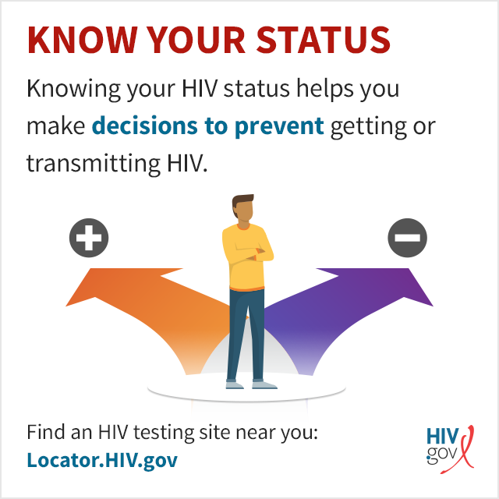
Status Neutral HIV Screening & Linkage to Care
Making HIV screening part of routine care helps ensure patients are screened, despite presumed risk, and helps reduce stigma
If HIV screen nonreactive/negative but continued exposure to HIV, linkage to HIV prevention (i.e. PEP, PrEP)
If HIV screen reactive/positive, linkage to HIV treatment (antiretroviral therapy & holistic care)
PEP=post-exposure prophylaxis, PrEP=pre-exposure prophylaxis
Notes:
HIV Screening is Important for Prevention
Knowing they have HIV allows people to
Protect others from becoming infected
Make safer decisions about sex, needle use, & their health care
PWH who know their status avoid behaviors that spread infection
Those at high risk but test negative can utilize prevention strategies
Coates, et al JAMA 1987;258:1889. Doll et al. Health Psychol 1990;9:253-65. Fox, et al. AIDS 1987;1:241-6. Gibson, et al. AIDS and Behavior 1999;3:3-12. Rietmeijer, et al. AIDS 1996; 10:291-8. van Griensven et al. Am J Epidemiol

Slide 27
Primary Care Providers Role in CDC recommendations for testing
Can make a substantial contribution to the implementation of expanded CDC HIV screening recommendations by:
advising 1-time screening for all of their adult patients who are sexually active and repeat screening for high-risk patients
Need to be knowledgeable about screening recommendations and available diagnostic tests including:
rapid tests and 4th generation tests that can identify acute HIV infection.
Important role in linkage and retention in HIV Care
P. Leone, 2018 HIV Testing and Diagnosis
Notes:
IV Testing and Diagnosis
Author: Peter Leone, MD (More Info)
Editors in Chief: Daniel R. Kuritzkes, MD; Joseph J. Eron, Jr., MD
Last Reviewed: 1/9/18 (What's New)

Slide 28
Reducing Acquisition of HIV
Increased testing & linkage to care
Delayed or fewer partners
Fewer activities with risk
Increased condom use
Empowerment & negotiation skills
Reducing alcohol & drug use
Reduce psychosocial barriers
Circumcision
Sexually Transmitted Infection (STI) treatment
HIV PEP & HIV PrEP

Slide 29
PEP vs. PrEP
Post-Exposure Prophylaxis
Given after high-risk exposure to reduce risk of HIV infection
Start within 72 hours of exposure
1-month course of daily 3-drug regimen
Pre-Exposure Prophylaxis
Daily regimen given before exposure to reduce risk of HIV infection
Start at least 7 days prior to exposure
Daily 2-drug regimen OR newly-approved q2 month injectable
https://www.cdc.gov/hiv/pdf/programresources/cdc-hiv-npep-guidelines.pdf
https://www.cdc.gov/hiv/pdf/risk/prep/cdc-hiv-prep-guidelines-2017.pdf
Notes:
PEP: Antiretroviral medication taken by someone who does NOT have HIV but who has had a potentially significant exposure in order to reduce the risk of infection with HIV
Taken daily for 28 days, started <72 hours after high risk activity (i.e. sexual activity, IDU) or unintentional exposure (i.e. occupational) with a known/potentially HIV-positive contact in order to reduce the risk of being infected with HIV. Occupational exposure: Needle stick, splash, bite. Non-occupational exposure: Unprotected sex, sexual assault, condom break, shared needles. Note: most pharmacies will dispense a 30d supply
PrEP: Antiretroviral medication taken by someone who does NOT have HIV in order to prevent infection with HIV. Taken daily before high risk activity (intercourse, IDU) with a known/potentially HIV-positive contact in order to reduce the risk of being infected with HIV.
https://www.cdc.gov/hiv/pdf/programresources/cdc-hiv-npep-guidelines.pdf
https://www.fda.gov/Drugs/DrugSafety/ucm608112.htm
https://www.cdc.gov/hiv/pdf/risk/prep/cdc-hiv-prep-guidelines-2017.pdf
https://www.cdc.gov/hiv/risk/prep/index.html
https://www.cdc.gov/hiv/guidelines/preventing.html

Slide 30
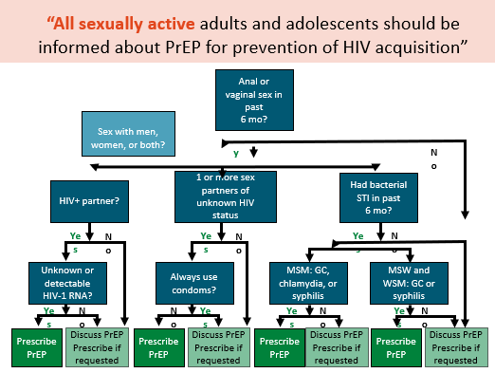
PrEP Guidelines
https://www.cdc.gov/hiv/guidelines/preventing.html

Slide 31
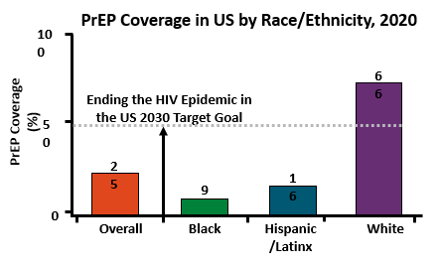
PrEP Coverage
1.2 million people are likely to benefit from PrEP
But in 2020, of those who could benefit, few were prescribed PrEP
Only 28% of males
Only 10% of females
cdc.gov/nchhstp/newsroom/fact-sheets/hiv/PrEP-for-hiv-prevention-in-the-US-factsheet.html

Slide 32
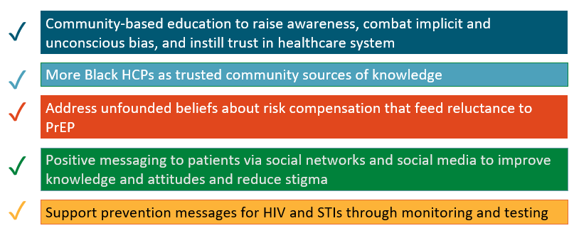
Increasing PrEP Coverage
Mayer. Adv Ther. 2020;37:1778

Slide 33
What is HIV pre-exposure prophylaxis (PrEP)?
Medication before sex to prevent infection in combination with safe sex practices
Who is it for?
Men who have sex with men (MSM) at high risk of HIV acquisition
Heterosexual men and women in relationships with person without confirmed virologic control
Persons who use injection drugs
Tenofovir Disproxyl Fumarate (TDF) + Emtricitabine
FDA approved 2012
USPHS Guidelines 2014
June 9, 2017 generic
Safe, well tolerated
Hendrix CW et al. Plos One 2013. Lehman DA et al JID 2015.
Grant RM et al AIDS 2015.
Notes:
Globally 6000 new HIV infections occur daily
Pre exposure prophylaxis
Strategy with historical precedent in Infectious Diseases, eg. Malaria Prophylaxis
HIV prophylactic control for HIV negative Individual

Slide 34
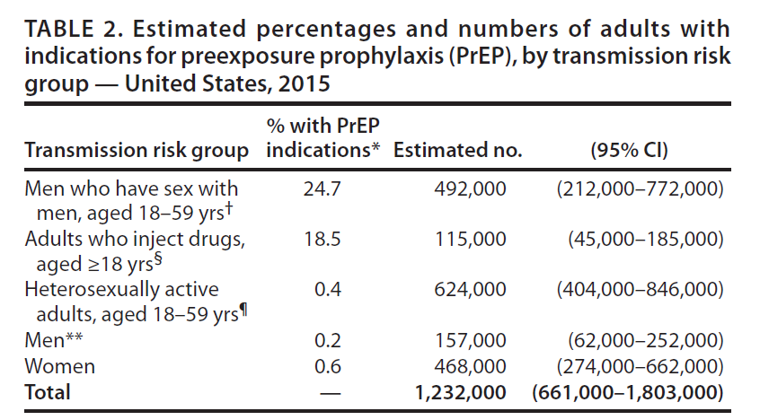
CDC Guidance on HIV Pre-Exposure Prophylaxis
Establish the Candidacy
Notes:
Indications for PREP
Estimated 1 in 4 sexually active HIV negative adult MSM
Estimated 1 in 5 HIV negative adults with IDU
Estimated 1 in 200 heterosexually active adults

Slide 35
HIV PrEP Pre-Exposure Prophylaxis
Grade A Rec
FDA-approved daily oral formulations:
Tenofovir/Emtricitabine
1 tablet by mouth once a day
Prescribe for ≤ 90-day supply
Approved for adolescents & adults > 35kg (77 lb)*
*TDF/FTC FDA-approved indication in adults 7/2012 and for youth 5/2018
**TAF/FTC FDA-approved for PrEP (except receptive vaginal sex) 10/2019
USPSTF Grade A Recommendation, 6/2019
https://www.cdc.gov/hiv/guidelines/preventing.html
TDF/FTC=tenofovir disoproxil fumarate/emtricitabine (Truvada® or generic);
TAF/FTC=tenofovir alafenamide/emtricitabine (Descovy®)
Notes:
- USPSTF Prevention of HIV Infection: Preexposure Prophylaxis. 2019
https://www.uspreventiveservicestaskforce.org/Page/Document/RecommendationStatementFinal/prevention-of-human-immunodeficiency-virus-hiv-infection-pre-exposure-prophylaxis
- Max intracellular concentrations in blood after 20d of daily dosing, rectal tissue at 7d, cervicovaginal tissues at 20d. No data on penile tissue concentrations.
- TAF/FTC data presented at CROI 2019: Hare CB et al. The Phase 3 Discover Study: Daily F/TAF or F/TDF for HIV PrEP. CROI 2019 Abstract #104. www.croiconference.org Noninferiority to date (50%+ reached 96weeks; 90% reached >48wks).
TAF/FTC data presented at IAS 2019: Spinner, CD et al. DISCOVER study for HIV PrEP: F/TAF has a more rapid onset and longer sustained duration of HIV protection compared with F/TDF. Abstract 4898. programme.ias2019.org/abstract. Risk assessed from computer-aided self-interview, lab-assessed STIs. Adherence by pill count and self report and in subset measured by intracellular TFV-DP concentrations in PBMCs at week 4 and DBS q12wks. Week 4PBMC TFV-DP levels were 6.3 fold higher with F/TAF; 98% vs 65% above protective threshold. Median duration of protection after last dose at steady state was 60% longer for F/TAF.Low DBS TFV-DP levels (adherence<2 doses/week) associated with increase risk of HIV for F/TAF (OR29.4) and F/TDF (OR 13).
Additional agents and routes in clinical trials currently
10/2019 TAF/FTC FDA-approved https://www.gilead.com/~/media/Files/pdfs/medicines/hiv/descovy/descovy_pi.pdf

Slide 36
Why emtricitabine/ tenofovir?
Known activity early HIV life cycle against Reverse Transcriptase (NRTI)
High potency
High genital tract levels
Good safety and tolerability
Low incidence of resistance
Notes:
ATN 110 Study
200 men ages 18-22
48 weeks of PrEP FTC/TDF (emtricitabine/tenofovir disoproxil fumarate)
Summary : modest decline in bone density at 24 weeks that stabilizes by week 48
Bone health returned to near baseline when meds discontinued at week 48

Slide 37
Concerns with the use of emtricitabine/tenofovir for PrEP
Bone and Kidney Side Effects
Minimal compared to full HIV treatment
Risk of Hepatitis Flair in HBV infected
Development of HIV Resistance
Uncommon and largely restricted to initiating PrEP during an undiagnosed window-period infection
Requires Adherence
As does many other HIV/STI prevention strategies
Perinatal HIV Research Unit, Univ of the Witwatersrand, Johannesburg.N Engl J Med 2012; 367:462-465
Walensky RP, Park JE, Wood R, et al. The cost-effectiveness of pre-exposure prophylaxis for HIV infection in South African women. Clin Infect Dis 2012;54:1504-1513/ Grohskopf et al (2013) J Acquir Immune Defic Syndr. 64(1):79-86.
Notes:
Side effects: H/A -7%, Abd pain- 4%, Weight changes-3%, Depression- 9%, Fatigue-9%, Rash-7%
Drug interaction potential TDF: Hepatitis C agents Sofosbuvir/velpatasavir, Sofosbuvir/velpatasvir/voxilaprevir,
Ledipasvir/sofosbuvir

Slide 38
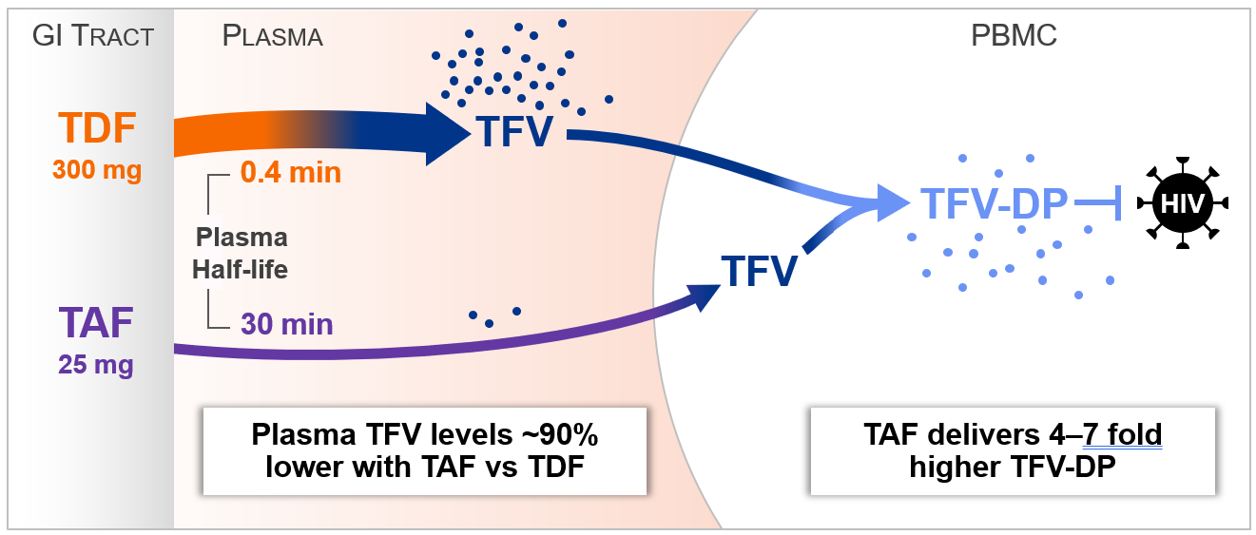
Tenofovir: Alafenamide (TAF) vs. Disoproxil Fumarate (TDF)
Spinner CD, et al. DISCOVER STUDY for HIV Pre-Exposure Prophylaxis: F/TAF has a more Rapid Onset and Longer Sustained Duration of HIV Protection Compared with F/TDF. 23July IAS 2019, Mexico City.

Slide 39
TAF vs. TDF
Descovy® (TAF/FTC)
Not indicated for receptive vaginal sex or injection drug use (IDU) alone
Less renal & bone toxicity
Can use if CrCl > 30 mL/min
Weight gain
1 - 1.7kg (TAF) vs. 0 - 0.5kg (TDF)
Smaller tablet
Truvada®* (TDF/FTC)
Use if receptive vaginal sex or if IDU is only risk factor (i.e., no sexual risk)
Potential renal & bone toxicity
Do not start if CrCl <60mL/min
Stop if CrCl drops to <50mL/min
Now generic* – cost-effective!
www.clinicalkey.com/pharmacology/

Slide 40
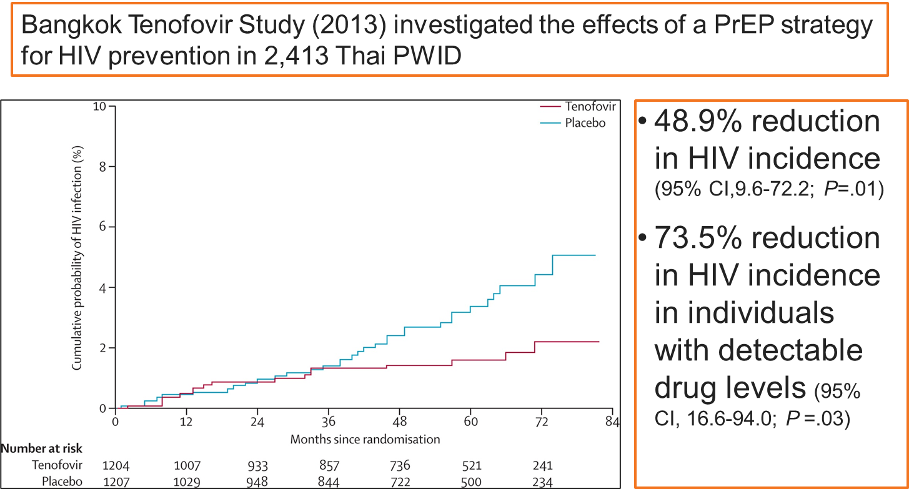
Clinical Study of PrEP in PWID
Kaplan-Meier Estimates of Time to HIV Infection in the Modified Intention-to-Treat Population
PWID = Persons who inject drugs
Choopanya K, et al. Lancet. 2013;381:2083-90.

Slide 41
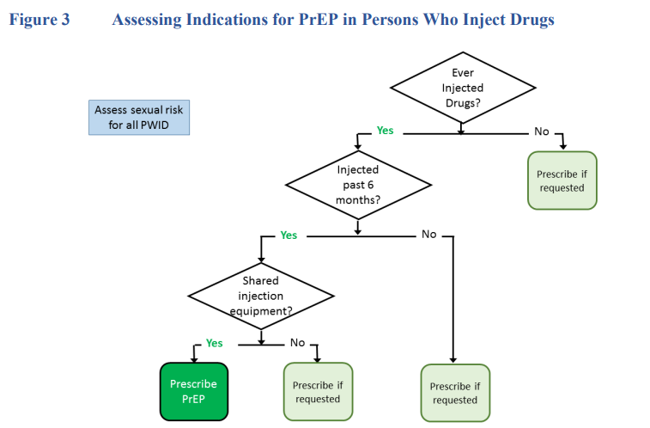
https://www.cdc.gov/hiv/pdf/risk/prep/cdc-hiv-prep-guidelines-2021.pdf

Slide 42
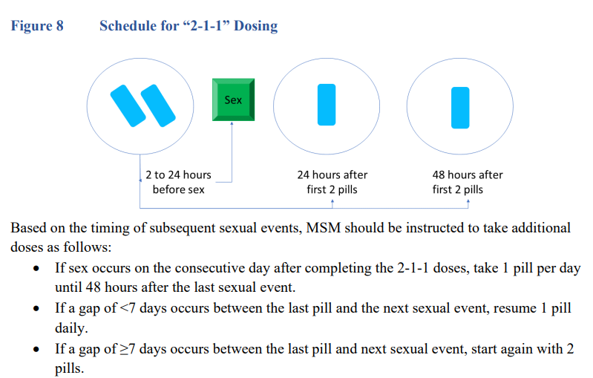
On Demand PrEP: 2-1-1
https://www.cdc.gov/hiv/pdf/risk/prep/cdc-hiv-prep-guidelines-2021.pdf
MSM=men who have sex with men
Notes:
https://apps.who.int/iris/rest/bitstreams/1239070/retrieve

Slide 43
Alternate Dosing of PrEP
IPERGAY and Prévenir studies demonstrated reduced risk of HIV infection in men who have sex with men (MSM) by 86% utilizing on-demand PrEP (2-1-1)
Used TDF/FTC
Not recommended in those with chronic hepatitis B, heterosexual men and women, transgender men and women and people who inject drugs
Off-label use
Saag. JAMA. 2018;320:379. Antoni, et al. IAS 2017. Molina JM et al. Lancet HIV. 2017;4(9):e402-410. Molina JM et al. 9th International AIDS Society Conference on HIV Science, 2017. Balavoine, S et al. . 9th International AIDS Society Conference on HIV Science, 2017. Swell WC et al. CROI 2020

Slide 44
Prescribing On Demand PrEP
Max 30 pills on rx- must have follow up and documentation of another negative HIV test
Sex <1x/week = sufficient supply for 7 intermittent events
Continue q3 month follow up visits for HIV and STI testing
Not indicated for anyone other than adult MSM
Only studied in this population
TAF not studied on-demand
https://www.cdc.gov/hiv/pdf/risk/prep/cdc-hiv-prep-guidelines-2021.pdf

Slide 45
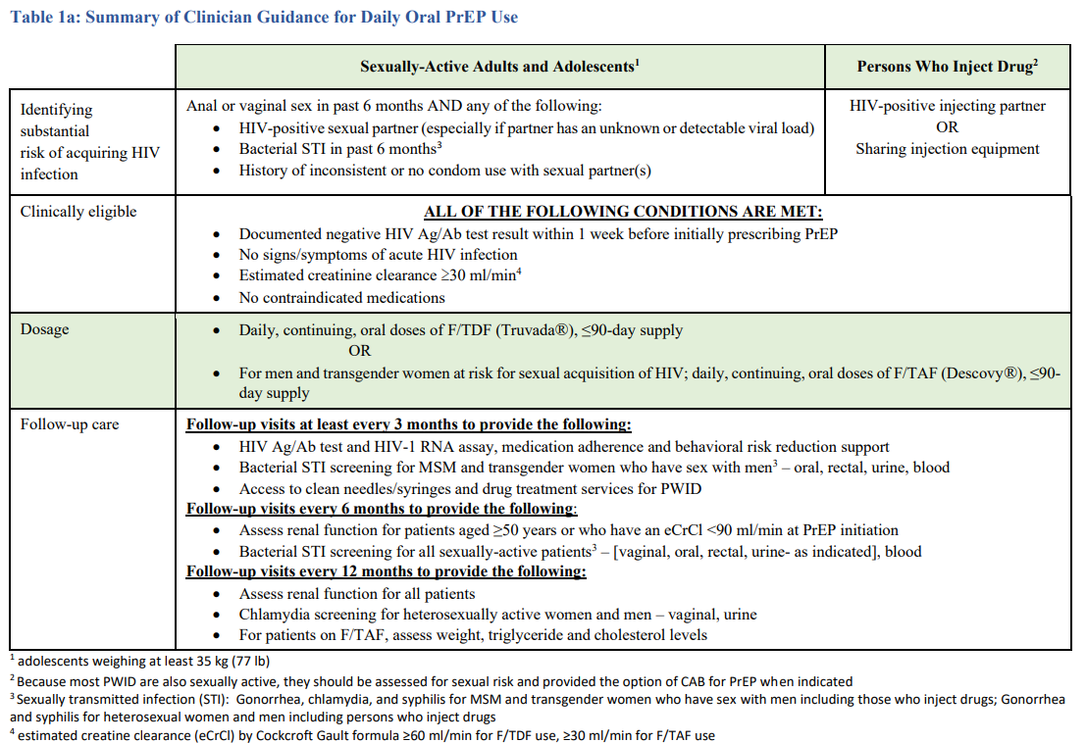
https://www.cdc.gov/hiv/pdf/risk/prep/cdc-hiv-prep-guidelines-2021.pdf
Notes:
PrEP in PWID: Any use of injection drugs (past 6 months)
AND
Any sharing of injection equipment OR participation in methadone, naloxone, or buprenorphine treatment program (past 6 months) OR risk of sexual acquisition
Additional consideration: transactional sex and high community and/or sexual network
The CDC has updated it’s webpage in regards to HIV prevention. For the first time the CDC has added percentages to various bio-medical HIV Prevention methods.
For Antiretroviral Therapy (ART)
For HIV-positive men and women, taking ART regularly greatly reduces the risk of HIV transmission to an HIV–negative partner. For persons who achieve and maintain viral suppression, there is effectively no risk of transmitting HIV to their HIV–negative sexual partner. This translates to an effectiveness estimate of 100% for taking ART regularly as prescribed and achieving and maintaining viral suppression. Effectiveness is lower, and there is a risk of transmitting HIV, when persons do not take ART as prescribed or stop taking ART, if viral suppression is not achieved, or if viral suppression is not maintained.
For PrEP
When taking PrEP daily or consistently (at least 4 times per week), the risk of acquiring HIV is reduced by about 99% among MSM. While daily use is recommended in the U.S., taking PrEP consistently (at least 4 times per week) appears to provide similar levels of protection among MSM. The effectiveness of oral PrEP is highly dependent on PrEP adherence. When taking oral PrEP daily or consistently, HIV acquisition is extremely rare and has not been observed in any of the studies described below. In clinical practice, a few cases of new HIV infections have been confirmed while HIV-negative individuals were on PrEP with verified adherence.
Persons Who Inject Drugs (PWIDs) face HIV risks from both injecting and sex behaviors. Studies on the effectiveness of PrEP when taken daily among PWID are limited. However, when taking PrEP consistently, the risk of acquiring HIV is reduced by an estimated 74 – 84% among PWID. These estimates are based on tenofovir alone and among a subset of PWID taking PrEP consistently, as verified by directly observed therapy or daily diary plus monthly pill count. The effectiveness of two-drug oral therapy has not been assessed among PWID but may be higher. The effectiveness of oral daily PrEP is highly dependent on PrEP adherence, with maximum effectiveness when taking PrEP daily and lower effectiveness when missing doses.

Slide 46
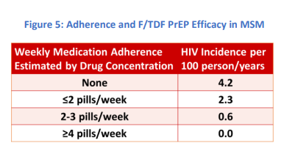
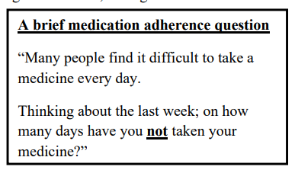
Daily PrEP Adherence
https://www.cdc.gov/hiv/pdf/risk/prep/cdc-hiv-prep-guidelines-2021.pdf

Slide 47
HIV PrEP Pre-Exposure Prophylaxis
FDA-approved long-acting injectable formulation:
Cabotegravir (Apretude®) 600mg/3mL every 2 months
Optional 30mg daily oral CAB 4-week lead-in
Approved for adolescents & adults > 35kg (77 lb)*
*Cabotegravir (CAB) FDA-approved indication for PrEP in 12/2021
Notes:
Injectable PrEP Side effects: Injection site reactions, Depressive disorders, Diarrhea 4%, Fatigue 4%, Sleep disorders 3%, Weight gain median 1.2 kg week 48

Slide 48
Long-Acting Injectables (LAI)
Cabotegravir (CAB) LAI q8weeks for MSM and transwomen who have sex with men (TGWSM) at high risk for HIV
4,570 MSM & TGWSM (12%) double-blinded
LAI CAB HIV incidents = 13
Daily oral TDF/FTC HIV incidents = 39
66% fewer HIV infections in LAI CAB vs. TDF/FTC
Well-tolerated: injection site reactions (ISRs) = 2.2% discontinued
https://www.hptn.org/research/studies/hptn083

Slide 49
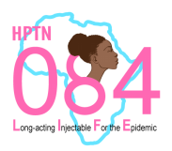
Long-Acting Injectables (LAI)
Cabotegravir (CAB) LAI q8weeks for sexually active cisgender women (not pregnant or breastfeeding, on contraception) at high risk for HIV
3,224 participants in Sub-Saharan Africa
LAI CAB HIV incidents = 4
Daily oral TDF/FTC HIV incidents = 36
89% fewer HIV infections in LAI CAB for cisgender women vs. TDF/FTC
Well-tolerated: ISRs – no discontinuations due to ISRs
https://www.084life.org/study-results/
Notes:
Cisgender= designated female at birth, identifies as female gender

Slide 50
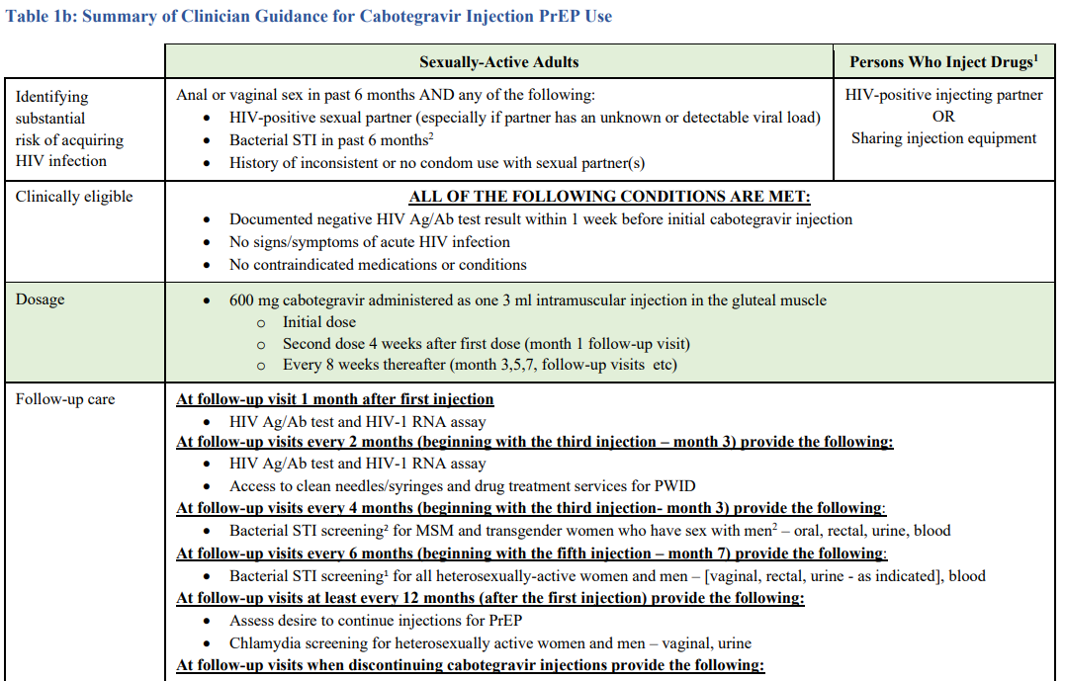
https://www.cdc.gov/hiv/pdf/risk/prep/cdc-hiv-prep-guidelines-2021.pdf

Slide 51
https://www.cdc.gov/hiv/pdf/risk/prep/cdc-hiv-prep-guidelines-2021.pdf

Slide 52
https://www.cdc.gov/hiv/pdf/risk/prep/cdc-hiv-prep-guidelines-2021.pdf

Slide 53
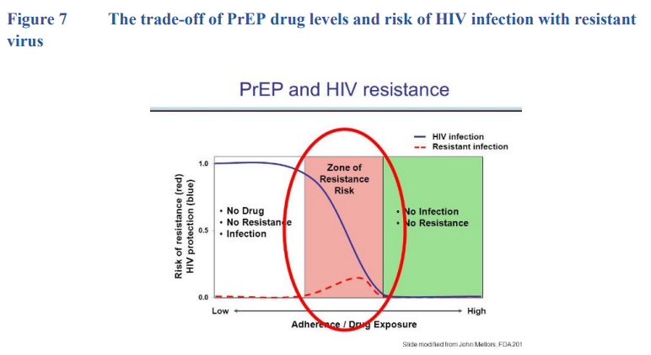
https://www.cdc.gov/hiv/pdf/risk/prep/cdc-hiv-prep-guidelines-2021.pdf

Slide 54
Cabotegravir drug interactions
Anticonvulsants
Antimycobacterials
Phenobarbital
Carbamazepine
Phenytoin
oxcarbaepine
Rifampin
Rifapentine
Rifabutin
Methodone level decrease

Slide 55
Follow up every 3 months
HIV testing
Pregnancy Testing
Medication Adherence
Behavioral/Risk Reduction Counseling
Assess STI symptoms-Treat if needed
Test STI every 3-6 months
Check Serum Creatinine
If stable, then every 6 months

Slide 56
Laboratory Testing Timing | Oral PrEP | Injectable PrEP
HIV Ag/Ab and HIV-1 RNA | Every 3 mo | In last 12 mo prior to initiation and then every 2 mo on IM CAB
Lipid panel | At initiation and then yearly on FTC/TAF | Not required
Serum creatinine | Every 6 mo if age ≥50 yr or eCrCl <90 mL/min Every 12 mo if age <50 yr and eCrCl ≥90 mL/min Persons with CrCl <60 mL/min should not take FTC/TDF for PrEP Persons with CrCl <30 mL/min should not take FTC/TAF for PrEP | Not required
https://www.cdc.gov/hiv/pdf/risk/prep/cdc-hiv-prep-guidelines-2021.pdf
Notes:
Ab, antibody; Ag antigen; CAB, cabotegravir; CrCl, creatinine clearance; eCrCl, estimated creatinine clearance; FTC, emtricitabine; PrEP, pre-exposure prophylaxis; TAF, tenofovir alafenamide; TDF, tenofovir disoproxil fumarate.

Slide 57
HIV RNA Levels
Every 3 mo with oral PrEP; every 2 mo with LA CAB¹
In HPTN 083, HIV detection with antigen/antibody testing was delayed compared with qualitative HIV-1 RNA testing²
5 patients in HPTN 083 (0 in HPTN 084) received LA CAB after HIV infection and developed INSTI resistance^{3,4}
1. cdc.gov/hiv/pdf/risk/prep/cdc-hiv-prep-guidelines-2021.pdf. 2. Marzinke. CROI 2021. Abstr 153. 3. Marzinke. J Infect Dis. 2021;224:1581. 4. Delany-Moretlwe. Lancet. 2022;399:1779.
Notes:
CAB, cabotegravir; FTC, emtricitabine; INSTI, integrase strand transfer inhibitor; LA, long-acting; PrEP, pre-exposure prophylaxis; TDF, tenofovir disoproxil fumarate.

Slide 58
Recommendations When Discontinuing PrEP
Perform HIV test(s) to confirm HIV status
Consider RNA testing if symptomatic
If HIV positive
order and document results of resistance testing
establish linkage to HIV care.
If HIV negative,
establish linkage to risk reduction support services as indicated.
If active hepatitis B
Consider continued Hep B treatment; Refer to a specialist as TDF/FTC also treats Hep B
If pregnant
inform OB provider of TDF/FTC use in early pregnancy
coordinate care to maintain HIV prevention during pregnancy

Slide 59
Transitioning From LA PrEP to HIV Treatment Regimen
General Management
Genotypic Testing and Starting Treatment
Confirm HIV status, CD4 count, and plasma HIV-1 RNA
Document genotypic HIV viral resistance test results to guide therapy
INSTI genotyping should be done prior to use of INSTI-based regimen
Connect with experienced HIV provider
Counsel about HIV status, steps to prevent HIV transmission, how to improve their own health
Assist with identification of sex partners who may have been recently exposed to HIV so partners can be tested and offered PEP
Convert PrEP regimen to guideline-recommended HIV treatment regimen without waiting for test results
If treating before genotype results are available or INSTI resistance is present, use boosted PI regimen containing DRV and XTC/TXF
Notes:
DRV, darunavir; INSTI, integrase strand transfer inhibitor; LA, long-acting; PI, protease inhibitor; PEP, postexposure prophylaxis; PrEP, pre-exposure prophylaxis; TXF, tenofovir alafenamide or tenofovir disoproxil fumarate; XTC, lamivudine or emtricitabine.

Slide 60
Medication Considerations
Side Effects: GI, headaches often self resolve
Contraindications:
HIV infection, Kidney disease (eGFR< 60), HIV exposure < 72 hours
Caution: osteoporosis, liver disease, mild renal impairment, hepatitis B infection (caution of flare with abrupt withdrawal of tenofovir/emtricitabine)

Slide 61
Disparities in PrEP
# of PrEP users increased 29% between 2016-2017
In 2017 94% of PrEP users were Male
16X more Male PrEP than Female PrEP
The South accounts for approx. 50% of all new HIV diagnoses
In 2017 the South accounted for only 30% of all PrEP users
AIDSVU.org

Slide 62
How do we overcome barriers?
Research of almost 9000 participant has demonstrated the effectiveness of PrEP even at 50% adherence, with minimal side effects/ risk and resistance
Initiating PrEP requires ongoing HIV/STD Pregnancy testing, prevention couseling and adherence support
Barrier exist for wide spread PrEP initiation that can be overcome via effective public health or health care interventions
You can help us overcome these barriers by identifying patients who are eligible for PrEP and linking them to services.
Okwundu, et al (2012) Cochrane Database System Rv ( 2012) 7.

Slide 63
Lack of personnel responsible for PrEP management
Inconsistent PrEP support and buy-in from clinic leadership
Difficulty retaining patients on PrEP
Current Challenges
Solution: Designate a PrEP Champion
Strengthen communication and leadership
Use proactive approach to increase PrEP retention
Train providers and PrEP coordinators to meet patient needs
Shrestha. AIDS Res Hum Retroviruses. 2022;38:611
Notes:
PrEP, pre-exposure prophylaxis.

Slide 64
Use of Telehealth¹
Expanding PrEP Options for All²
Intravaginal ring
Immediate PrEP Initiation¹
Guidelines outline procedures for providing PrEP on same day as initial evaluation for select patients
Implant
Antibody infusions
Conduct services by phone or web-based consult with HCPs
Obtain specimens for HIV, STI, or other PrEP-related laboratory tests by:
Laboratory visits for specimen collection only
Home specimen collection kits for specified tests
1. cdc.gov/hiv/pdf/risk/prep/cdc-hiv-prep-guidelines-2021.pdf. 2. hiv.gov/hiv-basics/hiv-prevention/potential-future-options/long-acting-prep.
Notes:
HCP, healthcare professional; PrEP, pre-exposure prophylaxis; STI, sexually transmitted infection.

Slide 65
What To Determine Before Prescribing HIV PEP
What was the exposure?
Is the source known/unknown?
Likelihood of HIV infection in the source?
Known antiretroviral (ART) resistance in the HIV infected source?
What is the time period since exposure?
What is the health of the contact and are they taking any other medications?
Notes:
Type of exposure: visible blood; hollow needle; deep puncture; through glove; mucosal contact

Slide 66
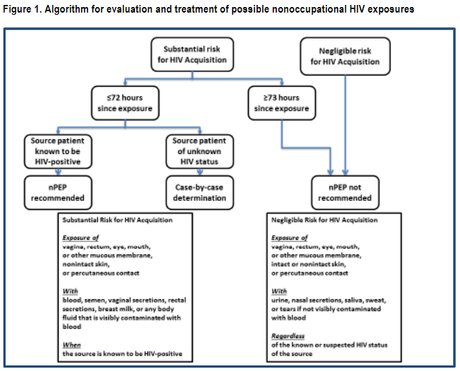
Updated guidelines for antiretroviral postexposure prophylaxis after sexual, injection drug use, or other nonoccupational exposure to HIV—United States, 2016
Notes:
For occupational HIV exposures, each organization should have their own workflows for how to handle a work-place needlestick. http://www.jstor.org/stable/10.1086/672271

Slide 67
Treatment IS Prevention
Cohen, et al. NEJM 2011; 365: 493-505. Skarbinski J, et al. JAMA Intern Med 2015;175:588-96.
Bavinton BR, et al. Lancet HIV. 2018. IAS 2018 http://programme.aids2018.org/Abstract/Abstract/13470
Notes:
Screening is important for treatment and treatment is prevention
Image: https://ght.org.uk/Undetectable
HPTN 052 Study: 1763 subjects; serodiscordant heterosexual couples, early versus delayed HAART initiation
Interim analysis 2011: Intention to treat analysis = 96% reduced risk in genetically linked infections
Then offered all patients HAART; 5 years follow-up
8 linked infections from partners who did not have suppressed viral load
Early ART was associated with 93% lower risk of linked partner infection, 69% lower risk in all partner infections
No linked infections when partner was stably suppressed by ART
PARTNER study (heterosexual and MSM partners)
Opposites Attract study (MSM; Partner with HIV with VL<200 and partner not on PrEP) Bavinton BR, et al. Lancet HIV. 2018
PARTNER 2 study (to gather more data on MSM couples; through 4/18). Partner with HIV with VL<200 and partner not on PrEP. 23-27% had STI during study follow-up period. Documented 75,000 condomless anal sex acts between mixed-HIV-status men.
The prospective observational study saw zero transmissions between study partners when the HIV-positive partner had a fully suppressed viral load, within those nearly 75,000 condomless sex acts.
HAART results in viral suppression and markedly reduced transmission. Very low risk of transmission to partner if consistently virally suppressed

Slide 68
Risk of HIV Acquisition
Substantial Risk
Negligible Risk
Exposure to: vagina, rectum, eye, mouth, or other mucous membrane, nonintact skin, or percutaneous contact
WITH
Blood, Semen,
Vaginal and Rectal secretions
Or any body fluid visibly contaminated with blood
From known HIV-positive source
Exposure to: vagina, rectum, eye, mouth, or other mucous membrane, intact or nonintact skin, or percutaneous contact
WITH NO visible blood contamination
Urine, saliva, sweat
Nasal secretions, sputum
Tears
Regardless of the known or suspected HIV status of source
Updated guidelines for antiretroviral postexposure prophylaxis after sexual, injection drug use, or other nonoccupational exposure to HIV—United States, 2016
Notes:
https://www.cdc.gov/hiv/risk/estimates/riskbehaviors.html
Potentially infectious fluids also include visibly bloody fluids, other bodily fluids (cerebral spinal fluid, synovial fluid, pleural fluid, pericardial fluid, amniotic fluid)
Not infectious: urine, saliva, sweat, tears, nasal secretions, sputum, vomitus, stool
Status neutral approach.
Screen all patients for HIV and all those with history sexual activity for STIs.
Inform all patients about HIV transmission risk – for their own use, to help spread reliable information to communities, to reduce spread of misinformation, to reduce stigma

Slide 69
What About Risks In Between?
Source HIV status unknown
Sexual assault
Substance use
Something outside of the boxes
If unclear, err on the side of higher risk, especially if patient wants to get PEP!
Updated guidelines for antiretroviral postexposure prophylaxis after sexual, injection drug use, or other nonoccupational exposure to HIV—United States, 2016

Slide 70
HIV Transmission Risk
Higher risk
Lower risk
Receptive anal sex
per episode: 0.3 - 3%
Needle sharing
per episode: 0.67%
Oral sex
per episode: 0.06%
Insertive sex
per episode 0.03 – 0.14%
1. Bell DM. Am J Med 1997;102(suppl5B):9--15. 2. Ippolito G et al. Arch Int Med 1993;153:1451--8. 3. Am J Epi 1999; 150:306-11.4. Am J Epi 1999;150:306-11.5. MMWR 47;RR-17, 1998.6. NEJM 336(15):1072-8. 7. Am J Epi 1999;150:306-11.8. Rothenberg RB et al. AIDS 1998;12:2095-2105.9. MMWR 47;RR-17, 1998.10. ACTG 076.

Slide 71
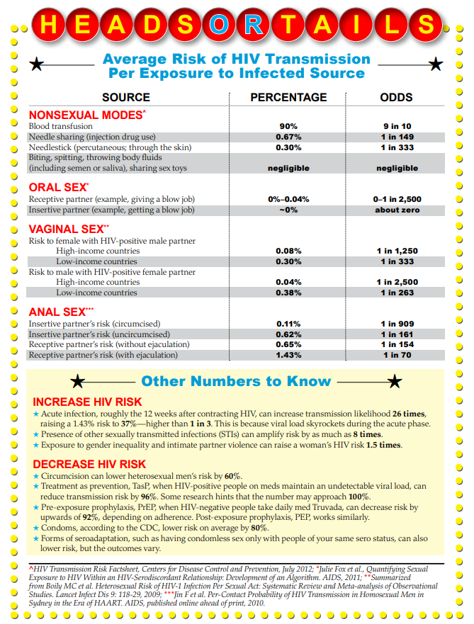
Risk Reference
Print and laminate
Review with patients while rapid test is processing
https://www.poz.com/pdfs/P04-14p53.risk_transmission.pdf

Slide 72
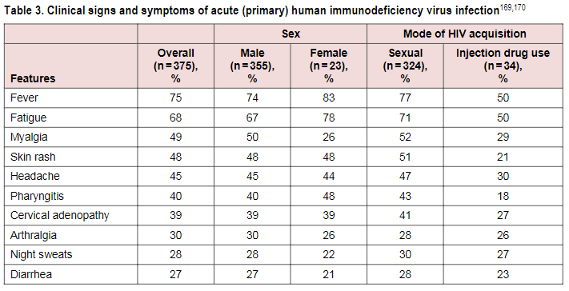
Acute Retroviral Syndrome (ARS)
Updated guidelines for antiretroviral postexposure prophylaxis after sexual, injection drug use, or other nonoccupational exposure to HIV—United States, 2016
Notes:
Counsel patients for the signs and symptoms of acute retroviral syndrome, an indication to seek urgent medical attention for assessment (HIV screen negative or indeterminant, HIV viral load high)

Slide 73
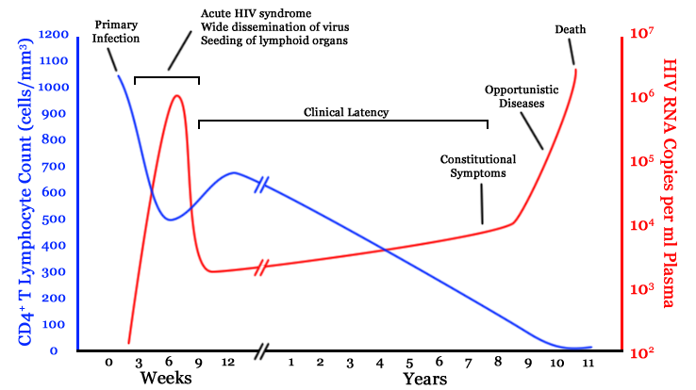
https://www.researchgate.net/figure/A-generalized-graph-of-the-relationship-between-HIV-copies-viral-load-and-CD4-counts_fig1_242611621

Slide 74
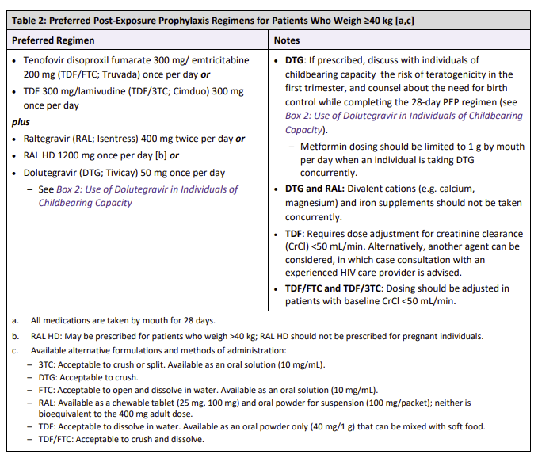
HIV PEP
Start complete 3-drug regimen <72 hours from exposure
Side effects:
Mild nausea
Diarrhea
Headache
Insomnia (take in AM)
Table: NYDOH
https://www.cdc.gov/hiv/pdf/programresources/cdc-hiv-npep-guidelines.pdf; https://www.fda.gov/Drugs/DrugSafety/ucm608112.htm
https://www.hivguidelines.org/pep-for-hiv-prevention/pep/#tab_7_0
Notes:
Prescribe #30. Most pharmacies will not dispense a partial bottle of #28 due to cost.

Slide 75
Initial Work Up for HIV PEP
Medical history
Pregnant
Kidney/liver disease
Allergies
Medications
Drug-drug interactions
Vaccination history
Hepatitis A & B
Physical exam
Assault/trauma
Complete Blood Count (CBC), creatinine, Liver Function Tests (LFTs)
HIV screen
Hepatitis B (HBV) Serum-ascites albumin gradient (SAg), HBV, Spontaneuos Abortion (Sab), HBV total Core Ab (Hepatitis B Core Antibody)
Hepatitis C Antibody (HCV Ab)
+/- STI testing
+/- Pregnancy testing

Slide 76
HIV PEP Initial Visit
Risk reduction education
Safe work practices – universal precautions
Barrier protection – condoms
Needle exchange program (if legal and available in your state)
Education about PEP medications & need to complete full 28-day course
If the source is found to be HIV negative, PEP should be discontinued
Follow up visit in 4 weeks for repeat testing
Referrals if needed
SANE, mental health counseling, substance use treatment program
Notes:
SANE=sexual assault nurse examiners
Follow up with patient within 1 week to chec

Slide 77
HIV PEP in Special Populations
In adolescents
Youth can consent for sexual/mental health in NM
In those with Chronic Kidney Disease (CKD)
If CrCl < 60 mL/min, avoid tenofovir disoproxil fumarate (TDF)
CrCl <30 mL/min use alternate
In pregnant women
Category B
Discuss risk/benefit dolutegravir in first trimester
No raltegravir HD
In breastfeeding women
If significant risk, pump and dump
TDF=tenofovir disoproxil fumarate; TAF= tenofovir alafenamide
Notes:
raltegravir HD: longer acting, once daily formulation of raltegravir, an integrase strand transfer inhibitor (INSTI)
TDF=tenofovir disoproxil fumarate; TAF= tenofovir alafenamide
NRTIs=nucleotide reverse transcriptase inhibitor

Slide 78
Prescribing HIV PEP
International Classification of Diseases (ICD-10) codes:
Z20.6 Contact with and (suspected) Exposure to HIV
Z20.2 Contact with and (suspected) Exposure to infections with a predominantly sexual mode of transmission
National Alliance of State and Territorial AIDS Directors (NASTAD) Billing & Coding Guide https://nastad.org/sites/default/files/2021-12/PDF-Billing-Coding.pdf
nPEP Toolkit https://aidsetc.org/resource/npep-toolkit

Slide 79
Prescribing HIV PEP
If requires prior authorization – put in “emergent request”
If large copay (Med D excluded), copay cards:
Gilead https://www.gileadadvancingaccess.com/copay-coupon-card
ViiV https://www.viivconnect.com/for-patients/savings-assistance/
Merck https://www.merckhelps.com/
If uninsured, medication assistance programs:
Gilead 1-800-226-2056 https://advancingaccessconsent.iassist.com/
ViiV 1-844-588-3288 https://www.viivconnect.com/for-providers/patient-enrollment/
Merck 1-800-727-5400 https://www.merckhelps.com/
https://aidsetc.org/resource/medication-assistance-programs#pep
Notes:
https://aidsetc.org/resource/medication-assistance-programs#pep
Don’t just prescribe and hope patient gets- need to call pharmacy! Consider sample packs at clinic? In house pharmacy (pt walks out with full month supply). Case manager/navigator should ensure patient gets meds ASAP

Slide 80
Rapid Start
This project is supported by the Health Resources and Services Administration (HRSA) of the U.S. Department of Health and Human Services (HHS) under grant number U1OHA33225 for the AIDS Education and Training Centers. This information or content and conclusions are those of the author and should not be construed as the official position or policy of, nor should any endorsements be inferred by HRSA, HHS or the U.S. Government.

Slide 81
HIV treatment with Rapid Start can change the HIV Care Continuum
Rapid Start

Slide 82
Treatment IS Prevention
Cohen, et al. NEJM 2011; 365: 493-505. Skarbinski J, et al. JAMA Intern Med 2015;175:588-96.
Bavinton BR, et al. Lancet HIV. 2018. IAS 2018 http://programme.aids2018.org/Abstract/Abstract/13470
Notes:
Screening is important for treatment and treatment is prevention
Image: https://ght.org.uk/Undetectable
HPTN 052 Study: 1763 subjects; serodiscordant heterosexual couples, early versus delayed HAART initiation
Interim analysis 2011: Intention to treat analysis = 96% reduced risk in genetically linked infections
Then offered all patients HAART; 5 years follow-up
8 linked infections from partners who did not have suppressed viral load
Early ART was associated with 93% lower risk of linked partner infection, 69% lower risk in all partner infections
No linked infections when partner was stably suppressed by ART
PARTNER study (heterosexual and MSM partners)
Opposites Attract study (MSM; Partner with HIV with VL<200 and partner not on PrEP) Bavinton BR, et al. Lancet HIV. 2018
PARTNER 2 study (to gather more data on MSM couples; through 4/18). Partner with HIV with VL<200 and partner not on PrEP. 23-27% had STI during study follow-up period. Documented 75,000 condomless anal sex acts between mixed-HIV-status men.
The prospective observational study saw zero transmissions between study partners when the HIV-positive partner had a fully suppressed viral load, within those nearly 75,000 condomless sex acts.
HAART results in viral suppression and markedly reduced transmission. Very low risk of transmission to partner if consistently virally suppressed

Slide 83
Continuum of Care for PWH in the United States in 2018
100
80
86
60
65
People (%)
56
40
50
20
0
Diagnosed
Receipt of Care
Retained in Care
Virologically
Suppressed
www.cdc.gov/hiv/pdf/library/slidesets/cdc-hiv-prevention-and-care-outcomes-2018.pdf.
Slide credit: clinicaloptions.com
Notes:
PWH, people with HIV.

Slide 84
Immediate Antiretroviral Therapy (ART) Initiation
Immediate ART refers to starting HIV treatment as soon as possible after the diagnosis of HIV infection
This strategy also is known as "rapid ART," "same-day ART," and "treatment upon diagnosis."
Preferably on the first clinic visit
On the same day the HIV diagnosis is made
Same day to 96 hours
https://aidsetc.org/blog/immediate-art

Slide 85
Rationale
May bring earlier benefits in personal health
Promotes equity
Earlier reductions in the risk of transmission of HIV
In acute infection, immediate ART may limit the HIV viral reservoir
Prior studies in the United States and in trials in resource-limited settings:
Reduced time to linkage to care
Reduced time to viral load suppression

Slide 86
Prior studies
RAPID San Francisco: Time to viral suppression < 200 copies/ml was significantly faster in the intervention managed patients (1.8 mths) vs. standard clinic treatment (4.3 mths
CrescentCare Start Initiative (CCSI) New Orleans: Median time to viral suppression (<200 copies/ml) was 30 days vs. 68 days

Slide 87
Immediate Start ART Programs Support
Coordinated activity among HIV testing sites
Assistance/involvement of patient navigators and public health tracking systems
Immediate ART clinical care site
-Structure or procedure specific to this program
-Referrals for new HIV diagnoses via a single point of contact which is efficient and reliable ( pager, identified front desk staff or nurse)
-“Immediate or Rapid” multi-disciplinary team available for same day care
-SW, insurance specialist, clinician, labs services
-Follow-up care within 1 week of the initial visit
https://aidsetc.org/blog/immediate-art

Slide 88
Patient Screening for Immediate ART
Nearly all persons confirmed with a new HIV diagnosis
Persons suspected with acute HIV
HIV Ag-Ab test negative at the time of the visit
Persons with a positive rapid HIV Ab test, prior to a resulted confirmation test if there is a high pretest probability of HIV infection
After counseling immediate ART can be offered, with the plan to stop ART if the confirmatory test is negative
Chronically infected patients returning to care after being out of care
Must have known wild type virus
OR
If the resistance pattern can be predicted
https://aidsetc.org/blog/immediate-art
Notes:
Patient screening for immediate ART
Immediate ART is appropriate for:
Nearly all persons with confirmed new diagnoses of HIV
Persons with suspected acute HIV, whose HIV diagnosis may not yet be confirmed (e.g., the HIV antigen or antibody test result may be negative at the time of evaluation)
Persons with positive results of rapid HIV antibody tests, before confirmatory test results are available, if the pretest probability of HIV infection is high (after counseling, immediate ART can be offered with the understanding that if confirmatory tests are negative, the patient would stop ART)
Chronically infected patients who are returning to care after being out of care also can be started rapidly if they have a known wild-type virus or if the resistance pattern of their virus can be predicted

Slide 89
Recommendations
Clinicians offer rapid ART initiation preferably same day or within 96 hours
To those who are candidates and who have:
1) A confirmed HIV diagnosis
OR
2) A reactive HIV screening result with a pending confirmatory HIV test
OR
3) Suspected acute HIV infection
I.e., HIV antibody negative and HIV RNA positive
Adapted from the NYSDOH AIDS Institute Clinical Guidelines Program 5/1/20

Slide 90
Recommendations (cont.)
Evaluate and prepare patients to start ART as soon as possible.
Risk and Benefits of ART
Benefit: Reduction in risk of HIV transmission after starting ART and achieving viral suppression.
Seronegative HIV negative partner
Assess patient readiness to start ART
Team effort to identify and improve factors that could hinder adherence to treatment
Medication access
Support services
Psychosocial barriers
Active substance abuse
Mental health disorders
Adapted from the NYSDOH AIDS Institute Clinical Guidelines Program 5/1/20

Slide 91
When Immediate ART is not utilized
Persons who decline Immediate ART
Immediate ART is not appropriate
Closely follow these patients
At subsequent appointments, ART should continue to offered
Patients may be ready to start sooner rather than later
Untreated opportunistic infections such as CNS infections
Cryptococcal meningitis
TB meningitis
Positive rapid HIV test in the setting of a low pretest probability
Low risk demographic group without a apparent HIV risk factor
https://aidsetc.org/blog/immediate-art
Notes:
Immediate ART is not appropriate for:
Persons with certain untreated opportunistic infections (OIs) such as cryptococcal meningitis and central nervous system (CNS) tuberculosis for whom a short period of treatment for the OI is recommended before ART initiation, to reduce risk of dangerous IRIS (immune reconstitution inflammatory syndrome); note that this is very rare in the outpatient clinic setting
Persons with a preliminary positive rapid HIV test result who have a low pretest probability of HIV infection. For persons who fit this description (e.g., those from a low-risk demographic group with no discernable individual risk factors for HIV), the preliminary result is more likely to be a false positive, and clinicians should probably wait for a positive confirmatory test result before starting ART.
Persons who decline immediate ART initiation:
Patients who are not willing or ready to start ART on the first clinic visit should be followed closely and offered ART at subsequent visits; in our experience, patients who are not ready at the first visit may be ready as soon as several days later.

Slide 92
What to Start
DHHS
IAS-USA
Recommended Regimens:
Integrase and Protease Inhibitor
Bictegravir/Emtricitabine/Tenofovir Alafenamide
Dolutegravir + Emtricitabine/Tenofovir
Darunavir+ ritonavir/Darunavir/cobicistat + Emtricitabine/Tenofovir
Recommended Regimens:
Unboosted Integrase regimens as initial therapy
Bictegravir/Emtricitabine/Tenofovir Alafenamide
or
Dolutegravir + Emtricitabine/Tenofovir Alafenamide
Avoid NNRTI’s, Abacavir, 2 drug regimens
1. DHHS Guidelines. December 2019. 2. Saag. JAMA. 2018;320:379

Slide 93
Treatment of HBV HIV
ART including agents with activity against HIV and HBV is recommended for all patients co-infected with HIV and HBV, regardless of CD4 cell count or need for HBV treatment
ART must include two drugs active against HBV, preferably tenofovir and emtricitabine, regardless of the level of HBV DNA. Such a regimen will
reduce the likelihood of immune reconstitution inflammatory syndrome (IRIS) against HBV
reduce risk of resistance which could occur with newer regimens without HBV active drugs or with 3TC or FTC alone
DHHS Guidelines 2017

Slide 94
Pregnancy and those wishing to conceive
The selection of a rapid ART regimens for those who are pregnant or may become pregnant must be done following discussion with the patient and done carefully.
Do not use cobicistat boosted regimens
Not studied in pregnancy: bictegravir
Dolutegravir: Patient counseling and informed decision making
https://aidsetc.org/blog/immediate-art
Notes:
For women who are pregnant, wish to become pregnant, or are at risk of becoming pregnant:
Dolutegravir is not currently recommended for use at the time of conception or during the early weeks of pregnancy. Elvitegravir and cobicistat (including darunavir/cobicistat) are not recommended for pregnant women, and bictegravir and TAF have not been studied in pregnancy.
Thus, rapid-ART regimens for a woman who is pregnant or may become pregnant must be selected individually, after careful discussion with her. Current HHS perinatal guidelines include raltegravir + TDF/FTC and darunavir + ritonavir + TDF/FTC among their recommended regimens for pregnant women.(9)

Slide 95
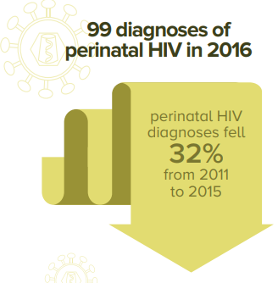
ART in Pregnancy
Pregnancy may alter ARV absorption, distribution, & metabolism
Dose adjustment, drug-drug interactions
Increased risk for pre-term labor when mom on perinatal ART
No increase in infant morbidity/mortality
Report all cases of ARV drug exposure
www.apregistry.com
Need mother’s consent
https://www.cdc.gov/hiv/group/gender/pregnantwomen/index.html https://aidsinfo.nih.gov/guidelines/html/3/perinatal-guidelines/0
Notes:
Extreme caution if methergine used for postpartum hemorrhage if on PI or NNRTI or cobicistat
Increased risk for pre-term labor when mom on perinatal HAART.
Hoffmann, RM et al. Adverse Pregnancy Outcomes Among Women Who Conceive on ART. CID. 2019;68(2):273-9. Seen on intention to treat analysis, in those on ART at conception, more likely to have spontaneous abortion or stillbirth compared with women randomized to stop ART however findings did not remain significant in the as-treated analysis. More data are needed on pregnancy outcomes among women conceiving on ART, particularly with newer regimens. (This study, most common used regimen was lopinavir/ritonavir +TDF/FTC. Some on AZT/3TC, rilpivirine, atazanavir, raltegravir. Study performed in Argentina, Botswana, Brazil, China, Hait, Peru, Thailand, US. 277/1652 had a pregnancy. Noted that rates of spontaneous abortion in study similar to rates in HIV-unifected general population for early pregnancy)

Slide 96
ART in Pregnancy
If mom suppressed, continue current regimen
In general, similar regimens recommended
Many ARV not testing in pregnancy (i.e. BIC, DOR)
Cobicistat-boosted regimens are not recommended
Preferred regimens:
TDF/FTC (TDForTAF) ABC/3TC (if HLAB5701 negative)
+ Boosted PI (ATV/r qday or DRV/r bid)
Or + INSTI ( dolutegravir*)
*Informed decision making around use in 1st trimester
https://aidsinfo.nih.gov/guidelines/html/3/perinatal-guidelines/0
Notes:
Dolutegravir: Early report of neural tube defects in those who were on dolutegravir at the time on conception. No increased risk seen when drug used later in pregnancy. Trial still ongoing. Drug Safety Communication from FDA
https://www.fda.gov/Drugs/DrugSafety/ucm608112.htm
http://www.ema.europa.eu/ema/index.jsp?curl=pages/news_and_events/news/2018/05/news_detail_002956.jsp&mid=WC0b01ac058004d5c1
Mulligan, N et al. AIDS. 2018. Dolutegravir exposure lower in pregnancy in those on qday dosing but median AUC similar. Trough concentrations well above EC90. Readilyy crosses placenta. Infant elimination prolonged with half-life over twice that in adults. 93% of 29 women enrolled were <50 copies.. All infants HIV neg.
NIH-funded study in Botswana: 0.3% increased risk of neural tube defects when DTG used around the time of conception. Ris was higher than NTD in those on efavirenz (0.05%) and women without HIV (0.08%) but not enough data to determine risk of NTD with preconception use. Dolutegravir is the preferred INSTI after first trimester.
Cobicistat NOT recommended
Tsepamo Update. Zash IAS 2929#oAXLB0102. 1 excess neural tube defect/1000 treated during conception. NTD in non-DTG at conceptinon=0.11%, DTG during preg=0.04%; HIV neg women=0.07%
Chinula CROI 2020 abstract #130LB. TAF in pregnancy. Less adverse outcomes in TAF (24%) vs TDF (33%); guidelines haven’t changed yet

Slide 97
PrEP or PEP exposure
If a patient is on PrEP or PEP
If a patient took it at the time of HIV infection
If a patient took it since HIV infection
Obtain a detailed history of the timing of PrEP vs. PEP exposure
If concern for HIV resistance is present, use a strengthened regimen:
Integrase inhibitor (dolutegravir or bictegravir)
+
Boosted darunavir
+
2 NRTIs (Tenofovir Ala/Emtricitabine or Tenfovir DF/emtricitabine or Tenofovir DF/ lamivudine)
Notes:
f patient is taking PrEP (pre-exposure prophylaxis) or PEP (post-exposure prophylaxis), or took it at the time of HIV infection or since HIV infection:
Take a careful history to determine the last time the patient took PrEP or PEP medications
If there is concern that resistance to the ARVs may have developed, start a reinforced ART regimen consisting of an integrase inhibitor (dolutegravir or bictegravir) + boosted darunavir + TAF/FTC (or TDF/FTC or TDF/3TC) while awaiting the results of the genotype assay

Slide 98
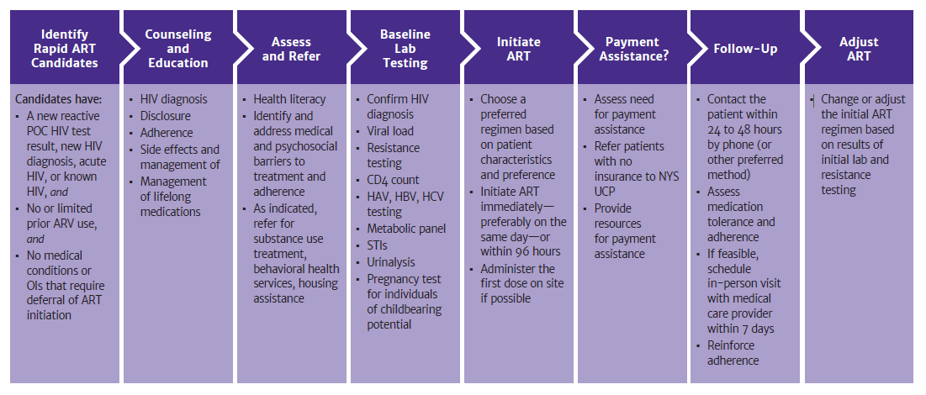
Safe and well tolerated
Leads to earlier Viral Suppression → Decreased transmission
Promotes Equity
A Powerful tool in our chest to aid in Ending the Epidemic

Slide 99
Potential Barriers to Implementation
Clinic/Provider Level
Lack of clinic/provider buy-in or bias
Lab results needed: creatinine, hepatitis status, genotype, latent TB screening
Advanced HIV at the time of diagnosis-concern for IRIS
Systematic Level
Off site HIV testing-
fragile referral process
Inability to obtain an appointment
Patient Level
Substance Abuse, Mental Illness
Housing and Food Security
Lack of patient buy-in/ Stigma

Slide 100
IT TAKES A TEAM !
Linkage Care Coordinators
Nurses
Case Managers (Medical and Non-Medical)
Mental Health Counselors
Substance Abuse Counselors
Psychiatrist
Pharmacy and Benefit Coordinator

Slide 101
References
www.cdc.gov/hiv
https://targethiv.org/
https://aidsinfo.nih.gov/guidelines
https://clinicaloptions.com/

Slide 102
SCAETC Social Media

Slide 103
Resources
National Clinician Consultation Center http://nccc.ucsf.edu/
HIV Management
Perinatal HIV
HIV PrEP
HIV PEP line
HCV Management
Substance Use Management
Present on ECHO
https://hsc.unm.edu/scaetc/programs-services/echo.html​
AETC National HIV Curriculum https://aidsetc.org/nhc
AETC National Coordinating Resource Center https://targethiv.org/library/aetc-national-coordinating-resource-center-0
HIVMA Resource Directory https://www.hivma.org/globalassets/ektron-import/hivma/hivma-resource-directory.pdf
Additional trainings scaetcecho@salud.unm.edu
www.scaetc.org
Notes:
IDEA Platform: Infectious Diseases Education & Assessment. https://idea.medicine.uw.edu/
AETC National HIV Curriculum: 6 core modules for self study; regularly updated; CME, CNE
Hepatitis C Online Curriculum: https://www.hepatitisc.uw.edu/
Hepatitis B Online Curriculum: https://www.hepatitisb.uw.edu/
National STD Curriculum: https://www.std.uw.edu/

Slide 104
If you are interested in other training opportunities, contact:
Dana Gray, SCAETC Program Director LSU Health – New Orleans, School of Public Health dgray@lsuhsc.edu or (504) 568-5647
Visit us at: https://hsc.unm.edu/scaetc/
or
https://sph.lsuhsc.edu/service/south-central-aetc/scaetc-events/

