Slide 1
Overcoming Barriers Related to HIV Care: Stigma
Lucinda Lundy Zeinelabdin MSN, APRN, FNP-C
January 26,2024

Slide 2
Conflict of Interest Disclosure Statement
The presenter has no conflicts to declare.
This presentation was created in collaboration with San Antonio Metropolitan Health Department and UT Health San Antonio AETC.
This program is supported by the Health Resources and Services Administration (HRSA) of the U.S. Department of Health and Human Services (HHS) as part of an award totaling $4,205,743 with 0% financed with non-governmental sources. The contents are those of the author(s) and do not necessarily represent the official views of, nor does mention of trade names, commercial practices, or organizations imply an endorsement by HRSA, HHS, or the U.S. Government. For more information, please visit HRSA.gov. Any trade/brand names for products mentioned during this presentation are for training and identification purposes only.

Slide 3
Unconscious Bias Disclosure
SCAETC recognizes that language is constantly evolving, and while we make every effort to avoid bias and stigmatizing terms, we acknowledge that unintentional lapses may occur in our presentations.
We value your feedback and encourage you to share any concerns related to language, images, or concepts that may be offensive or stigmatizing.
Your input will help us refine and improve our presentations, ensuring they remain inclusive and respectful to participants.
Notes:
Next slide

Slide 4
Learning Objectives
Define stigma and identify its impact on HIV patient-provider interactions
Recognize the traumatizing effects of stigma in healthcare on physical and mental health
Touch on trauma informed care, and understand how people first language can reduce stigma and improve patient and provider experiences
Be familiar with the End Stigma End HIV Alliance (ESEHA) anti-stigma guidelines and identify ways to implement anti-stigma and trauma informed care into healthcare practice

Slide 5
What is Stigma?
Stigma is discrimination against an identifiable group of people (CDC.gov), including marginalized and non-marginalized groups, and includes broad social and cultural factors including power relations, community values, and historical practices. (NASTAD.org)
Groups that experience stigma include:
Certain racial and ethnic minority groups
People who identify as LGBTQIA+
People with disabilities
People with large body sizes
People with certain health conditions, including HIV or HCV
People experiencing homelessness
People with substance use disorders
People who are or have experienced incarceration
People who seek or have certain medical procedures or treatments
Many, many more…
Notes:
Stigma can be fueled by certain Prejudice (stereotypes) – beliefs about certain persons or groups that are viewed or presented as factual, that carry a negative connotation. They are usually widely held beliefs that are considered normal in a culture (i.e. young black males are more likely to commit crimes)
Which can then lead to Discrimination – actions taken based on stereotypes/prejudices

Slide 6
Types of Stigma
Stigma comes in many forms and is experienced by many. People can experience different types of stigma, and these categories may overlap – this is referred to as intersectional or layered stigma (Marchofdimes.org).
Individual Stigma | Community Stigma | Structural and Institutional Stigma
Description: Internalizing perceptions of others or the public (NAMI, 2017). Adoption and application of negative beliefs or stereotypes about certain people or conditions (NASTAD.org) Example: A patient diagnosed with an STI believes that they got it because they were “sleeping around” or “being wild” | Description: Judgmental attitudes, beliefs and mistreatment by groups and social networks, including family, peers, co-workers, teachers, classmates, etc. (NASTAD.org) Example: Person who is ostracized by family, social groups or care providers due to refusing to get a COVID-19 vaccination. | Description: Programs, policies and practices that lead to discrimination or perpetuate stigma (NASTAD.org) Example: Criminalizing gender-affirming healthcare for transgender people or the discussion of gender identity or sexual orientation with patients

Slide 7
Stigma in Healthcare
Language: blaming, shaming, assuming
Body language, looks, attitudes
Stigma is not always intentional.
Stigma can be based on association.
This Photo by Unknown Author is licensed under CC BY-NC-ND
Notes:
Stigma can be conveyed verbally through our words, or expressed through our body language, looks or attitudes.
People can experience stigma through association with stigmatized persons or groups – i.e. “birds of a feather”. This is referred to as Courtesy or Associative stigma. – this is a type of stigma that requires more study, but can affect friends and family members of those who experience stigma such as persons living with HIV, mental illness, or who work in the sex industry as well as others. It is even experienced among people who work with certain stigmatized populations.
Stigma is not always intentional – great example is the “Don’t ask, don’t tell military policy which was intended to decrease homophobia, but instead lead to secrecy and shame in the LGBTQIA+ community

Slide 8
Who Might Experience Stigma in Healthcare Settings?
Anyone
Although some groups may experience it more than others

Slide 9
What Facilitates Stigma?
Knowledge deficits
Fear
Personal beliefs and discomfort
Education
Societal norms and expectations
Social culture
Workplace culture
Peer culture
Microsoft stock photo
Source: End Stigma End HIV Alliance

Slide 10
Impacts of Stigma
The effects of stigma can be traumatic, long-lasting and far-reaching.
Individual: Experience shame, fear of and belief that others are judging them, internalization, isolation and hopelessness. May impose these internalized beliefs on others, perpetuating stigma (NASTAD.org)
Community: Experience loss of support systems, rejection, isolation from important peer and social groups. May experience harassment, discrimination and violence (NASTAD.org).
Institutional: May avoid or not seek care when needed, may avoid seeking help when victimized, may experience loss or denial of jobs, housing, education or other opportunities or assistance (NASTAD.org).
Microsoft stock photos

Slide 11
How HIV Stigma Affects PWH
Can lead to the concealment of one’s HIV status for fear of being shunned (stigmatized) by others
Fear of disclosure can prevent accessing care and treatment for HIV
Patients may be unwilling to take medications where they can be seen by others
Concealment of HIV status leads to social isolation and internalized feelings of self-loathing and cycle of hopelessness

Slide 12
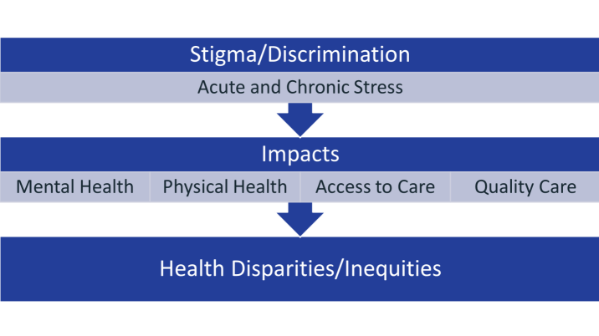
Notes:
Those having peer or family support are less likely to have these disparities

Slide 13
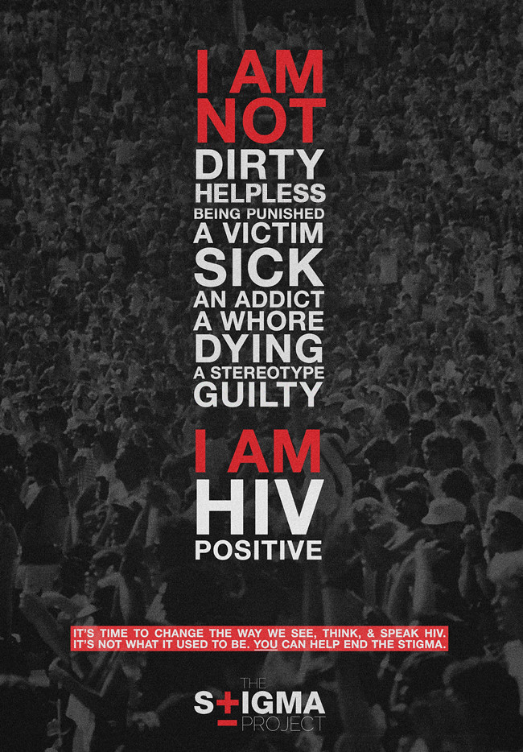
HIV Stigma in Healthcare
Reducing the stigma surrounding HIV is paramount to ending the epidemic.
We want to encourage people to get tested, and into treatment if positive.
We want to encourage people in treatment to stay in care because Undetectable equals Untransmittable (U=U).
Negative experiences in healthcare either currently or in the past, can determine whether patients get tested, seek treatment or stay in treatment
This Photo by Unknown Author is licensed under CC BY-NC-ND

Slide 14
True or False?
Stigma and judgment can be expressed through body language and looks as well as verbally.

Slide 15
TRUE
Patients often indicate that they often felt judged or stigmatized by providers based on looks, body language and the way they were treated in addition to things the providers say.

Slide 16
Trauma Informed Care
Microsoft stock photo

Slide 17
What is Trauma-Informed Care?
A universal way to interact with people who have experienced trauma.
Asking "What happened to you instead?" of "What’s wrong with you?"
Based on 5 principles
Seek to avoid re-traumatization
Promote safety, avoid triggering or causing anxiety, be sensitive to power differentials, allow for people to speak out, and have a system in place to address and follow up on problems and complaints.
Use EVENT principle when responding to traumatic events
Empathize – show empathy
Validate – the person and their experiences
Normalize – normalize their experience
Trust – respect personal and professional boundaries
Equalize – treat them as equals and the experts of themselves
Notes:
If you are interested in Trauma Informed Care training for your organization, please feel free to let us know, and we can provide resources.

Slide 18
Using People-First/ Anti-stigmatizing Language
This Photo by Unknown Author is licensed under CC BY-NC-ND

Slide 19
What is Person First Language?
Puts the person first, not their condition or diagnosis.
For example:
Jack is not homeless, but a person experiencing homelessness.
Joan is not diabetic, but a person diagnosed with diabetes, or living with diabetes.
John is not a COVID patient, but a patient diagnosed with COVID-19.
Jill is not an intravenous drug user, but a person who injects drugs.
This Photo by Unknown Author is licensed under CC BY-SA-NC
Notes:
Consider "Suicidal Ideations or Attempts"
Instead of "Addictions," consider "Substance Use" and maybe also "Compulsive Behaviors" since the term "addiction" can be stigmatizing term.
"Homelessness" can also be stigmatizing; consider instead "People without Housing or Homes";
"Consider "Smoking and Vaping"
"Lack of Peer or Support System"

Slide 20
Best practices | Say this!
When addressing patients, avoid using gender terms like “sir” or “ma’am” | “How may I help you today?”
When talking to co-workers about patients, avoid pronouns and other gender terms. Or, use gender-neutral words such as “they.” Never refer to someone as “it.” | “Your patient is here in the waiting room.” “They are here for their 3 o’clock appointment.”
Use the terms people use to describe themselves. | If someone uses “transgender,” do not use the term “transexual.”
Only ask for information that is required. | Ask yourself: What do I need to know? How can I ask in a sensitive way?
Frontline Communication Tips
Notes:
There are specific trauma informed care training available through the AETC for your organization if you would like.

Slide 21
Healthcare provider bias and stigma are not very prevalent and do not make a significant difference in patient engagement. If the patient cares about their own health, they will be engaged.
True or False?

Slide 22
False
When patients have positive experiences with healthcare providers, it leads to increased levels of involvement in care. Traumatic and stigmatizing encounters can affect future experiences and the patient's willingness to be engaged in care.

Slide 23
Stigma Perpetuates Health Disparities and Epidemics
Stigma that is experienced by patients in healthcare encounters can lead to:
Shame, guilt, denial, depression, increased risk behaviors
Avoidance of the healthcare system
Not getting needed tests and screening
Not disclosing or hiding risk behaviors
Not going to appointments
Dropping out or never entering treatment
Not taking medications as prescribed
Worsening of health conditions
Transmission of infections to partners, to unborn children and to children during birthing

Slide 24
Developing Trust
Microsoft stock photo

Slide 25
Meet Patients Where They Are
They are the experts of themselves
Accept and respectfully mirror the language or terminology the patient may use when
Naming their body parts
Disclosing their sexual orientation and gender identity
Describing sexual acts or risk behaviors such as drug use or sex work
Assess level of health literacy
Use language your patient can understand
Supplement teaching with pictures, videos, etc.
Use the "teach-back method" to ensure understanding

Slide 26
AVOID ASSUMPTIONS
A key principle of effective communication is to avoid making assumptions ​
Approach each new encounter as a clean slate
Don’t assume you know a person’s story
Don’t assume you know a person’s gender identity, sexual orientation, or sexual expression based on how they look or sound, dress, behave, etc.​
Don’t assume you know how a person wants to describe themselves or their partners​
Don’t assume all your patients are heterosexual and cisgender (not transgender)​, or that you know what a transgender person looks like – Only 40% of transgender people are "out" to their healthcare providers (2015 US Trans Survey)
Don't assume your patients are (or are not) sexually active​

Slide 27
Communicate
Explain to your patients why the questions you are asking are relevant to why they are being seen.
Example: If a patient comes in for their physical exam, you may need to explain that knowing their gender identity (cis/trans), substance use history or sexual behaviors is important to ensure you are recommending the appropriate screenings and preventative care.​
Notes:
Communication is very important. Explaining why you are asking the questions you are asking can help gain trust.

Slide 28
Now that you know….
Notes:
Now that you know, and were exposed to some examples to combat stigma….

Slide 29
How Do We Change Our Practices?
Individually
Counteract stigmatizing messages – educate your patients and yourself
Use trauma informed, person first language – commit to using words that humanize others (person before situation)
Recognize our own emotional patterns, biases, and triggers, and be mindful of our body language
Address the needs of the PERSON. Does it matter how infection was acquired?
Use judgment-free language when taking a sexual and substance use history
Don’t celebrate negative tests or convey anxiety about positive results
Ensure the patient feels safe in the exam room, foster an environment of trust, and be an active listener
Congratulate the patient for staying in or re-engaging in care
Convey to patients that you see them as more than their diagnosis – treat them with respect and as the expert of themselves
Source: End Stigma End HIV Alliance Source: (ESEHA) Anti-Stigma Guidelines

Slide 30
How Do We Change Our Practices?
Clinic/Workplace Environment
Create a welcoming and inclusive environment
Create a shame-free zone
Shame is not a healthy motivator and can exacerbate internalized stigma
Hold each other accountable – all members of the team play a role. The patient’s experience begins long before they make it to the exam room.
Use correct names and pronouns with all patients
Include options on registration paperwork, and provide an opportunity to indicate how they would like to be addressed
Cultivate shared decision making and collaborate with your patients on realistic goals for their care
Source: End Stigma End HIV Alliance Source: (ESEHA) Anti-Stigma Guidelines

Slide 31
How Do We Change Our Practices?
Organizational/Structural
Formalize anti-stigma training
Promote trauma informed care and person first language
Hold each other accountable
Prioritize peer support and warm handoffs – use patient navigators and care managers when possible, and warm handoff when referring patients to other providers
Identify a referral network of supportive and inclusive, trauma informed care providers
Identify workplace anti-stigma champions to create buy-in at all levels of the organization
Develop a method to track successes and barriers and use that data to continually improve care
Become certified in trauma informed care
Source: End Stigma End HIV Alliance Source: (ESEHA) Anti-Stigma Guidelines

Slide 32
How Do We Change Our Practices?
Policy Level
Join the End Stigma End HIV Alliance, and attend their meetings
Contact your clinician ambassadors with questions and for scheduling academic detailing sessions to help implement the ESEHA Anti-Stigma Guidelines
Use your network to improve care and reduce trauma and stigma in healthcare
Join the South Texas Trauma Informed Care Coalition
Pediatricians can sign up for free IPACE training
Become a champion and teach others about anti-stigma and trauma informed care
Source: End Stigma End HIV Alliance Source: (ESEHA) Anti-Stigma Guidelines

Slide 33
Resources
https://nastad.org/issues/stigma
https://endstigmaendhiv.com/resources/
https://endstigmaendhiv.com/wp-content/uploads/2021/06/Anti-Stigma-Guidelines-for-Distribution-3-2021-1.pdf
https://beyondlabels.marchofdimes.org/index.html#why_matters
http://www.healthpolicyproject.com/pubs/281_SDTrainingGuide.pdf
https://www.nami.org/Blogs/NAMI-Blog/October-2018/Overcoming-Stigma
https://www.cdc.gov/hiv/basics/hiv-stigma/
https://www.cdc.gov/stopoverdose/stigma/
https://www.cdc.gov/policy/hst/hi5/index.html
http://corazonsa.org/all-programs/

Slide 34
Resources
National Clinician Consultation Center http://nccc.ucsf.edu/
HIV Management
Perinatal HIV
HIV PrEP
HIV PEP line
HCV Management
Substance Use Management
AETC National HIV Curriculum https://aidsetc.org/nhc
AETC National Coordinating Resource Center https://targethiv.org/library/aetc-national-coordinating-resource-center-0
Notes:
Find an HIV-related topic TeleECHO in your area: https://echo.unm.edu/locations-2/echo-hubs-superhubs-united-states/
IDEA Platform: Infectious Diseases Education & Assessment. https://idea.medicine.uw.edu/
AETC National HIV Curriculum: 6 core modules for self study; regularly updated; CME, CNE
Hepatitis C Online Curriculum: https://www.hepatitisc.uw.edu/
Hepatitis B Online Curriculum: https://www.hepatitisb.uw.edu/
National STD Curriculum: https://www.std.uw.edu/

Slide 35
Follow us on Social Media!
@UTHSA_AETC
@UTHealthSAECHO

