Slide 1





current Advances in The global burden and treatment of cardiovascular diseases in hiv
Gerald S. Bloomfield, MD, MPH, FACC, FASE, FAHA
Associate Professor of Medicine and Global Health
Associate Director for Research, Duke Global Health institute

Slide 2


This conference is supported by the Health Resources and Services Administration (HRSA) of the U.S. Department of Health and Human Services (HHS) as part of an award totaling $4,036,482 with 50 percentage financed with nongovernmental sources. The contents are those of the author(s) and do not necessarily represent the official views of, nor an endorsement, by HRSA, HHS or the U.S. Government.

Slide 3
Disclosures
No relevant financial or other conflicts of interest
My research is supported by the following NIH grants
R01 HL157531, R01 MD013493, R56 HL152803, D43 TW011625, U01 HL146382
U01 HL123336 (REPRIEVE)

Slide 4
Outline
Global perspective of the HIV-CVD association
Mechanisms of ASCVD in PWH
Statins for the primary prevention of ASCVD in PWH
Mechanistic insights from the Randomized Trial to Prevent Vascular Events in HIV
Where do we go from here?
ASCVD: atherosclerotic cardiovascular disease; PWH: people with HIV

Slide 5
Global ART Coverage Over Time, 2000-2022
UNAIDS/WHO estimates

Slide 6
HIV-related Deaths, Incidence and Prevalence
GBD 2019 HIV Collaborators. Lancet HIV 2021;8

Slide 7
Causes of Death in PWH
 | Mortality Rate per 10,000 p-years (95% CI) | Observed Deaths | Expected Deaths | Standardized Mortality Ratio (95% CI)
Non-AIDS infections | 8·0 (7·2–8·9) | 358 | 33 | 10·8 (9·8–12·0)
Liver disease | 5·2 (4·6–5·9) | 234 | 63 | 3·7 (3·3–4·2)
Substance misuse | 2·7 (2·3–3·2) | 121 | 47 | 2·6 (2·1–3·1)
Other | 7·8 (7·0–8·6) | 348 | 141 | 2·5 (2·2–2·7)
Non-AIDS deaths | 44·9 (43·0–46·9) | 2017 | 923 | 2·2 (2·1–2·3)
Suicide | 2·1 (1·8–2·6) | 96 | 48 | 2·0 (1·6–2·4)
CVD and Stroke | 8·4 (7·6–9·3) | 378 | 223 | 1·7 (1·5–1·9)
Accident | 2·1 (1·7–2·6) | 94 | 68 | 1·4 (1·2–1·7)
Non-AIDS cancers | 8·6 (7·8–9·5) | 388 | 300 | 1·3 (1·2–1·4)
Croxford et al. Lancet Public Health 2017;2

Slide 8
Causes of Death in PWH
 | Mortality Rate per 10,000 p-years (95% CI) | Observed Deaths | Expected Deaths | Standardized Mortality Ratio (95% CI)
Non-AIDS infections | 8·0 (7·2–8·9) | 358 | 33 | 10·8 (9·8–12·0)
Liver disease | 5·2 (4·6–5·9) | 234 | 63 | 3·7 (3·3–4·2)
Substance misuse | 2·7 (2·3–3·2) | 121 | 47 | 2·6 (2·1–3·1)
Other | 7·8 (7·0–8·6) | 348 | 141 | 2·5 (2·2–2·7)
Non-AIDS deaths | 44·9 (43·0–46·9) | 2017 | 923 | 2·2 (2·1–2·3)
Suicide | 2·1 (1·8–2·6) | 96 | 48 | 2·0 (1·6–2·4)
CVD and Stroke | 8·4 (7·6–9·3) | 378 | 223 | 1·7 (1·5–1·9)
Accident | 2·1 (1·7–2·6) | 94 | 68 | 1·4 (1·2–1·7)
Non-AIDS cancers | 8·6 (7·8–9·5) | 388 | 300 | 1·3 (1·2–1·4)
Croxford et al. Lancet Public Health 2017;2

Slide 9
Observations Linking HIV and CVD
Rate of acute myocardial infarction and ischemic stroke higher in PWH
HIV-positive
HR 1.40 (95% CI 1.17-1.69)
p<0.001
RR 1.75 (95% CI 1.51-2.02)
p<0.0001
HIV-negative
35
100
*
30
80
25
MI Events per
1000 PYs
20
60
*
CVA Events per
1000 PYs
15
40
*
*
10
*
*
*
*
20
5
0
0
18-34
35-44
45-54
55-64
65-74
18-29
30-39
40-49
50-59
60-69
70-79
Age Group (years)
Age Group (years)
* statistically significant
Triant et al. J Clin Endocrinol Metab. 2007; 92
Chow et al.J Acquir Immune Defic Syndr. 2012; 60

Slide 10
1.5 – 2x Higher Risk of Myocardial Infarction in PWH
North American & European Cohorts
MI Relative Risk, PWH vs. PWOH
2014
Slide adapted courtesy of Dr. Zanni

Slide 11
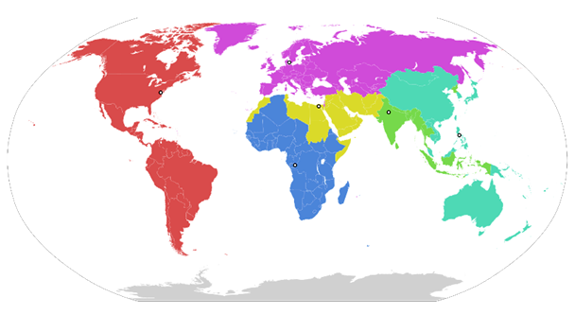
Global Prevalence of HIV

Slide 12
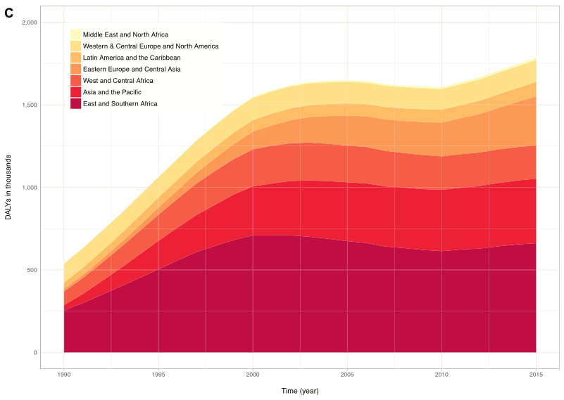
Global Burden of CVD in HIV - DALYs
2,000
1,500
1,000
500
0
DALYs in thousands
1990 1995 2000 2005 2010 2015
Shah et al. Circulation 2018;138

Slide 13
Global Burden of CVD in HIV - DALYs
2,000
1,500
1,000
500
0
- CVD DALYs due to HIV increasing
- CVD DALYs due to HIV greatest Asia, Pacific, E/S Africa
DALYs in thousands
1990 1995 2000 2005 2010 2015
Shah et al. Circulation 2018;138

Slide 14
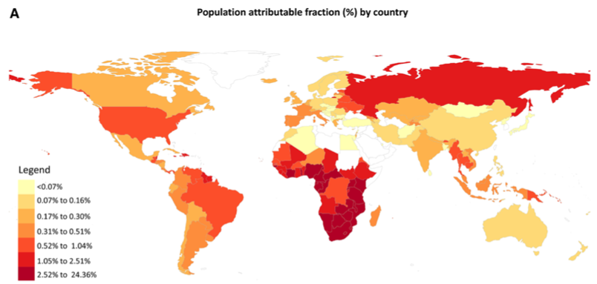
Fraction of CVD Attributable to HIV
Shah et al. Circulation 2018;138

Slide 15
Mechanisms of Coronary Artery Disease in PWH
Ntsekhe and Baker. Circ 2022;147

Slide 16
Mechanistic Pathways
Immune activation and inflammation
HIV-suppressed relative to HAART-naïve
100
HIV-suppressed relative to HIV-negative
80
60
40
20
Difference (%)
0
-20
filled markers p<0.002
-40
-60
sCD27
IL-10
IL-2
IFN-γ
TNF-α
sIL-6R
BAFF
CCL2
IL-6
CRP
IL-1β
IL-8
CCL4
CXCL10
sIL-2Rα
sTNFR2
CXCL13
IL-12p70
sCD14
CCL11
sGP130
CCL13
CCL17
GM-CSF
Wada et al. AIDS 2015;29

Slide 17
Mechanistic Pathways
Strategies for Management of Anti-Retroviral Therapy (SMART)
More composite CV events with higher IL-6, hsCRP, D-dimer
Immune activation and inflammation
20
IL-6
hsCRP
D-dimer
Quartile 4 (high)
Quartile 4 (high)
Quartile 4 (high)
Quartile 3
Quartile 3
Quartile 3
Quartile 2
Quartile 2
Quartile 2
15
Quartile 1 (low)
Quartile 1 (low)
Quartile 1 (low)
10
Cumulative Percent With Event
5
0
0
12
16
20
24
28
32
36
40
44
48
0
12
16
20
24
28
32
36
40
44
48
0
4
8
12
16
20
24
28
32
36
40
44
48
4
8
4
8
Months from randomization
Months from randomization
Months from randomization
Adj. HR per 1 SD increase: 1.39 (1.25-1.54)
Adj. HR per 1 SD increase: 1.43 (1.24-1.64)
Adj. HR per 1 SD increase: 1.40 (1.21-1.61)
Duprez et al. PLOS ONE 2012;7

Slide 18
Mechanistic Pathways
Immune activation and inflammation
CVD Risk Factors
  Tobacco
100
80
60
Smoking (%)
40
20
18%
14%
0
Global Male
HIV+
Global Female
HIV+
US Male
HIV+
US Female
HIV+
US Male
General
US Female
General

Slide 19
Mechanistic Pathways
Immune activation and inflammation
CVD Risk Factors
  Tobacco
100
80
60
55%
55%
Smoking (%)
40
20
18%
14%
0
Global Male
HIV+
Global Female
HIV+
US Male
HIV+
US Female
HIV+
US Male
General
US Female
General

Slide 20
Mechanistic Pathways
Immune activation and inflammation
CVD Risk Factors
  Tobacco
100
80
60
50%
55%
55%
Smoking (%)
40
36%
20
18%
14%
0
Global Male
HIV+
Global Female
HIV+
US Male
HIV+
US Female
HIV+
US Male
General
US Female
General

Slide 21
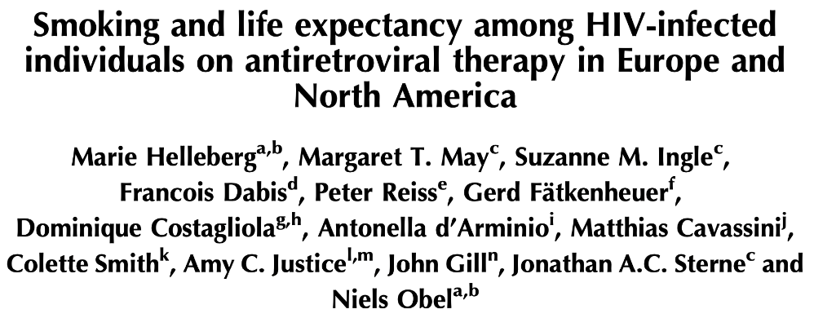
Mechanistic Pathways
Immune activation and inflammation
CVD Risk Factors
  Tobacco
Helleberg et al. AIDS 2015;29

Slide 22
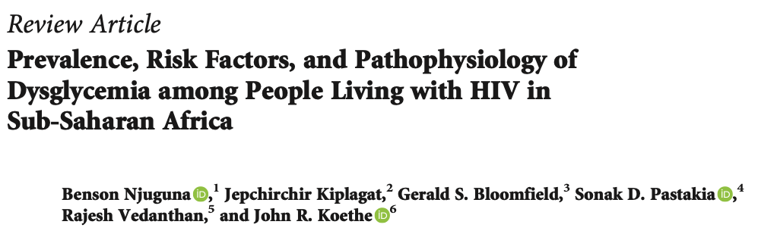
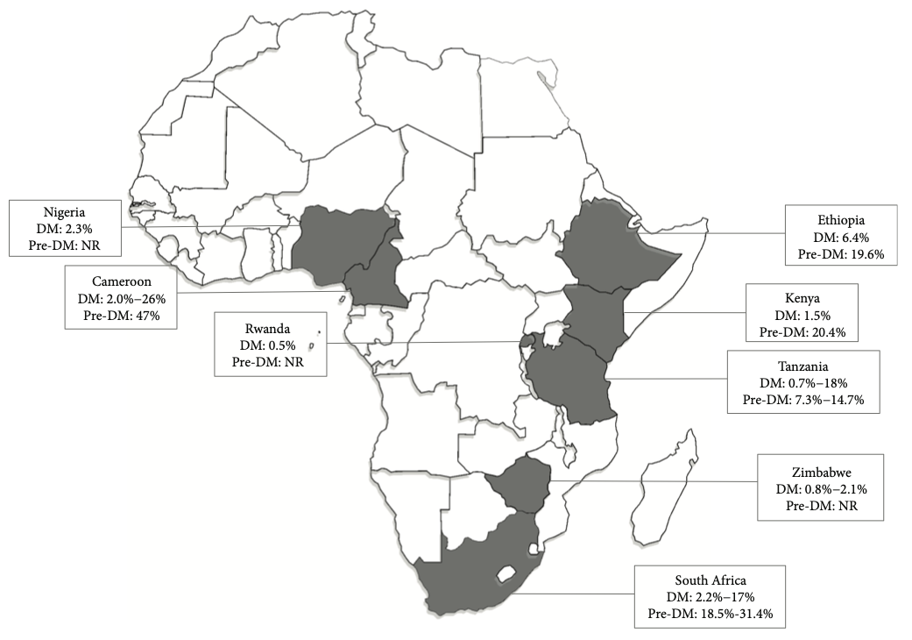
Mechanistic Pathways
Immune activation and inflammation
CVD Risk Factors
  Tobacco
  Diabetes
DM prevalence in HIV 6% (1-26%)
Elevated CRP increases risk ~2x
Njuguna et al. J Diab Res 2018;9; Memiah et al. Met Synd Relat Dis 2022; 20

Slide 23
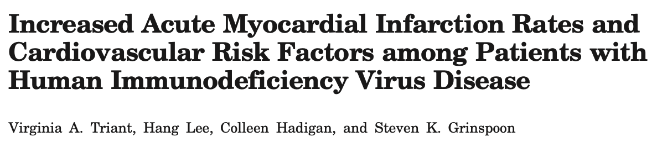
Mechanistic Pathways
Immune activation and inflammation
CVD Risk Factors
  Tobacco
  Diabetes
  Dyslipidemia
 | HIV (n=3851) |  | Non-HIV (n=1,044,589)
 | n | Proportion | N | Proportion
Hypertension | 818 | 21.2* | 165,665 | 15.9
Diabetes | 443 | 11.5* | 68,565 | 6.6
Dyslipidemia | 896 | 23.3* | 184,291 | 17.6
* p<0.001
Triant et al. JCEM 2007;92

Slide 24
Mechanistic Pathways
Immune activation and inflammation
CVD Risk Factors
  Tobacco
  Diabetes
  Dyslipidemia
 | HIV (n=3851) |  | Non-HIV (n=1,044,589)
 | n | Proportion | N | Proportion
Hypertension | 818 | 21.2* | 165,665 | 15.9
Diabetes | 443 | 11.5* | 68,565 | 6.6
Dyslipidemia | 896 | 23.3* | 184,291 | 17.6
* p<0.001
Triant et al. JCEM 2007;92

Slide 25
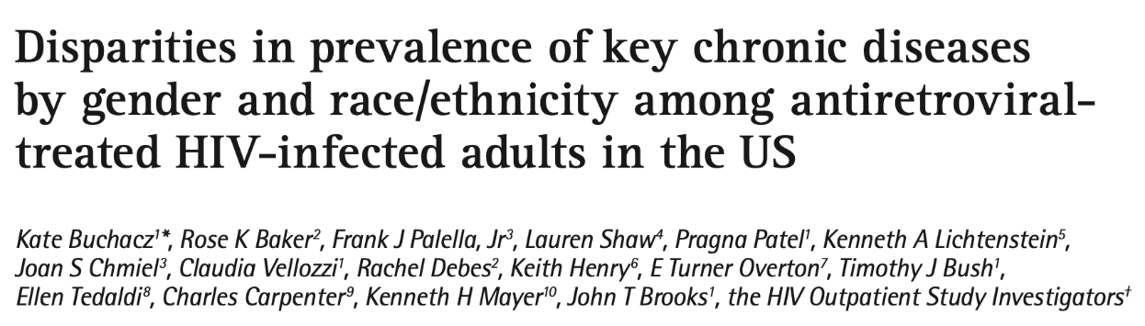
Mechanistic Pathways
Immune activation and inflammation
CVD Risk Factors
  Tobacco
  Diabetes
  Dyslipidemia
WOMEN | All (n=673) | Black (n=387) | White (n=176) | Hispanic (n=110) | P-value
Median age (IQR) | 43 (39-51) | 44 (38-50) | 46 (40-52) | 46 (40-51) | 0.009
Tobacco use, n(%) | 399 (59%) | 222 (57) | 120 (68) | 57 (52) | 0.019
Nadir CD4+ T-cell count (IQR) | 176 (48-295) | 177 (44-295) | 174 (54-322) | 195 (46-289) | 0.595
Prevalence ratio (95% CI)
Hypertension | 57 (54, 61) | 58 (53, 63) | 55 (47, 63) | 60 (50, 69) | 0.71
Obesity | 32 (28, 36) | 36 (31, 41) | 16 (11, 24) | 40 (31, 51) | <0.001
Dyslipidemia | 67 (64, 71) | 59 (54, 64) | 81 (75, 87) | 76 (66, 83) | <0.001
High Total Chol. | 7 (5, 10) | 5 (3, 9) | 9 (4, 15) | 11 (5, 21) | 0.204
Low HDL | 27 (32, 32) | 23 (17, 30) | 33 (25, 43) | 30 (19, 42) | 0.125
High LDL | 5 (3, 7) | 5 (3, 10) | 3 (1, 9) | 5 (1, 13) | 0.728
High non-HDL | 20 (16, 24) | 13 (8, 18) | 23 (16, 32) | 34 (23, 47) | <0.001
Buchacz et al. Antiviral Therapy 2013;18

Slide 26
Mechanistic Pathways
Immune activation and inflammation
CVD Risk Factors
  Tobacco
  Diabetes
  Dyslipidemia
WOMEN | All (n=673) | Black (n=387) | White (n=176) | Hispanic (n=110) | P-value
Median age (IQR) | 43 (39-51) | 44 (38-50) | 46 (40-52) | 46 (40-51) | 0.009
Tobacco use, n(%) | 399 (59%) | 222 (57) | 120 (68) | 57 (52) | 0.019
Nadir CD4+ T-cell count (IQR) | 176 (48-295) | 177 (44-295) | 174 (54-322) | 195 (46-289) | 0.595
Prevalence ratio (95% CI)
Hypertension | 57 (54, 61) | 58 (53, 63) | 55 (47, 63) | 60 (50, 69) | 0.71
Obesity | 32 (28, 36) | 36 (31, 41) | 16 (11, 24) | 40 (31, 51) | <0.001
Dyslipidemia | 67 (64, 71) | 59 (54, 64) | 81 (75, 87) | 76 (66, 83) | <0.001
High Total Chol. | 7 (5, 10) | 5 (3, 9) | 9 (4, 15) | 11 (5, 21) | 0.204
Low HDL | 27 (32, 32) | 23 (17, 30) | 33 (25, 43) | 30 (19, 42) | 0.125
High LDL | 5 (3, 7) | 5 (3, 10) | 3 (1, 9) | 5 (1, 13) | 0.728
High non-HDL | 20 (16, 24) | 13 (8, 18) | 23 (16, 32) | 34 (23, 47) | <0.001
Buchacz et al. Antiviral Therapy 2013;18

Slide 27
Mechanistic Pathways
Immune activation and inflammation
CVD Risk Factors
  Tobacco
  Diabetes
  Dyslipidemia
ART
Select NRTI’s > select NNRTI’s, PI’s
mitochondrial toxicity & lipodystrophy → metabolic dysregulation
Select NRTI’s (TDF) and PI’s
(atazanavir)
renal dysfunction
Select NRTI’s
(TAF) and INSTI’s
weight gain
Lake et al. CID 2017; Alfano J Clin Med 2019; Sax et al. CID 2020; Capeau et al. Curr Opin HIV AIDS 2024
Slide adapted courtesy of Dr. Zanni

Slide 28
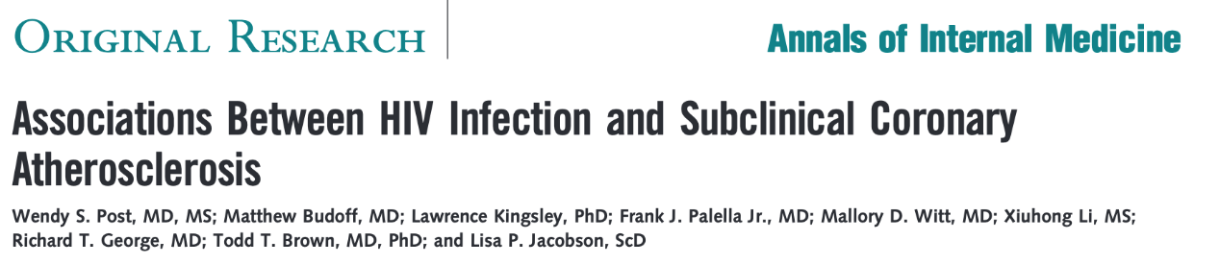
Mechanistic Pathways
Immune activation and inflammation
CVD Risk Factors
  Tobacco
  Diabetes
  Dyslipidemia
ART
 | Minimally adjusted |  | Adjusted for CAD risk factors
 | PR (95% CI) | P value | PR (95% CI) | P value
Detectable HIV RNA >50 copies/ml | 1.26 (0.76, 2.1) | 0.37 | 1.43 (0.84, 2.43) | 0.187
Duration of HAART (yrs) | 1.09 (1.02, 1.17) | 0.007 | 1.09 (1.02, 1.17) | 0.007
History of AIDS | 1.49 (0.92, 2.41) | 0.103 | 1.40 (0.87, 2.26) | 0.170
Current CD4 count | 1.01 (0.93, 1.09) | 0.87 | 1.00 (0.92, 1.08) | 0.97
Nadir CD4 count | 0.79 (0.68, 0.92) | 0.002 | 0.80 (0.69, 0.94) | 0.005
Post et al. Ann Intern Med 2014;160

Slide 29
Mechanistic Pathways
Immune activation and inflammation
CVD Risk Factors
  Tobacco
  Diabetes
  Dyslipidemia
ART
 | Minimally adjusted |  | Adjusted for CAD risk factors
 | PR (95% CI) | P value | PR (95% CI) | P value
Detectable HIV RNA >50 copies/ml | 1.26 (0.76, 2.1) | 0.37 | 1.43 (0.84, 2.43) | 0.187
Duration of HAART (yrs) | 1.09 (1.02, 1.17) | 0.007 | 1.09 (1.02, 1.17) | 0.007
History of AIDS | 1.49 (0.92, 2.41) | 0.103 | 1.40 (0.87, 2.26) | 0.170
Current CD4 count | 1.01 (0.93, 1.09) | 0.87 | 1.00 (0.92, 1.08) | 0.97
Nadir CD4 count | 0.79 (0.68, 0.92) | 0.002 | 0.80 (0.69, 0.94) | 0.005
Post et al. Ann Intern Med 2014;160

Slide 30
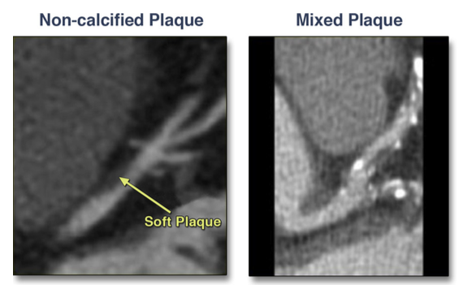
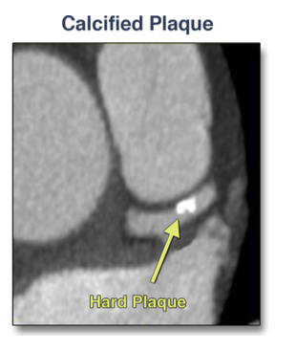
Mechanistic Pathways
Immune activation and inflammation
CVD Risk Factors
  Tobacco
  Diabetes
  Dyslipidemia
ART
…and others
Leading to subclinical atherosclerosis
10
8
sCD163
6
*
*
*
4
2
0.5
10
sCD14
**
8
Odds Ratio
6
4
2
0.5
10
CCL2
8
6
4
2
0.5
CAC
Any
Non-
Calc
Mixed
Calc
>=50%
Stenosis
Stein et al. JACC Imag 2014;7; McKIbben et al. JID 2015;211;Post et al. Ann Int Med 2014;160

Slide 31
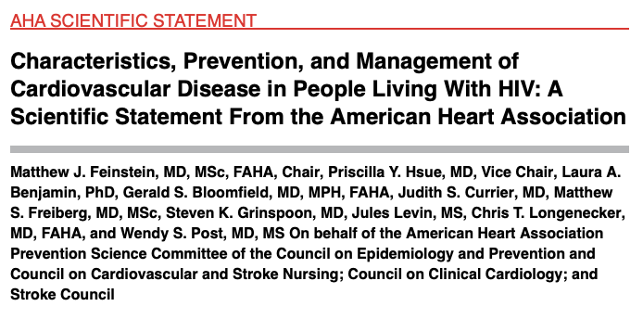
“Relative risks of various CVD manifestations are generally 1.5- to 2-fold greater for PLWH compared with uninfected individuals”
“After 2 decades of progress in studying the elevated risks for CVD among PLWH, the underlying mechanisms and biology of this process still remain incompletely defined”
“it is reasonable to consider selected ASCVD risk enhancers identified in the 2018 ACC/AHA cholesterol clinical practice guidelines as likely ASCVD risk enhancers in HIV”
“A practical expert consensus approach to ASCVD risk assessment and primary prevention in HIV that is based on available (albeit incomplete) evidence”
Feinstein et al. Circ 2019;140

Slide 32
“Relative risks of various CVD manifestations are generally 1.5- to 2-fold greater for PLWH compared with uninfected individuals”
“After 2 decades of progress in studying the elevated risks for CVD among PLWH, the underlying mechanisms and biology of this process still remain incompletely defined”
“it is reasonable to consider selected ASCVD risk enhancers identified in the 2018 ACC/AHA cholesterol clinical practice guidelines as likely ASCVD risk enhancers in HIV”
“A practical expert consensus approach to ASCVD risk assessment and primary prevention in HIV that is based on available (albeit incomplete) evidence”
Feinstein et al. Circ 2019;140

Slide 33
“Relative risks of various CVD manifestations are generally 1.5- to 2-fold greater for PLWH compared with uninfected individuals”
“After 2 decades of progress in studying the elevated risks for CVD among PLWH, the underlying mechanisms and biology of this process still remain incompletely defined”
“it is reasonable to consider selected ASCVD risk enhancers identified in the 2018 ACC/AHA cholesterol clinical practice guidelines as likely ASCVD risk enhancers in HIV”
“A practical expert consensus approach to ASCVD risk assessment and primary prevention in HIV that is based on available (albeit incomplete) evidence”
Feinstein et al. Circ 2019;140

Slide 34
“Relative risks of various CVD manifestations are generally 1.5- to 2-fold greater for PLWH compared with uninfected individuals”
“After 2 decades of progress in studying the elevated risks for CVD among PLWH, the underlying mechanisms and biology of this process still remain incompletely defined”
“it is reasonable to consider selected ASCVD risk enhancers identified in the 2018 ACC/AHA cholesterol clinical practice guidelines as likely ASCVD risk enhancers in HIV”
“A practical expert consensus approach to ASCVD risk assessment and primary prevention in HIV that is based on available (albeit incomplete) evidence”
Feinstein et al. Circ 2019;140

Slide 35
“Relative risks of various CVD manifestations are generally 1.5- to 2-fold greater for PLWH compared with uninfected individuals”
“After 2 decades of progress in studying the elevated risks for CVD among PLWH, the underlying mechanisms and biology of this process still remain incompletely defined”
“it is reasonable to consider selected ASCVD risk enhancers identified in the 2018 ACC/AHA cholesterol clinical practice guidelines as likely ASCVD risk enhancers in HIV”
“A practical expert consensus approach to ASCVD risk assessment and primary prevention in HIV that is based on available (albeit incomplete) evidence”
Feinstein et al. Circ 2019;140

Slide 36
Resulting question
Do PWH at low-to-moderate estimated cardiovascular risk (ASCVD) benefit from statins for primary prevention?

Slide 37
REPRIEVE: First Globally Representative Trial of CV Primary Prevention in People with HIV
https://www.reprievetrial.org

Slide 38

Trial Schema
Screening
Time
Screening
PLWH on ART, no known CVD
Asymptomatic HIV
+
patients with no history of CVD
And
And
Consent
Consent
R
(n=6500)
R
N= 7,769
Randomization
Randomization
Pitavastatin 4 mg/day
Placebo
Pitavastatin
4
mg
/
day
Placebo
Intervention
Intervention
Average fu 5 yrs
Coronary CTA
(n=~800, f/u 2 yrs)
Mechanistic
Study
Study
Coronary plaque
,
vascular
Coronary plaque, vascular
CCTA Study
Mechanistic
Inflammation, immune activation
inflammation
,
immune activation
Primary Endpoint
Primary Endpoint
Clinical
CV Death
PAD
Clinical
CV Death
MI
MI
Unstable Angina
Unstable Angina
Stroke
Stroke
Arterial Revasc
Arterial Revasc
Primary Endpoint
Primary Endpoint
Grinspoon et al. AHJ 2019; Hoffman et al. AHJ 2019

Slide 39
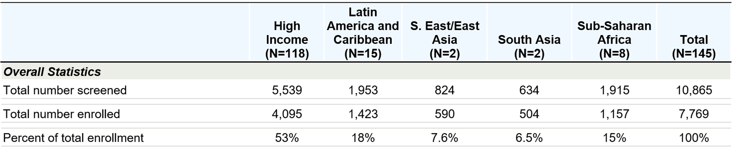
Globally Representative Trial

Slide 40
Baseline Characteristics |  | Total (N=7769) | Pitavastatin (N=3888) | Placebo (N=3881)
Age (years) | Median (Q1 – Q3) | 50 (45-55) | 50 (45-55) | 50 (45-55)
Natal sex | Male | 5350 (69%) | 2677 (69%) | 2673 (69%)
 | Female | 2419 (31%) | 1211 (31%) | 1208 (31%)
Gender identity | Cisgender | 7367 (95%) | 3687 (95%) | 3680 (95%)
 | Transgender spectrum | 127 (2%) | 63 (2%) | 64 (2%)
 | Not reported | 275 (4%) | 138 (4%) | 137 (4%)
Race | White | 2704 (35%) | 1634 (35%) | 1340 (35%)
 | Black/African American | 3208 (41%) | 1569 (40%) | 1639 (42%)
 | Asian | 1138 (15%) | 571 (15%) | 567 (15%)
CD4 count (cells/mm3) | Median (Q1 – Q3) | 621 (448-827) | 620 (449-832) | 622 (445-824)
Nadir CD4 count (cells/mm3) | < 50 50-199 ≥ 200 | 1409 (18%) 2392 (31%) 3706 (48%) | 688 (18%) 1202 (31%) 1859 (49%) | 721 (19%) 1190 (31%) 1847 (47%)
HIV RNA (Copies/mL) | < LLQ LLQ - < 400 400+ Missing | 5250 (88%) 617 (10%) 130 (2%) 1772 | 2641 (88%) 305 (10%) 63 (2%) 879 | 2609 (87%) 312 (10%) 67 (2%) 893
ASCVD risk score, (%) | Median (Q1 – Q3) | 4.5 (2.1-7.0) | 4.5 (2.1-7.0) | 4.5 (2.2-7.0)
LDL-C (mg/dL) | Median (Q1 – Q3) | 108 (87-128) | 109 (87-128) | 108 (87-127)

Slide 41
Baseline Characteristics |  | Total (N=7769) | Pitavastatin (N=3888) | Placebo (N=3881)
Age (years) | Median (Q1 – Q3) | 50 (45-55) | 50 (45-55) | 50 (45-55)
Natal sex | Male | 5350 (69%) | 2677 (69%) | 2673 (69%)
 | Female | 2419 (31%) | 1211 (31%) | 1208 (31%)
Gender identity | Cisgender | 7367 (95%) | 3687 (95%) | 3680 (95%)
 | Transgender spectrum | 127 (2%) | 63 (2%) | 64 (2%)
 | Not reported | 275 (4%) | 138 (4%) | 137 (4%)
Race | White | 2704 (35%) | 1634 (35%) | 1340 (35%)
 | Black/African American | 3208 (41%) | 1569 (40%) | 1639 (42%)
 | Asian | 1138 (15%) | 571 (15%) | 567 (15%)
CD4 count (cells/mm3) | Median (Q1 – Q3) | 621 (448-827) | 620 (449-832) | 622 (445-824)
Nadir CD4 count (cells/mm3) | < 50 50-199 ≥ 200 | 1409 (18%) 2392 (31%) 3706 (48%) | 688 (18%) 1202 (31%) 1859 (49%) | 721 (19%) 1190 (31%) 1847 (47%)
HIV RNA (Copies/mL) | < LLQ LLQ - < 400 400+ Missing | 5250 (88%) 617 (10%) 130 (2%) 1772 | 2641 (88%) 305 (10%) 63 (2%) 879 | 2609 (87%) 312 (10%) 67 (2%) 893
ASCVD risk score, (%) | Median (Q1 – Q3) | 4.5 (2.1-7.0) | 4.5 (2.1-7.0) | 4.5 (2.2-7.0)
LDL-C (mg/dL) | Median (Q1 – Q3) | 108 (87-128) | 109 (87-128) | 108 (87-127)

Slide 42
Trial Closure for Efficacy
REPRIEVE was an events driven trial with 85% power to detect a HR of 0.70 with 288 planned events
The DSMB convened at 75% of information and closed the trial for efficacy, concluding there were no unanticipated safety concerns and that the benefits outweighed the risk of statin therapy in this group

Slide 43
Primary and Key Secondary Endpoints
225 MACE events over a median of 5.6 years of follow-up
89 in Pitavastatin group and 136 in Placebo group*
MACE
MACE or
Death
-35% vs Placebo
-21% vs Placebo
*as reported in Grinspoon et al. NEJM 2023

Slide 44
Primary Endpoints and MACE Components

Slide 45
Primary Endpoints and MACE Components

Slide 46
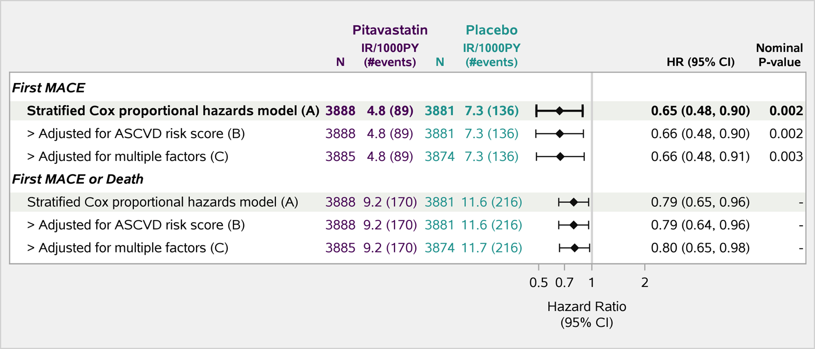
Robust Effect Controlling for ASCVD Score and Other Factors
(C) Adjusted for: age, race, smoking, hypertension, LDL-C,
nadir CD4, total ART duration and GBD region as covariates.

Slide 47
Robust Effect Controlling for ASCVD Score and Other Factors
(C) Adjusted for: age, race, smoking, hypertension, LDL-C,
nadir CD4, total ART duration and GBD region as covariates.

Slide 48
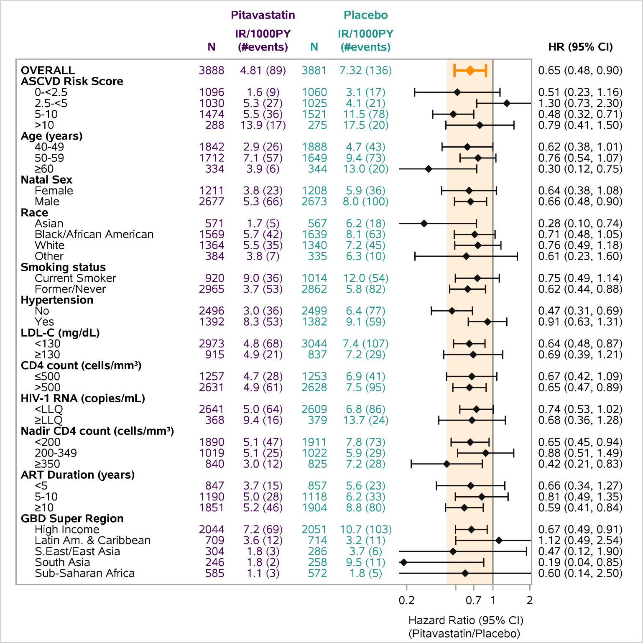
Effects on Key
Subgroups
Very consistent effect estimate across major subgroups
No treatment modification based on LDL, CD4, HIV RNA, ART duration
Generally consistent across race and GBD regions

Slide 49
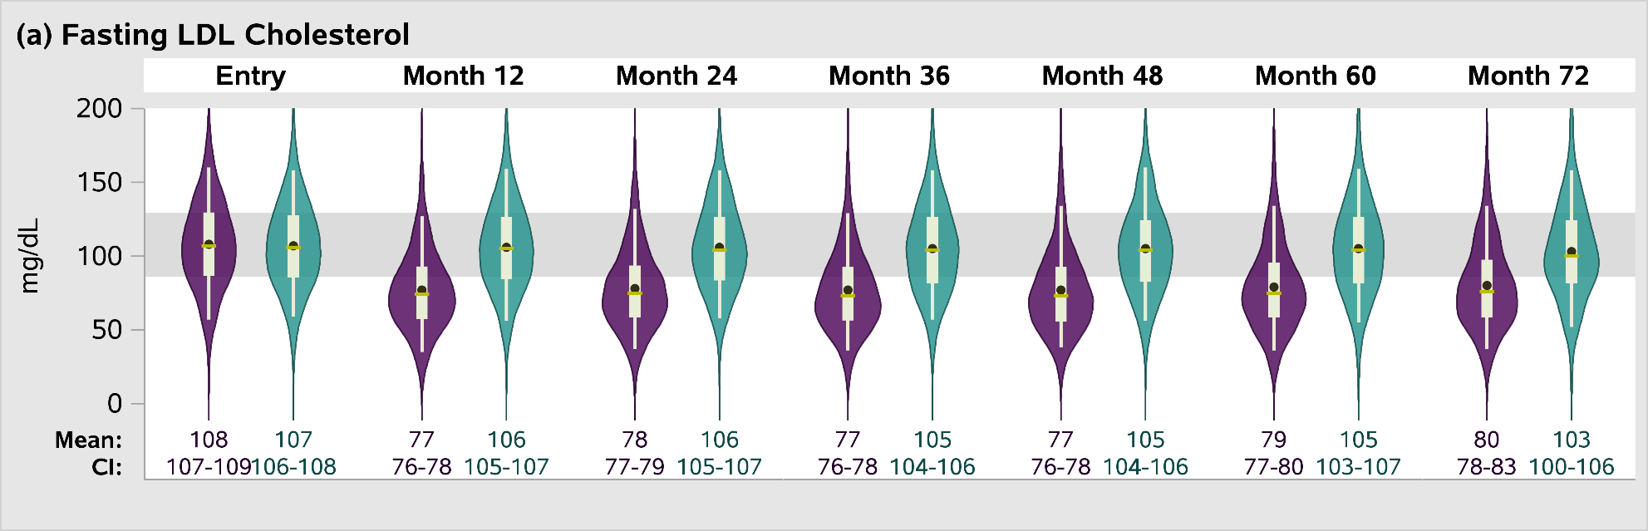
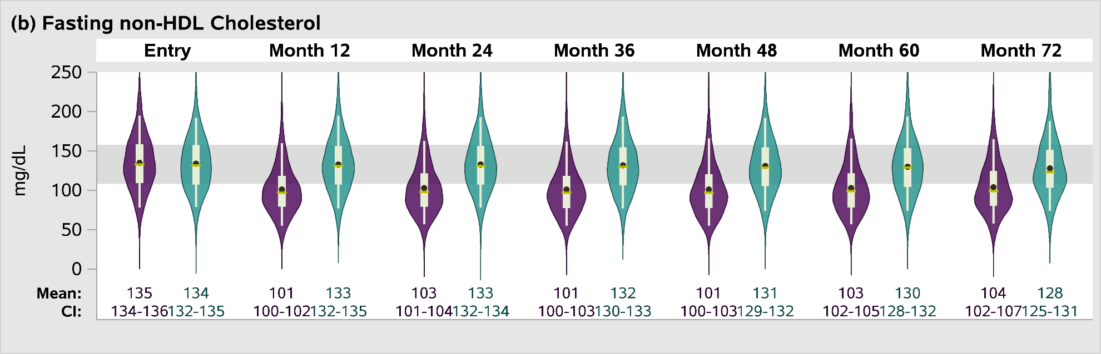
Effects on LDL and Non-HDL Cholesterol
30% reduction in LDL in pitavastatin group, no change in placebo
Durable effect over time
Placebo
Pitavastatin

Slide 50
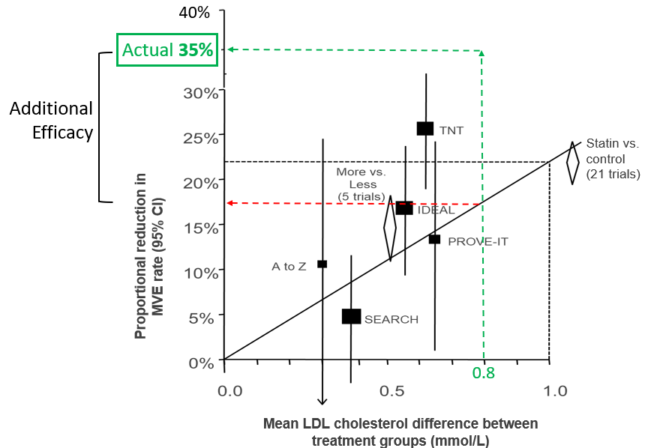
Effect Larger than Anticipated Based on LDL Lowering
■
REPRIEVE
Statin effect on MACE is beyond what is expected for LDL lowering alone
Predicted 17%
Cholesterol Treatment Trialists. Lancet 2010;376
Note: 35% is point estimate, CI % is 17 – 52%

Slide 51
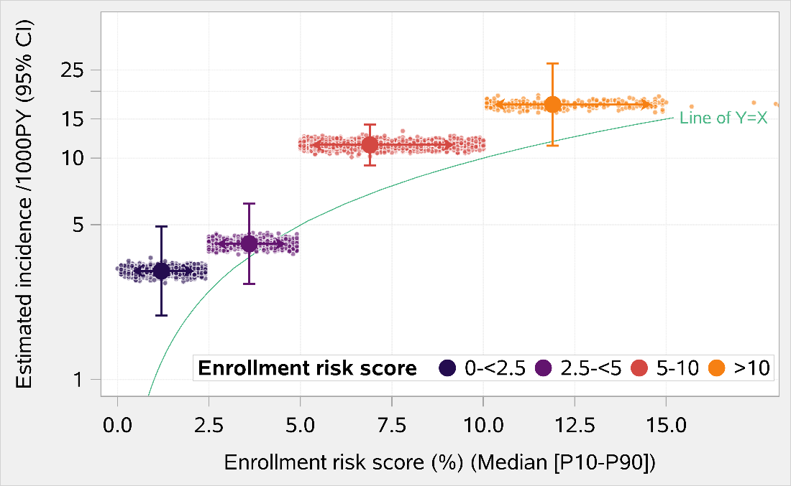
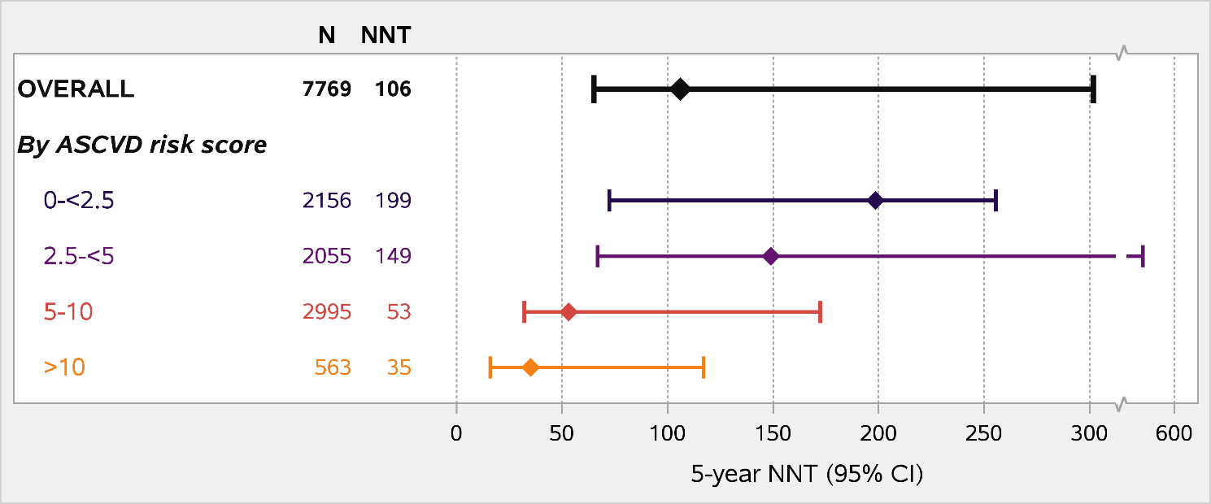
Number Needed to Treat by ASCVD Risk Score

Slide 52
Number Needed to Treat by ASCVD Risk Score

Slide 53
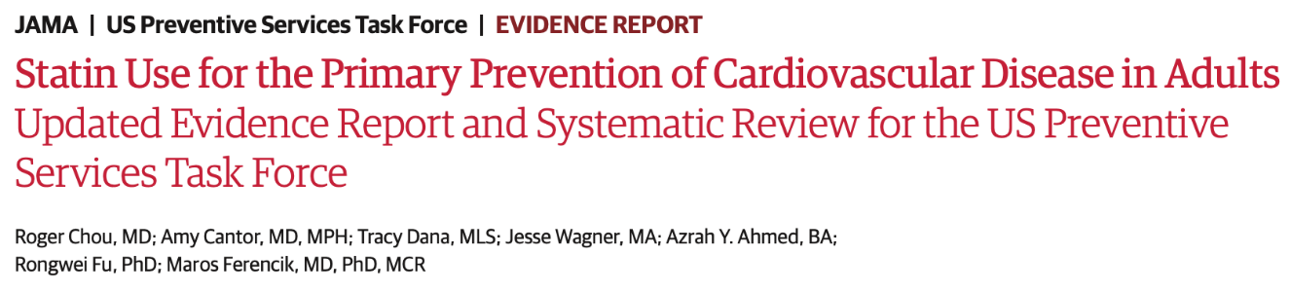
Number Needed to Treat by ASCVD Risk Score
Statins vs. placebo to reduce CVD-related morbidity or mortality in asymptomatic adults without prior CVD events ~ 6 years?
Outcome | NNT
All-cause mortality | 286
Fatal or non-fatal MI | 118
Revascularization | 169
Fatal or non-fatal stroke | 256
Chou et al. JAMA 2022;328

Slide 54
Number Needed to Treat by ASCVD Risk Score
Statins vs. placebo to reduce CVD-related morbidity or mortality in asymptomatic adults without prior CVD events ~ 6 years?
Outcome | NNT
All-cause mortality | 286
Fatal or non-fatal MI | 118
Revascularization | 169
Fatal or non-fatal stroke | 256
Chou et al. JAMA 2022;328

Slide 55
Safety
IRR 1.06
(0.98–1.15)
IRR 1.01
(0.91–1.12)
IRR 1.35
(1.09–1.66)
IRR 1.74
(1.24–2.45)
IRR 0.75
(0.17–3.37)
IRR 1.38
(0.56–3.43)

Slide 56
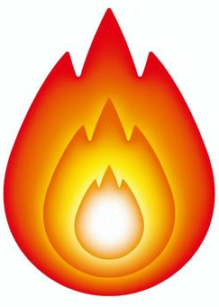
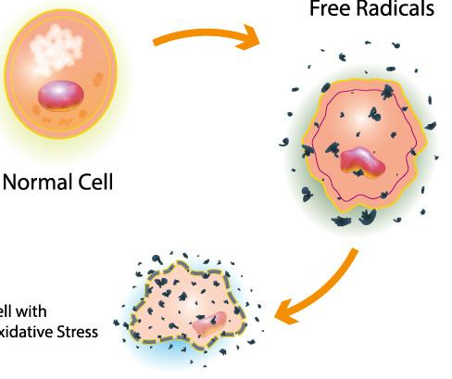
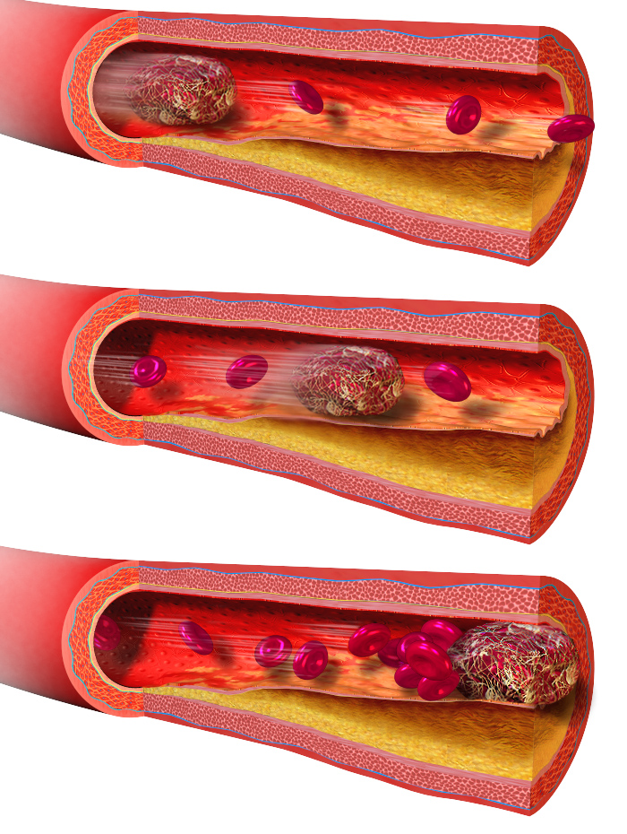
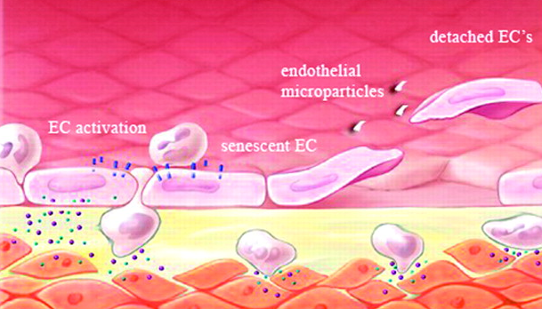
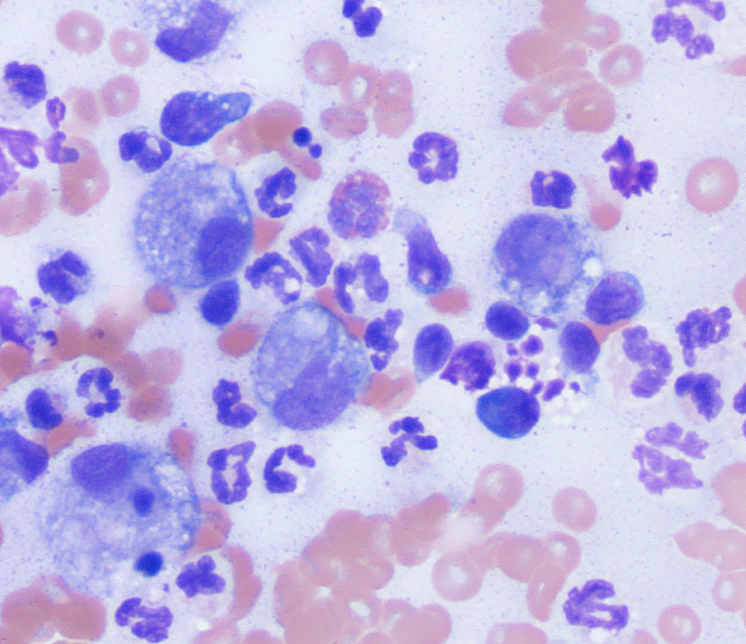
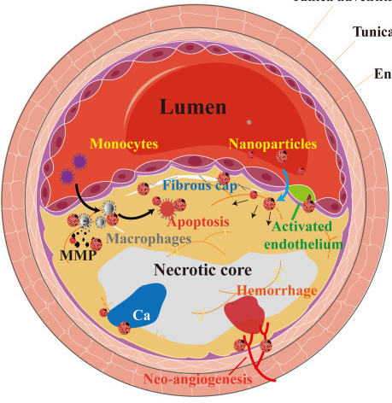
Mechanism? Pleiotropic Effects of Statins
Statins primary effect is to inhibit HMG-CoA reductase to lower LDL cholesterol
Statins have many other beneficial effects to reduce vascular disease
Reduced Oxidative Stress
Anti-inflammatory
Improved Endothelial Function/ Vascular Tone
Anti-thrombotic
STATINS
Plaque Stabilization
Immunomodulation
Arch Toxicol 2023 97:1529
Slide courtesy of Dr. Grinspoon

Slide 57
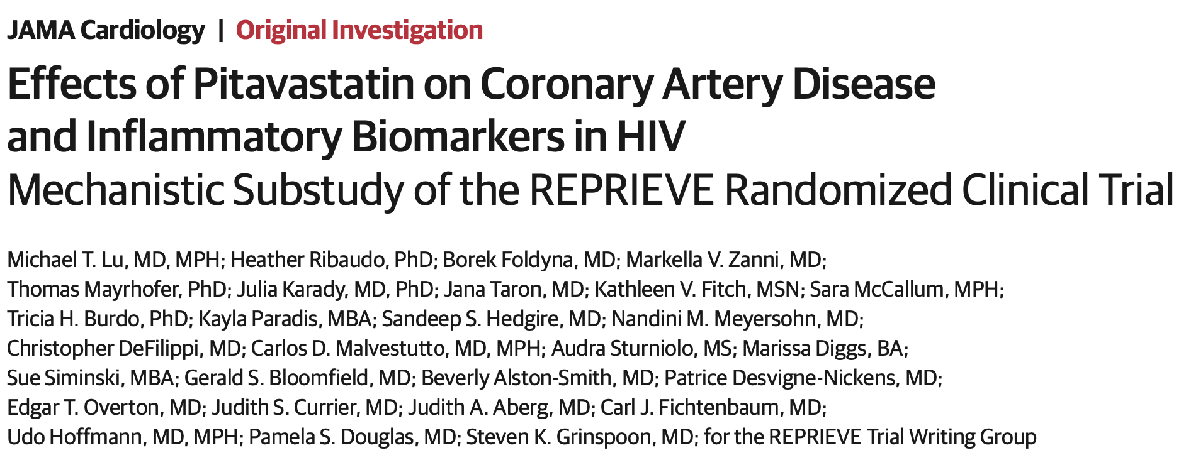
REPRIEVE Mechanistic Substudy Results
Lu et al. JAMA Cardiol 2024 published online Feb 21, 2024

Slide 58
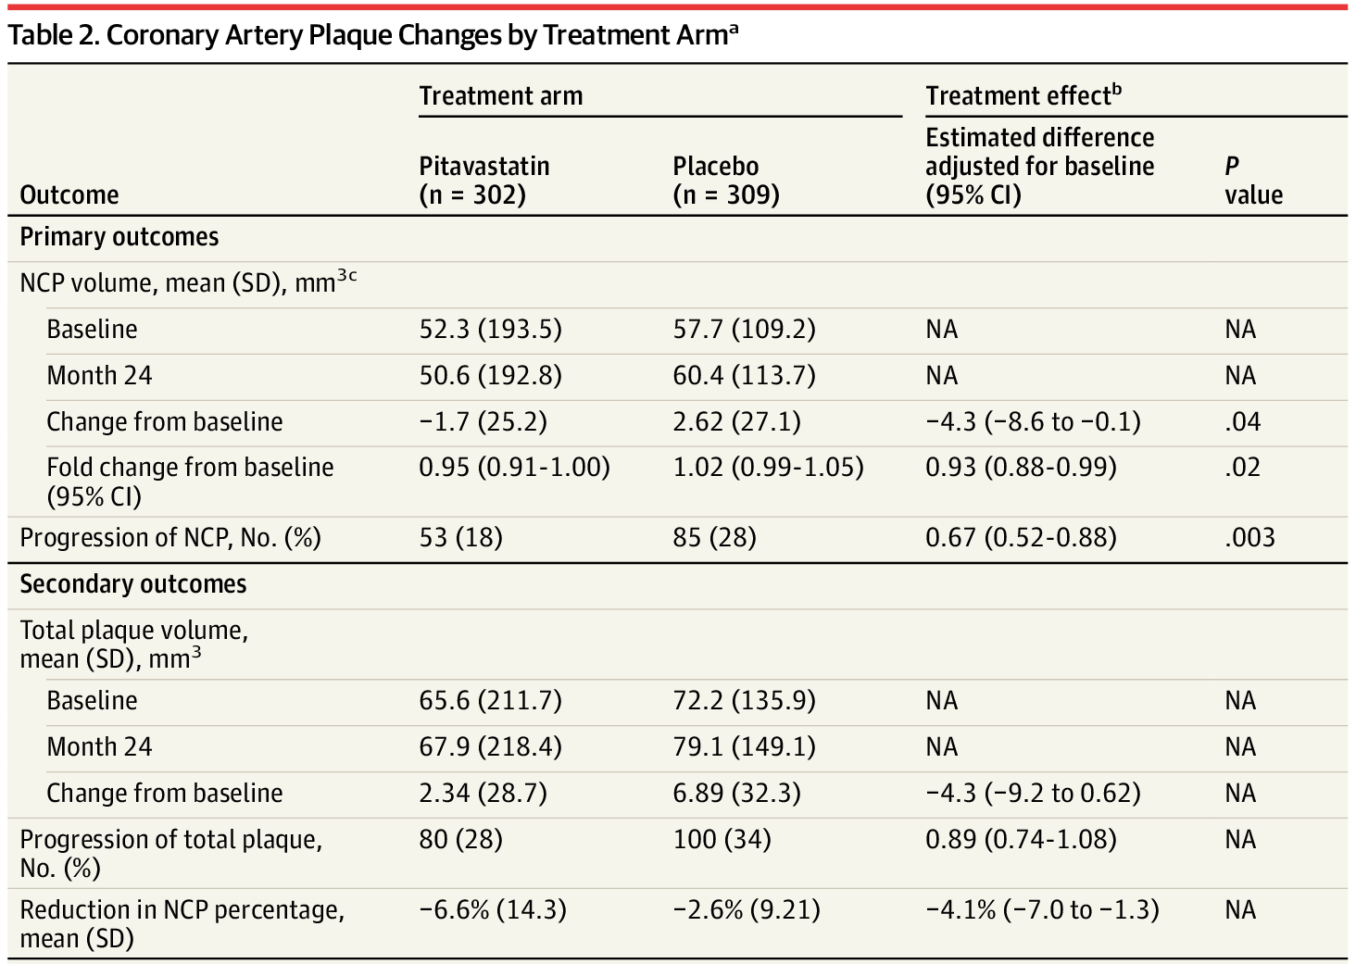
Can pitavastatin reduce noncalcified coronary plaque and inflammatory biomarkers in people with HIV?
N=611 with two coronary CTAs (baseline and 2 years)
- 302 pitavastatin, 309 placebo
Pitavastatin reduced noncalcified plaque volume by 7% c/w placebo
Less progression on noncalcified plaque (by 33%)
Lu et al. JAMA Cardiol 2024 published online Feb 21, 2024

Slide 59
Targeted Proteomic Analysis
Differential Expression Between Treatment Arms
Proteins showing differential expression between treatment groups
Decreased expression
ANGPTL3 | Angiopoietin-related protein 3: Involved in regulation of lipid and glucose metabolism.
MBL2 | Mannose-binding protein C: Calcium-dependent lectin involved in innate immune defense.
TFPI | Tissue factor pathway inhibitor: Inhibits factor Xa directly. It possesses an antithrombotic action and the ability to associate with lipoproteins in plasma.
TRAIL | Tumor necrosis factor ligand superfamily member 10: Induces apoptosis.
Increased expression
MIC-A/B | MHC class I polypeptide-related sequence A-B: Acts as a stress-induced self-antigen that is recognized by gamma delta T-cells. Binding to KLRK1 leads to cell lysis.
NRP1 | Neuropilin-1: Receptor involved in the development of the cardiovascular system, in angiogenesis.
PCOLCE | Procollagen C-endopeptidase enhancer 1: Binds to the C-terminal propeptide of type I procollagen and enhances procollagen C-proteinase activity
False discovery rate
corrected p value
Kolossváry et al. CROI 2024 Oral Abstract

Slide 60
Targeted Proteomic Analysis
Differential Expression Between Treatment Arms
Proteins showing differential expression between treatment groups
Decreased expression
ANGPTL3 | Angiopoietin-related protein 3: Involved in regulation of lipid and glucose metabolism.
MBL2 | Mannose-binding protein C: Calcium-dependent lectin involved in innate immune defense.
TFPI | Tissue factor pathway inhibitor: Inhibits factor Xa directly. It possesses an antithrombotic action and the ability to associate with lipoproteins in plasma.
TRAIL | Tumor necrosis factor ligand superfamily member 10: Induces apoptosis.
Increased expression
MIC-A/B | MHC class I polypeptide-related sequence A-B: Acts as a stress-induced self-antigen that is recognized by gamma delta T-cells. Binding to KLRK1 leads to cell lysis.
NRP1 | Neuropilin-1: Receptor involved in the development of the cardiovascular system, in angiogenesis.
PCOLCE | Procollagen C-endopeptidase enhancer 1: Binds to the C-terminal propeptide of type I procollagen and enhances procollagen C-proteinase activity
False discovery rate
corrected p value
The treatment effect of pitavastatin was largest on PCOLCE;
relative change compared to placebo: 24% [95% CI: 18-31%, p<0.001]
Kolossváry et al. CROI 2024 Oral Abstract

Slide 61
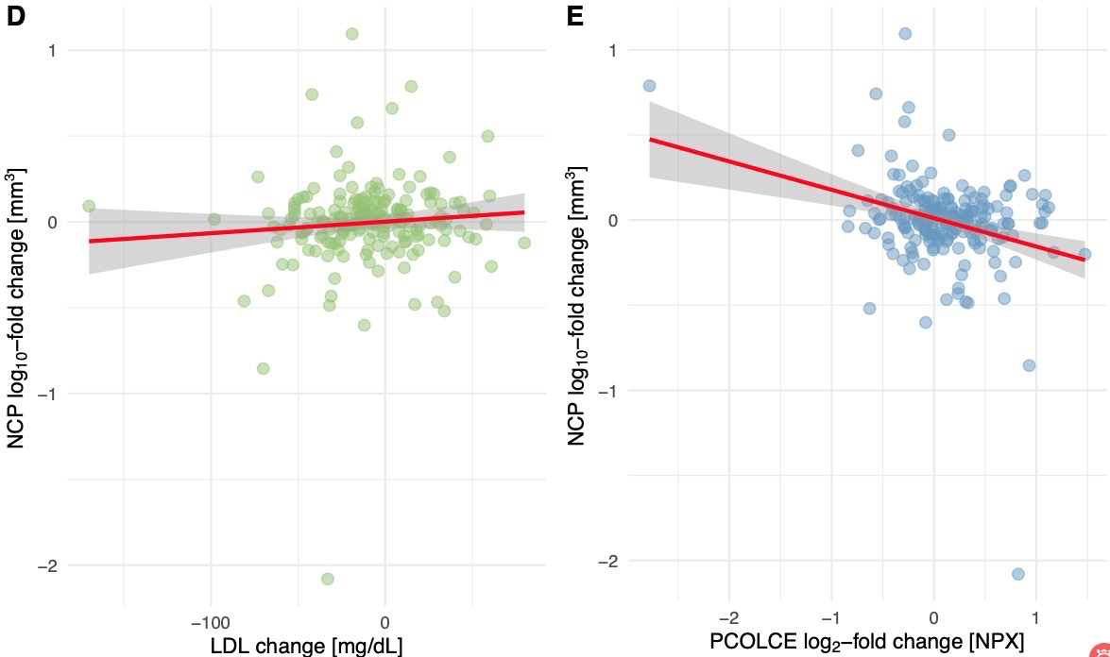
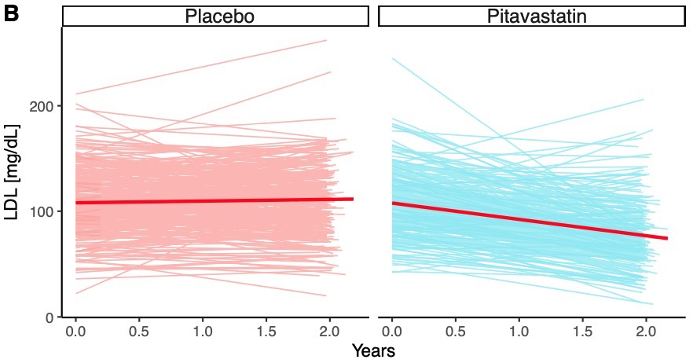
LDL Change vs. Non-Calcified Plaque Change
Temporal changes in LDL
LDL vs. noncalcified plaque
LDL decreased by 32.7%
[95% CI: -38.3%; -27.1%, p<0.001]
However, LDL change not associated with NCP volume change
Kolossváry et al. CROI 2024 Oral Abstract

Slide 62
Statin Effects on Plaque – Mediation Analysis
Multivariable mediation model
Variable | Multivariable mediation model
 | % change in NCP | 95% Confidence interval | Proportion mediated
LDL | 0.8 | [-7.5; 9.8] | 5.8%
ANGPTL3 | -0.1 | [-4.2; 3.9] | -0.6%
MBL2 | 2.0 | [-0.7; 6.7] | 14.2%
PCOLCE | -11.4 | [-22.7; -1.2] | -83.8%
84% of the total effect of statins on NCP volume change was
mediated through PCOLCE
Kolossváry et al. CROI 2024 Oral Abstract

Slide 63
Where do we go from here?
Guideline changes
Who is minding the shop?
Access to statins for primary prevention
Regional variation
A capacious view of CVD prevention

Slide 64
Where do we go from here?
British HIV Association | Dept Health & Human Services endorsed by ACC, AHA and HIV Medicine Association
November 2023 | Feb 2024
All people living with HIV >=40 years should be offered a statin for primary prevention of CVD irrespective of lipid profile or estimated CVD risk (Grade 1B). | Age 40–75 years, ASCVD risk 5 to <20% recommends initiating at least moderate intensity statin therapy (AI). Pitavastatin 4mg once daily (AI) Atorvastatin 20mg once daily (AII) Rosuvastatin 10mg once daily (AII)
>=40 years with an estimated 10-year CVD risk of >=5% are prioritised for primary prevention with a statin (Good Practice Point). | Age 40–75 years, ASCVD risk <5% at least moderate intensity statin therapy (CI) Consider HIV-related factors* that can increase ASCVD risk.
Pitavastatin 4 mg daily as the first-line (Grade 2A), atorvastatin 20 mg daily as an alternative statin (Grade 2B). | *longer total duration of HIV, prolonged viremia, low nadir CD4, Rx failure, lipodystrophy, Hep C, older ARVs drugs with cardiometabolic toxicity
https://www.bhiva.org/BHIVA-rapid-guidance-on-the-use-of-statins-for-primary-prevention-of-cardiovascular-disease
https://content.govdelivery.com/accounts/USOARHIVINFO/bulletins/38d8d17

Slide 65
Where do we go from here?
British HIV Association | Dept Health & Human Services endorsed by ACC, AHA and HIV Medicine Association
November 2023 | Feb 2024
All people living with HIV >=40 years should be offered a statin for primary prevention of CVD irrespective of lipid profile or estimated CVD risk (Grade 1B). | Age 40–75 years, ASCVD risk 5 to <20% recommends initiating at least moderate intensity statin therapy (AI). Pitavastatin 4mg once daily (AI) Atorvastatin 20mg once daily (AII) Rosuvastatin 10mg once daily (AII)
>=40 years with an estimated 10-year CVD risk of >=5% are prioritised for primary prevention with a statin (Good Practice Point). | Age 40–75 years, ASCVD risk <5% at least moderate intensity statin therapy (CI) Consider HIV-related factors* that can increase ASCVD risk.
Pitavastatin 4 mg daily as the first-line (Grade 2A), atorvastatin 20 mg daily as an alternative statin (Grade 2B). | *longer total duration of HIV, prolonged viremia, low nadir CD4, Rx failure, lipodystrophy, Hep C, older ARVs drugs with cardiometabolic toxicity
https://www.bhiva.org/BHIVA-rapid-guidance-on-the-use-of-statins-for-primary-prevention-of-cardiovascular-disease
https://content.govdelivery.com/accounts/USOARHIVINFO/bulletins/38d8d17

Slide 66
Where do we go from here?
Guideline changes
Who is “minding the shop”?
Access to CVD primary prevention
Regional variation
A capacious view of CVD prevention

Slide 67
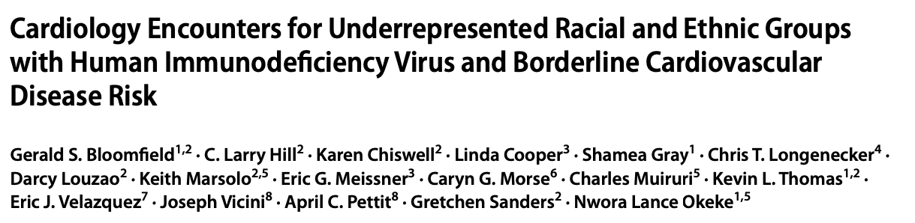
Where do we go from here?
Guideline changes
Who is “minding the shop”?
Access to CVD primary prevention
Regional variation
A capacious view of CVD prevention
Characteristic | Overall (N=2039) | Female (N=1061) | Male (N=978) | p-Value
Age, yrs | 45.0 (36.0, 50.0) | 48.0 (41.0, 53.0) | 42.0 (32.0, 47.0) | <.001
Race, n/N (%) |  |  |  | <.001
Asian | 35/1875 (1.9) | 5/1012 (0.5) | 30/863 (3.5)
Black or African American | 1755/1875 (93.6) | 979/1012 (96.7) | 776/863 (89.9)
White | 65/1875 (3.5) | 18/1012 (1.8) | 47/863 (5.4)
Viral Suppression, n/N (%) | 1304/1464 (89.1) | 635/712 (89.2) | 669/752 (89.0) | 0.891
ASCVD Risk Score, % [N] | 5.1 (3.6, 6.8) [1001] | 4.8 (3.2, 6.9) [577] | 5.3 (4.2, 6.6) [424]
LDL Cholesterol, mg/dL [N] | 100.0 (81.0, 123.0) [1597] | 102.0 (83.0, 125.0) [791] | 98.0 (80.0, 120.0) [806] | 0.013
Primary Provider, n (%) |  |  |  | <.001
HIV Specialist | 1171 (57.4) | 558 (52.6) | 613 (62.7)
Patients with a cards encounter, n (%) | 283 (13.9) | 179 (16.9) | 104 (10.6) | <.001
Time to first cards encounter, days [N] | 728.0 (365.0, 1350.0) [283] | 617.0 (333.0, 1102.0) [179] | 959.5 (512.0, 1613.5) [104]
Bloomfield et al. J Racial Ethn Disp 2023;May 9

Slide 68
Where do we go from here?
Guideline changes
Who is “minding the shop”?
Access to CVD primary prevention
Regional variation
A capacious view of CVD prevention
Comparable to
REPRIEVE
risk profile!
Characteristic | Overall (N=2039) | Female (N=1061) | Male (N=978) | p-Value
Age, yrs | 45.0 (36.0, 50.0) | 48.0 (41.0, 53.0) | 42.0 (32.0, 47.0) | <.001
Race, n/N (%) |  |  |  | <.001
Asian | 35/1875 (1.9) | 5/1012 (0.5) | 30/863 (3.5)
Black or African American | 1755/1875 (93.6) | 979/1012 (96.7) | 776/863 (89.9)
White | 65/1875 (3.5) | 18/1012 (1.8) | 47/863 (5.4)
Viral Suppression, n/N (%) | 1304/1464 (89.1) | 635/712 (89.2) | 669/752 (89.0) | 0.891
ASCVD Risk Score, % [N] | 5.1 (3.6, 6.8) [1001] | 4.8 (3.2, 6.9) [577] | 5.3 (4.2, 6.6) [424]
LDL Cholesterol, mg/dL [N] | 100.0 (81.0, 123.0) [1597] | 102.0 (83.0, 125.0) [791] | 98.0 (80.0, 120.0) [806] | 0.013
Primary Provider, n (%) |  |  |  | <.001
HIV Specialist | 1171 (57.4) | 558 (52.6) | 613 (62.7)
Patients with a cards encounter, n (%) | 283 (13.9) | 179 (16.9) | 104 (10.6) | <.001
Time to first cards encounter, days [N] | 728.0 (365.0, 1350.0) [283] | 617.0 (333.0, 1102.0) [179] | 959.5 (512.0, 1613.5) [104]
Bloomfield et al. J Racial Ethn Disp 2023;May 9

Slide 69
Where do we go from here?
Guideline changes
Who is “minding the shop”?
Access to CVD primary prevention
Regional variation
A capacious view of CVD prevention
Comparable to
REPRIEVE
risk profile!
Characteristic | Overall (N=2039) | Female (N=1061) | Male (N=978) | p-Value
Age, yrs | 45.0 (36.0, 50.0) | 48.0 (41.0, 53.0) | 42.0 (32.0, 47.0) | <.001
Race, n/N (%) |  |  |  | <.001
Asian | 35/1875 (1.9) | 5/1012 (0.5) | 30/863 (3.5)
Black or African American | 1755/1875 (93.6) | 979/1012 (96.7) | 776/863 (89.9)
White | 65/1875 (3.5) | 18/1012 (1.8) | 47/863 (5.4)
Viral Suppression, n/N (%) | 1304/1464 (89.1) | 635/712 (89.2) | 669/752 (89.0) | 0.891
ASCVD Risk Score, % [N] | 5.1 (3.6, 6.8) [1001] | 4.8 (3.2, 6.9) [577] | 5.3 (4.2, 6.6) [424]
LDL Cholesterol, mg/dL [N] | 100.0 (81.0, 123.0) [1597] | 102.0 (83.0, 125.0) [791] | 98.0 (80.0, 120.0) [806] | 0.013
Primary Provider, n (%) |  |  |  | <.001
HIV Specialist | 1171 (57.4) | 558 (52.6) | 613 (62.7)
Patients with a cards encounter, n (%) | 283 (13.9) | 179 (16.9) | 104 (10.6) | <.001
Time to first cards encounter, days [N] | 728.0 (365.0, 1350.0) [283] | 617.0 (333.0, 1102.0) [179] | 959.5 (512.0, 1613.5) [104]
Bloomfield et al. J Racial Ethn Disp 2023;May 9

Slide 70
Where do we go from here?
Guideline changes
Who is “minding the shop”?
More accurate risk prediction
Regional variation
A capacious view of CVD prevention

Slide 71
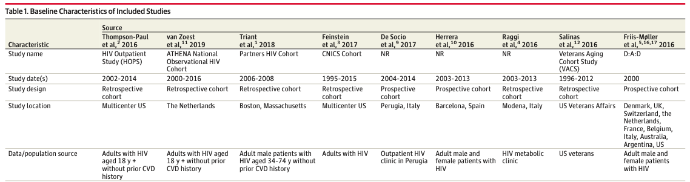
Performance of CVD Risk Prediction Models in HIV
Systematic review and meta-analysis of
retrospective or prospective cohorts with MI, CVD, CAD outcomes
patients with a diagnosis of HIV (with or without HIV-negative controls),
studies on adults older than 18 years, and
available data on a minimum of 1 cardiac risk score
Soares et al. JAMA Card 2022;1

Slide 72
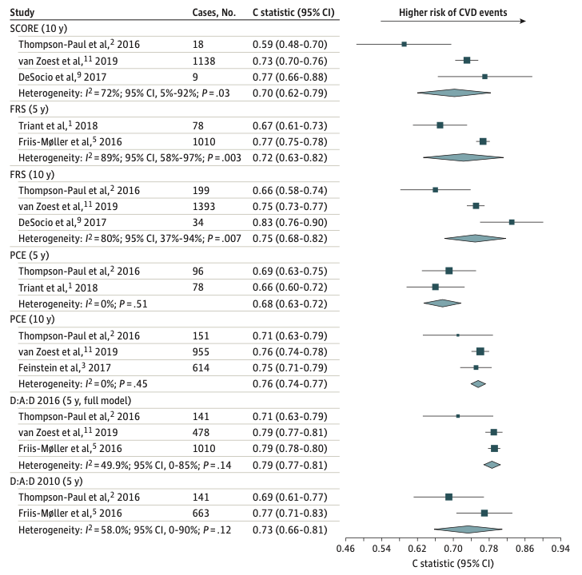
Performance of CVD Risk Prediction Models in HIV
Risk Prediction Model | # Cases | O:E ratio
D:A:D 2010 | 804 | 1.20
D:AD 2016 | 1629 | 1.31
Framingham 10yr | 1751 | 0.95
Framingham 5yr | 1088 | 1.51
Pooled Cohort Equations 10yr | 1720 | 1.13
Pooled Cohort Equations 5yr | 174 | 2.31
SCORE | 1165 | 1.37
Most scores moderate discrimination (AUC 0.7 to 0.8)
Most underpredict CVD risk (O:E >1)
FRS and PCE 10-year better calibrated
REPRIEVE analysis forthcoming
Soares et al. JAMA Card 2022;1

Slide 73
Where do we go from here?
Guideline changes
Who is “minding the shop”?
More accurate risk prediction
Non-CV Endpoints

Slide 74
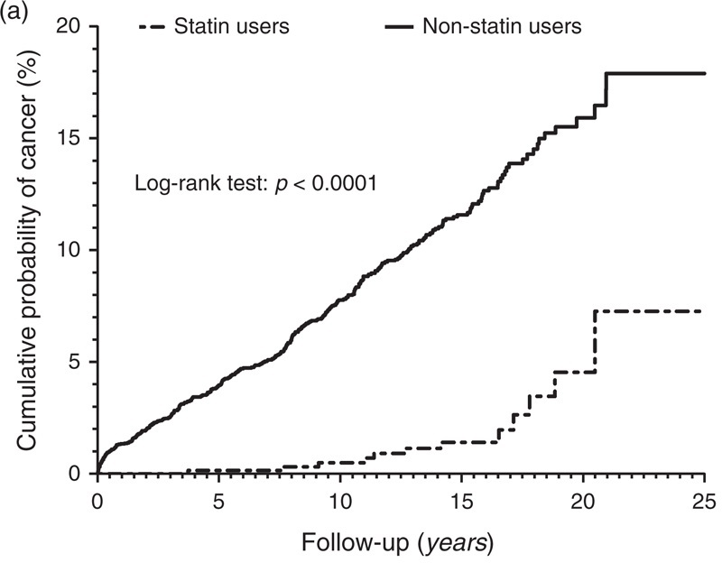
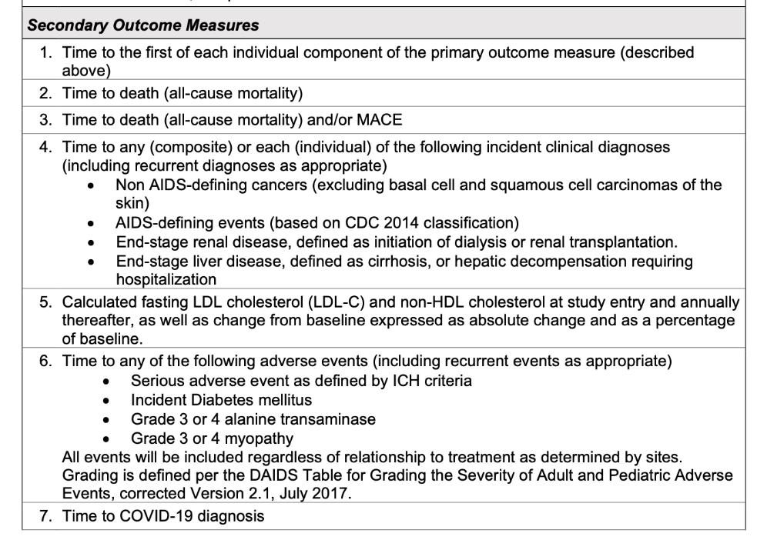
Where do we go from here?
Guideline changes
Who is “minding the shop”?
More accurate risk prediction
Non-CV Endpoints
…suggesting a beneficial effect from statins on overall mortality in HIV-infected patients…biological hypothesis that statins reduce inflammation and subsequent cancer risk in HIV-infected populations is certainly plausible…
Galli et al. AIDS 2014;28; Riedel & Jourdain AIDS 2014;28

Slide 75
Where do we go from here?
Guideline changes
Who is “minding the shop”?
More accurate risk prediction
Non-CV Endpoints
A capacious view of CV Health

Slide 76
Enrollment CV Risk Factors by Region
 |  | Total (N=7769) | HIC (N=4095) | LAC (N=1423) | SE/E. Asia (N=590) | S. Asia (N=504) | SSA (N=1157)
ASCVD score (%) | Median (Q1, Q3) | 4.5 (2.2, 7.0) | 5.2 (2.9, 7.6) | 4.4 (2.5, 6.9) | 1.8 (0.9, 4.2) | 2.7 (1.1, 5.2) | 3.8 (1.3, 6.6)
Smoking | Current | 1934 (25%) | 1289 (32%) | 292 (21%) | 69 (12%) | 69 (14%) | 215 (19%)
Diabetes |  | 37 (<1%) | 25 (1%) | 5 (<1%) | 1 (<1%) | 5 (1%) | 1 (<1%)
BMI | Median (Q1, Q3) | 25.8 (22.8, 29.4) | 26.8 (23.9, 30.6) | 25.8 (23.3, 28.7) | 22.7 (20.5, 25.0) | 22.9 (20.2, 25.9) | 24.7 (21.2, 29.6)
HTN |  | 2774 (36%) | 1538 (38%) | 522 (37%) | 141 (24%) | 165 (33%) | 408 (35%)
Family history |  | 1416 (19%) | 968 (25%) | 296 (22%) | 55 (9%) | 22 (4%) | 75 (7%)
REAP Score | Median (Q1, Q3) | 17 (13-20) | 16 (12-20) | 17 (14-20) | 18 (16-21) | 23 (21-25) | 15 (12-18)
Total chol (mg/dL) | Median (Q1, Q3) | 185 (162, 209) | 184 (162, 208) | 191 (167, 215) | 201 (177, 223) | 181 (159, 206) | 174 (154, 198)
HDL-C (mg/dL) | Median (Q1, Q3) | 48 (39, 59) | 49 (40, 59) | 44 (36, 55) | 48 (40, 57) | 41 (35, 51) | 55 (44, 66)
LDL-C (mg/dL) | Median (Q1, Q3) | 108 (87, 128) | 107 (87, 126) | 114 (93, 134) | 122 (103, 141) | 107 (87, 126) | 97 (78, 118)
Trig (mg/dL) | Median (Q1, Q3) | 114 (81, 169) | 112 (80, 165) | 138 (94, 200) | 122 (87, 179) | 137 (96, 205) | 89 (67, 128)
Grinspoon et al. NEJM 2023; Fitch et al. AIDS 2022;36

Slide 77
Enrollment CV Risk Factors by Region
 |  | Total (N=7769) | HIC (N=4095) | LAC (N=1423) | SE/E. Asia (N=590) | S. Asia (N=504) | SSA (N=1157)
ASCVD score (%) | Median (Q1, Q3) | 4.5 (2.2, 7.0) | 5.2 (2.9, 7.6) | 4.4 (2.5, 6.9) | 1.8 (0.9, 4.2) | 2.7 (1.1, 5.2) | 3.8 (1.3, 6.6)
Smoking | Current | 1934 (25%) | 1289 (32%) | 292 (21%) | 69 (12%) | 69 (14%) | 215 (19%)
Diabetes |  | 37 (<1%) | 25 (1%) | 5 (<1%) | 1 (<1%) | 5 (1%) | 1 (<1%)
BMI | Median (Q1, Q3) | 25.8 (22.8, 29.4) | 26.8 (23.9, 30.6) | 25.8 (23.3, 28.7) | 22.7 (20.5, 25.0) | 22.9 (20.2, 25.9) | 24.7 (21.2, 29.6)
HTN |  | 2774 (36%) | 1538 (38%) | 522 (37%) | 141 (24%) | 165 (33%) | 408 (35%)
Family history |  | 1416 (19%) | 968 (25%) | 296 (22%) | 55 (9%) | 22 (4%) | 75 (7%)
REAP Score | Median (Q1, Q3) | 17 (13-20) | 16 (12-20) | 17 (14-20) | 18 (16-21) | 23 (21-25) | 15 (12-18)
Total chol (mg/dL) | Median (Q1, Q3) | 185 (162, 209) | 184 (162, 208) | 191 (167, 215) | 201 (177, 223) | 181 (159, 206) | 174 (154, 198)
HDL-C (mg/dL) | Median (Q1, Q3) | 48 (39, 59) | 49 (40, 59) | 44 (36, 55) | 48 (40, 57) | 41 (35, 51) | 55 (44, 66)
LDL-C (mg/dL) | Median (Q1, Q3) | 108 (87, 128) | 107 (87, 126) | 114 (93, 134) | 122 (103, 141) | 107 (87, 126) | 97 (78, 118)
Trig (mg/dL) | Median (Q1, Q3) | 114 (81, 169) | 112 (80, 165) | 138 (94, 200) | 122 (87, 179) | 137 (96, 205) | 89 (67, 128)
Grinspoon et al. NEJM 2023; Fitch et al. AIDS 2022;36

Slide 78
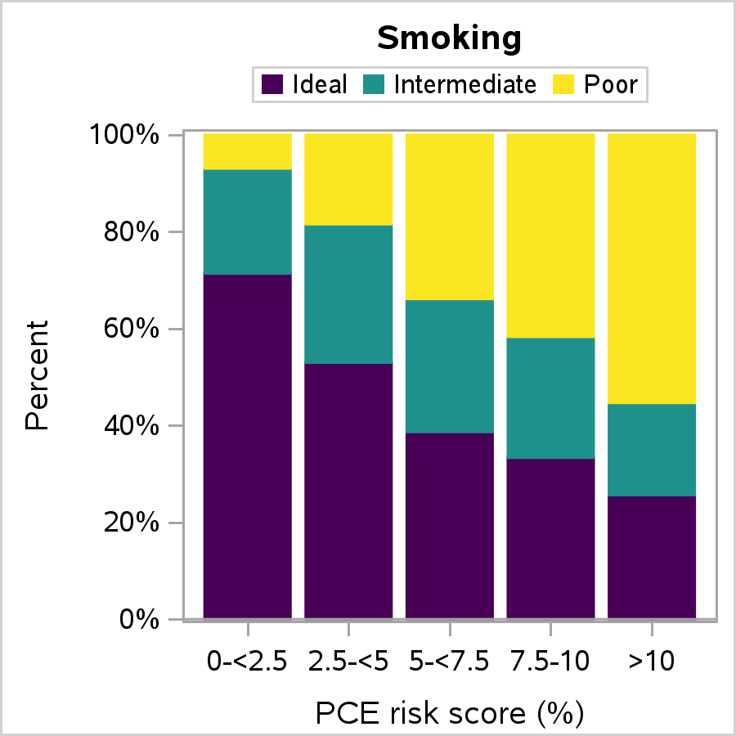
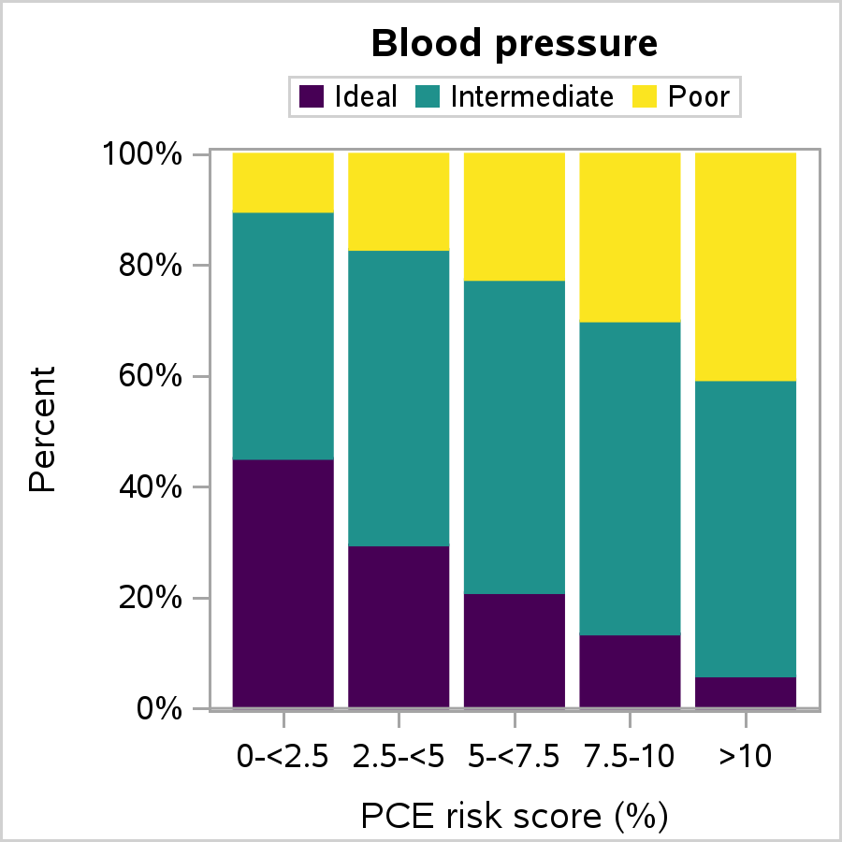
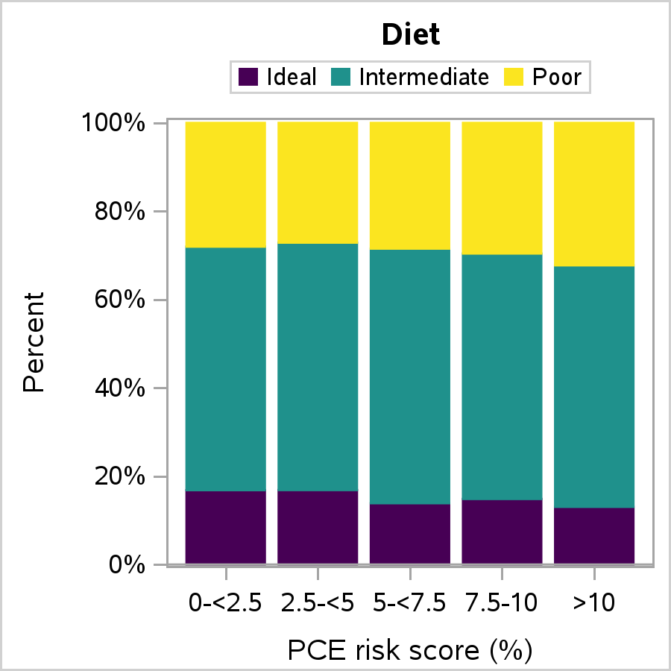
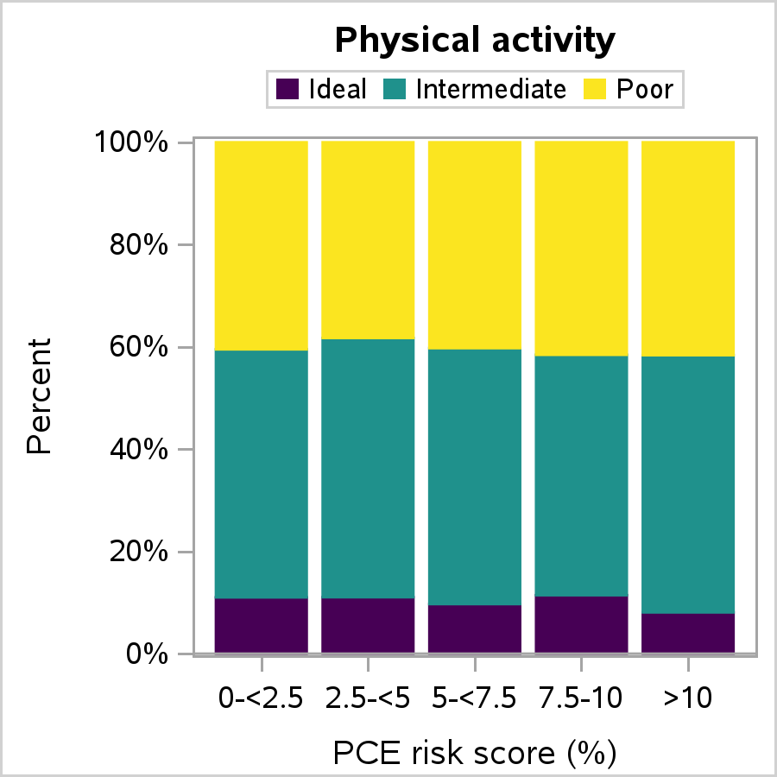
Where do we go from here?
Guideline changes
Who is “minding the shop”?
More accurate risk prediction
Non-CV Endpoints
A capacious view of CV Health

Slide 79
Where do we go from here?
Guideline changes
Who is “minding the shop”?
More accurate risk prediction
Non-CV Endpoints
A capacious view of CV Health

Slide 80
Where do we go from here?
Guideline changes
Who is “minding the shop”?
More accurate risk prediction
Non-CV Endpoints
A capacious view of CV Health
Assess and support healthy habits to prevent CV disease

Slide 81
Summary
Strong associations between HIV and ASCVD with multiple, synergistic mechanisms likely at play
Statins for the primary prevention of ASCVD in PWH reduce MACE by 35%
A much needed landmark trial to guide therapeutic discussions between clinicians and patients
Guidelines for treatment are evolving
Implementing these findings is critical to realize the potential benefits globally

Slide 82
Thank you
REPRIEVE Participants and CAB Members
REPRIEVE Site Teams
REPRIEVE CCC and DCC and Supportive Teams
DAIDS and ACTG for trial monitoring and collaboration
Study Funders including NIH as well as Kowa, Gilead and ViiV

Slide 83
MATEC Resources
National Clinician Consultation Center
http://nccc.ucsf.edu/
    HIV Management
    Perinatal HIV
    HIV PrEP
    HIV PEP line
    HCV Management
    Substance Use Management
AETC National HIV Curriculum
https://aidsetc.org/nhc
AETC National HIV-HCV Curriculum
https://aidsetc.org/hivhcv
National PrEP Curriculum https://www.hivprep.uw.edu
Hepatitis B Online https://www.hepatitisb.uw.edu
Hepatitis C Online
https://www.hepatitisc.uw.edu
AETC National Coordinating Resource Center
https://aidsetc.org/
Additional Trainings https://matec.info

