Slide 1
Long-Acting Antiretroviral Therapy: When and Why to Make the Switch
Melanie Goebel, MD
Assistant Professor
Baylor College of Medicine
Notes:
Version date: 1/23/24
Target participants: prescribing providers and trainees in the HIV clinic setting
Submitted HRSA/SCAETC CO: 2/21/24

Slide 2
Conflict of Interest Disclosure Statement
Speaker has nothing to disclose
This program is supported by the Health Resources and Services Administration (HRSA) of the U.S. Department of Health and Human Services (HHS) as part of an award totaling $4,205,743 with 0% financed with non-governmental sources. The contents are those of the author(s) and do not necessarily represent the official views of, nor does mention of trade names, commercial practices, or organizations imply an endorsement by HRSA, HHS, or the U.S. Government. For more information, please visit HRSA.gov. Any trade/brand names for products mentioned during this presentation are for training and identification purposes only.
Notes:
Please add presenter disclosures here if any exist.

Slide 3
Use of Trade/Brand Names
This program is supported by the Health Resources and Services Administration (HRSA) of the U.S. Department of Health and Human Services (HHS) as part of an award totaling $4,205,743, with 0% financed with non-governmental sources.
The views expressed do not necessarily reflect the official policies of the Department of Health and Human Services, nor does mention of trade names, commercial practices, or organizations imply endorsement by the U.S. Government. Any trade/brand names for products mentioned during this presentation are for training and identification purposes only.
Notes:
NOTE: THIS SLIDE MUST BE INCLUDED IF TRADE AND/OR BRAND NAMES FOR MEDICATIONS ARE USED IN THE PRESENTATION.
IT MAY BE DELETED IF THERE IS NO REFERENCE TO TRADE NAMES, INCLUDING PRESENTATIONS IN WHICH ONLY GENERIC MEDICATION NAMES ARE MENTIONED.
TRADE NAMES MUST BE PUT IN PARENTHESES AFTER THE GENERIC NAME THE FIRST TIME IT IS MENTIONED - E.G., FLUOXETINE (PROZAC). TRADE NAMES SHOULD ONLY BE MENTIONED FOR THE INITIAL REFERENCE AND THE GENERIC NAME ONLY SHOULD BE USED AFTER THAT. THIS APPLIES EQUALLY TO ALL MEDICATIONS OR PRODUCTS MENTIONED IN THIS PRESENTATION.

Slide 4
Unconscious Bias Disclosure
SCAETC recognizes that language is constantly evolving, and while we make every effort to avoid bias and stigmatizing terms, we acknowledge that unintentional lapses may occur in our presentations.
We value your feedback and encourage you to share any concerns related to language, images, or concepts that may be offensive or stigmatizing.
Your input will help us refine and improve our presentations, ensuring they remain inclusive and respectful to participants.

Slide 5
Learning Objectives
Review current literature on efficacy of long-acting cabotegravir-rilpivirine.
Differentiate reasons to switch from oral to long-acting antiretroviral therapy (ART).
Recognize barriers to switching to long-acting ART.
Notes:
Target learning objectives to the target trainee goals
Use active verbs (interpret, differentiate, apply, demonstrate, compose, design, create)
Ensure objectives are S.M.A.R.T. (specific, measurable, achievable, relevant, time-bound)
Ensure presentation is related to HIV screening, prevention, treatment.

Slide 6
Curr HIV/AIDS Rep. 2023 Oct;20(5):271-285.

Slide 7
Why do we need long-acting ART?
Monitoring selected national HIV prevention and care objectives by using HIV surveillance data—United States and 6 dependent areas, 2021. HIV Surveillance Supplemental Report 2023;28(4).
Notes:
At year-end 2021 in the United States and 6 dependent areas, an estimated 1,087,503 persons were living with diagnosed HIV infection.
In order to improve treatment adherence, decrease transmission, and end the HIV epidemic, novel, and innovative treatment approaches are needed.

Slide 8
Long-Acting Cabotegravir-Rilpivirine (LA-CAB/RPV Cabenuva®) Milestones
January 2021: LA-CAB/RPV became the first FDA-approved injectable, complete regimen for treatment of HIV-1 infection in adults
Initially approved for monthly gluteal intramuscular (IM) dosing
February 2022: approval expanded to IM administration every 2 months in adults
March 2022: approved for use in adolescents ≥ 12 years weighing ≥ 35 kg

Slide 9
Cabotegravir
Potent second-generation integrase-strand transfer inhibitor (INSTI)
Long-acting injectable nanoparticle suspension
Half-life 5-11 weeks after a single IM injection
High genetic barrier to resistance
Hepatic metabolism via UGT1A1
UGT1A1 = UDP-glucuronosyltransferase 1
Notes:
It has low risk for drug–drug interactions because it does not induce or inhibit cytochrome (CYP) enzymes

Slide 10
Rilpivirine
Second-generation nonnucleoside reverse-transcriptase inhibitor (NNRTI)
Long-acting suspension: half-life 13-28 weeks after a single IM injection
Higher genetic barrier to resistance than first-generation NNRTIs (efavirenz, nevirapine)
Metabolized through hepatic CYP3A4 system

Slide 11
Phase 3 randomized, open-label clinical trials of LA-CAB/RPV
FLAIR
ATLAS
ATLAS-2M
SOLAR

Slide 12
Exclusion criteria for phase 3 trials
Chronic hepatitis B infection
Presence of any major known INSTI or NNRTI resistance-associated mutations (other than K103N which was allowed*)
*K103N confers high-level resistance to efavirenz and nevirapine
Women who are pregnant or breastfeeding
Moderate or severe hepatic impairment
Chronic kidney disease with creatinine clearance < 50 ml/min (< 30 ml/min for SOLAR trial)
Previous virologic failure
Integrase Strand Transfer Inhibitor = INSTI Non-nucleoside Reverse Transcriptase Inhibitor = NNRTI
Notes:
*K103N confers high-level resistance to efavirenz and nevirapine; it is the most commonly transmitted drug resistance mutation. Rilpivirine remains susceptible.

Slide 13
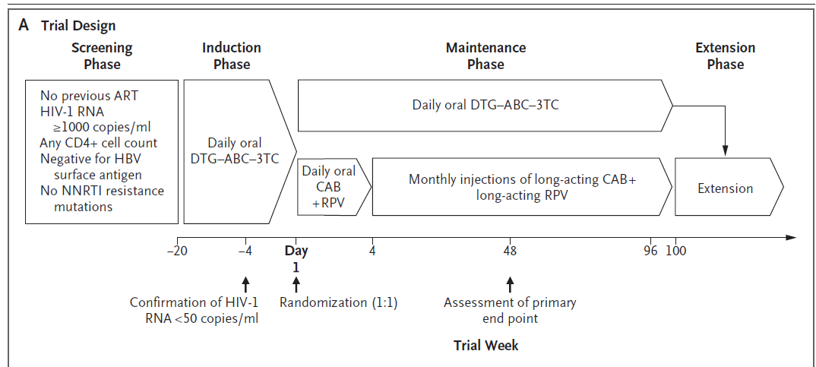
FLAIR Trial
Design: treatment-naïve adults received 20 weeks oral induction therapy (dolutegravir-abacavir-lamivudine); randomized 1:1 to current oral therapy versus monthly LA-CAB/RPV
N Engl J Med 2020;382:1124-35.
Notes:
Inclusion criteria: 18 years or older, no previous antiretroviral therapy, plasma HIV-1 RNA < 50 copies/mL after 16 weeks of oral induction
- Participants were treated with 20 weeks of daily oral induction with a fixed-dose combination of dolutegravir, abacavir, and lamivudine (DTG/ABC/3TC)
- Participants with HIV-1 RNA levels < 50 copies/ milliliter (mL) at 16 weeks were subsequently randomized to continue the oral regimen or switch to LA-CAB/RPV.
- Participants in the injection group completed a 1-month oral lead-in period (oral CAB + oral RPV) to assess safety

Slide 14
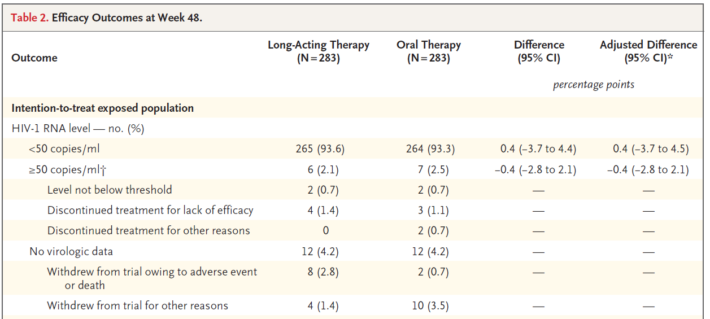
FLAIR Outcomes at Week 48
N Engl J Med 2020;382:1124-35.
Notes:
- At week 48, LA-CAB/RPV was non-inferior to oral DTG/ABC/3TC for maintenance of virologic suppression after oral induction.

Slide 15
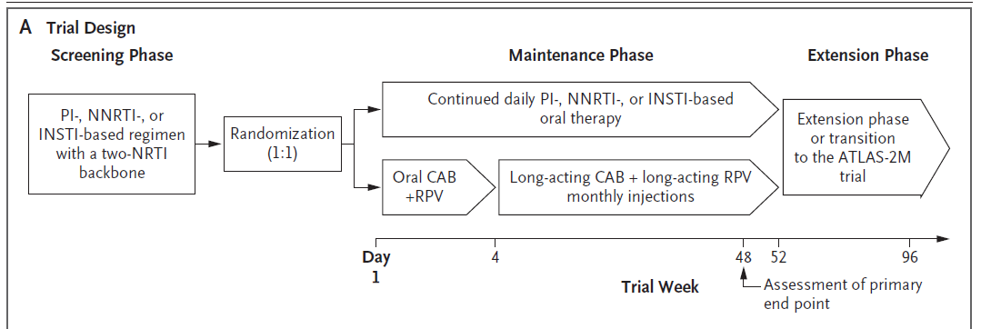
ATLAS Trial
Design: Virologically suppressed participants on standard oral therapy; randomized 1:1 to current oral therapy versus monthly LA-CAB/RPV
N Engl J Med 2020;382:1112-23.
Notes:
- Inclusion criteria: 18 years or older, uninterrupted oral regimen for 6 months, HIV-1 RNA < 50 copies/mL at screening
- At enrollment, participants were required to have a HIV-1 RNA level < 50 copies/mL for at least 6 months on a three-drug oral regimen (two NRTIs plus a third agent [INSTI, NNRTI,
boosted protease inhibitor, or unboosted atazanavir]). After a 4-week oral lead-in period (oral CAB + oral RPV), patients randomized to the injection group received monthly LACAB/RPV.

Slide 16
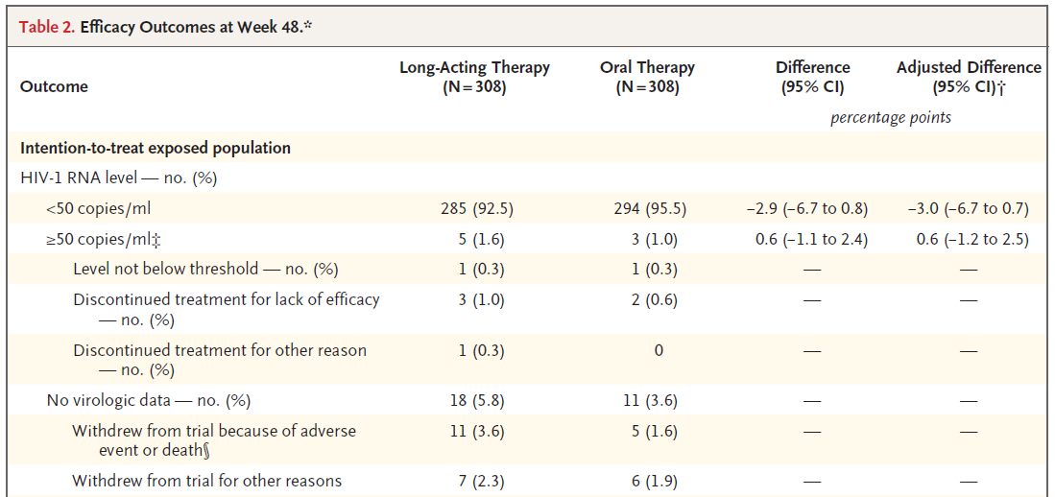
ATLAS Outcomes at Week 48
N Engl J Med 2020;382:1112-23.
Notes:
At 48 weeks, monthly LA-CAB/RPV was noninferior to standard oral regimens for maintenance of virologic suppression.

Slide 17
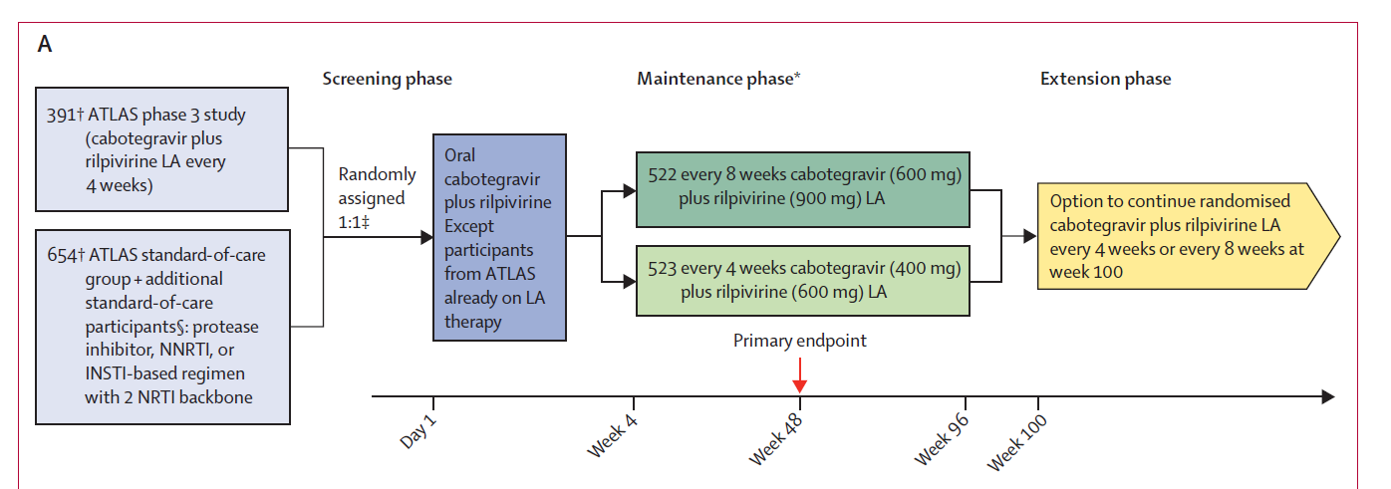
ATLAS-2M Trial
Design: Treatment-experienced adults; LA-CAB/RPV every 8 weeks versus every 4 weeks
Lancet 2020; 396: 1994–2005
Notes:
Inclusion criteria: 18 years or older; uninterrupted oral regimen for 6 months or participants transitioned from ATLAS trial; HIV-1 RNA < 50 copies/mL at screening

Slide 18
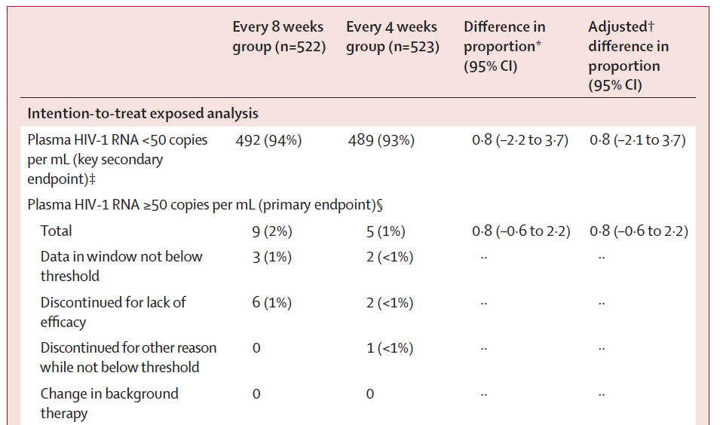
ATLAS-2M Outcomes at Week 48
Lancet 2020; 396: 1994–2005
Notes:
At 48 weeks, LA-CAB/RPV dosed every 8 weeks was non-inferior to every 4-week dosing for maintaining viral suppression.

Slide 19
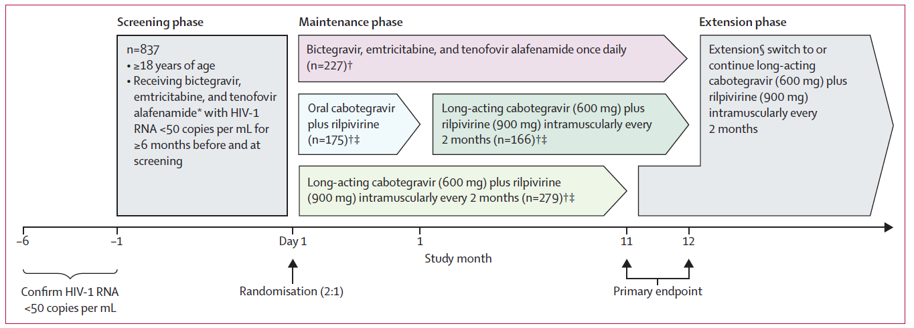
SOLAR Trial
Design: Treatment-experienced adults; bictegravir/emtricitabine/tenofovir alafenamide (BIC/FTC/TAF; Biktarvy®) versus LA-CAB/RPV every 8 weeks
Lancet HIV 2023; 10: e566–77
Notes:
18 years or older; receiving BIC/FTC/TAF with HIV-1 RNA < 50 for ≥ 6 months prior to and at screening

Slide 20
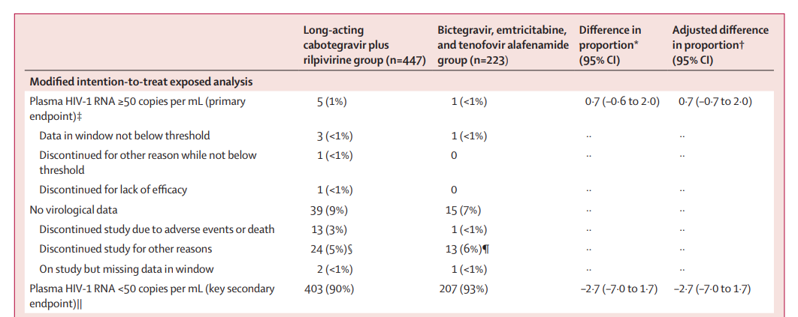
SOLAR Trial Outcomes at 12 months
Lancet HIV 2023; 10: e566–77

Slide 21
Safety and Tolerability
Overall, LA-CAB/RPV is safe and well-tolerated
Injection site reactions (ISRs) were the most common drug-related adverse event in phase 3 trials, occurring in 75–86% of participants
Most ISRs were mild or moderate (grade 1 or 2), including pain and less commonly nodules, induration, and swelling
No participants developed life-threatening or fatal (grade 4 or 5) ISRs
ISRs resolved within 7 days in 88% of participants (median duration 3 days)
In ATLAS-2M, ISRs decreased in frequency over the first 48 weeks and remained stable through week 152
N Engl J Med 2020;382:1124-35. N Engl J Med 2020;382:1112-23. Lancet 2020; 396: 1994–2005; Clin Infect Dis. 2023 May 3;76(9):1646-1654.
Notes:
Excluding ISRs, drug-related serious adverse events
were similar in the injection and oral therapy groups, occurring
in < 1 % of participants

Slide 22
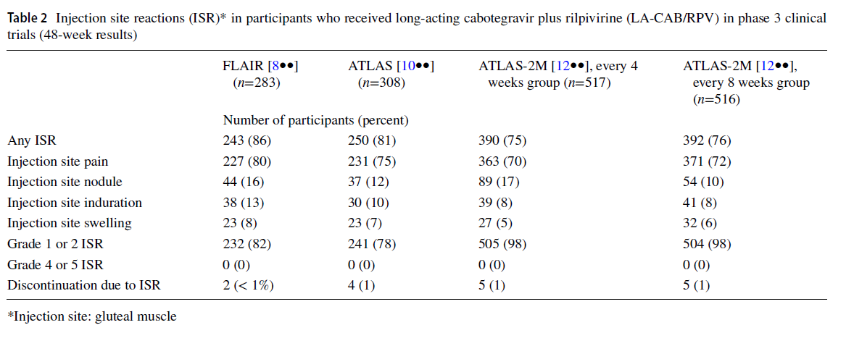
Injection Site Reactions
Curr HIV/AIDS Rep. 2023 Oct;20(5):271-285.

Slide 23
Virologic Failure in Clinical Trials of LA-CAB/RPV
Overall, in the FLAIR, ATLAS, and ATLAS-2M clinical trials, 1.4% (n = 23/1651) of participants had confirmed virologic failure through 152 weeks
Baseline factors associated with increased odds of confirmed virologic failure
Proviral RPV resistance associated mutations (RAMs)
HIV-1 subtype A6/A1c
BMI > 30 kg/m²
Obesity may cause inadvertent subcutaneous drug administration using the standard 1.5-inch needle, leading to inadequate absorption
For patients with BMI > 30 kg/m², use a longer needle length (2 inches)
AIDS. 2021;35(9):1333–42.
Clin Infect Dis. 2023 Nov 17;77(10):1423-1431.
Notes:
In the 152-week ATLAS-2M results, 6/14 (43%) participants with confirmed virologic failure had two or more risk factors at baseline (proviral RPV RAMs, HIV-1 subtype A6/A1c, and BMI > 30 kg/m2)
Obesity may
cause inadvertent subcutaneous drug administration using the provided 1.5-inch needle, leading to inadequate absorption
and drug distribution

Slide 24
The long pharmacokinetic tail of LA-CAB/RPV
Long-acting cabotegravir pharmacokinetics following single dose-administration in healthy adult patients
Curr Opin HIV AIDS 2015, 10:239–245
24
Notes:
This figure shows plasma concentrations of cabotegravir following single dose IM injections in healthy adults. The red line is the PA-IC90.
With different doses of IM cabotegravir, you have varying plasma concentrations. Notice that the plasma concentrations remain above the PA-IC90 for many weeks after a single injection
IC90 is the concentration of drug required for 90% inhibition of HIV replication
Because cabotegravir and rilpivirine are highly protein bound, higher concentrations are needed to overcome protein binding
The IC90 is adjusted by a protein bound correction factor
FIGURE 1. Long-acting cabotegravir pharmacokinetics following single-dose administration in healthy adult individuals. Mean cabotegravir plasma concentration–time profiles following a single long-acting intramuscular (gluteal) or subcutaneous (abdominal) injection in healthy volunteers. The dotted line represents the PA-IC90. The black dashed line represents 4PAIC90. 4PA-IC90, four times the PA-IC90; PA-IC90, protein-adjusted concentration required for 90% viral inhibition. A

Slide 25
The long pharmacokinetic tail of LA-CAB/RPV
Plasma concentrations remain above the protein-adjusted concentration required for 90% inhibition (PA-IC90) for many weeks following a single IM injection
Prolonged exposure to subtherapeutic drug concentrations may result in treatment-emergent resistance
https://clinicalinfo.hiv.gov/en/guidelines/hiv-clinical-guidelines-adult-and-adolescent-arv/optimizing-antiretroviral-therapy?view=full; Curr Opin HIV AIDS 2015, 10:239–245
25
Notes:
Given the long half-life of long-acting CAB and RPV, plasma concentrations remain above the protein-adjusted concentration required for 90% inhibition (PA-IC90) for many weeks following a single IM injection
To decrease the risk associated with reduced drug exposure, patients with injection visits delayed by more than 7 days should receive oral bridging therapy

Slide 26
The long pharmacokinetic tail of LA-CAB/RPV
Patients with injection visits delayed by more than 7 days should receive oral bridging therapy
When stopping LA-CAB/RPV, transition to a suppressive oral regimen should occur within 4 weeks of the last IM doses on monthly dosing and 8 weeks of the last IM doses for every 2-month dosing
https://clinicalinfo.hiv.gov/en/guidelines/hiv-clinical-guidelines-adult-and-adolescent-arv/optimizing-antiretroviral-therapy?view=full; Curr Opin HIV AIDS 2015, 10:239–245
26
Notes:
Given the long half-life of long-acting CAB and RPV, plasma concentrations remain above the protein-adjusted concentration required for 90% inhibition (PA-IC90) for many weeks following a single IM injection
To decrease the risk associated with reduced drug exposure, patients with injection visits delayed by more than 7 days should receive oral bridging therapy

Slide 27
Case 1
A 32 y/o female with HIV on bictegravir/emtricitabine/tenofovir alafenamide (Biktarvy®) for 1 year presents for follow up. CD4 250, viral load < 20 for 9 months. She states that she is “tired of taking pills every day.” She asks if she can be switched to “shots.” What is the best next step?
Switch to long-acting CAB-RPV
Review her genotype(s) for mutations
Discuss family planning, including contraception and risks of becoming pregnant on LA-CAB/RPV
B and C

Slide 28
Case 1
A 32 y/o female with HIV on bictegravir/emtricitabine/tenofovir alafenamide (Biktarvy®) for 1 year presents for follow up. CD4 250, viral load < 20 for 9 months. She states that she is “tired of taking pills every day.” She asks if she can be switched to “shots.” What is the best next step?
Switch to long-acting CAB-RPV
Review her genotype(s) for mutations
Discuss family planning, including contraception and risks of becoming pregnant on LA-CAB/RPV
B and C
Notes:
Answer: B and C

Slide 29
Eligibility Criteria for Switching to LA-ART
HHS guidelines: “Data from the ATLAS, FLAIR, and ATLAS-2M trials support that separate monthly or every 2-month ventrogluteal IM injections of long-acting CAB and RPV can be used to replace an existing oral ARV regimen in People with HIV (PWH) with sustained viral suppression for 3 to 6 months (optimal duration is not defined) (AI).”
One month of oral lead-in with oral CAB and RPV is optional to assess tolerability per patient preference
https://clinicalinfo.hiv.gov/en/guidelines/hiv-clinical-guidelines-adult-and-adolescent-arv/optimizing-antiretroviral-therapy?view=full
Notes:
HHS guidelines: Data from the ATLAS, FLAIR, and ATLAS-2M trials support that separate monthly or every 2-month ventrogluteal IM injections of long-acting CAB and RPV can be used to replace an existing oral ARV regimen in people with HIV with sustained viral suppression for 3 to 6 months (optimal duration is not defined) (AI).

Slide 30
Eligibility Criteria for Switching to LA-ART
Good adherence and engagement in care
No baseline resistance to either medication
No prior virologic failures
No active or occult HBV infection (unless the patient also is receiving an HBV active regimen [e.g., entecavir])
Not pregnant or planning on becoming pregnant
Not receiving medications with significant drug interactions with oral (during lead-in or bridging therapy) or injectable CAB or RPV
No buttock implants or fillers
https://clinicalinfo.hiv.gov/en/guidelines/hiv-clinical-guidelines-adult-and-adolescent-arv/optimizing-antiretroviral-therapy?view=full
Notes:
Individuals with buttock implants or fillers may not be appropriate candidates because of concerns regarding drug absorption

Slide 31
LA-CAB/RPV in Pregnancy
LA-CAB/RPV is not recommended for initiation in pregnancy due to lack of dosing, Pharmacokinetics (PK), and safety data
People who conceive while suppressed on LA-CAB/RPV
Shared decision-making with provider
Options: continue LA-CAB/RPV with viral load monitoring every 1 to 2 months or switch to a recommended oral regimen
https://clinicalinfo.hiv.gov/en/guidelines/perinatal/recommendations-arv-drugs-pregnancy-situation-specific-conceive-full
Notes:
However, people who conceive while suppressed on LA-CAB/RPV may have few other treatment options, and the Guidelines Panel recommends shared decision-making to decide whether to continue this regimen with viral load monitoring every 1 to 2 months or to switch to a recommended oral regimen

Slide 32
Drug-drug interactions with LA-CAB/RPV
Although CAB and RPV are considered to have a low potential for drug–drug interactions, coadministration is contraindicated with strong or moderate CYP3A4 inducers:
Anti-epileptics (phenytoin, carbamazepine, phenobarbital)
Multi-dose dexamethasone
Anti-mycobacterials (rifampin, rifabutin)
Always review medications carefully prior to switching
Use a drug interactions tool: https://www.hiv-druginteractions.org/checker
https://clinicalinfo.hiv.gov/en/guidelines/hiv-clinical-guidelines-adult-and-adolescent-arv/optimizing-antiretroviral-therapy?view=full
Notes:
Several drugs, particularly those interacting with cytochrome P450 3A or uridine diphosphate glucuronosyltransferase 1A1, are contraindicated with CAB and RPV (oral and/or IM) due to significant drug interactions, including certain anticonvulsants and rifamycins.

Slide 33
Why should a PWH switch to LA-CAB/RPV?
Patient preference
Potential for improved adherence
New or worsening medical comorbidities
Chronic GI conditions (malabsorption, chronic vomiting, dysphagia)
Avoidance of adverse effects associated with oral ART
Ex: tenofovir disoproxil fumarate is associated with decreased bone mineral density and nephrotoxicity
Elimination of drug-drug or drug-food interactions with oral ART
Ex: oral INSTIs and oral RPV should not be taken with aluminum or magnesium-containing antacids
PWH = Person with HIV

Slide 34
Challenges associated with daily oral ART
2019 Positive Perspectives Survey→ 2389 PWH in 25 countries reported challenges associated with daily oral ART:
Anxiety about daily dosing
Difficulty swallowing pills
Perception that taking daily oral ART is a daily reminder of HIV
Anxiety that taking daily ART would lead to HIV disclosure
Internalized stigma associated with pills
LA-ART may improve quality of life for PWH
AIDS Behav. 2021;25(3):961–72.
Notes:
Those
who perceived that daily dosing limits their day-to-day life
had lower odds of optimal overall health

Slide 35
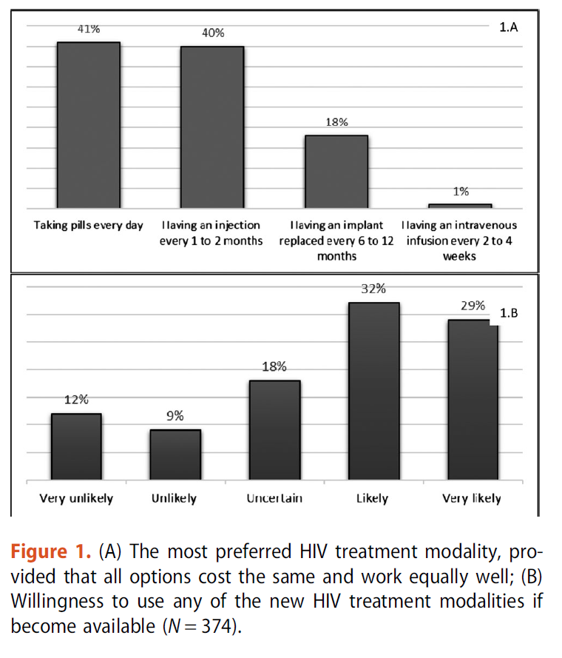
374 participants at Thomas Street Health Center
41% preferred pills to treat their HIV and 59% preferred alternative forms of long-acting ART (40% preferred injections)
Majority of participants (61%) reported that they would be “likely” or “very likely” to use LA-ART when available
AIDS Care. 2021;33(6):801–9.

Slide 36
Participants in Phase 3 Trials Preferred LA-ART versus Oral ART
ATLAS and FLAIR: patient-reported treatment satisfaction scores were higher in injection group compared to oral-therapy group
ATLAS-2M: treatment satisfaction scores were significantly higher in every 8-week dosing group compared to every 4-week dosing group
SOLAR: 90% (382/425) of participants in the injection group preferred LA-CAB/RPV over oral BIC/FTC/TAF
Notes:
Patient-reported reasons for preferring injections
included not worrying about remembering to take daily
medications, convenience, reduced potential for disclosure
of HIV status, and not having to think about their HIV status
every day
Notably, generalizability of treatment
satisfaction scores is limited, as persons who choose to
enroll in these randomized trials of LA-ART may be biased
toward a preference for injectable ART over oral options

Slide 37
LA-CAB/RPV may improve adherence to ART
Common barriers to adherence to ART
Forgetfulness
Depression
Alcohol and substance use
Stigma
Pill burden/pill aversion
Distance to clinic
Side effects
LA-ART may alleviate many (but not all) of these barriers
PLoS Med.2016;13(11):e1002183.
Notes:
Adherence to ART is complex, with many structural, behavioral,
and psychosocial factors

Slide 38
Adherence to LA-CAB/RPV in the Real World
ABOVE study: retrospective US cohort study using claims database from 2020-2022
PWH ≥12 years of age on stable guideline-recommended oral ART were categorized into those initiating LA-CAB/RPV and those remaining on oral ART
130,362 in the oral ART cohort (N=950 after propensity score matching) and 947 in the CAB+RPV LA cohort
IDWeek 2023: Abstract citation ID: ofad500.055
Notes:
Based on pooled data from the ATLAS
and FLAIR trials, 98% of injection visits occurred within
the allowed ―7 days of the planned injection window [20].
Although adherence to injections was very high in the phase
3 clinical trials, excellent adherence in the clinical trial setting
cannot be extrapolated to the uncontrolled “real-world”
Setting
Standardized mortality ratio (SMR) weights were generated based on propensity scores to balance baseline characteristics between cohorts.
Adherence (proportion of days covered (PDC) ≥0.9 over 6-months following index)
A higher proportion of PWH in the CAB+RPV LA cohort were adherent (72% vs 43%, p< 0.001) compared with the oral ART cohort
PWH in the CAB+RPV LA cohort had significantly higher adjusted odds of being adherent compared to the oral ART cohort (OR: 4.43, 95% CI: 2.38, 8.24, p< 0.001)

Slide 39
Adherence to LA-CAB/RPV in the Real World
A higher proportion of PWH in the LA-CAB/RPV cohort were adherent (72% vs 43%, p< 0.001) compared with oral ART cohort
PWH in the LA-CAB/RPV cohort had significantly higher adjusted odds of being adherent compared to the oral ART cohort (OR: 4.43, 95% CI: 2.38, 8.24, p< 0.001)
IDWeek 2023: Abstract citation ID: ofad500.055

Slide 40
Case 2
42 y/o man with HIV, substance use disorder, and depression presents for follow up. He is currently experiencing homelessness. CD4 150, viral load 32,000 on bictegravir/emtricitabine/tenofovir alafenamide. He reports challenges with adherence due to forgetfulness and depression. He has had medication bottles stolen from his backpack twice in the last year. He regularly comes to appointments. Multiple genotypes show no mutations. In addition to adherence counseling, what is the best next step?
Continue tenofovir alafenamide/emtricitabine/bictegravir
Switch to tenofovir alafenamide/emtricitabine/darunavir/cobicistat
Discuss risks versus benefits of switching to LA-CAB/RPV (off-label)
Switch to dolutegravir and darunavir/cobicistat
Notes:
All answers could be correct
No right answer!

Slide 41
LA-CAB/RPV in PWH with Viremia
Phase 3 clinical trials excluded patients with viremia (viral load > 50 copies/mL)
FDA approved LA-CAB/RPV only for patients who are virologically stable and suppressed (viral load < 50 copies/mL)
There are limited data on the off-label use of LA-CAB/RPV among people with viral load > 200 copies/mL at the time of switching to LA-ART

Slide 42
Compassionate Use of LA-CAB/RPV
From 2016–2020, LA-CAB/RPV was available through a compassionate use program for PWH with a need for parenteral therapy, no primary resistance mutations to CAB or RPV, and good retention to care
35 patients received LA-CAB/RPV, most due to chronic poor adherence to oral ART or medical conditions (malabsorption)
HIV Med.2023;24(2):202–11.
Notes:
- primary reason for requested compassionate use was chronic poor adherence to oral ART due to psychological conditions (43%)
or medical conditions (23%) such as such as malabsorption and gastrointestinal problems

Slide 43
Compassionate Use of LA-CAB/RPV
At enrollment, 28 (80%) individuals had HIV-1 RNA > 50 copies/mL; of these, 16 (57%) achieved virologic suppression
Of 7 individuals who discontinued LA-CAB/RPV due to incomplete virological response, 3 (43%) had BMI > 30 kg/m² and 6 had new treatment-emergent NNRTI RAMs
HIV Med.2023;24(2):202–11.

Slide 44
LA-CAB/RPV in Viremic PWH in San Francisco
Demonstration project at a safety-net clinic in San Francisco (Ward 86 HIV Clinic) with high prevalence of substance use (34%), mental illness, and unstable housing (42%)
57 had viremia (HIV-1 RNA > 30) at the time of starting LA-CAB/RPV every 4 weeks
Rigorous program that includes wraparound services (outreach, drop-in access, street medicine, and incentives)
On-time injections occurred for 74% of cohort
Ann Intern Med. 2023;176:969-974.
Notes:
- on-time injections occurred for 74% of cohort
- The 2 patients with early virologic failure had new NNRTI and INSTI mutations at the time of virologic failure
Beyond the 2 cases of virologic failure,
1 additional patient developed viral rebound after
initial suppression; the genotype failed to amplify, and
he immediately achieved resuppression with oral ART
(darunavir–cobicistat–tenofovir alafenamide–emtricitabine).
This patient had a BMI of 32 kg/m2 and inadvertently was
not given his injection with the longer 2-inch needle, which
may have contributed to low drug levels (11)

Slide 45
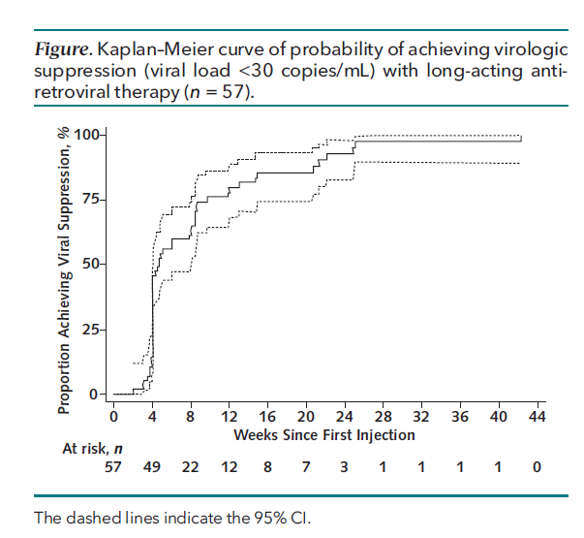
LA-CAB/RPV in Viremic PWH in San Francisco
Among 57 viremic patients:
54 achieved virologic suppression by a median of 33 days
2 had documented virologic failure soon after initiation (1 had a minor RT gene mutation at baseline, 1 had minor INSTI mutation at baseline)
1 had viral rebound after initial suppression and resuppressed with oral ART
Protocol was subsequently tightened to exclude patients with even minor resistance mutations
Ann Intern Med. 2023;176:969-974.
Notes:
- on-time injections occurred for 74% of cohort
The 2 patients with early virologic failure had new NNRTI and INSTI mutations at the time of virologic failure
Of note the 1 patient with NNRTI mutation at baseline had V179V/I mutation; V179I is a polymorphic mutation that is frequently selected in persons receiving ETR and RPV. However, it has little, if any, direct effect on NNRTI susceptibility.
Beyond the 2 cases of virologic failure,
1 additional patient developed viral rebound after
initial suppression; the genotype failed to amplify, and
he immediately achieved resuppression with oral ART
(darunavir–cobicistat–tenofovir alafenamide–emtricitabine).
This patient had a BMI of 32 kg/m2 and inadvertently was
not given his injection with the longer 2-inch needle, which
may have contributed to low drug levels (11)

Slide 46
LA-CAB/RPV in Viremic PWH in Mississippi
RRHAP-funded HIV clinic at University of Mississippi
LA-CAB/RPV offered as a salvage option for patients with viremia despite oral ART optimization
12 patients started LA-CAB/RPV
Payor source: 9 Medicaid*, 2 Medicare, 1 commercial insurance
Baseline resistance associated mutations were present in 10/12 patients, including NNRTI (K103N) and minor INSTI mutations
All patients achieved viral load <50 copies/mL within 3 months of initiation of LA-CAB/RPV; no cases of virologic rebound (VL > 200)
*Like Texas, Mississippi does not have Medicaid expansion
Clin Infect Dis. 2023 Sep 22:ciad511.
RWHAP=Ryan White HIV/AIDS Program
Notes:
- LA-CAB/RPV offered as a salvage option for patients with poor virologic outcomes (viremic at multiple time points) despite ART optimization and intensive case management strategies
- Baseline mean CD4 233 (range 131-475); baseline mean viral load 152, 657 copies/mL (range 2410–566 000)
- Baseline historical resistance-associated mutations were common, present in 83% (10 of 12) of patients. Non-nucleoside reverse
transcriptase inhibitor- (NNRTI) associated mutations noted in the cohort included K103N (2), V106I (1), and P225H (1). Integrase strand transfer inhibitor (INSTI) mutations included D232N (1), N155H (1), and E157Q (3).
Six patients were initially started on injections every month
(Q1M) but were transitioned to every 2 months (Q2M).

Slide 47
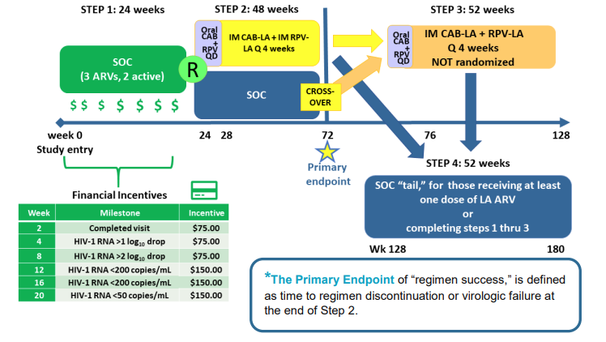
LATITUDE Clinical Trial
LATITUDE : Long-Acting Therapy to Improve Treatment sUccess in Daily LifE (ACTG 5359)
Currently enrolling PWH with previous non-adherence 30 Clinical Sites across U.S. + Puerto Rico
https://www.clinicaltrials.gov/study/NCT03635788
https://www.natap.org/2019/HIV/A5359providerhandoutFINAL.pdf
Notes:
- in this study, adherence is supported by conditional economic incentives
Randomizes patients with sub-optimal adherence to oral ART to receive LA-CAB/RPV or continue standard oral therapy
To be eligible for randomization to LA-ART, participants must achieve viral load < 200 copies/mL following an incentivized oral induction period with a three-drug regimen

Slide 48
Barriers to Switching to LA-CAB/RPV: Patient-Level Factors
Suboptimal adherence to antiretroviral therapy
Poor retention to care
Baseline resistance to NNRTIs and INSTIs
Prior virologic failure
Chronic hepatitis B infection
Pregnancy
Drug–drug interactions
Intolerance of injections/fear of needles
Inability to receive gluteal injections (gluteal implants)
Medical mistrust
Patient concerns about safety and effectiveness
Challenges with additional clinic visits for injections

Slide 49
Barriers to Switching to LA-CAB/RPV: Healthcare System Factors and Implementation Challenges
Time investment for training healthcare professionals
Limitations of clinic workflow
Clinic capacity for injection visits
Requirement for cold-chain storage
Cost of medication
Insurance denials and prior authorizations
Variability in state laws regarding pharmacy and medical benefits
LA-CAB/RPV is not currently on formulary for Texas ADAP*
No Medicaid expansion in Texas
*ADAP = AIDS drug assistance program

Slide 50
Facilitators to Switching to LA-CAB/RPV: Healthcare System Factors
Pharmacy-administered injections
Medicaid expansion
Insurance formulary coverage
ADAP coverage
Prescription medication assistance programs
Teamwork among clinic staff
Appointment reminder systems
Defined protocols
Designated clinic teams

Slide 51
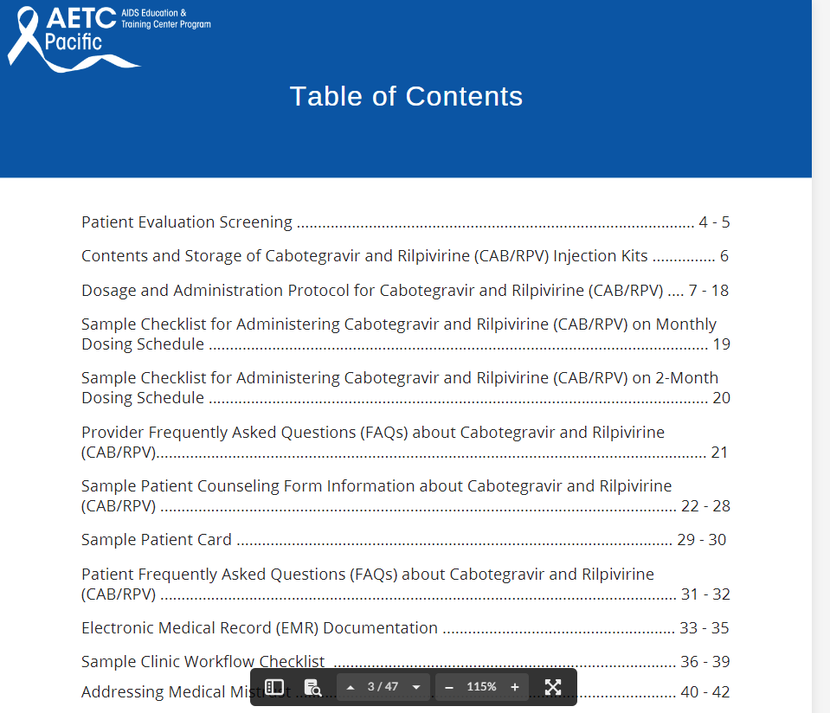
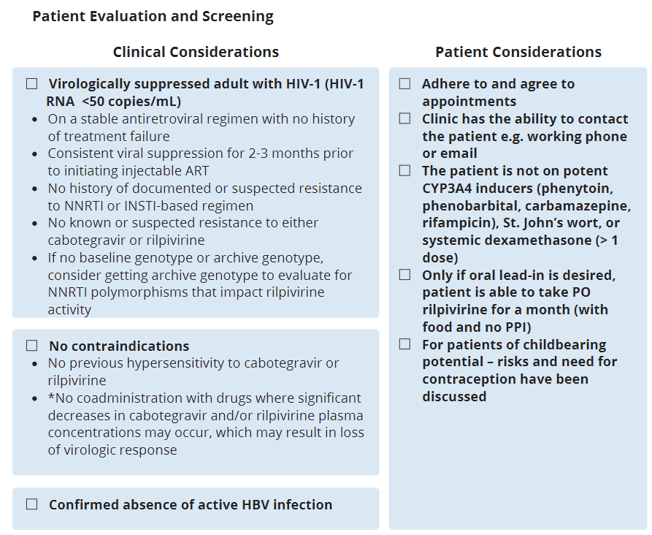
AETC Toolkit for LA-CAB/RPV
https://aidsetc.org/resource/expand-your-hiv-toolkit-cabotegravir-and-rilpivirine-cabrpv-essentials-and-clinical-guide

Slide 52
Implementation of LA-CAB/RPV at Thomas Street at Quentin Mease
Workflow includes steps for the provider, LAI champion, clinical pharmacy specialist, and pharmacy
As of January 2024, 21 patients have been switched to LA-CAB/RPV, and 3 additional patients are pending start
Currently only patients with Medicaid or insurance are eligible (not covered by ADAP)
Approval for off-label use (VL > 50 copies/mL) depends on the insurance company
2 patients were approved with high viral load due to absorption issues and another with extreme pill aversion
Notes:
- 2 patients were approved with high viral load due to absorption issues (tongue cancer with PEG tube) and another with extreme pill aversion
- If there is a clinical reason for LA-CAB/RPV, provider may offer this treatment option with the possibility of appeal/peer to peer

Slide 53
Summary
LA-CAB/RPV is an alternative to daily oral ART that may improve quality of life and adherence for some PWH
LA-CAB/RPV is approved for IM injection every 1-2 months in people who are virologically stable and suppressed
There are limited data to support LA-CAB/RPV in patients with poor adherence and/or high viral load on oral ART
Implementation studies are needed to understand best approaches to system-level barriers

Slide 54
Resources
https://clinicalinfo.hiv.gov/en/guidelines/hiv-clinical-guidelines-adult-and-adolescent-arv/optimizing-antiretroviral-therapy?view=full
https://aidsetc.org/resource/expand-your-hiv-toolkit-cabotegravir-and-rilpivirine-cabrpv-essentials-and-clinical-guide
Notes:
You may also add your own organization-specific resource slide in addition to the SCAETC Resources slide.

Slide 55
Resources
National Clinician Consultation Center http://nccc.ucsf.edu/
HIV Management
Perinatal HIV
HIV PrEP
HIV PEP line
HCV Management
Substance Use Management
Present on ECHO
https://hsc.unm.edu/scaetc/programs-services/echo.html​
AETC National HIV Curriculum https://aidsetc.org/nhc
AETC National Coordinating Resource Center https://targethiv.org/library/aetc-national-coordinating-resource-center-0
HIVMA Resource Directory https://www.hivma.org/globalassets/ektron-import/hivma/hivma-resource-directory.pdf
Additional trainings scaetcecho@salud.unm.edu
www.scaetc.org
Notes:
IDEA Platform: Infectious Diseases Education & Assessment. https://idea.medicine.uw.edu/
AETC National HIV Curriculum: 6 core modules for self study; regularly updated; CME, CNE
Hepatitis C Online Curriculum: https://www.hepatitisc.uw.edu/
Hepatitis B Online Curriculum: https://www.hepatitisb.uw.edu/
National STD Curriculum: https://www.std.uw.edu/

