Slide 1
Intimate Partner Violence: How Can We Help?
Cases in HIV for InterProfessional Students (CHIPS) SESSION 2
Presented by
Sheryl Malone-Thomas, DNP, APRN, FNP-BC
Assistant Professor of Nursing
UT Cizik School of Nursing
Notes:
Version date_ 02 2024
Target audience: IPE trainees and faculty

Slide 2
Conflict of Interest Disclosure Statement
Speaker has nothing to disclose
This program is supported by the Health Resources and Services Administration (HRSA) of the U.S. Department of Health and Human Services (HHS) as part of an award totaling $4,205,743 with 0% financed with non-governmental sources. The contents are those of the author(s) and do not necessarily represent the official views of, nor does mention of trade names, commercial practices, or organizations imply an endorsement by HRSA, HHS, or the U.S. Government. For more information, please visit HRSA.gov. Any trade/brand names for products mentioned during this presentation are for training and identification purposes only.
Notes:
Please add presenter disclosures here if any exist.

Slide 3
Use of Trade/Brand Names
This program is supported by the Health Resources and Services Administration (HRSA) of the U.S. Department of Health and Human Services (HHS) as part of an award totaling $4,205,743, with 0% financed with non-governmental sources.
The views expressed do not necessarily reflect the official policies of the Department of Health and Human Services, nor does mention of trade names, commercial practices, or organizations imply endorsement by the U.S. Government. Any trade/brand names for products mentioned during this presentation are for training and identification purposes only.
Notes:
NOTE: THIS SLIDE MUST BE INCLUDED IF TRADE AND/OR BRAND NAMES FOR MEDICATIONS ARE USED IN THE PRESENTATION.
IT MAY BE DELETED IF THERE IS NO REFERENCE TO TRADE NAMES, INCLUDING PRESENTATIONS IN WHICH ONLY GENERIC MEDICATION NAMES ARE MENTIONED.
TRADE NAMES MUST BE PUT IN PARENTHESES AFTER THE GENERIC NAME THE FIRST TIME IT IS MENTIONED - E.G., FLUOXETINE (PROZAC). TRADE NAMES SHOULD ONLY BE MENTIONED FOR THE INITIAL REFERENCE AND THE GENERIC NAME ONLY SHOULD BE USED AFTER THAT. THIS APPLIES EQUALLY TO ALL MEDICATIONS OR PRODUCTS MENTIONED IN THIS PRESENTATION.

Slide 4
Unconscious Bias Disclosure
SCAETC recognizes that language is constantly evolving, and while we make every effort to avoid bias and stigmatizing terms, we acknowledge that unintentional lapses may occur in our presentations.
We value your feedback and encourage you to share any concerns related to language, images, or concepts that may be offensive or stigmatizing.
Your input will help us refine and improve our presentations, ensuring they remain inclusive and respectful to participants.

Slide 5
CHIPS Logistics
Please complete the online participant information form and baseline student assessment if you have not done so already
2024 CHIPS Session dates: January 26, February 23, March 29, April 12
By joining CHIPS, you will be eligible to earn a CHIPS Certificate of Completion
To earn a CHIPS Certificate of Completion, you must attend all 4 sessions.
One live session can be missed, but you must watch the Zoom recording and complete a post-evaluation to receive credit.
Notes:
SCAETC is HRSA-funded and needs to submit demographic information for all participants in our trainings.
Once it has been filled out once, it will cover you for all AETC trainings and will not need to be filled out again for a year.

Slide 6
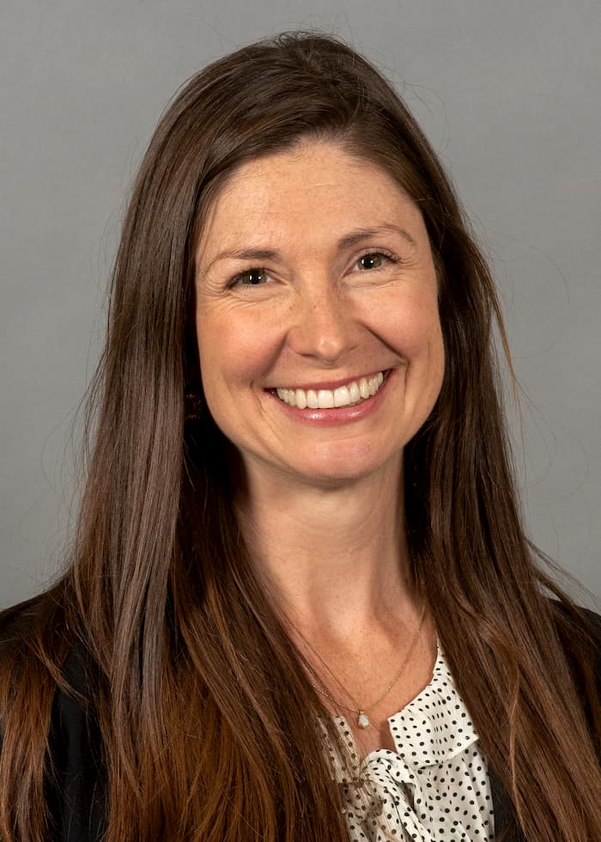
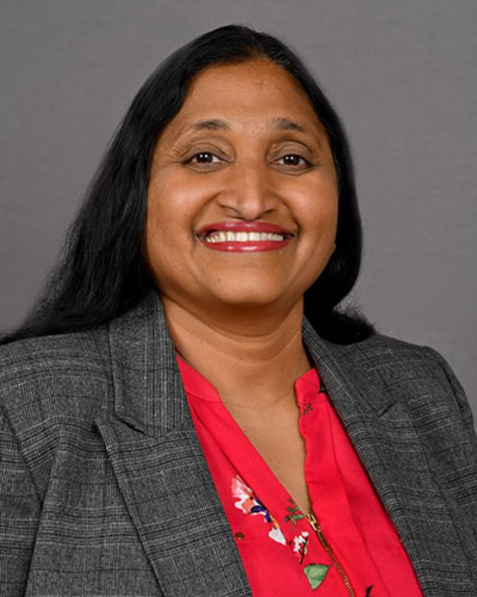
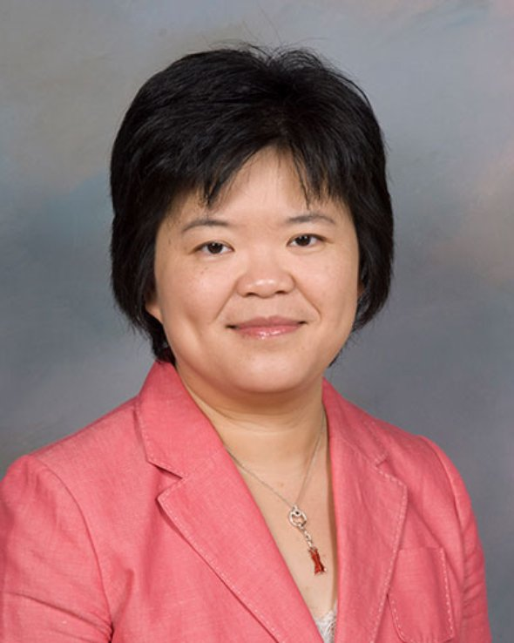
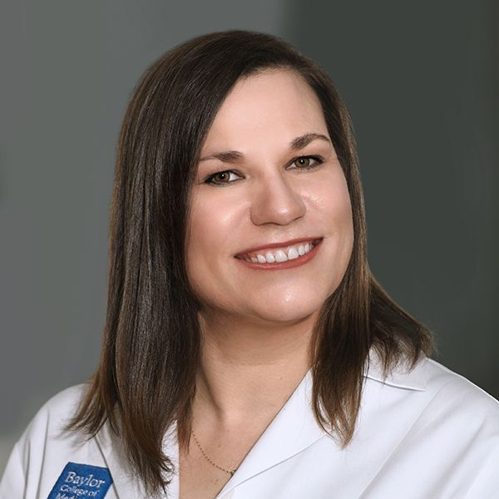
CHIPS Faculty and Collaborators
Padmavathy Ramaswamy, PhD
Assistant Professor
Cizik School of Nursing
The University of Texas
Erica Yu, PhD
Associate Dean & department chair
Cizik School of Nursing
The University of Texas
Sheryl Malone-Thomas, DNP, RN, FNP-BC
Assistant Professor
Cizik School of Nursing
The University of Texas
Shital Patel, MD
Assistant Professor
Infectious Diseases
Baylor College of Medicine
Melanie Goebel, MD
Assistant Professor
Infectious Diseases
Baylor College of Medicine
Chelsea Gilts Ratcliff, PhD
Assistant Professor
Department of Psychology and Philosophy
Sam Houston State University
School of
Health Professions
Lis Shell, PhD, PA-C
Assistant Professor
Baylor College of Medicine
Physician Assistant Program
Amy Moss, PharmD
Clinical Pharmacist
Harris Health System
Hongmei Wang, PharmD, PhD
Assistant Professor
Texas Southern University

Slide 7
Learning Objectives
Identify how the interprofessional team works together to screen and prevent negative outcomes related to intimate partner violence (IPV).
Recognize the legal and ethical responsibilities of health care providers in developing a thorough treatment plan for patients who experience IPV.
Model a team-based approach to assist individuals experiencing IPV to develop an effective survival action plan.

Slide 8
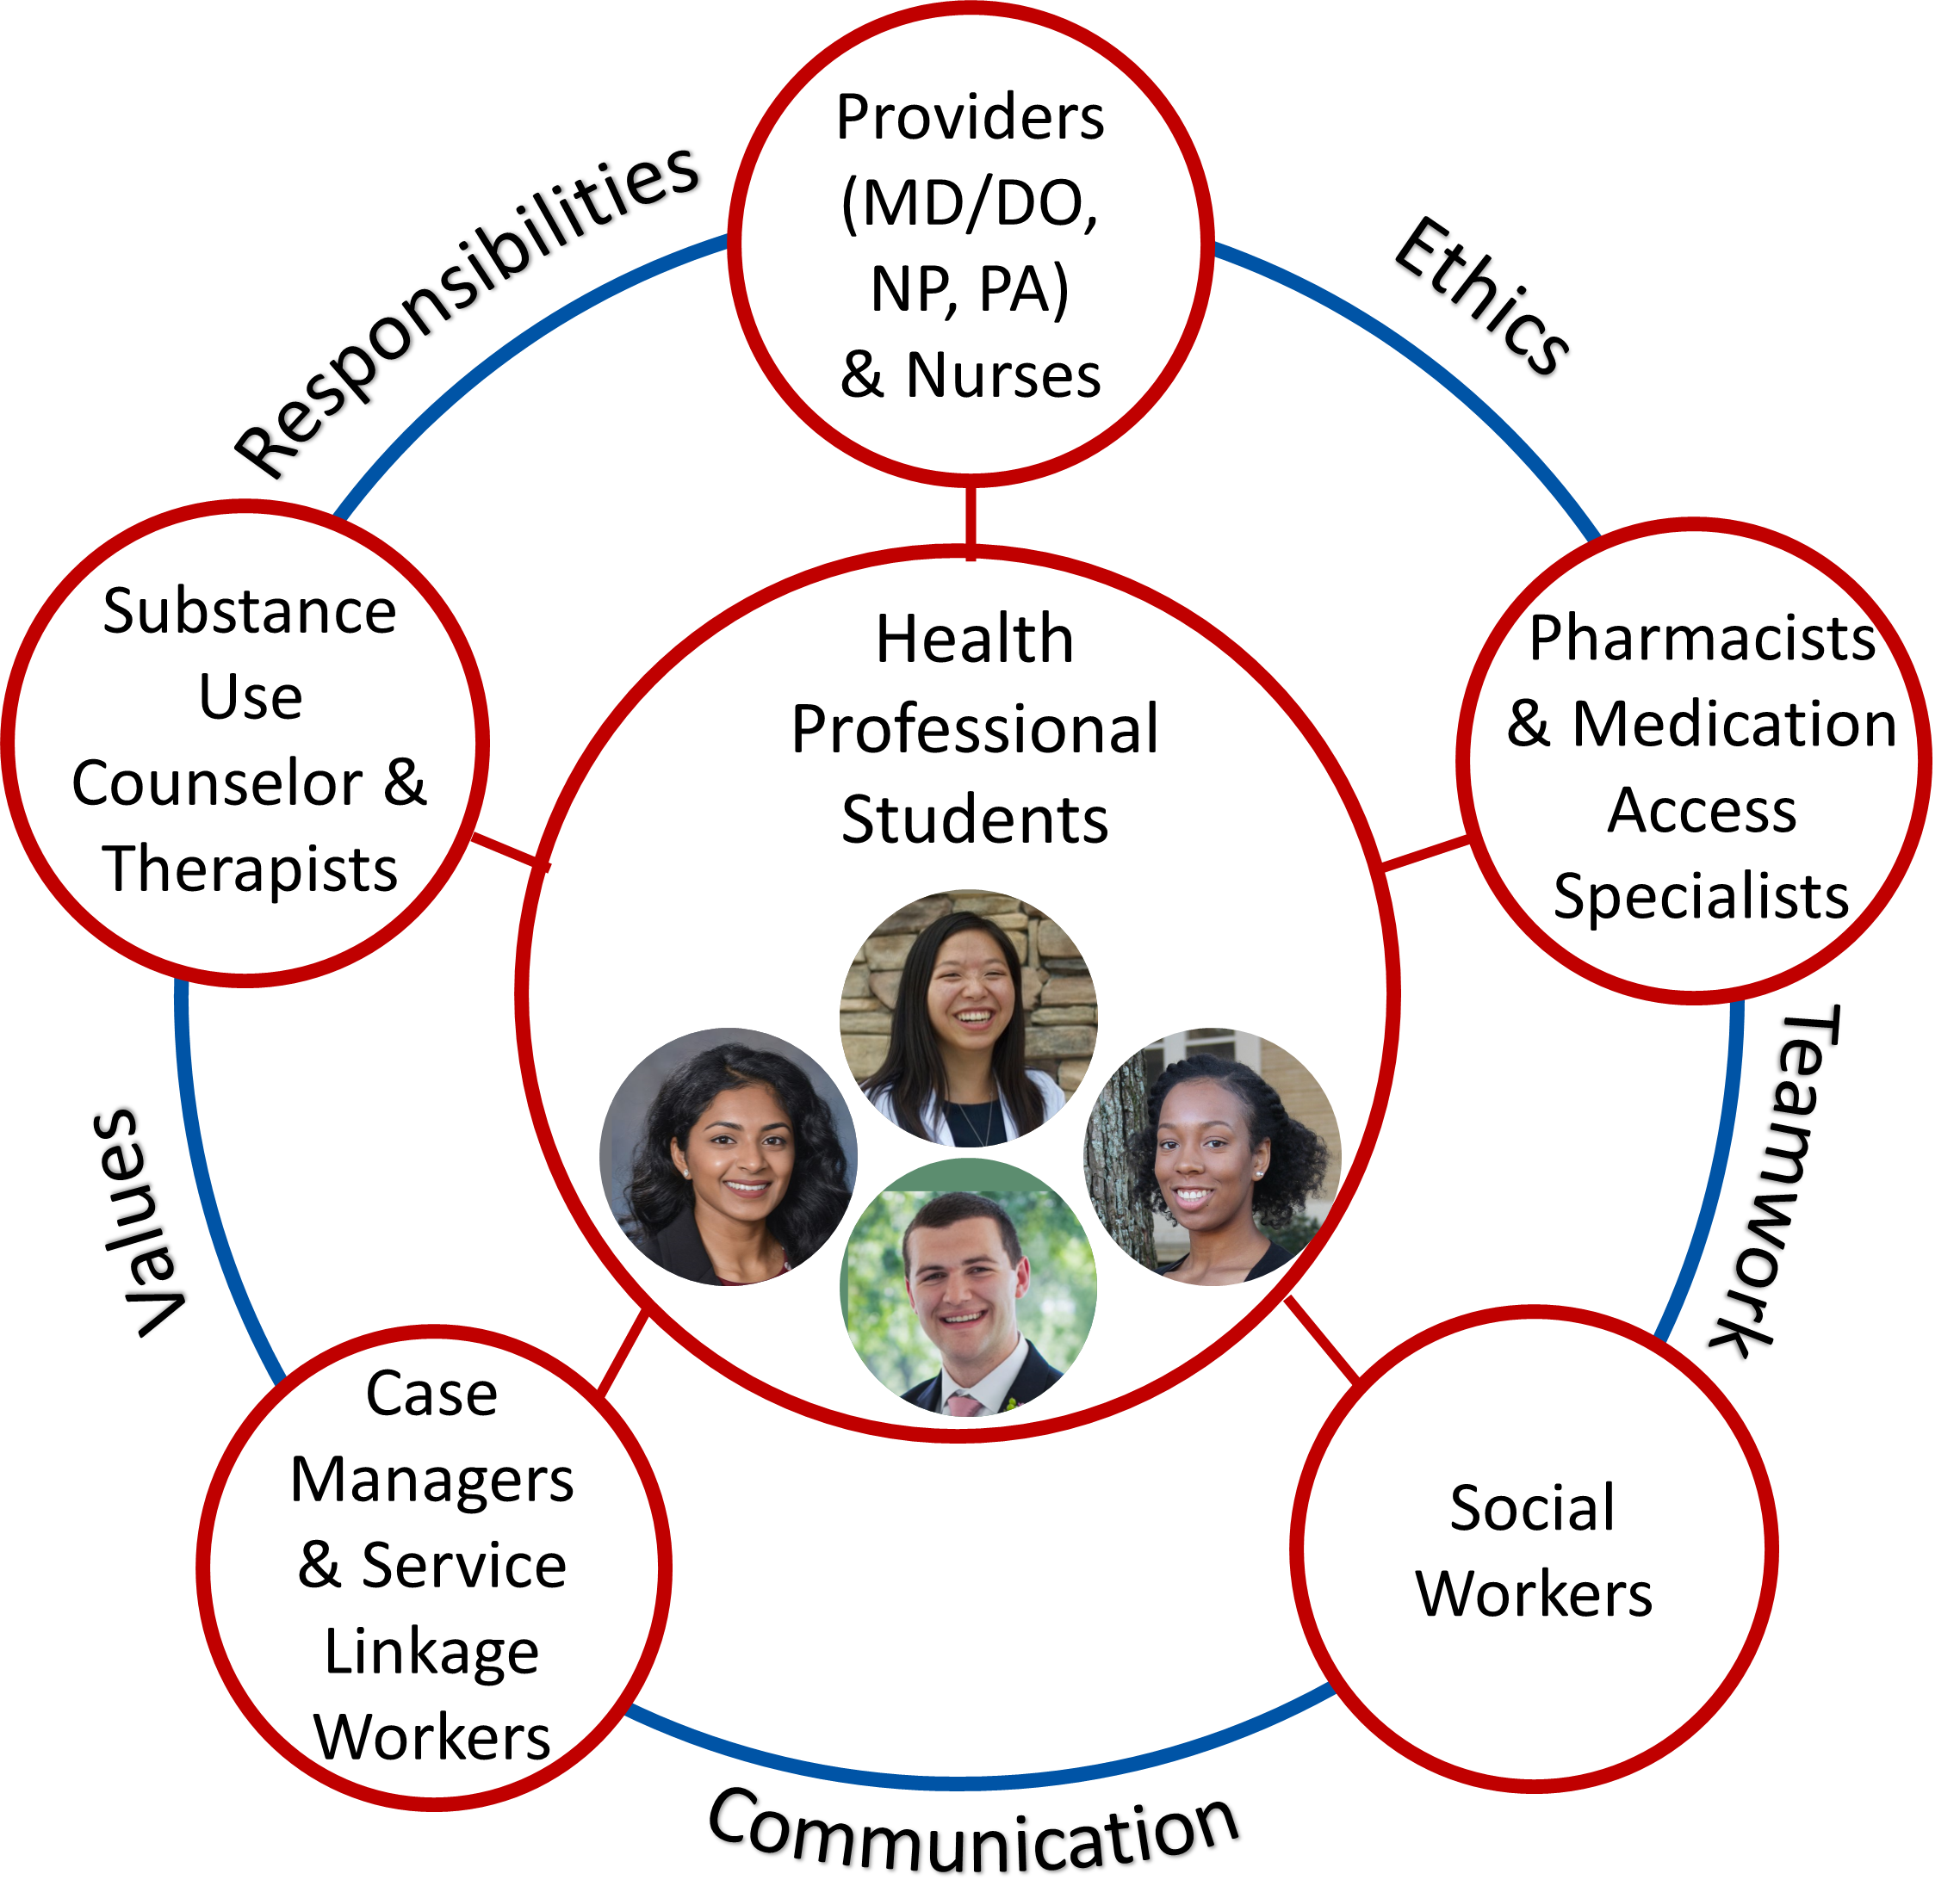
Core Competencies for Interprofessional Collaborative Practice
Values/Ethics for Interprofessional Practice
Roles/Responsibilities
Interprofessional Communication
Teams and Teamwork
Interprofessional Education Collaborative. (2016). Core competencies for interprofessional collaborative practice: 2016 update. Washington, DC: Interprofessional Education Collaborative.
Notes:
Image source: IPE collaborative, as referenced above

Slide 9
Core Competency: Roles and Responsibilities
Use the knowledge of one’s own role and those of other professions to appropriately assess and address the health care needs of patients.
Engage diverse professionals who complement one’s own professional expertise, as well as associated resources, to develop strategies to meet specific health and healthcare needs of patients and populations.
Interprofessional Education Collaborative. (2016). Core competencies for interprofessional collaborative practice: 2016 update. Washington, DC: Interprofessional Education Collaborative.

Slide 10
Core Competency: Roles and Responsibilities
Use the full scope of knowledge, skills, and abilities of professionals from health and other fields to provide care that is safe, timely, efficient, effective, and equitable.

Slide 11
Agenda
Case presentation
Breakout rooms
Group discussion

Slide 12
Session Expectations for Students
Respectful, collaborative discussions
Use people-first language
Active participation from all
Focus on team-based care
Break out sessions will not be recorded
Zoom logistics:
please turn on your camera (if possible)
change your “name” in zoom (name, profession, year)
All sessions will be recorded on Zoom

Slide 13
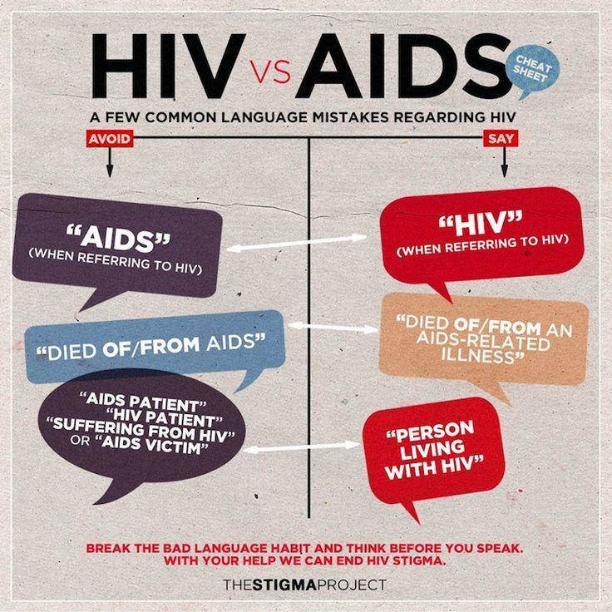
What is People-First Language?
Puts person before illness or label.
Describes and respects who they are, not what they have been diagnosed with.
Helps eliminate prejudice; removes value judgments.
Avoid saying “HIV patient” or “HIV-infected woman”
Preferred Phrase: “woman living with HIV”
Slide modified from presentation by Tana Pradia, Chair of Ryan White Planning Council
Notes:
Without People First Language:
People are described by labels or medical diagnoses which devalues and disrespects them as individuals.
–You never hear “cancerous people” or “I am cancer positive”
–But you often hear “HIV-infected woman”
Preferred Phrase: “woman living with HIV;” refers to person first, before mentioning their health condition

Slide 14
Case Presentation
35-year-old woman (DFAB; she/her)
Diagnosed with HIV 3 years ago
Patient presents today for routine STI screening without signs or symptoms.
Clinic nurses alert you that the IPV screen is positive
DFAB = designated female at birth

Slide 15
History
Reports that her boyfriend pushes, pinches, and hits her.
She states he hits her on the bottom of her feet with a belt “so that no one else can see the bruises/welts.”
Recently her mother took her to a local ER after her boyfriend “twisted my wrist so hard that I thought it was broken, but I left without seeing the doctor because I didn’t want him to go to jail. Instead, I went to a local pharmacy and asked for an ace wrap, some Aleve and Advil, and a cold pack.”
Notes:
ER = emergency room
Aleve (naproxen), Advil (ibuprofen) = nonsteroidal anti-inflammatory drugs (NSAIDs)

Slide 16
History (continued)
Patient has been taking “handfuls” of Aleve (naproxen) and Advil (ibuprofen); wrist pain is now improved
Patient starts crying and states she stays with her boyfriend because he helps to pay bills and she feels that no one else will love her since she has HIV.

Slide 17
HIV History
CD4 count
measures the number of CD4 T-cells.
CD4 cells are specialized cells of the immune system that are destroyed by HIV.
Lower CD4 count (especially less than 200) is associated with increased risk of opportunistic infections and mortality
Normal 500 to 1500 cell/mm^3
Patient
Current CD4 count: 600 cell/mm³
CD4 count 250 at the time of diagnosis

Slide 18
HIV History (continued)
Viral Load (VL)
Measures the number of HIV copies in a milliliter of blood (treatment goal=not detected or < lower limit of detection).
Patient
Current VL <20 copies/mL (undetectable)
VL at time of diagnosis: 300,000 copies/mL

Slide 19
Patient History
Medical: HIV, depression; Surgical: None
Gynecological: Nulliparous (never been pregnant)
Medications:
Current antiretroviral therapy (ART): bictegravir, tenofovir alafenamide, emtricitabine (single pill regimen, Biktarvy®)
Previously took Truvada® (tenofovir disoproxil fumarate, emtricitabine) for HIV prevention for 10 months; she stopped taking it because she desired pregnancy and felt “PrEP is not good for a baby.”
HIV Pre-exposure prophylaxis (PrEP) should be discussed with all sexually active people without HIV, including those who are trying to conceive
Tenofovir/emtricitabine can be continued throughout pregnancy and breastfeeding
https://clinicalinfo.hiv.gov/en/guidelines/perinatal/pre-exposure-prophylaxis-prep-prevent-hiv
Notes:
Health care providers should discuss PrEP with all sexually active people without HIV, including individuals who are trying to conceive, pregnant, postpartum, or breastfeeding, to prevent HIV acquisition (AII); counseling should include the benefits of PrEP to prevent HIV acquisition and perinatal transmission (AI) and potential adverse effects of PrEP during periconception, pregnancy, postpartum, and breastfeeding periods (AII). Health care providers should offer PrEP to those who desire PrEP or have specific indications for PrEP (AII).
The preferred PrEP option for HIV prevention in people who have receptive vaginal sex during pregnancy and breastfeeding is tenofovir disoproxil fumarate/emtricitabine (TDF/FTC) (AII). TDF/FTC is currently the only U.S. Food and Drug Administration (FDA)–approved PrEP option with known safety and efficacy data during pregnancy and breastfeeding. People who become pregnant while using TDF/FTC as PrEP can continue PrEP throughout pregnancy and breastfeeding. Risk for HIV acquisition should be reassessed, and people should be counseled regarding the benefits and risks of PrEP use in pregnancy and during breastfeeding (AII).

Slide 20
Sexual History
First sexual encounter at 16 years old
Lifetime sex partner(s): 5 lifetime partners. 2 partners in the last 6 months
Uses male (external) condoms 10% of the time
Last sexual encounter vaginally and orally 10 days ago without barrier protection
Treated for rectal, oral, and urogenital chlamydia and gonorrhea at least 7 times prior to HIV diagnosis. Last required treatment was 2 years ago

Slide 21
Social History
High School graduate
Attended college for 1 year
Never married
In a monogamous relationship with her boyfriend of 4 years with whom she lives in an apartment.
Previously worked at a recycling company
Previous binge drinking on “holidays;” Last drank a month ago
Most recent substance use 2 months ago: snorted cocaine, Ecstasy and alprazolam
Smokes marijuana daily
Smokes ½ pack of cigarettes per day (since age of 15=10 pack years)
Notes:
alprazolam (Xanax®) = benzodiazepine
Ecstasy = stimulant and hallucinogen; MDMA= substituted methylenedioxyphenethylamine and substituted amphetamine
Marijuana = cannabis

Slide 22
Physical Exam Findings
Physical Exam unremarkable.
No bruises
Left wrist with normal range of motion, no tenderness, no swelling

Slide 23
A Brief Primer on Intimate Partner Violence

Slide 24
Intimate Partner Violence (IPV)
Intimate partner violence (IPV) is abuse or aggression that occurs in a romantic relationship.
Physical violence: hitting, kicking, or other physical force
Sexual violence: forcing a partner to take part in a sex act when the partner does not or cannot consent.
Stalking: pattern of repeated, unwanted attention
Psychological aggression: verbal and non-verbal communication with the intent to harm
https://www.cdc.gov/violenceprevention/intimatepartnerviolence/index.html
Notes:
“Intimate partner” refers to both current and former spouses and dating partners. It can range from one episode of violence that could have lasting impact to chronic and severe episodes over multiple years.
Physical violence: when a person hurts or tries to hurt a partner by hitting, kicking, or using another type of physical force
Sexual violence: forcing or attempting to force a partner to take part in a sex act, sexual touching, or a non-physical sexual event (e.g., sexting) when the partner does not or cannot consent.
Stalking: a pattern of repeated, unwanted attention and contact by a partner that causes fear or concern for one’s own safety or the safety of someone close to the victim
Psychological aggression: verbal and non-verbal communication with the intent to harm a partner mentally or emotionally and/or to exert control over a partner. (CDC, 2022).

Slide 25
Statistics from CDC’s National Intimate Partner and Sexual Violence Survey
41% of women and 26% of men stated that they had experienced contact sexual violence, physical violence, and/or stalking by an intimate partner during their lifetime and experienced an intimate partner violence-related impact.
Domestic violence rates are even higher for
American Indian, Alaska Native populations
African American individuals
People from communities of color
People with disabilities
LGBTQI+ individuals
Source: CDC National Center for Injury Prevention and Control
https://www.cdc.gov/violenceprevention/intimatepartnerviolence/fastfact.html
Notes:
LGBTQI+ lesbian, gay, bisexual, transgender, queer (or those questioning their gender identity or sexual orientation), and intersex.

Slide 26
IPV Screening Instruments
Abuse Assessment Screen (AAS)
Humiliation, Afraid, Rape, Kick (HARK)
Hurt, Insult, Threaten, Scream (HITS)
Extended–Hurt, Insult, Threaten, Scream (E-HITS)
Partner Violence Screen (PVS)
Woman Abuse Screening Tool (WAST)
American Journal of Prevention Medicine: Intimate Partner Violence Screening Tools

Slide 27
Abuse Assessment Screen (AAS) Questions
Have you ever been emotionally or physically abused by your partner or someone important to you?
Within the last year, have you been hit, slapped, kicked, or otherwise physically hurt by someone? If yes, by whom? How many times?
Since you have been pregnant, have you been hit, slapped, kicked, or otherwise physically hurt by someone? If yes, by whom? How many times and where?
https://www.cdc.gov/violenceprevention/pdf/ipv/ipvandsvscreening.pdf

Slide 28
Abuse Assessment Screen (AAS) Questions, cont.
In the last year, has anyone forced you to have sexual activities? If so, whom? How many times?
Are you afraid of your partner or anyone you listed above?

Slide 29
Ethical Considerations
Healthcare professionals should follow a code of ethics that guides us to take appropriate action to help patients avert harms of violence and abuse.
Beneficence
The principle of beneficence is the obligation to act for the benefit of the patient, prevent harm, remove conditions that will cause harm, help persons with disabilities, and rescue persons in danger.
Confidentiality
Healthcare professionals are obligated not to disclose confidential information given by a patient to another party without the patient's authorization.
Interprofessional Education Collaborative. (2016). Core competencies for interprofessional collaborative practice: 2016 update. Washington, DC: Interprofessional Education Collaborative.

Slide 30
Legal Considerations in Texas
TITLE 4. PROTECTIVE ORDERS AND FAMILY VIOLENCE
CHAPTER 91. REPORTING FAMILY VIOLENCE
Sec. 91.003. A medical professional who treats a person for injuries that the medical professional has reason to believe were caused by family violence shall
(1) immediately provide the person with information regarding the nearest family violence shelter center;
(2) document in the person's medical file
the fact that the person has received the information provided under Subdivision (1); and
the reasons for the medical professional's belief that the person's injuries were caused by family violence; and
(3) give the person the written notice adopted by the Health and Human Services Commission under Section 51A.003, Human Resources Code.
https://statutes.capitol.texas.gov/Docs/FA/htm/FA.91.htm
https://statutes.capitol.texas.gov/Docs/HR/htm/HR.51A.htm#51A.003
Notes:
Sec. 91.003. INFORMATION PROVIDED BY MEDICAL PROFESSIONALS. A medical professional who treats a person for injuries that the medical professional has reason to believe were caused by family violence shall:
(1) immediately provide the person with information regarding the nearest family violence shelter center;
(2) document in the person's medical file:
(A) the fact that the person has received the information provided under Subdivision (1); and
(B) the reasons for the medical professional's belief that the person's injuries were caused by family violence; and
(3) give the person the written notice adopted by the Health and Human Services Commission under Section 51A.003, Human Resources Code.

Slide 31
What Can We Do as Healthcare Professionals?
Routinely screen all adults and children for domestic violence
Screening tools are available on the CDC website.
Indicate to patients that you are willing to discuss domestic violence and you can help.
Document injuries (photographs, written description) that are caused by abuse
Record the patient’s verbal or written testimony about how the injuries occurred
Your documented notes should remain objective with neutral language and clear observations.
Sources: CDC, Huecker et al, 2023; The Joint Commission Safety Issue 63
Notes:
Children who have developmental delays may be experiencing the trauma of witnessing domestic violence.
Patients may choose not to disclose abuse for a variety of reasons, even when screened.

Slide 32
What Can We Do as Healthcare Professionals? (continued)
Assess patient’s safety and help them develop an escape/safety plan
Obtaining a new cell phone
Changing a routine
Changing locks and installing security systems
Determining ways to keep children safe
Give patients the toll-free phone numbers and locations of domestic violence organizations in the area, as well as other resources that could help domestic violence victims.

Slide 33
What Can We Do as Healthcare Professionals?
(continued)
Encourage patients to obtain a protective order.
A legal document requiring someone stay away from you and gives you legal protection. In some cases, it can even remove someone from a shared home. This option is available if your patient has experienced family violence, dating violence, sexual assault, abuse, stalking, harassment, or human trafficking.
The local county or district attorney or Texas Advocacy Project can often help someone obtain a protective order for free. Do-it-yourself forms and instructions are also available here:
guides.sll.texas.gov/legal-forms/protective-orders
texaslawhelp.org/toolkit/i-need-protective-order

Slide 34
Case Summary
35-year-old female diagnosed with HIV in 2021.
Virally suppressed on single tablet ART regimen
Reports intimate partner violence during a routine IPV screen
Patient hesitant to leave the situation or involve law enforcement at this time.
Other concerns are depression and history of substance abuse.

Slide 35
BREAKOUT ROOMS

Slide 36
Breakout Session Ice Breaker
Name your school and program.
What is your favorite childhood memory?

Slide 37
Breakout Session Questions
Imagine you’re on an interdisciplinary team and you’re reviewing this case
As a ______ (physician, nurse, NP, PA, pharmacist, psychologist), what aspects of the case do you focus on?
As a ______ (physician, nurse, NP, PA, pharmacist, psychologist), what can you do to meet this patient’s needs?
What other healthcare professionals would you consult to address this patient’s needs?
Notes:
APP= advanced practice provider
NP=nurse practitioner
PA=physician assistant

Slide 38
Case Discussion after Breakout Sessions

Slide 39
Team-Based Plan of Care
Problem: HIV with virologic suppression
Team solution:
Encouraged adherence to ART
Patient keeps at least 95% of follow-up visits
Problem: wrist pain
Team solution:
X-ray showed no fractures
Referred to physical therapy
Pharmacist counseled patient to avoid taking more than 1 type of non-steroidal anti-inflammatory
Continue ibuprofen as needed (prn)

Slide 40
Team-Based Plan of Care
Problem: recent sexual activity (vaginal and oral) without use of barrier protection
Team solution:
Tested for syphilis, trichomonas, and gonorrhea/chlamydia (urine and pharyngeal)
Test results: treponema pallidum negative, trichomonas negative, urine and pharyngeal gonorrhea/chlamydia negative
Counseled patient on strategies to prevent STIs

Slide 41
Team-Based Plan of Care
Problem: Depression without suicidal ideation
Team solution:
Referred patient to psychiatrist and psychotherapist since her medical insurance covers behavioral health.
Patient started on Celexa® (citalopram) 20 mg tablet by mouth daily.
Notes:
Celexa® (citalopram) = selective serotonin reuptake inhibitor

Slide 42
Team-Based Plan of Care
Problem: Substance use disorder
Team solution:
Referral to behavioral health
Referral to substance use counselor
Problem: Tobacco dependence
Team solution:
Patient declined varenicline (Chantix®)
Prescribed a nicotine patch
Notes:
varenicline (Chantix®) = partial nicotine receptor agonist
nicotine = stimulant of autonomic ganglia, anxiolytic

Slide 43
Team-Based Plan of Care
Problem: Intimate Partner Violence
Team solution:
Referred to Houston Area Women’s Center (HAWC)
Safe, Anonymous, and Secure Chat.
https://hawc.org/
713-528-2121 (24/7 Hotline)
Referred to National Domestic Violence Hotline: 1-800-799-7233

Slide 44
Patient Course
IPV
Patient no longer lives with her abusive boyfriend, but they remain a couple. Her IPV screen continues to indicate physical, emotional, and verbal abuse, but the patient states “I will be okay.” Patient declines any further resources for IPV/Domestic violence.
HIV
Current regimen: Continued single pill regimen
Viral load: not detected
Patient keeps at least 95% of follow-up visits

Slide 45
Patient Course
Depression
Remains on citalopram for depression.
Sees regular psychotherapist at least every 3 to 6 months.
Currently denies suicidal or homicidal ideations/thoughts.
Substance and Tobacco Abuse
Smokes marijuana and cigarettes daily.
No other drug and alcohol use for 1 year

Slide 46
Take-Home Points
Patients of any age, gender, sexual orientation can experience intimate partner violence.
The role of health care professionals is to:
Screen all patients for IPV
Listen non-judgmentally
Encourage patients to seek assistance from counselors and law enforcement, and to develop a safety plan.
Provide resources for patients
Report evidence of abuse to appropriate law enforcement authorities.
Document, document, document!
Notes:
Screen all patients for IPV
Listen non-judgmentally.
Be kind and caring.
Try your best to assist patients in realizing the dangers of staying in a situation where there is IPV.
Encourage patients to seek assistance from counselors and law enforcement, and to develop a safety plan.
Provide resources for patients whether or not they are ready to leave the situation.
Report evidence of abuse to appropriate law enforcement authorities.
Document, document, document!

Slide 47
It takes a village!

Slide 48
Questions?
https://www.cdc.gov/stophivtogether/index.html
Notes:
https://www.gettingtozerosf.org/

Slide 49
Evaluations
Please complete the follow up assessment within 1 week of the session
We greatly value your feedback!!

Slide 50
References
Hegarty K, McKibbin G, Hameed M, Koziol-McLain J, Feder G, Tarzia L, Hooker L. Health practitioners' readiness to address domestic violence and abuse: A qualitative meta-synthesis. PLoS One. 2020 Jun 16;15(6):e0234067. doi: 10.1371/journal.pone.0234067. PMID: 32544160; PMCID: PMC7297351.
Huecker MR, King KC, Jordan GA, et al. Domestic Violence. [Updated 2023 Apr 9]. In: StatPearls [Internet]. Treasure Island (FL): StatPearls Publishing; 2024 Jan-. Available from: https://www.ncbi.nlm.nih.gov/books/NBK499891/
2019-2020 Houston Bar Association Family Law Handbook
Rabin RF, Jennings JM, Campbell JC, Bair-Merritt MH. Intimate partner violence screening tools: a systematic review. Am J Prev Med. 2009 May;36(5):439-445.e4. doi: 10.1016/j.amepre.2009.01.024. PMID: 19362697; PMCID: PMC2688958.
Texas Health and Human Services Family Violence Program Resources. https://www.hhs.texas.gov/services/safety/family-violence-program/family-violence-program-resources
Texas Protective Orders and Family Violence Law https://statutes.capitol.texas.gov/Docs/FA/htm/FA.91.htm
The Joint Commission. Quick Safety Issue 63: Addressing intimate partner violence and helping to protect patients. https://www.jointcommission.org/resources/news-and-multimedia/newsletters/newsletters/quick-safety/quick-safety-issue-63/
Interprofessional Education Collaborative. (2016). Core competencies for interprofessional collaborative practice: 2016 update. Washington, DC: Interprofessional Education Collaborative.

Slide 51
Patient Resources
Houston Area Women’s Center/Shelter (HAWC) Phone: 713.528.6798 https://hawc.org/
Houston Volunteer Lawyers (Civil) Legal advocacy to eligible families facing civil legal issues including: divorce; custody/visitation and support-Harris County. https://www.makejusticehappen.org/
Lone Star Legal Aid (Civil) Legal advocacy to eligible families related to civil cases related to domestic violence and sexual assault. https://www.lonestarlegal.org/
AVDA (Civil) Legal advocacy to eligible families related to domestic violence and sexual assault protective orders, divorce, child custody, child support and adoption cases-Harris County; Fort Bend County & Montgomery. https://avda.org/
DAYA (Civil) Legal advocacy to eligible families related to domestic violence and sexual assault-Harris County. http://www.dayahouston.org
Interprofessional Education Collaborative. (2016). Core competencies for interprofessional collaborative practice: 2016 update. Washington, DC: Interprofessional Education Collaborative.

Slide 52
Patient Resources
Texas Department of Public Safety Victim Services
Victim Services Counselors are available to help you understand the criminal justice process and your rights and connect you to helpful resources. To locate the Victim Services Counselor in your area, visit the Victim Services Counselors Regional Directory or call 512-424-2211.
Texas Health and Human Services Commission Family Violence Program
Family violence centers offer free emergency shelter and support services for males and females, adults and children who experience family or dating violence. Visit the Family Violence Program webpage to learn more.
Texas Advocacy Project
For free legal advocacy and legal services, call 800-374-HOPE or visit the Texas Advocacy Project website.
The Texas Council on Family Violence is the only 501(c)(3) nonprofit coalition in Texas dedicated solely to creating safer communities and freedom from family violence. https://tcfv.org/
Interprofessional Education Collaborative. (2016). Core competencies for interprofessional collaborative practice: 2016 update. Washington, DC: Interprofessional Education Collaborative.

Slide 53
Patient Resources
National Domestic Violence Hotline
The National Domestic Violence Hotline can connect you with an advocate that can provide safety plans, discuss options, and offer resources in your area.
Call: 800-799-SAFE (7233)
TTY: 800-787-3224
Chat online: thehotline.org
Text: “START” to 88788
National Sexual Assault Hotline — RAINN (Rape, Abuse & Incest National Network)
If you have been sexually assaulted, consider contacting the RAINN Hotline to connect with a trained staff member from a local sexual assault service provider in your area.
Call: 800-656-HOPE (4673)
Chat online: hotline.rainn.org
Interprofessional Education Collaborative. (2016). Core competencies for interprofessional collaborative practice: 2016 update. Washington, DC: Interprofessional Education Collaborative.

Slide 54
Patient Resources
National Human Trafficking Hotline
If you or someone you know needs help, call the National Human Trafficking Hotline toll-free, 24 hours a day, 7 days a week to speak with a specially trained Anti-Trafficking Hotline Advocate. Support is provided in more than 200 languages.
Call: 1-888-373-7888 (TTY:711)
Text: 233733
Chat online: humantraffickinghotline.org/en/chat
Email: help@humantraffickinghotline.org
Interprofessional Education Collaborative. (2016). Core competencies for interprofessional collaborative practice: 2016 update. Washington, DC: Interprofessional Education Collaborative.

Slide 55
Patient Resources
Harris County District Attorney's Office-Domestic Violence Division (Criminal) The Domestic Violence Division prosecutors handle domestic violence criminal cases, violations of protective orders cases and interference with child custody cases. https://app.dao.hctx.net/victim-services/domestic-violence-division

Slide 56
Resources
National Clinician Consultation Center http://nccc.ucsf.edu/
HIV Management
Perinatal HIV
HIV PrEP
HIV PEP line
HCV Management
Substance Use Management
Present on ECHO
https://hsc.unm.edu/scaetc/programs-services/echo.html​
AETC National HIV Curriculum https://aidsetc.org/nhc
AETC National Coordinating Resource Center https://targethiv.org/library/aetc-national-coordinating-resource-center-0
HIVMA Resource Directory https://www.hivma.org/globalassets/ektron-import/hivma/hivma-resource-directory.pdf
Additional trainings scaetcecho@salud.unm.edu
www.scaetc.org
Notes:
IDEA Platform: Infectious Diseases Education & Assessment. https://idea.medicine.uw.edu/
AETC National HIV Curriculum: 6 core modules for self study; regularly updated; CME, CNE
Hepatitis C Online Curriculum: https://www.hepatitisc.uw.edu/
Hepatitis B Online Curriculum: https://www.hepatitisb.uw.edu/
National STD Curriculum: https://www.std.uw.edu/

