Slide 1
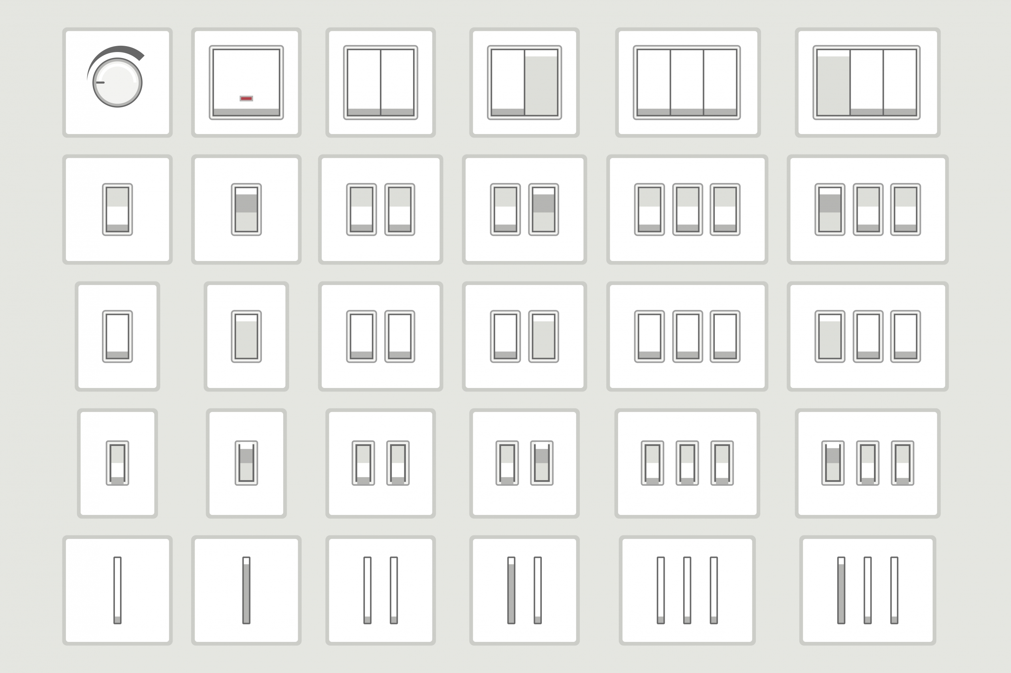
Switching ART
Danny Toub MD AAHIVS
dannyt@srhealth.org
Faculty Trainer, Pacific AETC - Bay Area, North & Central Coast
April 9, 2024
Image Source: Penna Electric

Slide 2
Disclaimer
The views and opinions expressed in this presentation are not necessarily those of the Pacific AIDS Education & Training Center (Pacific AETC) or its eight local partner sites in HRSA Region 9, the Regents of the University of California or its San Francisco campus (UCSF or collectively, University) nor of our funder the Health Resources and Services Administration (HRSA). Neither Pacific AETC, University, HRSA nor any of their officers, board members, agents, employees, students, or volunteers make any warranty, express or implied, including the warranties of merchantability and fitness for a particular purpose; nor assume any legal liability or responsibility for the accuracy, completeness or usefulness of information, product or process assessed or described; nor represent that its use would not infringe privately owned rights.
HRSA Acknowledgement Statement The Pacific AETC is supported by the Health Resources and Services Administration (HRSA) of the U.S. Department of Health and Human Services (HHS) as part of an award totaling $4,377,449. The contents are those of the author(s) and do not necessarily represent the official views of, nor an endorsement, by HRSA, HHS, or the U.S. Government. For more information, please visit HRSA.gov.
Trade Name Disclosure Statement Funding for this presentation was made possible by 5 U1OHA29292‐08‐00 from the Human Resources and Services Administration HIV/AIDS Bureau. The views expressed do not necessarily reflect the official policies of the Department of Health and Human Services nor does mention of trade names, commercial practices, or organizations imply endorsement by the U.S. Government. Any trade/brand names for products mentioned during this presentation are for training and identification purposes only.

Slide 3
Disclosures
All presenters of this continuing medical education activity have indicated that neither they nor their spouse/legally recognized domestic partner has any financial relationships with commercial interests related to the content of this activity

Slide 4
Learning Objectives
At the completion of this presentation, participants will be able to:
List common reasons to switch ART regimens
Identify resources and a framework for virologically suppressed patients who are appropriate candidates to consider a switch to a different ART regimen
Select individualized switch regimens that take account of relevant patient and regimen factors to optimize safety, efficacy, and tolerability
Image Source: AIDS Map

Slide 5
ART Switch: essential HIV management
Initiation of ART
Initial ART Regimens for Individuals With HIV
When and How to Switch ART Regimens
Laboratory Monitoring in Individuals With Established HIV at HIV Diagnosis and Starting ART
Weight Gain and Metabolic Complications With ART
HIV and Aging
Prevention of HIV Infection
Postexposure Prophylaxis for HIV and Bacterial STIs
Substance Use in Persons at Risk for and With HIV
Source: IAS-USA

Slide 6
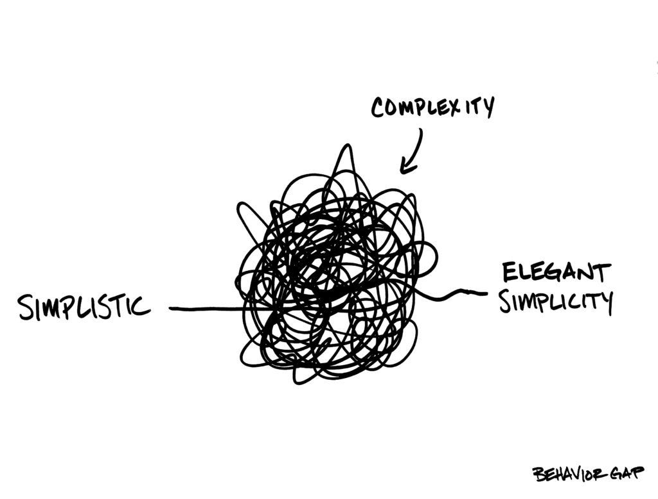
Simplification: ART switch for patients with virologic suppression
Image Source: OptimizDBA

Slide 7
What is Deprescribing?
The planned and supervised process of dose reduction or stopping of medication that:
might be causing harm, or
no longer be of benefit.
Deprescribing is part of good prescribing:
backing off when doses are too high, or
stopping medications that are no longer needed.
Source: deprescribing

Slide 8
Shared Decision-Making
Source: deprescribing

Slide 9
Principles of Harm Reduction
Source: Humanities Truck

Slide 10
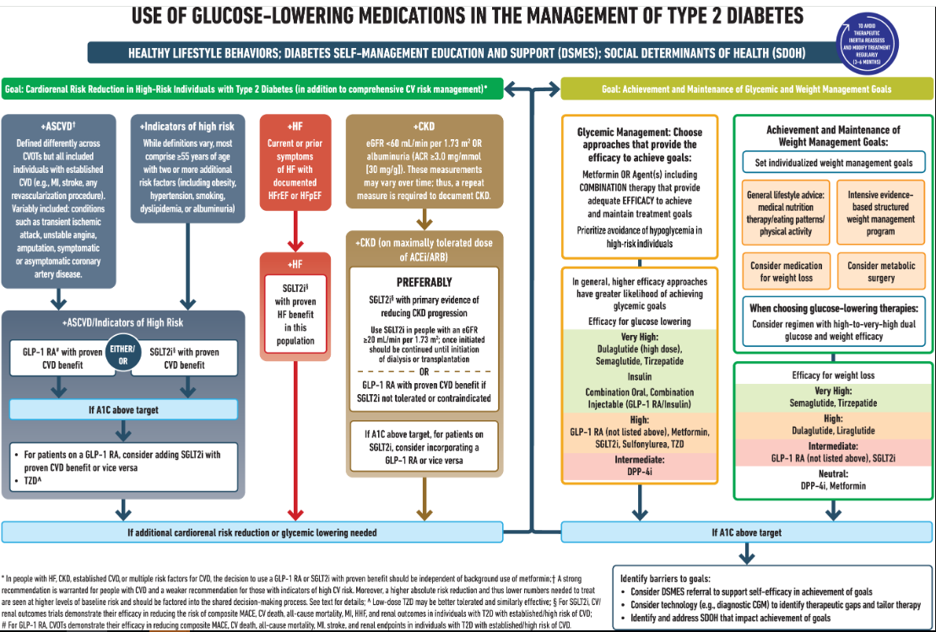
Overcoming Therapeutic Inertia
Source: Diabetes Journals

Slide 11
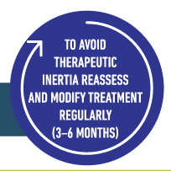
Overcoming Therapeutic Inertia
Source: Diabetes Journals

Slide 12
Chronic care visit components: regularly offer simplification
Strength-based/new issues
Efficacy: Viral suppression?
Taking Medications:
“What happened the last time you missed a dose?”
Tolerance: “What’s hardest for you about taking your meds?”
Access: pharmacy/insurance barriers?
Better?
Future labs/next visit

Slide 13
Do you have patients on these ART?
PI’s: lopinavir-ritonavir, saquinavir, nelfinavir, indinavir, fosamprenavir, and tipranavir
NRTI’s: zidovudine, didanosine, and stavudine
NNRTIs: nevirapine and efavirenz
Image Source: Tom Raftery

Slide 14
Reasons to switch (or NOT to switch): Patients’ lived experience with medicine
Image Source: Oxford University Press

Slide 15
Reasons to switch: increased med tolerability and/or convenience
Smaller pills
Less frequent dosing (bid to qd, qd to q1m or q2m)
Less cost
Toxicity (fewer adverse effects or reduce risk of toxicity)
Fewer pills (single tablet regimens, coformulations)
2 Drug Regimens
Avoid food requirements
Fewer drug interactions

Slide 16
Reasons to switch: Fewer pills = better adherence, fewer hospitalizations
Source: BMJ Journals
Notes:
Multiple studies have demonstrated that taking fewer pills translates to better adherence and higher rates of long-term virologic control.
O'Connor JL, Gardner EM, Mannheimer SB, et al. Factors associated with adherence amongst 5295 people receiving antiretroviral therapy as part of an international trial. J Infect Dis. 2013;208:40-9.[PubMed Abstract]
5.Aldir I, Horta A, Serrado M. Single-tablet regimens in HIV: does it really make a difference? Curr Med Res Opin. 2014;30:89-97.[PubMed Abstract]
6.Airoldi M, Zaccarelli M, Bisi L, et al. One-pill once-a-day HAART: a simplification strategy that improves adherence and quality of life of HIV-infected subjects. Patient Prefer Adherence. 2010;4:115-25.[PubMed Abstract]
7.Bangsberg DR, Ragland K, Monk A, Deeks SG. A single tablet regimen is associated with higher adherence and viral suppression than multiple tablet regimens in HIV+ homeless and marginally housed people. AIDS. 2010;24:2835-40.[PubMed Abstract]
8.Mallolas J, Podzamczer D, Milinkovic A, et al. Efficacy and safety of switching from boosted lopinavir to boosted atazanavir in patients with virological suppression receiving a LPV/r-containing HAART: the ATAZIP study. J Acquir Immune Defic Syndr. 2009;51:29-36.[PubMed Abstract]

Slide 17
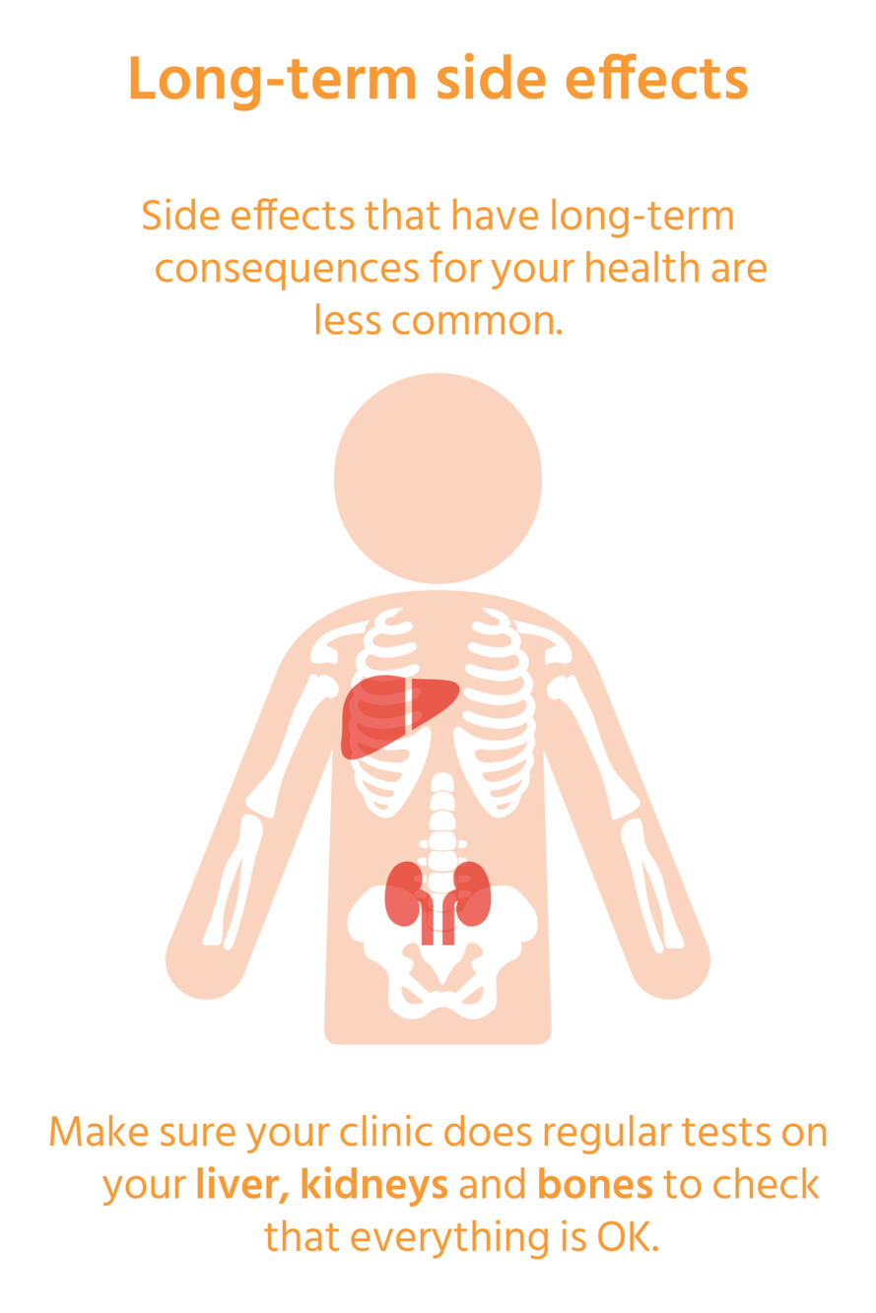
Reasons to switch: Side effects
Image Source: AIDSMap

Slide 18
Reasons to switch: Current Tolerability
Toxicity (Side effects)
Simplification (Pill burden, Drug-drug interactions)
New or worsening medical comorbidities (eg, CKD, ASCVD),
Cost issues or changes in insurance,
Desire to match a partner's regimen
Difficulty with food requirements,
Desire to conceive or pregnancy
Source: Up To Date

Slide 19
Reasons to switch: Economic impact
Image Source: Karolina Grabowska
Notes:
Simplifying antiretroviral therapy may also have a significant economic impact, including lower copayments for the patient, particularly if the switch involves a reduction in the number of medications in the regimen.
Llibre JM, Cardona G, Santos JR, et al. Antiretroviral treatment switch strategies for lowering the costs of antiretroviral therapy in subjects with suppressed HIV-1 viremia in Spain. Clinicoecon Outcomes Res. 2013;5:215-21.[PubMed Abstract]
12.Restelli U, Andreoni M, Antinori A, et al. Budget impact analysis of antiretroviral less drug regimen simplification in HIV-positive patients on the Italian National Health Service. Clinicoecon Outcomes Res. 2014;6:409-14.[PubMed Abstract]

Slide 20
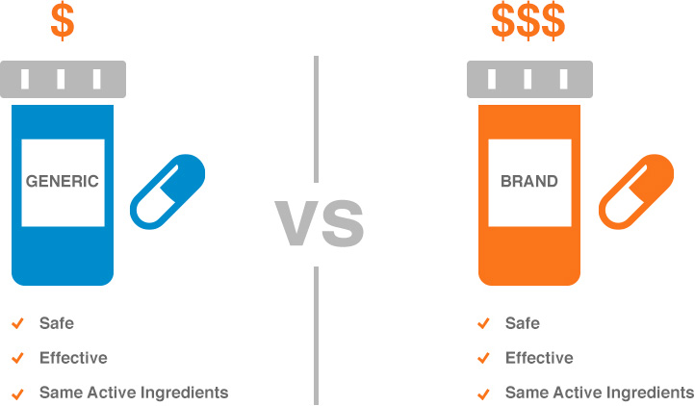
Caveat with economic impact: Switch may increase cost
Image Source: IBX
Notes:
By contrast, as more antiretroviral medications become available as generic preparations, a switch from an older medication (available as generic) to a new medication may increase the overall cost of the regimen; access to new medications and insurance coverage are important considerations before any antiretroviral therapy changes.

Slide 21
Provider initiated reasons to switch: Risk of long-term complications
On Tenofovir DF with normal eGFR, no osteoporosis
Renal disease risk (DM/HTN), age >50y, nephrotoxic meds
Bone disease risk (osteopenia, low BMI, family history)
On Abacavir with high risk of CV disease
Boosted regimens (elvitegravir or PIs)
Regularly (re)assess drug-drug interactions (include OTC meds)
1st generation NNRTIs (Efavirenz, Nevirapine)
Efavirenz: ask about depression/MH/CNS side effects
Older NRTIs (ZDV) or PIs (LPV/r, FPV, IDV, NFV, SQV)
Long-term risk of metabolic and other toxicities
Note: Atazanavir the only boosted PI not linked to higher CV risk
Source: Up To Date

Slide 22
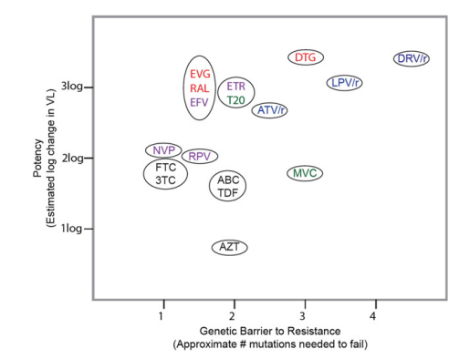
Provider initiated reasons to switch: Low genetic barrier to resistance: NNRTIs or 1st gen INSTIs (RAL, EVG/c)
Source: HIVDB Stanford

Slide 23
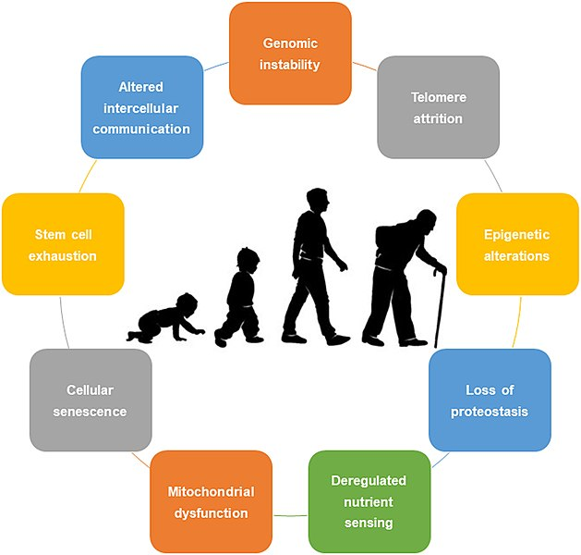
Reasons to switch: Aging may necessitate change
Image Source: Hallmarks of Aging
Notes:
Furthermore, as the population of individuals living with HIV ages, they will increasingly need to take more medications for non-HIV-related conditions, leading to added polypharmacy and treatment complexity, thus increasing the benefit of simpler antiretroviral therapy combinations.
Van den Eynde E, Podzamczer D. Switch strategies in antiretroviral therapy regimens. Expert Rev Anti Infect Ther. 2014;12:1055-74.[PubMed Abstract]
Krentz HB, Gill MJ. The Impact of Non-Antiretroviral Polypharmacy on the Continuity of Antiretroviral Therapy (ART) Among HIV Patients. AIDS Patient Care STDS. 2016;30:11-7.[PubMed Abstract]
Zhou S, Martin K, Corbett A, et al. Total daily pill burden in HIV-infected patients in the southern United States. AIDS Patient Care STDS. 2014;28:311-7.[PubMed Abstract]

Slide 24
Reasons not to switch: Validity/Bias of switch studies?
Image Source: PIX4FREE, PXHERE
Notes:
A number of clinical trials have examined the effects of switching antiretroviral therapy for patients with suppressed HIV RNA levels. Interpreting the results of antiretroviral therapy switch studies requires some caution, as these trials are often sponsored by industry and are frequently (though not always) designed as open-label trials, which may lead to bias against reporting adverse events. In addition, patients may enroll in these types of studies with a preference for randomization to the switch-therapy arm, which may lead to differential dropout from the control arm. Taken together, these factors may create a degree of inherent bias in switch trials.
Despite these limitations, switch studies have generated abundant data, as well as a number of key lessons, that provide imperative clinical reminders when considering an antiretroviral therapy regimen change.

Slide 25
Polling Question: Most common reason for ART regimen optimization?
Intolerance/Adverse Events
Drug–drug or drug–food interactions
Desire to simplify a regimen
Treatment failure
Notes:
Polling question slides will be converting to interactive live audience response polls during your presentation.

Slide 26
Switches: increasingly common
UK study: N=10,985 pts; 984 switches
Annual switch rate 18% (double rate of 10yrs ago)
availability of safer options
possibility of tailoring regimens to people’s individual needs.
Toxicity/Intolerance (37%):
25% EFV (75% CNS, 13% CV),
23% TDF (57% renal, 39% bone)
13% DOL (60% CNS, 17% weight gain)
12% ABC (86% CV)
5% DOR (60% CNS), TAF
4% each: BIC, RAL, DRV, Other
Drug interactions (33%): aging (tx other health conditions): avoid boosters
Treatment simplification (17%): example: ABC/3TC/DOL to 3TC/DOL (40%)
Treatment Failure/Inefficacy (3%)
Source: AIDSMap, EACS

Slide 27
Regimen Simplification
Image Source: HIV.gov

Slide 28
Switch studies in suppressed patients
Source: EACS

Slide 29
How to Simplify ART regimens
Source: Oxford University Press

Slide 30
Principles of Switching ART
Maintain viral suppression
Multiple prompts for regimen optimization.
Carefully review patient’s full ART/resistance history before switch
If no resistance mutations/failure: many options
If NRTI-resistance: use TXF/XTC + 2nd gen INSTI
LAI is an option for select patients
If present with pregnancy on CAB/RPV LAI: change to alternative
Avoid monotherapy
If HBV coinfection, ensure switch treats both viruses
Closely monitor after a regimen switch
Source: HIV.gov

Slide 31
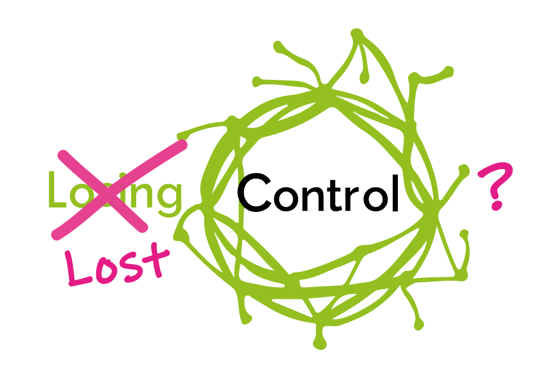
ART Switch: 1st Fundamental Principle
Maintain viral suppression without jeopardizing future treatment options
Source: HIV.org
Image Source: Losing Control

Slide 32
Careful review of full ART/Drug resistance history before optimization
virologic responses
cumulative resistance test results
past ARV-associated intolerances, toxicities, & adverse reactions
Image Source: Dvortygirl

Slide 33
Polling Question: 51yo cis-woman suppressed on TAF/FTC/EVG/cobi x10yrs. Healthy, no HBV, eGFR >90, no DM, ASCVD risk <5%. Simplification options?
BIC/TAF/FTC
DOL + TAF/FTC
DOL + TDF/FTC
DOL/3TC
A or D
Any of the above
Notes:
Polling question slides will be converting to interactive live audience response polls during your presentation.

Slide 34
If no hx resistance nor failure, any effective initial ART option is OK
Image Source: Rawpixel.com

Slide 35
Avoid Monotherapy
Even meds with high potency/genetic barrier to resistance (DRV/b, DOL) have high rates of virologic failure
Image Source: Wikimedia Commons

Slide 36
Plan for close monitoring after switch
Close follow-up 1st 3 mos. after change:
Adherence: Confirm taking new ART appropriately
Tolerance: Evaluate for adverse events
Efficacy: Obtain HIV VL 4-8 wks. after change
Source: HIV.gov

Slide 37
Simplification Principles Summary
Maintain virologic suppression
Careful review history before optimization:
ART history (reason/VL at time of change, # past regimens)
Drug Resistance history (failures, mutations)
Duration of suppression
Assess clinical conditions
Hepatitis B Virus Coinfection
Potential Drug Interactions
Pregnancy or Pregnancy Potential
Source: HIV.gov

Slide 38
Switch options for people with HBV
DHHS Guidelines:
Continue TXF or initiate entecavir.
OK TXF monotherapy.
XTC monotherapy not recommended (HBV resistance likely to emerge)
If no immunity to HBV infection, repeat HBV serology and re-vaccination should be completed if needed before optimization with a regimen that is not active against HBV.
IASUSA Guidelines:
Avoid 2-drug regimens. Continue 3-drug regimens that include TXF/XTC.
Documenting a seropositive response to HBV vaccine is recommended prior to switching from a TXF-based 3-drug regimen to a 2-drug regimen that does not include TXF.

Slide 39
Assess Potential Drug Interactions
PPIs, H2 blockers, antacids: oral rilpivirine (RPV) & atazanavir
Polyvalent cations (supplements, iron products, or antacids that contain aluminum, calcium, or magnesium): INSTIs
Rifamycins: many ART drugs
Consider new drug interactions
Reevaluate concomitant meds previously managed with dose adjustments when discontinuing pK boosters (ritonavir, cobicistat)

Slide 40
Assess for (Potential) Pregnancy
Pregnancy test before switching ART.
Refer to the Perinatal Guidelines
Report all pregnancies to Antiretroviral Pregnancy Registry.
Continuing ART for People Who Become Pregnant on a Fully Suppressive, Well-Tolerated Regimen | New ART Regimen for Pregnant People Whose Current Regimen Is Not Well Tolerated and/or Is Not Fully Suppressive
Continue DTG, BIC, RAL, all NRTIs, most NNRTIs (EFV, RPV oral, ETR, NVP), rtv-boosted PI's, | Preferred: DTG, ABC, XTC, TXF
Continue with frequent VL monitoring or consider switching: CAB, RPV IM, EVG/c, DOR, all 2 drug regimens, cobi-boosted PI's | Alternative: BIC, RAL, ATZ/r, DRV/r, EFV, RPV oral, ZDV
 | Insufficient data: CAB, RPV IM, DOR
 | Not recommended: EVG/c, LPV/r, ATV/c, DRV/c, 2 drug regimens, ETR, NVP, Entry/Attachment/Fusion/Capsid Inhibitors
Source: HIV.gov

Slide 41
Simplification Strategies No Resistance: 3 Drug Regimens Within Class
usually maintains viral suppression (if no resistance)
Examples studied without underlying drug resistance
prompted by:
adverse events or
availability of ARVs in the same class that offer:
better safety profile, reduced dosing frequency, higher barrier to resistance, lower pill burden or do not require PK boosting.
From | To
TDF or ABC | TAF
RAL | DTG
DTG, EVG/c or RAL | BIC
EFV | RPV or DOR

Slide 42
Switching within class NRTIs
From TDF to TAF
May reduce risk of long-term toxicity (renal or bone)
May lead to weight gain
From ABC
May reduce CV risk

Slide 43
Simplification Strategies No Resistance: 3 Drug Regimens Between Classes
Generally maintains suppression (if no resistance to regimen components)
Avoid if any doubt about activity of other regimen agents
Review prior resistance test results to guide this switch
Studied between-class switches:
From | To
Boosted PI | INSTI (DTG, BIC or EVG)
Boosted PI | RPV or DOR
NNRTI | INSTI

Slide 44
Switching to a NNRTI
From Boosted PI to NNRTI (DOR or RPV):
Improved lipids
Significant risk failure if hx failure/resistance (pre-switch M184V/I)
From Efavirenz to Rilpivirine:
Safe (maintains suppression), improved CNS side effects
To RPV if pretreatment VL >100K
most agree OK if: no hx failure/resistance, suppressed > 6m
To DOR following INSTI-Associated Weight Gain:
Doravirine: relatively neutral effects on weight.
No data yet that switch improves weight/CV risk (RCT underway)
Source: UW.edu

Slide 45
Simplification Strategy No Resistance: 2 Drug Regimens (reduce drug exposure)
Only for persons with:
sustained (> 3-6m) suppressed HIV RNA levels
no resistance to either of the medications in the regimen,
no evidence of chronic HBV
FDA approved options:
oral DOL/RPV or DOL/3TC or
Long acting injectable (CAB/RPV)
Other options (limited by pill burden, potential drug interactions)
Boosted Protease Inhibitor (DRV/r, DRV/c, ATV/r and LPV/r) +3TC
Boosted Darunavir plus Dolutegravir (small sample size)
Can be considered in particular for individuals with resistance and/or intolerance to 3TC (or FTC), ABC, and TDF (or TAF)
Source: UW.edu

Slide 46
2 Drug Regimen: Switch to oral Dolutegravir-Rilpivirine safe & effective
148w data; N=990
limited observed NNRTI RAMs, no integrase inhibitor resistance,
for individuals who are already suppressed on standard 3-drug or 4-drug regimens
No previous virologic failure
no concurrent hepatitis B infection
no resistance to DTG or RPV
no significant drug interactions
Source: NEJM Image Source:Wikimedia Commons

Slide 47
2 Drug Regimen: switch to oral Dolutegravir-Lamivudine safe and effective
TANGO: switching to DOL/3TC vs continuing TAF-based regimens in treatment-experienced adults;144w; N=741; No improvement in weight gain, total cholesterol/HDL, glucose metabolism, nor markers of inflammation. (TANGO CID 2022)
SALSA: switching to DTG/3TC compared with continuing various 3-/4-drug regimens 48 w; N=493; (SALSA CID 2023)
little change in lipid, renal, or bone parameters,
more weight gain (+2.1kg DTG/3TC, +0.6 kg 3-drugs)
ongoing virologic suppression
no hx virologic failure/resistance to DOL/3TC
Source: NEJM Image Source: Rawpixel

Slide 48
2 Drug Regimen: Switch to Injectable Cabotegravir-Rilpivirine safe, effective
Source: NEJM

Slide 49
Treatment frequency and Efficacy
Image Source: UCSF.edu

Slide 50
Simplification Strategy No Resistance: Long Acting ART: CAB/RPV
FDA indications in individuals with:
sustained (e.g., 3 to 6 months) virologic suppression (VL <50)
on a stable ARV regimen,
no history of treatment failure,
no known or suspected resistance to either CAB or RPV
Optional oral lead-in
Once monthly (ATLAS, FLAIR) or q 2-month (ATLAS-2M)
Caveats:
include individuals who have good adherence & engagement in care,
Need entecavir if HBV
who are not pregnant or planning on becoming pregnant;
and who are not receiving medications with DDIs with oral (PPIs)or injectable CAB or RPV (anticonvulsants, rifamycins)

Slide 51
Switch: Limited Drug Resistance
If existing NRTI resistance, use
2 NRTIs (TXF + XTC) with
fully active, high resistance barrier drug ( DTG, BIC or DRV/b)
Consider regimen with a fully active, high resistance barrier drug + 2 partially active NRTIs in some clinical situations:
when prior resistance testing is not fully available,
to avoid major drug–drug interactions,
to keep regimens simpler
other
Both TXF and XTC are partially active with resistance
Source: HIV.gov
Notes:
Within-Class Switch from Dolutegravir to Bictegravir (BI): some data
GS 4030 ; N=565 stably suppressed on DTG +2 NRTIs. Stay or switch to BIC/FTC/TAF; 48w data.
25% with NRTI resistance: similar suppression
theoretical support to other optimization strategies that include a switch from one high-barrier drug to another in the setting of a similar NRTI backbone.
This study also supports the recommendation that when using drugs with a high barrier to resistance, only one of the NRTIs needs to be active
Other Switches to Bictegravir in the Setting of Limited Drug Resistance
BRAAVE: Black people with HIV, suppressed >12m on 2 NRTIs +3rd agent (INSTI, NNRTI, or PI). Stay or change to BIC/FTC/
Baseline regimens included 61% INSTI, 31% NNRTI, and 9% PI.
Baseline resistance did not affect the outcomes of therapy. In particular, NRTI resistance was present in 14% of participants, and 10% harbored the M184V/I mutation.
Data from Non-Optimization Studies Inform Optimization in Clinical Practice
Several studies of ART changes in the setting of first-line NNRTI-based virologic failure support the use of specific treatment combinations for optimization, as well as the fact that
drugs with a high barrier to resistance need only one, or possibly no, fully active NRTIs paired with them.
DAWNING study,⁵¹ in individuals failing first-line NNRTI-based therapy, individuals with one active NRTI in their next regimen had similar virologic responses as those with two active NRTIs. Overall, viral suppression to <50 copies/mL at Week 48 was more common with DTG (84%) than LPV/r (73%).
NADIA study: 48w data, N=464 participants with virologic failure on initial NNRTI-based therapy (NNRTI plus TDF and either 3TC or FTC) were randomized to either DTG or DRV/r, and within each arm randomized to either TDF/3TC or zidovudine (ZDV)/3TC
Baseline: 86%: M184V, 50%: K65R, Dual-NRTI resistance: 37%
DTG was noninferior to DRV/r
At 96 weeks of follow-up, TDF was superior to ZDV

Slide 52
Switch with likely/proven NRTI resistance OK with 2nd generation INSTIs +2 NRTIs
Switch to DOL+ TXF/XTC or BIC/FTC/TAF in patients with current viral suppression and a documented history of M184V and K65R mutations is supported by the existing data from switch and failure studies.
2NRTIs+ DOL (Second Line Switch to Dolutegravir: 2SD): Kenya; 48w; N=795 NEJM 2023
BIC/FTC/TAF
N=565 (138 with resistance); no change in weight (CID 2020)
BRAAVE2020: N=495 Black Americans (10% with M184V/I) ( JAIDS 2022)
Pooled data from 6 trials: N=2034 (10% with M184V/I) (AIDS 2022)
Prospective studies of people with treatment failure show high rates of viral suppression with dolutegravir plus 2 nRTIs implying that this regimen would maintain suppression regardless of nRTI resistance.
DOL superior to LPV/rtv (both with 2NRTIs) after 1st failure (DAWNING Lancet ID 2019)
DOL noninferior to DRV/r (+ 3TC/TDF or 3TC/ZDV); N=464; 96w (NADIA Lancet 2022 )
Situations where such regimens might be chosen:
limited other treatment options,
to avoid drug interactions or
to maximize treatment simplicity to enhance adherence.
Source: JAMA Network

Slide 53
Switch with 184V resistance OK with 2 drug regimen (DTG/3TC)?
Retrospective studies of baseline samples
Furthermore, retrospective studies of baseline samples in the trials of DTG/3TC showed no adverse effect from archived resistance mutations, including M184V.
Assessing the Virologic Impact of Archived Resistance in the Dolutegravir/Lamivudine 2-Drug Regimen HIV-1 Switch Study TANGO through Week 144
Archived resistance and response to <40 c/mL & TND–DTG/3TC FDC at week 48 in SALSA (CROI 2022 Poster #481)
Source: JAMA Network

Slide 54
Switch: Complex Underlying Resistance
Before optimization of the ARV regimen of a person with viral suppression who has a history of treatment failure and drug resistance, a careful review of the individual’s ARV history and cumulative drug resistance profile should be undertaken.
Recommend consult with clinician with expertise in resistance
Elvitegravir/Cobicistat/Tenofovir Alafenamide/Emtricitabine + Darunavir
RCT N=135, 48w data, suppressed on DRV/b ART,
> 2 class resistance, no INSTI resistance.
< 3 TAMs and/or the K65R mutation, no hx Q151M nor T69 insertion
EVG/c/TAF/FTC + DRV: superior (94%) to continuing current regimen (76%)
Average pill burden reduction: from 5 daily to 2 daily
TAF/FTC/DRV/cobi+ DOL: no data Symtuza/DOL
Source: HIV.gov

Slide 55
Switching with virologic failure to LAI IASUSA Guideline update 2024-03-01
When supported by intensive follow-up and case management services, injectable cabotegravir and rilpivirine (CAB-RPV) may be considered for people with viremia who meet the criteria below when no other treatment options are effective due to a patient’s persistent inability to take oral ART
Unable to take oral ART consistently despite extensive efforts and clinical support
High risk HIV progression (CD4<200, hx AIDS-defining condition)
Virus susceptible to both CAB and RPV
If applicable, pts should also be referred for SUD +/or MH tx
Source: JAMA Network

Slide 56
Polling Question: Switching has been shown to help prevent the following condition:
Major Adverse Cardiovascular Events
Weight gain
Dialysis
Osteoporosis related fractures
None of the above
Notes:
Polling question slides will be converting to interactive live audience response polls during your presentation.

Slide 57
Switching for weight gain? No data yet
Weight gain can occur with switch to INSTI- or TAF-containing ART in individuals with viral suppression and is more likely:
in women and Black and Hispanic individuals
to occur mostly within the first year of ART switch
Unclear whether weight gain is reversible with switch to non-INSTI or non–TAF regimens
Switching off TAF does NOT lead to weight loss
SALSA & TANGO: DOL/3TC
Until there are data proving benefit, switching regimens because of weight gain is not recommended.
Source: JAMA Network

Slide 58
Switching when NPO (hospitalized pts)
Crushing and Liquid ART formulations (Toronto Immunodeficiency Clinic)
Source: UHN

Slide 59
Future of switching for cost? Generic regimens
Generic US ART:
NRTIs: Abacavir, Lamivudine, Abacavir/lamivudine, Tenofovir DF
NNRTIs: Efavirenz, Nevirapine
PIs: Darunavir, Atazanavir, Ritonavir
INSTIs: not yet
Anticipated date of generics
INSTI: Raltegravir (2024), Dolutegravir (2029), Cabotegravir (2031)
NNRTI: Rilpivirine (2024), Doravirine (2031)
NRTI: Tenofovir AF (2031), Emtricitabine (?: approved, not available)
STRs: Complera (2024), Triumeq (2029), Dovato (2030), Odefsey (2031), Genvoya (2032)
Coformulations with generic components
Lamivudine/tenofovir disoproxil (Cimduo or Temixys).
Efavirenz/lamivudine/tenofovir disoproxil (Symfi or Symfi Lo)
Doravirine/lamivudine/tenofovir disoproxil (Delstrigo)
Source: AIDSMap, Drugs.com

Slide 60
Future of simplification (CROI 2024)
Cabotegravir (IM q 1-2m) + lenacapavir (SQ q 6m) +/- rilpivirine: N=34 people with difficulty adhering to orals. Suppression 94% (up from 47% baseline)
Once weekly oral:
lenacapavir and islatravir: Phase 2
NRTTIs, INSTI, NNRTI all in Phase 1
Simplification to lenacapavir + bictegravir for people on complex combinations (ARTISTRY-1 24w data, N=128): planning STR for Phase 3
Ultra long acting (ULA) medications
CAB (> q4m IM or SQ): Phase 1, N=38; CROI 2024 #130
Other INSTIs (animal data only)
CAB stearate IM q6-12m, DOL implant q6m, BIC q6w
Source: i-base

Slide 61
References
DHHS Guidelines (2023-05-26): Optimizing Antiretroviral Therapy in the Setting of Viral Suppression
IASUSA Guidelines (2022-12-01): When and How to Switch ART Regimens
National HIV Curriculum (2023-09-01): Switching or Simplifying Antiretroviral Therapy
ARV-Trials.com Switch studies in virologically suppressed patients
UpToDate (2023-08-23) Switching antiretroviral therapy for adults with HIV-1 and a suppressed viral load

