Slide 1

Hepatitis B Vaccines
HIV ECHO Clinic
Paulina Deming, PharmD, PhC
Associate Professor of Pharmacy | College of Pharmacy
Viral Hepatitis Programs | Project ECHO
University of New Mexico
9 April 2024
Notes:
Version_ 08 2023
UNMRP clinical director reviewed MM/DD/YY

Slide 2
Conflict of Interest Disclosure Statement
Consultant – Gilead Sciences
This presentation was reviewed by UNMHSC and SCAETC faculty to ensure it meets Continuing Education guidelines.
Some slides are courtesy of vaccine manufacturer
This program is supported by the Health Resources and Services Administration (HRSA) of the U.S. Department of Health and Human Services (HHS) as part of an award totaling $4,205,743 with 0% financed with non-governmental sources. The contents are those of the author(s) and do not necessarily represent the official views of, nor does mention of trade names, commercial practices, or organizations imply an endorsement by HRSA, HHS, or the U.S. Government. For more information, please visit HRSA.gov. Any trade/brand names for products mentioned during this presentation are for training and identification purposes only.

Slide 3
Use of Trade/Brand Names
This program is supported by the Health Resources and Services Administration (HRSA) of the U.S. Department of Health and Human Services (HHS) as part of an award totaling $4,205,743, with 0% financed with non-governmental sources.
The views expressed do not necessarily reflect the official policies of the Department of Health and Human Services, nor does mention of trade names, commercial practices, or organizations imply endorsement by the U.S. Government. Any trade/brand names for products mentioned during this presentation are for training and identification purposes only.
Notes:
Note: this slide must be included if trade and/or brand names for medications are used in the presentation.
It may be deleted if there is no reference to trade names, including presentations in which only generic medication names are mentioned.
Trade names must be put in parentheses after the generic name the first time it is mentioned - e.g., fluoxetine (Prozac). Trade names should only be mentioned for the initial reference and the generic name only should be used after that. This applies equally to all medications or products mentioned in this presentation.

Slide 4
Unconscious Bias Disclosure
SCAETC recognizes that language is constantly evolving, and while we make every effort to avoid bias and stigmatizing terms, we acknowledge that unintentional lapses may occur in our presentations.
We value your feedback and encourage you to share any concerns related to language, images, or concepts that may be offensive or stigmatizing.
Your input will help us refine and improve our presentations, ensuring they remain inclusive and respectful to participants.

Slide 5
Learning Objectives
Recognize vaccines available for hepatitis B virus (HBV) infections
Differentiate between the available HBV vaccines

Slide 6
ACIP Recommendations, Feb. 2022
Any adults ages 19-59 should complete a 2, 3, or 4 dose vaccine series
Anyone age 60 years or older* and at risk for HBV infection
  Chronic liver disease
  HIV infection
  Sexual exposure
  Current or recent injection drug use
  Percutaneous or mucosal risk for exposure to blood
  Incarcerated persons
  Travel in countries with high or intermediate endemic HBV
  *ANYONE age 60 or older who wants vaccine
MMWR Feb. 18, 2022/ 71(7);229-233; ACIP = Advisory Committee on Immunization Practices

Slide 7
Vaccines
 | Engerix-B | Recombivax | HeplisavB | PreHevBrio
Viral antigen | sAg | sAg | sAg | sAg, pre-S2Ag, pre-S1Ag
Derivation | Yeast | Yeast | Yeast | Mammalian cell
Adjuvant | Aluminum hydroxide | Aluminum hydroxide | Cp-g 1018 | Aluminum hydroxide
Dose | 20 micrograms (double dose recommended for PWH) | 10 or 40 micrograms (HD) (double dose recommended for PWH) | 20 micrograms | 10 micrograms
Number of Doses | 3 | 3 | 2 | 3
Schedule | 0,1, 6 mo | 0,1, 6 mo | 0, 1 mo | 0,1, 6 mo

Slide 8
HBV-10: HEPISLAV-B Induced Higher Peak SPR
HEPLISAV-B
(N=1,503)
98.2%
81.2%
Engerix-B (N=521)
Δ=17.0%
95% CI
[13.8, 20.6]
Seroprotection
Rate
(%)
Weeks
Injections
HEPLISAV-B
  Halperin, 2012
  Per-Protocol Population
Engerix-B
Slide courtesy of Dynavax

Slide 9
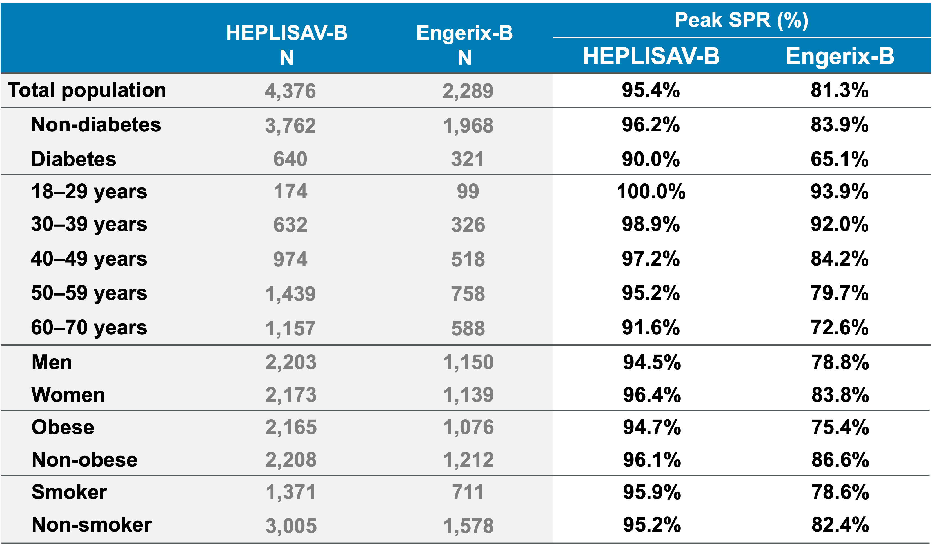
HBV-23:
Higher Seroprotection Rates for HEPLISAV-B (Hep-Cpg) in Pre-specified Populations
Slide courtesy of Dynavax
  Jackson, 2018 Per-Protocol Population

Slide 10
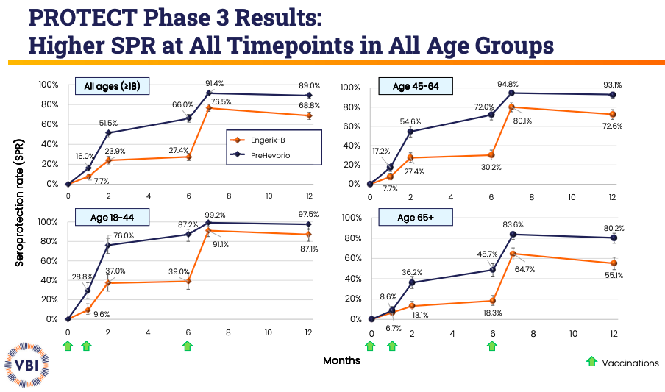
PreHevBrio Study Results Slide courtesy of VBI

Slide 11
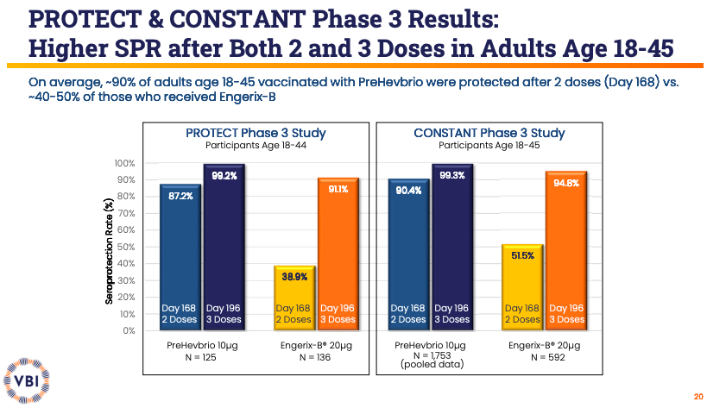
Slide courtesy of VBI

Slide 12
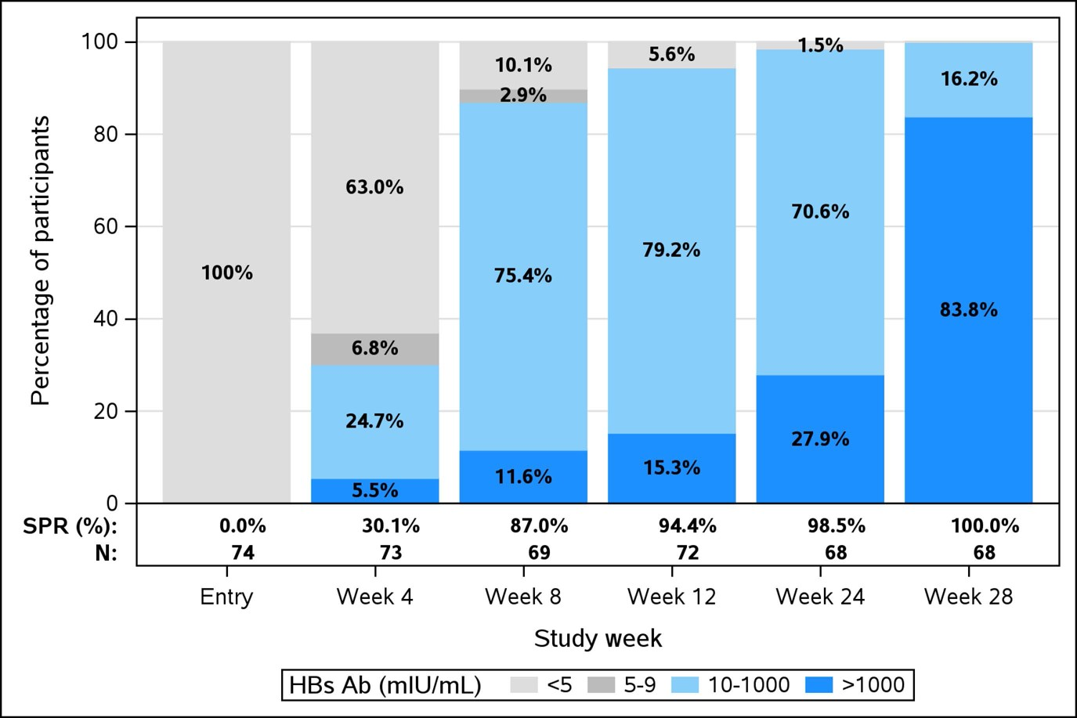

HepB-CpG Vaccine Seroprotection Achieved By Study Week in People with HIV
On-going prospective study
74 participants
  Median age 47
  Median CD4 625 cells/mm³
  96% had <60 copies HIV-1 RNA
  9% had diabetes
68 completed 3 doses at week 0, week 4, and week 24
Open Forum Infect Dis, Volume 9, Issue Supplement_2, December 2022, ofac492.1872, https://doi.org/10.1093/ofid/ofac492.1872
The content of this slide may be subject to copyright: please see the slide notes for details.
Notes:
Unless provided in the caption above, the following copyright applies to the content of this slide: © The Author(s) 2022. Published by Oxford University Press on behalf of Infectious Diseases Society of America.This is an Open Access article distributed under the terms of the Creative Commons Attribution License (https://creativecommons.org/licenses/by/4.0/), which permits unrestricted reuse, distribution, and reproduction in any medium, provided the original work is properly cited.

Slide 13
Vaccine Response
Immunocompetent children & adults who have vaccine-induced Hepatits B Surface Antibody (anti-HBs) levels of >10 mIU/mL 1-2 months after complete HepB vaccine series: considered vaccine responders
  Vaccine response is age-related
    16% if before age 1
    74% if vaccinated at age 1 or older
Vaccine titers may wane, but efficacy persists
  88% of patients receiving challenge dose 30 years after HBV vaccination show persistent antibody response (>10 mIU/mL)
Document anti-HBs >10mIU/mL 4 weeks after last dose of vaccine in PWH
CDC. Hepatitis B Questions and Answers for Health Professionals. Available at: https://www.cdc.gov/hepatitis/hbv/hbvfaq.htm
Notes:
Persistent cellular immunity even if antibody levels drop

Slide 14
Is Hepatitis B Vaccine Booster Dosing Recommended?
Not for people with normal immune status who have been vaccinated
People on hemodialysis, if annual testing indicates anti-HBs <10 mIU/mL, give booster dose
For PWH, hematopoietic stem-cell transplant recipients, or people receiving chemotherapy, need for booster dosing not determined
    Annual anti-HBs testing and booster doses should be considered in those with on-going risk for exposure
CDC. Hepatitis B Questions and Answers for Health Professionals. Available at: https://www.cdc.gov/hepatitis/hbv/hbvfaq.htm

Slide 15
Indications for HepB Vaccination According to Guidelines
People without chronic HBV infection and without immunity to HBV infection (anti-HBs <10 mIU/mL)
People with isolated anti-HBc
  One standard dose of HepB vaccine followed by anti-HBs at 1-2 months
    If anti-HBs >100 mIU/mL, no further vaccination needed
    If anti-HBs<100 mIU/mL, complete hepatitis B vaccine series and retest anti-HBs 4 weeks after completion
Panel on Guidelines for the Prevention and Treatment of Opportunistic Infections in Adults and Adolescents with HIV. https://clinicalinfo.hiv.gov/en/guidelines/hiv-clinical-guidelines-adult-and-adolescent-opportunistic-infections/hepatitis-b-0?view=full Accessed March 9, 2023

Slide 16
Why Do Guidelines Recommend Vaccination in PWH with Isolated anti-HBc Positivity?
Case reports of HBV reactivation or re-acquisition
Of 5,222 patients:
  347 had isolated anti-HBc positivity
  33 subsequently tested positive HBsAg reactive at later date (over a 3.7-year time frame)
    14 had persistent HBsAg reactivity
    Low CD4 count at time of onset (132 cells/microL)
Of 493 women with isolated anti-HBc positivity
  7 converted to HBsAg positivity was baseline CD4 (<200 cells)
Landrum ML et al. JMV 2011;83:1537-43. PWH = People with HIV
French AL et al. Clin Infect Dis. 2009;49:148-154.
Notes:
† These data were presented in part at the16th Conference on Retroviruses and Opportunistic Infections, Montreal, Canada, February 8–11, 2009
1
https://doi.org/10.1002/jmv.22155

Slide 17
Key Points
Updated ACIP recommendations for HBV vaccine for all persons 19-59
Newer HBV vaccines offer improved seroprotective rates as compared to historical vaccines
  Higher seroprotective rates of Heplisav-B and PreHevBrio as compared to Engerix-B
Vaccination of PWH with isolated anti-HBc positivity is recommended by guidelines but remains controversial
ACIP = Advisory Committee on Immunization Practices

Slide 18
References
MMWR Feb. 18, 2022/ 71(7);229-233; ACIP = Advisory Committee on Immunization Practices
Jackson, 2018 Per-Protocol Population
Open Forum Infect Dis, Volume 9, Issue Supplement_2, December 2022, ofac492.1872, https://doi.org/10.1093/ofid/ofac492.1872
CDC. Hepatitis B Questions and Answers for Health Professionals. Available at: https://www.cdc.gov/hepatitis/hbv/hbvfaq.htm
Landrum ML et al. JMV 2011;83:1537-43.
French AL et al. Clin Infect Dis. 2009;49:148-154.

Slide 19
Resources
National Clinician Consultation Center http://nccc.ucsf.edu/
  HIV Management
  Perinatal HIV
  HIV PrEP
  HIV PEP line
  HCV Management
  Substance Use Management
Present your case on ECHO
http://echo.unm.edu hivecho@salud.unm.edu
AETC National HIV Curriculum https://aidsetc.org/nhc
AETC National Coordinating Resource Center https://targethiv.org/library/aetc-national-coordinating-resource-center-0
HIVMA Resource Directory https://www.hivma.org/globalassets/ektron-import/hivma/hivma-resource-directory.pdf
Additional trainings scaetcecho@salud.unm.edu
www.scaetc.org
Notes:
Find additional ECHO sessions in your area: https://echo.unm.edu/locations-2/echo-hubs-superhubs-united-states/
https://hsc.unm.edu/echo/get-involved/join-an-echo/
IDEA Platform: Infectious Diseases Education & Assessment. https://idea.medicine.uw.edu/
AETC National HIV Curriculum: 6 core modules for self study; regularly updated; CME, CNE
Hepatitis C Online Curriculum: https://www.hepatitisc.uw.edu/
Hepatitis B Online Curriculum: https://www.hepatitisb.uw.edu/
National STD Curriculum: https://www.std.uw.edu/

Slide 20
