Slide 1
Motivational Interviewing in People with HIV: Everyone Has a Role
Cases in HIV for InterProfessional Students (CHIPS) SESSION 4
Chelsea Ratcliff, PhD
Sam Houston State University
Notes:
Target audience: interprofessional students
Last updated April 2024

Slide 2
Conflict of Interest Disclosure Statement
Slide developer
Melanie Goebel, MD and Chelsea Ratcliff, PhD
Slide developers have nothing to disclose
Speakers have nothing to disclose
This program is supported by the Health Resources and Services Administration (HRSA) of the U.S. Department of Health and Human Services (HHS) as part of an award totaling $4,205,743 with 0% financed with non-governmental sources. The contents are those of the author(s) and do not necessarily represent the official views of, nor does mention of trade names, commercial practices, or organizations imply an endorsement by HRSA, HHS, or the U.S. Government. For more information, please visit HRSA.gov. Any trade/brand names for products mentioned during this presentation are for training and identification purposes only.
Notes:
Please add presenter disclosures here if any exist.

Slide 3
Use of Trade/Brand Names
This program is supported by the Health Resources and Services Administration (HRSA) of the U.S. Department of Health and Human Services (HHS) as part of an award totaling $4,205,743, with 0% financed with non-governmental sources.
The views expressed do not necessarily reflect the official policies of the Department of Health and Human Services, nor does mention of trade names, commercial practices, or organizations imply endorsement by the U.S. Government. Any trade/brand names for products mentioned during this presentation are for training and identification purposes only.
Notes:
NOTE: THIS SLIDE MUST BE INCLUDED IF TRADE AND/OR BRAND NAMES FOR MEDICATIONS ARE USED IN THE PRESENTATION.
IT MAY BE DELETED IF THERE IS NO REFERENCE TO TRADE NAMES, INCLUDING PRESENTATIONS IN WHICH ONLY GENERIC MEDICATION NAMES ARE MENTIONED.
TRADE NAMES MUST BE PUT IN PARENTHESES AFTER THE GENERIC NAME THE FIRST TIME IT IS MENTIONED - E.G., FLUOXETINE (PROZAC). TRADE NAMES SHOULD ONLY BE MENTIONED FOR THE INITIAL REFERENCE AND THE GENERIC NAME ONLY SHOULD BE USED AFTER THAT. THIS APPLIES EQUALLY TO ALL MEDICATIONS OR PRODUCTS MENTIONED IN THIS PRESENTATION.

Slide 4
Unconscious Bias Disclosure
SCAETC recognizes that language is constantly evolving, and while we make every effort to avoid bias and stigmatizing terms, we acknowledge that unintentional lapses may occur in our presentations.
We value your feedback and encourage you to share any concerns related to language, images, or concepts that may be offensive or stigmatizing.
Your input will help us refine and improve our presentations, ensuring they remain inclusive and respectful to participants.

Slide 5
CHIPS Logistics
Please complete the online participant information form and baseline student assessment if you have not done so already
2024 CHIPS Session dates: January 26, February 23, March 29, April 12
By joining CHIPS, you will be eligible to earn a CHIPS Certificate of Completion
To earn a CHIPS Certificate of Completion, you must attend all 4 sessions.
One live session can be missed, but you must watch the Zoom recording and complete a post-evaluation to receive credit.

Slide 6
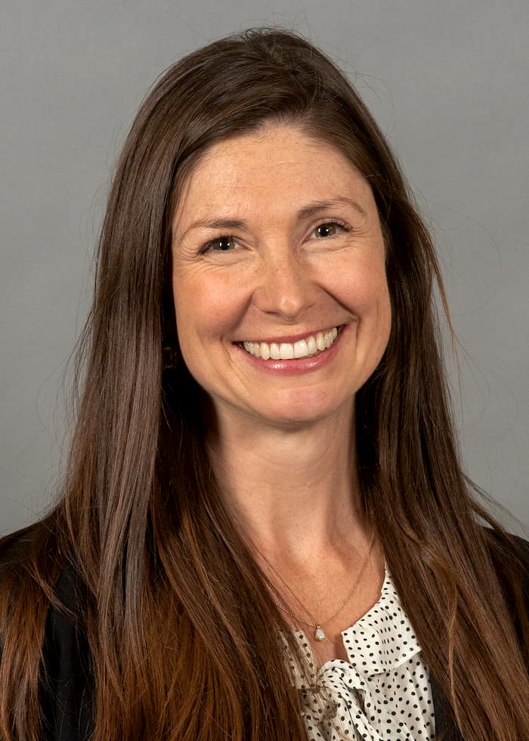
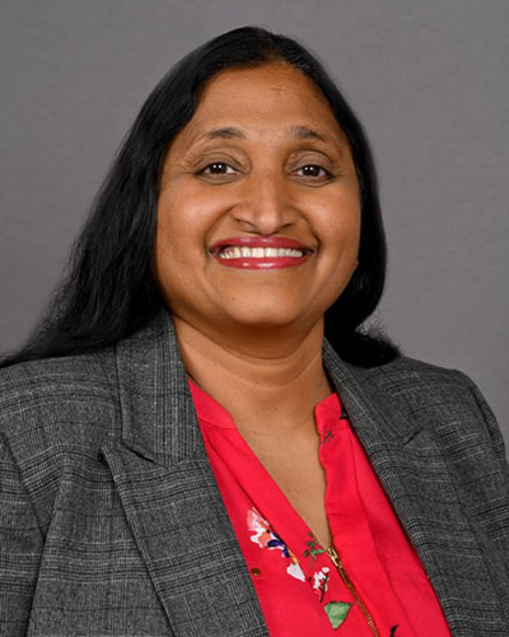
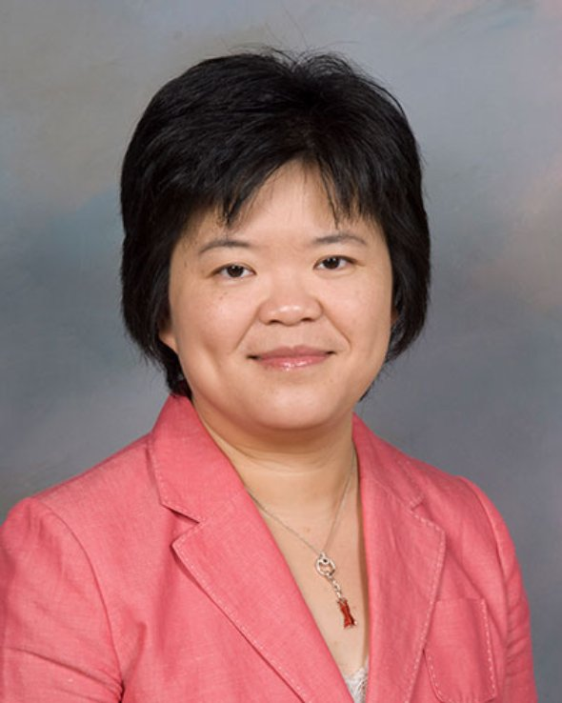
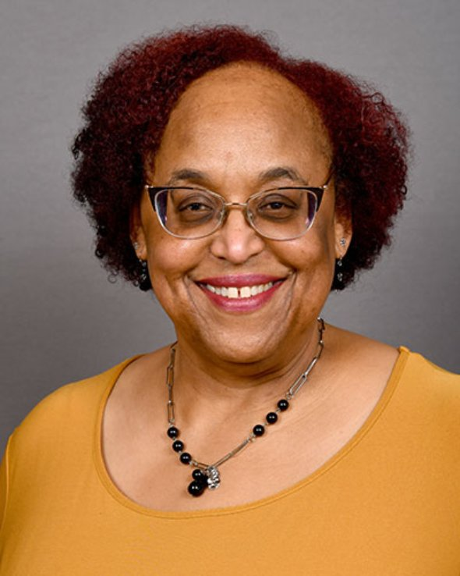
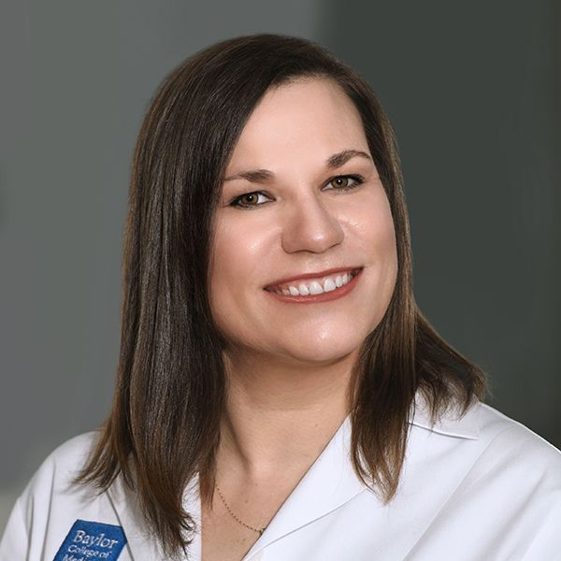
CHIPS Faculty and Collaborators
Padmavathy Ramaswamy, PhD
Assistant Professor
Cizik School of Nursing
The University of Texas
Erica Yu, PhD
Associate Dean & department chair
Cizik School of Nursing
The University of Texas
Sheryl Malone-Thomas, DNP, RN, FNP-BC
Assistant Professor
Cizik School of Nursing
The University of Texas
Shital Patel, MD
Assistant Professor
Infectious Diseases
Baylor College of Medicine
Melanie Goebel, MD
Assistant Professor
Infectious Diseases
Baylor College of Medicine
Chelsea Gilts Ratcliff, PhD
Assistant Professor
Department of Psychology and Philosophy
Sam Houston State University
School of
Health Professions
Lis Shell, PhD, PA-C
Assistant Professor
Baylor College of Medicine
Physician Assistant Program
Amy Moss, PharmD
Clinical Pharmacist
Harris Health System
Hongmei Wang, PharmD, PhD
Assistant Professor
Texas Southern University

Slide 7
Learning Objectives
Demonstrate the role of behavioral health providers in the treatment of people with HIV (PWH).
Apply motivational interviewing (MI) skills when talking with a person with HIV.
Model the way in which team-based care can be used to address the whole patient.

Slide 8
Agenda
Introduction to interprofessional core competency: Teams and Teamwork
Case presentation: Melanie Goebel, MD and Chelsea Ratcliff, PhD
Breakout rooms (30 minutes)
Group discussion

Slide 9
Session Expectations for Students
Respectful, collaborative discussions
Use people-first language
Active participation from all
Focus on team-based care
Break out sessions will not be recorded
Zoom logistics:
please turn on your camera (if possible)
change your “name” in zoom (name, profession, year)
All sessions will be recorded on Zoom

Slide 10
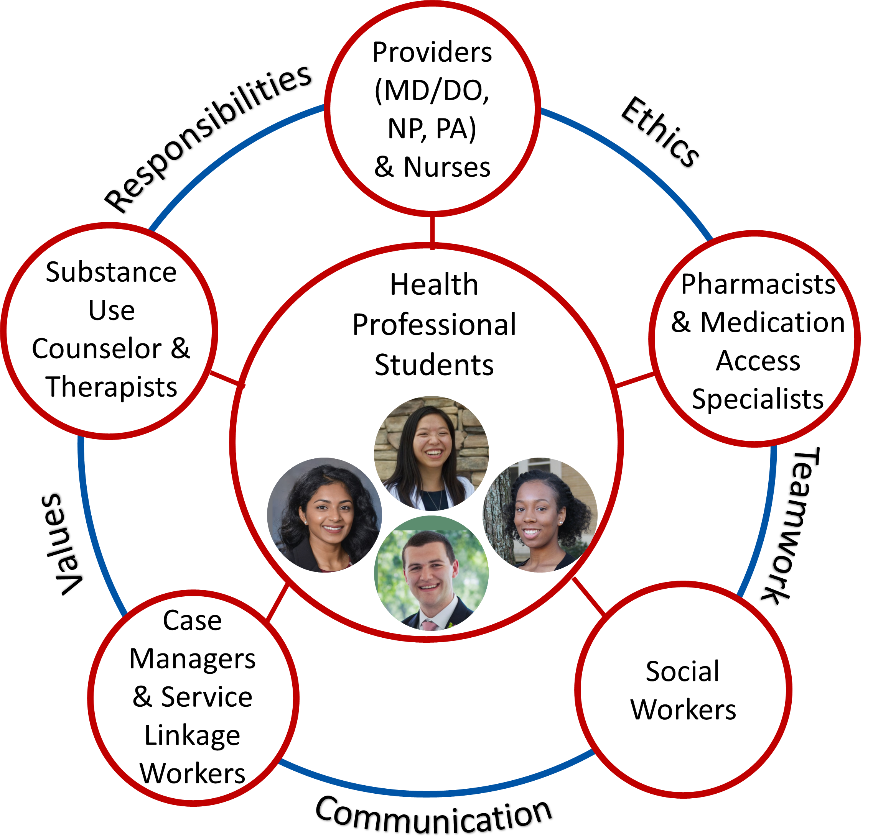
Core Competencies for Interprofessional Collaborative Practice
Values/Ethics for Interprofessional Practice
Roles/Responsibilities
Interprofessional Communication
Teams and Teamwork

Slide 11
CASE PRESENTATION

Slide 12
Patient History
A 27-year-old man with HIV who presents for follow-up care.
He often misses appointments for labs and clinic visits. He has not been seen by his primary provider for over a year.
He reports depression, anxiety, and insomnia.
He has chronic back pain and daily headaches related to multiple prior car accidents.
He often skips doses of medications.

Slide 13
HIV History
Diagnosed with HIV in 2014; reports that he acquired HIV from a sexual assault at a club
Antiretroviral therapy (ART) history
Abacavir/lamivudine/dolutegravir (Triumeq®) 2015-2017
Off ART 2017-2020
Tenofovir alafenamide/emtricitabine/bictegravir (Biktarvy®) 2020-present
Adherence: misses 1-2 doses per week
Notes:
Abacavir, tenofovir, lamivudine/emtricitabine =NRTI = nucleoside reverse transcriptase inhibitor
Dolutegravir, bictegravir = INSTI = integrase strand transfer inhibitors

Slide 14
Other Past Medical History
Syphilis: treated multiple times with intramuscular penicillin
Chronic daily headaches
Chronic back pain since multiple car accidents
Alcohol use disorder
Seizure disorder (previous seizure thought to be due to alcohol withdrawal)
Depression and anxiety

Slide 15
Social History
General: lives with his mother. Previously worked as a cashier; recently lost his job. Reports multiple financial stressors, including debt and food insecurity.
Sexual activity: sexually active with men; not sexually active for the last 6 months. History of sexual trauma (raped as teenager).
Alcohol use: drinks beer daily (history of binge drinking; most recently drinks 1-2 beers daily)
Smoking: never
Drug use: smokes marijuana daily. Previously used ecstasy (not recently).

Slide 16
Medications
Current outpatient medications:
Tenofovir alafenamide/emtricitabine/bictegravir 1 tablet daily
Sertraline 25 mg daily
Gabapentin 600 mg three times daily
Notes:
Sertraline = SSRI= selective serotonin reuptake inhibitor; medication for mood
Gabapentin = treatment for alcohol use disorder, neuropathic pain, mood stabilization, seizure

Slide 17
Labs
HIV-1 viral load: 1,960 copies/ml (treatment goal=undetectable/ below level of detection)
CD4 count: 772 (normal 550-1200)
HIV genotype (resistance testing): HIV-1, No mutations
Basic metabolic panel (includes electrolytes, glucose, renal function): normal
Liver function tests: normal
Complete blood count: normal WBC count, hemoglobin, and platelet count
Notes:
WBC=white blood cells
Hgb=hemoglobin
Viral load below level of detection< 30 by lab used at BCM

Slide 18
Mental Health History
Assessment by Behavioral Therapist and psychiatrist
PHQ-9 score: 26 (severe depression)
Patient reports depression, flashbacks, trouble sleeping, and severe anxiety in public spaces. He has panic attacks when he leaves home. When he comes to clinic, he feels reminded of prior rape and trauma. He has history of self harm (cutting). He reports history of suicidal thoughts without a plan; currently denies suicidal ideation.
Multiple recent stressors: financial challenges and deaths of several family members.
Current diagnoses: post-traumatic stress disorder, major depressive disorder, alcohol use disorder
Notes:
Behavioral Therapist (licensed clinical social worker)
Psychiatrist = prescribing physician specializing in mental health

Slide 19
Mental Status Exam
General: casually dressed, calm, socially appropriate
Gait: unremarkable
Abnormal movement: none
Language/speech: fluent
Mood: “sad”
Affect: distant, sad
Thought content: denies suicidal ideation/hallucinations, no delusions
Thought processes: linear
Cognition: alert and oriented x 4, memory intact
Insight/judgment: good/fair

Slide 20
What’s going on in therapy?

Slide 21
OUTSIDE WORLD
Behaviors
𝕄
POINT
OF VIEW
What do you tend to do when inner stuff shows up?
What can you do to move you toward what matters?
AWAY
TOWARD
Unwanted Experiences
Values
What inner stuff like thoughts, feelings, memories show up that get in the way?
Who and what is important to you?
INSIDE WORLD
Interpretations

Slide 22
EXAMPLE
𝕄
OUTSIDE WORLD
Behaviors
Drink alcohol
Keep to myself
Watch TV
Skip meds
Skip appointments
Visit family
Go for a walk
Take medications daily
Attend appointments
Finish a painting
AWAY
TOWARD
Unwanted Experiences
Values
Sadness
Shame
Flashbacks
Panic Symptoms
Family & friends
Being healthy
Being productive
Creating art
INSIDE WORLD
Interpretations

Slide 23
To Recap…
Who or what matters to you?
What does it look like to do what matters?
What inside stuff gets in the way of doing what matters?
How well are your “away” moves working?
Let’s put you back in the driver’s seat!
Practice acceptance strategies
Set SMART values-consistent goals
https://stock.adobe.com/search?k=stick+figure+hiking
Notes:
https://stock.adobe.com/search?k=stick+figure+hiking

Slide 24
𝕄
Moving from autopilot to choice
Pause.
Ask what/who is most important to you.
Accept difficult thoughts and feelings if they arise.
Choose an action that fits with what matters to you.

Slide 25
A Brief Primer on Motivational Interviewing (MI) in People with HIV

Slide 26
What is MI?
Get the conversation going
Focus conversation on change
Considers change as an option
An “attitude” we can have in every patient interaction.
“A directive, patient-centered counseling style for eliciting behavior change by helping patients to explore and resolve ambivalence.” (Rollnick and Miller, 1995)
Notes:
What do you already know about MI?
How much training have you had on it?
Intervention designed for situations in which a patient needs to make a behavior change but is unsure about it.

Slide 27
MI Strategies: OARS
Open-ended questions
(Open>Closed)
Affirmations
Reflective Listening
(Complex>Simple)
Summaries
Notes:
“OARS” is a useful mnemonic, but it does not mean these strategies are of equal importance… Remember:
Reflective listening is the MOST IMPORTANT part of MI. Open ended questions is the SECOND MOST IMPORTANT part of MI.
You want to have more reflections than questions in each MI-adherent interaction
You want to have more complex reflections than simple reflections
You want to have more open ended questions than closed ended
Bottom line, reflect TONS and work on coming up with open ended questions (it’s harder than it sounds ☺)

Slide 28
Reflections
Most important part of motivational interviewing
Clarifies meaning + move convo forward
Can be simple (surface level) or complex (deeper)
Simple
Patient: This has been a rough few weeks for me
Provider: Things aren’t going well right now.
Complex
Patient: I’ve been so good at taking the medication, then I saw my Uncle’s post and I just quit doing everything.
Provider: Taking the medications reminds you of what happened.
Provider: It isn’t fair that you have to take medications because of what he did to you.
Notes:
One way to clarify the meaning
"Do you mean that . .?” → turns into statement
Like questions but your voice goes down ☺
"You're angry about what I said?" (up)
"You're angry about what I said." (down)
Can be helpful to have ”Stems” but isn’t necessary:
So you feel . .
It sounds like you . .
You're wondering if . .
You . .
surface reflections tend to stabilize the client and the communication, as well as keep the conversation alive.

Slide 29
Questions
Closed Question | Open Question
How many doses do you skip per week? | What are some of the upsides for you about skipping doses?

Slide 30
Questions vs. Reflections
In MI, what ratio are we aiming for:
___ reflection :____ question
Why?
The question and answer trap!
Notes:
Questions are roadblocks in the short-term

Slide 31
Affirmations
Helps keep the conversation positive
Hot tips
Focus on behaviors
Avoid using “I” (start with “You” if need a word to launch from)
Make statements that recognize person’s strengths
Not everyone manages to give up smoking as you have.
You showed a lot of determination by doing that.
You’ve been working really hard at coming to your appointments, even when it’s really hard to find a way to get here!
You’re really dedicated to being healthy enough to be there for your family!
Notes:
Warning – this can feel super corny (but if you affirm with conviction, it can be invaluable!)
Affirmations usually take the form of clear and genuine words of understanding and appreciation.
we cannot genuinely affirm others without deeply knowing and appreciating them.
Apodaca and colleagues (2015) found affirmations were the only practitioner behavior that both increased change talk and decreased sustain talk!

Slide 32
Summaries
Summaries link what patients have already expressed, especially in terms of reflecting ambivalence, and move the conversation to another topic or expand the current discussion further.
It sounds like you are concerned about viral load because it’s making you feel bad and sometimes you end up in the hospital. You also said taking your medications regularly feels impossible because it reminds you of what your Uncle did to you. That doesn’t sound like an easy choice.
Notes:
part of what happens in this helping process is we assist clients in organizing their experiences.

Slide 33
Motivational Interviewing Behavior Counts
Targets to be “MI Proficient”
Aiming for 1:2 Q:R ratio
(2 x as many reflections as questions)
Aiming for 1:2 Open:Closed
Aiming for 1:2 Simple:Complex
Notes:
Put a tally mark each time you observe the practitioner doing any of these behaviors during the interaction.
At the end of the interaction, see how the ratios of these behaviors lines up with “MI Proficient” ratios (on next slide).

Slide 34
Now you try it!
Role play in breakout rooms
Use MI strategies (OARS) to highlight patient’s ambivalence in order to facilitate the patient’s commitment to changing a behavior

Slide 35
Patient Case Summary
27 y/o man with HIV, chronic back pain, chronic headaches, depression, anxiety, post traumatic stress disorder, alcohol use disorder, and history of sexual trauma. He reports ongoing symptoms of depression and anxiety.
Labs are significant for HIV-1 viral load 1,960 copies/ml
Likely* target behavior to change: Medication Adherence or appointment attendance (retention to care)
*see if the patient has any ambivalence about the behavior first

Slide 36
BREAKOUT ROOMS

Slide 37
Breakout Rooms Icebreaker
Name and your school/program
Icebreaker: What are you really into right now?

Slide 38
Breakout Room Questions for Discussion:
Imagine you’re on an interdisciplinary team and you’re reviewing this case
As a ______ (physician, nurse, NP, PA, pharmacist, psychologist), how would you approach this patient with missed visits and poor adherence to antiretroviral therapy?
Role play: practice motivational interviewing. One member of the group will play the role of patient, and other members will play the role of healthcare professional.
Reflections > Questions!
Complex > Simple!
Open > Closed!
As an interprofessional team, how can you work together to meet this patient’s needs?

Slide 39
Team-Based Plan of Care
Problem: HIV with virologic failure (viral load > 200 copies/ml)
Team solution:
Physician provided adherence counseling
Continued current antiretroviral therapy

Slide 40
Team-Based Plan of Care
Problem: Depression, PTSD, Anxiety
Team solution:
Patient saw behavioral therapy weekly for several months
Psychiatrist increased sertraline dose to 50 mg daily, titrated up to 100 mg daily
Psychiatrist prescribed trazodone for insomnia

Slide 41
Team-Based Plan of Care
Problem: Substance use disorder (alcohol, marijuana)
Team solution:
Referred to substance use counselor
Psychiatrist and behavioral therapist counseled patient to abstain from alcohol and substance use

Slide 42
Team-Based Plan of Care
Problem: Chronic back pain
Team solution:
Continue gabapentin
Physician prescribed naproxen and diclofenac topical gel
Referred to physical therapy

Slide 43
Patient Course
Patient continued to follow with psychiatry and behavioral therapy for anxiety and depression. He had frequent visits to emergency department for panic attacks. He missed multiple follow up appointments at clinic.
Continued to have challenges with adherence to medications; physician provided adherence counseling at each visit
HIV-1 viral load monitored every 2-3 months
HIV-1 RNA 300-900 copies/mL for the next year
Viral load undetectable 2 years later

Slide 44
Take-Home Points
Mental health problems impact every aspect of medical care, especially adherence to medications
Every healthcare professional can use motivational interviewing to help patients change their behavior

Slide 45
It takes a village!

Slide 46
Questions?
https://www.cdc.gov/stophivtogether/index.html
Notes:
https://www.gettingtozerosf.org/

Slide 47
Evaluations
Please complete the follow up assessment within 1 week of the session
We greatly value your feedback!!

Slide 48
Resources
National Clinician Consultation Center http://nccc.ucsf.edu/
HIV Management
Perinatal HIV
HIV PrEP
HIV PEP line
HCV Management
Substance Use Management
Present on ECHO
https://hsc.unm.edu/scaetc/programs-services/echo.html​
AETC National HIV Curriculum https://aidsetc.org/nhc
AETC National Coordinating Resource Center https://targethiv.org/library/aetc-national-coordinating-resource-center-0
HIVMA Resource Directory https://www.hivma.org/globalassets/ektron-import/hivma/hivma-resource-directory.pdf
Additional trainings scaetcecho@salud.unm.edu
www.scaetc.org
Notes:
IDEA Platform: Infectious Diseases Education & Assessment. https://idea.medicine.uw.edu/
AETC National HIV Curriculum: 6 core modules for self study; regularly updated; CME, CNE
Hepatitis C Online Curriculum: https://www.hepatitisc.uw.edu/
Hepatitis B Online Curriculum: https://www.hepatitisb.uw.edu/
National STD Curriculum: https://www.std.uw.edu/

