Slide 1
Effective Patient Counseling for Contraception in HIV Care and Prevention: A pharmacist’s review of shared-decision making and drug-drug interaction skills
Kirsten B Balano, PharmD, AAHIVP
Associate Professor, UCSF School of Pharmacy and Pacific AETC
April 25, 2024

Slide 2
Disclaimer
The views and opinions expressed in this presentation are not necessarily those of the Pacific AIDS Education & Training Center (Pacific AETC) or its eight local partner sites in HRSA Region 9, the Regents of the University of California or its San Francisco campus (UCSF or collectively, University) nor of our funder the Health Resources and Services Administration(HRSA). Neither Pacific AETC, University, HRSA nor any of their officers, board members, agents, employees, students or volunteers make any warranty, express or implied, including the warranties of merchantability and fitness for a particular purpose; nor assume any legal liability or responsibility for the accuracy, completeness or usefulness of information, product or process assessed or described; nor represent that its use would not infringe privately owned rights.
HRSA Acknowledgement Statement The Pacific AETC is supported by the Health Resources and Services Administration (HRSA) of the U.S. Department of Health and Human Services (HHS) as part of an award totaling $4,377,449. The contents are those of the author(s) and do not necessarily represent the official views of, nor an endorsement, by HRSA, HHS, or the U.S. Government. For more information, please visit HRSA.gov.
Trade Name Disclosure Statement Funding for this presentation was made possible by 5 U1OHA29292‐08‐00 from the Human Resources and Services Administration HIV/AIDS Bureau. The views expressed do not necessarily reflect the official policies of the Department of Health and Human Services nor does mention of trade names, commercial practices, or organizations imply endorsement by the U.S. Government. Any trade/brand names for products mentioned during this presentation are for training and identification purposes only.

Slide 3
Disclosures
All presenters of this continuing medical education activity have indicated that neither they nor their spouse/legally recognized domestic partner has any financial relationships with commercial interests related to the content of this activity.

Slide 4
Learning Objectives
At the completion of this presentation, participants will be able to:
Describe the value of practicing shared-decision making in sexual health counseling.
Identify HIV antiretroviral agents with significant interactions with contraceptive agents.
Elicit patient values and preferences that drive choice of contraception and HIV treatment/prevention options.

Slide 5
Polling Question #1
What is Shared Decision Making?
Health professionals sharing their viewpoints in lay language with patients.
Patients sharing their viewpoints with their healthcare professional.
A form of communication that helps patients make evidence-based healthcare decisions.
All of the Above
None of the Above

Slide 6
Definitions of SDM
A communication skill, focused on patient’s values and preferences as they apply to facilitate high-quality patient care in the context of medical decision making.
An attitude and philosophy; an approach to thinking about effective patient care.
Acknowledges the collaborative nature of good medical care and the dual expertise involved in all decision making–that of patient and doctor.

Slide 7
Shared Decision Making
Interpersonal and interdependent process.
Recognizes that a decision is required, and that providing information is helpful but not sufficient.
Highlights best available evidence about risks and benefits of each option married to the patients' values and preferences.
Dynamic interplay between the provider’s guidance and the patient’s values and preferences.

Slide 8
Traditional vs. Shared Decision Making
Image Source: IMG Induction - Dr. Mugdha Wakodkar MBBS, MRCOG, MRCGP

Slide 9
Shared Decision Making & Sexual Health
Skills have been used when deciding best fit for contraception.
Multiple effective options available (IUD, LAI, COC, barrier methods).
Choosing method that fits patient values and preferences improves patient satisfaction vs provider-driven decisions.
Skills are also suggested for HIV PrEP, now that have several effective options:
LAI
Daily PrEP
2:1:1 – On Demand PrEP
Dehlendorf D, Grumback K et al “Shared Decision Making in Contraceptive Counseling” Contraception 2017 May;95(5):452-455

Slide 10
Provider Role in Shared Decision Making
Provider’s expertise to describe advantages and disadvantages for this patient.
Contraceptive choices have preferred options based on patient characteristics – i.e. BMI, Age, smoking history
Conditions and drug-drug interactions with treatment of those conditions may also affect contraceptive choices
HIV Antiretroviral Therapy can have significant drug –drug interactions depending upon class of agents.

Slide 11
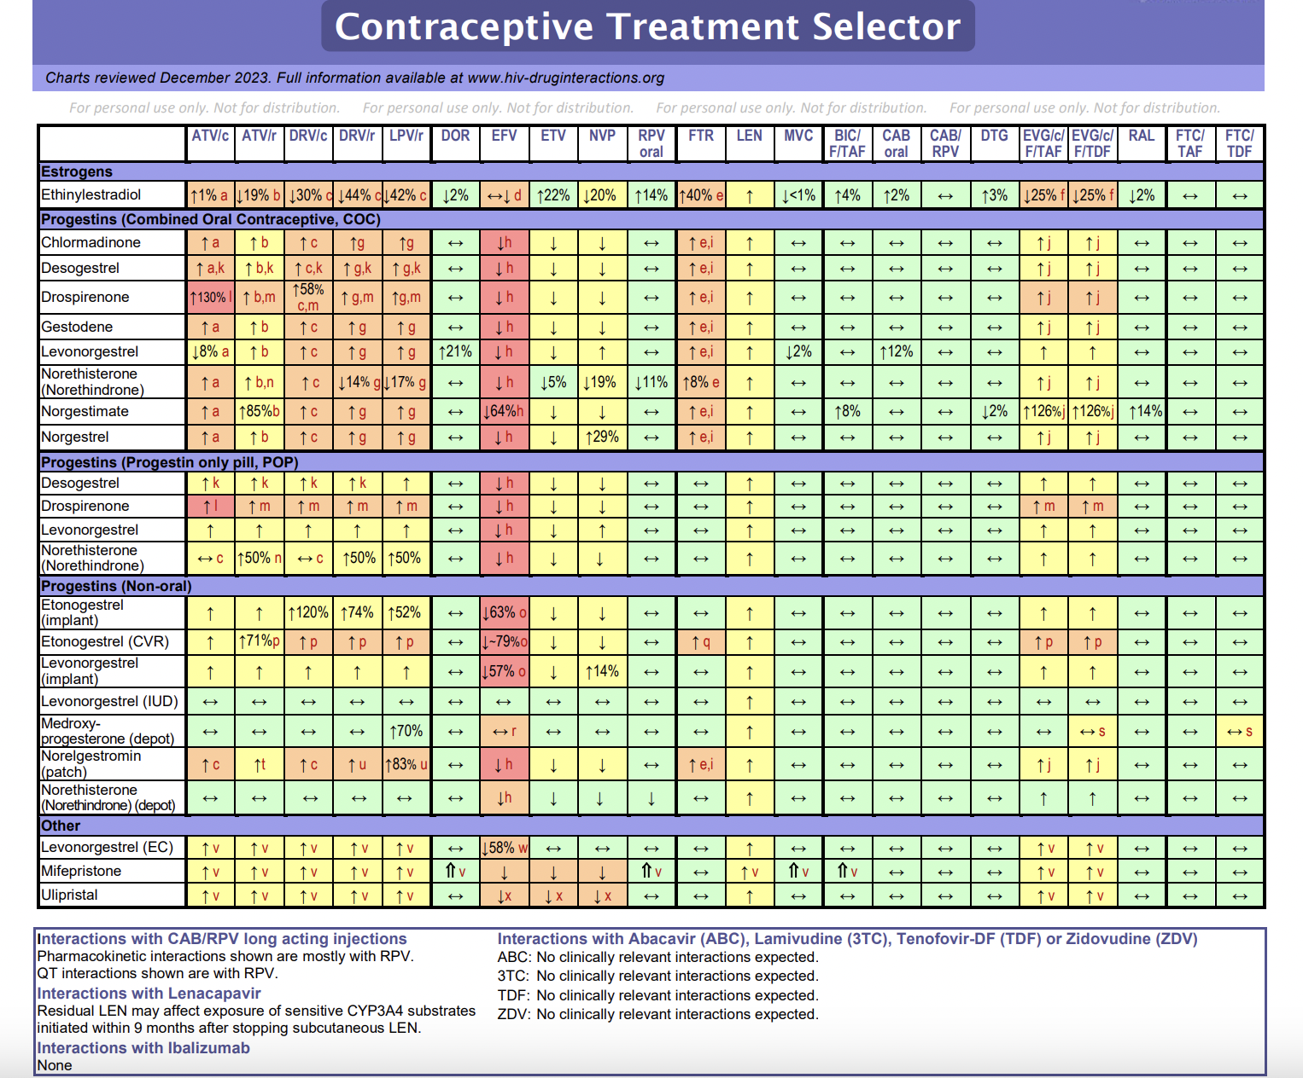
Contraception Selection with HIV
Significant interactions with PI and INTSTI-boosted ARV and some NNRI
From University of Liverpool www.hiv-druginteractions.org
Contraceptive Treatment Selector
Notes:
Will switch screen and walk through treatment selection chart and practice using the chart.

Slide 12
Patient role in Shared Decision Making
Expert on themselves – and what would work best for them in regard to contraception and family planning
What are some of the areas where patients have expertise?
Elicit patient’s goal with the health decision that needs to be made – i.e., family planning options.

Slide 13
Visual Aids can be Helpful
From: UCSF’s Beyond the Pill: How Well Does Birth Control Work?

Slide 14
HIV PrEP Medications Visual
Notes:
Brian this was a handout for our

Slide 15
AHRQ SHARE Approach
Seek your patient's participation.
Help your patient explore and compare treatment options.
Assess your patient's values and preferences.
Reach a decision with your patient.
Evaluate your patient's decision.
AHRQ SHARE Approach
15

Slide 16
How the conversation goes – Seek & Help
Seek your patient's participation.
Do you have time to go over all the options so we can find a path that works for you?
Help your patient explore and compare treatment options.
What ideas do you have for supporting your sexual health?
Let me tell you what the research says about the benefits and risks of the medicines you are considering.
Let me tell you how other patients have made choices.
Here are some picturegraphs that describe the options

Slide 17
How the conversation goes – Assess & Reach
Assess your patient's values and preferences.
As you think about your options – what is important to you?
Reach a decision with your patient.
What additional questions do you have for me to help you make your decision?

Slide 18
How the conversation goes - Evaluate
Evaluate your patient's decision.
Let’s plan to check in again (appropriate time frame) to see how you are doing.

Slide 19
Summary
Shared Decision Making is an evidence-based communication tool to elicit patient values and preferences that will optimize outcomes and patient satisfaction with health care decisions.
This tool has been valuable when discussion sexual health decisions including family planning, contraception and HIV PrEP.
Providers bring their expertise, including drug-drug interactions, to these discussions of various options.
Practicing these conversations takes time and can be implemented within busy clinical environments. Visual aids can support these decisions.

