Slide 1
Community Connections: Developing Strategic Partnership Alliances
Larry Scott-Walker
Executive Director
THRIVE SS Inc

Slide 2
Learning Objectives
How small agencies can partner for major impact
The Importance of strategic mapping/planning
The Importance of Org and Community Asset Mapping

Slide 3
Strategic Partnerships
A strategic partnership is a mutually beneficial arrangement between two separate parties that do not directly compete with one another.
Companies have long been engaging in strategic partnerships to enhance their offers and offset costs.

Slide 4
Strategy first:
You can’t have “strategic partnerships” without first having a strategy!
Strategy must be:
Rooted in the mission of the org
SMART
Specific
Measurable
Achievable
Realistic
Timely

Slide 5
Strategy
Strategy = The roadmap to impact that answers the “what, when, who and how”
Mission is the “why”
Being strategic also means being selective... normalize saying no!
**Not everyone’s brand will align with yours **

Slide 6
Teamwork makes the DREAM WORK
Once you’ve decided what your strategic goals and priorities are, then you find “Co-conspirators”
Main or New Partner?
There must be legally binding contracts!

Slide 7
Main Partner
Long lasting
Trusted
Reliable
Mutually beneficial
Synergistic

Slide 8
New Partner
Vetting
Partner on one project
Find alignments/synergies

Slide 9
THRIVE SS Inc
Founded by 3 Black Gay Men with HIV
Largest support network for BGMWH
Currently incubating 3 grassroot agencies
Formed as a collaboration of colleagues

Slide 10
Beginning – first 1-2yrs
Little to NO Funding
300+ members
Partnered with larger agencies for funding
Partnered with local agencies
National partnership (Huge Impact)

Slide 11
2017
First lead grant
Partnered with Bristol Myers Squibb to build poster presentation for USCA and IAS

Slide 12
2018
Leased first space
R3 Project
Partnered with almost every HIV provider to give centered care to people with HIV (PWH)
Providing training to agencies centering community feedback
Hosted exhibit at IAS in Amsterdam

Slide 13
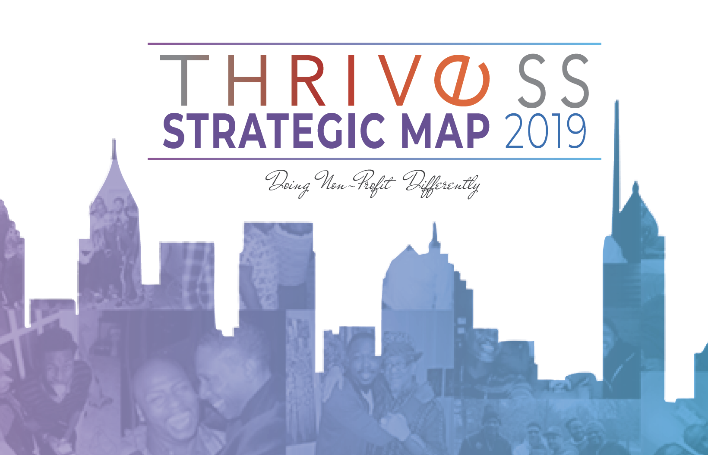
2019 - Strategic map
Importance
Lists are magic
Strategy maps/plans help to assure we have a measured approach forward
focuses efforts
prevents mission drift
helps with aligning and partnering with others

Slide 14
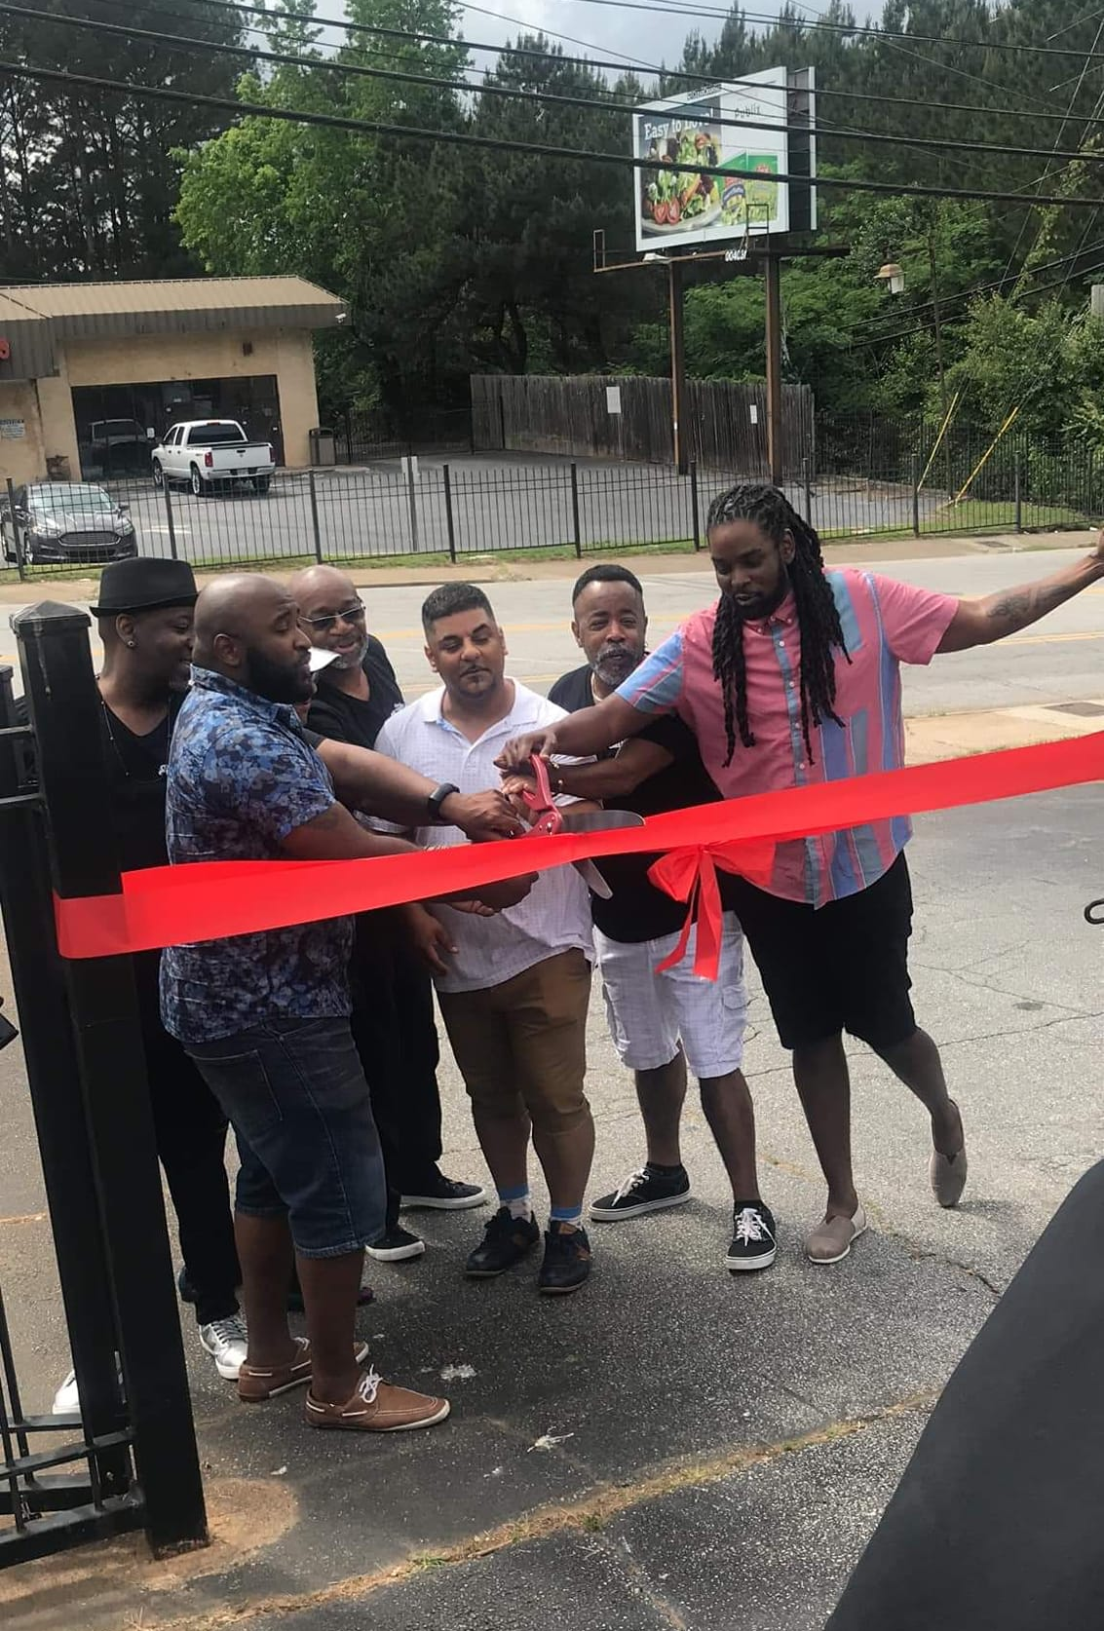
2019
Settled a 5,600 sq ft building,
National membership around 4000+
Linked 300+ PWH
Providing local and national TA
Filmed first documentary

Slide 15
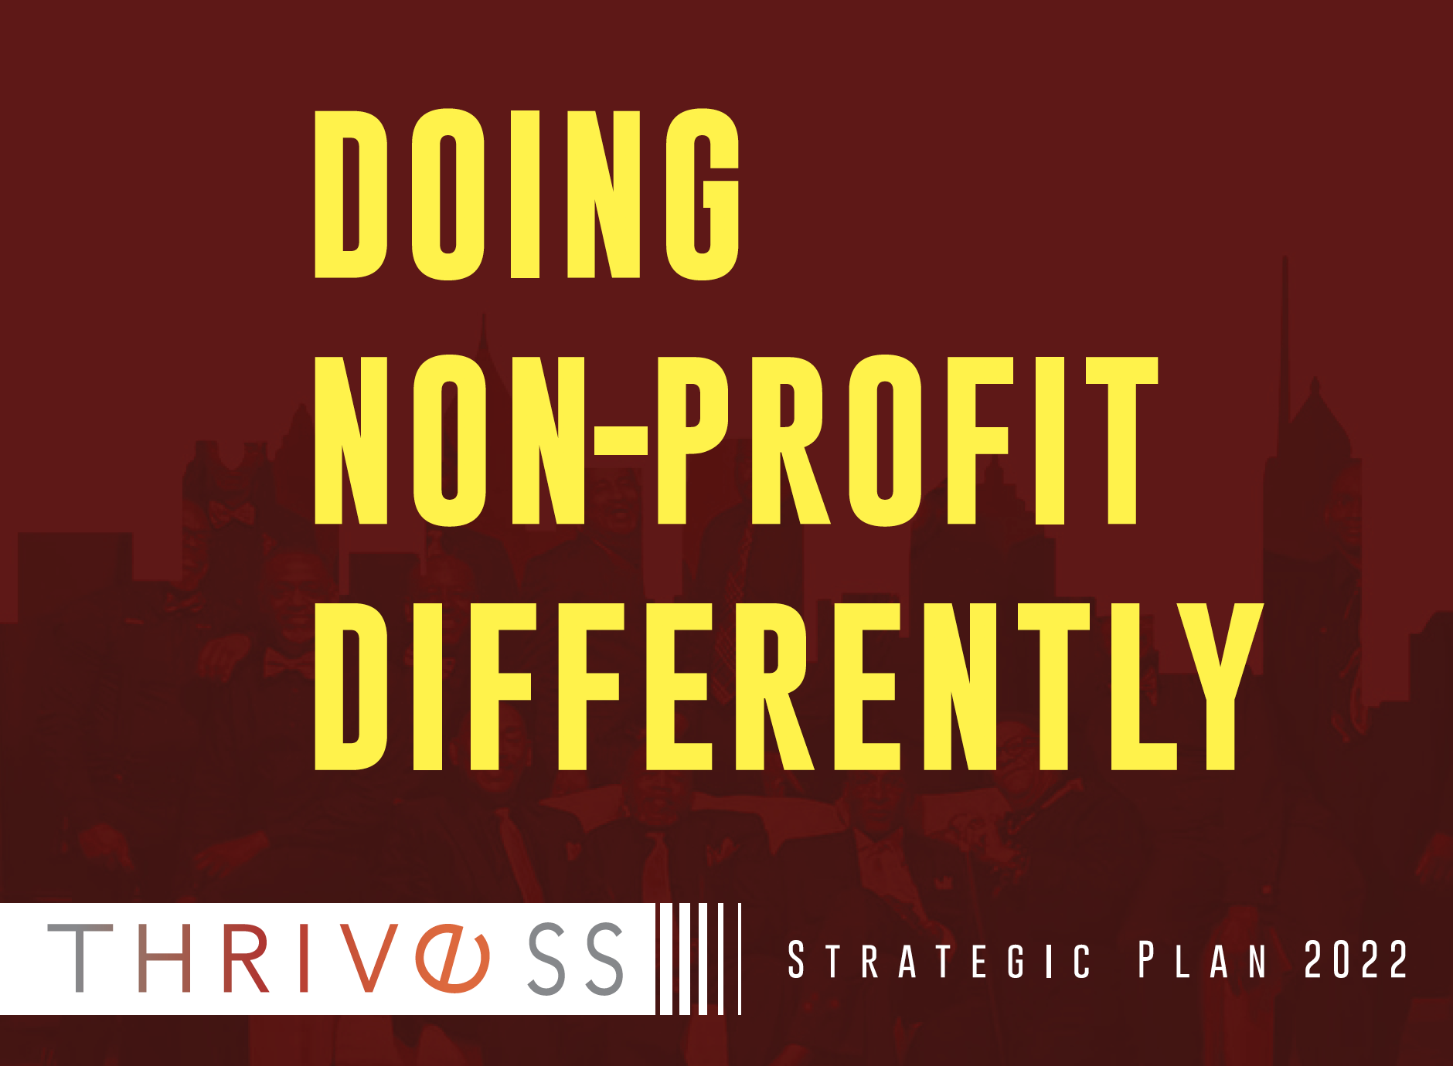
2020
National and Local partnerships - e.g., health departments, Ryan White-funded orgs, legacy agencies, AETCs, small startup agencies, incubating agencies
Strategic Plan

Slide 16
2021
Global partners
Twinning opportunities
Partnering outside of HIV and public health (tech developers, media)
Elected officials
Faith-based communities/leaders

Slide 17
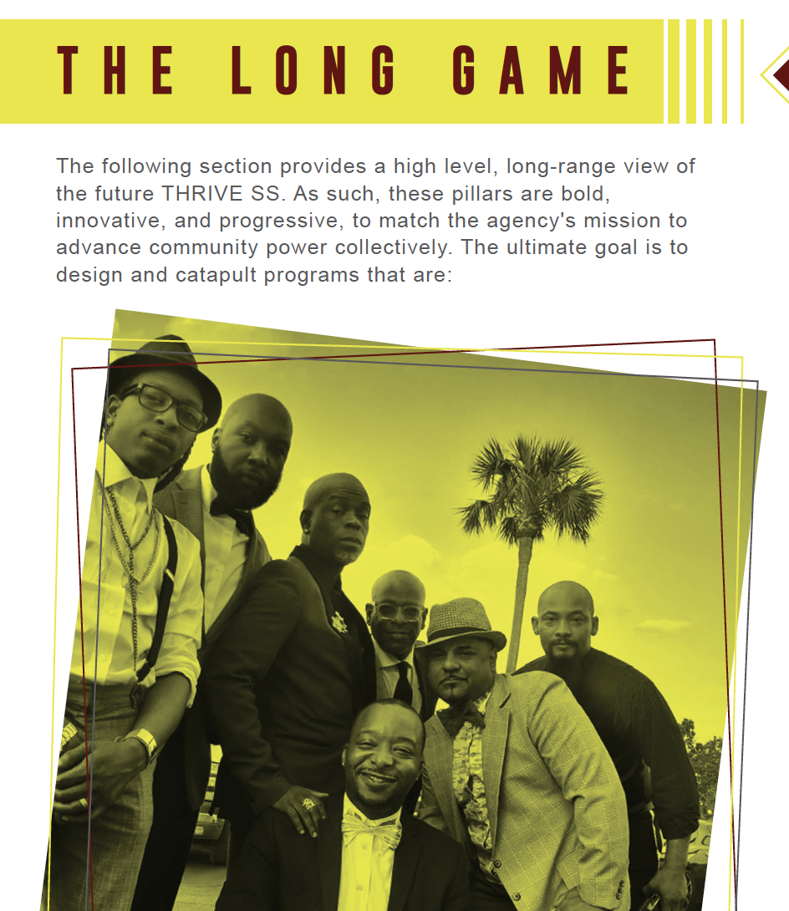
THRIVE Strategic Goals and Expansion Plans
Community Conversations/THRIVE365 App:
Partners: GA AETC, Rutgers University, The Corporate Lounge, local providers and SME
TA Center:
Partners: GA AETC, The Corporate Lounge
Expanding into testing and care provision:
Positive Impact Heath Centers, Odyssey Family Counseling

Slide 18
Partnerships can provide:
Space
Staffing
Revenue
Cost saving
Bolster services
Provide greater diversity of experience

Slide 19
Asset mapping
Asset Mapping is a tool that relies on a core belief of asset-based community development; namely, that good things exist in communities and that those things can be highlighted and encouraged — these are assets suited to advancing those communities.

Slide 20
Asset Mapping
YOUR Org/Mission = Asset
Who else is in community doing work
Whose work aligns with your vision/mission

Slide 21
Importance of Org and Community asset mapping
Org mapping
01
Helps to identify talent and service gaps
Scout talent
Know what NOT to do
Choose and vet partners
Community mapping
02
Helps gauge:
Who is where
What they are doing
How best to align

Slide 22
Partner with PURPOSE
Consider:
Cost vs. Benefit
Are there alignments
Main vs. New
Does this partnership support our 3-5 year goals?

Slide 23
Contact
Larry L. Scott-Walker
larry@thrivess.org

