Slide 1
Menopause and Bone Health in HIV infected Women
Marcia M. Holstad, PhD, RN, FAANP, FAAN
Associate Professor and Marcia Stanhope Professor in Public Health, Nell Hodgson Woodruff School of Nursing
Assistant Director for Clinical and Social Science Integration, Emory Center for AIDS Research
Emory University
nurmmcd@emory.edu

Slide 2
Aging and HIV infected women
HIV infected women are living longer
Older women are also among those newly diagnosed with HIV
In 2013 of those adults diagnosed with HIV:
About 18% are age 45-54 years
10% are age 55 and older
More HIV+ women are/will experience menopause
Notes:
With the use of combined ART, HIV is now a chronic disease and its estimated that in 2015 about half of HIV+ persons in the US will be over age 50. Older adults also represent an important group of those newly diagnosed. Changes in the vagina of post menopausal women may increase their risk for acquiring HIV. Therefore more HIV + women are experiencing or will experience menopause.
Purpose of this presentation is to briefly discuss what is known about menopause related to HIV and also discuss an important risk associated with menopause—bone health.

Slide 3
Menopause
Defined retrospectively as cessation of menstrual periods for one year; not associated with other causes.
Result of the natural decline of estrogen production from ovaries.
The average age of menopause in the US is about 52 years with a range of 40 to 58 years (North American Menopause Society, NAMS, 2015).
In the general population, women who achieve menopause at an earlier age are at higher risk for morbidity and mortality due to loss of the protective effects of estrogen.
Cardiovascular risk
Fracture risk
Notes:
Diagnosis made in retrospect, one year after the final menstrual period.
It is considered an important health event in a woman’s life and can signal an opportunity for health screening and changes in risk.

Slide 4
HIV and Menopause
A few studies to date suggest HIV is a risk factor for earlier than average age at menopause.
Risk factors for earlier menopause are often found in HIV+ women and may confound the association of HIV with early menopause:
Tobacco use
Substance abuse
Low body weight
Low socioeconomic status
Stress
Notes:
**The mechanism for earlier onset of age of menopause is not clear, including the role of immunodeficiency, chronic inflammation, ARVs.
Studies vary on median age and of the few studies in the US the median ages are 46, 47.7, 50. These studies were conducted between 2000-2005 and may not reflect improved treatments with combined ART.

Slide 5
HIV and Menopause
Episodes of irregular bleeding or amenorrhea are common in HIV+ women
Due to stress, serious illness, or low body weight/wasting.
may need careful evaluation, especially if this occurs at or below age 40.
Consider obtaining a FSH level to evaluate for menopause (levels > 25 IU/L in a random blood draw are consistent with menopause [STRAW + 10).
Notes:
In the early days of ART, I remember seeing women go from being amenorrhic to resuming menses as they gained weight on ART.

Slide 6
Menopausal symptoms
The core symptoms associated with menopause in all women are vasomotor symptoms (hot flashes, night sweats), sleep disturbance, vaginal dryness (NIH State of Science Conference, 2005).
Women are also at risk for depressive symptoms in the menopause transition period (period prior to final menstrual period).

Slide 7
HIV infected women and Menopausal symptoms
HIV infected women may experience more menopausal symptoms than the general population, particularly psychological symptoms and vasomotor symptoms.
Complaints of night sweats and hot flashes may need to be carefully evaluated to rule out other infections, TB or possibly lymphoma based on CD4 count.
Thorough health history and evaluation are important to investigate symptoms.

Slide 8
Hot flashes
HIV+ women report more hot flash severity and greater interference of hot flashes with daily activities (Looby, et al, 2014).
Treatment of hot flashes must consider whether the women is a candidate for hormone therapy and drug interactions with ART (CYP450 pathway) and other medications.

Slide 9
Effective treatments in general population: (very little data in HIV+ women)
Hormone Therapy (HT): low dose, short term
Check potential interactions between estrogen and PI or NNRTI
Nonhormonal therapy:
SNRI (venlafaxine, desvenlafaxine)
SSRI (fluoxetine, citalopram, escitalopram)
Gabapentin
Cognitive behavioral therapy– effective in one study
Complementary therapy
Black cohosh-no evidence for efficacy, side effect is potential liver toxicity
Phytoestrogens—no evidence for effectiveness
Acupuncture—conflicting evidence
Weight loss--effective

Slide 10
Case Example: Ms P. 45 yo AAF, perimenopausal, Severe night sweats
HIV+, Hep C (VL = UD), HTN
At ideal body weight
CD4 = 770, VL = UD,
ARV: Efavirenz/tenofovir/emtricitabine
PPD = negative
Self-treatment—fans, light bedclothing, soy estrogen OTC
Declines HT
Trial of gabapentin

Slide 11
Bone health in HIV+ menopausal women
HIV infected persons have a three times greater prevalence of osteopenia and osteoporosis than their HIV negative peers.
HIV-related risk factors for low bone mineral density (BMD) include:
Low CD4 count
ART-- There is a 2-6% loss of BMD after starting ART. Tenofovir confers greater risk.
Chronic inflammation associated with HIV.
Low Vitamin D –prevalent in as high as 60-75% HIV infected persons. Efavirenz confers greater risk.
High levels of bone turnover biomarkers
Other general risk factors are:
Low BMI, poor nutrition, sedentary lifestyle, tobacco, > 3 drinks alcohol/day
Notes:
Those on ART have greater risk of lower bone mineral density (BMD) than ART naïve persons. There is a 2-6% loss of BMD after starting ART. Tenofovir confers greater risk.
Chronic inflammation associated with HIV contributes to low BMD in HIV+ women.
Low Vitamin D has been associated with low BMD, and is common in HIV infected persons
Other risk factors for low BMD in general are present in many HIV infected women:
Low BMI, poor nutrition, sedentary lifestyle, tobacco, alcohol
Of interest, data from the WIHS study in premenopausal women show no differences in fractures between HIV+ and – women. There are few studies of fracture incidence in HIV infected postmenopausal women.

Slide 12
Evaluating Bone Density: DXA scan
DXA scans –under utilized by providers
Current recommendations: all women age 65 yrs or older.
Authoritative sources (American Association of Clinical Endocriniolgists, American College of Obstetrics and Gynecology, National Osteoporosis Foundation [NOF] do not list HIV as a risk factor for osteoporosis
Infectious Disease Society of America recommendations for HIV infected persons: (2009)
Postmenopausal women age 65
Young postmenopausal women with one or more risk factors
Notes:
DXA scan is used to assess bone density. It will diagnose osteoporosis and osteopenia. One retrospective chart review study found only 1% of 2924 pts had a DXA. And of these 96% had osteopenia or osteoporosis.

Slide 13
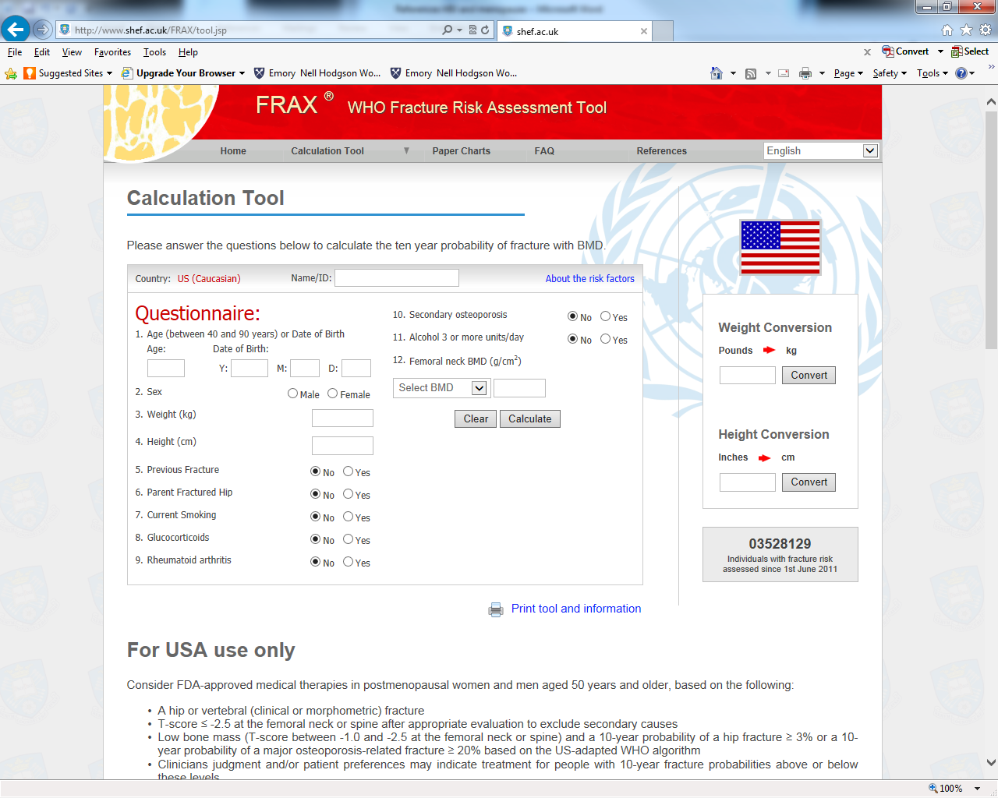
Notes:
Evaluating Bone risk: WHO FRAX Tool http://www.shef.ac.uk/FRAX/tool.jsp
Index used to measure 10 year risk of fracture.
Doesn’t include HIV as a risk
Underestimates the risk in HIV infected women.

Slide 14
Bone health recommendations
Correct Vitamin D deficiency: 700 – 800 IU daily
Calcium (1200 mg) + Vitamin D (800 – 1000 IU) daily for women over 50 years (National Osteoporosis Foundation, 2010).
Evaluate and Treat osteoporosis (e.g., alendronate found to be safe) and osteopenia according to NOF recommendations
Health promotion activities
Weight bearing exercise
Smoking cessation
Limit alcohol to less than 3 drinks a day.
Continue ART –-currently no evidence that changing regimen raises BMD or lowers fracture risk (Kanapathipillai, et al, 2013)
Notes:
Correcting Vit D deficiency to a level of 40 ng/mL reduces hip fx by 26% and non vertebral fx by 23%

Slide 15
Algorithm for Menopause Management in HIV infected women
Assess menstrual periods: 12 months amenorrhea
Assess FSH as needed (> 25 IU/L is c/w menopause)
Exclude other etiologies of amenorrhea
Assess for symptoms (exclude other etiologies):
Treatment based on severity and affect on quality of life
Assess Vitamin D, Bone density (DXA scan)
Assess FRAX
Treatment based on results
Health promotion/maintenance:
Calcium + Vit D, weight bearing exercise, weight loss, reduce alcohol, smoking cessation
Notes:
Summary HIV infected women have many risks associated with menopause.
Evaluating and treating worrisome symptoms and ensuring bone health in the setting of antiretroviral medications is essential to promote health and reduce risk of fractures.

Slide 16
References
Alcaide, M., Parmigiani, A., Pallikkuth, S., Roach, M., Freguja, R., Della Negra, M., Bolivar, H., Fischl, M., Pahwa, S. (2013). Immune activation in HIV-infected aging women on antiretrovirals—implications for age-associated comorbidities: A cross-sectional pilot study. PLOS ONE, 8 (5), 1-9.
Cejtin, H. (2012, August). Care of the human immunodeficiency virus-infected menopausal woman. American Journal of Obstetrics & Gynecology, 87-93.
Conde, D., Silva, E., Amaral, W., Finotti, M., Ferreira, R., Costa-Paiva, L., Pinto-Neto, A. (2009).
HIV, reproductive aging, and health implications in women: a literature review. Menopause: The Journal of The North American Menopause Society, 16 (1), 199-213.
Dickinson, S., Fantry, L. (2012). Use of Dual-Energy X-Ray Absorptiometry (DXA) Scans in HIV-Infected Patients. Journal of the International Association of Physicians in AIDS Care, 11 (4), 239-244.
Harlow, S., Gass, M., Hall, J., Lobo, R., Maki, P., Rebar, R., Sherman, S., Sluss, P., de Villiers, T. (2012). Executive summary of the Stages of Reproductive Aging Workshop + 10: addressing the unfinished agenda of staging reproductive aging. Menopause: The Journal of The North American Menopause Society, 19 (4), 1-9.
de Pommerol, M., Hessamfar, M., Lawson-Ayayi, S., Neau, D., Geffard, S., Farbos, S., Uwamaliya, B., Vandenhende, M-A., Pellegrin, J-L., Blancpain, S., Dabis, F., Morlat, P. (2011). Menopause and HIV infection: age at onset and associated factors, ANRS CO3 Aquitaine cohort. International Journal of STD & AIDS, 22 (2), 67-72.
Kanapathipillari, R., Hickey, M., Giles, M. (2013). Human immunodeficiency virus and menopause. Menopause: The Journal of The North American Menopause Society, 20 (9), 983-990.
Looby, S. (2012). Menopause-Associated Metabolic Manifestations and Symptomatology in HIV Infection: A Brief Review with Research Implications. Journal of the Association of Nurses in AIDS Care, 23 (3), 195-203.
McPheeters, C. (2013). Treatment Options for Hot Flashes in the HIV-Positive Menopausal Patient. The Journal for Nurse Practitioners, 9 (3), 166-171.
Looby, S., Shifren, J., Corless, I., Rope, A., Pedersen, M., Joffe, H., Grinspoon, S. (2013). Increased hot flash severity and related interference in perimenopausal human immunodeficiency virus-infected women. Menopause: The Journal of The North American Menopause Society, 21 (4), 403-409.
Maki, P., Rubin, L., Cohen, M., Golub, E., Greenblatt, R., Young, M., Schwartz, R., Anastos, K., Cook, J. (2012). Depressive symptoms are increased in the early perimenopausal stage in ethnically diverse human immunodeficiency virus-infected and human immunodeficiency virus-uninfected women. Menopause: The Journal of The North American Menopause Society, 19 (11), 1215-1223.
National Osteoporosis Foundation http://nof.org/
North American Menopause Society. http://www.menopause.org/
Stein, E., Yin, M., McMahon, D., Shu, A., Zhang, C., Ferris, D., Colon, I., Dobkin, J., Hammer, S., Shane, E. (2011). Vitamin D deficiency in HIV-infected postmenopausal Hispanics and African-American women. Osteoporosis International, 22 (2), 477-487.
Yin, M., Dalian, L., Cremers, S., Phyllis, T., Cohen, M., Shi, Q., Shane, E., Golub, E., Anastos, K. (2010). Short-Term Bone Loss in HIV-Infected Premenopausal Women. Journal of Acquired Immune Deficiency Syndrome, 53 (2) 202-208.
Yin, M., McMahon, D., Ferris, D., Zhang, C., Staron, A., Colon, I., Laurence, J., Dobkin, J., Hammer, S., Shane, E. (2009). Low Bone Mass and High Bone Turnover in Postmenopausal Human Immunodeficiency Virus-Infected Women. Clinical Endocrinology Metabolism, 95 (2), 620-629.
Yin, M., Qiuhu, S., Hoover, D., Anastos, K., Sharma, A., Young., M., Levine A., Cohen, M., Shane, E., Golub, E., Tien, P. (2010). Fracture incidence in HIV-infected women: results from Women’s Interagency HIV Study. AIDS, 24, 2679-2686

