Slide 1

Implementation of Long Acting Antiretrovirals: Opportunities and Challenges
Aadia Rana MD, FIDSA
Associate Professor of Medicine
University of Alabama-Birmingham Heersink School of Medicine
April 29, 2023

Slide 2
Faculty Disclosure
Merck – Research Funding for grant paid to institution (ended Oct 2021)
This program is supported by the Health Resources and Services Administration (HRSA) of the U.S. Department of Health and Human Services (HHS) under grant number U1OHA30535 as part of an award totaling $4.2m. The contents are those of the author(s) and do not necessarily represent the official views of, nor an endorsement, by HRSA, HHS, or the U.S. Government. For more information, please visit HRSA.gov.
Funding for this presentation was made possible by cooperative agreement U1OHA30535 from the Health Resources and Services Administration HIV/AIDS Bureau. The views expressed do not necessarily reflect the official policies of the Department of Health and Human Services nor does mention of trade names, commercial practices, or organizations imply endorsement by the U.S. Government. Any trade/brand names for products mentioned during this presentation are for training and identification purposes only.

Slide 3
Objectives
Overview of HIV epidemic in the U.S.
Review of data on Long Acting Antiretroviral therapy (LA ART)
Discuss challenges on the use of LA ART
Future directions in LA ART

Slide 4
Expected Outcome
Participants will become familiar with some of the opportunities and challenges in implementing LA ART programs.

Slide 5
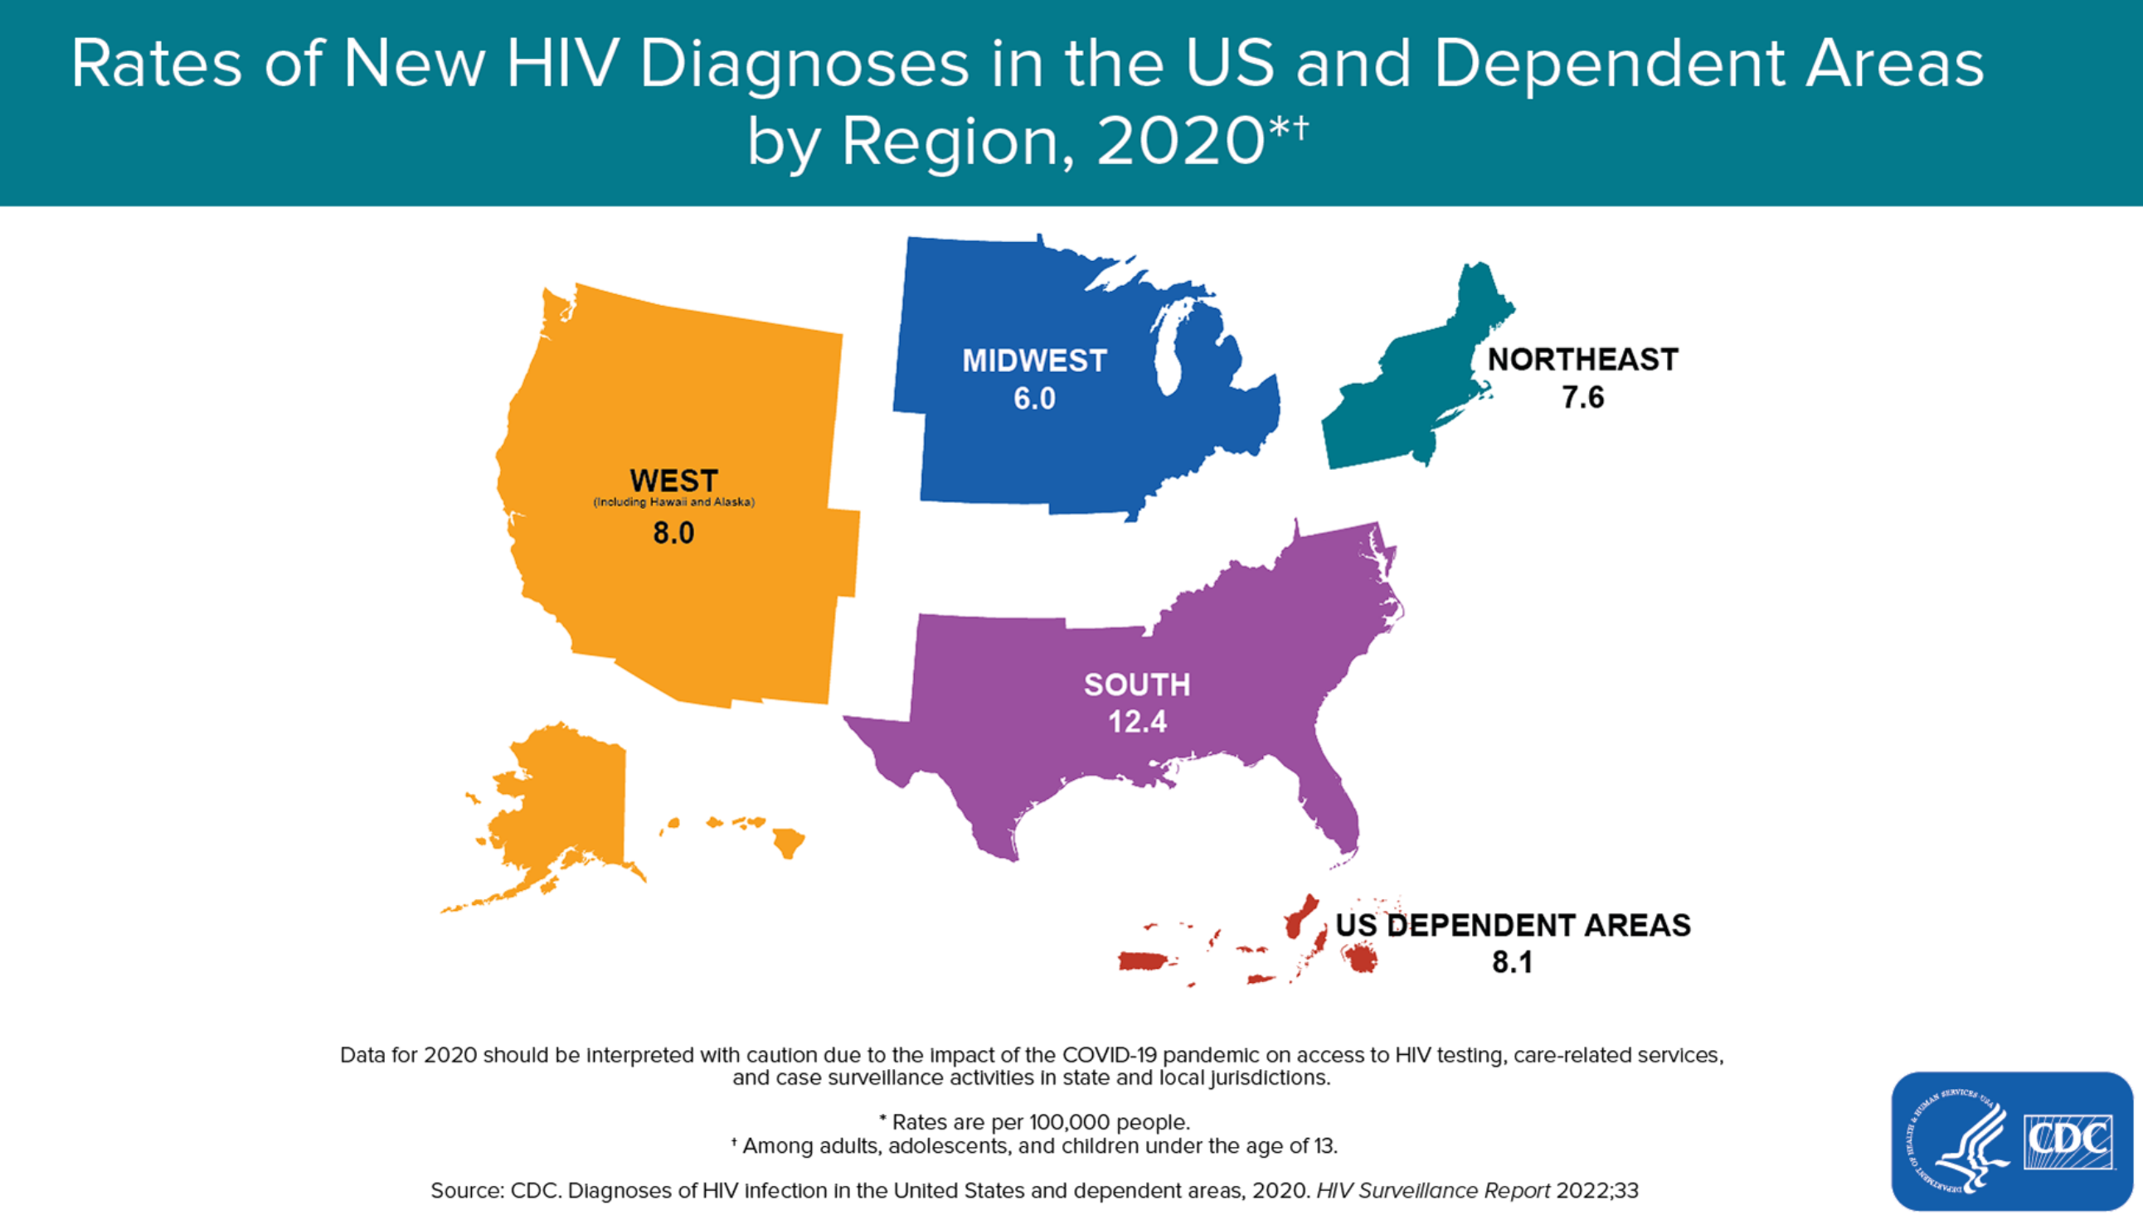
Notes:
Regionally, the South accounted for about half the number of HIV diagnoses in 202 by incidence rate, 8 of top 10 states are in the South.
Blacks also have the highest rate of new HIV diagnoses, followed by Latinos – in 2017, the rate of new HIV diagnoses per 100,000 for Blacks (41.1) was about 8 times that of whites (5.1); Latinos (16.1) had a rate 3 times that of whites.42
Blacks accounted for close to half (43%) of deaths among people with an HIV diagnosis in 2016.43
Survival after an AIDS diagnosis is lower for Blacks than for most other racial/ethnic groups, and Blacks have had the highest age-adjusted death rate due to HIV disease throughout most of the epidemic.44,45 HIV ranks higher as a cause of death for Blacks and Latinos, compared with whites46 Further, HIV was the 5th leading cause of death for Black women ages 35-44 in 2016

Slide 6
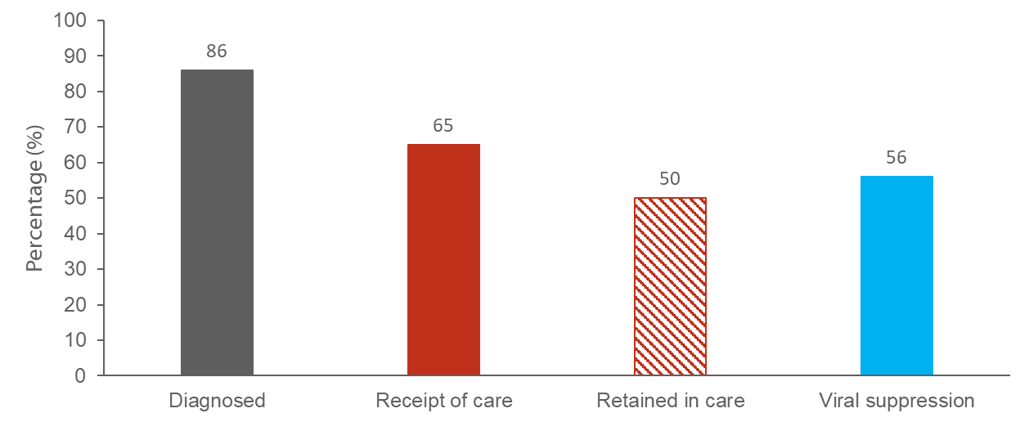
Persons with Diagnosed or Undiagnosed HIV Infection
HIV Care Continuum Outcomes, 2019—United States
87
66
57
Note. Receipt of medical care was defined as ≥1 test (CD4 or VL) in 2018. Retained in continuous medical care was defined as ≥2 tests (CD4 or VL) ≥3 months apart in 2018. Viral suppression was defined as <200 copies/mL on the most recent VL test in 2019. CDC, Monitoring selected national HIV prevention and care objectives by using HIV surveillance data—United States and 6 dependent areas, 2019. HIV Surveillance Supplemental Report 2021; 26(No. 2). Published May 2021.
Notes:
This slide presents the prevalence-based HIV care continuum for 2019 for persons living with diagnosed or undiagnosed HIV infection in the United States. Among the estimated 1.1 million people living with HIV in the United States, 86% have received a diagnosis, 65% received HIV medical care in 2018, 50% were receiving continuous care, and 56% were virally suppressed.
Receipt of medical care was defined as ≥1 test (CD4 or VL) in 2019. Retained in continuous medical care was defined as ≥2 tests (CD4 or VL) ≥3 months apart in 2018. Viral suppression was defined as <200 copies/mL on the most recent VL test in 2019.

Slide 7
Engagement in Care is Dynamic
“Consistently High” (26%)
“Steadily Declining” (16%)
“Early Increasing” (17%)
“Late Increasing” (15%)
“Consistently Low” (26%)
Powers et al, Longitudinal HIV Care Trajectories in North Carolina JAIDS 2017; 74(S2)

Slide 8
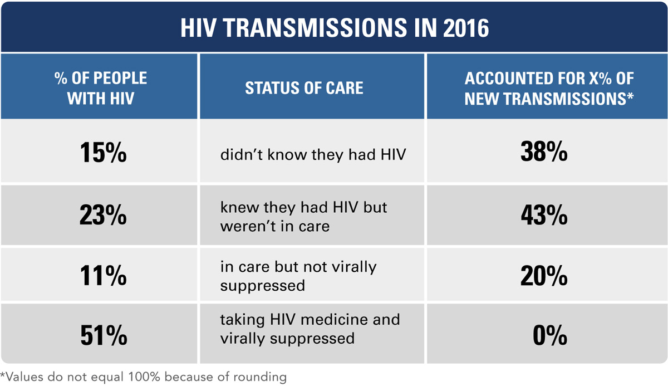
Li Z, Purcell DW, Sansom SL, Hayes D, Hall HI. Vital Signs: HIV Transmission Along the Continuum of Care — United States, 2016. MMWR Morb Mortal Wkly Rep. ePub: 18 March 2019.
Notes:
Modeling National surveillance Data, National HIV Behavioral Surveillance System and the Medical Monitoring Project suggests that the majority of ongoing transmission in this country is related to those who are aware of their diagnosis and not in care.
CDC Data to Care activities directs health departments to identify & re-engage out-of-care PLWH
Yet reintroducing them into the same system that could not retain them in the first place is an unlikely recipe for success

Slide 9
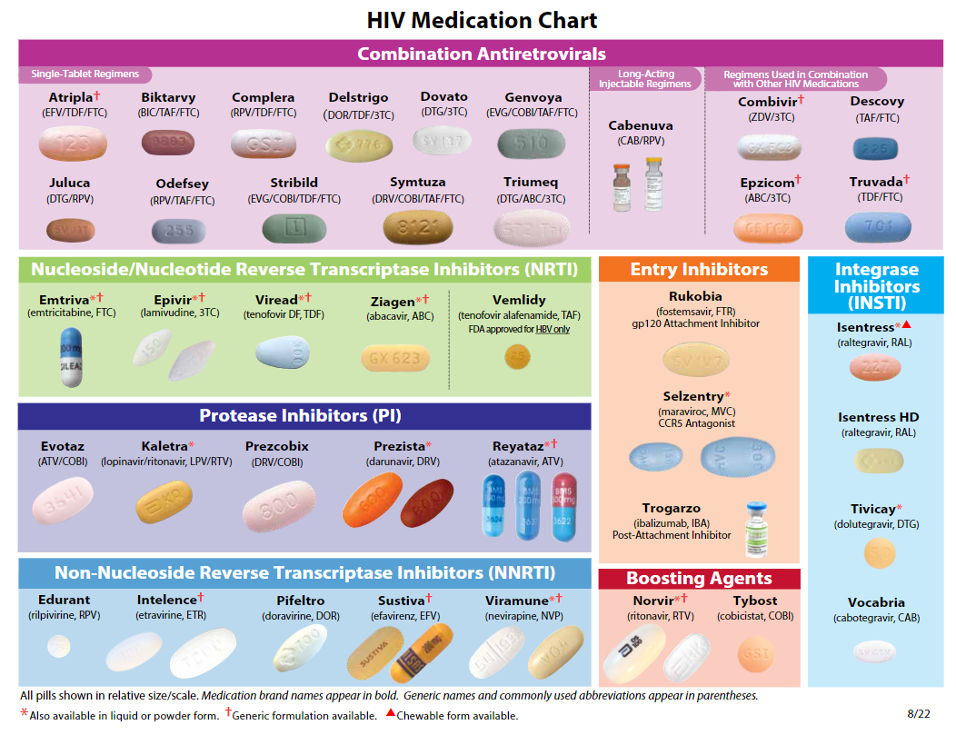
https://aidsetc.org/resource/hiv-medication-chart-pad
Notes:
Ibalizumab indication for heavily treatment-experienced adults with multidrug resistant HIV-1 infection failing their current antiretroviral regimen ; infusion every 2 weeks in conjunction with oral ART.

Slide 10
Assessing Individual Barriers to Care and Treatment
Adherence
Youth
Substance Use
Mental Health
Poverty
Stigma
Forgetting/ Competing Responsibilities
Medication Side Effects
Notes:
Assessing for barriers at time of diagnosis and re=engagement including:
Demographics: race/ethnic disparities, youth
Substance use
Mental Health: depression truama
Poverty: unstable housing, transportation, competing responsibilities, environment
Stigma: not just HIV-related stigma, racial/gender/socioeconomic stigmas that intersect
Forgetting
Side Effects

Slide 11
Is there a role for LA-ART in addressing these barriers?

Slide 12
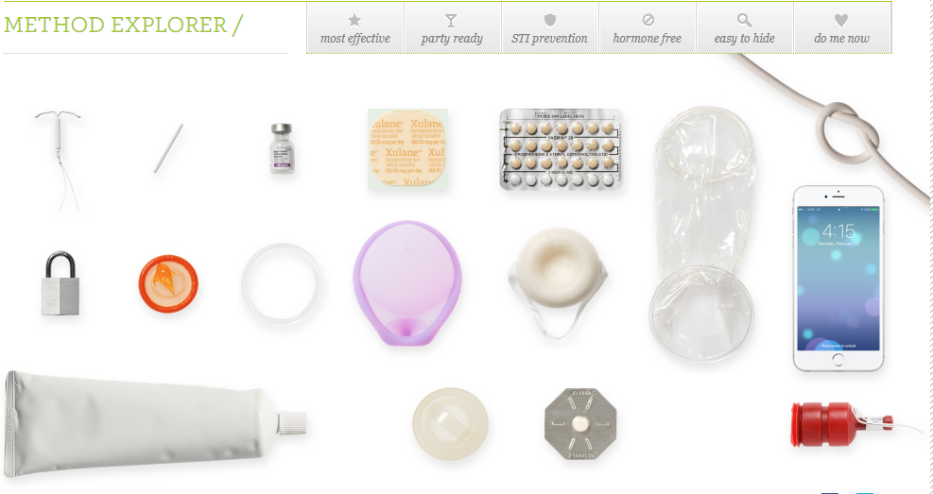
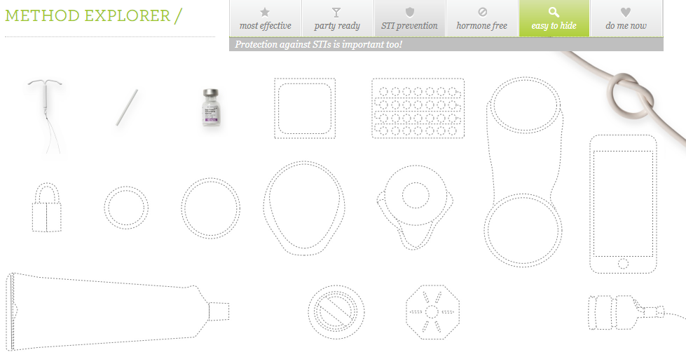
https://www.bedsider.org/methods

Slide 13
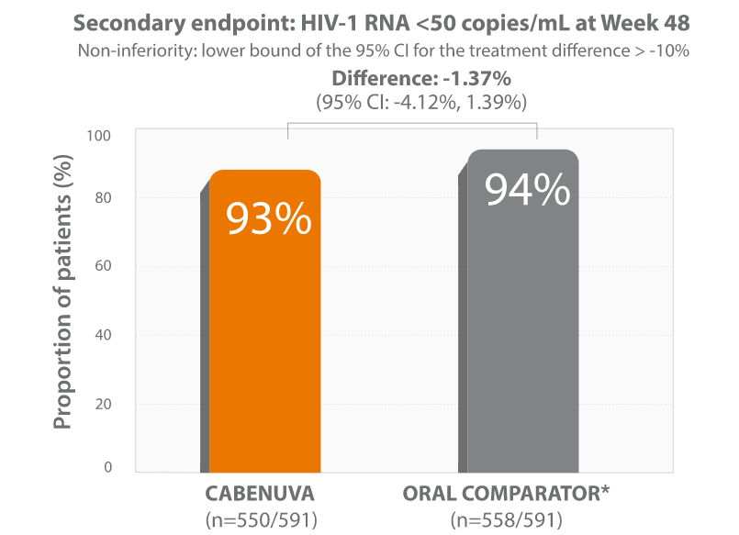
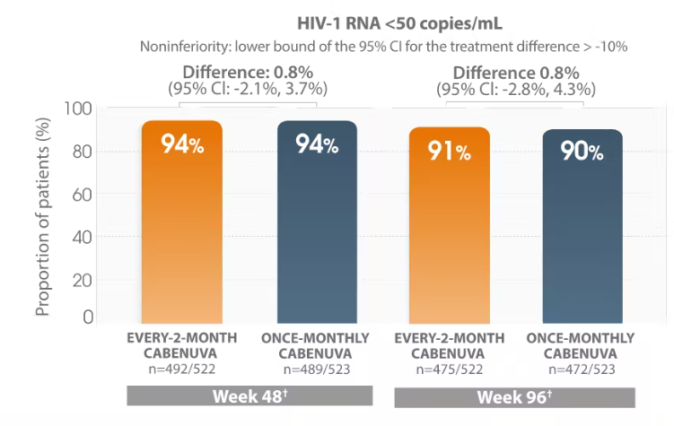
Phase III studies of LA-CAB/RPV
Pooled ATLAS/FLAIR
ATLAS-2M
BUT, these studies did not include PWH who face adherence barriers.
Orkin C, et al. NEJM 2020. Swindells S, et al. NEJM 2020.
Overton ET, et al. Lancet 2020. Jaeger H, et al. Lancet HIV 2021.
Orkin C, et al. NEJM 2020. Swindells S, et al. NEJM 2020.
Overton ET, et al. Lancet 2020. Jaeger H, et al. Lancet HIV 2021.

Slide 14



What do patients say about LA-ART?
At the beginning I thought…Oh my God…I hope I get over this depression. But, my God…I hope I won’t be taking these pills all my life. Then I went on to the injectable phase…and it was like I saw the light. And I said, God…how easy and convenient this is. It was like seeing the light.
-Spain, Male trial participant
Getty Images/iStockphoto
I love it because I don't have to take a daily medication, so that's just one less thing on my plate that I have to worry about… I definitely feel there's less pressure. I like the injection because it's not a daily, in my face, I have to do this.
- U.S., Female trial participant-
Staples®
In reality, taking the pill everyday keeps it [HIV] present …and the shot is just once a month…you remember it when you come in and the rest of the time you can basically forget it.
–Spain, Male trial participant
Choiceofny.org
Kerrigan D et al. Experiences with LA ART: A qualitative study among PLHIV participating in Latte-2 in the US and Spain. PLOS One. 2018.

Slide 15

Challenges with the uptake and use of LA ART
Induction period on oral ART
  Requires adherence / retention
6 months
Notes:
Beyond having to come in for injections at regular intervals-
6 month induction period on oral ART – pts with a h/o nonadherence still have to take daily pills ~ 6months to become eligible for LA ART, undetectable at time of switch
Resistance: only 2 drug therapy, rilpivirine (better than efv but still relatively low genetic barrier to resistance) heavily treatment experienced/extensive resistance not even eligible; additional concern re: development of resistance due to tail in those who miss appts/fall out of care
Injection side effects, currently only gluteal injections, no self-admin
No idea cost/coverage, cost not just of infections but implementation
Unstudies populations, concern about pregnancy, challenging populations; how will we implement these in a way that is considered equitable (must not accentuate inequities)
Additional challenges in resource limited settings – supply chain for needles/col chain transport/refrigeration, requirement for resistance testing due to 2 drug regimen

Slide 16

Oral lead-in therapy
Induction “On Ramp”
Maintenance Phase
Wk 20
Day 0
Wk 4
Oral ART
CAB 30 mg +
RPV 25 mg PO QD
LA CAB 400 mg IM +
LA RPV 600 mg IM Q4W
*now optional
abacavir, lamivudine, dolutegravir
6 Months!
ATLAS: Viral suppression at 6 and 12 months before screening
Notes:
The current paradigm of use of LA ART cab and RPV requires suppression on full ART (3 drugs), followed by a tolerability check of cab/rpv, prior to initiation of monthly injectables.
Note the prolonged induction phase – the ‘on ramp’ ;
Language from methods ATLAS – maintenance of VS:
were 18 years of age or older and had been receiving antiretroviral drugs in an uninterrupted regimen without virologic failure and without a change in medication for at least 6 months before screening. A single regimen switch was permitted 6 months or more before screening. A plasma HIV-1 RNA level of less than 50 copies per milliliter had to have been documented at screening and within 6 and 12 months before screening.
Language from FLAIR – new Dx

Slide 17
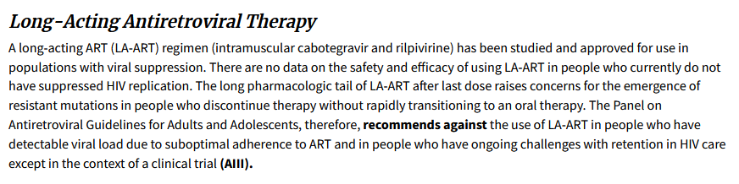
DHHS HIV Clinical Guidelines
Updated Sept 21, 2022
https://clinicalinfo.hiv.gov/en/guidelines/hiv-clinical-guidelines-adult-and-adolescent-arv/adherence-continuum-care?view=full
Notes:
Adherence to the Continuum of Care section of the DHHS guidelines includes a paragraph dedicated LA-ART that was just updated last month (September 2021)
This combination is indicated as a complete regimen for the treatment of HIV in adults to replace a current, stable ARV regimen in those with:
sustained (e.g., 3 to 6 months) virologic suppression (HIV-1 RNA <50 copies/mL)
no history of treatment failure
no known or suspected resistance to either CAB or RPV

Slide 18

Challenges with the uptake and use of LA ART
Induction period on oral ART
  Requires adherence / retention
Resistance
  2 drug ART regimen CAB/RPV
    limited to those WITHOUT an extensive history of resistance
  Long half-life of injectables: Risk of development of resistance
6 months
Notes:
Beyond having to come in for injections at regular intervals-
6 month induction period on oral ART – pts with a h/o nonadherence still have to take daily pills ~ 6months to become eligible for LA ART, undetectable at time of switch
Resistance: only 2 drug therapy, rilpivirine (better than efv but still relatively low genetic barrier to resistance) heavily treatment experienced/extensive resistance not even eligible; additional concern re: development of resistance due to tail in those who miss appts/fall out of care
Injection side effects, currently only gluteal injections, no self-admin
No idea cost/coverage, cost not just of infections but implementation
Unstudies populations, concern about pregnancy, challenging populations; how will we implement these in a way that is considered equitable (must not accentuate inequities)
Additional challenges in resource limited settings – supply chain for needles/col chain transport/refrigeration, requirement for resistance testing due to 2 drug regimen

Slide 19

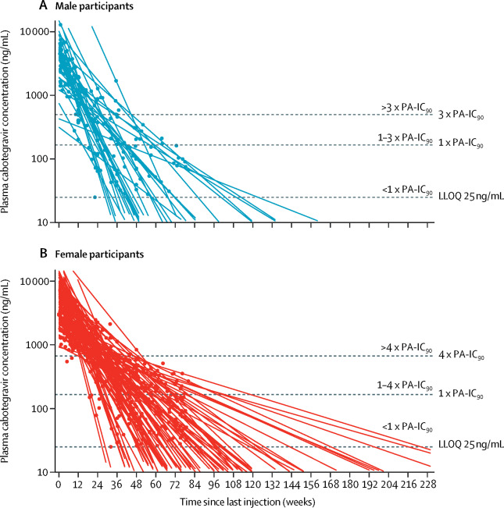
What’s a tail got to do with it?
Cabotegravir
1 yr
2 yr
3 yr
Landovitz et al. Lancet HIV. 2020

Slide 20
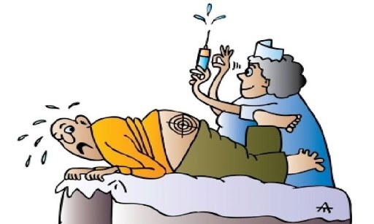
Challenges with the uptake and use of LA ART
Induction period on oral ART
  Requires adherence / retention
Resistance
  2 drug ART regimen CAB/RPV
    limited to those WITHOUT an extensive history of resistance
  Long half-life of injectables: Risk of development of resistance
Side-effects to Injections
6 months
Notes:
Beyond having to come in for injections at regular intervals-
6 month induction period on oral ART – pts with a h/o nonadherence still have to take daily pills ~ 6months to become eligible for LA ART, undetectable at time of switch
Resistance: only 2 drug therapy, rilpivirine (better than efv but still relatively low genetic barrier to resistance) heavily treatment experienced/extensive resistance not even eligible; additional concern re: development of resistance due to tail in those who miss appts/fall out of care
Injection side effects, currently only gluteal injections, no self-admin
No idea cost/coverage, cost not just of infections but implementation
Unstudies populations, concern about pregnancy, challenging populations; how will we implement these in a way that is considered equitable (must not accentuate inequities)
Additional challenges in resource limited settings – supply chain for needles/col chain transport/refrigeration, requirement for resistance testing due to 2 drug regimen

Slide 21
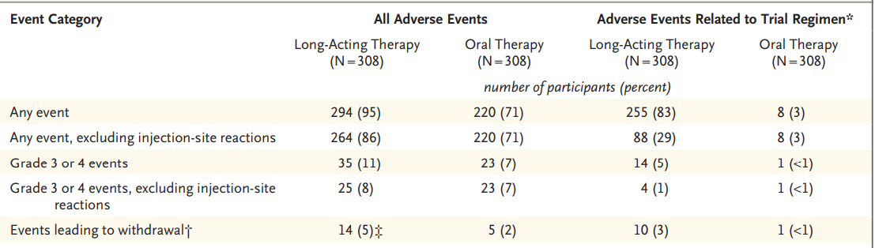
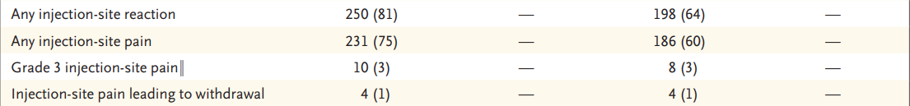
Side effect profile of LA Cabotegravir + Rilpivirine
Swindells. NEJM 2020
Notes:
The most frequent events leading to withdrawal in the long-acting–therapy group were injection-site pain (4 participants), viral hepatitis (3), and headache (2). All other events in both groups were reported in 1 participant each.
Important to note that while almost all participants reported ISR, (pain) almost all resolved within 7 days, rarely led to withdrawl and most isr by week 48.

Slide 22
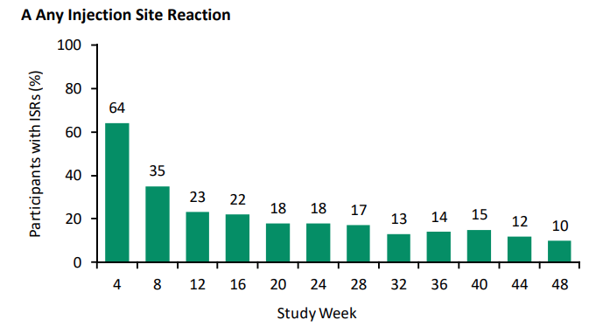
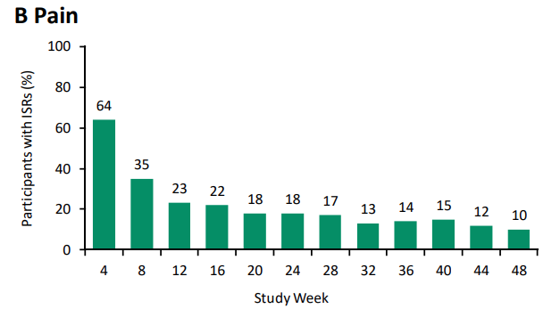
Incidence of injection site reaction adverse events
Swindells NEJM 2020 Supplementary Appendix

Slide 23


Challenges with the uptake and use of LA ART
oral ART
Requires adherence / retention
Resistance
  2 drug ART regimen CAB/RPV
    limited to those WITHOUT an extensive history of resistance
  Long half-life of injectables: Risk of development of resistance
  Side-effects to Injections
Unstudied populations
  Women of Child Bearing Potential, Youth
Cost and Equity
6 months
Notes:
Beyond having to come in for injections at regular intervals-
6 month induction period on oral ART – pts with a h/o nonadherence still have to take daily pills ~ 6months to become eligible for LA ART, undetectable at time of switch
Resistance: only 2 drug therapy, rilpivirine (better than efv but still relatively low genetic barrier to resistance) heavily treatment experienced/extensive resistance not even eligible; additional concern re: development of resistance due to tail in those who miss appts/fall out of care
Injection side effects, currently only gluteal injections, no self-admin
No idea cost/coverage, cost not just of infections but implementation
Unstudies populations, concern about pregnancy, challenging populations; how will we implement these in a way that is considered equitable (must not accentuate inequities)
Additional challenges in resource limited settings – supply chain for needles/col chain transport/refrigeration, requirement for resistance testing due to 2 drug regimen

Slide 24
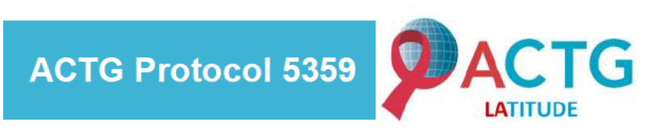
LATITUDE : Long-Acting Therapy to Improve Treatment sUccess in Daily LifE
ART-experienced, HIV-infected, males and non-pregnant females ≥18 years of age with:
      Evidence of non-adherence according to at least one of the following criteria:
        Poor virologic response to prescribed ART for at least 6 months
        Loss to clinical follow-up for >6 months with ART non-adherence
      Negative for Hepatitis B

Slide 25
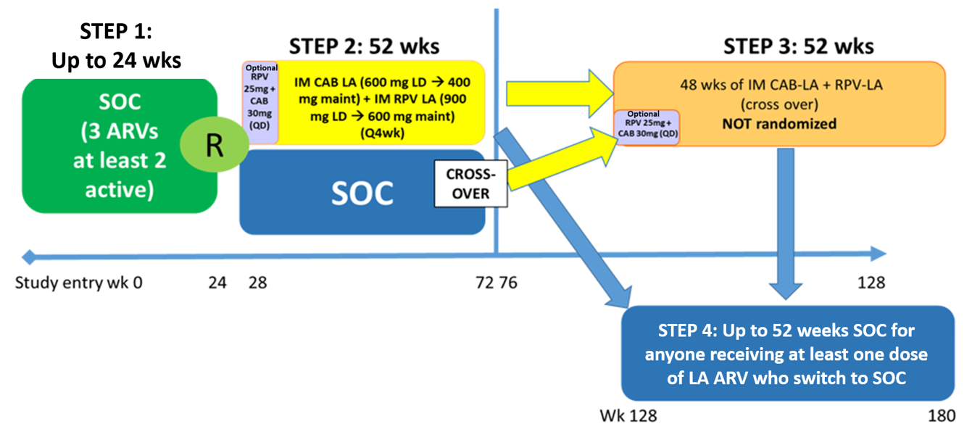
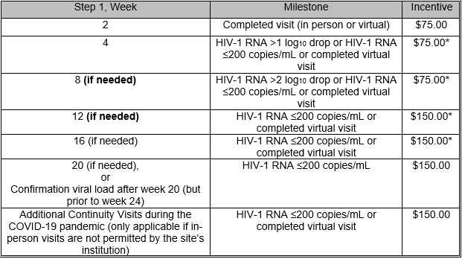
LATITUDE (A5359) Study Design (V3.0)
Conditional Economic Incentives

Slide 26

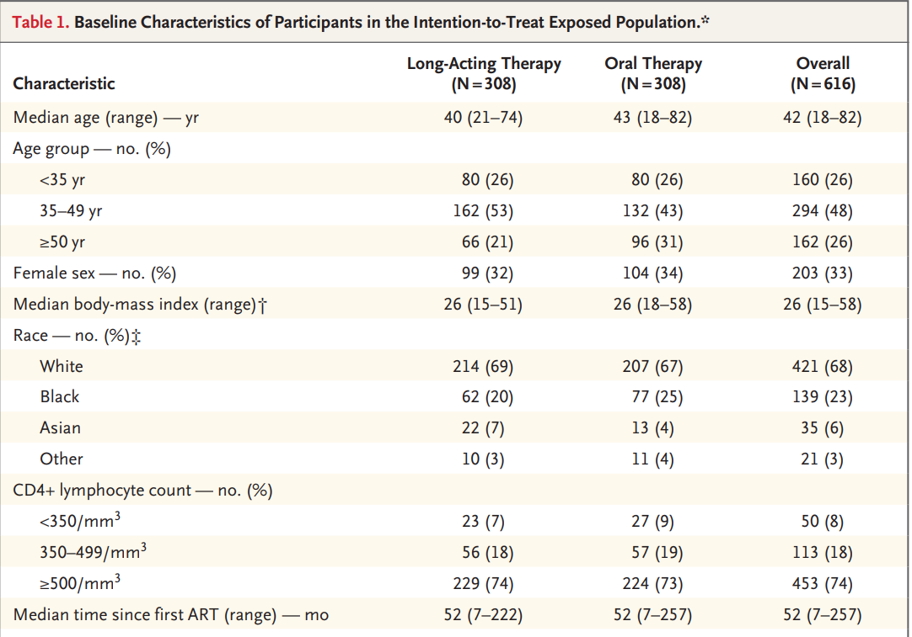
ATLAS baseline characteristics
Registered Sites: 31 ACTG, 4 IMPAACT – U.S + Puerto Rico
Screened: 717
Enrolled in Step 1: 347
  64% Black/African-American
  17% Hispanic/Latinx Ethnicity
  29% Female Sex at Birth
  6% Age 18-24 years
  14% Age 25-30 years
  4% Transgender (n=15)
  5% current injection substance use
  Median CD4 count 262 cells/mm3
  Median time since HIV diagnosis 13 years

Slide 27
emerging data on use of LA-ART in people with challenges with adherence
Notes:
Not quite data free zone

Slide 28
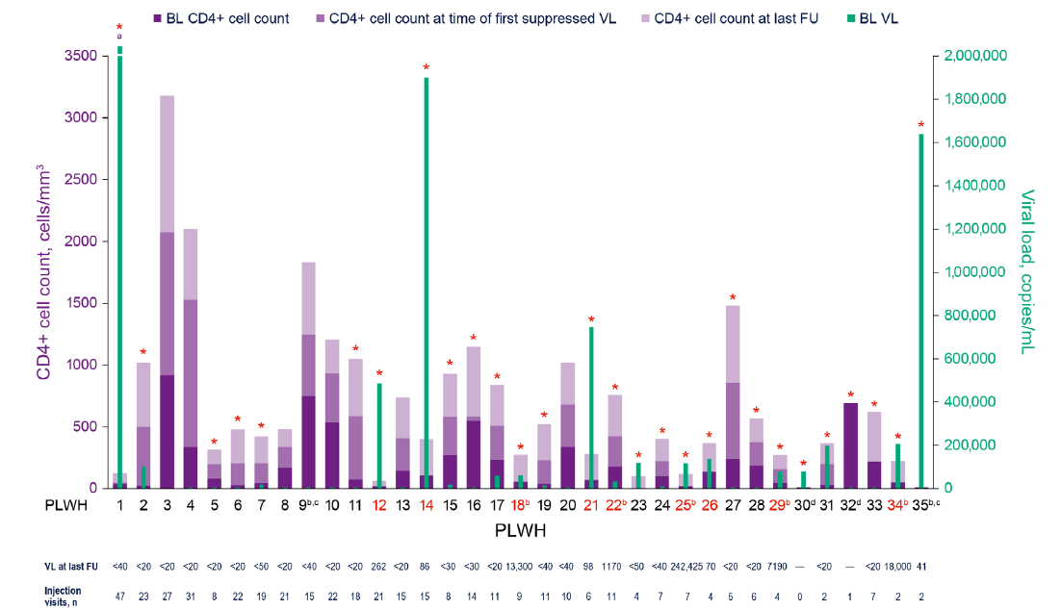
LA-CAB/RPV in PWH with viremia- Compassionate Use
Data through July 2020; median f/u 10 months
43% due to non-adherence (psychiatric)
16/28 with viremia suppressed (most ≤12 mo)
6/7 suppressed remained undetectable
NNRTI/INSTI resistance in those not suppressed
INSTI: integrase strand transfer inhibitor. NNRTI: non-nucleoside reverse transcriptase inhibitor. BL: baseline.
VL: viral load. FU: follow-up.
D’Amico R, et al. HIV Med 2022.
Notes:
In the la-Cab/RPV compassionate use program (not felt to have any other available options) , the most frequent reason for compassionate use request was chronic non-adherence due to psychological conditions with 15/35 participants. ). 28/35 did have detectable Viremia (median about 60K copies) at data cut off reported, with just over half of those viremecs suppressed.

Slide 29
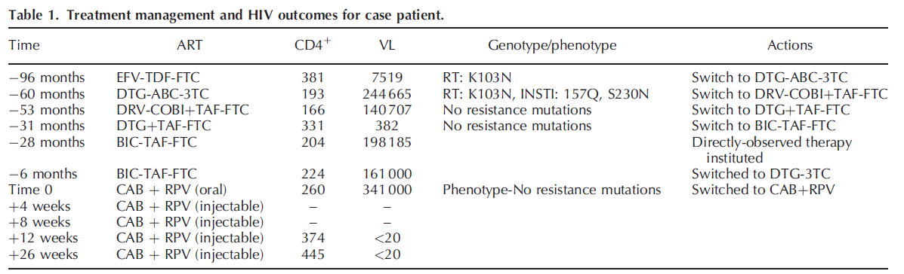
LA-CAB/RPV in PWH with viremia-Case Report
EFV: efavirenz. TDF: tenofovir disoproxil fumarate. FTC: emtricitabine. DTG: dolutegravir. ABC: abacavir.
3TC: lamivudine. DRV: darunavir. COBI: cobicistat. TAF: tenofovir alafenamide. BIC: bictegravir.
Barnett SK, et al. AIDS 2022.
Notes:
A case report of an indivudal who had failed 4 different oral ART regimens as outlined here and was switched first to ral cab/rpv and then long acting cab/rpv.

Slide 30
Implementation: Staff perceptions
 | Perceived Barrier (Baseline), n=26 | Actual Barrier (Month 4), n=24
Ability to keep monthly appt | 80% | 38%
Not being able to identify missed visit | 73% | 46%
Staffing / Clinic Flow | 54% | 38%
Reschedule missed visit | 50% | 20%
Patient failing CAB/RPV due to missed visit | 50% | 16%
Czarnogorski M et al. AIDS2020. LBPEE42
Notes:
Accceptability, appropriateness and fesiblity all >85% at baseline and 4 months. Who did staff think would be best: tired of taking pills, patients with concerns about stigma/disclosure, stress/anxiety with daily adherence
When we talk about implementation it’s important to really understand who all the stakeholders are from administration, pharmacists, navigators, social workers and patients and their clinicians – ultimately the patients have to be comfortable and want to receive it and the clinicians has to be comfortable prescribing. Historically, the system and treatment community have had a heavy hand in determining when is the right time to prescribe ART. We hope with LAI it can be different and we can ensure that all communities have suitable access.
On the surface LAI seems great but must remember that - For already adherent patients, clinic burden increases because LAI-ART requires more frequent visits than the every 4-12 month interval for patients on stable oral regimens, potentially shifting resources (appointment slots, staff effort) away from the less stably engaged patients who stand to gain the most marked individual and public health benefits
88% of youth said interested (can be a
Acceptability, appropriateness and feasibility all >85% at baseline and 4 months. Who did staff think would be best: tired of taking pills, patients with concerns about stigma/disclosure, stress/anxiety with daily adherence
TITLE
Perceived implementation barriers decrease during initial stages of the first implementation science hybrid III study (CUSTOMIZE) of cabotegravir and rilpivirine long-acting (CAB+RPV LA) in US healthcare settings: Healthcare team perspective
PRESENTER
Maggie Czarnogorski
AUTHORS
M. Czarnogorski * (1), C. Garris (1), P. Wannamaker (1), R. D'Amico (1), D. Merrill (1), C.A. McHorney (2), L. Stassek (2), S. Mansukhani (2), J. Flamm (3), B. Thedinger (4), P. Benson (5), M. Wolfeiler (6), G. Sinclair (7), W. Spreen (1)
INSTITUTIONS
(1) ViiV Healthcare, RTP, United States, (2) Evidera, Patient-Reported Outcomes, North Wales, United States, (3) Kaiser Permanente Sacramento, Sacramento, United States, (4) Kansas City Free Health Clinic, Kansas City, United States, (5) Be Well Medical Center, Detroit, United States, (6) AIDS Healthcare Foundation, Miami, United States, (7) PrismHealth North Texas, Dallas, United States
BACKGROUND: CAB+RPV LA administered monthly for HIV treatment can eliminate daily oral ART for some patients, but will require a paradigm shift in HIV care delivery with more frequent clinic appointments and resourcing/logistic changes. CUSTOMIZE, a novel prospective implementation science study, examined US provider perspectives of LA injectable ART prior to regulatory approval.
METHODS: Staff from diverse HIV care settings participated including Federally Qualified Healthcare Centers, universities, private practices, AIDS Healthcare Foundation, integrated managed-care consortium. Three providers from each site (physicians, injectors, administrators) completed surveys at Baseline (N=26) and Month 4 (M4) (N=24) evaluating acceptability (AIM), appropriateness (IAM), feasibility (FIM), and barriers to CAB+RPV LA implementation. Proportions and mean scores (higher scores more positive) were calculated for AIM, IAM, FIM.
RESULTS: Most staff (>84%) agreed/completely agreed that CAB+RPV LA was acceptable, appropriate and feasible at Baseline and M4 (Table 1) with some variability by provider type. Baseline scores were slightly higher among injectors. Overall FIM mean scores were high (Baseline, M4); FIM proportions were stable for administrators at M4 with a slight decrease for physicians and injectors. Proportion of clinical staff reporting barriers to implementation decreased between Baseline and M4 (Table 2).
CONCLUSIONS: CAB+RPV LA was highly acceptable, appropriate, and feasible for a large majority of staff across HIV care settings. Top rated perceived barriers at Baseline were patient ability to keep monthly appointments, transportation, and awareness of missed injection visits. At M4, a smaller proportion of staff reported these barriers, suggesting CAB+RPV LA implementation concerns notably decrease after an initial implementation phase.

Slide 31
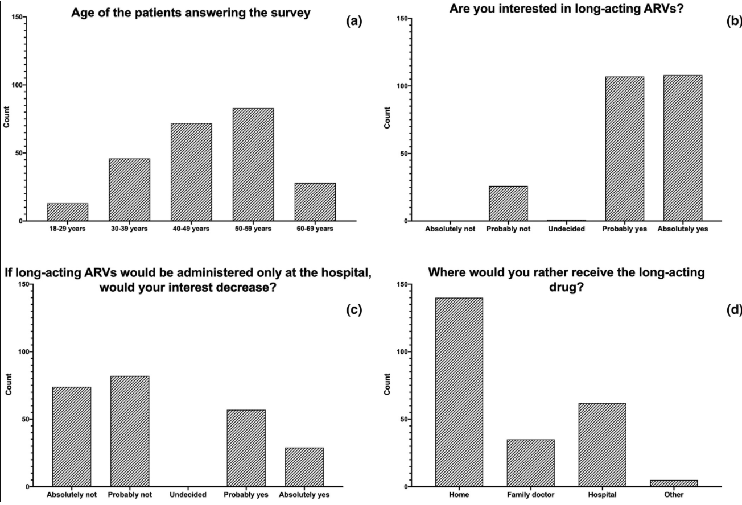
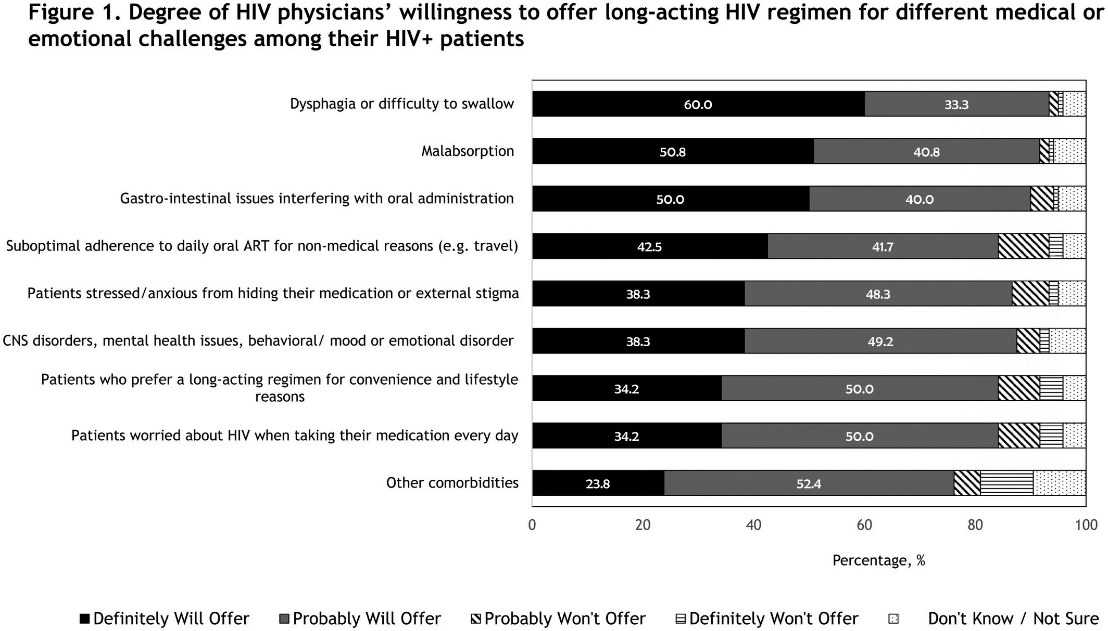
Interest in injectable ART:
People with HIV and physicians
Patients
Physicians
Akinwunmi B et al. HIV Glasgow 2020, abstract P014
Celesia M et al. HIV Glasgow 2020, abstract P015
Notes:
242 patients, 24% femailes, of whom 1/3 did report challenges with ART. Anonymous online survey
Akinunmi 4 countries in Europe, study done by viiv
Celesia in italy

Slide 32
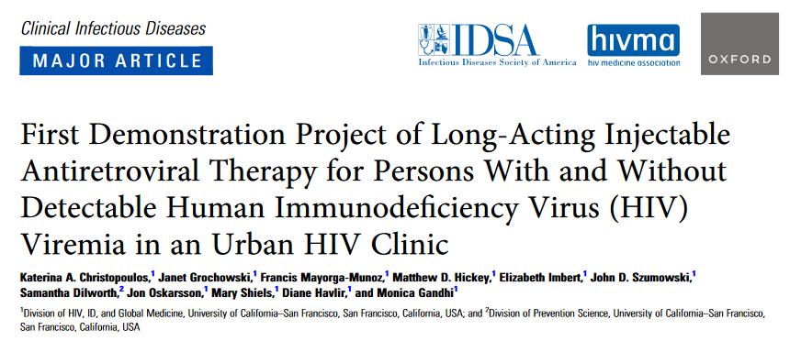
Ward 86 in San Francisco
Christoploulos KA, et al. CID. August 2022.

Slide 33
Demonstration Project of LA ART for Persons With and Without Detectable HIV Viremia
Ward 86 HIV clinic in San Francisco
June 2021-April 2022
  51 patients initiated LA ART; 39 received at least 2 follow-up injections
  90% cisgender men; 61% non-White; 41% marginally housed; 54% using stimulants
  24 initiated with viral suppression → 100% maintained viral suppression
  15 initiated with detectable viremia → 12 (80%) achieved suppression; 3 had 2-log decline by median of 22 days
Christoploulos KA, et al. CID. August 2022.
Notes:
It’s nothing short of remarkable!
Nearly half of the patients were marginally housed and/or using stimulants

Slide 34
Demonstration Project of LA ART for Persons With and Without Detectable HIV Viremia
Remarkable results achieved due to remarkable efforts by care team:
  Patients were allowed to drop in for injections
  Some injections delivered in field
    “1 patient with detectable viremia at baseline received injections…in partnership with street-based nursing staff from the San Francisco Department of Public Health.”
  All injections were on time
Important caveats:
  Very few women
  Monthly injections
  Follow-up time < 1 year
Christoploulos KA, et al. CID. August 2022.
Notes:
But these remarkable results were achieved with remarkable efforts →

Slide 35
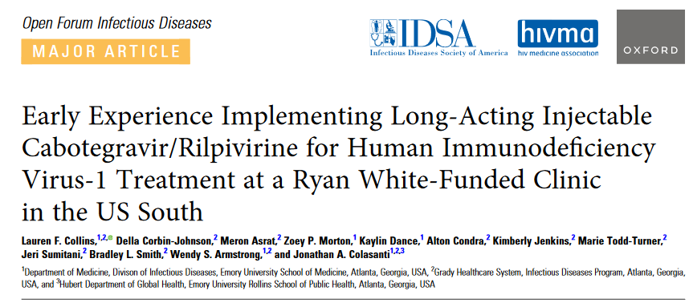
Pilot Data from the Grady Ponce de Leon Center
Collins LF, et al. OFID. September 2022.
Notes:
Even Grady’s Ponce clinic, one of the most well-resourced HIV programs in the country, has faced significant challenges

Slide 36
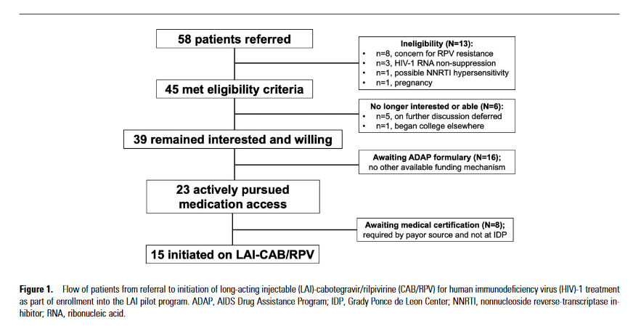
Of 58 referrals received and 39 patients enrolled, only 15 (38%) have successfully accessed LA CAB plus RPV
Collins LF, et al. OFID. September 2022.
Notes:
Of 58 referrals received and 39 patients enrolled, only 15 (38%) have successfully accessed LA CAB plus RPV over the course of 12 months

Slide 37
This is Despite a TREMENDOUS Amount of Effort
Team Members and Associated Effort on Pilot Program
Team Member | FTE Dedicated to Pilot
Medical director (MD) | 0.10
Clinician co-lead (MD) | 0.10-0.15
Program director (RPh) | 0.25-0.35
Pharmacy lead (PharmD) | 0.10
Medication access coordinator (MPH) | 0.10-0.15
Medical benefits specialist | 0.05
Nursing lead (RN) | <0.05
Injection administrator (MA) | 0.10
Scheduling lead | <0.05
FTE = full-time equivalent
Collins LF, et al. OFID. September 2022.

Slide 38
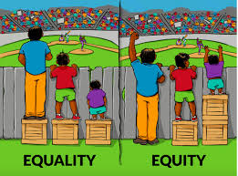
Narrow rather than widen the disparity gap
A Nudge
Travel Voucher
Appointment Reminders
“LAI available in our clinic”
More Help
Contingency Management
Patient Navigation
Mobile Units
Ptopnetwork.jff.org
“LAI available in our clinic AND we’ll do what we can to ensure you benefit from it”
Notes:
we have the equality model already – we have a federal funded payor of last resort. We can say that HIV care is available to all (and often free when necessary) for all those who need. But we see what results that has gotten us.
“Every system is perfectly designed to get the result that it does”
- William Edwards Deming

Slide 39

Thank you!

Slide 40
Q&A

Slide 41
AETC Program
National Centers and National HIV Curriculum
National Coordinating Resource Center serves as the central web based
repository for AETC Program training and capacity building resources; its
website includes a free virtual library with training and technical assistance
materials, a program directory, and a calendar of trainings and other events.
Learn more: https ://aidsetc.org
National Clinician Consultation Center provides free, peer to peer,
expert advice for health professionals on HIV prevention, care, and treatment
and related topics. Learn more: https ://nccc.ucsf.edu
National HIV Curriculum provides ongoing, up to date HIV training and
information for health professionals through a free, web based curriculum;
also provides free CME credits, CNE contact hours, CE contact hours, and
maintenance of certification credits. Learn more: www.hiv.uw.edu

