Slide 1
HIV Molecular Epidemiology and Cluster Detection
Ann Dennis, MD MS
May 1, 2023

Slide 2
Disclosures
I have no financial conflicts to disclose
This program is supported by the Health Resources and Services Administration (HRSA) of the U.S. Department of Health and Human Services (HHS) under grant number U1OHA30535 as part of an award totaling $4.2m. The contents are those of the author(s) and do not necessarily represent the official views of, nor an endorsement, by HRSA, HHS, or the U.S. Government. For more information, please visit HRSA.gov.

Slide 3
AETC Program National Centers and HIV Curriculum
National Coordinating Resource Center – serves as the central web –based repository for AETC Program training and capacity building resources; its website includes a free virtual library with training and technical assistance materials, a program directory, and a calendar of trainings and other events. Learn more: https://aidsetc.org/
National Clinician Consultation Center – provides free, peer-to-peer, expert advice for health professionals on HIV prevention, care, and treatment and related topics. Learn more: https://nccc/ucsf.edu
National HIV Curriculum – provides ongoing, up –to-date HIV training and information for health professionals through a free, web –based curriculum; also provides free CME credits, CNE contact hours, CE contact hours, and maintenance of certification credits. Learn more: www.hiv.uw.edu

Slide 4
Learning Objectives
Describe HIV molecular epidemiology and cluster detection
Recognize other signals for Response: Acute HIV and time-space clusters
Identify common concerns from the community

Slide 5
First some context – Ending the HIV Epidemic in the US

Slide 6
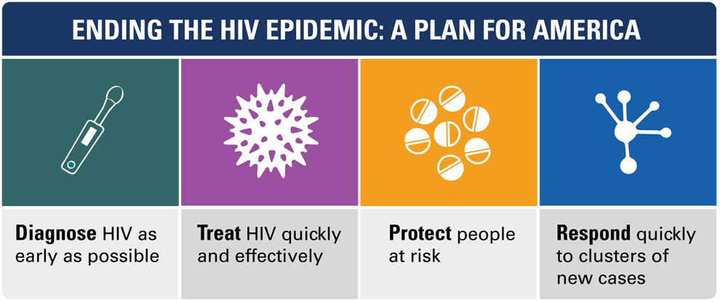
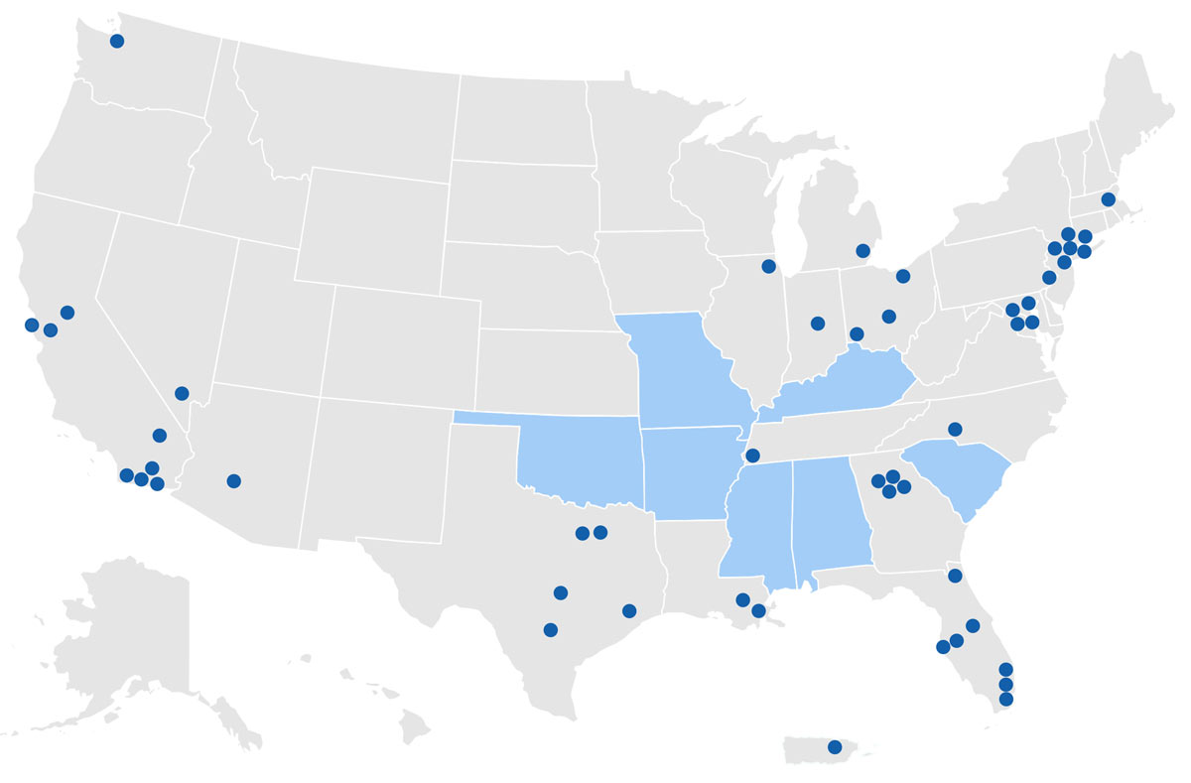
Respond Pillar
https://www.hiv.gov/federal-response/ending-the-hiv-epidemic/overview

Slide 7
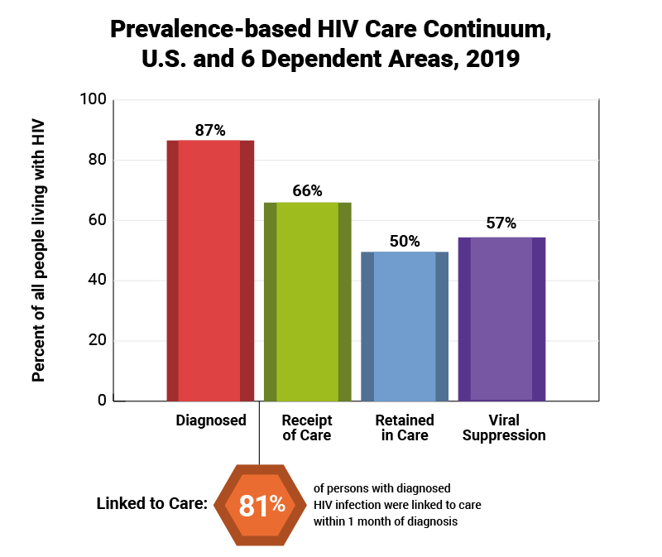

Reaching the 95-95-95 goals
Among Diagnosed
76.0% Receipt of Care
57.8% Retained in Care
65.5% Viral suppression
CDC, HIV Surveillance Supplemental Report 2021; 26(No. 2).

Slide 8
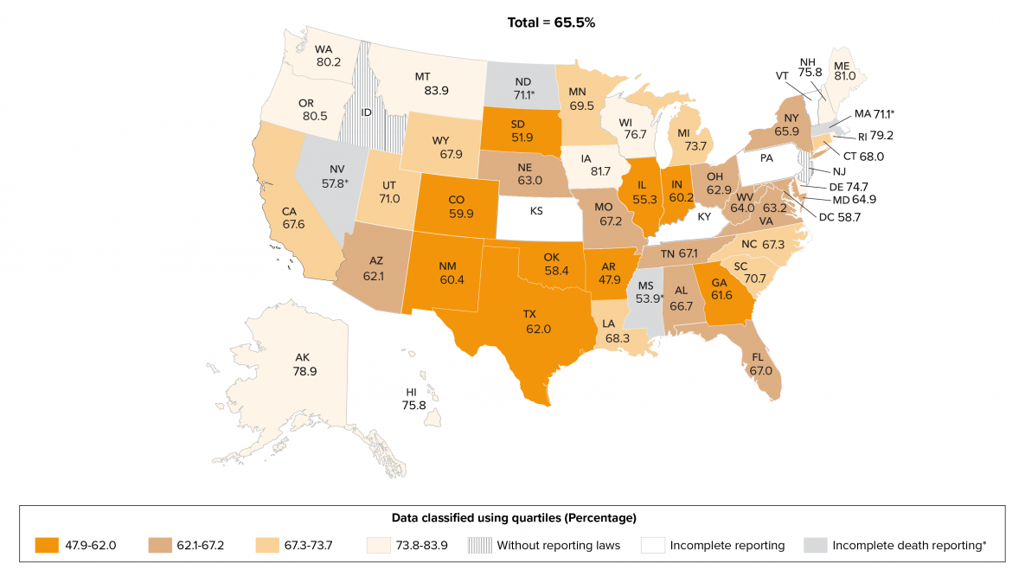
Understanding transmission networks can help direct interventions
Viral Suppression among Persons Aged ≥13 Years Living with Diagnosed HIV, 2019
Transmission is not evenly distributed
  Geography
  Risk groups
  Stage of infection
  Distribution of risk behaviors

Slide 9
Estimated contribution to transmissions along the care continuum
% | Unaware | Aware not suppressed | Taking ART & suppressed
Population | 14.9 | 33.9 | 51.2
Transmissions | 37.6 | 62.4 | 0
Li MMWR 2019
Earlier Diagnosis
Increase testing
Linkage to care
Retention in care
Adherence & viral suppression

Slide 10


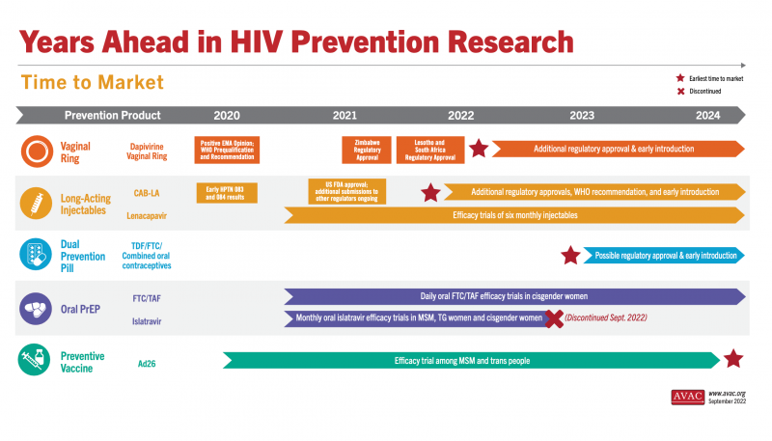

Deploying the combination prevention toolbox

Slide 11
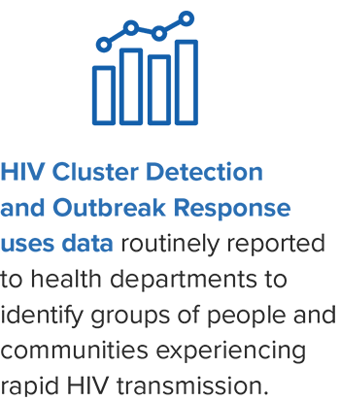
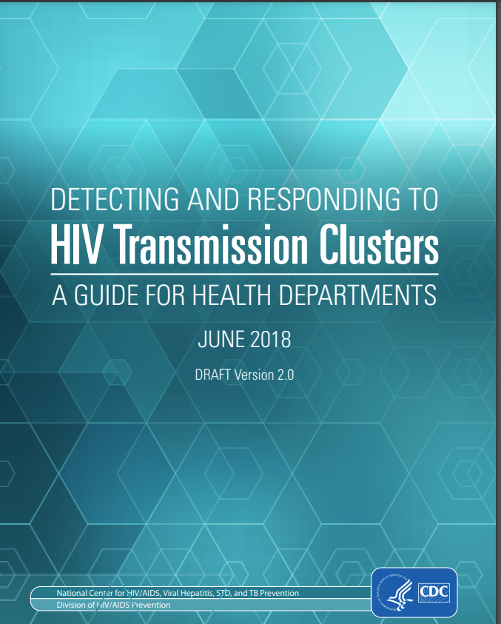
HIV Cluster Response
Identify outbreaks that can be stopped by interventions directed by local health departments

Slide 12
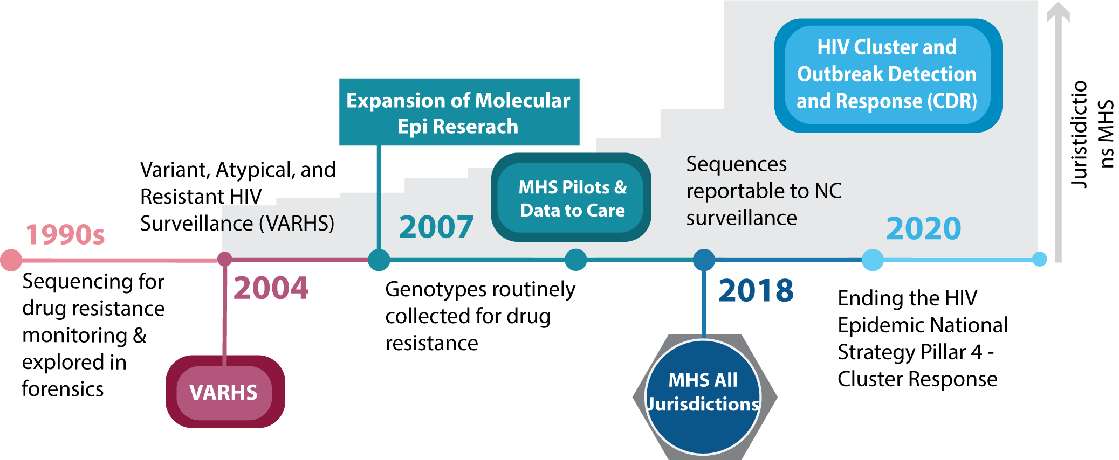
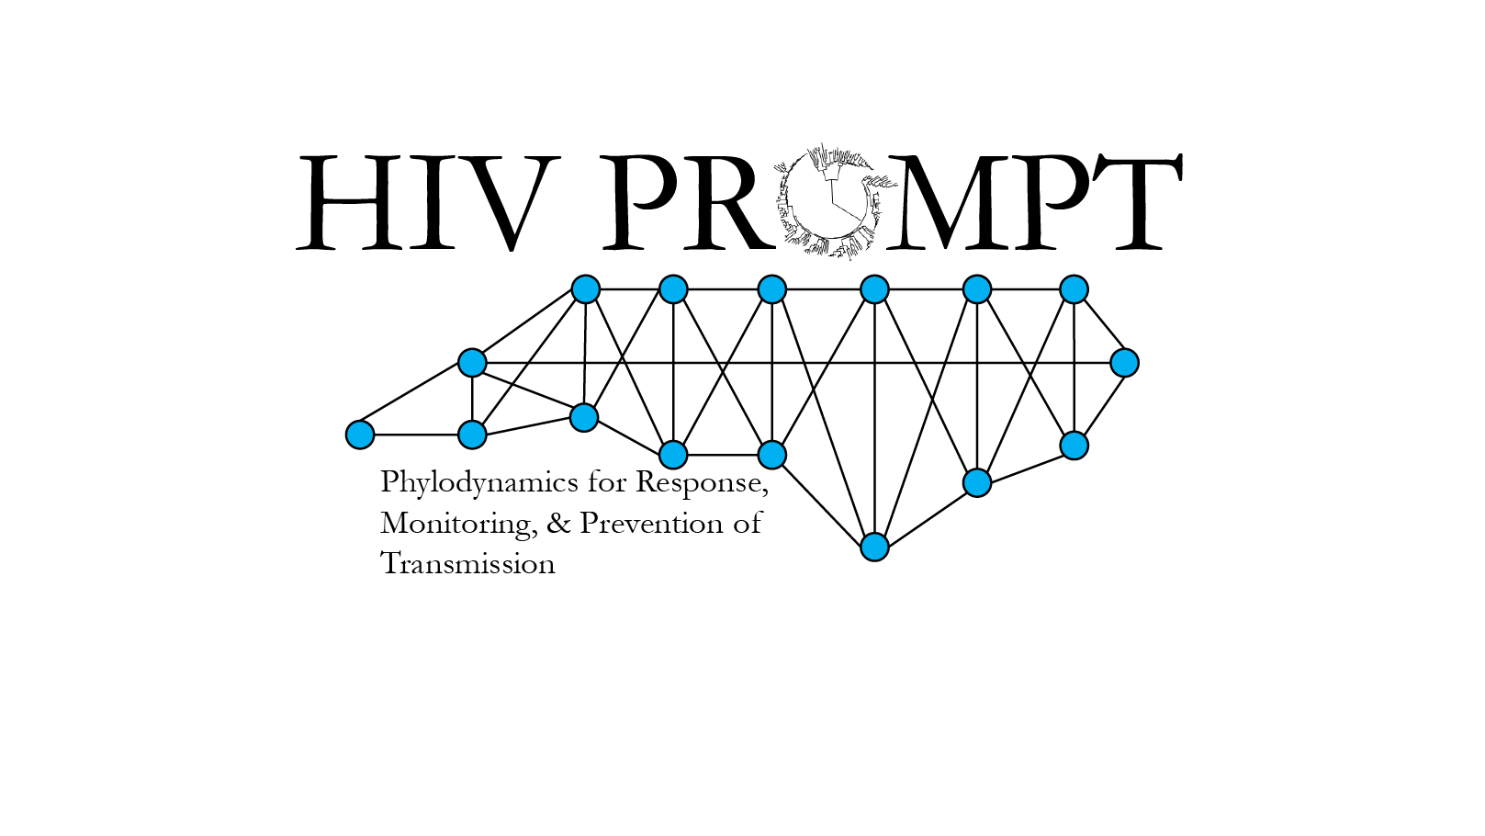
A brief timeline of Molecular HIV Epidemiology
  NIH R01 #AI135970
  Bioethics Supplement: Community Engagement

Slide 13




A note on terminology
Epidemiology
Surveillance

Slide 14
What can we learn from HIV molecular epidemiology?

Slide 15
HIV Molecular Epidemiology
Understanding the dynamics of HIV transmission through viral linkage between HIV nucleotide sequences to infer putative networks
HIV genetic clusters can be identified by phylogenetics or by comparison of pairwise genetic distances
Shorter genetic distance = less time elapsed since transmission and sampling
Cannot tell you:
Directionality (who infected who)
Full extent of trans chain (third parties unsampled)

Slide 16



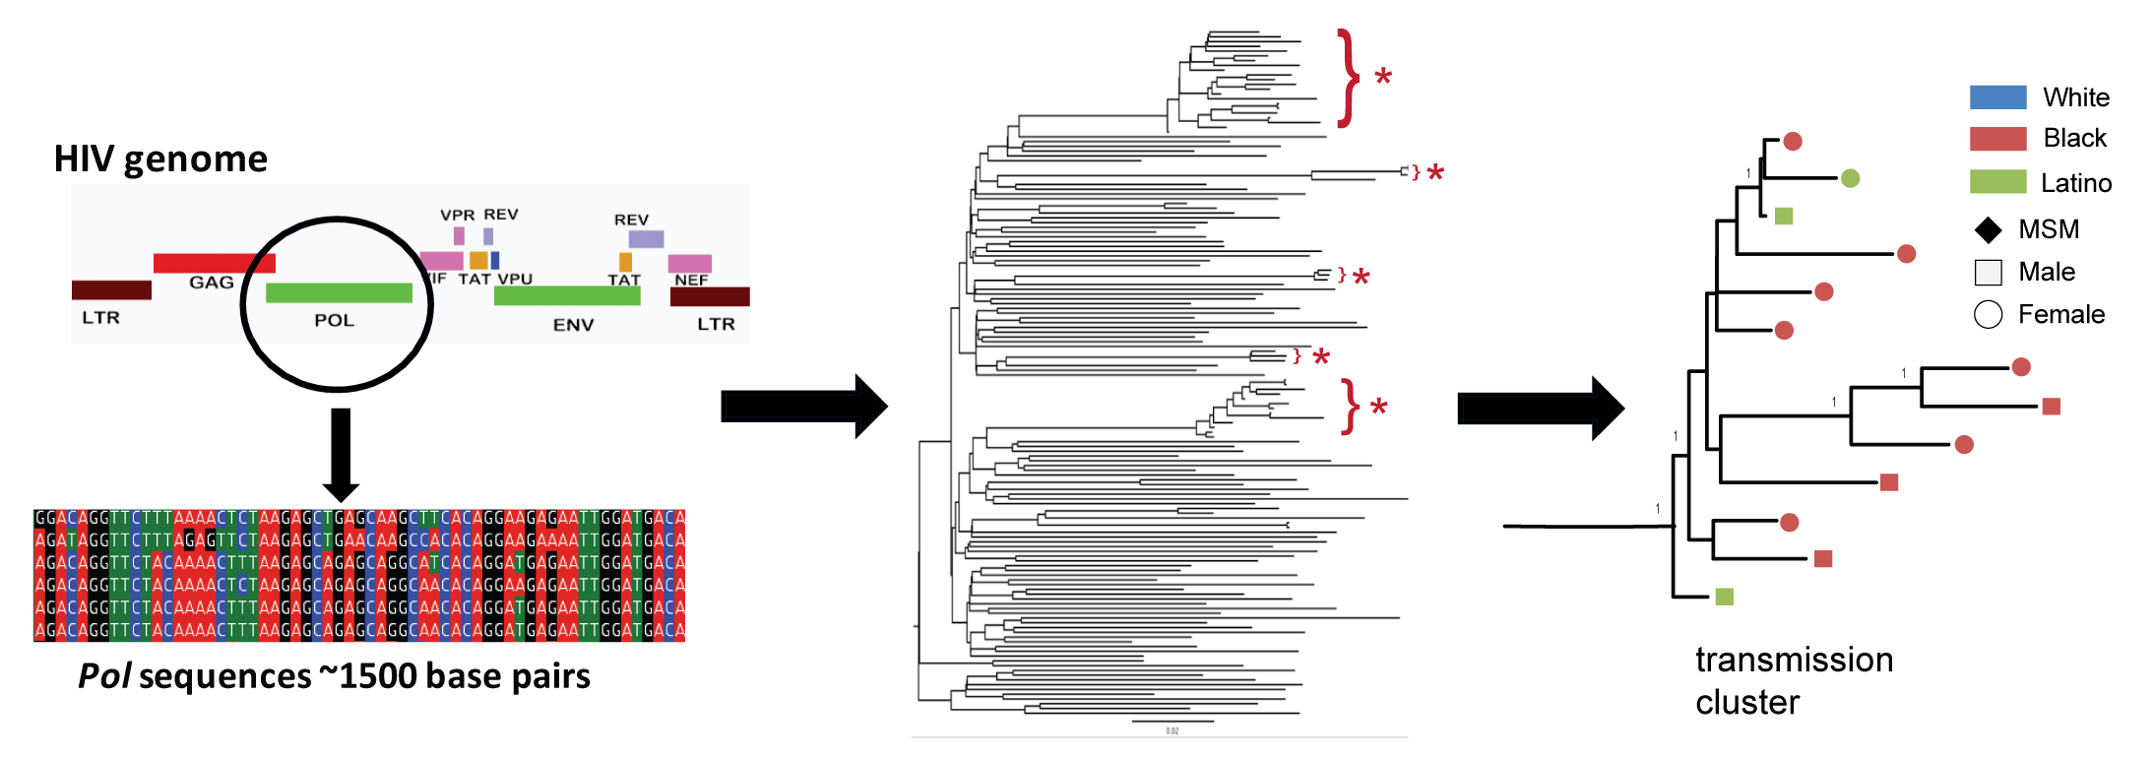
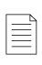
Most HIV molecular epidemiology studies use sequences from clinical genotypes
Care Entry
Virologic Failure
Viral sequence
Genotype Report of Resistance Mutations
Viral sequences sampled across the population

Slide 17
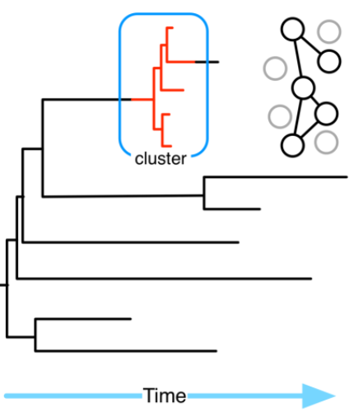
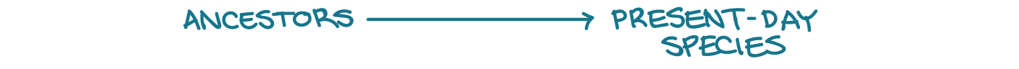
HIV Genetic Clusters/Networks
Cluster = closely related HIV viral sequences (no consensus on definition)
Likely related by recent transmissions (short branches)
Most recent common ancestor cluster
Most recent common ancestor clade
Tips
  Phylogenetics trees
  Evolutionary difference at each site

Slide 18
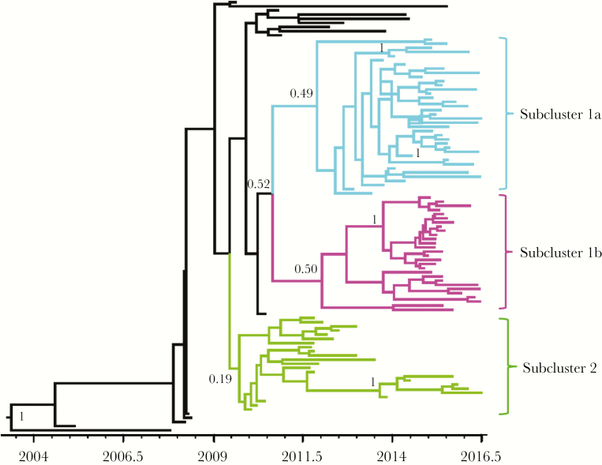
HIV Genetic Clusters/Networks
Cluster = closely related HIV viral sequences (no consensus on definition)
Likely related by recent transmissions (short branches)
Most recent common ancestor cluster
Most recent common ancestor clade
Tips
  Phylogenetics trees
  Evolutionary difference at each site
  Time-resolved
HIV among PWID in Scotland
Ragonnet-Cronin, JID 2018

Slide 19
HIV Genetic Clusters/Networks
Cluster = closely related HIV viral sequences (no consensus on definition)
Likely related by recent transmissions (short branches)
Most recent common ancestor cluster
Node
Edge
Most recent common ancestor clade
Tips
  Cluster represented as networks
  Pairwise genetic distances between
  sequences (nodes) resolved as linked pairs
  given a distance threshold (edges)
  Phylogenetics trees
  Evolutionary difference at each site

Slide 20
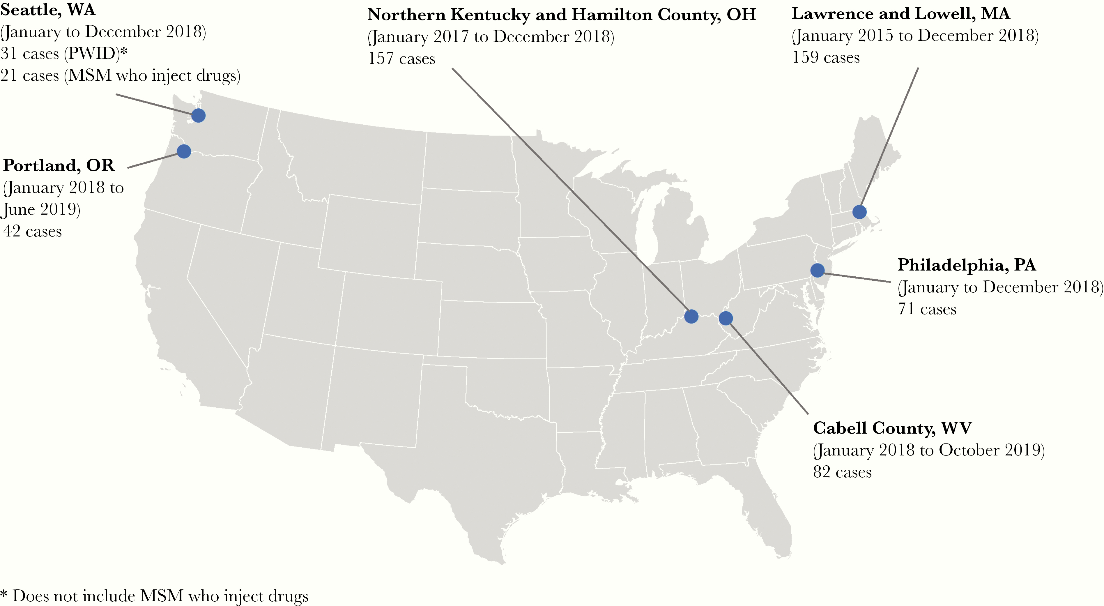
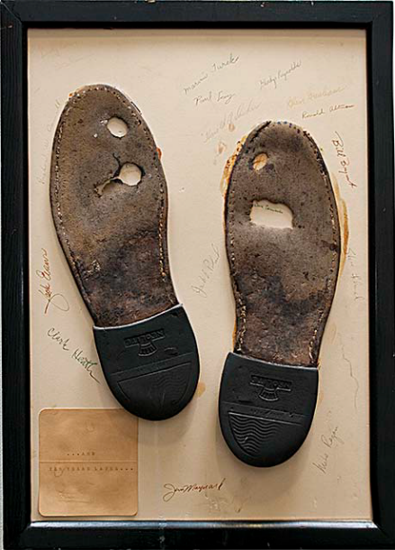
Examples –Outbreak Responses
Locations of 6 outbreaks CDC assisted in response, 2016-2019
Lyss, JID 2020

Slide 21
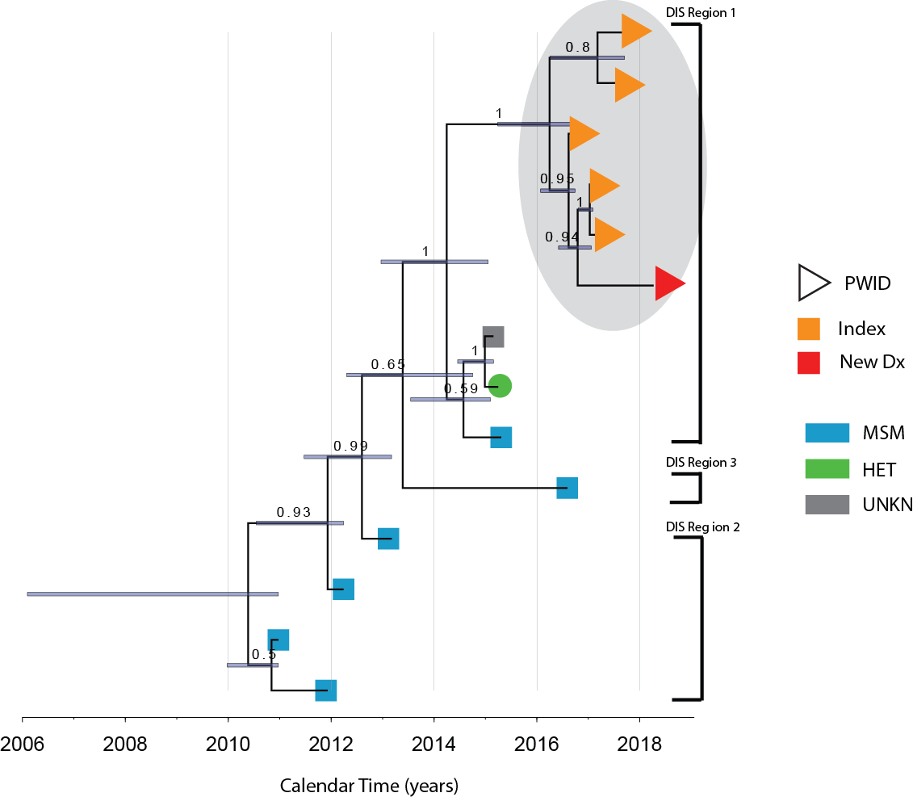
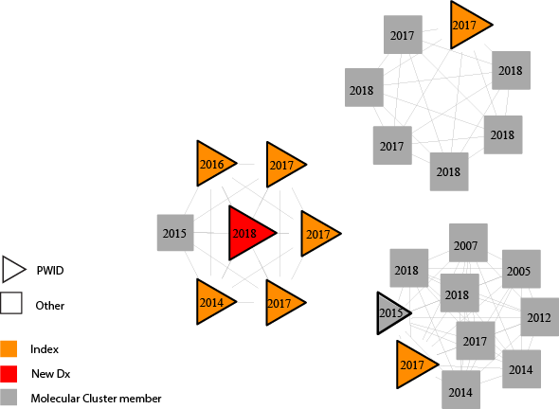
HIV outbreak among PWID in North Carolina
7 epi-linked HIV+ PWID in western NC recognized in 2017
Sub-cluster with multiple transmissions since 2016
Statewide Phylogenetics
5 in Genetic Cluster
Samoff et al. AJPH 2020

Slide 22
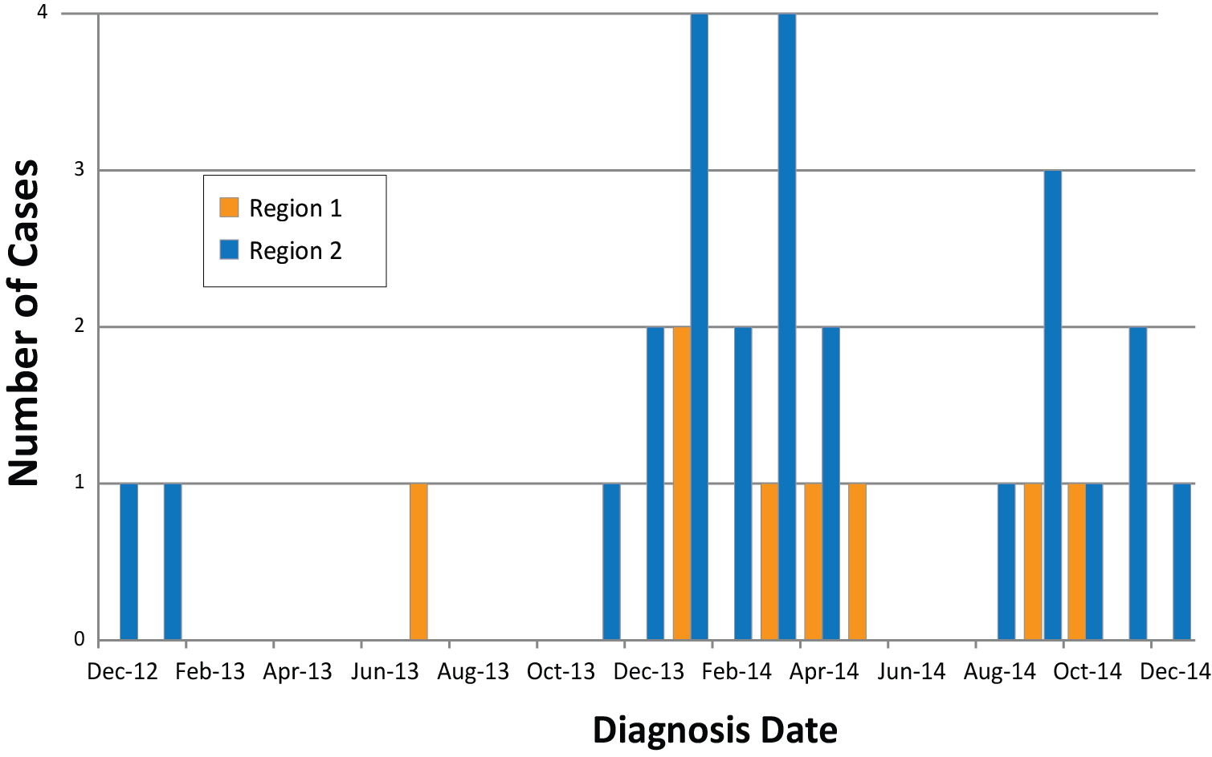
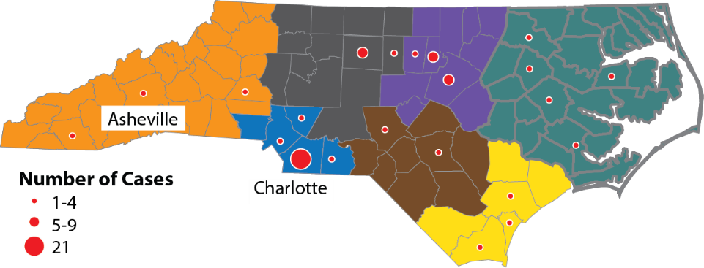
Spatial-temporal clustering of acute HIV in North Carolina, 2014
Phylogenetic analysis revealed cases did not form one genetically clustered “outbreak”
Dennis et al. STD. 2018

Slide 23
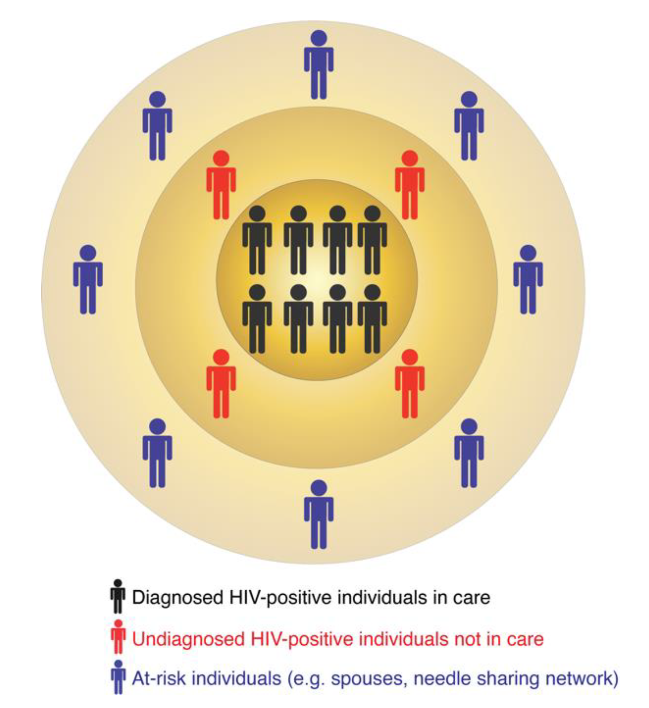
Genetic Clusters
The multi-layered structure of HIV transmission clusters
Very small genetic distance threshold captures recent transmissions
Miss potential members of transmission chain that do not have a sequence (i.e., undiagnosed)
Do not include at risk persons
Low sampling of sequences in a population could lead to spurious links
Romero-Severson, Viruses 2020

Slide 24
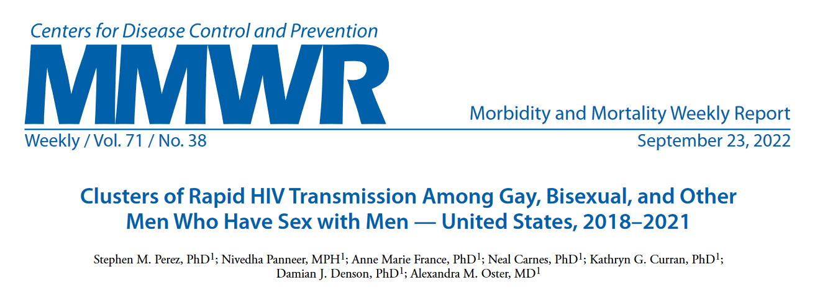
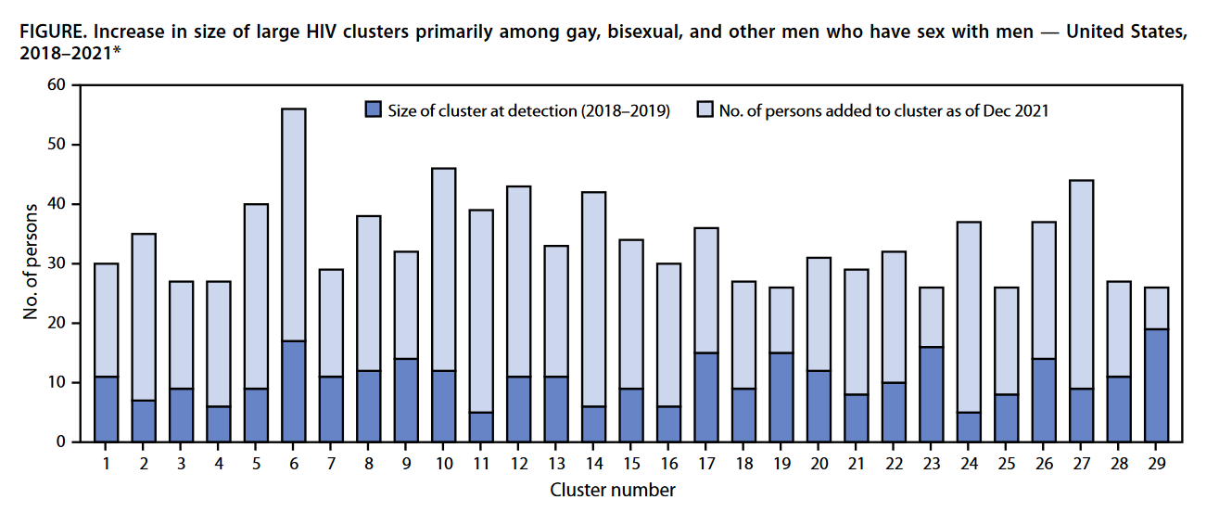
Clusters of Recent & Rapid Transmission
Genetic cluster threshold = 0.5% corresponds to 2-3 years of viral evolution between sequences
CDC clusters of concern = 5 PWH diagnosed in 12 months
Transmission rates >6x national estimates Oster JAIDS 2018
Most clusters were small at initial detection

Slide 25
Time-Space Clusters
Outbreaks can be identified changes in patterns of HIV diagnoses (i.e., clinics, community members, partner services)
Analyzing surveillance data to identify increased diagnoses during a specific time period in a geographic area “time-space clusters”

Slide 26
Importance of Acute and Early HIV Detection for Public Health

Slide 27
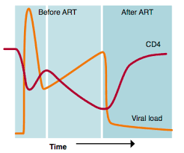

Acute and early HIV are sentinel events
Leading edge of the epidemic = incidence
Opportunity for:
  Rapid ART to reduce viremia and onward transmission
  Intensified services – identify gaps in HIV prevention and public health programs
Community Prevention
Care Linkage & Retention PWH
Index Person
Linkage to Care

Slide 28
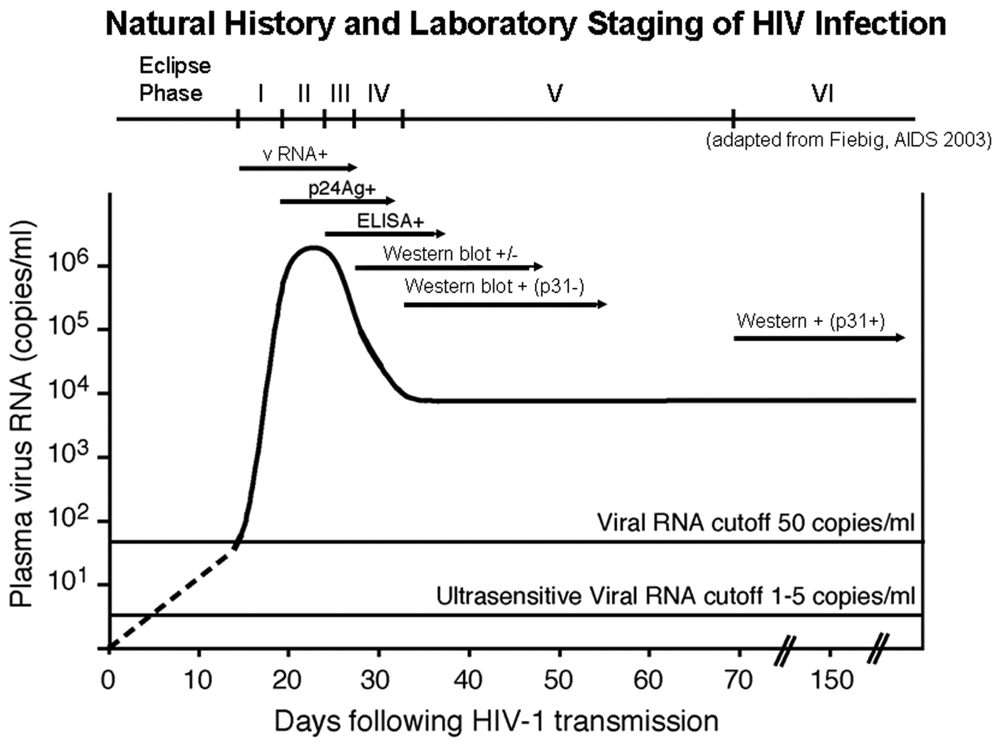
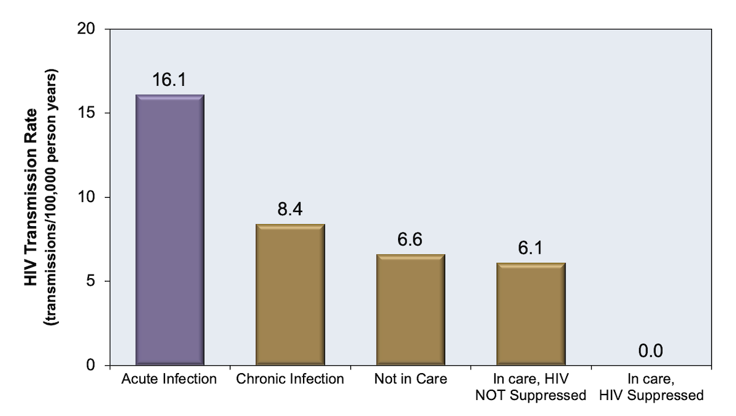
High rate of HIV transmission during AHI
Brief but efficient - Elevated transmission rate
Two-fold higher transmission rate compared to chronic infection
Cohen JID 2010
Li MMWR 2019

Slide 29
Key Points for Public Health
Estimated that 40% transmissions occur within one year of acquisition
Swiss Cohort, Martzel CID 2016
Response programs highly successful at rapid linkage to care
NC STAT, Kuruc JAIDS 2016
Immediate ART during AHI reduces transmission by 89%
Bangkok, Kroon JAIS 2017

Slide 30
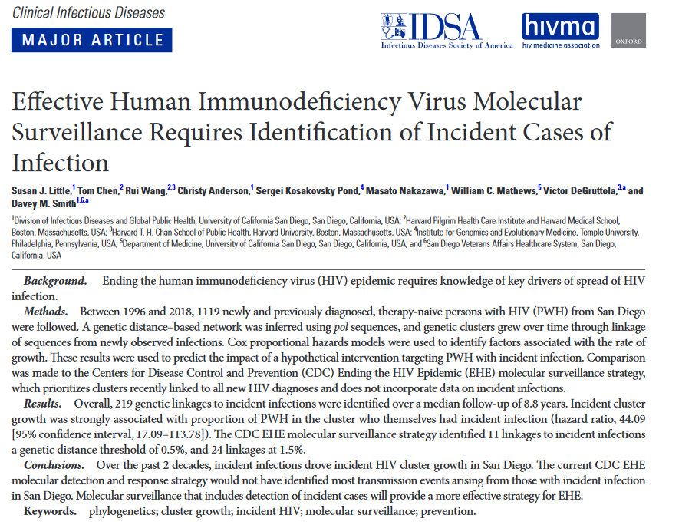
Importance of incident HIV in molecular epidemiology
Incident HIV were a major driver of cluster growth in San Diego
The CDC EHE strategy may fail to identify new linked incident transmissions
Little CID 2021

Slide 31
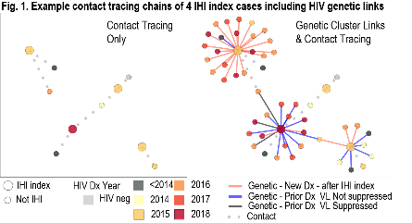
Can we improve response to incident HIV?
Rationale: Limited case finding during partner services
Dennis EClinicalMedicine 2021

Slide 32
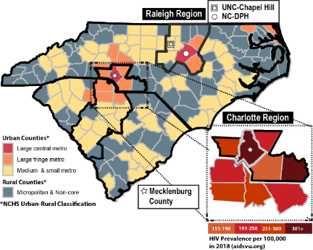
Carolinas RESPOND
Developing a social recruitment response to incident HIV infection among key population focused in EHE county Mecklenburg, North Carolina
Borders South Carolina, both high burden HIV in rural areas
Molecular epidemiology will be key to understand spatial & temporal transmission

Slide 33
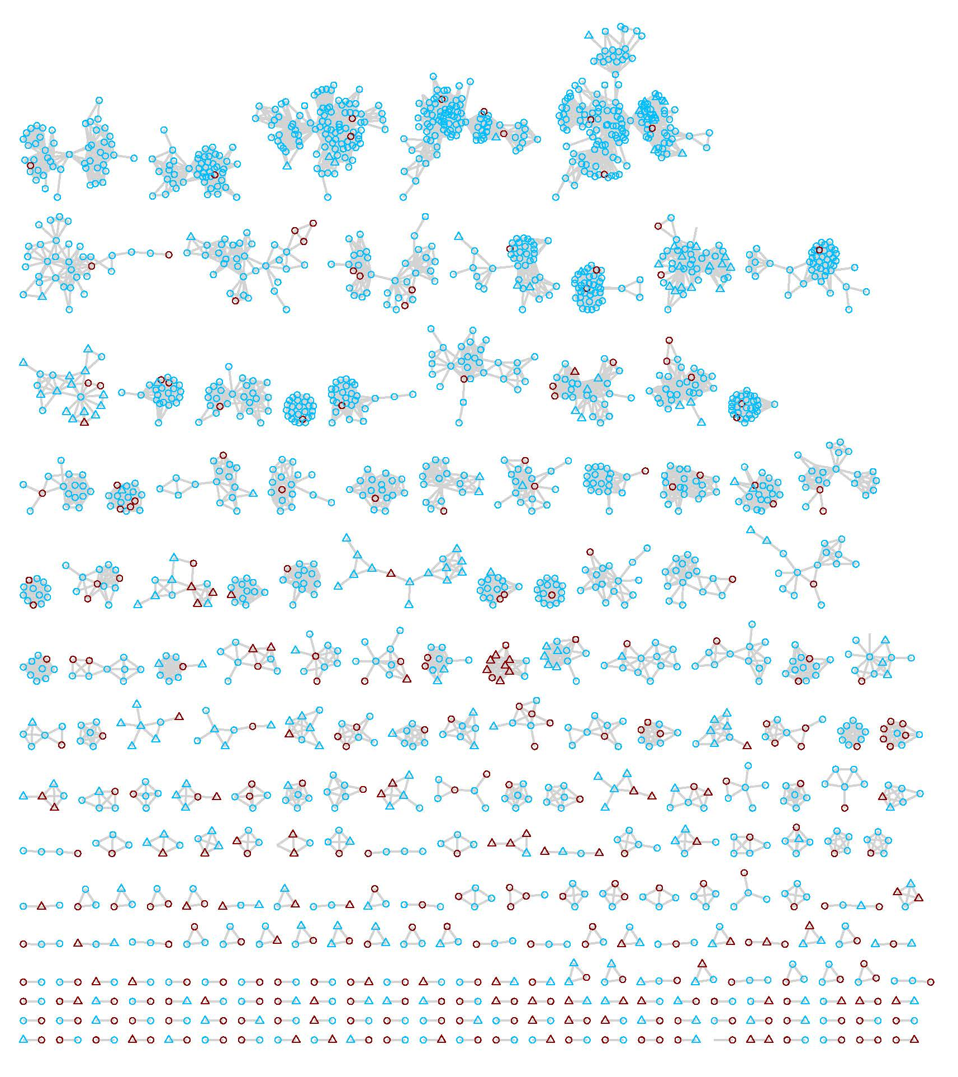
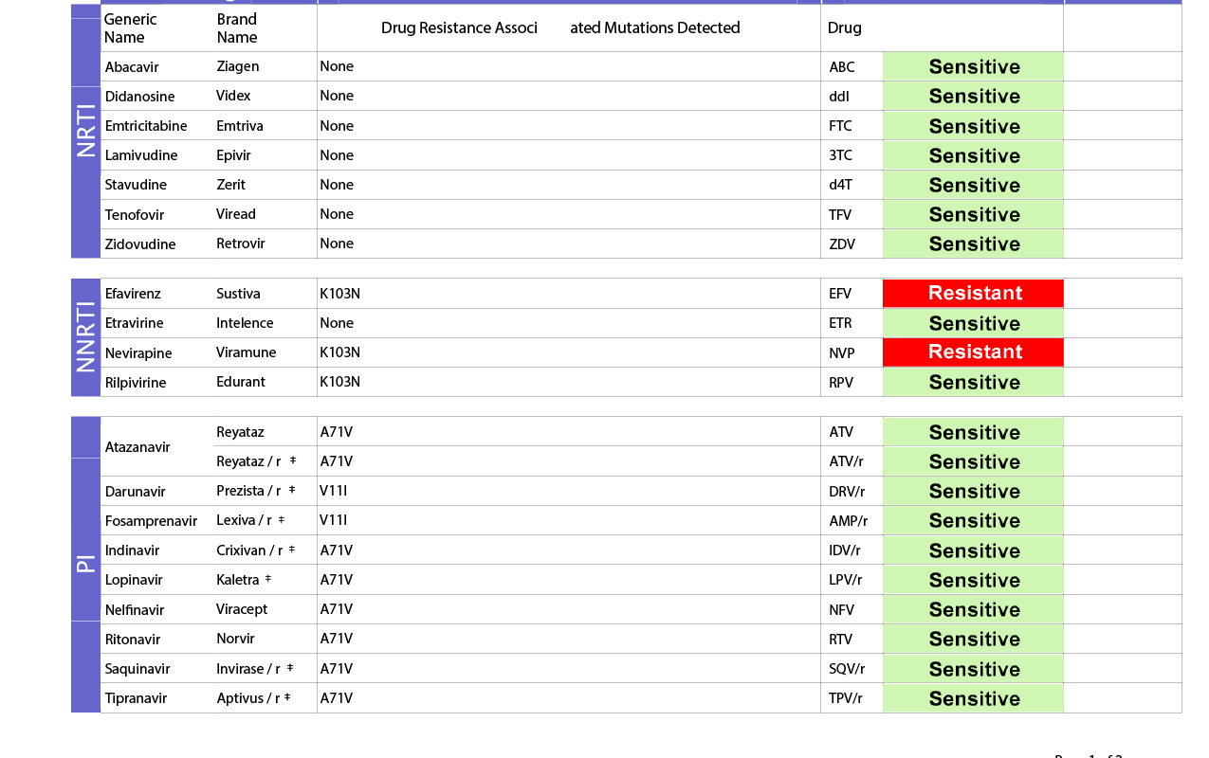
But what about drug resistance?
How it started
How it’s going

Slide 34
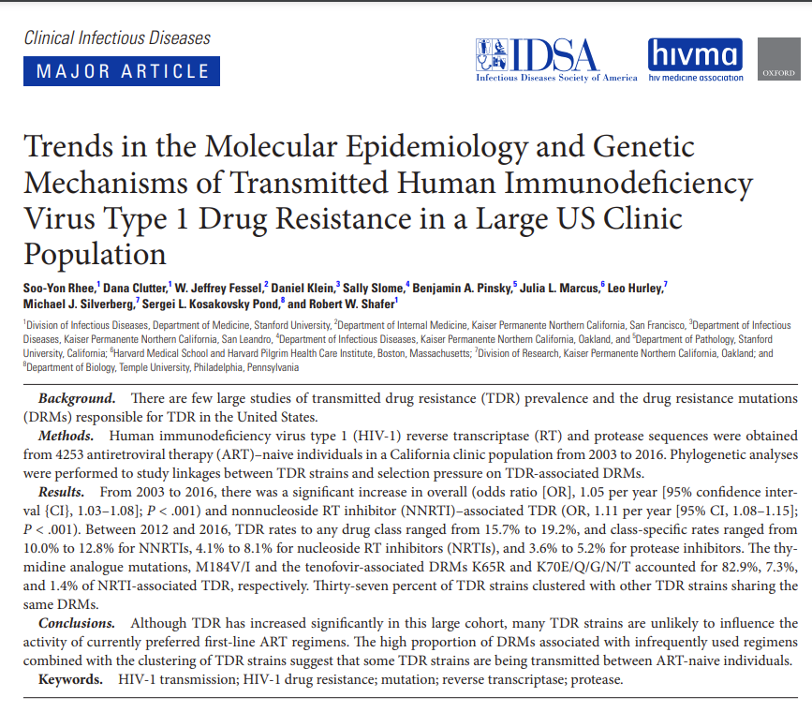
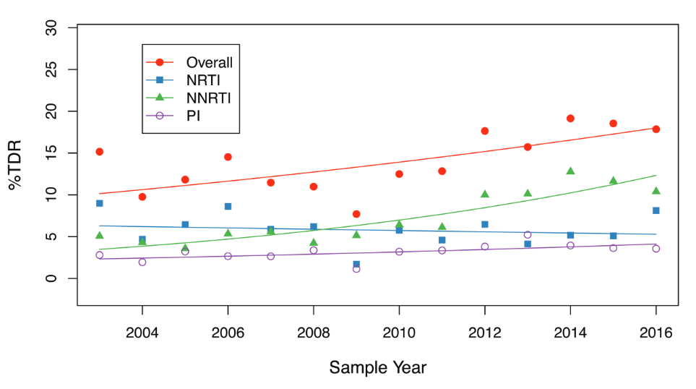
Trends in transmitted drug resistance
While increasing trend in TDR most strains unlikely to influence activity of first-line ART
Rhee CID 2019

Slide 35
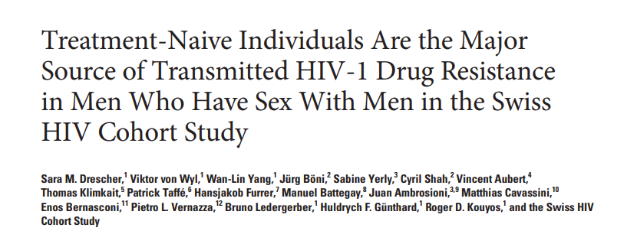
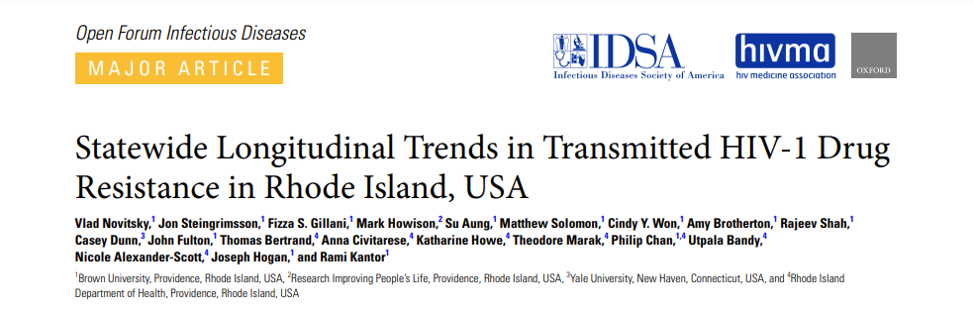
Many transmitted drug resistance mutations circulate among ART-naïve
Integration of phylogenetic analyses in drug resistance monitoring show clusters of TDR among ART-naïve
Drescher CID 2014
Other examples:
Rhee CID 2019
Levintow OFID 2018
Mbisa CID 2015
Novitsky OFID 2022

Slide 36
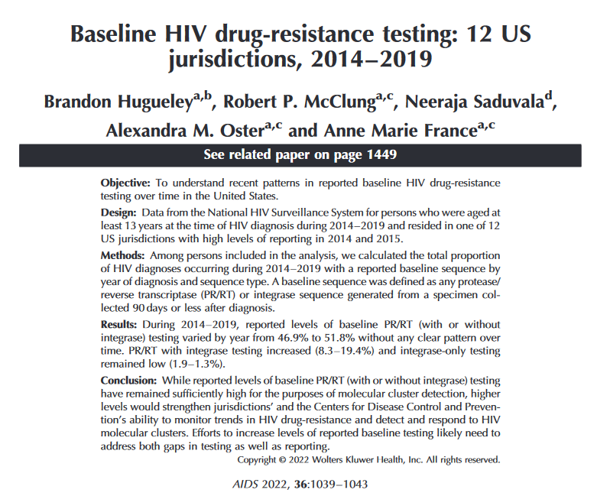
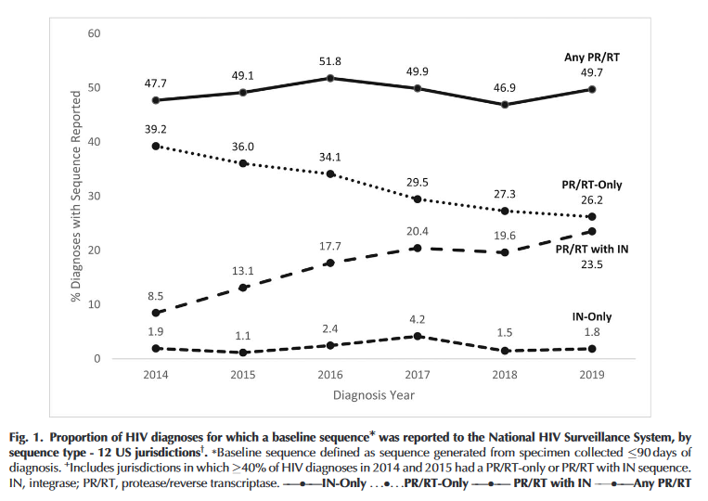
Baseline HIV drug resistance testing in the US
Proportion of HIV diagnoses with baseline sequence
Current levels of drug resistance testing can maintain molecular cluster detection & monitor TDR trends

Slide 37
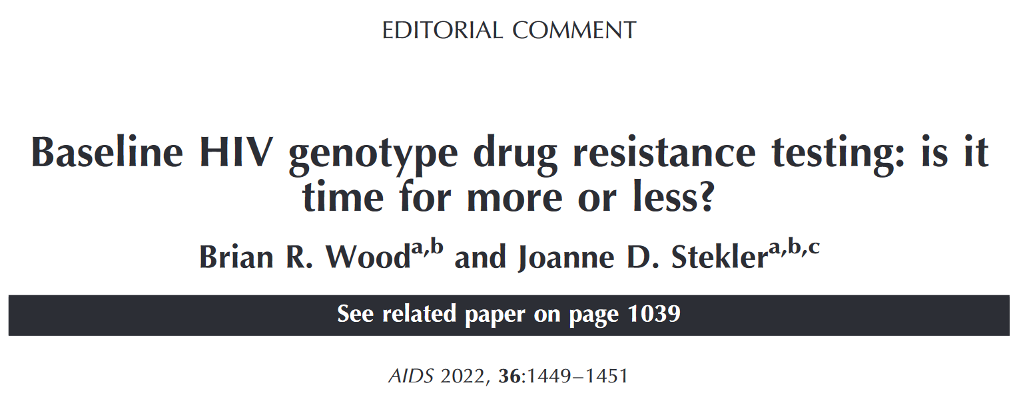
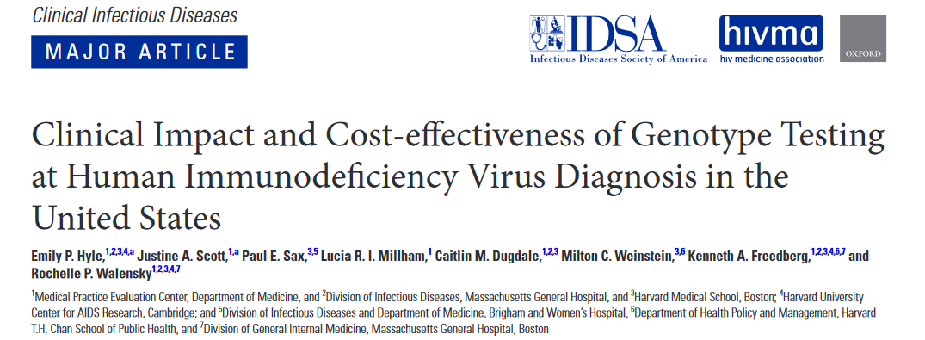
US guidelines continue to recommend baseline RT/PR resistance testing
Panel on Antiretroviral Guidelines for Adults and Adolescents, Sept 2022
Baseline genotypic resistance testing for mutations in reverse transcriptase (RT) and protease (PR) at entry to care recommended
Integrase genotype testing recommended if concern of acquisition after long-acting cabotegravir PrEP
Hyle CID 2020

Slide 38
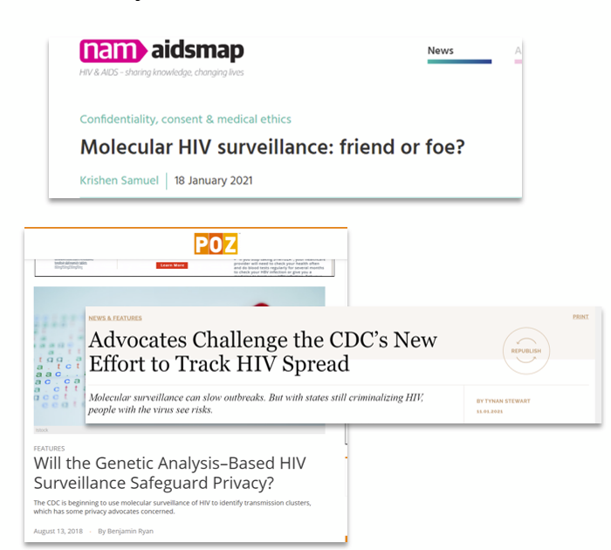
Shift in importance from clinical to public health impact – what are the ethical considerations?
Privacy
Data Confidentiality
Criminalization
Trust
Communication
Complexity
Accountability of institutions to the public

Slide 39

Community Engagement

Slide 40
Overview of HIV Prompt Bioethics Project
  Parent Study
  NIH R01 #AI135970
  03/2018-02/2024
  Optimize detection, monitoring, & response towards HIV transmission/outbreaks
Bioethics Supplement (Funded 2020)
What are stakeholders’ perceptions of MHS and ethical concerns?
Build a community-engaged framework for communication
Support future strategies (public health practice & research)
41 Interviewed
2 Townhall Meetings
White Paper

Slide 41
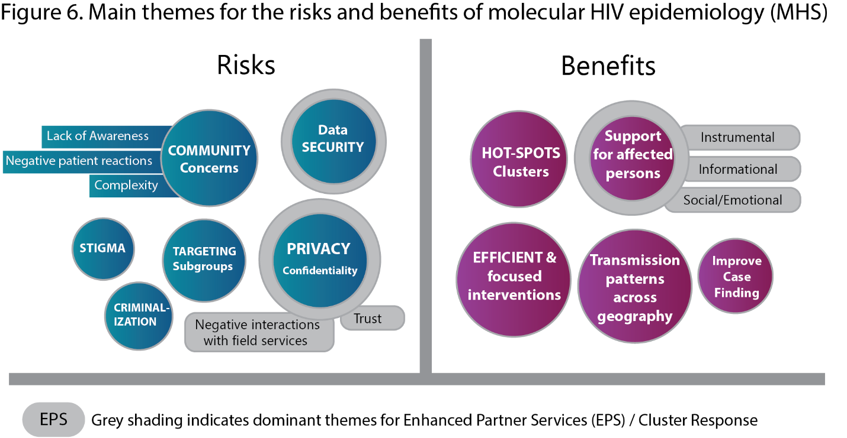
Summary of Stakeholder Interview Findings

Slide 42

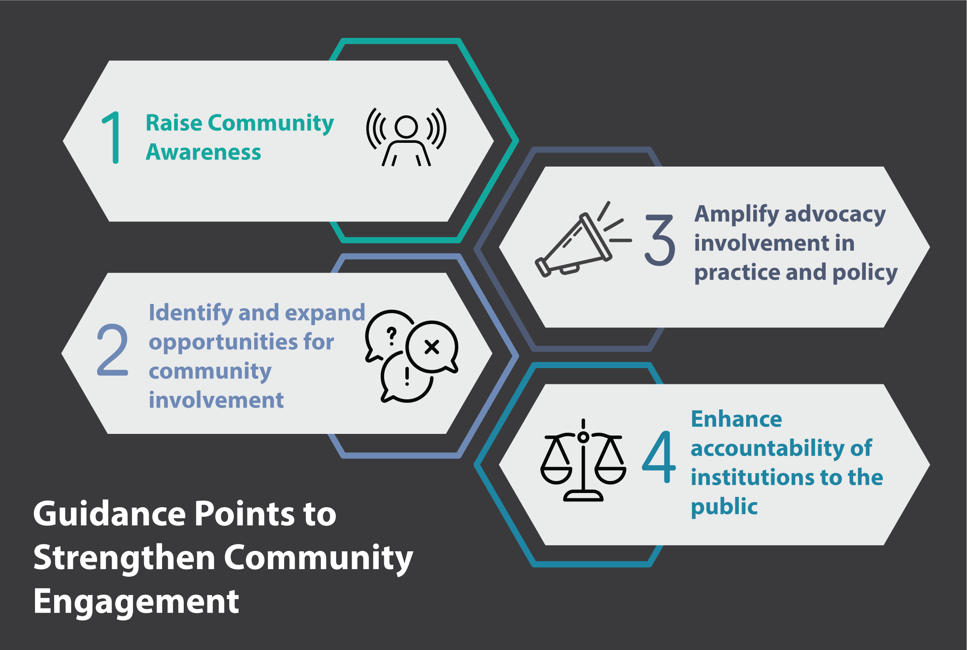
Revitalizing Community Engagement in the Public Health Use of Molecular HIV Epidemiology

Slide 43
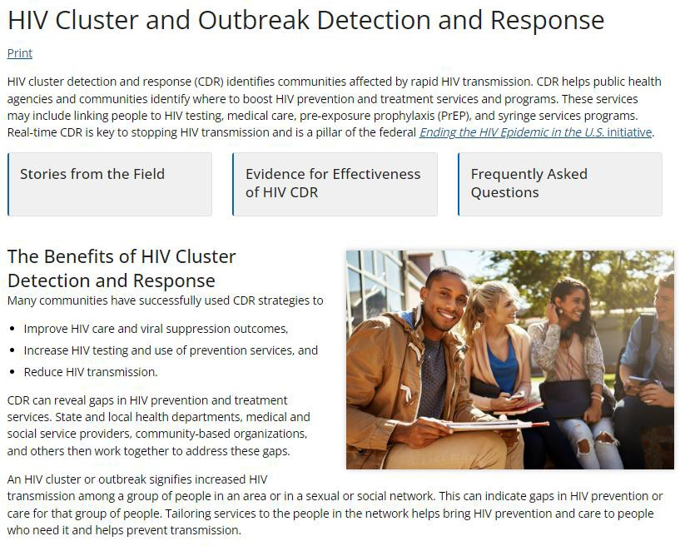
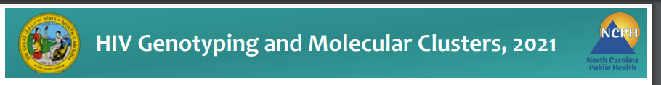
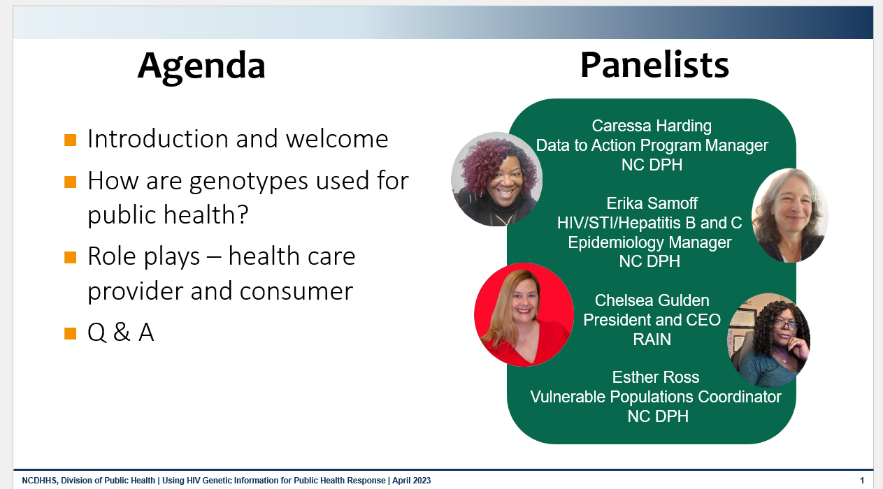
Resources
https://epi.dph.ncdhhs.gov/cd/stds/figures/HIV-GenotypeFactsheet.pdf
NC Department of Health and Human Services
Using HIV Genetic Information for Public Health Response
https://www.cdc.gov/hiv/programresources/guidance/cluster-outbreak/index.html

Slide 44
Summary
Molecular HIV epidemiology in the US largely hinges on the analysis of routine drug resistance genotypes sampled over the population
Cluster detection is used to identify outbreaks that can be stopped by interventions directed by local health departments
Both HIV clusters signifying recent and rapid transmission - and HIV diagnosed in the acute/early-stage - should trigger action in enhanced monitoring and response
Meaningful community engagement is needed in public health strategies that use HIV-related data collected during clinical care

Slide 45


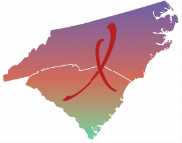


Thank You!
Erika Samoff, Victoria Mobley, Annalea Greifinger, John Barnhart
Study participants, Community organizations, Providers
Prompt Bioethics team:
Stuart Rennie, Suzanne Day, Kristen Sullivan, Sharon Parker
This program is supported by the Health Resources and Services Administration (HRSA) of the U.S. Department of Health and Human Services (HHS) under grant number U1OHA30535.. The contents are those of the author(s) and do not necessarily represent the official views of, nor an endorsement, by HRSA, HHS, or the U.S. Government. For more information, please visit HRSA.gov.

