Slide 1

Psychosomatic Unity:
Integrating Mental Health in Primary Care
Elizabeth Holcomb, MD
Psychiatric Clinical Lead
CrescentCare

Slide 2
Faculty Disclosure
No financial disclosures
This program is supported by the Health Resources and Services Administration (HRSA) of the U.S. Department of Health and Human Services (HHS) under grant number U1OHA30535 as part of an award totaling $4.2m. The contents are those of the author(s) and do not necessarily represent the official views of, nor an endorsement, by HRSA, HHS, or the U.S. Government. For more information, please visit HRSA.gov.
“Funding for this presentation was made possible by cooperative agreement U1OHA30535 from the Health Resources and Services Administration HIV/AIDS Bureau. The views expressed do not necessarily reflect the official policies of the Department of Health and Human Services nor does mention of trade names, commercial practices, or organizations imply endorsement by the U.S. Government. Any trade/brand names for products mentioned during this presentation are for training and identification purposes only.”

Slide 3
Educational Need/Practice Gap
Gap = Difference between current practice and optimal practice relevant to the educational need
Need = The issue/problem that underlies the practice gap

Slide 4
Objectives
At the conclusion of this presentation, you will be able to:
Review the components of a basic psychiatric assessment and treatment initiation for the primary care setting.
Recognize diagnostic and treatment challenges for patients with medical and psychiatric co-morbidities.
Discuss barriers to treatment and recovery for patients in special populations (queer, HIV, underrepresented minorities)

Slide 5
Expected Outcome
Increased confidence in assessing and initiating treatment of mental health conditions in primary care setting
Awareness of nuances in address mental health in special communities

Slide 6
Current state of psychiatry and mental health – THE NEED
1 in 5 U.S. adults experience mental illness each year
1 in 20 U.S. adults experience serious mental illness each year
1 in 6 U.S. youth aged 6-17 experience a mental health disorder each year
50% of all lifetime mental illness begins by age 14, and 75% by age 24
Suicide is the 2nd leading cause of death among people aged 10-14
Notes:
Nami
https://www.nami.org/mhstats

Slide 7
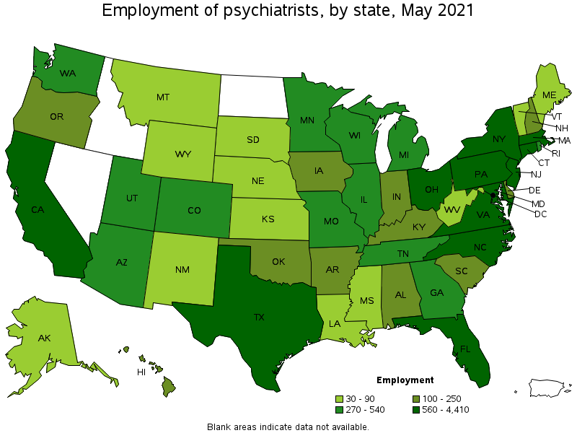
Mental Health Workforce
Psychiatrists
  25,520
Child/Adolescent
  10,597
  CAP/100K Children
  14
  Average CAP age
  52
Notes:
Mental health workforce
https://www.bls.gov/oes/current/oes291223.htm
Numbers as of May 2021
About May 2021 National, State, Metropolitan, and Nonmetropolitan Area Occupational Employment and Wage Estimates
These estimates are calculated with data collected from employers in all industry sectors, all metropolitan and nonmetropolitan areas, and all states and the District of Columbia. The top employment and wage figures are provided above. The complete list is available in the downloadable XLS files.
(9) The location quotient is the ratio of the area concentration of occupational employment to the national average concentration. A location quotient greater than one indicates the occupation has a higher share of employment than average, and a location quotient less than one indicates the occupation is less prevalent in the area than average.
CAP: https://www.aacap.org/aacap/Resources_for_Primary_Care/Workforce_Issues.aspx#:~:text=There%20are%20approximately%208%2C300%20practicing,a%20child%20and%20adolescent%20psychiatrist.

Slide 8
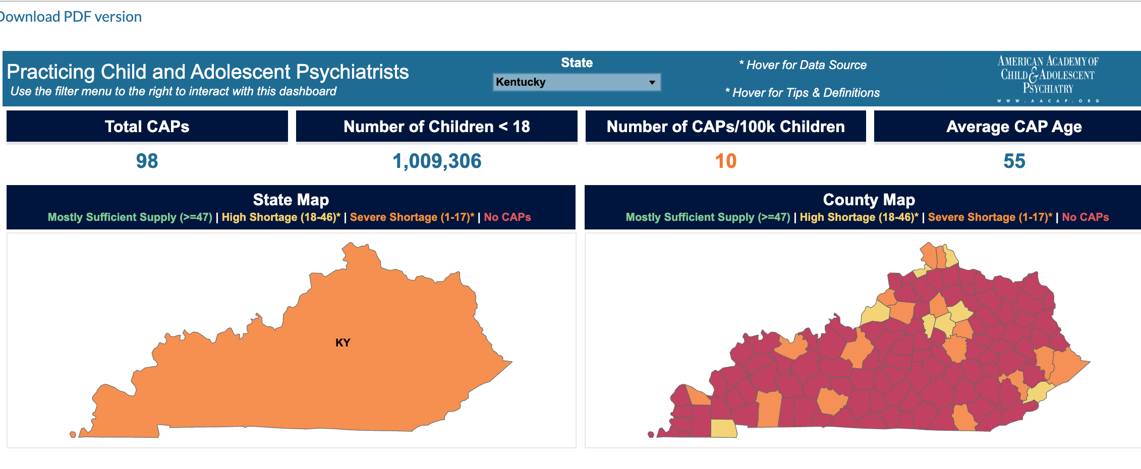
Mental Health Workforce –
CAP in Kentucky

Slide 9
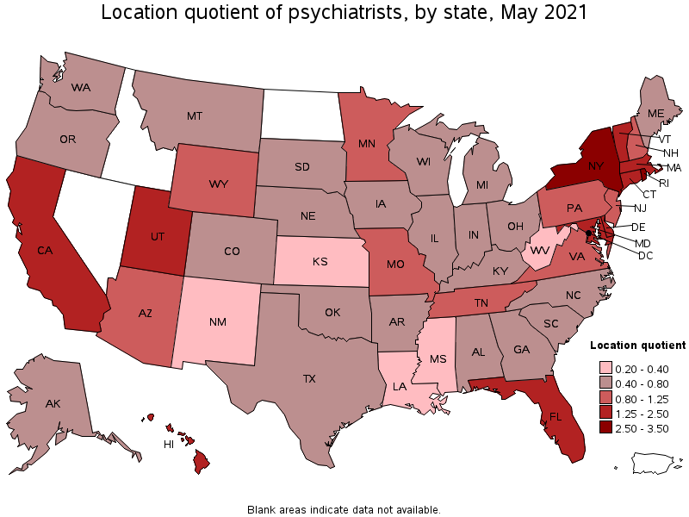
Mental Health Workforce
Psychiatrists
  25,520
Notes:
Mental health workforce
https://www.bls.gov/oes/current/oes291223.htm
Numbers as of May 2021
About May 2021 National, State, Metropolitan, and Nonmetropolitan Area Occupational Employment and Wage Estimates
These estimates are calculated with data collected from employers in all industry sectors, all metropolitan and nonmetropolitan areas, and all states and the District of Columbia. The top employment and wage figures are provided above. The complete list is available in the downloadable XLS files.
(9) The location quotient is the ratio of the area concentration of occupational employment to the national average concentration. A location quotient greater than one indicates the occupation has a higher share of employment than average, and a location quotient less than one indicates the occupation is less prevalent in the area than average.

Slide 10
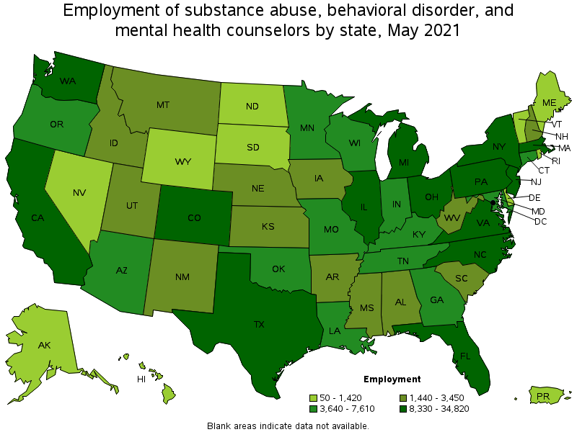
Mental Health Workforce
Psychologists
Mental health and substance abuse counselors
Notes:
!!! Need to finish/edit
Mental health workforce
https://www.bls.gov/oes/current/oes291223.htm
Numbers as of May 2021
About May 2021 National, State, Metropolitan, and Nonmetropolitan Area Occupational Employment and Wage Estimates
These estimates are calculated with data collected from employers in all industry sectors, all metropolitan and nonmetropolitan areas, and all states and the District of Columbia. The top employment and wage figures are provided above. The complete list is available in the downloadable XLS files.
(9) The location quotient is the ratio of the area concentration of occupational employment to the national average concentration. A location quotient greater than one indicates the occupation has a higher share of employment than average, and a location quotient less than one indicates the occupation is less prevalent in the area than average.

Slide 11
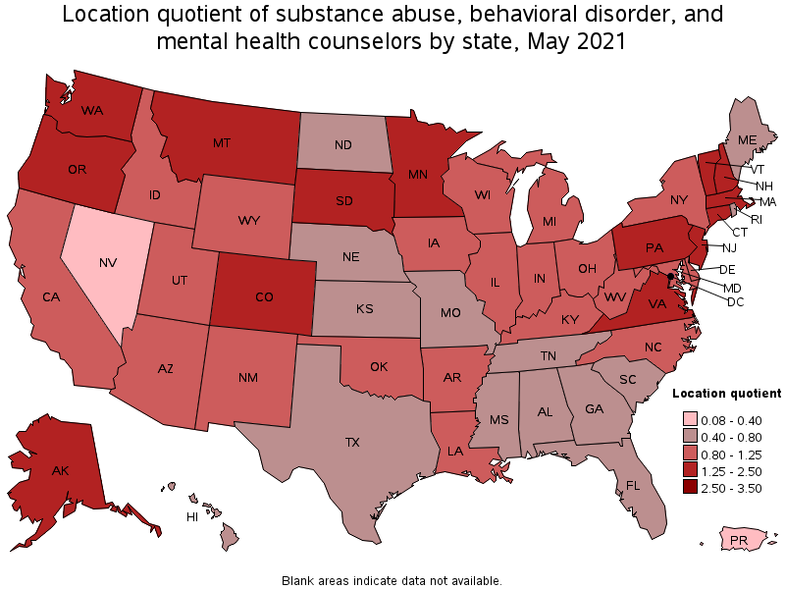
Mental Health Workforce
Psychologists
Mental health and substance abuse counselors
Notes:
Mental health workforce
https://www.bls.gov/oes/current/oes291223.htm
Numbers as of May 2021
About May 2021 National, State, Metropolitan, and Nonmetropolitan Area Occupational Employment and Wage Estimates
These estimates are calculated with data collected from employers in all industry sectors, all metropolitan and nonmetropolitan areas, and all states and the District of Columbia. The top employment and wage figures are provided above. The complete list is available in the downloadable XLS files.
(9) The location quotient is the ratio of the area concentration of occupational employment to the national average concentration. A location quotient greater than one indicates the occupation has a higher share of employment than average, and a location quotient less than one indicates the occupation is less prevalent in the area than average.

Slide 12
Primary Care + Mental Health
Up to 75% of primary care visits include mental or behavioral health components
Primary Care Mental Health Assessment
  HPI and Current Symptoms
  PHQ9, SIGECAPS for depression
  GAD7 for anxiety
  **Substance use history **
  Past psychiatric history
  Previous episodes, past medication trials, hospitalizations
Notes:
Fam Pract Manag. 2021;28(3):3-4

Slide 13
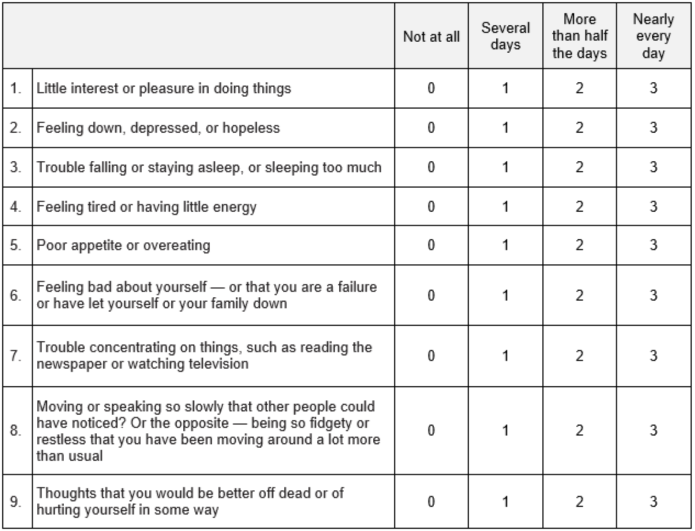
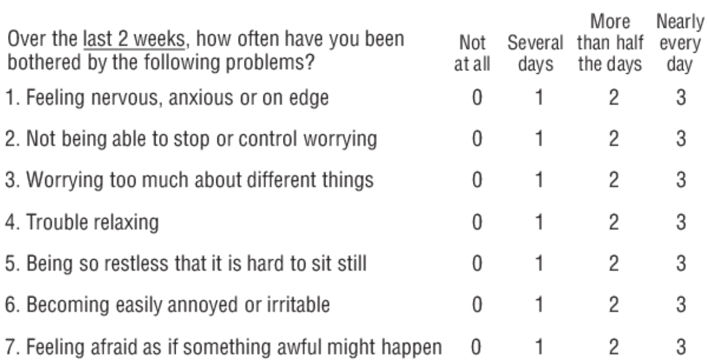
PHQ and GAD

Slide 14
Treatment
If there is active substance abuse, counsel patient on cessation and offer referral to substance abuse treatment
First line treatment for depression and anxiety is the same – SSRI’s
  Black box warning
Avoid use of benzodiazepines as first line treatment/daily use/use without long acting medication (like SSRI/SNRI/other antidepressant)
Patients should take antidepressants everyday.
  Starting and stopping the medication may make them feel worse
People may see benefits of medication within a few days to week, but the maximum benefit of a medication, at that dose, is not until at least 4-6 weeks of consistently taking the medication.

Slide 15
Depression
Anxiety
Monotherapy: SSRI
(Lexapro, Prozac, Sertraline)
Non Medication Treatment Alternatives
Partial Response or Nonresponse
Partial Response
If a patient has pain complaints, it might be best to start with duloxetine.
Propranolol can be helpful to augment treatment of anxiety. (10mg PRN anxiety)
Monotherapy:
Alternate SSRI
Augmentation with Remeron, Wellbutrin, Buspar
Partial Response
Partial Response or Nonresponse
Augmentation with Remeron, Wellbutrin, Buspar
Monotherapy with Alternate Class (SNRI, Wellbutrin, Remeron)

Slide 16
Dosing and adequate trials
Fluoxetine
  Generally more ”activating” or energizing (take in am)
  Long half life → patients w/ poorer compliance
  Start at 20mg PO qD and increase by 20mg every 4-8 weeks based on symptom severity, tolerability and response until symptom resolution or a max dose of 80mg PO qD
    May start at 10mg PO qD for patient’s who are nervous about medication/side effects, geriatric or children
Sertraline
  May cause more GI side effects than other SSRIs
  Preferred SSRI in pregnancy and breastfeeding
  Preferred SSRI in cardiac patients
  increase by 25-50 mg every 4-8 weeks based on symptom severity, tolerability and response until symptom resolution or a max dose of 200mg PO qD
  May start at 25mg if patient is nervous about medication or side effects. If they tend to struggle with nausea, start at 25mg before increasing.

Slide 17
Dosing and adequate trials (2)
Escitalopram
  Generally thought to have the least amount of side effects of the SSRIs
  Inhibits liver enzymes less than other SSRIs and is thus the SSRI of choice for situations in which drug-drug interactions are a concern (Safe in combo with PREP)
  Prolongs Qt more than other SSRIs (along with citalopram) – avoid if risk of arrhythmia
  Start at 5mg PO qD and increase by 5mg every 4-8 weeks based on symptom severity, tolerability and response until symptom resolution or a max dose of 20mg PO qD
Mirtazapine
  Atypical antidepressant
  Main side effects are sedation and increased appetite (weight gain)
  Good for older patients with poor appetite and insomnia
  Patients who use cannabis for sleep and appetite
  Start at 7.5mg or 15 PO qHS and increase by 15mg every 4-8 weeks based on symptom severity, tolerability and response until symptom resolution or a max dose of 45mg PO qHS

Slide 18
Dosing and adequate trials (3)
Bupropion
  Atypical antidepressant
  Can be particularly helpful with energy, motivation, and focus
  Can increase agitation/irritability
  Can suppress appetite and cause weight loss
  Should be avoided in patients with a history of eating disorders or seizures, etoh use
  Start Wellbutrin XL 150mg PO qAM and may increase by 150mg every 4-8 weeks based on symptom severity, tolerability and response until symptom resolution or a max dose of 450mg PO qAM
Duloxetine
  SNRI (similar side effect profile as SSRIs)
  Additional benefit for pain
  Indicated for fibromyalgia (treatment of choice)
  Start Duloxetine 20-30mg PO qAM and may increase to 40mg after 4-8 weeks based on symptom severity, tolerability and response until symptom resolution or a max dose of 60mg PO qAM
  Max dose of 120mg but doses greater than 60mg rarely more effective

Slide 19
It’s not working!
Verify adherence to tx plan and consider barriers to adherence
Appropriate dosing?
Adequate duration of treatment?
4-6 weeks for depression
Up to 12 weeks for anxiety disorders
Is the diagnosis correct?
Is there an untreated co-morbid condition?
Was it helping then symptoms worsened or new symptoms arose?

Slide 20
Safety Evaluation
Do you feel hopeless?
Have you had suicidal thoughts? Have you thought about what you would do?
Do you do things to hurt yourself, like cutting?
Do they have access to their means of self harm (gun, pills/drugs to lethally overdose on, etc.)?
  If so, would it be possible to give access to a trusted friend or family member until they feel safe again
Has anyone in your family ever attempted or completed suicide?
Risk Factors: Previous suicide attempts, Current SI, Suicide plan/Preparatory Acts, Active Substance Use, Feeling Trapped (Financial problems, legal problems, homelessness, job loss), Social Isolation/No social supports

Slide 21
Adult ADHD
Basic ADHD Screening
Sx present prior to 12 y/o
Clear evidence of impairment in two or more functional domains (work, school, relationships)
R/o other explanation (e.g. depression, anxiety, substance misuse, PTSD/trauma)
Treatment
Treat anxiety and depression first
If still symptomatic may consider non-stimulant alternative (strattera or wellbutrin) and/or psych referral

Slide 22
Insomnia
Treatment:
BEST EVIDENCE: CBT
Doxepin - FDA approved for sleep in low doses (3, 6 mg), safe for use in elderly
Trazodone - no benefit for sleep over 200 mg
Mirtazapine - lovely, but weight gain is real
Hydroxyzine, Benadryl - anticholinergic, not ideal in older individuals
AVOID:
Z- drugs - black box warning, high abuse potential, risk of seizures in withdrawal
Benzos - rebound insomnia, withdrawal, and dependence, co-occurring sub. use
Seroquel - side effects, monitoring
Characteristics: Difficulty with falling asleep (onset) or staying asleep (maintenance)
Sleep hygiene
Bed is for sleep and sex only
Quiet room, no tv or lights
Avoid cell phone, computer use if you wake up
Causes: depression/anxiety, substance use (alcohol), medication side effects
Notes:
Prolonged use of these drugs can lead to tolerance, dependence, rebound insomnia, residual daytime sedation, motor incoordination, cognitive impairment, and increased risk of falls in institutionalized older individuals.88 These drugs can have additive effects if taken together. Because of these adverse effects, and the equivalent or superior response seen with CBT-I for longer duration therapy, use of these drugs should be avoided in older individuals.

Slide 23
Addiction and Substance Use Disorder Assessment

Slide 24
Substance use ≠ Substance Use Disorder
Substance Use Disorder ≠ Addiction
Substance Use Disorder
11 criteria, including:
Tolerance
Withdrawal
Craving
Escalating use
Use despite significant consequences
Addiction
Chronic relapsing disorder
Moderate - Severe SUD
Characterized by:
Compulsive drive to take drug despite serious adverse consequences
Loss of control over intake
Emergence of negative emotional state during abstinence

Slide 25
What is addiction?
Three stages:
Binge/Intoxication, Withdrawal, Preoccupation/Anticipation
→ emotional dysregulation, stress response
Risk Factors:
Genetics (40-60%)
Environmental (low SES, poor parental support, peer influence)
PSYCHIATRIC COMORBIDITIES

Slide 26
Psychiatric Comorbidities
 | General Population | Substance Use Population
Depression | >10% | 50% Associated with worst outcome, including suicide risk
Bipolar Disorder | 1% | 40%
Anxiety |  | 80%
ADHD |  | Substance use disorders occurred earlier
Schizophrenia-spectrum |  | Range 25-75%

Slide 27
Ask about substance use
How much?
How often? (Daily? Every other day? Few times per week? Few times per month? Less than monthly?)
What does it do for you?
Have you ever felt your substance use was problematic? Has anyone ever expressed concern about your use?
Tobacco
Alcohol - liquor, beer, wine
Cannabis
Stimulants (Adderall, Cocaine, Meth)
Sedatives (Xanax, Klonopin, Valium, GHB)
Club drugs (Ecstasy, Molly)
Hallucinogens (LSD, PCP)
Plant based drugs (Mushrooms, Kratom)

Slide 28
Treating substance use
Assess risk for detoxing/starting treatment in outpatient setting
Using multiple substances?
Likely need detox, especially with alcohol or benzo use
Opioid use treatment with MAT
Are they a better candidate for buprenorphine, naltrexone, methadone
Overdose risk assessment and informed consent
Risk of overdose with buprenorphine induction
Risk of overdose with co-occurring substance use
Dual Diagnosis - evidence is for comprehensive treatment program

Slide 29
Dual Diagnosis and Treatment Challenges
Dual Diagnosis = Mental Health Dx + Sub. Use Disorder
Most common
Prev. 12-80%
Induced vs. primary?
DEPRESSION
ANXIETY
ADHD
depression
anxiety
Prev. 18-37%
Avoid benzos
High
co-morbidty (25%)
Psychosis
ADHD
Notes:
Dual diagnosis in Depression: treatment recommendations PMID: 28492960
[Dual diagnosis in anxiety disorders: pharmacologic treatment recommendations] PMID: 25314041
AED (esp. pregabalin) have show efficacy in recent case/open label studies
[ADHD in Adults and Comorbid Substance Use Disorder: Prevalence, Clinical Diagnostics and Integrated Therapy] PMID: 28645126

Slide 30
Special Populations –
People with HIV/Hep C
Adolescence
High MH burden →
poor quality of life
Mental status + risk bx
Women
Higher rates of depression, anxiety, trauma
Undertreated, underrepresented in literature
Older Adults
incr. susceptibility to depression, dementia, Alzheimer's
Notes:
Intervening for HIV prevention and mental health: a review of global literature. PMID 34164934
Growing older with HIV/AIDS: new public health challenges. PMID 23327276
Mental Health in Women Living With HIV: The Unique and Unmet Needs PMID 33472517
high prevalence of physical and sexual abuse histories, caregiving stress, and elevated internalized stigma as well as myriad barriers to care

Slide 31
Special Populations – LGBTQIA+
SMW and transgender women experience higher rates of mood and anxiety disorders, suicidality, and substance use disorders than their heterosexual and cisgender counterparts
Youth: Mental health services access may be difficult for personal and social barriers as well as a lack of adequate and specific mental health support
SAMHSA: 47.4% American LGB adults affected by SMI, 12.9% with dual dx
Policy needs -
Improved accessibility to mental health, promotion of educational training on LGBT mental health, develop specific assessments and treatments
Notes:
Mental Health in Lesbian, Gay, Bisexual, and Transgender (LGBT) Youth PMID: 26772206
Mental Health in Sexual Minority and Transgender Women PMID: 31078203
High Burden of Mental Health Problems, Substance Use, Violence, and Related Psychosocial Factors in Transgender, Non-Binary, and Gender Diverse Youth and Young Adults PMID: 31485801
Mental health for LGBTQI people: a policies' review PMID: 36151824
the need of initiatives against stigma and LGBT discrimination; a useful synergy between governments, LGBT rights organizations, mental health associations for improving accessibility to mental health care; the promotion of educational trainings on LGBT mental health among medical students and health professional; the development of specific assessments and treatments; the contrast to conversion and reparative therapies; the promotion of research and data collection on LGBT mental health

Slide 32
Special Populations – ethnic minorities
approximately 40% of the population is comprised of racial and ethnic minorities
Historical context of disparities in mental health – Rush, Cartwright, institutionalization
LGBTQIA+
Notes:
Most profitable institution in American history

Slide 33
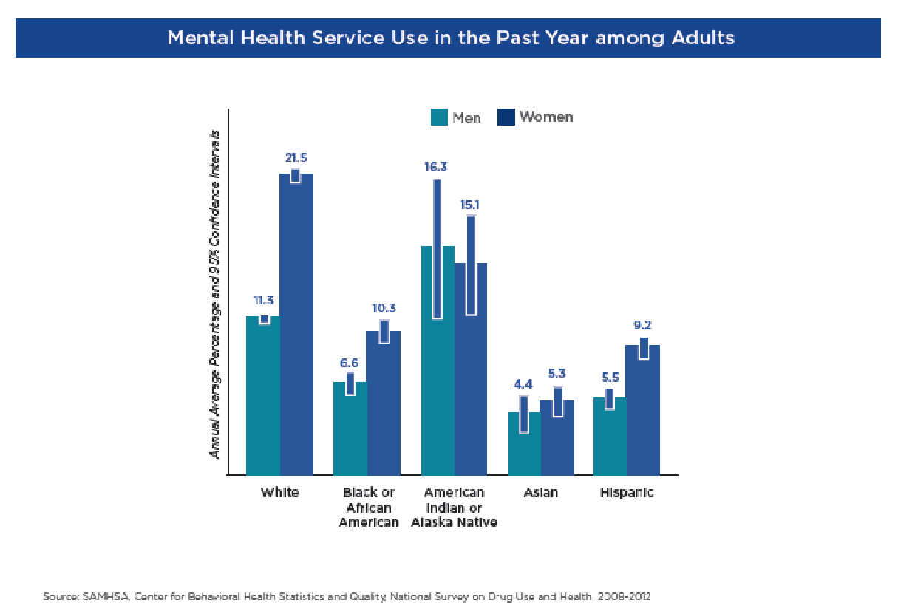

Slide 34
Q&A

Slide 35
AETC Program
National Centers and National HIV Curriculum
National Coordinating Resource Center serves as the central web based
repository for AETC Program training and capacity building resources; its
website includes a free virtual library with training and technical assistance
materials, a program directory, and a calendar of trainings and other events.
Learn more: https ://aidsetc.org
National Clinician Consultation Center provides free, peer to peer,
expert advice for health professionals on HIV prevention, care, and treatment
and related topics. Learn more: https ://nccc.ucsf.edu
National HIV Curriculum provides ongoing, up to date HIV training and
information for health professionals through a free, web based curriculum;
also provides free CME credits, CNE contact hours, CE contact hours, and
maintenance of certification credits. Learn more: www.hiv.uw.edu

