Slide 1
HIV and COVID-19: Where Are We Now?
Rajesh T. Gandhi, MD
Massachusetts General Hospital
Professor of Medicine, Harvard Medical School
Boston, Massachusetts
Acknowledgements: Drs. Rachel Bender Ignacio, Carlos del Rio, Arthur Kim, Michael Peluso, Jon Li, Kara Chew for sharing slides; Katherine Devine for help with slides

Slide 2
Objectives
Upon completion of this educational activity, you will be able to:
Describe the impact of HIV on COVID-19 outcomes
Summarize the importance of COVID-19 vaccination in persons with HIV (PWH)
Assess COVID-19 treatment options for PWH

Slide 3
Expected Outcome
What is the desired change/result in practice resulting from this educational intervention?
Improvement in clinical care for people with HIV and COVID

Slide 4
Outline
Are PWH at higher risk for severe or long COVID-19?
Preventing COVID-19 in PWH
Treating COVID-19 in PWH
Lessons from HIV and COVID-19

Slide 5
Are PWH at higher risk for severe COVID-19?
Early studies did not find difference in COVID outcomes in PWH as compared with people without HIV or were confounded by high rates of comorbidities or social determinants of health in PWH
Larger studies, which attempt to adjust for confounding, suggest PWH have worse COVID outcomes, particularly if low current or nadir CD4 cell counts or unsuppressed HIV RNA
Triant V and Gandhi RT, CID 2021; Miller K and Gandhi RT, Curr Op HIV, 2023

Slide 6
Higher mortality rates in PWH hospitalized with COVID
362,941 people hospitalized with COVID-19; 29,530 (8.1%) PWH
PWH: 50% higher in-hospital mortality
HIV RNA >1000 and CD4<200 doubled COVID-19 death risk
1.7
1.8
1.9
2.0
2.1
Bertagnolio et al, AIDS 2022, Abstract OAB0404

Slide 7
Low current or nadir CD4 cell count associated with worse outcomes
649 PWH with COVID-19 (March to Dec 2020)
95% on ART; 86% undetectable VL
Current CD4 <350, nadir CD4 <200, cardiovascular/liver comorbidities all highly predictive of COVID hospitalization
Minoritized racial/ethnic groups disproportionately affected
Shapiro & Bender Ignacio et al, JAIDS, 2022

Slide 8
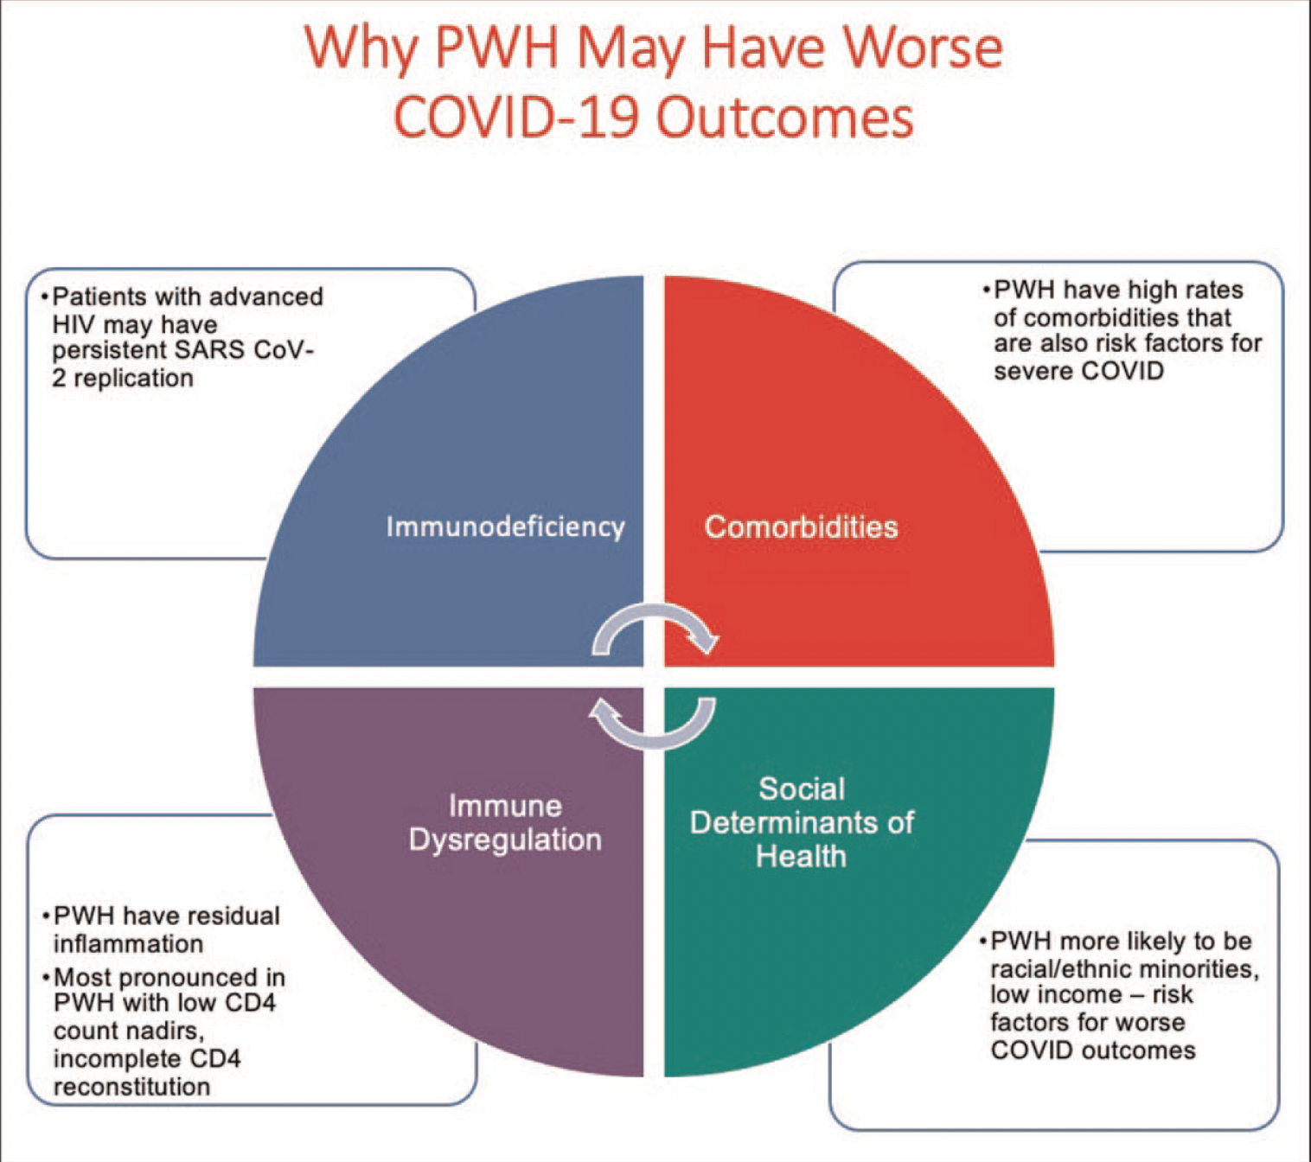
Triant V and Gandhi RT, CID 2021; Miller K and Gandhi RT, Curr Op HIV, 2023

Slide 9
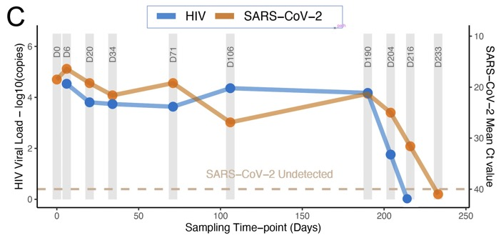
Persistent SARS-CoV-2 Replication in Woman with Advanced HIV
Initial CD4: 6. HIV RNA 34,000
SARS-CoV-2 PCR+ for 216 days (Ct 16 to 32)
Anti-S protein IgM, IgG negative
Emergence of multiple spike gene mutations (E484K, K417T, F490S, L455F, F456L, D427Y, N501Y) and evolution of neutralization escape
SARS-CoV-2 cleared after HIV was suppressed on ART
Karim F et al, https://www.medrxiv.org/content/10.1101/2021.06.03.21258228v1.full.pdf
Celle S, Cell Host and Microbe, 2022

Slide 10
Triant V and Gandhi RT, CID 2021; Miller K and Gandhi RT, Curr Op HIV, 2023

Slide 11
Long COVID in PWH
39 PWH and COVID compared with 43 people without HIV who had COVID (before vaccine available)
PWH had lower SARS-CoV-2-specific CD8 T cells, higher PD-1 expression on SARS-CoV-2-specific CD4 cells, higher IL-6
PWH 4-fold higher odds of post-acute sequelae of COVID-19 (PASC) (95% CI: 1.45–11.1)
Peluso M, AIDS, 2022

Slide 12
Prevention of COVID-19 in PWH

Slide 13
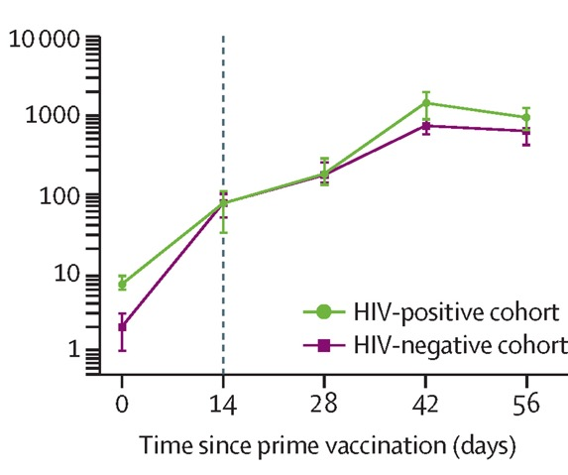
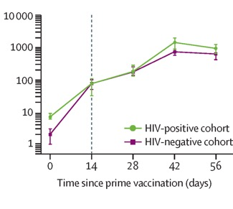
Immune Responses to COVID Vaccines in PWH
PWH on ART with high CD4 counts have good immune responses (antibodies, T cells) to vaccines
PWH who have low CD4 cell count or unsuppressed HIV RNA may have lower antibody responses to vaccines
SARS CoV-2 anti-spike protein IgG after AZ ChAdOx1 vaccine
Frater J et al, Lancet HIV, 2021; Madhi S et al, Lancet HIV 2021; Woldemeskel, CID, 2021; Ruddy JA et al., AIDS, 2021;
Spinelli M, et al, abstract LB8, IDWeek 2021; Antinori A, et al, European AIDS Conference 2021, Oral Abstract OS3/4. Nault L et al, Vaccine, 2022. Hassold N et al, AIDS 2022.
Notes:
Nault L et al, Vaccine, 2022. Hassold N et al, AIDS, 2022.

Slide 14
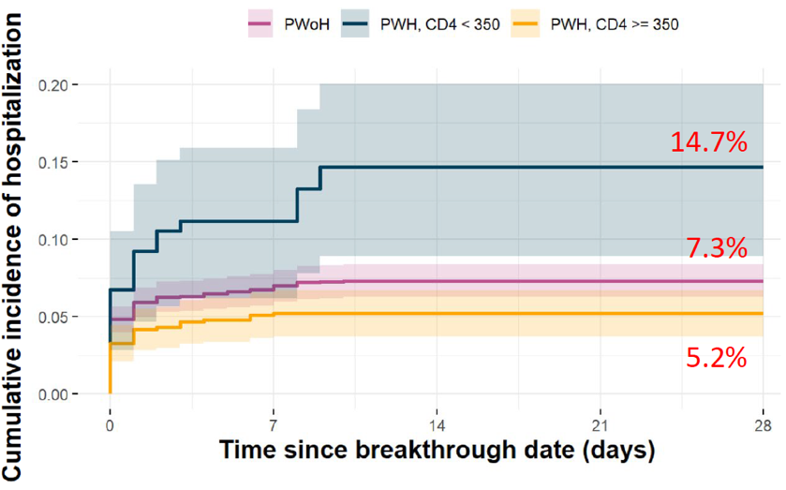
Hospitalization after Breakthrough COVID Higher in PWH with CD4 <350
Among those with breakthrough infection after vaccination, PWH and CD4 count <350 had increased risk of hospitalization relative to people without HIV and PWH with higher CD4 cell counts
Lang R et al, JAMA Network Open, Oct 13, 2022

Slide 15
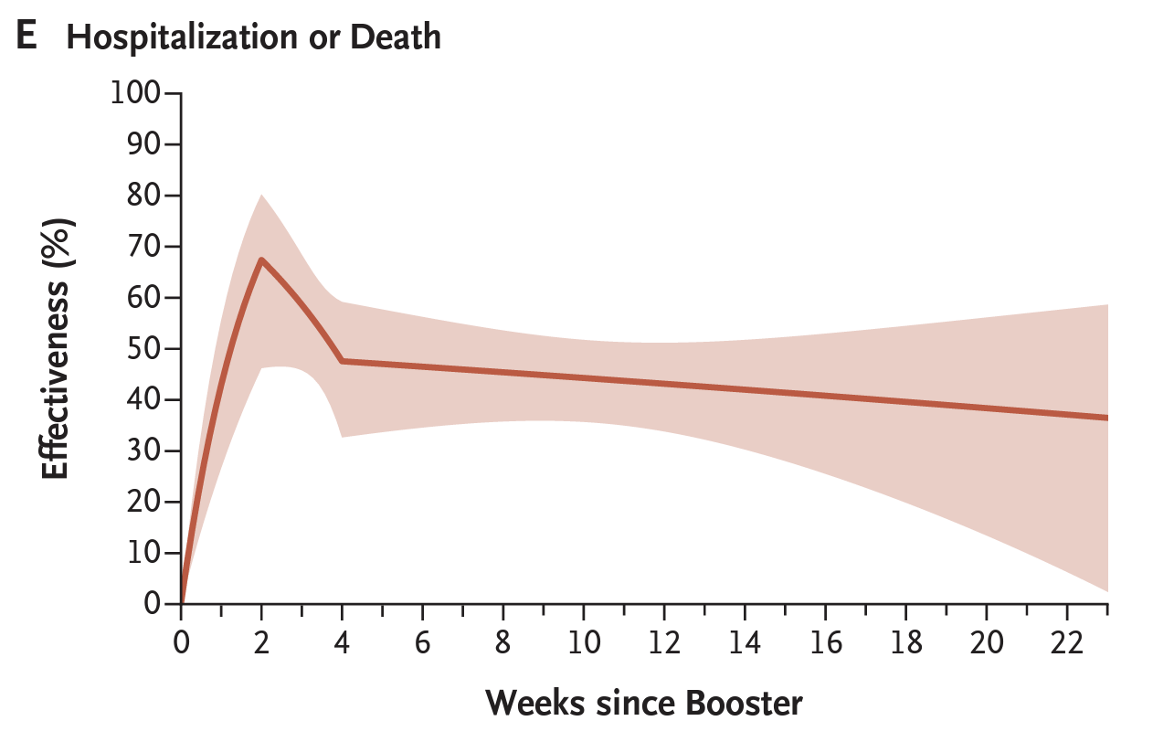
Bivalent Boosters against Omicron Subvariants
Vaccine effectiveness among people ≥65 years: 72% for hospitalization, 68% for death for up to 4 months (Israel)
Durability of protection (North Carolina):
6.3 million eligible; 1.3 million received booster
Protection against hospitalization or death
67% after 2 wk
38% after 20 wk
Arbel R, Lancet ID, 2023; Lin D-Y, NEJM, 2023.
Notes:
NEJM article

Slide 16
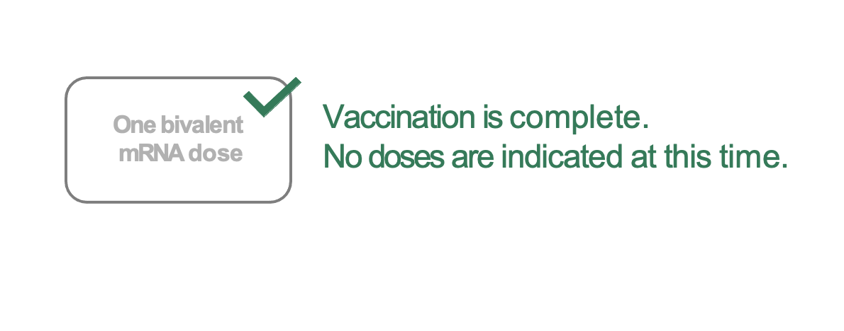
New recommendations for aged ≥6 years without immunocompromise who have already received a bivalent mRNA dose
CDC ACIP Meeting 4/19/2023
Notes:
add slide 8 before
https://www.cdc.gov/vaccines/acip/meetings/slides-2023-04-19.html
one dose of bivalent vaccine “counts” as fully vaccinated;
an additional dose of bivalent vaccine is optional for those over age 65 years at least 4 months after the last dose; and
immunocompromised patients (for HIV, I’d use CD4 <200 or not on suppressive ART), additional optional bivalent vaccine doses at least 2 months after last dose

Slide 17
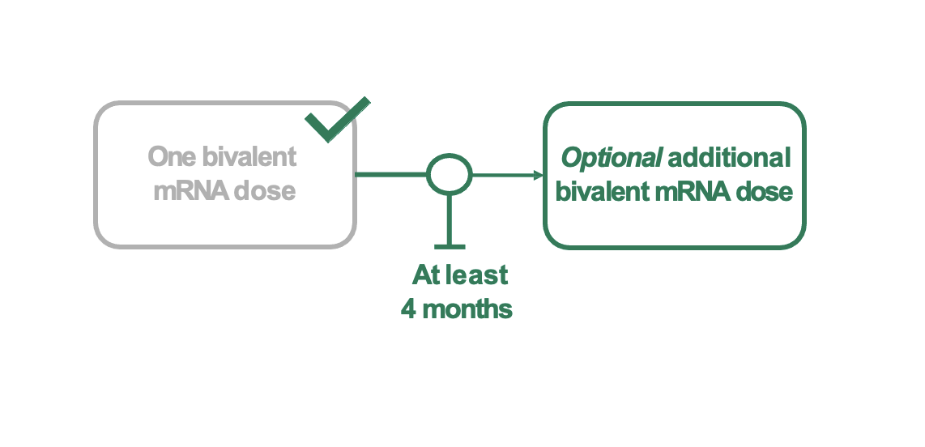
Flexible for people at higher risk of severe COVID-19:
People aged ≥65 years who have already received a bivalent mRNA dose
CDC ACIP Meeting 4/19/2023

Slide 18
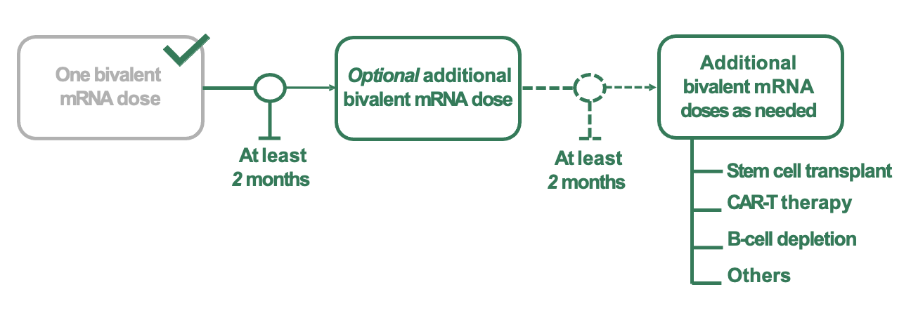
New flexibility for people at higher risk of severe COVID: People aged ≥6 years with immunocompromise who have already received a bivalent mRNA dose
*Including those with imminent immunocompromise (e.g., prior to organ transplant; other causes.)
CDC ACIP Meeting 4/19/2023

Slide 19
Treatment of COVID-19 in PWH

Slide 20
Case
62 yo woman presenting with 2 days of fever, cough, myalgias. SARS CoV-2 rapid antigen test positive
Oxygen saturation >95%
History of HIV (CD4 cell count 300; HIV RNA undetectable), pulmonary hypertension
Medications: bictegravir/FTC/TAF; tadalafil 40 mg daily
Received 2 doses of mRNA COVID-19 vaccine in 2021; has not received any booster doses
Would you treat? If so, with what?

Slide 21
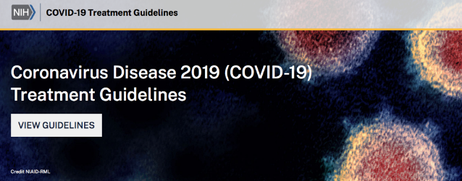
Refer to COVID-19 Treatment Guidelines When Treating PWH

Slide 23
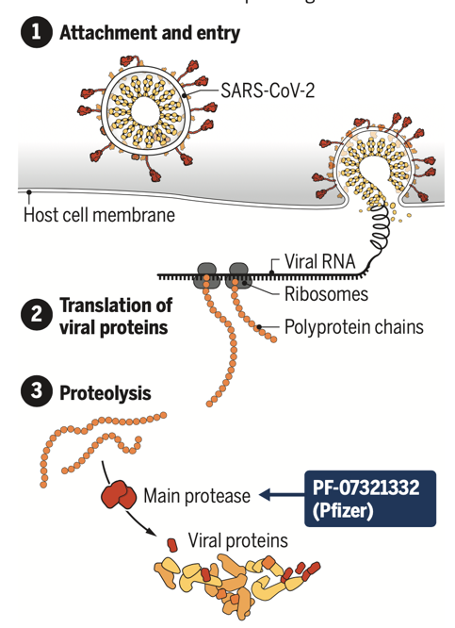
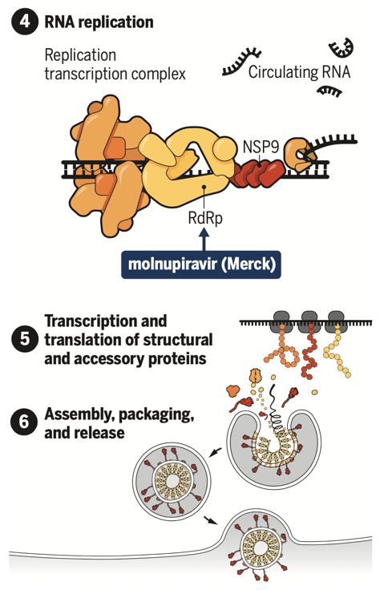
SARS CoV-2 Antivirals
Anti-spike monoclonal antibodies, including bebtelovimab:
Not active against circulating SARS CoV-2 variants
Molnupiravir (Lagevrio)
Remdesivir
(Veklury)
Protease inhibitor: Nirmatrelvir/ritonavir (Paxlovid)
Modified from https://www.science.org/doi/epdf/10.1126/science.acx9605
Notes:
Lagevrio

Slide 24
Small molecule antivirals anticipated to be active against new variants
 | 1) Nirmatrelvir/r | 2) Remdesivir | 3) Molnupiravir
Efficacy (hospitaliza-tion/death in unvaccinated, high risk) | Relative risk reduction: 88% (EPIC-HR) Absolute risk: 6.3%→0.8% NNT: 18 | Relative risk reduction: 87% (PINETREE) Absolute risk: 5.3%→0.7% NNT: 22 | Relative risk reduction: 30% (MOVe-OUT) Absolute risk: 9.7%→6.8% NNT: 35
Pros | Highly efficacious Oral regimen Ritonavir studied (safe) in pregnancy | Highly efficacious Studied in pregnancy Few/no drug interactions | Oral regimen Not anticipated to have drug interactions
Cons | Drug drug interactions | Requires IV infusion on 3 consecutive days | Lower efficacy Concern: mutagenicity Not recommended in pregnancy/children
Modified from Table in Gandhi RT, Malani P, del Rio C, JAMA, Jan 14, 2022

Slide 25
Nirmatrelvir/ritonavir: Drug Drug Interactions
Ritonavir inhibits CYP3A during treatment (5 days) and for additional 2-3 days after treatment completed
Some medicines should not be coadministered, eg rivaroxaban, amiodarone, rifampin, tadalafil (for pulmonary hypertension)
Others may need to be held or markedly dose reduced, eg calcineurin inhibitors
Other medications may be temporarily stopped: eg, atorvastatin, rosuvastatin
Useful resources:
NIH COVID-19 Treatment Guidelines
IDSA Management of Drug Interactions: Resource for Clinicians
Univ. of Liverpool COVID-19 Drug Interaction Checker
https://www.covid19treatmentguidelines.nih.gov/
https://www.idsociety.org/practice-guideline/covid-19-guideline-treatment-and-management/management-of-drug-interactions-with-nirmatrelvirritonavir-paxlovid/
https://www.covid19-druginteractions.org/

Slide 26
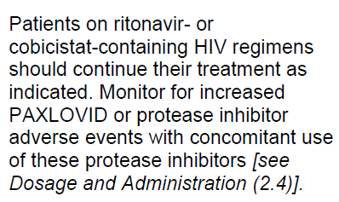
Nirmatrelvir/ritonavir: Drug Drug Interactions with ART
Antiretroviral considerations:
Continue ART, including boosted-PI regimens
Ok in untreated HIV – low risk for resistance with 5 days of treatment
Paxlovid Package insert
https://www.covid19treatmentguidelines.nih.gov
https://www.covid19-druginteractions.org/
https://www.fda.gov/media/155050/download
Notes:
At end of paxlovid slides, add the paxlovid slides
Add OPMAN slides COVID advances to after the end of paxlovid slides

Slide 27
Questions
Should vaccinated people be treated?
What about rebound?
Should therapy duration be extended?
Treat
Do Not Treat

Slide 28
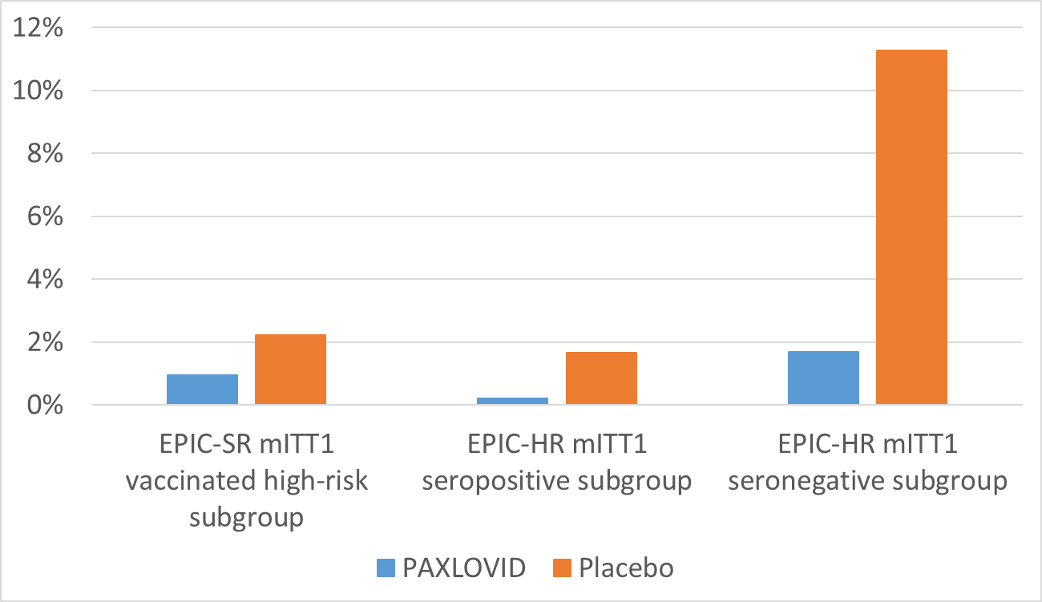
COVID-Related Hospitalization or Death in Patients with Baseline SARS CoV-2 Immunity: Clinical Trials
RRR 85%
11%
Proportion of Subjects
RRR 58%
RRR 88%
<1% 2%
<1%
2%
2%
ARR 10%
(56/497 vs 8/475, p*<0.0001)
ARR 1.3%
(7/314 vs 3/317, p*=0.2)
ARR 1.5%
(8/479 vs 1/490, p*=0.02)
*All displayed p-values are nominal (not adjusted for multiplicity, based on difference in estimated proportions using the Kaplan-Meier Method)
US FDA, Antimicrobial Drugs Advisory Committee Meeting, 16 March 2023.
Notes:
Fda ref

Slide 29
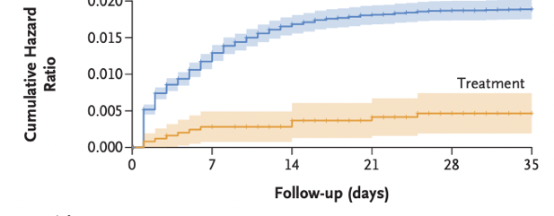
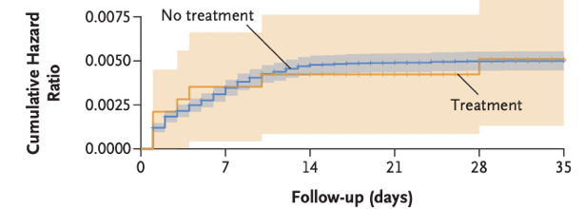
Nirmatrelvir/r in People with Previous Immunity
Retrospective cohort study, Israel
Rx (n=3902); No Rx (n=105,352)
~80% had previous immunity (vaccination, prior infection, both)
≥65 yo: hospitalization less likely in treated group (hazard ratio, 0.27). Benefit regardless of previous immunity status.
40–64 yo: hospitalizations similar in treated and untreated groups
Age ≥ 65 y
Age 40-64 y
Arbel R, NEJM, 2022

Slide 30
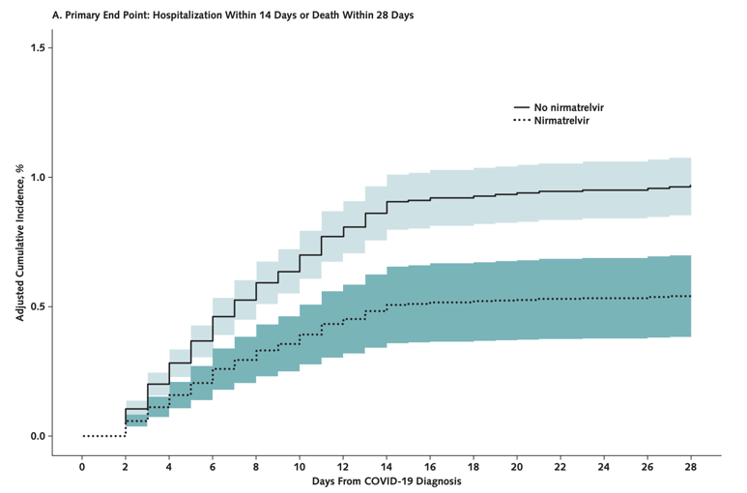
Nirmatrelvir/r for Early COVID-19 in Large US Health System
45,000 outpatients aged 50 years or older
90% with ≥3 vaccine doses
Hospitalization/death: 0.55% (NMV/r) vs. 0.97% (no NMV/r)
NMV/r recipients: lower risk for hospitalization (adjusted RR=0.60) and death (adjusted RR=0.29)
Dryden-Peterson S, Ann Intern Med, 2022

Slide 31
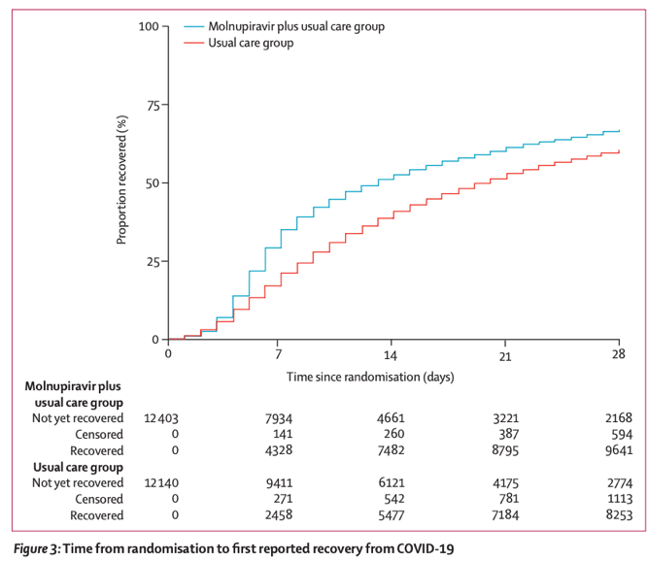
Molnupiravir (MOV) in Vaccinated Adults: PANORAMIC
Open-label, randomized controlled trial in UK, Dec 2021 to April 2022
≈25,000 non-hospitalized adults with COVID and symptoms for ≤5 days
MOV + usual care vs. usual care
Aged ≥50 y or ≥18 y with high-risk comorbidity
94% received ≥3 COVID vaccine doses
Hospitalization/death: 1% in both groups
Time to self-reported recovery: 9 days (MOV) vs. 15 days (usual care)
Butler CC, Lancet, 2022
Notes:
In the MOVe-OUT phase 3 clinical trial, molnupiravir reduced the likelihood of hospitalization or death by about 30% among high-risk unvaccinated outpatients with mild-to-moderate COVID-19. However, the effect of this drug in people who have received the COVID-19 vaccine is uncertain. Now, the PANORAMIC trial performed in the United Kingdom provides some answers.
Between December 2021 and April 2022, approximately 25,000 non-hospitalized adults with COVID-19 and symptoms for 5 days or less were randomized to receive molnupiravir plus usual care or usual care alone. The participants were age 50 years or older or were age 18 years or older with at least one comorbidity that placed them at high risk for severe COVID-19; 94% had received ≥3 doses of a COVID-19 vaccine. The main findings:
Hospitalization or death occurred in approximately 1% of participants; the rate was the same in those who received molnupiravir and those who did not.
Time to self-reported recovery was substantially shorter in the group that received molnupiravir: median 9 days vs. 15 days.
Comment: This study finds that, in a highly vaccinated population, molnupiravir does not reduce the already low rate of hospitalization or death. The drug hastens self-reported recovery, but this finding is not definitive because participants knew whether they were receiving molnupiravir or not, which may have affected their symptom reports. Where do these findings leave molnupiravir among options for treatment? For non-hospitalized patients who are at high risk for progression, nirmatrelvir/ritonavir is my first choice, with intravenous remdesivir an alternative for those who cannot take nirmatrelvir/ritonavir because of drug interactions. If both nirmatrelvir/ritonavir and remdesivir cannot be given to a patient at high risk for severe COVID-19, then I think there is a role for molnupiravir with the understanding that, if they are fully vaccinated, the likelihood of progression with or without the drug is thankfully very low.
-Rajesh T. Gandhi, MD
Dr. Gandhi is a member of the NIH and Infectious Diseases Society of America COVID-19 Treatment Guidelines Panels. The opinions in this review are his and not necessarily those of the Panels.

Slide 32
Should Vaccinated People Be Treated? My Take
Gradient of benefit: higher risk patients likely to derive more benefit
Recommend treatment for older people, regardless of vaccination status
For younger people who are vaccinated/boosted, recommend treatment if they have conditions that confer substantial risk, including obesity, heart or lung disease, immunosuppression, other high-risk conditions
Not yet known whether early treatment ameliorates post-acute sequelae of SARS CoV-2 (PASC) – important knowledge gap

Slide 33
Back to the Case
62 yo woman presenting with 2 days of fever, cough, myalgias. SARS CoV-2 rapid antigen test positive.
Oxygen saturation >95%
HIV (CD4 cell count 300; HIV RNA undetectable), pulmonary hypertension. Medications: bictegravir/FTC/TAF; tadalafil 40 mg daily
2 doses of mRNA COVID-19 vaccine in 2021; has not been boosted
Treatment recommended. Because NMV/r cannot be given with pulmonary hypertension medicine (tadalafil), received iv remdesivir with rapid clinical improvement

Slide 34
Questions
Should vaccinated people be treated?
What about rebound?
Should therapy duration be extended?
Treat
Do Not Treat

Slide 35
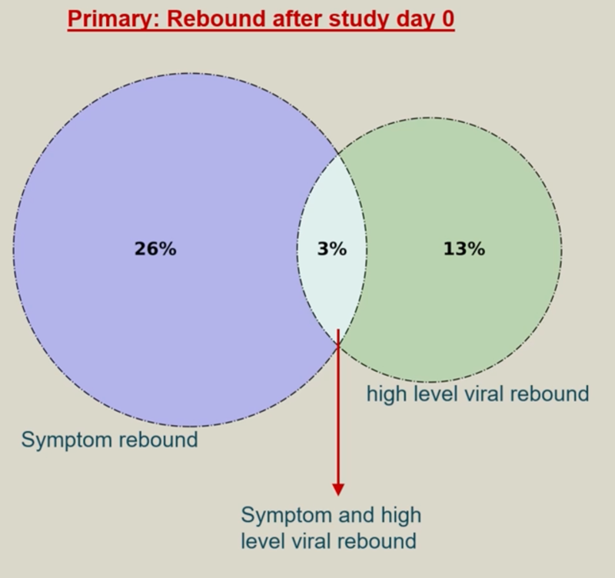
Symptom and Viral Load Rebound May Occur Even Without Treatment
563 participants receiving placebo (ACTIV-2)
Symptom rebound in 26%
High level viral rebound in 13%
Most symptom and viral rebound events transient: 89% of symptom rebound and 95% of viral rebound events occurred at only single time point before improving.
Combination of symptom and high-level viral rebound: 3% of participants.
Deo R et al. CROI 2023. Abstract 171,
Ann Int Med, 2023.
Notes:
Add citations

Slide 36
Rebound after Nirmatrelvir/ritonavir: What We Know So Far
Wide range in reported frequency; some but not all studies suggest symptomatic rebound slightly more frequent after NMV/r than after no treatment
Some patients with rebound have high SARS-CoV-2 levels, culture positive; suggests they may be infectious
Thus far, no resistance detected before or after NMV/r
Early reports: no decrements in antibody or adaptive immunity
Most cases are mild, resolve quickly
Charness NEJM Sept 15, 2022; Pandit J et al, CID, 2023; Epling, CID 2022; Boucau CID 2022; Carlin. CID. 2022;
Callaway E, Nature, 2022

Slide 37
What About Rebound? Should therapy duration be extended? My Take
I counsel patients that rebound may occur, but not likely to be severe; I do not suggest avoiding therapy because of potential for rebound
In patients who have symptomatic rebound and whose antigen test turns positive again, I reset isolation clock
I generally do not extend duration of therapy or re-treat; important area for future study
EPIC-IC: evaluating 5, 10 or 15 days of NMV/r in immunocompromised patients
https://clinicaltrials.gov/ct2/show/NCT05438602

Slide 38
ART in COVID-19 Treatment & Prevention
No evidence of benefit of LPV/r, TDF, other ARVs against SARS-CoV-2
Observational data from Spain and from US Veterans Aging Cohort Study suggesting benefit of TDF may have been confounded
Focus on attaining or maintaining viral suppression with any appropriate regimen
Hospitalized patients with COVID-19:
Continue ART without change
If not on ART, initiate ART once stable (including prior to discharge)
Del Amo J et al, Ann Int Med, 2020; Li G et al, AIDS, Oct 1, 2022

Slide 39
COVID-19 Treatment:
On the Horizon

Slide 40
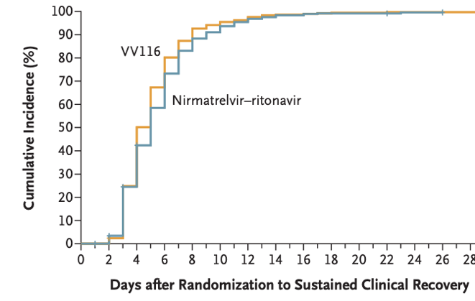
VV116 vs Nirmatrelvir-Ritonavir (NMV/r)
VV116: oral remdesivir analogue
Phase 3, observer-blinded, randomized trial during Omicron outbreak in China
771 adults, mild to moderate COVID-19, high risk of progression to severe disease
About 75% fully vaccinated or boosted
Randomized: VV116 or NMV/r for 5 days
Time to sustained clinical recovery: VV116 non-inferior to NMV/r (median 7 d in both groups).
No deaths or progression to severe disease
Obeldesivir (another oral remdesivir analogue) moving into phase 3 trials
Sustained clinical recovery
(alleviation of symptoms for two consecutive days)
Cao Z, NEJM, 2022

Slide 41
SCORPIO SR: Ensitrelvir for mild-to-moderate COVID-19
Protease inhibitor; emergency approval in Japan
Randomized placebo-controlled trial: 5-day course
Ages 12-69 yr, risk factors, ≤5 days of COVID onset
Median age: mid 30s. About 92% vaccinated
Ensitrelvir 125 mg: earlier (1 day) resolution of symptoms, more rapid clearance of virus
Suggestion of reduced risk of Long COVID symptoms with ensitrelvir
Time to resolution of 5 symptoms
(time from onset <72 hours)
Ensitrelvir 125 mg (Median=7.0 days)
Ensitrelvir 250 mg (Median=7.1 days)
Placebo (Median=8.0 days)
Uehara T et al. CROI 2023. Abstract 166.
Notes:
Add citations

Slide 42
Will Antiviral Therapy Reduce Long COVID?
VA Cohort Study: about 35,700 people who received NMV/r; 246,000 people who did not
Compared with controls, NMV associated with:
26% reduction in post-COVID conditions
Benefit seen in those who were unvaccinated, vaccinated and boosted, and those with reinfection
Difficult to exclude unmeasured confounding
Post-COVID Conditions
Assessing impact of antiviral therapy on Long COVID is important area of future research
Xie Y, JAMA Int Med, March 23, 2023
Notes:
Add citations

Slide 43
Lessons from HIV and COVID-19

Slide 44
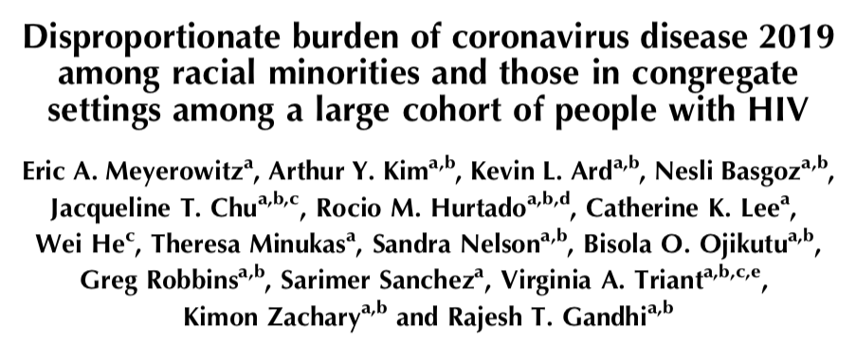
Disproportionate Impact of COVID-19 on Vulnerable Populations
People with HIV with COVID-19 in March/April 2020 at Mass General
∼80% racial/ethnic minorities
Meyerowitz E/Gandhi RT et al, AIDS 2020

Slide 45
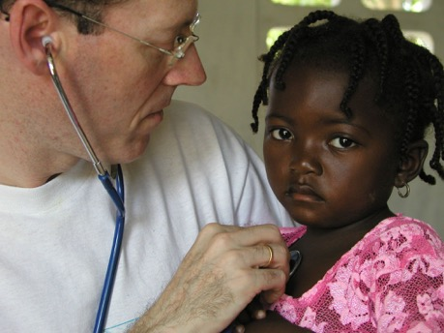
Lessons from HIV and COVID-19 for Future Pandemics
Pressure to deploy interventions must be tempered by importance of finding out if treatment or vaccine works
Randomized trials can and must be done during pandemic
Equity must be at center of our response
Siedner M, Gandhi RT, Kim AY, JID, 2020

Slide 46
Summary
COVID-19 outcomes may be more severe among PWH, particularly if they have low CD4 counts or untreated infection
All PWH should receive COVID-19 vaccination, including boosters
Treatment of PWH should follow general population guidelines
Lessons from HIV and COVID include importance of clinical trials as well as an unwavering focus on addressing inequities

Slide 47
Q&A

Slide 48
AETC Program
National Centers and National HIV Curriculum
National Coordinating Resource Center serves as the central web based
repository for AETC Program training and capacity building resources; its
website includes a free virtual library with training and technical assistance
materials, a program directory, and a calendar of trainings and other events.
Learn more: https ://aidsetc.org
National Clinician Consultation Center provides free, peer to peer,
expert advice for health professionals on HIV prevention, care, and treatment
and related topics. Learn more: https ://nccc.ucsf.edu
National HIV Curriculum provides ongoing, up to date HIV training and
information for health professionals through a free, web based curriculum;
also provides free CME credits, CNE contact hours, CE contact hours, and
maintenance of certification credits. Learn more: www.hiv.uw.edu

