Slide 1
HIV Is Not A Crime:
Implications Beyond the Bars
Kamaria Laffrey, WLHIV & SME Subject Matter Expert
Co-Managing Director
The Sero Project

Slide 2
Faculty Disclosure
The presenter of this workshop also represents Janssen Pharmaceuticals in a non-product based campaign to encourage relationship building with providers and PLHIV. The presenter’s role serves as informational and educational purposes only with Positively Fearless.
This program is supported by the Health Resources and Services Administration (HRSA) of the U.S. Department of Health and Human Services (HHS) under grant number U1OHA30535 as part of an award totaling $4.2m. The contents are those of the author(s) and do not necessarily represent the official views of, nor an endorsement, by HRSA, HHS, or the U.S. Government. For more information, please visit HRSA.gov.
“Funding for this presentation was made possible by cooperative agreement U1OHA30535 from the Health Resources and Services Administration HIV/AIDS Bureau. The views expressed do not necessarily reflect the official policies of the Department of Health and Human Services nor does mention of trade names, commercial practices, or organizations imply endorsement by the U.S. Government. Any trade/brand names for products mentioned during this presentation are for training and identification purposes only.”

Slide 3
Kamaria Laffrey (she/her)
Woman living with HIV for 19 years
Living with Chronic Optimism & Black Girl Magic for 40 years
Founder of emPOWERed Legacies
Co-Managing Director at the SERO Project
Coalition Facilitator for FL HIV Justice Coalition

Slide 4
SERO PROJECT centers PLHIV leadership to end HIV criminalization, mass incarceration, racial and social injustice by supporting inclusive PLHIV networks to improve policy outcomes, advance human rights and promote healing justice.
I am not an attorney or medical professional. Please take this presentation as informational and if you or someone you know is experiencing criminalization, or have epidemiology questions, please reach out to a trusted legal support or medical expert. There are PLHIV-led organizations that can guide but not guarantee legal representation.

Slide 5
Educational Need/Practice Gap
How will the reducing new HIV transmissions cases be impacted if there were not laws that criminalize a person's’ HIV status?
Notes:
Gap = Difference between current practice and optimal practice relevant to the educational need
Need = The issue/problem that underlies the practice gap

Slide 6
Objectives
Upon completion of this educational activity, you will be able to:
Define HIV Criminalization through it’s policy enforcement and data of communities impacted by the policies
Identify intersections of barriers in effective public health efforts towards reduction of new HIV transmission cases
Recognize the nuances in policy reform from strategy vs. implementation in various jurisdictions and how improving them can lessen barriers

Slide 7
Expected Outcome
Assess and understand the basic 5 things about what is wrong with HIV criminalization

Slide 8
HIV Criminalization
The unjust use of outdated criminal laws, policies and practices to punish people living with HIV (PLHIV), based on one’s HIV status.
These laws and the practice of criminalizing HIV is a racial, gender, and economic justice issue.
Studies from the Williams Institute show that HIV criminalization is disproportionately used to target Black, Indigenous, and other people of color, especially those who are also cis and trans women, gay and bisexual men, people who use drugs, sex workers, and immigrants
Criminalization increases risk of violence for women living with HIV
Incarceration and criminal records have lifelong effects on ability to exercise rights and access support systems including mental health to address the trauma

Slide 10
INTERACTIVE ASSESSMENT
A series of statements will be read with no context and will be read aloud 2 times while displayed on the screen. Each statement is up to your own interpretation and understanding. This will happen quickly without a lot of time to process. That is intentional. There are a total of 6 statements. When we complete all 6, we will revisit the statements, but please for now provide your reaction to them of AGREE OR DISAGREE. These statements are not to be taken as a true or false but whether you agree or disagree.
PURPOSE - To know why you believe what you believe and OWN IT or be willing to shift your mindset
Notes:
For the sake of time we will limit to hearing from up to 3 people

Slide 11
SILENT BRAVERY STATEMENT
Before we begin our conversation, it is important that we acknowledge that the subject matter discussed may contain sensitive subjects for some of us; including sexual assault, prosecution based on HIV status and other forms of violence. These are difficult conversations and this space honors the respect to every individual life experience and right to both privacy and non-participation in any part of our discussion.
This is a safe and brave space.

Slide 12
#1 - A law that targets any person living with HIV, targets all people living with HIV.
AGREE OR DISAGREE?

Slide 13
#2 - Sex workers would be less vulnerable to HIV laws if they’re required to take PrEP.
AGREE OR DISAGREE?

Slide 14
#3 - Racial injustice should be the center point of HIV criminalization reform dialogue.
AGREE OR DISAGREE?

Slide 15
#4 - In cases of rape or sexual assault, if HIV transmission occurs, sentencing should be enhanced.
AGREE OR DISAGREE?

Slide 16
#5 - Removing penalties for PLHIV who are virally suppressed is a successful approach in criminalization reform.
AGREE OR DISAGREE?

Slide 17
#6 - Proof of malicious intent should be required in cases of HIV transmission.
AGREE OR DISAGREE?

Slide 18
Brief Review/Debrief
A law that targets any person living with HIV, targets all people living with HIV.
Sex workers would be less vulnerable to HIV laws if they’re required to take PrEP.
Racial justice should be the center point of HIV criminalization dialogue.
In cases of rape/sexual assault, if HIV transmission occurs, sentencing should be enhanced.
Removing penalties for PLHIV who are virally suppressed is a successful approach in criminalization reform.
Proof of malicious intent should be required in cases of HIV transmission.

Slide 19
Changing Laws is Hard
Those statements are vague and open to interpretation just as our state statutes are in many cases
The purpose of asking you have a knee-jerk reaction to them is that in educating lawmakers, they already have an internal bias for where they land with policies depending on specific language or the removal of language that is too specific
The more we educate, the more we prioritize the communities impacted by laws that criminalize an HIV status to be the solution to their problem - the closer we will be to ending new HIV transmissions

Slide 20
DATA THAT HIGHLIGHTS A
NEED FOR CHANGE
Williams Institute Report Highlights - KY
Women account for nearly two-thirds of HIV-related arrests in Kentucky.
All but one of Kentucky’s HIV-related arrests since 2006 were related to sex work.
Per capita, Kenton County had about eight times more HIV-related arrests than Jefferson County.
32 people have been arrested for HIV-related crimes since 2006
97% of those arrests were related to sex-work
17% of PLHIV in KY are women
62% of those arrested for HIV related crimes were women

Slide 21
The Impact Criminalization Has On Community
Goes beyond the courtroom
Intersects w/ racism, classism, and bigotry
Does not protect or improve public health
Controls and enforces marginalization of women, POC, Transgender and Gender Diverse folks, LGBTQ+ communities, sex workers, immigrant/migrant communities, and people living in poverty

Slide 22
What Prosecution Can Look Like:
Media sensationalism and loss of privacy (whether convicted or not)
Felony convictions
Up to 30 years in prison
Sex offender status (some states like AR & TN)
Difficulty finding employment and housing
Threat of losing one’s children
Loss of rights to vote, travel, and choose where one lives
Vulnerability to violence and vigilantism

Slide 23
“Knowledge might be the Power.
But the activation of that power is the application of what you know and are willing to do.”
- Kamaria Laffrey

Slide 24
Points of Commonality - Concerns from Community
Notes:
https://www.hiv.gov/hiv-basics/overview/data-and-trends/impact-on-racial-and-ethnic-minorities

Slide 25
Points of Commonalities - Concerns of Community
Notes:
https://williamsinstitute.law.ucla.edu/wp-content/uploads/HIV-Crim-and-Race-Infographic.pdf
Tennessee’s two primary HIV criminalization laws—aggravated prostitution and criminal exposure—are considered a “violent sexual offense” and require a person convicted to register as a sex offender for life. Using data obtained from Tennessee’s sex offender registry, this study examines the enforcement of HIV criminalization laws in Tennessee from 1991 to 2022.
Enforcement of HIV crimes in Tennessee disproportionately affects women and Black people.
Shelby County, home to Memphis, accounts for most of the state’s HIV convictions.
Those convicted of an HIV-related offense are more likely to be economically vulnerable compared to others on the registry.
154 ppl are on the TN SOR for an HIV conviction
46% of those registrants are women but only 26% of the PLHIV in the state
75% of the registrants are Black while Black people only make up 17% of the state population
19% are experiencing housing insecurity and 9% of SOR registrants are homeless
64% of HIV registrants reside in Shelby County but Shelby county is only 13% of the state population
The cost of incarceration of HIV related offenses is 3.8 million dollars in TN

Slide 27
SLAVERY

Slide 28
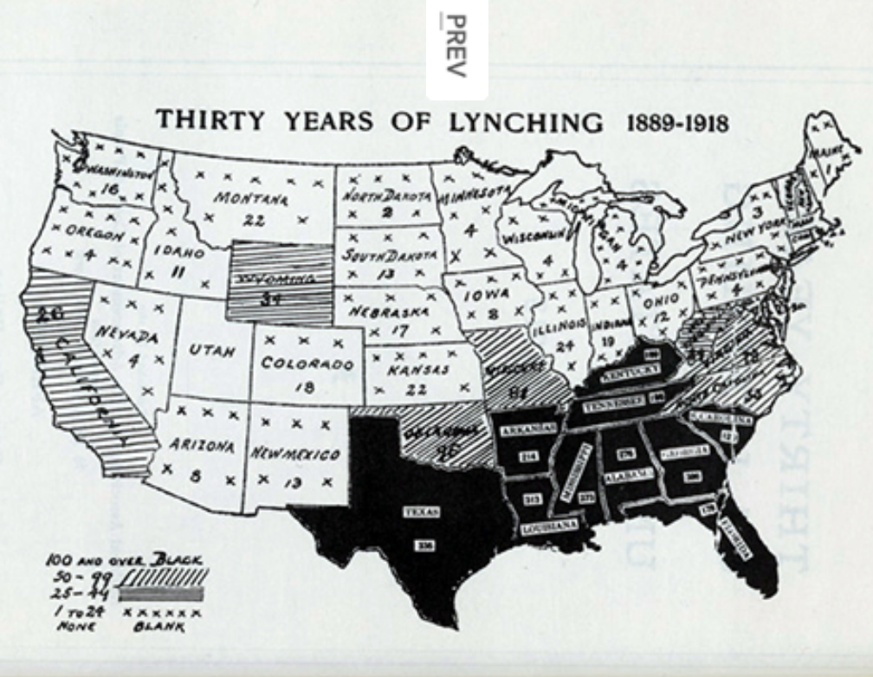
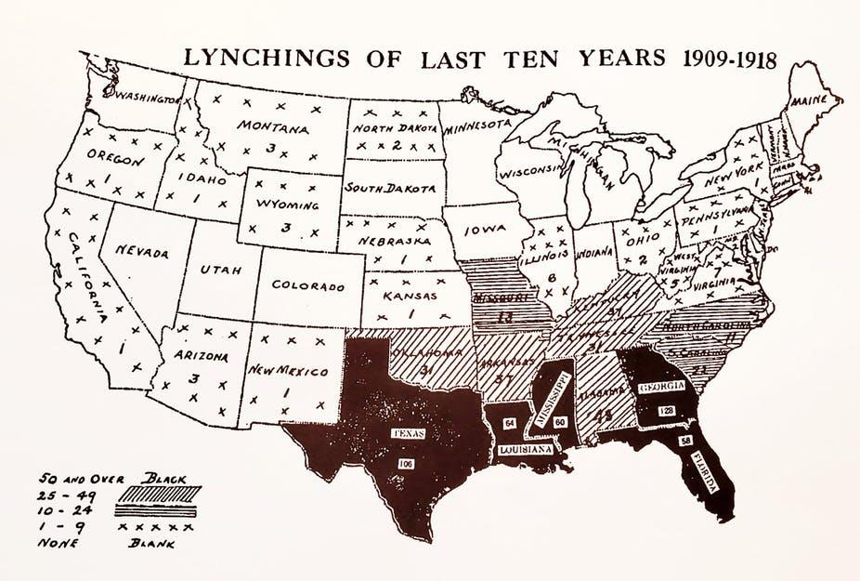
LYNCHING
Notes:
https://womenatthecenter.nyhistory.org/remembering-the-naacps-1917-silent-protest-parade-and-the-refusal-to-accept-barbaric-acts/

Slide 29
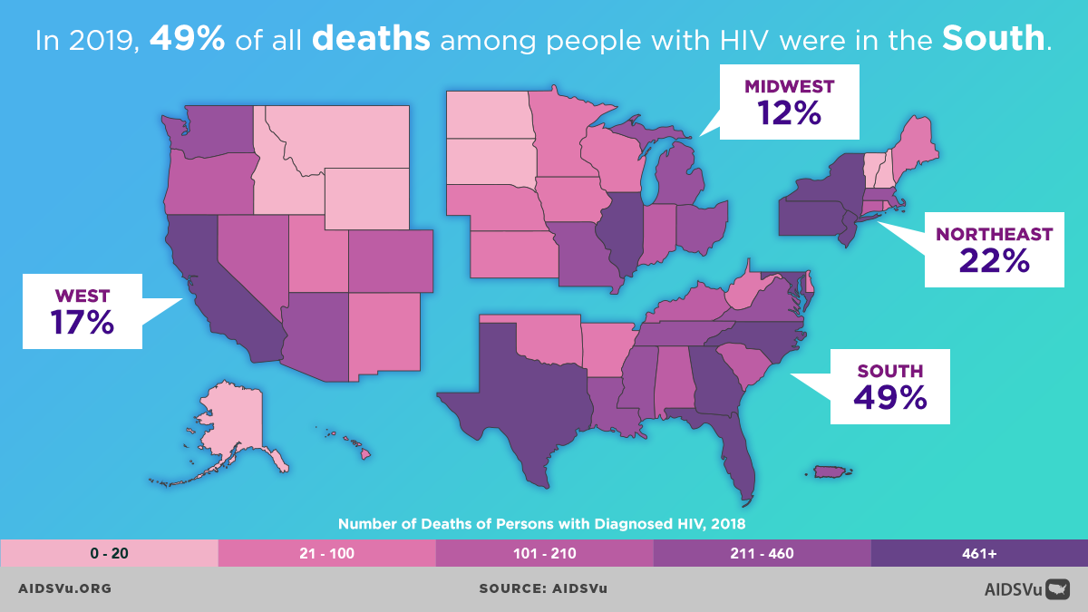
HIV DEATHS

Slide 30
IMPRISONMENT
SOURCE: Prisoners in 2016. US Bureau of Justice Statistics. January 2018, NCJ 251149. By E. Ann Carson, Ph.D., BJS Statistician.
Notes:
Imprisonment rate of sentenced prisoners under jurisdiction of state correctional authorities per 100,000 U.S. residents, age 18 or older. Does not include prisoners who have not been convicted or sentenced. Does not include jail inmates whether convicted or not. Does not include federal prisoners.

Slide 31
MEDICAID EXPANSION
Notes:
https://www.kff.org/medicaid/issue-brief/status-of-state-medicaid-expansion-decisions-interactive-map/

Slide 32
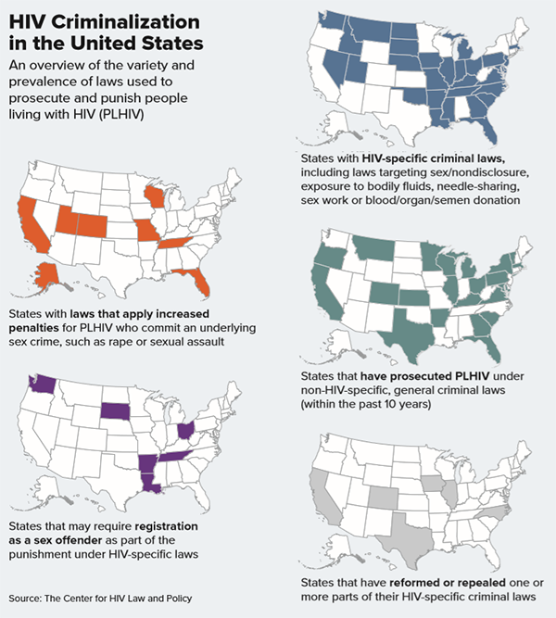
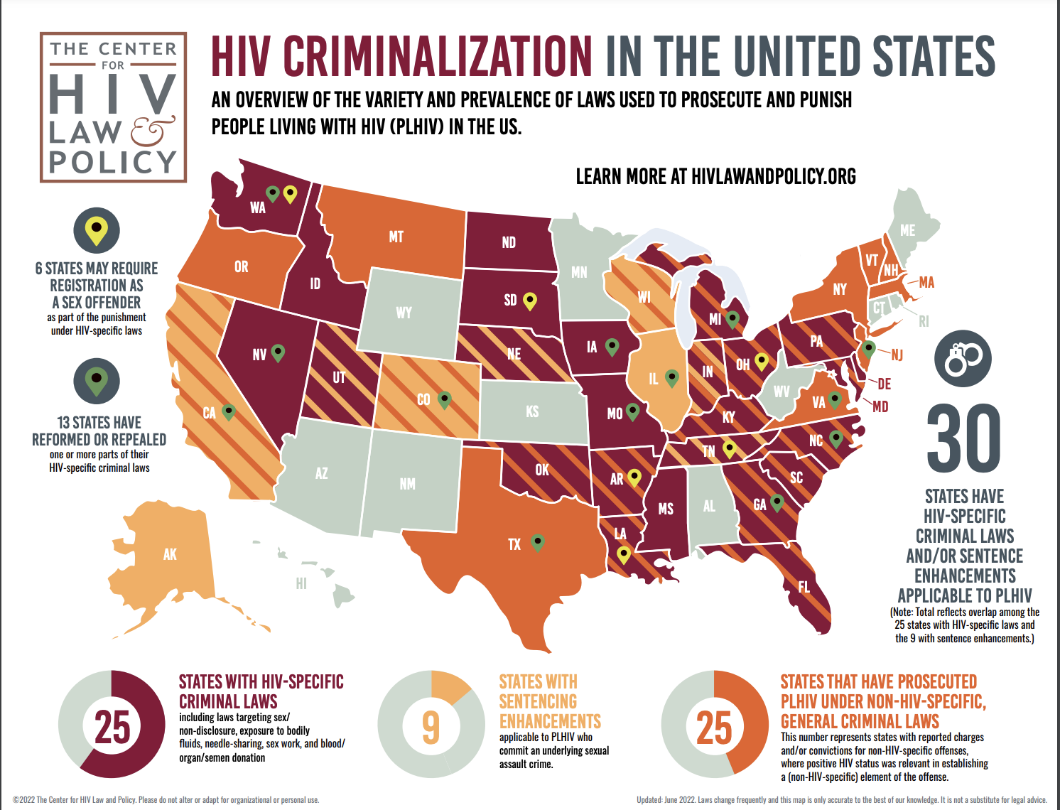
Snapshots of Criminalization
Notes:
Many states have laws that make alleged, perceived or potential HIV exposure a felony punishable up to 30 years
meanwhile some jurisdictions judges can go beyond that. A man in Washington was sentenced to 178 years.
host a lifetime sex offender registry (LA, OH, SD, TN, AR*, WA)
do not determine whether HIV transmission even occurs

Slide 33
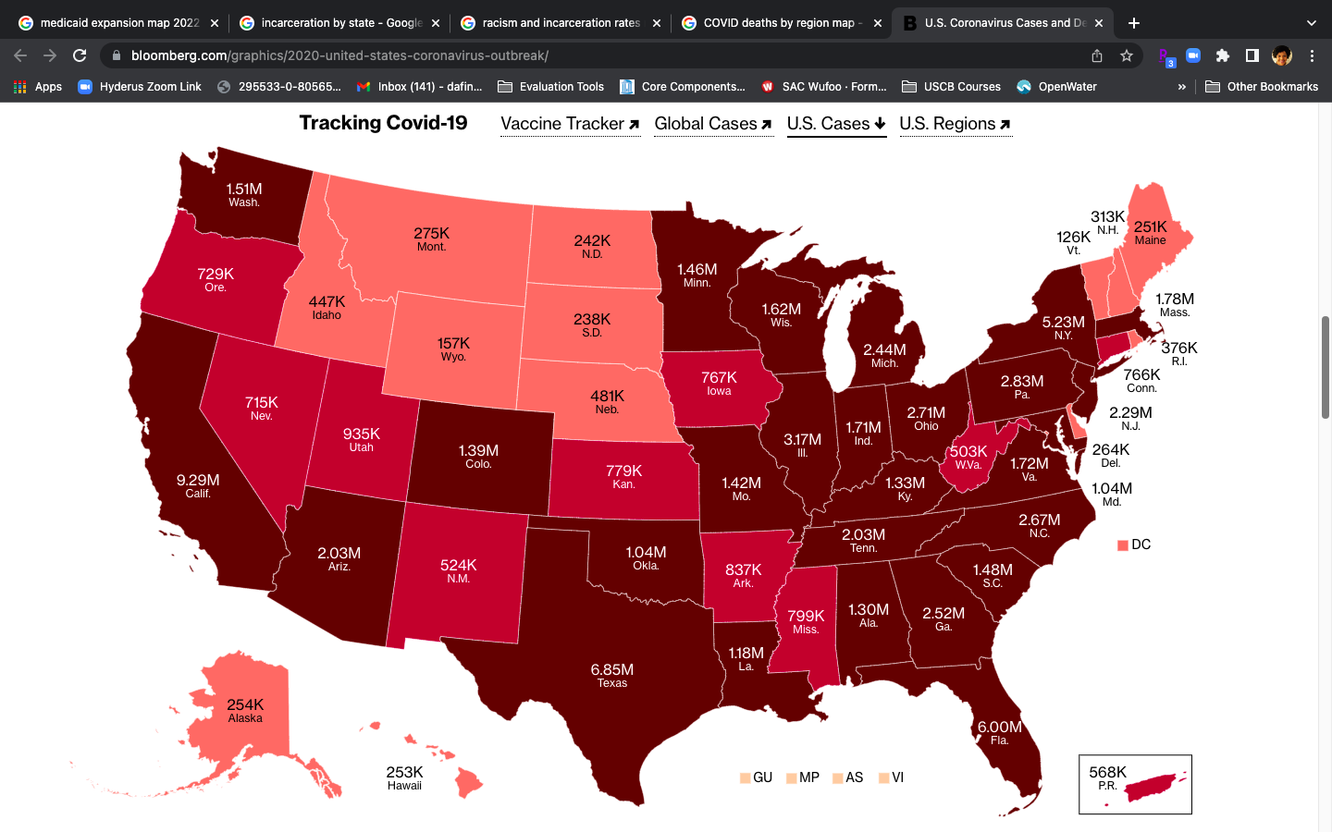
COVID-19

Slide 34
Levels of Solutions
Local Jurisdictions including public health workforce education on HIV criminalization
Statewide or region specific PLHIV-centered networks and coalitions built to mobilize in decriminalization and legislative reform
Federal engagement on the REPEAL Act and paying attention to trends in various policies laid out in the National HIV/AIDS Strategy
Trusting PLHIV and impacted communities to drive the engagement with policy makers and influence change

Slide 35
Notes:
Link to Policy Agenda - https://www.pwn-usa.org/wp-content/uploads/2021/07/Networks-Policy-Agenda-FINAL.pdf

Slide 36
What is Demanding Better?
A clear roadmap for the administration and Congress to achieve the goal of ending the epidemic and improving quality of life for people living with HIV.
Comprehensive but not exhaustive -- a living document.
A call for the federal response to HIV to uplift the dignity, human rights, and wellness of all people living with HIV in the U.S.
After 40 years, the domestic HIV epidemic continues to be driven by social determinants and structural inequities.
Racism
Gender inequities
Homophobia and transphobia
Poverty
Biomedical tools are necessary but not sufficient to overcome barriers to ending the epidemic.
Notes:
Issue areas include - Meaningful Involvement of PLHIV (MIPA)
Create a human rights environment for PLHIV
Racial and gender disparities
Add sex workers and immigrants as priority populations
Quality of life for PLHIV

Slide 37
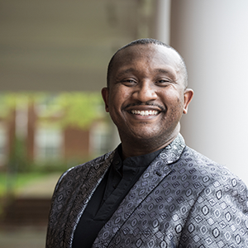
PLHIV MOVING LEGISLATION
Their new law:
broadly expanded the scope of the law to include all sexually transmitted infections — not just HIV, syphilis and Hepatitis B
provided provisions to include proof of intent
repeals misdemeanor penalty for non-disclosure, significantly raising burden of proof for “infected” sexual battery charges. Convictions require proof of transmission and that their partner engaged in risky behavior such as unprotected sex.
repeals a section of state code that requires Virginians convicted of sex work or IV drug use to be tested for HIV
removes the state’s current ban against patients with HIV donating organs, with notice and consent, in certain circumstances — putting Virginia in line with federal guidance.
Deirdre Johnson & Cedric Pulliam
Unprecedented success and movement:
met at 2018 HINAC Training Academy, Indiana
started ECHO-VA immediately after
Modernized law signed July 2021

Slide 38
Unprecedented success and movement:
hosted 2016 HINAC Alabama
revived a start/stop coalition from 2012
REPEALED law signed July 2021
Their new law:
House Bill 1063 ends criminal penalties against PLWH by amending the Criminal Code of 2012, repealing the statute creating the offense of criminal transmission of HIV, and makes conforming changes in the AIDS Confidentiality Act, the Illinois Sexually Transmissible Disease Control Act, the Illinois Vehicle Code, the Criminal Code of 2012, and the Unified Code of Corrections.
IL - Timothy Jackson
Coalition members & AIDS Foundation Chicago

Slide 39
Stakeholder Opportunities
Kentucky Public Health Association
National Alliance of State and Territorial AIDS Directors (NASTAD) Member
Association of Nurses of AIDS Care
The more you educate about this, the more support can be leveraged on a federal level. We need co-sponsors for the REPEAL Act when it gets reintroduced in the 118th Congress by Rep. Barbara Lee

Slide 40
How You Can Help
Testimony in legislative hearings
Letters to the editor
Support with creating continuing education opportunities for prosecutors and foundational curriculum
Connect with the state advocates and PLHIV working on decriminalization efforts by registering to attend HIV IS NOT A CRIME TRAINING ACADEMY June 4-7, 2023 in Emory, VA

Slide 41
Q&A

Slide 42
THANK YOU!
KAMARIA LAFFREY
kamaria.laffrey@seroproject.com

Slide 43
AETC Program
National Centers and National HIV Curriculum
National Coordinating Resource Center serves as the central web based
repository for AETC Program training and capacity building resources; its
website includes a free virtual library with training and technical assistance
materials, a program directory, and a calendar of trainings and other events.
Learn more: https ://aidsetc.org
National Clinician Consultation Center provides free, peer to peer,
expert advice for health professionals on HIV prevention, care, and treatment
and related topics. Learn more: https ://nccc.ucsf.edu
National HIV Curriculum provides ongoing, up to date HIV training and
information for health professionals through a free, web based curriculum;
also provides free CME credits, CNE contact hours, CE contact hours, and
maintenance of certification credits. Learn more: www.hiv.uw.edu

