Slide 1
Approaches to Harm Reduction And SSUD
Christopher Abert
Notes:
1

Slide 2
This program is supported by the Health Resources and Services Administration (HRSA) of the U.S. Department of Health and Human Services (HHS) under grant number U1OHA30535 as part of an award totaling $4.2m. The contents are those of the author(s) and do not necessarily represent the official views of, nor an endorsement, by HRSA, HHS, or the U.S. Government. For more information, please visit HRSA.gov.
“Funding for this presentation was made possible by cooperative agreement U1OHA30535 from the Health Resources and Services Administration HIV/AIDS Bureau. The views expressed do not necessarily reflect the official policies of the Department of Health and Human Services nor does mention of trade names, commercial practices, or organizations imply endorsement by the U.S. Government. Any trade/brand names for products mentioned during this presentation are for training and identification purposes only.”
Faculty Disclosure

Slide 3
AETC Program National Centers and HIV Curriculum
National Coordinating Resource Center – serves as the central web –based repository for AETC Program training and capacity building resources; its website includes a free virtual library with training and technical assistance materials, a program directory, and a calendar of trainings and other events. Learn more: https://aidsetc.org/
National Clinician Consultation Center – provides free, peer-to-peer, expert advice for health professionals on HIV prevention, care, and treatment and related topics. Learn more: https://nccc/ucsf.edu
National HIV Curriculum – provides ongoing, up –to-date HIV training and information for health professionals through a free, web –based curriculum; also provides free CME credits, CNE contact hours, CE contact hours, and maintenance of certification credits. Learn more: www.hiv.uw.edu

Slide 4
Objectives
Define harm reduction
Define Severe Substance Use Disorder
Illustrate the need for, and benefits of, harm reduction
Identify current and future Harm Reduction responses
Notes:
TRAINER INSTRUCTIONS
This is a half-day workshop with one scheduled break.
Workshop includes discussion and activities
By the end of this session you will be able to:
Define harm reduction.
Recognize key principles of harm reduction.
Identify the need for harm reduction, with a PWID focus.
Discuss key harm reduction strategies to support your work as HHRNs.
4

Slide 5
Glossary
PWID - People Who Inject Drugs
PWUD - People Who Use Drugs
SUD - Substance Use Disorders
SSUD - Severe SUD
SEP – Syringe Exchange Program
SSP - Syringe Service Program
SCS - Safe Consumption Site
OPC - Overdose Prevention Center
MOUD - Medication for Opioid Use Disorder
DSM – Diagnostic & Statistical Manual
Notes:
TRAINER INSTRUCTIONS
Because these terms will be used throughout the training, briefly review acronyms with participants.
What other terms are there?
HHRN – HIV Harm Reduction Navigators
SAP – Syringe Access Programs
IDU – Injection Drug User*
*This is what they used to call PWID, note how language is fluid and always changing.
5

Slide 6
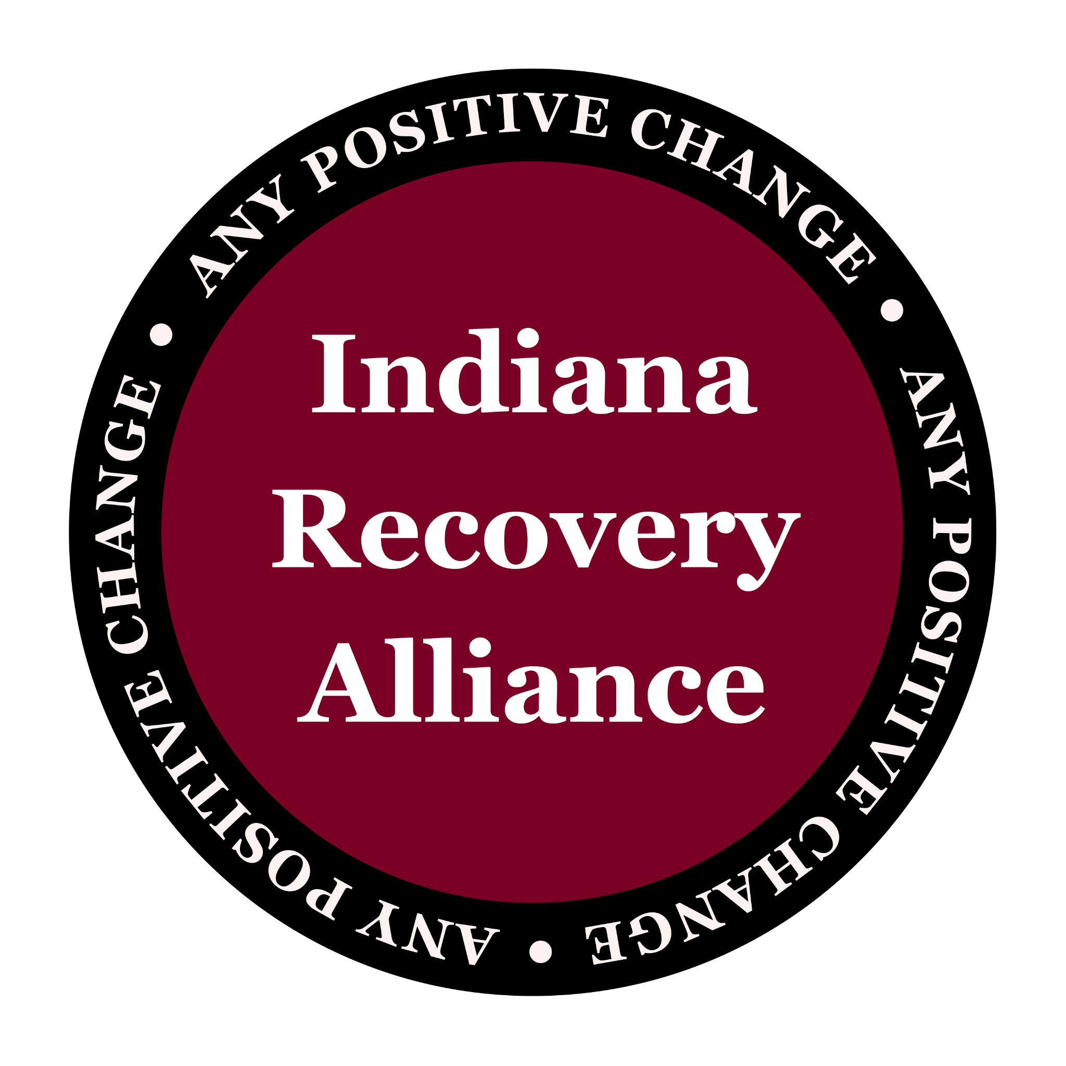
IRA shifts resources and power to people who use drugs. We reduce both the individual & structural harms caused by drug policies through direct action and advocacy.
Notes:
6

Slide 8
What is Harm Reduction?
Notes:
8
ASK
What is Harm Reduction?
TRAINER INSTRUCTIONS
Use this brainstorm as a way to open the training, getting a sense of what harm reduction means to participants, including their experiences with harm reduction.
This may be from a personal perspective (how harm reduction was -or was not- incorporated at their agency, or through their experience working as a peer/service provider).
Optional
Write down responses on Newsprint w. Thick Pen Markers
Or, ask if a volunteer would write down answers while you facilitate discussion
Or, have this discussion only

Slide 9
Harm Reduction
A set of practical strategies that reduce the negative consequences associated with drug use and other risk behaviors (ex: sexual risk)
In relation to drug use: incorporates a spectrum of strategies including safer use, managed use, abstinence
Harm reduction strategies meet people where they are
but we don’t leave them there
Notes:
9
TRAINER INSTRUCTIONS
Explain how harm reduction has its roots in drug use, particularly injection drug use, we are going to discuss harm reduction within that context, while broadening it to apply to other risk behaviors or circumstances as it applies.
We will be going into further detail throughout the training to discuss various harm reduction approaches, interventions, and strategies that HHRNs can incorporate into their work with PWUD/PWID.
KEY MESSAGES
Harm Reduction:
Accepts that some ways of using are safer than others, and applies evidence-based interventions (i.e. syringe access, overdose prevention) to reduce negative consequences of drugs use (i.e. overdose fatalities, HIV/HCV transmission, injection-related wounds).
Moves past judgment of another person to address their drug use and the harm that’s occurring to that person.
Recognizes a continuum of use, modeling the stages of change theory.
Does not making drug use acceptable; it’s accepting that people use drugs (pragmatic).
Means meeting clients where they are, and also where the service provider is capable of being. Self care includes meeting yourself where you are at also.
Works to ELICIT POSITIVE CHANGE (like motivational interviewing) based on individual client need, circumstance, and readiness to change.

Slide 10
What Harm Reduction Does Not Do
does not mean “anything goes”
does not enable drug use or high risk behaviors
does not condone, endorse, or encourage drug use
does not exclude or dismiss abstinence-based treatment models as viable options
Notes:
10

Slide 11
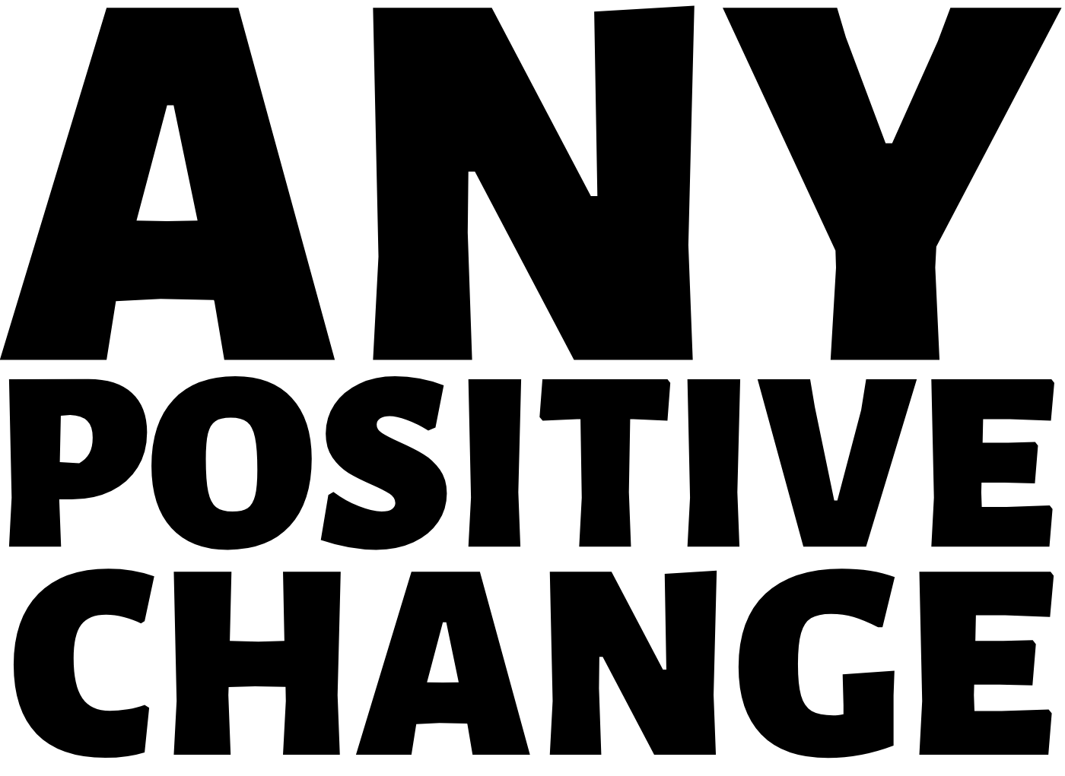

Slide 12
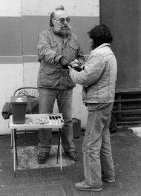
Civil Disobedience?
SSP’s
Naloxone Distro
SCS/OPC
Buyer’s Clubs
Safer Supply
Ethics & Legality
Doug Wilson
Dave Purchase handing out syringes on his own in Tacoma, Wash., in the late 1980s. New York Times, January 27, 2013
Notes:
KEY MESSAGES
Harm reduction stems from syringe exchange.
NOTES
Foto from the New York Times, January 27, 2013, featuring Dave Purchase handing out syringes on his own in Tacoma, Washington in the late 1980s.
“This is life and death. There were unnecessary deaths, unnecessary and preventable deaths.”
Dave Purchase has been regarded as the Godfather of Syringe Exchange in the United States (1940~2013).

Slide 13
What is SSUD?

Slide 14
Continuum of Use and SSUD
SSUD
no
use
situational
use
bio/psycho
dependence
chaotic use
social, ritual or
experimental
use
risky
use
severe
consequences
Notes:
It’s important to remember that simply using opioids, even illicitly, doesn’t indicate a disorder. Drug use happens along a continuum, it’s not always linear, it’s severity can increase over time, but it can also subside over time, or it can be simultaneously chaotic with one drug and ritual with another. For example, someone might have symptoms that indicate severe alcohol use disorder, but be in an experimental phase with marijuana. They may have situational use for benzodiazepine, but be experiencing chronic chaotic use with cocaine. It’s complicated.
The point is, we don’t always know where a person is on this continuum, and it can change. If we’re not sure, we can employ motivational interviewing techniques, such as open ended questions, which will allow the patient to self identify problematic drug use. We can also use simple tools like decisional balance sheets to help them identify any ambivalence that might need to be addressed. More on MI and decisional balance sheets in an upcoming didactic, though.
We should be aware, though, that due to stigma surrounding drug use, many providers automatically assume that ANY person who is using drugs illicitly is on the severe end of this continuum. In truth, people with Severe Substance Use Disorder (6 or more symptoms) are not the norm. Again, more on that in a future didactic.
So what are the symptoms according to the DSM 5?
14

Slide 15
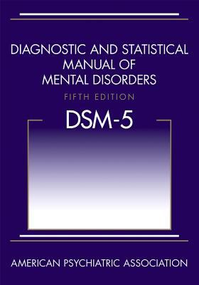
DSM Criteria for SUD
1) Opioids often taken in larger amounts/ over a longer period of time than intended.
2) There is a persistent desire or unsuccessful efforts to cut down or control opioid use.
3) A great deal of time is spent in activities necessary to obtain the opioid, use the opioid, or recover from its effects.
4) Craving, or a strong desire to use opioids.
5) Recurrent opioid use resulting in failure to fulfill major role obligations at work, school or home.
6) Continued opioid use despite having persistent or recurrent social or interpersonal problems caused or exacerbated by the effects of opioids.
7) Recurrent opioid use in situations in which it is physically hazardous.
8) Continued use despite knowledge of having a persistent or recurrent physical or psychological problem that is likely to have been caused or exacerbated by opioids.
9) Important social, occupational or recreational activities are given up or reduced because of opioid use.
10) *Tolerance, as defined by either of the following: (a) a need for markedly increased amounts of opioids to achieve intoxication or desired effect (b) markedly diminished effect with continued use of the same amount of an opioid
11) *Withdrawal, as manifested by either of the following: (a) the characteristic opioid withdrawal syndrome (b) the same (or a closely related) substance are taken to relieve or avoid withdrawal symptoms

Slide 16
Criteria:
1, 2, 4
using against their will,
without their permission
3, 5, 6, 7, 8, 9
using despite negative consequences

Slide 17
Punishment, Cruelty, Shame and Stigma
Do Not Work

Slide 18
Current Responses to SSUD
Punishment
Prevention
Treatment

Slide 19
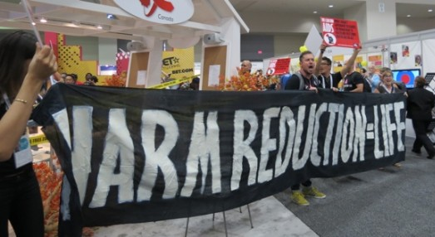
Ideal Responses to SSUD
Prevention
Treatment
Harm Reduction

Slide 20
The Need for Harm Reduction

Slide 21
Traditional Drug Treatment
Limited availability
People may not be ready to quit
Other reasons?
Insurance
Pregnant
Health issues
Rent
Employment
Child care
CPS
Probation or drug court
Mental health
Notes:
21
ASK
What is traditional drug treatment?
Other reasons: insurance, pregnant, health issues, rent, employment, child care, DCS, probation, drug court,

Slide 22
Who Needs Harm Reduction?
80% of people with OUD are not in treatment
ncbi.nlm.nih.gov/books/NBK409172/
Johns Hopkins and National Survey on Drug Use and Health
Notes:
Research from Johns Hopkins’ suggests that nearly 80% of people with OUD are past the point of prevention and not engaged in treatment, leaving them vulnerable to our third option, punishment. What if that trillion dollars we spend to punish them was spent on keeping them safe, healthy and connected instead?
Other research shows that only around 10% of people needing treatment received it in the past year. And up to 95.4% of people who qualify for an SUD do not perceive a need for treatment. We often focus on treatment as a magic bullet, and while there is no doubt we need more, and easier access, the reality is the vast majority don’t even think they need it. My suggestion is to keep them safe until they age out. More on this, and other, research in my next didactic on Harm Reduction.
ncbi.nlm.nih.gov/books/NBK409172/

Slide 23
Who Needs Harm Reduction?
10.8%
who needed treatment received treatment at specialty facility in the past year

Slide 24
Who Needs Harm Reduction?
95.4%
who classified as needing, but not receiving, substance use treatment at a specialty facility did not perceive a need for treatment

Slide 25
Harm Reduction Strategies
We Have Right now

Slide 26
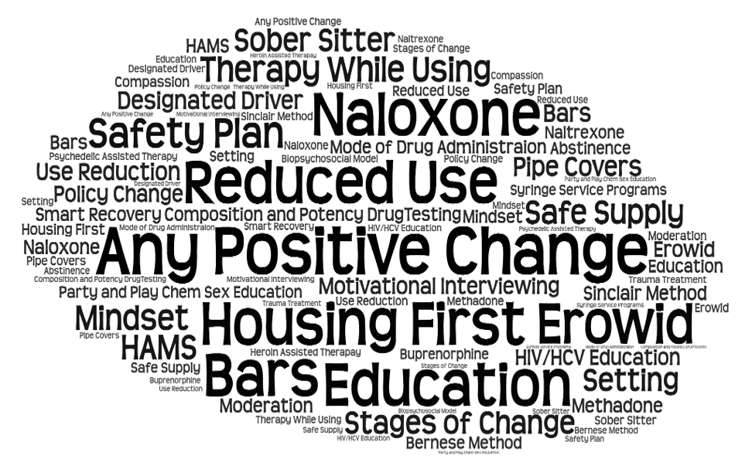
Harm Reduction Strategies YOU Could Facilitate Right Now
Notes:
use reduction
change form of drug
change mindset
change setting
smart recovery
hams/hr works/apc
psychedelic therapy
sinclair method
naloxone
moderation
buprenorphine
methadone
abstinence

Slide 27
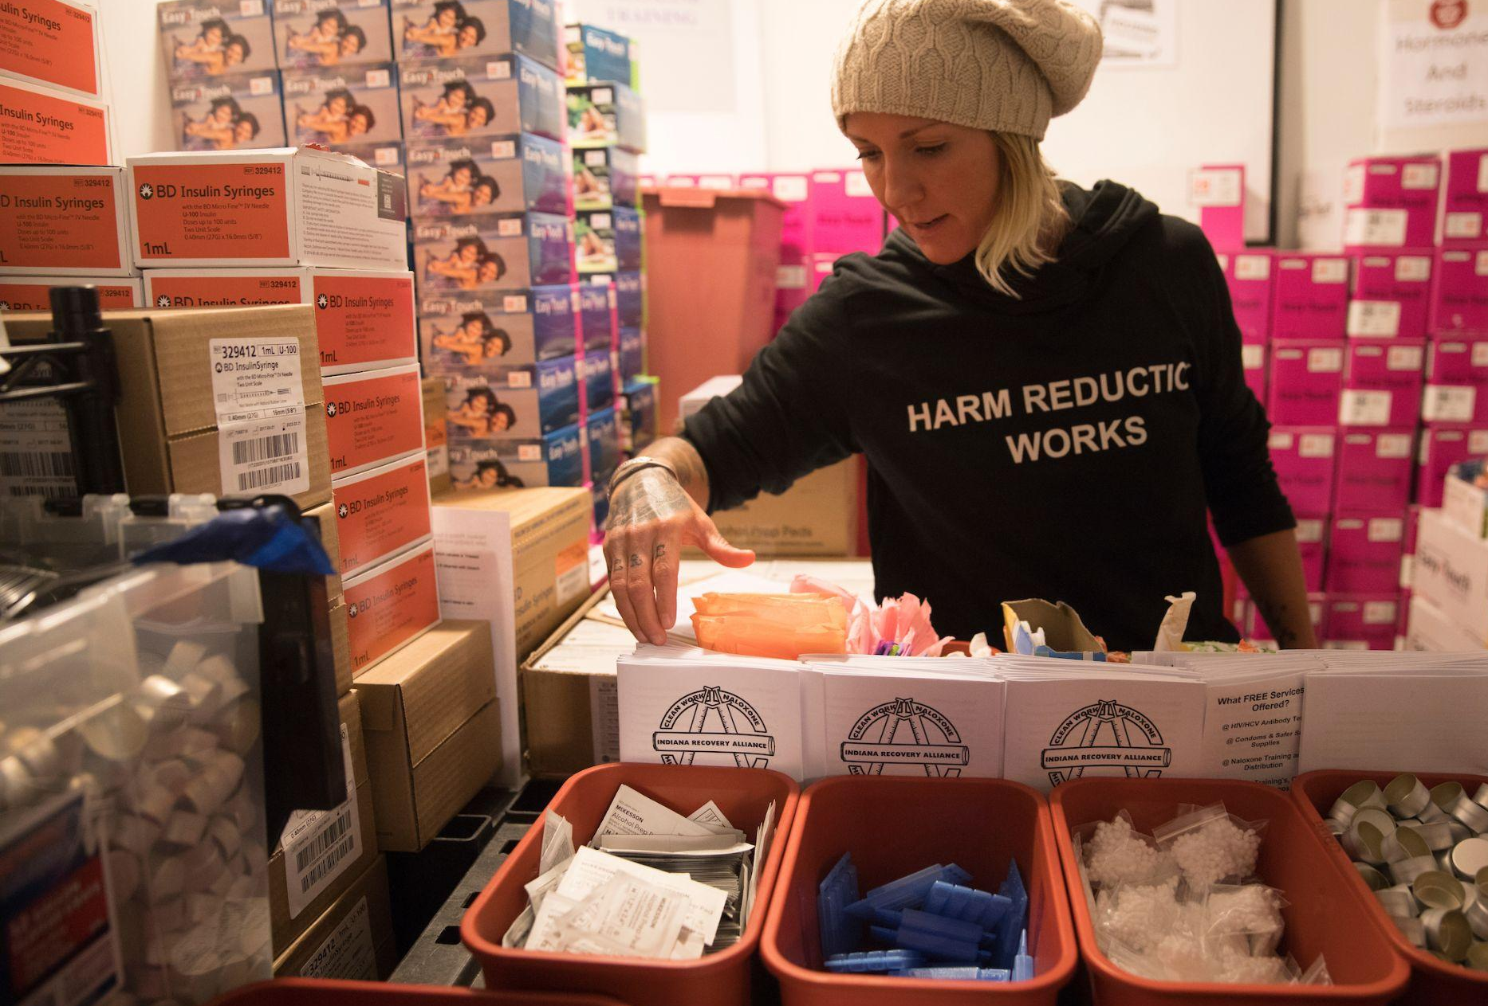
Syringe Service Program Benefits
80% reduction in HIV/HCV
5 x more likely to enter treatment programs
Decrease in syringe litter
Fentanyl/Xylazine test strips
Naloxone distribution
PLUS
Connection to services
Safety plans
Housing services
HIV/Hep C services
Overdose prevention
Hep A + B Vaccinations
Medical, dental
Safer sex supplies & education
Connection, responsibility and accountability
Notes:
KEY MESSAGES
Referrals to detox, rehab, domestic violence (DV) services
Safer sex supplies, Hep A + B vaccinations
A Bad Date Sheet describes violent and abusive customers in the sex industry. Some SAPs provide these with other travel size hygiene, safer sex/drug use supplies.
27

Slide 28
Harm Reduction Strategies We Need

Slide 29
Overdose Prevention Centers
Increased access to drug tx
Reduced HIV and hepatitis C risk
Reduced the prevalence and harms of bacterial infections
Successfully managing overdoses
Cost savings resulting from reduced disease, overdoses, and need for emergency medical services, and increased preventative health care and drug treatment utilizations
Notes:
KEY MESSAGES
Syringe Access Programs (SAPs) can help reduce incidents of sharing through providing sterile equipment and supplies, safer injection education, exploring barriers for the individual, and increasing self-efficacy.
Historically, SAP focus was on HIV prevention, leaving many long-time injectors infected with chronic Hep C – sometimes undetected for years.
For more than ten years, Hep C has been ‘on the map’ – if not, this percentage (31.8%) would be much higher.
More people now getting tested, treated, connected to care, and NOT SHARING syringes and equipment.
MORE NOT SHARING THAN SHARING.
Last bullet: focus on new injectors, discuss testing & treatment as prevention.
29

Slide 30
Drug Testing / Safe Supply
People are dying from adulterated drug supply
Test strips aren’t enough
Dance Safe
Points of Distribution
IRA
FTIR or Mass Spec can test quantity and quality
Urban Survivors Union mail-in
Notes:
KEY MESSAGES
Researchers say that this is the great success story of HIV Prevention.
The biggest successes we have managed to have in HIV transmission is with perinatal transmission and transmission among PWID.
Syringe access programs are the most effective, evidence-based HIV prevention tool for people who use drugs.
Seven federally funded research studies found that syringe exchange programs are a valuable resource.
In cities across the nation, PWID have reversed the course of the AIDS epidemic by using sterile syringes and harm reduction practices.
30

Slide 31
Expand Access to Medication for Opioid Use Disorder
Methadone and buprenorphine are the gold standard
Pharmacy based methadone
Remove criminalization of buprenorphine
Continue telehealth induction for buprenorphine
80% reduction in HIV/HCV with SSP
Get the DEA out of health care and SUD tx
On demand Treatment
treatment in 24 hours
Safe Drug Supply
DULF and decriminalization

Slide 32
Decriminalization: Portugal
Funding Transfer
Pre-Arrest Diversion Programs
Treatment Programs
Housing and Poverty Programs

Slide 33
What Do We Mean By Decriminalization in the U.S.?
We will prioritize and fund access to treatment, not years behind bars and second-class citizenship
Families can focus on wellness, not on navigating the carceral system
Invest in health services, not punishment
A world where someone's relationship with drugs is not used as an excuse to take away their autonomy, justice and safety
Stigma and fear replaced with compassion and collective care

Slide 34
30+ Years of Peer Reviewed Harm Reduction Research
1. Federal Research on Syringe Exchange Programs Proves EffectivenessBetween 1991 and 1997, the US Government funded seven reports on clean needle programs for persons who inject drugs. The reports are unanimous in their conclusions that clean needle programs reduce HIV transmission, and none found that clean needle programs caused rates of drug use to increase. The federal Department of Health and Human Services currently maintains a webpage on the effectiveness of syringe exchange programs is at http:/www.samhsa.gov/ssp/, last accessed September 17, 2016.National Commission on AIDS, The Twin Epidemics of Substance Abuse and HIV (Washington DC: National Commission on AIDS, 1991); General Accounting Office, Needle Exchange Programs: Research Suggests Promise as an AIDS Prevention Strategy (Washington DC: US Government Printing Office, 1993); Lurie, P. & Reingold, A.L., et al., The Public Health Impact of Needle Exchange Programs in the United States and Abroad (San Francisco, CA: University of California, 1993); Satcher, David, MD, (Note to Jo Ivey Bouffard), The Clinton Administration’s Internal Reviews of Research on Needle Exchange Programs (Atlanta, GA: Centers for Disease Control, December 10, 1993); National Research Council and Institute of Medicine, Normand, J., Vlahov, D. & Moses, L. (eds.), Preventing HIV Transmission: The Role of Sterile Needles and Bleach (Washington DC: National Academy Press, 1995); Office of Technology Assessment of the U.S. Congress, The Effectiveness of AIDS Prevention Efforts (Springfield, VA: National Technology Information Service, 1995); National Institutes of Health Consensus Panel, Interventions to Prevent HIV Risk Behaviors (Kensington, MD: National Institutes of Health Consensus Program Information Center, February 1997).2. In 1998, Donna Shalala, then Secretary of Health and Human Services in the Clinton Administration, stated: “A meticulous scientific review has now proven that needle exchange programs can reduce the transmission of HIV and save lives without losing ground in the battle against illegal drugs.”Shalala, D.E., Secretary, Department of Health and Human Services, Press release from Department of Health and Human Services (April 20, 1998).http://archive.hhs.gov/news/press/1998pres/980420a.html3. NIDA Director Nora Volkow Endorses Effectiveness of Syringe Exchange in Reducing Risk of HIV Infection “While it is not feasible to do a randomized controlled trial of the effectiveness of needle or syringe exchange programs (NEPs/SEPs) in reducing HIV incidence, the majority of studies have shown that NEPs/SEPs are strongly associated with reductions in the spread of HIV when used as a component of comprehensive approach to HIV prevention. NEPs/SEPs increase the availability of sterile syringes and other injection equipment, and for exchange participants, this decreases the fraction of needles in circulation that are contaminated.This lower fraction of contaminated needles reduces the risk of injection with a contaminated needle and lowers the risk of HIV transmission.“In addition to decreasing HIV infected needles in circulation through the physical exchange of syringes, most NEPs/SEPs are part of a comprehensive HIV prevention effort that may include education on risk reduction, and referral to drug addiction treatment, job or other social services, and these interventions may be responsible for a significant part of the overall effectiveness of NEPs/SEPs. NEPs/SEPs also provide an opportunity to reach out to populations that are often difficult to engage in treatment.”Nora Volkow, Director, US National Institute on Drug Abuse, correspondence with Allan Clear, “NIH Response on Harm Reduction and Needle Exchange,” Aug. 4, 2004.http://proxy.baremetal.com/csdp.org/research/ re_souderzerhou.pdfhttp://hepcproject.typepad.com/hep_c_project/2004/09/re_souderzerhou.html4. US Surgeon General’s Determination of Effectiveness of Syringe Exchange Programs, 2011“The Surgeon General of the United States Public Health Service, VADM Regina Benjamin, M.D., M.B.A., has determined that a demonstration needle exchange program (or more appropriately called syringe services program or SSP) would be effective in reducing drug abuse and the risk of infection with the etiologic agent for acquired immune deficiency syndrome. This determination reflects the scientific evidence supporting the important public health benefit of SSPs, and is necessary to meet the statutory requirement permitting the expenditure of Substance Abuse Prevention and Treatment (SAPT) Block Grant funds for SSPs.”Sebelius, Kathleen, Secretary of Health and Human Services, “Determination That a Demonstration Needle Exchange Program Would be Effective in Reducing Drug Abuse and the Risk of Acquired Immune Deficiency Syndrome Infection Among Intravenous Drug Users,” Federal Register, February 23, 2011, Vol. 76, No. 36, p. 10038.Determination That a Demonstration Needle Exchange Program Would be Effective in Reducing Drug Abuse and the Risk of Acquired Immune Deficiency Syndrome Infection Among Intravenous Drug Usershttp://www.gpo.gov/fdsys/pkg/FR-2011-02-23/pdf/2011-3990.pdf5. Centers for Disease Control on Syringe ExchangeThe basic service offered by SSPs [Syringe Services Programs] allows PWID [People Who Inject Drugs] to exchange used needles and syringes for new, sterile needles and syringes. Providing sterile needles and syringes and establishing appropriate disposal procedures substantially reduces the chances that PWID will share injection equipment and removes potentially HIV- and HCV-contaminated syringes from the community. Many SSPs have become multiservice organizations, providing various health and social services to their participants (8). HIV and HCV testing and linkage to care and treatment for substance use disorders are among the most important of these other services. The availability of new and highly effective curative therapy for HCV infection increases the benefits of integratingtesting and linkage to care among the services provided by SSPs.”Don C. Des Jarlais PhD, Ann Nugent, Alisa Solberg MPA, Jonathan Feelemyer MS, Jonathan Mermin MD, and Deborah Holtzman PhD. “Syringe Service Programs for Persons Who Inject Drugs in Urban, Suburban, and Rural Areas – United States, 2013,” Centers for Disease Control and Prevention Morbidity and Mortality Weekly Report (MMWR) 2015;64:1337 1341. http://www.cdc.gov/mmwr/pdf/wk/ mm6448.pdfttp://www.cdc.gov/mmwr/ preview/mmwrhtml/mm6448a3.htm6. Participation in Syringe Exchange Program and Entry Into Drug TreatmentAccording to a 1997 statement by the National Institutes of Health, “individuals in areas with needle exchange programs have an increased likelihood of entering drug treatment programs.”National Institutes of Health Consensus Panel, Interventions to Prevent HIV Risk Behaviors (Kensington, MD: NIH Consensus Program Information Center, February 1997), p. 6.http://consensus.nih.gov/1997/ 1997PreventHIVRisk104html.htm7. US Surgeon General’s Determination of Effectiveness of Syringe Exchange Programs“After reviewing all of the research to date, the senior scientists of the Department and I have unanimously agreed that there is conclusive scientific evidence that syringe exchange programs, as part of a comprehensive HIV prevention strategy, are an effective public health intervention that reduces the transmission of HIV and does not encourage the use of illegal drugs.”US Surgeon General Dr. David Satcher, Department of Health and Human Services, “Evidence-Based Findings on the Efficacy of Syringe Exchange Programs: An Analysis from the Assistant Secretary for Health and Surgeon General of the Scientific Research Completed Since April 1998,” (Washington, DC: Dept. of Health and Human Services, 2000), p. 11. http://home.mchsi.com/~apclc/8fedstudies2.pdf 8. How Syringe Exchanges WorkSyringe exchange programs (SEPs) provide free sterile syringes and collect used syringes from injection-drug users (IDUs) to reduce transmission of bloodborne pathogens, including human immunodeficiency virus (HIV), hepatitis B virus, and hepatitis C virus (HCV).”“Syringe Exchange Programs – United States, 2008,” Morbidity and Mortality Weekly Report (Atlanta, GA: US Centers for Disease Control, Nov. 19, 2010), Vol. 59, No. 45, p. 1488.http://www.cdc.gov/mmwr/pdf/wk/mm5945.pdf9. Legal Access to Syringes“Studies on behalf of the US government conducted by the National Commission on AIDS, the University of California and the Centers for Disease Control and Prevention, the National Academy of Science, and the Office of Technology Assessment all concluded that syringe prescription and drug paraphernalia laws should be overturned or modified to allow IDUs to purchase, possess, and exchange sterile syringes.”Diebert, Ryan J., MPH, Goldbaum, Gary, MD, MPH, Parker, Theodore R., MPH, Hagan, Holly, PhD, Marks, Robert, MEd, Hanrahan, Michael, BA, and Thiede, Hanne, DVM, MPH, “Increased Access to Unrestricted Pharmacy Sales of Syringe in Seattle-King County, Washington: Structural and Individual-Level Changes, 1996 Versus 2003,” American Journal of Public Health, Vol. 96, No. 8, Aug. 2006, p. 1352.http://ajph.aphapublications.org/cgi/reprint/96/8/1347.pdf10. Pediatrician Advocacy for Syringe & Needle Exchanges“Pediatricians should advocate for unencumbered access to sterile syringes and improved knowledge about decontamination of injection equipment. Physicians should be knowledgeable about their states’ statutes regarding possession of syringes and needles and available mechanisms for procurement. These programs should be encouraged, expanded, and linked to drug treatment and other HIV-1 risk-reduction education. It is important that these programs be conducted within the context of continuing research to document effectiveness and clarify factors that seem linked to desired outcomes.”“Policy Statement: Reducing the Risk of HIV Infection Associated With Illicit Drug Use,” Committee on Pediatric AIDS, Pediatrics, Vol. 117, No. 2, Feb. 2006 (Chicago, IL: American Academy of Pediatrics), p. 569.http://pediatrics.aappublications.org/content/117/2/566.full.pdf11. Services Offered by Syringe Services Programs / Syringe Exchange Programs“Despite differences in program size, operating budgets, and staffing among SSPs [Syringe Services Programs] in rural, suburban, and urban locations, there were similarities in on-site services (Table 3). Most SSPs offered HIV counseling and testing (87% among rural SSPs, 71% among suburban SSPs, and 90% among urban SSPs) and HCV testing (67% among rural SSPs, 79% among suburban SSPs, and 78% among urban SSPs). A minority of SSPs reported having referral tracking systems for HCV-related care and treatment (33% of rural SSPs, 43% of suburban SSPs, and 44% of urban SSPs). Rural SSPs were less likely to provide naloxone (for reversing opioid overdoses) (37%) compared with suburban (57%) and urban (61%) programs that provided this service.”Don C. Des Jarlais PhD, Ann Nugent, Alisa Solberg MPA, Jonathan Feelemyer MS, Jonathan Mermin MD, and Deborah Holtzman PhD. “Syringe Service Programs for Persons Who Inject Drugs in Urban, Suburban, and Rural Areas – United States, 2013,” Centers for Disease Control and Prevention Morbidity and Mortality Weekly Report (MMWR) 2015;64:1337-1341.http://www.cdc.gov/mmwr/pdf/wk/mm6448.pdfhttp:// www.cdc.gov/mmwr/preview/mmwrhtml/mm6448a3.htm12. Other Services Offered by SEPs“In addition to exchanging syringes, SEPs provided various supplies, services, and referrals in 2008; the percentage of programs providing each type of service was similar for the period 2005–2008 (Table 3). In 2008, all SEPs provided alcohol pads, and nearly all (98%) provided male condoms. Most (89%) provided referrals to substance abuse treatment. Other services also offered by SEPs included counseling and testing for HIV (87%) and HCV (65%), and screening for sexually transmitted diseases (55%) and tuberculosis (31%).Vaccinations for hepatitis A and B were provided by nearly half the programs (47% and 49%, respectively).”“Syringe Exchange Programs — United States, 2008,” Morbidity and Mortality Weekly Report (Atlanta, GA: Centers for Disease Control, November 19, 2010) Vol. 59, No. 45, p. 1489.http://www.cdc.gov/mmwr/pdf/wk/mm5945.pdf13. OTC Availability of Clean Syringes“Anti-OTC laws [laws against the over-the-counter sale or purchase of syringes without prescriptions] are not associated with lower population proportions of IDUs. Laws restricting syringe access are statistically associated with HIV transmission and should be repealed.Friedman, Samuel R. PhD, Theresa Perlis, PhD, and Don C. Des Jarlais, PhD, “Laws Prohibiting Over-the-Counter Syringe Sales to Injection Drug Users: Relations to Population Density, HIV Prevalence, and HIV Incidence,” American Journal of Public Health (Washington, DC: American Public Health Association, May 2001), Vol. 91, No. 5, p. 793.http://ajph.aphapublications.org/cgi/reprint/91/5/791.pdf14. Syringe Need and Availability“Respondents reported injecting a median of 60 times per month, visiting the syringe exchange program a median of 4 times per month, and obtaining a median of 10 syringes per transaction; more than one in four reported reusing syringes. Fifty-four percent of participants reported receiving fewer syringes than their number of injections per month. Receiving an inadequate number of syringes was more frequently reported by younger and homeless injectors, and by those who reported public injecting in the past month.Daliah I Heller, Denise Paone, Anne Siegler and Adam Karpati, “The syringe gap: an assessment of sterile syringe need and acquisition among syringe exchange program participants in New York City,” Harm Reduction Journal (London, United Kingdom: January 2009), p. 1. http://www.harmreductionjournal.com/content/pdf/1477-7517-6-1.pdf15. SEP Program Components “For injecting drug users who cannot gain access to treatment or are not ready to consider it, multi-component HIV prevention programs that include sterile needle and syringe access reduce drug-related HIV risk behavior, including self-reported sharing of needles and syringes, unsafe injecting and disposal practices, and frequency of injection. Sterile needle and syringe access may include needle and syringe exchange (NSE) or the legal, accessible, and economical sale of needles and syringes through pharmacies, voucher schemes, and physician prescription programs. Other components of multi-component HIV prevention programs may include outreach, education in risk reduction, HIV voluntary counseling and testing, condom distribution, distribution of bleach and education on needle disinfection, and referrals to substance abuse treatment and other health and social services.”Committee on the Prevention of HIV Infection among Injecting Drug Users in High-Risk Countries, Institute of Medicine, National Academy of Sciences, “Preventing HIV Infection among Injecting Drug Users in High Risk Countries: An Assessment of the Evidence” (Washington, DC: National Academy Press, 2006), p. 175.http://www.nap.edu/openbook.php?record_id=11731Modification and Partial Lifting of the Federal Ban on Funding of Syringe Exchange Programs, 2016“SEC. 520. Notwithstanding any other provision of this Act, no funds appropriated in this Act shall be used to purchase sterile needles or syringes for the hypodermic injection of any illegal drug: Provided, That such limitation does not apply to the use of funds for elements of a program other than making such purchases if the relevant State or local health department, in consultation with the Centers for Disease Control and Prevention, determines that the State or local jurisdiction, as applicable, is experiencing, or is at risk for, a significant increase in hepatitis infections or an HIV outbreak due to injection drug use, and such program is operating in accordance with State and local law.HR2029, “Consolidated Appropriations Act, 2016,” Passed by 114th Congress and Signed Into Law on December 18, 2015.https://www.congress.gov/ bill/114th-congress/house-bill/2029/text https://www.congress.gov/114/bills/hr2029/BILLS-114hr2029enr.pdf16. Laws Restricting Syringe Availability“Programs that provide access to sterile syringes have been proven time and again to reduce HIV transmission without either encouraging drug use or increasing drug related crime. Syringe exchange, as well as similar measures such as nonprescription pharmacy sale of syringes, is an effective and life-saving health intervention. Yet syringe exchange is banned in much of the United States and, where it is allowed, is obstructed by laws forbidding the possession of drug paraphernalia. Other modes of syringe access, such as nonprescription pharmacy sale of syringes, are as of this writing forbidden in five states: California, Massachusetts, New Jersey, Delaware, and Pennsylvania. Almost all fifty states have enacted drug paraphernalia laws similar to model legislation written by the Drug Enforcement Agency in 1979 under President Jimmy Carter. Drug paraphernalia laws are encouraged by United Nations anti-drug conventions, which call on governments to take aggressive law enforcement measures against illicit drug use.”Human Rights Watch, “Injecting Reason: Human Rights and HIV Prevention for Injection Drug Users,” (September 2003) http://www.hrw.org/reports/2003/usa0903/usa0903print.pdf17. Recommendation of British Advisory Council on Misuse of Drugs “Recommendation 1. Local service planners need to review local needle and syringe services (and be supported in this work) in order to take steps to increase access and availability to sterile injecting equipment and to increase the proportion of injectors who receive 100 per cent coverage of sterile injecting equipment in relation to their injecting frequency.”Advisory Council on the Misuse of Drugs, “The Primary Prevention of Hepatitis C Among Injecting Drug Users,” (London, United Kingdom: February 2009), p. 28.https://assets.publishing.service.gov.uk/government/uploads/system/uploads/attachment_data/file/119144/acmdhepcreport2.pdf18. Syringe Access Through Pharmacies“The purchase of syringes through pharmacies may be a major source of contact with the health service for some injectors, and the potential to exploit this contact point as a conduit to other services clearly exists. Work to motivate and support pharmacists to develop the services they offer to drug users could form an important part of extending the role of pharmacies, but to date only France, Portugal and the United Kingdom appear to be making significant investments in this direction.”“Annual Report 2006: The State of the Drugs Problem in Europe,” European Monitoring Centre for Drugs and Drug Addiction (Luxembourg: Office for Official Publications of the European Communities, 2006), p. 79.http://www.emcdda.europa.eu/attachements.cfm/att_37244_EN_ar2006-en.pdf19. Legality of Syringe PossessionAccording to a study in 1996, “Drug paraphernalia laws in 47 U.S. states make it illegal for injection drug users (IDUs) to possess syringes.” The study concludes, “decriminalizing syringes and needles would likely result in reductions in the behaviors that expose IDUs to blood borne viruses.”Bluthenthal, Ricky N., Kral, Alex H., Erringer, Elizabeth A., and Edlin, Brian R., “Drug paraphernalia laws and injection-related infectious disease risk among drug injectors”, Journal of Drug Issues, 1999;29(1):1-16. Abstract available on the web at http://www.nasen.org/NASEN_II/research1.htm.Pharmacy Access to Sterile Syringes20. Syringe Access Through Pharmacies“Although most US states have legal restrictions on the sale and possession of syringes, pharmaceutical practice guidelines often allow pharmacists discretion in syringe sales decisions; this may lead to wide variation in syringe sales by individual pharmacists and to discrimination based on gender, age, race, ethnicity, or socioeconomic status. Individual-level factors associated with pharmacists’ relative willingness to sell syringes include familiarity with customers; concerns about deception, disease transmission, improperly discarded syringes, and staff and customer safety; business concerns, including fear of theft and harassment of other customers by IDU patrons; and fear of increased drug use because of easier syringe access.”Diebert, Ryan J., MPH, Goldbaum, Gary, MD, MPH, Parker, Theodore R., MPH, Hagan, Holly, PhD, Marks, Robert, MEd, Hanrahan, Michael, BA, and Thiede, Hanne, DVM, MPH, “Increased Access to Unrestricted Pharmacy Sales of Syringe in Seattle-King County, Washington: Structural and Individual-Level Changes, 1996 Versus 2003,” American Journal of Public Health, Vol. 96, No. 8, Aug. 2006, p. 1347.http://ajph.aphapublications.org/ cgi/ reprint/96/8/1347.pdf 21. Over The Counter Syringe Availability“The data in this report offer no support for the idea that anti-OTC laws prevent illicit drug injection. However, the data do show associations between anti-OTC laws and HIV prevalence and incidence. In an ongoing epidemic of a fatal infectious disease, prudent public health policy suggests removing prescription requirements rather than awaiting definitive proof of causation. Such action has been taken by Connecticut, by Maine, and, recently, by New York. After Connecticut legalized OTC sales of syringes and the personal possession of syringes, syringe sharing by drug injectors decreased. Moreover, no evidence showed increased in drug use, drug-related arrests, or needlestick injuries to police officers.”Friedman, Samuel R. PhD, Theresa Perlis, PhD, and Don C. Des Jarlais, PhD, “Laws Prohibiting Over-the-Counter Syringe Sales to Injection Drug Users: Relations to Population Density, HIV Prevalence, and HIV Incidence,” American Journal of Public Health (Washington, DC: American Public Health Association, May 2001), Vol. 91, No. 5, p. 793.http://ajph.aphapublications.org/cgi/reprint/91/5/791.pdf22. SEPs and HIV Prevention“Access to sterile needles and syringes is an important, even vital, component of a comprehensive HIV prevention program for IDUs. The data on needle exchange in the United States are consistent with the conclusion that these programs do not encourage drug use and that needle exchanges can be effective in reducing HIV incidence. Other data show that NEPs help people stop drug use through referral to drug treatment programs. The studies outside of the United States are important for reminding us that unintended consequences can occur. While changes in needle prescription and possession laws and regulations have shown promise, the identification of organizational components that improve or hinder effectiveness of needle exchange and pharmacy-based access are needed.”Vlahov, David, PhD, and Benjamin Junge, MHSc, “The Role of Needle Exchange Programs in HIV Prevention,” Public Health Reports, Volume 113, Supplement 1, June 1998, p. 79.https://www.ncbi.nlm.nih.gov/ pmc/articles/PMC1307729/pdf/ pubhealthrep00030-0079.pdf23. SEPs and HIVA literature review in 2004 by the European Union’s drug monitoring agency, the European Monitoring Centre on Drugs and Drug Addiction, found that “Major reviews (summarised in Vlahov and Junge, 1998; Bastos and Strathdee, 2000; Ferrini, 2000) suggest that NSPs (Needle and Syringe Programs) may reduce rates of seroconversion to HIV and hepatitis by one third or more, without negative side effects on the number of IDUs (Vlahov and Junge, 1998). A landmark study from Hurley et al. combined HIV seroprevalence data from 81 cities with (n=52) or without (n=29) NSPs (Hurley et al., 1997). They showed that the average annual seroprevalence was 11% lower in cities with an NSP than in cities without an NSP, providing important evidence on the effectiveness of NSPs in reducing the spread of HIV.”de Wit, Ardine and Jasper Bos, “Cost-Effectiveness of Needle and Syringe Programmes: A Review of the Literature,” in Hepatitis C and Injecting Drug Use: Impact, Costs and Policy Options, Johannes Jager, Wien Limburg, Mirjam Kretzschmar, Maarten Postma, Lucas Wiessing (eds.), European Monitoring Centre on Drugs and Drug Addiction, 2004.24. SEPs and HIV“We found that in cities with NEPs HIV seroprevalence among injecting drug users decreased on average, whereas in cities without NEPs HIV seroprevalence increased. A plausible explanation for this difference is that the NEPs led to a reduction in HIV incidence among injecting drug users.“NEPs have the potential to decrease directly HIV transmission by lowering the rate of needle sharing and the prevalence of HIV in needles available for reuse, as well as indirectly through activities such as bleach distribution, referrals to drug treatment centres, provision of condoms, and education about risk behaviour. Although these mechanisms have strong theoretical support, the published evidence for NEP effectiveness is limited. Previous studies of the effect of NEPs on HIV incidence used observational designs or statistical models.“Observational designs included case studies; crosssectional, serial cross-sectional, and cohort studies (often without comparison groups); and case-control studies.4,5 Only one study assessed the impact of NEPs on HIV incidence. Des Jarlais and colleagues7 estimated that the hazard for incident HIV infection was 3•3 for injecting drug users in four high-seroprevalence cities without NEPs, compared with continuous users of NEPs in New York City. One case study investigated HIV prevention activities for five cities with low seroprevalence, but did not formally compare these with other cities that had high seroprevalence.13 The most frequently cited statistical model for assessment of NEP effectiveness was developed by the New Haven NEP evaluators, and is based on the theory that NEPs decrease HIV transmission rates by lowering the time that needles are in circulation.1“The conclusion of a 1993 review by a University of California team’ was that NEPs are associated with decreased HIV drug risk behaviour and are not associated with negative outcomes, but that there is no clear evidence that they decrease HIV infection rates.5 Few new data were available for the most recent US review by the Panel on Needle Exchange and Bleach Distribution Programs,4 which concluded that NEPs are effective, but acknowledged that the evidence was weak.“Our study is distinguished from previous work by its worldwide scope and its design, which compares changes in HIV seroprevalence in cities with and without NEPs, rather than changes within a single city.”Hurley, Susan F., Damien J. Jolley, John M. Kaldor, “Effectiveness of Needle-Exchange Programmes for Prevention of HIV Infection,” The Lancet, 1997; 349: 1797-1800, June 21, 1997.https://www.druglibrary.net/ schaffer/MISC/ effectiveness_of_neps_for_preven.htm25. Syringe Access, Limits, and Infection Risk“In multivariate analyses, we found that police contact was associated independently with residing in the area with no legal possession of syringes; among SEP users, those with access to SEPs without limits had lower syringe re-use but not lower syringe sharing; and that among non-SEP users, no significant differences in injection risk were observed among IDUs with and without pharmacy access to syringes.“Conclusion: We found that greater legal access to syringes, if accompanied by limits on the number of syringes that can be exchanged, purchased and possessed, may not have the intended impacts on injection-related infectious disease risk among IDUs.”Source:Bluthenthal, Ricky N., Mohammed Rehan Malik, Lauretta E. Grau, Merrill Singer, Patricia Marshall & Robert Heimer for the Diffusion of Benefit through Syringe Exchange Study Team, “Sterile Syringe Access Conditions and Variations in HIV Risk Among Drug Injectors in Three Cities,” Addiction Journal, Vol. 99, Issue 9, p. 1136, Sept. 2004, abstract online at https://onlinelibrary.wiley.com/doi/10.1111/j.1360-0443.2004.00694.x/abst last accessed June 8, 2013.26. Vulnerable Populations“We found that a large proportion of SEP [syringe exchange program] participants in NYC do not obtain adequate numbers of syringes from the SEPs to meet their monthly injecting needs. In addition, characteristics of social marginalization and vulnerability – homelessness and public injecting – were associated with inadequate syringe acquisition. For SEP participants with inadequate coverage, most reported ‘not needing’ more syringes, but many also identified program limits and fear of police contact as main reasons for not obtaining adequate syringes at their most recent visit to the SEP.”Daliah I Heller, Denise Paone, Anne Siegler and Adam Karpati, “The syringe gap: an assessment of sterile syringe need and acquisition among syringe exchange program participants in New York City,” Harm Reduction Journal (London, United Kingdom: January 2009), p. 4.http://www.harmreductionjournal.com/content/pdf/1477-7517-6-1.pdf

Slide 35
What you can Do Now

Slide 36
Ally and Provider Tips
Avoid becoming a rescuer.
Avoid taking it personally.
Avoid the assumption you have the same goals as the person using drugs.
Avoid trying to do this alone.
Avoid manipulating or coercing PWUD to change.

Slide 37
Ally and Provider Tips
Do advocate to expand harm reduction services.
Do say you don’t know when you don’t know.
Do roll with the punches.
Do set limits and boundaries.
Do keep your humor.
Do learn from your mistakes.
Do take care of yourselves.
Do celebrate Any Positive Change.

Slide 38
Ally and Provider Tips
Do remember who your patients are.

Slide 39
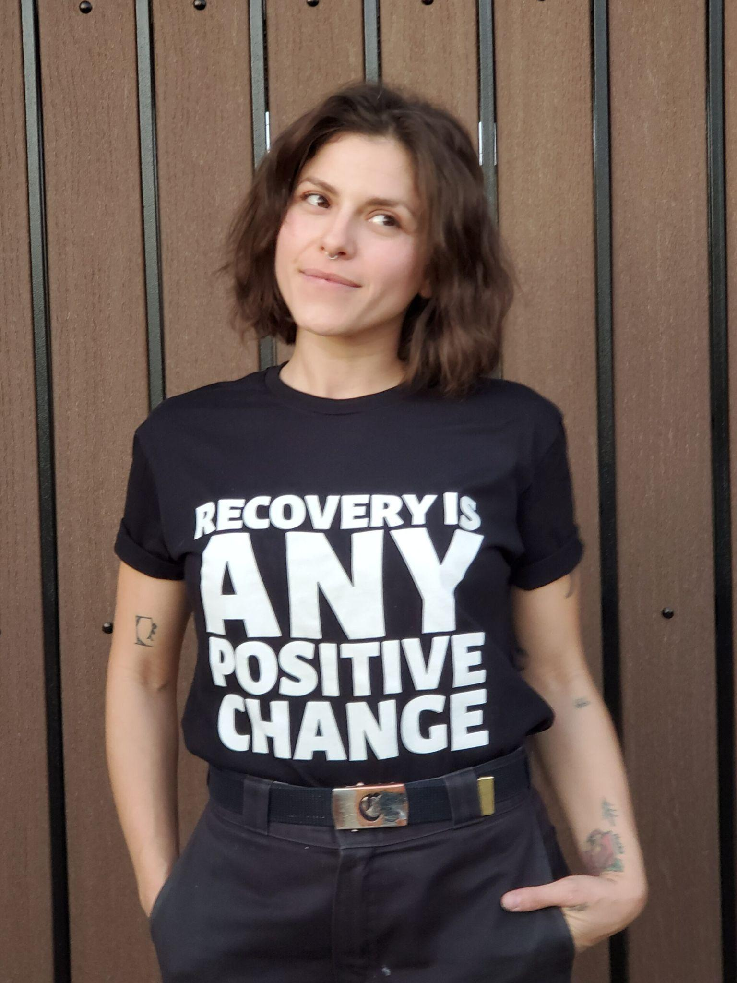
any positive change
Rather than measuring success based solely on abstinence from drug use, the primary measure of effectiveness should be the reduction of drug-related harm:
Reducing overdose death
Reducing HIV, Hepatitis C & infection
Reducing isolation & despair
Increasing health and connection
Responsibility and accountability
Notes:
http://www.drugpolicy.org/issues/new-solutions-drug-policy

Slide 40
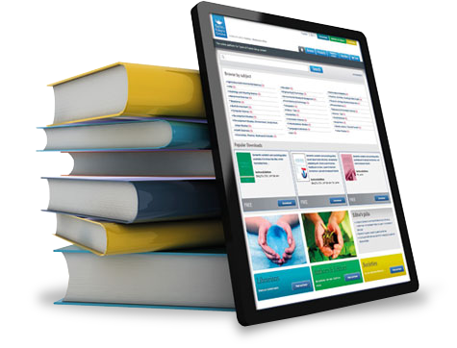
additional resources
Indiana Recovery Alliance indianarecoveryalliance.org
NY Recovery Alliance nyrecoveryalliance.org
Next Distro nextdistro.org
Harm Reduction Coalition harmreduction.org
Drug Policy Alliance drugpolicy.org
Chicago Recovery Alliance anypositivechange.org
Sonoran Prevention Works spwaz.org
People’s Harm Reduction Alliance phra.org
Urban Survivors Union ncurbansurvivorunion.org
Erowid erowid.org
SWRA southwestrecoveryalliance.org
Harm Reduction Action Center harmreductionactioncenter.org

Slide 41
AETC Program
National Centers and National HIV Curriculum
National Coordinating Resource Center serves as the central web based
repository for AETC Program training and capacity building resources; its
website includes a free virtual library with training and technical assistance
materials, a program directory, and a calendar of trainings and other events.
Learn more: https ://aidsetc.org
National Clinician Consultation Center provides free, peer to peer,
expert advice for health professionals on HIV prevention, care, and treatment
and related topics. Learn more: https ://nccc.ucsf.edu
National HIV Curriculum provides ongoing, up to date HIV training and
information for health professionals through a free, web based curriculum;
also provides free CME credits, CNE contact hours, CE contact hours, and
maintenance of certification credits. Learn more: www.hiv.uw.edu

