Slide 1

HIV Pre-Exposure Prophylaxis
Cynthia R. Young, MD MSc
Assistant Professor
University of Kentucky
14th Annual KY AETC HIV & HCV Conference
April 29, 2023

Slide 2
Faculty Disclosure
No personal disclosures
This program is supported by the Health Resources and Services Administration (HRSA) of the U.S. Department of Health and Human Services (HHS) under grant number U1OHA30535 as part of an award totaling $4.2m. The contents are those of the author(s) and do not necessarily represent the official views of, nor an endorsement, by HRSA, HHS, or the U.S. Government. For more information, please visit HRSA.gov.
“Funding for this presentation was made possible by cooperative agreement U1OHA30535 from the Health Resources and Services Administration HIV/AIDS Bureau. The views expressed do not necessarily reflect the official policies of the Department of Health and Human Services nor does mention of trade names, commercial practices, or organizations imply endorsement by the U.S. Government. Any trade/brand names for products mentioned during this presentation are for training and identification purposes only.”

Slide 3
Educational Need/Practice Gap
Gap = Despite effective interventions to reduce HIV transmission, new HIV infections continue to occur
Need = HIV pre-exposure prophylaxis (PrEP) is a safe and effective method of HIV prevention, but is not reaching many patients who could benefit from it

Slide 4
Objectives
Upon completion of this educational activity, you will be able to:
Discuss current PrEP medications and strategies
Provide appropriate baseline screening and follow-up

Slide 5
Expected Outcome
Engage in shared-decision making with your patients about HIV PrEP

Slide 6
HIV and PrEP
Prevent HIV infection BEFORE potential exposure
Time-limited prevention strategy
Evidence in diverse populations
Effectiveness directly related to adherence

Slide 7
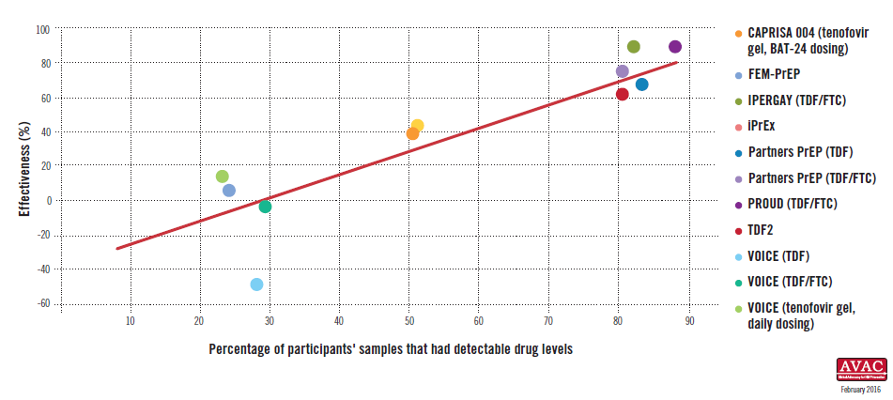
PrEP: Effectiveness and Adherence
https://www.avac.org/infographic/effectiveness-and-adherence-trials-oral-and-topical-tenofovir-based-prevention

Slide 8
PrEP Disparities

Slide 9
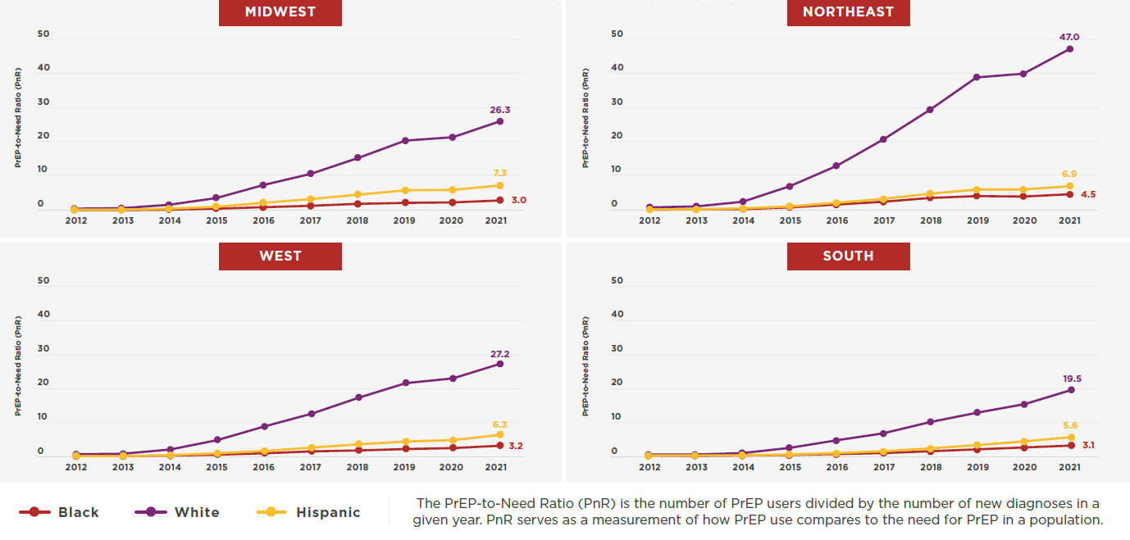
PrEP-to-Need Ratio by Race/Ethnicity and US Region, 2012-2021
Smith, AIDS 2022, Abstract OALBX0106

Slide 10
Medications

Slide 11
Oral Medications
TDF/FTC (Truvada®)
Tenofovir disoproxil fumarate 300mg/Emtricitabine 200mg
FDA-approved for PrEP 2012
TAF/FTC (Descovy®)
Tenofovir alafenamide 25mg/Emtricitabine 200mg
DISCOVER trial - MSM, transgender women
FDA-approved for PrEP Oct 2019 – not for receptive vaginal sex

Slide 12
TDF/FTC (Truvada®)
First-line medication for PrEP
All populations
Safe in pregnancy and breast/chestfeeding
Nausea, fatigue, headache - improve after the first month
Contraindicated if CrCl < 60ml/min
Small changes in renal function
Small changes in bone density
Reverse after discontinuing medication

Slide 13
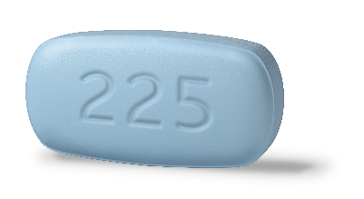
On-Demand/2-1-1 PrEP
Sex
Tue
Sun
Mon
Wed
Fri
Sat
Thur
Before Sex
2 PrEP tablets at least 2 hours, but ideally 24 hours before sex
After Sex
1 PrEP tablet 24 hours after first dose
1 PrEP tablet 48 hours after first dose
If sexual activity continues, take 1 PrEP tablet every 24 hours until 48 hours after last sex.
Molina NEJM 2015

Slide 14
On-Demand/2-1-1 PrEP
Only with TDF/FTC
For MSM: CDC guidelines
WHO: those assigned male at birth
Prescribe 30 day supply
Can anticipate sex; adherent
Avoid in patients with chronic hepatitis B

Slide 15
TAF/FTC (Descovy®)
DISCOVER trial - Non-inferior to TDF/FTC
MSM, transgender women
FDA-approved for PrEP Oct 2019 (not receptive vaginal sex)
Can be used in patients with CrCl > 30ml/min
No renal/bone effects
Small increases in LDL, triglycerides, and body weight
Mayer Lancet 2020

Slide 16
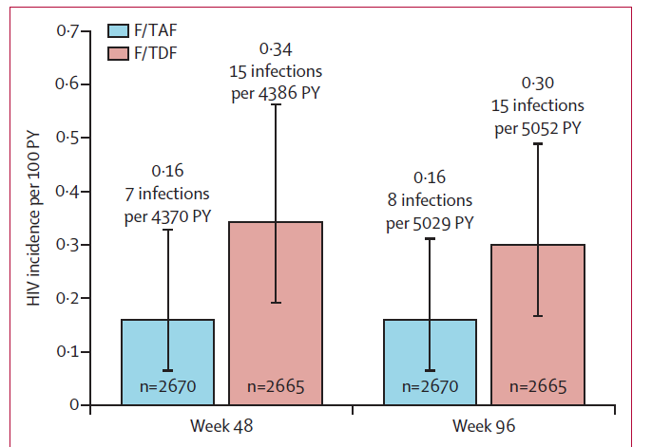
DISCOVER Trial
Ogbuagu Lancet 2021

Slide 17
TDF/FTC vs TAF/FTC

Slide 18
Injectable Medication

Slide 19
CAB-LA
Cabotegravir: long-acting, IM gluteal injection - Apretude®
Daily oral PrEP is highly effective against HIV acquisition
Adherence remains a challenge
Daily pills are not the best fit for all patients
(analogous to contraception)

Slide 20
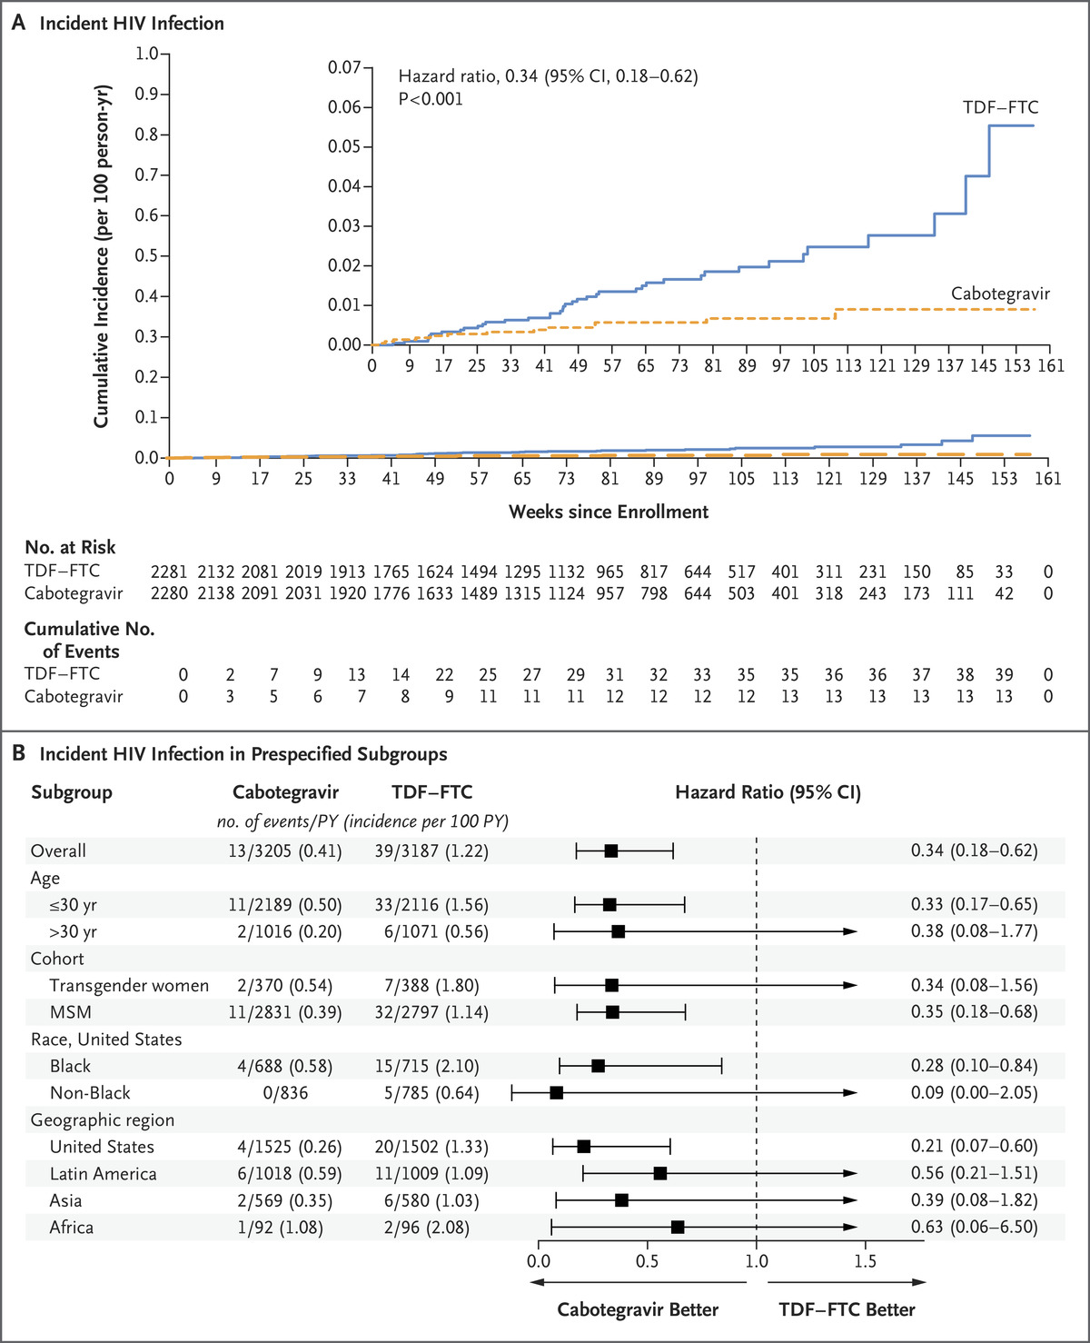

HPTN 083 Study
CAB-LA every 8 weeks vs. daily oral TDF-FTC
Cisgender MSM and transgender women
Efficacy: 66%
Landovitz NEJM 2021

Slide 21

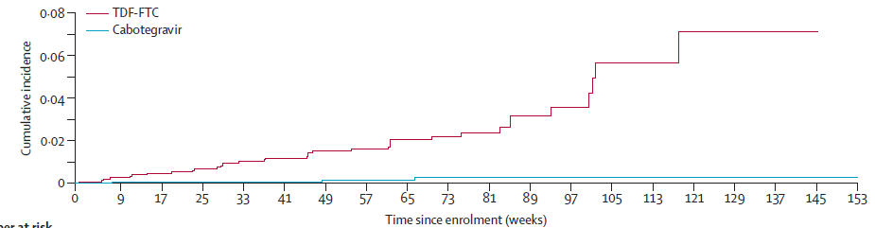
HPTN 084 Study
Sub-Saharan Africa
Assigned female sex at birth
Stopped Nov 2020 on basis of efficacy
Efficacy: 88%
Delaney-Moretlwe Lancet 2022

Slide 22
Cabotegravir (Apretude)
Optional: 4 week oral lead-in, with daily cabotegravir pill
Dose: 600mg gluteal injection
Initial dose:
  600 mg (3 ml) single gluteal injection
Second dose:
  4 weeks following dose 1
Subsequent doses:
  Every 8 weeks thereafter
Main side effect: injection site pain

Slide 23
Patient Eligibility

Slide 24
CDC PrEP Guidelines 2021: Identifying substantial risk of acquiring HIV infection
Sexually active adults and adolescents who had anal or vaginal sex in the past 6 months AND any of the following:
  HIV-positive sexual partner (especially if partner has an unknown or detectable viral load)
  Bacterial STI in the past 6 months
  History of inconsistent or no condom use with sexual partner(s)
PWID:
  HIV-positive partner OR sharing injection equipment
Anyone who asks for PrEP
New Recommendation: All sexually active adult and adolescent patients should receive information about PrEP

Slide 25
PrEP Initiation and Follow-up

Slide 26
HIV Testing
4th generation Ab/Ag test, within the past week
For those starting CAB-LA: send HIV-1 RNA assay
Send HIV-1 RNA assay if:
  Recent high-risk exposure
  Signs/symptoms of acute HIV
  Indeterminate Ab/Ag test

Slide 27
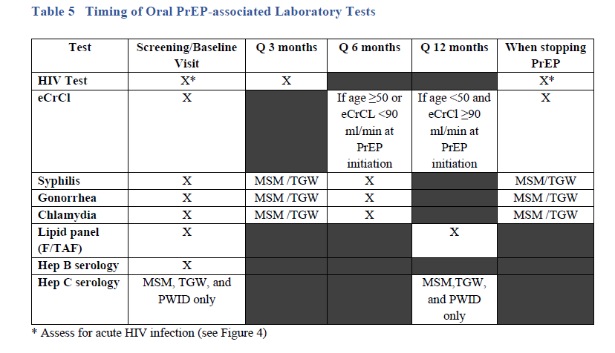
Labs: Oral PrEP

Slide 28
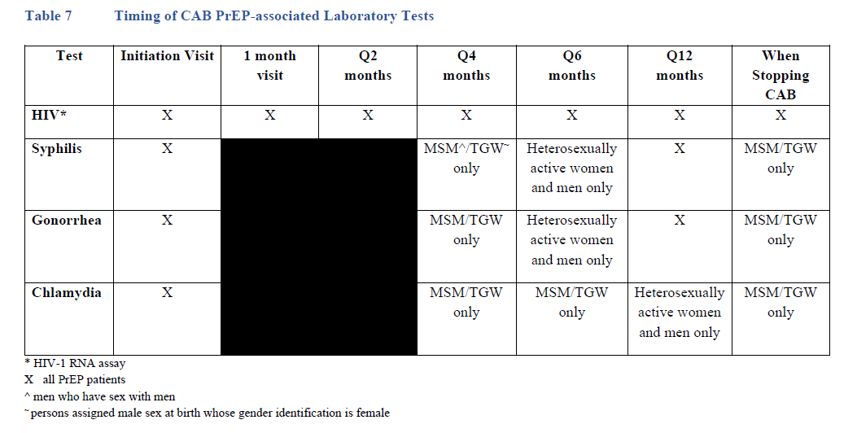
Labs: CAB-LA

Slide 29
PrEP Care
Adherence: barriers, strategies
STIs, Hep C prevention
Risk reduction counseling, condoms, contraception
Syringe service programs, substance abuse treatment
Primary care, mental health services

Slide 30
PrEP and Primary Care
Vaccines: Hepatitis A, Hepatitis B, HPV, Meningococcal B, Influenza
Screening: Hepatitis C, Depression, Unhealthy Alcohol Use, Smoking, Intimate Partner Violence
Mammography, Cervical Cancer Screening, Prostate Cancer Screening

Slide 31
CAB-LA and Pharmacokinetic “Tail”
After last CAB-LA injection:
  CAB concentration dropped below LLOQ at median of 10 months for males
  CAB concentration dropped below LLOQ at median of 15.5 months for females
When discontinuing CAB-LA
  Re-educate about the “tail” and risks with declining CAB levels
  Assess ongoing HIV risk and prevention plans
Prescribe TDF/FTC or TAF/FTC
Continue HIV testing (HIV Ab/Ag and RNA testing) every 3 months for a year after last injection
Landovitz Lancet HIV 2020

Slide 32
Addition of HIV-1 RNA testing
Antiretrovirals impact HIV test performance
HIV Ag/Ab positivity may be delayed beyond the HIV RNA assay for incident HIV infections by a median of:
  98 days in those receiving CAB-LA
  31 days in those receiving TDF/FTC
RNA assays can detect incident HIV infection before INSTI resistance emerges
Major INSTI resistance mutations in 7 cases
RNA assays would have detected HIV before a major INSTI mutation emerged in 4 cases and before additional major INSTI mutations emerged in 1 case
Eshleman JID 2022; Marzinke JID 2021

Slide 33
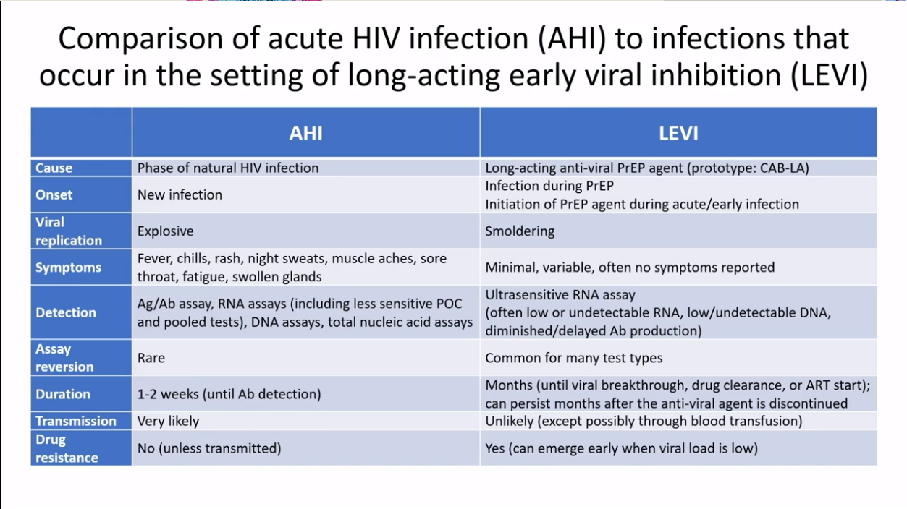
Eshleman CROI 2023, Abstract OA-8

Slide 34
Oral vs IM PrEP options
Oral Tenofovir/emtricitabine
Daily or “On-demand” options
Widely available
90 day supply at a time
No tail coverage needed
Usually covered by insurance
Labs every 3 months
Data available for pregnancy/breastfeeding
Daily pill not the best option for everyone
CAB-LA
Superior efficacy vs TDF/FTC
Month/bimonthly injections
Doesn’t require daily adherence
More discreet – but…
…must visit clinic for injection
Continued monitoring even after stopping the medication
Very limited pregnancy data
Insurance coverage and pharmacy logistics are complex
Workflows, patient tracking, staff support

Slide 35
Paying for PrEP

Slide 36
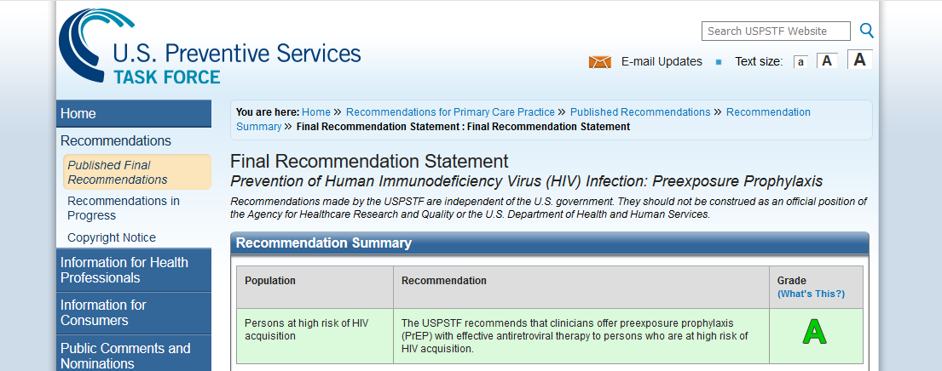
USPSTF: June 2019
(draft update: Dec 2022)
https://uspreventiveservicestaskforce.org/

Slide 37


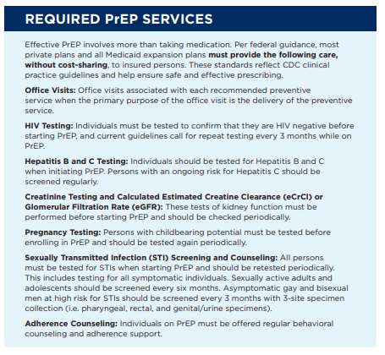
https://oneill.law.georgetown.edu/wp-content/uploads/2021/09/
Quick-Take-Ensuring-Compliance-With-New-Federal-USPSTF-PrEP-Guidance.pdf

Slide 38
Medication Coverage
Gilead Advancing Access Program-www.gileadadvancingaccess.com
Ready, Set, PrEP-https://readysetprep.hiv.gov/
www.nastad.org/prepcost-resources/prep-assistance-programs
Patient Advocate Foundation; Good Days

Slide 39
Take Home Points
PrEP is very effective at preventing HIV
Medications for PrEP are safe and well-tolerated
New CDC guidelines: addition of HIV-1 RNA assay
CAB-LA is a new treatment option
  Logistical/cost barriers – new models of care
  Many challenges for implementation
More to learn about HIV RNA testing, HIV infections on CAB-LA, and impact of CAB-LA pharmacologic ‘tail’

Slide 40
Q&A

Slide 41
AETC Program
National Centers and National HIV Curriculum
National Coordinating Resource Center serves as the central web based
repository for AETC Program training and capacity building resources; its
website includes a free virtual library with training and technical assistance
materials, a program directory, and a calendar of trainings and other events.
Learn more: https ://aidsetc.org
National Clinician Consultation Center provides free, peer to peer,
expert advice for health professionals on HIV prevention, care, and treatment
and related topics. Learn more: https ://nccc.ucsf.edu
National HIV Curriculum provides ongoing, up to date HIV training and
information for health professionals through a free, web based curriculum;
also provides free CME credits, CNE contact hours, CE contact hours, and
maintenance of certification credits. Learn more: www.hiv.uw.edu

