Slide 1
Obstetric Care for People with HIV:
Antiretroviral therapy (ART) and beyond
Jennifer McKinney MD MPH, Sarah Conrad MD, Jessica Gerard MD, Baylor College of Medicine
Notes:
Include version date:_5/23/23
Audience: Providers, fellows, residents and staff from TSHC- Quentin Mease Hospital and VA Hospital

Slide 2


Presenter Profile
Jennifer McKinney, MD MPH
Assistant Professor
Maternal Fetal Medicine
Baylor College of Medicine
Texas Children's Pavilion for Women
Jennifer.mckinney@bcm.edu

Slide 3
Conflict of Interest Disclosure Statement
Speakers have nothing to disclose
This program is supported by the Health Resources and Services Administration (HRSA) of the U.S. Department of Health and Human Services (HHS) as part of an award totaling $3,132,205, with 0% financed with non-governmental sources. The contents are those of the author(s) and do not necessarily represent the official views of, nor an endorsement of, by HRSA, HHS, or the U.S. Government. For more information, please visit HRSA.gov. Any trade/brand names for products mentioned during this presentation are for training and identification purposes only.

Slide 4
Learning Objectives
Review antepartum perinatal guidelines
Discuss perinatal and lactational transmission of HIV
List preferred and alternative regimens for Antiretroviral Therapy (ART)-naïve pregnant persons
Understand that there are currently no concerns about using dolutegravir (DTG) in a person of reproductive age
Notes:
Breastfeeding, contraceptive considerations.

Slide 5
Words Matter: Person-first Language
Transmission: Perinatal, Lactational
Lactation: Breastfeeding, Chestfeeding
Gender-inclusive language
  Except when reviewing data, when results are presented using the same terms used in the original publications, such as "pregnant women."

Slide 6
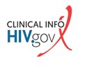
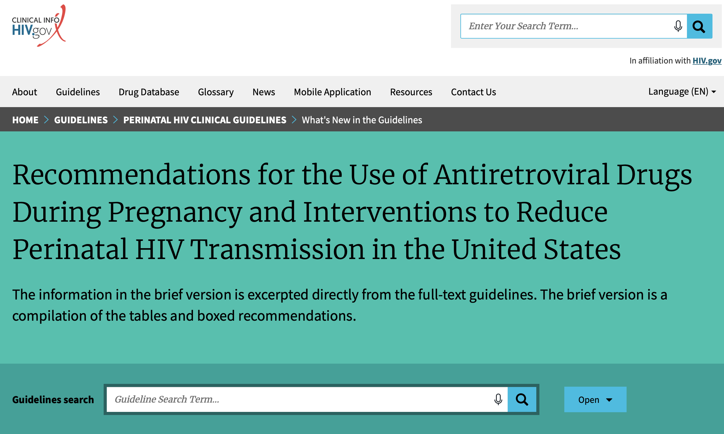
Guidelines: ART & Pregnancy
https://clinicalinfo.hiv.gov/en/guidelines/perinatal-hiv/whats-new-guidelines
Notes:
Last updated March 17, 2022

Slide 7
Pregnancy and HIV

Slide 8
Texas Testing Requirements
  First prenatal visit
    with Hepatitis B Virus (HBV), Hepatitis C Virus (HCV), Syphilis
  Third trimester
  On admission to Labor and Delivery (L&D)
    if unknown status
https://www.hiv.uw.edu/go/screening-diagnosis/diagnostic-testing/core-concept/all
Notes:
4th generation HIV immunoassay
a woman presents with symptoms that are suggestive of a sexually transmitted infection (STI), when a woman presents with a confirmed STI diagnosis, or
when a woman presents with symptoms that are consistent with acute HIV infection
Repeat HIV testing in the third trimester is recommended for pregnant women with negative initial HIV antibody tests who are at increased risk of acquiring HIV, including those who are receiving care in facilities that have an HIV incidence of ≥1 case per 1,000 pregnant women per year, those who reside in jurisdictions with elevated HIV incidence, or those who reside in states that require third-trimester testing – like TEXAS.
Expedited HIV testing should be performed during labor or delivery for any woman with undocumented HIV status; testing should be available 24 hours a day, and results should be available within 1 hour (CDC)
Texas: 2 Expedited test. Test must be expedited and result obtained < 6 hours. For newborn test, blood must be drawn < 2 hours after birth.

Slide 9
Prenatal Evaluation
Geno type | HLA B5701 | G6PD | HBsAg | Anti-HBc | Anti-HBs | HCV Ab | HAV IgG
H/H/Plt | BUN/Cr/ AST/ALT | Pap/ HPV | GC/ CT/ Trich | TB | Toxo IgG | CD4 | VL
Vaccines: SARS-CoV-2, Flu, Tdap, Hep A and Hep B if not immune, Pneumovax
H/H, hemoglobin/hematocrit; plt, platelets; HPV, human papillomavirus; GC/CT, gonorrhea and chlamydia trachomatis; trich, trichomonas; toxo, toxoplasmosis; VL, viral load

Slide 10
HIV LAB Monitoring
HIV viral load (VL)
  2-4 weeks after initiating treatment
  Q 4 weeks until undetectable
  at 34-36 weeks to inform decision regarding mode of delivery and optimal management of newborn
CD4
  First obstetric visit
  Q 3-6 months
Genotype
  If VL >500-1000, and initiating ART or modifying regimen with suboptimal virologic response
Notes:
CD4 T lymphocyte (CD4) cell count should be monitored at the initial antenatal visit (AI). Patients who have been on antiretroviral therapy (ART) for ≥2 years and who have had consistent viral suppression and CD4 counts that are consistently >300 cells/mm³ do not need to have their CD4 counts monitored after the initial antenatal visit during this pregnancy, per the Adult and Adolescent Antiretroviral Guidelines (CIII).Women who have been on ART for <2 years, women with CD4 counts <300 cells/mm³, and women with inconsistent adherence and/or detectable viral loads should have CD4 counts monitored every 3 to 6 months during pregnancy (CIII).
HIV drug-resistance testing should be performed in women whose HIV RNA levels are above the threshold for standard resistance testing (i.e., >500 copies/mL to 1,000 copies/mL) before:
Initiating ART in ARV-naive pregnant women who have not been previously tested for ARV resistance (AII);
Initiating ART in ARV-experienced pregnant women (AIII); or
Modifying ART regimens for women who become pregnant while receiving ARV drugs or women who have suboptimal virologic response to ARV drugs that were started during pregnancy (AII).
ART should be initiated in pregnant women prior to receiving results of ARV-resistance tests. ART should be modified, if necessary, based on the results of the resistance assay (BIII).
Laboratory testing for monitoring of complications of ARV drugs during pregnancy should be based on what is known about the adverse effects of the drugs a woman is receiving (AIII).
Women who are taking ART during pregnancy should undergo standard glucose screening at 24 to 28 weeks’ gestation (AIII). Some experts suggest glucose screening early in pregnancy for women who are receiving protease inhibitor (PI)-based regimens that were initiated before pregnancy, in accordance with recommendations for women who are at risk for glucose intolerance (BIII). For more information on PIs, see Combination Antiretroviral Drug Regimens and Maternal and Neonatal Outcomes.
Amniocentesis, if clinically indicated, should be performed on women with HIV only after initiation of an effective ART regimen and, ideally, when HIV RNA levels are undetectable (BIII). If a woman with detectable HIV RNA levels requires amniocentesis, consultation with an expert in the management of HIV in pregnancy should be considered (BIII).

Slide 11
Transmission Risk
Perinatal
Lactational

Slide 12
Perinatal transmission
Prior to antiretroviral therapy (ART): ~25%
With zidovudine (AZT) during pregnancy and labor and for the infant after delivery for 6 weeks: 8%
With maternal ART: <1%
With ART and undetectable VL at conception, throughout pregnancy, and at delivery (5482 mother-baby pairs):
0 transmissions!
Connor et al. NEJM 1994;331:1173-1180, Kind C et al. AIDS 1998;12:205-210 , Mandelbrot L et al.. JAMA 1998;280:55-60 , The European Mode of Delivery Collaboration. Lancet 1999;353:1035-1039 , Sibiude J et al. Clin Infect Dis. 2022

Slide 13
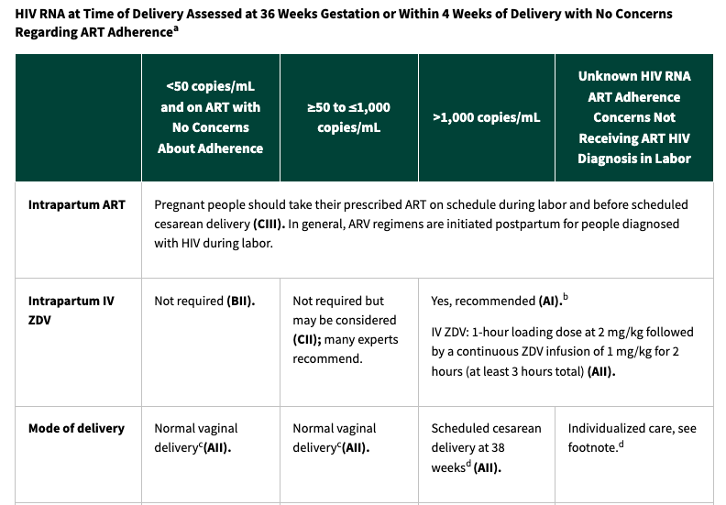
Obstetric management to decrease perinatal transmission
https://clinicalinfo.hiv.gov/en/guidelines/perinatal-hiv/whats-new-guidelines

Slide 14
Lactational transmission
Risk of transmission via breastfeeding prior to the availability of maternal ART: 16%
Transmission associated with antiretroviral therapy
  Babies who just received antiretrovirals during first week of life 5.7-9.5%
  Women on ART until weaning 1.1-2.9%
  Babies on antiretroviral prophylaxis throughout breastfeeding 1.7%
  No additional benefit of infant prophylaxis if mother is on ART throughout breastfeeding
Nduati et al. JAMA 2000; 283(9):1167-1174, Kesho Bora Study Group, Lancet, Infect Dis 2011;11:171–80, Shapiro R et al. N Engl J Med 2010; 362:2282–94, Chasela C et al.N Engl J Med 2010; 362:2271-81, Fowler, MJ et al. J Acquir Immune Defic Syndr. 2014, 65: 366-74
Notes:
Kesho Boro
N = 805 mother baby pairs
Women maintained on triple ARV therapy (zidovudine, lamivudine, and lopinavir/ritonavir=Combivir/Kaletra) BID until cessation of weaning at 20 weeks after birth had a lower risk of HIV transmission to their babies at 12-month follow-up (5.4%) than women who did not get ART and whose babies received prophylactic ARVs (single-dose nevirapine at birth and zidovudine twice daily) only during the first week of life (9.5%)
Mma bana
Maternal ARV use among 560 women (zidovudine/lamivudine BID with a) abacavir OR b) lopinavir/ritonavir OR c) nevirapine) during pregnancy, and up to 6 months of breastfeeding was associated with a 1.1% cumulative risk of transmission
92/93/95% of all women had VL<400, 83/77/84% had VL<50 during breastfeeding
BAN trial
N = 2369
Compared infant ARV prophylaxis (daily nevirapine in increasing doses according to infant weight) vs maternal ARV therapy (the majority received zidovudine/lamivudine with lopinavir/ritonavir BID) for the duration of breastfeeding vs a control group of 1 week of neonatal ARV prophylaxis
At 6 months postpartum, the cumulative HIV incidence was 1.7%, 2.9%, and 5.7%, respectively
No significant difference between maternal treatment vs. infant prophylaxis

Slide 15
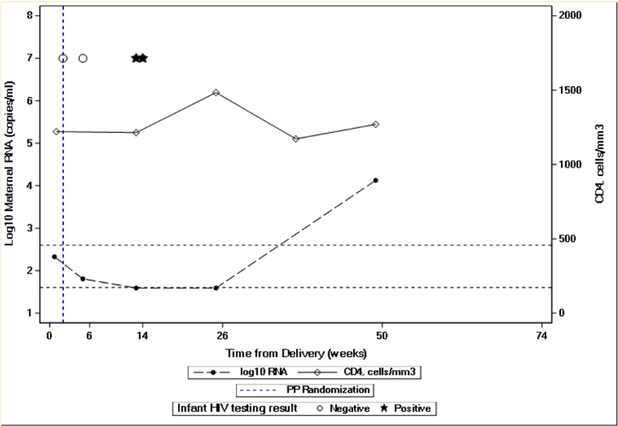
PROMISE study
Randomized trial to compare maternal ART (n=1219) to infant ARV prophylaxis (n=1211)
  Probability of HIV infection in maternal ART arm after delivery
    At 6 months: 0.3%
    At 9 months: 0.6%
    At 12 months: 0.7%
    At 18 months: 0.7%
  2 transmissions in patients with
  undetectable Viral Load (VL)
Flynn et al. JAIDS 2017; 77(4): 383-392
Flynn et al. JAIDS 2021; 88(2):206-13
Notes:
Increased VL and decreased CD4 counts were associated with transmission
Two transmissions occurred when VL undetectable
--What if I have “blips” in my viral load while breastfeeding? How high a viral load is too high? When does my risk of transmission increase?
--What if I was diagnosed during pregnancy or it took some time to achieve adequate viral suppression? Is my risk of transmitting HIV to my child higher?
India and sub-Saharan Africa
A randomized, open-label strategy trial was conducted in HIV-1-infected women with CD4 counts ≥350 cells/mm (or ≥country-specific ART threshold if higher) and their breastfeeding HIV-1-uninfected newborns. Randomization at 6-14 days postpartum was to mART or infant nevirapine (iNVP) prophylaxis continued until 18 months after delivery or breastfeeding cessation, infant HIV-1 infection, or toxicity, whichever occurred first. The primary efficacy outcome was confirmed infant HIV-1 infection. Efficacy analyses included all randomized mother-infant pairs except those with infant HIV-1 infection at entry.
Seven of 1219 (0.57%) and 7 of 1211 (0.58%) analyzed infants in the mART and iNVP arms, respectively, were HIV-infected (hazard ratio 1.0, 96% repeated confidence interval 0.3-3.1); infant HIV-free survival was high (97.1%, mART and 97.7%, iNVP, at 24 months). There were no significant differences between arms in median time to breastfeeding cessation (16 months) or incidence of severe, life-threatening, or fatal adverse events for mothers or infants (14 and 42 per 100 person-years, respectively).
Median VL at delivery 322, Median CD4 686 (>=350 only)

Slide 16

Undetectable= Untransmittable
Preconception
  U = U if partner living with HIV is taking ART daily and has an undetectable viral load
During pregnancy
  U = U for her baby if a person is on ART pre-pregnancy, during pregnancy, and has an undetectable VL at delivery
During lactation
  Cannot say U = U at this time, but each individual must do their own risk:benefit assessment
Notes:
So then why do people choose to infant feed
Image from CDC

Slide 17
ART in Pregnancy

Slide 18
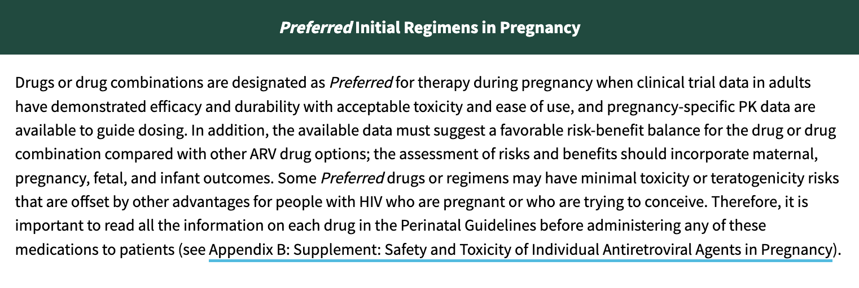
Perinatal Guideline Table 6
Table 6. What to Start: Initial Antiretroviral Regimens During Pregnancy for People Who Are Antiretroviral-Naive
https://clinicalinfo.hiv.gov/en/guidelines/perinatal-hiv/whats-new-guidelines
Notes:
It is important to emphasize that a lack of data does not indicate the absence or presence of risk; rather, it means that we do not have all the information about the possible effects when using these drugs during pregnancy.

Slide 19
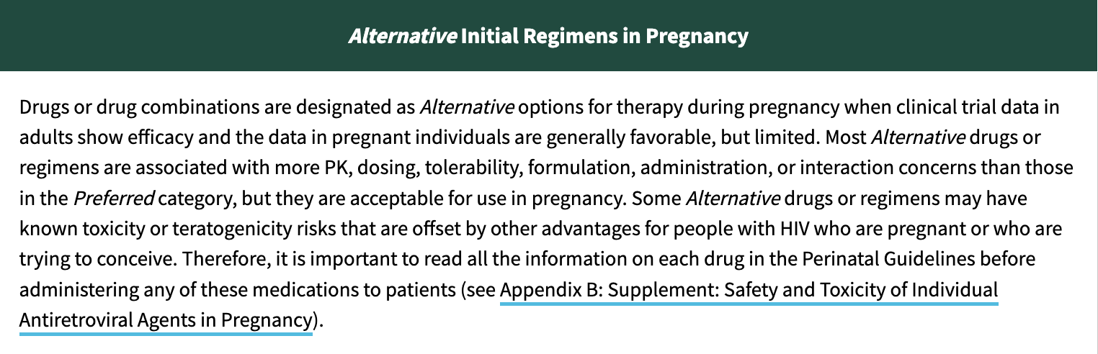
Perinatal Guideline Table 6
Table 6. What to Start: Initial Antiretroviral Regimens During Pregnancy for People Who Are Antiretroviral-Naive
https://clinicalinfo.hiv.gov/en/guidelines/perinatal-hiv/whats-new-guidelines
Notes:
It is important to emphasize that a lack of data does not indicate the absence or presence of risk; rather, it means that we do not have all the information about the possible effects when using these drugs during pregnancy.

Slide 20
Preferred for people who are ARV-naïve
Preferred NRTI | Preferred NNRTI | Preferred PI | Preferred INSTI
ABC/3TC (abacavir/lamivudine) | -- | ATV/r (atazanavir/ritonavir) | DTG (dolutegravir)
TAF/FTC (tenofovir alafenamide/ emtricitabine) or TAF/3TC (tenofovir alafenamide/ lamivudine) |  | DRV/r (darunavir/ritonavir) *BID dosing | RAL (raltegravir) *BID dosing
TDF/FTC (tenofovir disoproxil/emtricitabine) or TDF/3TC (tenofovir disoproxil/lamivudine)
https://clinicalinfo.hiv.gov/en/guidelines/perinatal-hiv/whats-new-guidelines
Notes:
DTG: lower rates of INSTI resistance than RAL
Like RAL, DTG rapidly decreases VL in naïve patient that presents late in pregnancy
BID dosing = 2x/day
TABLE 4
Dual NRTI backbone
Abacavir/lamivudine (ABC/3TC)
Tenofovir/emtricitabine (TDF/FTC) or Tenofovir/lamivudine (TDF/3TC)
INSTI regimens (*late to care, acute infxn)
Dolutegravir/abacavir/lamivudine (DTG/ABC/3TC)
Dolutegravir + dual-NRTI backbone
Raltegravir (RAL) + dual-NRTI backbone (BID dosing)
PI regimen
Atazanavir (ATV/r) + dual-NRTI backbone
Darunavir (DRV/r) + dual-NRTI backbone (BID dosing)
Available data about weight gain with TAF and with DTG during pregnancy have been reviewed and incorporated in the GL.
“Women initiating DTG compared with EFV during pregnancy gained more weight between 18 and 36 weeks gestation. Neither group gained as much weight as HIV-uninfected women. Initiating DTG compared with EFV during pregnancy could increase the risk of excess weight gain but decrease the risk of insufficient weight gain and weight loss, which could have positive and negative consequences in pregnancy.”

Slide 21
Dolutegravir (DTG)
Background rate of neural tube defects (NTDs) in US 0.07%
  7 per 10,000 pregnancies
The neural tube has closed by 6 weeks from last menstrual period (4 weeks after conception)
Image: N Engl J Med 1999; 341:1509-1519
Notes:
3000s NTDs per year in US

Slide 22
Dolutegravir (DTG)
Tsepamo study: May 2018 preliminary results of a study in Botswana suggested an increase in neural tube defects (NTDs) among women who conceived on dolutegravir (DTG) compared to women on non-DTG at conception
  4/429 (0.9%) vs. 14/11,300 (0.1%)
] *non-significant difference
EFV, efavirenz
Zash et al. NEJM, 2019
Zash et al. IAS, 2021
Notes:
Using the data from Botswana, we can now rule out a three-fold or more increased risk of NTDs associated with periconception use of EFV.
Folic acid is known to lower the risk of NTDs in the general population. The United States Public Health Service recommends that all pregnant women and women who might conceive take at least 400 mcg of folic acid daily and continue to do so throughout pregnancy. Unlike food in Botswana, food in the United States is routinely fortified with folate. However, there is no established link between the use of DTG and impaired folate metabolism, nor is there any evidence that folate supplementation prevents NTDs that are associated with the use of DTG.
No increase in NTDs with DTG in the U.S., U.K., or French registries
Neural Tube Defects in Pregnancies Among Women With Diagnosed HIV Infection — 15 Jurisdictions, 2013–2017
Weekly / January 10, 2020 / 69(1);1–5
Jennita Reefhuis, PhD
http://regist2.virology-education.com/presentations/2019/9HIVWomen/01_Gaolathe.pdf

Slide 23
Dolutegravir (DTG)
Updated results presented IAS July 2021: NTDs occurred in
  0.15% (DTG at conception)
  0.10% (non-DTG at conception)
  0.06% (EFV at conception)
  0.05% (DTG later in pregnancy)
  0.07% (without HIV)
No evidence that folate supplementation decreases risk of NTDs associated with the use of DTG
EFV, efavirenz
Zash et al. NEJM, 2019
Zash et al. IAS, 2021

Slide 24
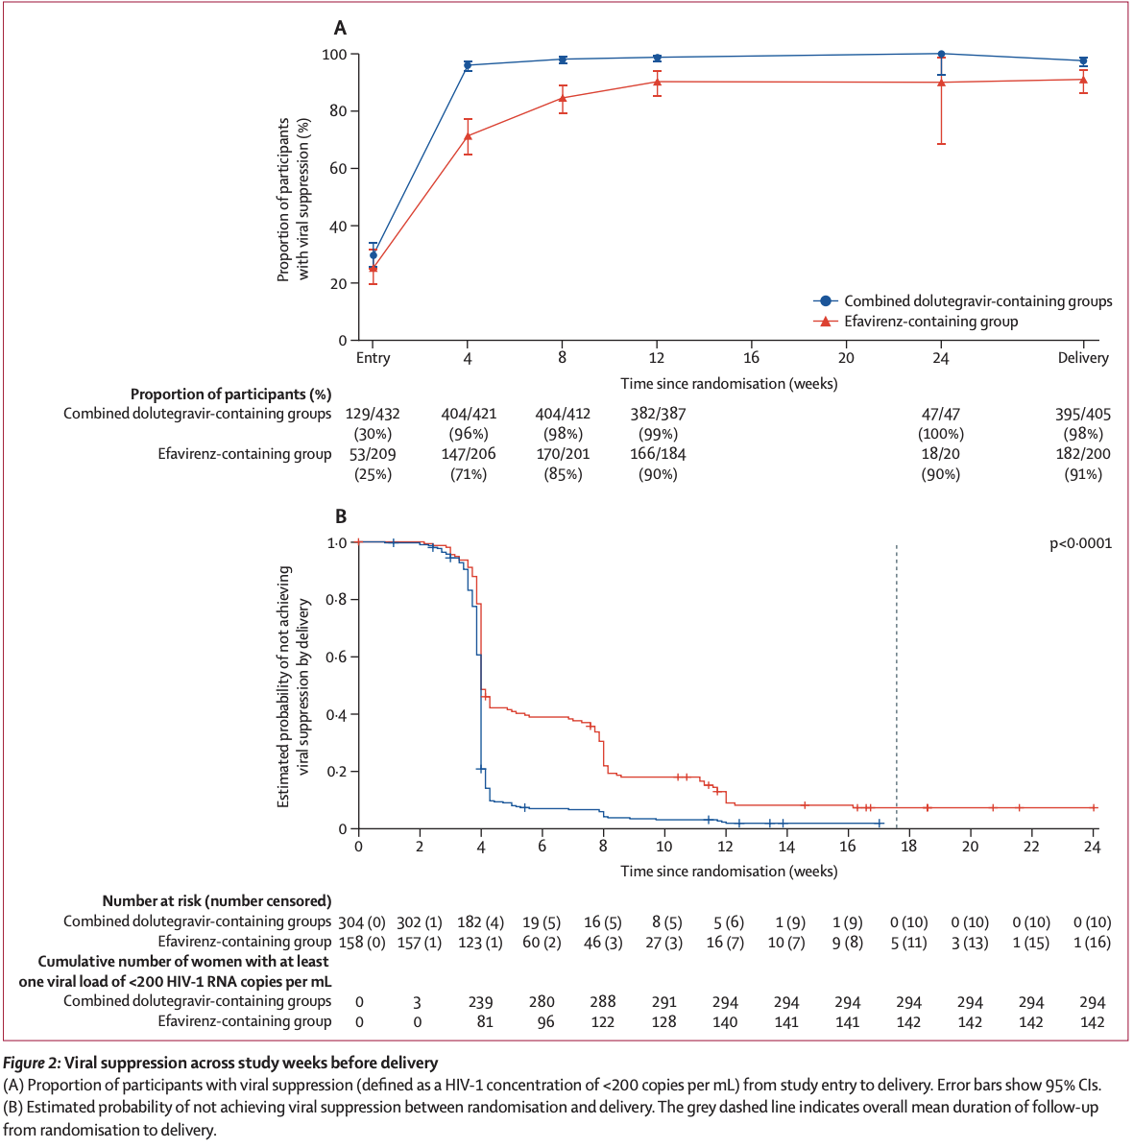
Dolutegravir (DTG)
Lockman et al. Lancet 2021
Notes:
Methods This multicenter, open-label, randomized controlled, phase 3 trial was done at 22 clinical research sites in nine countries (Botswana, Brazil, India, South Africa, Tanzania, Thailand, Uganda, the USA, and Zimbabwe). Pregnant women (aged ≥18 years) with confirmed HIV-1 infection and at 14–28 weeks’ gestation were eligible. Women who had previously taken antiretrovirals in the past were excluded (up to 14 days of ART during the current pregnancy was permitted), as were women known to be pregnant with multiple fetuses, or those with known fetal anomaly or a history of psychiatric illness. Participants were randomly assigned (1:1:1) using a central computerized randomization system. Randomization was done using permuted blocks (size six) stratified by gestational age (14–18, 19–23, and 24–28 weeks’ gestation) and country. Participants were randomly assigned to receive either once-daily oral dolutegravir 50 mg, and once-daily oral fixed-dose combination emtricitabine 200 mg and tenofovir alafenamide fumarate 25 mg; once-daily oral dolutegravir 50 mg, and once-daily oral fixed-dose combination emtricitabine 200 mg and tenofovir disoproxil fumarate 300 mg; or once-daily oral fixed-dose combination of efavirenz 600 mg, emtricitabine 200 mg, and tenofovir disoproxil fumarate 300 mg. The primary efficacy outcome was the proportion of participants with viral suppression, defined as an HIV-1 RNA concentration of less than 200 copies per mL, at or within 14 days of delivery, assessed in all participants with an HIV-1 RNA result available from the delivery visit, with a prespecified non-inferiority margin of –10% in the combined dolutegravir-containing groups versus the efavirenz-containing group (superiority was tested in a pre-planned secondary analysis). Primary safety outcomes, compared pairwise among treatment groups, were the occurrence of a composite adverse pregnancy outcome (ie, either preterm delivery, the infant being born small for gestational age, stillbirth, or spontaneous abortion) in all participants with a pregnancy outcome, and the occurrence of grade 3 or higher maternal and infant adverse events in all randomized participants. This trial was registered with ClinicalTrials.gov, NCT03048422.
Mathematical model suggests higher death rate among women and children if DTG is restricted to women of non-reproductive age and more transmissions to infants and partners
DTG offers more rapid viral suppression, greater tolerability, and less drug resistance compared to Efavirenz
Dugdale C et al. Annals of Internal Medicine 2019
Hoffman R and Mofenson M. Annals of Internal Medicine 2019

Slide 25
Dolutegravir (DTG)
Lockman et al. Lancet 2021
Notes:
Methods This multicenter, open-label, randomized controlled, phase 3 trial was done at 22 clinical research sites in nine countries (Botswana, Brazil, India, South Africa, Tanzania, Thailand, Uganda, the USA, and Zimbabwe). Pregnant women (aged ≥18 years) with confirmed HIV-1 infection and at 14–28 weeks’ gestation were eligible. Women who had previously taken antiretrovirals in the past were excluded (up to 14 days of ART during the current pregnancy was permitted), as were women known to be pregnant with multiple fetuses, or those with known fetal anomaly or a history of psychiatric illness. Participants were randomly assigned (1:1:1) using a central computerized randomization system. Randomization was done using permuted blocks (size six) stratified by gestational age (14–18, 19–23, and 24–28 weeks’ gestation) and country. Participants were randomly assigned to receive either once-daily oral dolutegravir 50 mg, and once-daily oral fixed-dose combination emtricitabine 200 mg and tenofovir alafenamide fumarate 25 mg; once-daily oral dolutegravir 50 mg, and once-daily oral fixed-dose combination emtricitabine 200 mg and tenofovir disoproxil fumarate 300 mg; or once-daily oral fixed-dose combination of efavirenz 600 mg, emtricitabine 200 mg, and tenofovir disoproxil fumarate 300 mg. The primary efficacy outcome was the proportion of participants with viral suppression, defined as an HIV-1 RNA concentration of less than 200 copies per mL, at or within 14 days of delivery, assessed in all participants with an HIV-1 RNA result available from the delivery visit, with a prespecified non-inferiority margin of –10% in the combined dolutegravir-containing groups versus the efavirenz-containing group (superiority was tested in a pre-planned secondary analysis). Primary safety outcomes, compared pairwise among treatment groups, were the occurrence of a composite adverse pregnancy outcome (ie, either preterm delivery, the infant being born small for gestational age, stillbirth, or spontaneous abortion) in all participants with a pregnancy outcome, and the occurrence of grade 3 or higher maternal and infant adverse events in all randomized participants. This trial was registered with ClinicalTrials.gov, NCT03048422.
Mathematical model suggests higher death rate among women and children if DTG is restricted to women of non-reproductive age and more transmissions to infants and partners
DTG offers more rapid viral suppression, greater tolerability, and less drug resistance compared to Efavirenz
Dugdale C et al. Annals of Internal Medicine 2019
Hoffman R and Mofenson M. Annals of Internal Medicine 2019

Slide 26
Dolutegravir (DTG)
DTG-containing regimens had superior virological efficacy at delivery compared with the efavirenz, emtricitabine, and tenofovir disoproxil fumarate regimen
The DTG/3TC/TAF regimen had the lowest frequency of composite adverse pregnancy outcomes and of neonatal deaths
Lockman et al. Lancet 2021
Notes:
DTG offers more rapid viral suppression, greater tolerability, and less drug resistance compared to Efavirenz
Dugdale C et al. Annals of Internal Medicine 2019
Hoffman R and Mofenson M. Annals of Internal Medicine 2019

Slide 27
Alternative for ARV-naïve
Alternative NRTI | Alternative NNRTI | Alternative PI | Alternative INSTI
ZDV/3TC (zidovudine/lamivudine) | EFV/TDF/FTC (efavirenz, tenofovir, emtricitabine) or EFV/TDF/3TC (efavirenz, tenofovir, lamivudine) | -- | --
 | EFV + preferred dual-NRTI backbone (efavirenz)
 | RPV/TDF/FTC (rilpivirine, tenofovir, emtricitabine) Or RPV/TAF/FTC (rilpivirine, tenofovir, emtricitabine) *not for VL >100K, CD4 <200
 | RPV + preferred Dual-NRTI backbone (rilpivirine)
https://clinicalinfo.hiv.gov/en/guidelines/perinatal-hiv/whats-new-guidelines
Notes:
Zidovudine/lamivudine (ZDV/3TC)
BID dosing, increased hematologic toxicity
Efavirenz/tenofovir/emtricitabine or lamivudine (EFV/TDF/FTC or 3TC)
Efavirenz + dual NRTI backbone
Birth defects in primate studies, none in humans, higher adverse event rates
Rilpivirine/tenofovir/emtricitabine (RPV/TDF/FTC)
RPV + dual NRTI backbone
Can not use if VL >100,000, CD4 <200
Cant use with PPIs
Lower drug levels and risk of viral rebound in 2, 3rd trimesters
Take with food

Slide 28
Insufficient Data to Recommend
BIC/TAF/FTC (bictegravir/emtricitabine/tenofovir alafenamide): limited data on use in pregnancy
DOR (doravirine): no data on use in pregnancy
IBA (ibalizumab): no data on use in pregnancy
Two-drug regimens: no data on use in pregnancy
  Pregnant persons who present to care on DTG/3TC (dolutegravir, lamivudine) or DTG/RPV (dolutegravir, rilpivirine) and have successfully maintained viral suppression can continue the two-drug regimen with more frequent viral load monitoring, every 1 to 2 months throughout pregnancy
  Pharmacokinetics (PK) have been well described and are adequate in pregnancy, and the components of each of the two-drug oral regimens are recommended as Preferred or Alternative ARV drugs by the Panel.
https://clinicalinfo.hiv.gov/en/guidelines/perinatal-hiv/whats-new-guidelines
Notes:
It is important to emphasize that a lack of data does not indicate the absence or presence of risk; rather, it means that we do not have all the information about the possible effects when using these drugs during pregnancy.

Slide 29
Not Recommended
Cobicistat boosted regimens: reduction in trough dose in the 2/3rd trimesters
  >2h from pre-natal vitamin
Long-acting injectable cabotegravir plus rilpivirine: extremely limited data, long half-life means levels may last up to 12 months after last dose
Lopinavir/ritonavir: liquid contains 42% alcohol and 15% propylene glycol, associated with preterm delivery, more nausea/vomiting, requires dose adjustment in 2/3rd trimesters
Nevirapine: risk of life-threatening hepatotoxicity if CD4 > 250, can have hypersensitivity reactions
Etravirine, fostemsavir, maraviroc, enfuvirtide: not recommended
Notes:
Generally, stay on same regimen
If on a regimen with cobicistat, the concern is that drug levels can drop during second and third trimester. Therefore, if a patient is stable on a cobicistat-containing regimen, you can choose to continue and monitor VLs frequently (q1-2 months) in second and third trimester or change ART.
A regimen change carries the risk of viral rebound
TABLE 8
The FDA advises women to avoid becoming pregnant while taking EFV and advises health care providers to avoid administration during the first trimester of pregnancy, as fetal harm may occur. However, the data on more than 7,900 periconception EFV exposures from Botswana rules out a ≥3-fold increased risk of NTDs. As a result, the current Perinatal Guidelines do not restrict the use of EFV in pregnant women or in women who are planning to become pregnant. This is consistent with both the British HIV Association and WHO guidelines for use of ARV drugs in pregnancy.
EFV should be continued in pregnant women who are on a virologically suppressive, EFV-based regimen, because ARV drug changes during pregnancy may be associated with loss of viral control and an increased risk of perinatal transmission

Slide 30
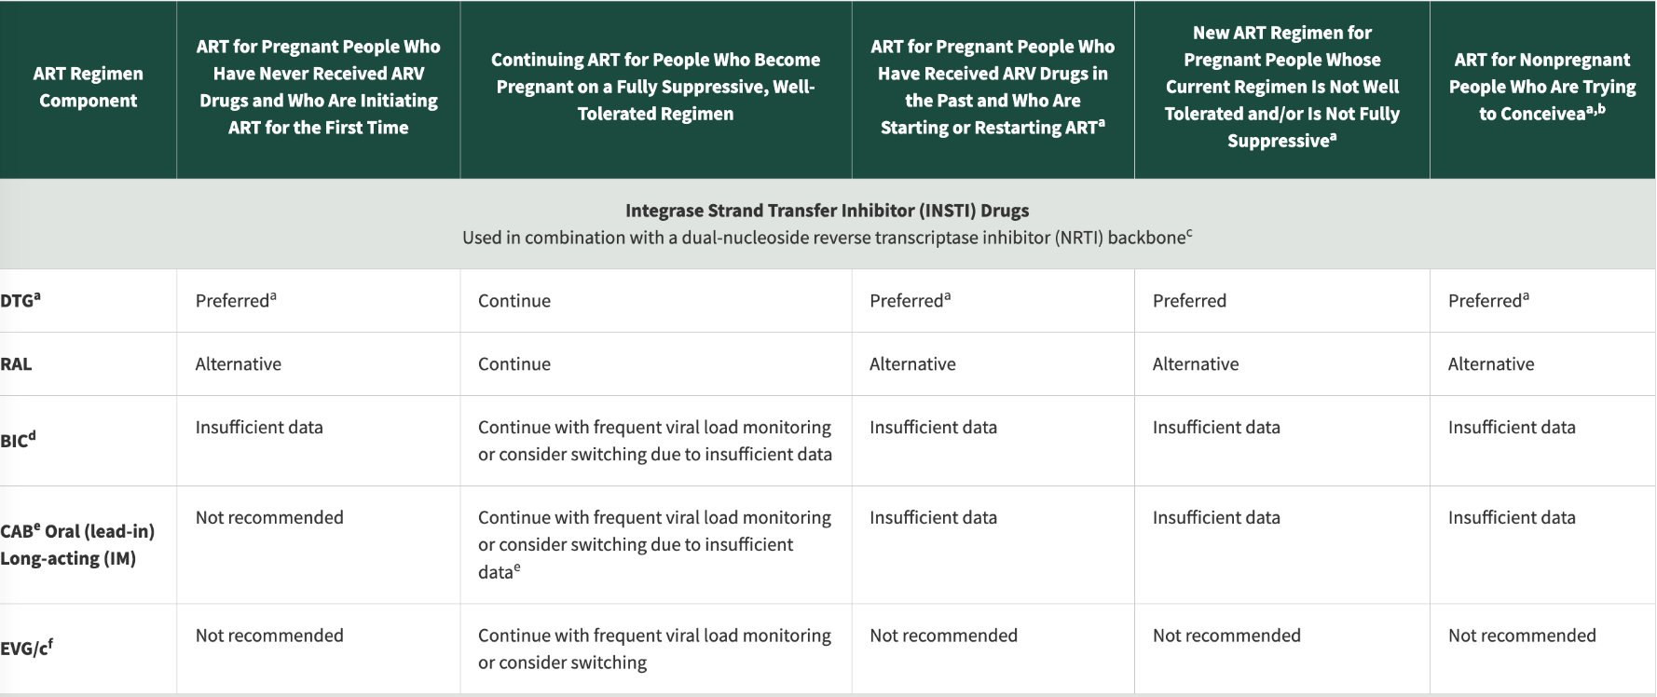
Perinatal Guidelines Table 7
Table 7. Situation-Specific Recommendations for Use of Antiretroviral Drugs in Pregnant People and Nonpregnant People Who Are Trying to Conceive
https://clinicalinfo.hiv.gov/en/guidelines/perinatal-hiv/whats-new-guidelines
Notes:
It is important to emphasize that a lack of data does not indicate the absence or presence of risk; rather, it means that we do not have all the information about the possible effects when using these drugs during pregnancy.
^{d} Data on the safety, PKs, and dosing of BIC in pregnancy are limited. Viral load should be monitored more frequently (every 1–2 months).Because fewer than 200 first trimester and periconception exposures have been reported in the Antiretroviral Pregnancy Registry, it is not yet possible to exclude a risk of birth defects greater than that in the general population. Please report all exposures to the Antiretroviral Pregnancy Registry.

Slide 31
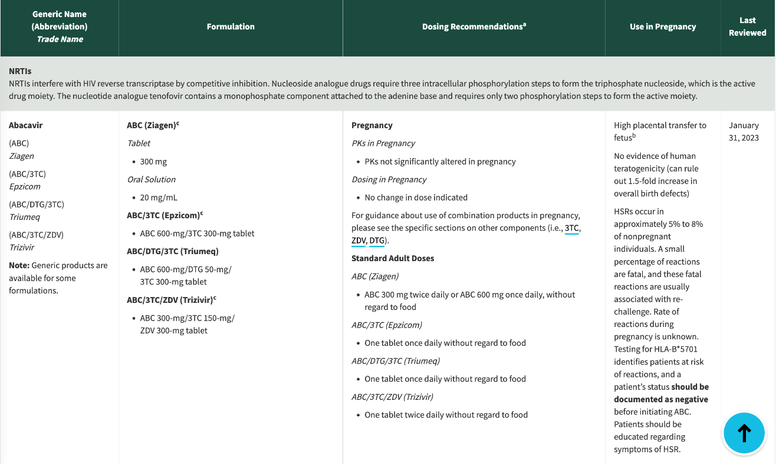
Table 14. Antiretroviral Drug Use in Pregnant People With HIV: Pharmacokinetic and Toxicity Data in Human Pregnancy and Recommendations for Use in Pregnancy
https://clinicalinfo.hiv.gov/en/guidelines/perinatal-hiv/whats-new-guidelines
Notes:
It is important to emphasize that a lack of data does not indicate the absence or presence of risk; rather, it means that we do not have all the information about the possible effects when using these drugs during pregnancy.
^{d} Data on the safety, PKs, and dosing of BIC in pregnancy are limited. Viral load should be monitored more frequently (every 1–2 months).Because fewer than 200 first trimester and periconception exposures have been reported in the Antiretroviral Pregnancy Registry, it is not yet possible to exclude a risk of birth defects greater than that in the general population. Please report all exposures to the Antiretroviral Pregnancy Registry.

Slide 32
ART – Take Home Messages
If someone is on a regimen they are happy with, and on which they are virally suppressed, continue the same regimen
Give what the person will take
  Size of pills
  Number of pills
Ask about nausea/vomiting in early pregnancy
  Prescribe ondansetron 4mg q 6 h prn (oral disintegrating tablets preferred)
Notes:
ODT= Oral disintegrating tablets
Prn=as needed

Slide 33
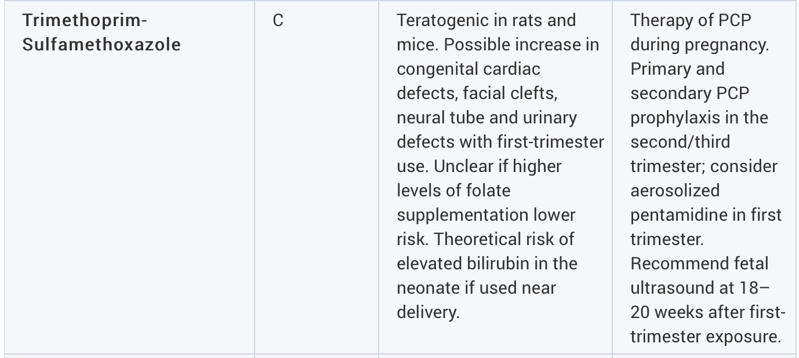
Opportunistic Infections (OI) prophylaxis
CD4 <200
Overall, BENEFITS outweigh RISKS
Notes:
Primary prophylaxis against disseminated MAC disease is not recommended for adults and adolescents with HIV who immediately initiate ART
Associations between macrolide antibiotics prescribing during pregnancy and adverse child outcomes in the UK: population based cohort study
BMJ 2020; 368
Abstract
Objective To assess the association between macrolide antibiotics prescribing during pregnancy and major malformations, cerebral palsy, epilepsy, attention deficit hyperactivity disorder, and autism spectrum disorder in children.
Design Population based cohort study.
Setting The UK Clinical Practice Research Datalink.
Participants The study cohort included 104 605 children born from 1990 to 2016 whose mothers were prescribed one macrolide monotherapy (erythromycin, clarithromycin, or azithromycin) or one penicillin monotherapy from the fourth gestational week to delivery. Two negative control cohorts consisted of 82 314 children whose mothers were prescribed macrolides or penicillins before conception, and 53 735 children who were siblings of the children in the study cohort.
Main outcome measures Risks of any major malformations and system specific major malformations (nervous, cardiovascular, gastrointestinal, genital, and urinary) after macrolide or penicillin prescribing during the first trimester (four to 13 gestational weeks), second to third trimester (14 gestational weeks to birth), or any trimester of pregnancy. Additionally, risks of cerebral palsy, epilepsy, attention deficit hyperactivity disorder, and autism spectrum disorder.
Results Major malformations were recorded in 186 of 8632 children (21.55 per 1000) whose mothers were prescribed macrolides and 1666 of 95 973 children (17.36 per 1000) whose mothers were prescribed penicillins during pregnancy. Macrolide prescribing during the first trimester was associated with an increased risk of any major malformation compared with penicillin (27.65 v 17.65 per 1000, adjusted risk ratio 1.55, 95% confidence interval 1.19 to 2.03) and specifically cardiovascular malformations (10.60 v 6.61 per 1000, 1.62, 1.05 to 2.51). Macrolide prescribing in any trimester was associated with an increased risk of genital malformations (4.75 v 3.07 per 1000, 1.58, 1.14 to 2.19, mainly hypospadias). Erythromycin in the first trimester was associated with an increased risk of any major malformation (27.39 v 17.65 per 1000, 1.50, 1.13 to 1.99). No statistically significant associations were found for other system specific malformations or for neurodevelopmental disorders. Findings were robust to sensitivity analyses.
Conclusions Prescribing macrolide antibiotics during the first trimester of pregnancy was associated with an increased risk of any major malformation and specifically cardiovascular malformations compared with penicillin antibiotics. Macrolide prescribing in any trimester was associated with an increased risk of genital malformations. These findings show that macrolides should be used with caution during pregnancy and if feasible alternative antibiotics should be prescribed until further research is available.

Slide 34


National Perinatal HIV Hotline
24 hours a day, 7 days a week, 365 days a year
(888) 448-8765
This project is supported by the Health Resources and Services Administration (HRSA) of the U.S. Department of Health and Human Services (HHS) under grant number U1OHA30039-01-00 (AIDS Education and Training Centers National Clinician Consultation Center) awarded to the University of California, San Francisco. (updated 10/24/17)
Notes:
The Clinician Consultation Center (CCC) provides free, confidential, and timely expert perinatal HIV and HIV-exposed infant consultation to clinicians of all experience levels and training backgrounds.
Advice is based on Federal treatment guidelines, current medical literature, and clinical best practices.

Slide 35
Cases

Slide 36
Case 1
Gloria is a 32-year-old woman has 3 pregnancies and 2 live births (G3P2) @ 16w diagnosed with HIV during her first pregnancy 7 years ago.
She is on EVG/c/FTC/TAF* and has been virally suppressed on this regimen for two years.
What do you recommend she take during pregnancy?
*Elvitegravir/cobicistat/emtricitabine/tenofovir alafenamide fumarate
Notes:
If on ART and virally suppressed, stay on same regimen
If on elvitegravir/cobicistat (such as Stribild or Genvoya), monitor viral load (VL) carefully or consider switch to more effective regimen

Slide 37
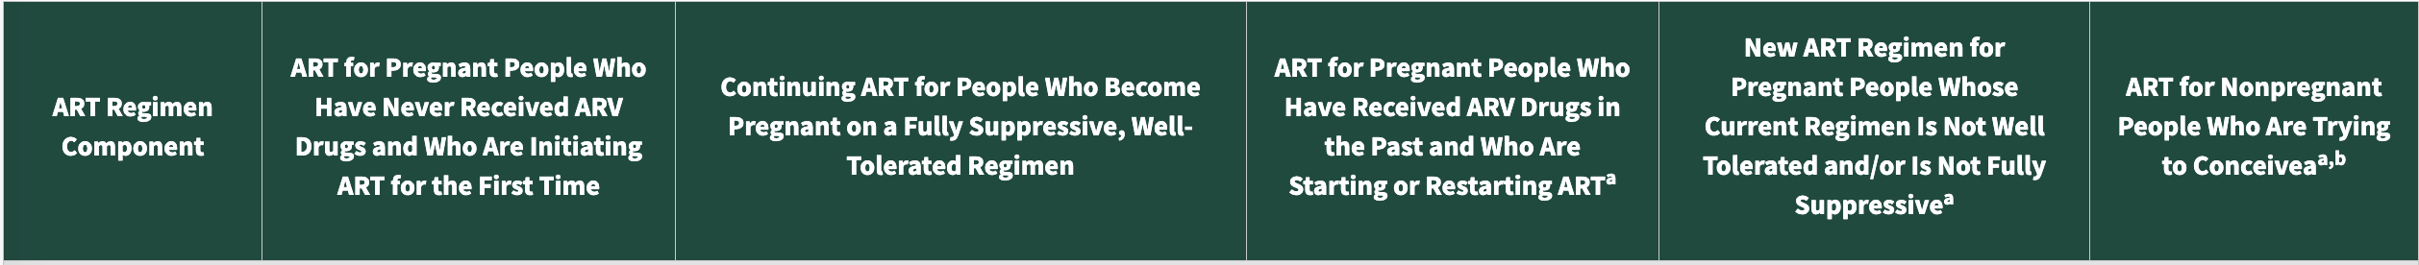
Table 7

Slide 38
Case 2
Sheila is a 23-year-old G1P0 diagnosed with HIV at her first prenatal visit at 8 weeks gestation through routine pregnancy screening.
What ART regimen do you start her on, and when do you start it?
Notes:
A: I would start immediately
B: I would wait for the results of the HIV genotype to make sure her virus is not resistant to the drug I am prescribing
C: I would place her on a regimen containing tenofovir alafenamide since that is the newest form of tenofovir
D: B and C
Initiate ART as soon as HIV is diagnosed
Begin ART while awaiting results of HIV genotype for resistance (if there is resistance to a prescribed drug, you can change it)
Consider including an integrase inhibitor such as raltegravir or dolutegravir if high viral load (VL) late in pregnancy (expect 1-log decrease per week)
Include tenofovir/emtricitabine (or tenofovir/lamivudine) if she is co-infected with hepatitis B (HBV)
“Give what she will take”*
Does she have trouble swallowing large pills?
Would she rather have 2 small pills or one large pill?
Most individuals adhere to once a day regimens better than twice a day regimens
The guidelines are guidelines

Slide 39
Preferred for people who are ARV-naïve
Preferred NRTI | Preferred NNRTI | Preferred PI | Preferred INSTI
ABC/3TC (abacavir/lamivudine) | -- | ATV/r (atazanavir/ritonavir) | DTG (dolutegravir)
TAF/FTC (tenofovir alafenamide/ emtricitabine) or TAF/3TC (tenofovir alafenamide/ lamivudine) |  | DRV/r (darunavir/ritonavir) *BID dosing | RAL (raltegravir) *BID dosing
TDF/FTC (tenofovir disoproxil/emtricitabine) or TDF/3TC (tenofovir disoproxil/lamivudine)
Notes:
DTG: lower rates of INSTI resistance than RAL
Like RAL, DTG rapidly decreases VL in naïve patient that presents late in pregnancy
TABLE 4
Dual NRTI backbone
Abacavir/lamivudine (ABC/3TC)
Tenofovir/emtricitabine (TDF/FTC) or Tenofovir/lamivudine (TDF/3TC)
INSTI regimens (*late to care, acute infxn)
Dolutegravir/abacavir/lamivudine (DTG/ABC/3TC)
Dolutegravir + dual-NRTI backbone
Raltegravir (RAL) + dual-NRTI backbone (BID dosing)
PI regimen
Atazanavir (ATV/r) + dual-NRTI backbone
Darunavir (DRV/r) + dual-NRTI backbone (BID dosing)
Available data about weight gain with TAF and with DTG during pregnancy have been reviewed and incorporated in the GL.
“Women initiating DTG compared with EFV during pregnancy gained more weight between 18 and 36 weeks gestation. Neither group gained as much weight as HIV-uninfected women. Initiating DTG compared with EFV during pregnancy could increase the risk of excess weight gain but decrease the risk of insufficient weight gain and weight loss, which could have positive and negative consequences in pregnancy.”

Slide 40
Case 3
Kate is a 33-year-old woman pregnant with third child, has 2 living full term children (G3P2002) @ 32 weeks who screened negative at her first prenatal visit but positive in her third trimester screen.
What ART regimen do you start her on?
Delivery timing?
Notes:
Concern for ACUTE HIV infection
Recent diagnosis of HIV
For example: HIV negative in first trimester and HIV positive in third trimester
Infants born to mothers infected with HIV during pregnancy (or breastfeeding) are at higher risk than infants whose mothers have had HIV prior to pregnancy
Imperative to reduce viral load rapidly
Dolutegravir is the preferred integrase inhibitor in this situation

Slide 41
Case 4
Melanie is a 20 year old Woman Pregnant First Time, has not Delivered (G1P0) at 35 weeks gestation who has been on ART since 18 weeks. She has an unstable living situation and her boyfriend has sometimes locked her out of her room, where she keeps her medications. Her viral load, which was undetectable at 26 weeks, is now 11,000.
What do you do?
Notes:
A: Do a genotype for resistance
B: Arrange for home health care or hospital admission to give directly observed therapy
C: Schedule her for a Cesarean at 38 weeks
D: Add an integrase inhibitor if she is not already on one
E: A, B, and D
Lack of viral suppression
Resistance vs. adherence
Add integrase inhibitor such as raltegravir or dolutegravir
Consider directly observed therapy
Scheduled Cesarean if VL>1000 at 38 weeks

Slide 42

Thank you!
jennifer.mckinney@bcm.edu

Slide 43
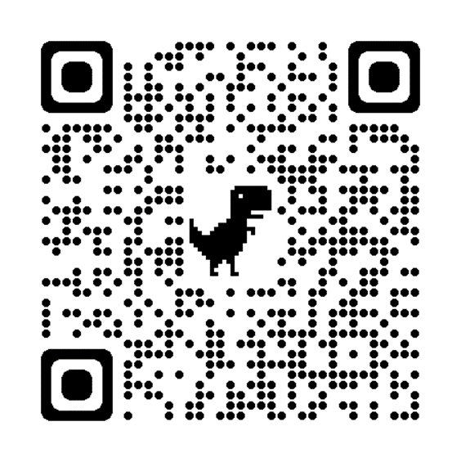

Post-Session Evaluation
Please take a minute to complete the post-session survey.
Thank you!

Slide 44
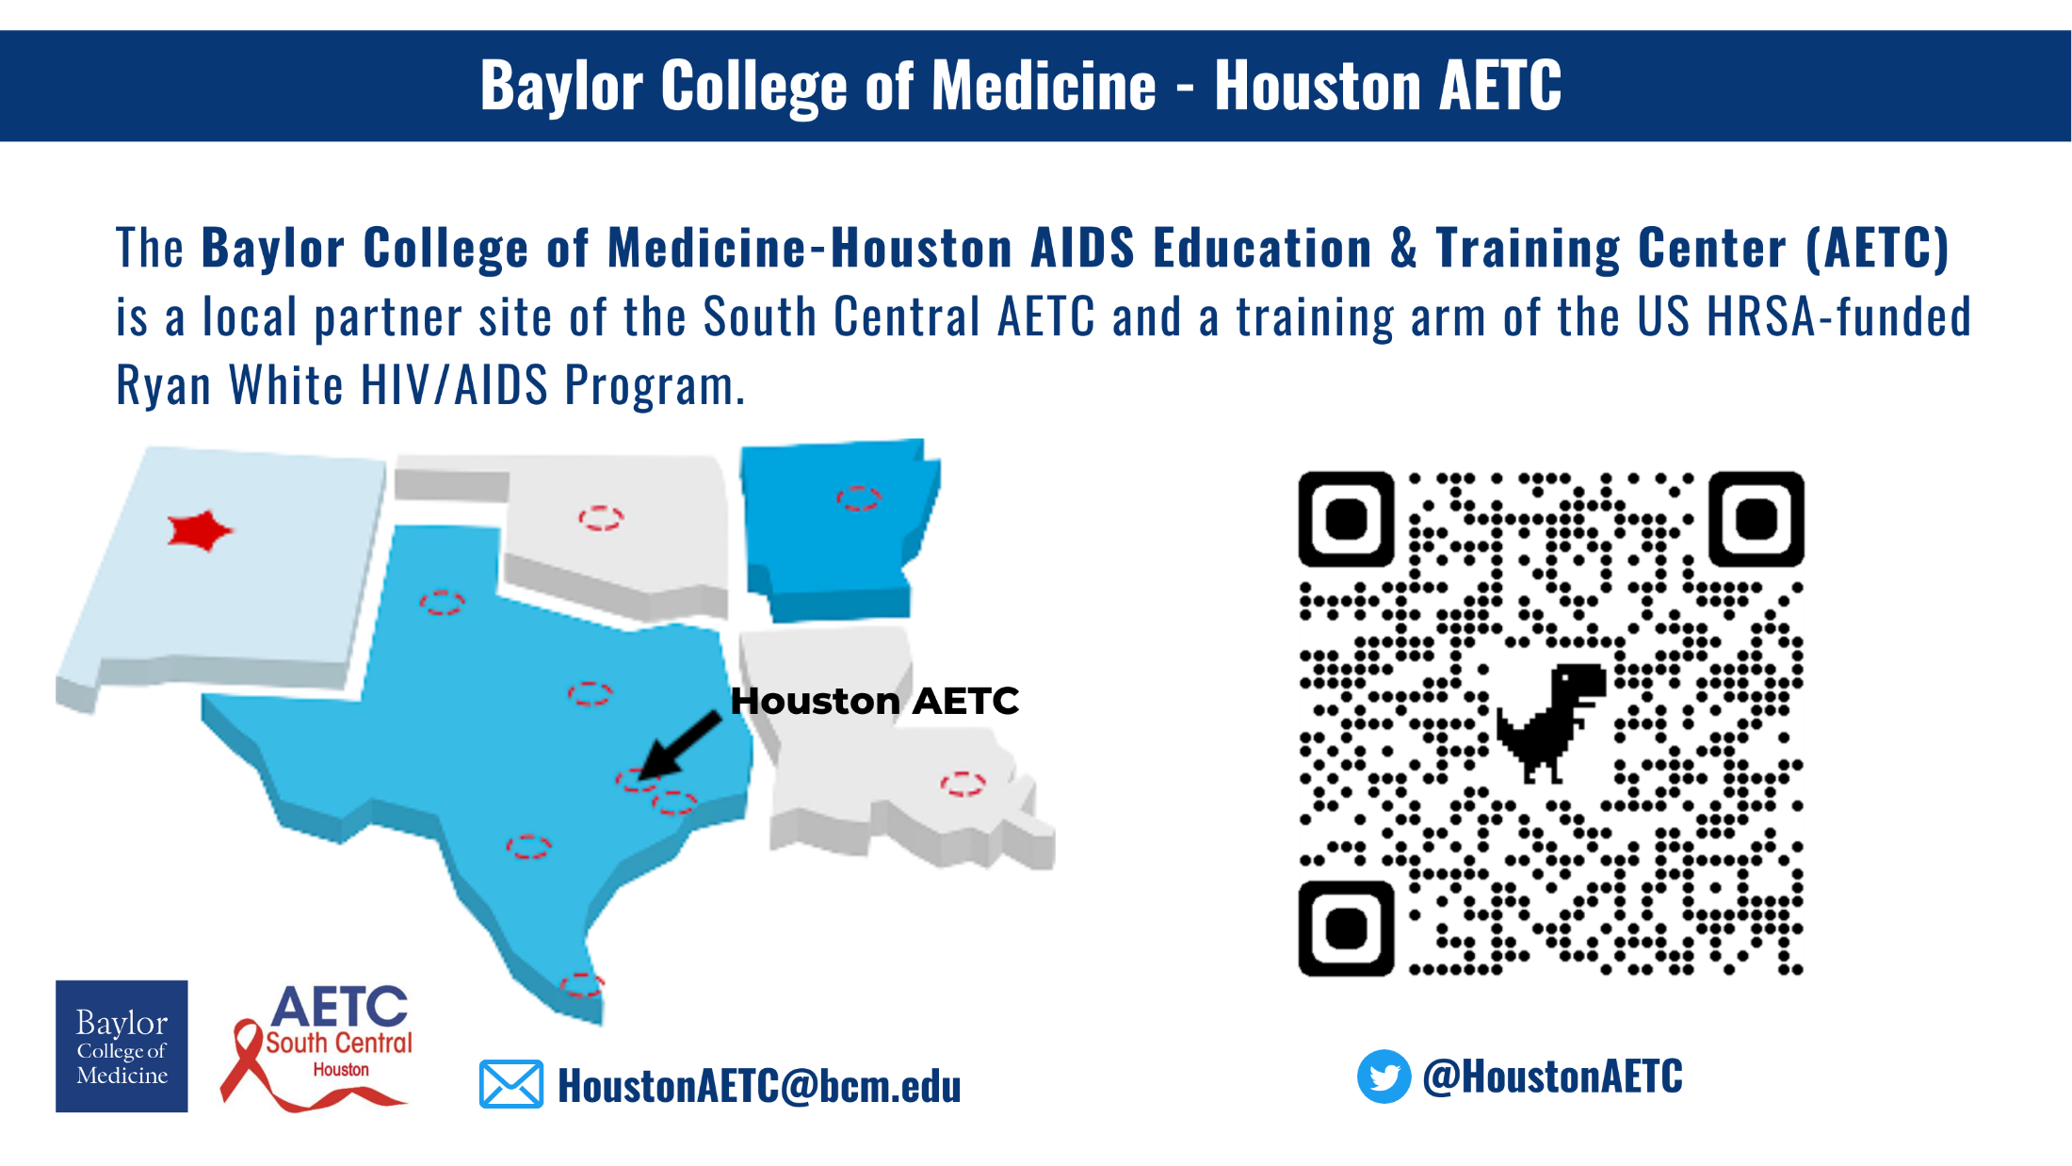

Slide 45
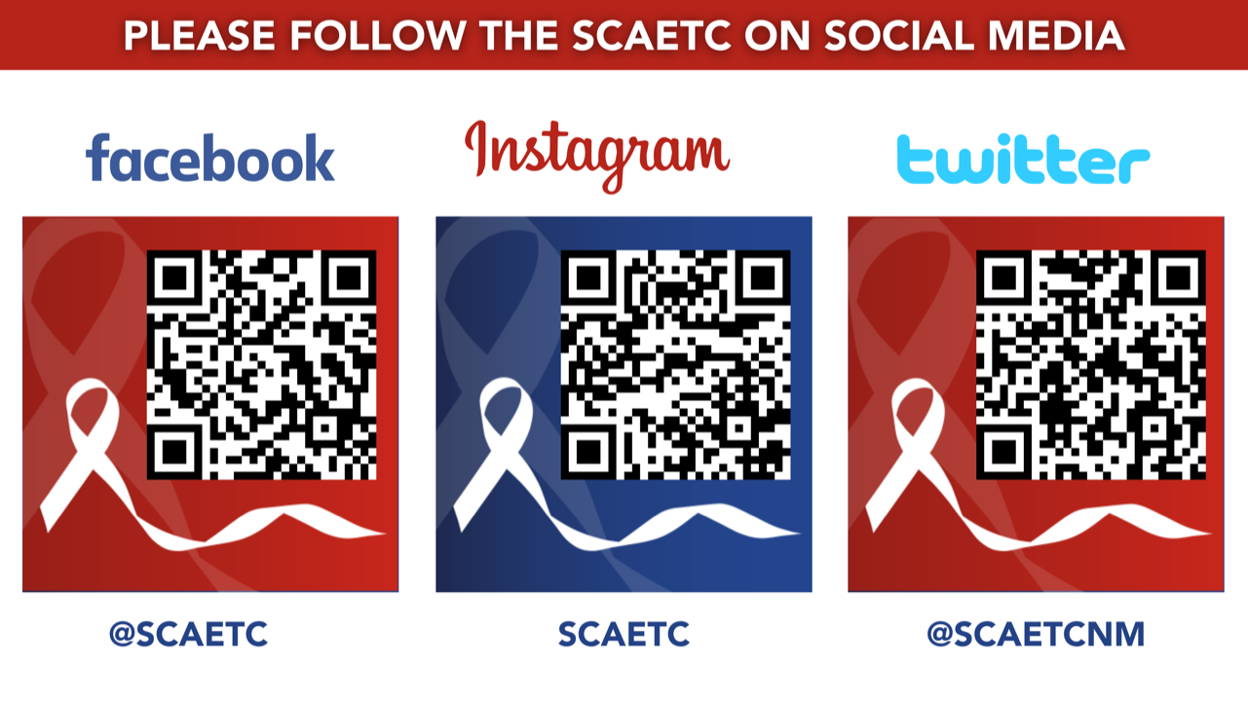
SCAETC Social Media

Slide 46
Resources
National Clinician Consultation Center http://nccc.ucsf.edu/
  HIV Management
  Perinatal HIV
  HIV PrEP
  HIV PEP line
  HCV Management
  Substance Use Management
Present case on ECHO https://hsc.unm.edu/scaetc/programs-services/echo.html
AETC National HIV Curriculum https://aidsetc.org/nhc
AETC National Coordinating Resource Center https://targethiv.org/library/aetc-national-coordinating-resource-center-0
Additional trainings scaetcecho@salud.unm.edu
www.scaetc.org
Notes:
Find an HIV-related topic TeleECHO in your area: https://echo.unm.edu/locations-2/echo-hubs-superhubs-united-states/
IDEA Platform: Infectious Diseases Education & Assessment. https://idea.medicine.uw.edu/
AETC National HIV Curriculum: 6 core modules for self study; regularly updated; CME, CNE
Hepatitis C Online Curriculum: https://www.hepatitisc.uw.edu/
Hepatitis B Online Curriculum: https://www.hepatitisb.uw.edu/
National STD Curriculum: https://www.std.uw.edu/
Clinical apps for HIV care https://aidsetc.org/resource/clinician-mobile-apps-hiv-related-care

