Slide 1


Management of Hepatitis B in People with HIV
Karen J. Vigil, MD
Associate Professor
UTHealth Houston
McGovern Medical School
Notes:
Include version date:_5/30/23

Slide 2
Conflict of Interest Disclosure Statement
Advisor – ViiV, Gilead Sciences, Theratechnologies
Researcher – Theratechnologies
Speaker – Gilead Sciences
This program is supported by the Health Resources and Services Administration (HRSA) of the U.S. Department of Health and Human Services (HHS) as part of an award totaling $3,132,205, with 0% financed with non-governmental sources. The contents are those of the author(s) and do not necessarily represent the official views of, nor an endorsement of, by HRSA, HHS, or the U.S. Government. For more information, please visit HRSA.gov. Any trade/brand names for products mentioned during this presentation are for training and identification purposes only.

Slide 3
Learning Objectives
Discuss Hepatitis B Virus (HBV) epidemiology and current immunizations recommendations and practices in people with HIV.
Explain HBV serologic diagnosis in people with HIV.
List current antiretroviral treatment options in people with chronic HBV and HIV coinfection.
Summarize indications and methods for hepatocellular carcinoma (HCC) surveillance in people with HBV and HIV coinfection.

Slide 4
4

Slide 5
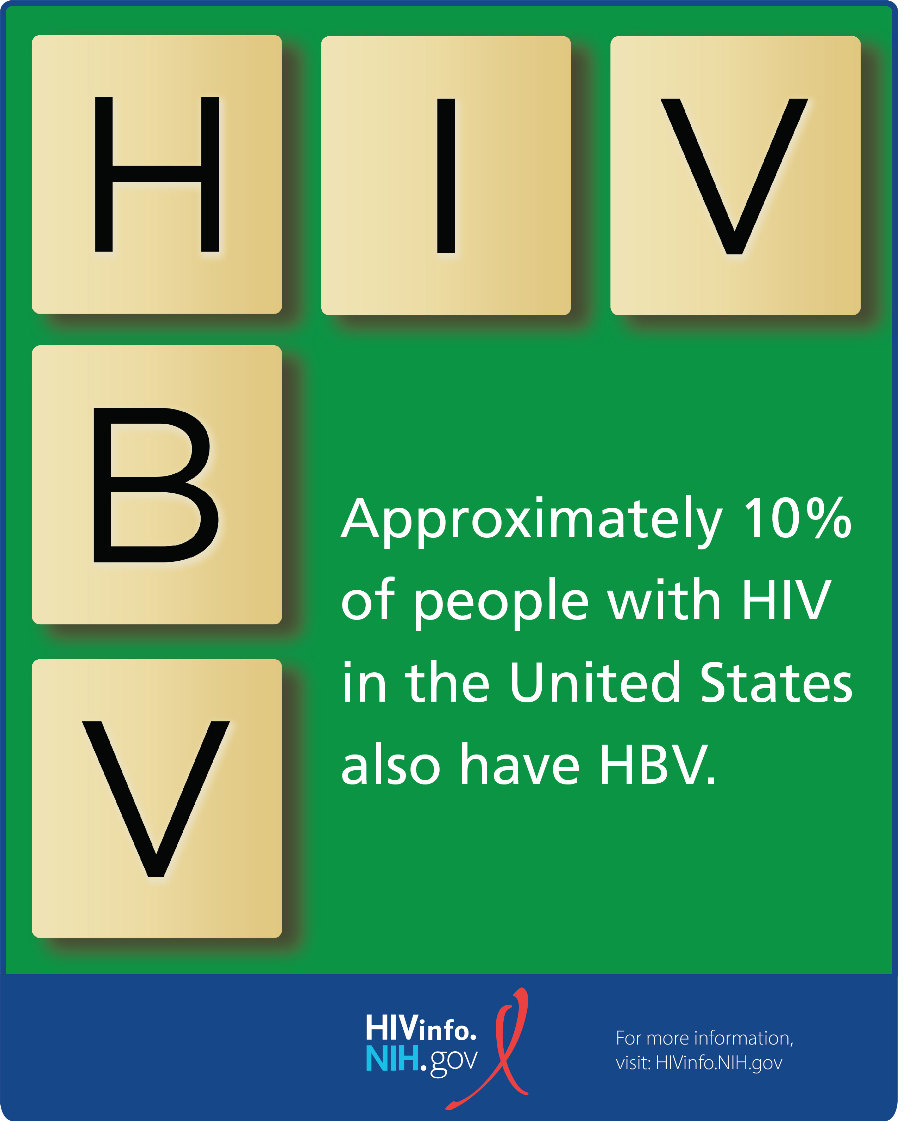
Epidemiology
Hepatitis B is the leading cause of chronic liver disease worldwide
HIV/HBV coinfection ~10%
HOPS Study 1996-2007: 8.4% (general population 0.42%)
US and Eastern Europe: 6-14%
  Heterosexual 4-6%
  Injecting Drug Users (IDU): 7-10%
  Men who have Sex with Men (MSM) 9-17%
J Hepatol . 2006;44(1 Suppl):S6-9
Journal of Viral Hepatitis, 2010, 17, 879–886
Notes:
The HOPS is an ongoing prospective observational cohort study of HIV-infected adults receiving care at ten particiating HIV clinics in eight US cities (Chicago, Illinois; Denver, Colorado; Long Island, New York; Oakland/San Leandro, California; Philadelphia, Pennsylvania; Tampa, Florida; and Washington, D.C.) since 1993

Slide 6
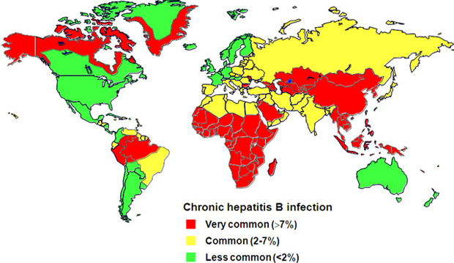
Epidemiology
https://www.hepbnet.org/about.asp
Notes:
The HOPS is an ongoing prospective observational cohort study of HIV-infected adults receiving care at ten particiating HIV clinics in eight US cities (Chicago, Illinois; Denver, Colorado; Long Island, New York; Oakland/San Leandro, California; Philadelphia, Pennsylvania; Tampa, Florida; and Washington, D.C.) since 1993

Slide 7
Transmission
Higher Prevalence regions
  Perinatal and early-childhood exposures
Low-prevalence regions (Europe and North America)
  Sexual contact and injection drug use
  Perinatal transmission - foreign-born population
HBV is transmitted more efficiently than HIV
Many genotypes : (A–J)
  Geographic distributions differ
  Genotype A : North America and Western Europe
  Genotypes B and C: Asia
Notes:
Genotype A (vs. B‐D) is associated with significantly higher rates of HBeAg and HBsAg loss with IFN therapy
higher incidence of HCC has been reported in persons infected with genotypes C or F in Alaska

Slide 8
Risk Factors Associated with
Reported Hepatitis B, 1990-2000, US-CDC
Source: NNDSS/VHSP
*Other: Surgery, dental surgery, acupuncture, tattoo, other percutaneous injury
8
Notes:
Risk Factors Associated with Reported Hepatitis B, 1990-2000, United States
Of persons with acute hepatitis B reported in the National Notifiable Diseases Surveillance System and the Viral Hepatitis Surveillance Program from 1990‑2000, 36% had a sexual risk factor (>1 sex partner during the previous 6 months, sex contact with a person with hepatitis, or men who have sex with men), 14% reported injecting drug use, and 18% had other risk factors (e.g., household contact with a hepatitis patient, health care employment). No risk factor could be identified for 32% of reported cases.

Slide 9
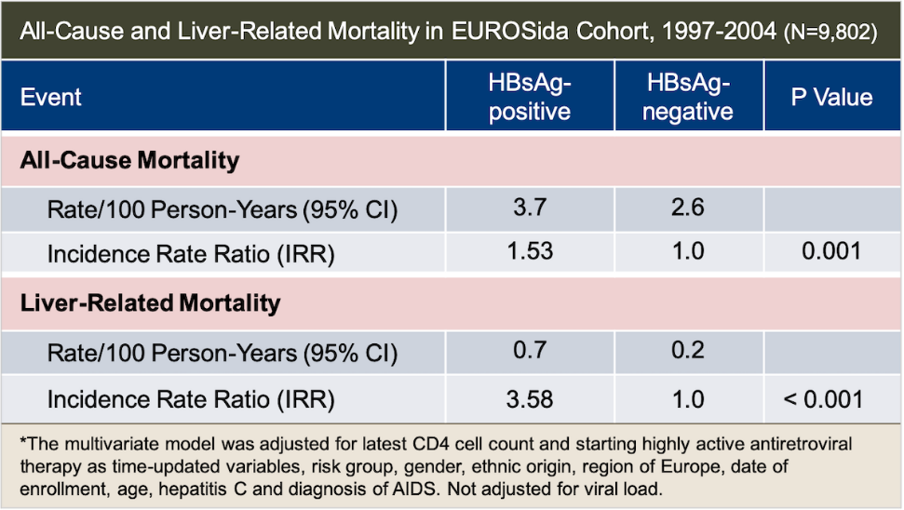
HIV-HBV coinfection
Higher HBV DNA
Lower ALT
< spontaneous HBeAg seroconversion
Accelerated progression of liver disease
Increased risk of HCC
Increased mortality
https://chip.dk/Research/Studies/EuroSIDA

Slide 10
Clinical Manifestations
Acute HBV infection is asymptomatic in approximately 70%
<1% of people with HBV infection develop fulminant hepatic failure
Symptoms: abdominal pain, nausea, vomiting, fever, arthralgias, jaundice
Incubation period:
  ~60 days (range 40–90 days) from exposure to onset of abnormal liver enzymes
  ~90 days (range 60–150 days) from exposure to onset of jaundice

Slide 11
Clinical Manifestations
Most people with chronic HBV infection are asymptomatic
Between 15% and 40% of people with chronic HBV infection will develop cirrhosis, hepatocellular carcinoma (HCC), or liver failure
Up to 25% of people will die prematurely from complications of chronic HBV infection

Slide 12
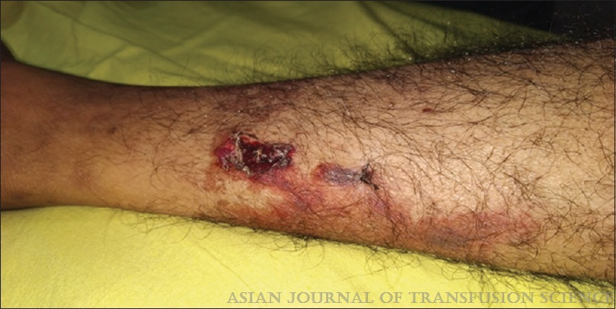
Case
A 44-year-old woman with HBsAg+ and negative HepC Ab presented with general malaise, fever, arthralgia and weight loss. Patient had purpura and large cutaneous ulcers as shown:
Polyarteritis nodosa (PAN)
Mixed cryoglobulinemia
Chronic spontaneous urticaria
Lichen planus
Others: Recurrent papular eruption of trunk and upper extremities, dermatomyositis like syndrome, erythema nodosum, leukocytoclastic vasculitis, pyoderma gangrenosum
Asian Journal of Transfusion Science 17(1):p 7-12,
Notes:
Circulating immune complexes
Glomerular disease: membranous nephropathy and, less often, membranoproliferative glomerulonephritis.

Slide 13
Diagnosis
Acute infection:
  Hepatitis B Surface Antigen (HBsAg) can be detected 4 weeks (range 1–9 weeks) after exposure
  Antibody to Hepatitis B Core Antigen (anti-HBc) immunoglobulin M is usually detectable at the onset of symptoms
Chronic HBV infection:
  Persistent HBsAg detected on two occasions at least 6 months apart

Slide 14
Serologic Evaluation of Hepatitis B
HBsAg | Anti-HBc total | IgM Anti-HBc | Anti-HBs | Diagnosis
NEG | NEG | NEG | NEG | No HBV
NEG | NEG | NEG | POS | Immune due to Vaccine
NEG | POS | NEG | POS | Immune due to HBV infection
POS | POS | POS | NEG | Acute HBV
POS | POS | NEG | NEG | Chronic HBV
NEG | POS | NEG | NEG | False positive Resolved infection Occult HBV
Notes:
Image from presenter

Slide 15
15

Slide 16
16

Slide 17
Patients who clear HBsAg
Patients who cleared HBsAg appeared to have a good prognosis
In the absence of other causes of liver injury, progression to cirrhosis and hepatic decompensation is rare
However, the risk of Hepatocellular Carcinoma (HCC) remains
Surveillance should continue in those who have Hepatitis C (HCV) or Hepatitis D (HDV) coinfection, cirrhosis, or are older than 50 years at the time of HBsAg clearance

Slide 18
Diagnostic Tests and Follow up
Baseline Liver Function Tests (LFTs), HBV DNA, Hepatitis B Viral Protein (HepBeAg) and Hepatitis B e Antibody Serum (anti-HepBe)
Staging of liver disease
Assess for Hepatitis C coinfection and Hep A immunization
Surveillance for HCC and other liver related complications: liver ultrasound preferred every 6 months
  HCC surveillance is considered cost‐effective if the annual risk of HCC is ≥0.2% per year. Therefore, all patients with cirrhosis and people with HIV warrant screening

Slide 19
Treatment
The Adult and Adolescent Antiretroviral Therapy (ART) Guidelines recommend treatment for all people with HIV/HBV coinfection, including pregnant people, regardless of CD4 count and HBV DNA level.
Therapy should be selected that includes drugs active against both HIV and HBV infections.
This is different from patients with only HBV (Treatment is based on HBV DNA, serum Alanine Aminotransferase (ALT) and severity of liver disease)

Slide 20
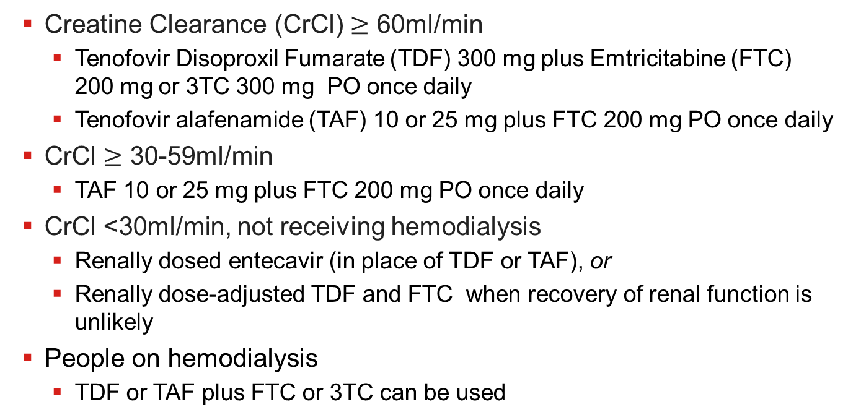
Preferred Therapies for people with HIV/HBV
Creatine Clearance (CrCl) $≥$ 60ml/min
  Tenofovir Disoproxil Fumarate (TDF) 300 mg plus Emtricitabine (FTC) 200 mg or 3TC 300 mg PO once daily
  Tenofovir alafenamide (TAF) 10 or 25 mg plus FTC 200 mg PO once daily
CrCl $≥$ 30-59ml/min
  TAF 10 or 25 mg plus FTC 200 mg PO once daily
CrCl <30ml/min, not receiving hemodialysis
  Renally dosed entecavir (in place of TDF or TAF), or
  Renally dose-adjusted TDF and FTC when recovery of renal function is unlikely
People on hemodialysis
  TDF or TAF plus FTC or 3TC can be used
Notes:
Lifelong treatment
Talk about people not on ART

Slide 21
21

Slide 22
22

Slide 23
23

Slide 24
Treatment Failure
Primary non-response (HBV DNA <1 log₁₀ decline) after 12 weeks of therapy
Increase in HBV DNA levels >1 log10 above nadir
Drug-resistant HBV if the patient is on 3TC/FTC monotherapy vs. non-adherence to therapy
If drug-resistant HBV is present, a change in treatment
3TC, LAM=lamivudine; FTC=emtricitabine

Slide 25
25
Notes:
LAM=lamivudine; TBV=telbivudine; ETV=entecavir; ADV=adefovir; TDF/TAF=tenofovir

Slide 26
26

Slide 27
HIV Increases the Risk of ESLD
MACS, 4,967 men
  HIV, 47%
  HBV, 6% (n=326)
  HIV/HBV, 4.3% (n=213)
HIV/HBV: 17-fold higher risk of liver death compared to HBV alone
  Alcohol
  Low CD4
  Increased risk after 1996
Thio C et al. Lancet 2002;360:9349.
27
Notes:
ESRD=end stage liver disease

Slide 28
HIV and HBV Co-infection
People with HBV/HCV/HIV coinfection appear to have accelerated liver fibrosis progression, high risk of HCC, and increased mortality, treatment for both HBV and HCV infection should be initiated.
If anti-HBV therapy must be discontinued, LFTs should be monitored every 6 weeks for 3 months, then every 3 to 6 months.
If a hepatic flare occurs after drug discontinuation, HBV therapy should be reinstituted.
Notes:
LFTs=liver function tests

Slide 29
People receiving immunosuppression
  If immunosuppressive therapy is given, HBV reactivation can occur. For people who are HBsAg-positive, treatment for HBV infection should be administered.
  People with isolated anti-HBc can either be monitored or be given prophylaxis to prevent reactivation depending on the degree of immunosuppression and whether HBV DNA is detectable.

Slide 30
Case
A 54 yo man with HBV/HIV coinfection is seen for follow up. He reports abdominal pain, nausea and vomiting. His urine is dark in color. He reports unprotected sex with men and women.
He was recently switched to dolutegravir-lamivudine due to increased creatinine from tenofovir alafenamide/emtricitabine/bictegravir.
What are you most concerned about?
→HBV reactivation

Slide 31
31

Slide 32
88% of the population was from Asia
HBV Genotype
A/D 22(20%) 33(30%)
B/C 84 (75%) 74 (68%)
https://www.natap.org/2022/IAC/IAC_29.htm; AIDS 2022, July 29-August 2, Montreal
32

Slide 33
Immunizations
Heplisav-B (Dynavax)
  Contains CPG 1019 adjuvant + 20 mcg Hepatitis surface antigen recombinant
  Two dose effective in immunocompetent patients
  Three dose regimen studied in those with Chronic Kidney Disease (CKD)
New Data in people with HIV

Slide 34
Immunization Recommendations
General population: HBV Vaccination recommended since 1980 for people at risk
People Living with HIV (PWH): recommended since 2006 for people living with HIV . However, there are low rates of completion.

Slide 35
Low Rates of Hepatitis B Vaccination
2009-2012 CDC: US
82% of patients that were candidates for HBV vaccination were not vaccinated
<10% PWH received 3-dose series in one year
Ann Intern Med. 2018 Feb 20;168(4):245-254
Jain, et al. CROI 2022

Slide 36
Post Vaccine Recommendations
Postvaccine testing for Hepatitis B Surface Antibodies (anti-HBs) should be performed 1 to 2 months after completing the final dose of the vaccine series
Titers of at least 10 mIU/mL are considered protective
Some experts recommend checking anti-HBs annually
If anti-HBs levels fall <10 mIU/L, experts suggest administering a booster HBV vaccine dose.
https://clinicalinfo.hiv.gov/en/guidelines/hiv-clinical-guidelines-adult-and-adolescent-opportunistic-infections/hepatitis-b-0?view=full
Notes:
Because of waning immunity, some experts would check anti-HBs annually and a booster dose would be given if levels fall below 10mIU/mL, particularly if a person has ongoing risk factors for acquiring HBV and is not receiving tenofovir.
Among people with HIV who did not respond (anti-HBs titers <10 mIU/mL) to a primary three dose vaccine series with a single-dose recombinant vaccine, 25% to 50% responded to an additional vaccine dose, and 44% to 100% responded to a three-dose revaccination series.⁷⁶⁻⁷⁹ As a result, people with HIV who do not respond to a complete HepB vaccination series with one of the recombinant vaccines should be revaccinated with three double doses of a recombinant HBV vaccine or with Heplisav-B (BIII),⁵⁶ although some specialists might delay revaccination until antiretroviral therapy (ART) results in a sustained increase in CD4 count (CIII).

Slide 37
Non-responders
  Revaccinate with a double-dose, 3-series with Engerix-B or Recombivax-HB given at 0, 1, and 6 months, or
  Revaccinate with a double-dose, 4-dose series with Engerix-B or Recombivax-HB given at 0, 1, 2, and 6 months, or
  Revaccinate with the two-dose series of Heplisav-B vaccine, or
  For persons with a CD4 count less than 200 cells/mm3, some experts would delay revaccination until after a CD4 count of 200 cells/mm3 or greater is achieved and sustained on antiretroviral therapy.

Slide 38
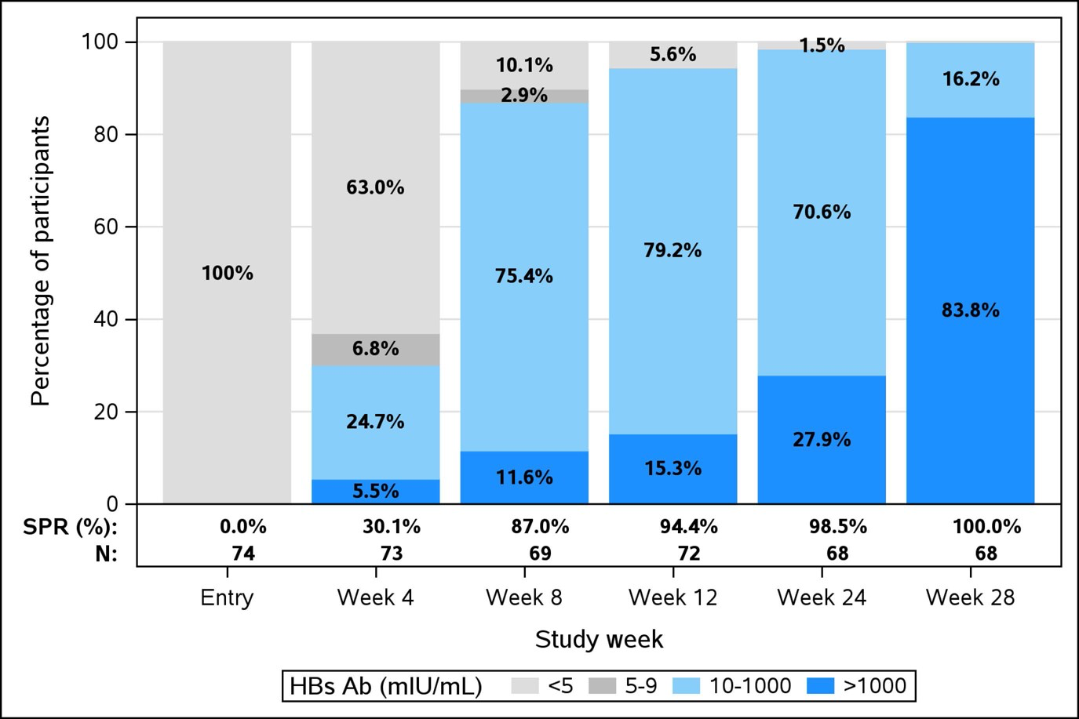
High HBsAb Seroprotection with
HepB-CpG Vaccine in People with HIV
Marks, et al. Open Forum Infectious Diseases, Volume 9, Issue Supplement_2, December 2022, ofac492.1872
Notes:
Kristen Marks, MD, MS and others, LB749. High HBsAb Seroprotection Achieved 4 Weeks after 3 doses of HepB-CpG Vaccine in People Living with HIV (PLWH) without Prior HBV Vaccination (ACTG A5379 Group B Preliminary Results), Open Forum Infectious Diseases, Volume 9, Issue Supplement_2, December 2022, ofac492.1872, https://doi.org/10.1093/ofid/ofac492.1872

Slide 39
Testing for other Hepatitis virus
If negative HepA IgG→ vaccinate
If positive Hepatitis C→ treat
HDV infection is associated with
    Increased liver disease severity
    More rapid of disease progression and early cirrhosis.
    Increased risk of HCC (up to 3x fold in HBV-cirrhosis)

Slide 40
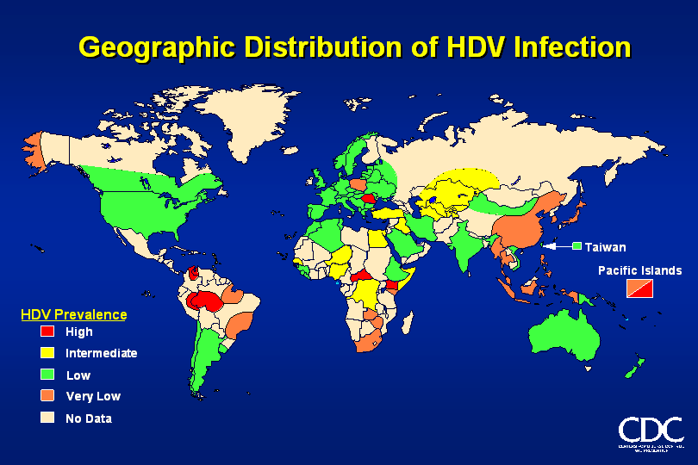
Hepatitis B and Hepatitis D
AASLD Guidelines: “test for HDV, in those at risk” which includes all individuals from HDV endemic areas and those with history of intravenous drug use
EASL Guidelines
APASL Guidelines
Low rates of testing by ID
Notes:
Hepatitis Delta Virus infections are found worldwide, but the prevalence varies in different geographical areas.
Worldwide, over 10 million people are infected with HDV.
Anti-HDV antibodies are found in 20-40% of HBsAg carriers in Africa, the Middle East, and Southern Italy.
HDV infection in the United States is relatively uncommon, except in drug addicts and hemophiliacs, who exhibit prevalence rates of 1-10%.
Homosexual men and health care workers are at high risk for contracting HBV.
Additional high-risk groups for contracting HDV include hemodialysis patients, sex contacts of infected individuals, and infants born to infected mothers (rare).

Slide 41
Thank you!
Questions?

Slide 42
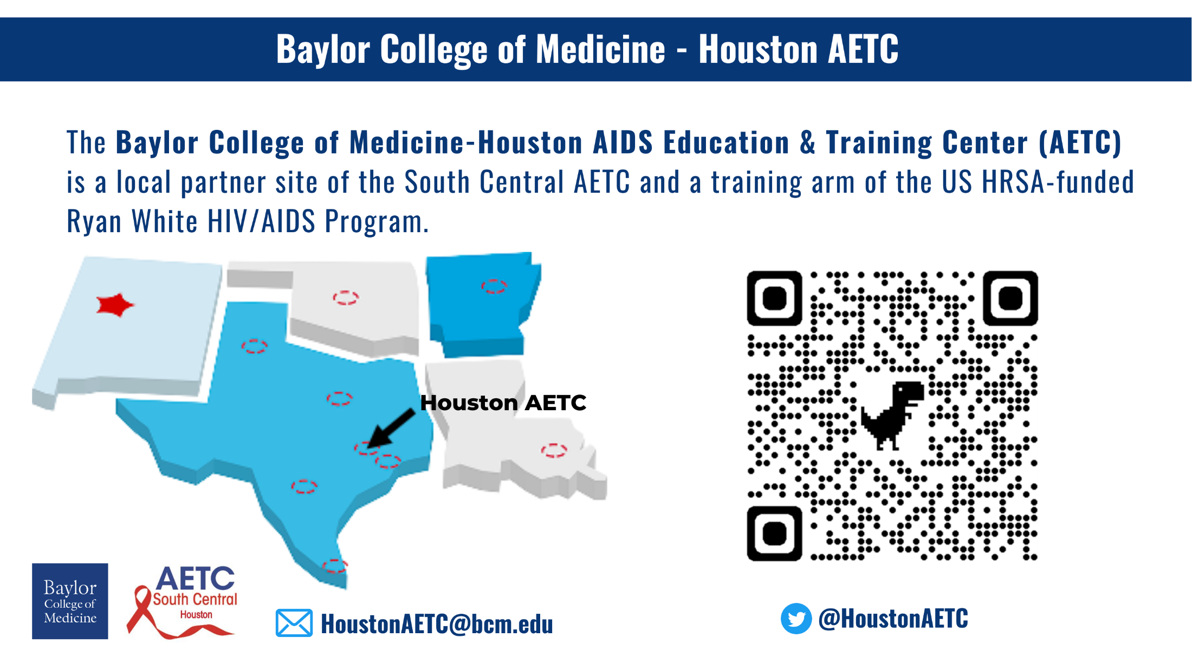

Slide 43
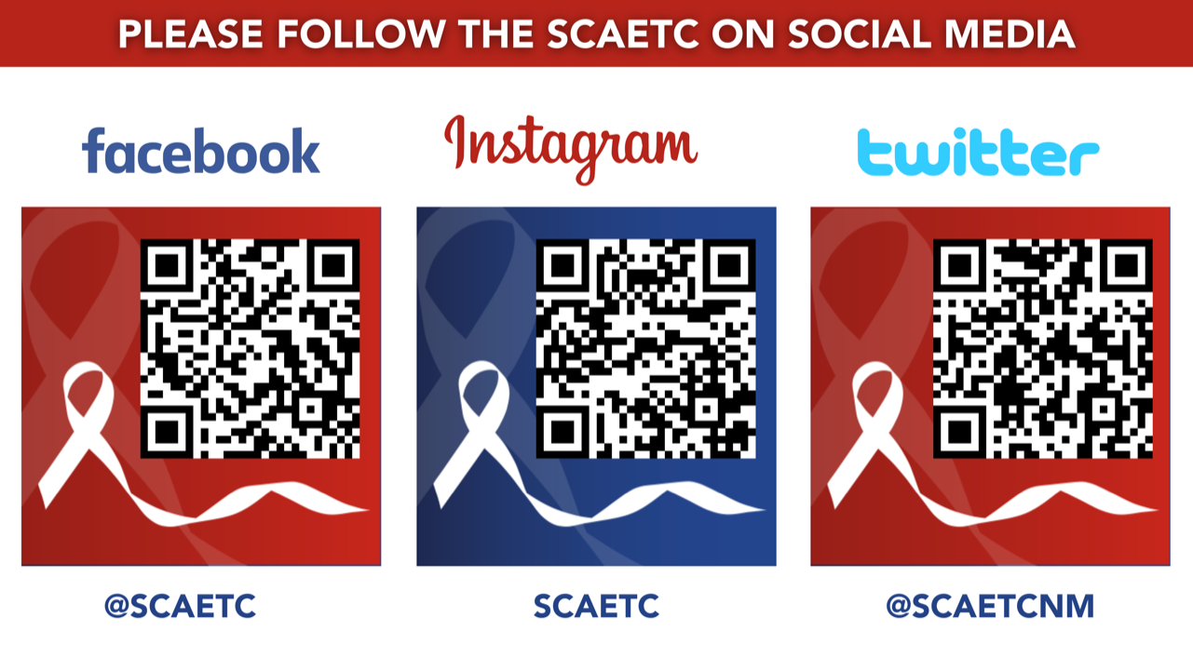
SCAETC Social Media

Slide 44
Resources
National Clinician Consultation Center http://nccc.ucsf.edu/
  HIV Management
  Perinatal HIV
  HIV PrEP
  HIV PEP line
  HCV Management
  Substance Use Management
Present case on ECHO https://hsc.unm.edu/scaetc/programs-services/echo.html
AETC National HIV Curriculum https://aidsetc.org/nhc
AETC National Coordinating Resource Center https://targethiv.org/library/aetc-national-coordinating-resource-center-0
Additional trainings scaetcecho@salud.unm.edu
www.scaetc.org
Notes:
Find an HIV-related topic TeleECHO in your area: https://echo.unm.edu/locations-2/echo-hubs-superhubs-united-states/
IDEA Platform: Infectious Diseases Education & Assessment. https://idea.medicine.uw.edu/
AETC National HIV Curriculum: 6 core modules for self study; regularly updated; CME, CNE
Hepatitis C Online Curriculum: https://www.hepatitisc.uw.edu/
Hepatitis B Online Curriculum: https://www.hepatitisb.uw.edu/
National STD Curriculum: https://www.std.uw.edu/
Clinical apps for HIV care https://aidsetc.org/resource/clinician-mobile-apps-hiv-related-care

