Slide 1
Pre-Survey
(Required for Continuing Medical Education (CME) Certified Nurse Educator (CNE) Continuing Education (CE)
https://forms.office.com/g/v7gcAZhpyk

Slide 2
Key CDC Updates to the STI Treatment Guidelines
Lucinda Lundy Zeinelabdin, MSN, APRN, FNP-C
Nurse Practitioner, Clinician Ambassador
Notes:
Version date_03 2023

Slide 3
Conflict of Interest Disclosure Statement
The presenter has no conflicts to declare.

Slide 4
Use of Trade/Brand Names
This program is supported by the Health Resources and Services Administration (HRSA) of the U.S. Department of Health and Human Services (HHS) as part of an award totaling $3,132,205, with 0% financed with non-governmental sources.
The views expressed do not necessarily reflect the official policies of the Department of Health and Human Services, nor does mention of trade names, commercial practices, or organizations imply endorsement by the U.S. Government. Any trade/brand names for products mentioned during this presentation are for training and identification purposes only.
Notes:
NOTE: THIS SLIDE MUST BE INCLUDED IF TRADE AND/OR BRAND NAMES FOR MEDICATIONS ARE USED IN THE PRESENTATION.
IT MAY BE DELETED IF THERE IS NO REFERENCE TO TRADE NAMES, INCLUDING PRESENTATIONS IN WHICH ONLY GENERIC MEDICATION NAMES ARE MENTIONED.
TRADE NAMES MUST BE PUT IN PARENTHESES AFTER THE GENERIC NAME THE FIRST TIME IT IS MENTIONED - E.G., FLUOXETINE (PROZAC). TRADE NAMES SHOULD ONLY BE MENTIONED FOR THE INITIAL REFERENCE AND THE GENERIC NAME ONLY SHOULD BE USED AFTER THAT. THIS APPLIES EQUALLY TO ALL MEDICATIONS OR PRODUCTS MENTIONED IN THIS PRESENTATION.

Slide 5
You Don’t Want to Miss These!
Upcoming CME/CNE Events for 2023
April – Syphilis Diagnosis and Treatment in Primary Care (CME/CNE)
May – Reducing Stigma in Primary Care Settings (CME/CNE)
June – “Let’s Talk About Sex” LGBTQIA+ Health & Taking a Sexual History Workshop (CME/CNE)
July – Hepatitis C for Primary Care

Slide 6
Learning Objectives
At the end of this presentation, learners will be able to:
Apply the 2021 Sexually Transmitted Infection (STI) Treatment Guidelines in the evaluation and treatment of Chlamydia, Gonorrhea, Trichomoniasis, Syphilis, HIV, Viral Hepatitis, Herpes, and HPV​
Determine the appropriate screening and testing recommendations for sexually transmitted infections based on the updated STI treatment guidelines
Implement Expedited Partner Therapy (EPT) as a best practice for optimal patient care​
Communicate HIV results in a way that decreases HIV stigma

Slide 7
Clinician Ambassador Overview
Clinician Ambassadors are a resource for clinicians in the San Antonio Metroplex, with an aim to improve public health through outreach and communication. We are available for in-person and virtual one-on-one and group discussions, educational presentations and assistance in implementing evidence-based practices. Please feel free to reach out by email or phone:
Lucinda Lundy Zeinelabdin, MSN, APRN, FNP-C
Nurse Practitioner, Clinician Ambassador
lucinda.zeinelabdin2@sanantonio.gov
Phone: 210-207-2407
Maria "Theresa" O'Carroll, RN
Registered Nurse, Clinician Ambassador
maria.ocarroll@sanantonio.gov
Phone: 210-207-2806
Provider Interest Form

Slide 8
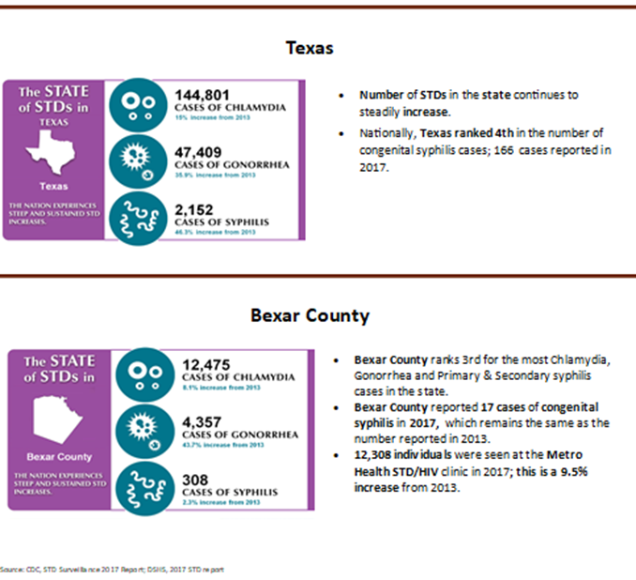

Slide 9
5 Strategies for Prevention and Control of STIs
Accurate risk assessment, education and counseling of people at risk on ways to avoid sexually transmitted infections (STIs) through changes in sexual behaviors and use recommended prevention services
Pre-exposure vaccination of people at risk for vaccine-preventable STIs
Identification of both symptomatic and asymptomatic people with STIs
Effective diagnosis, treatment, counseling, and follow up of people with infections
Evaluation, treatment, and counseling of sex partners of people with STIs
https://www.cdc.gov/mmwr/preview/mmwrhtml/rr6403a1.htm

Slide 10
Chlamydia & Gonorrhea

Slide 11
Screening for Chlamydia and Gonorrhea
Screen all sexually active women (esp. if pregnant) who are
24 years or younger regardless of risk factors or presence of symptoms
25 years or older and at increased risk for infection
NAAT (Nucleic Acid Amplification Test) preferred
Vaginal self-collection more accurate than urine
Consider extra genital (pharyngeal, rectal) testing based on risk factors; self-collection is acceptable
Free bathroom posters can be found here
Note: Extragenital testing is not always covered by insurance
(USPSTF, Sept. '21)
Notes:
What’s new?
This recommendation is consistent with the 2014 USPSTF recommendation.
Screen sexually active men if they have higher risk factors (men who have sex with men, high # of sex partners)
To whom does this recommendation apply?
Sexually active adolescents and adults, including pregnant persons, without signs and symptoms of chlamydia or gonorrhea infection.

Slide 12
Treatment

Slide 13
Treatment: Chlamydia
Doxycycline 100 mg orally twice a day for 7 days (assess tetracycline allergy)
Alternative:
Azithromycin 1 gm po x 1 (no longer routinely recommended), or
Levofloxacin 500 mg orally once daily for 7 days
Consideration of levofloxacin for patients with rectal infections as azithromycin may not be as effective in treating these infections
In pregnancy:
Azithromycin 1 g orally in a single dose
Alternative: amoxicillin 500 mg orally 3 times/day for 7 days

Slide 14
Chlamydia Treatment cont'd...
Test of cure to detect therapeutic failure is not advised for nonpregnant
people even with alternative regimens, unless therapeutic adherence is in question, symptoms persist, or reinfection is suspected
Test of cure in pregnancy is not recommended at <4 weeks due to potential false positives
Bloody discharge, perianal ulcers, or mucosal ulcers among people with acute proctitis and rectal chlamydia should be presumptively treated for LGV (Lymphogranuloma venereum) with extended doxycycline 100 mg po bid for 3 weeks
If painful perianal ulcers are present or mucosal ulcers are detected on anoscopy, presumptive therapy should also include a regimen for genital herpes

Slide 15
Treatment: Uncomplicated Gonococcal Infections of Cervix, Urethra, or Rectum Among Adults and Adolescents
Ceftriaxone 500 mg Intramuscular (IM) in a single dose for people weighing <150 kg.
For people weighing ≥150 kg, 1 g ceftriaxone should be administered
If chlamydial infection has not been excluded, treat for chlamydia, preferably with doxycycline 100 mg orally 2 times/day for 7 days
Dual therapy with azithromycin is no longer recommended*
During Pregnancy
Treat N. gonorrhoeae with ceftriaxone 500 mg in a single IM dose plus treatment for chlamydia, if infection has not been excluded

Slide 16
Uncomplicated Gonococcal Infection of the Pharynx
Ceftriaxone 500 mg* IM in a single dose for persons weighing <150 kg
For persons weighing ≥150 kg, 1 g ceftriaxone should be administered.
Follow up and test of cure with either culture or Nuceic Acid Amplification Test (NAAT) should occur 7–14 days after initial treatment; testing at 7 days may increase likelihood of false-positive NAAT
A test of cure is unnecessary after a diagnosis of uncomplicated urogenital or rectal gonorrhea even with alternative regimens unless therapeutic adherence is in question, symptoms persist, or reinfection is suspected.

Slide 17
Antimicrobial Resistance: Gonorrhea
Why did the treatment for gonorrhea change?
Appropriate use of antimicrobials is a major public health concern
Increase in azithromycin and ceftriaxone-resistant gonorrhea
Pharmacokinetic and pharmacodynamic considerations, especially with pharyngeal gonorrhea
Potential harm to the microbiome with dual therapy
For patients who present with proctocolitis and who have been treated, consider sexually transmissible enteric pathogens – Shigella and Campylobacter

Slide 18
Expedited Partner Therapy (EPT)

Slide 19
Overview
The clinical practice of treating the sex partners of patients diagnosed with chlamydia or gonorrhea by providing prescriptions or medications to the patient to take to his/her partner without the health care provider first examining the partner
EPT is legal in Texas
Recommended for chlamydia and gonorrhea infections
Use shared decision-making in men who have sex with men
Not recommended for Syphilis
Not recommended for trichomoniasis (lack of supporting evidence) – partners of those diagnosed should be referred for presumptive treatment
Concurrent treatment of partners is recommended to prevent reinfection
Notes:
https://www.dshs.texas.gov/sites/default/files/hivstd/ept/DearProviderEPT2022.pdf
DSHS Dear provider letter re: EPT issued in November 2022 (link above)

Slide 20
EPT Documentation
Do not write the names of partners receiving EPT in the index client health record
Sexual partners do not need a health record to get EPT
Document the following in the index client health record:
Number of partners receiving EPT
Medication and dose received
Whether partner(s) are pregnant or allergic to antibiotics (If known)
Keep a log that documents:
Date
Index client name
Date of birth
Name of medication and strength
Number of doses
National Drug Code (NDC), lot number and expiration date

Slide 21
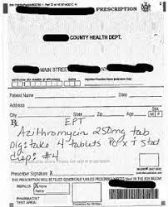
EPT Paper Prescription Example
Source: https://www.health.ny.gov/health_care/medicaid/program/update/2019/2019-04.htm

Slide 22
EPT Treatment of Gonorrhea Infections*
Oral EPT can be used to treat partners of patients diagnosed with gonorrhea
Give patient ceftriaxone IM, and give partner a single dose of oral cefixime 800 mg
If a chlamydia test result has not been documented, treat with oral cefixime regimen PLUS oral doxycycline 100mg BID x 7 day
*EPT may consist only of oral medications
https://www.cdc.gov/std/ept/gc-guidance.htm

Slide 23
Trichomoniasis

Slide 24
Screening Women
Test all women who seek care for vaginal discharge
Annual screening should be considered in:
Women with prior STIs, including HIV
Asymptomatic women at high risk for infection
Multiple sex partners
Transactional sex or sex work
Drug use
History of incarceration
Current partners should be referred for presumptive therapy
Advise to abstain from intercourse until patient and partners have been treated (concurrently, if possible) and any symptoms have resolved
Notes:
Risk factors:

Slide 25
Trichomoniasis in Women with HIV
Up to 53% of women with HIV have T. vaginalis infection
T. Vaginalis is associated with Pelvic Inflammatory Disease (PID) in women with HIV
In non-virally suppressed women with HIV, treatment of trichomoniasis is associated with decreased viral load and viral shedding
Can reduce transmission to partners
Decreases vertical transmission of HIV to baby in pregnancy
Routinely screen non-pregnant women with HIV at entry to care and annually afterward
Routinely screen pregnant women with HIV at the first prenatal visit
Notes:
Benefits of routine screening of asymptomatic pregnant women has not been established

Slide 26
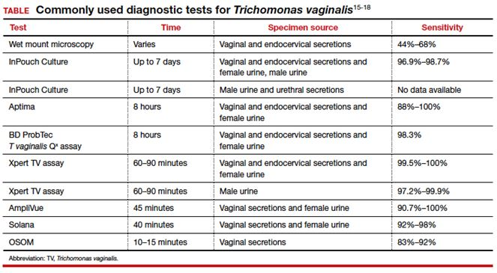
Diagnostic Tests
Notes:
Diagnostic testing among men with recurrent or persistent symptoms, including those with gonorrhea, chlamydia, M. genitalium, and trichomoniasis, can be used to
guide further management decisions

Slide 27
Treatment
Vaginal Trichomoniasis
Metronidazole 500 mg orally 2 times/day for 7 days
Reduces by half the number of women retesting positive, compared with single dose
No longer recommending vaginal gel due to lower efficacy
Urethral Trichomoniasis in Men
Metronidazole 2 g orally in a single dose
When managing recurrent Non-Gonococcal Urethritis (NGU), include presumptive treatment for trichomoniasis*
Alternative Regimen (regardless of gender)
Tinidazole 2 g orally in a single dose
Notes:
**Treatment is the same for women w/HIV
** Metronidazole crosses the placenta, but there is low risk to the fetus – benefit may outweigh risk in pregnancy
***recurrent of persistent NGU

Slide 28
When to Follow Up with Your Patients
Ask patients with diagnosed chlamydia, gonorrhea, or trichomoniasis to return in 3 months for repeat testing to detect possible re-infection, especially if the partner may not have been treated.
Notes:
Gonorrhea retest = test of cure

Slide 29
Syphilis

Slide 30
General Screening Recommendations
As San Antonio remains in a syphilis epidemic, syphilis screening should occur in the following situations:
Anytime a patient requests STI testing
Anytime a patient tests positive for another STI (if syphilis testing was not performed)
Notes:
**Screen asymptomatic adults at increased risk (hx of incarceration, transactional sex or sex work, geography, race/ethnicity Or male younger than 29 years) for syphilis infection. -CDC 2021 GL
Men accounted for 90.8% of all cases in 2014, Men aged 20-29 had highest prevalence rate – 3x higher than average population – USPFTS
Highest risk ethnic groups (primary and secondary syphilis) – AA = 18.9 cases per 100k, hispanic 7.6 per 100k, American Native/Alaskan Native 7.6 per 100k, Hawaiian/PI 6.5/100k, white 3.5/100k, asian 2.8/100k - USPFTS 2016 Recommendations
USPSTF gives A grade to screening for syphilis in asymptomatic, non-pregnant adults and adolescents who are at high risk – 2016 recommendation, and updated recommendation is in process
Frequency? Per the USPFTS – the optimal screening frequency for persons at increased risk for infection is not well established. MSM or PLWHIV – may benefit from more frequent screening – initial studies suggest detection improved among these groups when screening is performed q3mo. CDC and USPSTF do not make a recommendation regarding screening frequency among asymptomatic adults

Slide 31
Syphilis Screening Among Pregnant Persons
As of September 1, 2019, Texas Health and Safety Code §81.090 mandated syphilis screening:
At first prenatal care examination
During third trimester (between 28 and 32 weeks)
At delivery
CDC recommends that women who experience a stillbirth after
20 weeks be tested for syphilis
It's the law!
Notes:
Be sure that you (provider) are documenting any negative syphilis results in the chart – if the patient turns up positive at delivery or congenital syphilis case is suspected, documentation of the previous negative tests will be beneficial to you and to the health department.

Slide 32
Syphilis Screening Among Special Populations
Adolescents- Routine screening of asymptomatic adolescents and young adults who are not at increased risk is typically not recommended
Transgender and Gender Diverse Populations- Screening should be conducted based on the patient's current anatomy and sexual practices
Persons In Correctional Facilities- Opt-out screening should be conducted based on the local and institutional prevalence of early infectious syphilis
Early includes primary, secondary, and early latent syphilis
Notes:
More frequent screening for MSM or PLWHIV (as often as q3-6mo) is recommended by the USPSTF and CDC guidelines

Slide 33
Syphilis Staging
Primary (chancre stage): 10-90 days after innoculation
Latent (the silent stage)
Late latent – infection acquired more than 12 months ago
Tertiary (the imprint stage- the disease leaves its mark on organ systems)
Neurosyphilis (can occur at any stage)
Typically presents as a single, painless ulcer or chancre at the site of inoculation
May also present as multiple, painful, atypical lesions
Secondary (rash stage): 0-7 months after primary lesion onset
Presents as skin rashes, mucocutaneous lesions, warts, alopecia
Classically a palmar/plantar rash
No symptoms of either the primary or secondary stages. Positive serology
Early latent – infection acquired within the previous 12 months
Unknown duration – treated the same way as late latent
Now rare. May present with lesions called gummas, cardiac or other organ involvement
Ocular, otic, meningovascular, meningitis
Notes:
*OBGYN only slide
Primary lesions usually located on genitals, anus or oral cavity, depending on location of contact
Remember – neurosyphilis can occur at ANY stage, so a neuro screening should always be a part of your assessment in patients with syphilis

Slide 34
Syphilis Treatment - Adults
Primary and Secondary Syphilis
Benzathine penicillin G 2.4 million units intramuscular (IM) in a single dose
Early Latent Syphilis
Benzathine penicillin G 2.4 million units IM in a single dose
Available data demonstrate that additional doses of penicillin or other antibiotics in early latent syphilis do not enhance efficacy
Alternative for Primary, Secondary, Early Latent
Doxycycline 100 mg po bid x 2 weeks
Late Latent Syphilis or Syphilis of Unknown Duration
Benzathine penicillin G 7.2 million units total, administered as 3 doses of 2.4 million units IM each at 1-week intervals
Alternative: Doxycycline 100 mg po bid x 4 weeks (if non-pregnant)
Notes:
Available data indicate that the majority of persons with HIV respond appropriately to the recommended doses of Benzathine Penicillin G. Additional doses of Benzathine PCN G or other antibiotics do not result in enhanced efficacy in treating persons with HIV and primary or secondary syphilis
Neurosyphilis, Otosyphilis, Ocular Syphilis – if suspected, patient should be referred for CSF examination and possible LP confirmation or to
Treatment = Aqueous crystalline penicillin G 18–24 million units per day, administered as 3–4 million units IV every 4 hours or continuous infusion, for 10–14 days
Ocular – these patients require full ocular examination, including cranial nerve exam – if CN exam abnormal, CSF exam needed
Oto – suspect if otologic symptoms or hearing loss – include CN exam (esp CN8) – if CNS exam is normal, CSF is not recommended before treatment. Collab with otorolygologist and treat.
Neuro – If CNS exam reveals clinical evidence of neurologic involvement, CSF exam should be performed prior to treatment

Slide 35
Syphilis Treatment cont'd...
Pregnant Women–Treat with the same recommended penicillin regimen as non-pregnant women based on the stage of infection
New treatment window for syphilis during pregnancy is 7-9 days between doses
Patient needs to restart if they come earlier or later than the new timeframe
Penicillin G is the only known effective antimicrobial for treating fetal infection and preventing congenital syphilis
People with HIV- Should be treated with the same recommended penicillin regimen as those without HIV, based on the stage of infection.
Additional doses of penicillin or other antimicrobials are not recommended in this group
Notes:
* Available data indicate that the majority of persons with HIV respond appropriately to the recommended doses of Benzathine Penicillin G. Additional doses of Benzathine PCN G or other antibiotics do not result in enhanced efficacy in treating persons with HIV and primary or secondary syphilis
* CDC states that there is certain evidence that indicates that additional therapy in the form of a second dose of Benzathine PCN G 2.4M units may be beneficial for pregnant women to prevent congenital syphilis, in primary, secondary or early latent syphilis – this dose should be given 1 week after initial dose.

Slide 36
Penicillin Allergy

Slide 37
Special Considerations for Penicillin Allergy
Nonpregnant, penicillin-allergic persons who have primary or secondary syphilis: Regimens of doxycycline 100 mg orally twice daily for 14 days and tetracycline (500 mg four times daily for 14 days) have been used for many years
Only acceptable alternatives for the treatment of latent syphilis are doxycycline (100 mg orally twice daily) or tetracycline (500 mg orally four times daily), each for 28 days
Pregnant women with primary or secondary syphilis who are allergic to penicillin should be desensitized and treated with penicillin G

Slide 38
HIV

Slide 39
Screening
CDC and USPSTF recommend HIV screening at least once for all persons aged
15-65 years
HIV testing is recommended for all persons seeking STI evaluation who are not already known to have HIV infection
Testing should be routine at the time of the STI evaluation, regardless of whether the patient reports any specific behavioral risks for HIV
Persons at higher risk for HIV acquisition should be screened for HIV at least annually
Providers can consider the benefits of offering more frequent screening (e.g., every 3–6 months) based on risk factors
Opt-out HIV screening is recommended in all health care settings
Notes:
Why does this matter to you? – You may be the only provider a patient sees in a year or years, and therefore the only opportunity to get the patient tested

Slide 40
Screening cont'd...
HIV screening should be voluntary and free from coercion
Patients should not be tested without their knowledge
Requirement of specific signed consent for HIV testing is not recommended
General informed consent for medical care is considered sufficient to encompass informed consent for HIV testing
Those whose HIV test results are negative and are at higher risk to acquire HIV, should be offered HIV PrEP (pre-exposure prophylaxis) – including adolescents who are at risk
Daily oral antiretroviral PrEP with a fixed-dose combination of emtricitabine (FTC) and either tenofovir disoproxil fumarate (TDF) or tenofovir alafenamide (TAF)
Demonstrated safety and 99% reduction in the rate of HIV acquisition
All sexually active adults and adolescents should be informed about PrEP
Notes:
*December 2021 – CDC recommended sexually active adolescents at substantial risk of HIV acquisition should be offered PrEP
*Further – All sexually active adolescent patients should receive information about PrEP

Slide 41
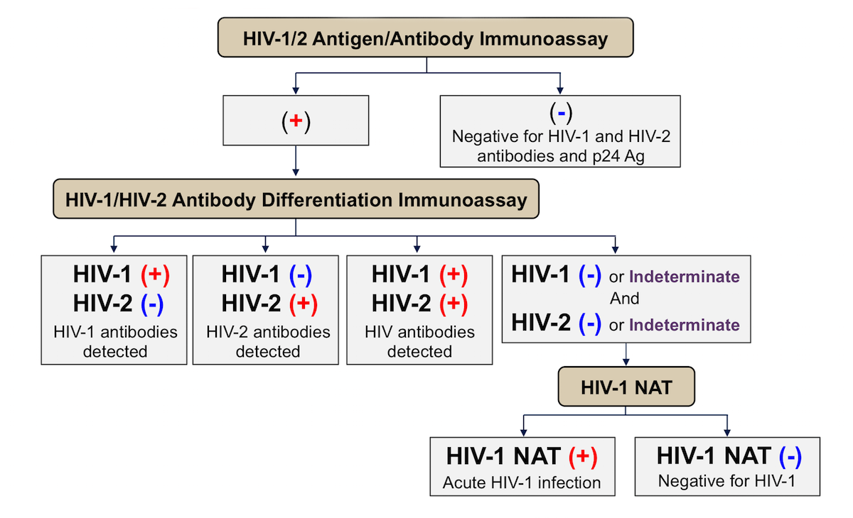
HIV Testing Algorithm
Notes:
HIV Agorithm-https://stacks.cdc.gov/view/cdc/50872

Slide 42
Treatment
ART (Antiretroviral Treatment) should be initiated as soon as possible for all persons with HIV infection regardless of CD4+ T-cell count, both for individual health and to prevent HIV transmission
Persons with HIV infection who achieve and maintain a viral load suppressed to <200 copies/mL with ART have no risk for sexually transmitting HIV
Provide prevention counseling to persons with diagnosed HIV infection
Provide additional counseling, either on-site or through referral, about the psychosocial and medical implications of having HIV infection
Assess the need for immediate medical care and psychosocial support

Slide 43
Communicating Test Results
Deliver results privately and in-person if possible
For rapid tests, explain that a confirmatory test is needed
HIV treatment works (U=U)
HIV prevention works
PrEP is 99% effective at preventing HIV
PEP (post-exposure prophylaxis) is at least 80% effective
HIV is a chronic health condition, not a death sentence
HIV stigma affects well-being of patients
RAPID Start Calendar
Notes:
Presenter Notes-
Stigma-Free guidelines were created based on patient's feedback
Almost 30% of people with HIV are lost to care after diagnosis, and some of that has to do with how they receive the news in the first place
Rapid Start-
Some clinics will accept even with rapid test result, others require confirmatory test
Explain that Metro Health will be reaching out
Not all patients can reach U=U due to other health conditions

Slide 44
Viral Hepatitis

Slide 45
Hep A Screening
Routine screening not recommended
Recommended only for those with higher risk factors
Men who have sex with men

Slide 46
Hep B Screening Recommendations (CDC, USPSTF)
Test for HBsAg during each pregnancy - preferably in the first trimester.
People who inject drugs (PWID)
Test for HBsAg, as well as for anti-HBc or anti-HBs to identify susceptible persons.
ALL pregnant persons (USPSTF A)
Men who have sex with men (MSM)
At delivery* (no documented testing, no PNC)
Test for HBsAg, as well as for anti-HBc or anti-HBs to identify susceptible persons.
Test for HBsAg, as well as for anti-HBc or anti-HBs to identify susceptible persons.
Was born in the US and not vaccinated in the US, if parents from country with > 8% endemicity
Was born outside of the US in country with > 2% endemicity of HBsAG
Has been exposed to body fluids of someone with Hepatitis B
Is a household contact, shares needles or has sex with persons who have tested positive for HBsAG
Infants born to mothers who test positive
Any person who
Persons with HIV (PWH)
Source: CDC.gov
Notes:
https://www.cdc.gov/hepatitis/hbv/pdfs/SerologicChartv8.pdf
*at delivery if no test results available or no PNC

Slide 47
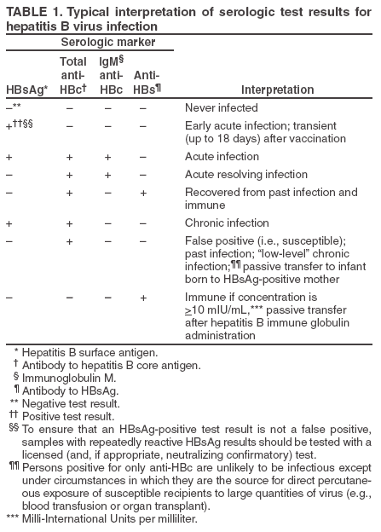
Hepatitis B Serology Interpretation
Source: https://www.cdc.gov/mmwr/preview/mmwrhtml/rr5416a1.htm#tab1
Notes:
https://www.cdc.gov/hepatitis/hbv/pdfs/SerologicChartv8.pdf

Slide 48
Hepatitis C Screening
Hepatitis C screening at least once in a lifetime for all adults aged 18 years and older
In Texas, the prevalence is estimated to be 1.8% overall, with South Texas having the state's highest rates.
As of 2021, CDC, ACOG and Texas DSHS all recommend testing during each pregnancy
Hepatitis C testing should be initiated with an FDA‑approved anti‑HCV test. People testing anti‑HCV positive/reactive should have follow-up testing with an FDA‑approved nucleic acid test (NAAT) for detection of HCV RNA
Notes:
Presenter Note-
Only acute Hep C, not chronic Hep C, is reportable, so we don’t have all the data we’d like

Slide 49
Hepatitis Prevention and Treatment

Slide 50
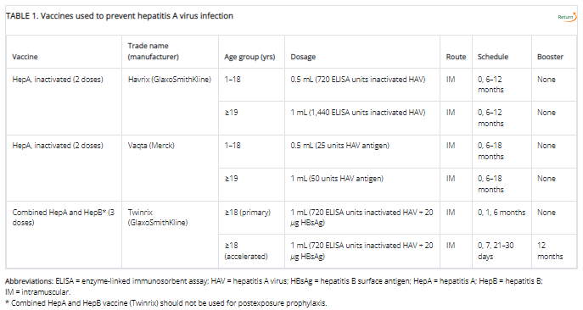
Hepatitis A (HAV) Vaccines
Source: https://www.cdc.gov/mmwr/volumes/69/rr/rr6905a1.htm#T1_down

Slide 51
Hepatitis A Vaccine Recommendations
Children
All children ages 12-23 months
Unvaccinated children and adolescents 2-18 years
Persons at increased risk for HAV infection
MSM
International travelers
Persons at risk for severe disease from HAV
Persons with chronic liver disease
Others
PWID
Occupational risk
Persons experiencing homelessness
Persons with HIV
Pregnant women at risk for HAV or severe HAV
Anyone requesting vaccination
Souce: https://www.cdc.gov/mmwr/volumes/69/rr/rr6905a1.htm#T1_down

Slide 52
Hepatitis B
Continued recommendation that vaccination be offered to people seeking STI care at STI clinics or other clinical settings
All people with HBV infection should be tested for other STIs
Two products have been approved for HBV prevention:
Hepatitis B immune globulin (HBIG) for PEP and
Hepatitis B vaccine

Slide 53
Hepatitis C
HEP C IS CURABLE!
Prior authorization changed effective Sept. 1, and there is no more requirement for drug screenings for those on Medicaid for their Hep C Antiviral Medication
Texas Vendor Drug Program Form
Two of the three Medicaid therapies are pan genotypic, so genotyping usually not needed
FIB-4 (Fibrosis) score often can be used in lieu of Fibroscan or biopsy. Learn more here

Slide 54
Herpes Simplex Virus 1 & 2 (HSV)

Slide 55
Screening
Test when lesions are present
FDA cleared PCR-based HSV tests are sensitive and specific
Can distinguish HSV-1 from HSV-2
The trouble with blood tests:
Positive predictive value is only 50%
Due to low accuracy, CDC recommends two-step testing: If HSV EIA (enzyme immunoassay) is positive, confirm with a Biokit or Western blot—neither of which is readily available. Do not confirm with HerpesSelect HSV-2 immunoblot, which uses the same antigen as the HSV-2 EIA
IgM testing: Not recommended because it isn't type-specific and can be positive in recurrent episodes
Limited cases where EIA might be useful:
Recurrent or atypical genital symptoms or lesions with a negative HSV PCR or culture result
Clinical diagnosis of genital herpes without laboratory confirmation
Patient’s partner has genital herpes
Not Useful- Screening of the general population

Slide 56
Recommended Antiviral Treatment (no change since 2015)
First Clinical Episode, Genital HSV
Acyclovir 400 mg orally 3 times/day for 7–10 days
Famciclovir 250 mg orally 3 times/day for 7–10 days
Valacyclovir 1 g orally 2 times/day for 7–10 days
Treatment can be extended if healing is incomplete after 10 days of therapy.
Acyclovir 200 mg orally 5 times/day is also effective but is not recommended because of the frequency of dosing

Slide 57
Recommended Antiviral Treatment (no change since 2015)
Suppression of Recurrences
Acyclovir 400 mg orally 2 times/day or
Valacyclovir 500 mg orally once a day*
Valacyclovir 1 g orally once a day
Famciclovir 250 mg orally 2 times/day
Valacyclovir 500 mg once a day might be less effective than other valacyclovir or acyclovir dosing regimens for persons who have frequent recurrences (i.e., ≥10 episodes/year)

Slide 58
Recommended Antiviral Treatment cont'd...
Suppression of Recurrent Genital Herpes Among Pregnant Women
Acyclovir 400 mg orally 3 times/day or Valacyclovir 500 mg orally 2 times/day
Starting at 36 weeks’ gestation
Additional regimens exist for daily suppression for people with HIV (See guidelines)
Notes:
**Per aafp.org – for pregnant women with recurrent herpes, suppressive therapy should be offered at 36 weeks.
Urgent care providers – you may be seeing a pregnant patient who has not been previously diagnosed – if this is the case, the standard of care is to treat them – remember that timing is important for the effectiveness of the treatment, and the medication is Cat B for pregnancy.

Slide 59
Recommended Antiviral Treatment cont'd...
Episodic Therapy for Recurrent HSV-2
Acyclovir 800 mg orally 2 times/day for 5 days, or 800 mg orally 3 times/day for 2 days
Famciclovir 1 g orally 2 times/day for 1 day; or 500 mg orally once, followed by 250 mg 2 times/day for 2 days; or 125 mg orally 2 times/day for 5 days
Valacyclovir 500 mg orally 2 times/day for 3 days; or 1 g orally once daily for 5 days
Acyclovir 400 mg orally 3 times/day for 5 days is also effective but not recommended because of frequency of dosing
Notes:
**Per aafp.org – for pregnant women with recurrent herpes, suppressive therapy should be offered at 36 weeks.
Urgent care providers – you may be seeing a pregnant patient who has not been previously diagnosed – if this is the case, the standard of care is to treat them – remember that timing is important for the effectiveness of the treatment, and the medication is Cat B for pregnancy.

Slide 60
Human Papillomavirus (HPV)

Slide 61
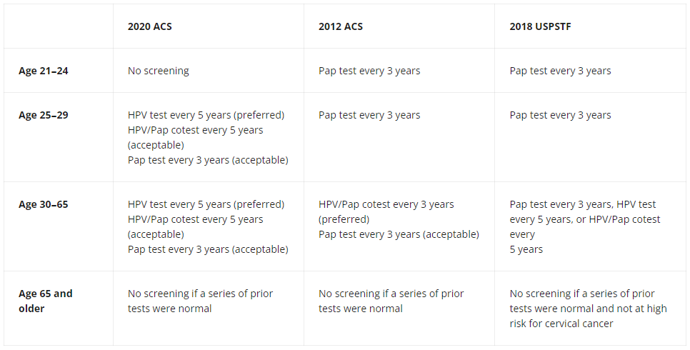
HPV Screening Recommendations
Source: https://www.cancer.gov/news-events/cancer-currents-blog/2020/cervical-cancer-screening-hpv-test-guideline#:~:text=ACS%20recommends%20cervical%20cancer%20screening,Pap%20test%20every%203%20years.
Notes:
USPSTF recommendation is currently being updated
https://www.uspreventiveservicestaskforce.org/uspstf/recommendation/cervical-cancer-screening

Slide 62
Prevention
Routine HPV vaccination for all adolescents at age 11 or 12 years (can start as early as 9 years)
Catch-up vaccination through age 26 years
No blanket recommendations for adults aged >26 years
Instead, shared clinical decision-making between a patient and a provider is recommended for certain adults aged 27–45 years not vaccinated previously
Effectiveness is low for people who are already sexually active
A 2-dose vaccine schedule (at 0- and 6- to 12-month intervals) is recommended for persons who initiate vaccination before their 15th birthday
A 3-dose vaccine schedule (at 0-, 1–2-, and 6-month intervals) who initiate on or after their 15th birthday or for immunocompromised persons regardless of age of initiation
Notes:
Starting vaccines at age 9 usually due to risk factors – i.e. hx of abuse etc.

Slide 63
Resources & References
Subscribe to DOCALERT!
For health alerts from Metro
Health text "DOCALERT" to
1-844-824-COSA (2672)
Message and data rates apply
2021 CDC STI Treatment Guidelines
CDC 2021 PREP Guidelines
2020 Hepatitis C Screening Guidelines
SA Metro Health STI Services
Hepatitis C ECHO UT Health San Antonio
End Sigma End HIV Alliance of SA
National HIV Curriculum
Fighting HIV Stigma to End the Epidemic: Evidence Based Solutions for Healthcare in Texas
Hepatitis C in Texas
EPT Legal in Texas
EPT Implementation Guide
NeedyMeds
USPSTF Cervical Cancer Screening Recommendations

Slide 64
Post-Survey
(Required for CME/CNE)
https://forms.office.com/g/cQj9BMg9Qy

Slide 65
Resources
National Clinician Consultation Center http://nccc.ucsf.edu/
HIV Management
Perinatal HIV
HIV PrEP
HIV PEP line
HCV Management
Substance Use Management
AETC National HIV Curriculum https://aidsetc.org/nhc
AETC National Coordinating Resource Center https://targethiv.org/library/aetc-national-coordinating-resource-center-0
Notes:
Find an HIV-related topic TeleECHO in your area: https://echo.unm.edu/locations-2/echo-hubs-superhubs-united-states/
IDEA Platform: Infectious Diseases Education & Assessment. https://idea.medicine.uw.edu/
AETC National HIV Curriculum: 6 core modules for self study; regularly updated; CME, CNE
Hepatitis C Online Curriculum: https://www.hepatitisc.uw.edu/
Hepatitis B Online Curriculum: https://www.hepatitisb.uw.edu/
National STD Curriculum: https://www.std.uw.edu/

Slide 66
Thank you. Questions?
lucinda.zeinelabdin2@sanantonio.gov

Slide 67
SCAETC Social Media

