Slide 1
Resilience In Providers
Dr. Maurice Brownlee
DBA, MBA, AGNP-C
Chief Wellness Officer & Medical Director
The Wellness Homes of Chicago
Notes:
Version date 6/2023

Slide 2
Conflict of Interest Disclosure Statement
Speaker has nothing to disclose
This program is supported by the Health Resources and Services Administration (HRSA) of the U.S. Department of Health and Human Services (HHS) as part of an award totaling $3,132,205, with 0% financed with non-governmental sources. The views expressed do not necessarily reflect the official policies of the Department of Health and Human Services, nor does mention of trade names, commercial practices, or organizations imply endorsement by the U.S. Government. Any trade/brand names for products mentioned during this presentation are for training and identification purposes only

Slide 3
Learning Objectives
Recognize burnout and compassion fatigue in HIV providers.
Identify common factors of resilience.
Differentiate resilience in providers, resilience focused HIV care systems, and resilience in people with HIV (PWH).

Slide 4
Resilience-Focused HIV Care
Does Resilience-Focused HIV Care + Resilience in PWH = Resilience in HIV Providers?

Slide 5
Resilience in Provider
The relationship…
“Can we have one without the other?”
Resilience-Focused HIV Care
Resilience in HIV Provider
Resilience in the PLWH

Slide 6
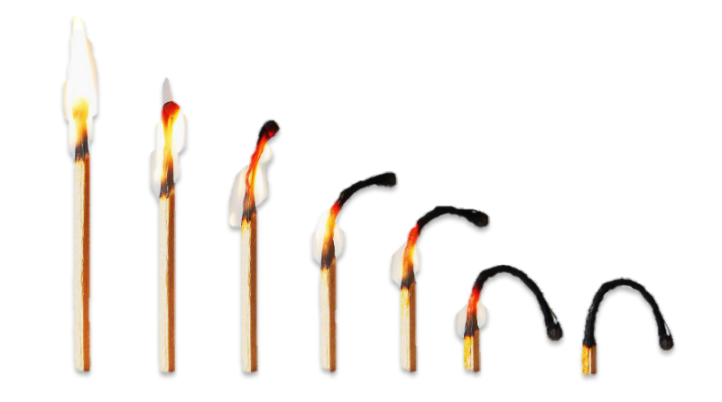
Resilience in Providers
Fatigue + Burnout
as Constructs

Slide 7
Resilience in Providers: Fatigue +Burnout
Compassion Fatigue and Burnout as constructs of provider resilience.
Compassion fatigue and burnout are constructs attributed to providers lacking resilience—those who are unable to “bounce back” following exposure to primary or secondary trauma.

Slide 8
Resilience in Providers: Fatigue +Burnout
Burnout
Condition resulting from difficult work conditions, which includes emotional exhaustion, cynicism, and reduced professional efficacy (Maslach et al. 2001).
Compassion Fatigue
Gradual lessening of compassion over time, resulting from a combination of burnout and secondary traumatic stress related to vicarious traumatization from repeated exposure to traumatic material (Figley 2002).

Slide 9
Resilience in Providers: POP
Burnout and Compassion Fatigue are multidimensional and negatively impacts providers, the organization and patients ‘POP’.
Providers- leads to higher rates of depression, anxiety, sleep problems, impaired physical health, increased substance use, impaired memory, and distrust in others.
Organization- negative economic outcome as a results of patient satisfaction, negative reviews, poor reputation, employee retention, and etc.
Patients-distrust in provider and health care system, leads to worse health behaviors (e.g., lower HIV medication adherence, poorer clinic attendance).

Slide 10
Resilience in PWH

Slide 11
Resilience in PWH
People living with human immunodeficiency virus (PWH) face numerous adversities:
Individually- (e.g., trauma),
Interpersonally (e.g., stigma), and at the
Neighborhood (e.g., socioeconomic deprivation and violence) levels.

Slide 12
Resilience in PWH
Resilience in PWH is described as positive psychological, behavioral, and/or social adaptation in the face of stressors and adversities that draws upon “an individual’s capacity, combined with families’ and communities’ resources to overcome serious threats to development and health.”

Slide 13
Resilience in Focused–HIV Care

Slide 14
Resilience–Focused HIV Care
Resilience-focused HIV care is defined as a model of care in which providers promote optimum health for people with HIV by facilitating multi-level resourcing to buffer the effects of adversity and foster well-being.
HIV care and services that fosters the adaptive capacity to change.
A system that doesn't crumble when protocols are breached.

Slide 15
Building Resilient HIV Providers – And Leading Resilient HIV Care Teams

Slide 16
Building Resilient HIV Providers – And Leading Resilient HIV Care Teams
Wellness and operating from a space of SELF-FULLNESS

Slide 17
Building Resilient HIV Providers – And Leading Resilient HIV Care Teams
Resilience can be learned, and then the muscle needs to be flexed to make it happen.
Communicate empathetically. Empathetic communication fosters trust and improves performance.
Determine sources of distress.
Normalize help-seeking behavior.

Slide 18
Resilience Factors
Structure,
Accountability,
Supportive relationships,
A powerful identity and culture,

Slide 19
Resilience Factors
Gratitude and positive outlook,
Self-confidence,
Flexibility,
Meaning making,
Mindfulness, and self-care.

Slide 20
Real Life Perspective – Provider Resilience

Slide 21
Resilience in Provider
The relationship…
“Can we have one without the other?”
Resilience-Focused HIV Care
Resilience in HIV Provider
Resilience in the PWH

Slide 22
References
Akilah J. Dulin, Sannisha K. Dale, Valerie A. Earnshaw, Joseph L. Fava, Michael J. Mugavero, Sonia Napravnik, Joseph W. Hogan, Michael P. Carey & Chanelle J. Howe (2018) Resilience and HIV: a review of the definition and study of resilience, AIDS Care, 30:sup5, S6-S17, DOI: 10.1080/09540121.2018.1515470
Cieslak R, Anderson V, Bock J, Moore BA, Peterson AL, Benight CC. Secondary traumatic stress among mental health providers working with the military: prevalence and its work- and exposure-related correlates. J Nerv Ment Dis. 2013;201(11):917–25. doi:10.1097/NMD.0000000000000034.
Figley, C. R. (2002). Compassion fatigue: Psychotherapists’ chronic lack of self care. Journal of Clinical Psychology, 58(11), 1433–1441.https://www.ncbi.nlm.nih.gov/pmc/articles/PMC5034205/ https://ajp.psychiatryonline.org/doi/10.1176/appi.ajp-rj.2017.120402
https://bmchealthservres.biomedcentral.com/articles/10.1186/s12913-022-08131-x
Maslach, C., Schaufeli, W. B., & Leiter, M. P. (2001). Job burnout. Annual Review of Psychology, 52, 397–422.
Morse, G., Salyers, M. P., Rollins, A. L., Monroe-DeVita, M., & Pfahler, C. (2012). Burnout in mental health services: A review of the problem and its remediation. Administration and Policy in Mental Health and Mental Health Services Research, 39(5), 341–352

Slide 23
SCAETC Social Media
Notes:
Find an HIV-related topic TeleECHO in your area: https://echo.unm.edu/locations-2/echo-hubs-superhubs-united-states/
IDEA Platform: Infectious Diseases Education & Assessment. https://idea.medicine.uw.edu/
AETC National HIV Curriculum: 6 core modules for self study; regularly updated; CME, CNE
Hepatitis C Online Curriculum: https://www.hepatitisc.uw.edu/
Hepatitis B Online Curriculum: https://www.hepatitisb.uw.edu/
National STD Curriculum: https://www.std.uw.edu/

Slide 24
Resources
National Clinician Consultation Center http://nccc.ucsf.edu/
HIV Management
Perinatal HIV
HIV PrEP
HIV PEP line
HCV Management
Substance Use Management
Present case on ECHO hivecho@salud.unm.edu
AETC National HIV Curriculum https://aidsetc.org/nhc
AETC National Coordinating Resource Center https://targethiv.org/library/aetc-national-coordinating-resource-center-0
Additional trainings scaetcecho@salud.unm.edu
www.scaetc.org
Notes:
Find an HIV-related topic TeleECHO in your area: https://echo.unm.edu/locations-2/echo-hubs-superhubs-united-states/
IDEA Platform: Infectious Diseases Education & Assessment. https://idea.medicine.uw.edu/
AETC National HIV Curriculum: 6 core modules for self study; regularly updated; CME, CNE
Hepatitis C Online Curriculum: https://www.hepatitisc.uw.edu/
Hepatitis B Online Curriculum: https://www.hepatitisb.uw.edu/
National STD Curriculum: https://www.std.uw.edu/

