Slide 1
Addressing the Latino HIV Epidemic in the United States: Priority Areas for Action
Vincent Guilamo-Ramos, PhD, MPH, LCSW, RN, ANP-BC, PMHNP-BC, FAAN
Dean, Duke University School of Nursing
Vice Chancellor for Nursing Affairs
Director, Center for Latino Adolescent and Family Health
Notes:
Version date_05 2023

Slide 2
Conflict of Interest Disclosure
Dr. Vincent Guilamo-Ramos reports grants from ViiV Healthcare and serves as a member of:
The Presidential Advisory Council on HIV/AIDS (PACHA)
The CDC/HRSA Advisory Committee on HIV, Viral Hepatitis, and STD Prevention and Treatment
The HHS Panel on Antiretroviral Guidelines for Adults and Adolescents
This program is supported by the Health Resources and Services Administration (HRSA) of the U.S. Department of Health and Human Services (HHS) as part of an award totaling $3,132,205, with 0% financed with non-governmental sources. The contents are those of the author(s) and do not necessarily represent the official views of, nor does mention of trade names, commercial practices, or organizations imply an endorsement by HRSA, HHS, or the U.S. Government. For more information, please visit HRSA.gov. Any trade/brand names for products mentioned during this presentation are for training and identification purposes only.

Slide 3
Learning Objectives
List action areas for Latino-focused HIV policy & programming
Recognize the current context of the Latino HIV epidemic in the U.S.
Identify system failures as drivers of HIV inequities among Latinos
I
II
III

Slide 4
I
Current Context of the Latino HIV
Epidemic in the U.S.

Slide 5
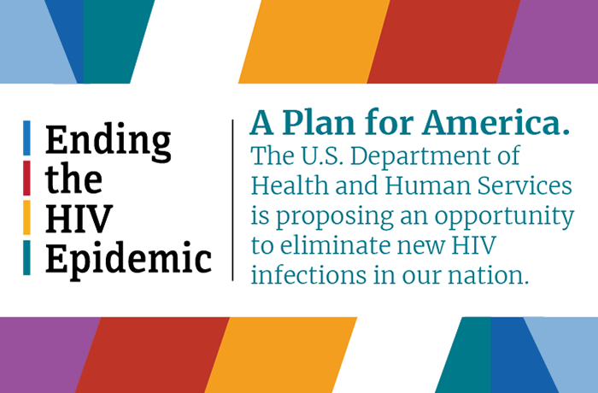
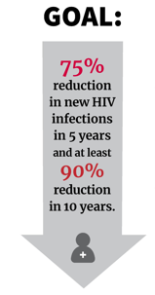
Ending the U.S. HIV Epidemic (EHE) by 2030
GOAL:
75%
reduction
in new HIV infections
by 2025
and at least
90% reduction
by 2030
Source: Ending the HIV Epidemic in the U.S. (EHE). Centers for Disease Control and Prevention Division of HIV Prevention. Reviewed July 07, 2022. Accessed May 1, 2023. https://www.cdc.gov/endhiv/index.html

Slide 6
Assessing Progress Towards Achieving the 2030 EHE Goal
Annual HIV Infections in the U.S., 2010-2019
Average annual progress 2010-2019:
~500 reduction per year
Average annual progress needed
2019-2030
+6% annual new HIV infections among Latinos
>2800
reduction per year
EHE 2030 Target
≤3,000
Sources: The White House. National HIV/AIDS Strategy for the United States 2022–2025. https://files.hiv.gov/s3fs-public/NHAS-2022-2025.pdf; CDC. NCHHSTP AtlasPlus. https://www.cdc.gov/nchhstp/atlas/index.htm.

Slide 7
Latinos are a fast-growing priority population in the U.S. HIV epidemic.
Latino HIV Prevalence Estimates from 2010-2019
Increases in the Estimated Number of People Living with HIV from 2010–2019
(Diagnosed and Undiagnosed)
+20%
+19%
+13%
+33%
Overall
Black
White
Latino
Source: CDC NCHHSTP AtlasPlus, cdc.gov/nchhstp/atlas/index.htm
Notes:
Overall estimated PLWHIV in the U.S.: ~1.2 million
Estimated Latinos living with HIV in the U.S.: ~300,000

Slide 8
Latino HIV Incidence and Diagnoses Inequities from 2010-2019*
2010-2019
Estimated
Annual New Infections
+6%
2010-2019
Annual New Diagnoses
+5%
-12%
Latino
+20%
+33%
Black
-15%
-15%
White
-17%
Overall
-19%
-19%
*2020 data not included due to COVID-19 pandemic-related disruptions. Incidence data for 2021 and 2022 are not yet available.
Source: CDC NCHHSTP AtlasPlus, cdc.gov/nchhstp/atlas/index.htm

Slide 9
Data Update: Concerning Trends Continue During 2019-2021
Incidence estimates for 2020 and 2021 are not yet available.
2019-2021*
Change in New HIV Diagnoses
+4% among Latinos
–5% among non-Latinos
+33%
*2021 diagnoses data are provisional
Sources: CDC HIV Surveillance Reports, https://www.cdc.gov/hiv/library/reports/hiv-surveillance.html; CDC NCHHSTP AtlasPlus, cdc.gov/nchhstp/atlas/index.htm. Accessed May 5, 2023.
Notes:
Incidence estimate release schedule: The last 2 incidence estimate reports were released in May 2021 and May 2020 (different release schedule prior to that)
Normal reporting delay: Surveillance reports (Diagnoses) and incidence estimate supplements are usually released with a 2 year delay (ie report released in 2022 has data from 2020)

Slide 10
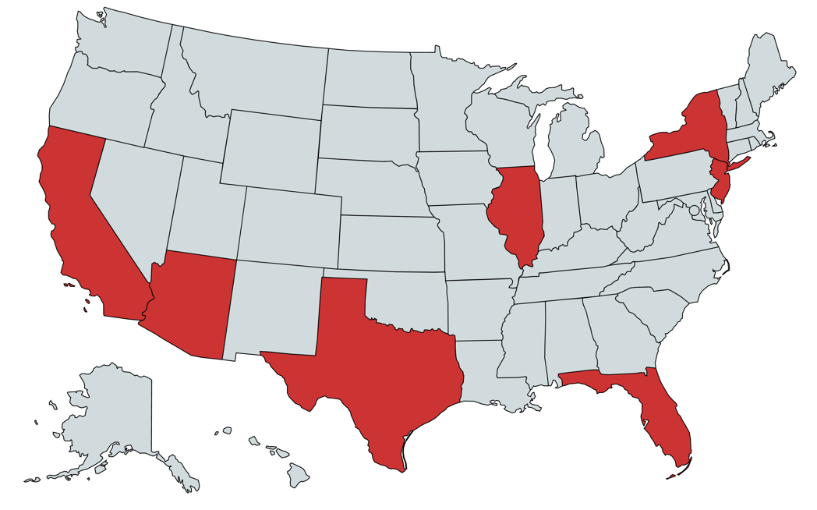
Geographic Hotspots of HIV Diagnoses Among Latinos
7 States + Puerto Rico accounted for roughly
8 in 10
new HIV diagnoses among Latinos in 2021*
+33%
*Consistent with data prior to the COVID-19 pandemic. 2020 data must be interpreted with caution due to pandemic-related disruptions.
Source: CDC NCHHSTP AtlasPlus, cdc.gov/nchhstp/atlas/index.htm

Slide 11
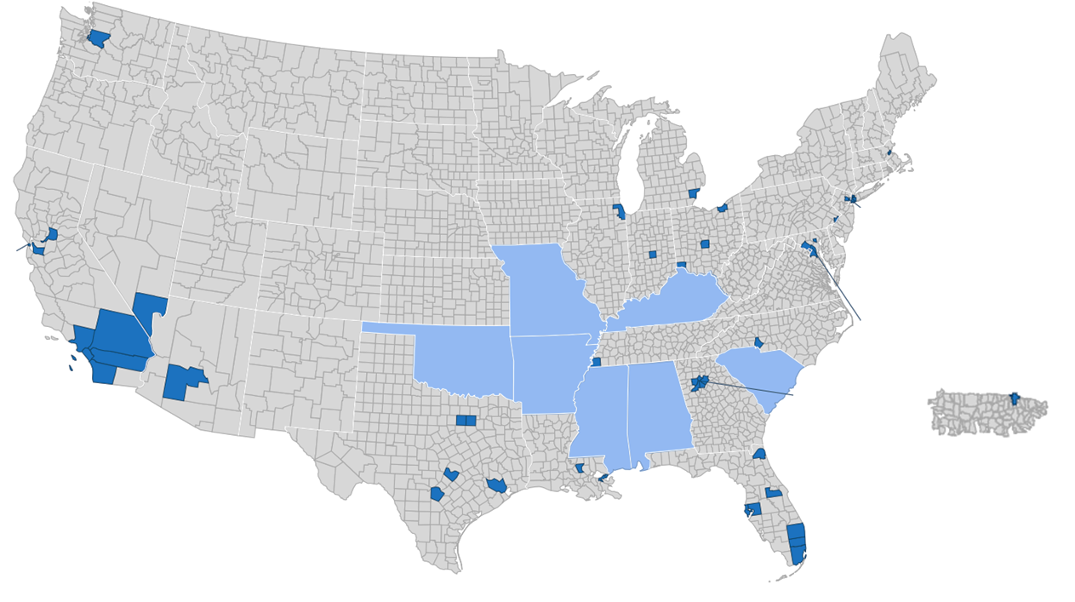
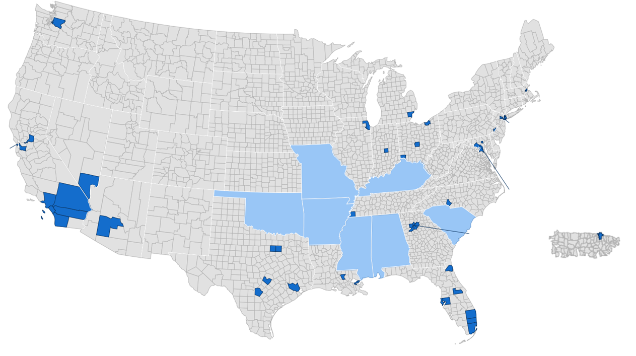
Geographically Heterogeneous Hotspots in the Latino HIV Epidemic Within and Outside of EHE Priority Jurisdictions
Since 2019, new HIV diagnoses among Latinos increased both within and outside of EHE priority jurisdictions
In 2021, approximately
6 in 10
new HIV diagnoses among Latinos were in EHE priority jurisdictions,
with about
4 in 10
reported outside of EHE priority jurisdictions.
Source: CDC NCHHSTP AtlasPlus, cdc.gov/nchhstp/atlas/index.htm. Accessed May 5, 2023.
Notes:
+5% within EHE jurisdictions (From 2019 to 2021)
+3% outside EHE jurisdictions (From 2019 to 2021)

Slide 12
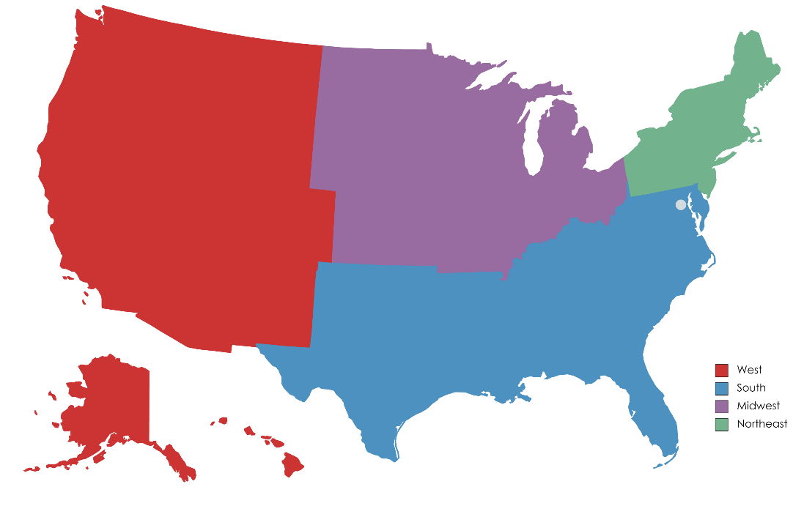
HIV High Transmission Clusters Have Been Linked to Spikes in Local Transmission Dynamics Across the US
Molecular HIV Surveillance by Census Region, 2018-2019
The CDC reported the identification of
136 high HIV transmission clusters across 19 U.S. states
from 2018-2019.
Priority clusters were defined as those with ≥5 diagnoses in the preceding 12 months
West (n= 4 States)
Northeast (n= 3 States)
South (n=10 States)
Midwest (n=2 States)
Source: Oster AM, et al. Increasing capacity to detect clusters of rapid HIV transmission in varied populations—United States. Viruses. 2021 Apr;13(4):577.

Slide 13
Latino HIV Diagnoses in High Transmission Clusters
Latinos were overrepresented among people in high transmission clusters in
11 out of 19 (58%)
states where HIV high transmission clusters were identified in 2018-19*
*as compared to the Latino proportion of all HIV diagnoses in the state
25%
19%
Overall, Latinos accounted for 28% of all diagnoses in HIV high transmission clusters detected from 2018-19, despite accounting for 19% of the U.S. population.
Source: Oster AM, et al. Viruses. 2021;13(4):577; U.S. Department of Health and Human Services Office of Minority Health. Profile: Hispanic/Latino Americans. HHS.gov. Updated Feb. 2023.

Slide 14
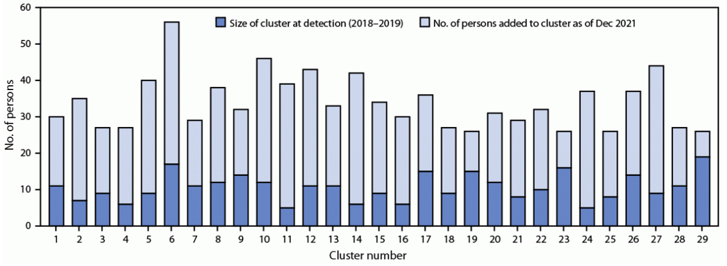
Persistence and Growth of HIV High Transmission Clusters Indicate Breakdowns in HIV Prevention and Treatment Systems
Of the 136 high transmission clusters identified:
38 (28%) had grown to exceed 25 persons living with HIV by December 2021.
Among those clusters, 29 primarily involved men who have sex with men (MSM).
Increase in size of large HIV clusters primarily involving MSM – United States, 2018-2021
Source: Perez SM, Panneer N, France AM, et al. Clusters of Rapid HIV Transmission Among Gay, Bisexual, and Other Men Who Have Sex with Men – United States, 2018-2021. MMWR Morb Mortal Wkly Rep 2022;71:1201-206. DOI: http://dx.doi.org/10.15585/mmwr.mm7138a1

Slide 15
Characteristics of Persons in Primarily MSM High Transmission HIV Clusters (n=29)
Northeast
South
Midwest
West
Geographic Region
Latino
Black
White
Other
Race/
Ethnicity
Heterosexual
Other
Male-to-Male
Transmission
Category
<30 years
≥30 years
Age
Source: Perez SM, Panneer N, France AM, et al. Clusters of Rapid HIV Transmission Among Gay, Bisexual, and Other Men Who Have Sex with Men – United States, 2018-2021. MMWR Morb Mortal Wkly Rep 2022;71:1201-206. DOI: http://dx.doi.org/10.15585/mmwr.mm7138a1

Slide 16
Section I: Summary Points
Latinos represent a rapidly growing priority population in the U.S. HIV epidemic
The number of annual new HIV infections and diagnoses has increased among Latinos, but decreased overall
There are geographic hotspots in the Latino HIV epidemic within and outside of Ending the HIV Epidemic (EHE) priority jurisdictions
Latinos are overrepresented in HIV high transmission clusters that are growing rapidly across the U.S., particularly in the South
Young Latino men who have sex with men represent a key priority population for ending the HIV epidemic
4.
5.

Slide 17
II
System Failures as Drivers of HIV Inequities Among Latinos

Slide 18
System Failures as Drivers of Latino HIV Inequities
Inequity in the Reach of Prevention and Treatment Services to Latinos
Lack of Access to Healthcare Services for Latinos
HIV Stigma & Discrimination Experienced by Latinos
Invisibility of the Latino HIV Crisis
Harmful Social Determinants of Health Impacting Latinos
Misalignment of Workforce to Address Latino Needs
1
2
3
4
5
6

Slide 19
1. Invisibility of the Latino HIV Crisis
“If we don’t make significant changes to how we fight the epidemic, we will fall short. Our slow progress isn’t because we lack the tools. It’s because we haven’t used the tools to reach the people most in need.
“There has been immense progress in curbing the HIV epidemic in the US, but clinicians fear Hector and Latino youngsters like him are being left behind.”
Article URL: https://www.theguardian.com/society/2019/feb/15/hiv-aids-us-young-latino-men-bronx-new-york
Article URL: https://www.cnn.com/2022/12/01/opinions/hiv-inequity-world-aids-day-ramos/index.html
Sources: Holpuch A. The Guardian. 2019 Feb 15.; Guilamo-Ramos V. CNN Opinions. 2022 Dec 1.

Slide 20
2. Inequity in the Reach of Services to Latinos: Testing
Estimated Percentage of People Living With HIV Without Knowledge of Their HIV Status, 2019
56%
Of Latinos have never been tested for HIV
Among Latinos who have never tested for HIV, 1 in 3 report never having been offered a test
(no perceived risk was the most common reason for never testing, ~60%)
16.4%
Sources: CDC NCHHSTP AtlasPlus, cdc.gov/nchhstp/atlas/index.htm; Febo-Vazquez I, Copen CE, Daugherty J. National Health Statistics Reports; no 107; KFF. Adults Who Report Ever Receiving an HIV Test by Race/Ethnicity, 2021.
Notes:
CDC recommendations:
- Routine, opt-out HIV screening of adults, adolescents in all health care settings.
- Everyone between the ages of 13 and 64 get tested for HIV at least once.
- Test at least once a year if you are a man who has had sex with another man, you’ve had more than one sex partner since your last HIV test, you’ve been diagnosed with or treated for another STI, etc.

Slide 21
2. Inequity in the Reach of Services to Latinos: Prevention
312,423
Latinos with indications for PrEP in 2022
From 2011-2021, condom use at last sex among Latino high school students* decreased by ~14%
54,674
Latinos prescribed PrEP in 2022
(Q1 & Q2)
*Research shows that individuals who use condoms at their sexual debut are more likely to report using a condom at their last sex and experience fewer STIs throughout their lifetime, than those who do not
Sources: CDC NCHHSTP AtlasPlus, cdc.gov/nchhstp/atlas/index.htm; Calabrese SK, et al. AIDS and Behavior. 2014;18(2):226-40; Centers for Disease Prevention and Control. Monitoring selected national HIV prevention and care objectives by using surveillance data. HIV Surveillance Supplemental Report. (2021)26(2).; Shafii T, Stovel K, Holmes K. Association between condom use at sexual debut and subsequent sexual trajectories: A longitudinal study using biomarkers. Am J. Public Health. 2007 June;97(6):1090-1095. doi: 10.2105/AJPH.2005.068437; National Center for HIV, Viral Hepatitis, STD, and TB Prevention. Youth risk behavior survey data summary & trends report: 2011-2021. Centers for Disease Prevention and Control. Reviewed April 27, 2023. Accessed May 4, 2023. https://www.cdc.gov/healthyyouth/data/yrbs/pdf/YRBS_Data-Summary-Trends_Report2023_508.pdf
Notes:
YRBS: Compared to a 13% decrease for all high school aged students
2021 Condom use:
Latino Condom Use at Last Sex: 48.8%; All youth: 51.8%
Opposite Sex Condom Use at Last Sex: 55.5%; Same Sex: 18.3%; Both Sex: 40.3%

Slide 22
2. Inequity in the Reach of Services to Latinos: Treatment
Among Latinos newly diagnosed with HIV in 2020:
A study indicates only ~50% of Latinos living with diagnosed HIV reach sustained viral suppression
Crepaz et al. 2018
Nearly 1 in 6 was not linked to HIV care within 30 days of diagnosis
Nearly 1 in 3 did not achieve viral suppression within 6 months of diagnosis
Sources: Centers for Disease Control and Prevention. Monitoring selected national HIV prevention and care objectives by using HIV surveillance data—United States and 6 dependent areas, 2020. HIV Surveillance Supplemental Report 2020;27(3).; Crepaz N, et al. Racial and ethnic disparities in sustained viral suppression and transmission risk potential among persons receiving HIV Care—United States, 2014. MMWR Morb Mortal Wkly Rep. 2018;67(4):113-118.
Notes:
Sustained viral suppression defined as having all viral load test results in 2014 <200 HIV RNA copies/mL
Viral suppression compared to overall: 48.4%, Black: 40.8%, White: 56.3% (Latino Viral Suppression: 49.9%)

Slide 23
3. Lack of Access to Health Care Services
In 2022, roughly 50% of Latinos were uninsured or underinsured at any time in the past year, limiting access to HIV prevention and treatment services
*Uninsured includes anyone who is not currently covered by employee, private, Medicaid, Medicare, ACA state marketplace, or military/veterans coverage. Insured estimates do not include those with coverage for specific conditions (e.g. Ryan White ADAP)
Sources Sudano JJ, Baker DW. Intermittent lack of health insurance coverage and use of preventive services. American Journal of Public Health. 2011;93:130-137. https://ajph.aphapublications.org/doi/abs/10.2105/AJPH.93.1.130; Collins SR, Hayne LA, Masitha R. The state of U.S. health insurance in 2022: findings from the Commonwealth Fund Biennial Health Insurance Survey. Commonwealth Fund. 2022. https://www.commonwealthfund.org/publications/issue-briefs/2022/sep/state-us-health-insurance-2022-biennial-survey
Notes:
Uninsured includes anyone who is not currently covered by employer, private, Medicaid, Medicare, ACA state marketplace, or military/veterans coverage. Insured estimates do not include those with coverage for specific conditions (e.g. Ryan White ADAP)
Underinsured includes persons for whom either of the following is true:
Out-of-pocket costs over the prior 12 months, excluding premiums, were equal to 10 percent or more of household income, or, were equal to 5 percent or more of household income for individuals living under 200 percent of the federal poverty level ($27,180 for an individual or $55,500 for a family of four in 2022).
The deductible constituted 5 percent or more of household income.

Slide 24
3. Misalignment of Workforce to Address Latino Needs
The Current Latino HIV Workforce
Percent Latino by Occupation, 2022
Sources: U.S. Bureau of Labor Statistics. Employed persons by detailed occupation, sex, race, and Hispanic or Latino ethnicity, Labor Force Statistics from the Current Population Survey.; Weiser J, et al. Clinical Infectious Diseases. 2016;7(1):966-75. *Weiser et al. 2016

Slide 25
Approximately 1 in 4 (23%) Latinos living with HIV experienced health care discrimination from 2018-2020.
5. HIV Stigma & Discrimination Experienced by Latinos
Forms of HIV Healthcare Discrimination Experienced by Latinos in HIV healthcare settings
HIV Stigma and Health Care Discrimination Experienced by Hispanic or Latino Persons with HIV – United States, 2018 – 2020
HCP was not listening to what they were saying
62%*
Treated with less respect than others
48%*
Treated with less courtesy than others
48%*
*Percentage of Latinos who reported HIV healthcare discrimination
Sources: Hein I. Stigma, health discrimination common for Hispanic adults with HIV. Medpage Today. 2022.; Padilla M, Patel D, Beer L, et al. HIV Stigma and Health Care Discrimination Experienced by Hispanic or Latino Persons with HIV — United States, 2018–2020. MMWR Morb Mortal Wkly Rep 2022;71:1293–1300.
Notes:
Participants who reported experiencing at least one form of health care discrimination were considered to have experienced discrimination in an HIV health care setting (not necessarily specific to HCPs).

Slide 26
6. Harmful Social Determinants of Health Impacting Latinos
Social determinants of health (SDOH) account for ~80% of modifiable contributors to health outcomes.
Exemplar SDOH Influences on Latino HIV Inequities:
Environmental Context:
High community viral load, increased exposure risks
Distribution of Health Resources: Inequities in access to HIV services and existing tools (PrEP, ART)
Syndemic Factors:
Co-occurring sexually transmitted infections (STIs), substance use epidemics
PrEP=pre-exposure prophylaxis; ART=antiretroviral therapy
Magnan S, Social determinants of health 101 for health care: Five plus five. NAM Perspectives. 2017.; Glynn TR, Safren SA, Carrico AW, et al. High levels of syndemics and their association with adherence, viral non-suppression, and biobehavioral transmission risk in Miami, a U.S. city with an HIV/AIDS epidemic. Aids Behavior. 2019;23(11):2956-2965.

Slide 27
Syndemic Factors and the Latino HIV Epidemic
Other STIs
Mental Health
Substance Use
From 2012 to 2020, there was a significant rise in annual reported STIs among Latinos, about:
Gonorrhea, 2x
Syphilis, 3x
In 2021, nearly 2 in 3 adult Latinos with any mental illness did not receive mental health services in the past year.
19 out of 20 Latinos in the U.S. with an alcohol or substance use disorder did not receive any treatment in the past year (2021).
Sources: Substance Abuse and Mental Health Services Administration. Key substance use and mental health indicators in the United States: Results from the 2021 National Survey of Drug Use and Health. Center for Behavioral Health Statistics and Quality, Substance Abuse and Mental Health Services Administration. https://www.samhsa.gov/data/report/2021-nsduh-annual-national-report; CDC NCHHSTP AtlasPlus, cdc.gov/nchhstp/atlas/index.htm
Notes:
In 2020, the rate of Chlamydia among Latinos was 0.84x the rate in 2012.

Slide 28
III
Action Areas for Latino-Focused HIV Policy & Programming

Slide 29
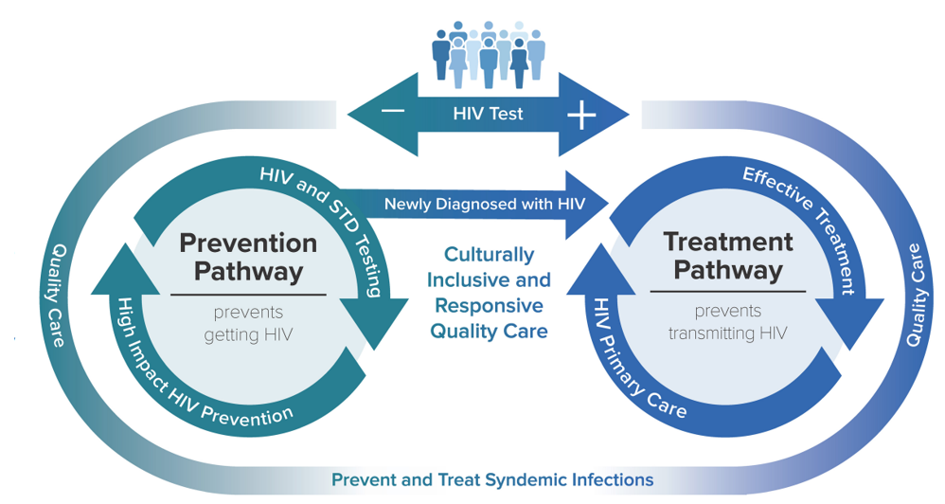
Priority Areas for Action in the Latino HIV Epidemic
Enhancing the Visibility of Latinos in the HIV Epidemic
Increasing Adoption of a Status Neutral Model of HIV Care
Broadening the HIV Workforce to Address Latino Needs
Improving the Trustworthiness of Status Neutral HIV Care for Latinos
Mitigating Harmful Social Determinants of Health Among Latinos
Recommitting and Reinvesting in Latino Health and Leadership

Slide 30
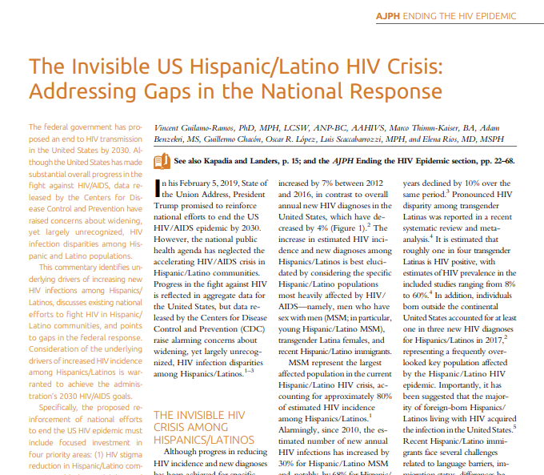
Priority Area #1: Enhancing the Visibility of Latinos in the HIV Epidemic
A Call to Action to Enhance the Visibility of Latinos in the U.S. HIV Epidemic Response
Sources: Guilamo-Ramos, et al. American Journal of Public Health. 2020;100:27-31.

Slide 31
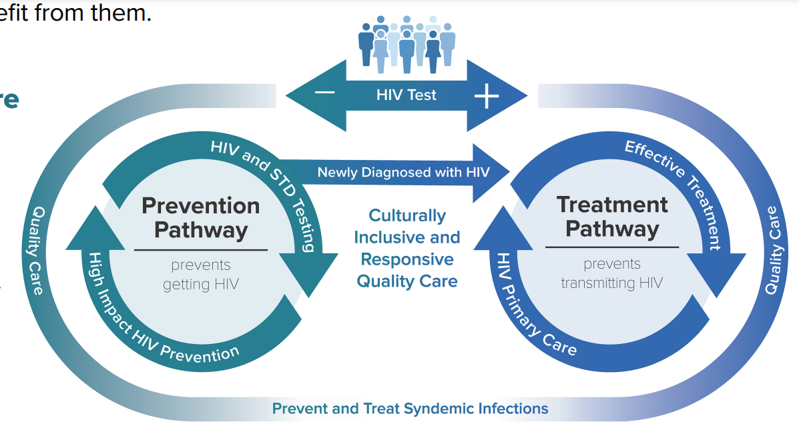
Priority Area #2: Increasing Adoption of a Status Neutral Model of HIV Care
Sexual Health Focus
Rapid Start PrEP, PEP, Doxy-PEP, Condoms, etc.
Wraparound Services
Screening and Treatment for Comorbidities
Sexual Health Focus
Rapid Start ART
Primary Care
Wraparound Services
Screening and Treatment for Comorbidities
Source: Centers for Disease Control and Prevention. Status Neutral HIV Prevention and Care. Reviewed March 1, 2023. Accessed April 26, 2023. https://www.cdc.gov/hiv/effective-interventions/prevent/status-neutral-hiv-prevention-and-care/index.html
Notes:
PEP=post-exposure prophylaxis

Slide 32
A status neutral model facilitates high-quality comprehensive health care by
Benefits of a Status Neutral Model of Care
Offering a whole-person health approach
Reducing stigma
Integrating services and increasing efficiency
Source: Centers for Disease Control and Prevention. Issue brief: status-neutral HIV care and service delivery. Division of HIV Prevention. Reviewed November 28, 2022. Accessed May 1, 2023. https://www.cdc.gov/hiv/policies/data/status-neutral-issue-brief.html?CDC_AA_refVal=https%3A%2F%2Fwww.cdc.gov%2Fhiv%2Fpolicies%2Fdata%2Fstatus-netural-issue-brief.html

Slide 33
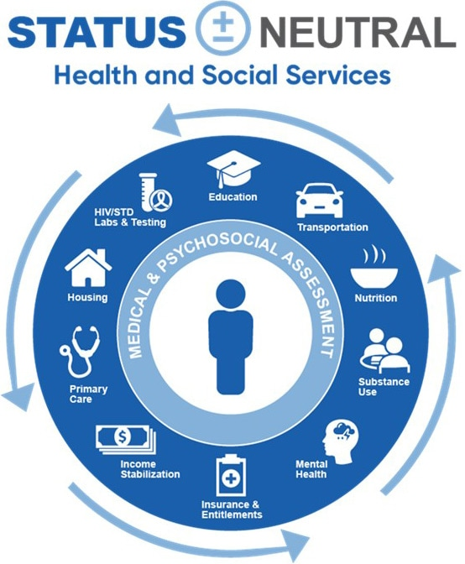
Addressing Drivers of Latino HIV Inequities: Wraparound Services
Example:
HIV Viral Suppression Rates among Latinos
(2021)
91%
Sources: CDC Division of HIV Prevention. Status Neutral HIV Prevention and Care. U.S. Department of Health and Human Services. Accessed May 3, 2023. https://www.cdc.gov/hiv/effective-interventions/prevent/status-neutral-hiv-prevention-and-care/index.html; CDC. Monitoring selected HIV prevention and care objectives by using HIV surveillance data—United States and 6 dependent areas, 2018. HIV Surveillance Supplemental Report 2020;25(2); Health Resources and Services Administration. Ryan White HIV/AIDS Program annual client-level data report 2021.
Notes:
For Ryan White (91%), viral suppression was based on data for Latinos with HIV who had at least 1 outpatient ambulatory health services visit during the measurement year. For Overall (88%), viral suppression was based on data for Latinos with HIV who had at least 1 CD4 or VL test during the measurement year.

Slide 34
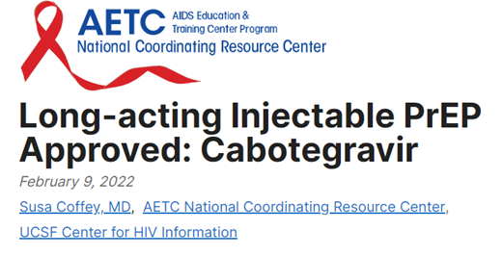
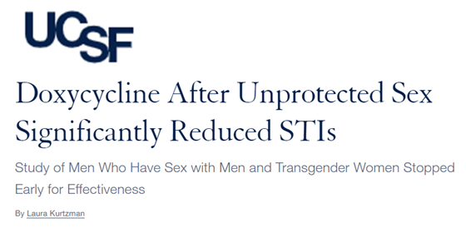
New Resources and Strategies for Providers
Funding and Training Opportunities Focused on Status Neutral HIV Care
Long-Acting PrEP and Doxy-PEP
Sources: Kurtzman L. Doxycycline for STI prevention: highly effective, minimal drug resistance. University of California San Francisco. February 22, 2023. Accessed May 3, 2023. https://www.ucsf.edu/news/2023/02/424861/doxycycline-sti-prevention-highly-effective-minimal-drug-resistance; Coffey S. Long-acting injectable PrEP approved: cabotegravir. AIDS Education and Training Center. February 9, 2022. Accessed May 3, 2023. https://aidsetc.org/blog/long-acting-injectable-prep-approved-cabotegravir;
Notes:
Doxy-PEP protocol: 200 mg taken after unprotected anal sex has been studied among MSM and transgender women; results demonstrated reduction in incident chlamydia and syphilis by 70% and 73%
Cabotegravir PrEP injections: 600 mg injected into cluteal muscle every 2 months, 30 mg daily oral cabotegravier optional for a 4-week lead in prior to injections.

Slide 35
Priority Area #3: Broadening the HIV Workforce to Address Latino Needs
Traditional Model for Defining the HIV Workforce
Broadened Definition of the HIV Workforce
Singular focus on HIV specialty service providers
Non-HIV specialist practitioners involved in delivery of comprehensive health and social services to people at risk of and living with HIV
Infectious Disease (ID) Physicians who provide HIV care
Nurse Practitioners who provide HIV care
Physician Assistants
who provide HIV care
PWH, Primary Care Providers, RNs, LPNs, Pharmacists, Dentists, Social Workers, Behavioral/Mental Health Professionals, Community Health Workers, etc.
Non-ID Physicians
who provide HIV care
Notes:
PWH=people with HIV
RN=registered nurses
LPN=licensed practical nurses

Slide 36
Priority Area #3: Broadening the HIV Workforce to Address Latino Needs
Latino Representation and Cultural Alignment is a Priority for Recruitment, Training, and Continued Education of the HIV Workforce
Cultural competence is associated with better Latino patient-provider communication:
Increased treatment adherence
Higher patient satisfaction
Overall improvement in health behaviors and outcomes
Link: www.bxconsortium.org/cewebinarseries.html

Slide 37
Priority Area #4: Improving the Trustworthiness of Status Neutral HIV Care for Latinos
Research suggests the need for strategies to increase the
Trustworthiness
of health systems, providers, and HIV prevention and treatment in order to improve HIV service outcomes for Latinos
Sources: Jaiswal J, Halkitis PN. Towards a more inclusive and dynamic understanding of medical mistrust informed by science. Behavioral Medicine. 2019 Apr 3;45(2):188-96; Newman AM. Moving beyond mistrust: centering institutional change by decentering the white analytical lens. Bioethics. 2022 Mar;36(3):267-73.

Slide 38
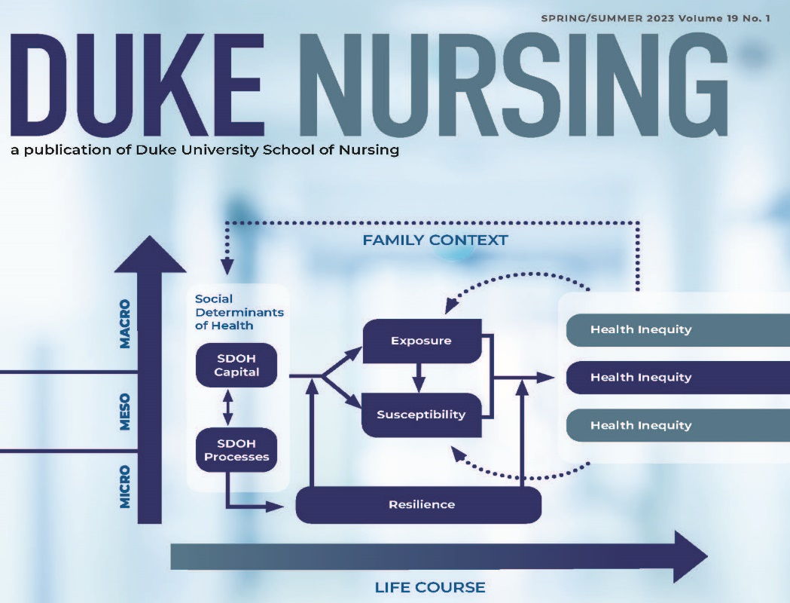
Priority Area # 5: Mitigating Harmful Social Determinants of Health Among Latinos
Visit DUSONTrailblazer.com to explore our interactive guide to 8 key principles and an innovative new framework to better mitigate harmful SDOH.
Social Determinants of Health and the Path to Health Equity
Thimm-Kaiser M, Benzekri A., Guilamo-Ramos V. Conceptualizing the mechanisms of social determinants of health: A heuristic framework to inform future directions for mitigation. Milbank Q. 2023. doi: 10.1111/1468-000912642

Slide 39
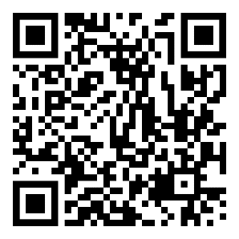
NO FEARS Family-based Stigma Reduction Intervention
The NO FEARS stigma reduction intervention for youth living with HIV includes:
Animated video series telling the story of No Fears, an adolescent superhero living with HIV, and his adventures in overcoming three HIV stigma villains with the support of his family.
A family workbook that outlines specific family activities designed to reduce the impact of stigma on youth living with HIV and increase youth’s well-being and adherence to HIV medication.
This material will soon be available in Spanish
JOIN THE FIGHT AGAINST HIV STIGMA

Slide 40
Priority Area #6: Recommitting and Reinvesting in Latino Health and Leadership
Identifying and Addressing Historical and Structural Drivers of Medical Mistrust among Hispanic/Latino Gay, Bisexual and Other Men Who Have Sex with Men (HLMSM) for HIV Prevention
RFA-PS-23-006
Since the launch of the EHE initiative in 2019, there has been only one HHS funding opportunity specific to improving the HIV response in Latino communities
More Latino-specific HIV funding is needed
Source: Grants.gov

Slide 41
Latino HIV Leadership Development
The Instituto DILES is a program that strengthens knowledge and leadership skills to drive meaningful change in communities toward ending the HIV epidemic for Latino men.
The Instituto DILES curriculum consists of several components:
Webinars with expert speakers on HIV topics and areas of leadership
And more…
Instituto Latinx de Desarrollo Integral de Lideres Empoderados contra el SIDA
SCAN TO LEARN MORE
Prevention & Treatment
Targeted HIV Research
Community Engagement
in Latino Communities

Slide 42
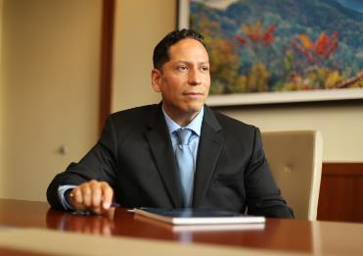
Thank You!
Special thanks to the CLAFH research team:
Adam Benzekri
Marco Thimm-Kaiser
Celia Johnson
Nash Wilhelm-Hilkey
Vincent Guilamo-Ramos
Please send any questions or comments to:
vincent.ramos@duke.edu

Slide 43
SCAETC Social Media

Slide 44
Resources
National Clinical Consultation Center http://nccc.ucsf.edu/
HIV Management
Perinatal HIV
HIV PrEP
HIV PEP line
HCV Management
Substance Use Management
Present case on ECHO https://hsc.unm.edu/scaetc/programs-services/echo.html
AETC National HIV Curriculum https://aidsetc.org/nhc
AETC National Coordinating Resource Center https://targethiv.org/library/aetc-national-coordinating-resource-center-0
Additional trainings scaetcecho@salud.unm.edu
www.SCAETC.org
Notes:
Find an HIV-related topic TeleECHO in your area: https://echo.unm.edu/locations-2/echo-hubs-superhubs-united-states/
IDEA Platform: Infectious Diseases Education & Assessment. https://idea.medicine.uw.edu/
AETC National HIV Curriculum: 6 core modules for self study; regularly updated; CME, CNE
Hepatitis C Online Curriculum: https://www.hepatitisc.uw.edu/
Hepatitis B Online Curriculum: https://www.hepatitisb.uw.edu/
National STD Curriculum: https://www.std.uw.edu/

