Slide 1
HIV & Aging
THRIVING IN THE NEW NORMAL
Shital M. Patel, MD, MSc
Infectious Diseases
Director, Houston AIDS Education & Training Center
Baylor College of Medicine
Notes:
Version date_06 2023

Slide 2
Conflict of Interest Disclosure Statement
No significant financial disclosures
This program is supported by the Health Resources and Services Administration (HRSA) of the U.S. Department of Health and Human Services (HHS) as part of an award totaling $3,132,205, with 0% financed with non-governmental sources. The views expressed do not necessarily reflect the official policies of the Department of Health and Human Services, nor does mention of trade names, commercial practices, or organizations imply endorsement by the U.S. Government. Any trade/brand names for products mentioned during this presentation are for training and identification purposes only.

Slide 3
Learning Objectives
Recognize the landscape of HIV and Aging.
Discuss health challenges with aging.
Identify ways that we can optimize quality of care for patients aging with HIV.

Slide 4
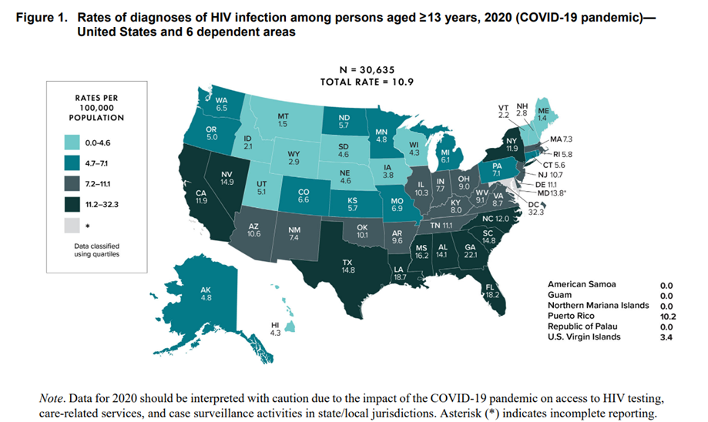
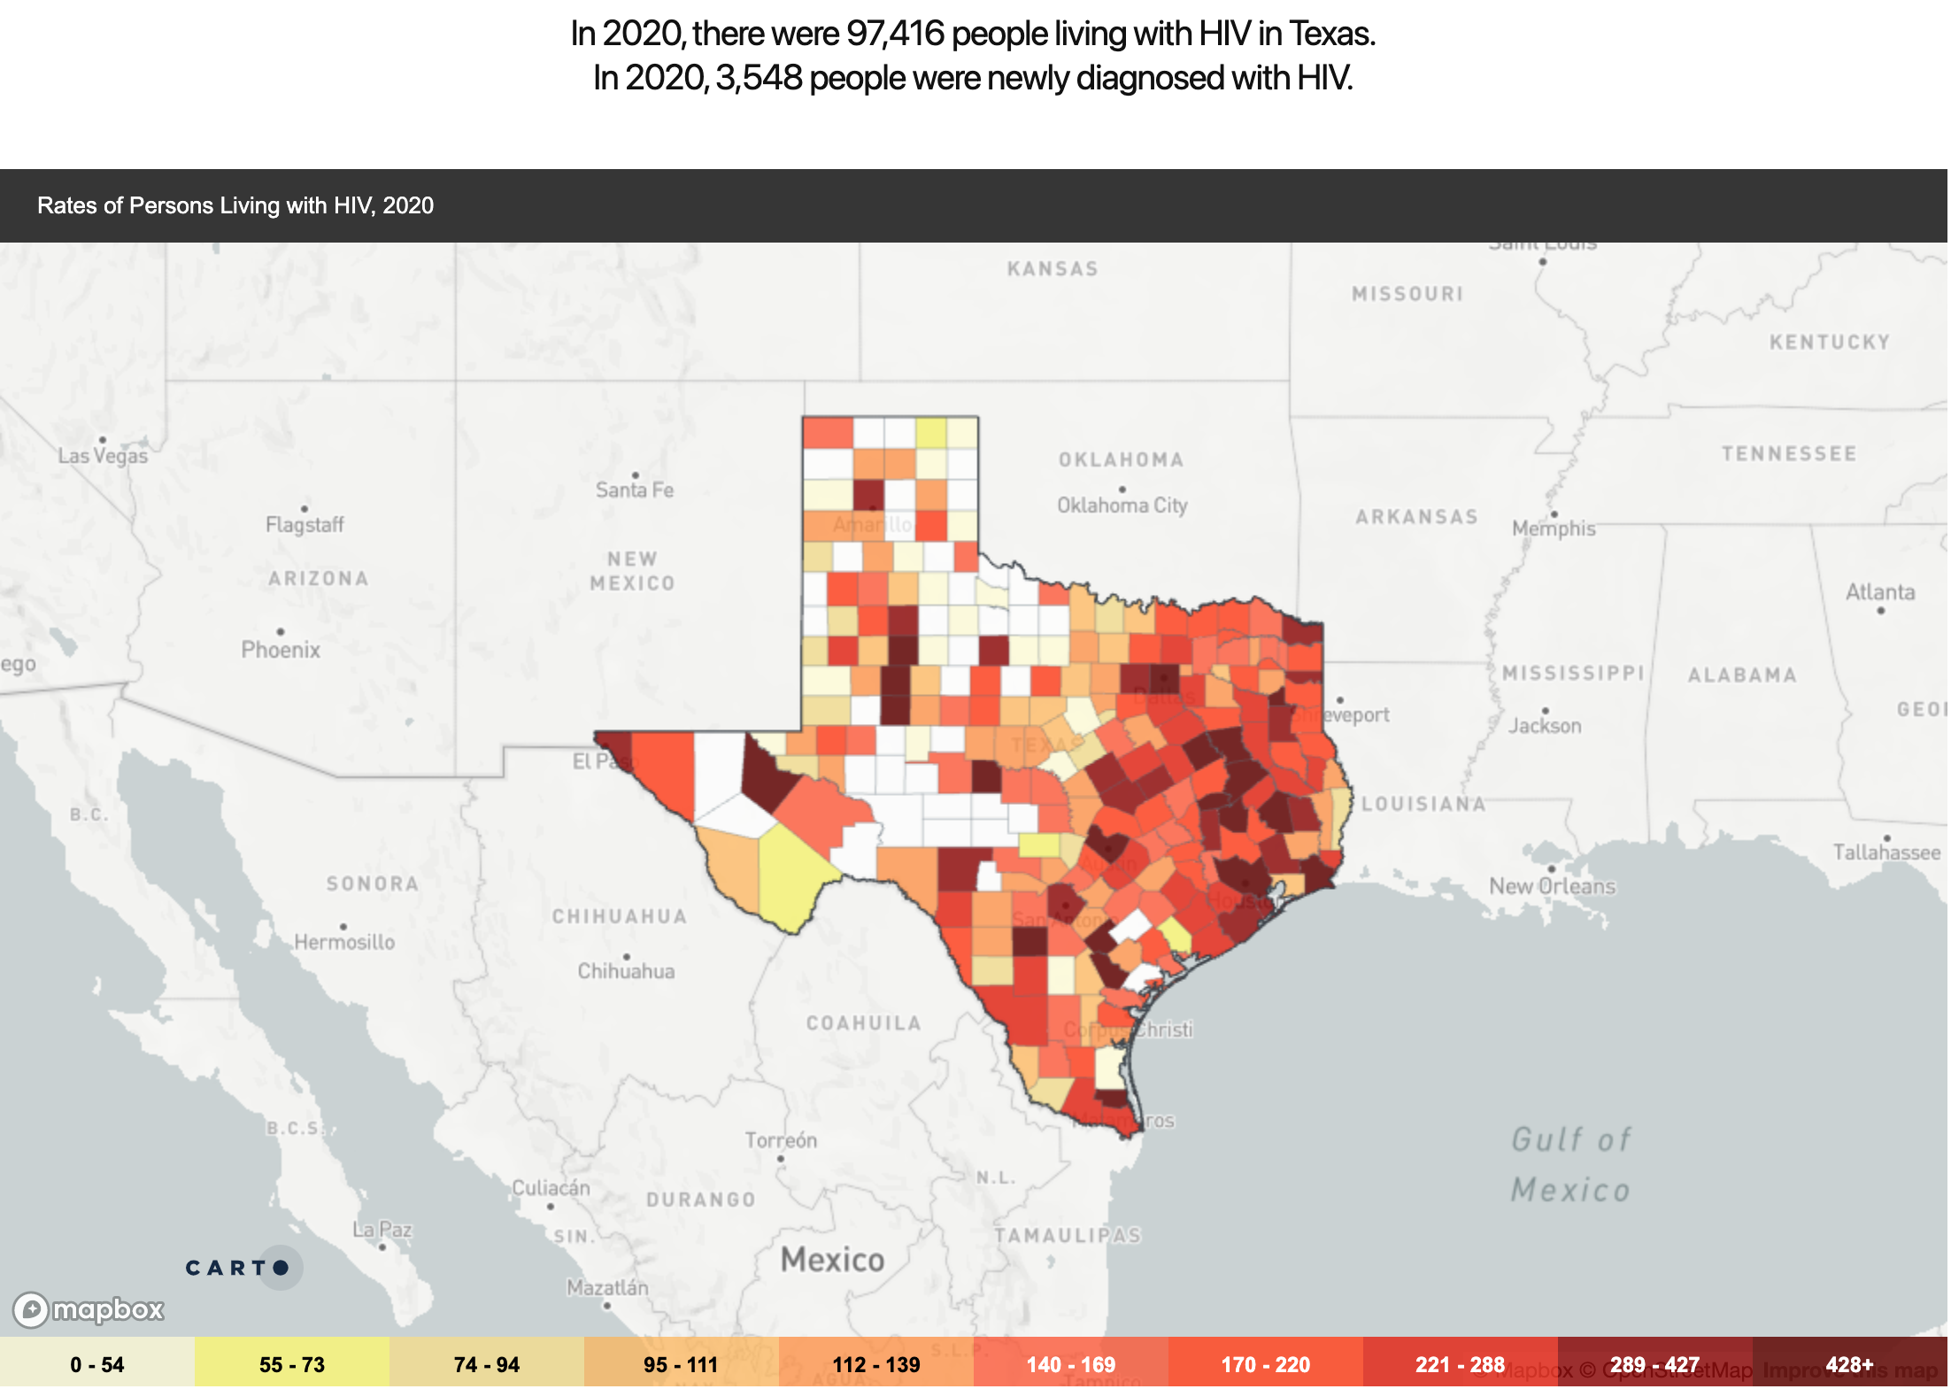
Snapshot:
Rates of HIV Diagnoses Highest in South
>50% of all new HIV diagnosis in 2019
Texas rate 14.8 per 100,000 people
CDC.Gov https://aidsvu.org/local-data/united-states/south/texas/

Slide 5

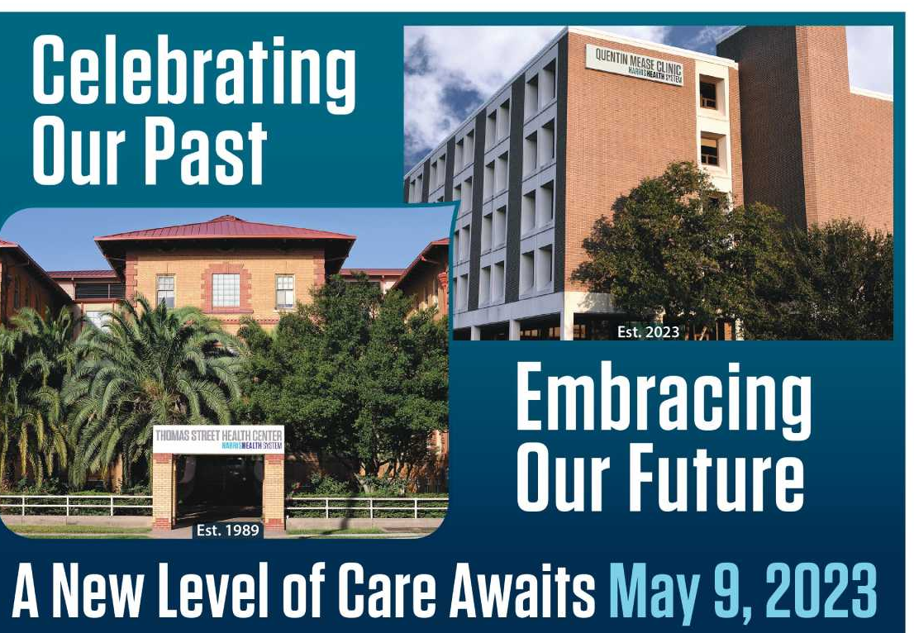
Thomas Street Health Center (TSHC)
Since 1989 – HIV services for Harris Health System
Notes:
Serve about 5000-6000 patients annually with HIV

Slide 6
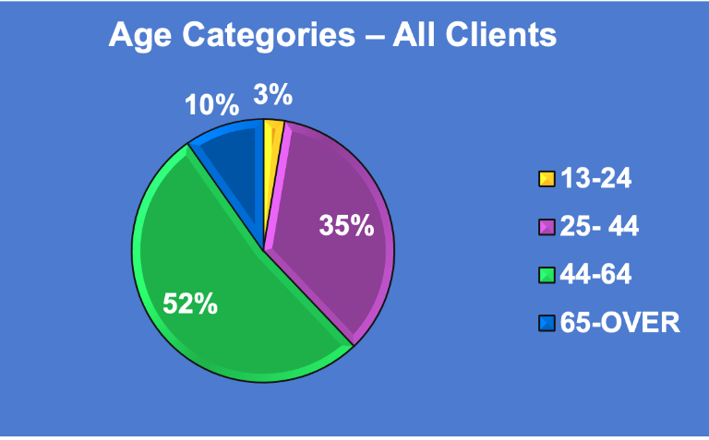
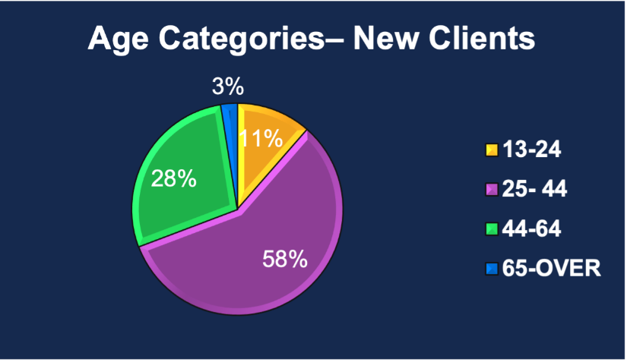
2021 TSHC Demographics
All clients | 5327 | 67% male 33% female | 56% Black, 33% Hispanic, 9% White
New Clients | 436 | 79% male 21% female | 50% black, 30% Hispanic, 18% white
https://nextlevelharrishealth.org/thomas-street/
Notes:
Race. 2021 demographics
56% black, 33% Hispanic, 9% white – all clients
50% black, 30% Hispanic, 18% white – new clients

Slide 7
What Does Aging with HIV look like?

Slide 8
67 yo male, HIV diagnosis (1994)
Comorbidities include
  Diabetes mellitus type 2
  Cardiovascular disease (history of myocardial infarction)
  Ulcerative colitis
  Bipolar disorder
>10 medications
Daily concerns
Persistent peripheral neuropathy
Slowing cognition/memory loss
Slowing gait/fatigue
Notes:
Medications in the past, medications today

Slide 9

HIV Long Term Survivors (HLTS)
A diverse group of people diagnosed with HIV before the advent of Highly Active Antiretroviral Therapy or HAART in 1996
HLTS make up about 25% of all people living with HIV of the 1.2 million people are living with HIV in the U.S.
Estimated at 300,000 long-term survivors, defined as individuals who acquired HIV before 1996 and the introduction of HAART)
2023 THEME
Mobilize to Thrive: Prioritizing Quality of Life.
https://www.hltsad.org/
https://www.hiv.gov/events/awareness-days/hiv-long-term-survivors-day/
Notes:
HLTS includes people born with HIV or who acquired the virus as babies and are now in their 30s and 40s. HLTS are also those living with HIV and AIDS for over 25 years.
Make the quality of life for HIV long-term survivors and older adults aging with HIV and AIDS a true priority
Demand universal treatment access to help end the HIV epidemic, which is the message of the #JourneyTo400K campaign from the team that created Undetectable Equals Untransmittable (#UequalsU)
Prioritize culturally aware mental health care
Overcome the challenges of poverty and economic insecurity
Fight discrimination and invisibility against older adults with HIV and AIDS. It is called “ageism.” We will not condone it.

Slide 10
55 yo male, HIV diagnosis (2021)
Comorbidities include
  Pre-diabetes
  Hypertension
  Anxiety
3 medications
Daily concerns
Managing anxiety
Financial stability
Notes:
Medications in the past, medications today

Slide 11
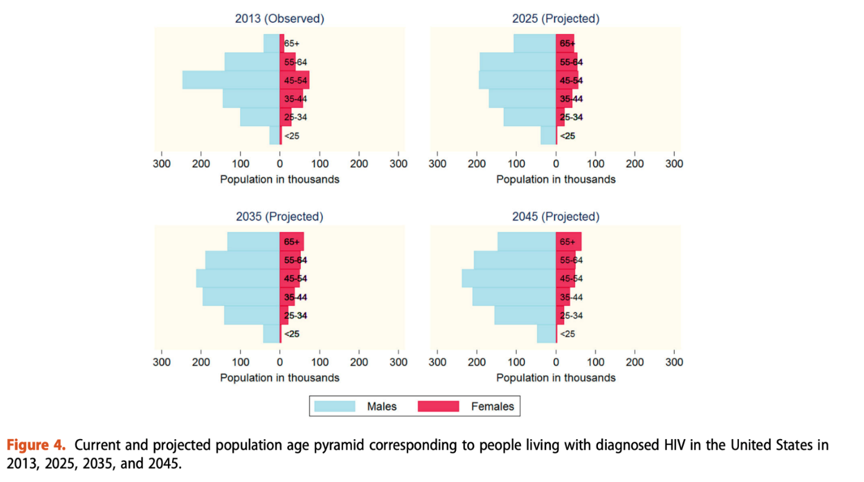
Projected Demographic Composition of the United States Population of People With HIV (PWH)
National HIV Surveillance System and US census data was used to project the demographic composition of the population of people living with diagnosed HIV (PWH) in the United States through 2045.
PWH 2013 2045___
All 917,294 1,232,054
Age55+ 232,113 470,221
55+ (%) 25.3% 38.2%
Projected demographic composition of the United States population of people living with diagnosed HIV, AIDS Care, 29:12, 1543-1550, (2017) DOI: 10.1080/09540121.2017.1308466

Slide 12
Factors Accounting For The Rise of The 50 and Over

Slide 13
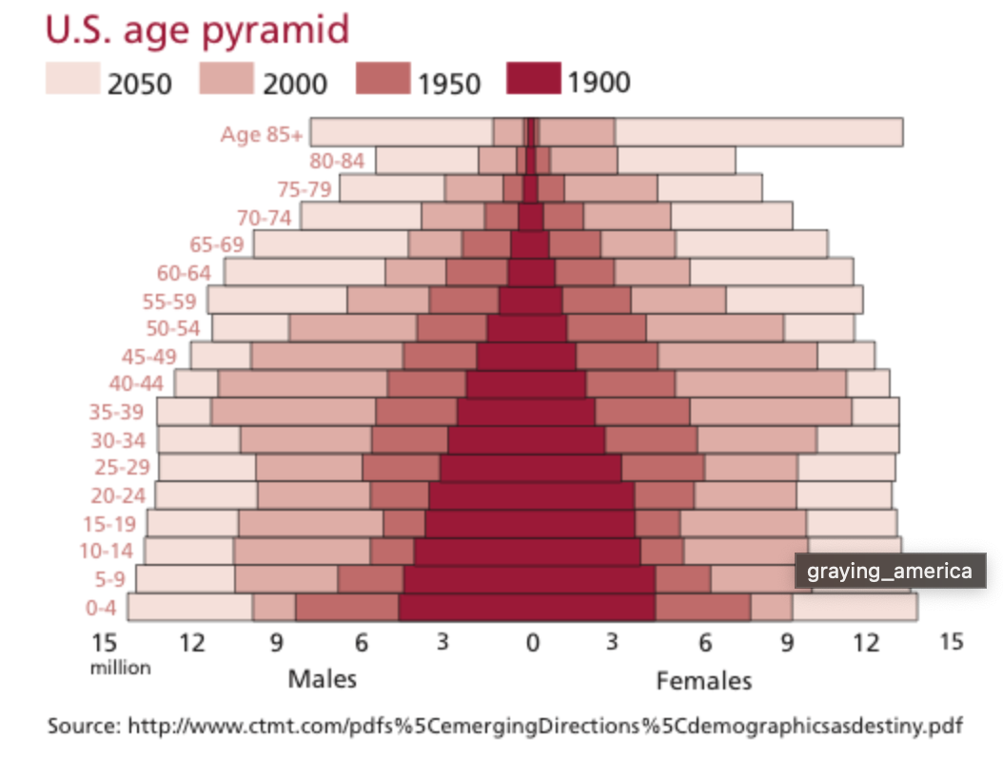
Aging Population
24% of the U.S. population is >50yo

Slide 14
Antiretroviral Therapy (ART)
1996 – HAART
ART improvements
  Side effect profiles
  Decrease in drug-drug interactions
  Combination tablet formulations
In 2018, over half (51%) of people in the United States with diagnosed HIV were aged 50 and older

Slide 15
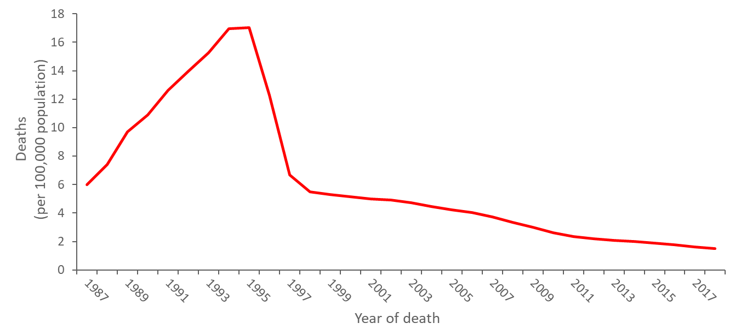
Annual age-adjusted rates of death with HIV infection as the underlying cause, 1987−2018, United States
Improvement in life expectancy
HIV is a chronic disease
https://www.cdc.gov/hiv/pdf/library/slidesets/cdc-hiv-surveillance-mortality-2018.pdf

Slide 16
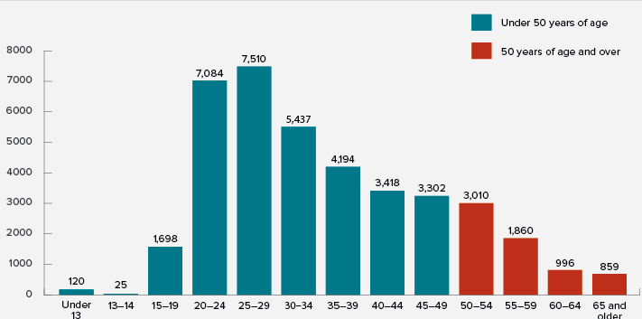
New HIV Infections
Total 39,533
Age >50: 6,735
(17.01%)
Diagnoses of HIV infection
Age
Hood et al. AIDS Care. 2017 Dec;29(12):1543-1550.
Notes:
2018, people aged 50 and older accounted for 17% of the 37,968 new HIV diagnoses in 2018 in the United States (around 1 in 6 HIV diagnoses in 2018)

Slide 17
WhaT are the Needs?

Slide 18
Health issues
Medical¹
Late diagnosis
Polypharmacy
Multimorbidity
Other geriatric syndromes
  Cognitive impairment³
  Falls³
  Frailty⁴
Psychosocial²
Mental health
Substance use
Stigma
Loneliness
Social support systems
1. hiv.gov/hiv-basics/living-well-with-hiv/taking-care-of-yourself/aging-with-hiv. 2. Rueda. Curr Opin HIV AIDS.
2014;9:325. 3. Greene. JAIDS. 2015;69:161. 4. Brothers. Eur Geriatr Med. 2019;10:219.

Slide 19
Second Annual State of Aging With HIV National Survey
Online survey - 102 questions
  Data collected from 15 March - 16 June, 2021
Included in report analysis
(N = 479)
  PWH aged ≥50 yr
  PWH aged <50 yr but living with HIV for ≥15 yr
healthhiv.org/wp-content/uploads/2021/07/HealthHIV_Second_Annual_State_of_Aging_with_HIV.pdf
Notes:
healthhiv.org/wp-content/uploads/2021/07/HealthHIV_Second_Annual_State_of_Aging_with_HIV.pdf

Slide 20

Second Annual State of Aging With HIV National Survey: Mental Health
25%
have been diagnosed with posttraumatic stress disorder
32%
went 24 hr without interaction with another person in the past week
39%
have been diagnosed with a mental health condition
~60%
reported memory loss issues, of which
only 64% had HCPs discuss memory loss with them
27%
reported being in substance abuse recovery
~50%
reported having support when sick or injured

Slide 21

Stigma
Discrimination remains a barrier to care
  Stigma: 28%
  Homophobia: 19%
  Ageism: 17%
  Racism: 10%
Use People First Language
***You have the Power to EMPOWER!!***
healthhiv.org/wp-content/uploads/2021/07/HealthHIV_Second_Annual_State_of_Aging_with_HIV.pdf

Slide 22
Mental Health
Aging PWH are more likely than younger PWH to experience:
Depression²
Social isolation²
Adverse clinical outcomes³
Loneliness and rejection²
Lower status disclosure^{1,4}
1. Emlet. Gerontologist. 2013;53:963. 2. Bogart. AIDS Behav. 2008;12:244.
3. Logie. AIDS Care. 2009;21:742. 4. Emlet. AIDS Patient Care and STDs. 2006;20:350.

Slide 23
Polypharmacy
Decrease Adherence
Increase Pill Fatigue
Increase Risk of Adverse Drug Events
Drug-drug and drug-disease interactions
Mortality
Geriatric Syndromes (falls, cognitive impairment, frailty)
Definition: use of ≥5 medications¹
Increased medication use is associated with¹:
Polypharmacy is one of the strongest predictors of serious Antibody-dependant Enhancement (ADEs),² drug–drug interactions,² and fall risk³
Dose–response association with all-cause and Cardiovascular Disease (CVD) mortality⁴
1. Back. J Int AIDS Soc. 2020;23:e25449. 2. Sharp. Crit Rev Clin Lab Sci. 2019;1.
3. Edelman. Curr Opin HIV AIDS. 2020;15:126. 4. Huang. J Gerontol A Biol Sci Med Sci. 2022;77:1002.

Slide 24
Multimorbidity
More common in older PWH due to intersection of disease, lifestyle risk factors, polypharmacy, chronic inflammation and immune activation¹
Associated with increased mortality and frailty²
Treatment of one disease can impact outcomes of other comorbidities^{3,4}
  Holistic approach should be provided to manage multimorbidity
1. Montano. Lancet Health Longevity. 2022;3:E194. 2. Guaraldi. AIDS. 2015;29:1633.
3. DHHS ART Guidelines. December 2019. 4. Sangarlangkarn. Pathogens. 2021;10:1332.

Slide 25
Care today
People over age 50 with HIV make up 46.8% of the over half a million clients served by the Ryan White HIV/AIDS Program (RWHAP).
In 2019, 92.2% of clients aged 50 and older receiving RWHAP HIV medical care were virally suppressed, which was higher than the national RWHAP average (88.1%)

Slide 26
Rising numbers of medical co-morbidities in an urban Ryan White-funded clinic
Hypercholesterolemia
Hypertension
Diabetes
% Patients with condition
Renal disease
Coronary artery disease
Vance et al., JANAC Vol. 22, No. 1, January/February 2011

Slide 27
Frailty
Consequences of frailty
  Falls³
  Delayed recovery from illness^{4,5} and/or fall
  Greater functional impairment³
  (eg, disabled or dependent)
  Hospitalization resulting in worse outcomes^{3,4} (eg, dependency)
  Mortality³
Frailty characterized by decline in physiologic reserve and increase in susceptibility to stressors¹
Fried’s frailty phenotype^{2,3}:
  Weight loss
  Fatigue
  Low activity level
  Slow gait
  Weak grip
1. Selman. JGEM. 2022;3:1. 2. Fried. J Gerontol. 2001;56A:M146. 3. Bloch. AIDS Res Ther. 2018;15:19.
4. Lees. J Infect Dis. 2020;222:428. 5. Hatheway. Age Aging. 2017;46:920.

Slide 28
WhaT Can we Do?

Slide 29
Health Issues | Best Practices
Multimorbidity | Care navigation/coordination Advance care planning (eg, prevention, multi-subspecialty management)
Frailty | Screen patients ≥50 yr of age, every 1-2 yr if frail/prefrail, less frequent in those who are robust* Address modifiable factors (smoking cessation, substance use counseling, physical activity, diet)³ Comprehensive geriatric assessment⁴ Management of polypharmacy⁴
2. Wong. Clin Infect Dis. 2018;66:1230.
3. Falutz. Curr Opin HIV AIDS. 2021;16:133. 4. Saag. JAMA. 2020;324:1651
Notes:
*Fried’s frailty phenotype or FRAIL scale.^{1,3}

Slide 30
Health Issues | Best Practices
Polypharmacy | Medication review at every visit¹ Medication reconciliation at least yearly including prescription, Over the Counter (OTC), topical, herbal medications¹: Review for Dedicated Drug to Drug Interactions (DDI’s) Discontinue unnecessary medications Simplify regimen Consider ADEs for potential new syndrome Consider nonpharmaceutical approaches Substitute medications with safer options if able (eg, Beers or STOPP criteria) Ensure appropriate dosing
1. Sangarlangkarn. Open Forum Infect Dis. 2020;7:ofaa485

Slide 31
 | Best Practices
Social Determinants of Health | Assessment of needs Care navigation/coordination
Autonomy/advocacy/Privacy | Shared decision making
Patient –oriented care | Multidisciplinary team “Aging –friendly” care (signs, location of services, patient journey, autonomy)
Notes:
*Fried’s frailty phenotype or FRAIL scale.^{1,3}

Slide 32












Challenges Faced by Aging Persons With HIV
MEDICAL
PSYCHOSOCIAL
Menopause¹
Low bone mineral density⁷
Neurocognitive decline, mental health issues²
Frailty⁸
Stigma,³ ageism,⁴ sexism, racism
Sexuality³
Lack of
self-care⁵
Other diseases⁶
(eg, CVD, cancer)
Isolation and loneliness
1. King. Lancet HIV. 2021;8:e591. 2. Vance. Curr HIV/AIDS Rep. 2016;13:399. 3. Rubtsova. Curr HIV/AIDS Rep. 2017;14:17.
4. Interdiscip Top Gerontol Geriatr. 2017;42:234. 5. Durvasula. Behav Med. 2014;40:85. 6. thewellproject.org. 7. Andany.
Int J Womens Health. 2016;8:1. 8. Van Epps. Infect Dis Clin North Am. 2017;31:791.
Notes:
CVD, cardiovascular disease

Slide 33
Take Home Points
Landscape of HIV care continues to change
How can we meet patients where it is needed
  Patient level
  System level

Slide 34
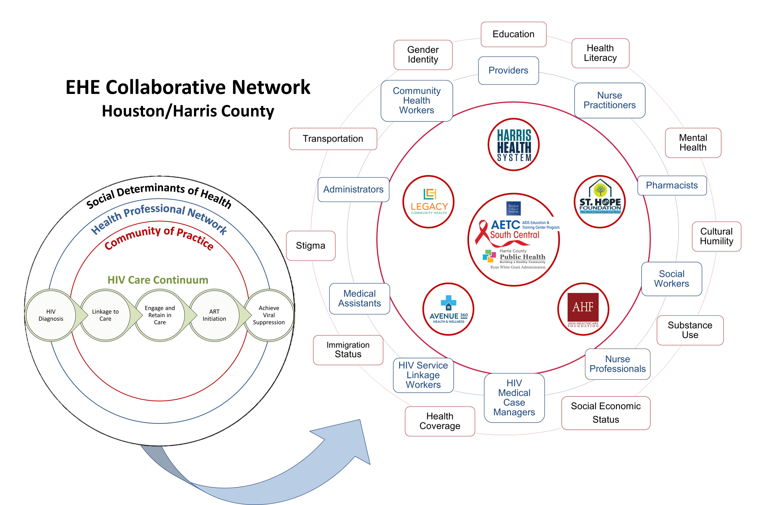
Comprehensive HIV Care Coordination
Created by SM Patel, MD & N Rodriguez, MPH

Slide 35
Additional References
Julia E. Hood, Matthew R. Golden, James P. Hughes, Steven M. Goodreau, Azfar-E-Alam Siddiqi, Susan E. Buskin & Stephen E. Hawes (2017) Projected demographic composition of the United States population of people living with diagnosed HIV, AIDS Care, 29:12, 1543-1550, DOI: 10.1080/09540121.2017.1308466
healthhiv.org/wpcontent/uploads/2021/07/HealthHIV_Second_Annual_State_of_Aging_with_HIV.pdf
https://primeinc.org/resourcecenter/practical-toolkit-for-providing-holistic-care-for-aging-people-with-hiv

Slide 36
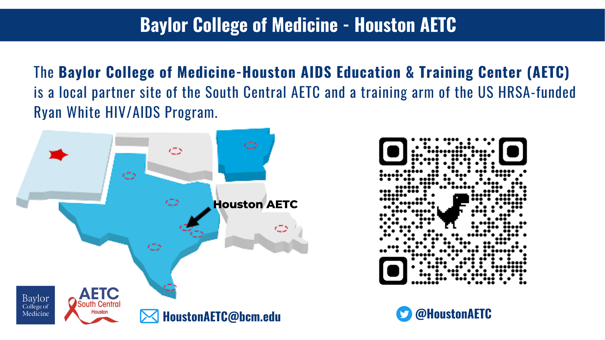

Slide 37
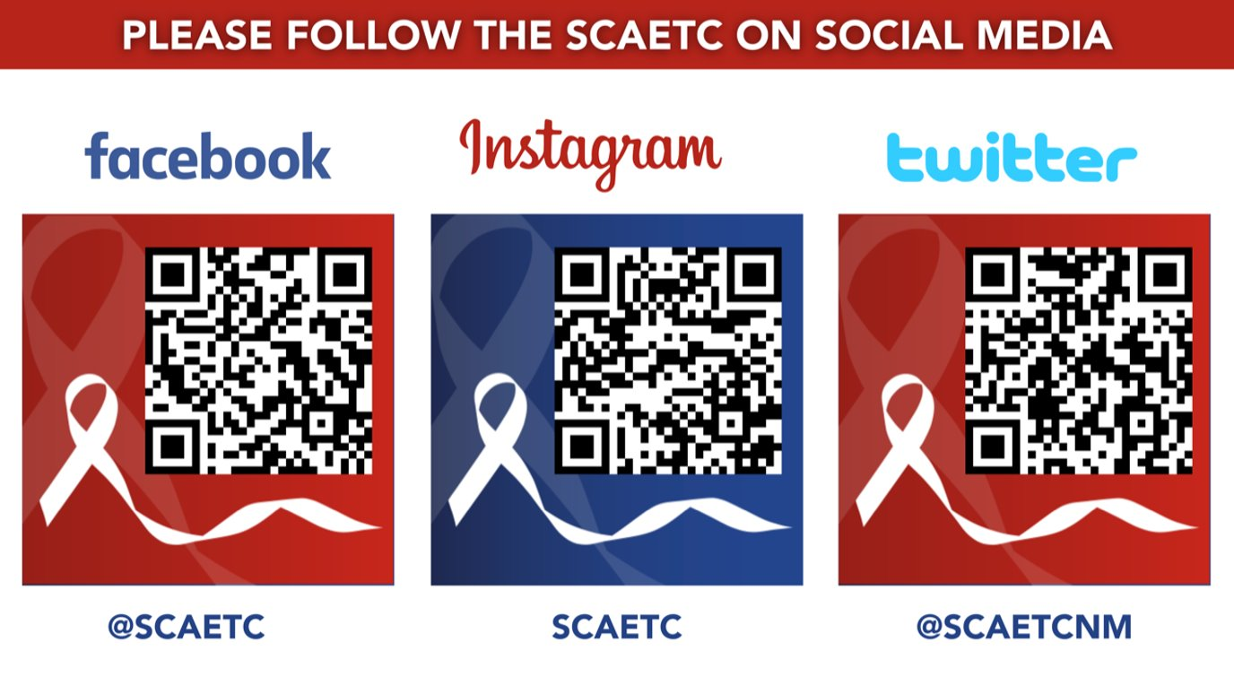
SCAETC Social Media

Slide 38
Resources
National Clinician Consultation Center http://nccc.ucsf.edu/
  HIV Management
  Perinatal HIV
  HIV PrEP
  HIV PEP line
  HCV Management
  Substance Use Management
Present case on ECHO hivecho@salud.unm.edu
AETC National HIV Curriculum https://aidsetc.org/nhc
AETC National Coordinating Resource Center https://targethiv.org/library/aetc-national-coordinating-resource-center-0
Additional trainings scaetcecho@salud.unm.edu
www.scaetc.org
Notes:
Find an HIV-related topic TeleECHO in your area: https://echo.unm.edu/locations-2/echo-hubs-superhubs-united-states/
IDEA Platform: Infectious Diseases Education & Assessment. https://idea.medicine.uw.edu/
AETC National HIV Curriculum: 6 core modules for self study; regularly updated; CME, CNE
Hepatitis C Online Curriculum: https://www.hepatitisc.uw.edu/
Hepatitis B Online Curriculum: https://www.hepatitisb.uw.edu/
National STD Curriculum: https://www.std.uw.edu/

