Slide 1
HIV Medication Adherence Strategies
Carly Floyd, PharmD, PhC, AAHIVP, CDCES, TTS
UNM-AETC, Clinical Director
Albuquerque, New Mexico
Notes:
Include version date:_05 2023

Slide 2
Conflict of Interest Disclosure Statement
Speaker has nothing to disclose
This program is supported by the Health Resources and Services Administration (HRSA) of the U.S. Department of Health and Human Services (HHS) as part of an award totaling $3,132,205, with 0% financed with non-governmental sources. The contents are those of the author(s) and do not necessarily represent the official views of, nor an endorsement of, by HRSA, HHS, or the U.S. Government. For more information, please visit HRSA.gov.

Slide 3
Use of Trade/Brand Names
This program is supported by the Health Resources and Services Administration (HRSA) of the U.S. Department of Health and Human Services (HHS) as part of an award totaling $3,132,205, with 0% financed with non-governmental sources.
The views expressed do not necessarily reflect the official policies of the Department of Health and Human Services, nor does mention of trade names, commercial practices, or organizations imply endorsement by the U.S. Government. Any trade/brand names for products mentioned during this presentation are for training and identification purposes only.
Notes:
NOTE: THIS SLIDE MUST BE INCLUDED IF TRADE AND/OR BRAND NAMES FOR MEDICATIONS ARE USED IN THE PRESENTATION.
IT MAY BE DELETED IF THERE IS NO REFERENCE TO TRADE NAMES, INCLUDING PRESENTATIONS IN WHICH ONLY GENERIC MEDICATION NAMES ARE MENTIONED.
TRADE NAMES MUST BE PUT IN PARENTHESES AFTER THE GENERIC NAME THE FIRST TIME IT IS MENTIONED - E.G., FLUOXETINE (PROZAC). TRADE NAMES SHOULD ONLY BE MENTIONED FOR THE INITIAL REFERENCE AND THE GENERIC NAME ONLY SHOULD BE USED AFTER THAT. THIS APPLIES EQUALLY TO ALL MEDICATIONS OR PRODUCTS MENTIONED IN THIS PRESENTATION.

Slide 4
Learning Objectives
Identify factors that affect medication adherence for people with HIV (PWH).
Recognize the importance of a patient-centered approach to antiretroviral therapy (ART) adherence.
Describe strategies to help improve ART adherence.

Slide 5
Text projectecho442
to 22333
Or scan this code
Notes:
Poll Title: Do not modify the notes in this section to avoid tampering with the Poll Everywhere activity. More info at polleverywhere.com/support Join instructions https://www.polleverywhere.com/join_instructions

Slide 6
Notes:
Poll Title: Do not modify the notes in this section to avoid tampering with the Poll Everywhere activity. More info at polleverywhere.com/support Please share your profession/role https://www.polleverywhere.com/free_text_polls/kSUsxGJbT33SDV4IPrl3z

Slide 7
Notes:
Poll Title: Do not modify the notes in this section to avoid tampering with the Poll Everywhere activity. More info at polleverywhere.com/support What are some medication adherence barriers patients have shared with you or your team? https://www.polleverywhere.com/free_text_polls/510T2nzmXrrK8j8Ou0nW8

Slide 8
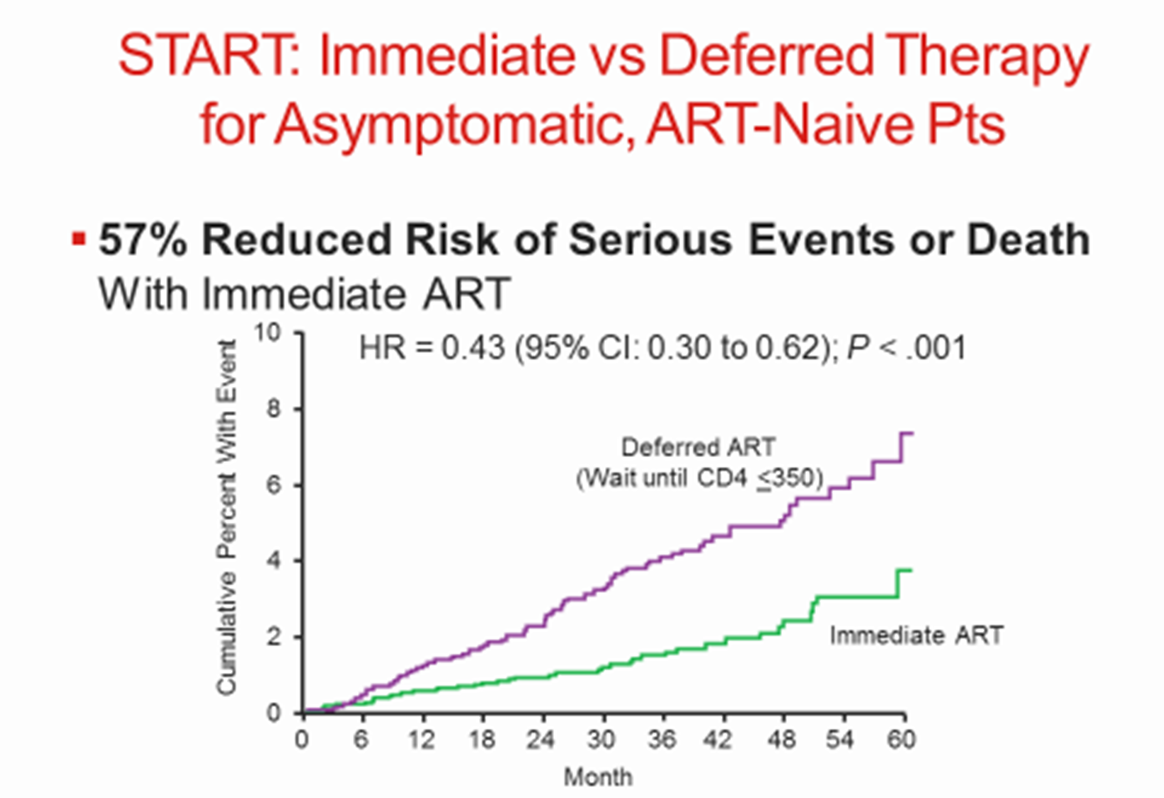
HIV Replication Increases Mortality
Total cumulative exposure to replicating virus over time is independently associated with mortality
Mugavero, et al. CID 2011;53(9):927-935. INSIGHT START Group. NEJM. 2015;373:795-807.

Slide 9
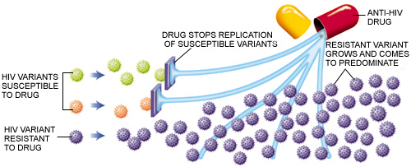
Suboptimal Adherence Leads to Resistance
AETC National Resource Center

Slide 10
Treatment IS Prevention
Studies from 2008-2016 show zero linked HIV transmissions after >100,000 condomless sex acts
PWH had a durably undetectable viral load
Cohen, et al. NEJM 2011; 365: 493-505. Skarbinski J, et al. JAMA Intern Med 2015;175:588-96.
Bavinton BR, et al. Lancet HIV. 2018. IAS 2018 http://programme.aids2018.org/Abstract/Abstract/13470
Notes:
HPTN 052 was the randomized trial of starting people earlier vs later and showed very few—only 1—HIV transmission.
Three observational cohort studies were PARTNER, Opposites Attract, PARTNER 2. PARTNER had some heterosexual couples, and then the other 2 were all men who had sex with men. These are couples where one partner is positive and one is negative. The person who is positive is taking antiretroviral therapy. HIV-1 RNA to be and stay at < 200 copies/mL. In all 3 studies, there were very large numbers of condomless sex acts—more than 100,000—and there were no linked HIV transmissions, evidence that U = U means a lot.
The CDC and other multiple organizations have endorsed U = U and shows why it’s connected to rapid antiretroviral therapy—the sooner that you get your virus down to undetectable, the sooner you’re undetectable and you’re untransmittable.

Slide 11
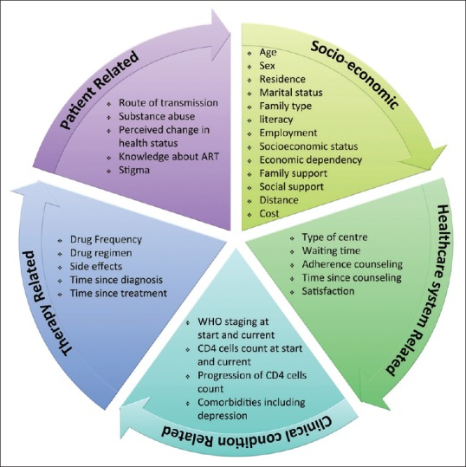
5 Dimensions of Adherence to Antiretroviral Therapy (ART)
Alvi Y, et al. Indian J Community Med. 2019;44(2):118-124. doi:10.4103/ijcm.IJCM_164_18

Slide 12
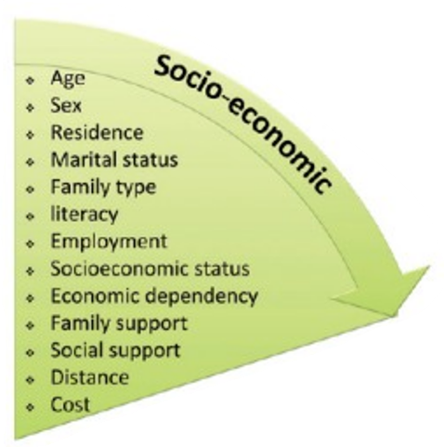
Socio-economic Factors
Language barriers
Unstable living conditions
Medication cost
Cultural and lay beliefs about illness and treatment
Lack of family or social support network
Living in rural communities
Image adapted from: Alvi Y, et al. 2019;44(2):118-124
Muessig, KE et al. AIDS Patient Care and STDs. October 2015;29(11): 606-616. American College of Preventive Medicine.

Slide 13
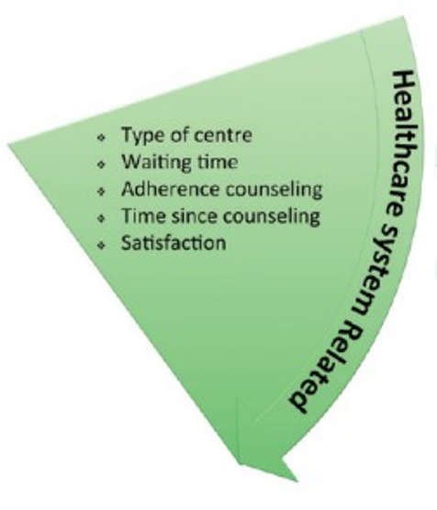
Healthcare System Factors
Patient-healthcare provider relationship
Struggling with ART and healthcare providers
Perceived limited treatment options,
shock at diagnosis
Tensions with providers (stigma, paternalism, mistrust)
Advocating for and educating oneself
Supportive providers
Image adapted from: Alvi Y, et al. 2019;44(2):118-124
Muessig, KE et al. AIDS Patient Care and STDs. October 2015;29(11): 606-616. American College of Preventive Medicine.

Slide 14
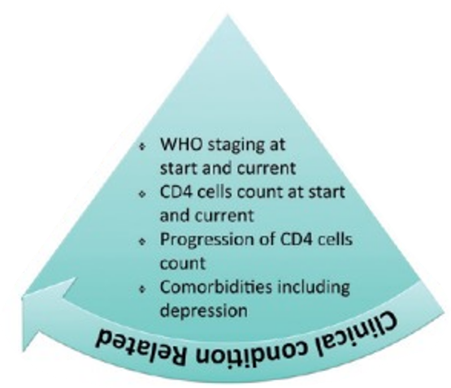
Clinical Condition Factors
Illness-related demands faced by the patient
Strong determinants:
Severity of symptoms
Level of disability
Rate of progression
Available effective treatments
Impact dependent on influence of patient’s risk perception
Image adapted from: Alvi Y, et al. 2019;44(2):118-124
Muessig, KE et al. AIDS Patient Care and STDs. October 2015;29(11): 606-616. American College of Preventive Medicine.

Slide 15
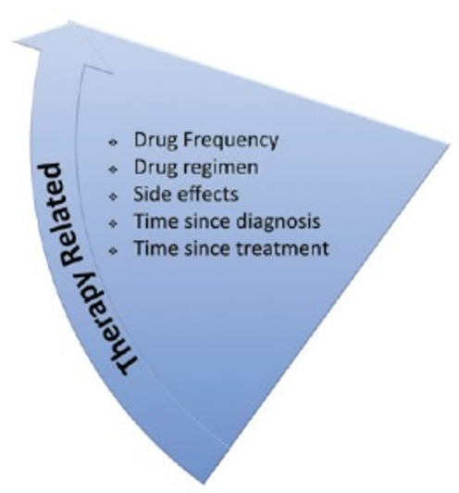
ART Factors
Dosing complexity
Food requirements
Struggling with ART and one’s body
Pill burden
Perceived impact on the body
Developing medication practices that work for one’s life
Managing comorbidities
Image adapted from: Alvi Y, et al. 2019;44(2):118-124
Muessig, KE et al. AIDS Patient Care and STDs. October 2015;29(11): 606-616. American College of Preventive Medicine.

Slide 16
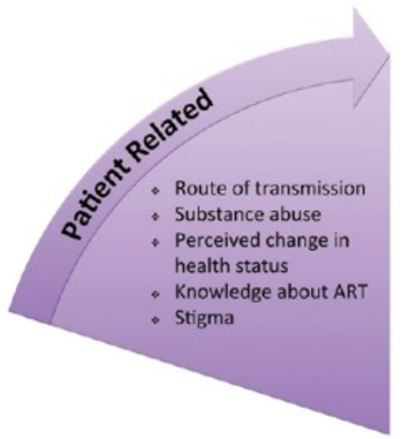
Patient-Related Factors
Physical factors:
Impairment (e.g., visual, hearing, cognitive)
Swallowing problems
Psychological/behavioral factors:
Substance use
Youth
Active depression
Desire for control over one’s life & death, fear of ART, fear of death
Denial of HIV status
Beliefs of HIV, CD4, viral load and ART +/- skepticism
Image adapted from: Alvi Y, et al. 2019;44(2):118-124
Muessig, KE et al. AIDS Patient Care and STDs. October 2015;29(11): 606-616. American College of Preventive Medicine.

Slide 17
Centering the Person
“What are your priorities for your health?”
Priorities may be very different from ours- this is ok!
Answers can guide healthcare team
Motivational interviewing
What is a typical day like for them?
Does schedule change on the weekends? Travel?
Circumstances/lifestyle changes over time

Slide 18
Strategies to Improve ART Adherence
Design a plan the patient can commit to
Consider:
Patient’s daily schedule and lifestyle
Priorities for health
Tolerance of pill number, size, frequency
Issues affecting absorption (e.g., acid suppressants, food requirements)
https://clinicalinfo.hiv.gov/en/guidelines/hiv-clinical-guidelines-adult-and-adolescent-arv/adherence-continuum-care?view=full
Notes:
Regimens are selected based on a variety of factors to optimize chances for treatment success
Let all patients know that there are resources to assist them in staying on ART and they should communicate any access issues to their provider or case manager immediately

Slide 19
Strategies to Improve ART Adherence
Establish trust & maintain good communication
Medication reminder aids
Text messaging
Pill boxes, pill box monitors, bubble packing
Alarms, apps
Calls for missed appointments or med pickups
Positive reinforcement & motivational interviewing
https://clinicalinfo.hiv.gov/en/guidelines/hiv-clinical-guidelines-adult-and-adolescent-arv/adherence-continuum-care?view=full
Notes:
Community resources to promote adherence (e.g., family, peer advocates)
Retention coordinator
Point person for managing retention efforts
Software/flowsheet to track appointments

Slide 20
Strategies to Improve ART Adherence
Education for each new patient
HIV infection basics
Goals of therapy
Importance of adherence
Potential for development of resistance with suboptimal adherence
Assess barriers every visit
https://clinicalinfo.hiv.gov/en/guidelines/hiv-clinical-guidelines-adult-and-adolescent-arv/adherence-continuum-care?view=full

Slide 21
Strategies to Improve ART Adherence
Assess barriers & develop multidisciplinary plan
Explain process for obtaining ART & refills
Transportation
Insurance, copay assistance, AIDS Drug Assistance Programs (ADAP)
Rapid start at time of diagnosis
Collaborate with pharmacy
https://clinicalinfo.hiv.gov/en/guidelines/hiv-clinical-guidelines-adult-and-adolescent-arv/adherence-continuum-care?view=full

Slide 22
Where We’ve Been
1990 to 2010
Life saving, but toxic and complex
Refinement of drugs within a class
2015 to 2021
Focus on combo regimens
Higher barrier to resistance
Advantages in tx-naïve & experienced
↓ side effects, easier dosing
Evolution of 2 drug regimens & injectables
↑ convenience- many dosed once/day
2010 to 2015
New classes of drugs rapidly evolving
https://hivinfo.nih.gov/understanding-hiv/infographics/fda-approval-hiv-medicines
slide courtesy of Dr. Linda Gorgos, MD

Slide 23
Where Are We Going?
New mechanisms of action
Role in treatment experienced and treatment naïve
Less toxicity
Engaging the immune system
Extended dosing intervals
Weekly, monthly, and beyond….
A good partner is needed – aligned dosing intervals
Alternate dosing methods
Injectables, implants, infusions
Tailored to what individual wants across time
Available, studied, & deliverable in multiple settings – less resourced settings, pediatric populations, women, pregnancy
slide courtesy of Dr. Linda Gorgos, MD

Slide 24
Antiretrovirals with New Mechanisms of Action
Capsid Inhibitors
Lenacapavir – recently approved for use in multidrug resistance
Maturation Inhibitors
GSK 3640254 – Phase 2 trials in treatment naive
Nucleoside Reverse Transcription Translocation Inhibitors (NRTTI)
Islatravir – in Phase 2 and Phase 3 trials
Immune based therapy
Broadly neutralizing antibodies (bNAbs) - Phase 1 & Phase 2 trials for treatment
slide courtesy of Dr. Linda Gorgos, MD

Slide 25
Novel Delivery Mechanisms
Multi-drug Nanoparticle Injectables
Refillable Implants
Ultra Long-Acting Implants
Grattoni A et al, Ultra long-acting refillable islatravir implant fully protects NHP against SHIV, CROI 2023, Abstract 192
Young I et al, Pharmacokinetics and Xray Imaging of Long Acting Cabotegravir In Situ forming Implant, CROI 2023, Abstract 991
Fofana J et al, Dual antiretroviral loaded nanoparticles for long-acting suppressive HIV therapy, CROI 2023, Abstract 427
slide courtesy of Dr. Linda Gorgos, MD
Notes:
All animal data to date

Slide 26
The hope for long-acting therapy
High demand
Patients want it!
Unrealized potential for current long acting injectables
Implementation hurdles
Delivery in less resourced settings
slide courtesy of Dr. Linda Gorgos, MD
Notes:
Getting new ARVs to those who most need them!

Slide 27
Long-Acting Injectables: Benefits
Less frequent dosing
Avoidance of “pill fatigue”
Oral dosing bypassed; ~100% bioavailable
↓ adverse events (AEs)
↓ drug-drug interactions (DDIs)
Protection of health privacy
Avoidance of HIV-related stigma
Improved adherence?

Slide 28
Long-Acting Injectables: Challenges
Patients
Large injection volumes
Body habitus
+/- oral lead in
Coverage of the “tail”
Development of drug resistance
? use in children & pregnancy
? use in virologic suppression
Workforce
Management of missed doses, DDIs, serious AEs
Clinic workflows
Tracking patients
Logistics
Insurance coverage, billing/payment
Med shipments
Notes:
Gandhi M, High Virologic Suppression Rates on Long-Acting ART in a Safety-Net Clinic Population (https://www.croiwebcasts.org/p/2023croi/croi/518)

Slide 29
Long-Acting Injectables: Lessons Learned
Managing side effects:
Anticipatory guidance goes a long way
Heat/cold
Ibuprofen/acetaminophen
Before and/or after injections
Encourage movement, but not overexertion
Plan activities accordingly

Slide 30
Long-Acting Injectables (LAI): Lessons Learned
Scheduling Considerations
Long-acting navigator? Pharmacist/tech, RN, MA, CHW
Plan for success
Retention strategies
Those who may benefit most from LAI may be at highest risk for non adherence
Clinic | Patient | Exceptions
Staffing Space | Work School Personal Travel | Walk-ins Triaging patient concerns/issues unrelated to injections

Slide 31
Key Points
Adherence to ART and viral suppression:
improves mortality
decreases resistance
prevents HIV transmission
Challenges to adherence are multifactorial and require a patient-centered approach for success
Multidisciplinary teams needed
Long-acting injectables may help with adherence, but challenges remain

Slide 32
References
Cohen MS, et al. HPTN 052 Study Team. Prevention of HIV-1 infection with early antiretroviral therapy. N Engl J Med. 2011 Aug 11;365(6):493-505. doi: 10.1056/NEJMoa1105243. Epub 2011 Jul 18. PMID: 21767103; PMCID: PMC3200068.
Skarbinski J, Rosenberg E, Paz-Bailey G, Hall HI, Rose CE, Viall AH, Fagan JL, Lansky A, Mermin JH. Human immunodeficiency virus transmission at each step of the care continuum in the United States. JAMA Intern Med. 2015 Apr;175(4):588-96. doi: 10.1001/jamainternmed.2014.8180. PMID: 25706928.
Bavinton BR, Pinto AN, Phanuphak N, Grinsztejn B, Prestage GP, Zablotska-Manos IB, Jin F, Fairley CK, Moore R, Roth N, Bloch M, Pell C, McNulty AM, Baker D, Hoy J, Tee BK, Templeton DJ, Cooper DA, Emery S, Kelleher A, Grulich AE; Opposites Attract Study Group. Viral suppression and HIV transmission in serodiscordant male couples: an international, prospective, observational, cohort study. Lancet HIV. 2018 Aug;5(8):e438-e447. doi: 10.1016/S2352-3018(18)30132-2. Epub 2018 Jul 17. Erratum in: Lancet HIV. 2018 Oct;5(10):e545. PMID: 30025681.
Mugavero MJ, Napravnik S, Cole SR, et al. Viremia copy-years predicts mortality among treatment-naive HIV-infected patients initiating antiretroviral therapy. Clin Infect Dis. 2011;53(9):927-935. doi:10.1093/cid/cir526
INSIGHT START Study Group, Lundgren JD, Babiker AG, Gordin F, Emery S, Grund B, Sharma S, Avihingsanon A, Cooper DA, Fätkenheuer G, Llibre JM, Molina JM, Munderi P, Schechter M, Wood R, Klingman KL, Collins S, Lane HC, Phillips AN, Neaton JD. Initiation of Antiretroviral Therapy in Early Asymptomatic HIV Infection. N Engl J Med. 2015 Aug 27;373(9):795-807. doi: 10.1056/NEJMoa1506816. Epub 2015 Jul 20. PMID: 26192873; PMCID: PMC4569751.
Alvi Y, Khalique N, Ahmad A, Khan HS, Faizi N. World Health Organization Dimensions of Adherence to Antiretroviral Therapy: A Study at Antiretroviral Therapy Centre, Aligarh. Indian J Community Med. 2019;44(2):118-124. doi:10.4103/ijcm.IJCM_164_18
Muessig, KE et al. Medication-Taking Practices of Patients on Antiretroviral HIV Therapy: Control, Power, and Intentionality. AIDS Patient Care and STDs. October 2015;29(11): 606-616
HIV Guidelines: https://clinicalinfo.hiv.gov/en/guidelines/hiv-clinical-guidelines-adult-and-adolescent-arv/adherence-continuum-care?view=full
https://hivinfo.nih.gov/understanding-hiv/infographics/fda-approval-hiv-medicines
Grattoni A et al, Ultra long-acting refillable islatravir implant fully protects NHP against SHIV, CROI 2023, Abstract 192
Young I et al, Pharmacokinetics and Xray Imaging of Long Acting Cabotegravir In Situ forming Implant, CROI 2023, Abstract 991
Fofana J et al, Dual antiretroviral loaded nanoparticles for long-acting suppressive HIV therapy, CROI 2023, Abstract 427

Slide 33
SCAETC Social Media

Slide 34
Resources
National Clinician Consultation Center http://nccc.ucsf.edu/
HIV Management
Perinatal HIV
HIV PrEP
HIV PEP line
HCV Management
Substance Use Management
Present case on ECHO hivecho@salud.unm.edu
AETC National HIV Curriculum https://aidsetc.org/nhc
AETC National Coordinating Resource Center https://targethiv.org/library/aetc-national-coordinating-resource-center-0
Additional trainings scaetcecho@salud.unm.edu
www.scaetc.org
Notes:
Find an HIV-related topic TeleECHO in your area: https://echo.unm.edu/locations-2/echo-hubs-superhubs-united-states/
IDEA Platform: Infectious Diseases Education & Assessment. https://idea.medicine.uw.edu/
AETC National HIV Curriculum: 6 core modules for self study; regularly updated; CME, CNE
Hepatitis C Online Curriculum: https://www.hepatitisc.uw.edu/
Hepatitis B Online Curriculum: https://www.hepatitisb.uw.edu/
National STD Curriculum: https://www.std.uw.edu/

Slide 35
Notes:
Poll Title: Do not modify the notes in this section to avoid tampering with the Poll Everywhere activity. More info at polleverywhere.com/support Questions https://www.polleverywhere.com/free_text_polls/9z1QYaVDxYGXTz5yES8Qt

