Slide 1
Motivational Interviewing: A tool to improve health outcomes across the HIV Continuum
Kathryn Fergus
AETC Program Manager
Houston AIDS Education and Training Center
Baylor College of Medicine
Feb 15, 2023
Notes:
Version date:_2/15/23 pm_Email version to participants with additional reading slides entered back in

Slide 2
Kathryn Fergus
Attended the UH Graduate College of Social Work and has been serving individuals and communities impacted by HIV since 2015 with experience working in HIV prevention & care in both community-based organizations and healthcare settings.
Joined the Houston AETC 2021 and assists with developing training curricula and learning opportunities for HIV service providers and leads a Community of Practice program to support EHE initiatives and implementation of RAPID StART protocols within Ryan White funded clinics in the Houston area.
Current Advocacy & HIV Planning Associations: Community Co-Chair HHD HIV Prevention Community Planning Group, Ryan White Planning Council, Comprehensive HIV Planning Committee, African American State of Emergency Task Force
Program Manager
Houston AETC
Baylor College of Medicine
kathryn.fergus@bcm.edu
Presenter Profile
Notes:
Hello everyone, I want to first, welcome and acknowledge everyone here for taking the time and energy out of their day to be present for, what I hope to be an engaging learning opportunity and discussion, which Im grateful to be a part of, so thank you for having me.
My name is Kathryn Fergus, Pronouns SHE/HER/HERS, I have 20+ years experience in serving and advocating for vulnerable populations, with experience working in HIV prevention & care in both community-based organizations and healthcare settings, since 2015, before joining the Baylor College of Medicine Houston AIDS Education & Training Center team as the Program Manager in 2021.
In advocacy & HIV planning, I serve as the current Community Co-Chair of the Houston Health Department’s HIV Prevention Community Planning Group, am a member of Houston/Harris County Ryan White Planning Council, the African American State of Emergency Task Force, as well as other workgroups and community advisory boards focused on ending the HIV epidemic.

Slide 3
Conflict of Interest Disclosure Statement
Speaker has nothing to disclose
This program is supported by the Health Resources and Services Administration (HRSA) of the U.S. Department of Health and Human Services (HHS) as part of an award totaling $3,132,205, with 0% financed with non-governmental sources. The contents are those of the author(s) and do not necessarily represent the official views of, nor an endorsement of, by HRSA, HHS, or the U.S. Government. For more information, please visit HRSA.gov. Any trade/brand names for products mentioned during this presentation are for training and identification purposes only.

Slide 4
Group Agreements
Respect
Balanced Participation
Open to Learning
Confidentiality
Take Risks
People First & Non-Stigmatizing Language
Notes:
Before we get started, I want to review some expectations and agreements for this session, to ensure that we are able to maximize the impact of session by creating a safe space to explore, discuss and share thoughts, experience and ideas around the topics we will be discussing.
In addition to what is listed, feel free to share Some others you may be familiar with, like ELMO – Enough, Let’s Move On, which I aim to hold myself to, as well. ;)
Lastly, I want to state the importance of using and modeling Pl 1st and non-stigmatizing language, and remind that we don’t always get it right, it takes practice, and learning opportunities are just that, and can be done with respect, care, discussion if needed and ELMO.

Slide 5
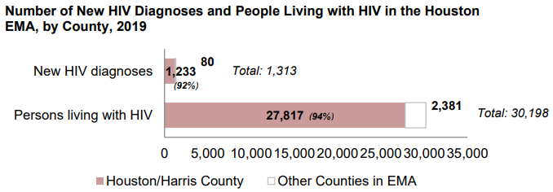
Purpose
Explore, discuss and expand skills, tools and strategies that frontline service providers can utilize and implement across the HIV continuum, to better understand, address and meet the needs of individuals and communities that are most vulnerable and in need of available HIV prevention and care services and support, yet not accessing care, remaining in care and reaching viral suppression.
To do this, we must:
Ask the right questions, in the right way, at the right time
Create safe spaces practicing empathy and cultural humility
Improve communication skills and respond to needs, motivations and priorities
Provide people with the tools, resources and education to improve overall health and well-being
https://www.houstontx.gov/health/HIV-STD/Documents/epi-profile-20220210.pdf
Notes:
Before I get into the objectives for today, I want to go over the reason and purpose for this discussion.
Overall, great strides have been made in HIV treatment, biomedical prevention and access to care in underserved communities. In Houston/Harris County, incredible work being is still being done by planning bodies, researchers, health departments, community advocates and providers to improve access to HIV prevention and care, reduce barriers and has even gained national recognition for innovative strategies that focus on improving quality of life, reducing stigma and addressing health equity and social determinates of health that is included in integrated EHE plans for Houston/HarrisCounty.
Yet, In both Houston/Harris County and the Houston EMA, the rates of new HIV diagnoses and prevalence continue to exceed rates for Texas, and the rate of new HIV diagnoses in Houston/Harris County is almost twice the rate for the U.S.
This graph is of the Houston EMA HIV care continuum for Houston EMA in 2019, and you will notice that it is not linear, as it represents PWH both previously diagnosed and newly diagnosed.
At the end of calendar year 2019, there were 30,198 diagnosed people with HIV in the Houston EMA, with 92% of those residing in Houston/Harris County.
• Of those 1,313 were new diagnoses of HIV reported in the Houston EMA with 94% residing in Houston/Harris County.
• So, among 30,149 HIV-diagnosed individuals ages 13 years or older in the Houston EMA in 2019, 75% had receipt of care (at least one CD4/VL test in year); 60% were retained in HIV care (at least two CD4/VL tests in year, at least three months apart ); 59% maintained or reached viral load suppression (≤200 copies/mL); and 63% among the newly diagnosed were linked to care.
This illustrates areas of focus needed within the HIV care continuum, and the purpose of our discussion today, which is to… Explore…. Which brings us to the objectives for today.

Slide 6
Learning Objectives
Discuss essential concepts and considerations that are important for Motivational Interviewing (MI)
Understand the importance of Motivational Interviewing (MI) as a tool to support health outcomes along the HIV Continuum
Build skills in utilizing Motivational Interviewing (MI) to improve health outcomes along the HIV Continuum
Notes:
Using motivational interviewing as a tool with a trauma-informed approach to meet the needs of clients falling within the gaps of the HIV Care Continuum….
Research shows that the therapeutic relationship (with service provider) & what the client brings with them impacts health outcomes the most – both positively & negatively.

Slide 7
Review of Essential Concepts & Considerations
Notes:
These are some of the building blocks that pertain to all services delivered, and hopefully with all people we encounter, and have relationships with within and outside of the work we do.

Slide 8
Trauma Informed Care
Core Principles of Practice
Empowerment, Voice, & Choice: Support patients having a say, Invite feedback early and often, Affirm and empower patients to take responsibility of their own health care
Collaboration & Mutuality: Patients share the role in making plans for care, Reinforce patient control and power in decision making about the process, Respect their feedback
Safety: Creating an environment that is welcoming, feels safe, maintains privacy, consider environmental triggers
Trustworthiness & Transparency: Creating clear expectations with clients about what proposed treatments entail, who, how and when services will be provided. Maintain clear professional boundaries, and be upfront about what can and cannot be done
Humility & Responsiveness to Cultural, Historical, & Gender Issues: Practice cultural humility, Practice reflection on your own experience in the world and how this may affect interactions with patients
M. Harris and R. Fallot (Eds.). “Using Trauma Theory to Design Service Systems.” New Directions for Mental Health Services, no. 89; (2001).
Notes:
Within practice and within organizations - Research shows that the therapeutic relationship (with service provider) & what the client brings with them (ie: Resilience) impacts health outcomes the most – both, both positively & negatively.
Empowerment, Voice, & Choice:
Collaboration & Mutuality:
Safety: (Consider trauma of exam room)
Trustworthiness & Transparency: Be genuine and honest in setting and managing expectations
Humility & Responsiveness to Cultural, Historical, & Gender Issues:
How do you show up in the world?
What are your hot spots?
What are your blind spots?

Slide 9
Presentation and Representation:
Understanding how you show up, will help you to better understand how your clients are showing up.
Communication
Language
Context
Intention
Norms = Standards
Values = The standards one chooses as important
Beliefs = standards one lives by
Notes:
Notice on the last statement – the word “Chooses” to live by… Why do you think the word may have been omitted in the last statement?

Slide 10
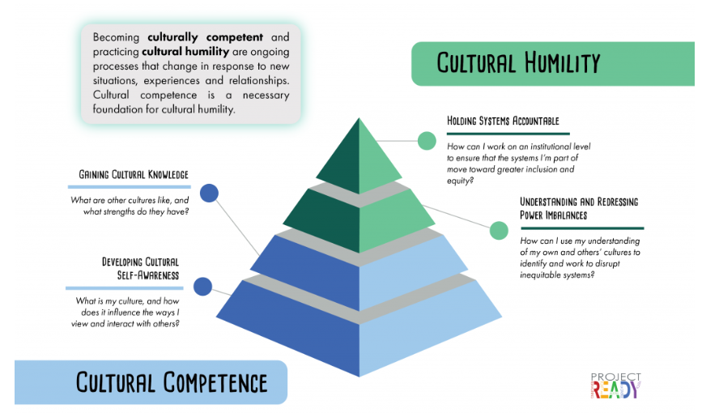
(Tervalon M., Murray-García J. (1998). Cultural humility versus cultural competence: A critical distinction in defining physician training outcomes in multicultural education. Journal of Health Care for the Poor and Underserved, 9, 117-125.

Slide 11
Traumatic Events & Experiences
Grief/Betrayal/Loss of loved one, relationships, resources, security, support, job, trust, medical care | Political Unrest, Terrorism, Refugee, War Zone, Religious Persecution, Kidnapping, Racism, Sexism, Homophobia, Transphobia
Abandonment, Neglect, Separation, Rejection, Isolation, Quarantine, Forced Confinement | Serious Medical/Mental Illness/Disability - diagnosis, hospitalization, treatment, symptoms, suicide
Natural/Man-made Accidents, Disaster | Incarceration/Judicial System/Interactions with Police/ Authority figures, Child Protective Services (CPS), Foster Care
Homelessness, Frequent Moves, Eviction, Home Invasion | Physical/sexual/emotional/verbal/financial Abuse, Coercion, Assault
Physical/cyber/emotional Bullying, Stalking, Harassment, | Violence – Intimate Partner/Domestic (IP/D), community, school, towards animals, robbery, murder, rape, incest
Notes:
What is traumatic to you may not be traumatic to me, vice versa
This can be an event that is experienced or witnessed, over time, in the past or in the moment
Normalize the reactions (“Normal reaction to abnormal experience”)
Consider power imbalance as trauma- IPV & SIRR

Slide 12
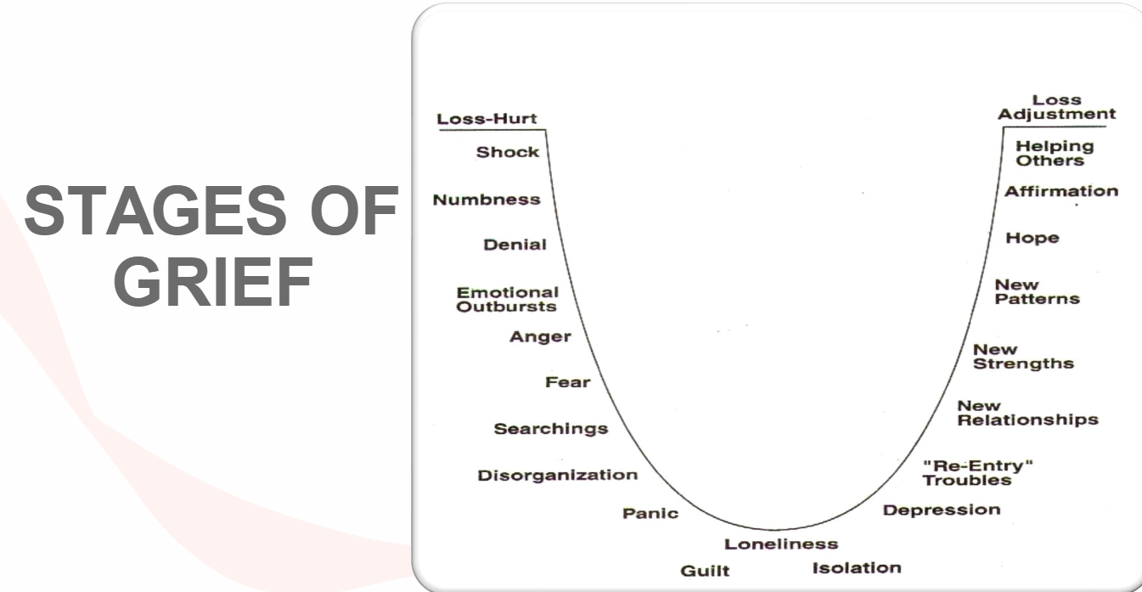
Normalize the Process: Getting through it vs over it
http://changingminds.org/disciplines/change_management/kubler_ross/kubler_ross.htm
Notes:
Grief and loss – healing & hope, anxiety from fear of unknown… think about a time when someone has tried to encourage you and it made you feel worse… ie: “ it could be worse”, “be grateful for what you DO have”, “you need to just get over it.
It is normal to have these feelings when you have experienced loss and the stages are not linear, but you do have to move through them to heal… getting stuck in one or more stages, just keeps you stuck…

Slide 13
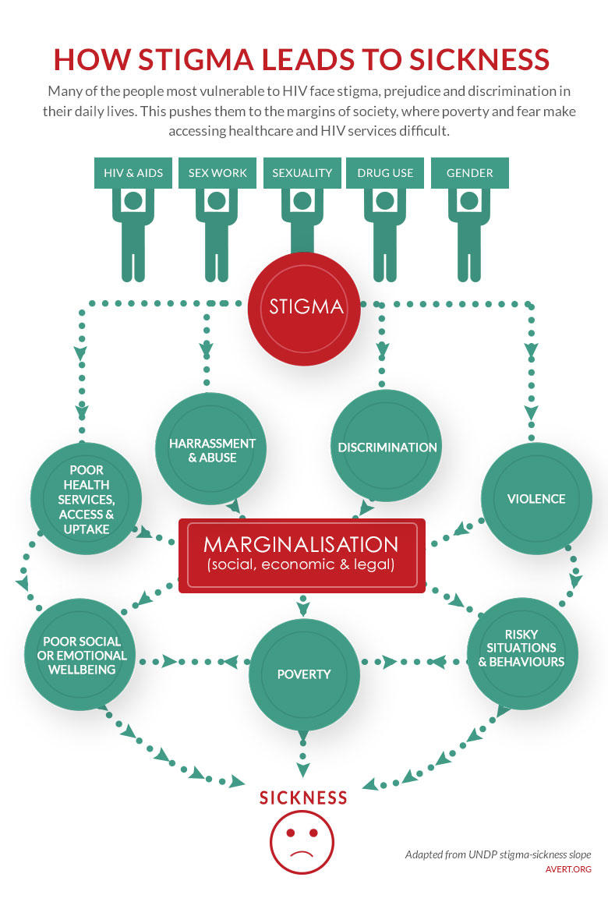
How Stigma Leads To Sickness
Poor health outcomes
https://www.beintheknow.org/understanding-hiv-epidemic/context/stigma-and-hiv
Notes:
Many of the people most vulnerable to HIV face stigma, prejudice and discrimination in their daily lives, that pushed them to the margins of society where poverty and fear make accessing healthcare and HIV services difficult
How do the experiences impact someone accessing and navigating their health… how might this be traumatizing, make you not want to come back
The disapproval of or discrimination against, a person based on perceivable social characteristics that serve to distinguish them from other members of a society.
Based on:
Age, Culture, Gender, Health, Intelligence, Race, Sexual ID, Socioeconomic Status, Religion, Etc.
Promotes:
Labeling, Stereotyping, Unconscious Bias, Micro aggressions
Leads to:
Judgmental Interactions, Isolation, Marginalization, Health Inequity, Barriers to Engagement & Retention in Care

Slide 14
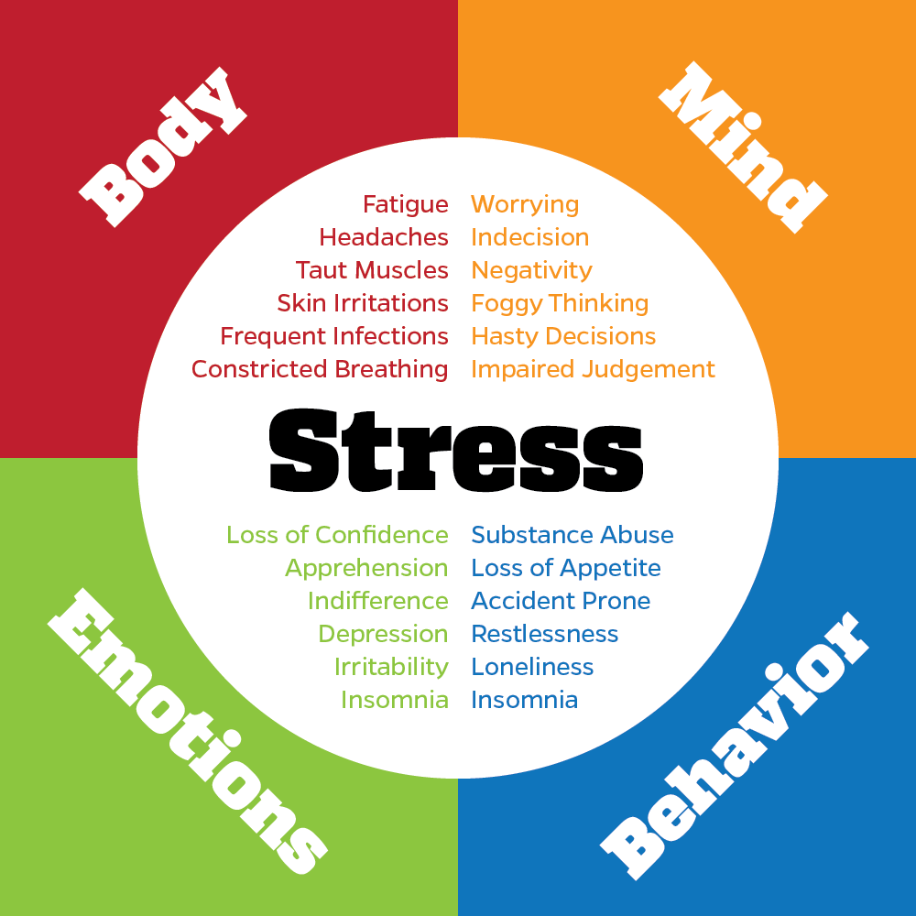
Acute & Prolonged Impacts of Stress
https://www.mayoclinic.org/healthy-lifestyle/stress-management/in-depth/stress-symptoms/art-20050987
Notes:
Mental and physical impacts of stress are REAL, we have all felt it… Navigating healthcare can be stressful, navigating all the reasons you are having to access HIV prevention & care are stressful… coping with stress is stressful!

Slide 15
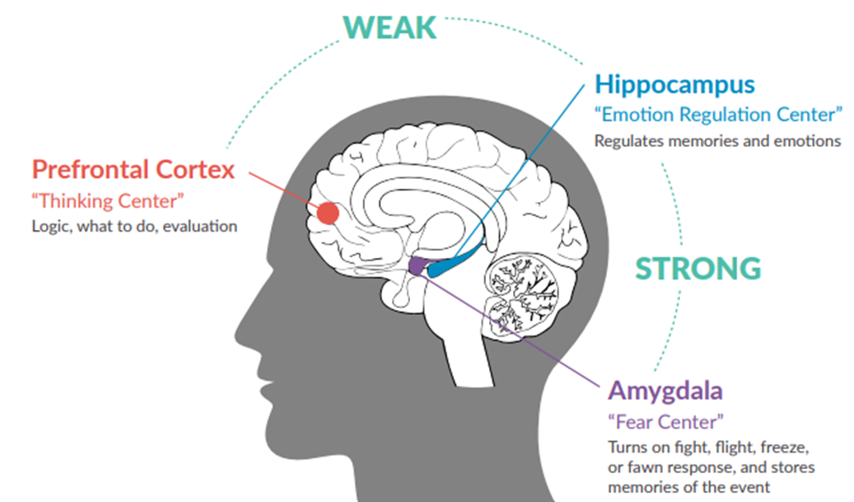
Traumatic stress responses
Fight – Temper and angry outbursts, aggressive, dominates and controls, demands perfection from others, pursues power and control, impulsive decision making, critical and rageful
Flight – Feelings of panic and anxiety, obsessive or compulsive disorders, always on the go or staying busy, over worrying, hyperactive, over analytical
Freeze – Depression, dissociation, brain fog, avoiding human contact, detached, struggles with decisions, hibernating, isolation, lifeless
Fawn – People pleasing, co-dependent, lack of boundaries, defers to others to make decisions, avoids conflicts, concerned about fitting in
https://www.helpguide.org/articles/ptsd-trauma/coping-with-emotional-and-psychological-trauma.htm
Notes:
Three primary areas of the brain are impacted by trauma and resilience, the prefrontal cortex and hippocampus regions are weakened, meanwhile, the amygdala is on high alert.
Helpful to implementing trauma-informed approaches and can also help providers better understand the actions and responses of individuals who have experienced trauma.
During and after a traumatic experience, the brain’s amygdala can be shifted into overdrive, making a person significantly more attuned to potential threats in their physical surrounding. It also causes strong emotional reactions to certain people or situations – these are known as triggers.
Triggers can be anything, including: a smell, sound, voice recording, picture, or a question. They bring back memories or emotions associated with a traumatic event. Such memories can be highly intrusive and extremely painful because it forces the person into re-experiencing the crime or trauma all over again. It is even possible for their body to have corresponding physiological responses, such as a racing heartbeat, bodily shaking, crying, etc.
When there is a trigger, the victim may seem paranoid and mistrustful, causing them to shut down. Be aware of their need to feel safe, and if they seem upset or afraid, offer them the opportunity to take a break.
Consider alternative locations for interviewing that promote feelings of neutrality and trust (meet the victim at a location where they feel safe).
How might a Trauma Response present during diagnosis?
How might these be misinterpreted? What assumptions are made?
What are the possible assumptions/provider reactions?
Is there an opportunity to engage the individual in holistic care or support (i.e., providing for their physical, mental, spiritual, and social needs)? If so, what would that look like?

Slide 16
Resilience
Refers to a person’s ability to recover from and adapt to difficult experiences.
The most common resilience factor is the existence of a caring and supportive relationship.
Other resilience factors include the capacity to make and follow through with plans, a positive self-view and confidence in one’s strengths and abilities.
It also includes the ability to communicate, problem solve, and the capacity to manage feelings and impulses.
For those individuals engaged in care, resilience is positively associated with treatment adherence and undetectable viral load.
Resilience (harvard.edu)
Notes:
The single most common factor for children who develop resilience is at least one stable and committed relationship with a supportive parent, caregiver, or other adult. These relationships provide the personalized responsiveness, scaffolding, and protection that buffer children from developmental disruption. They also build key capacities—such as the ability to plan, monitor, and regulate behavior—that enable children to respond adaptively to adversity and thrive. This combination of supportive relationships, adaptive skill-building, and positive experiences is the foundation of resilience.

Slide 17
Trauma-informed Service Providers
What You should know, understands, acknowledge, and be aware of:
People with HIV (PWH) are more likely to experience ongoing/increased traumatic experiences due to HIV and/or in addition to HIV.
PWH may engage with healthcare and service providers differently for different reasons related to past, ongoing and/or acute trauma that may or may not have been caused by, attributed to or related to HIV or in addition to HIV.
Structural, social and generational factors vs. traumatic events/experiences and normal vs. abnormal trauma is different for everyone.
1. SAMHSA Trauma Informed Care Approach Improving Care for People Living with HIV
2. LeGrand, S., et al. (2015). A Review of Recent Literature on Trauma Among Individuals Living with HIV. Current HIV/AIDS reports, 12(4), 397–405.
PTSD= post-traumatic stress disorder
Notes:
i.e. increased isolation, stress, fears, shame, discrimination, stigma, medical encounters – social determinates of health/why disproportionately impacted by or at higher risk for HIV
-PWH report high levels of trauma exposure, both in childhood and adulthood
2. Ie: Experiences of trauma without adequate protective factors, especially in childhood, can change a person’s brain structure, contributing to long-term physical and behavioral health problems.
, coping skills, fight, flight or freeze, PTSD, Stress, anxiety, depression
3. Traumas can be experienced by a single individual (e.g., sexual assault) or an entire population (e.g., slavery).
-Trauma can be a onetime event (e.g., natural disaster or loss of a loved one), repeated events (e.g., abuse or neglect), or a vicarious event (e.g., witnessing trauma experienced by another).
4-5. Exposure to trauma is associated with development of depression, PTSD, and anxiety (among other conditions)

Slide 18
Trauma-informed Service Providers cont’d
Avoiding and resisting potential triggers and possible re-traumatization with intentional care and engagement is essential.
Impacts and exposure to trauma are associated with negative physical and mental health outcomes
Trauma can be a direct barrier to accessing and retaining necessary care, and associated with poor adherence, increased viral load, and poor engagement when unaddressed, and impacts increase when a person is blamed, shamed, silenced ignored, or not believed, especially by a trusted caregiver or service provider

Slide 19
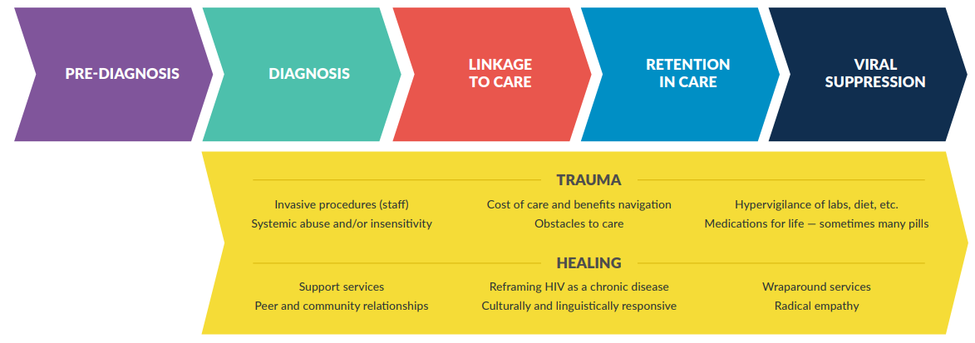
Trauma and Healing Across The HIV Continuum
Past and current traumatic experiences can have impacts along the HIV continuum and can contribute to an individual’s health outcomes; however, opportunities for healing across the continuum are plentiful.
https://nastad.org/trauma-informed-approaches-toolkit/trauma-and-healing-across-hiv-continuum
Notes:
Pre-Diagnosis
Traumatic experiences can be the cause of exposure to HIV and/or lead to coping skills, attitudes, beliefs and behaviors, regardless of socioeconomic status, or health literacy, that may impact:
Risk for HIV within or outside of their control
Access to testing and prevention services, healthcare, resources and support
A status-neutral approach incorporates a trauma informed approach to HIV testing and offers linkage to prevention services for people who test negative.
Prevention services, including use of Pre-exposure prophylaxis (PrEP), should be trauma-informed and include culturally and linguistically responsive testing, information, and referral services.
however, opportunities for healing across the continuum are plentiful.
Diagnosis
The impact of receiving an HIV diagnosis can be exacerbated by:
Method of delivery (e.g., by letter, phone call, or partner disclosure)
Person delivering the diagnosis (e.g., use of stigmatizing language, discriminatory practices or treatment, or lack of training)
Health of the person receiving the diagnosis (e.g., the person is experiencing a life-threatening illness at time of diagnosis)
Timeliness of the diagnosis (e.g., lab results taking longer than expected or are inconclusive).
Other related fears (e.g., disclosures, threat of intimate partner violence).
Linkage to Care
The experience of linking to care may be traumatic due to:
Invasive medical procedures, insensitive providers, cost of care, and navigation of health and medication benefits.
Required disease investigation services may be intrusive and raise questions about privacy and confidentiality for individuals just diagnosed.
Other obstacles to care include housing, transportation, adequate treatment for mental health and substance use disorder, health literacy, documentation requirements, and language and cultural barriers
Retention in Care
People who have experienced trauma often have difficulty staying in care, and despite the best intentions of providers, as HIV medical care and support services can be re-traumatizing.
Examples:
Providers may be late, rushed, or distracted during an appointment; use overly complicated or redundant forms, procedures, or policies; expect perfect adherence or immediate behavior change; and ignore client’s perspectives about treatment or services.
A provider that they have built a relationship with/trust, is no longer employed there, out sick or on vacation, but a client was not informed until they have first felt ignored or abandoned.
Viral Suppression
It is important to consider that viral suppression may not be a goal for an individual; perhaps housing or social and emotional support are their priorities.
Although we know viral suppression is key to the physical health of a person with HIV and their community, as well as to the RWHAP, it is important to consider the way that individuals define health and wellness and meet them where they are.
For those individuals engaged in care, resilience is positively associated with treatment adherence and undetectable viral load.
Conversely, trauma can be associated with a variety of poor health outcomes, including treatment adherence issues.
Considerations:
What is the language utilized when discussing the importance of viral suppression with an individual?
Does the individual even understand the term?
How do you assess contributing factors leading to viral suppression?
How do you assess for health literacy, assumptions, myths and motivations for adherence, retention and viral suppression?
Putting it all together in the context of frontline services
What tools are available…meaning free to you and your organization, don’t require permission to implement, every human interaction in your life is practice, is evidence based, and makes sense to you in the context of how you might wanted to be treated

Slide 20
Pre-Diagnosis
Traumatic experiences can be the cause of exposure to HIV and/or lead to coping skills, attitudes, beliefs and behaviors, regardless of socioeconomic status, level of education or health literacy, that may impact:
Risk for HIV within or outside of their control
Access to testing and prevention services, healthcare, resources and support
A status-neutral approach incorporates a trauma informed approach to HIV testing and offers linkage to prevention services for people who test negative.
Prevention services, including use of Pre-exposure prophylaxis (PrEP), should be trauma-informed and include culturally and linguistically responsive testing, information, and referral services.
https://nastad.org/trauma-informed-approaches-toolkit/trauma-and-healing-across-hiv-continuum
Notes:
Examples of
Risk: sexual practices, sexual assault, sex trafficking, sex work, substance use, incest, partner cheating, occupational/needle stick
Access: Shame, fear, denial, poverty, stigma, abusive/controlling partner or caregiver, disclosure to parents, substance

Slide 21
Diagnosis
The impact of receiving an HIV diagnosis can be exacerbated by:
Method of delivery (e.g., by letter, phone call, or partner disclosure)
Person delivering the diagnosis (e.g., use of stigmatizing language, discriminatory practices or treatment, or lack of training)
Health of the person receiving the diagnosis (e.g., the person is experiencing a life-threatening illness at time of diagnosis)
Timeliness of the diagnosis (e.g., lab results taking longer than expected or are inconclusive).
Other related fears (e.g., disclosures, threat of intimate partner violence).
Healing-Centered Considerations:
How do you assess an individual’s level of comfort and safety?
Are the organizations you connect individuals to agencies that you would go to yourself?
https://nastad.org/trauma-informed-approaches-toolkit/trauma-and-healing-across-hiv-continuum
Notes:
Avoidance of stressful experiences is common among people who have experienced trauma and may contribute to delayed testing and diagnosis. Alternatively, streamlining of administrative processes provide opportunities for healing. For example, as noted by the TIA Toolkit Advisory Panel (TAP), offering rapid start to medications, support services, or peer services on the same day as diagnosis can create a sense of comfort and control for the client. Suggestions offered by the TIA TAP include framing of HIV as a chronic disease, like diabetes or high blood pressure, which can normalize the stress of receiving a HIV diagnosis. Ensuring results and referrals are provided by a culturally and linguistically responsive provider is imperative.
Healing-Centered Considerations:
How do you assess an individual’s level of comfort and safety?
How do you collaborate to determine next steps post-diagnosis and connection to care?
Are the organizations you connect individuals to agencies that you would go to yourself?

Slide 22
Reflection Questions:
How might a Trauma Response present during diagnosis?
Think of: Flight, Fight, Freeze & Fawn
How might these be misinterpreted? What assumptions are made?
What are the possible assumptions/provider reactions?
Is there an opportunity to engage the individual in holistic care or support (i.e., providing for their physical, mental, spiritual, and social needs)? If so, what would that look like?
Notes:
Avoidance of stressful experiences is common among people who have experienced trauma and may contribute to delayed testing and diagnosis. Alternatively, streamlining of administrative processes provide opportunities for healing. For example, as noted by the TIA Toolkit Advisory Panel (TAP), offering rapid start to medications, support services, or peer services on the same day as diagnosis can create a sense of comfort and control for the client. Suggestions offered by the TIA TAP include framing of HIV as a chronic disease, like diabetes or high blood pressure, which can normalize the stress of receiving a HIV diagnosis. Ensuring results and referrals are provided by a culturally and linguistically responsive provider is imperative.

Slide 23
When Trauma Experience(s) Come up During Intake/Assessment
Thank the individual for sharing the information with you.
Let the person know that you will not be disclosing what they shared unless they give permission.
Inform them how the information will be used, if at all.
If you do write things down, highlights are sufficient, e.g., age of incident, what the incident was, and the client’s affect when sharing, etc.
https://nastad.org/trauma-informed-approaches-toolkit/trauma-and-healing-across-hiv-continuum
Notes:
Remember the trauma-informed principles: safety; trustworthiness and transparency; collaboration and mutuality; peer support; empowerment; voice and choice; and, historical, gender, and cultural considerations.
PRE-ASSESSMENT FACTORS TO CONSIDER Are intakes/assessments performed in a private location?
Are interpreters made available so that clients can engage in their preferred language?
Are individuals provided a blank copy of their intake/ assessment so they know what questions they will be asked ahead of time?
Are individuals informed of the rationale for why they are being asked specific questions and what the information will be used for?
Are individuals informed of the confidentiality of their answers?
PDF-Microsite-Trauma-Toolkit-Healing-Centered-Considerations-Program-Intake-Psychosocial-Assessments.pdf (nastad.org)

Slide 24
Linkage to Care
The experience of linking to care may be traumatic due to invasive medical procedures, insensitive providers, cost of care, and navigation of health and medication benefits.
Required disease investigation services may be intrusive and raise questions about privacy and confidentiality for individuals just diagnosed.
Other obstacles to care include housing, transportation, adequate treatment for mental health and substance use disorder, health literacy, documentation requirements, and language and cultural barriers.
https://nastad.org/trauma-informed-approaches-toolkit/trauma-and-healing-across-hiv-continuum
Notes:
Healing-Centered Considerations:
How do you assess an individual’s level of comfort and safety?
How do you collaborate to determine next steps post-diagnosis and connection to care?
Are the organizations you connect individuals to agencies that you would go to yourself?

Slide 25
Retention in Care
People who have experienced trauma often have difficulty staying in care, and despite the best intentions of providers, as HIV medical care and support services can be re-traumatizing.
For some individuals, engagement in care may offer opportunities for services, such as dental care or housing support, which may be a higher priority for individuals than taking HIV medications.
It is important to provide wraparound services without requirement or expectation for engagement in HIV medical care.
https://nastad.org/trauma-informed-approaches-toolkit/trauma-and-healing-across-hiv-continuum
Notes:
For example, providers may be late, rushed, or distracted during an appointment; use overly complicated or redundant forms, procedures, or policies; expect perfect adherence or immediate behavior change; and ignore client’s perspectives about treatment or services.
A provider that they have built a relationship with/trust, is no longer employed there, out sick or on vacation, but a client was not informed until they have first felt ignored or abandoned.
Reflection Questions:
How do you assess factors that contribute to keeping individuals retained in care?
What is your course of action when you receive poor feedback about an individual’s experience with a specific provider or provider agency?

Slide 26
Viral Suppression
It is important to consider that viral suppression may not be a goal for an individual; perhaps housing or social and emotional support are their priorities.
Although we know viral suppression is key to the physical health of a person with HIV and their community, it is important to consider the way that individuals define health and wellness and meet them where they are.
Considerations:
What is the language utilized when discussing the importance of viral suppression with an individual? Does the individual even understand the term?
How do you assess contributing factors leading to viral suppression?
How do you assess for health literacy, assumptions, myths and motivations for adherence, retention and viral suppression?
https://nastad.org/trauma-informed-approaches-toolkit/trauma-and-healing-across-hiv-continuum
Notes:
For those individuals engaged in care, resilience is positively associated with treatment adherence and undetectable viral load.
Conversely, trauma can be associated with a variety of poor health outcomes, including treatment adherence issues.

Slide 27
Tools for Practice
https://www.goalcast.com/
Notes:
In order to create change of any kind, we have to understand what really motivates people… earlier I asked you about something you have tried, wanted to, needed to, should, did change… What was the motivation for change, (norms, values, beliefs), desire to change, pros & cons of change that impact commitment and success in that change.

Slide 28
What is Motivation?
The reason why people do and do not change
A person’s current state of readiness for change
Modifiable; it can be nurtured or hampered
Affected by external factors
Think of something that you have, would like to, or need to change…a goal - we will chat later.
https://positivepsychology.com/what-is-motivation/
Notes:
Norms = Standards
Values = The standards one chooses as important
Beliefs = standards one lives by

Slide 29
What is Motivational Interviewing?
Motivational interviewing (MI) is a collaborative, goal-oriented style of communication with particular attention to the language of change.
It is designed to strengthen personal motivation for and commitment to a specific goal by eliciting and exploring the person’s own reasons for change within an atmosphere of acceptance and compassion.
The heart of MI is a spirit of empathy, acceptance, respect, honesty, and caring
Miller & Rollnick, 2013; Moyers, Miller, & Hendrickson, 2005
Notes:
Background of MI: Developed by Drs. Rollnick & Miller in the mid- to late 1980’s
Rollnick & Miller (1995) define Motivational Interviewing as: “a directive, client-centered counseling style for eliciting behavior change by helping clients explore and resolve ambivalence.”
Started as a way to help individuals with substance use issues and has now been expanded to behavior change in general
MI is not an intervention; it is a communication approach that reinforces the patient’s own desire to change
Reason for Practicing MI • IT WORKS! • It doesn’t cost much small intervention, big effect! • The opposite approach, confrontational counseling, has poor results. • It fits well with other treatment interventions § It makes our jobs easier and more enjoyable § Robust and enduring effects when MI is added at the beginning of treatment § MI increases treatment retention, adherence and staff-perceived motivation.

Slide 30
Applying MI in HIV Care and Prevention
Adherence Sexual Safety Drug/Alcohol Use
1. An integrative review of the efficacy of motivational interviewing in HIV management (2017) 2. Hill, Kavookjian, (2011) 3. Hettema et al.,(2005); Lundahl et al., (2010).
Notes:
In general, MI had a positive effect on almost all behavior outcomes studied (16 of 19 studies), regardless of the interventionist.
Motivational interviewing as a behavioral intervention to increase HAART adherence in patients with HIV
MI enhances change for a range of behaviors, including diet, exercise, medication adherence, safer sex practices, and reducing the use of alcohol and drugs…
Also in school settings, parenting, relationships, IPV
We are not just aiming to CHANGE “bad” behaviors into “good” behavior, but sometimes we are aiming to create a new behavior in general. Ie: having to take a daily medication for the first time, using condoms more often, drinking less… sometimes the motivation alone is not enough, sometimes you are weighing the cost/benefits, sometimes you don’t know what you don’t know…

Slide 31
Motivational Interviewing Key Components
Spirit of MI
The RULE of MI
Skills,Tools, Techniques, Processes
Partnership
Acceptance
Compassion
Evocation
Resist
Understand
Listen
Empower
These work together to motivate clients to make a positive change in their overall health.
Miller & Rollnick, 2013; Moyers, Miller, & Hendrickson, 2005​
Notes:
Start to think of MI as a longitudinal conversation, rather than a situational one
SPIRIT OF MI: Roll with resistance – It’s OK if your patient doesn’t agree or simply doesn’t want to do anything at this time
The RULE of MI:
R: Avoid telling, direction or convincing the patient
U: What is important to the patient
L: For change talk and barriers to change
E: Collaborate and engender change with your patients

Slide 32
What Makes Change Challenging for Clients?
Their values don’t support it.
They don’t think it’s important.
They don’t think they can.
They haven’t worked through their ambivalence about it.
They aren’t ready for it.
They don’t have a good plan.
They don’t have adequate social support.

Slide 33
What is Ambivalence?
The state of having mixed feelings or contradictory ideas about something or someone.
Oxford Dictionary

Slide 34
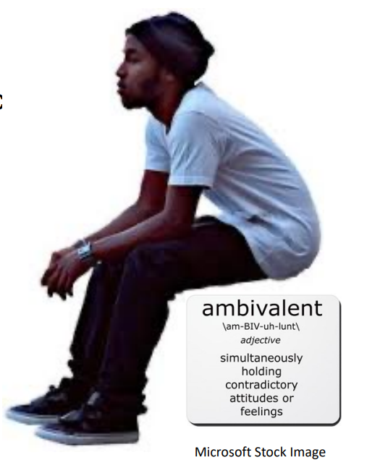
What Might Clients Feel Ambivalent About?
Accessing Care/Prevention Services
Taking Medication
Making regular appointments
Counseling
Reducing Alcohol/Drug Use
Connecting to Referrals

Slide 35
Why Might they Feel Ambivalent?
Trauma Response
Fear/Re-traumatization
Stigma/Shame
Distrust
Disclosure
IPV (Intimate Partner Violence)
Low Health Literacy
Priorities/Oher Needs
Past Experience with Healthcare Systems
Unaware of Available Services
Overwhelmed/Current Coping Skills
Fear of Rejection/Loss - Support Systems, Relationships, Child Custody, Employment
Criminalization
Notes:
What about just not feeling like it? What if just motivated? Don’t really care? Don’t feel sick? Need the money at work? Somethings, when discussed are way more solvable than you or they think, but we don’t ask/explore.

Slide 36
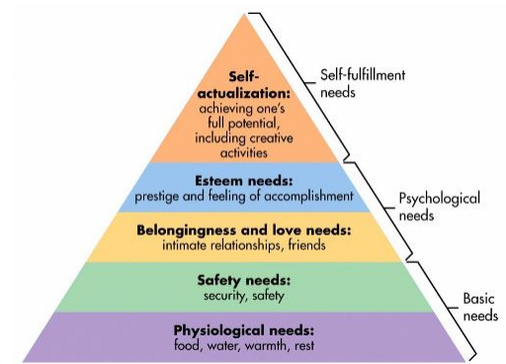
Maslow’s Hierarchy of Needs
Culture Clue™: Communication Guide. UWMC Patient and Family Education Committee. University of Washington Medical Center, Oct. 2011. Web. 2 Dec. 2016
Notes:
Maslow proposed that motivation is the result of a person's attempt at fulfilling five basic needs: physiological, safety, social, esteem and self-actualization. Physiological needs are those needs required for human survival such as air, food, water, shelter, clothing and sleep.
A person can be motivated, willing and able to change, but priority of current needs might re-order what they can or want to tackle first.

Slide 37
Motivational Interviewing Framework
Adapted from Miller and Rollnick (2012)

Slide 38
MI Framework: Spirit
A style, attitude or approach. A way of being when talking about change. A powerful ingredient in the fuel that drives good practice.
Collaborative: working with the client, respect the client’s expertise; understand their goals.
Evocative: drawing out ideas and solutions from the client as the experts about themselves.
Honor Autonomy: decision making is left to the client. They are ultimately responsible.
Motivational Interviewing: Preparing people for change, Miller & Rollnick, 2002
Notes:
SPIRIT OF MI: Roll with resistance – It’s OK if your patient doesn’t agree or simply doesn’t want to do anything at this time
The RULE of MI:
R: Avoid telling, direction or convincing the patient
U: What is important to the patient?
L: For change talk and barriers to change
E: Collaborate and engender change with your patients

Slide 39
MI Framework: Principles
Express Empathy
Enhance Self-Efficacy
Develop Discrepancy
Avoid Argumentation
Motivational Interviewing: Preparing people for change, Miller & Rollnick, 2002

Slide 40
Empathy vs Sympathy
“Rarely can a response make something better. What makes something better is connection.”
– Dr. Brené Brown
https://youtu.be/1Evwgu369Jw
Notes:
https://youtu.be/1Evwgu369Jw
Radical Empathy:
Encourages people to actively consider another person’s point of view – even when we strongly disagree – in order to connect more deeply with them
Paramount for those newly diagnosed but not yet ready to engage in care.

Slide 41
Enhance Self-Efficacy
Self-efficacy is a crucial component to facilitating change. If a participant believes that they have the ability to change, the likelihood of change occurring is greatly increased.
A person's belief in the possibility of change is an important motivator.
The participant, not the counselor, is responsible for choosing and carrying out change.
The counselor's own belief in the participant's ability to change becomes a self-fulfilling prophecy.
Reinforce even small changes
Affirm strengths and competencies
Remind person that relapse is normal
Support optimism that change is possible
Communicate that the decision & responsibility to change belongs with the person
Believe in the person’s ability to make positive changes in their life
Motivational Interviewing: Preparing people for change, Miller & Rollnick, 2002
Notes:
belief in the possibility of change – Why should I care or prioritize ART when I am going to die anyway? Chronic and Manageable
I can never be in a relationship again, so why does it even matter? U=U
The participant is responsible – What is the boundary here on supporting vs. enabeling – I am going to change by showing up to every appointment, but only if you call and wake me up, call an uber for me, and tell me when to go outside…. Client doesn’t believe they can do it without you or help…

Slide 42
Develop Discrepancy
How does “X” (behavior to change) fit with your goal?
“How does continuing to drink fit with staying healthy while managing HIV?”
The Colombo Approach: On the one hand “X” and on the other “Y”
“Help me understand, on the one hand you say that you’ve regretted not taking your medications and on the other, you feel you don’t really need to begin them because you feel good.”
Ask for the specifics about the “less good things” about behavior.
“You say that worrying about being without a place to live in the past has been awful. Tell me more about that experience.”
Enables the client to see that his/her present situation does not necessary fit into her values and what they would like in the future.
The principle of developing discrepancy is based on the understanding that motivation for change is created when the person perceives a discrepancy between their present behavior and important personal goals.
Motivational Interviewing: Preparing people for change, Miller & Rollnick, 2002
Notes:
Norms = Standards
Values = The standards one chooses as important
Beliefs = standards one lives by
Personal Goals – cant have a goal without motivation, BUT you can have motivation without a goal. I want to loose weight, but I don’t want to exercise.
I don’t want to be homeless, I want my own apartment (Motivation & Goal)… Action = Intention… in order to get housing, you have to take a drug test… (power embalance/re-traumatization, trauma response – avoidance, fall back on beliefs - I am never going to get housing anyway…

Slide 43
Avoid Argumentation
Invite the person to consider a different perspective
Look to the person to find their own answers and solutions
Avoid debating, proving a point, or imposing your point of view
Establish trust, ask permission, and elicit the person’s own perceptions before offering information
Motivational Interviewing: Preparing people for change, Miller & Rollnick, 2002

Slide 44
The “Righting Reflex”
Care providers have a powerful desire to heal, prevent harm, and “set the patient straight,” but this can have a paradoxical effect because people don’t like to be told what to do.
You need to stop ______
- “Tell me something I don’t already know”
You need to be compliant with the treatment plan for it to work
- “I’ve tried numerous times and can’t seem to stick with it”
Not connecting to our services will make it worse
- “You sound like my partner”
Resist the urge to correct the patient!! …referred to as the “righting reflex.”
Rollnick and colleagues (2008)

Slide 45
Simple Summary of Principles
Show client you understand their perspective
Be optimistic, supportive and hopeful
Explore inconsistencies between the “problem” behavior and the client’s goals and values
Try not to argue or push your agenda

Slide 46
Four Processes in MI
Engaging
Focusing
Evoking
Planning
Connecting with and understanding the perspective/ concerns of the other person
Based on those concerns, what direction are we headed?
Where is the person in the process of change?
When “yes” to moving ahead, what will that look like?
William R. Miller and Stephen Rollnick, 2010

Slide 47
Helpful Questions on Client Beliefs
So that I might be aware of and respect your beliefs...
1. What cultural, religious, spiritual or personal beliefs may impact the kind of health care you want to receive?
2. Would you like to receive your test results and diagnosis information, or do you prefer this information be given to someone else?
3. Would you like the information written, in pictures, or both?
Remember to ask the patient to “teach back” the information you give them and then document their understanding.
4. How does the care plan I’m recommending fit with your lifestyle and beliefs? Will you be able to follow this plan?
5. Can a family member, friend, or someone else help you follow your plan of care?
Culture Clue™: Communication Guide. UWMC Patient and Family Education Committee. University of Washington Medical Center, Oct. 2011. Web. 2 Dec. 2016

Slide 48
Helpful Questions on Client Beliefs
So that I might be aware of and respect your beliefs...
6. Do you use any traditional health remedies such as herbal treatments, homeopathy, Ayurveda, etc.?
7. Is there someone, in addition to yourself, with whom you want us to consult in making medical decisions about your care?
8. Are there certain health care procedures and tests that your culture prohibits?
9. Do you change your diet in celebration of religious or other holidays that you feel I should know?
10.Is there anything else you would like to know?
11.Do you have any questions for me?
Encourage two-way communication!

Slide 49
Active Listening: Using OARS
Open-Ended Questions
Affirmation
Reflective Listening
Summarizing
Nonverbal Communication & Managing Silence
Motivational Interviewing: Preparing people for change, Miller & Rollnick, 2002
Notes:
Open-ended questions: Draw out and explore the person’s experiences, perspectives, and ideas. Evocative questions guide the client to reflect on how change may be meaningful or possible. Information is often offered within a structure of open questions (Elicit-Provide- Elicit) that first explores what the person already knows, then seeks permission to offer what the practitioner knows and then explores the person’s response. o Affirmation: of strengths, efforts, and past successes help to build the person’s hope and confidence in their ability to change. o Reflections: are based on careful listening and trying to understand what the person is saying, by repeating, rephrasing or offering a deeper guess about what the person is trying to communicate. This is a foundational skill of MI and how we express empathy. o Summarizing: ensures shared understanding and reinforces key points made by the client.

Slide 50
Reflective Listening
Simple: Direct restatement of what the person said.
Complex: Paraphrase and extrapolate
Feeling/Behavior: Making a guess about meaning; usually adds something that was not said directly
“You’re feeling ___, because ___?
“ I noticed you just ___ , what are you thinking or feeling right now?”
Motivational Interviewing: Preparing people for change, Miller & Rollnick, 2002

Slide 51
Listening for Change Talk
"People are generally better persuaded by the reasons which they have themselves discovered than by those which have come into the mind of others.”
-BLAISE

Slide 52
Listening for Change Talk
When a client is ambivalent it’s common to hear two kinds of talk mixed together. They see both the reasons to change and reasons not to.
Sustain Talk: The opposite of change talk, the persons own arguments for not changing, for maintaining the status quo. Sometimes in the same sentence.
Change Talk: The person’s own statements that favor change, self-motivational statements.
“I want to quit smoking but every time I’ve tried I gain weight then start again. I know it’s bad for my health yet I can’t imagine not smoking.”
Motivational Interviewing: Preparing people for change, Miller & Rollnick, 2002

Slide 53
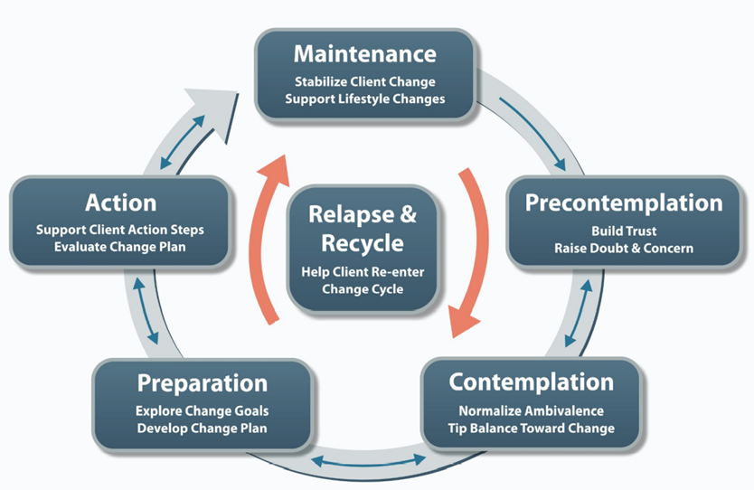
Stages of Change and MI
Originated by James Prochaska and Carlo DiClemente (1983) adapted in (2018)

Slide 54
Evoking Change Talk (DARN CAT)
Desire to change
Ability to change
Reasons to
Need to change
Commitment
Activation (Stages of Change)
Taking steps
What makes this change important to you?
What do you think you could do right now to move towards our goal?
What benefits might you notice? For yourself? Children? Family?
How important is this to you 1-10?
How confident are you in your ability to take that step 1-10?
Precontemplation? Contemplation? Reflection?
What have you done already? What can we do going forward?
Contemplation Stage
Action Stage
Helping People Change, 3rd edition, Miller & Rollnick, 2012
Notes:
Ask evocative questions:
Why would you want to make this change?
How might you go about it?
What are the three best reasons to do it?
How important is it for you to make this change
So what do you think you will do?
Ask for elaboration:
After a hint of change talk, ask for more detail. (How come? How so? Tell me about that)
Look Back Ask about a time before the current concern emerged. How were things better? § Look Forward What may happen if things continue as they are? Miracle question: If you were 100% successful in making the changes you want, what would be different? § Explore Extremes What are the worst things that might happen if you don’t make a change? What are the best if you do make the change?
Pros and Cons • Pros and Cons are nearly equal • Pros are short term and more emotional • Cons are longer term and more grave • There are rational reasons on both sides • For a person who is stressed and feeling fine, the pros for not making a change (i.e. taking meds) may legitimately outweighs the cons. • We need to understand individual’s pros/cons to help them make health decisions

Slide 55
Strategy for Providing Information: Informing
Asking Permission
“Would it be all right if I tell you one concern I have about this aspect your HIV treatment plan?”
Offer Choices
When discussing options offer several
What Other People Do
“You clearly want to take steps to take of your health, some patients in your situation…”
Rollnick and Miller (2007)

Slide 56
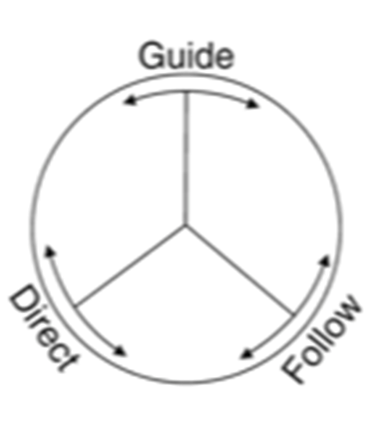
Communication Styles
Guiding: I can help you solve this, let’s discuss the options
Following: Follow the patients lead, emphasizes patient autonomy
Directing :Telling the patient what to do, patient expected to listen
Changing behavior: using motivational interviewing techniques Christine Bundy, 2009

Slide 57
Challenges for Providers: MI Traps
Question/Answer
Labeling Trap
Premature Focus
Taking Sides
Blaming
Expert
Notes:
1. Question-Answer Trap. Setting the expectation that the therapist will ask questions and the client will then answer, fosters client passivity. This trap can get sprung inadvertently when you ask many specific questions related to filling out forms early in treatment. Consider having clients fill out questionnaires in advance, or wait until the end of the session to obtain the details you need. Asking open-ended questions, letting the client talk, and using reflective listening are several ways to avoid this trap.
2. Labeling Trap. Diagnostic and other labels represent a common obstacle to change. There is no persuasive reason to use labels, and positive change is not dependent upon acceptance of a diagnostic label. It is often best to avoid “problem” labels, or refocus attention. For example, “Labels are not important. You are important, and I’d like to hear more about...”
3. Premature Focus Trap. When a counselor persists in talking about her own conception of “the problem” and the client has different concerns, the counselor gets trapped and loses touch with the client. The client becomes defensive and engages in a struggle to be understood. To avoid getting trapped start with the client’s concern, rather than your own assessment of the problem. Later on, the client’s concern may lead to your original judgment about the situation.
4. Taking Sides Trap. When you detect some information indicating the presence of a problem and begin to tell the client about how serious it is and what to do about it, you have taken sides. This may elicit oppositional “no problem here” arguments from the client. As you argue your view, the client may defend the other side. In this situation you can literally talk the client out of changing. You will want to avoid taking sides.
5. Blaming Trap. Some clients show defensiveness by blaming others for their situation. It is useful to diffuse blaming by explaining that the placing of blame is not a purpose of counseling. Using reflective listening and reframing, you might say, “Who is to blame is not as important as what your concerns are about the situation.”
6. Expert Trap. When you give the impression that you have all the answers, you draw the client into a passive role. In MI the client is the expert about his/her situation, values, goals, concerns, and skills. In MI style counseling you seek collaboration and give your clients the opportunity to explore and resolve ambivalence for themselves.

Slide 58
Summary
Motivational Interviewing is a practical solution to help support clients with adherence and improve health outcomes across the HIV continuum.
Experiment with your communication style. Try using a guiding, directing, or following style with your patients going forward.
Don’t forget DARN-CAT, and ensure you ask your patients about the importance and confidence of the plan before you end the visit.

Slide 59
What can I do tomorrow?
Consider trauma histories in client interactions, trauma responses in behavior and motivation for change
Make recommendations that consider whole person health, quality of life, and client’s priorities
Amplify patient autonomy, power, and control in decision making
Provide services within the spirit and principals of both TIC & MI, to better understand, engage and support the motivation to change or not change at this time.
Notes:
normalize the reactions (“Normal reaction to abnormal experience”)

Slide 60
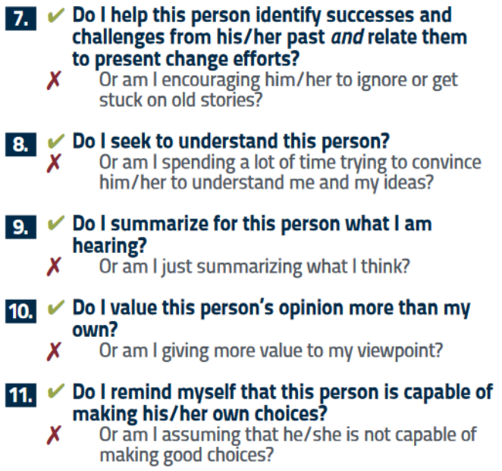
Encouraging Engagement in Care
Developed by: Ric Kruszynski, Paul M. Kubek, Deborah Myers, and Jeremy Evenden

Slide 61
MI References
Cook, Corwin and Bradley-Springer (2013) Motivational Interviewing, Reducing Risk, Inspiring Change
Rollnick, Miller (2007), Motivational Interviewing, Helping People Change 3rd Edition
Rollnick, Miller, and Butler, (2007), Motivational Interviewing in Health, Helping Patients to Change
Martino, S., Ball, S.A., Gallon, S.L., Hall, D., Garcia, M., Ceperich, S., Farentinos, C., Hamilton, J., and Hausotter, W. (2006) Motivational Interviewing Assessment: Supervisory Tools for Enhancing Proficiency. Salem, OR: Northwest Frontier Addiction Technology Transfer Center, Oregon Health and Science University.

Slide 62
TMI Project (Tailored Motivational Interviewing)
HRSA project to engage youth with HIV into medical care
Naar S, MacDonell K, Chapman JE, Todd L, Gurung S, Cain D, et al (2019). Testing a Motivational Interviewing Implementation Intervention in Adolescent HIV Clinics: Protocol for a Type 3, Hybrid Implementation-Effectiveness Trial. JMIR Research Protocols, 8(6):e11200

Slide 64
SCAETC Social Media

Slide 65
Resources
National Clinician Consultation Center http://nccc.ucsf.edu/
HIV Management
Perinatal HIV
HIV PrEP
HIV PEP line
HCV Management
Substance Use Management
Present case on ECHO hivecho@salud.unm.edu
AETC National HIV Curriculum https://aidsetc.org/nhc
AETC National Coordinating Resource Center https://targethiv.org/library/aetc-national-coordinating-resource-center-0
Additional trainings scaetcecho@salud.unm.edu
www.scaetc.org
Notes:
Find an HIV-related topic TeleECHO in your area: https://echo.unm.edu/locations-2/echo-hubs-superhubs-united-states/
IDEA Platform: Infectious Diseases Education & Assessment. https://idea.medicine.uw.edu/
AETC National HIV Curriculum: 6 core modules for self study; regularly updated; CME, CNE
Hepatitis C Online Curriculum: https://www.hepatitisc.uw.edu/
Hepatitis B Online Curriculum: https://www.hepatitisb.uw.edu/
National STD Curriculum: https://www.std.uw.edu/

