Slide 1

The Science of U=U
Carly Floyd, PharmD, PhC, AAHIVP, CDCES, TTS
UNM-AETC, Clinical Director​
Albuquerque, New Mexico​
Notes:
Version date: 09 2022
Target audience: prescribing providers, pharmacists, nurses, health educators

Slide 2
Conflict of Interest Disclosure Statement
Speaker has nothing to disclose
This program is supported by the Health Resources and Services Administration (HRSA) of the U.S. Department of Health and Human Services (HHS) as part of an award totaling $3,132,205, with 0% financed with non-governmental sources. The views expressed do not necessarily reflect the official policies of the Department of Health and Human Services, nor does mention of trade names, commercial practices, or organizations imply endorsement by the U.S. Government. Any trade/brand names for products mentioned during this presentation are for training and identification purposes only.

Slide 3
Learning Objectives
Review the evidence of HIV viral suppression and the impact it has on transmission
Understand how treatment as prevention can reduce the spread of HIV
Identify when partner testing & treatment can be recommended

Slide 4
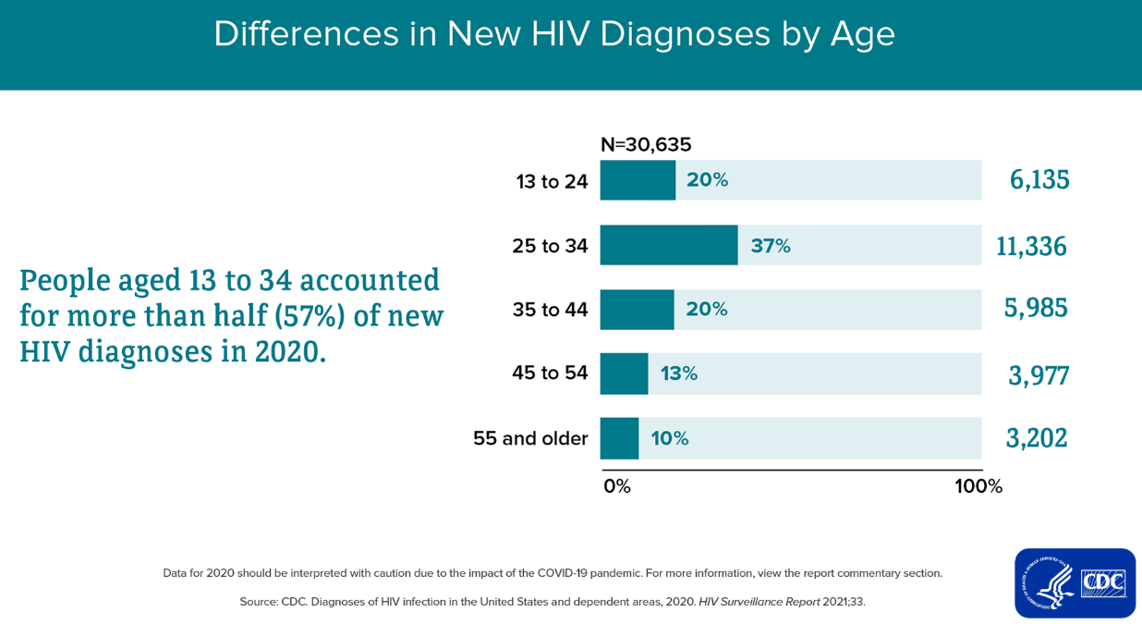
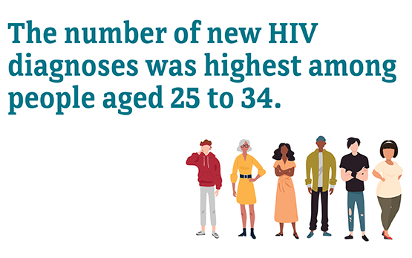
CDC http://www.cdc.gov/hiv/statistics/overview/ataglance.html

Slide 5
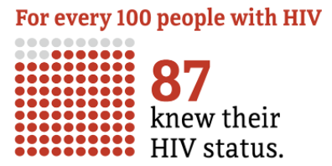
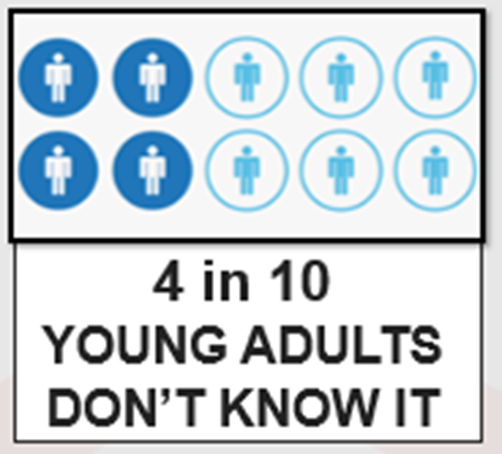
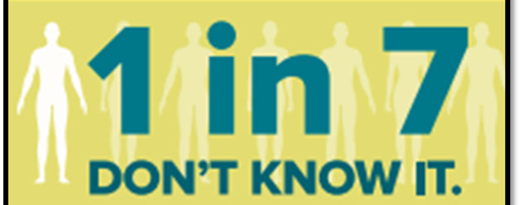
Not all People with HIV know their status
1,189,700 PWH 2019
http://www.cdc.gov/hiv/statistics/overview/ataglance.html
Notes:
PWH= people with HIV
13% don’t know their status (1 in 7.5 don’t know it)
36,801 new hiv dx in US and dependent areas in 2019.
Of those, 69% gay and bisexual men, 23% heterosexual, 7% IDU
Number highest among 25-34yo
Transgender people: 2% MTF, 1% FTM
86% male
Rates of Diagnoses of HIV Infection among Adults and Adolescents, by Age at Diagnosis, 2008–2012—U.S. 50,000 new patients infected with HIV/yr.
CDC. MMWR 2015;64:657-662 (2012 data).
Estimated 1 in 8 HIV-infected women in the U.S. do not know their status
-13% general US population- 44% of 13-24yo do not know
http://www.cdc.gov/hiv/library/reports/surveillance/
NM: We have roughly 3,300 persons living with HIV. And average 131 new infections per year. 119 in 2012 – 142 in 2013 – 129 in 2014, 133 in 2015 – 134 in 2016
CDC. MMWR 2015;64:657-662 (2012 data).
Estimated 1 in 8 HIV-infected women in the U.S. do not know their status
-13% general US population- 44% of 13-24yo do not know
http://www.cdc.gov/hiv/library/reports/surveillance/

Slide 6
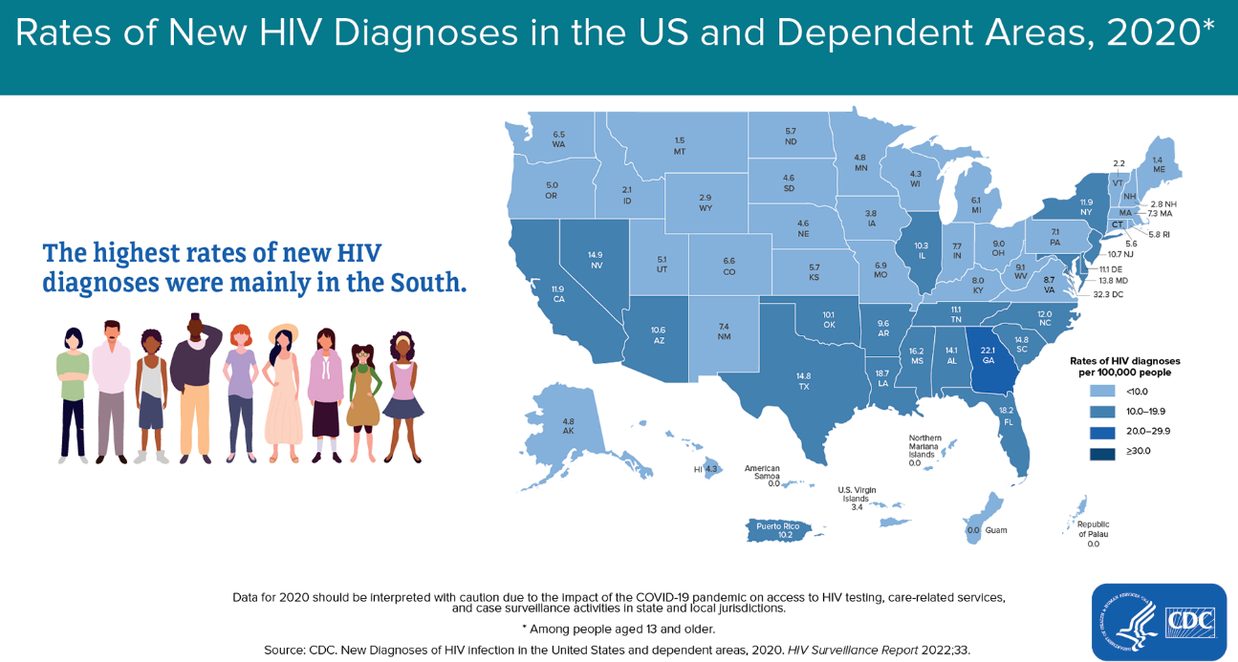
In U.S., 13% don’t know their status
In SCAETC region (NM, OK, TX, AR, LA) 17-20% don’t know their status
https://www.cdc.gov/hiv/basics/statistics.html

Slide 7
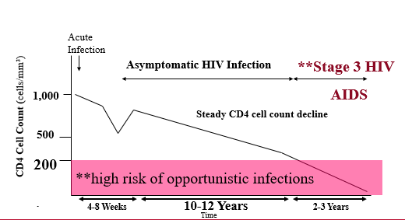
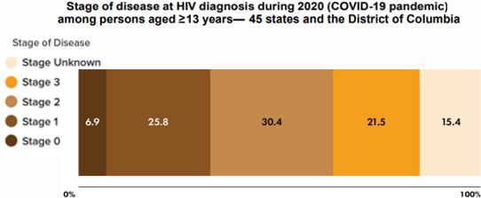
Late-stage diagnosis is associated with more morbidity and potential increased transmission
Late-stage diagnosis (2020)
Natural history of HIV: steady decline in CD4 count
Centers for Disease Control and Prevention. Monitoring selected national HIV prevention and care objectives by using HIV surveillance data United States and 6 dependent areas, 2020. HIV Surveillance Supplemental Report 2022;27(No. 3). http://www.cdc.gov/hiv/library/reports/hiv-surveillance.html. Published May 2022. Accessed 8/9/22
Notes:
2017 data
This means that patients have had undiagnosed HIV infections for about 10 years.
Stage 3 HIV: CD4<200 or CD4<14% or any CD4 with active opportunistic infection or malignancy
HIV Screening is Important for Treatment of HIV
21% new HIV diagnoses in the U.S. already have advanced disease (21% stage 3, 51% stage 2+3)
People who know they are infected can start HIV treatment
HIV treatment (HAART/ART) results in viral suppression and markedly reduced transmission¹⁻³
Studies show the benefit of ART on all people with HIV (PWH)^{4,5}
1. Cohen MS, et al. NEJM 2011;365:493-505. 2. Skarbinski J, et al. JAMA Intern Med 2015;175:588-96. 3. Rodger AJ et al. JAMA 2016;316(2):1-11. 4. Smith et al. JAIDS 2013; 63S2:S187-99. 5. Kitahata MM, et al. NEJM 2009;360:1815-26.

Slide 8
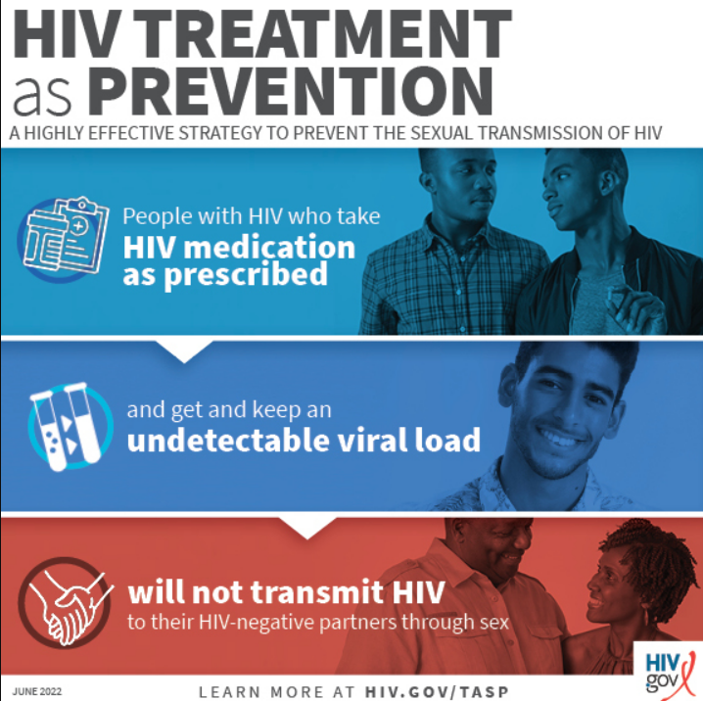
https://www.hiv.gov/tasp

Slide 9
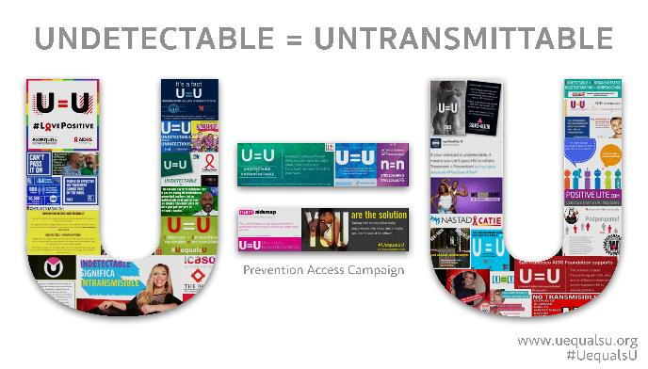
Treatment IS Prevention
Studies from 2008-2016 show zero linked HIV transmissions after >100,000 condomless sex acts
People with HIV (PWH) had a durably undetectable viral load
Cohen, et al. NEJM 2011; 365: 493-505. Skarbinski J, et al. JAMA Intern Med 2015;175:588-96.
Bavinton BR, et al. Lancet HIV. 2018. IAS 2018 http://programme.aids2018.org/Abstract/Abstract/13470
Notes:
HPTN 052 was the randomized trial of starting people earlier vs later and showed very few—only 1—HIV transmission.
Three observational cohort studies were PARTNER, Opposites Attract, PARTNER 2. PARTNER had some heterosexual couples, and then the other 2 were all men who had sex with men. These are couples where one partner is positive, and one is negative. The person who is positive is taking antiretroviral therapy. HIV-1 RNA to be and stay at < 200 copies/mL. In all 3 studies, there were very large numbers of condomless sex acts—more than 100,000—and there were no linked HIV transmissions, evidence that U = U means a lot.
The CDC and other multiple organizations have endorsed U = U and shows why it’s connected to rapid antiretroviral therapy—the sooner that you get your virus down to undetectable, the sooner you’re undetectable and you’re untransmittable.

Slide 10
Hiv PrEVENTION Trials Network (HPTN 052)

Slide 11
Does ART Reduce Transmission?
HIV Prevention Trials Network (HPTN) 052
5-year study
HIV-discordant couples
HIV-positive partner either:
  started antiretroviral therapy (ART) immediately
  OR
  Delayed ART initiation
https://www.nejm.org/doi/full/10.1056/NEJMoa1600693

Slide 12
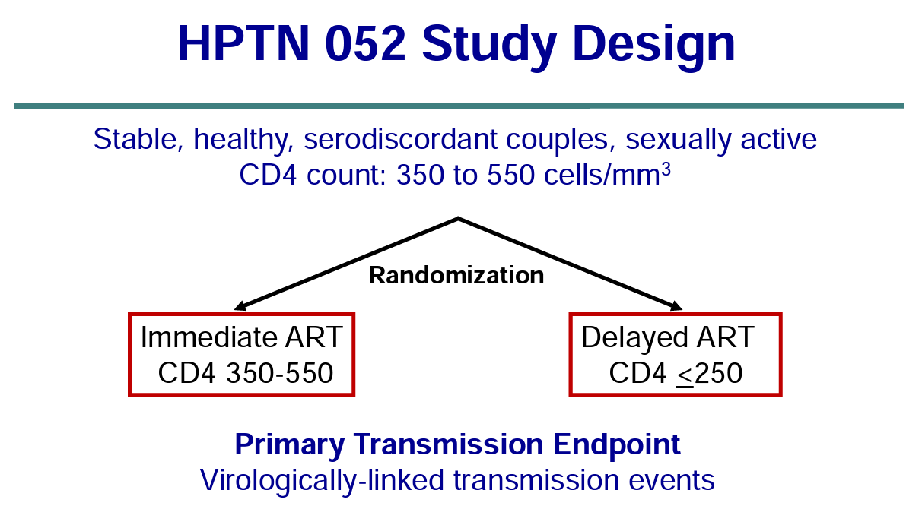
https://www.hptn.org/sites/default/files/inline-files/CohenIAS_HPTN17july2011_0.pdf
Notes:
CD4 count is used to stage HIV infection
CD4>500 = stage 1
CD4<200/14% = stage 3; advanced immunosuppression

Slide 13
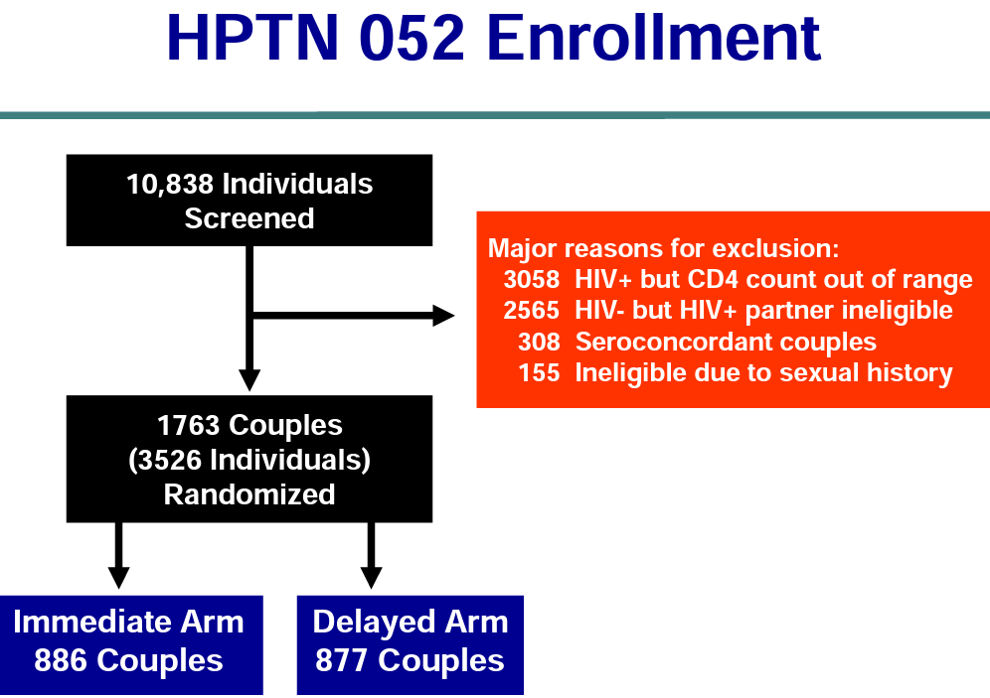
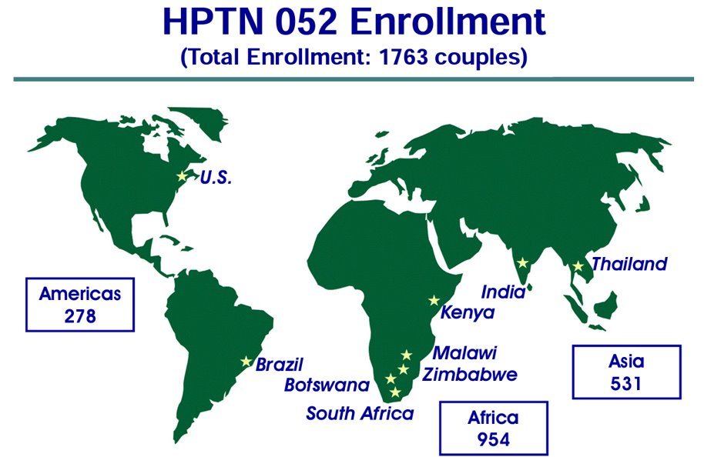
https://www.hptn.org/sites/default/files/inline-files/CohenIAS_HPTN17july2011_0.pdf

Slide 14
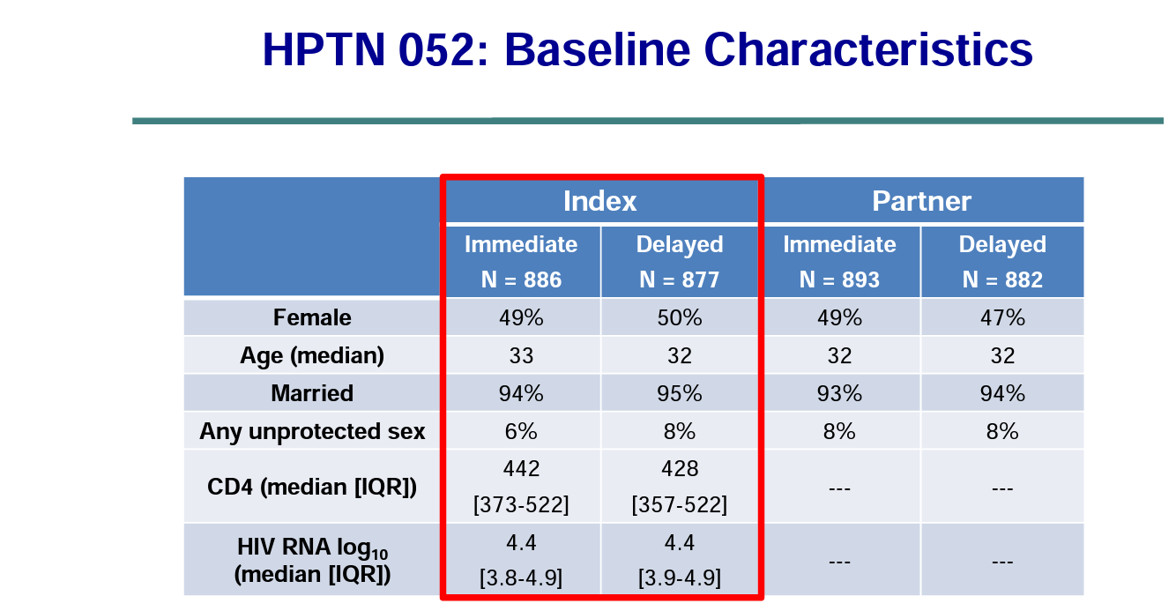
https://www.hptn.org/sites/default/files/inline-files/CohenIAS_HPTN17july2011_0.pdf
Notes:
In the delayed-ART group, 877 participants started therapy after two consecutive CD4+ counts fell below 250 or if an illness indicative of the acquired immunodeficiency syndrome (i.e., an AIDS-defining illness) developed

Slide 15
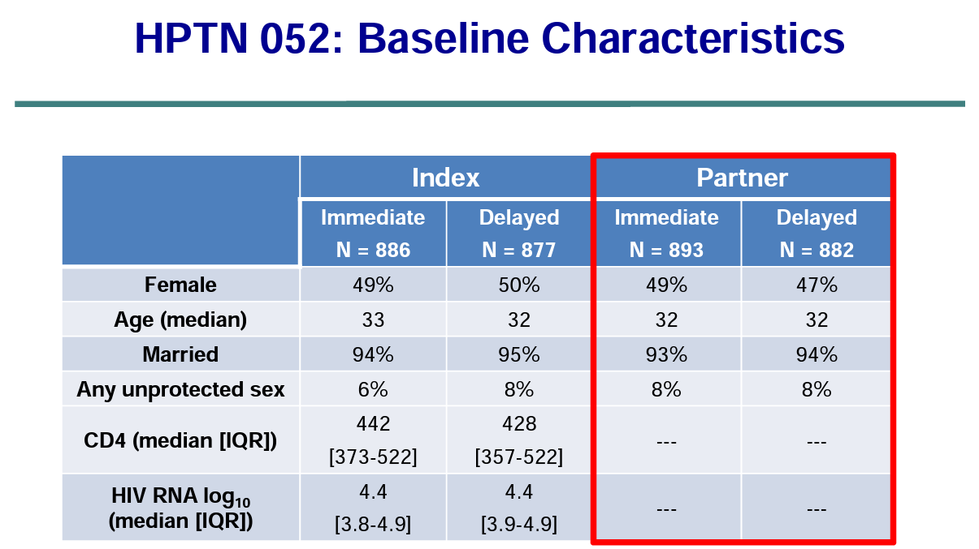
https://www.hptn.org/sites/default/files/inline-files/CohenIAS_HPTN17july2011_0.pdf

Slide 16
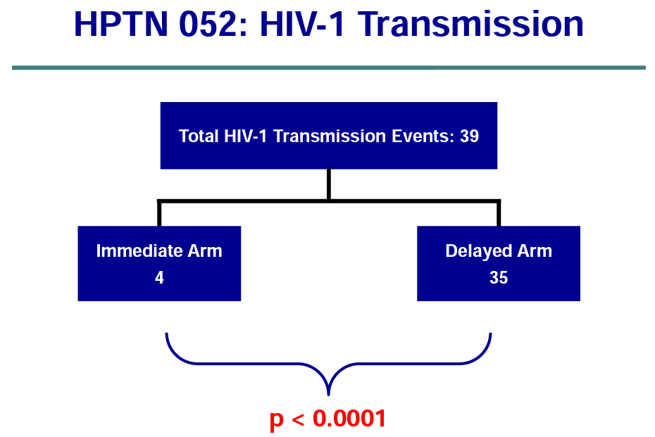
https://www.hptn.org/sites/default/files/inline-files/CohenIAS_HPTN17july2011_0.pdf

Slide 17
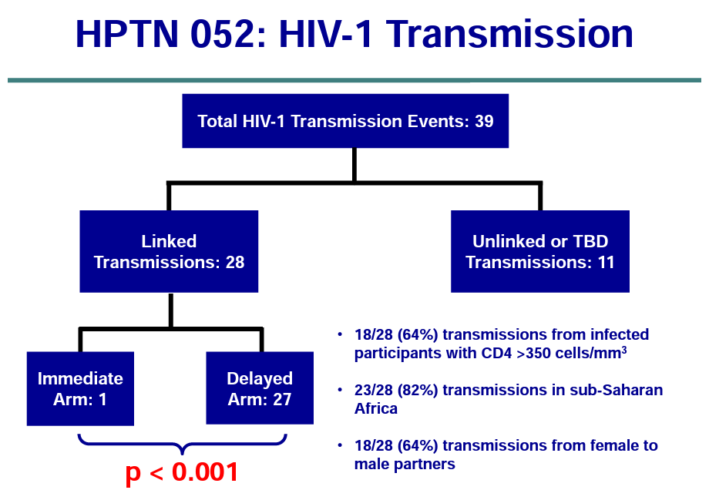
https://www.hptn.org/sites/default/files/inline-files/CohenIAS_HPTN17july2011_0.pdf
Notes:
Early Arm- Infection Occurred before patient was stably suppressed
The single transmission in the immediate ART group occurred within weeks of starting treatment, when viral load would have still been high and certainly detectable.

Slide 18
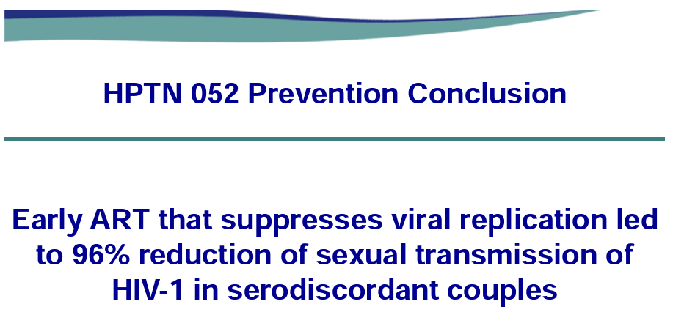
https://www.hptn.org/sites/default/files/inline-files/CohenIAS_HPTN17july2011_0.pdf

Slide 19
HPTN 052 – Final Results 2016
HIV+ people followed for 10,031 person-years, partners for 8509 person-years
No HIV transmissions within these couples when the HIV+ partner had suppressed viral load (<400 copies/mL)
ART is highly effective for preventing sexual transmission of HIV
  >98% heterosexual
  STI rates were very low and immediately treated
https://www.nejm.org/doi/full/10.1056/NEJMoa1600693
Notes:
No quantification of sexual activity

Slide 20
Partner 1 study
Notes:
Preliminary results presented at CROI 2014, final results in 2016

Slide 21
Primary Aim
Observational cohort of serodiscordant partnerships across Europe that have condomless penetrative sex
  HIV+ partner is on ART and VL <200 copies/mL
Goal: to study the risk of HIV transmission through anal and vaginal sex
  Heterosexual
  Men who have sex with men (MSM)
https://jamanetwork.com/journals/jama/fullarticle/2533066

Slide 22
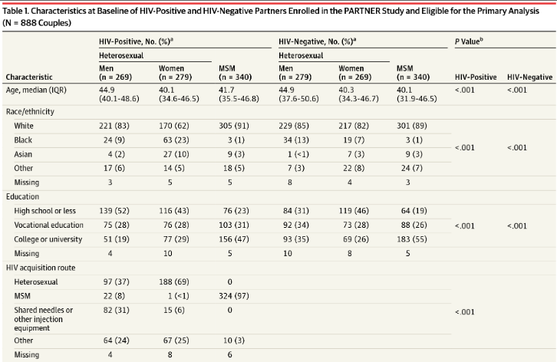
https://jamanetwork.com/journals/jama/fullarticle/2533066

Slide 23
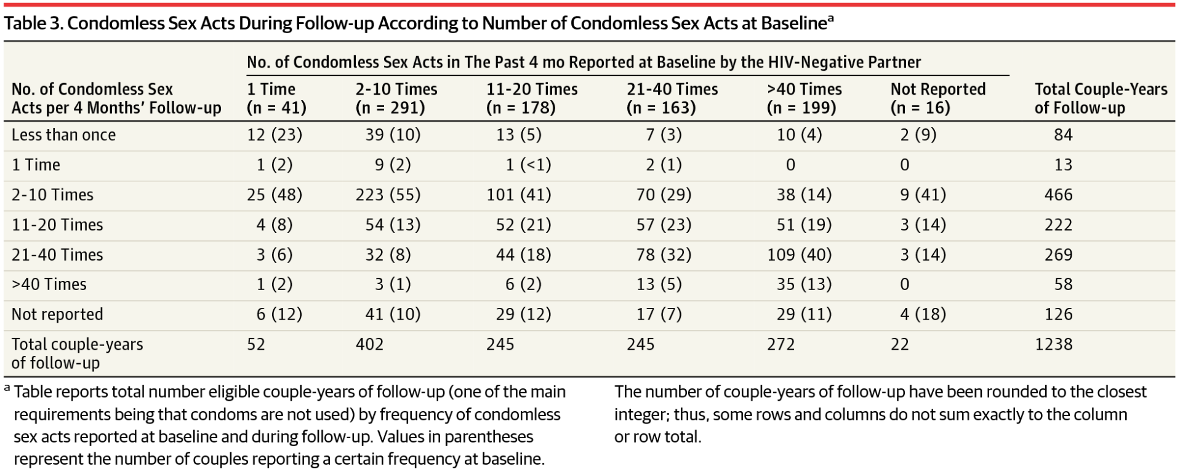
https://jamanetwork.com/journals/jama/fullarticle/2533066

Slide 24
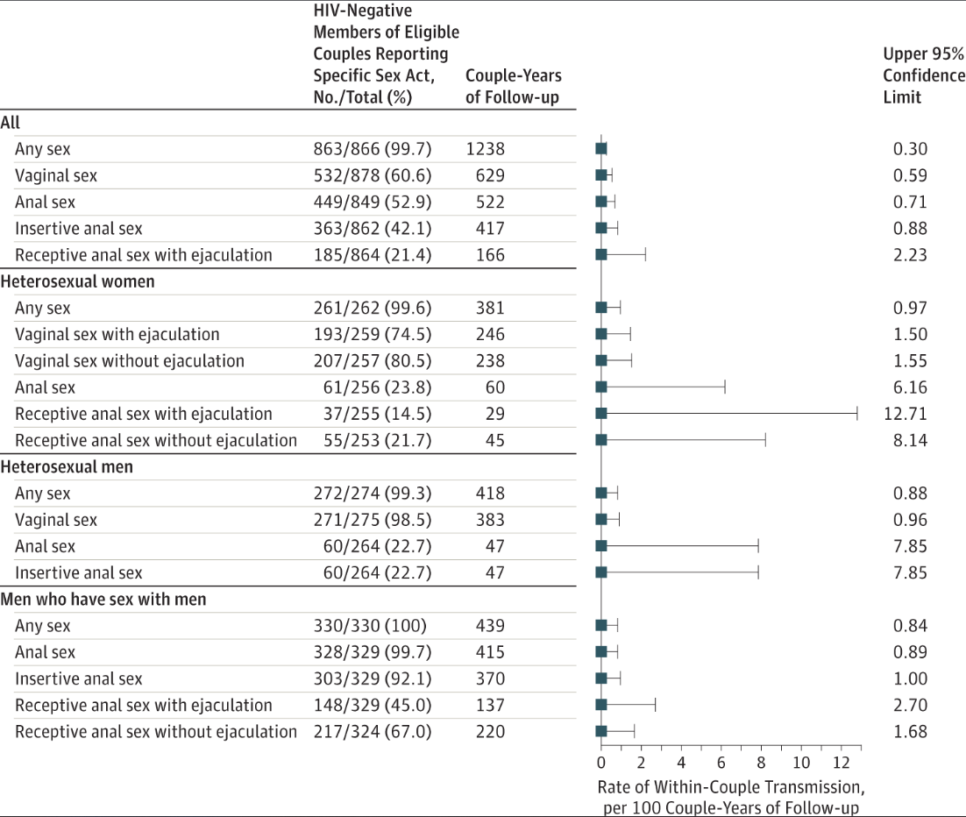
https://jamanetwork.com/journals/jama/fullarticle/2533066

Slide 25
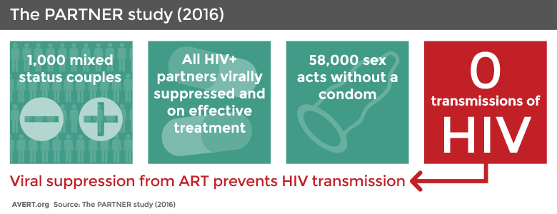
www.avert.org
Notes:
888 serodiscordant couples

Slide 26
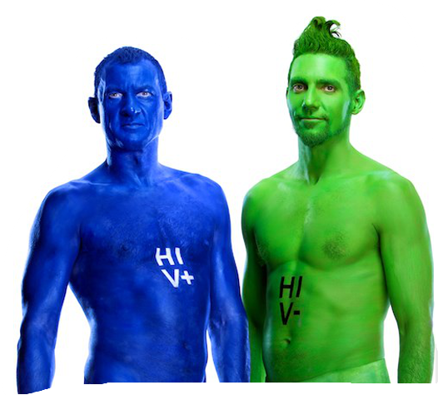
Opposites attract study
https://kirby.unsw.edu.au/sites/default/files/kirby/news/Final-Analysis-Factsheet_20170711.pdf
Notes:
2017- results presented at IAS. Included people in Australia, Thailand, and Brazil from 2012-2016

Slide 27
Study Design
Observational cohort of 343 MSM couples
No requirements for person with HIV (PWH) to take ART (antiretroviral therapy), no requirements for person without HIV to take PrEP (pre-exposure prophylaxis)
Minimum of 2 clinic visits annually
  Person with HIV had viral load (VL) tested
  Person without HIV tested for HIV antibodies
  Both tested for sexually transmitted infections (STIs)
https://kirby.unsw.edu.au/sites/default/files/kirby/news/Final-Analysis-Factsheet_20170711.pdf

Slide 28
Results
588 couple-years of follow up
16,800 acts of condomless anal sex
  12,447 acts of condomless anal sex with undetectable VL in PWH, and partner not on PrEP
No linked HIV transmissions
  Genetic analysis of virus was different from partner with HIV
  3 transmissions found were from outside the relationship
https://www.thelancet.com/journals/lanhiv/article/PIIS2352-3018(18)30132-2/fulltext
Notes:
If the positive partner is on successful treatment, even having another sexually transmitted infection (STI) does not increase the risk of HIV being transmitted. In Opposites Attract, participants had an STI during 6% of anal sex acts (Partner- 17.5%)
Sexual position also made no difference even though when viral load is not suppressed, transmission is 10-20 times more likely if the HIV-positive partner is the insertive one; in Opposites Attract, the HIV-positive partner was ‘top’ over a third of the time.
3 men became infected with HIV, but genetic analysis showed that these infections came from a partner outside the main relationship who was not virally suppressed.

Slide 29
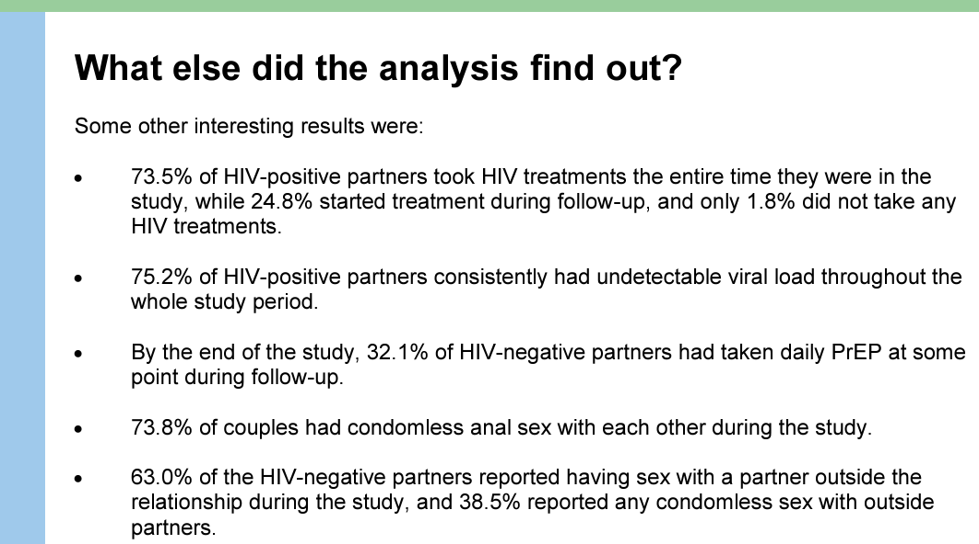
https://kirby.unsw.edu.au/sites/default/files/kirby/news/Final-Analysis-Factsheet_20170711.pdf

Slide 30
Partner 2 study

Slide 31
Study Design
Second phase of PARTNER study- only gay couples
  972 couples recruited between 2010 – 2017
  Data collected every 4-6 months
1593 observation years of follow up data from 782 couples
  Those not included reported no acts of condomless anal sex, a partner using PEP/PREP, or were missing results (HIV or VL tests)
https://www.ncbi.nlm.nih.gov/pmc/articles/PMC6584382/
Notes:
European study with 75 sites

Slide 32
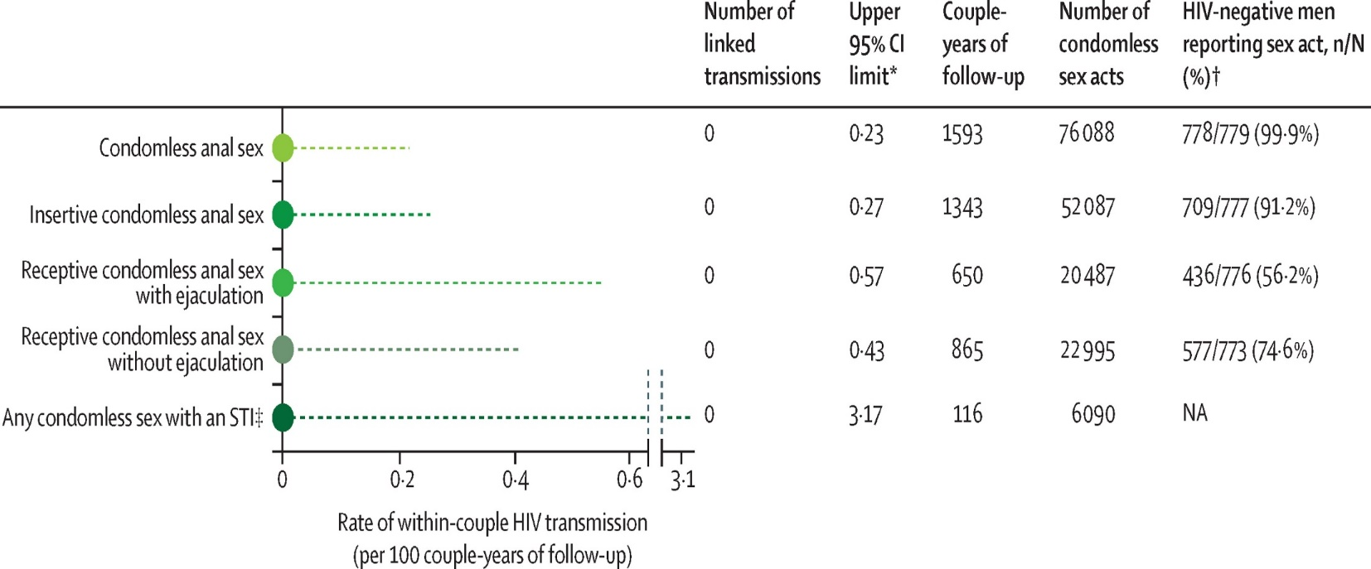
Results
https://www.ncbi.nlm.nih.gov/pmc/articles/PMC6584382/
Notes:
>76,000 reports of condomless sex
In the absence of ART, on the basis of the frequency and type of sex, for receptive condomless anal sex acts alone approximately 472 transmissions (95% CI 83–714) would have been expected.

Slide 33
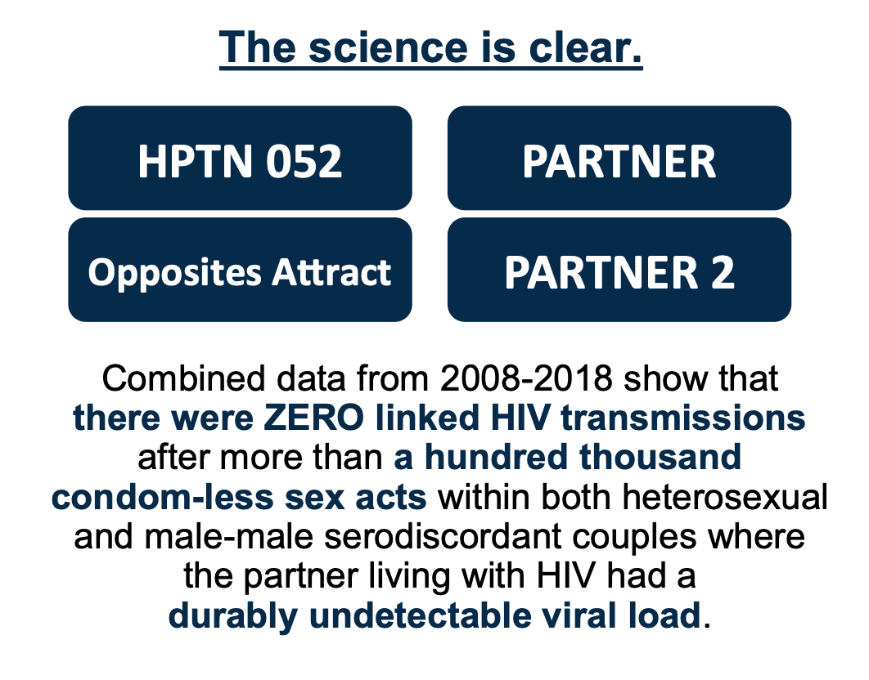
https://www.niaid.nih.gov/news-events/science-clear-hiv-undetectable-equals-untransmittable

Slide 34




U = U is a Game Changer
Transforms social, sexual, & reproductive lives
Dismantles HIV stigma
Encourages getting tested and starting and staying on treatment and in care
Provides a strong public health argument for eliminating barriers to universal access (The third U = Universal)
Notes:
“Like so many of us who live with HIV, I never imagined a time when I could love, have sex, have babies without fear. Fear has been present in the most intimate moments of our lives. We’ve had to protect our partners from us. U=U takes away that fear, changing our social, sexual and repro lives.
Changes the way we see ourselves, others see us, treated in clinical settings, they way policy decisions are made about us in employment, housing, education healthcare,
It also means that people are more likely to get tested, to start and stay on treatment and engaged in care for their health and our partners.
And this is really important. We had the argument “we need treatment and care to save our lives” but I learned quickly that not everyone in this field cares about our lives. They care about preventing HIV. They are moved by the argument “we need treatment and care to save our lives AND prevent new transmissions bringing us closer to ending the epidemic. “ – Brandon Mizroch, MD/MBBS

Slide 35
Hesitation with U=U
Suppressed VL vs undetectable VL
Blip in VL
For the purposes of U=U, the term "undetectable" is used synonymously with the term "virally suppressed”
Most viral load blips are short-lasting and of no significance
Notes:
Undetectable viral load: ART can reduce a person’s viral load to the point where it is so low (usually under 40 copies/ml depending on the test and region of the world) that it cannot be detected by measurements.
Viral load suppression: When ART suppresses a person's viral load to less than 200 copies/ml, this is called being "virally suppressed.“ Studies show that when a person is virally suppressed they cannot transmit HIV to sexual partners.
For the purposes of the U=U campaign, the term "undetectable" is used synonymously with the term "virally suppressed.“
Viral blips have not been shown to increase the transmission of HIV. Small transient increases in viral load (between 50 and 1000 copies) known as ‘blips’ sometimes result on effective ART when people are adherent, but typically return to undetectable levels without any change in treatment.
A person’s viral load is considered “durably undetectable” when all viral load test results are undetectable for at least six months after their first undetectable test result. This means that most people will need to be on treatment for 7 to 12 months to have a durably undetectable viral load. It is essential to take every pill every day to maintain durably undetectable status.
https://www.preventionaccess.org/faq
https://www.niaid.nih.gov/news-events/10-things-know-about-hiv-suppression

Slide 36
Language Matters
Do Say:
Don’t Say:
Can’t pass it on
Can’t transmit
Effectively no risk
No risk
Zero risk
Prevents HIV
Eliminates transmission
Greatly reduces
Extremely unlikely
Virtually impossible
Almost no risk
Close to zero
Helps prevent
Makes it hard to transmit
Notes:
First, be consistent and clear.
“greatly reduces the risk” and these others means “there is still a risk to take into consideration.”
Be mindful of the message you’re conveying.

Slide 37

Viral Load ≠ Value
Recognize structural barriers to care, stigma, and trauma
  make it difficult or impossible for people to start and stay on treatment especially marginalized communities
Acknowledge treatment is a personal decision, not a public health responsibility
U=U offers hope and surge of activism for universal access

Slide 38
Key Points
Over 100,000 condomless sex acts in studies → zero transmissions of HIV to HIV-negative partner
Undetectable = untransmittable
  Zero transmitted HIV infections in persons with VL <200 copies/mL
STIs when undetectable have not shown increased HIV transmission
  Opportunity to test and treat partners

Slide 39
References
www.cdc.gov/hiv
https://targethiv.org/
Saag, et al. 2018 Recommendations of the International Antiviral Society-USA Panel. Antiretroviral Drugs for Treatment and Prevention of HIV Infection in Adults. JAMA. 2018; 320(4):379-396. https://www.iasusa.org/2018/07/24/antiretroviral-drugs-treatment-prevention-hiv-infection-adults-2018-recommendations-of-the-international-antiviral-society-usa-panel/
DHHS Guidelines for the Use of Antiretroviral Agents in HIV-1 Infected Adults & Adolescents. http://aidsinfo.nih.gov/contentfiles/adultandadolescentgl.pdf
NCRC Immediate ART Initiation: Guide for Clinicians https://aidsetc.org/blog/immediate-art

Slide 40
Resources
Clinical Consultation Center http://nccc.ucsf.edu/
  HIV Management
  Perinatal HIV
  HIV PrEP
  HIV PEP line
  HCV Management
  Substance Use Management
Present case on ECHO http://echo.unm.edu hivecho@salud.unm.edu
AETC National HIV Curriculum https://aidsetc.org/nhc
AETC National Coordinating Resource Center https://targethiv.org/library/aetc-national-coordinating-resource-center-0
Additional trainings scaetcecho@salud.unm.edu
Notes:
Find an HIV TeleECHO clinic in your area: https://echo.unm.edu/locations-2/echo-hubs-superhubs-united-states/
AETC National HIV Curriculum: 6 core modules for self study; regularly updated; CME, CNE

Slide 41
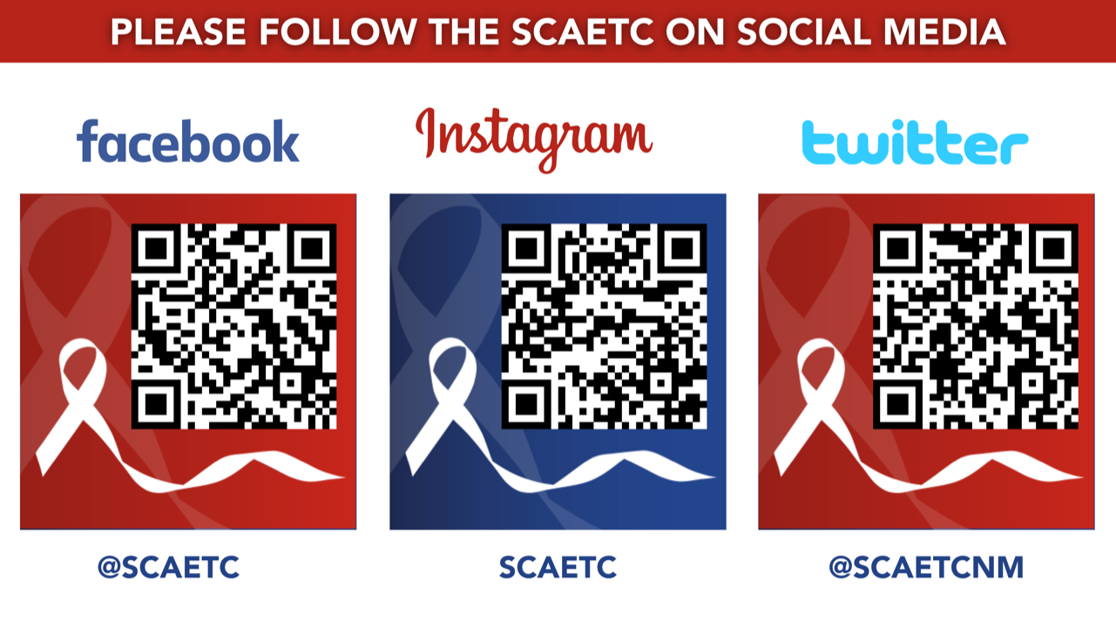
SCAETC Social Media

