Slide 1

Syndemic Approaches in HIV and Hepatitis Programs
Edwin Corbin-Gutierrez
Zakiya Grubbs
Isabel Lechuga
Notes:
Version date_05 2023

Slide 2
Conflict of Interest Disclosure
Speakers have nothing to disclose

Slide 3
Use of Trade/Brand Names
This program is supported by the Health Resources and Services Administration (HRSA) of the U.S. Department of Health and Human Services (HHS) as part of an award totaling $3,132,305, with 0% financed with non-governmental sources.
The views expressed do not necessarily reflect the official policies of the Department of Health and Human Services nor does mention of trade names, commercial practices, or organizations imply endorsement by the U.S. Government. Any trade/brand names for products mentioned during this presentation are for training and identification purposes only.
Notes:
NOTE: THIS SLIDE MUST BE INCLUDED IF TRADE AND/OR BRAND NAMES FOR MEDICATIONS ARE USED IN THE PRESENTATION.
IT MAY BE DELETED IF THERE IS NO REFERENCE TO TRADE NAMES, INCLUDING PRESENTATIONS IN WHICH ONLY GENERIC MEDICATION NAMES ARE MENTIONED.
TRADE NAMES MUST BE PUT IN PARENTHESES AFTER THE GENERIC NAME THE FIRST TIME IT IS MENTIONED - E.G., FLUOXETINE (PROZAC). TRADE NAMES SHOULD ONLY BE MENTIONED FOR THE INITIAL REFERENCE AND THE GENERIC NAME ONLY SHOULD BE USED AFTER THAT. THIS APPLIES EQUALLY TO ALL MEDICATIONS OR PRODUCTS MENTIONED IN THIS PRESENTATION.

Slide 4

Learning Objectives
Review five innovative strategies to implement syndemic approaches in HIV and viral hepatitis programs
Summarize common challenges when advocating for greater integration across programmatic areas
Discuss the public health lens to the syndemics framework to focus on addressing social and structural drivers of health
Notes:
PLWH now PWH per HRSA guidance

Slide 5




ABOUT NASTAD
WHO: A non-partisan non-profit association founded in 1992 that represents public health officials who administer HIV and hepatitis programs in the U.S.
WHERE: National Alliance of State & Territorial AIDS Directors (NASTAD) represents all 50 U.S. states, the District of Columbia, Puerto Rico, the U.S. Virgin Islands, seven local jurisdictions receiving direct funding from the Centers for Disease Control and Prevention (CDC), and the U.S. Pacific Island jurisdictions.
HOW: We work to advance the health and dignity of people living with and impacted by HIV/AIDS, viral hepatitis, and intersecting epidemics by strengthening governmental public health through advocacy, capacity building, and social justice.
Notes:
NASTAD is a non-partisan, non-profit membership organization representing public health officials that administer HIV and hepatitis programs in the US. We represent all 50 US states, DC, Puerto Rico, the US Virgin Islands and seven local jurisdictions from the CDC and the US Pacific Island Jurisdictions. Our main areas include strengthening governmental public health through advocacy, capacity building, and social justice.

Slide 6
MISSION
NASTAD’s mission is to advance the health and dignity of people living with and impacted by HIV/AIDS, viral hepatitis, and intersecting epidemics by strengthening governmental public health and leveraging community partnerships.
VISION
NASTAD's vision is a world committed to ending HIV/AIDS, viral hepatitis, and intersecting epidemics.
Notes:
NASTAD recently revised its mission and vision; our mission is to advance the health and dignity of people living with and impacted by HIV/AIDS, viral hepatitis, and intersecting epidemics with the vision of a world committed to ending HIV/AIDS, viral hepatitis, and intersecting epidemics

Slide 7
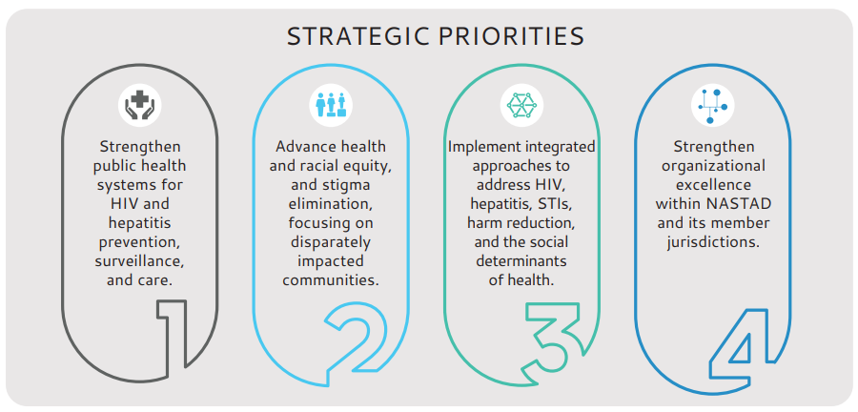
NASTAD Strategic Plan

Slide 8
NASTAD Strategic Plan, Priority 3
3.1 Build stronger cross-program collaboration activities and partnerships to jointly address HIV, hepatitis, STIs, drug user health, mental health, and housing programs.
3.2 Local, state, and federal policies and guidance encourage and even incentivize innovative awareness, prevention, care, and treatment initiatives that integrate HIV, viral hepatitis, and harm reduction.

Slide 9
NASTAD Strategic Plan, Priority 3
3.3 Harm reduction programs and trauma-informed approaches are more effectively used and supported by public health programs.
3.4 Remove policies that are barriers to achieving the goals of a syndemics approach and break down programmatic siloes.

Slide 10
What is Syndemic Approaches
“Syndemics are epidemics—of diseases or health conditions, such as viral hepatitis, sexually transmitted infections (STI), substance use, and behavioral health issues—that interact with each other and by that interaction increase their adverse effects on the health of communities that face systematic, structural, and other inequities.”
Division of HIV Prevention. (2023). Division of HIV Prevention Strategic Plan Supplement: An Overview of Refreshed Priorities for 2022-2025. Retrieved February 28, 2023, from https://www.cdc.gov/hiv/division-of-hiv-prevention/strategic-plan/index.html

Slide 11
Health Equity and Social Determinants of Health
Structural Factors
Community Factors
Interpersonal Factors
Addressing Social Determinants of Health
“We had a particular focus this year on housing. We worked with a land bank, HUD, and other partners to develop a housing unit for black trans and gay/bi youth with integrated medical care and safe spaces.
HIV
DUH
VH

Slide 12
Strategy and Organizational Buy-in
Perspective shift from disease-specific to whole-person care
Integrated strategic planning
Re-organization of programs
Syndemic-focused positions
Identifying opportunities for collaboration
Opportunities
  Increased capacity to respond to emerging health needs
  Innovation in service provision
Challenges
  Funding restrictions
  Limited opportunity to change organizational structure and goals

Slide 13
Strategy and Organizational Buy-in
“As part of EHE, we have formed an alliance with the health department's Office of Healthy Equity to ensure adequate understanding and support of the Social Determinants of Health (SDOH).”
Opened an HIV and its Syndemics Specialist position
Created a position with the Bureau of Substance Use Disorder Prevention, Treatment, and Recovery to create a common strategic plan for people who use drugs and who have or at risk for infectious diseases.
“We are now organizationally more integrated across HIV, hepatitis, STIs - and social determinants are an overarching theme in our programming and work.”

Slide 14
Community Engagement
Assessing community needs
Centering voices in planning and implementation
Actively responding to outbreaks impacting People Who Inject Drugs (PWID). Working closely with community partners and key leaders with lived experience.
“Thinking syndemically requires a commitment to community partnerships and a recognition that ending new HIV transmissions means addressing other STI, like syphilis and gonorrhea, and working to address structural factors that make people vulnerable to HIV and STI, like lack of housing and food insecurity.”

Slide 15
Data and Systems
Analysis of data using a health equity lens
Data sharing agreements
Data-to-Care activities
Opportunities
  Improved care coordination
  Improved data on demographics and risk factors
  Improved data quality
  Uniform standards for data confidentiality and security
Challenges
  Cross-program and agency data-sharing restrictions
The program uses HIV care assessments and other data to be able to prioritize and address social determinants of health (SDoH).

Slide 16
Braided Funding and Partnership
Opportunities
  Increase funding for under-resourced programs
  Private funding opportunities
  Funding for social determinants of health and health equity
Challenges
  Limitations in the use of local, state, and federal funding
  Stigma may impact wide community support
We have also worked to integrate data and education at an annual housing conference that invites HIV program staff, housing staff and Housing Opportunities for Persons with AIDS (HOPWA) staff statewide. This is becoming core to our program.

Slide 17
Braided Funding and Partnership
Currently working on an integrated RFA for services for HIV prevention, HCV prevention, drug user health and STIs
We are working with the state Department of Corrections and a local jail to pilot a new 340B drug pricing program model. The goal is to extend our 340B STI/HIV covered entity status to jails who meet key readiness/infrastructure criteria to increase STI/HIV screening and treatment in correctional settings.
Integrated into the Infectious Disease Bureau, with an integrated advisory council and service delivery system. SDOH are addressed through collaborations.

Slide 18
Integrated Service Delivery
Increased access to care
Integrated service bundles
Collaboration with non-traditional partners
Trauma-informed approaches
Models:
Low-threshold sexual health sites
Low-threshold treatment clinic in the Safe and Sound Protocol (SSP)
Opportunities
  Improved access
  Cost-effectiveness
  Reduced stigma
  Whole-person focus
Challenges
  Funding siloes
  Staff capacity and knowledge
  Availability of resources

Slide 19
Integrated Service Delivery
The HIV program supports field-based integrated HIV/STI and HCV testing and implemented dried blood spot (DBS) testing in 2019. Additionally, the HIV program has a direct contract with a lab to allow health departments to order DBS home test kits and use them with priority populations and in non-clinical, outreach settings. The health departments can use the lab’s web portal to view results and follow up on positives.
We have expanded on the status neutral approach around prevention and care. We incorporated harm reduction most recently as we prepare to launch a statewide SSP registration initiative.

Slide 20
Status-Neutral Approaches
Status neutral service navigation program supports the implementation of integrated delivery models. The program connects people to services addressing the social determinants of health. Comprehensive Harm Reduction programs include focus on HIV, hepatitis and STIs and these programs support clients with accessing a variety of services including health insurance enrollment, family planning, social services etc.
Supportive services and person-centered care strategies
  Equitable level of care regardless of HIV status
  Navigation to improve access to care
  Strategies to address social determinants
  Addressing as many health care needs as possible

Slide 21



The Hepatitis Network for Education and Testing (HepNET) is a network of public health partners, Harm Reductionists, community-based organizations, tribal health organizations, people with lived experience, and healthcare providers.
HepNET is focused on identifying and addressing the unmet needs of people who inject drugs (PWID) to improve their access to viral hepatitis education, prevention, testing, linkage to care, and treatment.
Implementation Partners: NASTAD, National Viral Hepatitis Roundtable (NVHR) and National Association of County and City Health Officials (NACCHO)

Slide 22
Discussion/Questions

Slide 23
References
Division of HIV Prevention. (2023). Division of HIV Prevention Strategic Plan Supplement: An Overview of Refreshed Priorities for 2022-2025. Retrieved February 28, 2023, from https://www.cdc.gov/hiv/division-of-hiv-prevention/strategic-plan/index.html
HIV AZ. (2023, January 25). The Arizona 2022-2026 HIV/STI/Hep C Integrated Plan. HIVAZ.org. Retrieved February 28, 2023, from https://hivaz.org/the-arizona-2022-2026-hiv-sti-hep-c-integrated-plan/
National Governors Association. (2022, June 22). Maximizing Impact: State Strategies to Manage and Prevent HIV, Viral Hepatitis, STDs and TB. https://www.nga.org/publications/maximizing-impact-state-strategies-to-manage-and-prevent-hiv-viral-hepatitis-stds-and-tb/
Connecticut Ending the Syndemic Initiative. (2022, May 27). End the Syndemic in CT. End The Syndemic. https://endthesyndemicct.org/
California Department of Public Health. (2022). Ending the Epidemics: Addressing HIV, Hepatitis C and STIs in California: Integrated Statewide Strategic Plan. Retrieved February 28, 2023, from https://www.cdph.ca.gov/Programs/CID/DOA/CDPH%20Document%20Library/CDPH_StratPlan2021_FINAL_ADA.pdf
End the Syndemics Tennessee. (2022). End The Syndemic – Many Voices, One Plan. Retrieved February 28, 2023, from https://endthesyndemictn.org/

Slide 24
References
Valdiserri, R. (2021, April 12). What’s A Syndemic? Hepatitis C Among Injection Drug Users Is An Urgent Example. Health Affairs Forefront. Retrieved March 1, 2023, from https://www.healthaffairs.org/do/10.1377/forefront.20210407.8040/full/
Indiana Department of Health. (2021). Zero is Possible: Indiana’s Plan to End HIV and Hepatitis C (2021-2030). ZIP IN. Retrieved February 28, 2023, from https://www.zipindiana.org/
The White House. (2021). National HIV/AIDS Strategy for the United States 2022–2025. Retrieved February 28, 2023, from https://www.hiv.gov/federal-response/national-hiv-aids-strategy/national-hiv-aids-strategy-2022-2025/
U.S. Department of Health and Human Services. (2021). HIV National Strategic Plan for the United States: A Roadmap to End the Epidemic 2021–2025. Retrieved February 28, 2023, from https://files.hiv.gov/s3fs-public/HIV-National-Strategic-Plan-2021-2025.pdf
Washington State Department of Health. (2021). Strategy for Integrated Testing & Linkage Services. Retrieved March 1, 2023, from https://doh.wa.gov/sites/default/files/2022-02/150-151-StrategyIntegratedTestingLinkageServices.pdf
U.S. Department of Health and Human Services. (2020a). Sexually Transmitted Infections National Strategic Plan for the United States, 2021-2025. Retrieved February 28, 2023, from https://www.hhs.gov/sites/default/files/STI-National-Strategic-Plan-2021-2025.pdf
U.S. Department of Health and Human Services. (2020b). Viral Hepatitis National Strategic Plan for the United States: A Roadmap to Elimination (2021–2025). Retrieved February 28, 2023, from https://www.hhs.gov/hepatitis/viral-hepatitis-national-strategic-plan/index.html

Slide 25
Contact Information
Edwin Corbin-Gutierrez
Senior Program Advisor
ecorbin-gutierrez@nastad.org
Rita Isabel Lechuga
Associate Director, Hepatitis
rlechuga@nastad.org
Zakiya Grubbs
Manager, Hepatitis
zgrubbs@nastad.org

Slide 26
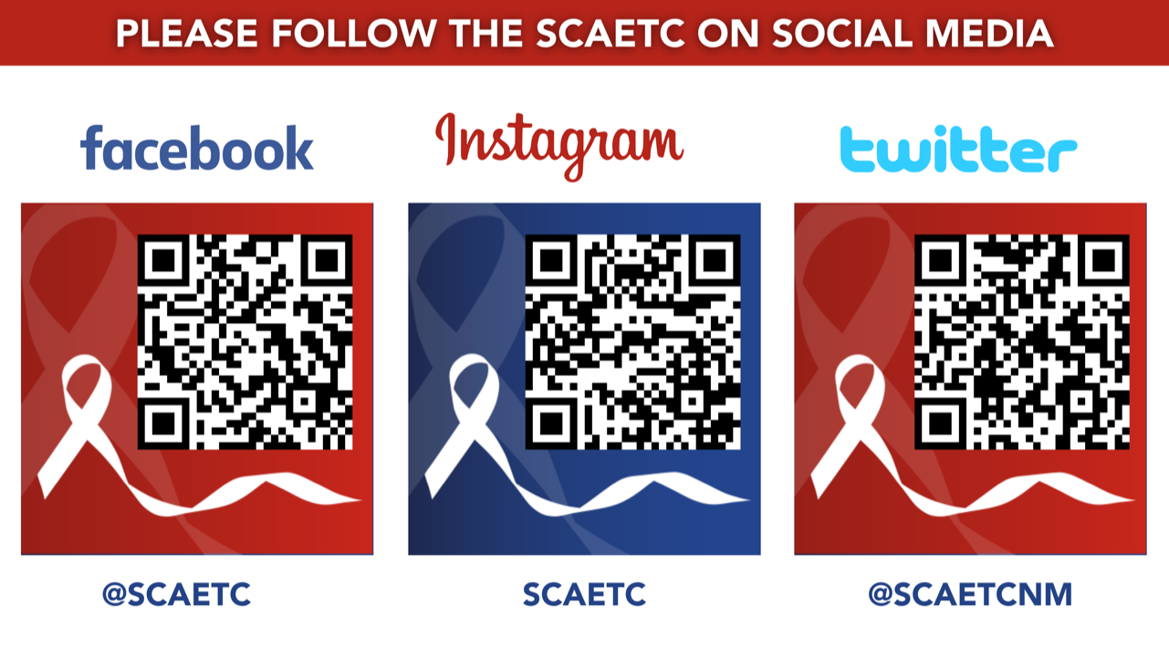
SCAETC Social Media

Slide 27
Resources
National Clinical Consultation Center http://nccc.ucsf.edu/
  HIV Management
  Perinatal HIV
  HIV PrEP
  HIV PEP line
  HCV Management
  Substance Use Management
Present case on ECHO https://hsc.unm.edu/scaetc/programs-services/echo.html
AETC National HIV Curriculum https://aidsetc.org/nhc
AETC National Coordinating Resource Center https://targethiv.org/library/aetc-national-coordinating-resource-center-0
Additional trainings scaetcecho@salud.unm.edu
www.SCAETC.org
Notes:
Find an HIV-related topic TeleECHO in your area: https://echo.unm.edu/locations-2/echo-hubs-superhubs-united-states/
IDEA Platform: Infectious Diseases Education & Assessment. https://idea.medicine.uw.edu/
AETC National HIV Curriculum: 6 core modules for self study; regularly updated; CME, CNE
Hepatitis C Online Curriculum: https://www.hepatitisc.uw.edu/
Hepatitis B Online Curriculum: https://www.hepatitisb.uw.edu/
National STD Curriculum: https://www.std.uw.edu/

