Slide 1
Hepatitis C: Drug-Drug Interactions
Clark Allen, PharmD, CSP | Regional One Health

Slide 2
Disclosures
This program is supported by the Health Resources and Services Administration (HRSA) of the U.S. Department of Health and Human Services (HHS) under grant number U1OHA30535 as part of an award totaling $4.2m. The contents are those of the author(s) and do not necessarily represent the official views of, nor an endorsement, by HRSA, HHS, or the U.S. Government. For more information, please visit HRSA.gov.
“Funding for this presentation was made possible by cooperative agreement U1OHA30535 from the Health Resources and Services Administration HIV/AIDS Bureau. The views expressed do not necessarily reflect the official policies of the Department of Health and Human Services nor does mention of trade names, commercial practices, or organizations imply endorsement by the U.S. Government. Any trade/brand names for products mentioned during this presentation are for training and identification purposes only.”
This content is owned by the AETC, and is protected by copyright laws. Reproduction or distribution of the content without written permission of the sponsor is prohibited, and may result in legal action.

Slide 3
AETC Program National Centers and HIV Curriculum
National Coordinating Resource Center – serves as the central web –based repository for AETC Program training and capacity building resources; its website includes a free virtual library with training and technical assistance materials, a program directory, and a calendar of trainings and other events. Learn more: https://aidsetc.org/
National Clinician Consultation Center – provides free, peer-to-peer, expert advice for health professionals on HIV prevention, care, and treatment and related topics. Learn more: https://nccc/ucsf.edu
National HIV Curriculum – provides ongoing, up –to-date HIV training and information for health professionals through a free, web –based curriculum; also provides free CME credits, CNE contact hours, CE contact hours, and maintenance of certification credits. Learn more: www.hiv.uw.edu

Slide 4
Objectives
Understand the mechanism of action for drug interactions with hepatitis c medications
Recognize which medications should be avoided in co-administration with hepatitis c medications
Indicate which medications are safe for use or need modification with hepatitis c medications
Select appropriate hepatitis c medication based on patient’s medication profile

Slide 5
Abbreviations
GLE/PIB - Glecaprevir/pibrentasvir – Mavyret
SOF/VEL - Sofosbuvir/velpatasvir – Epclusa
LDV/SOF - Ledipasvir/sofosbuvir - Harvoni
HIV – Human Immunodeficiency Virus
TB – Tuberculosis
H2RA – Histamine H2 Receptor Antagonist
PPI – Proton Pump Inhibitor
DAA – Direct Acting Antiviral
DF – Disoproxil Fumarate
AF – Alafenamide Fumarate

Slide 6
Drug-Drug Interaction Assessment

Slide 7
Drug-Drug Interaction Assessment
AASLD/IDSA HCV Guidelines. Jan 2021.

Slide 8
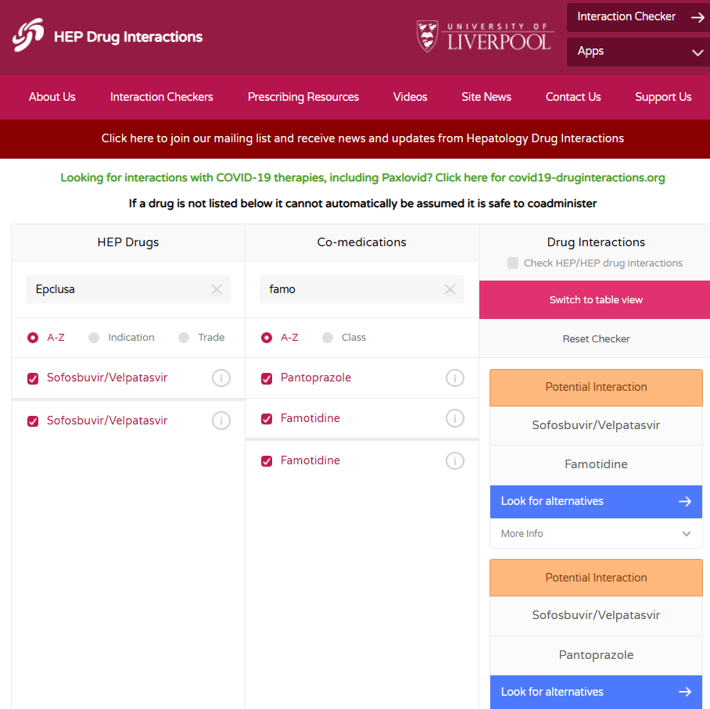
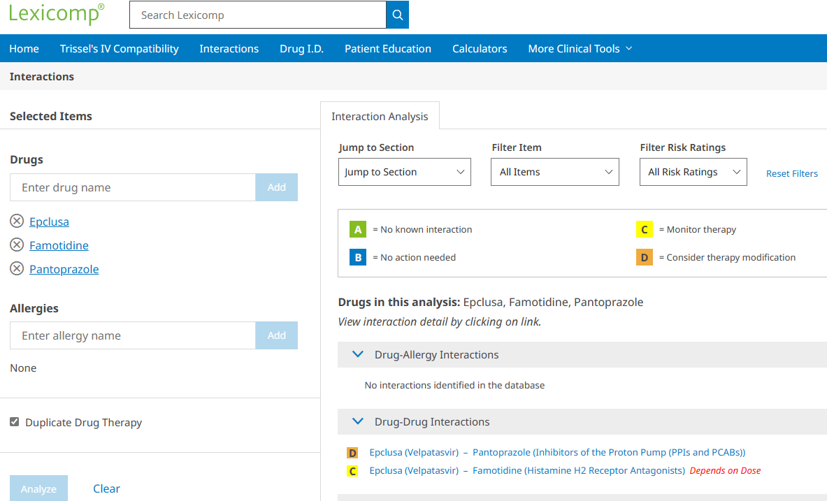
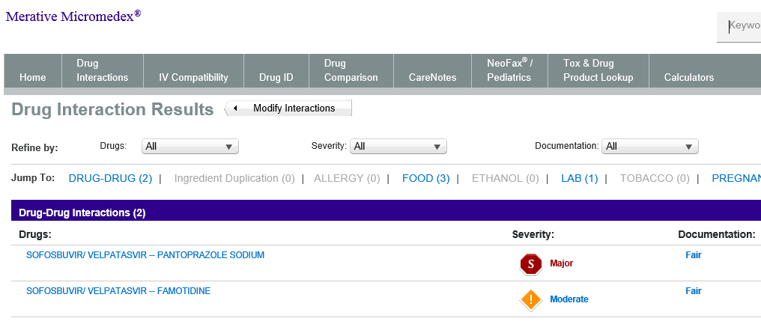
Drug Interaction Resources
www.lexicomp.com
www.micromedexsolutions.com
www.hep-druginteractions.org

Slide 9
Drug-Drug Interaction Mechanisms

Slide 10
Mechanisms
Medications that share a pathway = potential drug interaction
Cytochrome P450 (CYP)
Examples: CYP3A4, CYP2B6, CYP2C8
P-Glycoprotien (P-gp)
Organic Anion-Transporting Polypeptides (OATP)
Inducers and Inhibitors
McDonnell AM, Dang CH. Basic review of the cytochrome p450 system. J Adv Pract Oncol. 2013 Jul;4(4):263-8
Notes:
CYP450 – Group of Enzymes that helps with drug metabolism
PGP – Efflux (OUT) transporter, many drug metabolized by CYP3A4 also use PGP
OATPs – Influx (IN) Transporters

Slide 11
Common Drug-Drug Interactions

Slide 12
Common Drug-Drug Interactions
Statins
Acid-Suppressants
Anticonvulsants
Anticoagulants
Antiarrhythmics
HIV medications
TB medications
Ethinyl Estradiol containing medications
Pulmonary Hypertension medication
Herbal Supplements
AASLD/IDSA HCV Guidelines. Jan 2021.

Slide 13
Statins
 | GLE/PIB | SOF/VEL | LDV/SOF
Atorvastatin
Rosuvastatin | Max 10 mg | Max 10 mg
Simvastatin
Pravastatin | dose 50%
Lovastatin
Pitavastatin
Fluvastatin
AASLD/IDSA HCV Guidelines. Jan 2021.
hep-druginteractions.org
Notes:
increased risk of myopathy, including rhabdomyolysis. Monitor closely

Slide 14
Acid Suppressants
 | GLE/PIB | SOF/VEL | LDV/SOF
Antacids |  | Separate by 4 hours | Separate by 4 hours
H2RA |  | Famotidine 40 mg at same time or 12 hours after DAA | Famotidine 40 mg at same time or 12 hours after DAA
PPI | *Omeprazole 20 mg at same time or dose equivalent* | Omeprazole 20 mg 4 hours after DAA + meal | Omeprazole 20 mg at same time or dose equivalent
AASLD/IDSA HCV Guidelines. Jan 2021.
hep-druginteractions.org
Notes:
Mavyret and PPI – Omeprazole 20 at same time, AUC reduced, BUT no clinically significant interactions was observed

Slide 15
Anticonvulsants
 | GLE/PIB | SOF/VEL | LDV/SOF
Amobarbital
Carbamazepine
Phenytoin
Phenobarbital
Primidone
Oxcarbazepine
Quetiapine
Levetiracetam
AASLD/IDSA HCV Guidelines. Jan 2021.
hep-druginteractions.org

Slide 16
Anticoagulants
 | GLE/PIB | SOF/VEL | LDV/SOF
Apixaban
Dabigatran
Edoxaban | Consider dose reduction
Rivaroxaban
Ticagrelor
Warfarin | Monitor INR | Monitor INR | Monitor INR
AASLD/IDSA HCV Guidelines. Jan 2021.
hep-druginteractions.org
Notes:
Warfarin is metabolized by CYP2C19, 2C9, and 3A4

Slide 17
ECHO Pause
Scenery Slide from my trip to Banff National Park when I return, I will return on 6/15/23

Slide 18
Antiarrhythmics
 | GLE/PIB | SOF/VEL | LDV/SOF
Amiodarone
Dronedarone
Digoxin
Quinidine
AASLD/IDSA HCV Guidelines. Jan 2021.
hep-druginteractions.org

Slide 19
HIV Medications
 | GLE/PIB | SOF/VEL | LDV/SOF
Tenofovir-DF
Tenofovir-AF
Doravirine/Rilpivirine
Efavirenz/Etravirine
Cobicistat
Protease Inhibitors
Integrase Inhibitors
AASLD/IDSA HCV Guidelines. Jan 2021.
hep-druginteractions.org

Slide 20
TB Medications
 | GLE/PIB | SOF/VEL | LDV/SOF
Isoniazid
Ethambutol
Pyrazinamide
Rifampin
Rifabutin
Rifapentine
AASLD/IDSA HCV Guidelines. Jan 2021.
hep-druginteractions.org

Slide 21
Other Drug-Drug Interactions
 | GLE/PIB | SOF/VEL | LDV/SOF
Ethinyl Estradiol
Bosentan
Cyclosporine
St. John’s Wort
Cancer Medications
Diabetes Medications
Hypertension Medications
Mental Health Medications
AASLD/IDSA HCV Guidelines. Jan 2021.
hep-druginteractions.org
Notes:
Combined Oral Contraceptives containing Ethinyl Estradiol

Slide 22
Drug Interaction Follow Up
Not sure how to handle a drug interaction
Reach out and ask a pharmacist!
Clark Allen, PharmD, CSP – clallen@regionalonehealth.org
Monitor/follow-up with patient throughout treatment course for new or discontinued medications
Be engaged with patient to let them know how important it is to get cured!
AASLD/IDSA HCV Guidelines. Jan 2021.
hep-druginteractions.org

Slide 23
Hepatitis C: Drug Interactions
Clark Allen, PharmD, CSP | Regional One Health
Notes:
So with that, I am going to turn it over to Dr. Clark Allen to provide our didactic for today. Dr. Allen please say next slide when you would like us to advance the slides.

