Slide 1
HIV Health Outcomes: Beyond Viral Suppression
Screening & Risk Reduction for Common HIV Comorbidities
July 2023
Notes:
https://aidsetc.org/resource/comorbidities

Slide 2
About This Presentation
These slides were developed by the AETC NCRC based on a tool created by the AETC HIV Comorbidities Community of Practice and Learning in 2022-2023.
The intended audience is clinicians involved in the care of persons with HIV (PWH).
Because the field of HIV care is rapidly changing, users are cautioned that the information in this presentation may become out of date quickly.
It is intended that these slides be used as prepared, without changes in either content or attribution. Users are asked to honor this intent.

Slide 3
Introduction
Although people with HIV in the United States are now less likely to die of HIV-specific causes compared to past years, they are burdened with more chronic diseases and attendant mortality than HIV uninfected persons. (Buchacz, 2020; Bosh, 2020; Kitahata, 2009; CDC, 2021)
We seek to increase clinician awareness of the increased prevalence of specific illnesses and mortalities among PWH in the US, with recommendations for prevention, screening, and risk reduction.
Notes:
Buchacz K, Armon C, Palella FJ Jr, et al. The HIV Outpatient Study-25 Years of HIV Patient Care and Epidemiologic Research. Open Forum Infect Dis. 2020;7(5):ofaa123. Published 2020 Apr 11.
Bosh KA, Johnson AS, Hernandez AL, et al. Vital Signs: Deaths Among Persons with Diagnosed HIV Infection, United States, 2010–2018. MMWR Morb Mortal Wkly Rep 2020;69:1717–1724.
Kitahata MM, Gange SJ, Abraham AG, et al. Effect of early versus deferred antiretroviral therapy for HIV on survival. N Engl J Med. 2009;360(18):1815-1826.
CDC HIV cohort, HIV Outpatient Study (HOPS); Edwards JK, Cole SR, Breger TL, et al. Mortality among persons entering HIV care compared with the general U.S. population: An observational study. Ann Intern Med. 2021;174(9):1197-1206.

Slide 4
Comorbidities with increased prevalence in people with HIV
Disease | Relative Rates in PWH
Anal Cancer | Up to 80x more common
Bronchopulmonary Cancer | 48% more common
Cervical Cancer | 3-4x more common
Dental/Oropharyngeal Cancers (OPC) | 3x more common
Atherosclerotic Cardiovascular Disease (ASCVD) | 2x more likely
Mental Health (MHD) & Substance Use Disorders (SUD) | MHD almost 2x more common SUD 4x more common
Notes:
PWH: People with HIV
OPC: Oropharyngeal Cancers
ASCVD: Atherosclerotic Cardiovascular Disease
MHD: Mental Health Disorders
SUD: Substance Use Disorders

Slide 5
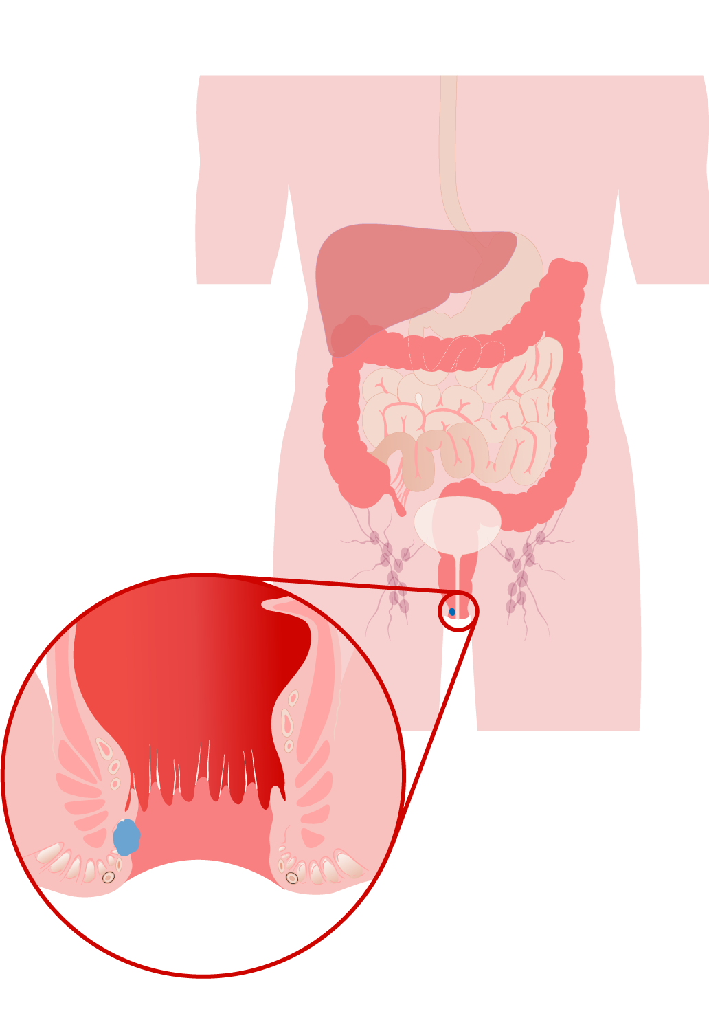
Anal Cancer: Prevalence
80 times more common in men who have sex with men (MSM) with HIV than in MSM without HIV (ANCHOR Study, 2022)
The rates of anal cancer in women with HIV and men with HIV who have sex with women are higher than the rate in the general population, though lower than in MSM with HIV (Clifford, 2021)
The rate of anal dysplasia in transgender women with HIV is similar to that of MSM with HIV (Kobayashi, 2017)
Notes:
MSM: men who have sex with men
ANCHOR Study. Anal Cancer Risks Compared. Accessed 12/28/22. https://anchorstudy.org/anal-cancer-risk-among-hiv-positive-men-and-women
Clifford GM, Georges D, Shiels MS, et al. A meta-analysis of anal cancer incidence by risk group: Toward a unified anal cancer risk scale. Int J Cancer. 2021;148(1):38-47.
Kobayashi T, Sigel K, Gaisa M. Prevalence of Anal Dysplasia in Human Immunodeficiency Virus-Infected Transgender Women. Sex Transm Dis. 2017 Nov;44(11):714-716.

Slide 6
Anal Cancer: Risk Reduction
Human papillomavirus (HPV) vaccination if ≤26 years old (HHS, 2021)
Shared decision-making for completing HPV vaccination of those 27-45 years old (HHS, 2021)
Smoking cessation counseling, support, medications (Ranjit, 2018)
Notes:
HPV: Human papillomavirus
Guidelines for the Prevention and Treatment of Opportunistic Infections in Adults and Adolescents with HIV. Human Papillomavirus Disease. August 18, 2021. Accessed 12/28/22. https://clinicalinfo.hiv.gov/en/guidelines/hiv-clinical-guidelines-adult-and-adolescent-opportunistic-infections/human-0.
Ranjit S, Kumar S. Recent advances in cancer outcomes in HIV-positive smokers. F1000Res. 2018 Jun 11;7:F1000 Faculty Rev-718. doi: 10.12688/f1000research.12068.1.

Slide 7
Anal Cancer: Screening
Annual symptom screening, perianal visual inspection, and digital anal rectal exam (DARE), for PWH of all genders aged ≥35 years (HHS, 2021; Hirsch, 2022)
For those aged ≥35 years and if HRA is available: annual anal Pap test with reflex HPV testing
If Pap shows ≥ LSIL, refer for HRA
If Pap shows ASCUS: refer for HRA if high-risk HPV DNA positive, or repeat anal Pap in 6 months if HPV testing not available (Hirsch, 2022)
LSIL: low-grade intraepithelial lesion ASCUS: atypical squamous cells of undetermined significance HRA: high-resolution anoscopy
Notes:
DARE: Digital anal rectal exam
PWH: people with HIV
LSIL: low-grade intraepithelial lesion
ASCUS: atypical squamous cells of undetermined significance
HRA: high-resolution anoscopy
HPV: Human papillomavirus
Guidelines for the Prevention and Treatment of Opportunistic Infections in Adults and Adolescents with HIV. Human Papillomavirus Disease. August 18, 2021. Accessed 12/28/22. https://clinicalinfo.hiv.gov/en/guidelines/hiv-clinical-guidelines-adult-and-adolescent-opportunistic-infections/human-0.
Hirsch BE, McGowan JP, Fine SM, et al. Screening for Anal Dysplasia and Cancer in Adults With HIV [Internet]. Baltimore (MD): Johns Hopkins University; 2022 Aug 9. Available from: https://www.ncbi.nlm.nih.gov/books/NBK556472/. Accessed 12/28/22.

Slide 8
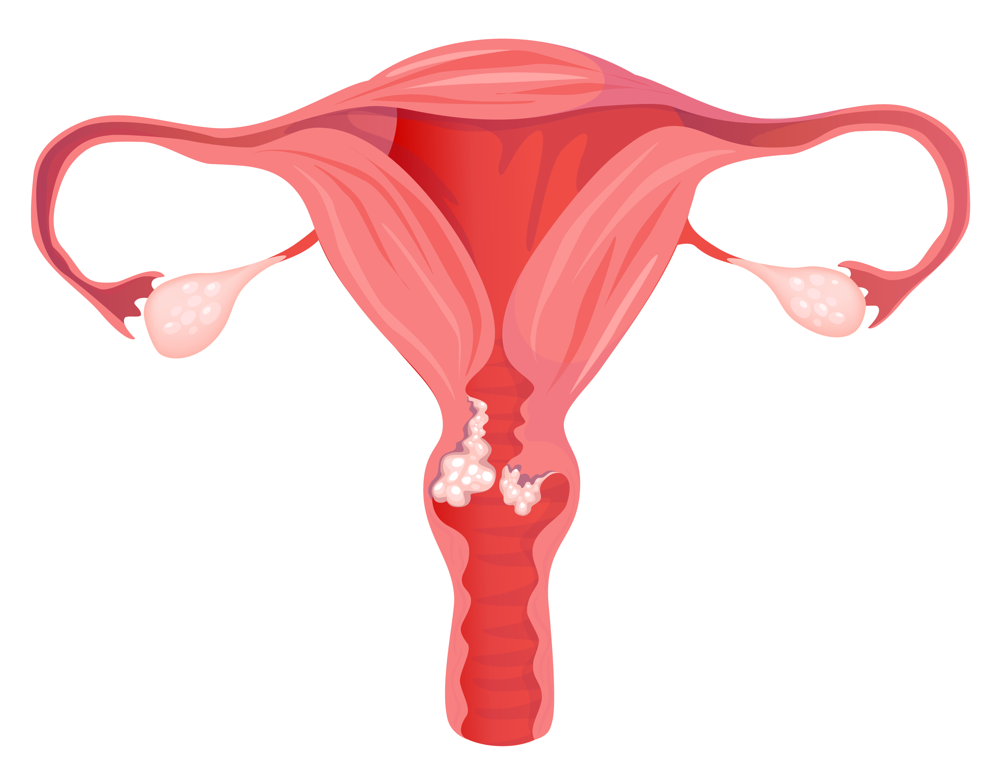
Cervical Cancer: Prevalence
3-4 times more common in cisgender women with HIV than in cisgender women without HIV (Stier, 2021)
Anyone with a cervix is at risk of cervical cancer; this may include transgender men, and non-binary and intersex individuals
Screening should be based on age recommendations
Notes:
Stier EA, Engels E, Horner MJ, Robinson WT, Qiao B, Hayes J, Bayakly R, Anderson BJ, Gonsalves L, Pawlish KS, Zavala D, Monterosso A, Shiels MS. Cervical cancer incidence stratified by age in women with HIV compared with the general population in the United States, 2002-2016. AIDS. 2021 Sep 1;35(11):1851-1856. doi: 10.1097/QAD.0000000000002962. PMID: 34049357; PMCID: PMC8373779.

Slide 9
Cervical Cancer: Risk Reduction
HPV vaccination if ≤26 years old (HHS, 2021)
Shared decision-making for completing HPV vaccination of those 27-45 years old (HHS, 2021)
Smoking cessation counseling, support, medications (Ranjit, 2018)
Notes:
HPV = Human papillomavirus
Guidelines for the Prevention and Treatment of Opportunistic Infections in Adults and Adolescents with HIV. Human Papillomavirus Disease. August 18, 2021. Accessed 12/28/22. https://clinicalinfo.hiv. gov/en/guidelines/hiv-clinical-guidelines-adult-and-adolescent- opportunistic-infections/human-0.
Ranjit S, Kumar S. Recent advances in cancer outcomes in HIV-positive smokers. F1000Res. 2018 Jun 11;7:F1000 Faculty Rev-718. doi: 10.12688/f1000research.12068.1.

Slide 10
Cervical Cancer: Screening (ages 21-29 years)
Persons with an intact uterine cervix aged 21-29 years: cervical Pap test at the time of initial HIV diagnosis (HHS, 2021)
If the initial Pap result is normal, repeat every 12 months.
If the results of 3 consecutive annual Pap tests are normal, do follow-up Pap tests every 3 years
For abnormal Pap results of ASCUS or higher grade (LSIL or HSIL), refer for colposcopy
LSIL: low-grade intraepithelial lesion
HSIL: high-grade intraepithelial lesion
ASCUS: atypical squamous cells of undetermined significance
Notes:
LSIL: low-grade intraepithelial lesion
HSIL: high-grade intraepithelial lesion
ASCUS: atypical squamous cells of undetermined significance
Guidelines for the Prevention and Treatment of Opportunistic Infections in Adults and Adolescents with HIV. Human Papillomavirus Disease. August 18, 2021. Accessed 12/28/22. https://clinicalinfo.hiv. gov/en/guidelines/hiv-clinical-guidelines-adult-and-adolescent- opportunistic-infections/human-0.

Slide 11
Cervical Cancer: Screening – ages ≥30 years (1)
Cervical Pap test (with reflex HPV test if available) at the time of HIV diagnosis (HHS, 2021)
Continue screening for the lifetime of the person
If only Pap testing is done:
If the initial Pap result is normal, repeat every 12 months.
If the results of 3 consecutive annual Pap tests are normal, do follow-up Pap tests every 3 years
Notes:
HPV: Human papillomavirus
Guidelines for the Prevention and Treatment of Opportunistic Infections in Adults and Adolescents with HIV. Human Papillomavirus Disease. August 18, 2021. Accessed 12/28/22. https://clinicalinfo.hiv.gov/en/guidelines/hiv-clinical-guidelines-adult-and-adolescent-opportunistic-infections/human-0.

Slide 12
Cervical Cancer: Screening – ages ≥30 years (2)
If Pap and HPV co-testing are done: (HHS, 2021)
If both test results are negative, repeat screening in 3 years
If normal Pap but positive HPV test, repeat co-testing in 1 year
If HPV 16 or 18 positive, refer for colposcopy
Abnormal results:
If ≥ LSIL, or HPV test shows HPV 16 or 18, refer for colposcopy
If ASCUS without positive HPV, then repeat the Pap test alone in 6-12 months or do Pap test with HPV test in 12 months
Refer for colposcopy if result is ≥ ASCUS
LSIL: low-grade intraepithelial lesion
ASCUS: atypical squamous cells of undetermined significance
Notes:
LSIL: low-grade intraepithelial lesion
HSIL: high-grade intraepithelial lesion
ASCUS: atypical squamous cells of undetermined significance
HPV: Human papillomavirus
Guidelines for the Prevention and Treatment of Opportunistic Infections in Adults and Adolescents with HIV. Human Papillomavirus Disease. August 18, 2021. Accessed 12/28/22. https://clinicalinfo.hiv.gov/en/guidelines/hiv-clinical-guidelines-adult-and-adolescent-opportunistic-infections/human-0.

Slide 13
Dental—Oropharyngeal Cancers (OPC)
Prevalence:
HPV-related and HPV-unrelated OPCs occur 3 times more frequently among PWH than in the general US population (HHS, 2021; Beachler, 2014)
Risk Reduction:
HPV vaccination if ≤26 years old (HHS, 2021; Kaczmarczyk, 2022)
Shared decision-making for completing HPV vaccination of those 27-45 years old (HHS, 2021)
Smoking cessation counseling, support, medications (Ranjit, 2018)
Screening:
Dental exam at least once every 6 months (regardless of dentition status) inclusive of thorough exam of head, neck, and oropharyngeal tissue
Notes:
HPV: Human papillomavirus
OPC: Oropharyngeal cancers
Guidelines for the Prevention and Treatment of Opportunistic Infections in Adults and Adolescents with HIV. Human Papillomavirus Disease. August 18, 2021. Accessed 12/28/22. https://clinicalinfo.hiv.gov/en/guidelines/hiv-clinical-guidelines-adult-and-adolescent- opportunistic-infections/human-0.
Beachler DC, Abraham AG, Silverberg MJ et al (2014). Incidence and risk factors of HPV-related and HPV-unrelated Head and Neck Squamous Cell Carcinoma in HIV-infected individuals. Oral Oncol 50: 1169–1176.
Kaczmarczyk KH, Yusuf H. The impact of HPV vaccination on the prevention of oropharyngeal cancer: A scoping review. Community Dent Health. 2022;39(1):14-21.
Ranjit S, Kumar S. Recent advances in cancer outcomes in HIV-positive smokers. F1000Res. 2018 Jun 11;7:F1000 Faculty Rev-718. doi: 10.12688/f1000research.12068.1.

Slide 14
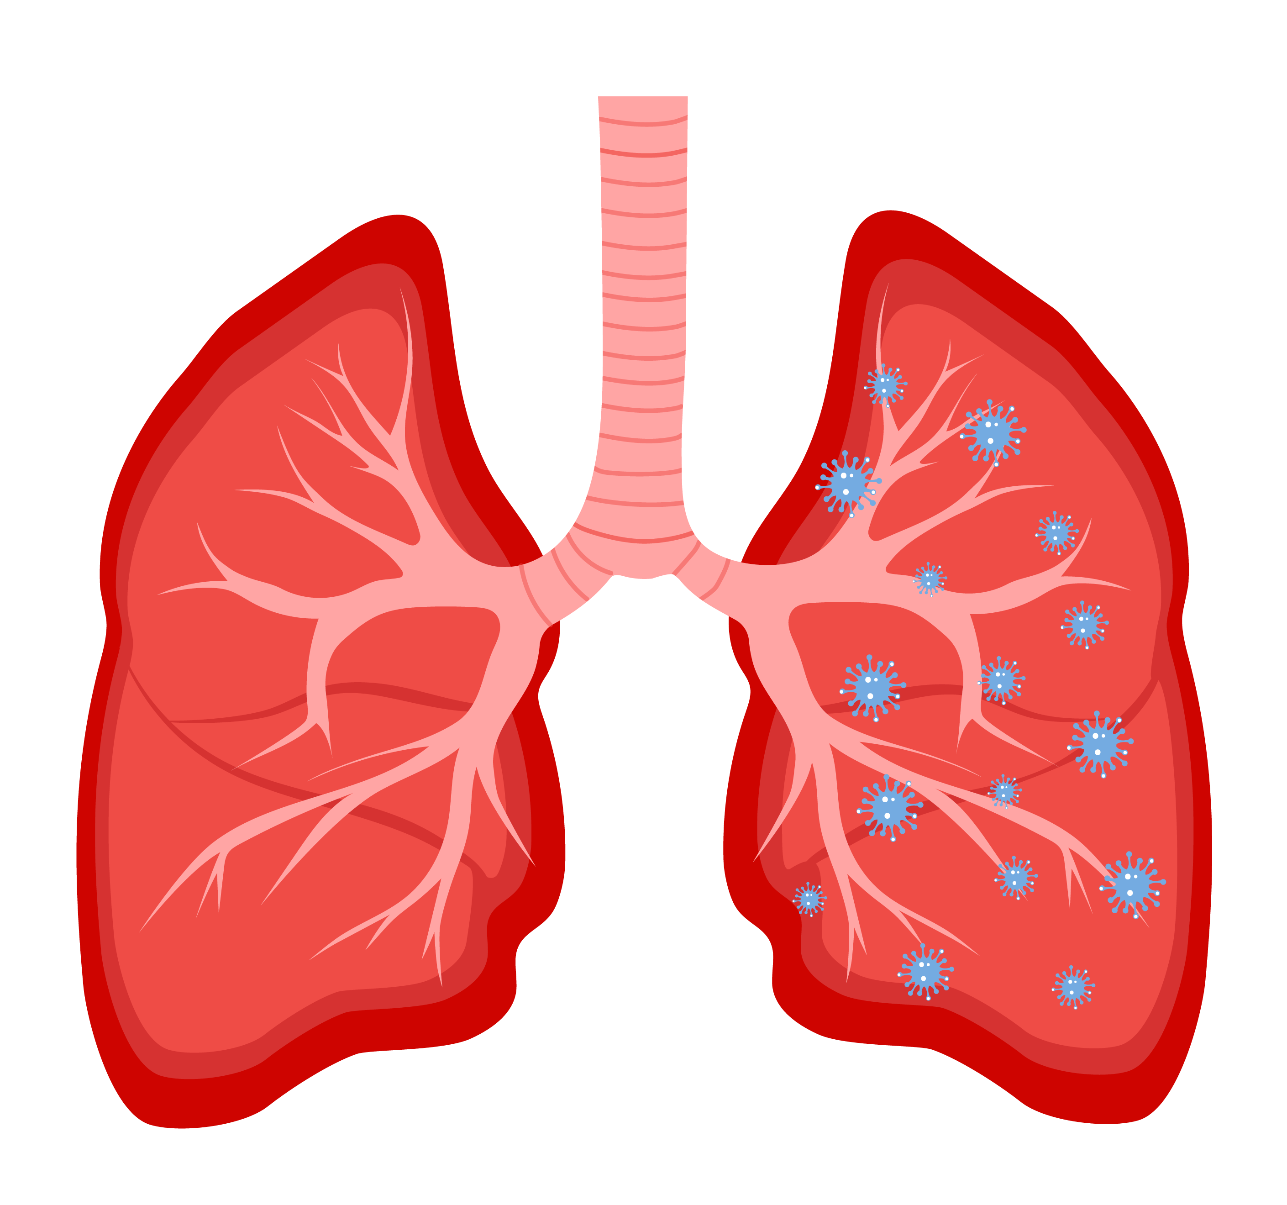
Bronchopulmonary Cancers
Prevalence
PWH have a 48% higher risk of lung cancer compared to the general US population (Haas, 2022)
Screening
Annual LDCT in those aged 50-80 years who have ≥20-pack-year smoking history (# cigs/day x # years smoked) and currently smoke or have quit within the past 15 years (USPSTF, 2021; ACS, 2022)
LDCT: low-dose computed tomography
Risk Reduction
Smoking cessation counseling, support, medications (Ranjit, 2018)
Notes:
PWH: People with HIV
LDCT: low-dose computed tomography
Haas CB, Engels EA, Horner MJ, et al. Trends and risk of lung cancer among people living with HIV in the USA: a population-based registry linkage study. Lancet HIV. 2022 Oct;9(10):e700-e708.
Ranjit S, Kumar S. Recent advances in cancer outcomes in HIV-positive smokers. F1000Res. 2018 Jun 11;7:F1000 Faculty Rev-718. doi: 10.12688/f1000research.12068.1.
USPSTF. Lung Cancer: Screening. March 9, 2021. https://www.uspreventiveservicestaskforce.org/uspstf/recommendation/lung-cancer-screening. Accessed 12/29/22.
American Cancer Society. Lung Cancer Screening Guidelines. https://www.cancer.org/health-care-professionals/american-cancer-society-prevention-early-detection-guidelines/lung-cancer-screening-guidelines.html. Accessed 12/29/22.

Slide 15
Atherosclerotic Cardiovascular Disease (ASCVD): Prevalence
Adults with HIV are 2 times more likely to develop ASCVD compared to adults without HIV (Shah, 2018)
Notes:
ASCVD: Atherosclerotic Cardiovascular Disease
Shah ASV, Stelzle D, Lee KK, et al. Global Burden of Atherosclerotic Cardiovascular Disease in People Living With HIV: Systematic Review and Meta-Analysis. Circulation. 2018 Sep 11;138(11):1100-1112.

Slide 16
ASCVD: Risk Reduction (1)
ART with sustained viral suppression (Feinstein, 2019)
Smoking cessation: counseling, support, medication (Ranjit, 2018)
Diabetes screening/control: random or fasting glucose every 12 months for screening, and glucose control for people who have DM (Thompson, 2021)
Blood pressure (BP) control (<130 mm Hg systolic and <80 mm Hg diastolic) (Whelton, 2018)
Lipid lowering: Prescribe statins and other lipid-lowering medications as recommended by the ACC/AHA Task Force on Clinical Practice Guidelines (Grundy, 2019)
Note that PK boosters (e.g., RTV or COBI) may interact with statins; generally, may use limited doses of atorvastatin or rosuvastatin (assess with drug-drug interaction checker)
Notes:
ASCVD: Atherosclerotic Cardiovascular Disease
ART: Antiretroviral therapy
DM: Diabetes millitus
PK: pharmacokinetic
RTV: ritonavir
COBI: cobicistat
Feinstein MJ, Hsue PY, Benjamin LA, et al. Characteristics, Prevention, and Management of Cardiovascular Disease in People Living With HIV: A Scientific Statement From the American Heart Association. Circulation. 2019 Jul 9;140(2):e98-e124.
Ranjit S, Kumar S. Recent advances in cancer outcomes in HIV-positive smokers. F1000Res. 2018 Jun 11;7:F1000 Faculty Rev-718. doi: 10.12688/f1000research.12068.1.
Thompson MA, Horberg MA, Agwu AL, et al. Primary Care Guidance for Persons With Human Immunodeficiency Virus: 2020 Update by the HIV Medicine Association of the Infectious Diseases Society of America, Clinical Infectious Diseases, Volume 73, Issue 11, 1 December 2021, Pages e3572–e3605, https://doi.org/10.1093/cid/ciaa1391. Accessed 7/14/23.
Whelton PK, Carey RM, Aronow WS, et al. 2017 ACC/AHA/AAPA/ABC/ACPM/AGS/APhA/ASH/ASPC/NMA/PCNA Guideline for the Prevention, Detection, Evaluation, and Management of High Blood Pressure in Adults: A Report of the American College of Cardiology/American Heart Association Task Force on Clinical Practice Guidelines. et al. Hypertension. 2018 Jun;71(6):e13-e115. Erratum in: Hypertension. 2018 Jun;71(6):e140-e144.
Grundy SM, Stone NJ, Bailey AL, et al. 2018 AHA/ACC/AACVPR/AAPA/ABC/ACPM/ADA/AGS/APhA/ASPC/NLA/PCNA Guideline on the Management of Blood Cholesterol: A Report of the American College of Cardiology/ American Heart Association Task Force on Clinical Practice Guidelines. J Am Coll Cardiol. 2019 Jun 25;73(24):e285-e350. Erratum in: J Am Coll Cardiol. 2019 Jun 25;73(24):3237-3241. https://pubmed.ncbi.nlm.nih.gov/30423391/

Slide 17
ASCVD: Risk Reduction (2) – Lifestyle measures
150 minutes/week of accumulated moderate-intensity physical activity or 75 minutes/week of vigorous-intensity physical activity (DHHS, 2018)
Changes in diet (to plant-based or Mediterranean-like diet) (Grundy, 2019)
Alcohol use reduction to ≤1 drink/day (14 g of alcohol) for women and ≤2 drinks/day for men (USDA, 2020)
Weight reduction if overweight or obese (BMI ≥25) (Grundy, 2019; Whelton, 2018)
Reduction or elimination of medications or other substances (OTC and illicit) that increase BP, or heart rate, or that can cause vasospasm – e.g., stimulants (Whelton, 2018)
Notes:
U.S. Department of Health and Human Services. Physical Activity Guidelines for Americans, 2nd edition. Washington, DC: U.S. Department of Health and Human Services; 2018.
Grundy SM, Stone NJ, Bailey AL, et al. 2018 AHA/ACC/AACVPR/AAPA/ABC/ACPM/ADA/AGS/APhA/ASPC/NLA/PCNA Guideline on the Management of Blood Cholesterol: A Report of the American College of Cardiology/American Heart Association Task Force on Clinical Practice Guidelines. J Am Coll Cardiol. 2019 Jun 25;73(24):e285-e350. Erratum in: J Am Coll Cardiol. 2019 Jun 25;73(24):3237-3241. https://pubmed.ncbi.nlm.nih.gov/30423391/
U.S. Department of Agriculture and U.S. Department of Health and Human Services. Dietary Guidelines for Americans, 2020-2025. 9th Edition. December 2020. Available at DietaryGuidelines.gov.
Whelton PK, Carey RM, Aronow WS, et al. 2017 ACC/AHA/AAPA/ABC/ACPM/AGS/APhA/ASH/ASPC/NMA/PCNA Guideline for the Prevention, Detection, Evaluation, and Management of High Blood Pressure in Adults: A Report of the American College of Cardiology/American Heart Association Task Force on Clinical Practice Guidelines. et al. Hypertension. 2018 Jun;71(6):e13-e115. Erratum in: Hypertension. 2018 Jun;71(6):e140-e144.
Feinstein MJ, Hsue PY, Benjamin LA, et al. Characteristics, Prevention, and Management of Cardiovascular Disease in People Living With HIV: A Scientific Statement From the American Heart Association. Circulation. 2019 Jul 9;140(2):e98-e124.

Slide 18
Mental Health Disorders & Related Problems: Prevalence
Adults with HIV are nearly 2 times more likely to be diagnosed with a mental illness compared to adults without HIV infection (Gooden, 2020)
Past-year illegal drug use is 4 times more likely in adults with HIV (Shiau, 2017)
Mental health problems are associated with mortality through their link to suicide, overdose, fatal injury, and end-stage organ damage
Notes:
Gooden TE, Gardner M, Wang J, et al. The risk of mental illness in people living with HIV in the UK: a propensity score-matched cohort study. Lancet HIV. 2022;9(3):e172-e181.
Shiau S, Arpadi SM, Yin MT, Martins SS. Patterns of drug use and HIV infection among adults in a nationally representative sample. Addict Behav. 2017 May;68:39-44. https://doi.org/10.1016/ j.addbeh.2017.01.015. Epub 2017 Jan 7.

Slide 19
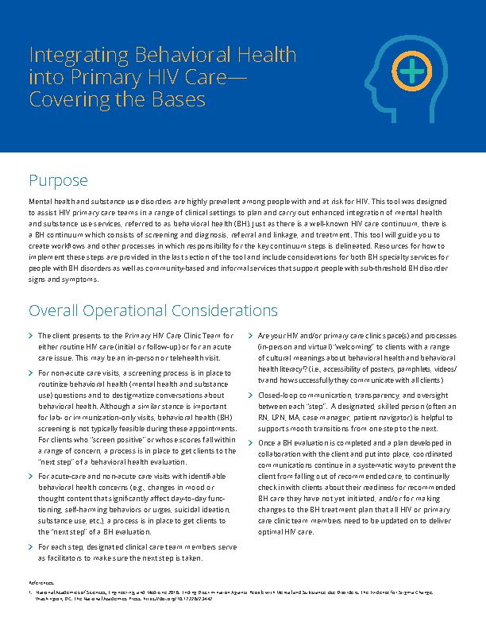
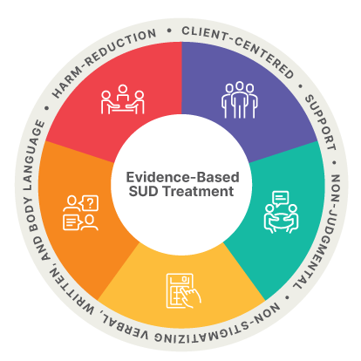
Mental Health Disorders & Related Problems: Risk Reduction
Inform patients about the 988 National Suicide and Crisis Lifeline that can be called or texted 24/7
Use local and national resources to help incorporate behavioral health screening, referral, or treatment into primary HIV care
Notes:
Resources:
Implementing Substance Use Disorder (SUD) Services in HIV Care Settings Toolkit: https://aidsetc.org/resource/sud-toolkit
Behavioral Health Resource Toolkit: https://aidsetc.org/ toolkit/mental-health/resources
Integrating Behavioral Health into HIV Primary Care — Covering the Bases: https://aidsetc.org/resource/ integrating-behavioral-health-primary-hiv-care-covering-bases
Strengthening Systems of Care for People with HIV & Opioid Use Disorder — Tools from a Ryan White HIV/AIDS Program SPNS initiative: https://targethiv.org/spns-ssc

Slide 20
Mental Health Disorders & Related Problems: Screening
Screen at least annually for depression, anxiety, post-traumatic stress disorder, alcohol/ substance use disorders, including tobacco smoking.
Mental Health Screening
Anxiety: GAD-2, GAD-7
Dementia: IHDS
Depression: PHQ-2, PHQ-9
PTSD: PC-PTSD-5
Substance Use Screening
Alcohol: AUDIT-C, CAGE
Drug & Alcohol Use: TICS, CAGE-AID
Opioid: Risk Tool
Online screeners from the National HIV Curriculum (https://www.hiv.uw.edu)
Notes:
Mental Health Screening Tools
Generalized Anxiety Disorder 2-item (GAD-2)
Generalized Anxiety Disorder 7-item (GAD-7)
International HIV Dementia Scale (IHDS)
Patient Health Questionnaire-2 (PHQ-2)
Patient Health Questionnaire-9 (PHQ-9)
Primary Care Post-traumatic Stress Disorder Screen for DSM-5 (PC-PTSD-5)
Substance Use Screening Tools
Alcohol Use Disorders Identification Test (AUDIT-C)
CAGE Alcohol Questionnaire (Cut down – Annoyed – Guilty – Eye-opener)
CAGE Adapted to Include Drugs (CAGE-AID) Questionnaire
Two-Item Conjoint Screen (TICS) for Alcohol and Other Drug Problems
Opioid Risk Tool (ORT)
See also Substance Use Screening Tools for HIV Service Delivery Settings (https://targethiv.org/spns-ssc/substance-use-screening-tools)

Slide 21
References (1)
Buchacz K, Armon C, Palella FJ Jr, et al. The HIV Outpatient Study-25 Years of HIV Patient Care and Epidemiologic Research. Open Forum Infect Dis. 2020;7(5):ofaa123. Published 2020 Apr 11.
Bos KA, Johnson AS, Hernandez AL, et al. Vital Signs: Deaths Among Persons with Diagnosed HIV Infection, United States, 2010–2018. MMWR Morb Mortal Wkly Rep 2020;69:1717–1724.
Kitahata MM, Gange SJ, Abraham AG, et al. Effect of early versus deferred antiretroviral therapy for HIV on survival. N Engl J Med. 2009;360(18):1815-1826.
CDC HIV cohort, HIV Outpatient Study (HOPS); Edwards JK, Cole SR, Breger TL, et al. Mortality among persons entering HIV care compared with the general U.S. population: An observational study. Ann Intern Med. 2021;174(9):1197-1206.
ANCHOR Study. Anal Cancer Risks Compared. Accessed 12/28/22.
Clifford GM, Georges D, Shiels MS, et al. A meta-analysis of anal cancer incidence by risk group: Toward a unified anal cancer risk scale. Int J Cancer. 2021;148(1):38-47.
Kobayashi T, Sigel K, Gaisa M. Prevalence of Anal Dysplasia in Human Immunodeficiency Virus-Infected Transgender Women. Sex Transm Dis. 2017 Nov;44(11):714-716.
Guidelines for the Prevention and Treatment of Opportunistic Infections in Adults and Adolescents with HIV. Human Papillomavirus Disease. August 18, 2021. Accessed 12/28/22.
Hirsch BE, McGowan JP, Fine SM, et al. Screening for Anal Dysplasia and Cancer in Adults With HIV [Internet]. Baltimore (MD): Johns Hopkins University; 2022 Aug 9. Accessed 12/28/22.

Slide 22
References (2)
Haas CB, Engels EA, Horner MJ, et al. Trends and risk of lung cancer among people living with HIV in the USA: a population-based registry linkage study. Lancet HIV. 2022 Oct;9(10):e700-e708.
Ranjit S, Kumar S. Recent advances in cancer outcomes in HIV- positive smokers. F1000Res. 2018 Jun 11;7:F1000 Faculty Rev-718.
USPSTF. Lung Cancer: Screening. March 9, 2021. Accessed 12/29/22.
American Cancer Society. Lung Cancer Screening Guidelines. Accessed 12/29/22.
Stier EA, Engels E, Horner MJ, et al. Cervical cancer incidence stratified by age in women with HIV compared with the general population in the United States, 2002-2016. AIDS. 2021 Sep 1;35(11):1851-1856.
Beachler DC, Abraham AG, Silverberg MJ et al (2014). Incidence and risk factors of HPV-related and HPV-unrelated Head and Neck Squamous Cell Carcinoma in HIV-infected individuals. Oral Oncol 50: 1169–1176.
Kaczmarczyk KH, Yusuf H. The impact of HPV vaccination on the prevention of oropharyngeal cancer: A scoping review. Community Dent Health. 2022;39(1):14-21.
Shah ASV, Stelzle D, Lee KK, et al. Global Burden of Atherosclerotic Cardiovascular Disease in People Living With HIV: Systematic Review and Meta-Analysis. Circulation. 2018 Sep 11;138(11):1100-1112.
Feinstein MJ, Hsue PY, Benjamin LA, et al. Characteristics, Prevention, and Management of Cardiovascular Disease in People Living With HIV: A Scientific Statement From the American Heart Association. Circulation. 2019 Jul 9;140(2):e98-e124.

Slide 23
References (3)
Grundy SM, Stone NJ, Bailey AL, et al. 2018 AHA/ACC/AACVPR/AAPA/ ABC/ACPM/ADA/AGS/APhA/ ASPC/NLA/PCNA Guideline on the Management of Blood Cholesterol: A Report of the American College of Cardiology/American Heart Association Task Force on Clinical Practice Guidelines. J Am Coll Cardiol. 2019 Jun 25;73(24): e285-e350. Erratum in: J Am Coll Cardiol. 2019 Jun 25;73(24): 3237-3241.
Whelton PK, Carey RM, Aronow WS, et al. 2017 ACC/AHA/AAPA/ABC/ ACPM/AGS/APhA/ASH/ASPC/ NMA/PCNA Guideline for the Prevention, Detection, Evaluation, and Management of High Blood Pressure in Adults: A Report of the American College of Cardiology/American Heart Association Task Force on Clinical Practice Guidelines. Hypertension. 2018 Jun;71(6):e13-e115. Erratum in: Hypertension. 2018 Jun;71(6):e140-e144.
U.S. Department of Agriculture and U.S. Department of Health and Human Services. Dietary Guidelines for Americans, 2020-2025. 9th Edition. December 2020.
Thompson MA, Horberg MA, Agwu AL, et al. Primary Care Guidance for Persons With Human Immunodeficiency Virus: 2020 Update by the HIV Medicine Association of the Infectious Diseases Society of America, Clinical Infectious Diseases, Volume 73, Issue 11, 1 December 2021, Pages e3572–e3605. Accessed 7/14/23.
U.S. Department of Health and Human Services. Physical Activity Guidelines for Americans, 2nd edition. Washington, DC: U.S. Department of Health and Human Services; 2018.
Gooden TE, Gardner M, Wang J, et al. The risk of mental illness in people living with HIV in the UK: a propensity score-matched cohort study. Lancet HIV. 2022;9(3):e172-e181.
Shiau S, Arpadi SM, Yin MT, Martins SS. Patterns of drug use and HIV infection among adults in a nationally representative sample. Addict Behav. 2017 May;68:39-44. Epub 2017 Jan 7.

Slide 24
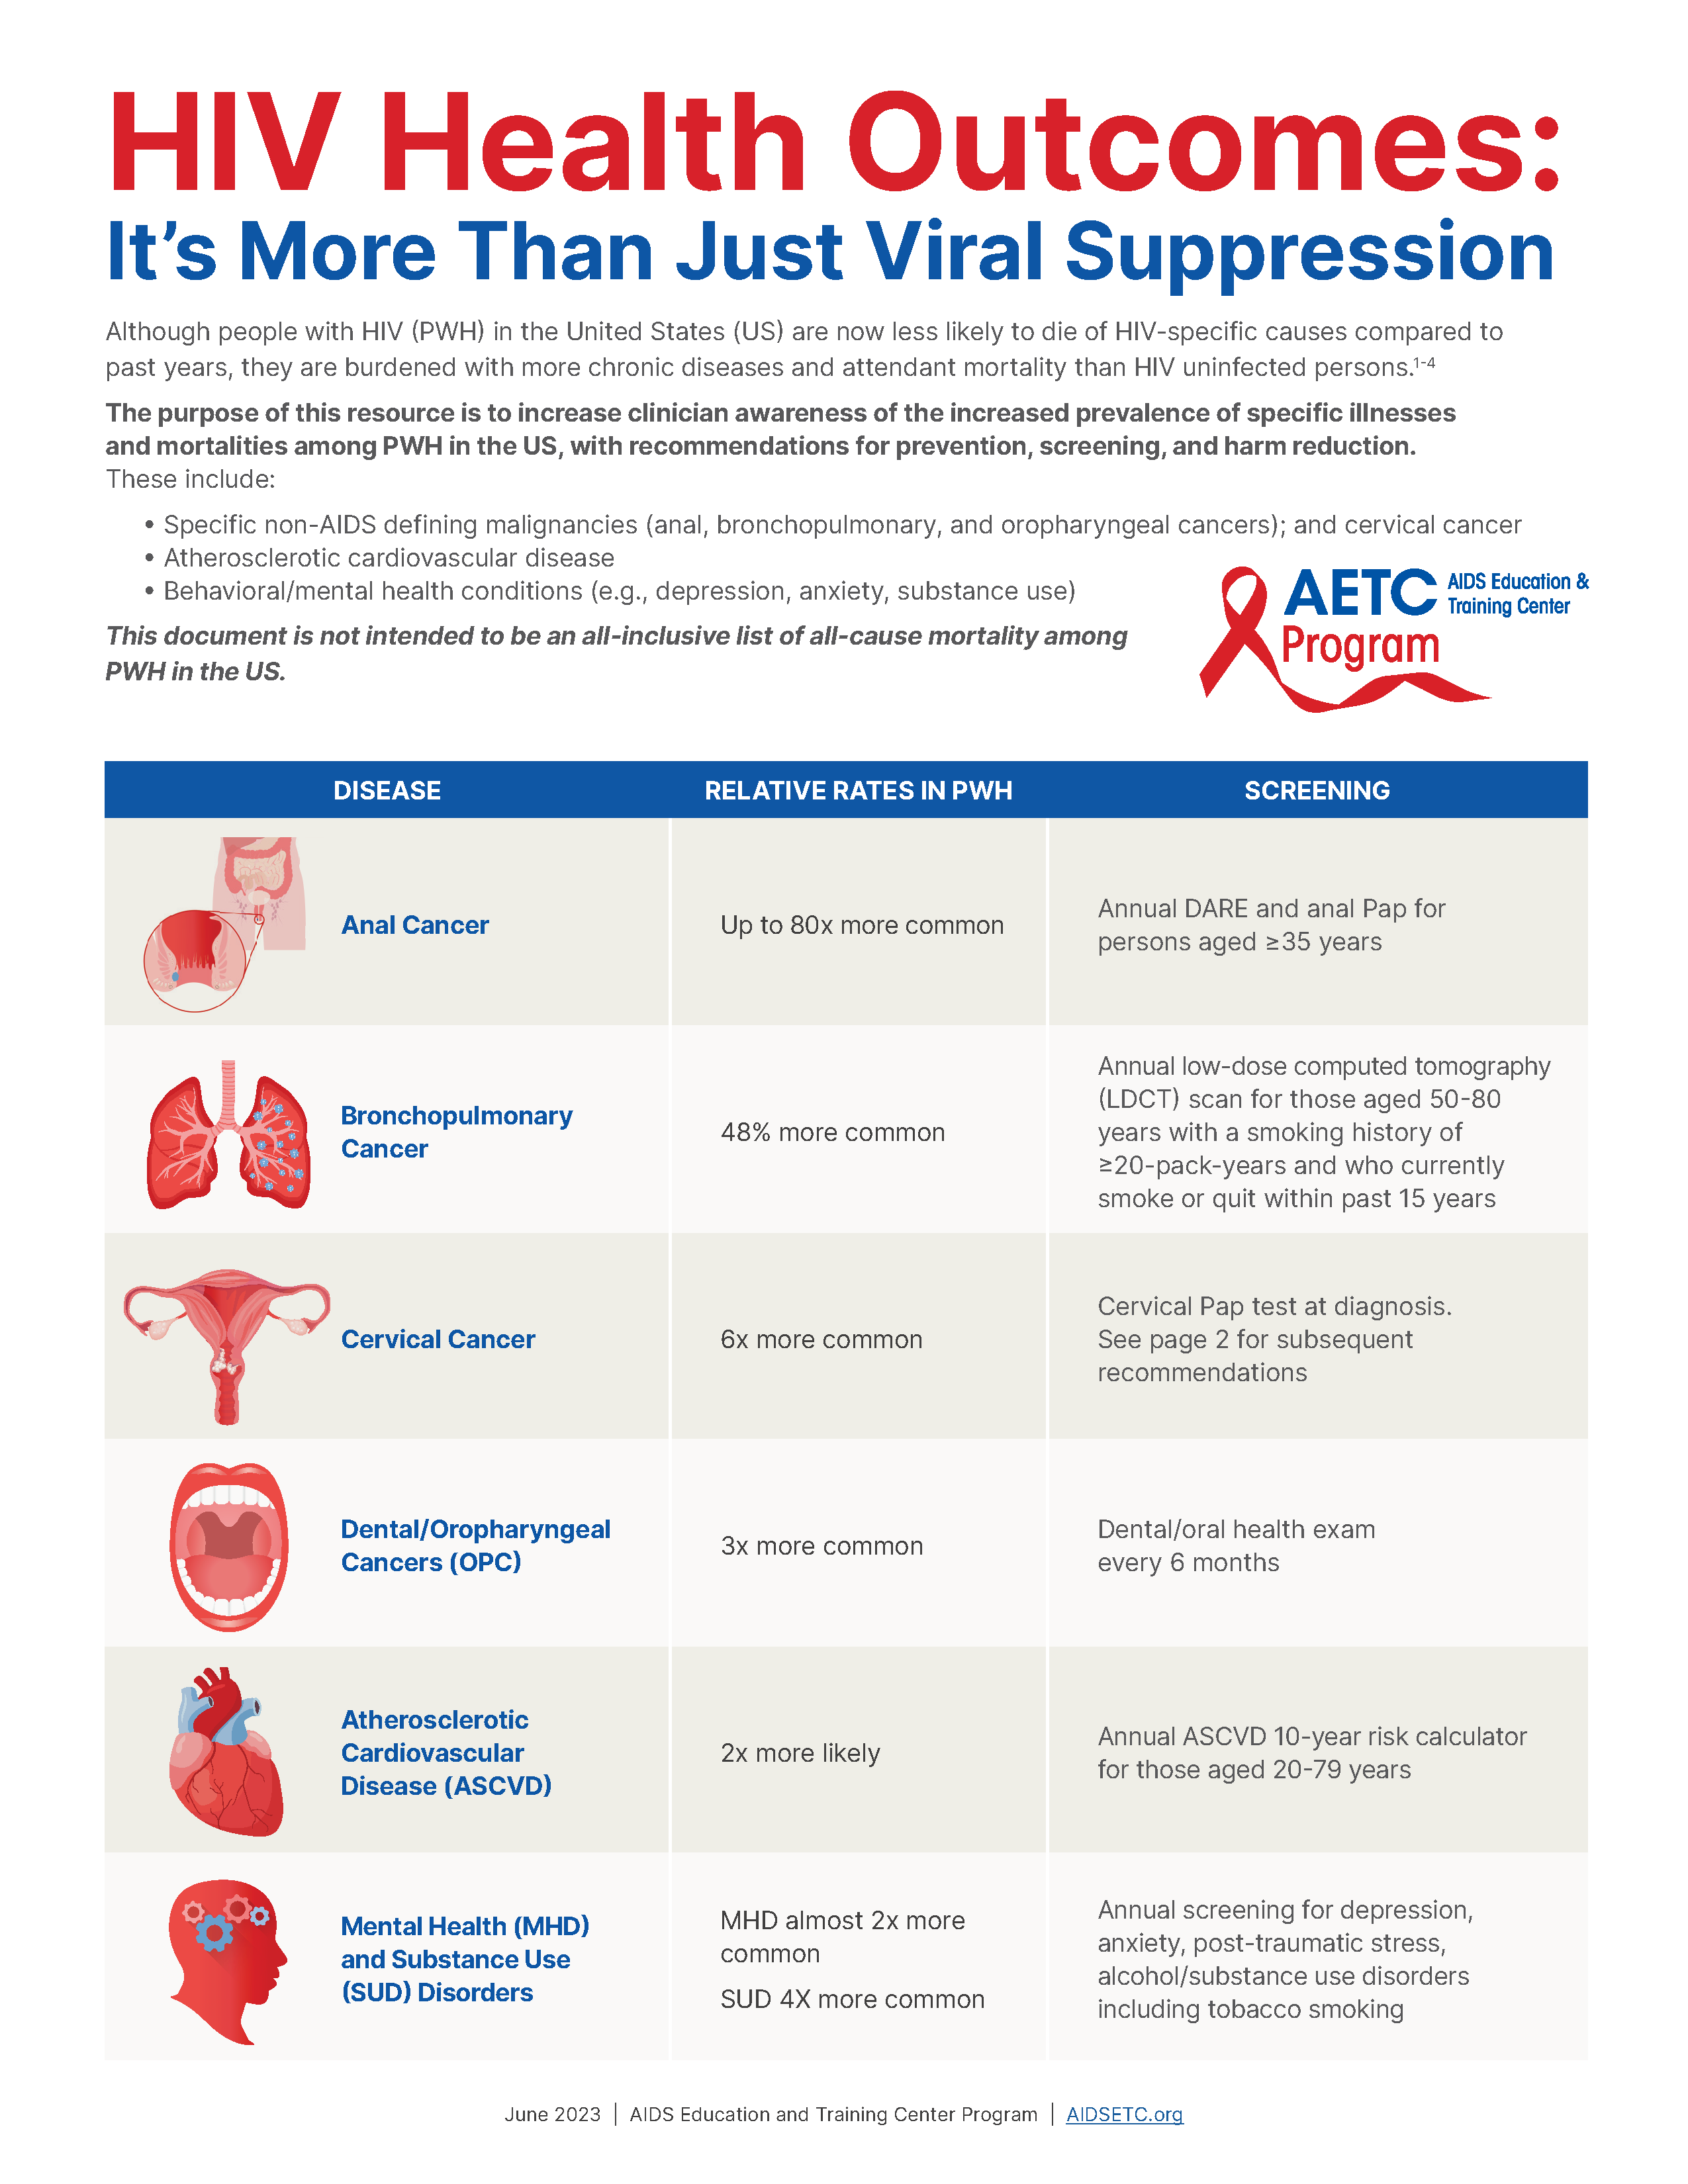
About This Slide Set
This presentation was prepared by the AETC NCRC for the AETC Comorbidity Community of Practice and Learning in August 2023.
Visit the AETC NCRC website for the Provider handout and most current version.
https://aidsetc.org/resource/comorbidities
Notes:
https://aidsetc.org/resource/comorbidities

