Slide 1
FAQs in HIV Care:
Beyond the Basics
Christopher B. Hurt, MD, FIDSA 17 April 2023

Slide 2
AETC Program – National Resources
2
National Coordinating Resource Center – serves as the central web-based repository for AETC Program training and capacity building resources; its website includes a free virtual library with training and technical assistance materials, a program director, and a calendar of trainings and other events. Learn more: https://aidsetc.org/
National Clinician Consultation Center – provides free, peer-to-peer, expert advice for health professionals on HIV prevention, care, and treatment and related topics. Learn more: https://nccc.ucsf.edu
National HIV Curriculum – provides ongoing, up-to-date HIV training and information for health professionals through a free, web-based curriculum; also provides free CME credits, CNE contact hours, CE contact hours, and maintenance of certification credits. Learn more: www.hiv.uw.edu

Slide 3
Disclosures
3
This program is supported by the Health Resources and Services Administration (HRSA) of the U.S. Department of Health and Human Services (HHS) under grant number U1OHA30535 as part of an award totaling $4.2m. The contents are those of the author(s) and do not necessarily represent the official views of, nor an endorsement, by HRSA, HHS, or the U.S. Government. For more information, please visit: https://www.hrsa.gov
Funding for this presentation was made possible by cooperative agreement U1OHA30535 from the Health Resources and Services Administration HIV/AIDS Bureau. The views expressed do not necessarily reflect the official policies of the Department of Health and Human Services nor does mention of trade names, commercial practices, or organizations imply endorsement by the U.S. Government. Any trade/brand names for products mentioned during this presentation are for training and identification purposes only.

Slide 4
Christopher B. Hurt, MD, FIDSA
4
Associate Professor of Medicine
Associate Chief for Clinical Operations, UNC Division of ID Director, North Carolina HIV Training & Education Center Site PI, Ryan White HIV/AIDS Program Part D, UNC ID Clinic
Institute for Global Health & Infectious Diseases University of North Carolina at Chapel Hill School of Medicine
Dr. Hurt is supported by the Health Resources and Services Administration (HRSA-17-039, U1OHA30535), the National Institute on Drug Abuse (UH3DA044823), and the National Institute of Allergy and Infectious Diseases (P30AI50410, R61AI174285, UM1AI069423, UM1AI068619).
The views expressed are not necessarily those of HRSA or the NIH.
11 Apr 2023

Slide 5
Objectives
6
Improve knowledge to address common questions patients have about HIV medications, adherence, and complications
Recognize some “red flag” issues that should prompt you to discuss the patient’s question with a pharmacist or the patient’s provider
Identify some signs and symptoms that might point to a complication related to having HIV

Slide 6
Will my meds stop working someday, even if I take them religiously?
7

Slide 7
Relationship between adherence & resistance
8
Risk for resistance
Viral Load
Not enough drug No resistance
Sufficient drug No resistance
Perfect nonadherence
Perfect adherence
Level of ARV Adherence

Slide 8
Relationship between adherence & resistance
9

Slide 9
Will my meds stop working someday, even if I take them religiously?
10
If your viral loads are undetectable, you take your meds consistently, and you make sure to let us know about anything new you might be taking, there’s no reason that the medications will stop working for you.

Slide 10
Next week, I’m going to California for work. I’ll be gone for about 2 weeks. What do I do about my meds with the change in time zones?
11

Slide 11
General tips for travelers with HIV
12
Less important when you take your meds than to make sure you actually take them
ALWAYS carry your pills on your person or in your carry-on – DON’T EVER PUT THEM IN YOUR CHECKED BAGGAGE!
Try to stick with your regular routine as much as possible – use alarms to help
If crossing multiple time zones, it’s probably better to take your meds somewhat early than to take them very late
Consider putting pills into an unlabeled or alternatively-labeled container, for privacy (e.g., pill box, multivitamin bottle)

Slide 12
I started on new meds last week, and my provider told me to call if I had any problems. This morning, I noticed a rash on my chest, arms, and back. What should I do?
13

Slide 13
and look up their most recent CD4 count and what meds they’re
supposed to be on
14

Slide 14
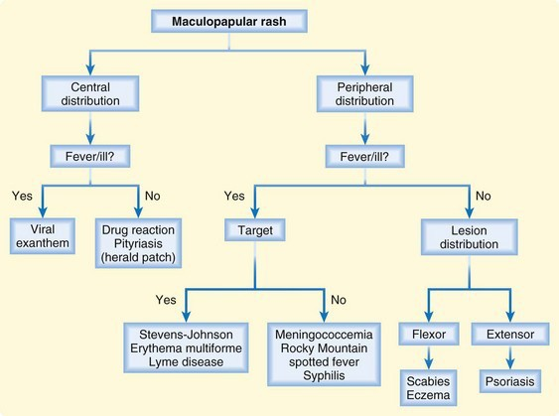
Working through possible drug rashes…
15
Always ask if there’s any irritation inside the mouth or inside the vagina
Murphy-Lavoie H, LeGros TL. Emergent diagnosis of the unknown rash: an algorithmic approach. Emerg Med 2010;42[3]:6-17

Slide 15
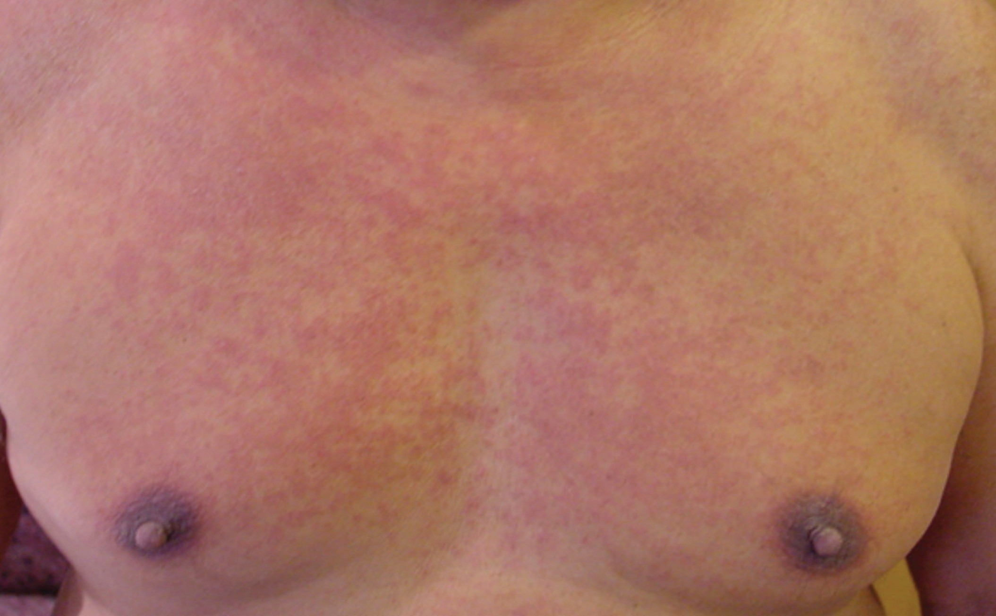
Maculopapular drug rash
16
Abrams EM, Khan DA. CMAJ. 2018 Apr 30;190(17):E532-E538.

Slide 16
I started on new meds last week, and my provider told me to call if I had any problems. This morning, I noticed a rash on my chest, arms, and back. What should I do?
17
It sounds like you may be having a reaction to your new medication.
Don’t take any more of it until I have a chance to talk to your provider.

Slide 17
Last week, I started feeling this weird tingling sensation on my chest. Today, it’s red in that area.
What should I do?
18

Slide 18
and look up their most recent CD4 count!
19

Slide 19
Opportunistic conditions by CD4 count
20
Opportunistic conditions
400
Above 200 cells/µL Non-Hodgkin lymphoma Kaposi sarcoma (KS) Oral candidiasis (thrush) Oral hairy leukoplakia
Tuberculosis Zoster (shingles)
300
CD4 T-lymphocyte count
(cells / µL)
200
100 – 200 cells/µL Pneumocystis pneumonia (PCP) Esophageal candidiasis
Severe HSV outbreaks
100
Below 100 cells/µL
Toxoplasma and fungal infections
M. avium complex CMV and PML
10 11
0
6
7
8
9
Years
Adapted from: Horsburgh CR Jr. N Engl J Med. 1991 May 9;324(19):1332-8 Corey L, Coombs RW. Clin Infect Dis. 1993 Feb;16 Suppl 1:S2-6

Slide 20
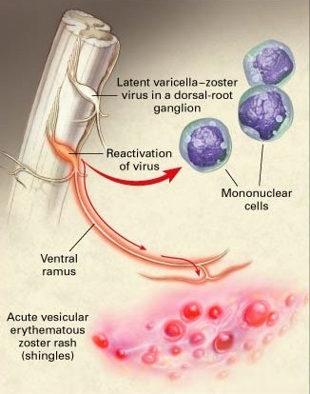
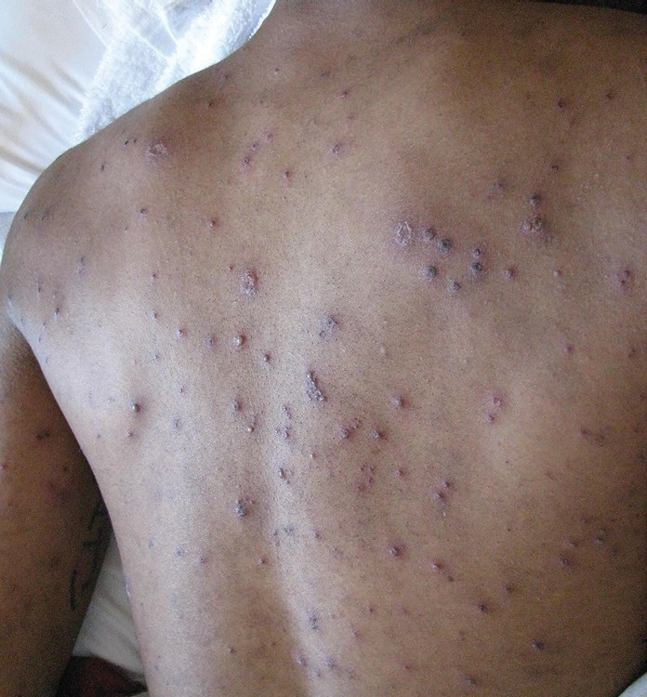
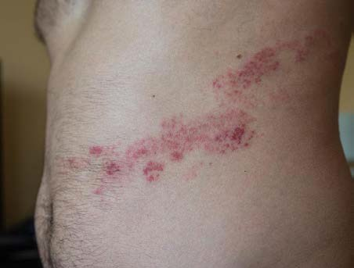
Tingly skin, vesicular rash? Think shingles!
21
Caused by | Signs & Symptoms | Diagnosis
Varicella zoster virus | Headache & malaise | Physical exam
(the virus that causes chickenpox) | Dermatomal pain, tingling, numbness | VZV PCR from lesion
 | vesicles/pustules
 | Dissemination less common ➔➔➔
Drawing: https://microbewiki.kenyon.edu/images/c/cd/Varicella-zoster_virus_enhanced_by_an_electron_microscope.jpg Clinical photographs: (L) https://www.bmj.com/content/364/bmj.k5095 (R) Konheim A, et al. Am Fam Phys. 2016 Oct 15;94(8):658-660.

Slide 21
Last week, I started feeling this weird tingling sensation on my chest. Today, it’s red in that area.
What should I do?
22
It sounds like you might have shingles, but the only way to know for sure is for a provider to examine you. It’s important that you get checked out as soon as you can.

Slide 22
My provider told me to call if anything new came up, since my count was really low. My throat is scratchy and it hurts to swallow. I’ve never had anything like this. What should I do?
23

Slide 23
and look up their most recent CD4 count!
24

Slide 24
Opportunistic conditions by CD4 count
25
Opportunistic conditions
400
Above 200 cells/µL Non-Hodgkin lymphoma Kaposi sarcoma (KS) Oral candidiasis (thrush) Oral hairy leukoplakia
Tuberculosis Zoster (shingles)
300
CD4 T-lymphocyte count
(cells / µL)
200
100 – 200 cells/µL Pneumocystis pneumonia (PCP) Esophageal candidiasis
Severe HSV outbreaks
100
Below 100 cells/µL
Toxoplasma and fungal infections
M. avium complex CMV and PML
10 11
0
6
7
8
9
Years
Adapted from: Horsburgh CR Jr. N Engl J Med. 1991 May 9;324(19):1332-8 Corey L, Coombs RW. Clin Infect Dis. 1993 Feb;16 Suppl 1:S2-6

Slide 25
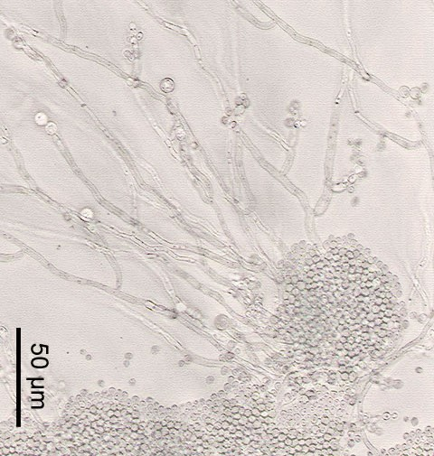
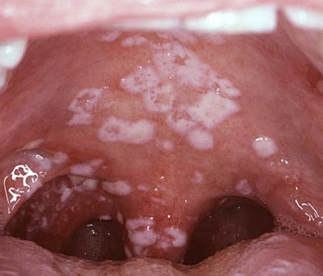
Scratchy throat, painful swallow? Think thrush!
26
Caused by | Signs & Symptoms | Diagnosis
Candida albicans | Painless, white | History
(a fungus that normally lives in our GI tract) | plaques in mouth or throat | Physical exam
 | Red patches without white plaques on palate or tongue | Microscopy (if needed)
 | Pain with swallowing
 | “Burning” chest pain
 | (especially behind sternum)
Photomicrograph: https://upload.wikimedia.org/wikipedia/commons/b/b6/Candida_albicans.jpg
Clinical photograph: https://phil.cdc.gov/details.aspx?pid=6053
https://aidsinfo.nih.gov/guidelines/html/4/adult-and-adolescent-opportunistic-infection/331/candidiasis

Slide 26
My provider told me to call if anything new came up, since my count was really low. My throat is scratchy and it hurts to swallow. I’ve never had anything like this. What should I do?
27
It sounds like you might have thrush, but the only way to know for sure is for a provider to examine you. It’s important that you get checked out as soon as you can.

Slide 27
The past couple of weeks, I’ve been getting winded really easily. I’ve felt feverish and have a little cough, too.
Do you think it’s just allergies?
28

Slide 28
and look up their most recent CD4 count!
29

Slide 29
Opportunistic conditions by CD4 count
30
Opportunistic conditions
400
Above 200 cells/µL Non-Hodgkin lymphoma Kaposi sarcoma (KS) Oral candidiasis (thrush) Oral hairy leukoplakia
Tuberculosis Zoster (shingles)
300
CD4 T-lymphocyte count
(cells / µL)
200
100 – 200 cells/µL Pneumocystis pneumonia (PCP) Esophageal candidiasis
Severe HSV outbreaks
100
Below 100 cells/µL
Toxoplasma and fungal infections
M. avium complex CMV and PML
10 11
0
6
7
8
9
Years
Adapted from: Horsburgh CR Jr. N Engl J Med. 1991 May 9;324(19):1332-8 Corey L, Coombs RW. Clin Infect Dis. 1993 Feb;16 Suppl 1:S2-6

Slide 30
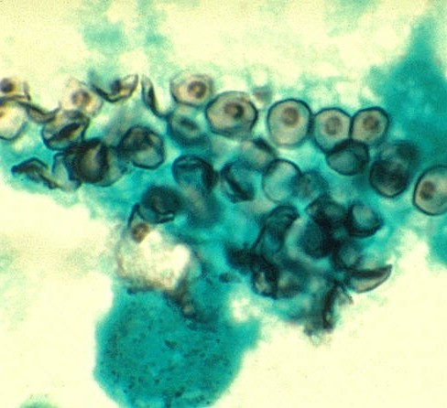
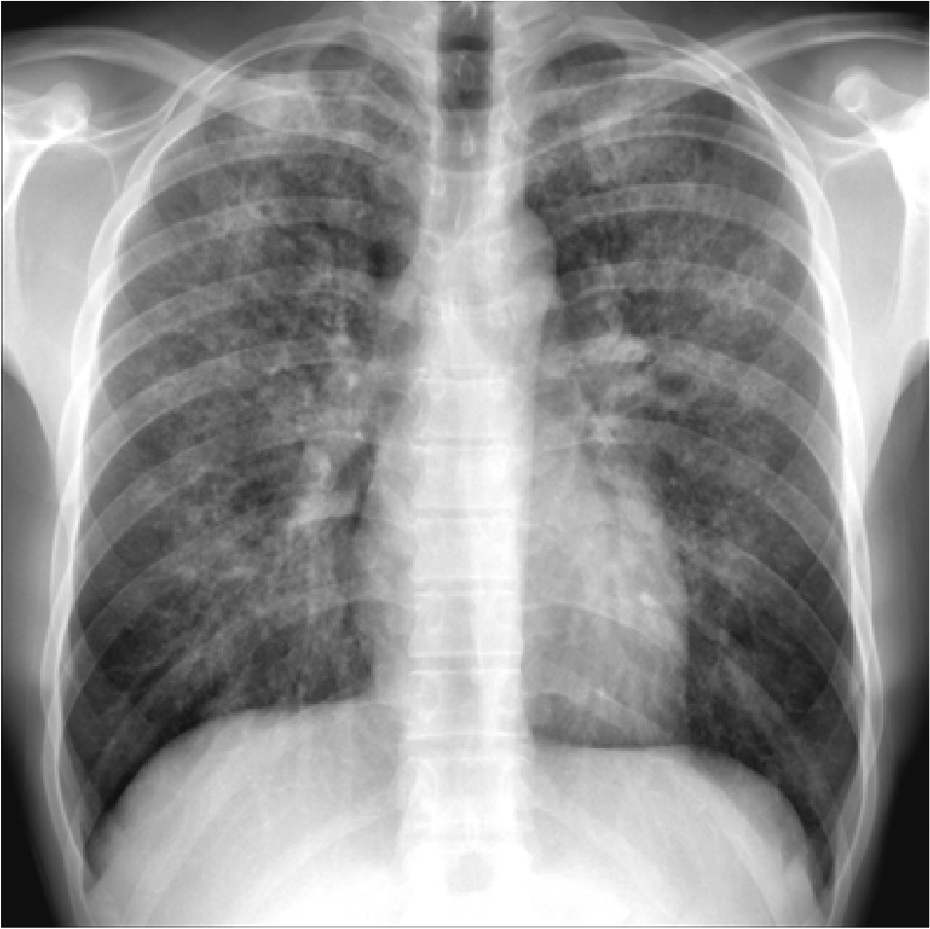
Fever, dry cough, DOE? Think Pneumocystis!
31
Caused by | Signs & Symptoms | Diagnosis
Pneumocystis jirovecii | Fevers | Chest x-ray
(a fungus acquired through our lungs, from other people) | Progressively worsening shortness of breath (especially | Microscopy of specimens (sputum or bronchoscopy)
 | with exertion)
 | Dry cough
 | Chest discomfort
 | Poor oxygenation
 | of the blood
Photomicrograph: https://phil.cdc.gov/Details.aspx?pid=554 Chest x-ray: Case courtesy of Dr Andrew Dixon, Radiopaedia.org, rID: 9613 https://aidsinfo.nih.gov/guidelines/html/4/adult-and-adolescent-opportunistic-infection/321/pneumocystis-pneumonia

Slide 31
The past couple of weeks, I’ve been getting winded really easily. I’ve felt feverish and have a little cough, too.
Do you think it’s just allergies?
32
It’s hard to know what might be going on, but I’m worried it might be more than just allergies. It’s important that you get seen by a provider as soon as you can.

Slide 32
I’ve had a pretty bad headache for the past week or so. I’ve still been able to work, but the pain is not going away. Should I just keep taking headache medicine?
33

Slide 33
and look up their most recent CD4 count!
34

Slide 34
Opportunistic conditions by CD4 count
35
Opportunistic conditions
400
Above 200 cells/µL Non-Hodgkin lymphoma Kaposi sarcoma (KS) Oral candidiasis (thrush) Oral hairy leukoplakia
Tuberculosis Zoster (shingles)
300
CD4 T-lymphocyte count
(cells / µL)
200
100 – 200 cells/µL Pneumocystis pneumonia (PCP) Esophageal candidiasis
Severe HSV outbreaks
100
Below 100 cells/µL
Toxoplasma and fungal infections
M. avium complex CMV and PML
10 11
0
6
7
8
9
Years
Adapted from: Horsburgh CR Jr. N Engl J Med. 1991 May 9;324(19):1332-8 Corey L, Coombs RW. Clin Infect Dis. 1993 Feb;16 Suppl 1:S2-6

Slide 35
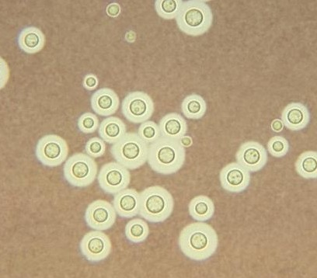
Head hurts, but mentation OK? Think Cryptococcus!
36
Caused by | Signs & Symptoms | Diagnosis
Cryptococcus | Fever | Spinal tap
neoformans (a fungus acquired through our lungs, from the environment) | Constant headache (most often without neck stiffness) | Elevated intracranial pressure (ICP) Analysis of
 | Loss of energy / feeling unwell | spinal fluid Cultures
 | Confusion or disorientation | Lab tests
Photomicrograph: https://phil.cdc.gov/Details.aspx?pid=3771 https://aidsinfo.nih.gov/guidelines/html/4/adult-and-adolescent-opportunistic-infection/333/cryptococcosis

Slide 36
I’ve had a pretty bad headache for the past week or so. I’ve still been able to work, but the pain is not going away. Should I just keep taking headache medicine?
37
It’s hard to know what might be going on, but I’m worried it might be something related to your HIV.
It’s important that you get seen by a provider as soon as you can.

Slide 37
I had syphilis about 9 months ago, and my provider rechecked my syphilis test last week. It says “reactive” and there are some numbers I don’t understand. Help!
38

Slide 38
and look up their RPR titer results
39
if it’s not in the EMR, ask the attending of the day to help

Slide 39
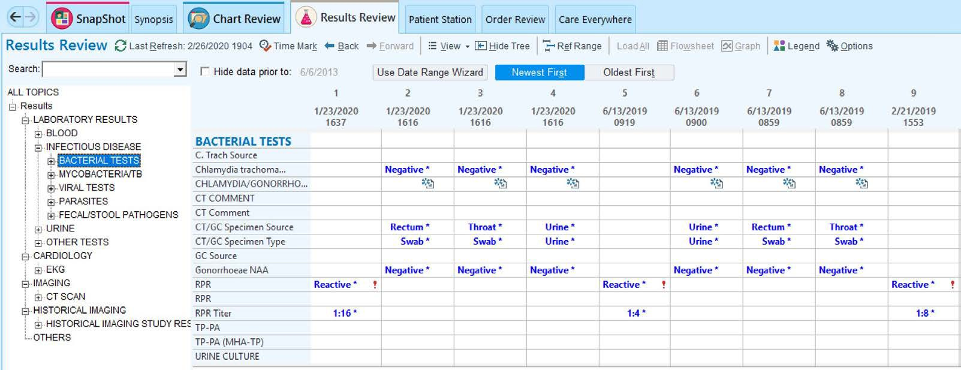
40

Slide 40
Diagnosing syphilis
41
T. pallidum incorporates substances from human cells into its membranes
Treponemal antibodies
are generated against surface proteins of
T. pallidum itself
Non-treponemal antibodies that can bind those human substances will rise and fall related to growth & spread of
T. pallidum in tissues
Once positive, TP-PA is almost always positive for life
Rapid plasma reagin (RPR)
Toluidine red unheated serum test (TRUST) Venereal Disease Research Laboratory (VDRL)
(CONFIRMATORY TEST)
Figure by Christopher Hurt

Slide 41
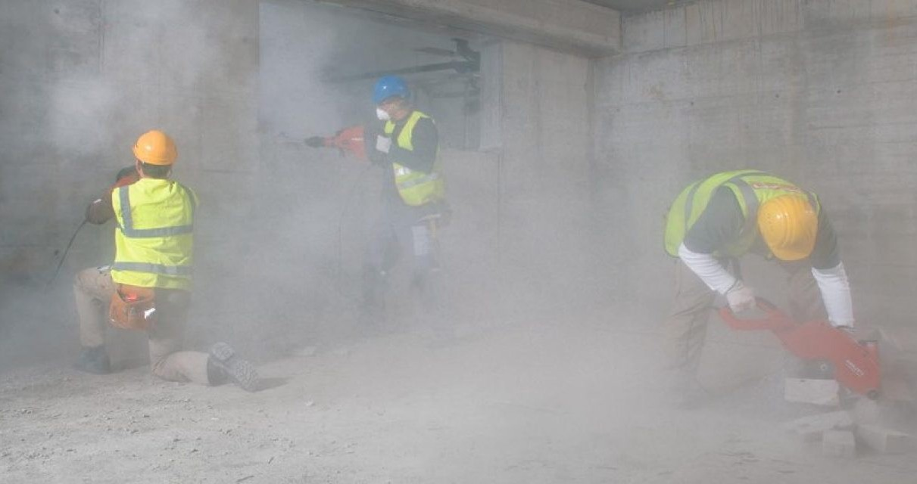
Think of T.pallidum like a teeny-tiny drill
42
RPR asks, “how much dust is there?” but by itself, it cannot tell you if the dust is from drilling or something else
Confirmatory tests (e.g., TP-PA) pretty reliably tell you if the dust is from drilling (T. pallidum) or not
Image from: https://www.hilti.com.sg/content/hilti/A2/SG/en/company/health-safety- and-environment/health-and-safety-community/being-aware-of-dust.html

Slide 42
Non-treponemal serological tests
43
Rapid plasma reagin (RPR)
Toluidine red unheated serum test (TRUST
Venereal Disease Research Laboratory (VDRL) on CSF
1:1
(undiluted)
1:2
1:4
1:8
1:16
1:32
One “step” up or down = ONE DILUTION = TWO FOLD
Figure by Christopher Hurt

Slide 43
Why do we do annual screening for syphilis?
44
Incubation Period
Primary
Early Latent
Secondary
Early Latent
Late Latent
≥ 128
64
64
RPR Titer
32
32
8
8
16
2
Negative
1
2
Serofast
Chancre
Rash
Clinical
Exposure
–3
0
1
2
3
6
Weeks
12
52
Adapted from: Gunn RA, Klausner JD. Sex Transm Dis. 2019 Oct;46(10):629-636
Figure by Christopher Hurt

Slide 44
Why do we do annual screening for syphilis?
45
Incubation Period
Primary
Early Latent
Secondary
Early Latent
Late Latent
≥ 128
64
64
RPR Titer
32
32
8
8
16
2
Negative
1
2
Serofast
Chancre
Rash
Clinical
Exposure
–3
0
1
2
3
6
Weeks
12
52
Adapted from: Gunn RA, Klausner JD. Sex Transm Dis. 2019 Oct;46(10):629-636
Figure by Christopher Hurt

Slide 45
Using the RPR can be a pain in the butt
46
One dilution (two-fold) up or down is within the margin of error
1:2 1:4 1:8 1:16 1:32
Does NOT generally require intervention
1:2 1:4 1:8 1:16 1:32
More than one dilution (> two-fold) up or down is meaningful
MIGHT need add’l intervention, if it’s moving the wrong direction
Response = at least 2 dilutions (four-fold) by one year after treatment

Slide 46
Using the RPR can be a pain in the butt
47
Not everyone will get back to being non-reactive.
This is called “serofast” and can result in patients getting
retreated multiple times –
perhaps unnecessarily.
1:2 1:4 1:8 1:16 1:32
Reasonable schedule for checking RPRs?
3 6 12 24
months after treatment

Slide 47
I had syphilis about 9 months ago, and my provider rechecked my syphilis test last week. It says “reactive” and there are some numbers I don’t understand. Help!
48
You’re OK! Just keep an eye on the second number in those results. We want it to keep getting smaller, over time. I’ll let your provider know you reached out. They may want to discuss this with you in more detail.

Slide 48
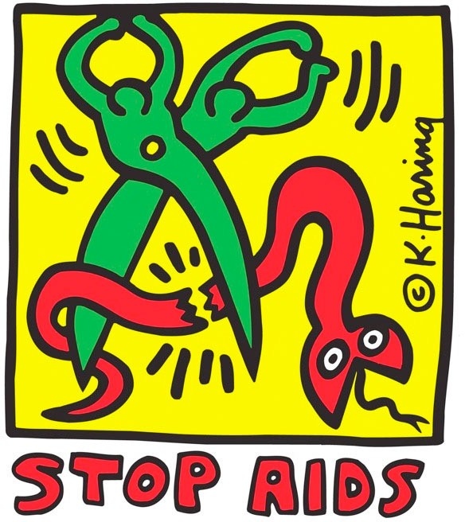
Questions?
50
Christopher Hurt, MD
churt@med.unc.edu
https://www.wikiart.org/en/keith-haring/stop-aids-1989

