Slide 1
Contemporary Cardiovascular Disease Prevention and Management for People with HIV
Matthew J. Feinstein, MD MSc
Associate Professor of Medicine-Cardiology
Northwestern Univ. Feinberg S.O.M (NUFSM)
matthewjfeinstein@northwestern.edu
Tw/X: @MattFeinsteinMD

Slide 2
Learning Objectives
Describe the contemporary scope and presentations of cardiovascular disease (CVD) among people with HIV
Define HIV-specific risk factors for CVD
Identify practical approaches to CVD risk stratification and lipid-lowering therapy for people with HIV

Slide 3
Disclosures / conflicts
Grant funding: National Institutes of Health, American Heart Association
Consultant: Abbott Laboratories
This program is supported by the Health Resources and Services Administration (HRSA) of the U.S. Department of Health and Human Services (HHS) under grant number U1OHA30535 as part of an award totaling $4.2m. The contents are those of the author(s) and do not necessarily represent the official views of, nor an endorsement, by HRSA, HHS, or the U.S. Government. For more information, please visit HRSA.gov.
“Funding for this presentation was made possible by cooperative agreement U1OHA30535 from the Health Resources and Services Administration HIV/AIDS Bureau. The views expressed do not necessarily reflect the official policies of the Department of Health and Human Services nor does mention of trade names, commercial practices, or organizations imply endorsement by the U.S. Government. Any trade/brand names for products mentioned during this presentation are for training and identification purposes only.”

Slide 4
Outline
What: Scope & Clinical Manifestations of CVD in HIV
Discussion of clinical presentations / manifestations
Why: CVD Mechanisms and Risk Factors in HIV
Framework of HIV, inflammation, and CVDs
Contribution of traditional CVD risk factors (e.g., smoking) & ARVs
How, When and in Whom: CVD Prevention & Treatment
Risk assessment
Therapies: old, new, and future

Slide 5
HIV and Cardiovascular Diseases
Scope and Manifestations

Slide 6
But First, a Primer on CVDs
Common, Highly Morbid CVD Outcomes ↑ in HIV
@MattFeinsteinMD

Slide 7
HIV and Athero-Thrombosis
Athero = plaque; thrombosis = clot
Athero-Thrombosis
Arterial Plaque due to cholesterol and inflammatory material getting under the artery lining
Key Features include:
Lipid/cholesterol (inflammatory response to retention in artery lining)
Activated/inflamed artery lining
@MattFeinsteinMD

Slide 8
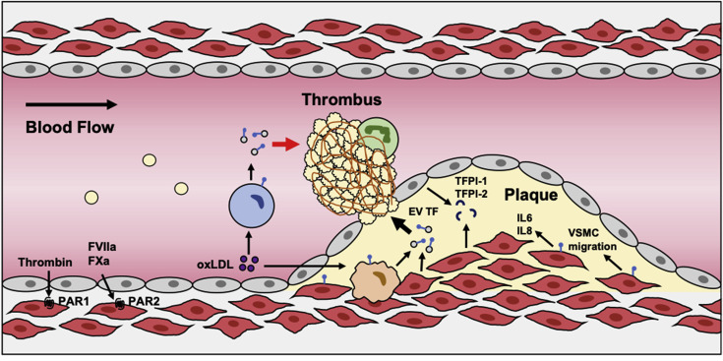
HIV and Athero-Thrombosis
Athero = plaque; thrombosis = clot
Athero-Thrombosis
Clot forming (generally) in response to plaque rupture or erosion
Grover SP and Mackman N. Atherosclerosis 2020;307:80-86.
@MattFeinsteinMD

Slide 9
HIV and Athero-Thrombosis
Clot forming (generally) in response to plaque rupture or erosion
End Result: Flow-Limiting Blockage resulting in reduced blood/oxygen delivery to the heart→ angina, heart attack (MI)
Grover SP and Mackman N. Atherosclerosis 2020;307:80-86.
@MattFeinsteinMD

Slide 10
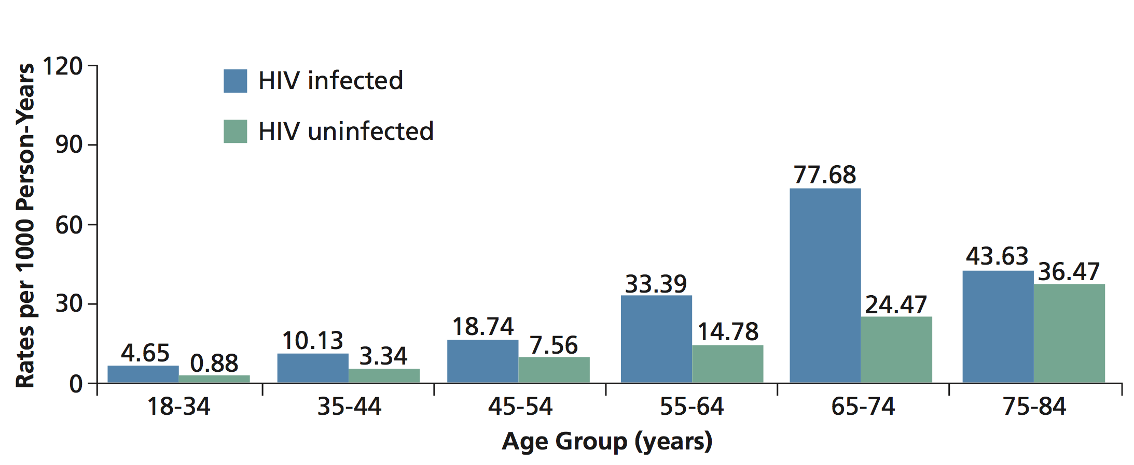
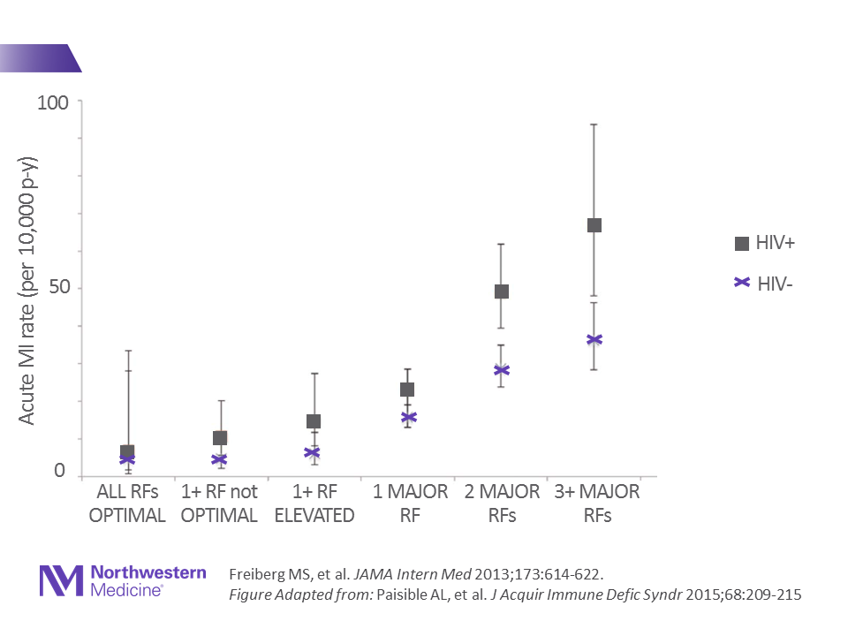
HIV and Athero-Thrombosis
Epidemiology: 1.5-2x HIV-associated MI (heart attack) risk
Increased MI risk across age ranges
(early/pre-ART: Partners)
VACS: Increased MI Risk Across Risk Factor Strata
adapted from Triant V., et al. J Clin Endocrinol Metab 2007;92(7): 2506-12.
@MattFeinsteinMD

Slide 11
HIV and Athero-Thrombosis
Epidemiology: 1.5-2x HIV-associated MI (heart attack) risk
Increased MI risk across age ranges
(early/pre-ART: Partners)
Increased MI Risk Across Risk Factor Strata (2003-2009; VACS)
adapted from Triant V., et al. J Clin Endocrinol Metab 2007;92(7): 2506-12.
Freiberg MS, et al. JAMA Intern Med 2013;173:614-622. Figure Adapted from: Paisible AL, et al. J Acquir Immune Defic Syndr 2015;68:209-215
@MattFeinsteinMD

Slide 12
HIV and Athero-Thrombosis
Epidemiology: 1.5-2x HIV-associated MI (heart attack) risk
Biologic Gradient: Viremia and Immune Progression Matter
Hazard Ratio of MI (vs. HIV-)
HIV VL (Time-updated, copies/mL)
<500: 1.39 (1.17-1.66)
≥500: 1.75 (1.40-2.18)
CD4 (Time-updated, cells/mm³)
≥200: 1.43 (1.21-1.69)
<200: 1.88 (1.46-2.40)
Increased MI risk across age ranges
(early/pre-ART: Partners)
Increased MI Risk Across Risk Factor Strata (2003-2009; VACS)
adapted from Triant V., et al. J Clin Endocrinol Metab 2007;92(7): 2506-12.
Freiberg MS, et al. JAMA Intern Med 2013;173:614-622. Figure Adapted from: Paisible AL, et al. J Acquir Immune Defic Syndr 2015;68:209-215
@MattFeinsteinMD

Slide 13
HIV and Athero-Thrombosis
Epidemiology: 1.5-2x HIV-associated MI risk – Still in the Contemporary Era
Kaiser Permanente Northern California & Partners (Boston)
2005-2017 (baseline) followed up for up to 5 years, through 2020
9401 PWH, 29,408 propensity-matched PWoH Matched on: demographics & cardiovascular risk factors
Difference in cumulative incidence of MI for PWH vs. PWoH actually increased from 2005-9 to 2010-17 baseline periods: HR for MI 1.6 for PWH vs. PWoH
Increased MI risk across age ranges
(early/pre-ART: Partners)
adapted from Triant V., et al. J Clin Endocrinol Metab 2007;92(7): 2506-12.
Freiberg MS, et al. JAMA Intern Med 2013;173:614-622. Figure Adapted from: Paisible AL, et al. J Acquir Immune Defic Syndr 2015;68:209-215
Silverberg MJ, Triant VA, et al. Conference on Retroviruses and Opportunistic Infections 2022.
@MattFeinsteinMD

Slide 14
HIV and Heart Failure
Common, Highly Morbid CVD Outcomes ↑ in HIV
@MattFeinsteinMD

Slide 15
HIV and Heart Failure
Epidemiology: ~1.5-2x HIV-associated HF risk
Northwestern Cohort (N=8890): 2000-2016
Overall:
Hazard Ratio of HF (vs. PWoH):
2.10 (1.38-3.21)
Among HIV+:
HR per log₁₀higher time-updated viral load: 1.22 (1.11-1.33)
HR per 100 cells/mm³ higher time-updated CD 4 count: 0.80 (0.69-0.92)
@MattFeinsteinMD
Feinstein MJ, et al. J Am Heart Assoc 2018. 7(21):e009985. doi:10.1161/JAHA.118.0099865

Slide 16
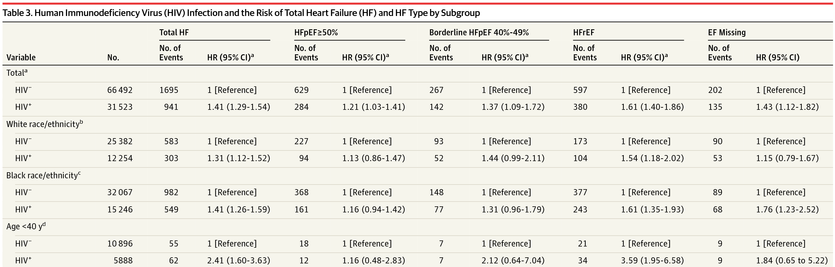
HIV and Heart Failure
Epidemiology: ~1.5-2x HIV-associated HF risk
Veterans Aging Cohort Study (2003-2012)
@MattFeinsteinMD
Freiberg MS, et al. JAMA Cardiology 2017;2(5):536-46

Slide 17
HIV and Arrhythmias
What do we know about HIV and arrhythmias?
HIV and Atrial Fibrillation Risk: Uncertain No Difference: MACS, NM Cohorts Osuji N, Post WS et al. Medicine 2021;100(29):e26663 Sanders JM, Feinstein MJ, et al. PLoS One 2018;13(3):e0194754 Increased Risk: UCSF Cohort Sardana M, Hsue PY, et al. JACC 2019;74(11):1512-4.
@MattFeinsteinMD

Slide 18
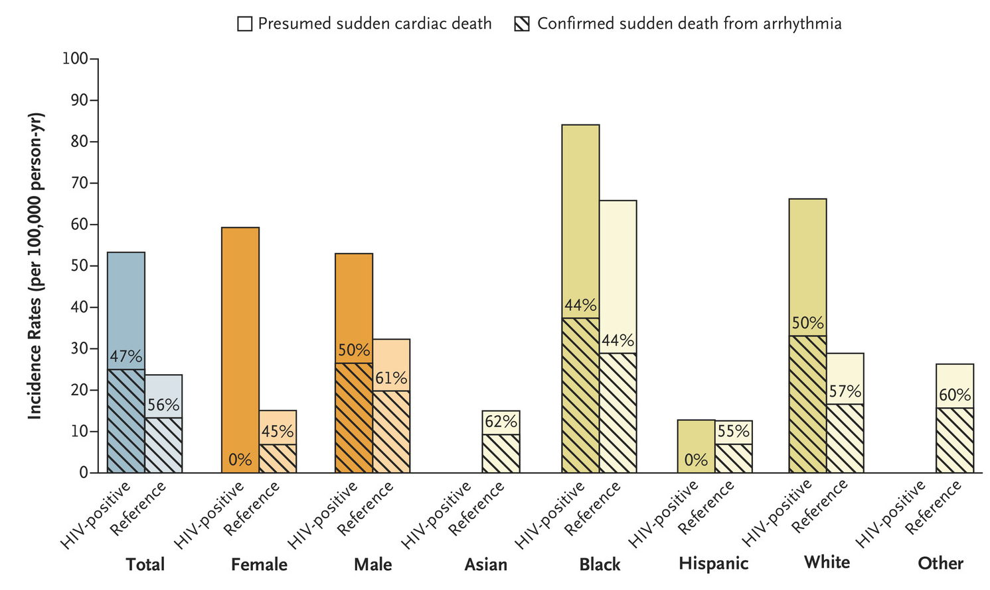
HIV and Arrhythmias
HIV and Sudden Cardiac Death: ↑ Risk
Sudden Cardiac Death Incidence Rates (SF Medical Examiner)
HIV: 53.3 deaths/100k p-y
Mean CD4 475; 79% ART
PWoH: 23.7 deaths/100k p-y
@MattFeinsteinMD
Tseng ZH … Hsue PY. N Engl J Med 2021;384:2306-2316.

Slide 19
BREAK:
Any questions regarding scope/epidemiology?
Next sections:
Mechanisms
Clinical Approach

Slide 20
Why CVDs in HIV?
A Mechanistic Detour:
Immune Dysregulation, Unresolving Inflammation, and Cardiovascular Diseases
2. Why this is relevant for HIV

Slide 21
Inflammation and CVDs
What we know
Myeloid & lymphoid inflammation are clinically/epidemiologically and causally/experimentally implicated in CVDs
CAD: plaque rupture, erosion, and vasculopathy
HF: Maladaptive response to injury, microvascular dysfunction, direct myocardial inflammatory infiltrates → systolic +/- diastolic dysfunction, ,HF
Arrhythmia: implicated in both electrical and structural remodeling
A complex interplay between comorbidities and underlying immunologic abnormalities/inflammatory bias can accelerate inflammation-CVD
Blanton RM, Alcaide P, et al. Am J Physiol 2019;317(1):H324-H340.
Libby P et al. J Am Coll Cardiol 2018;72(17):2071-2081.
Simons KH et al. Nature Rev Cardiol 2019;16(6):325-343.
Tracy RP et al. J Am Heart Assoc 2013;2(3):e000117
@MattFeinsteinMD

Slide 22
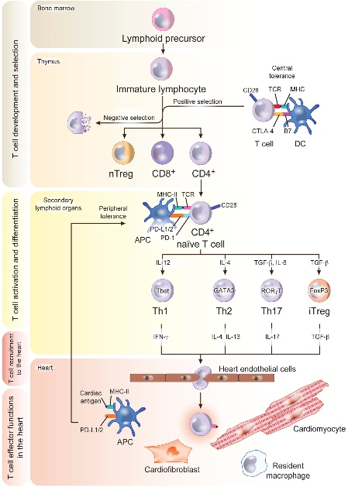
Inflammation and CVDs
Antigens (”the thing” – e.g., piece of virus (“epitope”) or even cholesterol!) → immune response recognizing these
Antigens &
Antigen-like
triggers
Immune Response:
Immune cell activation/biasing; phenotype switching: Self-tolerance vs. autoimmunity
Cardiac & Vascular Inflammation,
Overt CVDs
Inflammation
Key effectors: monocyte-derived (CCR2+) macrophages, CD4+ Th1/Th17
vs.
Inflammation
Resolution
Key effectors: T_{regs} (when functional), cardiac resident (CCR2-) macrophages
@MattFeinsteinMD
Adapted from Feinstein MJ, Arteriorscler Thromb Vasc Biol 2021;41:523-5

Slide 23
Inflammation and CVDs
Antigens (”the thing” – e.g., piece of virus (“epitope”) or even cholesterol!) → immune response recognizing these
Antigens &
Antigen-like
triggers
Immune Response:
Immune cell activation/biasing; phenotype switching: Self-tolerance vs. autoimmunity
Cardiac & Vascular Inflammation,
Overt CVDs
Balance & Timing is Critical:
“appropriate” inflammation (pathogen/debris clearance)
vs. sustained inflammation, loss of self-tolerance, amplified auto-reactivity
Inflammation
Key effectors: monocyte-derived (CCR2+) macrophages, CD4+ Th1/Th17
vs.
Inflammation
Resolution
Key effectors: T_{regs} (when functional), cardiac resident (CCR2-) macrophages
@MattFeinsteinMD
Adapted from Feinstein MJ, Arteriorscler Thromb Vasc Biol 2021;41:523-5

Slide 24
Inflammation and CVDs
Antigens (”the thing” – e.g., piece of virus (“epitope”) or even cholesterol!) → immune response recognizing these
Antigens &
Antigen-like
triggers
Immune Response:
Immune cell activation/biasing; phenotype switching: Self-tolerance vs. autoimmunity
Cardiac & Vascular Inflammation,
Overt CVDs
How does HIV-related immune progression affect this bias between persistent inflammation and resolution thereof?
Inflammation
Key effectors: monocyte-derived (CCR2+) macrophages, CD4+ Th1/Th17
vs.
Inflammation
Resolution
Key effectors: T_{regs} (when functional), cardiac resident (CCR2-) macrophages
@MattFeinsteinMD
Adapted from Feinstein MJ, Arteriorscler Thromb Vasc Biol 2021;41:523-5

Slide 25
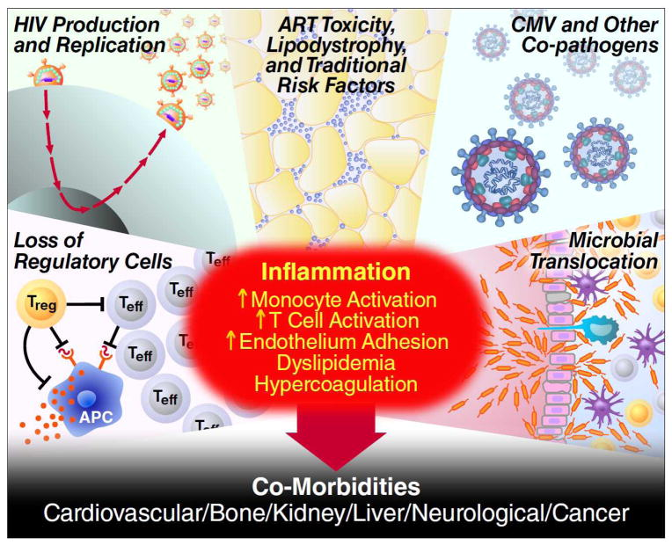
HIV and Persistent Inflammation
Core mechanisms
Bias away from regulation, toward persistent inflammatory/
effector response
**Even when suppressed peripheral viral load, reservoir in tissues remains as antigenic trigger
Deeks SG, et al. Lancet 2013;382:1525-33.
@MattFeinsteinMD

Slide 26
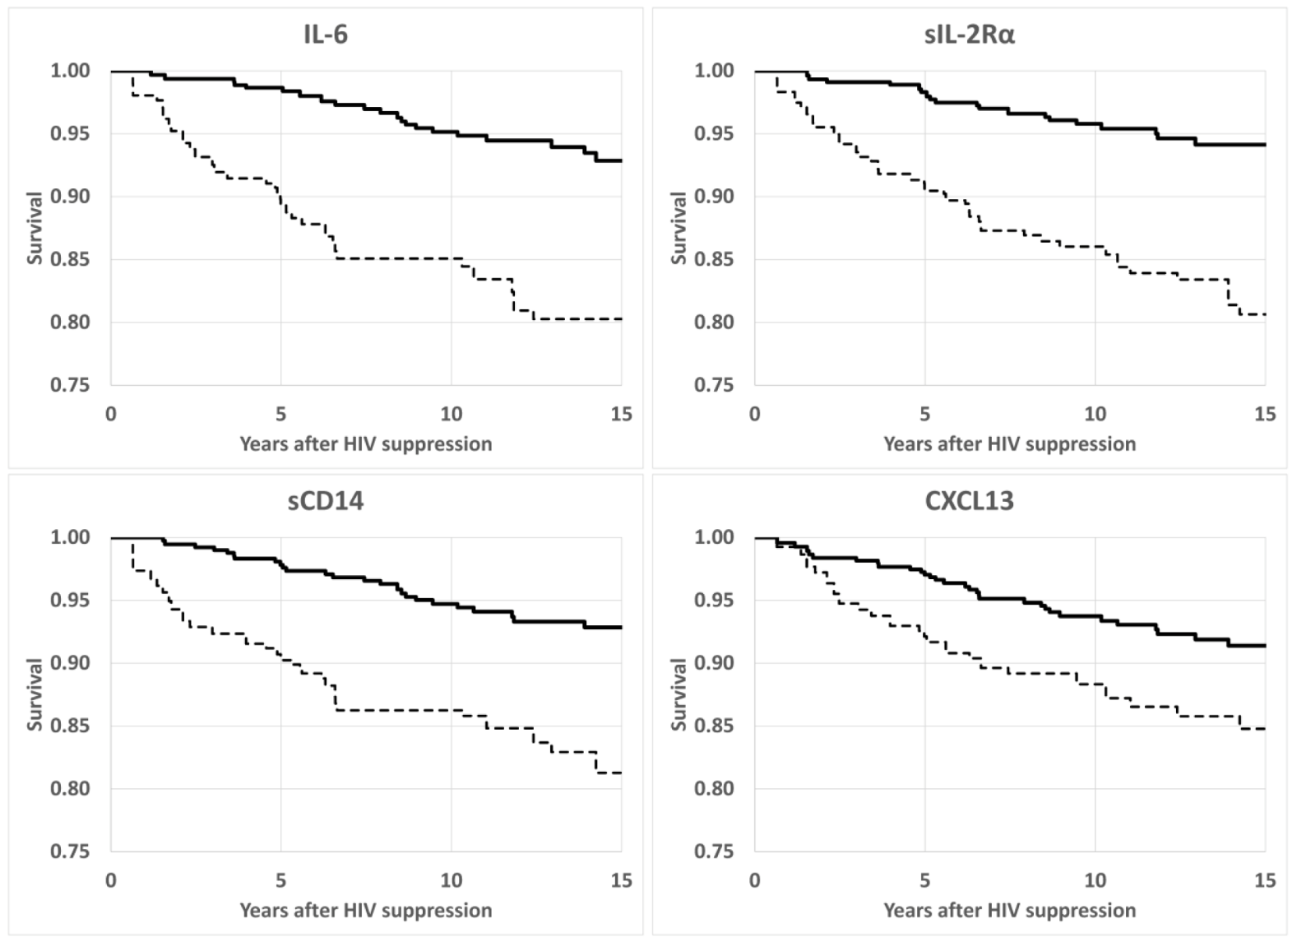
HIV and Persistent Inflammation
Observational evidence…and evidence that it matters (mortality)
Highest
Quartile
Lowest 3
Quartiles
@MattFeinsteinMD
Wada N et al. Clin Infect Dis 2016;63(7):984-990.

Slide 27
HIV and Persistent Inflammation
Concomitant “Traditional” Cardiovascular Risk Factors
Smoking: Highly Prevalent
Dyslipidemia
Due to virus/inflammation: ↑HIV RNA: ↓HDL, stable/↓LDL-c(but some ApoB discordance), ↑TG, ↑TC/HDL ratio
ART-related (some)
PIs: ↑ TC, LDL, and TG levels
NNRTIs: Variable, may ↑ TC, LDL, and TG levels
NRTIs: Variable, may ↑ TC and TG levels
Fusion inhibitors, CCR5 antagonists, INSTIs: limited data
Metabolic dysregulation & more
El-Sadr WM et al. HIV Med 2005;6(2):114-21.
Feinstein MJ et al. Circulation 2019;140(2):e98-e124
Feinstein MJ et al Am J Cardiol 2016
Oka F et al. J Infect Chemother 2012;18(1):17-21.
@MattFeinsteinMD

Slide 28
What is the Role of ART?
1. ART is clearly better than no ART (CVD and overall)
2. But there is drug- and class-specific nuance re: CVD risk

Slide 29
Effective ART better than none re: MI
(and, of course, HIV control in general)
MI Rate (over 2700 person-years’ follow-up):
Interrupted ART: 1.3 per 100 person-years
Uninterrupted ART: 0.8 per 100 person/years
@MattFeinsteinMD

Slide 30
ARV-specific implications re: CVDs
Some signals, some spotty data
Not all ARVs are created equal re: CVD risk!
Protease inhibitors; initial concern re: class effect (NEJM 2007) for MI risk, but more drug-specific nuance now apparent
Ritonavir-boosted darunavir: ↑ CVD risk
Ritonavir-boosted Atazanavir: Neutral to ↓ CVD risk
NRTIs
Older: ↑↑ Mitochondrial toxicity → myopathy, neuropathy, etc
TDF – nephrotoxicity; ABC – cardiomyopathy; 3TC – neuropathy
TAF vs. TDF: increased cholesterol, LDL; TDF→TAF weight gain; less clear actual CVD effect
More on abacavir
Longer term follow-up cohorts: ↑ CVD risk vs. non-abacavir ART
?mechanisms: Endothelial dysfunction, vascular inflammation, platelet reactivity
Shorter term clinical trials: No significant effect on CVD risk
INSTIs: Weight gain but =/↓ CVD risk
References for ART-CVD Slides :
Friis-Moller N et al for DAD Study Group. NEJM 2007;356:1723-35
Feinstein MJ et al. Circulation 2019;140:e98-e124
Monforte Ad et al. AIDS 2013;27:407-15
Ryom L et al. Lancet HIV 2018;5:e291-300.
Marconi VC et al. JAHA 2018;7:e007792.
Marcus JL et al. JAIDS 2016;71:413-419
Elion RA et al. JAIDS 2018;78:62-72.
Hsue PY et al. AIDS 2009;23:2021-7
Alvarez A et al. AIDS 2017;31:1781-95
Cid-Silva P et al. Basic Clin Phamarcol Toxicol 2019;124(4):479-90
Huhn G et al. OFID 2019;7(1):ofz472 –
O’Halloran JA et al. JAIDS 2020;84(4):396-9.
Kileel EM et al. OFID 2021;8(12):ofab537
Mallon PW et al. J Int AIDS Soc 2021;24(4):e25702
@MattFeinsteinMD

Slide 31
ARV-specific implications re: CVDs
Some signals, some spotty data
Not all ARVs are created equal re: CVD risk!
Protease inhibitors; initial concern re: class effect (NEJM 2007) for MI risk, but more drug-specific nuance now apparent
Ritonavir-boosted darunavir: ↑ CVD risk
Ritonavir-boosted Atazanavir: Neutral to ↓ CVD risk
NRTIs
Older: ↑↑ Mitochondrial toxicity → myopathy, neuropathy, etc
TDF – nephrotoxicity; ABC – cardiomyopathy; 3TC – neuropathy
TAF vs. TDF: increased cholesterol, LDL; TDF→TAF weight gain; less clear actual CVD effect
More on abacavir
Longer term follow-up cohorts: ↑ CVD risk vs. non-abacavir ART
?mechanisms: Endothelial dysfunction, vascular inflammation, platelet reactivity
Shorter term clinical trials: No significant effect on CVD risk
INSTIs: Weight gain but =/↓ CVD risk
References for ART-CVD Slides :
Friis-Moller N et al for DAD Study Group. NEJM 2007;356:1723-35
Feinstein MJ et al. Circulation 2019;140:e98-e124
Monforte Ad et al. AIDS 2013;27:407-15
Ryom L et al. Lancet HIV 2018;5:e291-300.
Marconi VC et al. JAHA 2018;7:e007792.
Marcus JL et al. JAIDS 2016;71:413-419
Elion RA et al. JAIDS 2018;78:62-72.
Hsue PY et al. AIDS 2009;23:2021-7
Alvarez A et al. AIDS 2017;31:1781-95
Cid-Silva P et al. Basic Clin Phamarcol Toxicol 2019;124(4):479-90
Huhn G et al. OFID 2019;7(1):ofz472 –
O’Halloran JA et al. JAIDS 2020;84(4):396-9.
Kileel EM et al. OFID 2021;8(12):ofab537
Mallon PW et al. J Int AIDS Soc 2021;24(4):e25702
@MattFeinsteinMD

Slide 32
ARV-specific implications re: CVDs
Some signals, some spotty data
Not all ARVs are created equal re: CVD risk!
Protease inhibitors; initial concern re: class effect (NEJM 2007) for MI risk, but more drug-specific nuance now apparent
Ritonavir-boosted darunavir: ↑ CVD risk
Ritonavir-boosted Atazanavir: Neutral to ↓ CVD risk
NRTIs
Older: ↑↑ Mitochondrial toxicity → myopathy, neuropathy, etc
TDF – nephrotoxicity; ABC – cardiomyopathy; 3TC – neuropathy
TAF vs. TDF: increased cholesterol, LDL; TDF→TAF weight gain; less clear actual CVD effect
More on abacavir
Longer term follow-up cohorts: ↑ CVD risk vs. non-abacavir ART
?mechanisms: Endothelial dysfunction, vascular inflammation, platelet reactivity
Shorter term clinical trials: No significant effect on CVD risk
INSTIs: Weight gain but =/↓ CVD risk
References for ART-CVD Slides :
Friis-Moller N et al for DAD Study Group. NEJM 2007;356:1723-35
Feinstein MJ et al. Circulation 2019;140:e98-e124
Monforte Ad et al. AIDS 2013;27:407-15
Ryom L et al. Lancet HIV 2018;5:e291-300.
Marconi VC et al. JAHA 2018;7:e007792.
Marcus JL et al. JAIDS 2016;71:413-419
Elion RA et al. JAIDS 2018;78:62-72.
Hsue PY et al. AIDS 2009;23:2021-7
Alvarez A et al. AIDS 2017;31:1781-95
Cid-Silva P et al. Basic Clin Phamarcol Toxicol 2019;124(4):479-90
Huhn G et al. OFID 2019;7(1):ofz472 –
O’Halloran JA et al. JAIDS 2020;84(4):396-9.
Kileel EM et al. OFID 2021;8(12):ofab537
Mallon PW et al. J Int AIDS Soc 2021;24(4):e25702
@MattFeinsteinMD

Slide 33
ARV-specific implications re: CVDs
Some signals, some spotty data
Not all ARVs are created equal re: CVD risk!
Protease inhibitors; initial concern re: class effect (NEJM 2007) for MI risk, but more drug-specific nuance now apparent
Ritonavir-boosted darunavir: ↑ CVD risk
Ritonavir-boosted Atazanavir: Neutral to ↓ CVD risk
NRTIs
Older: ↑↑ Mitochondrial toxicity → myopathy, neuropathy, etc
TDF – nephrotoxicity; ABC – cardiomyopathy; 3TC – neuropathy
TAF vs. TDF: increased cholesterol, LDL; TDF→TAF weight gain; less clear actual CVD effect
More on abacavir – still some uncertainty
Longer term follow-up cohorts: ↑ CVD risk vs. non-abacavir ART
?mechanisms: Endothelial dysfunction, vascular inflammation, platelet reactivity
Shorter term clinical trials: No significant effect on CVD risk
References for ART-CVD Slides :
Friis-Moller N et al for DAD Study Group. NEJM 2007;356:1723-35
Feinstein MJ et al. Circulation 2019;140:e98-e124
Monforte Ad et al. AIDS 2013;27:407-15
Ryom L et al. Lancet HIV 2018;5:e291-300.
Marconi VC et al. JAHA 2018;7:e007792.
Marcus JL et al. JAIDS 2016;71:413-419
Elion RA et al. JAIDS 2018;78:62-72.
Hsue PY et al. AIDS 2009;23:2021-7
Alvarez A et al. AIDS 2017;31:1781-95
Cid-Silva P et al. Basic Clin Phamarcol Toxicol 2019;124(4):479-90
Huhn G et al. OFID 2019;7(1):ofz472 –
O’Halloran JA et al. JAIDS 2020;84(4):396-9.
Kileel EM et al. OFID 2021;8(12):ofab537
Mallon PW et al. J Int AIDS Soc 2021;24(4):e25702
@MattFeinsteinMD

Slide 34
ARV-specific implications re: CVDs
Some signals, some spotty data
Not all ARVs are created equal re: CVD risk!
Protease inhibitors; initial concern re: class effect (NEJM 2007) for MI risk, but more drug-specific nuance now apparent
Ritonavir-boosted darunavir: ↑ CVD risk
Ritonavir-boosted Atazanavir: Neutral to ↓ CVD risk
NRTIs
Older: ↑↑ Mitochondrial toxicity → myopathy, neuropathy, etc
TDF – nephrotoxicity; ABC – cardiomyopathy; 3TC – neuropathy
TAF vs. TDF: increased cholesterol, LDL; TDF→TAF weight gain; less clear actual CVD effect
More on abacavir – still some uncertainty
Longer term follow-up cohorts: ↑ CVD risk vs. non-abacavir ART
?mechanisms: Endothelial dysfunction, vascular inflammation, platelet reactivity
Shorter term clinical trials: No significant effect on CVD risk
INSTIs: Weight gain but =/↓ CVD risk
References for ART-CVD Slides :
Friis-Moller N et al for DAD Study Group. NEJM 2007;356:1723-35
Feinstein MJ et al. Circulation 2019;140:e98-e124
Monforte Ad et al. AIDS 2013;27:407-15
Ryom L et al. Lancet HIV 2018;5:e291-300.
Marconi VC et al. JAHA 2018;7:e007792.
Marcus JL et al. JAIDS 2016;71:413-419
Elion RA et al. JAIDS 2018;78:62-72.
Hsue PY et al. AIDS 2009;23:2021-7
Alvarez A et al. AIDS 2017;31:1781-95
Cid-Silva P et al. Basic Clin Phamarcol Toxicol 2019;124(4):479-90
Huhn G et al. OFID 2019;7(1):ofz472 –
O’Halloran JA et al. JAIDS 2020;84(4):396-9.
Kileel EM et al. OFID 2021;8(12):ofab537
Mallon PW et al. J Int AIDS Soc 2021;24(4):e25702
@MattFeinsteinMD

Slide 35
HIV and Heart Failure: Why?
Heart Failure as “Final Common Pathway”…which means many potential causes…address underlying causes!
HIV-RELATED RISK FACTORS
GENERAL MECHANISMS OF MYOCARDIAL INJURY
PRE-HEART FAILURE PHENOTYPES
TL;DR: It's complicated and area of active investigation. In the meantime, address underlying risk factors (e.g., HTN) and identify those at particularly high risk (viremia, risk factors, chronic substance use (esp. stimulants))
VASCULAR STIFFNESS, CHRONIC ART USE
HYPERTENSION
INFLAMMATION, IMMUNE AND AUTONOMIC DYSREGULATION, THROMBOSIS, DYSLIPIDEMIA
CORONARY MICROVASCULAR DISEASE
MYOCARDIAL DYSFUNCTION & IMPAIRED RELAXATION
HIV
ACUTE OR CHRONIC
ISCHEMIC HEART DISEASE & MYOCARDIAL INFARCTION
HEART FAILURE
FIBROSIS & SCAR
HIV VIREMIA, HIV MEDS, METABOLIC DYSFUNCTION, SUBSTANCE USE
TOXIC DAMAGE TO THE MYOCARDIUM
VALVE OBSTRUCTION & REGURGITATION
CO-INFECTION, ENDOCARDITIS
VALVULAR DISEASE
CARDIAC DYSSYNCHRONY, FAST/SLOW RATE-MEDIATED DYSFUNCTION
INFLAMMATION, CRITICAL ILLNESS
ARRHYTHMIA
Feinstein MJ et al. Circulation 2019;140(2):e98-e124.
@MattFeinsteinMD

Slide 36
BREAK: Now onto the ”What/How”
(Last section)
What Can We Do About it?
Preventing and Treating CVDs
in People with HIV

Slide 37
CVD Risk Assessments
Why Assess Risk?
General Principle:
Higher Absolute Risk → Higher Absolute Benefit from CVD-Reducing Rx
A (not very) theoretical example:
55 y/o person A with 3% risk for ASCVD in next 10y → Theoretical Med X reduces to 2%. So adding Med X gives 1/100 chance of preventing ASCVD over next 10y
55 y/o person B with 30% risk for ASCVD in next 10y → Theoretical Med X reduces to 20%. So adding Med X gives 1/10 chance of preventing ASCVD over next 10y
How does this absolute risk reduction balance against side effects risk? If 5% getting significant adverse/side effects, Med X justifiable in person B >>> A
@MattFeinsteinMD

Slide 38
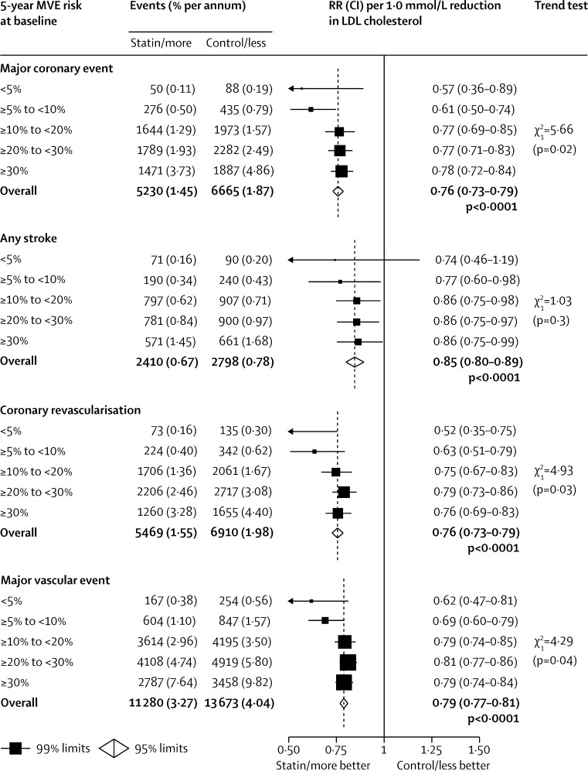
CVD Risk Assessments
Why Assess Risk?
Statin therapy reduces ASCVD risk (relative risk reduction) by ~20-25% across most groups studied per 1 mmol/L LDL reduction
Cholesterol Treatment Trialists Collaboration. Lancet 2012;380(9841):581-90
@MattFeinsteinMD

Slide 39
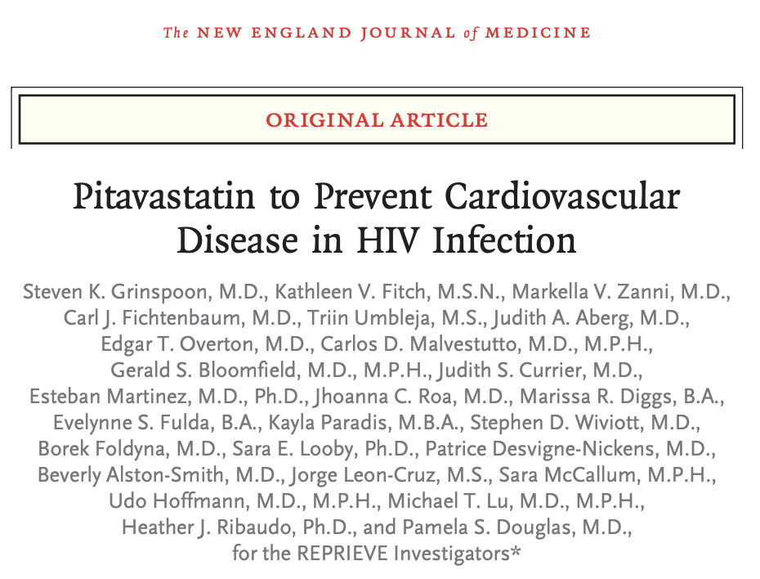
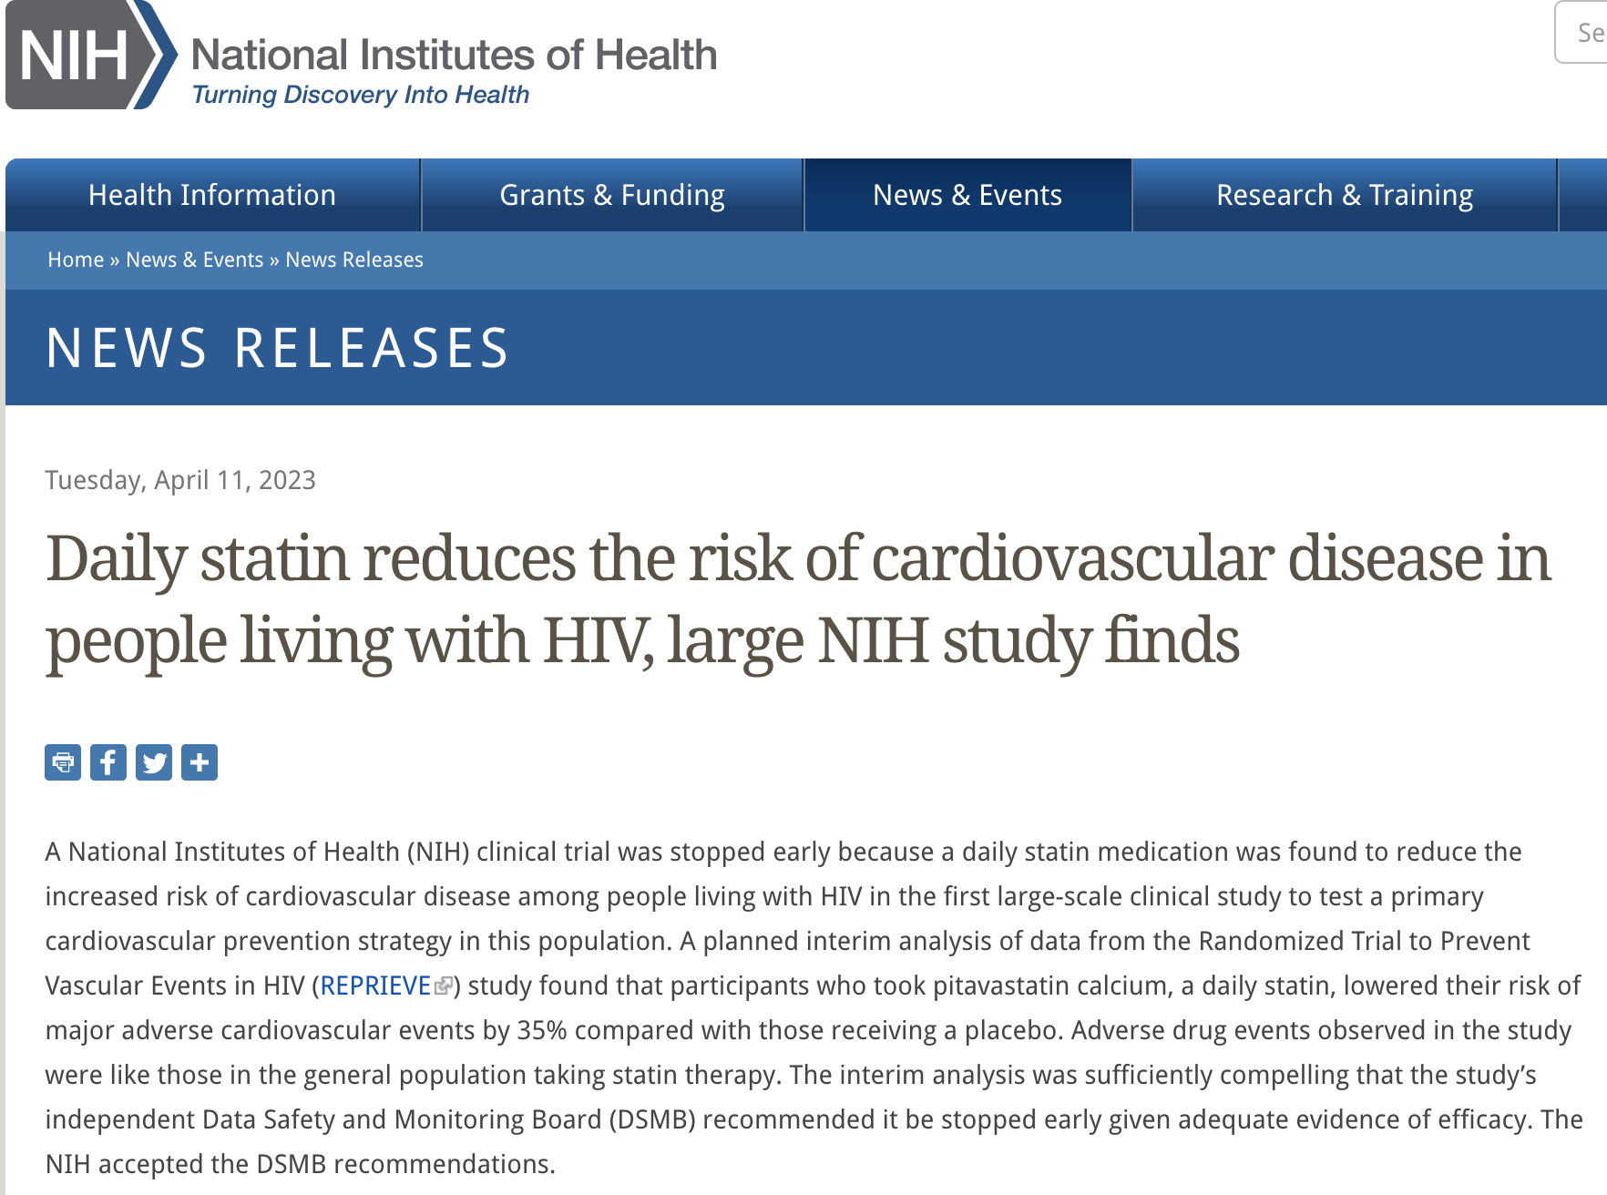
CVD Risk Assessments
Why Assess Risk?
Statin therapy reduces ASCVD risk (relative risk reduction) by ~20-25% across most groups studied per 1 mmol/L LDL reduction
…and now we have data in HIV (maybe stronger effect..35%)
@MattFeinsteinMD

Slide 40
CVD Risk Assessments
Why Assess Risk?
Statin therapy reduces ASCVD risk (relative risk reduction) by ~20-25% across most groups studied per 1 mmol/L LDL reduction
…and now we have data in HIV (maybe stronger effect..35%)
REPRIEVE: KEY POINTS
N=7769 PWH globally
3888 pitavastatin 4 mg vs. 3881 placebo
Low-moderate predicted ASCVD risk (4.5% 10y risk, IQR 2.1-7.0%)
LDL-c lowering average 0.86 mmol/L in pitavastatin group
Median f/u 5.1 years
MACE: 4.81/1000 person-years (pitavastatin) vs. 7.32/1000 person-years (placebo), HR 0.65
Compared to general population, suspect ~20% RRR with this LDL lowering…but observed 35%!
@MattFeinsteinMD

Slide 41
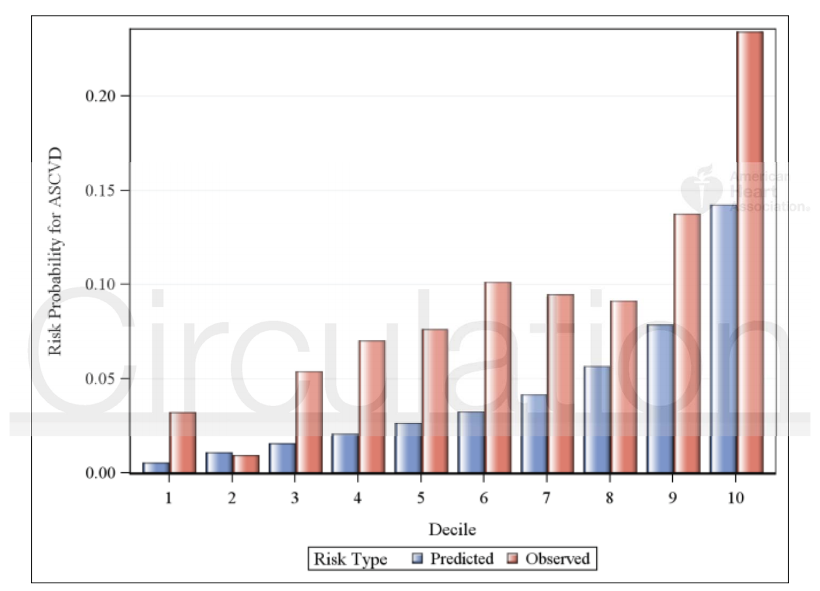
CVD Risk Assessments
But how do our risk scores work?
CVD Risk Scores:
Under-predict risk for ASCVD among people with HIV (in most cohorts and with most equations)
Triant VA, et al. Circulation 2018;137:2203-14.
Feinstein MJ, et al. JAMA Cardiology. 2017;2:155-162.
Achhra AC, et al. Curr HIV/AIDS Rep. 2021;18(4):271-9.
@MattFeinsteinMD
Figure from Triant VA, et al. Circulation 2018;137:2203-14

Slide 42
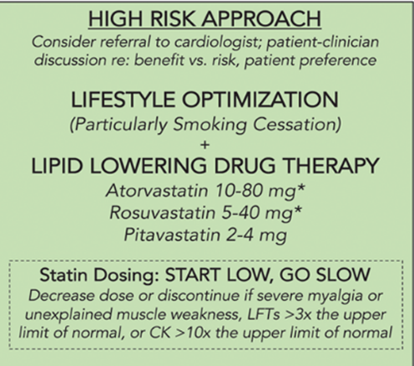
Interim Approach
To CVD-preventive statin Rx
@MattFeinsteinMD
Feinstein MJ et al. Circulation 2019;140(2):e98-e124.

Slide 43
Interim Approach
To CVD-preventive statin Rx
How might the new REPRIEVE data affect this risk/benefit calculus? (based on anticipated results following the NIH press release…I know no more than the general public on this!)
Somewhat more than anticipated benefit for statins in HIV
Side effect profile similar as in gen pop
Perhaps lower threshold to initiate / converse with patients re: statins & shared decision-making
@MattFeinsteinMD
Feinstein MJ et al. Circulation 2019;140(2):e98-e124.

Slide 44
Interim Approach
To CVD-preventive statin Rx
Challenging but absolutely critical
Effect size of smoking on CVD/MI risk >> effect of most preventive/therapeutic Rx
@MattFeinsteinMD
Feinstein MJ et al. Circulation 2019;140(2):e98-e124.

Slide 45
What about Antiplatelet Therapy?
Aspirin, clopidogrel, others?
Aspirin (ASA) did not impact markers of immune activation or endothelial function in HIV in RCT
Young study population (mean age 48-50), 12 week f/u, FMD endpoint
O’Brien MP, et al. Open Forum Infect Dis 2017;4(1):ofw278.
@MattFeinsteinMD

Slide 46
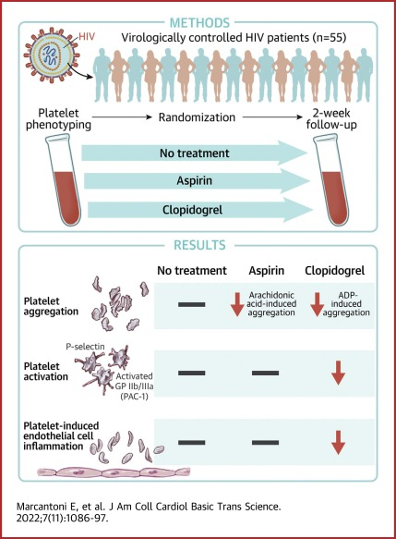
What about Antiplatelet Therapy?
Aspirin, clopidogrel, others?
Aspirin (ASA) did not impact markers of immune activation or endothelial function in HIV in RCT
Young study population (mean age 48-50), 12 week f/u, FMD endpoint
What about clopidogrel? Recent RCT: Reduced platelet activation and platelet-induced endothelial inflammation whereas ASA did not
@MattFeinsteinMD

Slide 47
What about Antiplatelet Therapy?
Aspirin, clopidogrel, others?
What does this mean for antiplatelet Rx for primary prevention of ASCVD in HIV? Despite pro-thrombotic milieu in HIV, need clinical data to inform risks/benefits of antiplatelet Rx for primary prevention
For secondary prevention (e.g., after MI or coronary intervention), if single antiplatelet Rx long term may preference clopidogrel > aspirin
@MattFeinsteinMD

Slide 48
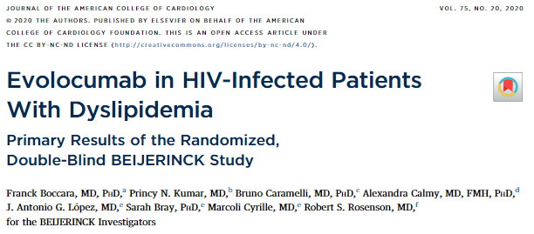
Newer Cholesterol-reducing therapies: relevance in HIV?
Limited data
PCSK9 inhibition – direct, substantial reduction in LDL cholesterol and ASCVD events in general population. Via monoclonal antibody or (investigational) RNA silencing. Limited data in HIV show LDL-c reduction of 56.9%, as well as reduction in Lp(a), ApoB
Bempedoic acid: statin alternative (less potent), TBD in HIV and need outcome data in gen. pop
@MattFeinsteinMD

Slide 49
What about Inflammation Reduction?
We know even less about this
Gen Pop: IL-1β antagonism modest effect size but fatal infection risk; colchicine modest effect size
General inflammation reduction in HIV: TBD whether benefit>risk with respect to CVDs but also immune function
@MattFeinsteinMD

Slide 50
Heart Failure and Sudden Cardiac Death
Limited data. Prevent/treat contributors in the meantime
Studies ongoing to understand the why’s (mechanisms, manifestations)
More investigation is needed to determine which screening tests and therapies unique to HIV-related heart failure prevention & treatment will be most useful. These have implications for sudden cardiac death & its substrate
In the meantime, diagnosis/treatment as in general population but with high index of suspicion. And with focus on treating underlying causes (e.g., CAD/MI prevention, hypertension, metabolic dysregulation)
@MattFeinsteinMD

Slide 51
So, What Can I Do About HIV and CVD?
Guidance for self-advocacy and patient-provider discussions
(a.k.a, doing the most with what we know to maximize benefit but avoid unanticipated harm)

Slide 52
Practical Guidance to CVD Risk Assessment
How can we inform our patient-provider discussions? Our advocacy work?
What do we know?
What do we think?
What do we have no idea about?
@MattFeinsteinMD

Slide 53
Practical Guidance to CVD Risk Assessment
How can we inform our patient-provider discussions? Our advocacy work?
What do we know?
Can be most assertive about this
What do we think?
What do we have no idea about?
@MattFeinsteinMD

Slide 54
Practical Guidance to CVD Risk Assessment
How can we inform our patient-provider discussions? Our advocacy work?
What do we know?
Can be most assertive about this
People with HIV have elevated cardiovascular disease risk. This is true in particular for atherosclerotic/thrombotic cardiovascular diseases (including coronary artery disease and myocardial infarction) and heart failure. Treating HIV effectively with ART helps reduce this risk but does not get rid of it.
@MattFeinsteinMD

Slide 55
Practical Guidance to CVD Risk Assessment
How can we inform our patient-provider discussions? Our advocacy work?
What do we know?
Can be most assertive about this
People with HIV have elevated cardiovascular disease risk.
Given this elevated CVD risk, anyone with HIV can and should consider the following in their discussion with providers (as should HIV providers) - What are my cardiovascular risk factors / risk enhancing factors? How might this impact my risk? Can consider risk calculator (ASCVD, FRS) to quantify, but imperfect - Examples (general): Smoking (cessation is key CVD risk-reducing behavioral change), drugs (meth!), hypertension, hyperlipidemia, diabetes. Treat w lifestyle +/- meds - HIV-specific: History of viremia? CD4 progression (<500 or <200 nadir or current)? - AGE. CVD risk up with age. Absolute risk up → lower threshold for CVD-preventive Rx
@MattFeinsteinMD

Slide 56
Practical Guidance to CVD Risk Assessment
How can we inform our patient-provider discussions? Our advocacy work?
What do we know?
Can be most assertive about this
People with HIV have elevated cardiovascular disease risk.
Given this elevated CVD risk, anyone with HIV can and should consider the following in their discussion with providers (as should HIV providers) - What are my cardiovascular risk factors / risk enhancing factors? How might this impact my risk? Can consider risk calculator (ASCVD, FRS) to quantify, but imperfect - Examples (general): Smoking (cessation is key CVD risk-reducing behavioral change), drugs (meth!), hypertension, hyperlipidemia, diabetes. Treat w lifestyle +/- meds - HIV-specific: History of viremia? CD4 progression (<500 or <200 nadir or current)? - AGE. CVD risk up with age. Absolute risk up → lower threshold for CVD-preventive Rx
@MattFeinsteinMD

Slide 57
Practical Guidance to CVD Risk Assessment
How can we inform our patient-provider discussions? Our advocacy work?
What do we know?
Can be most assertive about this
People with HIV have elevated cardiovascular disease risk.
Given this elevated CVD risk, anyone with HIV can and should consider the following in their discussion with providers (as should HIV providers)
Limited data exist on ARV-specific CVD risks - How might my antiretroviral regimen be affecting my risk? - Strongest data on abacavir with respect to cardiovascular risk increase. Otherwise re: most modern regimens the data are limited. Most important is being on something that effectively suppresses HIV viremia
@MattFeinsteinMD

Slide 58
Practical Guidance to CVD Risk Assessment
How can we inform our patient-provider discussions? Our advocacy work?
What do we know?
What do we think? 1. Cardiovascular risk stratification may help inform potential benefit of CVD risk-reducing therapy
But what type of risk stratification to consider? Risk calculator to start (probably)
Beyond risk factor counting, would risk-stratification via imaging (CAC, carotid plaque ultrasound) help meaningfully stratify?
What does REPRIEVE mean for me? (probably tilts balance slightly more in favor of net benefit>risk of statins, but limited absolute benefit at low risk / younger individuals)
@MattFeinsteinMD

Slide 59
Practical Guidance to CVD Risk Assessment
How can we inform our patient-provider discussions? Our advocacy work?
What do we know?
What do we think?
What do we have no idea about?
What is the role for cardiovascular screening for existing disease (e.g., ECG, echocardiogram. Different than CAC for subclinical disease for risk stratification)? Symptom-/risk-triggered
ECG/echo broad disease screening not routine in general population, and pretest probability informs this (when too low, risk of false positives is high → subsequent testing, over-Rx, harm)
Appropriate, potentially helpful: symptom-triggered (e.g., palpitations + lightheadedness potentially due to arrhythmia → ECG/monitor; exertional chest pressure → ischemic eval)
Less appropriate or likely to be helpful: no symptoms, good exertional tolerance → “routine” ECG or monitor (finding something doesn’t mean it matters or is actionable)
@MattFeinsteinMD

Slide 60
Conclusions
People living with HIV have elevated risks for atherosclerotic disease, thrombosis, and cardiac dysfunction / heart failure
Chronic inflammation and immune activation persist despite effective ART and appear to play a role in CVD pathogenesis
New data suggest statins may be particularly effective in CVD risk reduction in HIV (await full REPRIEVE results) → Lower threshold to consider ASCVD-preventive statin Rx in HIV may be reasonable.
We still don’t know how to best prevent/treat HF in HIV. Need mechanistic and clinical data to inform this. Reducing burden of common risk factors with lifestyle, then meds as necessary is a good start to preventing HIV-associated CVDs (and CVDs in general)
@MattFeinsteinMD

Slide 61
Thank You and Discussion
matthewjfeinstein@northwestern.edu
@MattFeinsteinMD

