Slide 1
HIV 101
Christopher B. Hurt, MD, FIDSA 2023 Update

Slide 2
AETC Program – National Resources
2
National Coordinating Resource Center – serves as the central web-based repository for AETC Program training and capacity building resources; its website includes a free virtual library with training and technical assistance materials, a program director, and a calendar of trainings and other events. Learn more: https://aidsetc.org/
National Clinician Consultation Center – provides free, peer-to-peer, expert advice for health professionals on HIV prevention, care, and treatment and related topics. Learn more: https://nccc.ucsf.edu
National HIV Curriculum – provides ongoing, up-to-date HIV training and information for health professionals through a free, web-based curriculum; also provides free CME credits, CNE contact hours, CE contact hours, and maintenance of certification credits. Learn more: www.hiv.uw.edu

Slide 3
Disclosures
3
This program is supported by the Health Resources and Services Administration (HRSA) of the U.S. Department of Health and Human Services (HHS) under grant number U1OHA30535 as part of an award totaling $4.2m. The contents are those of the author(s) and do not necessarily represent the official views of, nor an endorsement, by HRSA, HHS, or the U.S. Government. For more information, please visit: https://www.hrsa.gov
Funding for this presentation was made possible by cooperative agreement U1OHA30535 from the Health Resources and Services Administration HIV/AIDS Bureau. The views expressed do not necessarily reflect the official policies of the Department of Health and Human Services nor does mention of trade names, commercial practices, or organizations imply endorsement by the U.S. Government. Any trade/brand names for products mentioned during this presentation are for training and identification purposes only.

Slide 4
Christopher B. Hurt, MD, FIDSA
4
Associate Professor of Medicine
Associate Chief for Clinical Operations, UNC Division of ID Director, North Carolina HIV Training & Education Center Site PI, Ryan White HIV/AIDS Program Part D, UNC ID Clinic
Institute for Global Health & Infectious Diseases University of North Carolina at Chapel Hill School of Medicine
Dr. Hurt is supported by the Health Resources and Services Administration (HRSA-17-039, U1OHA30535), the National Institute on Drug Abuse (UH3DA044823), and the National Institute of Allergy and Infectious Diseases (P30AI50410, R61AI174285, UM1AI069423, UM1AI068619).
The views expressed are not necessarily those of HRSA or the NIH.
11 Apr 2023

Slide 5
Objectives
6
Define key terms: HIV, CD4 cell, AIDS, viral load, ARV, adherence, and undetectability
Describe who is living with HIV in the US and who is at risk for acquiring HIV
Outline how HIV infects someone and what happens in the body after infection
Describe the process of getting tested and what happens when someone enters HIV care
Explain U=U and what it means for people with HIV

Slide 6
7

Slide 7
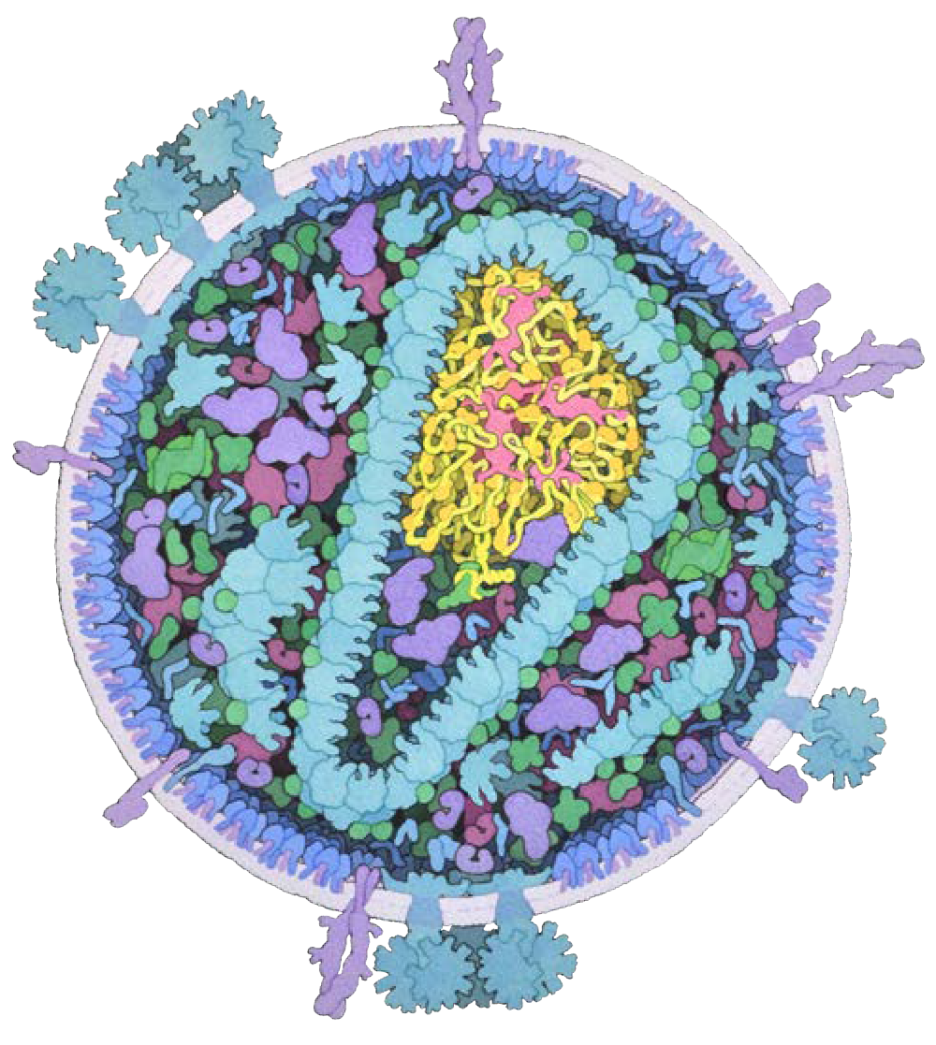
Defining some key terms
8
Illustration of HIV by Dr David Goodsell, Scripps Research Institute
Human immunodeficiency virus (HIV)
Retrovirus that attacks the immune system
CD4 T lymphocyte
Also called a “T helper” cell
Orchestrates the immune system’s function
HIV hijacks CD4 cells and then kills them off
Acquired immune deficiency syndrome (AIDS)
Clinical term describing when CD4 counts fall to 200 or less
Not all people living with HIV have AIDS
Viral load
The number of copies of HIV genetic material in a volume of blood
( one copy = one virus )

Slide 8
Defining some key terms
9
Illustration of HIV by Dr David Goodsell, Scripps Research Institute
Antiretroviral (ARV)
A medication used to treat HIV
Combinations of ARVs are called antiretroviral therapy (ART)
Adherence
How consistently someone takes their meds
Replaces the term “compliance”
Undetectable
When the viral load is so low that blood tests can’t detect it
Occurs when a patient has good adherence to their ARVs
Being undetectable is not the same as being cured

Slide 9
How did HIV get to the US?
New York City
1972
SF
1978
Haiti
1969
Kinshasa
1910s
Sharp & Hahn. Philos Trans R Soc Lond B Biol Sci. 2010 Aug 27;365(1552):2487-94
Faria NR et al. Science. 2014 Oct 3; 346(6205):56-61
Worobey M et al. Nature. 2016 Nov 3; 539(7627):98-101
Illustration by Christopher Hurt

Slide 10
How many Americans have HIV?
12
US Population
329.5
million
in 2019
Approximately
0.4%
infected
(1.19 million in 2019)
Approximately
158,500
unaware of their infection
(in 2019)
1.03M
diagnosed with HIV
(in 2019)
Charts and figures by Christopher Hurt
https://www.census.gov/popclock/ Accessed 23 Aug 2019
https://www.cdc.gov/hiv/pdf/library/reports/surveillance/cdc-hiv-surveillance-supplemental-report-vol-26-1.pdf Accessed 20 Oct 2021

Slide 11
Where have we been with HIV in the US?
14
1.14
million
1994: AIDS leading cause of death
among all Americans aged 25-44
150
1500
Estimated Infections and AIDS Deaths
(Thousands)
1995: “cocktail” available
living with HIV
(2016)
125
1250
Persons Living with HIV
(Thousands)
100
1000
75
750
50
500
25
250
Charts and figures by Christopher Hurt
0
0
Before 1981
1985
1990
1995
2000
2005
2010
2015
Year
Incidence AIDS Deaths
Data from various CDC sources. 1994 AIDS mortality: https://www.cdc.gov/mmwr/preview/mmwrhtml/00040227.htm
Prevalence

Slide 12
Who has HIV in the US?
16
23%
cisgender women
(n=256,500)
77%
cisgender men (n=866,400)
21% 54,100 | IDU | 16%* 57,300 + 81,000
78% 201,000 | Het | 11% 93,600
– | MSM | 73% 632,300
Charts and figures by Christopher Hurt
* This chart is simplified from CDC data
MSM who also inject drugs = 6.6% of IDUs here; MSM-IDUs not included in this MSM figure
Who’s missing? Trans folks
CDC. HIV Surveillance Supplemental Report. Vol 23 (No. 1) 2018

Slide 13
Who has HIV in the US?
17
US Population
2020
HIV Prevalence
2019 (estimated)
12%
28%
19%
40%
62%
24%
Charts and figures by Christopher Hurt
Black
Hispanic
Asian
Multi/Other
White
Census data from: https://factfinder.census.gov/bkmk/table/1.0/en/ACS/17_5YR/DP05/0100000US
Prevalence data from: https://www.cdc.gov/hiv/pdf/library/reports/surveillance/cdc-hiv-surveillance-supplemental-report-vol-26-1.pdf

Slide 14
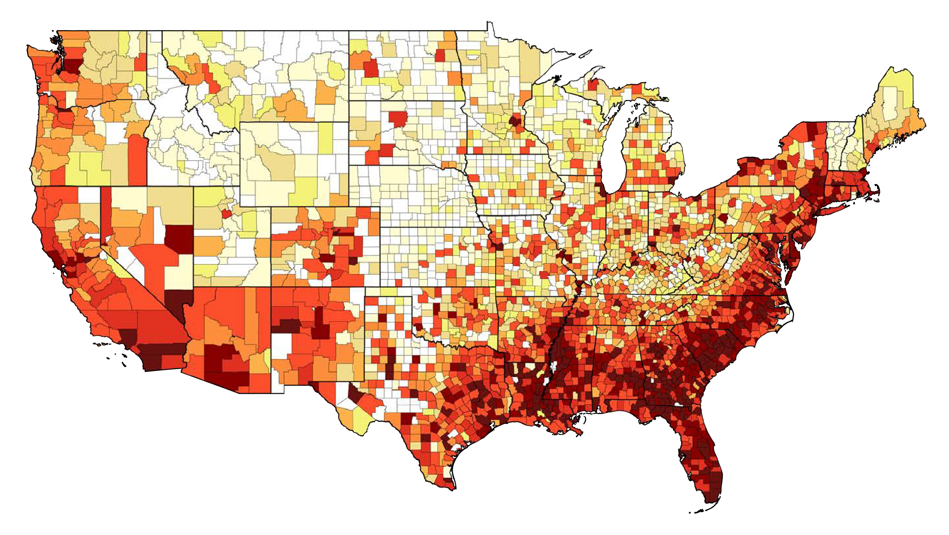
Where do Americans with HIV reside?
18
382
of every 100,000 Americans
(1.07M living with HIV in 2020)

Slide 15
How many new infections occur each year?
19
24%
70
Incidence is the number of new cases that occur in a population over a specified period of time.
Thousands of Infections (Estimated)
60
50
40
46
43.9
41.1
40.3
40
38.9
38
37.8 37.9
36.7
36.2
30
34.8
20
10
0
Charts and figures by Christopher Hurt
2008
2009
2010
2011
2012
2013
2014
2015
2016
2017
2018
2019
* This date range uses an updated, consistent method for estimation of incidence (CD4 T-lymphocyte model)
Hall HI et al. JMIR Public Health Surveill 2017 Feb 3;3(1):e8 Satcher Johnson A et al. JAIDS 2017 Oct 1;76(2):116-22 https://www.cdc.gov/hiv/pdf/library/reports/surveillance/cdc-hiv-surveillance-supplemental-report-vol-26-1.pdf

Slide 16
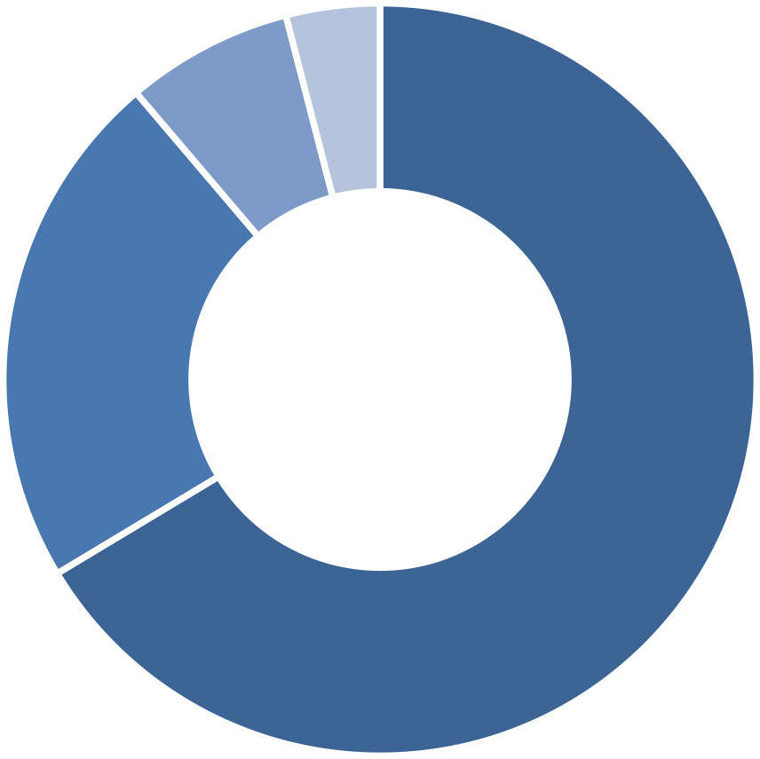
Who is acquiring HIV in the US?
20
24%
Estimated new infections by transmission category, 2019
MSM – IDU
4%
Men Who Have Sex with Men
66%
Injection Drug Users
7%
Charts and figures by Christopher Hurt
Heterosexuals
22%
https://www.cdc.gov/hiv/pdf/library/reports/surveillance/cdc-hiv-surveillance-supplemental-report-vol-26-1.pdf

Slide 17
Who is acquiring HIV in the US?
21
Estimated new infections by race/ethnicity, sex, and risk, 2019
Blacks
Hispanic/Latinx
Whites
Het ♂
MSM
IDU ♂
MSM
MSM- IDU
MSM- Het
IDU ♂
Charts and figures by Christopher Hurt
MSM
I D
MSM- IDU
IDU ♂
IDU ♂
Het ♂
U
ID U
Het ♀
♀ Het ♀
Het ♀
IDU ♀
CDC. HIV Surveillance Suppl Rep 2019;26(1)

Slide 18
Who is acquiring HIV in the US?
22
Estimated new infections by race/ethnicity, sex, and age, 2019
Blacks |  |  | Hispanic/Latinx |  |  | Whites
≥25 ♂ | 13-24 ♂ |  | ≥25 ♂ |  |  | ≥25 ♂ 13-24 ♂
 |  |  | 13-24 ♂ |  |  |  | 1
≥25 ♀ |  | 13- 24 ♀ |  |  |  | ≥25 ♀ | 3- 2
 |  |  | ≥25 ♀ | 13- 24
Charts and figures by Christopher Hurt
CDC. HIV Surveillance Suppl Rep 2019;26(1)

Slide 19
Who is acquiring HIV in the US?
23
Estimated new infections by race/ethnicity, sex, and age, 2019
Blacks
Hispanic/Latinx Whites
Adolescents (13-19) and young adults (20-24) accounted for
21%
of HIV diagnoses in 2019.
(7,588 of 36,801)
13-24 ♂
Charts and figures by Christopher Hurt
13-24 ♂
13-24 ♂
1
3-
2
13-
24 ♀
13-
24
CDC. HIV Surveillance Suppl Rep 2019;26(1)

Slide 20
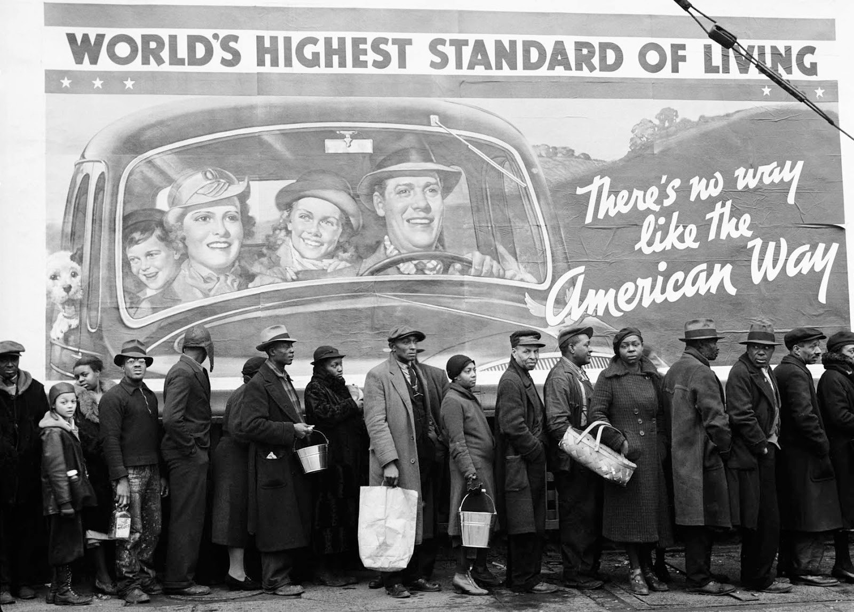
Why are there such disparities by race?
24
“The Louisville Flood” by Margaret Bourke-White, 1937
https://rarehistoricalphotos.com/there-no-way-like-american-way-1937/

Slide 21
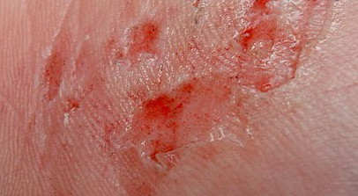
How is HIV transmitted?
25
The virus can pass from person to person only if
Blood
Semen
Vaginal
fluid
Breast
milk
containing HIV comes into direct contact with
a mucosal surface non-intact skin
(any wet lining of the body)
your bloodstream
(injuries, shared needles)
Illustration by Christopher Hurt
https://www.cdc.gov/hiv/basics/transmission.html Skin image: https://commons.wikimedia.org/wiki/File:Abrasion_on_hand_20050906.jpg

Slide 22
How is HIV NOT transmitted?
26
The virus is NOT transmitted through
~~~
Air or water
Sweat, saliva, tears
Urine
animals
insect or tick bites
shared utensils
shared toilets
Illustration by Christopher Hurt
https://www.cdc.gov/hiv/basics/transmission.html

Slide 23
What behaviors put someone at risk for HIV?
27
2000x
Relative risk of acquiring HIV from a sex partner who is not taking ART
A person with untreated HIV performing oral sex on someone with a penis who is wearing
a condom
is the reference for all other categories
with condom
without condom
400x
260x
200x
100x
20x
40x
10x
20x
13x
Illustration by Christopher Hurt
1
2x
Insertive Receptive
ORAL SEX
Insertive Receptive
VAGINAL SEX
Insertive Receptive
ANAL SEX
Adapted from CDC Prevention Is Care Campaign, v1.0

Slide 24
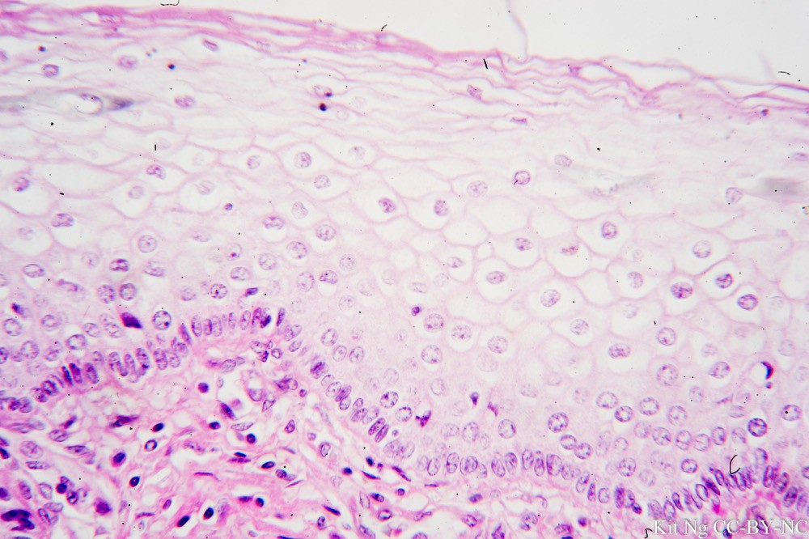
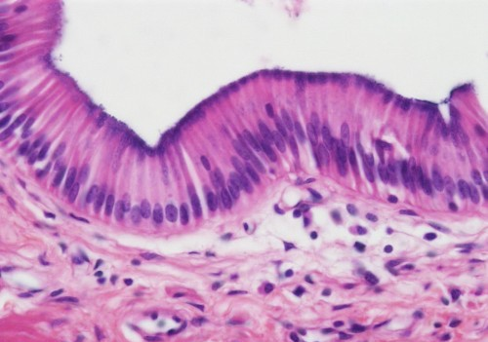
28
Stratified, non-keratinized squamous epithelial tissue
(lining the mouth, vagina, and anal canal)
Simple columnar epithelial tissue
(lining the rectum)
Illustration by Christopher Hurt

Slide 25
Immune cells are constantly on patrol
29
CD4+
dendritic cell
Illustration by Christopher Hurt

Slide 26
30
Semen
Blood
Intact, healthy tissue lining the mouth, vagina, or anal canal is a good defense against HIV infection.
Illustration by Christopher Hurt

Slide 27
Healthy rectal tissue is not as reliable
31
Semen Blood
a defense against HIV infection.
Illustration by Christopher Hurt

Slide 28
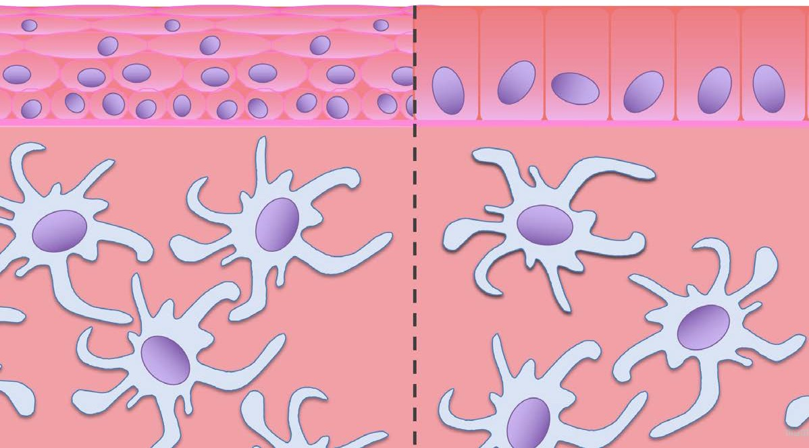
Inflammation from STIs increases risk
32
Syphilis
Herpes
Gonorrhea Chlamydia Trichomonas
HIGHER
LOWER

Slide 29
Disrupted linings are “portals of entry”
33
Damage or disruption from enemas/douches or sexual activity
Ulcers, abrasions, tears, or cuts
Illustration by Christopher Hurt

Slide 30
No virus in body fluids? No transmission!
34
undetectable = untransmittable (U=U)
Illustration by Christopher Hurt

Slide 31
No virus in body fluids? No transmission!
35
The virus is NOT transmitted through
condomless sex with people with HIV IF they take antiretroviral medications consistently
AND they are “undetectable”
https://www.cdc.gov/hiv/basics/transmission.html Image: https://www.sfaf.org/collections/beta/start-and-continue-hiv-meds-as-soon-as-you-can/

Slide 32
93%*
Treatment as prevention (U=U) is a proven fact
36
HPTN 052
2007-2010
Botswana, Malawi, South Africa, Zimbabwe, Brazil, India, Thailand (& US)
reduction
8509 couple-years f/u
Upper CI bound: 1.1/100 couple-years
PARTNER1
2010-2014
Europe (888)
100%
reduction
1238 couple-years f/u
Upper CI bound: 0.3/100 couple-years
Opposites Attract
2012-2016
Australia (153), Thailand (97), Brazil (93)
100%
reduction
588.4 couple-years f/u
Upper CI bound: 1.59/100 couple-years
PARTNER2
2014-2018
Europe (782)
100%
reduction
1593 couple-years f/u
Upper CI bound: 0.23/100 couple-years
Illustration by Christopher Hurt
* linked transmissions were from sources who had not yet become undetectable or had lapses in treatment
HPTN 052: Cohen MS, et al. New Engl J Med. 2016;375(9):830-839. PARTNER1: Rodger AJ, et al. JAMA. 2016;316(2):171-181.
Opposites Attract: Bavinton BR, et al. Lancet HIV. 2018 ;5(8):e438-e447. PARTNER2: Rodger AJ, et al. Lancet. 2019;393(10189):2428-2438.

Slide 33
What happens after HIV disseminates?
37
Acute infection
Clinical latency
Symptoms
Opportunistic conditions
1000
1M
1E+6
900
800
100K
CD4 T-lymphocyte count
(cells / µL)
1E+5
700
HIV RNA Viral Load
(copies / mL)
600
//
500
10K
//
1E+4
400
300
Viral set point
1000
1E+3
200
AIDS
(CD4 <200 or 14%)
100
0
//
100
6 9 12
Weeks
1E+2
0
3
1
2
3
4
5
6
7
8
9 10 11
Y3
Y6
Y9
Y10
Y11
Years
Adapted from: Fauci AS, et al. Ann Int Med 1996;124:654-63

Slide 34
What is the HIV continuum of care?
38
DIAGNOSED WITH HIV
ENGAGED OR RETAINED IN CARE
ACHIEVED VIROLOGIC SUPPRESSION
PRESCRIBED ANTIRETROVIRAL THERAPY
LINKED TO CARE
Illustration by Christopher Hurt
Gardner EM, et al. Clin Infect Dis. 2011;52(6):793-800

Slide 35
What factors affect linkage & retention?
39
Mental Health
Rural vs Urban Residence
Age
Substance Use Disorders
Stigma
Fear
Insurance Status
Gender
Family Care Responsibilities
Housing Stability
Provider Experience
Transportation
Illustration by Christopher Hurt

Slide 36
What if someone is uninsured?
40
Photo from https://www.cdc.gov/stophivtogether/library/topics/treatment/flyers/cdc-hiv-lsht-treatment-flyer-undetectable-is-prevention-provider.pdf
Established by Congress in 1990 as a “payor of last resort” for people with HIV
Dedicated funding for care, housing, support services, and medications
Promotes and maintains high standards of care through training and innovation

Slide 37
561,416
clients in 2020
Who is served by Ryan White programs?
41
https://www.cdc.gov/stophivtogether/library/topics/prevention/brochures/cdc-lsht-prevention-brochure-discussing-sexual-health-provider.pdf
https://ryanwhite.hrsa.gov/sites/default/files/ryanwhite/resources/rwhap-hrsa-numbers-2020.pdf
More than half of all people diagnosed with HIV in the US
24%
of clients identified as Hispanic or Latinx
47%
of clients identified as Black or African American
61%
of clients are living at or below 100% of Federal Poverty Level

Slide 38
42
Antiretroviral therapy is recommended for everyone with HIV, regardless of how long they’ve had the infection or what their CD4 count is.

Slide 39
How does antiretroviral therapy work?
43
Illustration by Christopher Hurt

Slide 40
How does antiretroviral therapy work?
44
Good adherence to ART keeps the power to the factories reliably turned off
Illustration by Christopher Hurt

Slide 41
How does antiretroviral therapy work?
45
The factories are still there… and will definitely come back on-line if the power is restored
Illustration by Christopher Hurt

Slide 42
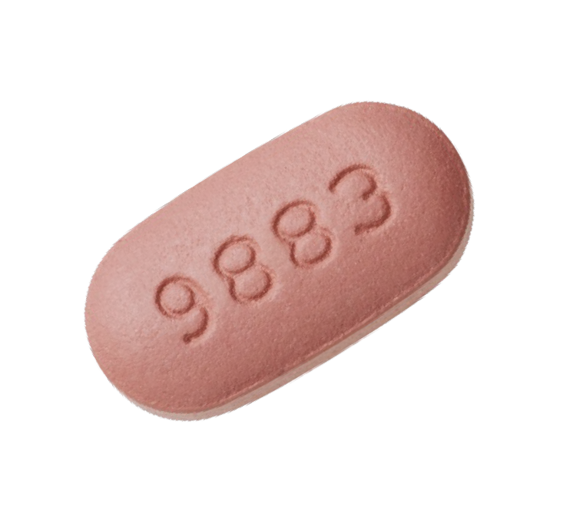
What is “virological suppression”?
46
Lower limit of HIV RNA
detection
(copies/mL)
1500
“Undetectable”
400
20
Illustration by Christopher Hurt
“Detected but less than…”
“HIV RNA
not detected”

Slide 43
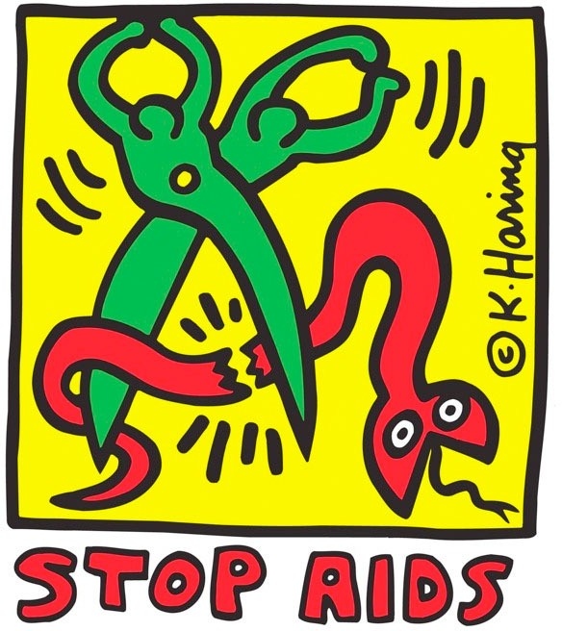
Questions?
47
Christopher Hurt, MD
churt@med.unc.edu
https://www.wikiart.org/en/keith-haring/stop-aids-1989

