Slide 1
Women’s Health & HIV
Tiffany Stivers, APRN, FNP-C, AAHIVS
Director Population Health Services
Bluegrass Care Clinic

Slide 2
Disclosures
This program is supported by the Health Resources and Services Administration (HRSA) of the U.S. Department of Health and Human Services (HHS) under grant number U1OHA30535 as part of an award totaling $4.2m. The contents are those of the author(s) and do not necessarily represent the official views of, nor an endorsement, by HRSA, HHS, or the U.S. Government. For more information, please visit HRSA.gov.
“Funding for this presentation was made possible by cooperative agreement U1OHA30535 from the Health Resources and Services Administration HIV/AIDS Bureau. The views expressed do not necessarily reflect the official policies of the Department of Health and Human Services nor does mention of trade names, commercial practices, or organizations imply endorsement by the U.S. Government. Any trade/brand names for products mentioned during this presentation are for training and identification purposes only.”
This content is owned by the AETC, and is protected by copyright laws. Reproduction or distribution of the content without written permission of the sponsor is prohibited, and may result in legal action.

Slide 3
AETC Program National Centers and HIV Curriculum
National Coordinating Resource Center – serves as the central web –based repository for AETC Program training and capacity building resources; its website includes a free virtual library with training and technical assistance materials, a program directory, and a calendar of trainings and other events. Learn more: https://aidsetc.org/
National Clinician Consultation Center – provides free, peer-to-peer, expert advice for health professionals on HIV prevention, care, and treatment and related topics. Learn more: https://nccc/ucsf.edu
National HIV Curriculum – provides ongoing, up –to-date HIV training and information for health professionals through a free, web –based curriculum; also provides free CME credits, CNE contact hours, CE contact hours, and maintenance of certification credits. Learn more: www.hiv.uw.edu

Slide 4
Learning Objectives
Describe epidemiologic features of women with HIV in the Unites States
Describe cancer screening recommendations for women with HIV
Discuss contraceptive options and recommendations for women with HIV

Slide 5
HIV and Cancer
PWH have increased risk of cancer compared to general population
  Immune dysregulation; low CD4 cell count
Shift from AIDS-defining cancers (Kaposi’s sarcoma & non-Hodgkin’s lymphoma) to non-AIDS-defining malignancies
Screening Not Impacted by HIV
Breast Cancer
Colon Cancer
Lung Cancer
Screening Impacted by HIV
Cervical Cancer
Anal Cancer
Patel P, Hanson DL, Sullivan PS, et al. Incidence of types of cancer among HIV-infected persons compared with the general population in the United States, 1992-2003. Ann Intern Med. 2008;148:728-36.
Notes:
- A correlation between HIV-related immunodeficiency and malignancy, possibly through a mechanism of immune dysregulation and decreased immune surveillance; it is now well recognized that a low CD4 cell count increases the risk of malignancy.

Slide 6
Cervical Cancer Screening
Higher incidence of cervical cancer in HIV-infected women
  Increase in HIV/HPV coinfection
  Higher risk for contracting oncogenic HPV subtypes (Types 16 & 18)
Initiate within 1 year of the onset of sexual activity regardless of mode of HIV transmission, but no later than 21 years old.
Cervical cancer screening in HIV-infected women should continue throughout a woman’s lifetime
  Do not stop at 65 years of age
Guidelines for Prevention and Treatment of Opportunistic Infections in Adults and Adolescents with HIV. (2023). https://clinicalinfo.hiv.gov/en/guidelines/hiv-clinical-guidelines-adult-and-adolescent-opportunistic-infections/human-0?view=full
Notes:
Screening among general population ends at 65 yo

Slide 7
Cervical Cancer Screening
21 years old + sexually active or
WWH aged 21-29
What:
Pap Test
HPV Co-Testing not recommended
When:
Within 1 year of sexual activity onset
Initial diagnosis
Every 12 months
Annually until 3 consecutive Pap tests are normal
≥30 years old
What:
Pap Test
When:
Initial diagnosis
Every 12 months
Annually until 3 consecutive Pap tests are normal then q 3 years
Guidelines for Prevention and Treatment of Opportunistic Infections in Adults and Adolescents with HIV. (2023). https://clinicalinfo.hiv.gov/en/guidelines/hiv-clinical-guidelines-adult-and-adolescent-opportunistic-infections/human-0?view=full

Slide 8
≥30 years old
Abnormal Pap
LSIL or HSIL
Colposcopy regardless of HPV status
ACS-US HRHPV (-)
Rescreen with Pap and reflex HPV test in 6-12 months
Refer for colposcopy if ASCUS on repeat
ASC-US HRHPV (+)
Refer for colposcopy
What:
Pap Test w/ HPV Co-test
When:
If, Pap normal + HPV negative
- Repeat in 3 years
If, Pap Normal + High Risk HPV positive (type 16/18)
- Colposcopy recommended
If, Pap Normal + High Risk HPV (other high risk types)
- Repeat Pap and HPV co-testing in 1 year
- Colposcopy if still abnormal
Guidelines for Prevention and Treatment of Opportunistic Infections in Adults and Adolescents with HIV. (2023). https://clinicalinfo.hiv.gov/en/guidelines/hiv-clinical-guidelines-adult-and-adolescent-opportunistic-infections/human-0?view=full

Slide 9
Cervical Cancer Screening
Normal Cervical Cytology and Negative High-Risk HPV test (women > 30yo)
  If 3 consecutive cervical cytology tests are normal then cervical cytology every 3 years
Cytology-Negative, High-Risk HPV-positive: Colposcopy
ASC-US:
  Negative HPV: Repeat cytology in 6-12 months
  Positive HPV: Colposcopy
LSIL or more higher: Colposcopy (regardless of HPV testing)
Guidelines for Prevention and Treatment of Opportunistic Infections in Adults and Adolescents with HIV. (2022). https://clinicalinfo.hiv.gov/en/guidelines/hiv-clinical-guidelines-adult-and-adolescent-opportunistic-infections/human-0?view=full
Notes:
Atypical Squamous Cells of Unknown Significance. This result means that cells were found that were not normal, but also not identifiable. This can be caused by dysplasia, but it can also be caused by inflammation or other factors.
Low Grade Squamous Intraepithilial Lesion. Also known as mild dysplasia. These can be warts or lesions. They aren't considered pre-cancerous, but they can turn to HSIL in time.
High Grade Squamous Intraepithilial Lesion. A pre-cancerous change to the skin of the anal canal or perianal area. HSIL is not cancer. Only a small fraction of HSIL progresses into cancer.

Slide 10
Cervical Cancer Screening After Hysterectomy
Few data to guide follow-up and risk of vaginal cancer
  No vaginal cytologic screening
    HIV + women with no history of CIN 2,3 who had hysterectomy for benign reasons
  Vaginal cytologic screening:
    HIV + women with history of CIN 2,3
    Screening for 20 years after last finding of CIN 2,3
Guidelines for Prevention and Treatment of Opportunistic Infections in Adults and Adolescents with HIV. (2022). https://clinicalinfo.hiv.gov/en/guidelines/hiv-clinical-guidelines-adult-and-adolescent-opportunistic-infections/human-0?view=full
Few data to guide follow-up and risk of vaginal cancer
  No vaginal cytologic screening
    HIV + women with no history of CIN 2,3 who had hysterectomy for benign reasons
  Vaginal cytologic screening:
    HIV + women with history of CIN 2,3
    Screening for 20 years after last finding of CIN 2,3

Slide 11
A 28-year-old woman is newly diagnosed with HIV on a routine screening test. Her only risk factor is heterosexual sex with 3 male partners since her sexual debut at age 16. She presents for her first visit after diagnosis. She never received the human papillomavirus (HPV) vaccine.
Which one of the following is TRUE regarding cervical cancer screening in this 28-year-old woman with HIV?
Cervical cancer screening should not be initiated until at age 30.
Pap smear should be performed at the time of initial HIV diagnosis, and if the initial test is normal, it should be repeated 1 year later
Pap smear should be performed at the time of initial HIV diagnosis, and if the initial test is normal, it should be repeated 3 years later
Pap smear should be performed at the time of initial HIV diagnosis, and if the initial test is normal, it should be repeat 5 years later
Pap smear and HPV cotesting should be performed at the time of initial diagnosis, and if the initial test is normal, cotesting should be repeated 3 years later

Slide 12
Anal Cancer Screening
Who?
  HIVMA/IDSA Recommendation:
    MSM
    Women with history of receptive anal intercourse
    Women with abnormal cervical pap smears
    Men and women with genital warts
  Bluegrass Care Clinic:
    All HIV + patients
Clinical Infectious Diseases, Volume 73, Issue 11, 1 December 2021, Pages e3572–e3605, https://doi.org/10.1093/cid/ciaa1391

Slide 13

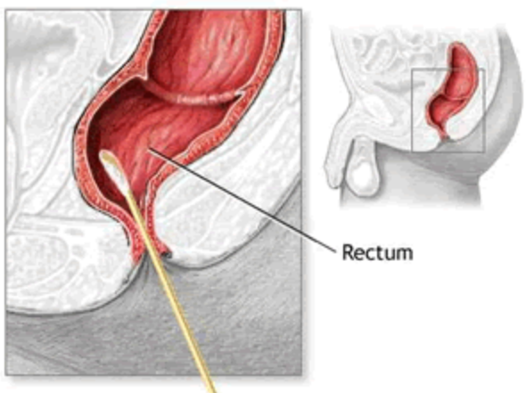
Anal Cancer Screening
Why?
  HPV causes over 90% of anal cancers
  Increased HIV/HPV coinfection and higher risk for contracting oncogenic HPV subtype
  ANCHOR study showed 57% lower progression to anal cancer with treatment of biopsy-proven anal HSIL
How?
  Anal Pap/Anal Cytology
  Polyester or Dacron Swab
Notes:
No douche or have an enema or insert anything into their anus for 24 hours prior to an anal cytology exam.
Lubricants should not be used prior to obtaining a cytology sample because the lubricant may interfere with the processing and interpretation of the sample.
Dacron or polyester tipped swab moistened in tap water is inserted for approximately 2 to 3 inches into the anus. The swab can be felt to pass through the internal sphincter so the sample is obtained from the junction of the anus and rectum, which is where most of the HPV-related lesions are found.

Slide 14
Anal Cancer Screening
Yearly Anal Pap Smear*
If access to appropriate referral available
ASCUS x 2 or LSIL/HSIL
High resolution Anoscopy and Biopsy
Abnormal Findings
Biopsy based therapy

Slide 15
Breast Cancer Screening
Available data do not suggest a relative increase in breast cancer among women with HIV
Current guidelines based on HIV-negative patients
Follow the standard guidelines for women in the general population
Available data do not suggest a relative increase in breast cancer among women with HIV
Current guidelines based on HIV-negative patients
Follow the standard guidelines for women in the general population

Slide 16


Breast Cancer Screening
American Cancer Society
Screening mammography annually beginning at age 45 years.
Biennial screening age 55
Earlier screening (ages 40-44) should be offered
Continue as long as > 10 year life expectancy
USPSTF
Screening mammography every other year in women aged 50-74 years
Earlier screening (ages 40-49) individual decision
U.S. Preventive Services Task Force. (2022). Breast Cancer Screening. https://www.uspreventiveservicestaskforce.org/uspstf/recommendation/breast-cancer-screening.
Notes:
(U.S. Preventive Services Task Forces) USPSTF – recommends biennial screening for women 50-74
American Cancer Society – Mammograms yearly starting at age 45 and biennial at age 55

Slide 17
Breast Cancer Risk Assessment Tool
National Cancer Institute
Estimates woman’s risk of developing invasive breast cancer over the next
5 year and up to age 90 (lifetime risk)
Cannot accurately assess risk for women carrying BRCA1 or BRCA2
https://bcrisktool.cancer.gov/

Slide 18
HIV Primary Care Resources
IDSA Primary Care Guidelines
  https://www.idsociety.org/practice-guideline/primary-care-management-of-people-with-hiv/
National HIV Curriculum
  https://www.hiv.uw.edu/
Southeast AIDS Education & Training Center
  https://www.seaetc.com/?s=primary+care

Slide 19

Contraception Counseling for Women with HIV
DHHS Recommendations
  Discuss reproductive desires and plans with all persons with HIV of childbearing potential on an ongoing basis and throughout the course of their care
  Provide information about effective and appropriate contraceptive methods to people who do not currently desire pregnancy
    Offer all contraceptive methods or refer for contraceptive services
    PWH can use all contraceptive methods, but must consider medical co-morbidities and DDI
  When selecting or evaluating an ARV regimen for persons of childbearing potential with HIV, consider a regimen’s effectiveness, a person’s hepatitis B status, and the possible adverse outcomes for the pregnant person and their fetus
This Photo by Unknown Author is licensed under CC BY-SA
US DHHS Perinatal ART Guidelines, 2023.

Slide 20
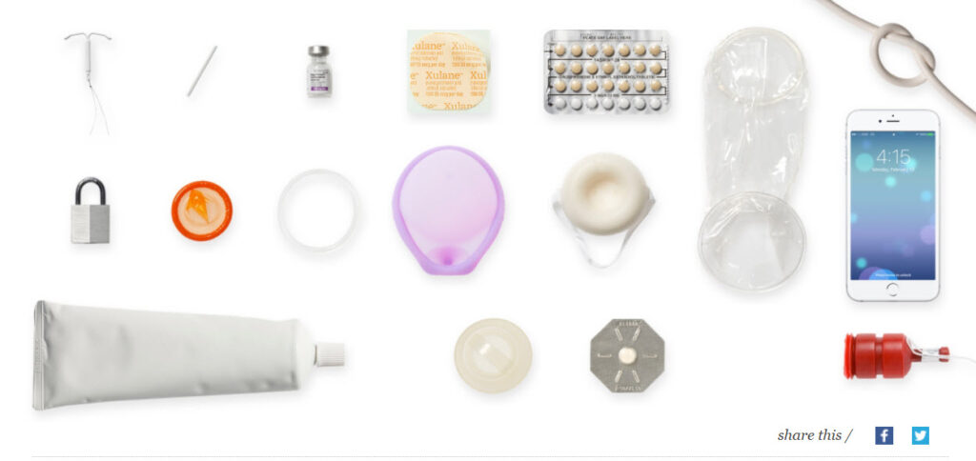
HIV and Hormonal Contraception
~ 78% of pregnancies for women living with HIV are unintended¹
Unintended pregnancy associated with suboptimal virologic control and increased perinatal transmission²
DDI between hormonal contraceptive and ART exist
  Mainly with coadministration with EFV or boosted PI
Hormonal contraception does not appear to significantly alter the efficacy of HIV ART
This Photo by Unknown Author is licensed under CC BY
1. Sutton MY, et al. PLoS One. 2018; 13(5):e0197216 2. Shah PS, et al. Matn Child Health J. 2011; 15(2):205-16.

Slide 21
CDC U.S. MEC Categories for Classifying Contraceptive Methods
Curtis KM, et al. MMWR Recomm Rep. 2016; 65(3):1-103
Rating system to categorize relative risks and benefits of each contraceptive method depending on a woman’s
medical comorbidities and medication use
  1 = A condition for which there is no restriction for the use of the contraceptive method.
  2 = A condition for which the advantages of using the method generally outweigh the theoretical or proven risks.
  3 = A condition for which the theoretical or proven risks usually outweigh the advantages of using the method.
  4 = A condition that represents an unacceptable health risk if the contraceptive method is used.

Slide 22
Combined Hormonal Contraceptives (CHC)
DHHS Recommendations – CHC + ART
What is CHC? Estrogen (most commonly ethinyl estradiol) + Progestin
CHC options:
  Daily oral pill
  Weekly patch – avoid in obesity
  Monthly vaginal ring
AUC of CHC may be decreased with use of EFV and some RTV-boosted and COBI-boosted Pis
MEC category 1 or 2, depending on ART
Additional Contraceptive protection not needed | Can Consider alternative method | Consider Alternative Method
NRTIs
All
NNRTIs
NVP RPV DOR ETR |  | EFV
PIs
ATV/r LPV/r | DRV/c | ATV/COBI DRV/COBI
INSTIs
BIC/FTC/TAF DTG RAL EVG/COBI
US DHHS Perinatal ART Guidelines, 2023.

Slide 23
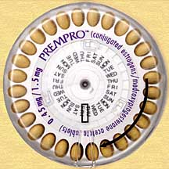
Progestin Only Pills (POP) aka “mini-pill”
An option for women who cannot use estrogen-containing contraception
Requires taking it at the same time every day
AUC of progestin may be decreased with use of EFV and some RTV-boosted PIs
MEC category 1 or 2, depending on ART
DHHS Recommendations – POP + ART
Additional Contraceptive protection not needed | Can Consider alternative method |  | Consider Alternative Method
NRTIs
All
NNRTIs
NVP RPV DOR ETR |  |  | EFV
PIs
ATV/r ATV/COBI DRV/COB LPV/r | DRV/r | DRV/r
INSTIs
BIC/FTC/TAF DTG RAL EVG/COBI
This Photo by Unknown Author is licensed under CC BY-ND
US DHHS Perinatal ART Guidelines, 2023.

Slide 24
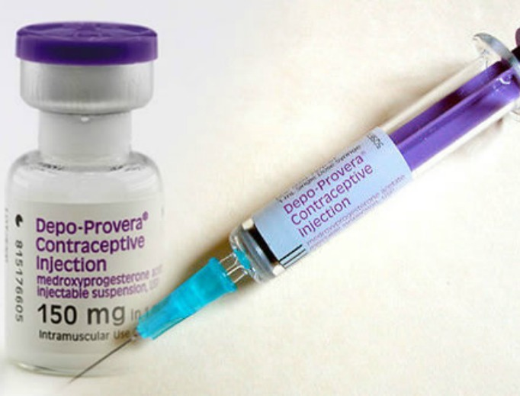
Depot Medroxyprogesterone Acetate (DMPA) – Depo Provera
Injectable progestin-only
  Delivers higher dose than other progesterone-based contraception
Minimal interactions between DMPA and ART → limited studies
Weight gain
  11-20 pounds
MEC category 1
DHHS Recommendation – DMPA + ART
Additional Contraceptive protection not needed | Can Consider alternative method |  | Consider Alternative Method
NRTIs
All
NNRTIs
NVP RPV DOR ETR EFV
PIs
ATV/r ATV/COBI DRV/COB LPV/r DRV/r | DRV/r
INSTIs
BIC/FTC/TAF DTG RAL EVG/COBI
This Photo by Unknown Author is licensed under CC BY-NC-ND
US DHHS Perinatal ART Guidelines, 2023.

Slide 25
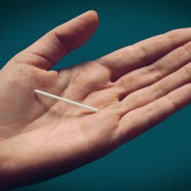
Contraceptive Implants
DHHS Recommendations – Implant + ART²
Additional Contraceptive protection not needed | Can Consider alternative method |  |  | Consider Alternative Method
NRTIs
All
NNRTIs
NVP RPV DOR ETR |  |  |  | EFV
PIs
ATV/r ATV/COBI DRV/COB LPV/r DRV/r | DRV/r |  | DRV/r
INSTIs
BIC/FTC/TAF DTG RAL EVG/COBI
This Photo by Unknown Author is licensed under CC BY-NC-ND
Contains either etonogestrel (Nexplanon)
Very effective
No restrictions with ART
  PK study reported 3 pregnancies among 20 women (15%) taking EFV and using levonorgestrel implants over 48 weeks¹
  EFV lowers levonorgestrel
MEC 1 or 2 depending on ART
1. Curtis KM, et al. MMWR Recomm Rep. 2016; 65(3):1-103. 2. US DHHS Perinatal ART Guidelines, 2023.

Slide 26
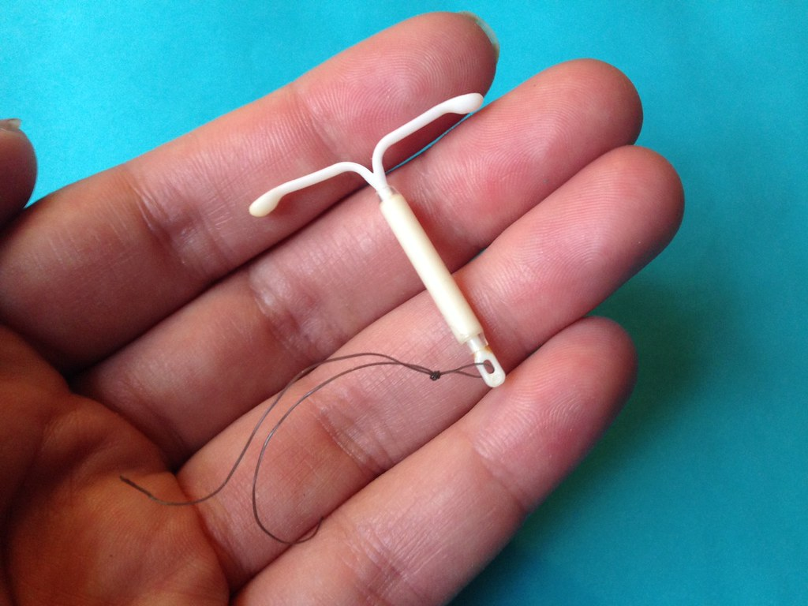
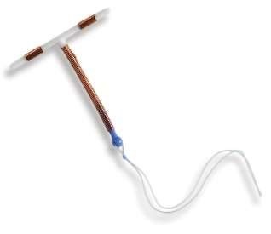
Intrauterine Devices (IUD)
This Photo by Unknown Author is licensed under CC BY-NC
This Photo by Unknown Author is licensed under CC BY
Levonorgestrel IUD (e.g. Mirena, Skyla)
  Long acting, highly effective, reversible
  Local (intrauterine release vs. systemic absorption)
  No DDI with ART
  MEC 1
Copper IUD
  Does not release hormones
  No DDI with ART
  MEC 1

Slide 27
40-year-old woman with HIV who has a CD4 count of 410 cells/mm³ and an HIV RNA level of <40 copies/mL. She is a non-smoker with a normal BMI. She is taking Biktarvy daily and reports good adherence.
For this patient, which one of the following contraceptive options would you recommend?
A.) Avoid contraceptives due to the risk to significantly alter the efficacy of Biktarvy.
B.) Offer all contraceptive methods and use shared decision making when recommending contraceptive.
C.) Recommend IUD due to less DDI and improved efficacy.
D.) Recommend progesterone only pill “POP” due to risks associated with estrogen.

Slide 28
Serodifferent Couples Desiring Pregnancy
Female Partner with HIV
  Female to achieve sustained virologic suppression on ART x 3 months prior to attempting to conceive
Male Partner with HIV
  Male to achieve sustained virologic suppression on ART x 3 months prior to attempting to conceive
Periconception PrEP
  HIV-negative person in the serodifferent couple attempting conception if any of the following exist:
    the partner with HIV had not achieved suppressed HIV RNA levels for at least 3 months
    the partner’s plasma HIV RNA level is not known
    the HIV seronegative partner prefers to take HIV PrEP
DHHS Perinatal ART Guidelines, 2023.

Slide 29
33-year-old woman recently diagnosed with HIV who has a CD4 count of 510 cells/mm³ and an HIV RNA level of 27,440 copies/mL presents with her HIV-seronegative male partner for preconception counseling.
For this HIV serodifferent couple who wish to conceive, which one of the following would you recommend to prevent the male partner from acquiring HIV?
The male partner should take preexposure prophylaxis (PrEP) with tenofovir DF-emtricitabine daily for 24 hours prior to and 48 hours after each episode of condomless sexual intercourse
The female partner should achieve a suppressed HIV RNA levels on an antiretroviral regimen that is recommended in pregnancy, and the male partner should take preexposure prophylaxis (PrEP) with tenofovir alafenamide-emtricitabine daily for 24 hours prior to and 48 hours after each episode of condomless sexual intercourse
The male partner should take postexposure prophylaxis (PEP) with tenofovir DF-emtricitabine and raltegravir for 24 hours after each episode of unprotected sexual intercourse
The female partner should achieve a suppressed HIV RNA levels on an antiretroviral regimen that is recommended in pregnancy, and the male partner should take daily preexposure prophylaxis (PrEP) with tenofovir DF-emtricitabine for at least 6 months

Slide 30
QUESTIONS?

