Slide 1
Hepatitis C Virus and Evaluating for Cirrhosis
Dr. Ligia Alfaro Cruz, MD / Dr. Cody A. Chastain, MD

Slide 2
Disclosures
This program is supported by the Health Resources and Services Administration (HRSA) of the U.S. Department of Health and Human Services (HHS) under grant number U1OHA30535 as part of an award totaling $4.2m. The contents are those of the author(s) and do not necessarily represent the official views of, nor an endorsement, by HRSA, HHS, or the U.S. Government. For more information, please visit HRSA.gov.
“Funding for this presentation was made possible by cooperative agreement U1OHA30535 from the Health Resources and Services Administration HIV/AIDS Bureau. The views expressed do not necessarily reflect the official policies of the Department of Health and Human Services nor does mention of trade names, commercial practices, or organizations imply endorsement by the U.S. Government. Any trade/brand names for products mentioned during this presentation are for training and identification purposes only.”
This content is owned by the AETC, and is protected by copyright laws. Reproduction or distribution of the content without written permission of the sponsor is prohibited, and may result in legal action.

Slide 3
AETC Program National Centers and HIV Curriculum
National Coordinating Resource Center – serves as the central web –based repository for AETC Program training and capacity building resources; its website includes a free virtual library with training and technical assistance materials, a program directory, and a calendar of trainings and other events. Learn more: https://aidsetc.org/
National Clinician Consultation Center – provides free, peer-to-peer, expert advice for health professionals on HIV prevention, care, and treatment and related topics. Learn more: https://nccc/ucsf.edu
National HIV Curriculum – provides ongoing, up –to-date HIV training and information for health professionals through a free, web –based curriculum; also provides free CME credits, CNE contact hours, CE contact hours, and maintenance of certification credits. Learn more: www.hiv.uw.edu

Slide 4
Objectives
At the end of this session, learners will be able to:
Identify symptoms of advanced liver disease
Identify signs of chronic liver disease
Contrast at least three methods of liver fibrosis staging
Recommend appropriate evaluation of cirrhosis after sustained virologic response (SVR)

Slide 5
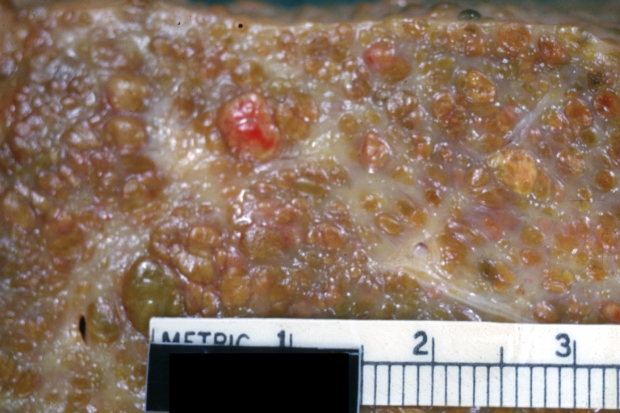
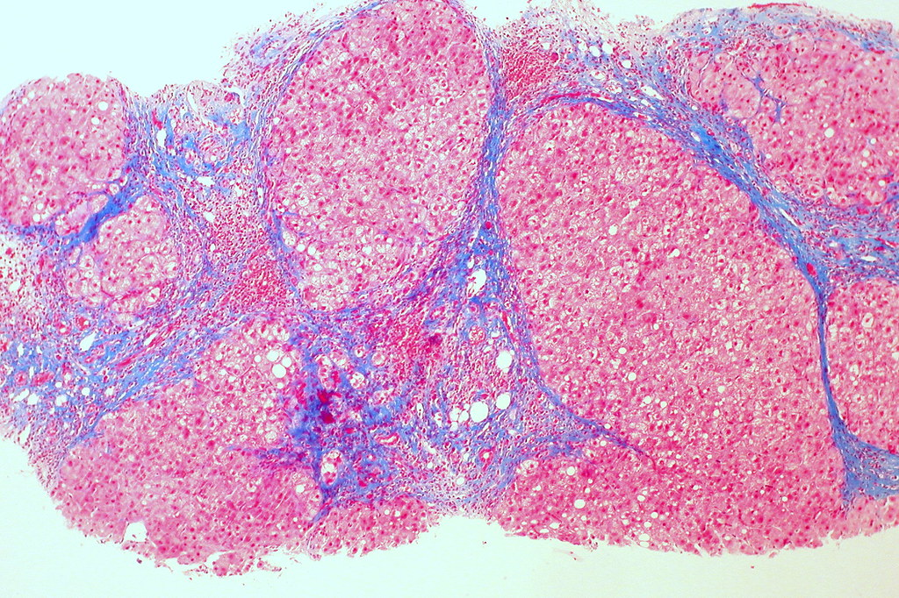
What Is Cirrhosis?
Severe, fibrotic scar tissue
Reduces hepatic function
Increase risk of liver-related morbidity and mortality
This Photo by Unknown Author is licensed under CC BY-SA
This Photo by Unknown Author is licensed under CC BY

Slide 6
Causes of Cirrhosis
Adults
Chronic viral hepatitis (hepatitis B, C)
Alcohol-associated liver disease
Hemochromatosis
Nonalcohol-associated fatty liver disease
Children
Biliary atresia
Genetic/metabolic
Viral hepatitis
Autoimmune hepatitis

Slide 7
Hepatitis C & Cirrhosis
Adults
Estimated that approximately 20-30% of those infected with HCV will develop cirrhosis during the 20- to 30-year period after HCV acquisition
Children
Progression of chronic hepatitis to cirrhosis is unlikely
In patients with chronic HCV and a a mean age of 10 years, cirrhosis was only present in 2% of the sample in one study.
Lingala, S et al. Gastroenterol Clin North Am 2015. // Borger R et al. World J Hepatol 2015.

Slide 8
Symptoms of Advanced Liver Disease
Upper gastrointestinal bleeding
Ascites
Hepatic encephalopathy
Liver failure
Pulmonary complications

Slide 9
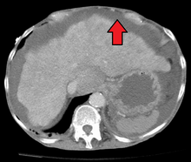
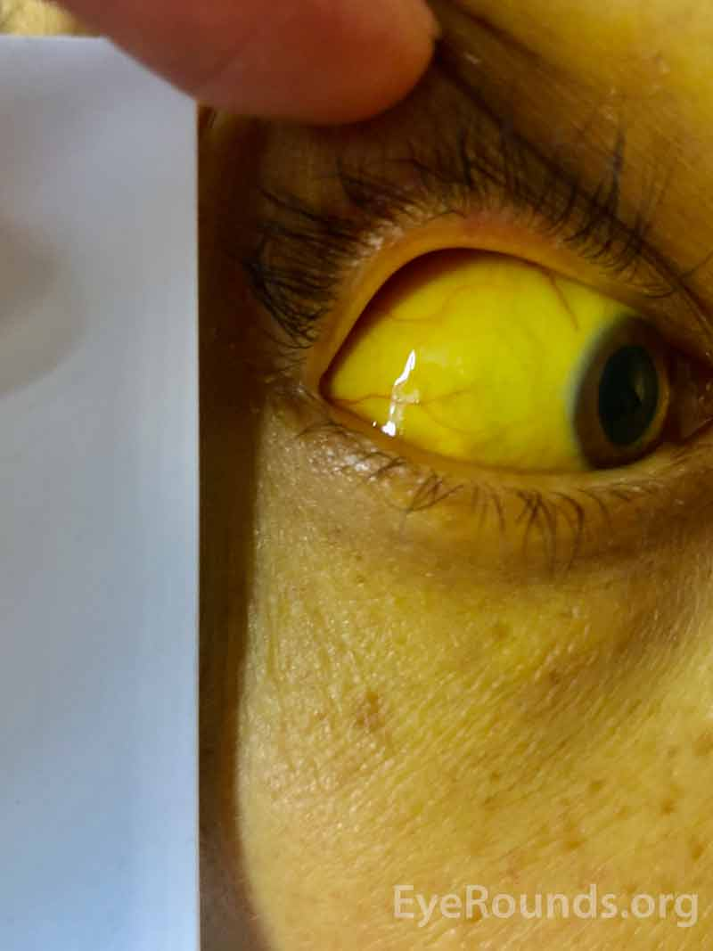
Signs of Chronic Liver Disease
Jaundice
Ascites
Palmar erythema
Spider nevi
Telangiectasias
Gynecomastia
Encephalopathy
This Photo by Unknown Author is licensed under CC BY-SA
This Photo by Unknown Author is licensed under CC BY-NC-ND

Slide 10
Staging Liver Fibrosis/METAVIR
Importance of Staging
Identify patients with greatest need for therapy
Identify patients for cirrhosis-specific care
Triage resources
Types of Staging
Liver biopsy
Biomarkers
Elastography
Notes:
Liver fibrosis is, in simple terms, chronic inflammation that has lead to some scarring of the liver. Fibrosis progression varies markedly between individuals based on host, environmental, and viral factors, but the presence of existing fibrosis is a strong risk factor for future fibrosis progression. (host = fibrosis, inflammation, age, male) (viral = GT 3, coinfection with HBV or HIV)
Staging the degree of liver fibrosis is important for multiple reasons. It may…
Bottom line is it is one of the most robust prognostic factors used to predict HCV disease progression and clinical outcomes.
Staging score is called Metavir (meta-analysis of viral hepatitis) F0-F4
There are multiple types of liver fibrosis staging available, including…

Slide 11
METAVIR Scoring
Score | Pathologic Description
0 | No fibrosis
1 | Periportal fibrosis
2 | Periportal septae
3 | Bridging fibrosis (portal-central septae)
4 | Cirrhosis
Notes:
Very frequently, the results you will get will be F2-3 or F3-4
So, multiple modalities are used in our clinic; we don’t rely on just a single evaluation.

Slide 12
Liver Biopsy To Stage Liver Fibrosis
Historical gold standard
May be helpful in evaluating other causes of liver disease
Results may be impacted by quality of specimen (i.e., length of biopsy)
Limited by invasive nature of test, cost, and access to proceduralist
Risks/complications can be significant
Notes:
A liver biopsy is the historical gold standard and may be helpful…
However, the data from liver biopsies may be impacted by the quality of the specimen obtained.
Furthermore, the use of liver biopsies for the sole purpose of liver fibrosis staging is limited by…

Slide 13
Indirect Markers of Liver Fibrosis
APRI (AST-To-Platelet Ratio Index)
Includes AST and Platelet Count
Sens 76% and Spec 72% at cutoff of 1.0 for predicting cirrhosis
Sens 46% and Spec 91% at cutoff of 2.0 for predicting cirrhosis
FIB-4 Index
Includes Age, ALT, AST, and Platelet Count
Negative predictive value 90% for advanced fibrosis if <1.45
Positive predictive value 65% and specificity 97% for advanced fibrosis if >3.25
Indeterminate when >1.45 but <3.25
Fibrosure®
Multiple known inputs and proprietary equation
Recognized by many payers
Sterling R et al. Hepatology 2006. // Carvalho-Filho R et al. Liver Int 2008.
Notes:
Ideally would allow staging of liver disease without invasive procedures or specialized imaging
Multiple scoring systems and proprietary tests available but vary in utility
All perform better on the “extremes” (i.e. no fibrosis vs. cirrhosis rather than intermediate stages)
The APRI, or AST-To-Platelet ratio index (calculate on web site), provides a rough estimate of cirrhosis status; however, the tool’s sensitivity and specificity are dramatically impacted based on the laboratory cutoffs used.
The FIB-4 index (calculate on website) includes age, AST, ALT, and platelet counts to predict fibrosis status. While this test performs well in patients with very little or very severe fibrosis, it provides little data for many patients.
So, you can imagine, you can plug in a lot of different values or even something as simple as a different age, and the calculation results could be significantly affected.
SENSITIVITY – how sensitive is the test for condition – very sensitive will always pick up the condition; but also picks up other conditions (positive test doesn’t tell you much, but negative can exclude condition)
SPECIFICITY – how specific is this test for condition – if very specific, nothing else will give you a positive result; but not all cases of condition are picked up (positive helpful but negative doesn’t tell you much)
Finally, some proprietary tests are available that can assist with fibrosis assessment. However, some tests are costly and may not perform at the level of other staging mechanisms.
I would encourage providers to become familiar with these options, particular studies that utilize available laboratory data, to see how they perform in their own patient population.

Slide 14
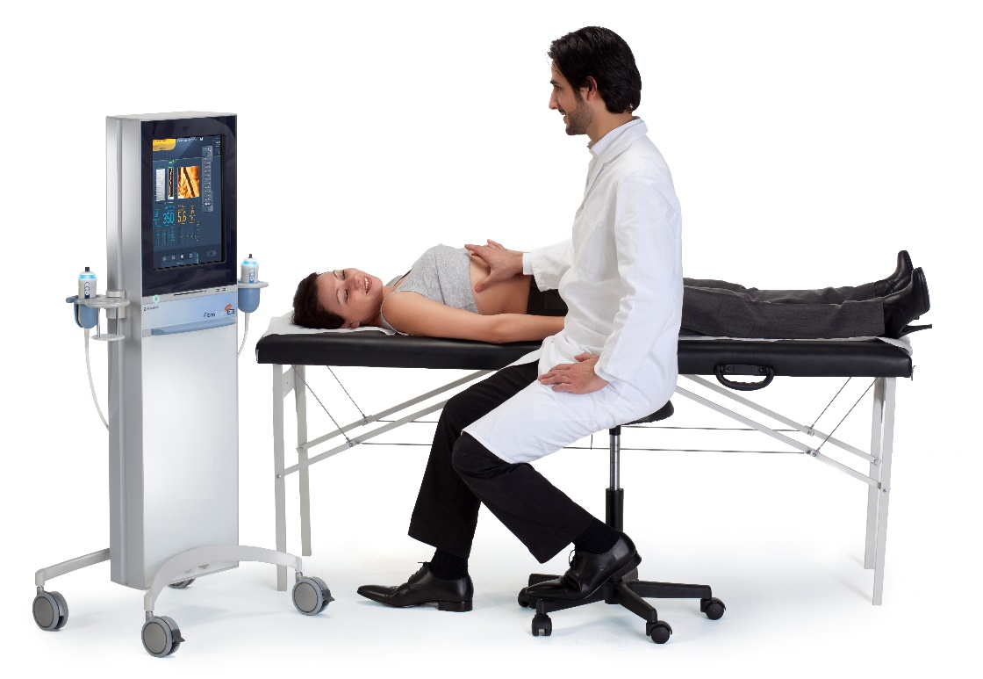
Elastography
Measures mechanical shear wave velocity, which is proportional to liver stiffness
Multiple methods (transient, magnetic resonance, acoustic radiation force impulse)
May be a reasonable alternative to biopsy
Notes:
Elastography is a newer mechanism for liver fibrosis assessment
These tests provide accurate, noninvasive methods of liver fibrosis staging and are increasingly available.

Slide 15
Notes About Anatomic Imaging
Anatomic imaging (i.e., ultrasound, CT, MRI) NOT adequate for staging
Insensitive for underlying fibrosis
If seen, advanced fibrotic changes likely correlate with pathology
Appropriate for hepatocellular carcinoma monitoring
Notes:
When discussing liver fibrosis, it is important to discuss anatomic imaging.
Anatomic imaging is NOT adequate for staging liver fibrosis.
These tests are most appropriate for hepatocellular carcinoma diagnosis.
It is reasonable to consider anatomic imaging in any patient undergoing HCV evaluation with unknown or suspected advanced fibrosis, but this should be considered on a case-by-case basis.

Slide 16
HCV Simplified Guidance (www.hcvguidelines.org)

Slide 17
Simplified HCV Treatment: Treatment-Naive Patients Without Cirrhosis (www.hcvguidelines.org)

Slide 18
After Sustained Virologic Response ≥12 Weeks After Therapy
Counseling
HCV antibody will remain positive lifelong
Reinfection is possible
Future testing will require HCV RNA PCR or similar test
Need for Follow-Up
F0-2 = “As if they were never infected”
Cirrhotic
Hepatocellular carcinoma (HCC) screening with ultrasound every 6 months, CT abdomen with triple phase contrast annually, or MRI abdomen with contrast annually
Gastroenterology/Hepatology referral for endoscopy
Notes:
Additionally, if patient was a treatment failure, monitoring for disease progression every 6-12 months with specific assessments is recommended. CT/MRI/US all viable options but do not need all three. Additionally, recommend endoscopic screening for esophageal varices.

Slide 19
HCV Simplified Guidance (www.hcvguidelines.org)

Slide 20
Compensated Cirrhosis
AASLD/IDSA HCV Guidelines. www.hcvguidelines.com.

Slide 21
Decompensated Cirrhosis
Symptomatic liver disease on a spectrum leading to overt liver failure and liver-associated mortality
Associated with classic physical exam findings
Hepatic encephalopathy
Ascites
Associated with laboratory abnormalities
Elevated bilirubin
Low albumin
Elevated prothrombin time/INR
Calculators to classify and predict outcomes should be ONLY be applied to patients with cirrhosis

Slide 22
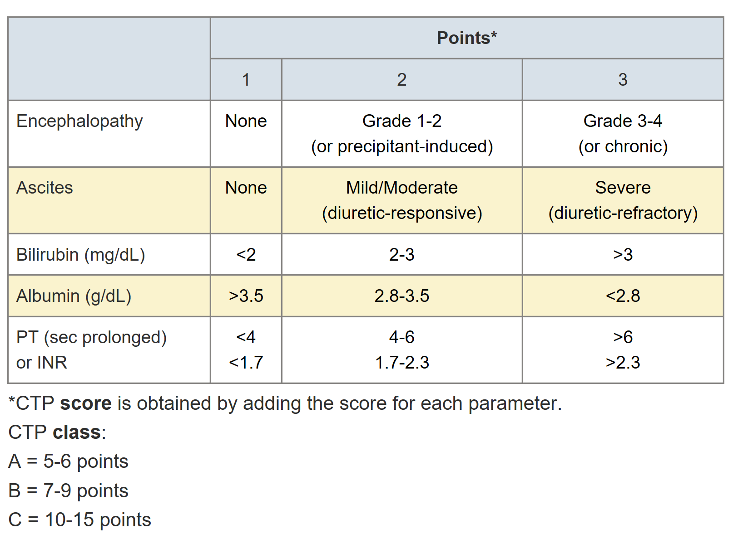
Child Turcotte Pugh Score
Developed for predicting operative mortality
Now used for assistance with predicting prognosis and liver dysfunction
Image from www.hepatitis.va.gov

Slide 23
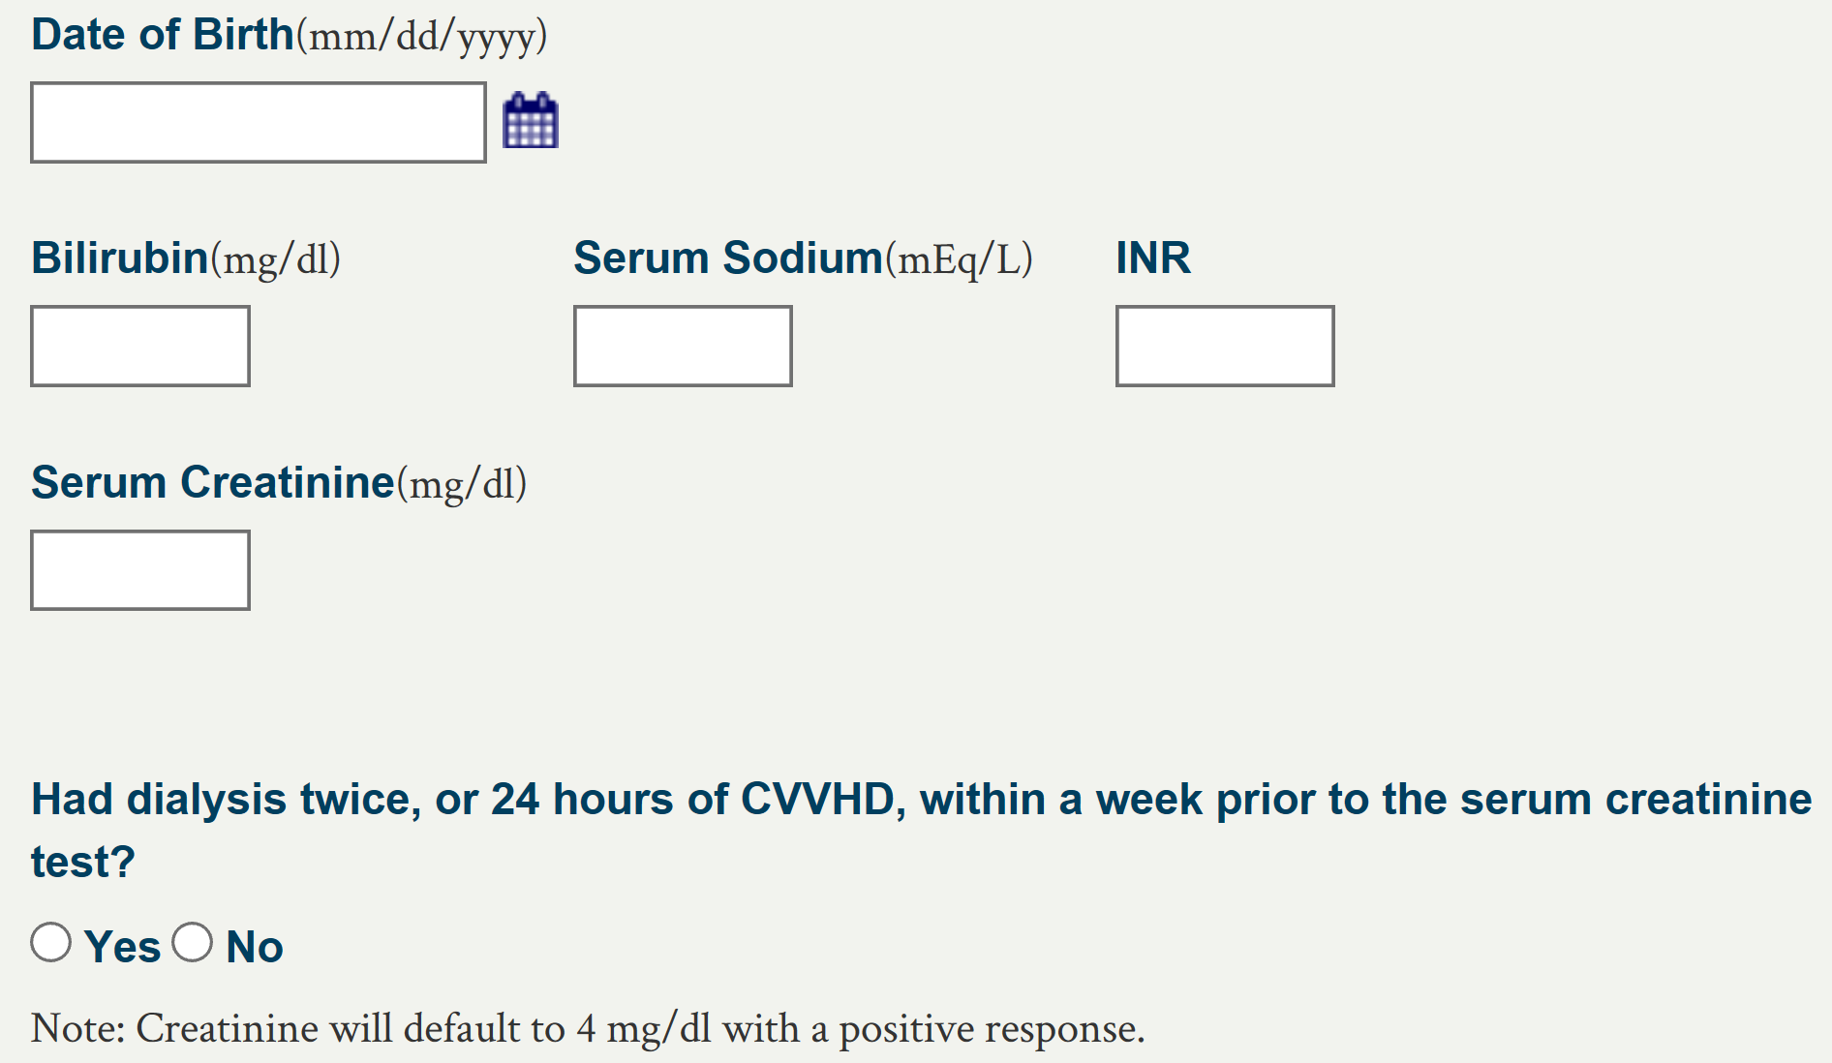
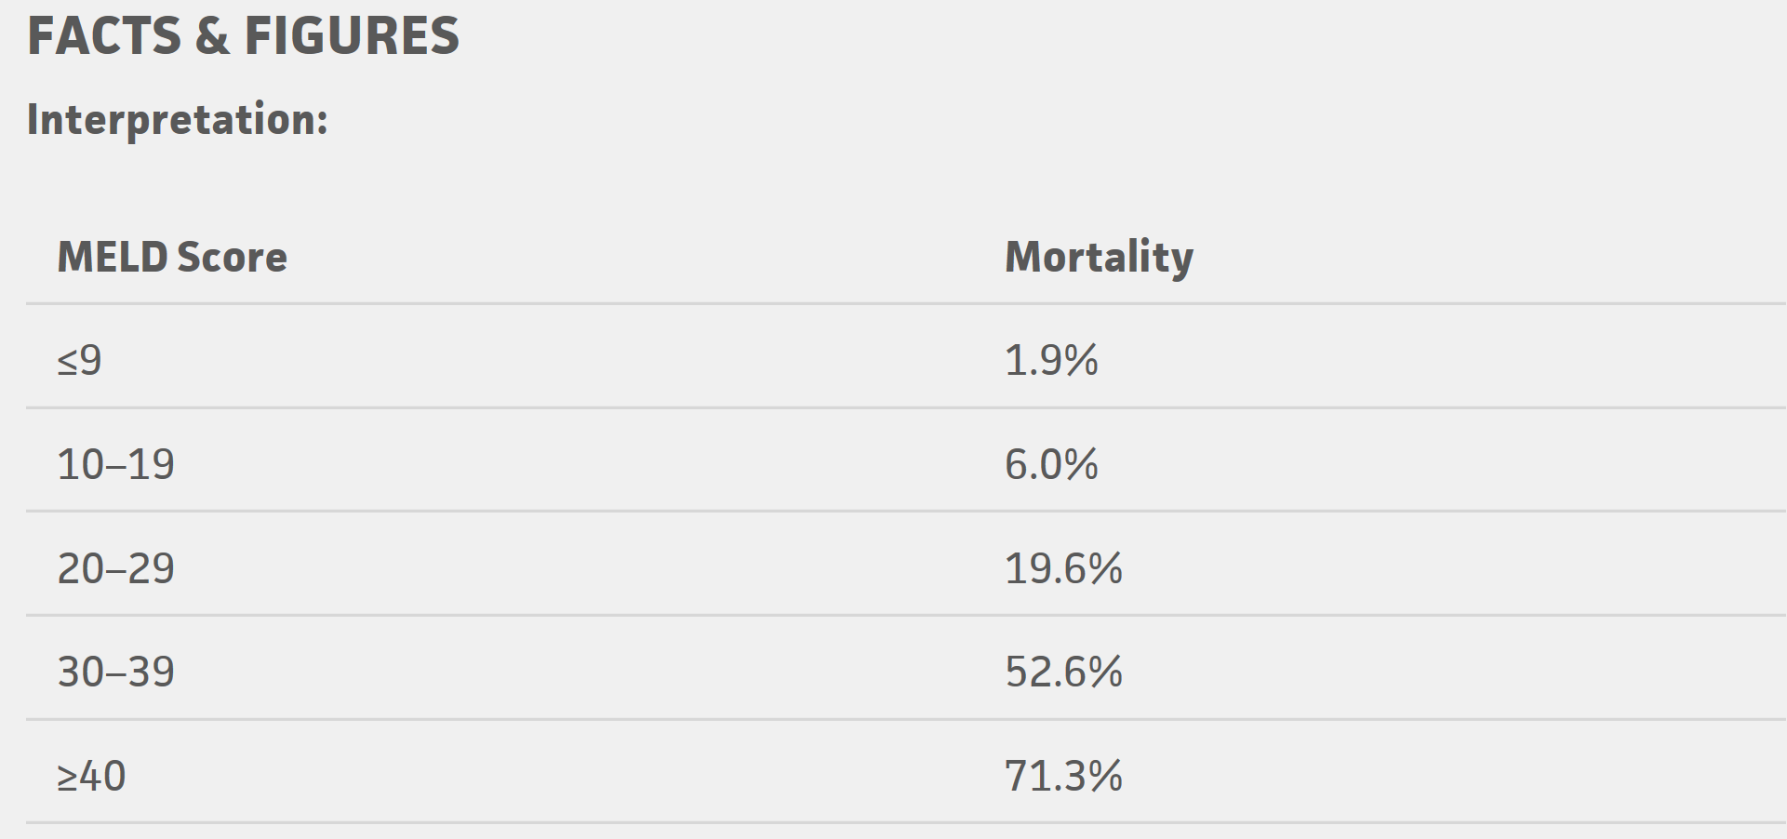
MELD Score
Used for organ allocation ≥ 12 years of age
Includes bilirubin, sodium, INR, Cre, and dialysis status
Predicts 3-month mortality among:
Decompensated cirrhosis
Cirrhosis undergoing surgical procedures
Alcoholic hepatitis
Acute variceal hemorrhage
After transjugular intrahepatic portosystemic shunt (TIPS)
Images from optn.transplant.hrsa.gov and mdcalc.com

Slide 24
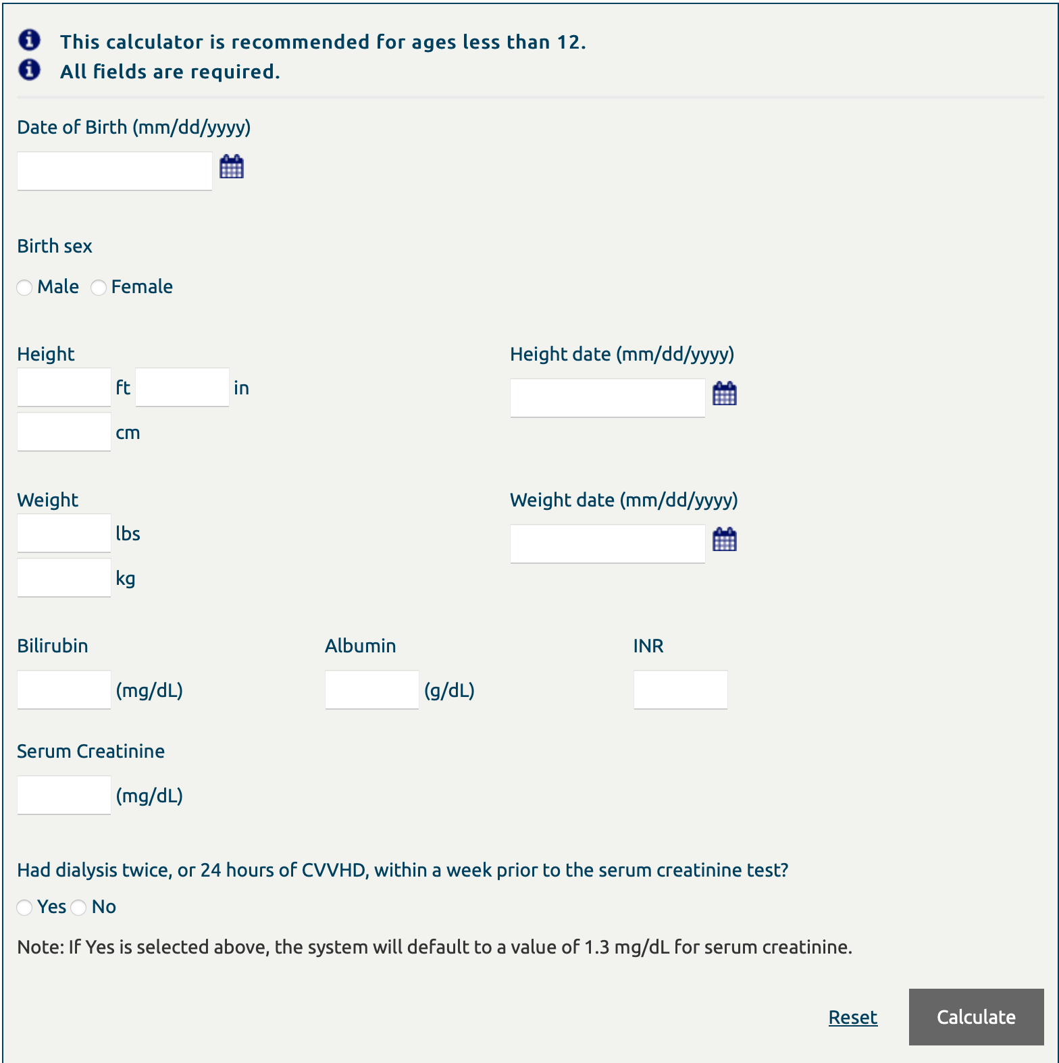
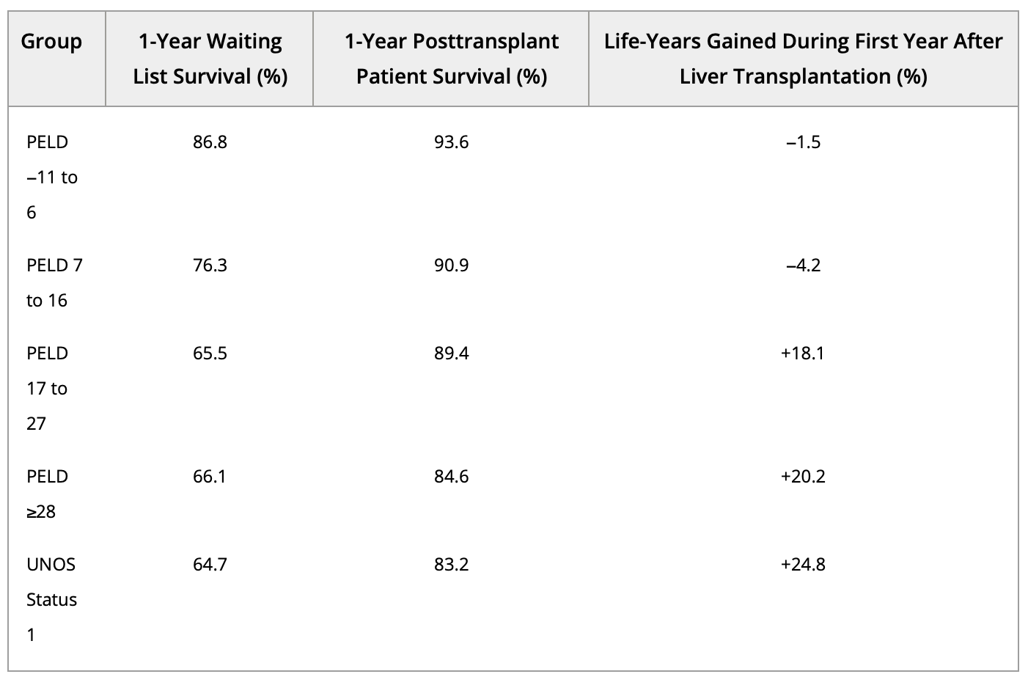
PELD Score
Used for organ allocation children <12
Includes albumin, bilirubin, INR, age of listing, growth failure
Images from optn.transplant.hrsa.gov and aasld.com

Slide 25
HCV Treatment and Liver Failure (www.hcvguidelines.org)
HCV treatment reduces MELD score in patients with decompensated cirrhosis but mortality benefit uncertain
Liver transplant is the best treatment for HCV-related decompensated cirrhosis
The decision to treat HCV should be made in concert with expert clinicians at a liver transplant center in patients with decompensated cirrhosis (CTP Class B or C and/or MELD > 10) when possible.

Slide 26
Research Article
868 patients with cirrhosis from four hepatology clinics followed for median of 28 months
149 with Child-Pugh B/C cirrhosis; SVR achieved in 120 (81%).
96 (64%) experienced clinical progression.
SVR independently associated with survival in Child-Pugh A patients BUT NOT Child-Pugh B/C patients.
28 (19%) of Child-Pugh B/C patients had >=2-point MELD decline 12 weeks at SVR but 2-year event-free survival did not differ.

Slide 27
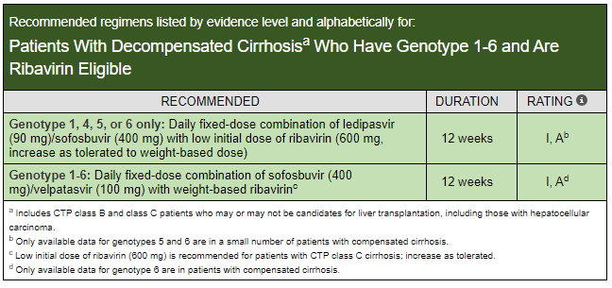
www.hcvguidelines.org

Slide 28
www.hcvguidelines.org

Slide 29
www.hcvguidelines.org

Slide 30
Questions? Thank You!

