Slide 1

ART Adherence
HIV ECHO Clinic
Carly Floyd, PharmD, PhC, AAHIVP, CDCES, TTS
Clinician Educator, Asst Professor | UNM College of Pharmacy
Clinical Director | NM partner site of South Central AETC (UNM-AETC)
August 29, 2023
Notes:
Version_ 08 2023
UNMRP clinical director reviewed 08/25/2023

Slide 2
Conflict of Interest Disclosure Statement
Speaker has nothing to disclose.
This presentation was reviewed by UNMHSC and SCAETC faculty to ensure it meets Continuing Education guidelines.
This program is supported by the Health Resources and Services Administration (HRSA) of the U.S. Department of Health and Human Services (HHS) as part of an award totaling $4,205,743 with 0% financed with non-governmental sources. The contents are those of the author(s) and do not necessarily represent the official views of, nor does mention of trade names, commercial practices, or organizations imply an endorsement by HRSA, HHS, or the U.S. Government. For more information, please visit HRSA.gov. Any trade/brand names for products mentioned during this presentation are for training and identification purposes only.

Slide 3
Use of Trade/Brand Names
This program is supported by the Health Resources and Services Administration (HRSA) of the U.S. Department of Health and Human Services (HHS) as part of an award totaling $4,205,743, with 0% financed with non-governmental sources.
The views expressed do not necessarily reflect the official policies of the Department of Health and Human Services, nor does mention of trade names, commercial practices, or organizations imply endorsement by the U.S. Government. Any trade/brand names for products mentioned during this presentation are for training and identification purposes only.
Notes:
Note: this slide must be included if trade and/or brand names for medications are used in the presentation.​
​
It may be deleted if there is no reference to trade names, including presentations in which only generic medication names are mentioned. ​
​
Trade names must be put in parentheses after the generic name the first time it is mentioned - e.g., fluoxetine (Prozac). Trade names should only be mentioned for the initial reference and the generic name only should be used after that. This applies equally to all medications or products mentioned in this presentation.​
​
​
​

Slide 4
Unconscious Bias Disclosure
SCAETC recognizes that language is constantly evolving, and while we make every effort to avoid bias and stigmatizing terms, we acknowledge that unintentional lapses may occur in our presentations.
We value your feedback and encourage you to share any concerns related to language, images, or concepts that may be offensive or stigmatizing.
Your input will help us refine and improve our presentations, ensuring they remain inclusive and respectful to participants.

Slide 5
Learning Objectives
Compare and contrast factors that affect medication adherence
Apply a patient-centered approach to address barriers to antiretroviral (ART) adherence
5

Slide 6
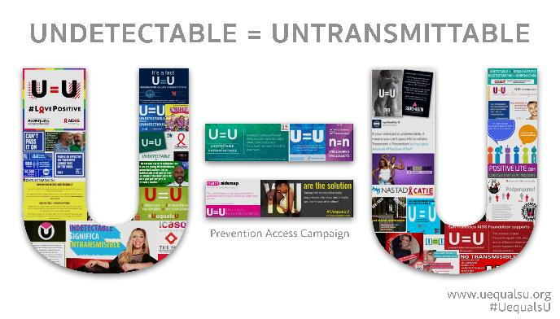
Importance of Adherence
Treatment IS Prevention
Studies from 2008-2016 show zero linked HIV transmissions after >100,000 condomless sex acts
PWH had a durably undetectable viral load
Cohen, et al. NEJM 2011; 365: 493-505. Skarbinski J, et al. JAMA Intern Med 2015;175:588-96.
Bavinton BR, et al. Lancet HIV. 2018. IAS 2018 http://programme.aids2018.org/Abstract/Abstract/13470
6
Notes:
HPTN 052 was the randomized trial of starting people earlier vs later and showed very few—only 1—HIV transmission.
Three observational cohort studies were PARTNER, Opposites Attract, PARTNER 2. PARTNER had some heterosexual couples, and then the other 2 were all men who had sex with men. These are couples where one partner is positive and one is negative. The person who is positive is taking antiretroviral therapy. HIV-1 RNA to be and stay at < 200 copies/mL. In all 3 studies, there were very large numbers of condomless sex acts—more than 100,000—and there were no linked HIV transmissions, evidence that U = U means a lot.
The CDC and other multiple organizations have endorsed U = U and shows why it’s connected to rapid antiretroviral therapy—the sooner that you get your virus down to undetectable, the sooner you’re undetectable and you’re untransmittable.

Slide 7
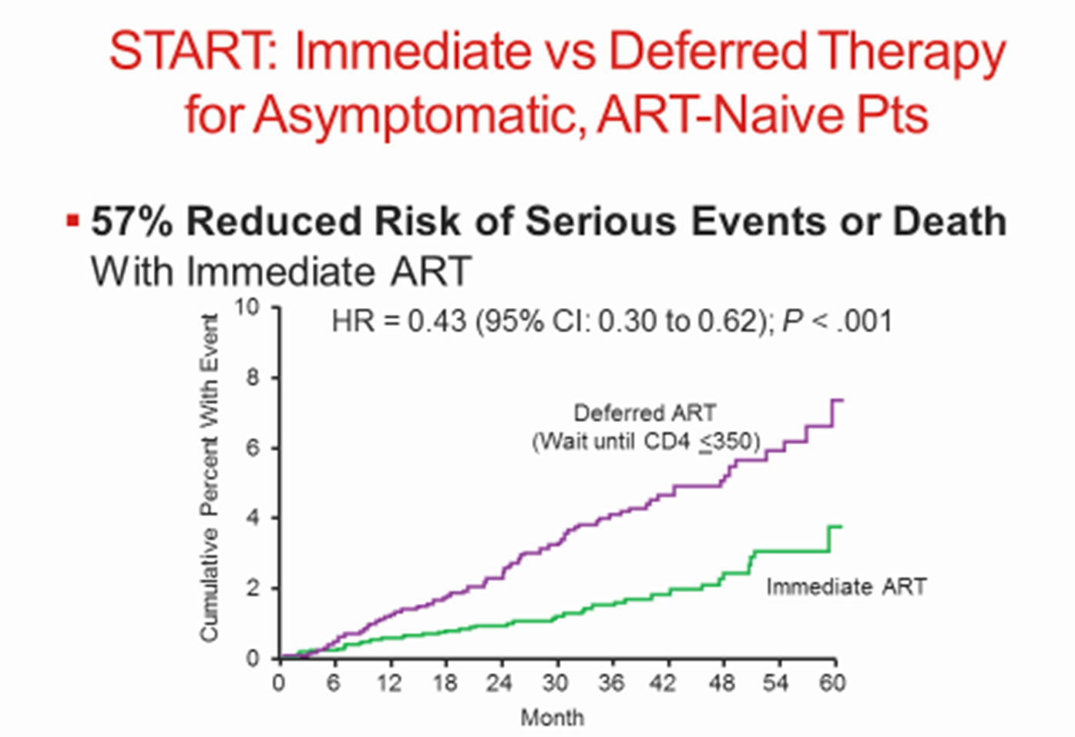
HIV Replication Increases Mortality
Total cumulative exposure to replicating virus over time is independently associated with mortality
Mugavero, et al. CID 2011;53(9):927-935. INSIGHT START Group. NEJM. 2015;373:795-807.
Notes:
Study design
22 HIV research cohorts from US and Canada
Prospective observational data during medical care 1996-2005
Early versus deferred ART analysis
Asymptomatic treatment-naïve patients
No prior AIDS-defining illness
Two distinct study groups
CD4 count 351-500 cells/mm³ (n=8362)
CD4 count >500 cells/mm³ (n=9155)
Compared relative risk of death for patients who initiated early therapy versus deferred therapy
Study outcome: death any cause
Other results
Fewer patients with history of IDU and HCV were in the early therapy group
Both groups initiating therapy were similar
Study controlled for factors that could affect the decision to defer ART
Adjustment was made for sex, age, and CD4 counts at baseline
Study limitations: observational study, unmeasured factors associated with
therapy deferral and death
CD4 between 350 and 500 – ART Cohort Collaboration Study – 45,691 patients. Rate of death and/or progression to AIDS was higher when therapy was deferred until CD4 between 251 and 350 versus 351 and 450. RR 1.28 (1.04-1.57). Mortality alone not significantly different between groups. Kitahata M et al. NEJM. 2009;360:1815-1826
http://www.clinicaloptions.com/HIV/Conference%20Coverage/IAS%202015/Treatment/Capsules/MOSY03.aspx
International, randomized trial. HIV-positive, ART-naive adults with CD4 > 500 (N = 4685)
Composite primary endpoint: Serious AIDS-related (AIDS-related death or AIDS-defining event) or non-AIDS–related event (non-AIDS–related death, CVD, end-stage renal disease, decompensated liver disease, non-AIDS–defining cancer)
Median follow-up: 3.0 yrs; med. baseline CD4: 651; med. baseline VL: 12,759
Median CD4 at initiation of ART for deferred group: 408
Immediate ART: ART initiated immediately following randomization (n = 2326)
Deferred ART: Deferred until CD4 ≤ 350, AIDS, or event requiring ART(n = 2359)
Study closed by DSMB following interim analysis
57% Reduced risk of serious events or death with immediate ART
4.1% vs. 1.8% deferred vs immediate arms experienced serious AIDS or non-AIDS-related event or death (HR:0.43;05% CI 0.3-0.62; P<0.001)
NA-ACCORD²:
Prospective study of early versus deferred ART
Early therapy (CD4>500) RR 1.94 (p<.001)
Deferred therapy (351-500) RR 1.69

Slide 8
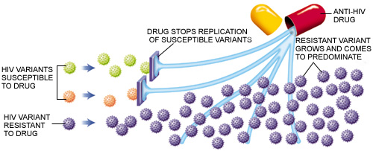
Suboptimal Adherence Leads to Resistance
AETC National Resource Center

Slide 9
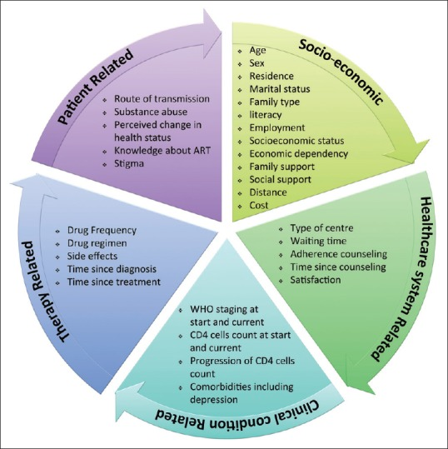
5 Dimensions of Adherence to Antiretroviral Therapy (ART)
Alvi Y, et al. Indian J Community Med. 2019;44(2):118-124. doi:10.4103/ijcm.IJCM_164_18

Slide 10
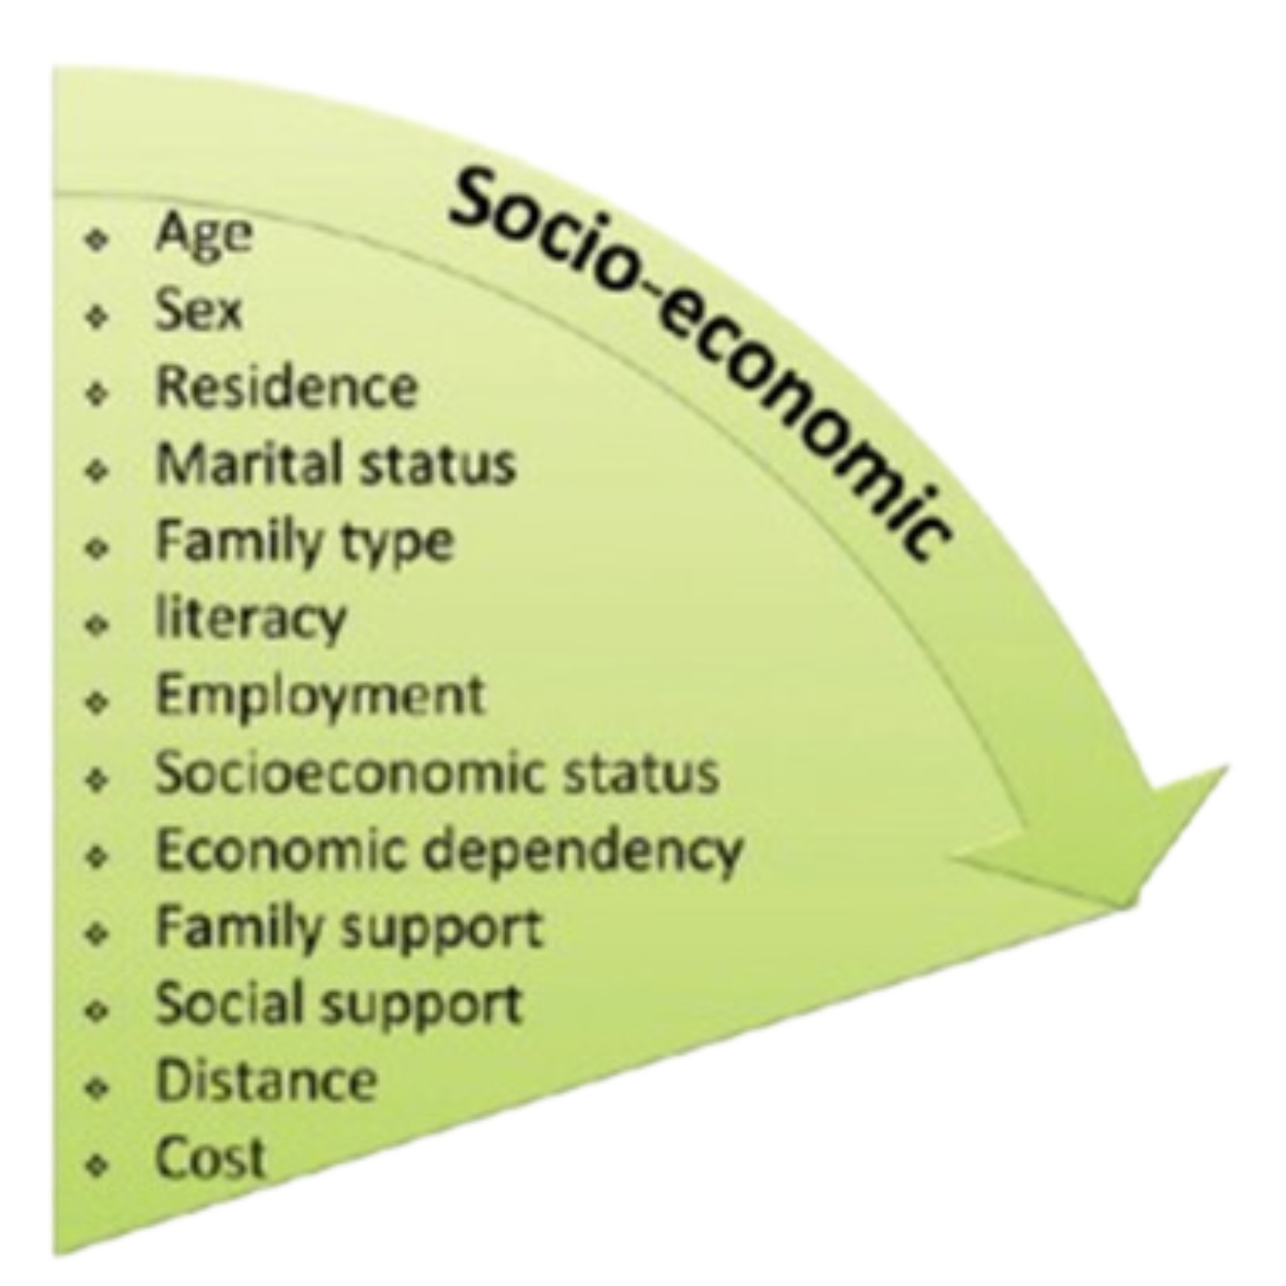
Socioeconomic Factors
Language barriers
Unstable living conditions; homelessness
Medication cost
Cultural and lay beliefs about illness and treatment
Lack of family or social support network
Living in rural communities- far from clinic
Muessig, KE et al. AIDS Patient Care and STDs. October 2015;29(11): 606-616. American College of Preventive Medicine. Image adapted from: Alvi Y, et al. 2019;44(2):118-124

Slide 11
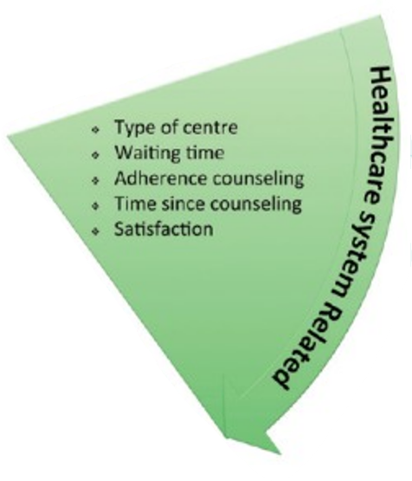
Healthcare System Factors
Patient-healthcare provider relationship
Struggling with ART and healthcare providers
  Perceived limited treatment options, shock at diagnosis
  Tensions with providers (stigma, paternalism, mistrust)
  Advocating for and educating oneself
  Support from providers
Muessig, KE et al. AIDS Patient Care and STDs. October 2015;29(11): 606-616. American College of Preventive Medicine. Image adapted from: Alvi Y, et al. 2019;44(2):118-124

Slide 12
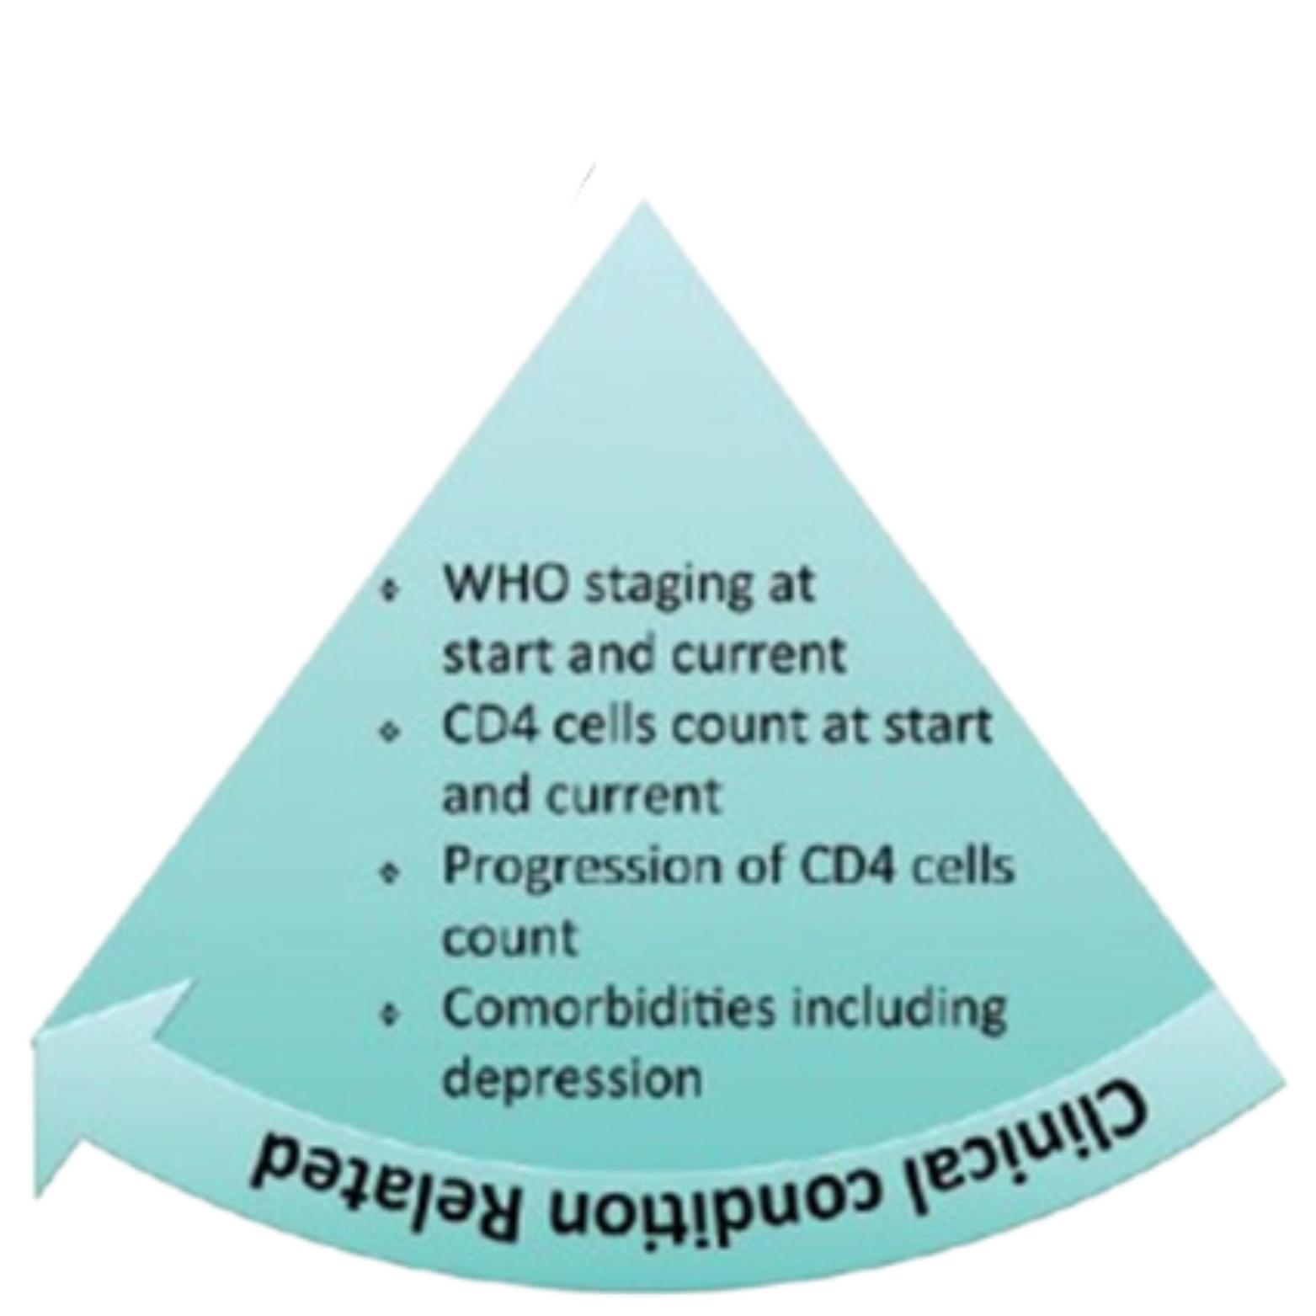
Clinical Condition Factors
Illness-related demands faced by the patient
  Strong determinants:
    Severity of symptoms
    Level of disability
    Rate of progression
    Available effective treatments
Impact dependent on influence of patient’s risk perception
Muessig, KE et al. AIDS Patient Care and STDs. October 2015;29(11): 606-616. American College of Preventive Medicine. Image adapted from: Alvi Y, et al. 2019;44(2):118-124

Slide 13
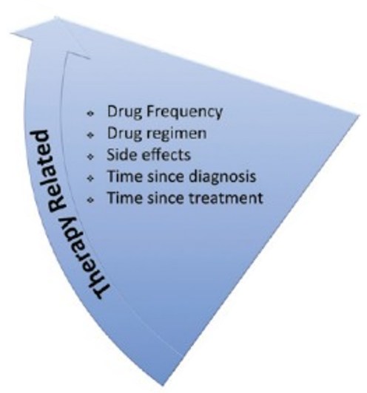
ART Factors
Dosing complexity
Food requirements
Struggling with ART and one’s body
  Pill burden
  Perceived impact of ART on body
  Developing medication practices that work for one’s life
  Managing comorbidities
Muessig, KE et al. AIDS Patient Care and STDs. October 2015;29(11): 606-616. American College of Preventive Medicine. Image adapted from: Alvi Y, et al. 2019;44(2):118-124

Slide 14
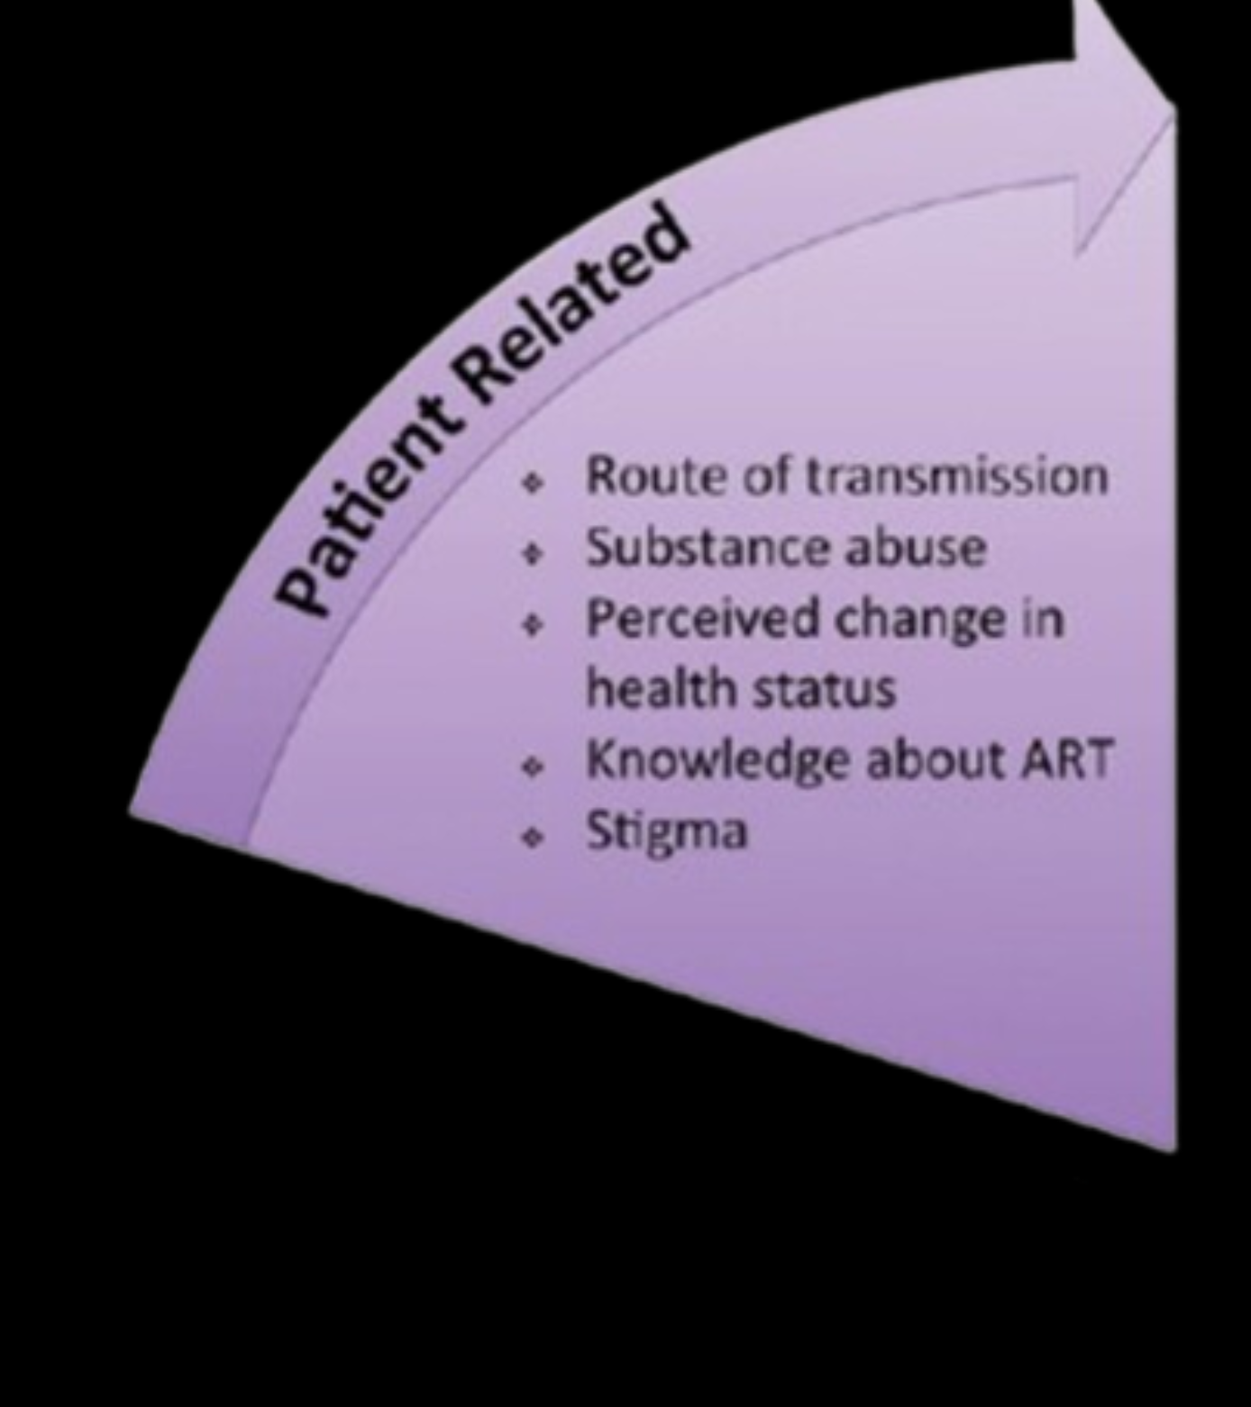
Patient-Related Factors
Physical Factors:
Impairment (e.g., visual, hearing, cognitive)
Swallowing problems
Psychological/Behavioral Factors:
Substance use
Youth
Active depression
Desire for control over one’s life & death
Fear of ART, fear of death
Denial of HIV status
Beliefs of HIV, CD4, and viral load
Beliefs and skepticism about ART
Muessig, KE et al. AIDS Patient Care and STDs. October 2015;29(11): 606-616. American College of Preventive Medicine. Image adapted from: Alvi Y, et al. 2019;44(2):118-124
14

Slide 15
Strategies to Improve ART Adherence
Design a plan the patient can commit to, considering:
  Patient’s daily schedule
  Tolerance of pill number, size, frequency
  Issues affecting absorption (e.g., acid suppressants, food requirements)
Establish trust & maintain good communication
Medication reminder aids
  Text messaging
  Pill boxes, pill box monitors, bubble packing
  Alarms
Positive reinforcement & motivational interviewing
https://clinicalinfo.hiv.gov/en/guidelines/hiv-clinical-guidelines-adult-and-adolescent-arv/adherence-continuum-care?view=full

Slide 16
Strategies to Improve ART Adherence
Education for each new patient
  HIV infection basics
  Goals of therapy
  Importance of adherence
  Potential for development of resistance with suboptimal adherence
Assess for barriers & develop multidisciplinary plan
  Explain process for obtaining ART & refills
  Transportation to pharmacy and clinic
  Insurance, copay assistance, AIDS Drug Assistance Programs (ADAP)
  Rapid start at time of diagnosis
https://clinicalinfo.hiv.gov/en/guidelines/hiv-clinical-guidelines-adult-and-adolescent-arv/adherence-continuum-care?view=full

Slide 17
References
Cohen MS, et al. HPTN 052 Study Team. Prevention of HIV-1 infection with early antiretroviral therapy. N Engl J Med. 2011 Aug 11;365(6):493-505. doi: 10.1056/NEJMoa1105243. Epub 2011 Jul 18. PMID: 21767103; PMCID: PMC3200068.
Skarbinski J, Rosenberg E, Paz-Bailey G, Hall HI, Rose CE, Viall AH, Fagan JL, Lansky A, Mermin JH. Human immunodeficiency virus transmission at each step of the care continuum in the United States. JAMA Intern Med. 2015 Apr;175(4):588-96. doi: 10.1001/jamainternmed.2014.8180. PMID: 25706928.
Bavinton BR, Pinto AN, Phanuphak N, Grinsztejn B, Prestage GP, Zablotska-Manos IB, Jin F, Fairley CK, Moore R, Roth N, Bloch M, Pell C, McNulty AM, Baker D, Hoy J, Tee BK, Templeton DJ, Cooper DA, Emery S, Kelleher A, Grulich AE; Opposites Attract Study Group. Viral suppression and HIV transmission in serodiscordant male couples: an international, prospective, observational, cohort study. Lancet HIV. 2018 Aug;5(8):e438-e447. doi: 10.1016/S2352-3018(18)30132-2. Epub 2018 Jul 17. Erratum in: Lancet HIV. 2018 Oct;5(10):e545. PMID: 30025681.
Mugavero MJ, Napravnik S, Cole SR, et al. Viremia copy-years predicts mortality among treatment-naive HIV-infected patients initiating antiretroviral therapy. Clin Infect Dis. 2011;53(9):927-935. doi:10.1093/cid/cir526
INSIGHT START Study Group, Lundgren JD, Babiker AG, Gordin F, Emery S, Grund B, Sharma S, Avihingsanon A, Cooper DA, Fätkenheuer G, Llibre JM, Molina JM, Munderi P, Schechter M, Wood R, Klingman KL, Collins S, Lane HC, Phillips AN, Neaton JD. Initiation of Antiretroviral Therapy in Early Asymptomatic HIV Infection. N Engl J Med. 2015 Aug 27;373(9):795-807. doi: 10.1056/NEJMoa1506816. Epub 2015 Jul 20. PMID: 26192873; PMCID: PMC4569751.
Alvi Y, Khalique N, Ahmad A, Khan HS, Faizi N. World Health Organization Dimensions of Adherence to Antiretroviral Therapy: A Study at Antiretroviral Therapy Centre, Aligarh. Indian J Community Med. 2019;44(2):118-124. doi:10.4103/ijcm.IJCM_164_18
Muessig, KE et al. Medication-Taking Practices of Patients on Antiretroviral HIV Therapy: Control, Power, and Intentionality. AIDS Patient Care and STDs. October 2015;29(11): 606-616
HIV Guidelines: https://clinicalinfo.hiv.gov/en/guidelines/hiv-clinical-guidelines-adult-and-adolescent-arv/adherence-continuum-care?view=full

Slide 18
Resources
National Clinician Consultation Center http://nccc.ucsf.edu/
  HIV Management
  Perinatal HIV
  HIV PrEP
  HIV PEP line
  HCV Management
  Substance Use Management
Present your case on ECHO
http://echo.unm.edu hivecho@salud.unm.edu
AETC National HIV Curriculum https://aidsetc.org/nhc
AETC National Coordinating Resource Center https://targethiv.org/library/aetc-national-coordinating-resource-center-0
Additional trainings scaetcecho@salud.unm.edu
www.scaetc.org
Notes:
Find additional ECHO sessions in your area: https://echo.unm.edu/locations-2/echo-hubs-superhubs-united-states/
https://hsc.unm.edu/echo/get-involved/join-an-echo/
IDEA Platform: Infectious Diseases Education & Assessment. https://idea.medicine.uw.edu/
AETC National HIV Curriculum: 6 core modules for self study; regularly updated; CME, CNE
Hepatitis C Online Curriculum: https://www.hepatitisc.uw.edu/
Hepatitis B Online Curriculum: https://www.hepatitisb.uw.edu/
National STD Curriculum: https://www.std.uw.edu/

Slide 19
