Slide 1
Project ECHO® - UNM
HIV TeleECHO Clinic
Benefits of SVR Post-DAA Therapy
11 July 2023
Paulina Deming, PharmD, PhC
Associate Professor of Pharmacy- College of Pharmacy
Associate Director HCV Programs- ECHO institute
University of New Mexico Health Sciences Center
Notes:
Version_ MM YYYY

Slide 2
Conflict of Interest Disclosure Statement
Speaker has nothing to disclose.
This presentation was reviewed by UNMHSC and SCAETC faculty to ensure it meets Continuing Education guidelines.
This program is supported by the Health Resources and Services Administration (HRSA) of the U.S. Department of Health and Human Services (HHS) as part of an award totaling $3,132,205, with 0% financed with non-governmental sources. The contents are those of the author(s) and do not necessarily represent the official views of, nor an endorsement of, by HRSA, HHS, or the U.S. Government. For more information, please visit HRSA.gov.

Slide 3
Learning Objectives
Describe the impact of sustained virologic response (SVR) on the risk of diabetes in patients treated with direct-acting antivirals (DAAs) for Hepatitis C virus (HCV) compared to untreated patients
Describe the impact of SVR on development of liver complications including hepatocellular carcinoma (HCC) in patients with HCV

Slide 4
Background
Chronic Hepatitis C virus (HCV) infections known to confer risk of diabetes
HCV direct-acting antiviral (DAA) therapy reported to have beneficial impact on diabetic control in patients treated for HCV with known diabetes

Slide 5
Improvement in Glycemic Control After SVR: The VA Experience
24,089 patients treated for HCV between January 1, 2014-June 30 2015
  Excluded patients treated with interferon or ribavirin
  Excluded patients with prior treatment
  Excluded patients with concurrent use of ribavirin
  Excluded patients without a prior diagnosis of Type 2 Diabetes Mellitus (T2DM)
  Analyzed 2,435 patients treated with directly acting antivirals (DAAs)
    2,180 with SVR
    255 without SVR
Hum J et al. Clin Infect Dis.2020;70(6):1153-1160.
Notes:
DAAs were ledip/sofosb, ombitasvir/ paritaprevir/ritonavir, or SOF plus SMV
Ribavirin exclusion because of hemolytic anemia and artificial decrease in HbA1c

Slide 6



Impact of SVR on HbA1c
Improvement in HbA1c if baseline A1c greater than 7.2%
Improvement if no cirrhosis present
Decrease in the number of patients receiving insulin
Notes:
There was no statistically significant difference if patients had a lower HbA1c at baseline, or if patients had more advanced liver disease
They also looked at the number of classes of diabetic meds taken and found a trend of decreasing number of meds if patients achieved SVR as compared to those who did not achieve SVR

Slide 7
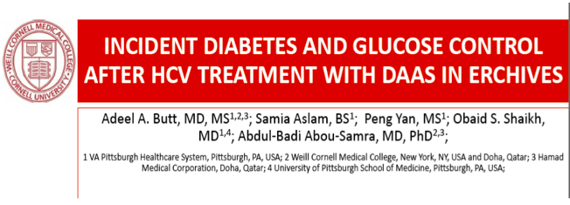
Objective: determine the impact of newer DAA regimens upon incidence and risk of diabetes
Methods: data from the Veterans Health Administration (ERCHIVES: electronically retrieved cohort of HCV-infected veterans)
  All persons with confirmed chronic HCV infection
  Excluded patients with prevalent diabetes, co-infection with HIV or HBV, or received both interferon and DAA therapy
  Used a propensity matched control for each identified patient
Butt AA et al. Clin Infect Dis.2020;70(6):1153-1160.
Notes:
Did allow patients who received IFN plus boc or telap

Slide 8
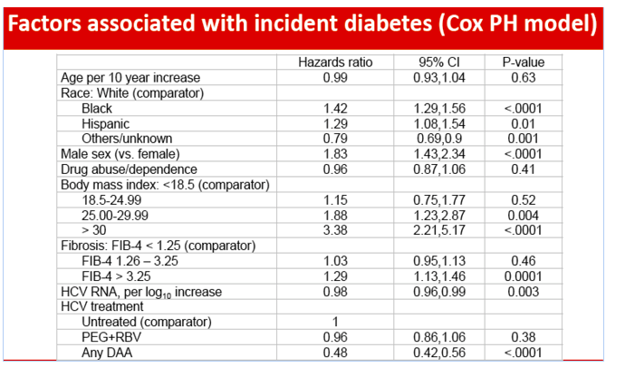
Butt AA et al. Clin Infect Dis.2020;70(6):1153-1160.
Notes:
Cox Proportional-Hazards Model (Cox PH Model)

Slide 9
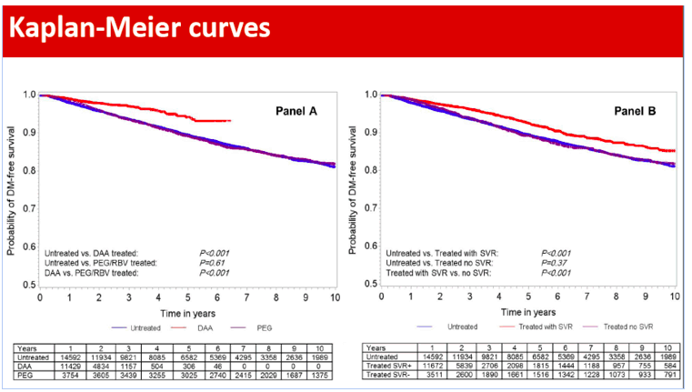
Probability of DM-free Survival
Butt AA et al. Clin Infect Dis.2020;70(6):1153-1160.

Slide 10
Long-Term Follow Up of F2/F3 Fibrosis After Achieving SVR in SOF-based Clinical Trials
Gilead SVR Registry
2348 patients with F2 or F3 fibrosis who achieved SVR with DAA treatment were enrolled for long-term follow up to 144 weeks
Demographics
 | F2 n=1490 | F3 n=858
Mean age, years (range) | 55 (19–80) | 57 (19–82)
Male, % | 856 (57) | 615 (72)
Median registry f/u, years (range) | 2.5 (0–3.8) | 2.3 (0–3.3)
Patients were enrolled in the Gilead SVR Registry within 3 months of achieving SVR.
Zeuzem, EASL 2018, FRI-366

Slide 11
Long-Term Follow Up of F2/F3 Fibrosis After Achieving SVR in SOF-based Clinical Trials (cont’d)
Liver-Related Complications After SVR
Complication | F2 N=1456 | F3 N=838
HCC, n Exposure-adjusted incidence rate/100 p-y | 2 0.06 | 5 0.25
Liver related events (Ascites/Varices/Encephalopathy/Jaundice) | 7 | 21
Deaths | 4 | 5
HCV relapse, n | 0 | 1
HCV re-infection, n | 4 | 2
Achieving SVR after DAA treatment is linked to low likelihood of development of HCC, decompensation, and death in F2 and F3 patients
Zeuzem, EASL 2018, FRI-366

Slide 12
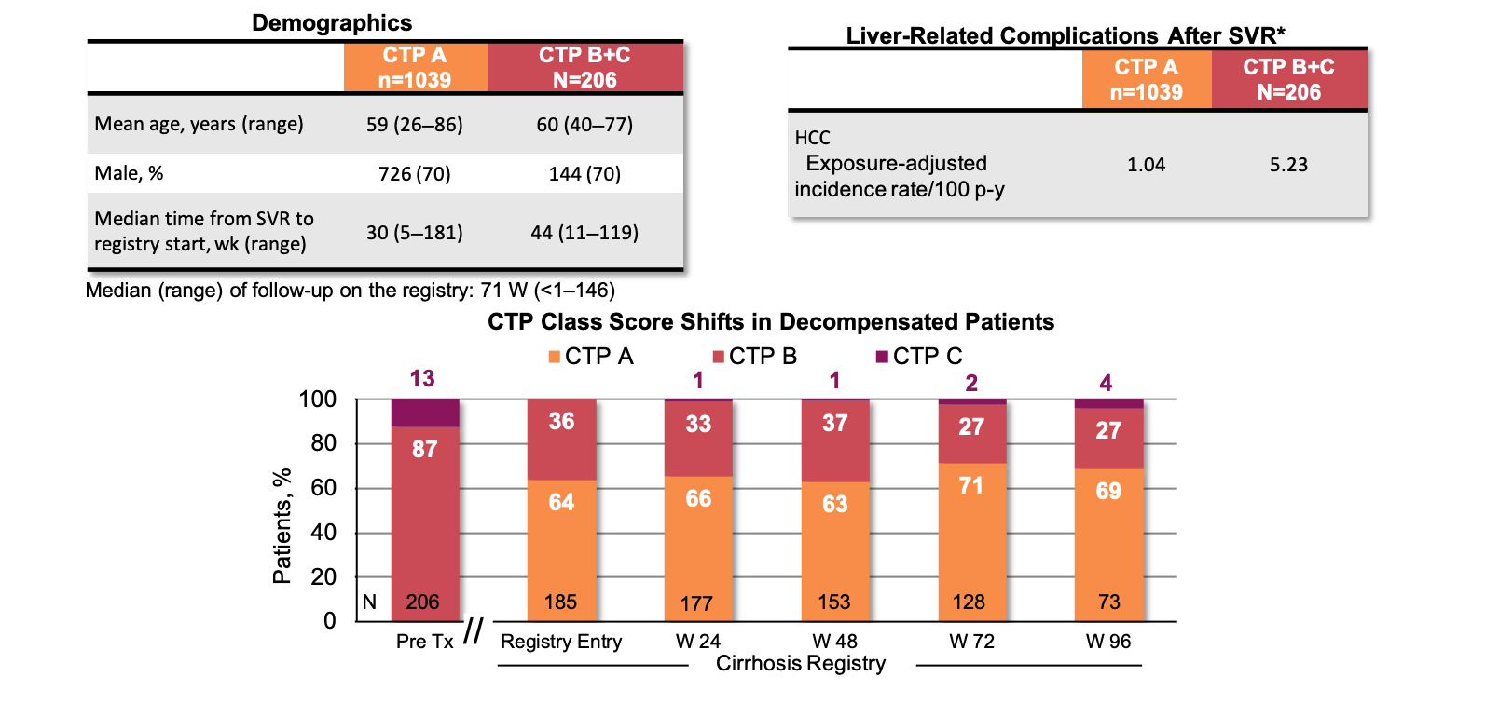
Long-Term Follow Up on Patients with Cirrhosis After Achieving SVR in SOF-based Clinical Trials
Gilead Cirrhosis Registry
1245 patients with decompensated and compensated cirrhosis followed after SVR with a SOF-based regimen
The majority of those with decompensated cirrhosis showed improvement in CTP class and rate of de novo HCC was decreased with the achievement of SVR
*13 reported deaths were excluded from the analysis. 6 were due to liver-related causes.
SOF = sofosbuvir; Mangia, EASL 2018, GS-018

Slide 13
Gilead Long-Term SVR Registries
Kaplan-Meier Analysis of Time to HCC Since Achieving SVR12
Proportion of patients
with no HCC event (%)*
Cumulative events over time : at risk (events)
F2 |  | N= 1490 (0) | 1453 (1) | 1380 (1) | 1176 (1) | 1070 (1) | 965 (2)
F3 |  | N= 858 (0) | 832 (4) | 782 (4) | 648 (4) | 572 (4) | 508 (5)
CPT A |  | N= 1037 (0) | 1014 (2) | 868 (7) | 677 (7) | 592 (12) | 466 (16)
CPT B+C |  | N= 205 (0) | 200 (4) | 185 (11) | 174 (16) | 151 (19) | 90 (20)
Registry Entry
The rate of de novo HCC was decreased with the achievement of SVR, including patients with decompensated cirrhosis.
*0-60% is not included
Integrated Analysis: Gilead Long-Term SVR Registries, EASL 2018

Slide 14
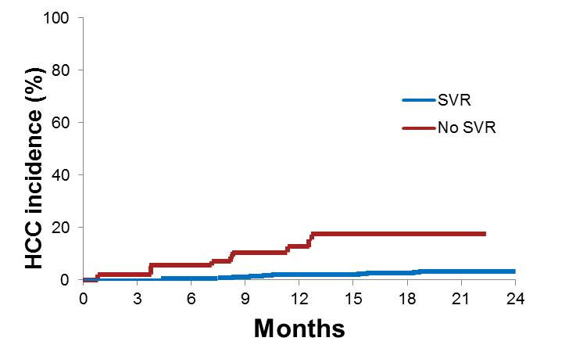
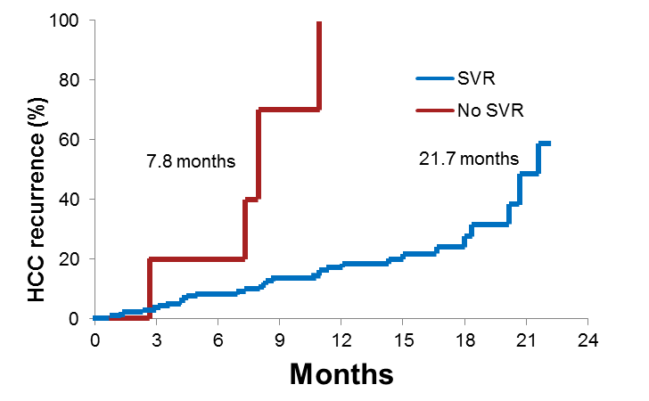
SVR as a Predictor of De Novo and Recurrent HCC in HCV Patients
Multicenter, prospective cohort of 1927 HCV-infected cirrhotic patients from Italy
De Novo HCC
HCC Recurrence
1766 patients no previous history of HCC;
50 patients developed HCC (50/1766 – 2.8%);
Average annual incidence of 2.4%
161 patients with previously treated
HCC; 38 patients developed HCC;
average annual incidence of 24.8%
p<0.0001
p<0.0001
HCC Recurrence (%)
HCC Incidence (%)
SVR with DAA regimens is associated with a significant reduction of
incidence and recurrence of HCC
Lleo, EASL 2018, SAT-PS-154

Slide 15
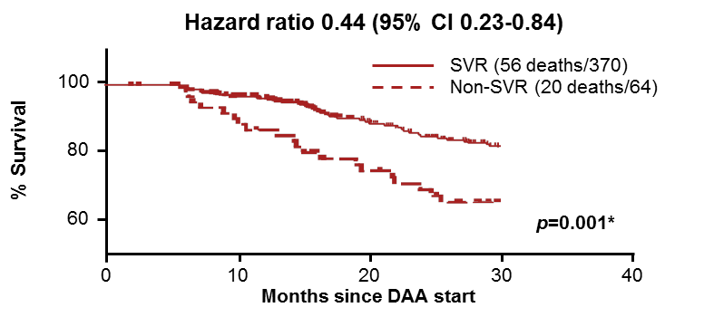
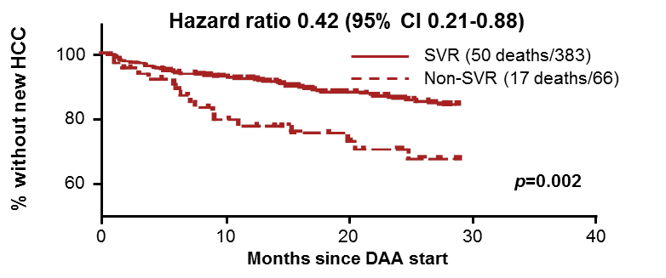
Long-Term Real-Life Follow-Up of Patients with Chronic HCV and Decompensated Cirrhosis After DAAs
NHS England Expanded Access Program (EAP)
Outcomes in 449 patients with decompensated cirrhosis treated with LDV/SOF or SOF+DCV±RBV
Transplant-Free Survival
Demographics
 | N=449
Male, % | 74
Median age, years | 54 (28-79)
MELD, mean | 12 (7-32)
Achieved SVR, n | 383
Treatment failures, n | 66
Median f/u, weeks | 136 (24-174)
De Novo HCC Development
SVR in decompensated patients is associated with improved transplant-free survival and reduced risk of HCC
LDV = ledipasvir; DCV = daclatasvir; RBV = ribavirin; Cheung, EASL 2018, LBP-009

Slide 16
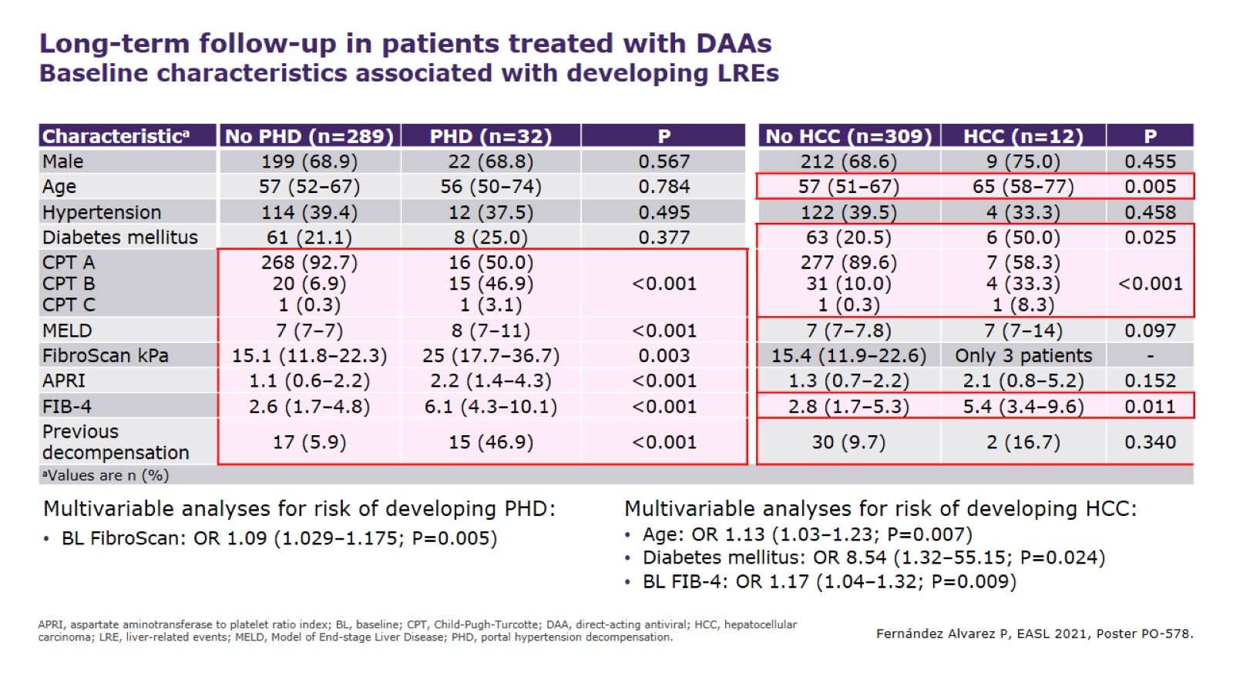
Fernandez Alvarez P, EASL 2021, Poster PO-578
Notes:
321 patients
68.8% male, median age 57, median follow up 52 months (41-63)
44 patients developed liver related events: 32 with portal hypertension decompensation
12 patients developed HCC (3.7%); 22 patients died
Patients who developed HCC were older, had cirrhosis, GT3, and diabetes

Slide 17
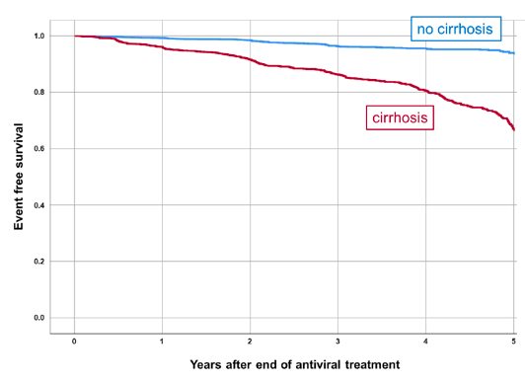
Long-Term Event-free Survival of Patients with SVR
Results:
Overall SVR:
95% (9,951/10,448) ITT
97% (9,824/10,157) PP
181 patients died
415 patients (5.7%) had liver related clinical events (liver transplantation, HCC, hepatic decompensation, or increase in MELD by > 3 points
Risk of de novo HCC 0.6%/yr
In pts with cirrhosis: 1.2% in yr 1-2, then 0.8% from yr 3-7
Wedemeyer, H et al. Persistent long-term risk of liver related complications in HCV patients after antiviral therapy- Data from the German Hepatitis C-Registry. EASL June 23-26 2021.
Notes:
About 1/3 (32%) of patients had liver cirrhosis at baseline
26% (2,712/10,448) had a follow up of at least 3 years
2,359 got ribavirin, 8,089 did not

Slide 18
Key Points
Successful treatment of HCV associated with improved HgbA1c, reduced need for insulin, and lower incidence of diabetes as compared to patients with untreated HCV
Rates of HCC, decompensation, and death due to liver disease are decreased in patients with F2 or F3 who achieve SVR
Rates of de novo HCC reduced in patients after SVR
In patients with HCC who achieve SVR, HCC recurrence is reduced
Long-term liver disease complications reduced after SVR, especially among patients without cirrhosis
Patients with advanced fibrosis/cirrhosis need
  Follow-up and management for their liver disease
  On-going HCC surveillance every 6 months indefinitely

Slide 19
References
Hum J, Jou JH, Green PK, Berry K et al. Improvement in glycemic control of type-2 diabetes after successful treatment of hepatitis virus. Diabetes Care. 2017:40;(9):1173-1180.
Butt AA, Yan P, Aslam S, Shaikh OS, Abou-Samra AB. Hepatitis C Virus (HCV) Treatment With Directly Acting Agents Reduces the Risk of Incident Diabetes: Results From Electronically Retrieved Cohort of HCV Infected Veterans (ERCHIVES). Clin Infect Dis. 2020 Mar 3;70(6):1153-1160.
Mangia A, et al. Long-term follow-up of patients with chronic HCV infection and compensated or decompensated cirrhosis following treatment with sofosbuvir-based regimens. 53rd EASL; Paris, France; April 11-15, 2018. Abstract GS-018.
Lleo A, et al. SVR is the strongest predictor of occurrence and recurrence of hepatocellular carcinoma in HCV cirrhotic patients after treatment with DAAs: a prospective multi-centric Italian study. 53rd EASL; Paris, France; April 11-15, 2018. Abstract PS-154.
Cheung M, et al. LBP-009 Long-term real-life follow-up of patients with chronic hepatitis C virus and decompensated cirrhosis after direct acting antivirals – what is the clinical benefit of antiviral treatment? Journal of Hepatology 68;s109-s110.
Wedemeyer, H et al. Persistent long-term risk of liver related complications in HCV patients after antiviral therapy- Data from the German Hepatitis C-Registry. EASL June 23-26, 2021. PO-52.
Fernandez Alvarez, P et al. Long-term follow up in patients with hepatitis C virus treated with direct-acting-antiviral agents. EASL June 23-26, 2021. PO-578.

Slide 20
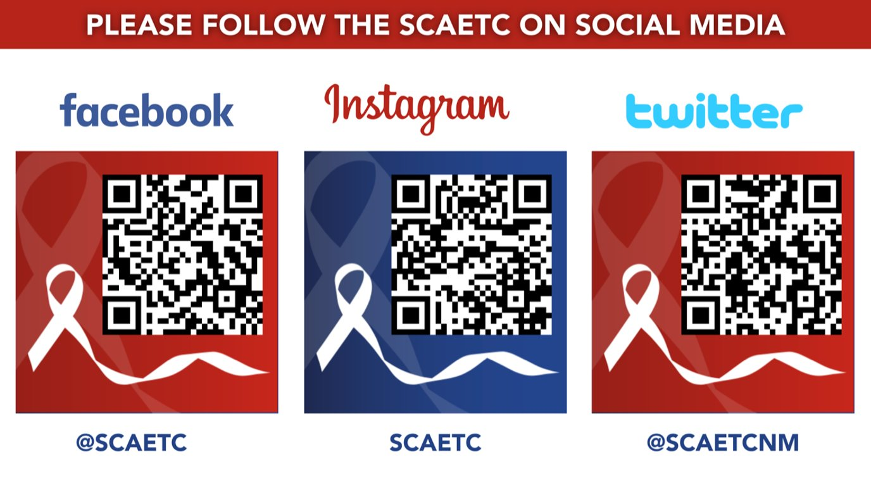
SCAETC Social Media

Slide 21
Resources
National Clinician Consultation Center http://nccc.ucsf.edu/
  HIV Management
  Perinatal HIV
  HIV PrEP
  HIV PEP line
  HCV Management
  Substance Use Management
Present case on ECHO http://echo.unm.edu hivecho@salud.unm.edu
AETC National HIV Curriculum https://aidsetc.org/nhc
AETC National Coordinating Resource Center https://targethiv.org/library/aetc-national-coordinating-resource-center-0
Additional trainings scaetcecho@salud.unm.edu
www.scaetc.org
Notes:
Find additional TeleECHO sessions in your area: https://echo.unm.edu/locations-2/echo-hubs-superhubs-united-states/
https://hsc.unm.edu/echo/get-involved/join-an-echo/
IDEA Platform: Infectious Diseases Education & Assessment. https://idea.medicine.uw.edu/
AETC National HIV Curriculum: 6 core modules for self study; regularly updated; CME, CNE
Hepatitis C Online Curriculum: https://www.hepatitisc.uw.edu/
Hepatitis B Online Curriculum: https://www.hepatitisb.uw.edu/
National STD Curriculum: https://www.std.uw.edu/

