Slide 1
Project ECHO® - Indian Country
HIV ECHO
Treatment of Anxiety in People with HIV
Presenter:
Original Slides Prepared By:
Jasen Christensen, DO
Associate Professor
Department of Psychiatry
UNM Health Science Center
Brant Hager, MD
Associate Professor
Department of Psychiatry
UNM Health Science Center
Christopher Morris, PhD
Associate Professor
Department of Psychiatry
UNM Health Sciences Center
Notes:
V_07_2023

Slide 2

Conflict of Interest Disclosure Statement
Presenter has no financial conflicts of interest to disclose.
This program is supported by the Health Resources and Services Administration (HRSA) of the U.S. Department of Health and Hum an Services
(HHS) as part of an award totaling $4,205,743 with 0% financed with non-governmental sources. The contents are those of the author(s) and
do not necessarily represent the official views of, nor does mention of trade names, commercial practices, or organizations imply an
endorsement by HRSA, HHS, or the U.S. Government. For more information, please visit HRSA.gov. Any trade/brand names for products
mentioned during this presentation are for training and identification purposes only.

Slide 3
Learning Objectives
Highlight prevalence and impacts of anxiety disorders in people with HIV (PWH).
Identify key diagnostic features and effective treatments for common anxiety disorders.
Examine some basic brief anxiety coping skills.

Slide 4
Anxiety in People with HIV
Prevalence of anxiety disorders in PWH similar to general population
Comorbidity of anxiety disorders in PWH similar to general population
Mixed findings on impact of anxiety or anxiety disorders on antiretroviral therapy (ART) taking behavior or viral suppression
Mixed findings on impact of anxiety disorders treatment on ART taking behavior or viral suppression
Gaynes et al 2008, Levy et al 2019, Springer et al 2012

Slide 5
Anxiety in PWH: Comorbidity
Gaynes et al 2008

Slide 6
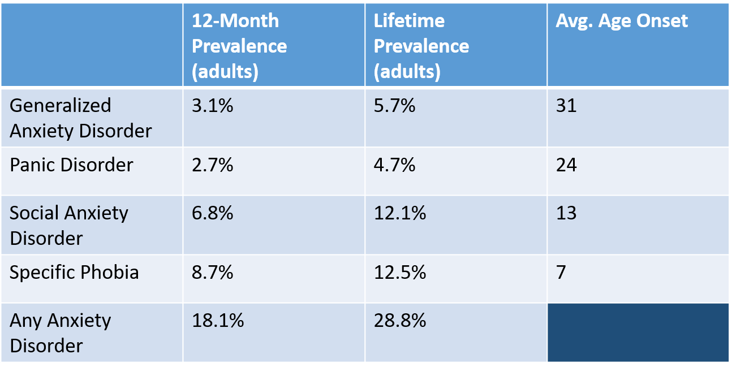
Anxiety Prevalence & Onset
Kessler et al 2005; Kessler et al 2005

Slide 7


Anxiety Definitions and Manifestations
Persistent fear response disproportionate to the eliciting stimuli
  Sympathetic activation
    May cue further/escalating activation
  Emotional experience
    Fear, anger, sadness
  Cognitive interpretation
    Threats everywhere, I’m powerless, I’m deficient, if I worry / control enough I can escape anxiety
  Avoidance behavior
    Avoid feared stimuli stimulus generalization
  Other compensatory behavior
    Frequently seeking medical care, substance use, sex

Slide 8
Screening: GAD-7
Reasonable screening performance for
  Generalized Anxiety Disorder (GAD)
  Panic disorder
  Social anxiety disorder
Will also detect some cases of PostTraumatic Stress Disorder (PTSD)
Typical cutoff ≥ 10
Kroenke et al 2007

Slide 9
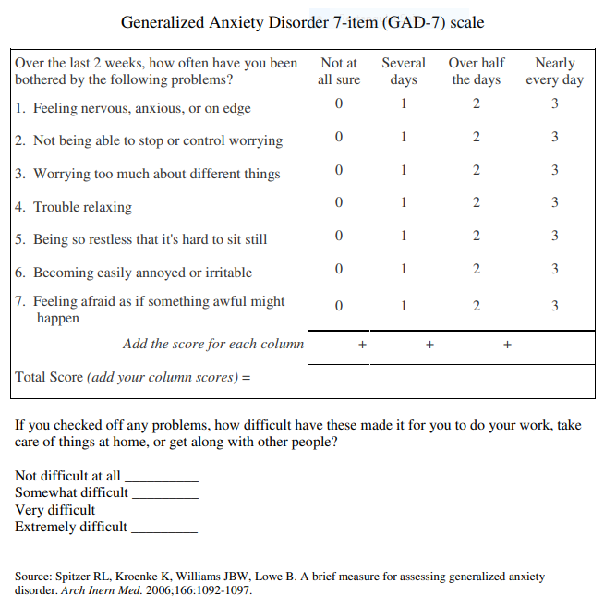

Slide 10
GAD – Key Features
Key feature is persistent and pervasive worry, disproportionate to the topic of worry.
7-8% prevalence in primary care population.
Almost twice as common among women.
Age of onset varies widely, median in 30s.
Worry is rarely reported as a primary complaint.
Headache, GI distress, other physical symptoms often reported as primary complaint.
Do you worry about things? Tell me more about that.
“Overthinking things” ; “What if _________”
Stein & Sareen, 2015

Slide 11
Panic Disorder – Key Features
Persistent panic attacks that are unexpected, i.e. without an apparent cue
Strong element of fear or intense discomfort
Persistent worry about further attacks, or maladaptive avoidance behavior
Panic attacks may occur as part of other disorders
Initial trigger is likely sympathetic activation that escalates and is cognitively interpreted as alarming.

Slide 12
Social Anxiety Disorder – Key Features
Fear, anxiety, avoidance of social interactions and situations
Fear negative judgment by others:
  “I’m always thinking about what others are thinking about me.”
To assess, ask:
  “What’s it like for you to walk into a room full of people?”
  “How are you at speaking or eating around other people?”

Slide 13
Specific Phobia – Key Features
Fear and avoidance of a specific stimulus, for example:
  Dogs
  Public speaking
  Small spaces
  Flying
  Blood/injections
Panic-like symptoms with clear and consistent trigger
High prevalence but half of all cases have mild functional impairment National Institute of Mental Health (NIMH, 2018)
If treatment is necessary, is often straightforward.
  As needed Pro Re Nata (PRN) medication
  Systematic desensitization

Slide 14
Other Conditions Including Significant Anxiety Elements
Adjustment Disorder
Posttraumatic Stress Disorder (PTSD)
Obsessive Compulsive Disorder (OCD)
Somatic Symptom Disorder
Illness Anxiety Disorder
Conversion Disorder

Slide 15
Addressing Anxiety Disorders in HIV Primary Care
  Convey empathy
  De-stigmatize
  Instill hope
  Empower through increased knowledge
  Help patient create an action step

Slide 16
Anxiety Patient Education
Point out that the symptoms endorsed by patient on the GAD-7 are indication of a possible anxiety disorder.
Anxiety disorders differ from everyday stress/anxiety: they are a medical condition that can be persistent and interfere with daily life.
Briefly reflect on their difficult and painful experience.
Explain there are a few common types of anxiety disorders and you’d like to assess further to determine the appropriate diagnosis.
Even if no anxiety disorder, anxiety reduction strategies may be helpful.

Slide 17
Anxiety Patient Education
Note that anxiety disorders are a common medical condition, experienced by 1 in 5 adults, and not indication of personal failure/weakness.
Provide a brief explanation of the condition you’ve diagnosed using examples of symptoms the patient has described; also point out a strength or coping skill you’ve noticed; provide written materials.
Anxiety is treatable. Extensive research shows benefits of either medication, psychotherapy, or combination of both.
Offer medication, referral to behavioral health therapy, or provide a brief intervention/skills training.

Slide 18
Generalized Anxiety Disorder:
Treatment Effect Sizes
Psychotherapy 0.51
Hydroxyzine 0.45
Selective Serotonin Reuptake Inhibitors (SSRI) 0.36 or Seratonin and Norepinephrine Inhibitors (SNRI) 0.42
Pregabalin 0.50
Benzodiazepine 0.38
Buspirone 0.17
SSRI = selective serotonin reuptake inhibitor; SNRI = selective norepinephrine reuptake inhibitor; Hidalgo et al 2007, Huhn et al 2014

Slide 19
Panic Disorder: Treatments
Psychotherapy 0.35
SSRI or SNRI 0.47
Benzodiazepine
Psychotherapy + medication > medication alone (0.2-0.5)
No anti-panic properties
  Buspirone
  Propranolol
  Hydroxyzine
Huhn et al 2014, Otto et al. 2001

Slide 20
Social Anxiety Disorder: Treatments
Psychotherapy (0.62)
SSRI or SNRI
Gabapentinoid
Benzodiazepine
MAOI
Medication + psychotherapy > psychotherapy alone (0.42)
MAOI = monoamine oxidase inhibitor; Huhn et al 2014, Schatzberg and Nemeroff 2009

Slide 21
PTSD: Treatments
Trauma focused psychotherapy (0.62)
SSRI or SNRI
Second SSRI or SNRI
Prazosin augmentation
  Civilian studies: ~3mg PO at bedtime
  Veteran studies: total daily dose ~20mg men, ~15mg women
Tricyclic antidepressant
Quetiapine
Huhn et al. 2014

Slide 22
A Word on Cannabis
Neither cannabis nor cannabinoids have been studied in randomized controlled trials for specific anxiety disorders (non-PTSD) per se
Cannabinoids may secondarily improve anxiety related to primary indication, for example chemotherapy related nausea and vomiting, or MS related spasticity
Efficacy of cannabis or cannabinoids for PTSD remains an open area of investigation
  Small crossover trial of nabilone with benefit over placebo for PTSD sleep symptoms
  Moderately sized trial of smoked cannabis with no differences between arms
  Observational studies demonstrate temporary benefits, tolerance, as well as several harms
Whiting et al 2015, LeFrance et al 2020

Slide 23
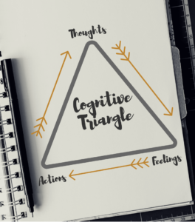
Cognitive Behavioral Therapy (CBT) Basics
Your thoughts, feelings and actions all influence one another.
By becoming more aware of how they affect each other, you can improve anxiety.
Changing your thoughts or actions can help change difficult emotional states.

Slide 24
Cognitive Coping Skills
Check your Thought
Change 3-P Thinking
Your thoughts, feelings and actions all influence one another
By becoming more aware of how they affect each other, you can improve anxiety
Changing your thoughts or actions can help change difficult emotional states
Thoughts that are overly:
  Personalized
  Permanent
  Pervasive
What could I say to myself instead?
How would I help a friend or loved one who was thinking this way?

Slide 25
Learn Relaxed Breathing in 3 Minutes
When we are tense or distressed, it can affect our breathing. This in turn can increase distress even more. You can counteract this with relaxed breathing.
If you watch someone sleeping, you will see their stomach rising and falling with each breath. Breathing with your stomach is the most natural and relaxing way to breathe. If you are stressed, try breathing with your stomach. The steps below explain how.
When you are first learning, check to make sure you are breathing with your stomach and not your chest. It helps if you put one hand on your stomach and one hand on your chest when you breathe; then you can watch your hands to make sure the one on the stomach is moving the most.

Slide 26
Learn Relaxed Breathing in 3 Minutes
Breathe in through your nose, deeply and slowly, while counting to 4.
Breathe out through your mouth, deeply and slowly, counting to 4 and allowing the air to fully escape.
Repeat this sequence of breathing in and out while counting to four at a pace that is comfortable for you. Continue for 30 to 60 seconds, or as long as you like.
You will probably need to practice this to get good at it. At first, it might be hard to relax using breathing. But you will get better with practice!

Slide 27
Anxiety & Acceptance
We often find it difficult to accept what we are feeling. A common pattern is to have some difficult or unpleasant experience, then to feel bad because of feeling bad, and then to feel bad about feeling bad about feeling bad, and so on. It is a vicious cycle of feeling bad about feeling bad.
We can break this by accepting what we are feeling, saying something like, “It’s okay that I feel this way; let me feel it for the moment.”
Acceptance means acknowledging what you’re feeling and standing back from it so that although you experience the unpleasant emotion, you don’t entirely define yourself by it. Then you may intentionally choose a way to move on.

Slide 28
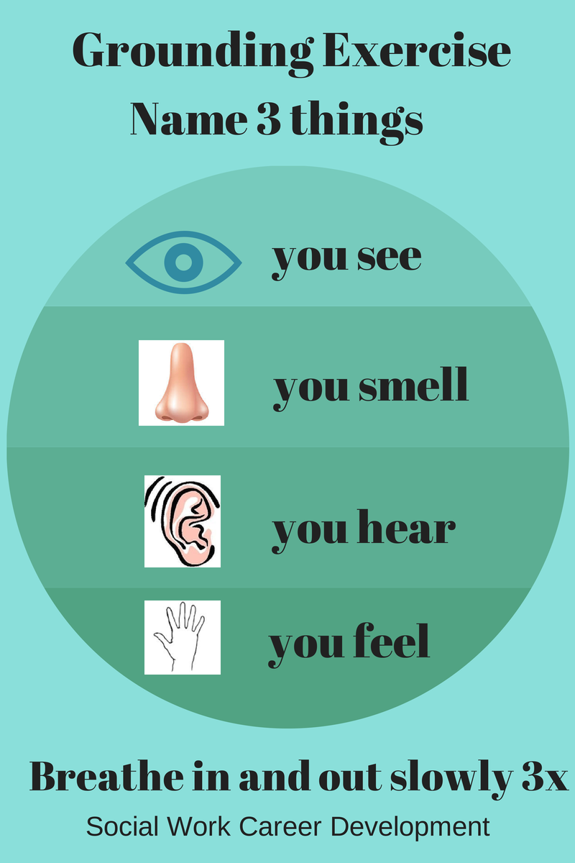

Slide 29
Summary
Anxiety disorders are common in PWH, and may have mixed impacts on ART taking behavior and viral suppression
Screen for anxiety disorders in PWH using GAD-7, followed by clinical inquiry into type of anxiety
Common cognitive and behavioral approaches have broad efficacy for anxiety management
Medications have modest benefits in treatment of anxiety disorders

Slide 30
References
Gaynes et al 2008, Levy et al 2019, Springer et al 2012
Kessler et al 2005
Norton and Paulus 2017
Kroenke et al 2007
Spritzer RL., Williams JBW, Lowe B. A brief measure for assessing generalized anxiety disorder. Arch Inern Med. 2006;166:1092-1097
Stein & Sareen, 2015
Hidalgo et al 2007, Huhn et al 2014
Huhn et al 2014, Otto et al. 2001
Huhn et al 2014, Schatzberg and Nemeroff 2009
Sijbrandij et al 2015, Shalev et al 2012
Whiting et al 2015, LeFrance et al 2020
Cuijpers et al 2014, Dahlin et al 2015, Evans et al 2008, Roemer and Orsillo 2007

Slide 31
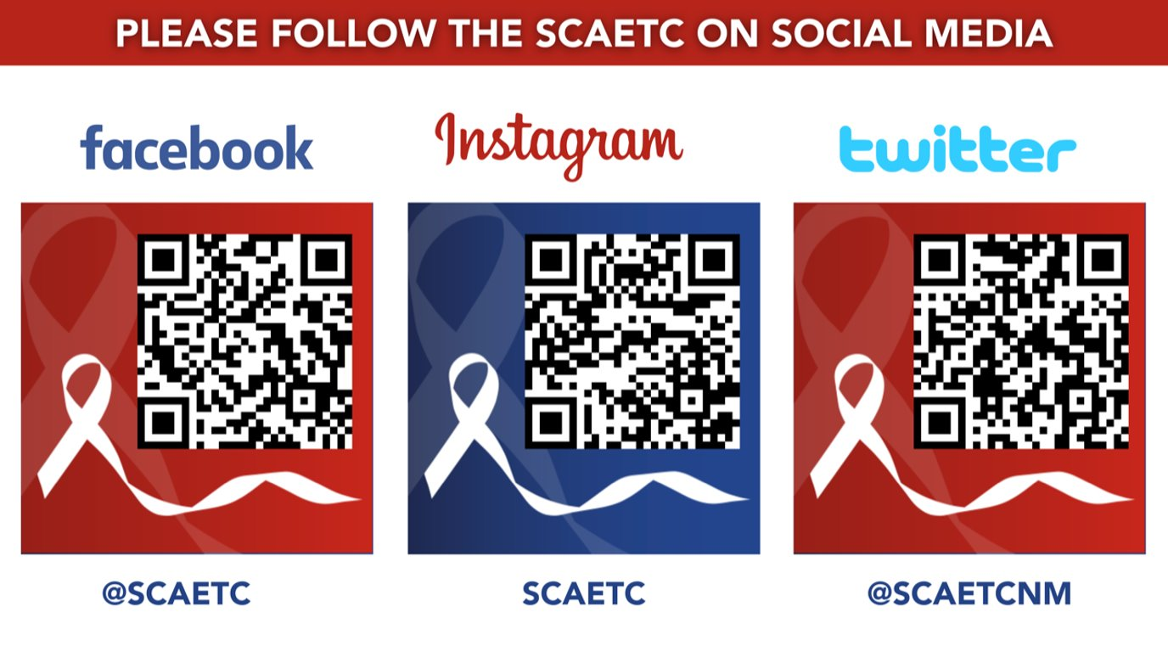
SCAETC Social Media

Slide 32
Resources
National Clinician Consultation Center http://nccc.ucsf.edu/
  HIV Management
  Perinatal HIV
  HIV PrEP
  HIV PEP line
  HCV Management
  Substance Use Management
Present case on ECHO http://echo.unm.edu hivecho@salud.unm.edu
AETC National HIV Curriculum https://aidsetc.org/nhc
AETC National Coordinating Resource Center https://targethiv.org/library/aetc-national-coordinating-resource-center-0
Additional trainings scaetcecho@salud.unm.edu
www.scaetc.org
Notes:
Find additional TeleECHO sessions in your area: https://echo.unm.edu/locations-2/echo-hubs-superhubs-united-states/
https://hsc.unm.edu/echo/get-involved/join-an-echo/
IDEA Platform: Infectious Diseases Education & Assessment. https://idea.medicine.uw.edu/
AETC National HIV Curriculum: 6 core modules for self study; regularly updated; CME, CNE
Hepatitis C Online Curriculum: https://www.hepatitisc.uw.edu/
Hepatitis B Online Curriculum: https://www.hepatitisb.uw.edu/
National STD Curriculum: https://www.std.uw.edu/

