Slide 1

Project ECHO® - UNM
Indian Country HIV ECHO
Pneumocystis in HIV
Alithea Gabrellas, MD
Infectious Diseases Physician
Gallup Indian Medical Center
Notes:
Version_ 08 2023
Target audience: nurses, pharmacists, clinicians

Slide 2
Conflict of Interest Disclosure Statement
Speaker has nothing to disclose.
This presentation was reviewed by UNMHSC and SCAETC faculty to ensure it meets Continuing Education guidelines.
This program is supported by the Health Resources and Services Administration (HRSA) of the U.S. Department of Health and Human Services (HHS) as part of an award totaling $4,205,743 with 0% financed with non-governmental sources. The contents are those of the author(s) and do not necessarily represent the official views of, nor does mention of trade names, commercial practices, or organizations imply an endorsement by HRSA, HHS, or the U.S. Government. For more information, please visit HRSA.gov. Any trade/brand names for products mentioned during this presentation are for training and identification purposes only.

Slide 3
Use of Trade/Brand Names
This program is supported by the Health Resources and Services Administration (HRSA) of the U.S. Department of Health and Human Services (HHS) as part of an award totaling $4,205,743, with 0% financed with non-governmental sources.
The views expressed do not necessarily reflect the official policies of the Department of Health and Human Services, nor does mention of trade names, commercial practices, or organizations imply endorsement by the U.S. Government. Any trade/brand names for products mentioned during this presentation are for training and identification purposes only.
Notes:
NOTE: THIS SLIDE MUST BE INCLUDED IF TRADE AND/OR BRAND NAMES FOR MEDICATIONS ARE USED IN THE PRESENTATION.
IT MAY BE DELETED IF THERE IS NO REFERENCE TO TRADE NAMES, INCLUDING PRESENTATIONS IN WHICH ONLY GENERIC MEDICATION NAMES ARE MENTIONED.
TRADE NAMES MUST BE PUT IN PARENTHESES AFTER THE GENERIC NAME THE FIRST TIME IT IS MENTIONED - E.G., FLUOXETINE (PROZAC). TRADE NAMES SHOULD ONLY BE MENTIONED FOR THE INITIAL REFERENCE AND THE GENERIC NAME ONLY SHOULD BE USED AFTER THAT. THIS APPLIES EQUALLY TO ALL MEDICATIONS OR PRODUCTS MENTIONED IN THIS PRESENTATION.

Slide 4
Unconscious Bias Disclosure
SCAETC recognizes that language is constantly evolving, and while we make every effort to avoid bias and stigmatizing terms, we acknowledge that unintentional lapses may occur in our presentations.
We value your feedback and encourage you to share any concerns related to language, images, or concepts that may be offensive or stigmatizing.
Your input will help us refine and improve our presentations, ensuring they remain inclusive and respectful to participants.

Slide 5
Learning Objectives
Recognize the clinical features of Pneumocystis infection in persons with HIV (PWH).
Identify methods for diagnosing and treating disease caused by Pneumocystis.
Describe who is at risk for infection with Pneumocystis and how to prevent it.

Slide 6
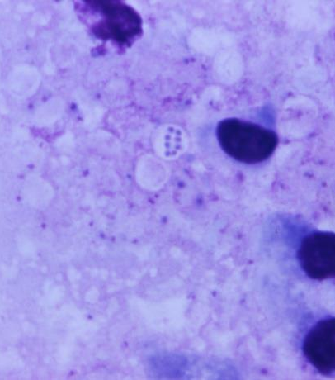
Pneumocystis
P. jiroveci (formerly identified as P. carinii; pronounced “yee row vet zee”) causes opportunistic infection in humans
Cell membrane lacks ergosterol
  Hence antifungal agents such as azoles and amphotericin B are not active against it
Image Source: CDC Dr. Mae Melvin 1971. Giemsa stained lung tissue. Note the P. jirovecii cyst in the center containing 8 maturing spores.
Notes:
Most commonly causes pulmonary infection but can cause infection elsewhere

Slide 7
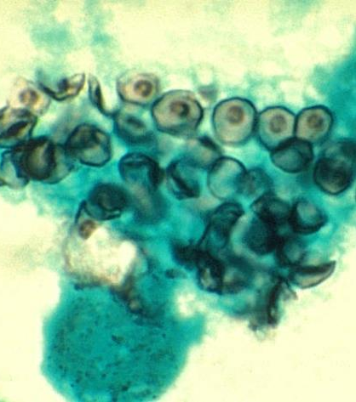
Pneumocystis
The fungus must synthesize its own folic acid
Hence this is a typical target for treatment (TMP-SMX)
Cyst wall contains beta-glucans, which can be helpful for diagnosis
TMP-SMX= trimethoprim/sulfamethoxazole
Image Source: CDC Dr. Russell Brynes. Methenamine silver stained BAL smear.

Slide 8
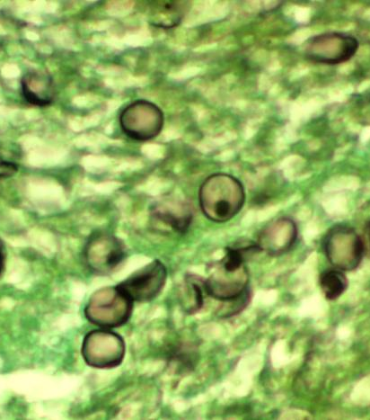
Ecological Niches and Transmission
Specific environmental reservoirs are not well understood
Transmission is via airborne asci (cyst) forms; passed from person to person
P. jiroveci may be present at low levels in healthy humans
Image Source: CDC Dr. Edwin Ewing Jr. Methenamine silver stained lung tissue.
Notes:
P. jiroveci may be present at low levels in healthy humans, who may serve as a source of transmission

Slide 9
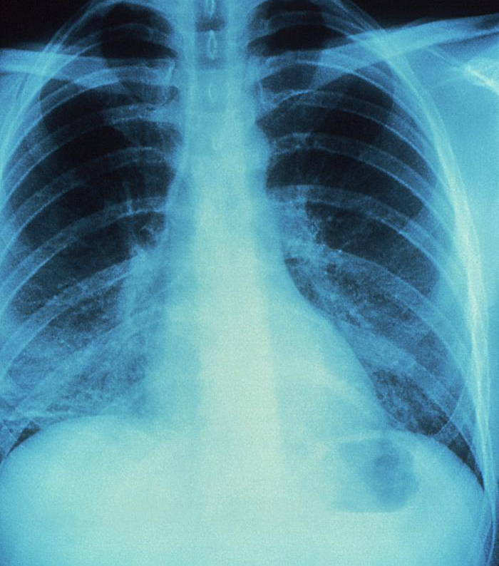
Clinical Presentation in HIV
Subacute onset of fever, non-productive cough, dyspnea and chest pain that is progressive over days to weeks in a susceptible host (CD4 < 200)
Often with hypoxemia, partial pressure of oxygen (paO2) on room air < 70 at rest or post-exercise
Image Source: CDC Jonathan Gold, MD. 1986.
Notes:
(Cluster of Differentiation 4 - CD4 < 200)

Slide 10
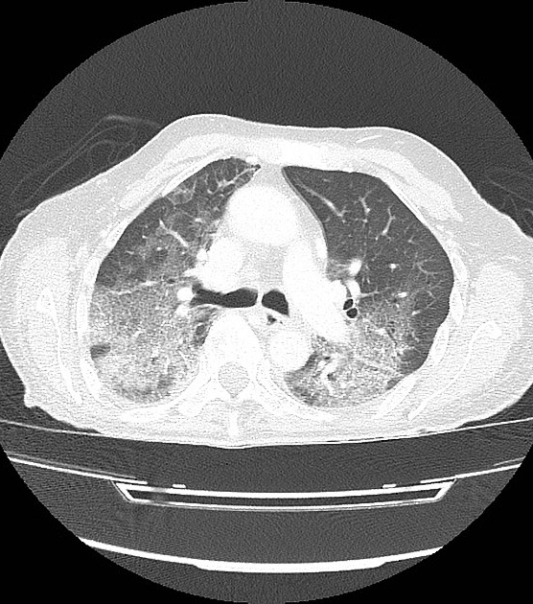
Imaging
Typically shows bilateral fine, reticular-interstitial infiltrates, may eventually progress to a more consolidation-like picture
May be normal in early disease
Less common findings: nodules, blebs, cysts, pneumothorax
Uncommon: pleural effusion
Image Source: Radiopaedia.org

Slide 11
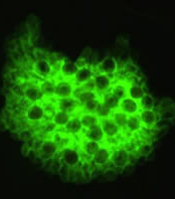
Diagnosis
Definitive: demonstration of P. jiroveci cysts on induced sputum or bronchoscopy specimen
Common stains employed include Giemsa, Diff-Quick and methenamine silver
Immunofluorescence significantly improves sensitivity and specificity
Image Source: CDC DPDx

Slide 12
Alternative Diagnosis Methods
Beta glucan (serum)
  Favorable performance characteristics for ruling out infection
  Elevated beta glucan levels may be due to another fungal infection and/or non-infectious causes
  Cutoff for distinguishing between colonization and infection unknown
  Higher levels (>200) seem to correlate better with infection
Quantitative real-time Polymerase Chain Reaction (PCR) can be done from BAL or induced sputum
  Negative qPCR from BAL rules out PJP but not from induced sputum
  Positive qPCR from BAL may be helpful but cutoff values for infection vs colonization not established
Lactate Dehydrogenase (LDH) > 500 common, but not specific
PCR = polymerase chain reaction; BAL = bronchoalveolar lavage

Slide 13
Treatment
Severe disease (paO2 < 70 on room air, A-a gradient >35):
TMP (15-20 mg/kg/day) + SMX (75-100 mg/kg/day) in divided dose q6-8 hrs IV (switch to oral once clinically improved)
PLUS prednisone 40 mg twice daily x 5d then taper to day 21
Treatment duration is 21d
Alternatives:
Avoid if G6PD deficiency*
Primaquine* 30 mg PO/day + clindamycin 600-900 mg ID/day given q6-8 h or 450 mg PO q6 h + prednisone
Mild/Moderate Disease (paO2 > 70 on room air)
  TMP-SMX 2 DS PO TID
  Dapsone* 100 mg PO daily + TMP 5 mg/kg PO TID
  Atovaquone 750 mg PO BID
Notes:
Avoid if G6PD deficiency: primaquine, dapsone
BID=twice a day
TID=three times a day
q=every, h=hour, d=day

Slide 14
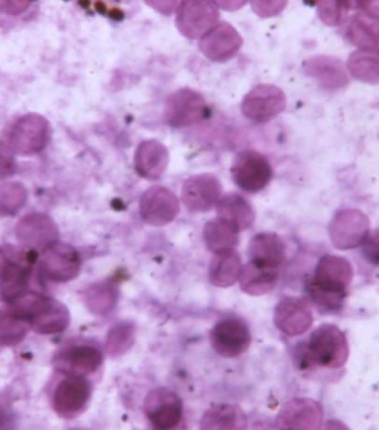
Pneumocystis Prophylaxis
Indications:
  Individuals with HIV with CD4 count < 200 (AI)
  May also be considered if CD4 cell percentage <14% (BII)
  May be discontinued in patients who have responded to antiretroviral therapy (ART) with an increase in CD4 counts from <200 cells/mm³ to >200 cells/mm³ for >3 months (AI)
Source: Guidelines for the Prevention and Treatment of Opportunistic Infections in Adults and Adolescents with HIV

Slide 15
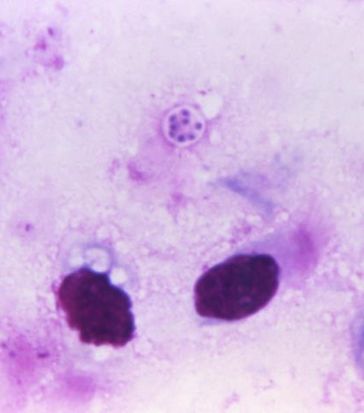
Pneumocystis Prophylaxis
TMP-SMX one DS tab daily is preferred (also confers cross-protection against Toxoplasmosis) but one SS tab daily is also effective and may be better tolerated (A1)
One DS tab TMP-SMX 3 x weekly is also effective (B1)
Alternatives: dapsone (check G6PD), atovaquone or aerosolized pentamidine administered with the Respirgard II nebulizer
Source: Guidelines for the Prevention and Treatment of Opportunistic Infections in Adults and Adolescents with HIV

Slide 16

Antiretroviral (ART) Considerations
If not already started, ART should be initiated in patients, when possible, within 2 weeks of diagnosis of Pneumocystis infection
Paradoxical immune reconstitution inflammatory syndrome (IRIS) with Pneumocystis is uncommon but does sometimes occur
Source: Guidelines for the Prevention and Treatment of Opportunistic Infections in Adults and Adolescents with HIV

Slide 17
Resources
National Clinician Consultation Center http://nccc.ucsf.edu/
  HIV Management
  Perinatal HIV
  HIV PrEP
  HIV PEP line
  HCV Management
  Substance Use Management
Present case on ECHO http://echo.unm.edu hivecho@salud.unm.edu
AETC National HIV Curriculum https://aidsetc.org/nhc
AETC National Coordinating Resource Center https://targethiv.org/library/aetc-national-coordinating-resource-center-0
HIVMA Resource Directory https://www.hivma.org/globalassets/ektron-import/hivma/hivma-resource-directory.pdf
scaetcecho@salud.unm.edu
www.scaetc.org
Notes:
Find additional TeleECHO sessions in your area: https://echo.unm.edu/locations-2/echo-hubs-superhubs-united-states/
https://hsc.unm.edu/echo/get-involved/join-an-echo/
IDEA Platform: Infectious Diseases Education & Assessment. https://idea.medicine.uw.edu/
AETC National HIV Curriculum: 6 core modules for self study; regularly updated; CME, CNE
Hepatitis C Online Curriculum: https://www.hepatitisc.uw.edu/
Hepatitis B Online Curriculum: https://www.hepatitisb.uw.edu/
National STD Curriculum: https://www.std.uw.edu/

Slide 18
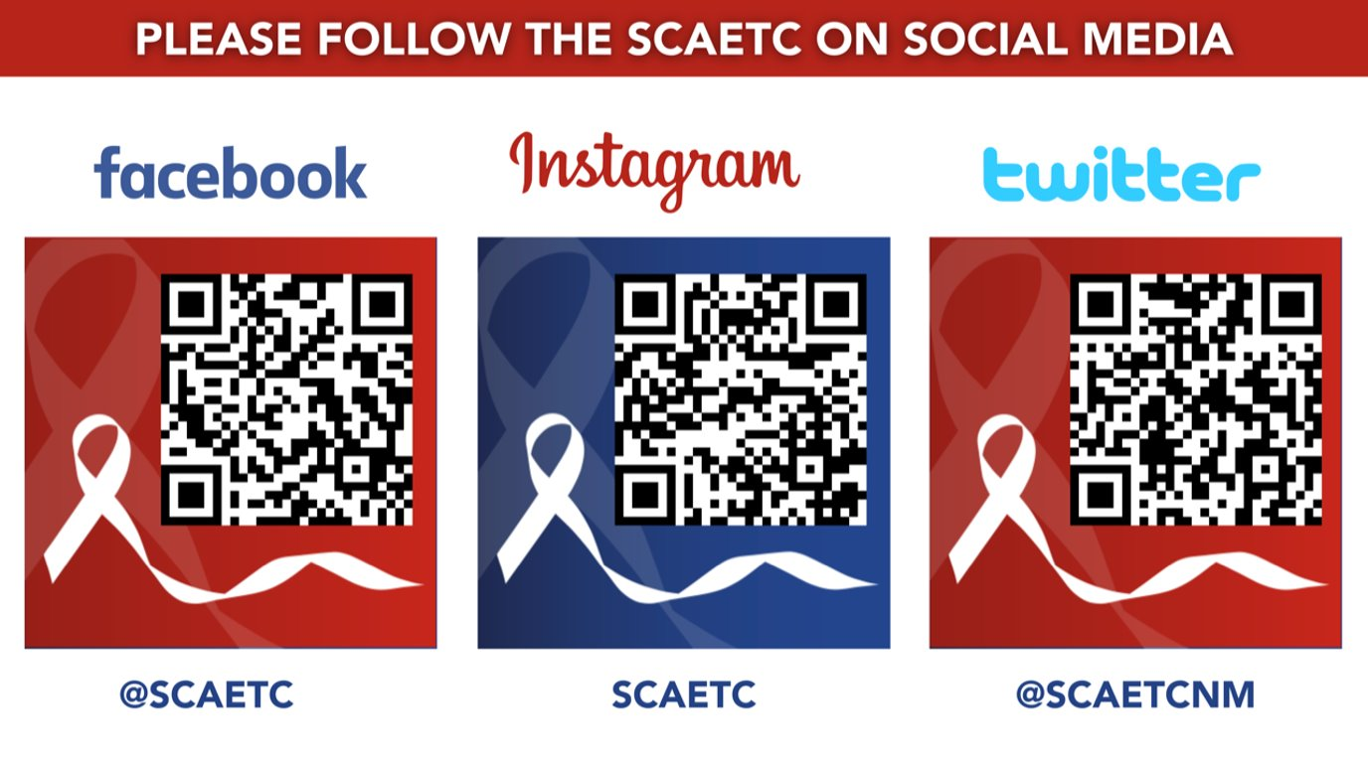
SCAETC Social Media

