Slide 1
Injectable Antiretroviral Therapy
Lucas Hill, PharmD, AAHIVP
Notes:
Version date_06 2023

Slide 2
Conflict of Interest Disclosure Statement
Speaker’s bureau for Gilead Sciences and ViiV Healthcare
This program is supported by the Health Resources and Services Administration (HRSA) of the U.S. Department of Health and Human Services (HHS) as part of an award totaling $3,132,205, with 0% financed with non-governmental sources. The views expressed do not necessarily reflect the official policies of the Department of Health and Human Services, nor does mention of trade names, commercial practices, or organizations imply endorsement by the U.S. Government. Any trade/brand names for products mentioned during this presentation are for training and identification purposes only

Slide 3
Learning Objectives
Understand updated data for long acting injectable (LAI) cabotegravir/rilpivirine for treatment.
Differentiate monitoring strategies for oral vs. injectable HIV pre-exposure prophylaxis (PrEP).
Compare clinical trials with Owen clinic real world experience.

Slide 4
Injectable Antiretroviral Therapy
Enfuvirtide (Fuzeon) - 2003
Ibalizumab (Trogarzo) - 2018
Cabotegravir/Rilpivirine (Cabenuva) - 2021
Cabotegravir (Apretude) - 2021
Lenacapavir (Sunlenca) - 2022

Slide 5
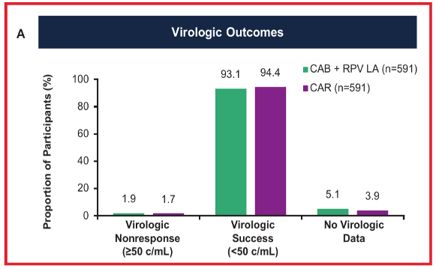
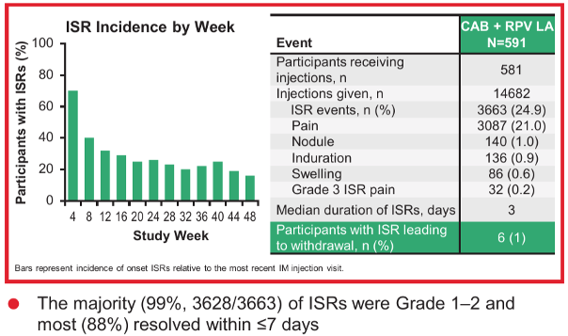
Long-Acting Cabotegravir/Rilpivirine (LAI CAB/RPV; Cabenuva®) – ATLAS and FLAIR
Rizzardi et al.JAIDS.2020;85:498-506.

Slide 6

CAB/RPV - Indication and dosing
Indicated as a complete regimen for the treatment of HIV-1 infection in adults to replace the current antiretroviral regimen in those who are virologically suppressed (<50cpm) on a stable antiretroviral regimen with no history of treatment failure and with no known or suspected resistance to either cabotegravir (CAB) or rilpivirine (RPV)
Prior to initiating treatment optional oral lead in dosing for approximately one month

Slide 7
CAB/RPV - Indication and dosing
Every 1-month dosing
  Initiate injections (600mg CAB + 900mg RPV) on the last day of oral lead-in or Diffusion Tensor Imaging (DTI) from other oral antiretroviral therapy (ART) and continue with 400mg CAB + 600mg RPV every month thereafter
Every 2-month dosing
  Initiate injections (600mg CAB + 900mg RPV) on the last day of oral lead-in or from other oral antiretroviral therapy
  Injections should be administered at month 1, month 2, and every 2 months thereafter

Slide 8
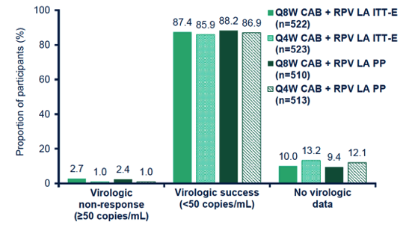
ATLAS-2M: LA CAB+RPV Q8W vs Q4W – Wk 152
11 (2%) confirmed virologic failures in q8w vs. 2 (<1%) in q4w arm
  10/13 failures with RPV RAMs and 10/13 with INSTI RAMs
Patient satisfaction scores significantly favored q8w vs. q4w dosing at week 24, 48, and 152
Overton E, et al. Clin Infec Dis.2023.

Slide 9
Predictors of Virologic Failure with LAI CAB/RPV
Updated data presented at HIV drug therapy Glasgow 2022
  FLAIR week 124, ATLAS week 96, ATLAS 2-M week 152
1.4% confirmed virologic failure (23/1651)
Predictors of virologic failure
  Baseline factors
    Rilpivirine RAMs (IRR 21.7), subtype A6/A1 (IRR 12.9), baseline BMI ≥30mg/kg² (IRR 1.09)
Q4 vs. Q8 week dosing, sex at birth, CAB or Integrase strand transfer inhibitors (INSTI) Resistance-associated mutations (RAMs), and other Non-nucleoside reverse transcriptase inhibitors (NNRTI) RAMs not predictive of failure
Percentage of those with virologic failure
  No baseline factors = 0.4%
  Any 1 baseline factor = 2.0%
  2 or greater baseline factor = 19.3%

Slide 10
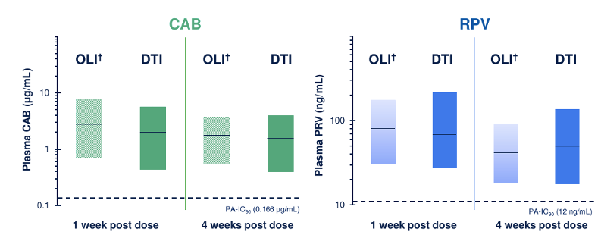
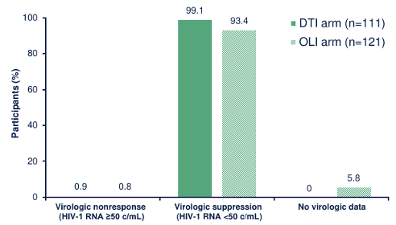
Oral Lead-in
D’Amico R et al. HIV Drug Therapy Glasgow. October 5-8, 2020.

Slide 11
SOLAR Study
Phase 3b, Randomized (2:1), Open-Label, Active-Controlled, Multicenter, Parallel-Group, Noninferiority Study
Screening Phase
Maintenance Phase
Extension Phase
≥18 years of age
Receiving BIC/FTC/TAF* with HIV-1 RNA
<50 copies/mL for
≥6 months prior to
and at screening
BIC/FTC/TAF
QD n=227†
Extension§ Switch to or continue
CAB (600 mg) +
RPV (900 mg) LA
Oral
CAB + RPV
n=175†‡
CAB (600 mg) + RPV (900 mg) LA
IM Q2M n=166†‡
Randomization (2:1)
CAB (600 mg) + RPV (900 mg) LA IM Q2M n=279†‡
Study month
−6
−1
Day 1
1
12
Confirm HIV-1 RNA <50 copies/mL
Primary endpoint
Ramgopal et al. CROI 2023; Virtual and Seattle, WA. Oral presentation 191.
Notes:
*A single prior INI regimen is allowed if BIC/FTC/TAF is a second-line regimen 6 months prior to screening. Any prior change in regimen, defined as a change of a single drug or multiple drugs simultaneously,
must have occurred due to tolerability/safety, access to medications, or convenience/simplification, and must not have been done for treatment failure (HIV-1 RNA ≥400 copies/mL).
†n values are based on the safety population.
‡Participants randomized to the LA arm were offered an optional OLI; the decision was determined by the participants following informed consent discussions with the investigator.
§The extension phase will continue study treatment until CAB LA and RPV LA are either locally approved and commercially available, the participant no longer derives clinical benefit, the participant meets a protocol-defined reason
for discontinuation, or until development of either CAB LA or RPV LA is terminated. Visits will continue to occur Q2M.
IM, intramuscular; LA, long-acting; OD, once daily; OLI, oral lead-in; Q2M, every 2 months.

Slide 12
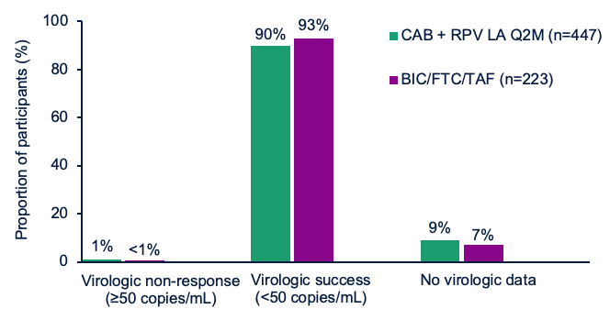
12-month virologic outcomes
LAI CAB/RPV non-inferior to B/F/TAF
3 confirmed virologic failures in the CAB/RPV arm, none in the B/F/TAF* arm
  One failure with BMI>30
  3/3 with RPV RAMs at failure, 2/3 with INSTI RAMs
Significantly greater treatment satisfaction for those on LAI CAB/RPV at 6 and 12 months
*B/F/TAF- Bictegravir/Emtricitabine/Tenofovir
Ramgopal et al. CROI 2023; Virtual and Seattle, WA. Oral presentation 191.
Notes:
BMI=body mass index

Slide 13
LAI CAB/RPV in patients with HIV viremia
Demonstration project at Ward 86 of which 57/133 had detectable viremia at time of starting LAI CAB/RPV
  58% with unstable housing, 33% with stimulant use, 38% with psychiatric disease, median CD4 count of 215cells/mm3 in those non-suppressed
Had to express willingness to come to clinic every 4 weeks, have available contact information, be open to outreach from staff
  Rigorous protocol with biweekly review of patients
55/57 (96.5%) of those non-suppressed achieved viral suppression with median follow up of 26 weeks
Ghandi et al. CROI 2023; Seattle, WA. Poster 518.

Slide 14
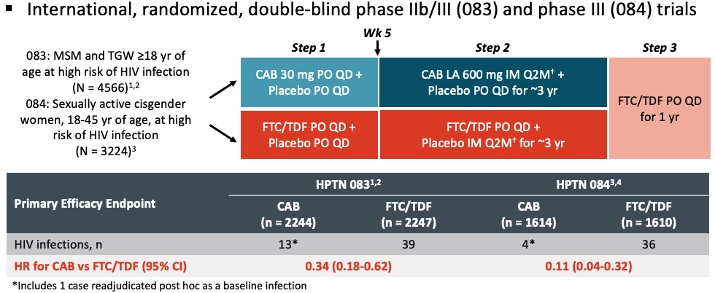
Cabotegravir for PrEP
Landovitz. et al. NEJM. 2021;385:595. 2. Delaney-Moretlwe, et al. The Lancet. 2022;399:1779-1789.

Slide 15
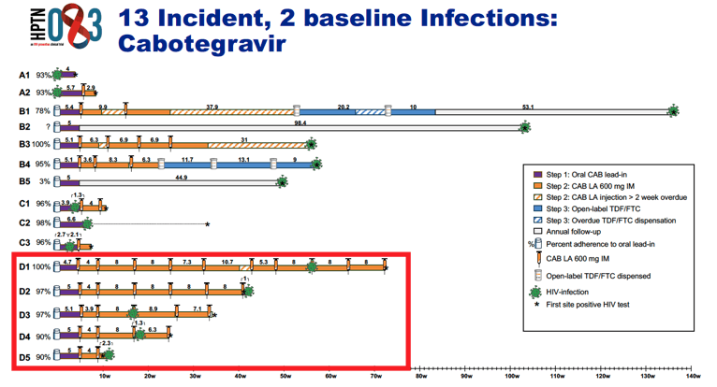
Breakthrough infections
Marzinke et al. CROI 2021, Virtual.

Slide 16
Long-acting Early Viral Inhibition (LEVI) syndrome
 | Acute HIV | LEVI
Cause | Phase of natural HIV infection | Long-acting anti-viral PrEP agent
Onset | New infection | Infection during PrEP or PrEP initiation during acute infection
Viral replication | Explosive | Smoldering
Symptoms | Fever, chills, rash, night sweats, muscle aches, sore throat, fatigue | Minimal, variable, often no symptoms
Detection | Ag/Ab assay, RNA assays, DNA assays, total nucleic acid assays | Ultrasensitive RNA assay
Assay Reversion | Rare | Common
Duration | 1-2 weeks (until Ab detection) | Months; can persist months after the anti-viral agent is discontinued
Transmission | Very likely | Unlikely
Drug resistance | No (unless transmitted) | Yes (can emerge early when viral load is low)
Eshleman..CROI 2023. Seattle, WA. .

Slide 17
Logistics/Challenges
Patient selection
Drug-drug interactions (DDI) during oral lead in
Reimbursement/Acquisition/Billing
Electronic medical record (EMR)/Tracking Injections
Resources to administer injections
Viral load monitoring
Patient outreach/missed doses
Oral bridge
Hospitalizations

Slide 18
Owen Clinic Experience

Slide 19
Owen Clinic Process
Patient expresses interest in LAI CAB/RPV
Eligibility reviewed by their Physician and clinical pharmacy team
  Necessary resistance work up completed
Insurance coverage investigation
  Includes researching patient responsibility
  Pharmacy technician
Patient contacted to review optional oral lead-in
  Delivery set up to patient home or clinic
Patient contacts clinic when oral lead-in received to schedule first injection visit or first injection visit scheduled after deciding to skip oral lead-in
  Treatment plan entered in Electronic Medical Record (EMR)

Slide 20
Owen Clinic Process
Medication obtained from outpatient pharmacy or purchased by clinic one week prior to injection visit
  Tracking sheet
  Pharmacy technician
Reminder call to all patients day before each injection
First injection visit with clinical pharmacy team and nurse visit
  Review and sign counseling sheet
Viral load monitoring performed at loading dose injection, first maintenance injection, then every 3-4 months
Subsequent visits scheduled as nurse visit
Tracking sheet updated
  Pharmacy technician

Slide 21
Evaluating/Initiating CAB/RPV
As of 3/31/23 there have been 807 patients who expressed interest in LAI CAB/RPV
Completed retrospective review of those that expressed interest between April 2021 and June 2022 who had a definitive decision made on starting LAI CAB/RPV
Compared characteristics between those who did and did not start CAB/RPV
Evaluated reasons for not starting CAB/RPV and results of resistance testing as part of the work up for LAI CAB/RPV
Included 383 patients of which 201 (52.5%) started CAB/RPV

Slide 22
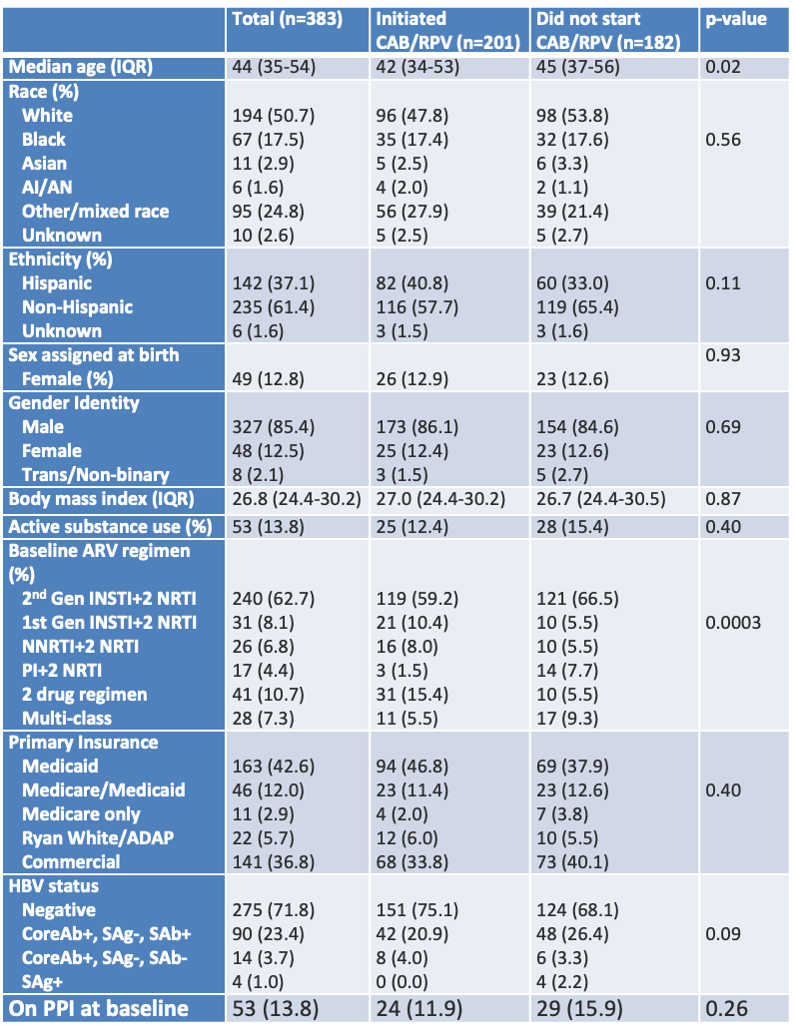
Evaluating/Initiating CAB/RPV

Slide 23
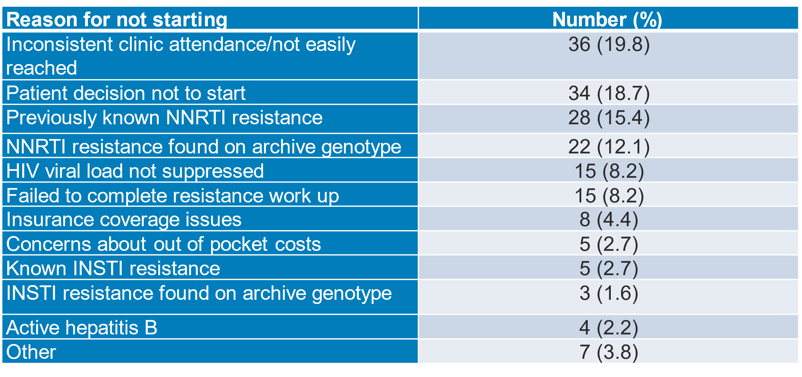
Evaluating/Initiating CAB/RPV

Slide 24
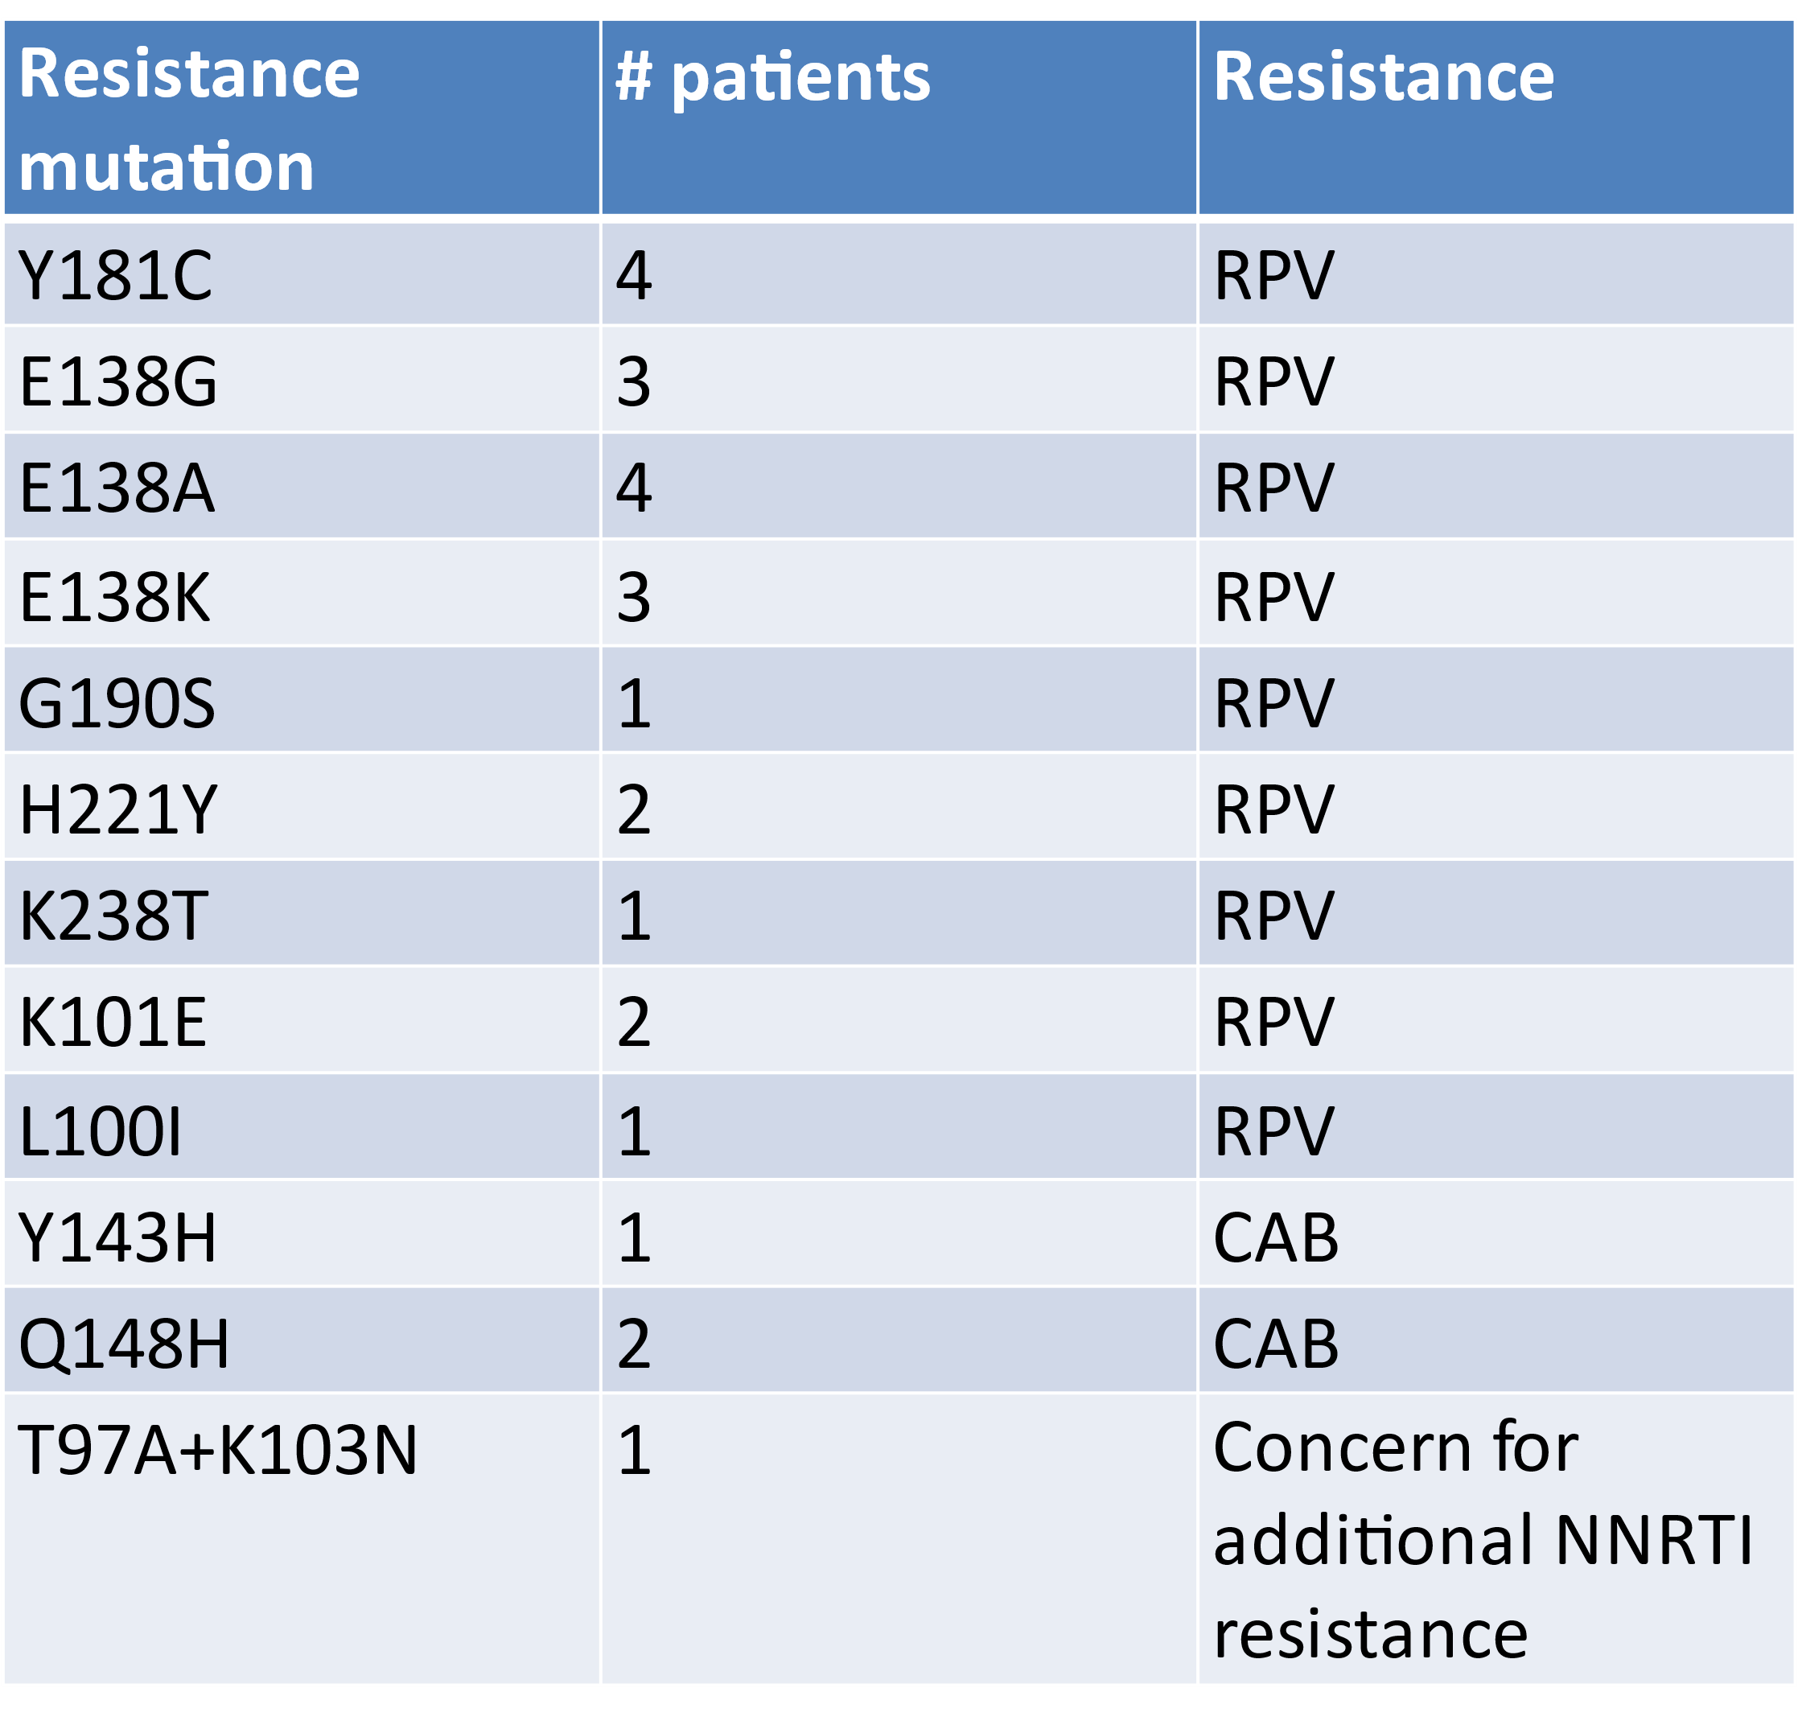
Resistance testing
Baseline genotype was available for 159 (41.5%) of individuals and prior HIV genotype, phenotype, or archive genotype other than baseline for 92 (24%) of individuals
Archive genotype was performed in 135 (35.2%) of individuals as part of the work up for LAI CAB/RPV
Of those that had an archive genotype, 25 (18.5%) had a resistance mutation identified that may impact the effectiveness of CAB/RPV
Hill et al. AIDS. 2023;37:605-609.

Slide 25
Overview of Owen clinic outcomes
 | Total started CAB/RPV (n=431) | Entire Owen Clinic
Median Age (range) | 42 (20-83) | 53
Race (%) White Black Asian Mixed/Other Unknown | 199 (46.2) 78 (18.1) 15 (3.5) 129 (29.9) 18 (4.2) | 53.4% 12.4% 3.7% 30.4%
Ethnicity (%) Hispanic Non-Hispanic Other/unknown | 161 (37.4) 264 (61.3) 6 (1.4) | 32.4%
Sex Assigned at Birth (%) Female | 66 (15.3) | 9.8%
Gender Identity (%) Male Female Trans/non-binary Unknown | 274 (63.6) 45 (10.4) 19 (4.4) 93 (21.6) | 2.4%
As of 3/31/23 total of 431 patients have started treatment with 371 actively on treatment (60 discontinuations (13.9%). 4 virologic failures.

Slide 26
Overview of Owen clinic outcomes
 | Total CAB/RPV
Insurance Medicaid Medicare/Medicaid Medicare Only Ryan White/ADAP Commercial | 46.4% 11.9% 1.9% 6.0% 33.9%
Regimen at switch 2nd Gen INSTI+2 NRTI 1st Gen INSTI+2 NRTI NNRTI+2 NRTI PI+2 NRTI 2-drug regimen Multi-class regimen | 61.4% 8.5% 7.2% 3.1% 14.1% 5.6%
Median BMI (range) | 26.8 (16.9-44.9)
Median CD4 count (range) | 720 (12-1733)

Slide 27
Reasons for stopping CAB/RPV (n=60)
Pain due to the injection (16, 26.7%)
Unable to come in consistently for injections (11, 18.3%)
Other side effect (unrelated facial swelling, hives/pruritis, GI side effects) (6, 10%)
Detectable HBV viral load after switching (2, 3.3%)
Virologic Failure (4, 6.7%)
Death (1, 1.7%)
Moved/transferred care (13, 21.7%)
Lost to follow up (3, 5%)
Incarcerated (1, 1.7%)
Insurance change (1, 1.7%)
Pregnancy (1, 1.7%)
Other (1, 1.7%)

Slide 28
Virologic Failures
Patient | Age and SAB | Race | BMI | VL and CD4 count | Baseline mutations | Regimen/# of injections | VL at failure | Mutations at failure | Clinical situation
1 | 42, F | Black | 37.7 | UD, 907cells/mm³ | K103N, K238T | Q2months/3 | 62cpm at 2 weeks, 1100cpm at failure | NNRTI: L100I, K103N, K238T; INSTI: R263K | High BMI, prior EFV failure. Doing well on Symtuza
2 | 37, F | Black | 31.3 | UD, 565 cells/mm³ | None | Q2months/5 | UDx2 prior, 1670cpm at failure | NNRTI: M230L; INSTI: E138K, Q148K | High BMI, possible leakage of medication after injection. Doing well on Symtuza
Owen clinic outcomes

Slide 29
Virologic Failures Cont.
Patient | Age and SAB | Race | BMI | VL and CD4 count | Baseline mutations | Regimen/# of injections | VL at failure | Mutations at failure | Clinical situation
3 | 62, M | White | 29.3 | 109cpm, 239 cells/mm3 | NRTI only | Q2months/5 | 114cpm at 3 months, 39,800cpm at 6 months | NNRTI: A98G, V108I, E138K; INSTI: G140C, Q148R | Very high VL and CD4<100 less than 2 months prior to starting, meth use and very poor adherence to oral therapy
4 | 36, M | White | 25.0 | 53cpm, 137 cells/mm³ | None | Q2months/3 | UD at 3 months, 125,000cpm at failure | NNRTI: E138A, M230L, K238T; INSTI: G140S, Q148H | Short term suppression with very high VL and low CD4 <100 shortly before starting. Significant substance use with very poor adherence to orals
Owen clinic outcomes

Slide 30
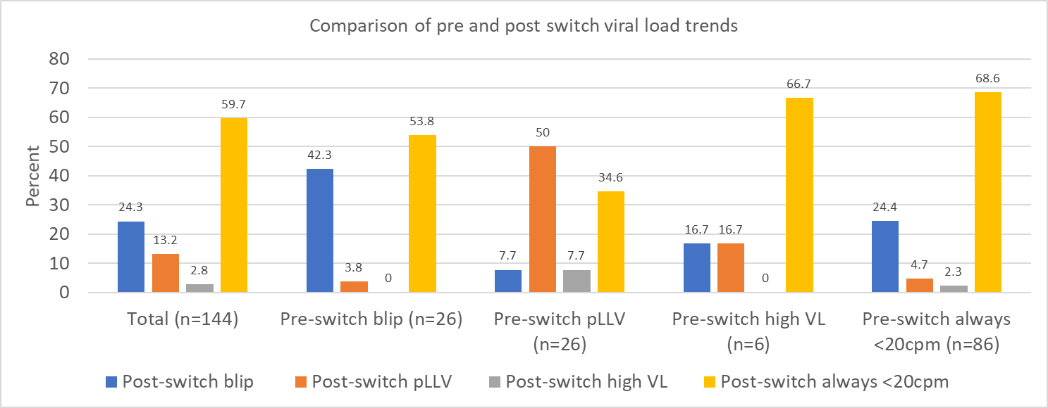
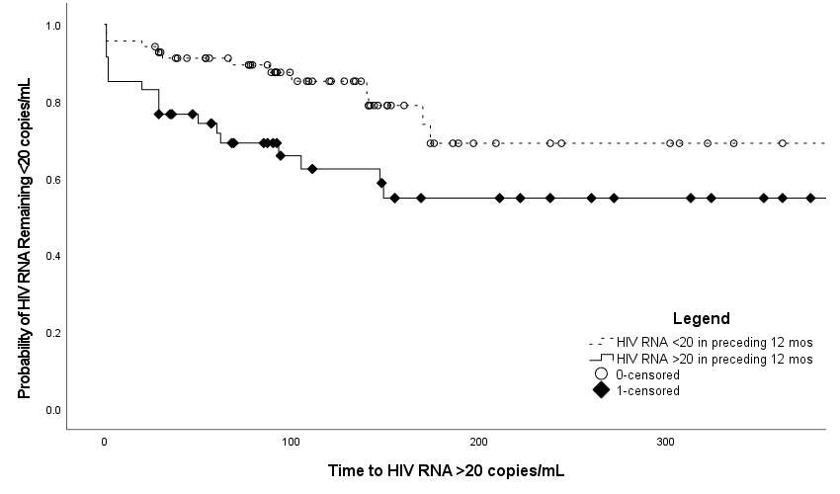
Post-switch viremia
Total participants = 144
Mean follow up = 278 days
After switching to LAI CAB/RPV:
  59.7% maintained all HIV RNA <20cpm
  81.9% maintained all HIV RNA <50cpm
  97.2% maintained all HIV RNA <200cpm
Four patients had viral loads >200cpm after switching to LAI CAB/RPV
  3 participants = re-suppressed
  1 participant = virologic failure
Owen clinic outcomes
Notes:
N = 144
Mean follow-up time after switching to LAI CAB/RPV was 278 days
After switching to LAI CAB/RPV, about 60%, 82%, and 98% of participants maintained all viral loads < 20, < 50, and < 200 cpm respectively
Within our total cohort, four patients had viral load increases >200cpm after switching to LAI CAB/RPV - 3 of which re-suppressed without intervention, and one of which developed virologic failure.
The figure on the top right shows a comparison of pre- and post-switch viral load trends within our four major categories. The x-axis represents pre-switch viral load trends, while the individual colored bars represent post-switch trends. Within the total cohort, about 60% of participants had post-switch VLs that were continually suppressed. I want to highlight that the group most likely to remain continually suppressed post-switch were those participants with pre-switch VL that were continually suppressed. Likewise participants with pLLV pre-switch were most likely to have pLLV post-switch, and in fact exactly 50% of participants with pre-switch pLLV continued to have pLLV after switching to LAI CAB/RPV.
Our time-to-event analysis (shown below) compared the probability of the viral load remaining <20 cpm post-switch in those with all pre-switch viral loads <20 cpm (solid line) and those with at least one viral load >20 cpm in the 12 months prior to switching to LAI CAB/RPV (dotted line). We found that participants with any detectable viremia (VL >20) prior to switching were less likely to have continual suppression post-switch, while those who were continually suppressed prior to switching had a higher probability of remaining undetectable post-switch.

Slide 31
Results
​In the multivariate regression model:
Having persistent low level viremia pre-switch was significantly associated with having at least one VL >20cpm post switch [OR 3.55 (1.54-8.66)]
​ | Total (n=144)​ | At least one VL ≥20cpm (n=58)​ | All VL <20 cpm (n=86)​ | p-value​
Median Age (IQR)​ | 44 (34-54)​ | 45 (33-53)​ | 41 (34-54)​ | 0.99
Race (%) White Black Asian Other/unknown | ​ 62 (43.1)​ 27 (18.8) 4 (2.8) 51 (35.4) | ​ 27 (46.6) 13 (22.4) 1 (1.7) 17 (29.3) | ​ 35 (40.7)​ 14 (16.3) 3 (3.5) 34 (39.5) | 0.51
Ethnicity (% Hispanic)​ | ​58 (40.3) | ​27 (46.6) | ​31 (36.0)​ | 0.46
Female​ SAB (%) | ​16 (11.1)​ | ​5 (8.6)​ | ​11 (12.8)​ | ​0.43
Completed oral lead-in (%)​ | 125 (86.8)​ | 49 (84.5)​ | 76 (88.4)​ | 0.50
Late injection or used oral bridge (%) ​ | 15 (10.4)​ | 5 (8.6)​ | 10 (11.6)​ | 0.56
CAB/RPV regimen (%) Every 1 month only Every 2 month only Switched to every 2 month | 3 (2.1) 73 (50.7) 68 (47.2) | 1 (1.7) 27 (46.6) 30 (51.7) | 2 (2.3) 46 (53.5) 38 (44.2) | 0.67
Median CD4 count (IQR)​ | 745 (520-941)​ | 809 (554-961)​ | 680 (504-923)​ | 0.08
Median BMI (IQR)​ | 26.9 (24.3-30.2)​ | 27.4 (24.6-31.7)​ | 26.4 (24.2-30.0)​ | 0.33
Pre-switch category (%)​ Blip 20-199 cpm​ pLLV​ High viral load​ Always <20 cpm​ | ​ 26 (18.1)​ 26 (18.1)​ 6 (4.2)​ 86 (59.7)​ | ​ 12 (20.7)​ 17 (29.3)​ 2 (3.4)​ 27 (46.6)​ | ​ 14 (16.3)​ 9 (10.5)​ 4 (4.7)​ 59 (68.6)​ | 0.0001​
Notes:
Here we looked at which participants in our cohort had detectable viral load (shown here as at least one VL >20 cpm), or undetectable viral load post-switch. As previously mentioned, our findings were similar when evaluating the data with cutoffs defined as both <20cpm and <50cpm post switch, but are summarized here using the cutoff of 20.
Baseline characteristics of our study cohort were similar to those of our general clinic cohort on oral standard of care ARVs.
We found that BMI, late injection, and monthly vs every 2 month dosing did not correlate w/ detectable viremia post-switch.
However, there was a significant difference in participants with persistent low level viremia prior to switching to LAI CAB/RPV. These participants were more likely to have at least one viral load >20 cpm post-switch, with an odds ratio of 3.55.

Slide 32
Owen Clinic Experience – CAB (Apretude®) for PrEP
119 active patients
  No seroconversions
21 discontinuations
  Injection site reactions (5)
  Relocated/transferred care (2)
  Lost to follow up (7)
  Change in HIV risk (1)
  Death (1)
  Insurance (2)
  Unable to adhere to injection schedule (3)

Slide 33
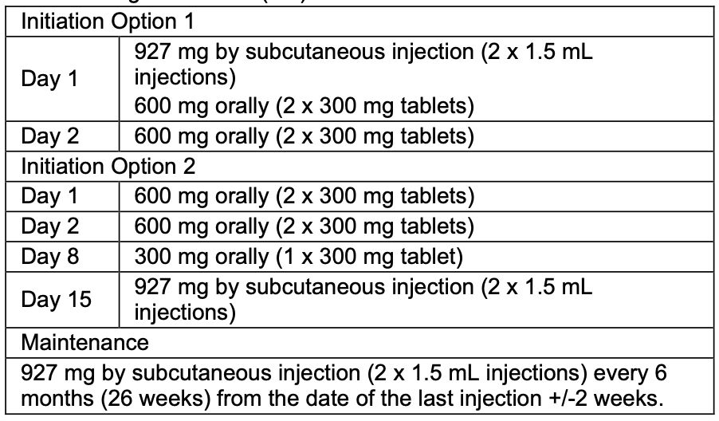
Lenacapavir (LEN; Sunlenca®) – Capsid Inhibitor
Indication: In combination with other antiretrovirals for the treatment of HIV-1 infection in heavily treatment-experienced adults with multidrug resistant HIV-1 infection failing their current antiretroviral regimen due to resistance, intolerance, or safety considerations.
Dosing

Slide 34
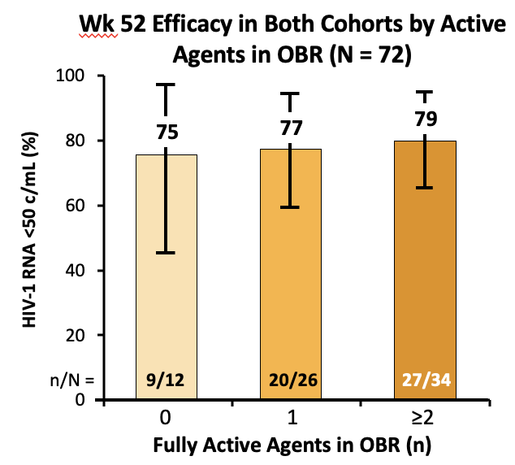
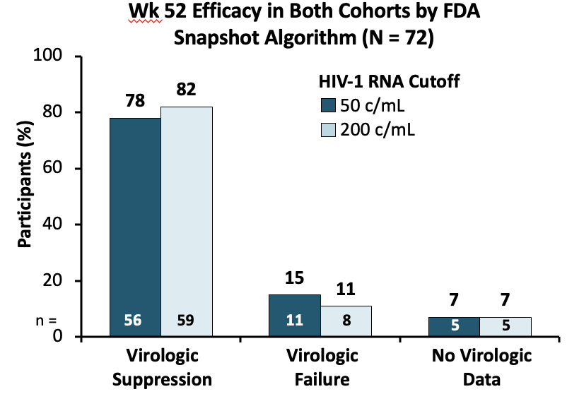
CAPELLA – 52 week results
Ogbuagu. IDWeek 2022. Abstr 1585.

Slide 35
CAPELLA - Resistance
21/22 who qualified for resistance analysis had data
9 (13%) with emergent LEN resistance
  M66I (6), Q67H/K/N (4), K70H/N/R/S (4), N74D (3), A105S/T (4), T107A/C/N (4)
All 9 participants either had poor adherence to the background regimen (5) or no active agents in the background regimen (4)
All 9 with resistance continued LEN
  4 resuppressed with (2) and without (2) change in optimized background regimen (OBR)
Ogbuagu. IDWeek 2022. Abstr 1585.

Slide 36
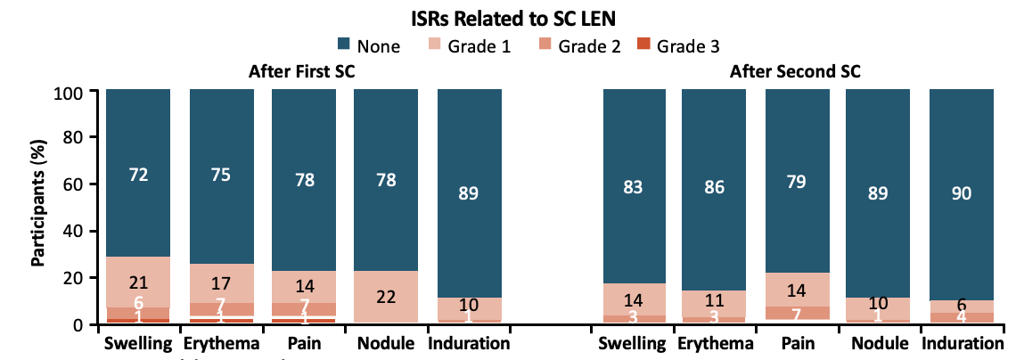
Injection Site Reactions
Ogbuagu. IDWeek 2022. Abstr 1585

Slide 37
Owen Clinic Experience
14 patients initiated on Lenacapavir (LEN)
Reasons for using LEN include:
  Detectable viral load and unable to adhere to oral therapy – given with Cabenuva (9)
  Suppressed viral load but high body weight and wants injectables – given with Cabenuva (1)
  Detectable viral load, unable to take oral therapy and resistance – regimen of IBA+CAB+LEN (1)
  Simplification in multi drug resistance with suppression – regimen of LEN+B/F/TAF+DOR (1)
  Unable to tolerate boosted Pis, drug resistance, not suppressed – regimen of B/F/TAF+LEN (1)
  Multi-drug resistance, suppressed, wanted to stop Trogarzo – regimen of LEN+FTR+D/c/F/TAF (1)
All patient still with only one injection, limited follow up on viral loads
One patient lost to follow up after first Cabenuva injection
1. B/F/TAF= Bictegravir/Emtricitabine/Tenofovir 2. D/c/F/TAF = Darunavir/Cobicistat/Emtricitabine/Tenofovir 3. FTR= Fostemsavir 4. DOR= Doravirine 5. CAB= Cabotegravir 6. IBA= Ibalizumab

Slide 38
Resources
National Clinician Consultation Center http://nccc.ucsf.edu/
  HIV Management
  Perinatal HIV
  HIV PrEP
  HIV PEP line
  HCV Management
  Substance Use Management
Present case on ECHO hivecho@salud.unm.edu
AETC National HIV Curriculum https://aidsetc.org/nhc
AETC National Coordinating Resource Center https://targethiv.org/library/aetc-national-coordinating-resource-center-0
Additional trainings scaetcecho@salud.unm.edu
www.scaetc.org
Notes:
Find an HIV-related topic TeleECHO in your area: https://echo.unm.edu/locations-2/echo-hubs-superhubs-united-states/
IDEA Platform: Infectious Diseases Education & Assessment. https://idea.medicine.uw.edu/
AETC National HIV Curriculum: 6 core modules for self study; regularly updated; CME, CNE
Hepatitis C Online Curriculum: https://www.hepatitisc.uw.edu/
Hepatitis B Online Curriculum: https://www.hepatitisb.uw.edu/
National STD Curriculum: https://www.std.uw.edu/

Slide 39
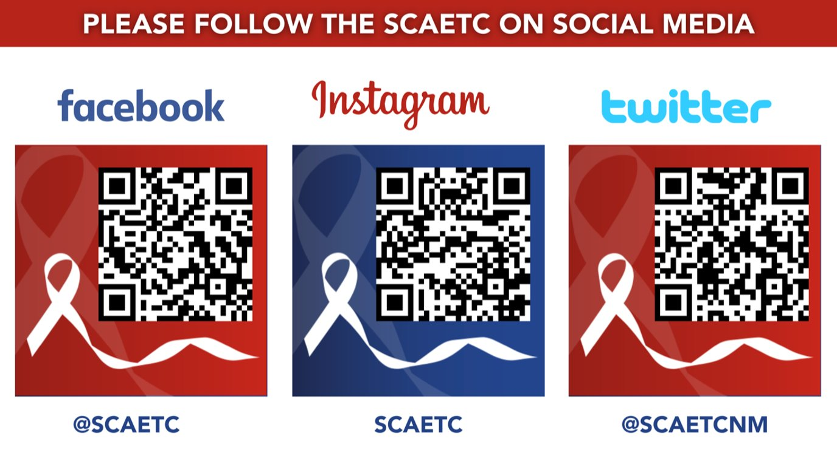
SCAETC Social Media

