Slide 1

HIV Basics
Epidemiology, Care, and Prevention
Notes:
Version date_July 20, 2023
Target participants: HIV Basics for members of the healthcare team in Texas
Some slides adapted from Pedro Coronado and Armando Molina, SCAETC- Valley AIDS Council

Slide 2





SCAETC Regional Collaborative Training

Slide 3
Conflict of Interest Disclosure Statement
Original slide developers:
  Shital M. Patel, MD & Melanie Goebel, MD; SCAETC-Baylor College of Medicine
  Some slides adapted from Pedro Coronado and Armando Molina, SCAETC- Valley AIDS Council
  Slide developers have no financial conflicts of interest to disclose
Speaker: Melanie Goebel, MD
  Speaker has no financial conflicts of interest to disclose
This program is supported by the Health Resources and Services Administration (HRSA) of the U.S. Department of Health and Human Services (HHS) as part of an award totaling $4,205,743 with 0% financed with non-governmental sources. The contents are those of the author(s) and do not necessarily represent the official views of, nor does mention of trade names, commercial practices, or organizations imply an endorsement by HRSA, HHS, or the U.S. Government. For more information, please visit HRSA.gov. Any trade/brand names for products mentioned during this presentation are for training and identification purposes only.
Notes:
Each site can add their slide here when they do the presentation

Slide 4
Unconscious Bias Disclosure
SCAETC recognizes that language is constantly evolving, and while we make every effort to avoid bias and stigmatizing terms, we acknowledge that unintentional lapses may occur in our presentations.
We value your feedback and encourage you to share any concerns related to language, images, or concepts that may be offensive or stigmatizing.
Your input will help us refine and improve our presentations, ensuring they remain inclusive and respectful to participants.

Slide 5
Sharing PDF Slides Statement
Please feel free to use and share in your noncommercial presentations to colleagues or patients
These slides may not be published, posted online, or used in commercial presentations without permission. Please contact HoustonAETC@bcm.edu for details

Slide 6
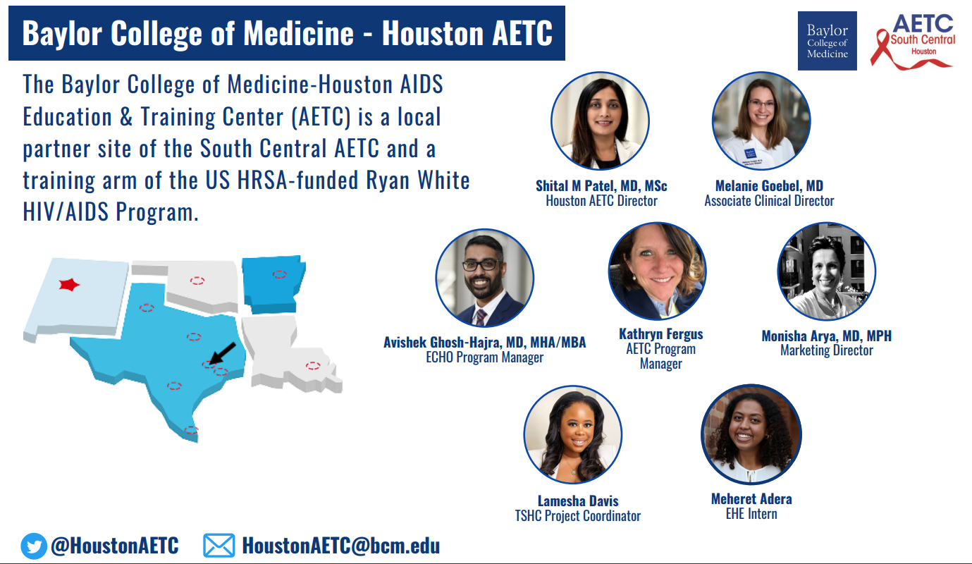


Slide 7
Learning Objectives
Interpret HIV epidemiology within the context of social determinants of health.
Differentiate between behaviors associated with HIV transmission versus ways HIV is not transmitted.
Identify current recommendations related to HIV screening, treatment and prevention.
Outline the steps of linkage and retention in care.

Slide 8
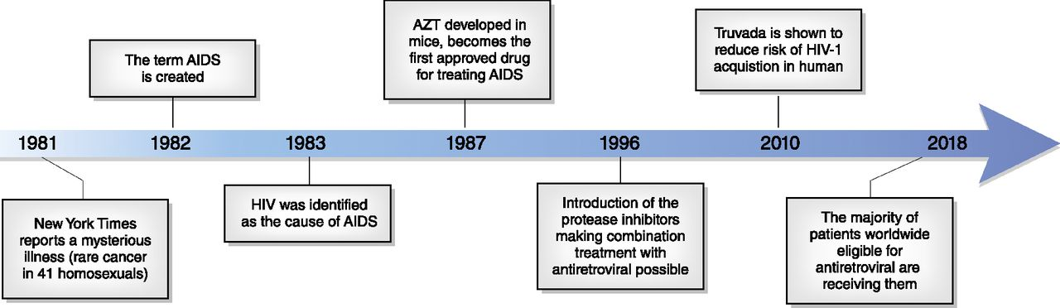
HIV Milestones
CJASN March 2019, 14 (3) 435-444; DOI: https://doi.org/10.2215/CJN.02240218
Notes:
In 1987, AZT or zidovudine, became the first approved drug for treating HIV
Combination antiretroviral therapy was introduced in 1996
In the last 40 years, there has been remarkable progress in the treatment of HIV
And in 2018, the majority of people eligible for antiretroviral therapy were receiving them

Slide 9
Definitions & Meanings
H
Human
Only affects HUMANS and lives in HUMANS
I
Immunodeficiency
Refers to a lack (deficiency) or breakdown of Immune System
V
Virus
Virus attacks and destroys the immune system which is usually able to defend against infections

Slide 10
Learning Objectives
Interpret HIV epidemiology within the context of social determinants of health.
Differentiate between behaviors associated with HIV transmission versus ways HIV is not transmitted.
Identify current recommendations related to HIV screening, treatment and prevention.
Outline the steps of linkage and retention in care.

Slide 11
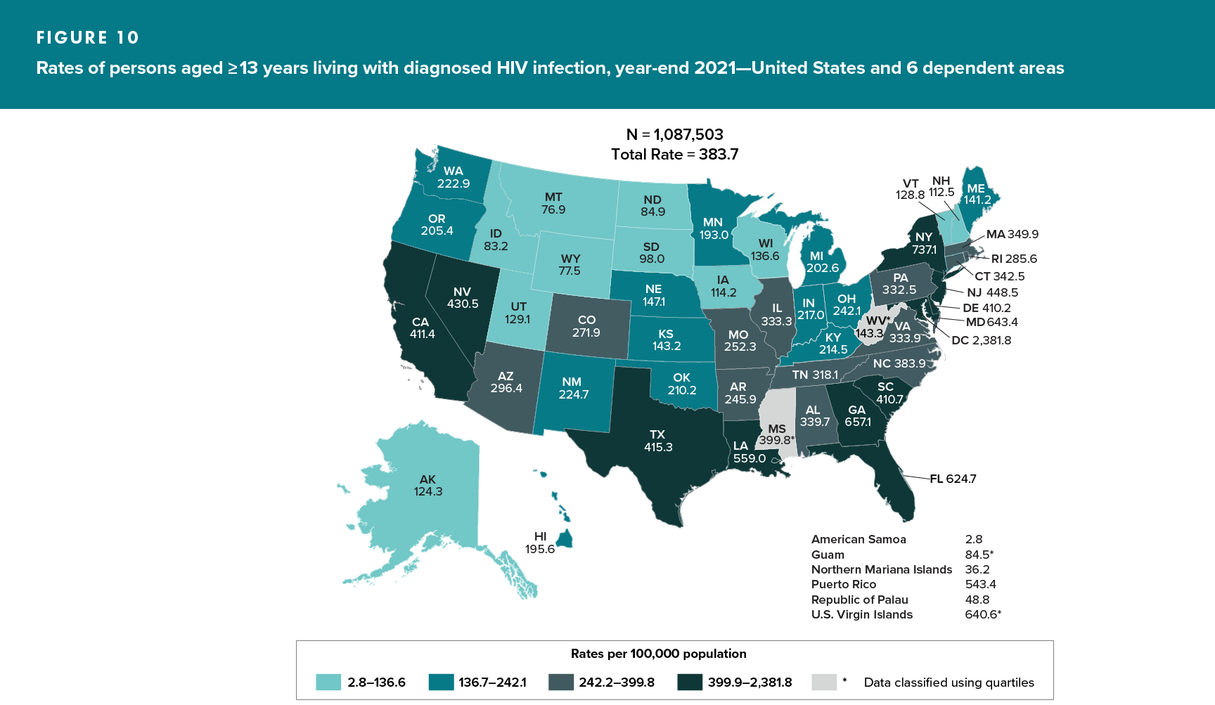
Prevalence of HIV in US
Centers for Disease Control and Prevention. HIV Surveillance Report, 2021; vol. 34. http://www.cdc.gov/hiv/library/reports/hiv-surveillance.html. Published May 2023.
Notes:
At year-end 2021 in the United States and 6 dependent areas, an estimated 1,087,503 persons were living with diagnosed HIV infection.
By region, the prevalence of diagnosed HIV infection was highest in the Northeast and Southern states including Texas

Slide 12
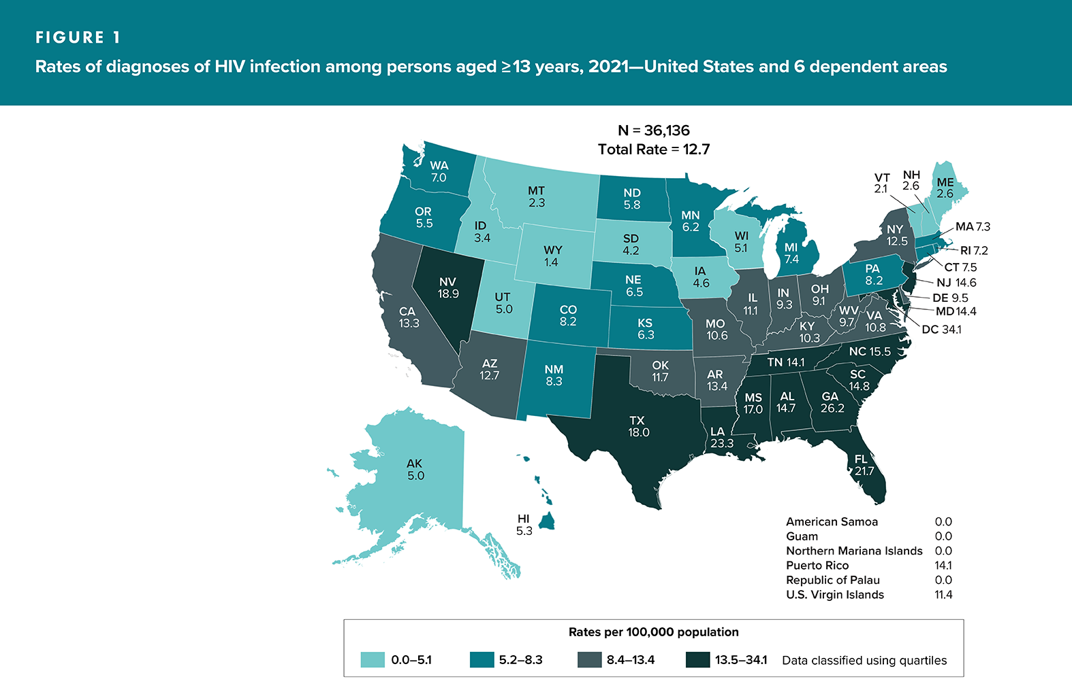
Diagnoses of HIV Infection
Centers for Disease Control and Prevention. HIV Surveillance Report, 2021; vol. 34. http://www.cdc.gov/hiv/library/reports/hiv-surveillance.html. Published May 2023.
Notes:
In 2021, 36,136 people were diagnosed with HIV in the US.
Notice that the rate is highest in the Southern US, including Texas, Louisiana, Georgia, and Florida

Slide 13
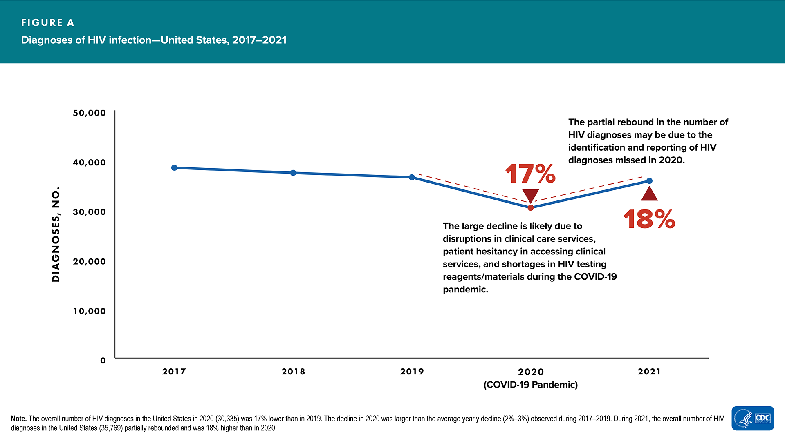
Diagnoses of HIV infection, 2017-2021
Centers for Disease Control and Prevention. HIV Surveillance Report, 2021; vol. 34. http://www.cdc.gov/hiv/library/reports/hiv-surveillance.html. Published May 2023.

Slide 14
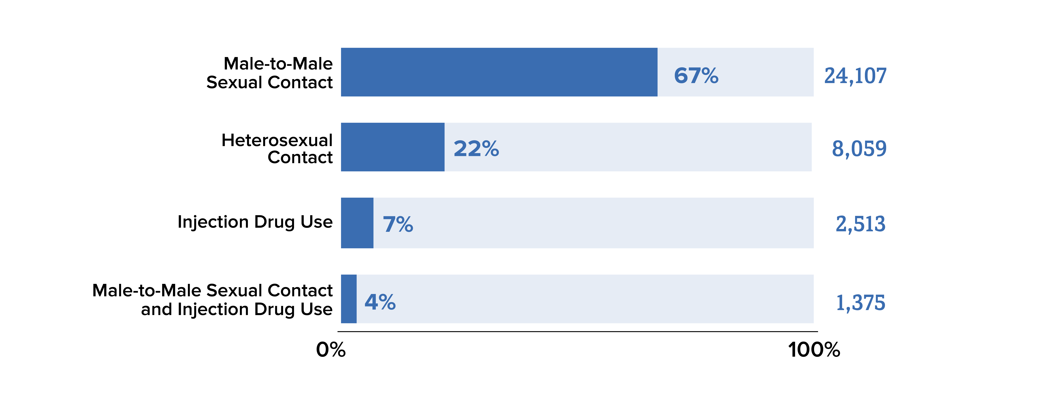
New HIV Diagnoses in US in 2021
Centers for Disease Control and Prevention. HIV Surveillance Report, 2021; vol. 34. http://www.cdc.gov/hiv/library/reports/hiv-surveillance.html. Published May 2023.
Notes:
Gay, bisexual, and other men who reported male-to-male sexual contact^{f} are the population most affected by HIV.
In 20121 gay and bisexual men accounted for 67% of the new HIV diagnoses
Heterosexuals accounted for 22% of new diagnoses.
People who inject drugs accounted for 7% of new diagnoses.

Slide 15
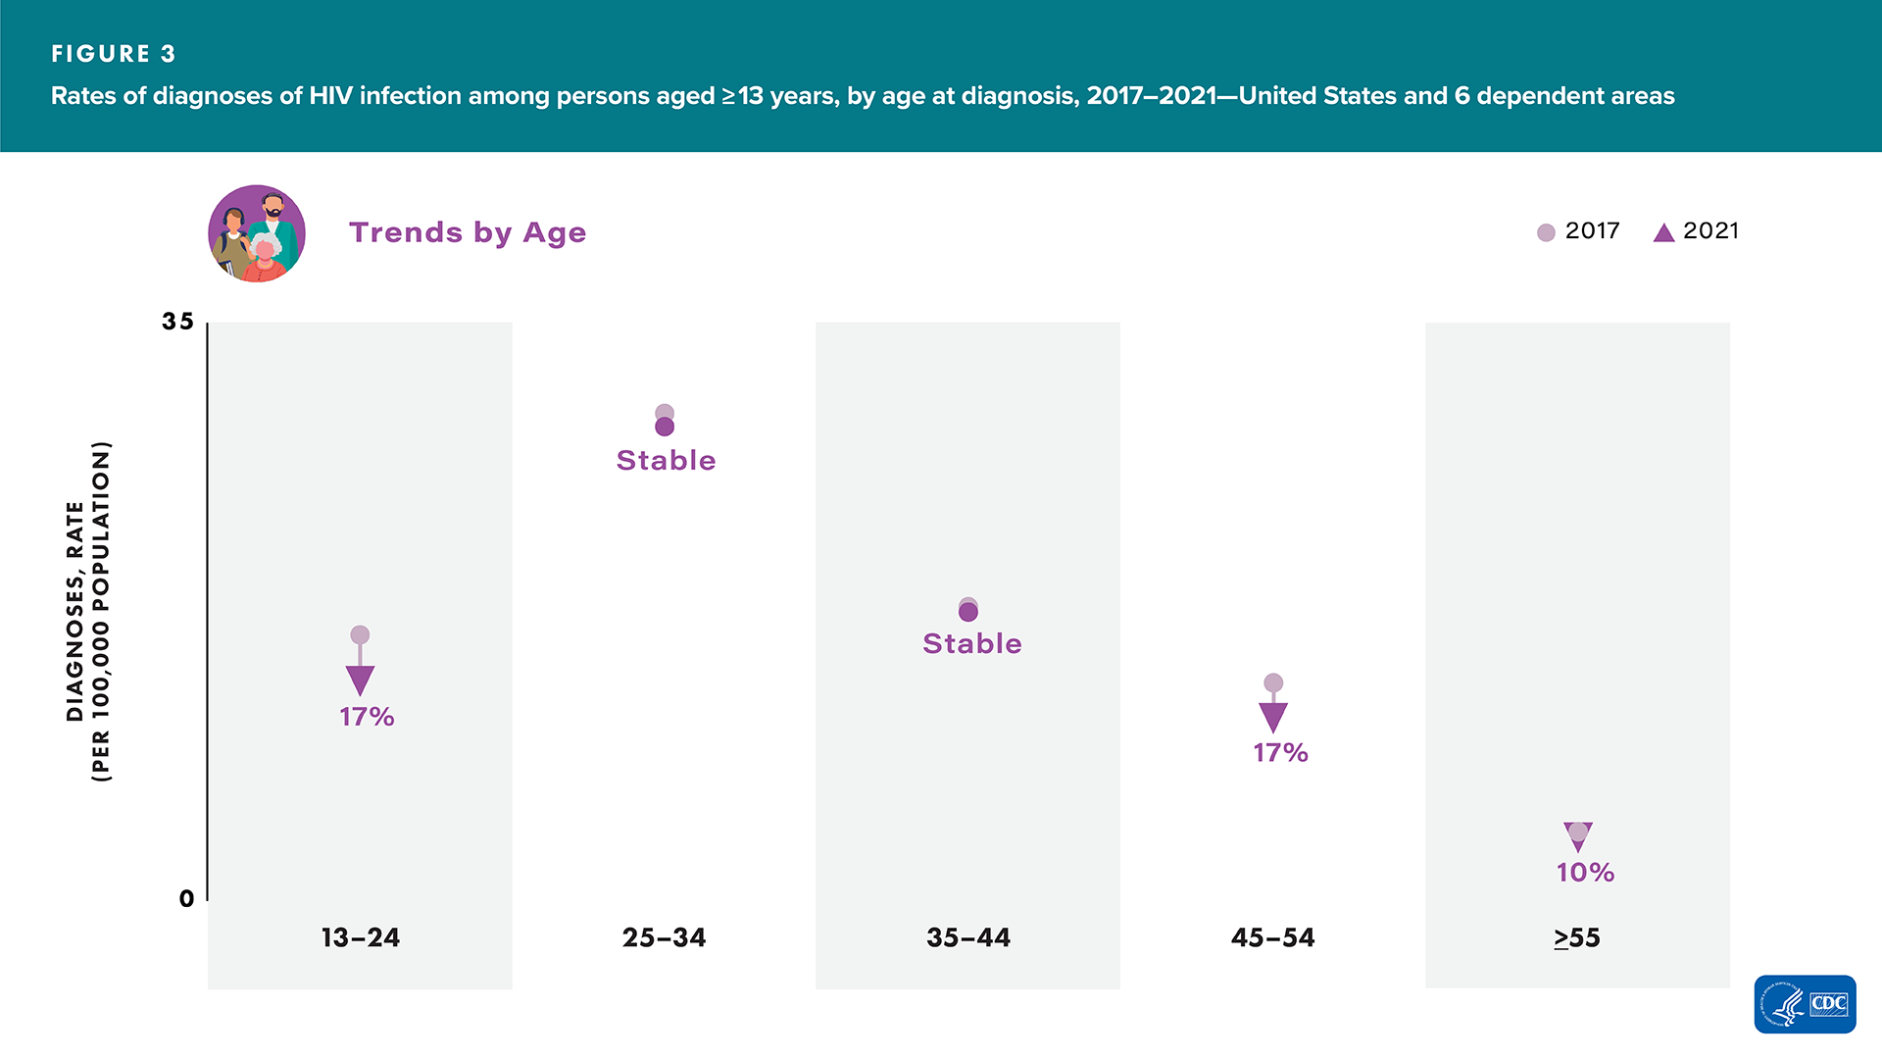
Rates of new HIV diagnoses are highest in people aged 25-34 years old
Centers for Disease Control and Prevention. HIV Surveillance Report, 2021; vol. 34. http://www.cdc.gov/hiv/library/reports/hiv-surveillance.html. Published May 2023.

Slide 16
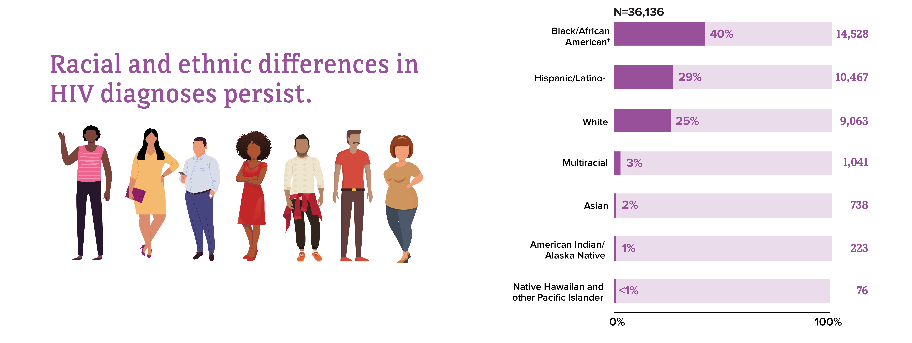
New HIV Diagnoses in 2021 by Race and Ethnicity
Centers for Disease Control and Prevention. HIV Surveillance Report, 2021; vol. 34. http://www.cdc.gov/hiv/library/reports/hiv-surveillance.html. Published May 2023.
Notes:
If we look at HIV diagnoses by race and ethnicity, we see that Black/African American people are most affected by HIV. In 2021, Black/African American people accounted for 40% (14,528) of all new HIV diagnoses. Additionally, Hispanic/Latino people are also strongly affected. They accounted for 29% (10,467) of all new HIV diagnoses.

Slide 17
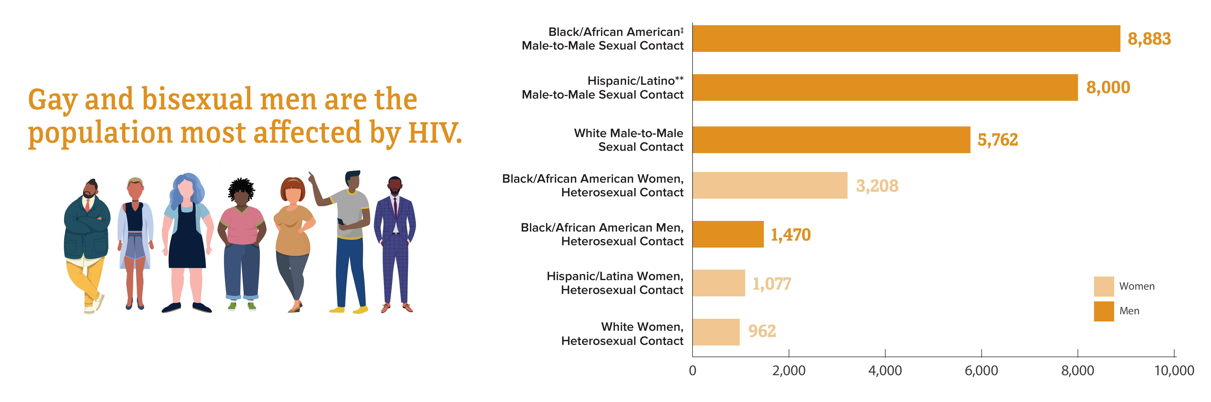
New HIV Diagnoses in 2021 by Subpopulation
Centers for Disease Control and Prevention. HIV Surveillance Report, 2021; vol. 34. http://www.cdc.gov/hiv/library/reports/hiv-surveillance.html. Published May 2023.
Notes:
The most affected subpopulation is Black/African American gay and bisexual men.

Slide 18
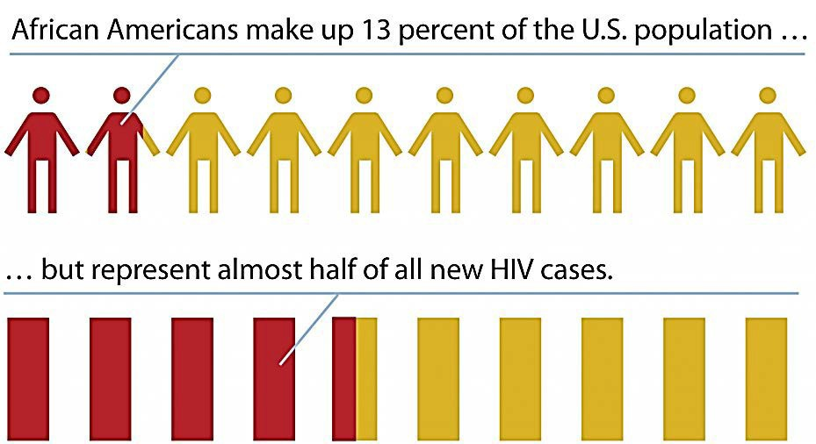
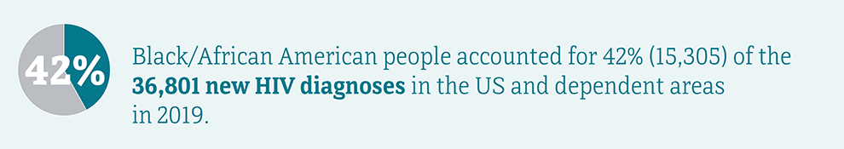
Health Disparity
“..the term used in epidemiology to describe differences, variations and disproportions in the health status of individuals or groups.”​
1) Kawachi,I., Subramanian, S., & Almeida-Filho (2002). A glossary for health inequalities. Journal of Epidemiology and Community Health: 56: 647 -652
Carter-Pokras, O., & Baquet, C. (2002). hat is a health disparity? Public Health Reports, 17: 426 - 434 http://www.cdc.gov/hiv/library/reports/hiv-surveillance.html.
Notes:
Adapted from Slides by Tim incent and JaDawn Wright Morgan on Social Determinants of Health and HIV-Related Health Equity
In 2019, Black/African American people made up 13% of the US population, but 42% (15,305)^{b} of the 36,801 new HIV diagnoses in the United States and dependent areas
Read definition – many of us are familiar with this term
Health disparities result in poor health status and poor health outcomes for vulnerable and/or disadvantaged communities
These differences in health status are often closely linked with social, economic, and/or environmental disadvantage
The example is from HIV –so how do you interpret this ---related to cause---(it really doesn’t imply causality)--but can be interpreted as a result of stigma, racism, homophobia, etc.
What disparities do you see in your work?

Slide 19
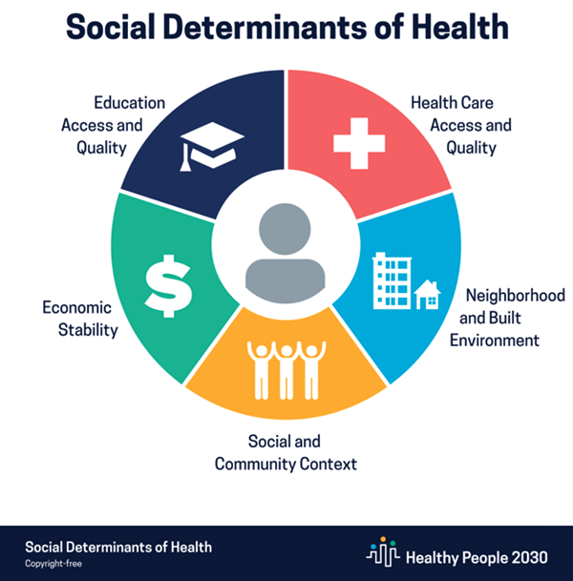
Why do we see health disparities?
  Conditions in which people are born, grow, live, work, pray and age
    shaped by distribution of money, power and resources at global, national, local levels
    influenced by policies and regulations
Adapted from World Health Organization, 2018
Notes:
Adapted from Slides by Tim incent and JaDawn Wright Morgan on Social Determinants of Health and HIV-Related Health Equity

Slide 20
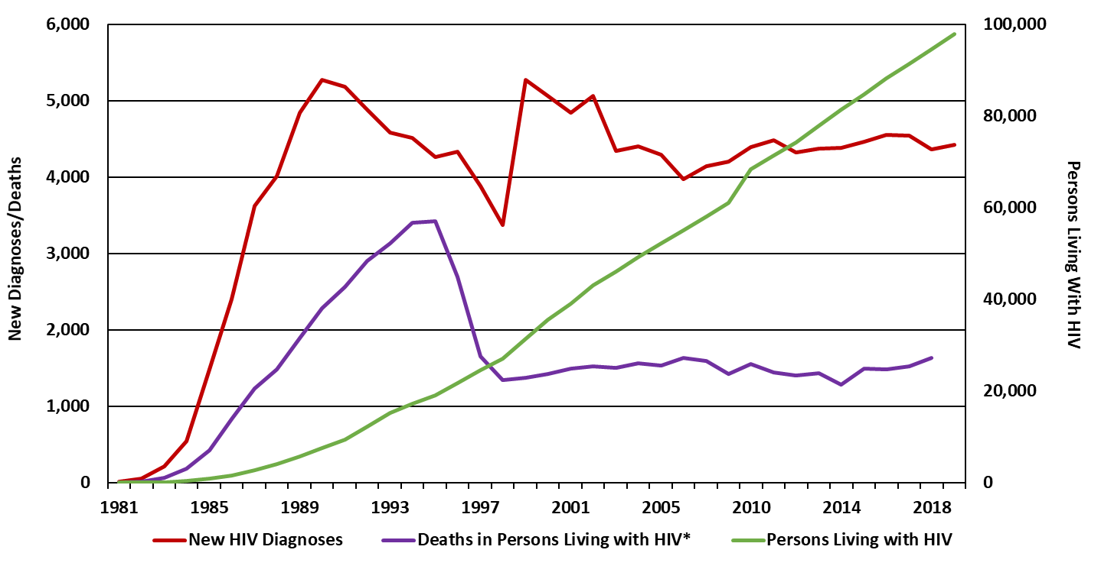

New HIV Diagnoses, Persons with HIV (PWH), and Deaths in Texas (1981-2019)
Texas HIV Surveillance Report 2019
Notes:
Effective treatment has extended the lifespans of people with HIV (PWH). As fewer persons with HIV die from HIV-related causes, the number of PWH continues to increase as additional persons are diagnosed.
https://www.dshs.texas.gov/hivstd/reports/

Slide 21
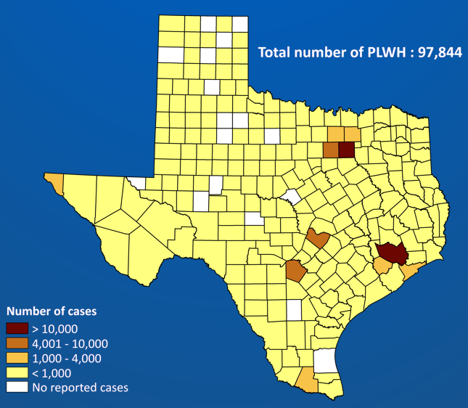
People Living with Diagnosed HIV by Texas County, 2019 (Prevalence)
Texas HIV Surveillance Report 2019
Notes:
In 2019, 97, 844 people were living with diagnosed HIV in Texas.
The highest prevalence is in big cities including Dallas and Houston

Slide 22
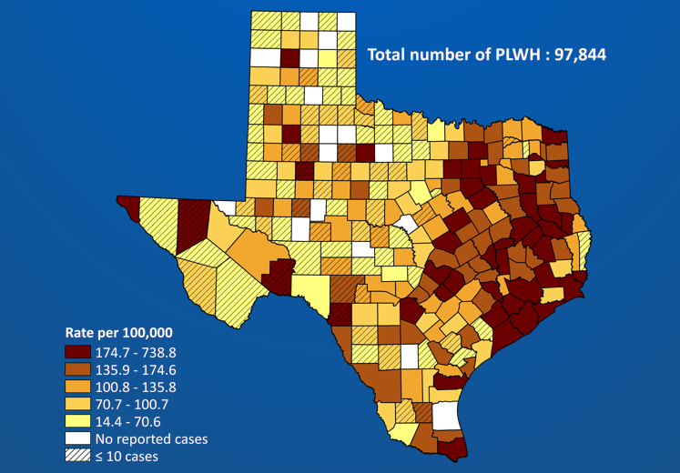
Rates of People Living with Diagnosed HIV by Texas County, 2019
Texas HIV Surveillance Report 2019

Slide 23
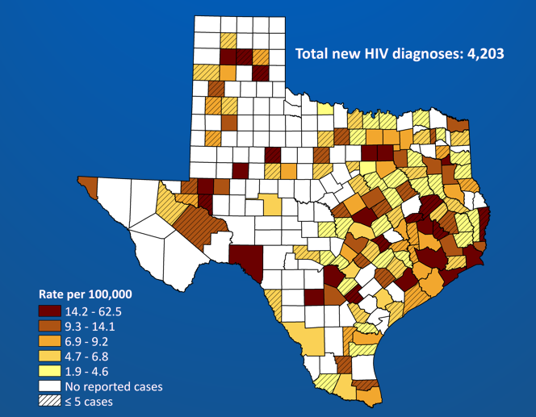
Rate of New HIV Diagnoses by Texas County, 2019 (Incidence)
https://www.dshs.texas.gov/hivstd/reports/
Notes:
In 2019, 4203 people were diagnosed with HIV in Texas
Rates are highest along the border and east Texas.

Slide 24
New HIV Diagnoses by Age at Diagnosis in Texas, 2019
Texas HIV Surveillance Report 2019
Notes:
The higher rates of new HIV diagnosis are among those aged under 40, with 25-29 year olds having the highest rates.
https://www.dshs.texas.gov/hivstd/reports/

Slide 25
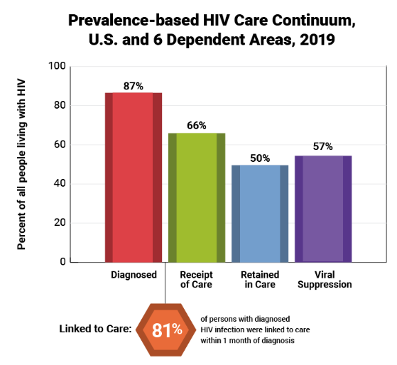
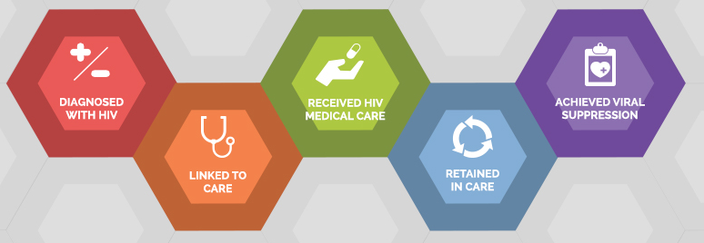
HIV Care Continuum in U.S.
Optimal viral suppression: HIV RNA level (viral load) below the level of detection (HIV RNA < 20 copies/mL)
*
*defined as < 200 copies/ml on most recent test
https://www.hiv.gov/federal-response/policies-issues/hiv-aids-care-continuum
Notes:
The HIV care continuum includes the steps between being diagnosed with HIV and achieving viral suppression
Optimal viral suppression is defined generally as a viral load persistently below the level of detection (HIV RNA <20 to 75 copies/mL, depending on the assay used).
Based on CDC data from 2019, 87% of people living with HIV were actually diagnosed, 66% were receiving care, 50% were retained in care, and 57% had viral suppression
For this data, viral suppression was defined as < 200 copies/mL on the most recent test
Definitions:
Receipt of care: CDC measures receipt of care as the percentage of persons with diagnosed HIV who had at least one CD4 or viral load test run by a health care professional in a given year.
Recention in care: CDC measures retention in care as the percentage of persons with diagnosed HIV who had two or more CD4 or viral load tests, performed at least three months apart.
Viral suppression: CDC measures viral suppression as a viral load test result of <200 copies/mL at the most recent viral load test during measurement year.
Linkage to care: CDC defines linkage as having one or more documented CD4 or viral load tests within 30 days (1 month) of HIV diagnosis. The denominator is limited to the number of people receiving an HIV diagnosis in a given year, rather than the total number of people living with HIV that is used in the calculations for the other continuum steps.
Diagnosis—An estimated 87% were diagnosed. That means that 13% of people with HIV (nearly 1 in 7) did not know they had HIV and were therefore not accessing the care and treatment they need to stay healthy and prevent transmitting the virus to their partners.
Receipt of Care—Approximately 66% had received HIV medical care. CDC measures receipt of care as the percentage of persons with diagnosed HIV who had at least one CD4 or viral load test run by a health care professional in a given year. Once in medical care, people can start HIV medicine to help them stay healthy and protect their partners. Initiating ART is recommended for all people with diagnosed HIV.
Retention in Care—Approximately 50% were retained in care. CDC measures retention in care as the percentage of persons with diagnosed HIV who had two or more CD4 or viral load tests, performed at least three months apart. People with HIV who have ongoing, regularly scheduled medical care have been shown to have better health outcomes and increased safer sexual behaviors.
Viral Suppression—An estimated 57% had achieved viral suppression. CDC measures viral suppression as a viral load test result of <200 copies/mL at the most recent viral load test during measurement year.
Linkage to care—According to CDC, of those who received an HIV diagnosis in 2019, 81% were linked to care within one month. This figure is calculated differently from other steps in the continuum, so it cannot be directly compared. CDC defines linkage as having one or more documented CD4 or viral load tests within 30 days (1 month) of HIV diagnosis. The denominator is limited to the number of people receiving an HIV diagnosis in a given year, rather than the total number of people with HIV that is used in the calculations for the other continuum steps. Rapid linkage to care is important because it can shorten the time to viral suppression, which helps people stay healthy and prevents sexual transmission of the virus.
Receipt of care = at least 1 test in 2019
Retained in care = at least 2 tests at least 3 months apart in 2019
Viral suppression: less than 200 copies/ml on the most recent test in 2019
Linkage to care: at least 1 test within 30 days of diagnosis

Slide 26
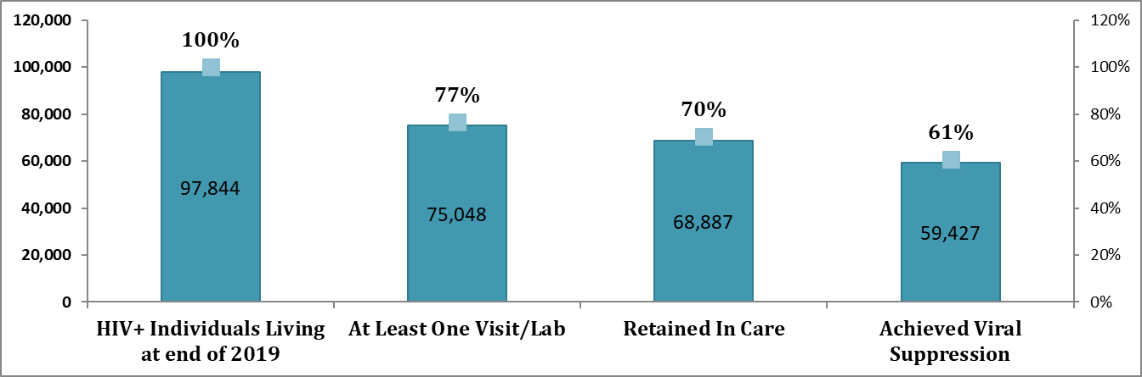
HIV Care Continuum in Texas, 2019
Number of Texans Living With HIV
Percentage
https://www.dshs.texas.gov/hivstd/reports/
Notes:
Out of the 97,844 Texans living with HIV by the end of 2019, 77% had at least one doctor’s visit or labs drawn, 70% were retained in care, and more than half (61%) have achieved viral suppression.

Slide 27
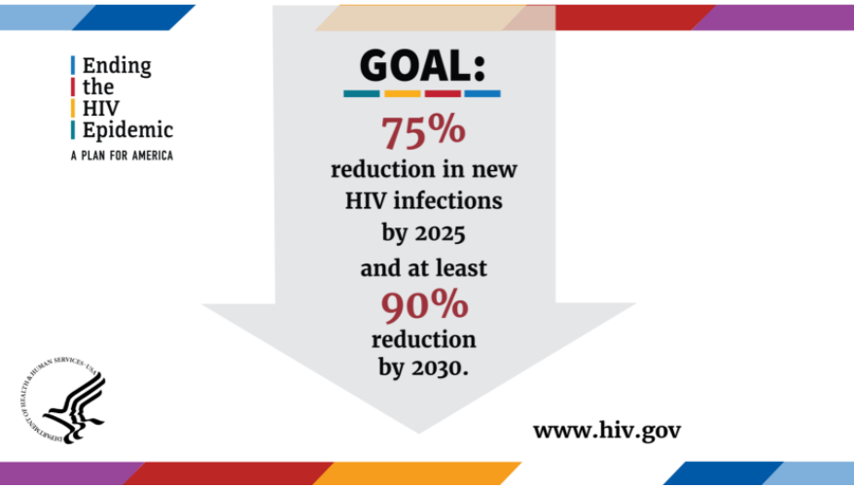
ENDING THE HIV EPIDEMIC: A PLAN FOR AMERICA
Phase 1: reduce new infections by 75% in
5 years
Phase 2: Widely disseminate effort to reduce by 90% in the following 5 years
Phase 3: Intense case management to maintain the number of new infections at <3,000 per year
https://www.hiv.gov/federal-response/ending-the-hiv-epidemic/overview/
Notes:
Ending the HIV Epidemic in the U.S. (EHE) is a bold plan announced in 2019 that aims to end the HIV epidemic in the United States by 2030.
There are 3 phases in the plan:
In its first phase, the initiative is focusing on areas where HIV transmission occurs most frequently, providing 57 geographic focus areas with an infusion of additional resources, expertise, and technology to develop and implement locally tailored EHE plans.
Phase 2: then expands the efforts to other parts of the US
Phase 3: includes efforts to help maintain the number of new infections at <3000 per year.
Over all GOAL:
The initiative seeks to reduce the number of new HIV infections in the United States by 75 percent by 2025, and then by at least 90 percent by 2030, for an estimated 250,000 total HIV infections averted.
https://www.hiv.gov/federal-response/ending-the-hiv-epidemic/overview

Slide 28
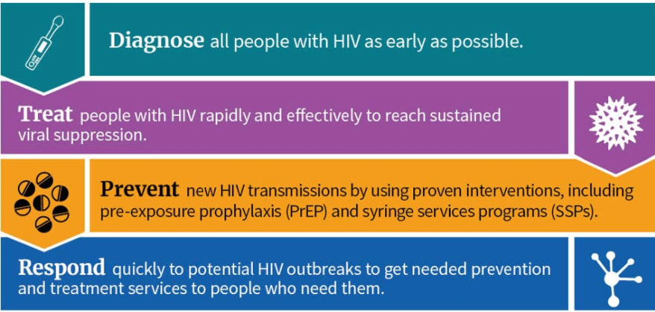
The 4 Pillars - Key Strategies
https://www.hiv.gov/federal-response/ending-the-hiv-epidemic/overview/

Slide 29
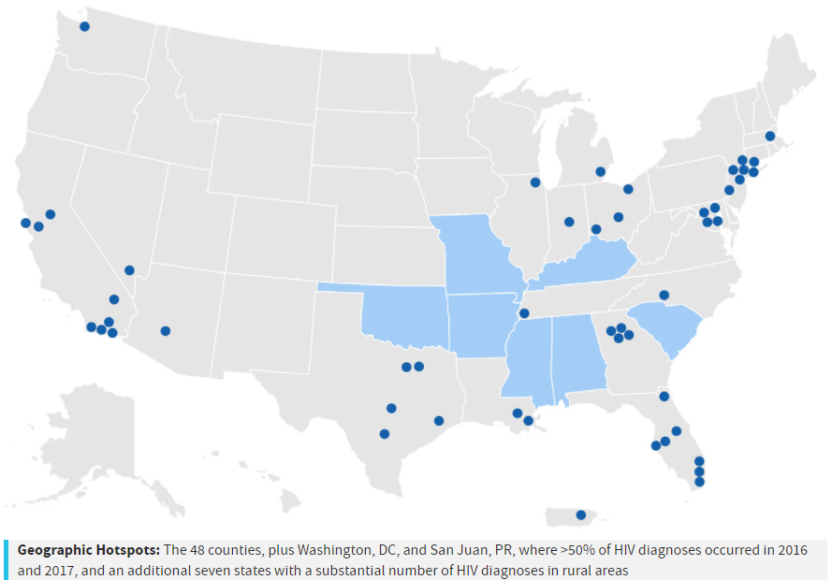
Priority jurisdictions
First 5 years: Phase 1
Focus on 57 priority jurisdictions
48 counties where >50% of new HIV diagnoses occurred in 2016 and 2017, and also seven states with a disproportionate occurrence of HIV in rural areas
https://www.hiv.gov/federal-response/ending-the-hiv-epidemic/overview/
Notes:
Who are these priority jurisdictions – there are 57. they are areas where >50% of the new HIV diagnoses occurred in 2016 and 2017, and also seven states with a substantial number of new HIV diagnoses in rural areas. Texas has 5 priority areas and Houston/Harris County is one of those.

Slide 30
Learning Objectives
Interpret HIV epidemiology within the context of social determinants of health.
Differentiate between behaviors associated with HIV transmission versus ways HIV is not transmitted.
Identify current recommendations related to HIV screening, treatment and prevention.
Outline the steps of linkage and retention in care.

Slide 31
How is HIV transmitted?
Contact with certain body fluids from a person with HIV:
  Blood
  Semen
  Pre-seminal fluid
  Vaginal fluids
  Rectal fluids
  Breast milk

Slide 32
Transmission Risks of Different Exposures
Exposure | Risk/10,000 exposures | 95% CI
Blood transfusion | 9250 | 8900-9610
Needle-sharing IDU | 63 | 41-92
Needle stick | 23 | 0-46
Receptive AI | 138 | 102-186
Insertive AI | 11 | 4-28
Receptive PVI | 8 | 6-11
Insertive PVI | 4 | 1-14
Receptive oral | Low | 0-4
Insertive oral | Low | 0-4
Mother-to-child | 2260 | 1700-2900
Parental
Sexual
Vertical
IDU: Injecting Drug Users AI: anal intercourse, PVI: penile-vaginal intercourse
AIDS. 28(10):1509-1519, June 19, 2014.
Notes:
These are average estimates. There are many mitigating factors, the most important of which is HIV viral load

Slide 33
NOT Considered Infectious for HIV Unless Visibly Bloody
Feces
Nasal Secretions
Saliva
Sputum
Sweat
Tears
Urine
Vomitus

Slide 34
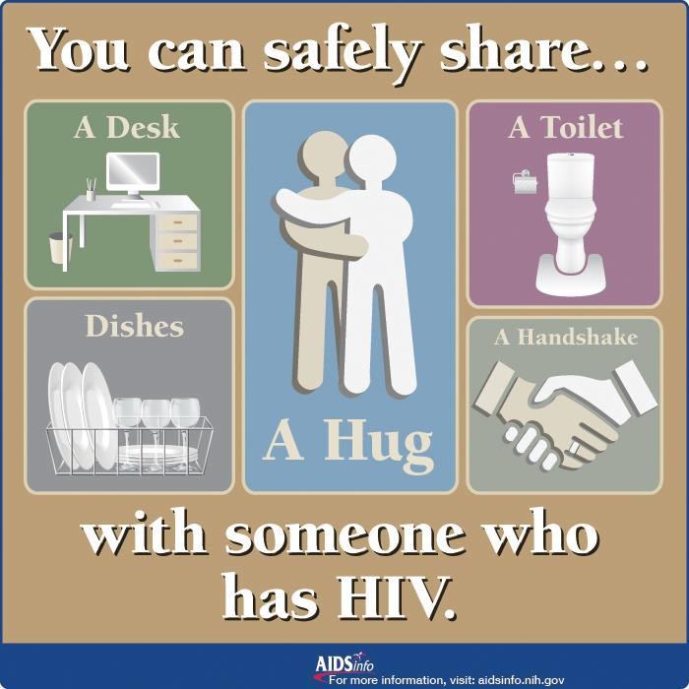
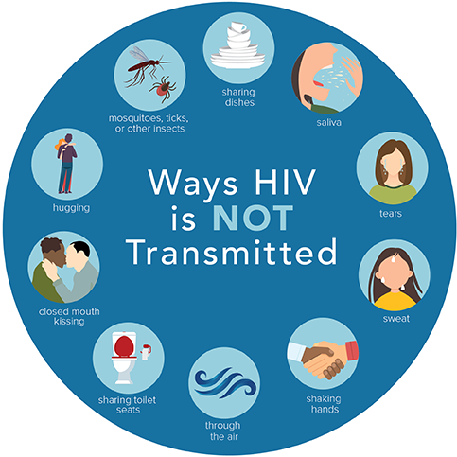
Ways HIV is not transmitted
https://www.cdc.gov/hiv/basics/hiv-transmission/not-transmitted.html
Notes:
Not infectious: Urine, Saliva, Sweat, Tears, Nasal secretions, Sputum, Vomitus, Stool

Slide 35
Reducing Transmission of HIV
Increase testing & linkage to care
Delayed or fewer partners
Increased condom use
Empowerment and negotiation skills
Reduce alcohol & drug use
Reduce psychosocial barriers
Circumcision
STI treatment
HIV PEP
HIV PrEP
STI= sexually transmitted infection; PEP= post-exposure prophylaxis; PrEP= pre-exposure prophylaxis

Slide 36
Learning Objectives
Interpret HIV epidemiology within the context of social determinants of health.
Differentiate between behaviors associated with HIV transmission versus ways HIV is not transmitted.
Identify current recommendations related to HIV screening, treatment and prevention.
Outline the steps of linkage and retention in care.

Slide 37
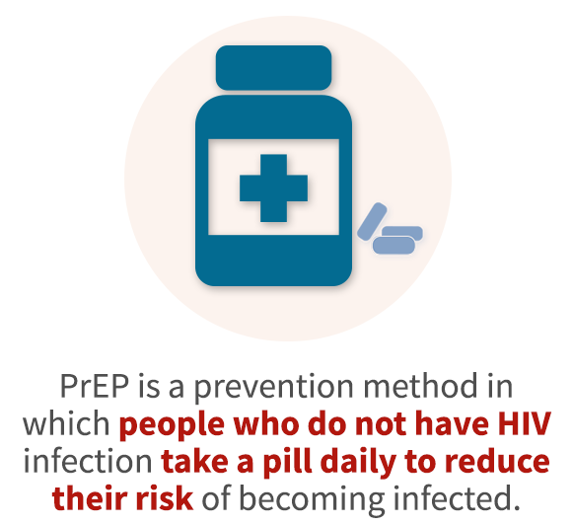
HIV Pre-Exposure Prophylaxis (PrEP)
Current FDA-approved medications for PrEP:
  Tenofovir/Emtricitabine (Truvada®* or Descovy®**)
    1 tablet by mouth once a day
    Prescribe for ≤ 90-day supply
    Approved for adolescents & adults > 35kg
  Cabotegravir (Apretude®***)
    Intramuscular injection given by a healthcare provider once monthly for 2 doses, then once every 2 months
  PrEP given USPSTF Grade A Recommendation
*TDF/FTC FDA approved indication in adults 7/12 and for youth 5/18; now available as generic
**TAF/FTC FDA approved for PrEP (except receptive vaginal sex) 10/19 ***CAB FDA approved for PrEP 12/21
https://www.cdc.gov/hiv/guidelines/preventing.html
Notes:
Since 6/2019, PrEP given USPSTF Grade A Recommendation

Slide 38
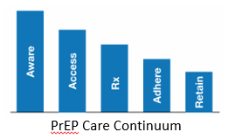
Need for PrEP to reach more people at risk
Continued disparities among certain populations with new HIV infections and lack of access to HIV PrEP
Interventions to improve metrics at each step of PrEP care continuum could reduce disparities
Jenness, S et al. CROI2018. Abstract 1149
Notes:
-Jenness, S et al. CROI2018. The PrEP care continuum and HIV racial disparities among MSM. Abstract 1149. Mathematical model of HIV transmission for MSM to include race-stratefied transitions through PrEP continuing from awareness to access to rx to adherence to retention.
https://www.cdc.gov/mmwr/volumes/68/wr/pdfs/mm6827-H.pdf

Slide 39

What is nPEP?
nPEP = nonoccupational post-exposure prophylaxis
Medication to prevent HIV after a potential exposure
Must be started within 72 hours of possible exposure to HIV
  From sex (for example, if the condom broke),
  Through sharing needles, syringes, or other equipment to inject drugs (for example, cookers), or
  After sexually assault
Must complete 4-week course
https://www.cdc.gov/hiv/basics/pep/about-pep.html
Notes:
PEP given for 28 days (many pharmacies will dispense 30-d supply but some state DOH programs provide 4 week/28d supply
Not a substitute for regular use of other HIV prevention
Not the right choice for people who may be exposed to HIV frequently

Slide 40
HIV Screening Recommendations
CDC: test everyone between ages of 13 and 64 years old at least once as part of routine health care
  For those at higher risk, test at least once a year
U.S. Preventative Services Task Force Grade A recommendation: screen all pregnant persons and all adolescents and adults aged 15 to 65 years old
  Screen younger adolescents and older adults at increased risk of infection
https://www.cdc.gov/hiv/testing/index.html
https://www.uspreventiveservicestaskforce.org (USPSTF 2019 recommendation)
Notes:
https://www.uspreventiveservicestaskforce.org/uspstf/recommendation/human-immunodeficiency-virus-hiv-infection-screening

Slide 41
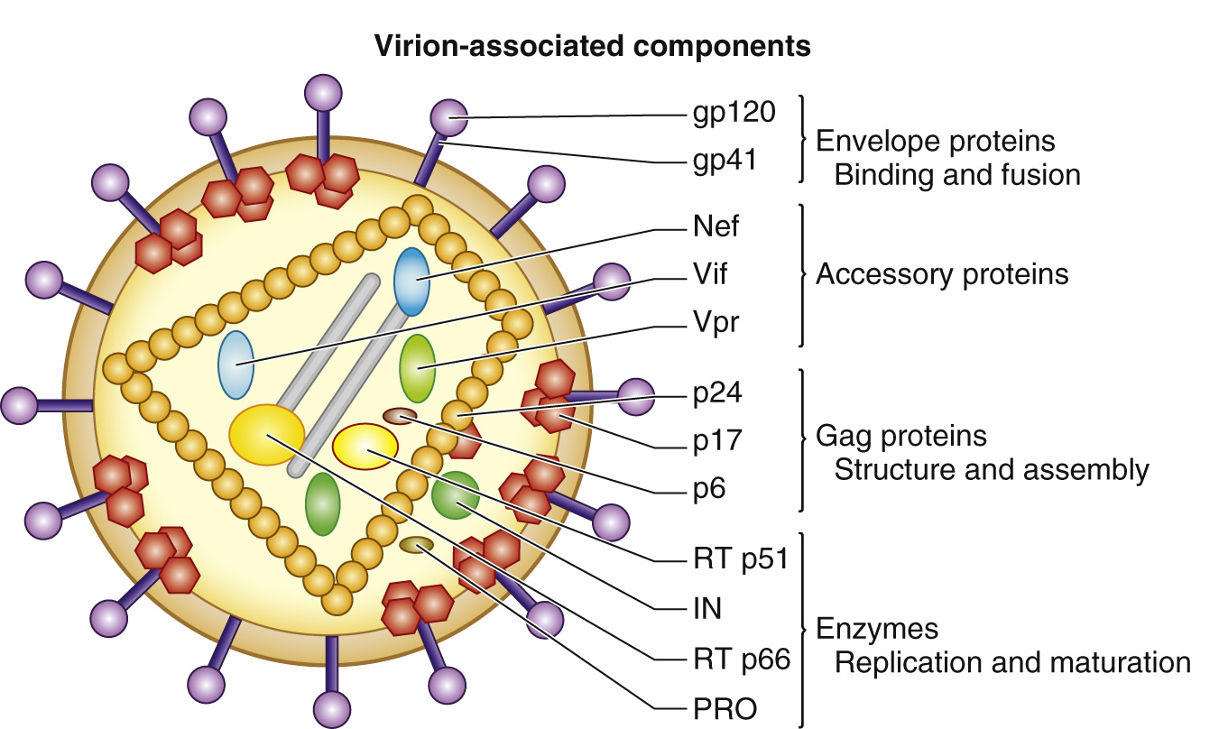
HIV testing
Three types of HIV tests are available:
  Nucleic acid amplification tests (NAATs) — detect HIV ribonucleic acid (RNA)
  Antigen/antibody combination tests — detect HIV p24 antigen as well as HIV immunoglobulin M (IgM) and immunoglobulin G (IgG) antibodies
  Antibody tests — detect HIV IgM and/or IgG antibodies
Mandell, Douglas, and Bennett's Principles and Practice of Infectious Diseases. 2020

Slide 42
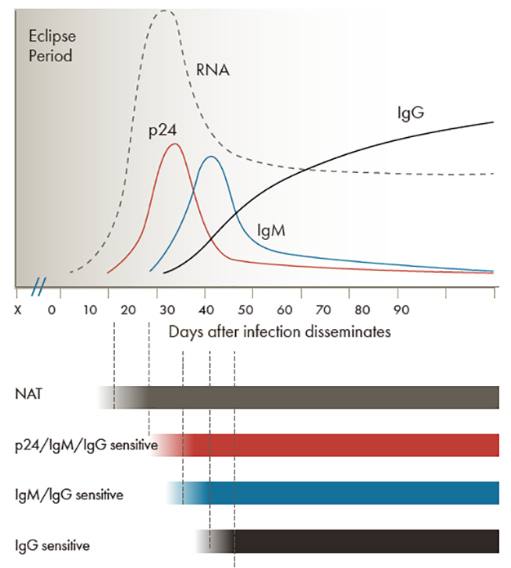
Laboratory markers for HIV-1 infection
Eclipse period: time during which no existing diagnostic test can detect HIV
Window period: time between acquisition of HIV and when the lab test will detect HIV in almost all persons
https://www.cdc.gov/hiv/clinicians/screening/diagnostic-tests.html
https://www.hiv.uw.edu/go/screening-diagnosis/diagnostic-testing/core-concept/all#tests-used-diagnosis-hiv
Notes:
Immediately after HIV acquisition, no viral markers will be positive. The time during which no existing diagnostic test is capable of detecting HIV is called the eclipse period.
The window period is the time between acquisition of HIV and the time when that specific lab test will accurately detect HIV in almost all persons. This window period depends on the diagnostic test used.
Following HIV acquisition, HIV RNA is first detectable on standard laboratory tests approximately 10 to 11 days after infection
P24 antigen, which is part of the combination tests, can be detected by 4th generation immunoassays within 4-10 days after the emergence of HIV RNA
Next, IgM antibodies are detectable about 3-5 days later, followed by IgG antibodies which appear 2-6 weeks after initial HIV RNA detection
Additional information: Window Period: The window period is most often defined as the time between acquisition of HIV and the time when the laboratory test will accurately detect HIV infection in almost all persons. The window period depends on the diagnostic test used. From a practical standpoint, the window period is used as the time period to rule out HIV infection after a potential exposure. The CDC recommends using 45 days as the window period for laboratory-based HIV-1/2 antigen-antibody assays, and 90 days after all HIV antibody tests and all HIV point-of-care tests.

Slide 43
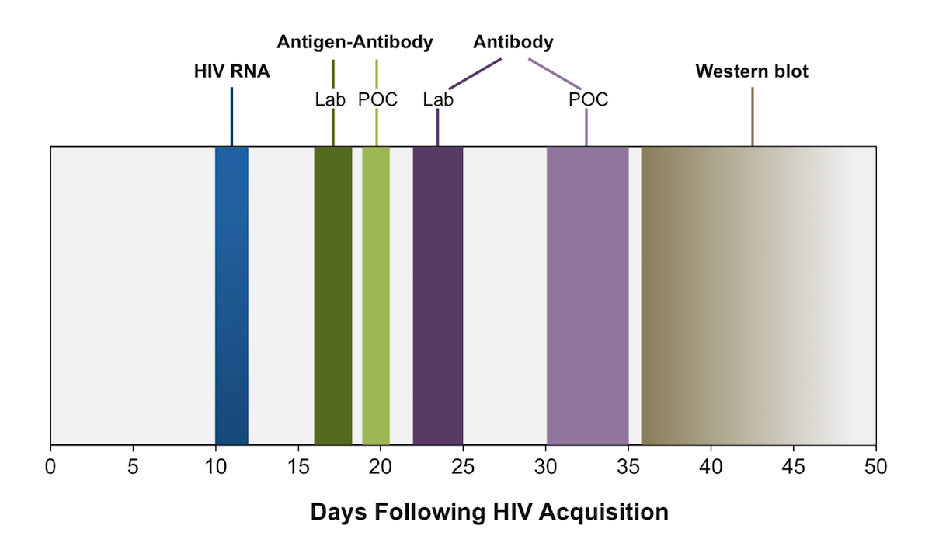
Timing of positivity for HIV diagnostic tests
POC=
point-of-care
https://www.hiv.uw.edu/go/screening-diagnosis/diagnostic-testing/core-concept/all

Slide 44
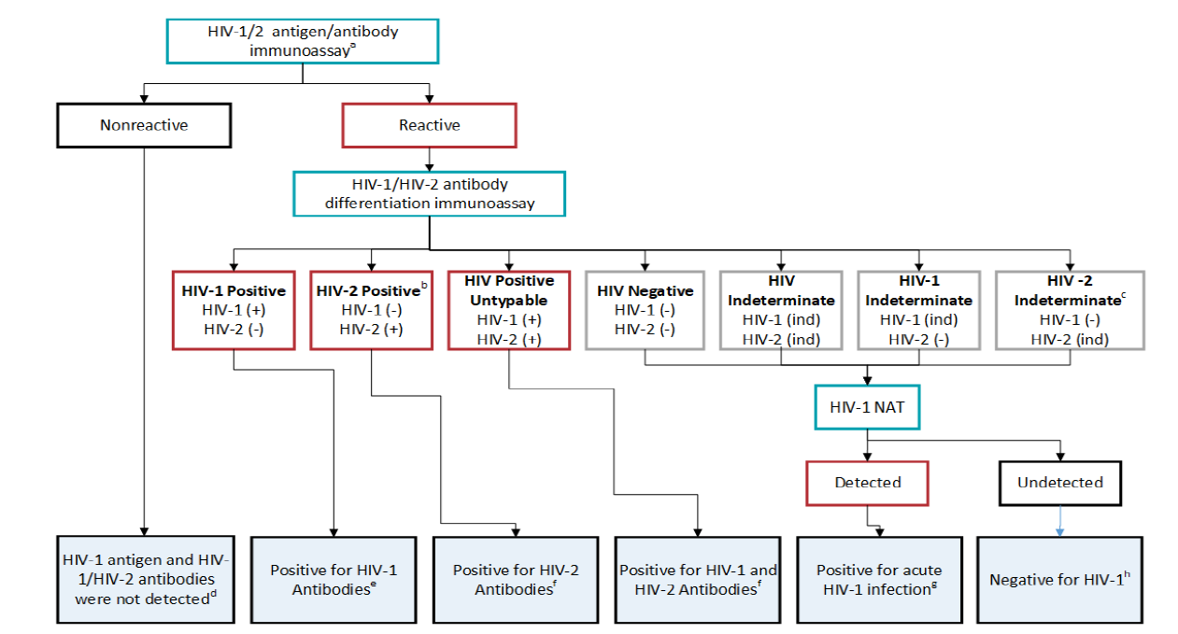
HIV testing algorithm
https://www.aphl.org/aboutAPHL/publications/Documents/ID-2019Jan-HIV-Lab-Test-Suggested-Reporting-Language.pdf
Notes:
This algorithm is modified from the CDC algorithm and published by the association of public health laboratories
APHL and CDC recommend that labs use an FDA-approved instrumented HIV 1/2 antigen/antibody immunoassay as the initial assay in the HIV testing algorithm. The fda-approved single-used rapid HIV-1/HIV-2 antigen/antibody immunoassay can be used if an instrumented assay is not available
This includes specimens reported as HIV-2 positive with HIV-1 cross reactivity
Per the Geenius package insert, specimens with this final assay interpretation should be retested with a new cartridge. If the final assay interpretation is again HIV-2 indeterminate, its should be reported as such and followed with an HIV-1 NAT
If recent HIV exposure is suspected or reported, conduct HIV-1 NAT or request a new specimen and repeat the algorithm according to CDC guidance
Link patient to HIV medical care and provide appropriate prevention counseling
Link patient to HIV medical care and provide appropriate prevention counseling. Provider may consider additional testing
Link patient to HIV medical care and provide appropriate prevention counseling immediately to expedite prevention practices
A negative HIV-1 NAT result and repeatedly HIV-2 indeterminate or HIV indeterminate antibody differentiation immunoassay result should be referred for testing with a different validated supplemental HIV-2 test (antibody test or NAT) if available. Alternatively, redraw and repeat algorithm in 2-4 weeks to assess HIV-2 infection

Slide 45
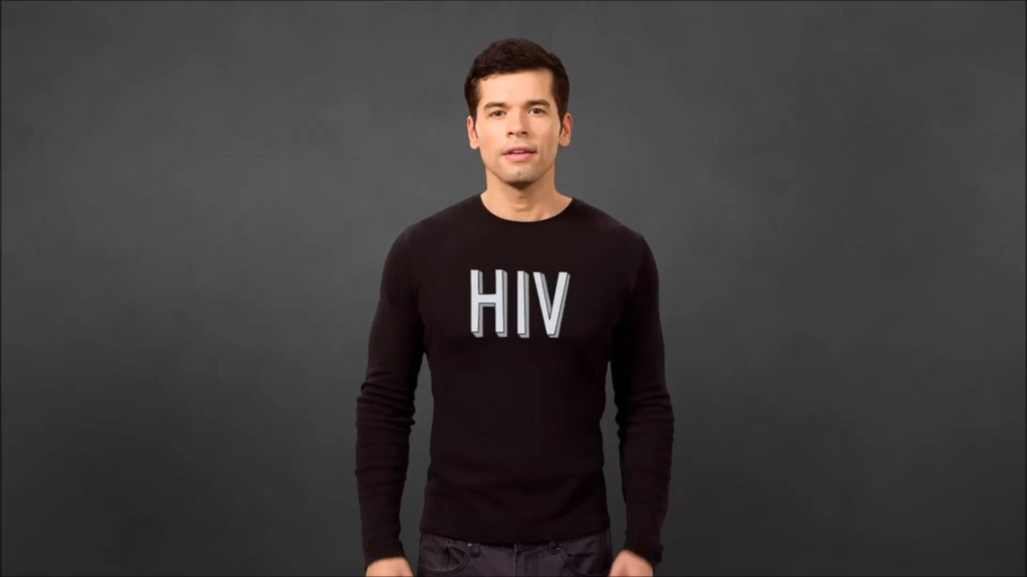
HIV: What’s going inside the body
https://www.youtube.com/watch?v=TYNiE6BnXp0

Slide 46
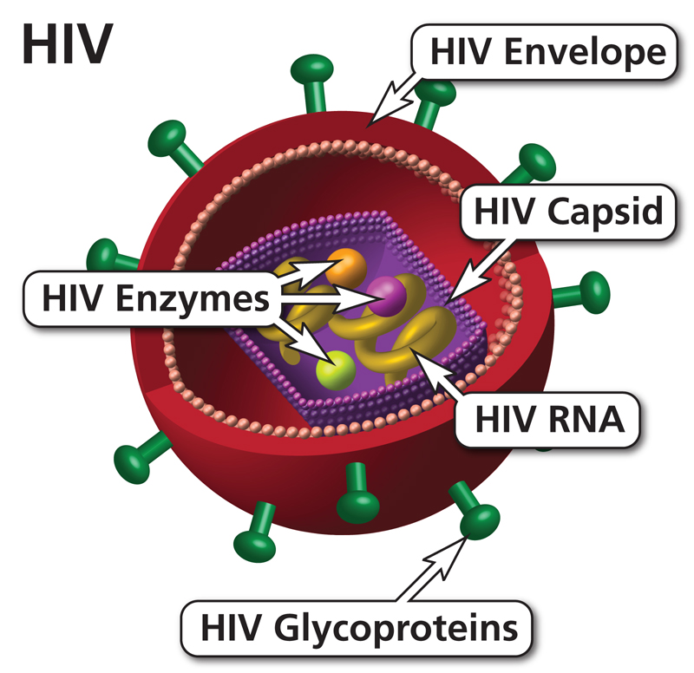
Human Immunodeficiency Virus
Retrovirus
Targets CD4+ T-cells and macrophages
Lives and multiplies inside of cells
Latent (dormant) in resting cells
Destroys active cells
https://clinicalinfo.hiv.gov/en

Slide 47
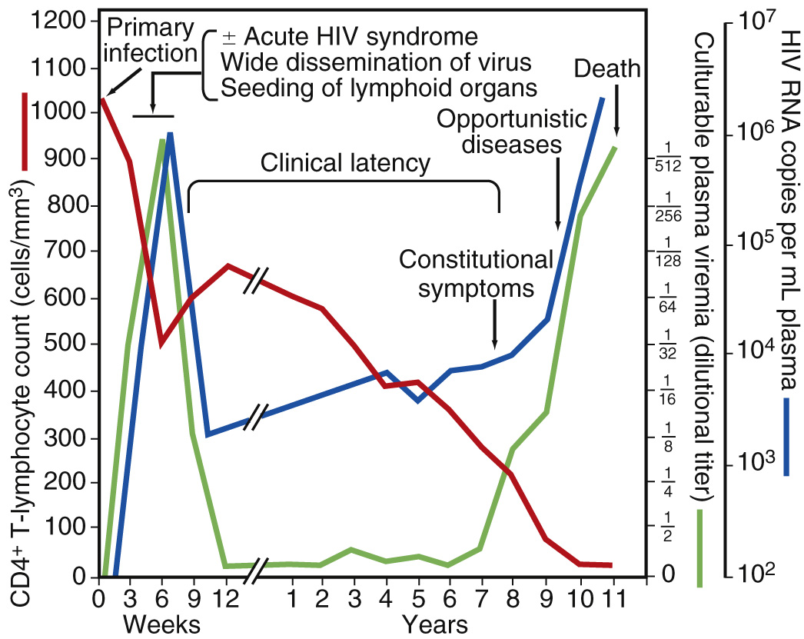
Natural History of Untreated HIV
Steady decline in the number of CD4 cells
Increased risk of opportunistic infections
Increased inflammation
Increased mortality
Increased risk of transmission
https://www.hiv.uw.edu/
Mandell, Douglas, and Bennett's Principles and Practice of Infectious Diseases, 2019.
Notes:
Following acquisition of HIV, people who are untreated typically develop a steady decline in CD4 cell count that is inversely related to the HIV viral load. As the HIV viral load increases, the CD4 count declines.
People with HIV typically progress to AIDS, or stage 3 HIV, within 10 years of the initial infection.
As the CD4 count declines, the patient’s risk for constitutional symptoms, opportunistic infections and death increases.

Slide 48
Opportunistic Infections in People with HIV (PWH)
Fungi
  Pneumocystis pneumonia (PCP)
  Cryptococcosis
  Candidiasis
  Histoplasmosis
  Coccidioidomycosis
  Talaromycosis
Bacteria
  Tuberculosis (TB)
  Disseminated Mycobacterium avium comples (MAC)
  Bartonella
Protozoa
  Toxoplasmosis
  Cryptosporidiosis
  Microsporidiosis
  Cystoisosporiasis
  Leishmaniasis
  Chagas disease
Viruses
  Cytomegalovirus disease (CMV)
  Progressive multifocal leukoencephalopathy (JC virus)
  Varicella-zoster virus (VZV)
  Human papilloma virus (HPV)
  Herpes simplex virus (HSV)
  Human herpesvirus-8 disease (HHV-8/KS)
National HIV Curriculum: https://www.hiv.uw.edu/
OI Treatment Guidelines (clinicalinfo.hiv.gov)
Notes:
Opportunistic infections are defined as infections that are more frequent or more severe because of HIV-mediated immunosuppression
These infections can be categorized by type of organism, including fungi, bacteria, protozoa, and viruses.
This slide is just for reference – a demonstration of the wide variety of serious infections that could occur.

Slide 49
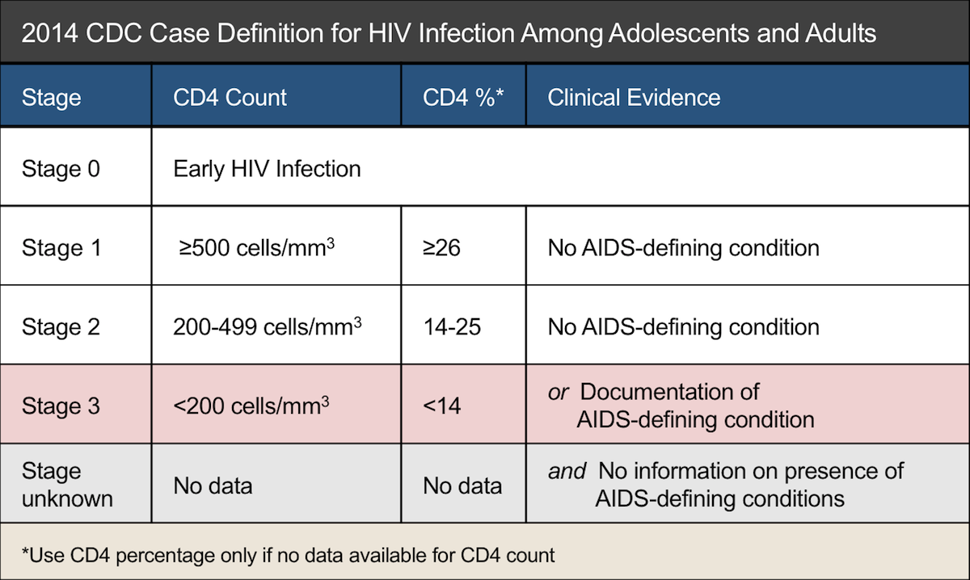
HIV Clinical Assessment
CD4 count: used to stage disease
HIV viral load (VL)
  HIV RNA quantitative PCR
  Used to monitor response to treatment
CDC. Revised surveillance case definition for HIV infection—United States, 2014. MMWR Recomm Rep. 2014;63(RR-03):1-10.
Notes:
In the most recent 2014 CDC case definition for HIV, there is a 5-stage system. A patient’s status can change in either direction after diagnosis.
Stage 0 is early infection
Stage 1 is defined as a CD4 > 500
Stage 2 is a CD4 of 200-499
Stage 3 is a CD4 > 200 or the presence of an AIDS-defining condition
We aren’t going to go into detail about AIDS-defining conditions. This includes conditions such as opportunistic infections and HIV-related malignancies

Slide 50
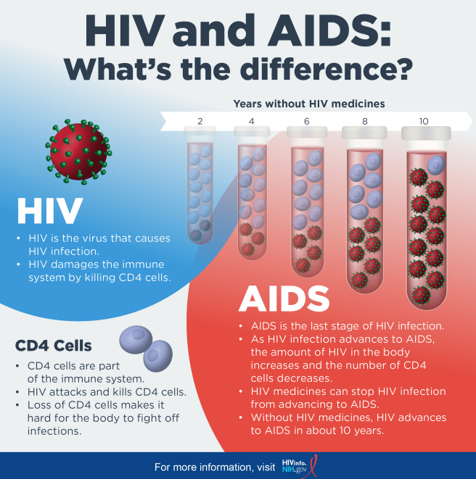

Slide 51
Initiating Antiretroviral Therapy (ART)
Who should start ART?
  ART is recommended for all persons with HIV
When should you start ART?
  Initiate ART as soon as possible after HIV diagnosis
  Prompt initiation is especially critical for:
    Pregnant women with HIV
    Certain comorbidities
  ART is safe and well tolerated
Notes:
You may recall that years ago it was recommended to wait to initiate ART until the CD4 dropped below a certain threshold
Current guidelines recommend to initiate ART for all people with HIV as soon as possible after HIV diagnosis.
Early initiation of ART improves linkage to care, decreases the time to viral suppression, and improves the rate of virologic suppression among people with HIV
Certain comorbidities
HIV-associated nephropathy
Co-infection with hepatitis B
HIV-associated immune thrombocytopenia (ITP)
Lymphoma

Slide 52
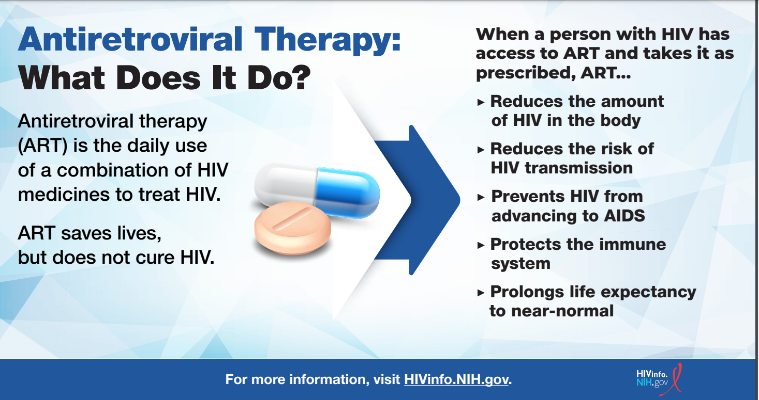

Slide 53
ART Treatment Goals
Maximally and durably suppress plasma HIV RNA (viral load)
Restore and preserve immunologic function
Reduce HIV-associated morbidity and prolong the duration and quality of survival
Prevent HIV transmission

Slide 54

Treatment as prevention
“…[P]eople who take ART daily as prescribed and achieve and maintain an undetectable viral load have effectively no risk of sexually transmitting the virus to an HIV-negative partner.”
- CDC Letter, September 2017
Fact: A person with HIV who is on treatment and has an undetectable viral load CANNOT transmit HIV through sex.
In other words, Undetectable = Untransmittable
Cohen, etal. NEJM 2011; 365: 493-505. Skarbinski J, et al. JAMA Intern Med 2015;175:588-96. Bavinton BR, et al. Lancet HIV. 2018. IAS 2018 http://programme.aids2018.org/Abstract/Abstract/13470. https://www.preventionaccess.org/undetectable
Notes:
The U=U message is that patients with undetectable viral load cannot sexually transmit the virus to others, so undetectable equals untransmittable.
This message is based on several prospective observational studies that followed sero-discordant couples in which the partner with HIV was on ART with a viral load less than 200. After thousands of condomless sex acts, there were zero phylogenetically linked HIV transmissions. These studies were a breakthrough with important public health implications. Simply put, ART not only treats HIV but prevents sexual transmission of HIV infection.

Slide 55

Video: Stopthevirus.com
https://www.helpstopthevirus.com/undetectable
Notes:
https://c62506104e66a43471f5-70bb4dd68e9719e25721f0fcbc9e8812.ssl.cf1.rackcdn.com/videos/2022/07/treat_to_prevent.mp4

Slide 56
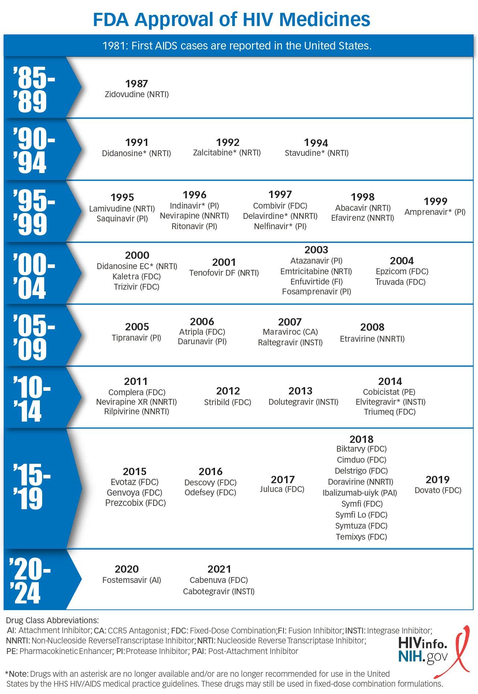
FDA-approved ART
https://hivinfo.nih.gov/understanding-hiv/infographics/fda-approval-hiv-medicines
Notes:
Slide is for reference only – just to demonstrate the number of ART available and to demonstrate the progress in ART development over the years.
Currently there are more than 30 FDA-approved antiretroviral medications, starting with zidovudine in 1987, to most recently injectable cabotegravir and raltegravir.
Fostemsavir- approved in July 2020
https://aidsetc.org/resource/hiv-medication-chart-pad

Slide 57
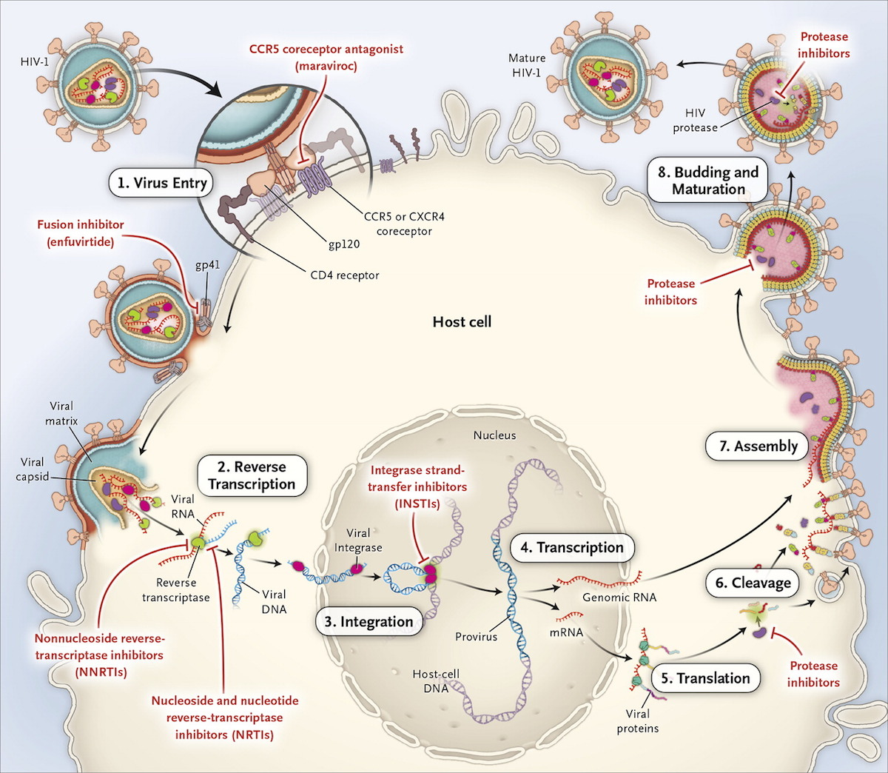
HIV Reproductive Cycle
N Engl J Med. 2014;371:248-59.
Notes:
This figure shows the lifecycle of HIV and the sites of action of major classes of ART.
Step 1 is virus entry. Viral envelope protein gp120 binds to the CD4 molecule, followed by a conformational change in gp120 that allows binding to the host-cell co-receptor (e.g. CCR5 or CXCR4). Glycoprotein 41 (gp41) then mediates HIV-cell fusion to permit viral entry. The fusion inhibitor, enfuvirtide, blocks fusion between the virus (through gp41) and the CD4 molecule, and the CCR5 coreceptor antagonist, maraviroc, blocks viral binding (through gp120) to CCR5. Step 2 is reverse transcription, in which the single-stranded HIV-1 RNA is transcribed into double-stranded DNA by the HIV enzyme (polymerase) called reverse transcriptase. This step is the site of action of nucleoside and nucleotide reverse-transcriptase inhibitors (NRTIs) and non-nucleoside reverse-transcriptase inhibitors (NNRTIs). Step 3 is the migration of HIV DNA into the nucleus and its integration into the DNA of the host cell, a process catalyzed by the viral enzyme integrase. Integrase strand-transfer inhibitors (INSTIs) target this step. Step 4 is the transcription of the HIV-1 DNA into HIV messenger RNA (mRNA) and HIV genomic RNA. Step 5 is the transport of the HIV-1 RNA out of the nucleus and the translation of HIV-1 mRNA into viral polyproteins. To be functional, the transcribed proteins must be cleaved into smaller component proteins, a process that occurs in step 6 through the action of the HIV-1 enzyme protease. This is the site of action of protease inhibitors. Step 7 is the assembly of viral genomic RNA and viral enzymes (reverse transcriptase, integrase, and protease) into viral particles. Step 8 is the budding and maturation of new viral particles, which then go on to infect other host cells.

Slide 58
ART Guidelines: Initial Regimen
Current guidelines
  2 nucleoside reverse transcriptase inhibitors (NRTIs) + 1 integrase strand transfer inhibitor (INSTI)
  Or 1 NRTI + INSTI
Always ≥2 ART drug classes
Alternates: 2 NRTIs + 3rd Class (boosted-protease inhibitor or non-nucleoside reverse transcriptase inhibitor)
Current regimens are easier to take, more effective, and safer than older regimens
Many single-tablet once-daily regimens are currently FDA approved
https://clinicalinfo.hiv.gov/en/guidelines/adult-and-adolescent-arv/whats-new-guidelines
Notes:
Now that we have discussed some of the details of how ART works, we will review the currently recommended regimens for treatment-naïve patients with HIV
DHHS Guidelines for the Use of Antiretroviral Agents in HIV-1 Infected Adults and Adolescents.
https://aidsinfo.nih.gov/guidelines/html/1/adult-and-adolescent-arv/0
Saag, Benson, Gandhi, et al, JAMA, 2018. 2018 Recommendations of the International Antiviral Society-USA Panel. Antiretroviral Drugs for Treatment and Prevention of HIV Infection in Adults. https://www.iasusa.org/2018/07/24/antiretroviral-drugs-treatment-prevention-hiv-infection-adults-2018-recommendations-of-the-international-antiviral-society-usa-panel/
Initial 2-drug regimens are only recommended in the rare situations in which a patient cannot take abacavir, TAF, or TDF

Slide 59
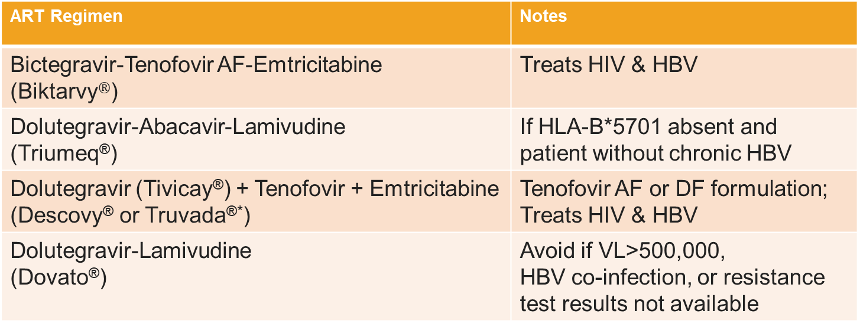
ART Guidelines: Preferred Initial Regimen
  2 NRTI + INSTI or 1 NRTI + INSTI (All regimens below AI rating)
ART Regimen | Notes
Bictegravir-Tenofovir AF-Emtricitabine (Biktarvy$®$) | Treats HIV & HBV
Dolutegravir-Abacavir-Lamivudine (Triumeq®) | If HLA-B*5701 absent and patient without chronic HBV
Dolutegravir (Tivicay®) + Tenofovir + Emtricitabine (Descovy® or Truvada®*) | Tenofovir AF or DF formulation; Treats HIV & HBV
Dolutegravir-Lamivudine (Dovato®) | Avoid if VL>500,000, HBV co-infection, or resistance test results not available
https://clinicalinfo.hiv.gov/en/guidelines/adult-and-adolescent-arv/what-start-initial-combination-regimens-antiretroviral-naive?view=full
Notes:
These are the recommended initial regimens for most people with HIV
Notice that all of these regimens include an integrase inhibitor with either 1 or 2 NRTIs
Several of these regimens are available as a single-tablet co-formulation
Rating Recommendation: A=strong, B=moderate, C=optional
Rating Evidence: I=data from RCTs; II= data from well-designed nonrandomized traials, observational cohort studies with long-term clinical outcomes, relative bioavailability/bioequivalence studies, or regimen comparisons from randomized switch studies; III=expert opinion
HBV=hepatitis B virus
VL=viral load
Top 3 options in recommended list by IAS-USA 2018 guidance & are the recommended regimens if ART started prior to having baseline HIV VL or CD4 or resistance testing available. https://www.iasusa.org/2018/07/24/antiretroviral-drugs-treatment-prevention-hiv-infection-adults-2018-recommendations-of-the-international-antiviral-society-usa-panel/
*tenofovir/emtricitabine now available as generic agent

Slide 60
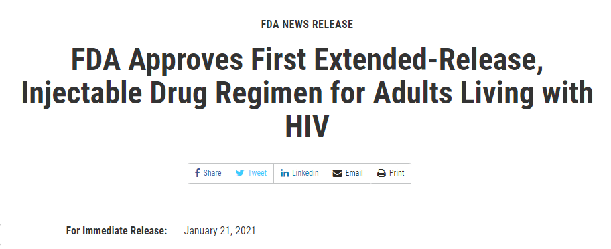
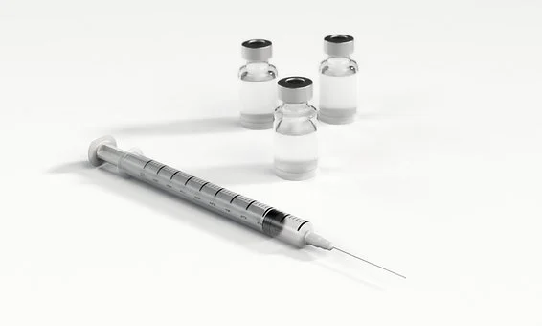
The Future of ART: Injectables
Injectable long-acting cabotegravir and rilpivirine (Cabenuva®)
Administered once every month or once every 2 months
Most frequent adverse event: injection site reaction (pain)
https://www.fda.gov/news-events/press-announcements/fda-approves-first-extended-release-injectable-drug-regimen-adults-living-hiv
Notes:
On January 2021 the FDA approved the first injectable, complete regimen for HIV
This regimen is for patients who are virologically suppressed on a stable regimen with no history of treatment failure and no known or suspected resistance to cabotegravir or rilpivirine
Clinical trials published in 2020 showed that virologic suppression was similar for long-acting cabotegravir plus rilpivirine administered every 8 weeks vs every 4 weeks
Q2mo dosing now standard
Intramuscular injection administered by a training healthcare professional (i.e. registered nurse)
Note that oral cabotegravir can be taken in combination with oral rilpivirine for one month prior to switching to the injectable formulation to ensure the medications well-tolerated; recommended in some patients but not required

Slide 61
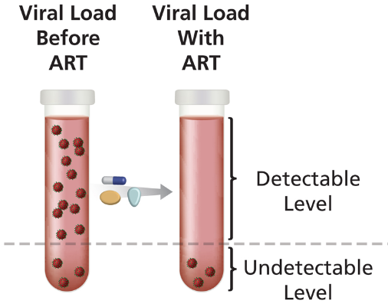
What is virologic success?
Virologic suppression: HIV RNA level < lower limit of detection (<20 copies/ml, depending on lab assay)
After initiation of effective ART, virologic suppression usually occurs within the first 12 to 24 weeks of therapy.
Predictors of virologic success:
  Low baseline viremia
  High potency of the ART regimen
  Tolerability of the regimen
  Convenience of the regimen
  Excellent adherence
<20
https://clinicalinfo.hiv.gov/en/glossary/viral-suppression
Notes:
Once we have linked a patient and care and initiated ART, how do we define success?
https://clinicalinfo.hiv.gov/en/guidelines/adult-and-adolescent-arv/treatment-goals?view=full

Slide 62
Learning Objectives
Interpret HIV epidemiology within the context of social determinants of health.
Differentiate between behaviors associated with HIV transmission versus ways HIV is not transmitted.
Identify current recommendations related to HIV screening, treatment and prevention.
Outline the steps of linkage and retention in care.

Slide 63
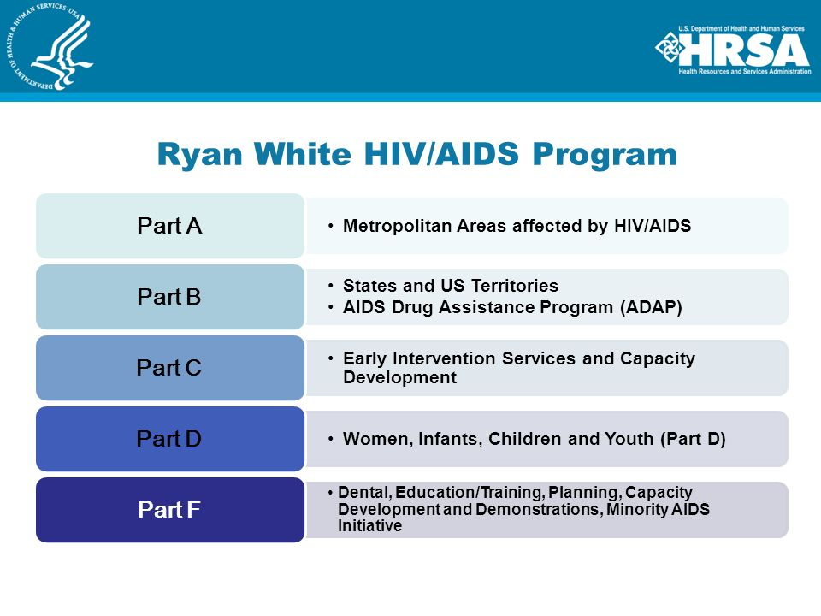


HRSA – Ryan White HIV/AIDS Programs
Comprehensive system of HIV primary medical care for low-income people living with HIV who are uninsured and underserved
Ryan White
Notes:
Ryan White was 13 when he was diagnosed with AIDS after a blood transfusion in December 1984. Living in Kokomo, Indiana, doctors gave him six months to live.
When Ryan tried to return to school, he faced AIDS-related discrimination in his Indiana community. Along with his mother Jeanne White Ginder, he rallied for his right to attend school. He gained national attention and became the face of public education about the disease.
Surprising his doctors, Ryan lived five years longer than expected. He died in April 1990, one month before his high school graduation. Congress passed the Ryan White Comprehensive AIDS Resources Emergency (CARE) Act in August 1990.
HRSA’s Ryan White HIV/AIDS Program is divided into five Parts, following from the authorizing legislation

Slide 64

Medication Access
Private Insurance, Medicaid, or Medicare
***may need assistance with co-pay
No insurance
Patient assistance programs
Harbor Path/Common Med forms & printed script
TX State ADAP
(AIDS Drug Assistance Program)
https://dshs.texas.gov/hivstd/meds/

Slide 65
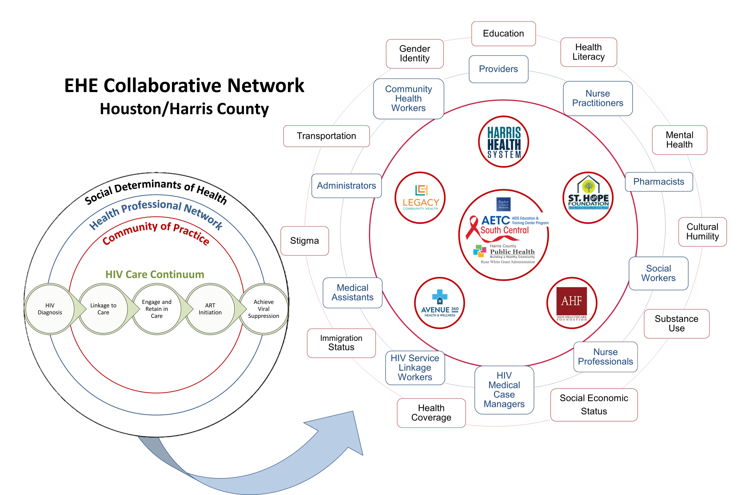
Comprehensive HIV Care Coordination
Created by Shital M. Patel, MD and Natalia Rodriguez, MPH

Slide 66
Clinician experience
Communication skills
Early Diagnosis ✔
Access to medications✔
Potency
Pharmacokinetics
(dosage schedule)
Tolerability
Toxicity
Convenience
Resistance
Drug interactions
Continued Challenges to Successful Treatment
Clinician
Replication rate
(Viral load)
Mutation rate
(Resistance)
Latent HIV reservoirs
Virus
Drug
Patient
Linkage to care ✔
Adherence
Access to care
Life situation
Retention in care ✔
Notes:
Slide adapted from Oklahoma AETC HIV 101 slide-deck
Slide #5: Challenges to Successful ART: Considerations When Initiating Therapy
This Venn diagram illustrates the four interrelated components that play a role in determining successful outcomes with antiretroviral therapy and therefore should be addressed when initiating treatment.
Designing a general strategy for interventions specific to each of these components right from the beginning of treatment is a key factor in the overall success of anti-HIV therapy.

Slide 67
Barriers to Initiation, Retention and Adherence to Treatment and Care...
What might be unique to PWH?
What might be compounded by HIV?
Stigma
Fear of Disclosure
Trauma of Exposure
Mistrust of Healthcare System
Fear of Judgement
Trauma Response
Shame
Guilt
Substance Abuse & Mental Health
https://www.cdc.gov/stophivtogether/campaigns/hiv-stigma/index.html
Notes:
Healthcare providers can contribute to stigma and misinformation or can be part of the solution, depending on approach
Image: https://www.hiv.gov/hiv-basics/overview/making-a-difference/standing-up-to-stigma

Slide 68

Addressing Stigma
Stigma still exists
Essential to recognize & address
https://www.cdc.gov/stophivtogether/campaigns/hiv-stigma/index.html
Notes:
Healthcare providers can contribute to stigma and misinformation or can be part of the solution, depending on approach
Image: https://www.hiv.gov/hiv-basics/overview/making-a-difference/standing-up-to-stigma

Slide 69
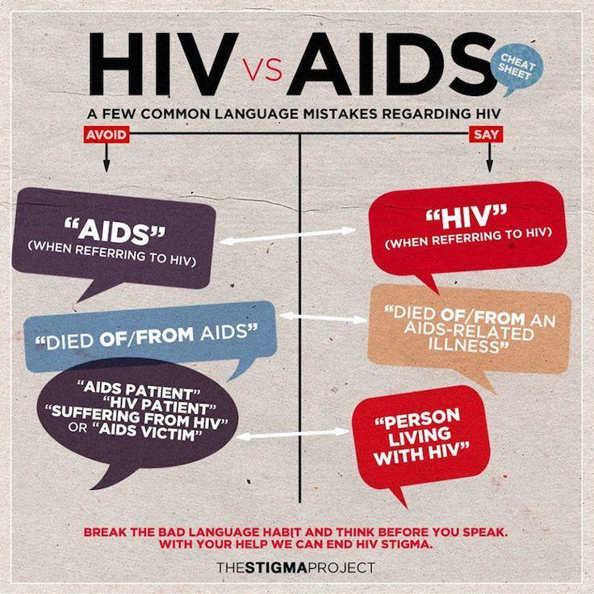
What is People-First Language?
Puts person before illness or label.
Describes and respects who they are, not what they have been diagnosed with.
Helps eliminate prejudice; removes value judgments.
Avoid saying “HIV patient” or “HIV-infected woman”
Preferred Phrase: “woman living with HIV”
Slide modified from presentation by Tana Pradia, Chair of Ryan White Planning Council
Notes:
Without People First Language:
People are described by labels or medical diagnoses which devalues and disrespects them as individuals.
–You never hear “cancerous people” or “I am cancer positive”
–But you often hear “HIV-infected woman”
Preferred Phrase: “woman living with HIV;” refers to person first, before mentioning their health condition

Slide 70

We all have a role!
https://www.hiv.gov/federal-response/ending-the-hiv-epidemic/key-strategies
https://www.hiv.gov/federal-response/ending-the-hiv-epidemic/overview
Notes:
In 2019 the US Department of Health and Human Services launched the Ending the HIV epidemic campaign.
The initiative focuses resources on areas with high rates of HIV transmission, including 48 counties where more than 50% of new HIV diagnoses occurred in 2016 and 2017.
Notice that 5 of the 48 targeted counties are in Texas, including harris county

Slide 71

Questions?
https://www.cdc.gov/stophivtogether/index.html
Notes:
https://www.gettingtozerosf.org/

Slide 72
References and Resources
DHHS Guidelines for the Use of Antiretroviral Agents in HIV-1 Infected Adults & Adolescents. https://clinicalinfo.hiv.gov/en/guidelines
AETC National HIV Curriculum https://aidsetc.org/nhc
2020 ART Recommendations of the International Antiviral Society-USA Panel. JAMA. 2020;324(16):1651–1669.
International Antiviral Society USA guidelines: https://www.iasusa.org/guidelines

Slide 73
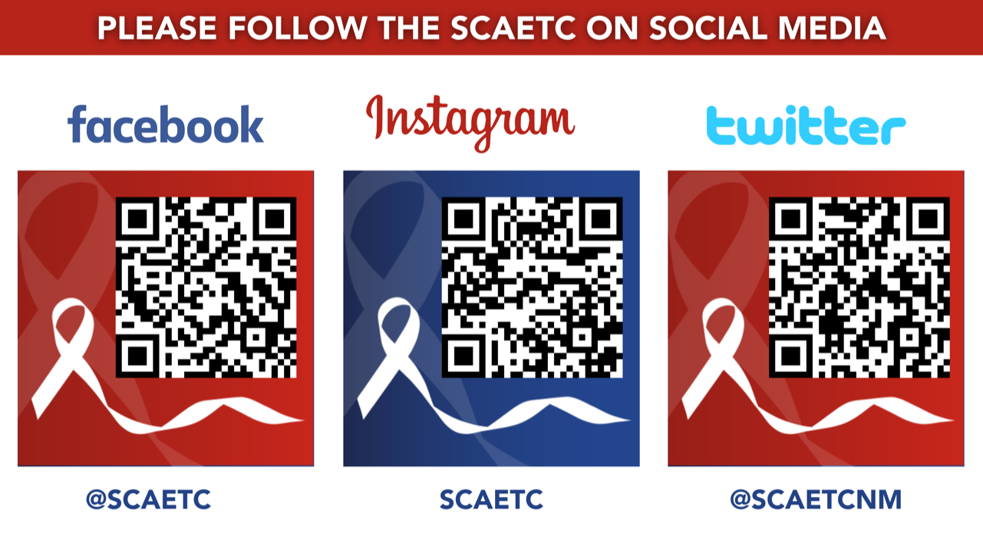
SCAETC Social Media

Slide 74
Resources
National Clinician Consultation Center http://nccc.ucsf.edu/
  HIV Management
  Perinatal HIV
  HIV PrEP
  HIV PEP line
  HCV Management
  Substance Use Management
Present on ECHO
https://hsc.unm.edu/scaetc/programs-services/echo.html​
AETC National HIV Curriculum https://aidsetc.org/nhc
AETC National Coordinating Resource Center https://targethiv.org/library/aetc-national-coordinating-resource-center-0
HIVMA Resource Directory https://www.hivma.org/globalassets/ektron-import/hivma/hivma-resource-directory.pdf
Additional trainings scaetcecho@salud.unm.edu
www.scaetc.org
Notes:
IDEA Platform: Infectious Diseases Education & Assessment. https://idea.medicine.uw.edu/
AETC National HIV Curriculum: 6 core modules for self study; regularly updated; CME, CNE
Hepatitis C Online Curriculum: https://www.hepatitisc.uw.edu/
Hepatitis B Online Curriculum: https://www.hepatitisb.uw.edu/
National STD Curriculum: https://www.std.uw.edu/

