Slide 1
HIV Screening for Pre-Exposure Prophylaxis (PrEP)
Michelle Lewis, PharmD, BCPS, AAHIVP
Clinical Associate Professor
Co-Clinical Director AIDS Education and Training Center
University of Oklahoma Health Sciences Center
Notes:
Version date_09/2023
Target participants: Physicians, APPs

Slide 2
Conflict of Interest Disclosure Statement
I have no relevant financial relationships or affiliations with commercial interests to disclose
This program is supported by the Health Resources and Services Administration (HRSA) of the U.S. Department of Health and Human Services (HHS) as part of an award totaling $4,205,743 with 0% financed with non-governmental sources. The contents are those of the author(s) and do not necessarily represent the official views of, nor does mention of trade names, commercial practices, or organizations imply an endorsement by HRSA, HHS, or the U.S. Government. For more information, please visit HRSA.gov. Any trade/brand names for products mentioned during this presentation are for training and identification purposes only.
Notes:
Please add presenter disclosures here if any exist.

Slide 3
Unconscious Bias Disclosure
SCAETC recognizes that language is constantly evolving, and while we make every effort to avoid bias and stigmatizing terms, we acknowledge that unintentional lapses may occur in our presentations.
We value your feedback and encourage you to share any concerns related to language, images, or concepts that may be offensive or stigmatizing.
Your input will help us refine and improve our presentations, ensuring they remain inclusive and respectful to participants.

Slide 4
Learning Objectives
Utilize current HIV epidemiology to inform screening practices.
Incorporate HIV screening recommendations into practice.
Interpret HIV testing for diagnosis and prevention.
Notes:
Target learning objectives to the target trainee goals
Use active verbs (interpret, differentiate, apply, demonstrate, compose, design, create)
Ensure objectives are S.M.A.R.T. (specific, measurable, achievable, relevant, time-bound)
Ensure presentation is related to HIV screening, prevention, treatment.

Slide 5
Ending the HIV Epidemic (EHE)
&
HIV Prevention

Slide 6
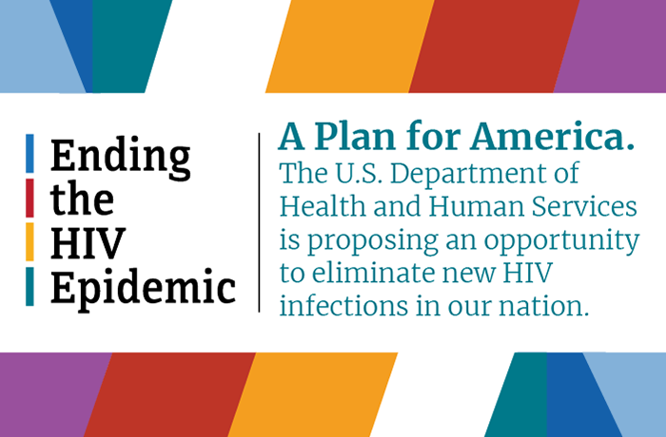
2019
https://www.hiv.gov/federal-response/ending-the-hiv-epidemic/overview
Notes:
Announced by President Trump during the 2019 State of the Union Address, Ending the HIV Epidemic is an initiative directed by the Department of Health and Human Services. The initiative involves collaboration between many agencies within the department and works with communities to leverage scientific advances in prevention, diagnosis, treatment, and response to maximize benefit.

Slide 7
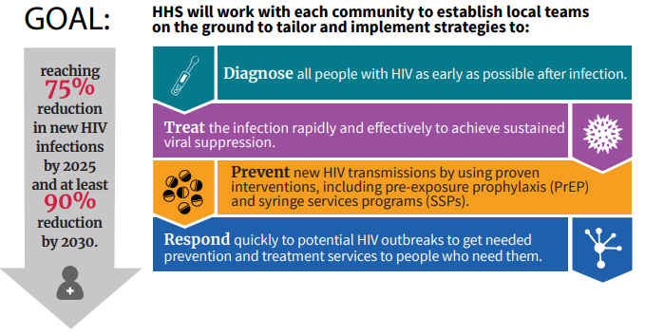
EHE Goals/Strategies
https://www.hrsa.gov/ending-hiv-epidemic HHS = Health and Human Services
Notes:
This initiative highlights 4 key strategies: diagnose, treat, prevent, respond
The goal of the initiative is to reduce new hiv infections by 75% in the first 5 years (2020 to 2025) and to reduce new HIV infections by 90% by the year 2030.
Based on 2019 new infections that would mean 8700 new infections/year by 2025 and 3500 new infections/year by 2030
38,000 new infections in 2014: decrease in new infections for the past 5 years is <10%
The NHAS is a broader, overarching national plan across many departments. The EHE is encompassed within the Dept of Health and Human Services and is one of the ways in which the National Strategy will be implemented

Slide 8
EHE Goals/Strategies
https://www.hrsa.gov/ending-hiv-epidemic

Slide 9
HIV Prevention
Person with HIV
  Abstinence (sex and drugs)
  TREATMENT (U=U)
  Pregnancy care
Person without HIV
  Abstinence (sex and drugs)
  Condoms (safer sex)
  Clean injection supplies (SSPs)
  Prophylaxis: pre-exposure and post-exposure
U=U Undetectable=Untransmittable, SSP’s = Syringe Services Programs
Notes:
How do you know who to treat and who to provide prophylaxis to??

Slide 10
HIV Prophylaxis
PrEP: Pre-Exposure Prophylaxis
  Antiretrovirals (1 or 2 medications) taken prior to HIV exposure to prevent infection
PEP: Post-Exposure Prophylaxis
  Antiretrovirals (usually 3) taken immediately following HIV exposure to prevent infection
    Occupational – healthcare workers, first responders
    Nonoccupational – all other exposures

Slide 11
HIV Prophylaxis
PrEP: Pre-Exposure Prophylaxis
  Antiretrovirals (1 or 2 medications) taken prior to HIV exposure to prevent infection
PEP: Post-Exposure Prophylaxis
  Antiretrovirals (usually 3) taken immediately following HIV exposure to prevent infection
    Occupational – healthcare workers, first responders
    Nonoccupational – all other exposures
Notes:
In order to provide optimal prevention services, you would need to know who has HIV, who doesn’t have HIV and who is at risk for HIV.

Slide 12
HIV Screening and Testing
In order to provide PrEP services, you need to know:
  Who is most vulnerable to HIV acquisition
  Who has HIV
  Who doesn’t have HIV
Notes:
In order to provide PrEP services, you need to know:
Who is most vulnerable to HIV acquisition
Who has HIV – link to care for treatment services
Who doesn’t have HIV – evaluate for appropriateness for PrEP services
For number 1, you need to understand some basic concepts about HIV including transmission and epidemiology.
For 2 and 3 we can determine this with routine testing.

Slide 13
Transmission & Epidemiology

Slide 14
https://www.cdc.gov/hiv; 2018

Slide 15
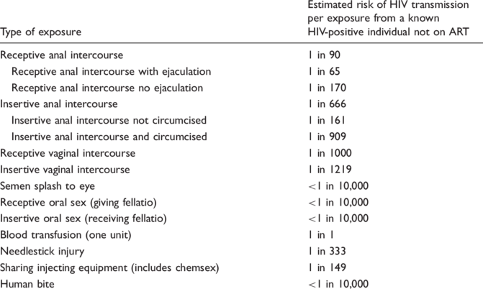
HIV Transmission Risk
Cresswell F. International Journal of STD & AIDS;27(9):713
Notes:
Cresswell F. International Journal of STD & AIDS;27(9):713
All risk is not the same. Some routes of transmission are much more effective at transmitting virus.
Different route of infection has different transmission rates
Receptive anal intercourse

Slide 16
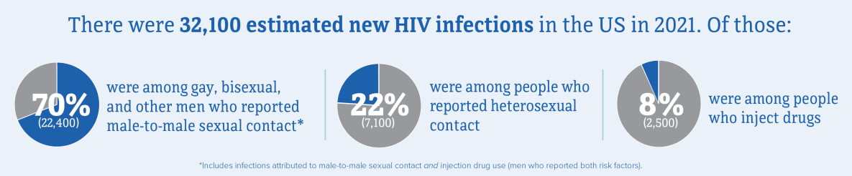
Incidence US (2021)
CDC. Estimated HIV incidence and prevalence in the United States, 2017–2021. HIV Surveillance Supplemental Report, 2023; 28(3).

Slide 17
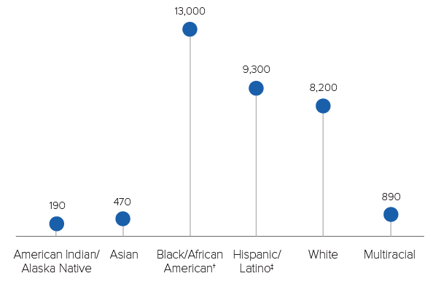
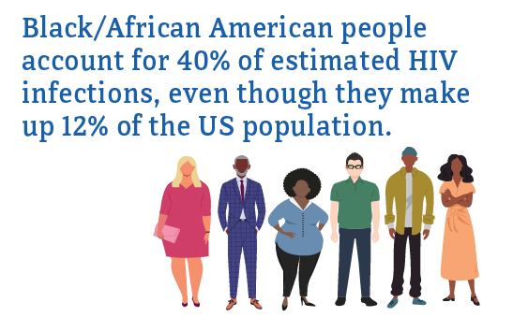
Race and Ethnicity
CDC. Estimated HIV incidence and prevalence in the United States, 2017–2021. HIV Surveillance Supplemental Report, 2023; 28(3).
Notes:
CDC. Estimated HIV incidence and prevalence in the United States 2017–2021. HIV Surveillance Supplemental Report 2023;28(3)
Black and brown people are at disproportiate risk of HIV infection, likely secondary to generally health disparities and access to health services.

Slide 18
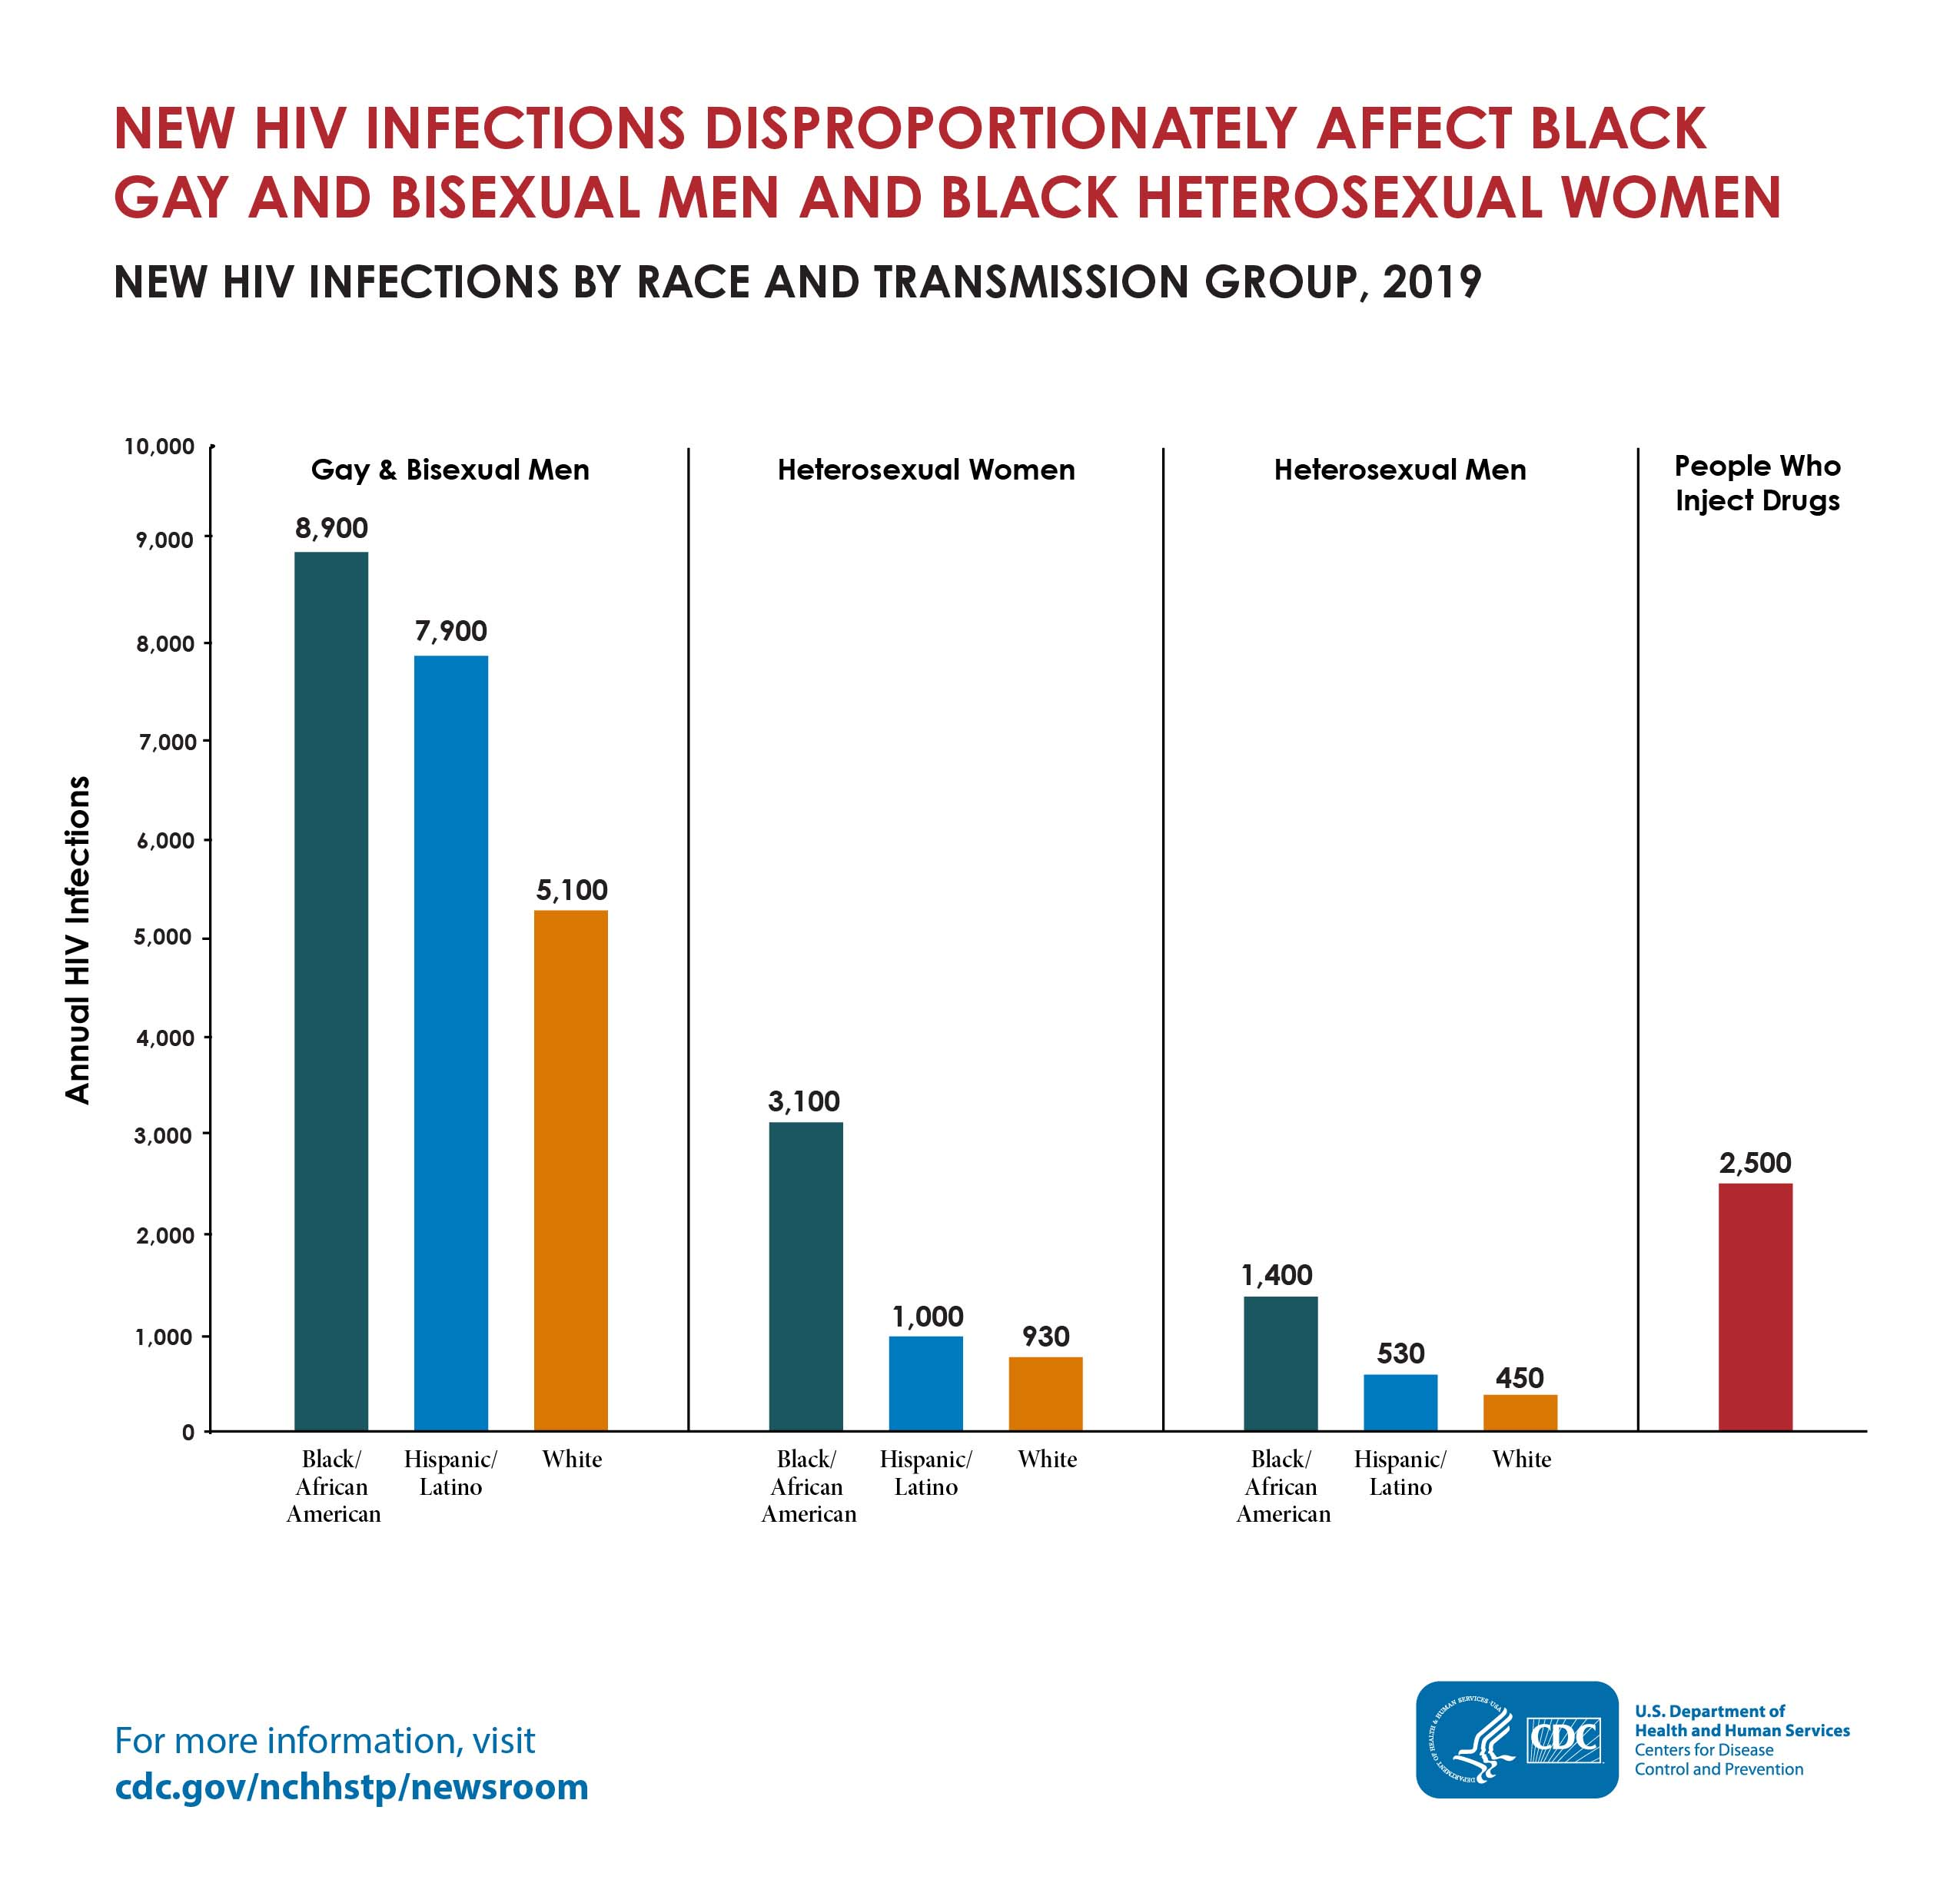
Race and Transmission Group
https://www.cdc.gov/nchhstp/newsroom/fact-sheets/hiv/black-african-american-factsheet.html
Notes:
https://www.cdc.gov/nchhstp/newsroom/fact-sheets/hiv/black-african-american-factsheet.html
This is true across transmission categories.

Slide 19
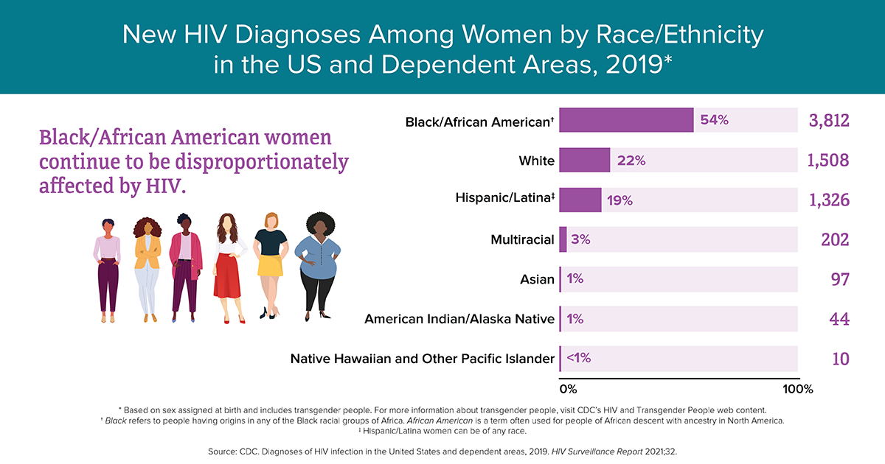
Women
CDC. Diagnoses of HIV infection in the United States and dependent areas, 2019. HIV Surveillance Report 2021;32.
Notes:
Source: CDC. Diagnoses of HIV infection in the United States and dependent areas, 2019. HIV Surveillance Report 2021;32.
Women account for about 20% of all newly diagnosed HIV infections, but among these women, Black/African American women account for over 50% of these infections.

Slide 20
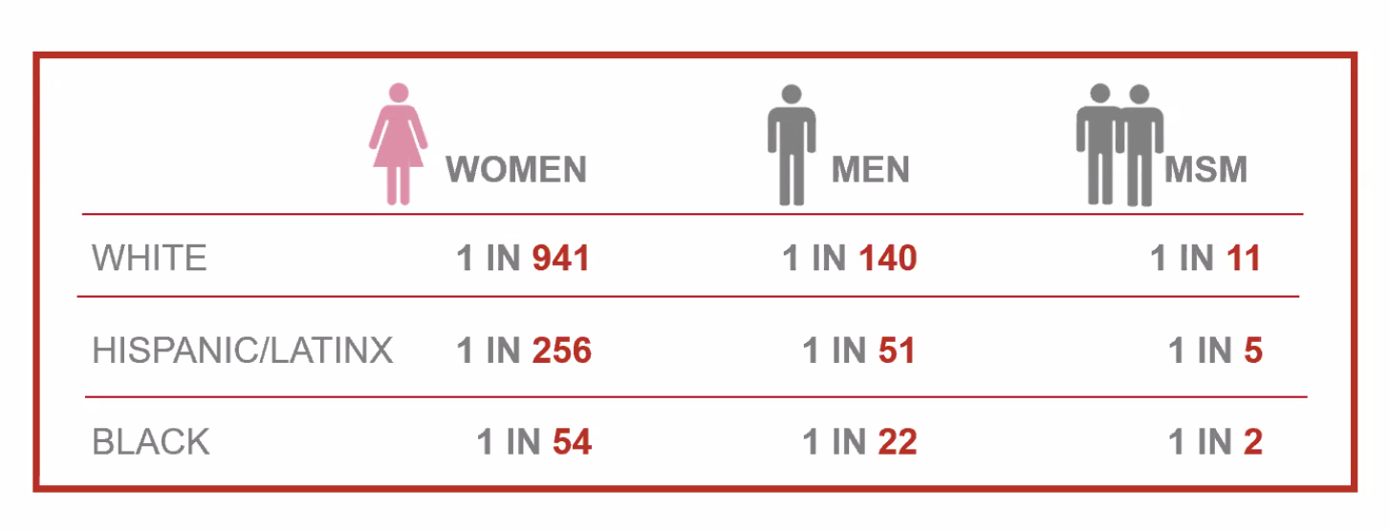
Lifetime Risk for HIV
Hess K, et al. Ann Epidemiol. 2017; 27:238-243
Notes:
MSM disproportionately higher rates of syphilis and GC.
We forget to include women a lot of the time. Why is this important? We know that STIs may lead to increased susceptibility for HIV acquisition. Some STIs are lifelong, and some are treatable. However, HIV is lifelong with significant morbidity/mortality.
Rates aren’t like this because people are doing things differently, but due to medical distrust, healthcare disproportions, among many other things. Could it be that we aren’t creating a safe environment to talk about sex?

Slide 21
Screening Recommendations

Slide 22
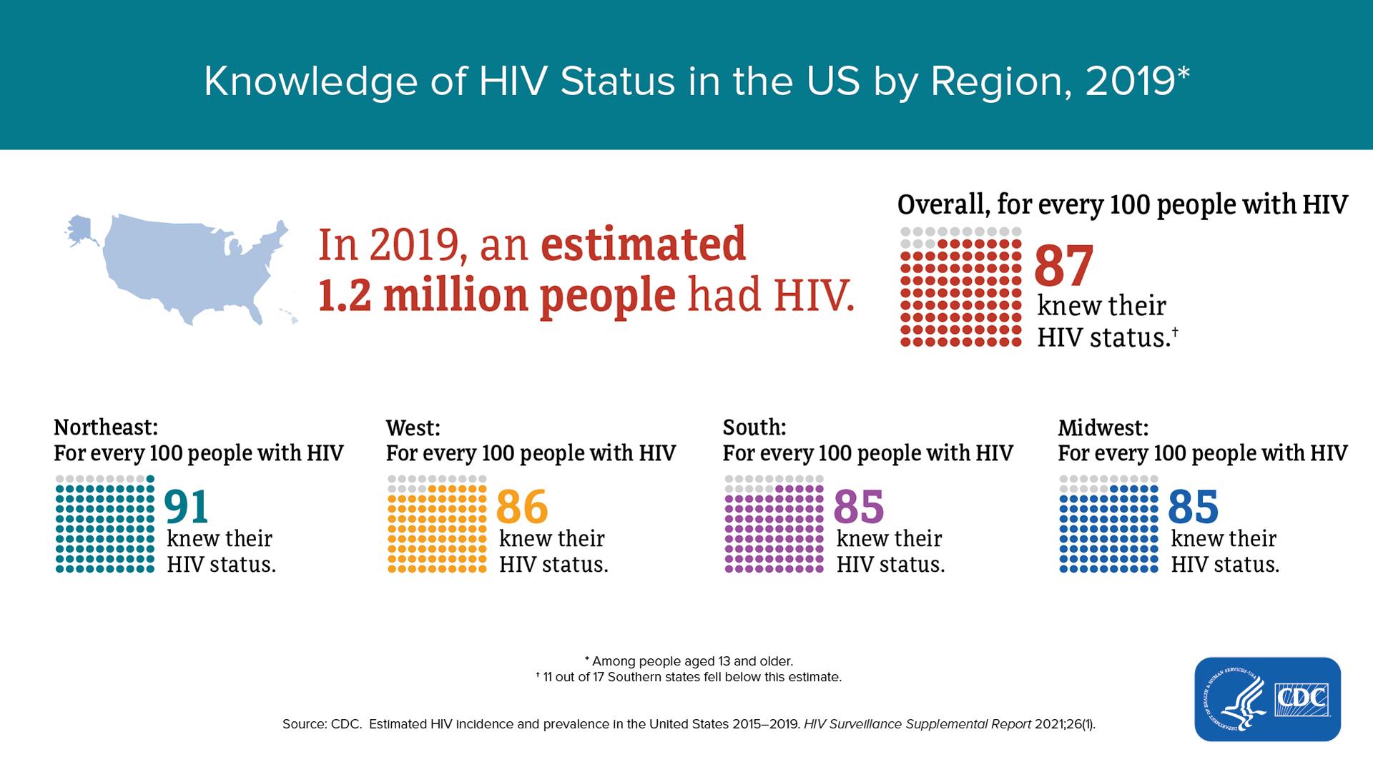
CDC. Estimated HIV incidence and prevalence in the United States 2015-2019. HIV Surveillance Supplemental Report 2021

Slide 23
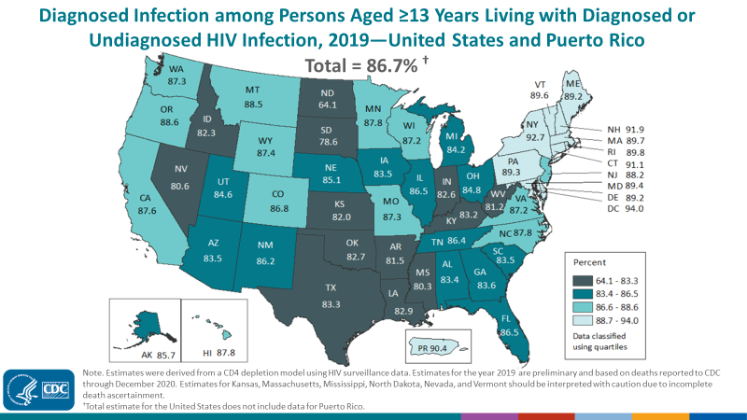
Undiagnosed HIV US & Oklahoma 2019
CDC. Estimated HIV incidence and prevalence in the United States 2015-2019. HIV Surveillance Supplemental Report 2021
Notes:
Estimated 13% of people in the US living with HIV infection are unaware of their diagnosis
We are above the national estimate in Oklahoma with about 17% undiagnosed HIV.
CDC. Estimated HIV incidence and prevalence in the United States 2015-2019. HIV Surveillance Supplemental Report 2021

Slide 24
HIV Screening Recommendations
CDC - 2006
USPSTF - 2019
All persons 13 to 64 years old
Treatment for other STIs
Treatment for TB
Yearly screening for high risk (maybe 3 or 6 months)
Opt-out screening; no prevention counseling required
Pregnancy
All persons 15 to 65 years old
Younger than 15 or older than 65 if increased risk
Pregnancy
Repeat screening – no interval defined
Reimbursement implications
https://www.uspreventiveservicestaskforce.org/uspstf/recommendation/human-immunodeficiency-virus-hiv-infection-screening
https://www.cdc.gov/mmwr/preview/mmwrhtml/rr5514a1.htm CDC = Centers for Disease Control
Notes:
If your patient has ever had sex or has ever injected drugs with a needle, they should be tested. Your assessment of their HIV risk as previously discussed, would then help you decide how often the patient should be tested and what additional care/services the patient may benefit from.

Slide 25
Opt-Out HIV Screening
Patients should be informed HIV testing will be included in screenings and given the option to decline
  Brochures, practice literature/forms, discussion
Prevention counseling is not required as a condition for testing
  What do you do if it is positive?
https://www.cdc.gov/hiv/clinicians/screening/opt-out.html

Slide 26
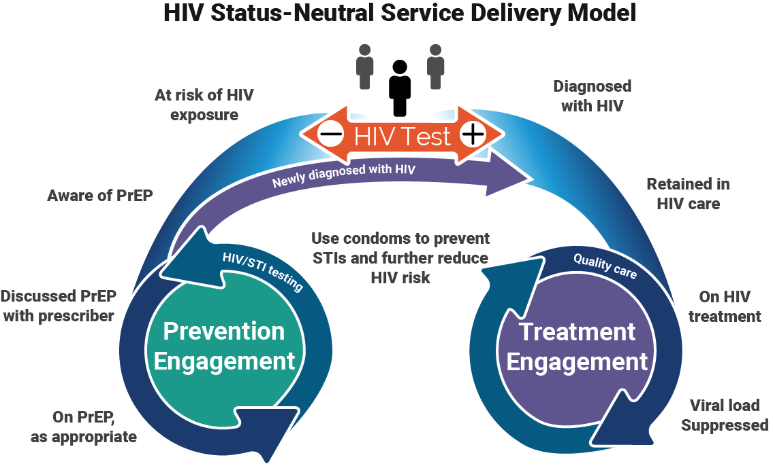
Status-Neutral Care
https://blog.catie.ca/2019/11/04/an-hiv-status-neutral-paradigm-shift/
Notes:
https://blog.catie.ca/2019/11/04/an-hiv-status-neutral-paradigm-shift/
Positive
Link to care
Treatment
Decreased transmission
Negative
Pre-exposure prophylaxis
Post-exposure prophylaxis
Risk reduction counseling
Decreased transmission
What is the one key to status neutral care? Screening for HIV. In order to provide status neutral care and to decrease transmission of HIV, patients must be screened for HIV.
Which patients should be screened?
Everyone.

Slide 27
HIV Screening Recommendations
CDC - 2006
USPSTF - 2019
All persons 13 to 64 years old
Treatment for other STIs
Treatment for TB
Yearly screening for high risk (maybe 3 or 6 months)
Opt-out screening; no prevention counseling required
Pregnancy
All persons 15 to 65 years old
Younger than 15 or older than 65 if increased risk
Pregnancy
Repeat screening – no interval defined
Reimbursement implications
https://www.uspreventiveservicestaskforce.org/uspstf/recommendation/human-immunodeficiency-virus-hiv-infection-screening
https://www.cdc.gov/mmwr/preview/mmwrhtml/rr5514a1.htm
Notes:
So let’s go back to this slide.

Slide 28
HIV Screening Recommendations
CDC - 2006
USPSTF - 2019
All persons 13 to 64 years old
Treatment for other STIs
Treatment for TB
Yearly screening for high risk (maybe 3 or 6 months)
Opt-out screening; no prevention counseling required
Pregnancy
All persons 15 to 65 years old
Younger than 15 or older than 65 if increased risk
Pregnancy
Repeat screening – no interval defined
Reimbursement implications
https://www.uspreventiveservicestaskforce.org/uspstf/recommendation/human-immunodeficiency-virus-hiv-infection-screening
https://www.cdc.gov/mmwr/preview/mmwrhtml/rr5514a1.htm
Notes:
So the highlighted criteria are pretty easily distinguished.
1. Basically all persons should be screened at some point and status documented. You just screen everyone. If you don’t have documentation of status or they are a new patient you screen them.
2. Someone with documented STI – screen them
3. Someone with TB – screen them
4. A pregnant person – screen them

Slide 29
HIV Screening Recommendations
CDC - 2006
USPSTF - 2019
All persons 13 to 64 years old
Treatment for other STIs
Treatment for TB
Yearly screening for high risk (maybe 3 or 6 months)
Opt-out screening; no prevention counseling required
Pregnancy
All persons 15 to 65 years old
Younger than 15 or older than 65 if increased risk
Pregnancy
Repeat screening – no interval defined
Reimbursement implications
https://www.uspreventiveservicestaskforce.org/uspstf/recommendation/human-immunodeficiency-virus-hiv-infection-screening
https://www.cdc.gov/mmwr/preview/mmwrhtml/rr5514a1.htm
Notes:
This one requires you to talk to your patient.
We know that transmission is related to sexual activity and IV drug use, so you have to talk to your patient about these risk factors.

Slide 30
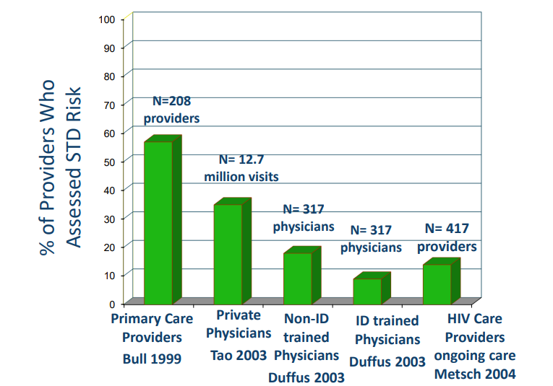

Are We Talking About Risk?
Johnston C. Taking a Sexual History & Behavioral STD Risk Assessment. Uwptc.org
Notes:
Johnston C. Taking a Sexual History & Behavioral STD Risk Assessment. Uwptc.org

Slide 31
Barriers
Structural
  Time
  Reimbursement
Provider
  Comfort
  Training
Patient
  Confidentiality/privacy
  Perceived risk

Slide 32
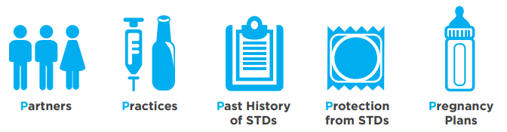
The 5 P’s
of STIs
from STIs
Image: https://www.lgbtqiahealtheducation.org/wp-content/uploads/COM-827-sexual-history_toolkit_2015.pdf
https://www.cdc.gov/std/treatment/sexualhistory.pdf
STI= sexually transmitted infection
Notes:
Taking a sexual health history.
This is an entire presentation within itself, but at a minimum you should consider discussing the 5 Ps as outlined by the CDC.

Slide 33
Testing

Slide 34
HIV Natural History
Primary
infection
1200
1100
1000
900
800
700
600
500
400
300
200
100
0
Possible acute HIV syndrome
Wide dissemination of virus
Seeding of lymphoid organs
Death
Opportunistic
diseases
Clinical latency
1:512
1:256
1:128
1:64
1:32
1:16
1.8
1.4
1.2
0
CD4 T Cells/mm³
Constitutional
symptoms
Plasma Viremia Titer
0
3
6
9
12
1
2
3
4
5
6
7
8
9
10
11
Weeks
Years
Adapted from Ann Intern Med 1996;124:654
Notes:
Natural history of HIV without treatment

Slide 35
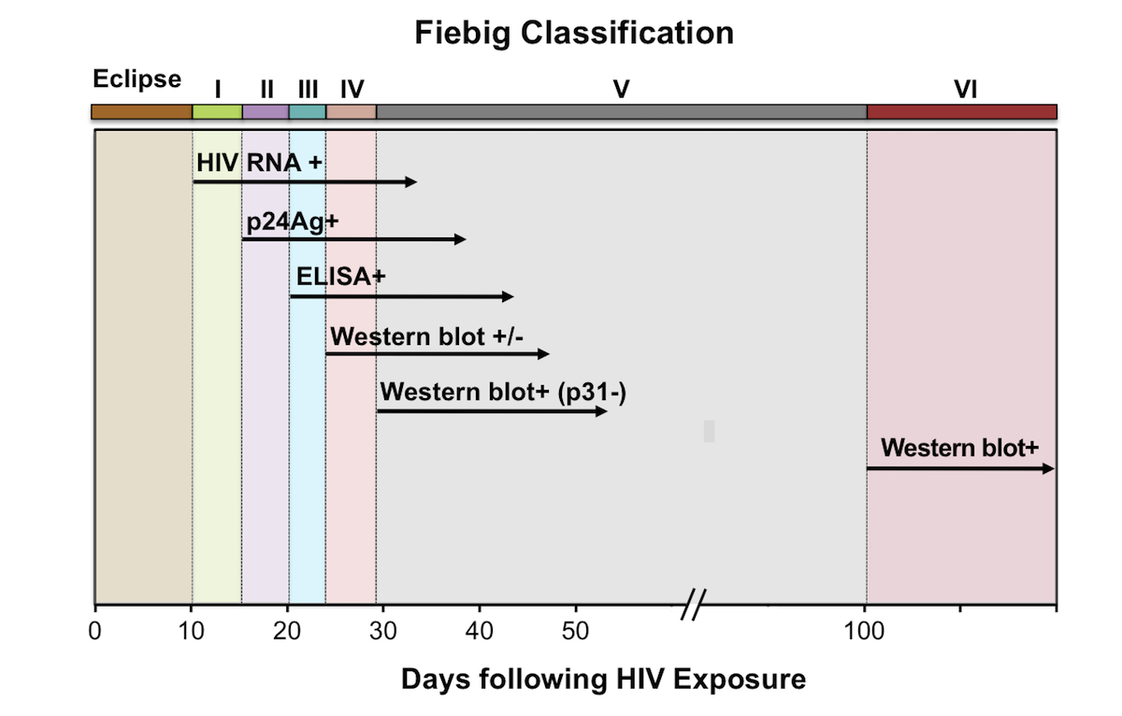
Laboratory Markers
Image from National HIV Curriculum.https://www.hiv.uw.edu/
Fiebig EW, Wright DJ, Rawal BD, et al. Dynamics of HIV viremia and antibody seroconversion in plasma donors: implications for diagnosis and staging of primary HIV infection. AIDS. 2003;17:1871-9.

Slide 36
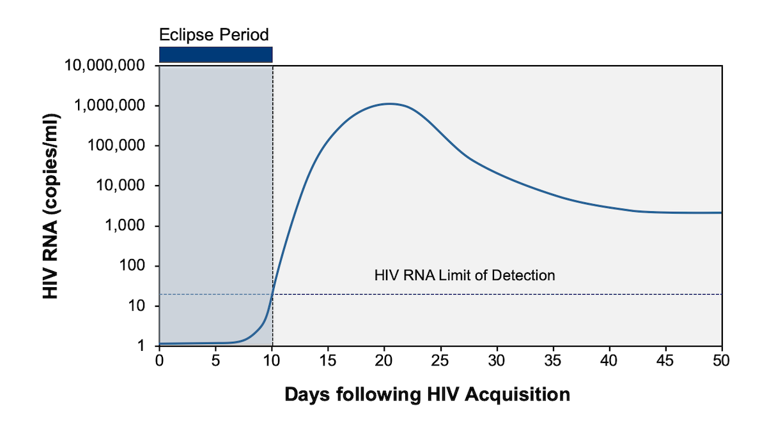
HIV RNA
National HIV Curriculum. Illustration: David H. Spach, MD. https://www.hiv.uw.edu/

Slide 37
HIV Testing
Antibody
IgG and/or IgM
Lab-based
  Plasma/serum
  Dried blood spot
  Oral fluid
Point of care (POC)
  Rapid
  Plasma, serum, whole blood
  Oral fluid
Nucleic Acid
HIV RNA PCR
  Qualitative
  Quantitative (viral load)
Branched DNA (bDNA)
Lab-based
  Plasma/serum
Antigen/Antibody
(4th generation)
Lab-based
  Plasma/serum
Point of care (POC)
  Rapid
  Plasma, serum, whole blood
https://www.cdc.gov/hiv/clinicians/screening/diagnostic-tests.html
Hurt C, et al. Sex Transm Dis 2017 (Dec);44(12):739

Slide 38
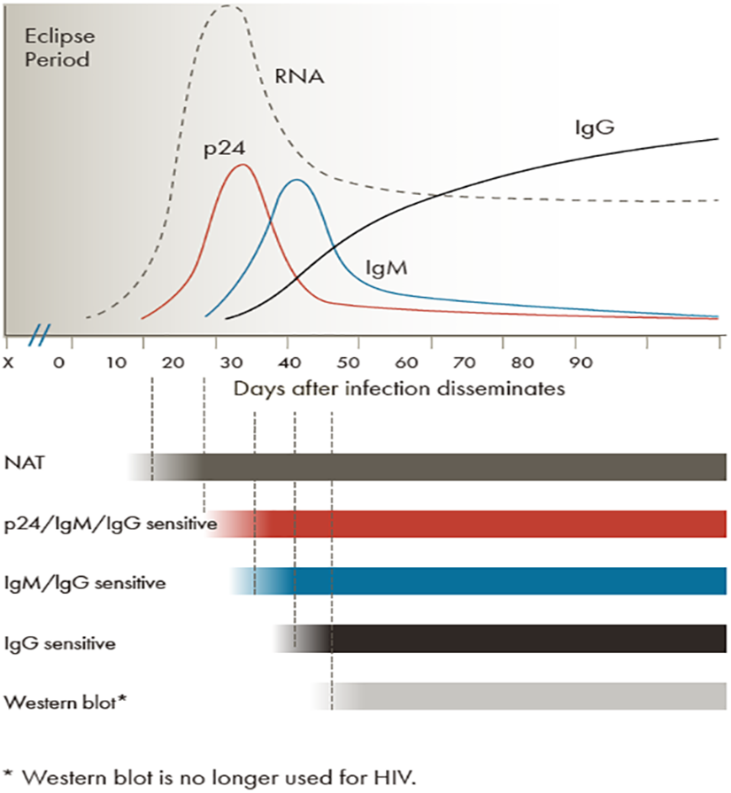
Testing Method
CDC, HIV, Which Tests Should I Use? https://www.cdc.gov/hiv/clinicians/screening/tests.html

Slide 39
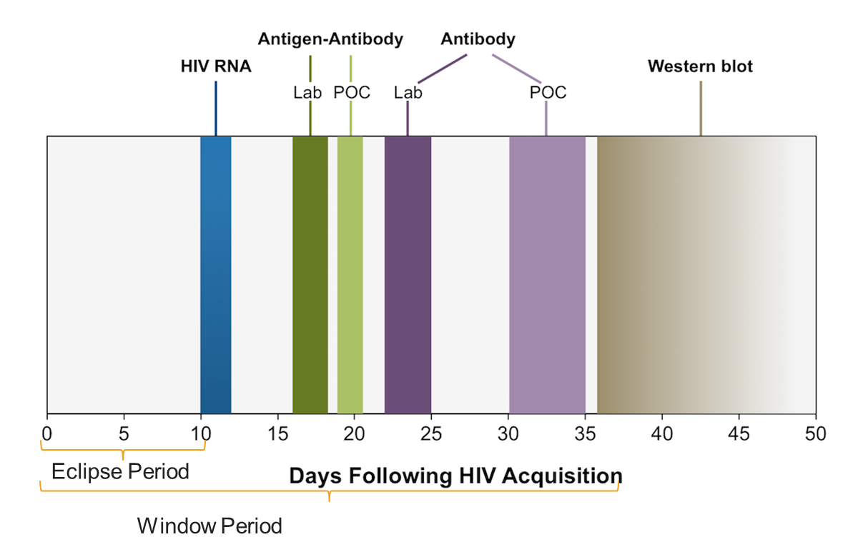
Window Period
Time between acquisition of HIV and time when a laboratory test will accurately detect HIV infection (in almost all people)
  Varies based on test used
  A test might be positive in as little as 15 days, but might take as long as 45 days
Image from National HIV Curriculum.https://www.hiv.uw.edu/
Adapted from Centers for Disease Control and Prevention and Association of Public Health Laboratories. Laboratory Testing for the Diagnosis of HIV Infection: Updated Recommendations. Published June 27, 2014.

Slide 40
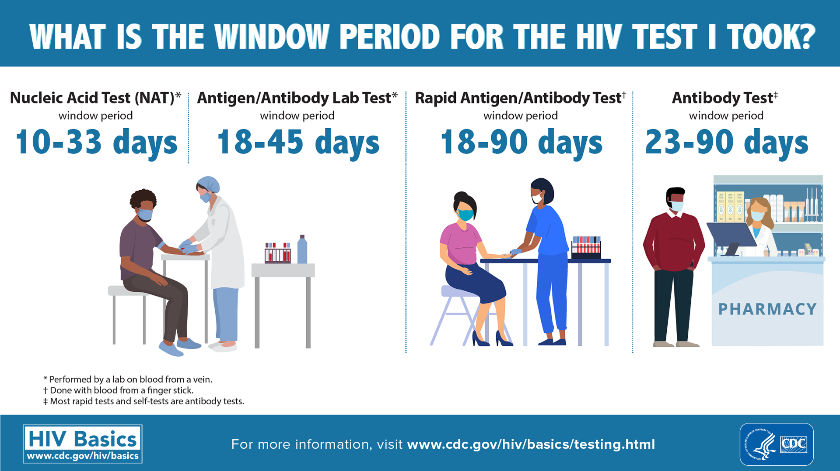

Slide 41
Performance
Sensitivity/Specificity
False-Negative – retest with clinical suspicion
False-Positive – confirmatory testing

Slide 42
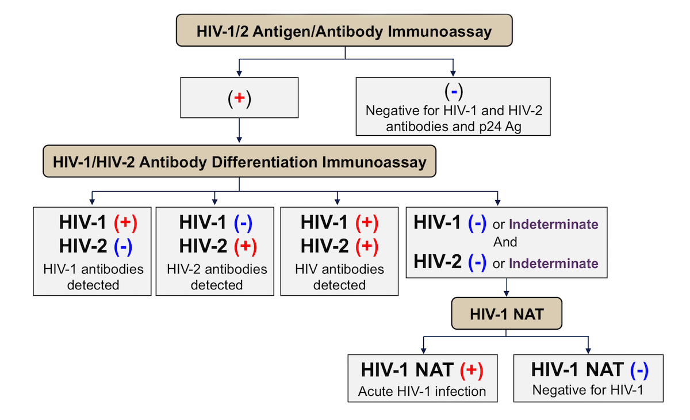
HIV Testing Algorithm
Image from National HIV Curriculum.https://www.hiv.uw.edu/
Centers for Disease Control and Prevention and Association of Public Health Laboratories. Laboratory Testing for the Diagnosis of HIV Infection: Updated Recommendations. Published June 27, 2014.
Centers for Disease Control and Prevention and Association of Public Health Laboratories. 2018 Quick reference guide: Recommended laboratory HIV testing algorithm for serum or plasma specimens. Published January 27, 2018.
Notes:
CDC & APHL (Association of Public Health Laboratories) testing algorithm

Slide 43
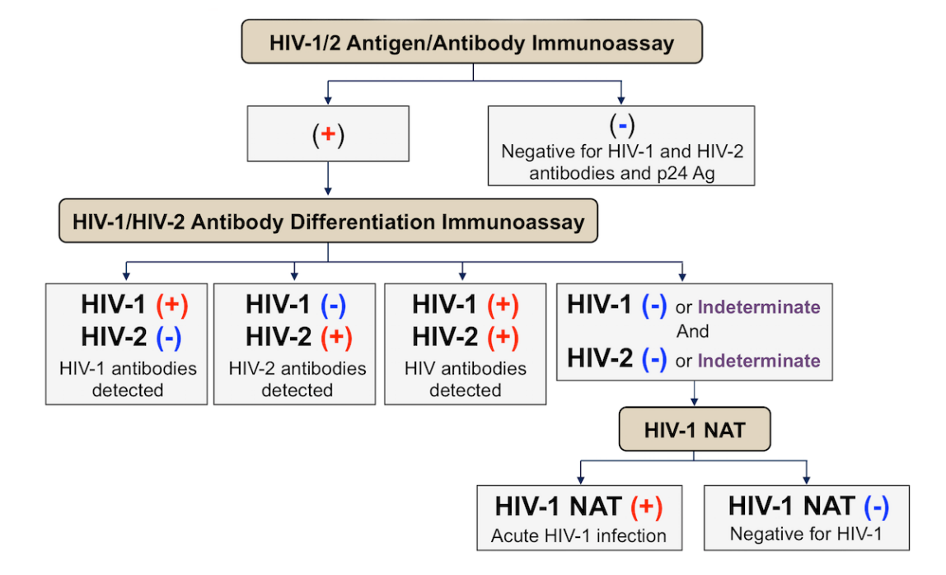
Testing Method
Image from National HIV Curriculum.https://www.hiv.uw.edu/
CDC, HIV, Which Tests Should I Use? https://www.cdc.gov/hiv/clinicians/screening/tests.html
CDC, HIV, Which Tests Should I Use? https://www.cdc.gov/hiv/clinicians/screening/tests.html
Centers for Disease Control and Prevention and Association of Public Health Laboratories. 2018 Quick reference guide: Recommended laboratory HIV testing algorithm for serum or plasma specimens. Published January 27, 2018.
Notes:
CDC, HIV, Which Tests Should I Use? https://www.cdc.gov/hiv/clinicians/screening/tests.html
Centers for Disease Control and Prevention and Association of Public Health Laboratories. 2018 Quick reference guide: Recommended laboratory HIV testing algorithm for serum or plasma specimens. Published January 27, 2018.

Slide 44
Acute HIV Infection
Notes:
Dr. Drevets covered this in the HIV 101 lecture, but I want to review it here as it is uniquely important for providing HIV pre-exposure prophylaxis.

Slide 45
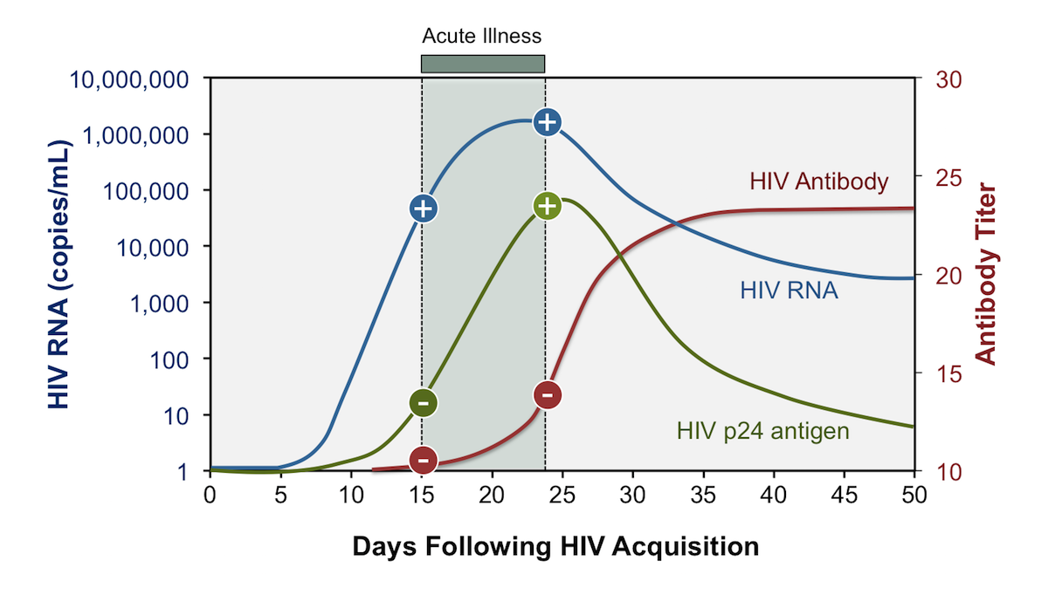
Acute HIV Infection
Time immediately following HIV acquisition, detectable HIV RNA and/or p24 antigen, but no detectable antibodies
Acute retroviral syndrome
  Symptomatic presentation
National HIV Curriculum. Illustration: David H. Spach, MD. https://www.hiv.uw.edu/

Slide 46
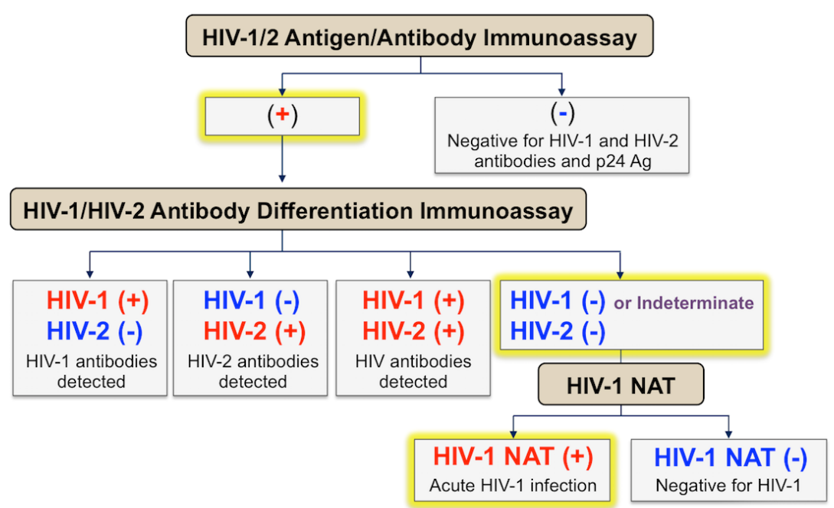
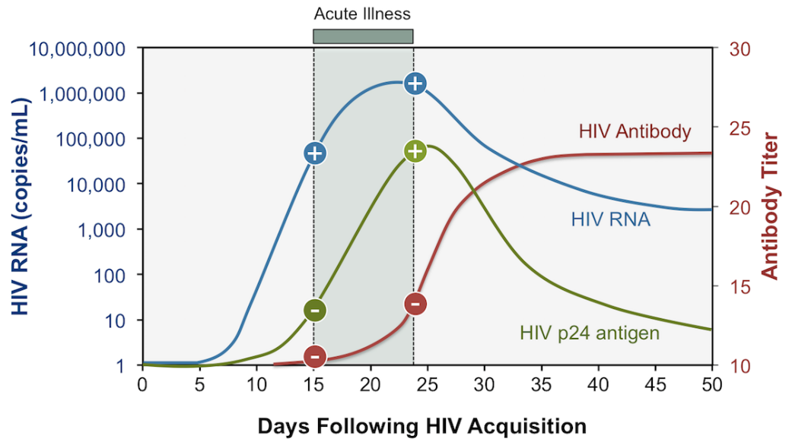
Testing Algorithm
National HIV Curriculum. Illustration: David H. Spach, MD
Image from National HIV Curriculum.https://www.hiv.uw.edu/
Centers for Disease Control and Prevention and Association of Public Health Laboratories. 2018 Quick reference guide: Recommended laboratory HIV testing algorithm for serum or plasma specimens. Published January 27, 2018.
National HIV Curriculum. Illustration: David H. Spach, MD. https://www.hiv.uw.edu/
Notes:
The HIV testing algorithm recommended by the CDC and APHL uses HIV-1/2 antigen-antibody immunoassays as the initial HIV screening test and this test will detect approximately 80 to 85% of persons with acute HIV. The characteristic algorithm pattern with acute HIV-1 infection is a positive HIV-1/2 antigen-antibody immunoassay, a negative HIV-1/HIV-2 antibody differentiation immunoassay, and a positive HIV-1 RNA test.

Slide 47
Acute Retroviral Syndrome
Asymptomatic infection → mild nonspecific viral infection → severe viral infection (hospitalization)
Nonspecific, viral-like, self-limiting
Develop within 28 days of inoculation
Generally, lasts about 14 days
National HIV Curriculum. https://www.hiv.uw.edu/
Notes:
The diagnosis of acute HIV infection requires a high index of suspicion and careful history taking to identify recent (within 2 to 6 weeks) high-risk exposure to HIV.
Assessing signs/symptoms at time of testing can help you rule-in or rule-out acute infection.

Slide 48
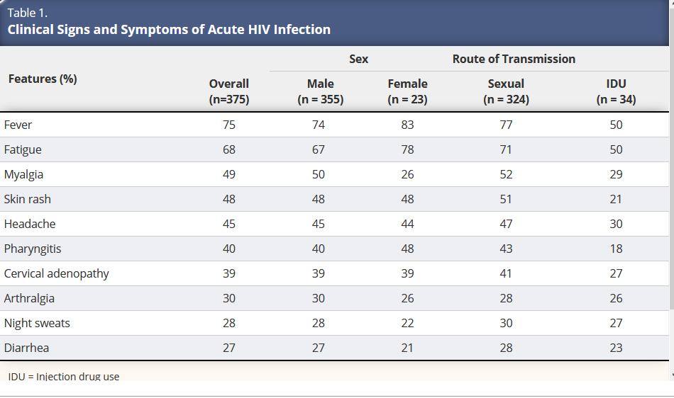
Clinical Manifestations
US Public Health Service. Preexposure prophylaxis for the prevention of HIV infection in the United States—2017 Update. A Clinical Practice Guideline. March 2018:1-77.
Notes:
Usually occurs shortly after infection up to 4 weeks after. Varies in presentation from asymptomatic to hospitalization. Will resolve on its own with time (generally about 2 week course) and will not recur.

Slide 49
Patient Cases: Testing

Slide 50
Case 1
Patient Information
27-year-old man is seen in clinic today for primary care. He has no chronic medical problems and his physical exam is unremarkable. He came in today to inquire about HIV preexposure prophylaxis (PrEP).
He reports sexual activity with men; both an insertive and receptive partner.
Current medications: daily multiple vitamin and daily vitamin C supplement
Adapted from: Case Studies in PrEP Management. Kevin Ard, MD. April 15, 2016. Available at: https://www.umc.edu/UMMC/Outreach-Programs/MS-AIDS-Education-Training-Center/images/prep-case-studies-kevin-ard.pdf

Slide 51
HIV Screening and Testing
In order to provide PrEP services, you need to know:
  Who is most vulnerable to HIV acquisition
  Who has HIV
  Who doesn’t have HIV
Notes:
In order to provide PrEP services, you need to know:
Who is most vulnerable to HIV acquisition
Who has HIV – link to care for treatment services
Who doesn’t have HIV – evaluate for appropriateness for PrEP services
For number 1, you need to understand some basic concepts about HIV including transmission and epidemiology.
For 2 and 3 we can determine this with routine testing.

Slide 52
Case 1
Patient Information
27 year-old man is seen in clinic today for primary care. He has no chronic medical problems and his physical exam is unremarkable. He came in today to inquire about HIV PrEP.
He reports sexual activity with men; both an insertive and receptive partner.
Current medications: daily multiple vitamin and daily vitamin C supplement
From what we discussed, is he vulnerable to HIV acquisition?
Adapted from: Case Studies in PrEP Management. Kevin Ard, MD. April 15, 2016. Available at: https://www.umc.edu/UMMC/Outreach-Programs/MS-AIDS-Education-Training-Center/images/prep-case-studies-kevin-ard.pdf

Slide 53
Case 1
Patient Information
27 year-old man is seen in clinic today for primary care. He has no chronic medical problems and his physical exam is unremarkable. He came in today to inquire about HIV PrEP.
He reports sexual activity with men; both an insertive and receptive partner.
Current medications: daily multiple vitamin and daily vitamin C supplement
From what we discussed, is he vulnerable to HIV acquisition?
What is your next step?
Adapted from: Case Studies in PrEP Management. Kevin Ard, MD. April 15, 2016. Available at: https://www.umc.edu/UMMC/Outreach-Programs/MS-AIDS-Education-Training-Center/images/prep-case-studies-kevin-ard.pdf
Notes:
There are 2 answers to this one.
We could certainly just test for HIV, which I would absolutely recommend.
We could also engage in a conversation about sexual health and substance use to further assess risk for HIV acquisition. I would recommend this as well.

Slide 54
The 5 P’s
of STIs
from STIs
Image: https://www.lgbtqiahealtheducation.org/wp-content/uploads/COM-827-sexual-history_toolkit_2015.pdf
https://www.cdc.gov/std/treatment/sexualhistory.pdf
STI= sexually transmitted infection
Notes:
This is a good time to discuss sexual health in the context of the 5 Ps.
He reports sexual activity with men; he is both an insertive and receptive partner. We don’t know anything about his partners. Does he require a recent HIV test to engage in activity? This might decrease his risk. Does he 100% of the time use condoms for both insertive and receptive sex, this would also decrease his risk. I’m in no way saying this would talk me out of using PrEP, just further clarifying the patient’s specific situation.

Slide 55
Case 1
Partners: all men with unknown HIV status; 3 partners in past month
Practices: oral and anal sex (insertive and receptive)
Past STIs: Syphilis once 2 years ago, treated with penicillin injections
Protection: inconsistent condom use
Pregnancy plans: no desire to have children
Adapted from: Case Studies in PrEP Management. Kevin Ard, MD. April 15, 2016. Available at: https://www.umc.edu/UMMC/Outreach-Programs/MS-AIDS-Education-Training-Center/images/prep-case-studies-kevin-ard.pdf

Slide 56
Case 1
Substance use history
  Smokes marijuana recreationally (3-4 times weekly)
  No other history; denies any IV drug use
Last HIV test about 1 year ago - negative
Adapted from: Case Studies in PrEP Management. Kevin Ard, MD. April 15, 2016. Available at: https://www.umc.edu/UMMC/Outreach-Programs/MS-AIDS-Education-Training-Center/images/prep-case-studies-kevin-ard.pdf

Slide 57
Case 1
Substance use history
  Smokes marijuana recreationally (3-4 times weekly)
  No other history; denies any IV drug use
Last HIV test about 1 year ago – negative
Now what do you want to do?
Adapted from: Case Studies in PrEP Management. Kevin Ard, MD. April 15, 2016. Available at: https://www.umc.edu/UMMC/Outreach-Programs/MS-AIDS-Education-Training-Center/images/prep-case-studies-kevin-ard.pdf

Slide 58
HIV Testing Algorithm
Image from National HIV Curriculum.https://www.hiv.uw.edu/
Centers for Disease Control and Prevention and Association of Public Health Laboratories. 2018 Quick reference guide: Recommended laboratory HIV testing algorithm for serum or plasma specimens. Published January 27, 2018.

Slide 59
Negative HIV Test
Tests: (1) AB HIV 1 2 (4TH GENERATION) (HIV12AB)
AB HIV 1 2 (4TH GENERATION)
Nonreactive NONREACITVE *1
Biotin interferes with this assay and can affect results.
Samples should not be collected from patients who have taken
biotin within the last 8 hours or longer for patients on
high dose therapy.
Tests: (1) AB HIV 1 2 (hIV12)
! HIV 1/2 ANTIBODY COMENT
NON REACTIVE *1
HIV-1 Antigen and HIV-1/HIV-2 antibodies were not detected.
There is no laboratory evidence of HIV infection.
Image: presenter image of electronic medical record

Slide 60
Positive HIV Test
Image: presenter image of electronic medical record

Slide 61
Let’s back up a few steps
What if he tells you he has had some fever and chills over the past 2 days and on exam he has lymphadenopathy
And when you do the sexual health history, he states his last sexual encounter was 15 days ago, no condom use
Does that change anything?
Adapted from: Case Studies in PrEP Management. Kevin Ard, MD. April 15, 2016. Available at: https://www.umc.edu/UMMC/Outreach-Programs/MS-AIDS-Education-Training-Center/images/prep-case-studies-kevin-ard.pdf

Slide 62
Testing Algorithm
Image from National HIV Curriculum.https://www.hiv.uw.edu/
Centers for Disease Control and Prevention and Association of Public Health Laboratories. 2018 Quick reference guide: Recommended laboratory HIV testing algorithm for serum or plasma specimens. Published January 27, 2018.
Notes:
APHL – Association of Public Health Laboratories

Slide 63
Antigen/Antibody
Tests: (1) AB HIV 1 2 (4TH GENERATION) (HIV12AB)
AB HIV 1 2 (4TH GENERATION)
[A] REACTIVE NONREACITVE *1
The OUMS laboratory forwards all repeatedly reactive
HIV 1,2 Ag/Ab screening tests to a certified laboratory
for confirmatory HIV-1 and HIV-2 antibody differentiation
assay testing.
Biotin interferes with this assay and can affect results.
Samples should not be collected from patients who have taken
biotin within the last 8 hours or longer for patients on
high dose therapy.
Image: presenter image of electronic medical record

Slide 64
Antibody Differentiation
Tests: (1) AB HIV 1 2 (hIV12)
! HIV 1 ANTIBODY Indeterminate *1
! HIV 2 ANTIBODY Indeterminate *2
! HIV 1/2 ANTIBODY COMENT
<No Reported Value> *3
This test was performed at Quest Diagnostics as routine
confirmation for a reactive result obtained at OU health
Laboratories. Quest reported that this sample was
non-reactive. These discordant results should be collected
interpreted as indeterminate. Recommend repeat antibody or
PCR testing on a fresh sample.
Image: presenter image of electronic medical record
Notes:
Point out that indeterminate mean negative.

Slide 65
Antibody Differentiation
Tests: (1) AB HIV 1 2 (hIV12)
! HIV 1 ANTIBODY Indeterminate *1
! HIV 2 ANTIBODY Indeterminate *2
! HIV 1/2 ANTIBODY COMENT
<No Reported Value> *3
This test was performed at Quest Diagnostics as routine
confirmation for a reactive result obtained at OU health
Laboratories. Quest reported that this sample was
non-reactive. These discordant results should be collected
interpreted as indeterminate. Recommend repeat antibody or
PCR testing on a fresh sample.
Now what do we do?
Image: presenter image of electronic medical record

Slide 66
Testing Algorithm
Image from National HIV Curriculum.https://www.hiv.uw.edu/
Centers for Disease Control and Prevention and Association of Public Health Laboratories. 2018 Quick reference guide: Recommended laboratory HIV testing algorithm for serum or plasma specimens. Published January 27, 2018.
Notes:
APHL – Association of Public Health Laboratories

Slide 67
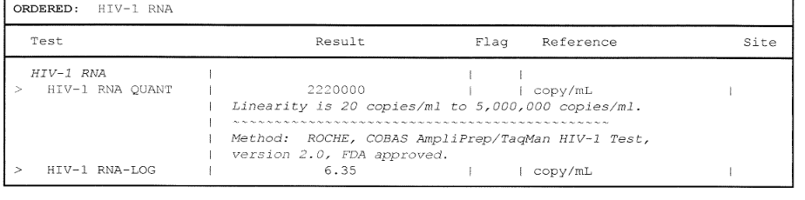
HIV RNA
Image: presenter image of electronic medical record

Slide 68
HIV RNA
What is going on?
Image: presenter image of electronic medical record

Slide 69
Acute HIV Infection
National HIV Curriculum. Illustration: David H. Spach, MD. https://www.hiv.uw.edu/
Notes:
National HIV Curriculum. Illustration: David H. Spach, MD. https://www.hiv.uw.edu/

Slide 70
Case 2
25 year-old woman who was recently diagnosis of rectal herpes simplex virus (HSV); would like to discuss PrEP
Partners: all men, unknown HIV status, 1-2 new partners per month
Practices: oral, vaginal, and anal intercourse
Past STIs: previously treated for chlamydia, gonorrhea and current HSV infection
Protection: inconsistent condom use
Pregnancy: combination oral contraceptive for birth control
Adapted from: Case Studies in PrEP Management. Kevin Ard, MD. April 15, 2016. Available at: https://www.umc.edu/UMMC/Outreach-Programs/MS-AIDS-Education-Training-Center/images/prep-case-studies-kevin-ard.pdf

Slide 71
Case 2
25 year-old woman who was recently diagnosis of rectal herpes simplex virus (HSV); would like to discuss PrEP
Partners: all men, unknown HIV status, 1-2 new partners per month
Practices: oral, vaginal, and anal intercourse
Past STIs: previously treated for chlamydia, gonorrhea and current HSV infection
Protection: inconsistent condom use
Pregnancy: combination oral contraceptive for birth control
What do you want to do next?
Adapted from: Case Studies in PrEP Management. Kevin Ard, MD. April 15, 2016. Available at: https://www.umc.edu/UMMC/Outreach-Programs/MS-AIDS-Education-Training-Center/images/prep-case-studies-kevin-ard.pdf
Notes:
Test her for HIV

Slide 72
Case 2
25 year-old woman who was recently diagnosis of rectal herpes simplex virus (HSV); would like to discuss PrEP
Partners: all men, unknown HIV status, 1-2 new partners per month
Practices: oral, vaginal, and anal intercourse
Past STIs: previously treated for chlamydia, gonorrhea and current HSV infection
Protection: inconsistent condom use
Pregnancy: combination oral contraceptive for birth control
What do you want to do next? What if she tells you her last sexual encounter was 48 hours ago?
Adapted from: Case Studies in PrEP Management. Kevin Ard, MD. April 15, 2016. Available at: https://www.umc.edu/UMMC/Outreach-Programs/MS-AIDS-Education-Training-Center/images/prep-case-studies-kevin-ard.pdf
Notes:
Still test her for HIV, but know that the test will not tell you anything about her possible acquisition from this encounter.

Slide 73
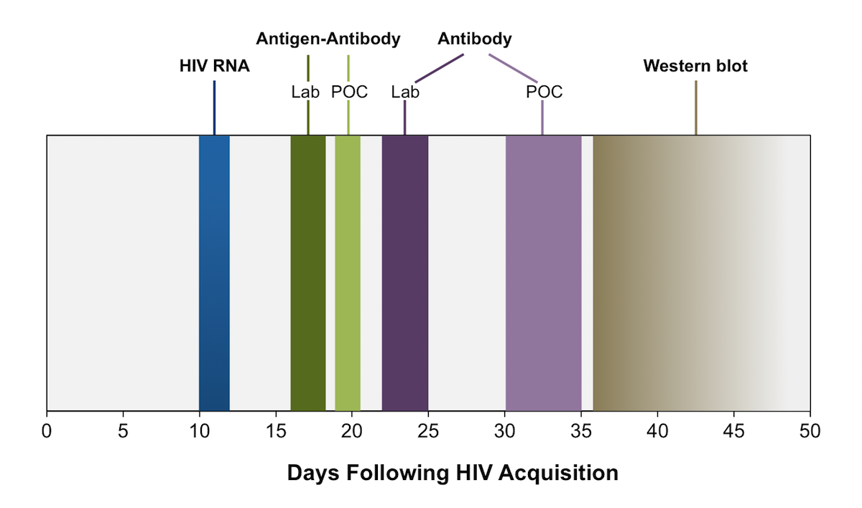
Testing Method
Image from National HIV Curriculum.https://www.hiv.uw.edu/
Source: modified from Centers for Disease Control and Prevention and Association of Public Health Laboratories. Laboratory Testing for the Diagnosis of HIV Infection: Updated Recommendations. Published June 27, 2014.

Slide 74
Antigen/Antibody
Tests: (1) AB HIV 1 2 (4TH GENERATION) (HIV12AB)
AB HIV 1 2 (4TH GENERATION)
Nonreactive NONREACITVE *1
Biotin interferes with this assay and can affect results.
Samples should not be collected from patients who have taken
biotin within the last 8 hours or longer for patients on
high dose therapy.
What could you do?
Image: presenter image of electronic medical record
Notes:
2 things:
Provide post-exposure prophylaxis – that is another topic for another time
Be sure she is retested in 4 to 12 weeks

Slide 75
References
Office of Infectious Disease and HIV/AIDS Policy. (2023, Aug 1). Overview. HIV.gov. https://www.hiv.gov/federal-response/ending-the-hiv-epidemic/overview
Health Resources & Services Administration. (2023, June). Ending the HIV Epidemic in the U.S. https://www.hrsa.gov/ending-hiv-epidemic
Cresswell F, et al. UK guideline for the use of HIV post-exposure prophylaxis following sexual exposure, 2015. International Journal of STD & AIDS. 2016;27(9):713-738
Center for Disease Control and Prevention. Estimated HIV incidence and prevalence in the United States, 2017-2021. HIV Surveillance Supplemental Report. 2023:28(3). http://www.cdc.gov/hiv/library/reports/hiv-surveillance.html. Published May 2023
Centers for Disease Control and Prevention (2022, July 6). HIV and Black/African American People in the U.S. https://www.cdc.gov/nchhstp/newsroom/fact-sheets/hiv/black-african-american-factsheet.html
Case Studies in PrEP Management. Kevin Ard, MD. April 15, 2016. https://www.umc.edu/UMMC/Outreach-Programs/MS-AIDS-Education-Training-Center/images/prep-case-studies-kevin-ard.pdf

Slide 76
References
Center for Disease Control and Prevention. Diagnoses of HIV infection in the United States and dependent areas, 2019. HIV Surveillance Report, 2019;32. http://www.cdc.gov/hiv/library/reports/hiv-surveillance.html. Published May 2021
Hess K, et al. Lifetime risk of diagnosis of HIV infection in the United States. Ann Epidemiol. 2017; 27:238-243
Centers for Disease Control and Prevention. Estimated HIV incidence and prevalence in the United States, 2015-2019. HIV Surveillance Supplemental Report. 2021;26(1). http://www.cdc.gov/hiv/library/reports/hiv-surveillance.html. Published May 2021
U.S. Preventive Services Task Force. (2019, June 11). Human immunodeficiency virus (HIV) infection: screening. https://www.uspreventiveservicestaskforce.org/uspstf/recommendation/human-immunodeficiency-virus-hiv-infection-screening
Branson, BM, et al. Revised recommendations for HIV testing of adults, adolescents, and pregnant women in health-care settings. MMWR. 2006;55(rr14): 1-17 https://www.cdc.gov/mmwr/preview/mmwrhtml/rr5514a1.htm

Slide 77
References
Centers for Disease Control and Prevention. (2023, June 1). How Do I Screen for HIV? https://www.cdc.gov/hiv/clinicians/screening/opt-out.html
Arkell C. (2019, Nov 4). An “HIV status neutral” paradigm shift. CATIE BLOG. https://blog.catie.ca/2019/11/04/an-hiv-status-neutral-paradigm-shift/
Johnston C. (2019, March 27). Taking a Sexual History & Behavioral STD Risk Assessment. North Dakota Health and Human Services. https://www.ndhealth.gov/hiv/Provider/
Centers for Disease Control and Prevention. A guide to taking a sexual history. https://www.cdc.gov/std/treatment/sexualhistory.pdf
Fauci AS, et al. Immunopathogenic mechanisms of HIV infection. Ann Intern Med. 1996;124(7):654-663
Fiebig EW, Wright DJ, Rawal BD, et al. Dynamics of HIV viremia and antibody seroconversion in plasma donors: implications for diagnosis and staging of primary HIV infection. AIDS. 2003;17:1871-9

Slide 78
References
National HIV Curriculum. https://www.hiv.uw.edu/
Centers for Disease Control and Prevention. (2023, June 1). Which HIV tests should I use? https://www.cdc.gov/hiv/clinicians/screening/tests.html
Hurt C, et al. Selecting an HIV test: a narrative review for clinicians and researchers. Sexually Transmitted Diseases. 2017;44(12):739-746
Centers for Disease Control and Prevention and Association of Public Health Laboratories. Laboratory Testing for the Diagnosis of HIV Infection: Updated Recommendations. Published June 27, 2014. https://stacks.cdc.gov/view/cdc/23447
Centers for Disease Control and Prevention. HIV testing. www.cdc.gov/hiv/basics/testing.html
Centers for Disease Control and Prevention and Association of Public Health Laboratories. 2018 Quick reference guide: Recommended laboratory HIV testing algorithm for serum or plasma specimens. Published January 27, 2018. https://stacks.cdc.gov/view/cdc/50872
US Public Health Service. Preexposure prophylaxis for the prevention of HIV infection in the United States—2017 Update. A Clinical Practice Guideline. March 2018:1-77. https//www.cdc.gov/hiv/pdf/risk/prep/cdc-hiv-prep-guidelines-2017.pdf

Slide 79
Resources
National Clinician Consultation Center http://nccc.ucsf.edu/
  HIV Management
  Perinatal HIV
  HIV PrEP
  HIV PEP line
  HCV Management
  Substance Use Management
Present on ECHO
https://hsc.unm.edu/scaetc/programs-services/echo.html​
AETC National HIV Curriculum https://aidsetc.org/nhc
AETC National Coordinating Resource Center https://targethiv.org/library/aetc-national-coordinating-resource-center-0
HIVMA Resource Directory https://www.hivma.org/globalassets/ektron-import/hivma/hivma-resource-directory.pdf
Additional trainings scaetcecho@salud.unm.edu
www.scaetc.org
Notes:
IDEA Platform: Infectious Diseases Education & Assessment. https://idea.medicine.uw.edu/
AETC National HIV Curriculum: 6 core modules for self study; regularly updated; CME, CNE
Hepatitis C Online Curriculum: https://www.hepatitisc.uw.edu/
Hepatitis B Online Curriculum: https://www.hepatitisb.uw.edu/
National STD Curriculum: https://www.std.uw.edu/

Slide 80
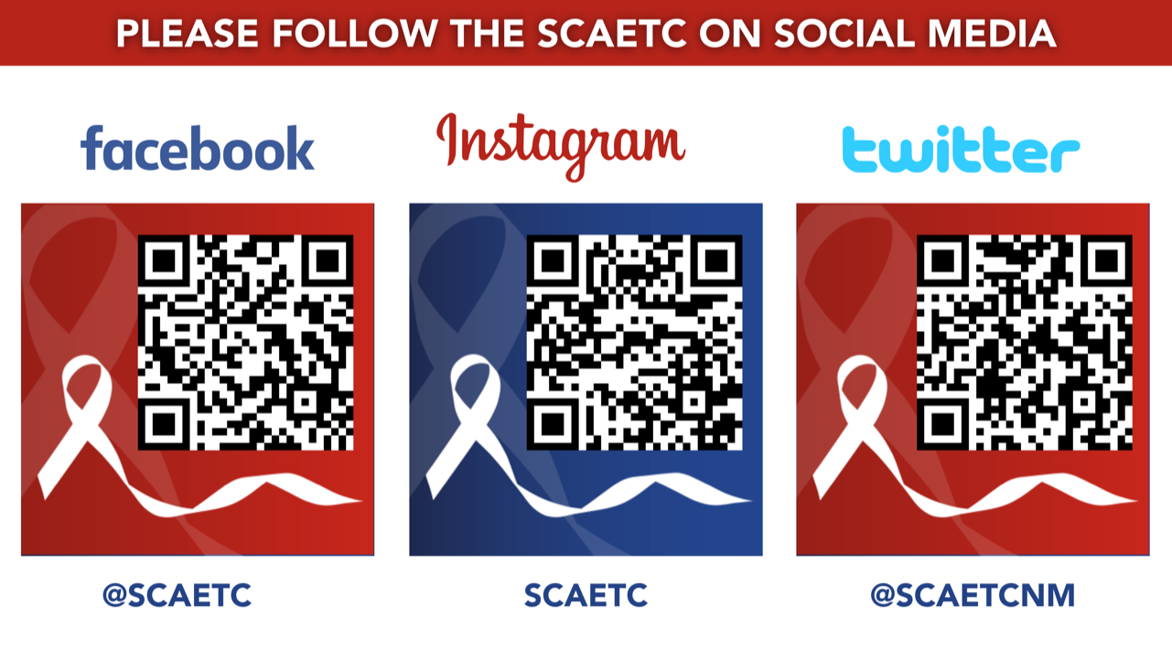
SCAETC Social Media

