Slide 1
Initial clinical evaluation of persons with HIV
Prathit A. Kulkarni, M.D.
Assistant Chief of Medicine & Fellowship Program Director
Michael E. DeBakey Veterans Affairs Medical Center / Baylor College of Medicine
Notes:
Version date_08 2023
Target audience:

Slide 2
Conflict of Interest Disclosure Statement
Speaker has nothing to disclose
This program is supported by the Health Resources and Services Administration (HRSA) of the U.S. Department of Health and Human Services (HHS) as part of an award totaling $4,205,743 with 0% financed with non-governmental sources. The contents are those of the author(s) and do not necessarily represent the official views of, nor does mention of trade names, commercial practices, or organizations imply an endorsement by HRSA, HHS, or the U.S. Government. For more information, please visit HRSA.gov. Any trade/brand names for products mentioned during this presentation are for training and identification purposes only.

Slide 3
Use of Trade/Brand Names
This program is supported by the Health Resources and Services Administration (HRSA) of the U.S. Department of Health and Human Services (HHS) as part of an award totaling $4,205,743, with 0% financed with non-governmental sources.
The views expressed do not necessarily reflect the official policies of the Department of Health and Human Services, nor does mention of trade names, commercial practices, or organizations imply endorsement by the U.S. Government. Any trade/brand names for products mentioned during this presentation are for training and identification purposes only.
Notes:
NOTE: THIS SLIDE MUST BE INCLUDED IF TRADE AND/OR BRAND NAMES FOR MEDICATIONS ARE USED IN THE PRESENTATION.
IT MAY BE DELETED IF THERE IS NO REFERENCE TO TRADE NAMES, INCLUDING PRESENTATIONS IN WHICH ONLY GENERIC MEDICATION NAMES ARE MENTIONED.
TRADE NAMES MUST BE PUT IN PARENTHESES AFTER THE GENERIC NAME THE FIRST TIME IT IS MENTIONED - E.G., FLUOXETINE (PROZAC). TRADE NAMES SHOULD ONLY BE MENTIONED FOR THE INITIAL REFERENCE AND THE GENERIC NAME ONLY SHOULD BE USED AFTER THAT. THIS APPLIES EQUALLY TO ALL MEDICATIONS OR PRODUCTS MENTIONED IN THIS PRESENTATION.

Slide 4
Unconscious Bias Disclosure
SCAETC recognizes that language is constantly evolving, and while we make every effort to avoid bias and stigmatizing terms, we acknowledge that unintentional lapses may occur in our presentations.
We value your feedback and encourage you to share any concerns related to language, images, or concepts that may be offensive or stigmatizing.
Your input will help us refine and improve our presentations, ensuring they remain inclusive and respectful to participants.

Slide 5
Learning Objectives
Describe the initial clinical management of patients with a new diagnosis of HIV.
Differentiate the initial preferred antiretroviral regimens as recommended by the U.S. Department of Health & Human Services for patients with newly diagnosed HIV.

Slide 6
Case presentation
Mr. S is a 52-year-old man with no significant prior medical history. He is referred to your clinic by his PCP for new diagnosis of HIV.
Positive 4th generation combination antibody/antigen assay and positive HIV-1/HIV-2 differentiation immunoassay
Notes:
PCP=primary care provider

Slide 7
Case presentation (cont.)
Test was obtained because the patient had 3 sexual partners (men + women) over the past year
When you evaluate him, he feels fine. Completely negative review of systems. Physical exam normal.
What labs and other tests should be obtained as the patient establishes care and starts treatment for HIV (including typical testing and other screening that would be done in primary care)?

Slide 8
Clinical Infectious Diseases, Volume 73, Issue 11, 1 December 2021, Pages e3572–e3605

Slide 9
Diagnostic tests to obtain for new diagnosis of HIV
CD4⁺ count
HIV viral load
HIV genotype
INSTI resistance testing only required if clinical suspicion for INSTI mutation
CBC with differential
Comprehensive metabolic profile (chem7 + LFTs)
INSTI= integrase strand transfer inhibitor
Notes:
Can also obtain CD8⁺ count, although not really needed for clinical purposes
Only need tropism testing is CCR5 antagonist is being considered. This is not recommended for those who are treatment naïve.

Slide 10
Diagnostic tests to obtain for new diagnosis of HIV (cont.)
Lipid profile
Hemoglobin A1c
Urinalysis
Screening for latent TB infection (tuberculin skin test or IGRA)
Hepatitis A,B,C
Pregnancy test (for persons of childbearing potential)
Sexually transmitted infection screening
Gonorrhea/Chlamydia nucleic acid amplification testing
All sites of contact (oral, anal, urine, and vaginal)
Trichomoniasis (in all persons who have receptive vaginal sex)
Syphilis
T.pallidum Antibody
Notes:
IGRA=interferon gamma release assay like quantifuron gold
Hepatitis A/B/C: hepatitis A total Ab, hepatitis B surface antigen, hepatitis B surface antibody, hepatitis B core total antibod, hepatitis C antibody (reflex to viral load if positive)

Slide 11
Diagnostic tests to obtain for new diagnosis of HIV (cont.)
Measles/mumps/rubella titers – immunity conferred by:
U.S.-born prior to 1957
Written documentation of adequate vaccination
Positive serology
If vaccinated during 1960’s, might have received killed measles vaccine
Varicella IgG if no known history of chickenpox or shingles

Slide 12
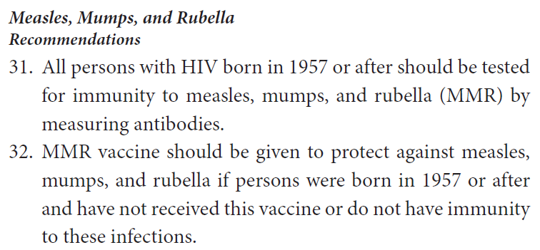
Screening for measles, mumps, and rubella
Clinical Infectious Diseases, Volume 73, Issue 11, 1 December 2021, Pages e3572–e3605
Notes:
In 2019, 1282 individual cases of measles were confirmed in 31
states, the largest number of cases reported in the United States
since 1992 [103]. The majority were among people not vaccinated
against measles. Acceptable evidence of immunity against
measles includes at least 1 of the following: written documentation
of adequate vaccination, laboratory evidence of immunity,
laboratory confirmation of measles, or birth in the United
States before 1957

Slide 13
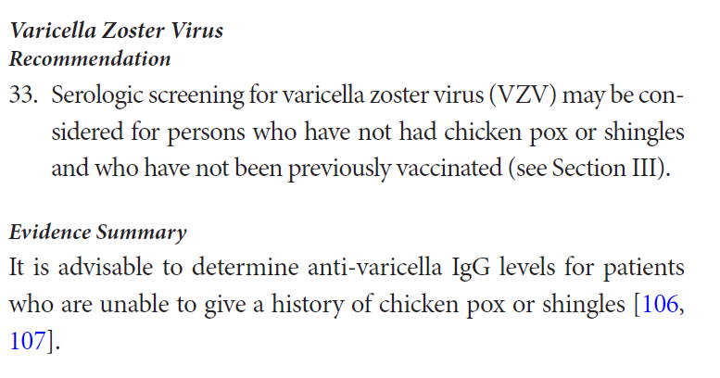
Screening for varicella zoster virus
Clinical Infectious Diseases, Volume 73, Issue 11, 1 December 2021, Pages e3572–e3605

Slide 14
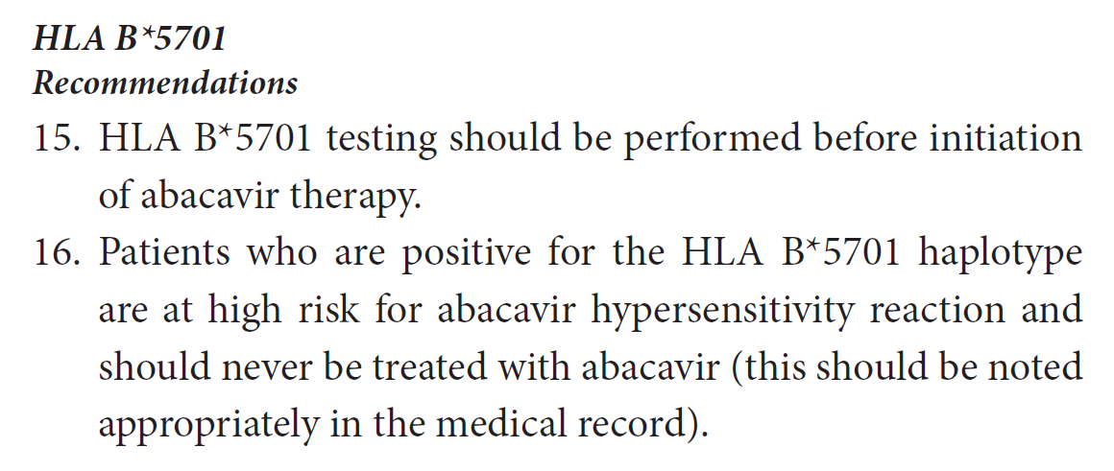
HLA B*5701 testing
Clinical Infectious Diseases, Volume 73, Issue 11, 1 December 2021, Pages e3572–e3605

Slide 15
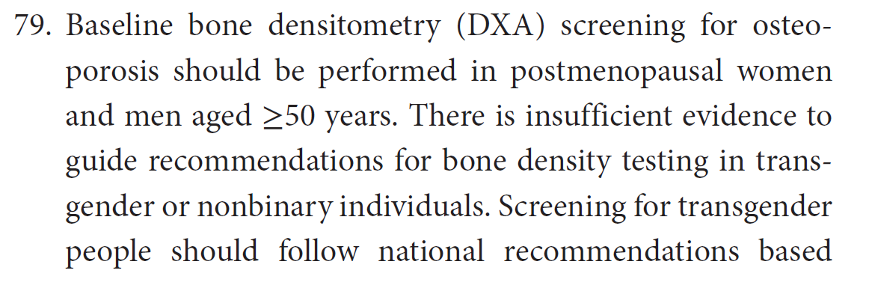
Screening for osteoporosis
Clinical Infectious Diseases, Volume 73, Issue 11, 1 December 2021, Pages e3572–e3605

Slide 16
Cervical Pap smear
Within 1 year of onset of sexual activity and not later than age 21
Routine HPV testing not recommended for people with HIV and cervix in place who are <30 years old unless Pap is abnormal
For persons with cervix >30 years old, can obtain:
Pap test alone
Pap test + HPV testing
After hysterectomy for benign disease, routine screening for vaginal cancer not recommended
However, patients with history of high-grade CIN, adenocarcinoma in-situ, or invasive cervical cancer should have annual vaginal cuff Pap tests
HPV= human papilloma virus; CIN = cervical intraepithelial neoplasia

Slide 17
Anal cancer screening
All persons with history of receptive anal intercourse
Abnormal cervical Pap test
All persons with genital warts
Should obtain anal Pap test if there is access to appropriate follow-up, including high-resolution anoscopy

Slide 18
Other cancer screening
Prostate/breast/lung/colon/liver
All according to usual guidelines for general population

Slide 19
Tests to consider
Chest X-ray
For persons with positive LTBI screen
“May also be useful in other patients who are likely to have preexisting lung abnormalities”
G6PD level
Should be obtained before starting any oxidating drugs (dapsone, primaquine, etc.)
LTBI = latent tuberculosis infection; G6PD= glucose-6-phosphate dehydrogenase
Clinical Infectious Diseases, Volume 73, Issue 11, 1 December 2021, Pages e3572–e3605

Slide 20
Routine testing not needed
HSV IgG
CMV IgG
Toxoplasma IgG
May be obtained in patients in whom prophylaxis is indicated (CD4<100)
Inflammatory biomarkers
Notes:
IgG=immunoglobulin G; evidence of prior infection
In asymptomatic persons, routine testing for all persons is not recommended for HSV, CMV, and toxoplasma.
Biomarkers of inflammation are not recommended. Toxoplasma IgG and cryptococcal antigen
should be obtained in the context of suspicion for clinical disease. Toxoplasma IgG may be obtained in
patients for whom prophylaxis is indicated. CMV IgG may be considered if blood transfusion is contemplated
in a person at low risk for CMV exposure. A negative CMV IgG may support use of CMV-free
blood products.

Slide 21
Returning to our patient, CD4⁺ count comes back as 35
Serum cryptococcal antigen
Per IDSA: “may be considered in persons with CD4⁺ <100”
Per DHHS: “routine surveillance testing for serum CrAg…is recommended for patients whose CD4⁺ counts are ≤100”
Prevalence of cryptococcal antigenemia in U.S. 2.9% if CD4⁺ count ≤100; 4.3% if CD4⁺ count ≤50
All patients with asymptomatic cryptococcal antigenemia should have lumbar puncture
Clinical Infectious Diseases, Volume 73, Issue 11, 1 December 2021, Pages e3572–e3605
https://clinicalinfo.hiv.gov/en/guidelines/hiv-clinical-guidelines-adult-and-adolescent-opportunistic-infections

Slide 22
Histoplasmosis
Itraconazole can reduce incidence of histoplasmosis in persons with advanced HIV who live in highly endemic areas
Some experts give prophylaxis with itraconazole 200 mg daily to patients with CD4 < 150 who are at high risk (occupational exposure or hyperendemic community)
https://clinicalinfo.hiv.gov/en/guidelines/hiv-clinical-guidelines-adult-and-adolescent-opportunistic-infections
Notes:
Data from a prospective, randomized, controlled trial indicate that itraconazole can reduce the frequency of histoplasmosis, although not mortality, in patients who have advanced HIV and who live in areas in which histoplasmosis is highly endemic.¹³ Some experts would give prophylaxis with itraconazole at a dose of 200 mg daily to patients with CD4 counts <150 cells/mm³ who are at high risk because of occupational exposure or who live in a community with a hyperendemic rate of histoplasmosis (>10 cases/100 patient-years) (BI).
If used, primary prophylaxis can be discontinued in patients on antiretroviral therapy (ART) once CD4 counts are ≥150 cells/mm³ for 6 months and HIV-1 viral load is undetectable (BIII). Prophylaxis should be restarted if the patient’s CD4 count falls to <150 cells/mm³(BIII).

Slide 23
Mycobacterium avium complex (MAC) disease
Primary prophylaxis against disseminated MAC disease NOT recommended if ART will be started imminently
If not receiving ART or remain viremic on ART with no good treatment options → primary prophylaxis against disseminated MAC disease if CD4⁺ count <50
https://clinicalinfo.hiv.gov/en/guidelines/hiv-clinical-guidelines-adult-and-adolescent-opportunistic-infections
Notes:
ART=antiretroviral therapy

Slide 24
Starting antiretroviral therapy
In general, ART should be initiated as quickly as possible after diagnosis
More urgent indications:
Acute HIV infection, pregnancy, malignancy, HIV-associated nephropathy, progressive multifocal leukoencephalopathy (JC-virus-associated neurological disease), cryptosporidiosis, microsporidiosis
https://clinicalinfo.hiv.gov/en/guidelines/hiv-clinical-guidelines-adult-and-adolescent-opportunistic-infections

Slide 25
In what situations should ART initiation specifically be delayed?
Cryptococcal meningitis: 4-6 weeks after initiation of antifungal therapy
Tuberculosis (TB) meningitis: complex. Requires individualized assessment and care
Other TB with CD4⁺ count <50: within 2 weeks of starting TB treatment
Other TB with CD4⁺ count ≥50: within 8 weeks of starting TB treatment
Other OIs: usually within 2 weeks of diagnosing and treating as patient improves
https://clinicalinfo.hiv.gov/en/guidelines/hiv-clinical-guidelines-adult-and-adolescent-opportunistic-infections
Notes:
Can vary based on individual circumstances
Cryptococccal meningitis: Unlike with other opportunistic infections, ART initiation generally is deferred for 4 to 6 weeks after antifungal agents are started (AI). A randomized clinical trial conducted at three sites in Africa compared patients with cryptococcal meningitis who started ART within 1 to 2 weeks (median 8 days) after the diagnosis of meningitis with patients for whom ART was delayed for 4 to 6 weeks (median 35 days) after diagnosis.⁴⁶ This clinical trial used amphotericin B deoxycholate 0.7 to 1.0 mg/kg once daily plus fluconazole 800 mg once daily during the induction phase of antifungal treatment. A significantly greater increase in 6-month mortality occurred in the early ART group than in the delayed ART group (45% versus 30%, P = 0.03). This increase was most pronounced during the first 8 to 30 days of study (P = 0.007). The difference in mortality between the early ART group and the delayed ART group was even greater among individuals with CSF white cell count <5 cells/µL (P = 0.008). The excess of deaths in the early ART group was likely attributable to paradoxical IRIS. Most experts aim to start ART after 4 to 6 weeks of antifungal therapy; however, individual patient factors may alter this timing. In general, ensuring that the patient’s CSF cultures are sterile before starting ART will reduce the risk of IRIS

Slide 26
Recommended first-line treatment for new diagnosis of HIV for most patients
Tenofovir AF/emtricitabine/bictegravir (Biktarvy®)
Abacavir/lamivudine/dolutegravir (Triumeq®)
HLA B*5701 must be negative
No hepatitis B (HBV) co-infection
Dolutegravir (Tivicay®) + emtricitabine or lamivudine + tenofovir AF/DF
Dolutegravir/lamivudine (Dovato®)
HIV VL should be <500K
No hepatitis B co-infection
HIV genotype and HBV test results should be available
HBV = hepatitis B virus; tenofovir AF = tenofovir alafenamide; tenofovir DF = tenofovir disoproxil fumarate

Slide 27
Few notes about first-line regimens
All regimens are 2 NRTIs + 1 INSTI with exception of dolutegravir/lamivudine (1 NRTI + 1 INSTI)
No protease inhibitors listed
Select carefully if patient has chronic kidney disease
NRTI=nucleoside reverse transcriptase inhibitor; INSTI=integrase strand transfer inhibitor

Slide 28
For persons with HIV and prior use of long-acting cabotegravir for PrEP
Obtain INSTI genotypic resistance testing
If treatment is started prior to the results of this testing being available:
Boosted darunavir (PI) + emtricitabine or lamivudine + tenofovir AF/DF

Slide 29
References
Thompson MA et al. Primary care guidance for persons with HIV: 2020 update by the HIV Medicine Association of the Infectious Diseases Society of America. Clin Infect Dis. Published online November 6, 2020.
Clinical Info at HIV.gov. https://clinicalinfo.hiv.gov/en

Slide 30
Resources
National Clinician Consultation Center http://nccc.ucsf.edu/
HIV Management
Perinatal HIV
HIV PrEP
HIV PEP line
HCV Management
Substance Use Management
Present on ECHO
https://hsc.unm.edu/scaetc/programs-services/echo.html​
AETC National HIV Curriculum https://aidsetc.org/nhc
AETC National Coordinating Resource Center https://targethiv.org/library/
HIVMA Resource Directory https://www.hivma.org/globalassets/ektron-import/hivma/hivma-resource-directory.pdf
Additional trainings scaetcecho@salud.unm.edu
www.scaetc.org
Notes:
IDEA Platform: Infectious Diseases Education & Assessment. https://idea.medicine.uw.edu/
AETC National HIV Curriculum: 6 core modules for self study; regularly updated; CME, CNE
Hepatitis C Online Curriculum: https://www.hepatitisc.uw.edu/
Hepatitis B Online Curriculum: https://www.hepatitisb.uw.edu/
National STD Curriculum: https://www.std.uw.edu/

