Slide 1
Treating Adolescents and
Young Adults with HIV
Jeremy Snyder, MD FAAP, FACP, AAHIVS
Internist and Pediatrician | UNM Truman Health Services
Notes:
Include version date:_10/18/2023

Slide 2

JEREMY SNYDER, MD
Staff Internist and Pediatrician
Program Lead, Young Adult Clinic for Patients Living with HIV
Part D Quality Program Lead, Ryan White Part D Services for Women, Infants, Children and Youth
Truman Health Services, University of New Mexico Medical Group (UNMMG)
Clinical Adjunct Assistant Professor, Departments of Internal Medicine and Pediatrics,
University of New Mexico Health Science Center (UNMHSC) School of Medicine
Jeremy Snyder is a pediatrician and internist at Truman Health Services, part of the University of New Mexico in Albuquerque. Jeremy received his medical doctorate from Saint Louis University and completed residency training in IM/Peds at the Johns Hopkins Hospital in Baltimore, Maryland. Jeremy serves as medical director of the young adult clinic where he works closely with an interdisciplinary team to provide evidence-based, comprehensive and compassionate care to adolescents with HIV across New Mexico.
jwsnyder@unmmg.org
Presenter Profile
Notes:
Bio

Slide 3
Conflict of Interest Disclosure Statement
Speaker served as advisor on Gilead Sciences advisory board.
This presentation was reviewed by SCAETC faculty to ensure it meets Continuing Education guidelines.
This program is supported by the Health Resources and Services Administration (HRSA) of the U.S. Department of Health and Human Services (HHS) as part of an award totaling $4,205,743 with 0% financed with non-governmental sources. The contents are those of the author(s) and do not necessarily represent the official views of, nor does mention of trade names, commercial practices, or organizations imply an endorsement by HRSA, HHS, or the U.S. Government. For more information, please visit HRSA.gov. Any trade/brand names for products mentioned during this presentation are for training and identification purposes only.

Slide 4
Use of Trade/Brand Names
This program is supported by the Health Resources and Services Administration (HRSA) of the U.S. Department of Health and Human Services (HHS) as part of an award totaling $4,205,743, with 0% financed with non-governmental sources.
The views expressed do not necessarily reflect the official policies of the Department of Health and Human Services, nor does mention of trade names, commercial practices, or organizations imply endorsement by the U.S. Government.
Any trade/brand names for products mentioned during this presentation are for training and identification purposes only.
Notes:
Note: this slide must be included if trade and/or brand names for medications are used in the presentation.
It may be deleted if there is no reference to trade names, including presentations in which only generic medication names are mentioned.
Trade names must be put in parentheses after the generic name the first time it is mentioned - e.g., fluoxetine (Prozac). Trade names should only be mentioned for the initial reference and the generic name only should be used after that. This applies equally to all medications or products mentioned in this presentation.

Slide 5
Unconscious Bias Disclosure
SCAETC recognizes that language is constantly evolving, and while we make every effort to avoid bias and stigmatizing terms, we acknowledge that unintentional lapses may occur in our presentations.
We value your feedback and encourage you to share any concerns related to language, images, or concepts that may be offensive or stigmatizing.
Your input will help us refine and improve our presentations, ensuring they remain inclusive and respectful to participants.

Slide 6
Learning Objectives
Recognize epidemiology of HIV infections about adolescents and young adults (AYA) across the United States.
Identify specific barriers preventing AYA from accessing HIV prevention and treatment services.
Describe one model for caring for AYA with HIV.

Slide 7
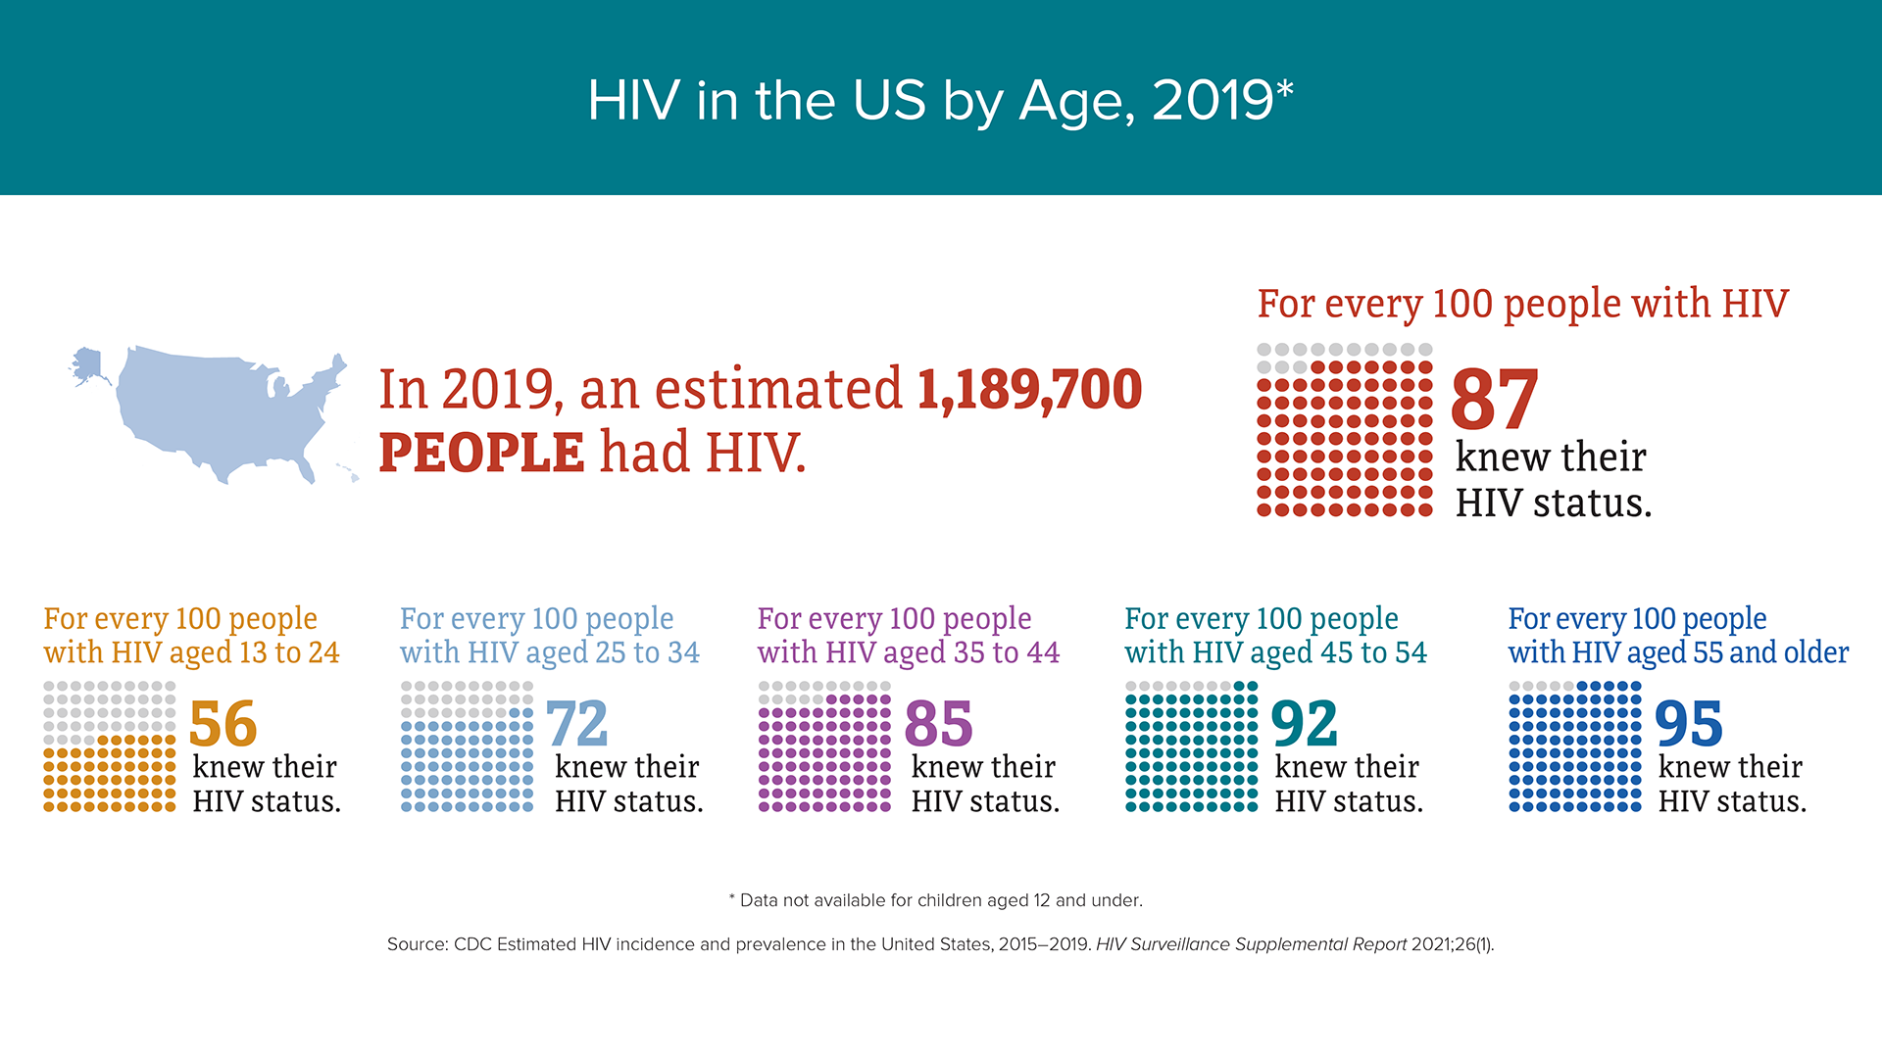
CDC. https://www.cdc.gov/hiv/group/age/status-knowledge.html

Slide 8

Youth and HIV
In 2020, 20% of new HIV diagnoses were among people aged 13-24
  Only 6% of high school students have ever been tested for HIV
CDC. https://www.cdc.gov/healthyyouth/youth_hiv/hiv-information-and-youth.htm
Notes:
Fewer high school students are sexually active (47% in 2011, 30% in 2021)
Condom use is down
Substance use is up

Slide 9
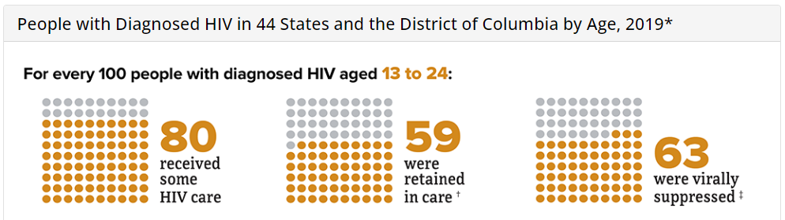
Youth and HIV
CDC. https://www.cdc.gov/hiv/group/age/viral-suppression.html

Slide 10
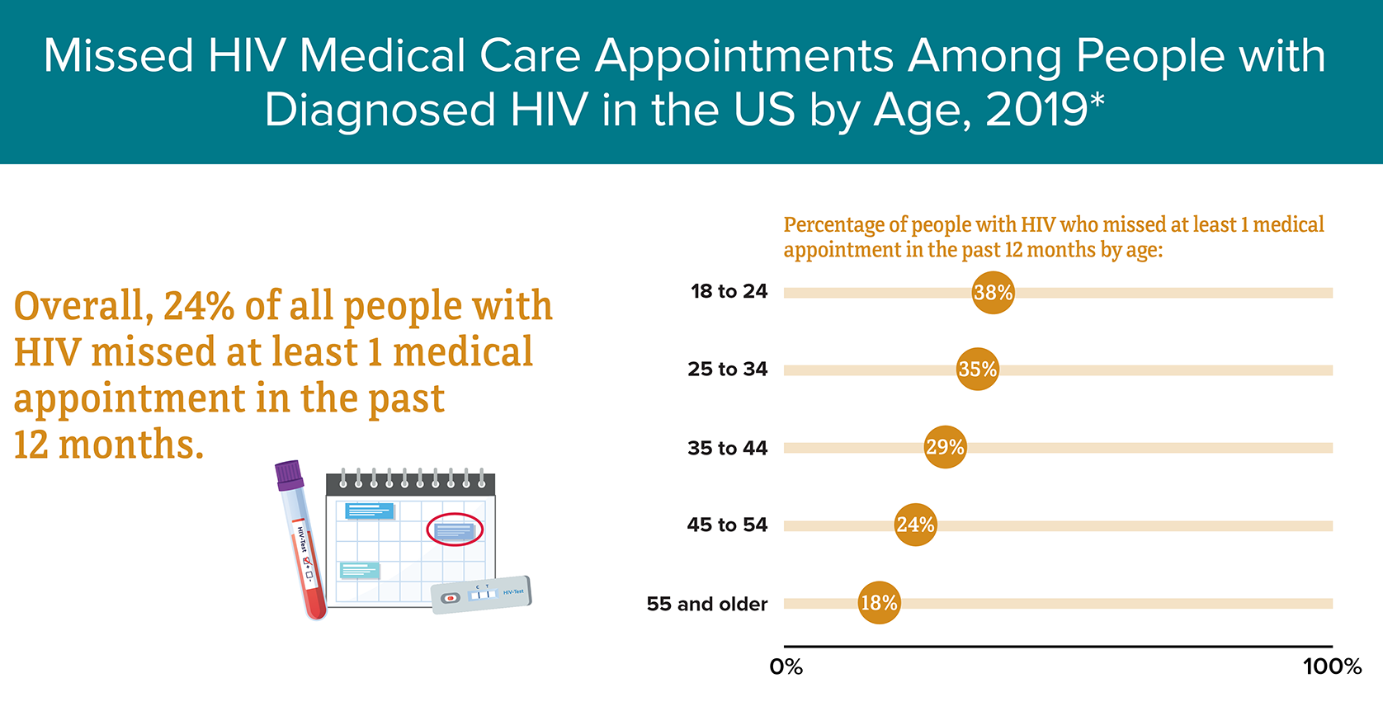
CDC. https://www.cdc.gov/hiv/group/age/viral-suppression.html
Notes:
Data not available for people aged 17 and under
Source: CDC. Medical Monitoring Project.

Slide 11
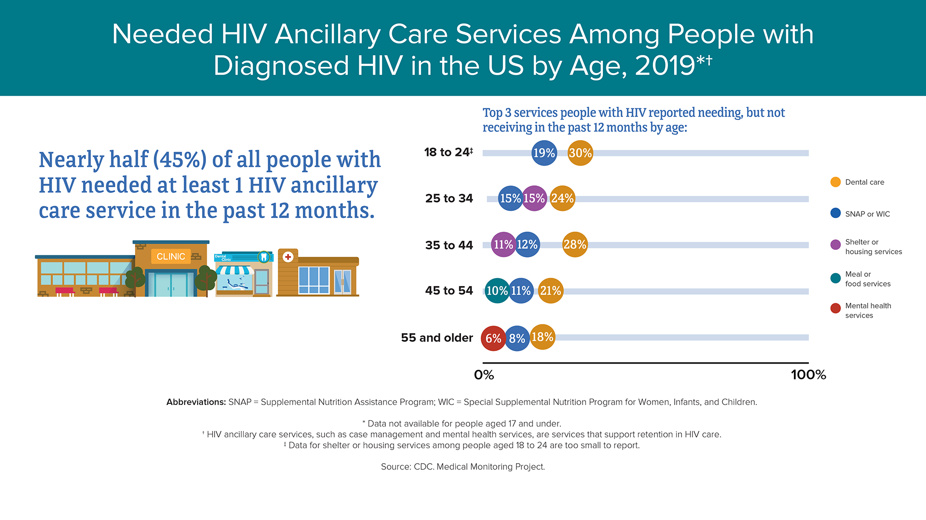
Data for shelter or housing services among people aged 18 to 24 are too small to report. CDC. https://www.cdc.gov/hiv/group/age/viral-suppression.html
Notes:
Source: CDC. Medical Monitoring Project.
Data not available for people aged 17 and under
HIV ancillary care services, such as case management and mental health services, are services that support retention in HIV care
Data for shelter or housing services among people aged 18 to 24 are too small to report.

Slide 12
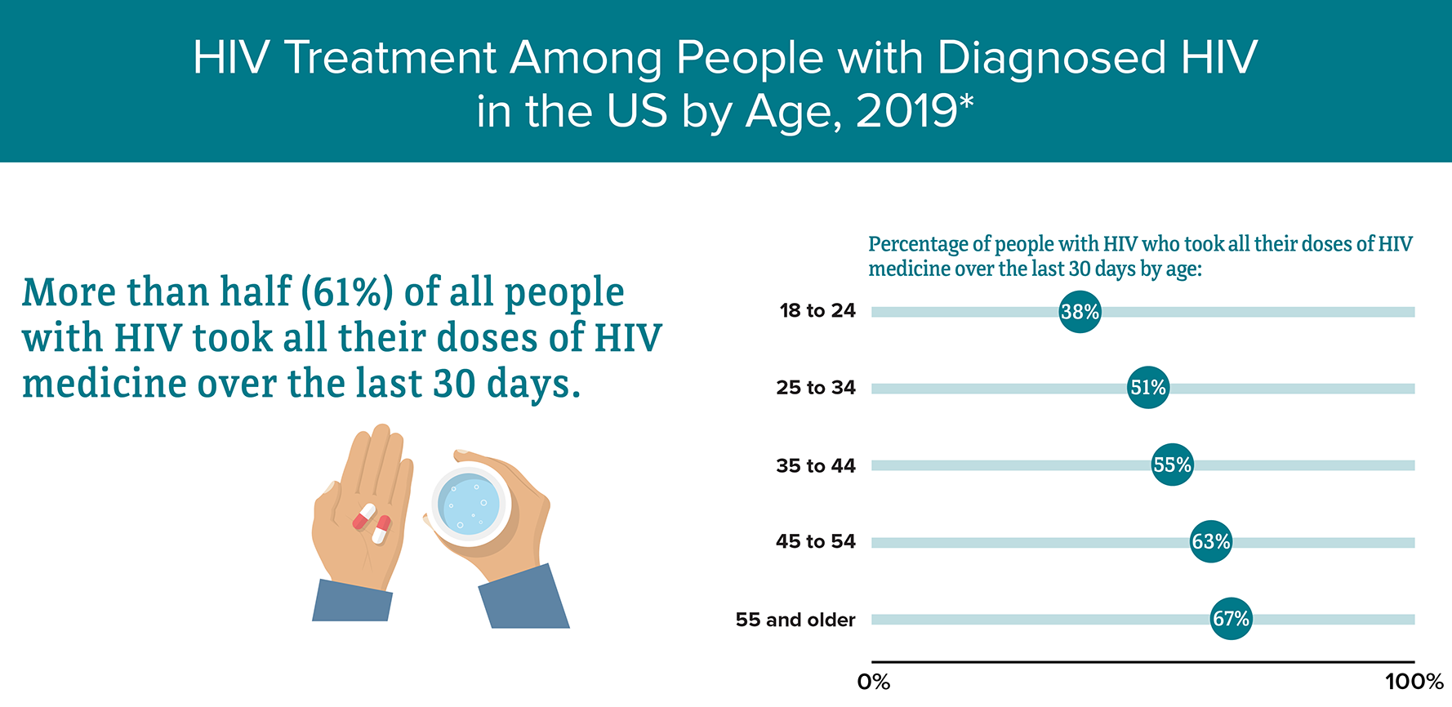
CDC. https://www.cdc.gov/hiv/group/age/viral-suppression.html
Notes:
Source: CDC. Medical Monitoring Project.
Data not available for people aged 17 and under

Slide 13
Challenges Amongst
Adolescent & Young Adults (AYA)
Inadequate sex education
Health-related behaviors
Low rates of pre-exposure prophylaxis (PrEP) use
Socioeconomic challenges
High rates of sexually transmitted infections (STIs)
Stigma and misperceptions about HIV
Feelings of isolation
CDC. https://stacks.cdc.gov/view/cdc/45104/cdc_45104_DS1.pdf
Notes:
Prevention Challenges
Inadequate Sex Education. The status of sexual health education varies throughout the United States and is insufficient in many areas according to CDC’s 2016 School Health Profiles. In most states, fewer than half of high schools teach all 19 sexual health topics recommended by CDC. In addition, sex education is not starting early enough: in no state did more than half of middle schools teach all 19 sexual health topics recommended by CDC. Finally, sex education has been declining over time. The percentage of US schools in which students are required to receive instruction on HIV prevention decreased from 64% in 2000 to 41% in 2014, according to the School Health Policies and Practices Study.
Health-related behaviors. 2017 data from the Youth Risk Behavior Surveillance System (YRBS), which monitors health behaviors that contribute to the leading causes of death and disability among youth, reveal:
Low rates of testing. Only 9% of high school students have been tested for HIV. Among male students who had sexual contact with other males, only 15% have ever been tested for HIV. Low rates of testing mean more young people have undiagnosed HIV. People who do not know they have HIV cannot take advantage of HIV care and treatment and may unknowingly pass HIV to others.
Substance use. Nationwide, 19% of all students who are currently sexually active (had sexual intercourse during the previous 3 months) and 20% of male students who had sexual contact with other males drank alcohol or used drugs before their most recent sexual intercourse. Young people may engage in high-risk behaviors, such as sex without a condom or medicine to prevent or treat HIV, when under the influence of drugs or alcohol.
Low rates of condom use. Nationwide, 46% of all sexually active high school students and 48% of male students who had sexual contact with other males did not use a condom the last time they had sexual intercourse. Using condoms the right way can protect from HIV and some sexually transmitted diseases (STDs).
Number of partners. Nearly one-quarter (24%) of male students who had sexual contact with other males reported sexual intercourse with 4 or more persons during their life, compared to 10% of all students. The more sexual partners you have, the more likely you are to have sex with someone who has HIV and doesn’t know it.
Research has also shown that young gay and bisexual men who have sex with older partners are at a greater risk for HIV infection. This is because an older partner is more likely to have had more sexual partners or other risks, and is more likely to have HIV.
Low rates of pre-exposure prophylaxis (PrEP) use. A 2018 study found that young people are less likely than adults to use medicine to prevent HIV. Barriers include cost, access, perceived stigma, and privacy concerns.
Socioeconomic challenges for young people living with HIV. Among people with HIV who are receiving medical care, young people aged 18 to 24 are more likely than older people to be living in households with low income levels, to have been recently homeless, recently incarcerated, or uninsured. All of these factors pose barriers to achieving viral suppression.
High rates of STDs. Some of the highest STD rates are among youth aged 20 to 24, especially youth of color. The presence of another STD greatly increases the likelihood that a person exposed to HIV will become infected.
Stigma and misperceptions about HIV. In a 2017 Kaiser Family Foundation survey, 51% of young adults aged 18 to 30 said they would be uncomfortable having a roommate with HIV, and 58% said they would be uncomfortable having their food prepared by someone with HIV. More than half of young people incorrectly believe that HIV can be transmitted by spitting or kissing. Stigma and misperceptions about HIV negatively affect the health and well-being of young people, and may prevent them from testing, disclosing their HIV status, and seeking HIV care.
Feelings of isolation. High school students may engage in risky sexual behaviors and substance abuse because they feel isolated from family or peers and lack support. This is especially true for gay and bisexual students who are more likely than heterosexual youth to experience bullying and other forms of violence, which also can lead to mental distress and engagement in risk behaviors that are associated with getting HIV. In the 2017 YRBS, 33% of gay, lesbian, or bisexual students reported being bullied on school property in the previous 12 months, compared to 19% of all students.

Slide 14
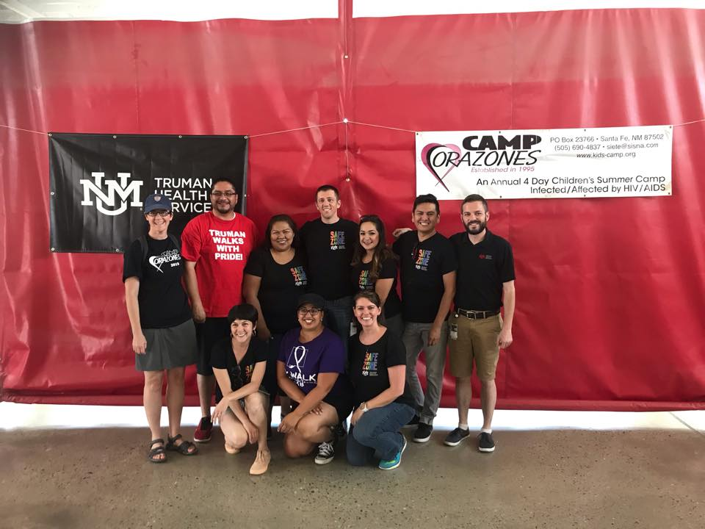
Truman Health Services:
Young Adult Clinic
Started in 2008
  “A multidisciplinary, culturally and developmentally sensitive, team approach to the care of adolescents and young adults infected with HIV…”
Photo: UNMMG THS
Notes:
Described “holistic approach to patient care can improve patient self-efficacy and quality of life and promote retention in care.”
- Culturally and developmentally sensitive team approach to provide improved control of co-morbid mental health and substance abuse conditions.
All young adults diagnosed with HIV at THS were seen, at least initially, in YAC.

Slide 15
Truman Health Services:
Young Adult Clinic
Co-located, low-barrier clinic for patients ages 13-25yo
  Interdisciplinary Team
    Medical assistant
    Registered nurse
    Medical case manager(s)
    Community health worker(s)
    Nutritionist
    Health Educator
    Medical Practitioner (MD, PA, etc.)
    Pharmacist Clinician
    Prescribing Psychiatric Practitioner (MD, NP, etc.)
    Behavioral Health Therapist/ Psychologist

Slide 16
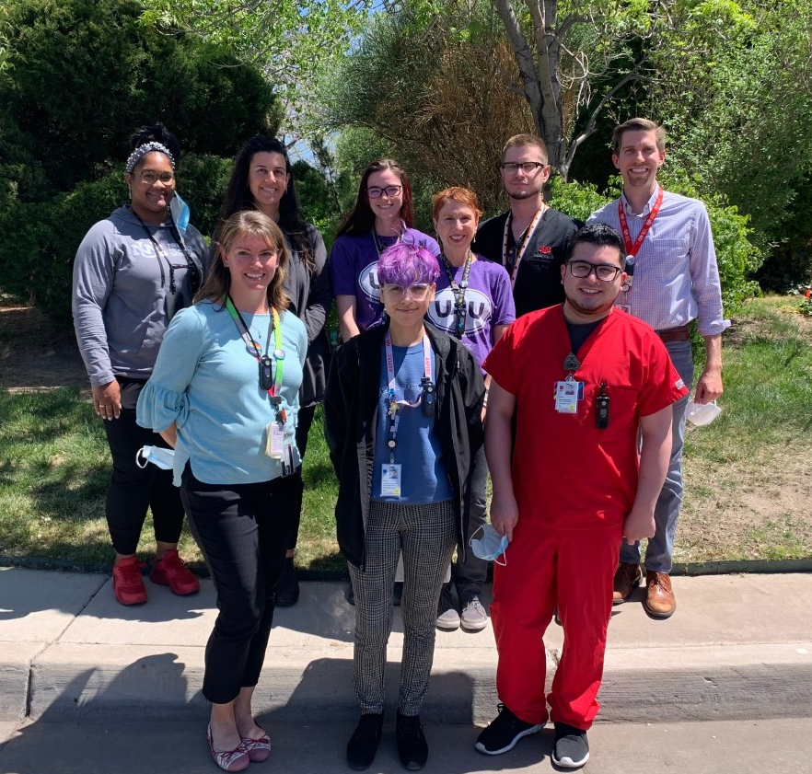
Truman Health Services:
Young Adult Clinic
The Mission of the Young Adult team is to engage, encourage and empower New Mexico’s young adults living with HIV to reach their full potential by delivering patient-centered, interdisciplinary care that decreases stigma, improves access to care, and holistically supports each person during their transition into adulthood by addressing medical and psychosocial barriers that may hinder success.
Photo: UNMMG THS

Slide 17
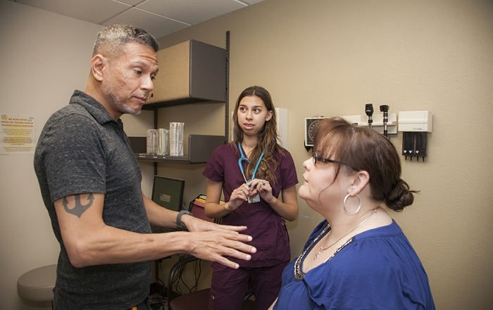

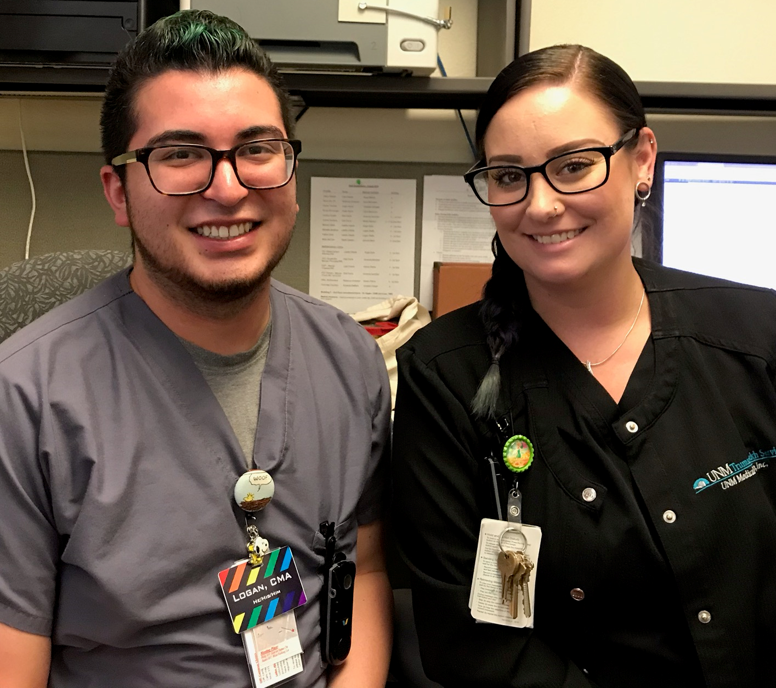
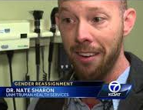


Youth at Truman Health Services
In 2017 YAC was recognized by Health Resources and Services Administration (HRSA) for its achievement of high HIV viral suppression
  97% (Top ten clinic in the nation) in this age group
Photos: UNMMG THS

Slide 18
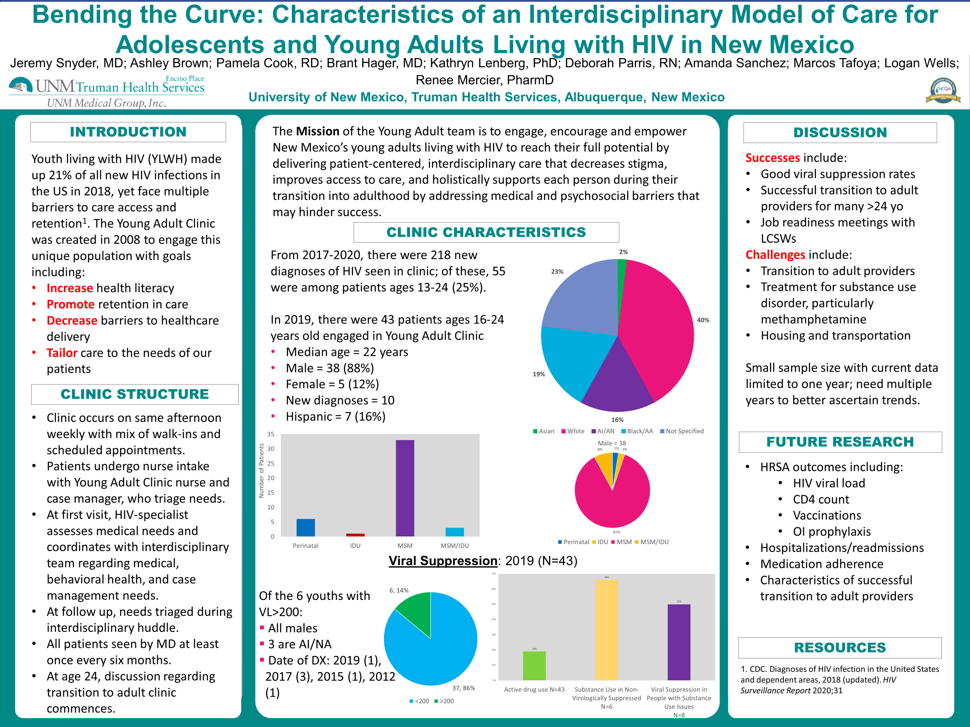

Slide 19
Challenges and Opportunities
Transitions in care often challenging
  Implemented multi-step transitions program in Sept. 2019
Care retention remains challenging
  Integrated community health workers and new outreach options
Stigma and misinformation remain prevalent
  Piloted incentive programs to encourage patient engagement
Notes:
Since implementing our multi-step transitions program, we have successfully transitioned more than 40 patients to our general adult practice.
To improve care retention, we have developed a home visiting model where we visit patients with high barriers to coming to clinic. These often include people with no transportation, unstable or no housing, people who are pregnant or who recently gave birth, and those with severe trauma or other limitations that make coming to clinic more difficult. These home visits have allowed us to reach out to more patients that would potentially be lost to care.
Stigma often manifests among our patients as a desire to avoid the clinic and all reminders of one’s diagnosis. To combat this, we are finding ways to incentivize patients to keep appointments that are booked with members of the team. This fall, we implemented an incentive program, also known as a contingency management program often seen in substance use treatment setting, whereby patients who attend their appointments are eligible to “draw” a prize out of a fishbowl at the end of the clinic setting. Prizes are most often affirmative sayings and candy, but also can include gift cards and physical prizes, such as water bottles, hoodie sweatshirts, and phone chargers. Our hope is that by utilizing this model, our patients will begin to more positively associate clinical visits and become more likely to engage with members of the interdisciplinary team.

Slide 20

With rare exceptions, all of your most important achievements on this planet will come from working with others – or, in a word, partnership.
Paul Farmer
Notes:
Image: Stock.

Slide 21
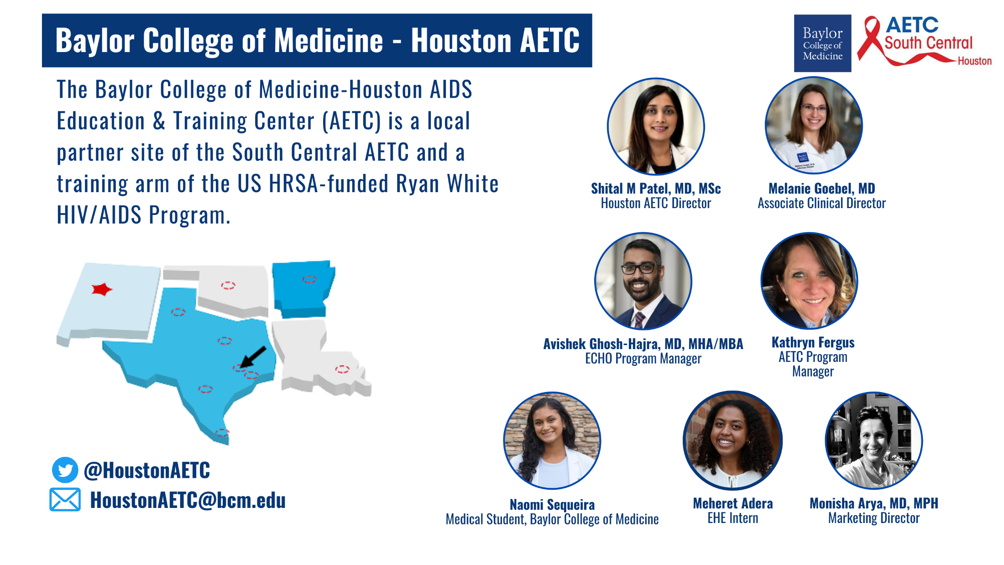

Slide 22
Resources
National Clinician Consultation Center http://nccc.ucsf.edu/
  HIV Management
  Perinatal HIV
  HIV PrEP
  HIV PEP line
  HCV Management
  Substance Use Management
Present on ECHO
https://hsc.unm.edu/scaetc/programs-services/echo.html​
AETC National HIV Curriculum https://aidsetc.org/nhc
AETC National Coordinating Resource Center https://targethiv.org/library/aetc-national-coordinating-resource-center-0
HIVMA Resource Directory https://www.hivma.org/globalassets/ektron-import/hivma/hivma-resource-directory.pdf
Additional trainings scaetcecho@salud.unm.edu
www.scaetc.org
Notes:
IDEA Platform: Infectious Diseases Education & Assessment. https://idea.medicine.uw.edu/
AETC National HIV Curriculum: 6 core modules for self study; regularly updated; CME, CNE
Hepatitis C Online Curriculum: https://www.hepatitisc.uw.edu/
Hepatitis B Online Curriculum: https://www.hepatitisb.uw.edu/
National STD Curriculum: https://www.std.uw.edu/

Slide 23
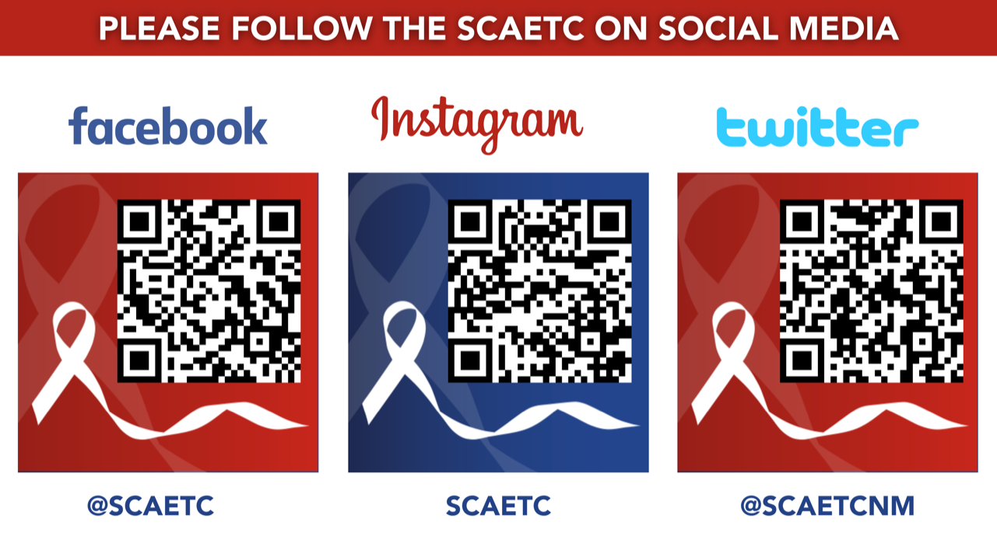
SCAETC Social Media

