Slide 1

Primary Prevention of Cardiovascular Disease in PWH: The REPRIEVE Trial
HIV ECHO Clinic
Linda Gorgos, MD, MSc, FIDSA
Medica Director | AXCES Research Group
Santa Fe, NM
17 October 2023
Notes:
Version_ 10 2023
UNMRP clinical director reviewed 10/12/2023

Slide 2
Conflict of Interest Disclosure Statement
My clinic receives funding for HIV clinical trials from Gilead, Merck, and GSK/ ViiV
I do not personally receive funds from or give talks for the sponsors
I am a member of the DHHS Adult Antiretroviral Guidelines Panel
What I present in this talk is my personal opinion and not that of the Panel
This presentation was reviewed by UNMHSC and SCAETC faculty to ensure it meets CME guidelines.
This program is supported by the Health Resources and Services Administration (HRSA) of the U.S. Department of Health and Human Services (HHS) as part of an award totaling $4,205,743 with 0% financed with non-governmental sources. The contents are those of the author(s) and do not necessarily represent the official views of, nor does mention of trade names, commercial practices, or organizations imply an endorsement by HRSA, HHS, or the U.S. Government. For more information, please visit HRSA.gov. Any trade/brand names for products mentioned during this presentation are for training and identification purposes only.

Slide 3
Use of Trade/Brand Names
This program is supported by the Health Resources and Services Administration (HRSA) of the U.S. Department of Health and Human Services (HHS) as part of an award totaling $4,205,743, with 0% financed with non-governmental sources.
The views expressed do not necessarily reflect the official policies of the Department of Health and Human Services, nor does mention of trade names, commercial practices, or organizations imply endorsement by the U.S. Government. Any trade/brand names for products mentioned during this presentation are for training and identification purposes only.
Notes:
Note: this slide must be included if trade and/or brand names for medications are used in the presentation.
It may be deleted if there is no reference to trade names, including presentations in which only generic medication names are mentioned.
Trade names must be put in parentheses after the generic name the first time it is mentioned - e.g., fluoxetine (Prozac). Trade names should only be mentioned for the initial reference and the generic name only should be used after that. This applies equally to all medications or products mentioned in this presentation.

Slide 4
Unconscious Bias Disclosure
SCAETC recognizes that language is constantly evolving, and while we make every effort to avoid bias and stigmatizing terms, we acknowledge that unintentional lapses may occur in our presentations.
We value your feedback and encourage you to share any concerns related to language, images, or concepts that may be offensive or stigmatizing.
Your input will help us refine and improve our presentations, ensuring they remain inclusive and respectful to participants.

Slide 5
Learning Objectives
Recognize the need for primary prevention of cardiovascular disease (CVD) in persons with HIV (PWH).
Understand new data from the REPRIEVE trial.
Describe how to apply this new data in your clinical practice.

Slide 6
Increased Risk of CVD in PWH
Rosenson et al, Excess Risk for Atherosclerotic Cardiovascular Outcomes Among US Adults With HIV in the Current Era, J Am Heart Assoc. 2020;9:e013744
Notes:
cardiovascular disease (CVD) in persons with HIV (PWH)
The MarketScan database contains administrative and claims data from individuals enrolled in various employer-sponsored healthcare plans and Medicare supplemental plans. We identified beneficiaries in the MarketScan database who had HIV infection,
Assessed risk for ASCVD events between US adults aged ≥19 years with and without HIV between January 1, 2011, and December 31, 2016. Beneficiaries with HIV
(n=82 426) were frequency matched 1:4 on age, sex, and calendar year to those without HIV (n=329 704). Beneficiaries with and without HIV were followed up through December 31, 2016, for ASCVD events, including myocardial infarction, stroke, and lower extremity artery disease hospitalizations. Most beneficiaries were aged <55 years (79%) and men (84%).
Graphs show INCIDENT HOSPITALIZATION events
Meaningful difference persists even after adjusting for multiple baseline clinical and demographic factors, smoking, CKD, liver dz, and statin use
Shah et al. found a pooled cardiovascular disease event rate of 6.18 per 1000 person-years among young persons with HIV infection, which was twice the rate in the general population in a global meta-analysis

Slide 7
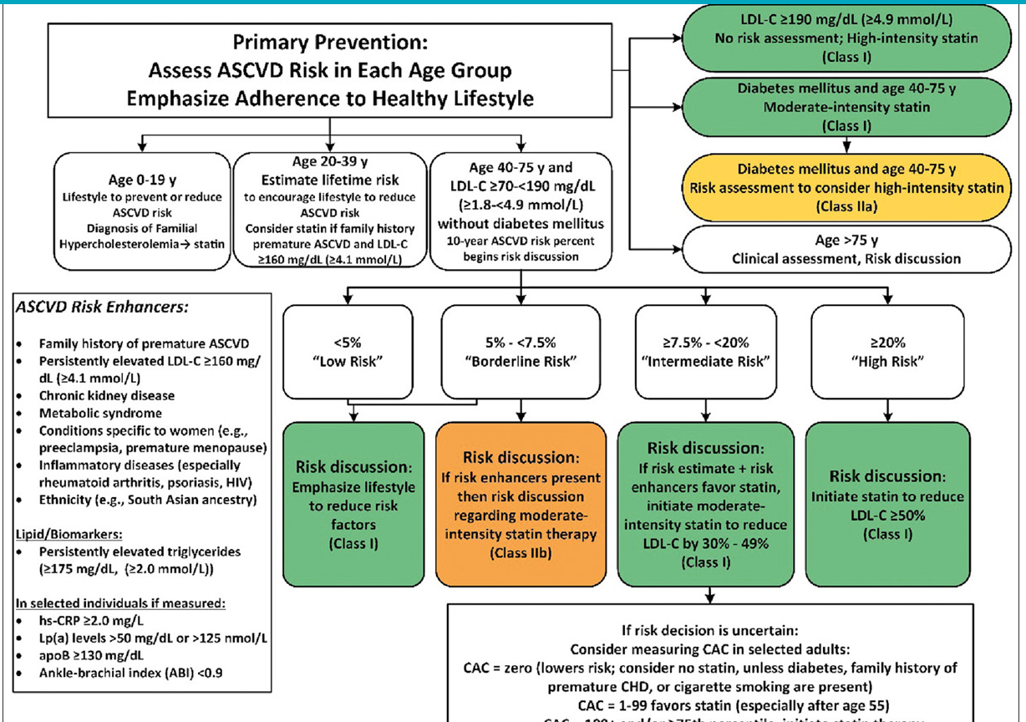
In 2019 Guideline, HIV considered a “risk enhancing factor”
ASCVD = atherosclerotic cardiovascular disease
2019 ACC/AHA Guideline on the Primary Prevention of Cardiovascular Disease: A Report of the American College of Cardiology/American Heart Association Task Force on Clinical Practice Guidelines, https://doi.org/10.1161/CIR.0000000000000678op
Notes:
The presence of risk-enhancing factors may affect the threshold for statin initiation or intensification.

Slide 8
Statins by LDL Lowering Potency
High-Intensity Statin | Moderate-Intensity Statin | Low-Intensity Statin
Lowers LDL by ≥ 50% | Lowers LDL by 30-49% | Lowers LDL by <30%
Atorvastatin 40-80 mg Rosuvastatin 20-40 mg | Atorvastatin 10-20 mg Rosuvastatin 5-10 mg Pravastatin 40-80 mg Pitavastatin 2-4 mg Simvastatin 20-40 mg Lovastatin 40 mg Fluvastatin 80 mg | Pravastatin 40-80 mg Simvastatin 10mg Lovastatin 20 mg Fluvastatin 20-40 mg
Low-density Lipoprotein = LDL

Slide 9
The REPRIEVE Trial
PRIMARY prevention trial in PWH 40-75 y.o. on antiretroviral therapy (ART)
Targeted those NOT meeting criteria for statin use – those considered low or moderate risk for CVD by standard guidelines
Randomized to receive moderate-intensity pitavastatin 4 mg vs. placebo
  Pitavastatin has little interaction with ART (not CYP3A4 metabolized)
  Lipid lowering and anti-inflammatory effects
Grinspoon et al, Pitavastatin to Prevent Cardiovascular Disease in HIV Infection, NEJM, 23JUL2023, DOI: 10.1056
Notes:
Excluded those with any known CVD. Also could not be on statin, gemfibrozil, or PCSk9 inhibitors at study entry
Flat dosing of statin – not LDL targeted therapy
Stains lower LDL but also potentially impact inflammation nand immune activation
Included those rated as low to moderate risk using ASCVD risk score – those who would NOT meet criteria for statin therapy by current guidelines
4.5% (interquartile range, 2.1 to 7.0) on a scale of low risk (<5%), borderline risk, (5 to <7.5%), intermediate risk (7.5 to <20%), and high risk (≥20%).

Slide 10
The REPRIEVE Trial
Large worldwide cohort (N=7,769), high income and lower income settings
Median follow up of 5.1 years, >80% remained in follow up
Composite endpoint: CVD death, myocardial infarction (MI), unstable angina, transient ischemic attack (TIA) and stroke, arterial revascularization, peripheral arterial disease
Data Safety Monitoring Board (DSMB) closed trial early for efficacy
Grinspoon et al, Pitavastatin to Prevent Cardiovascular Disease in HIV Infection, NEJM, 23JUL2023, DOI: 10.1056

Slide 11
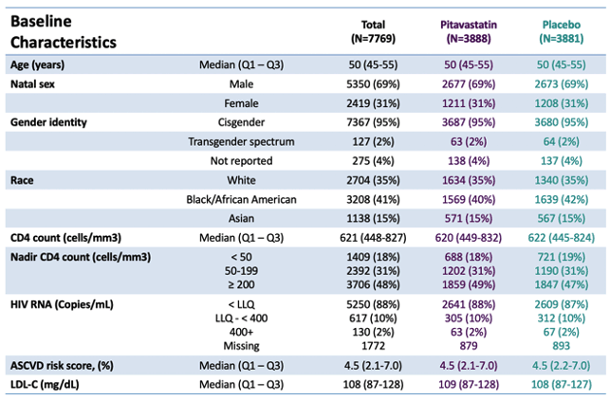
The REPRIEVE Trial: Developing a cardiovascular prevention strategy for people living with HIV, IAS 2023. https://natap.org/

Slide 12
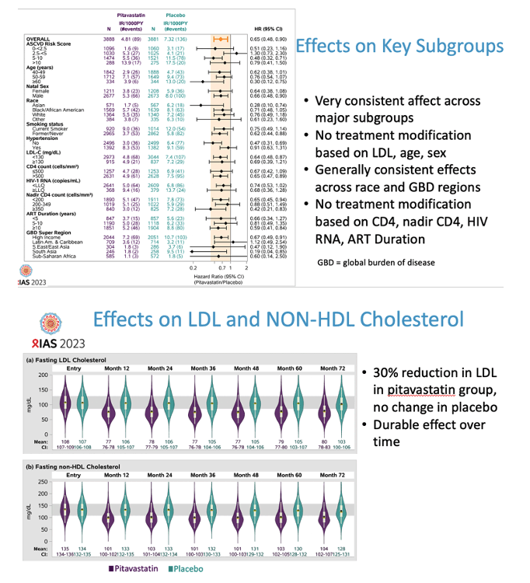
Median decrease in LDL cholesterol on study
Pitavastatin: 107 → 74
Placebo: 106 → 105
The REPRIEVE Trial: Developing a cardiovascular prevention strategy for people living with HIV, IAS 2023. https://natap.org; Grinspoon et al, Pitavastatin to Prevent Cardiovascular Disease in HIV Infection, NEJM, 2023

Slide 13
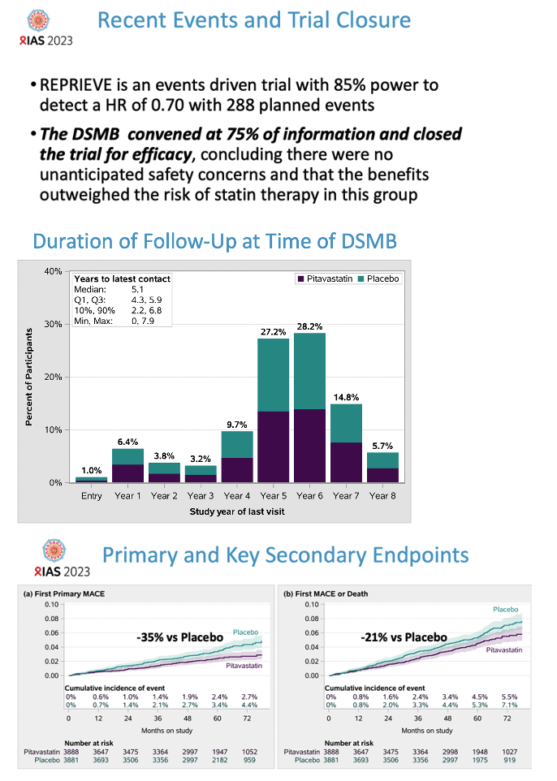
Incidence of major adverse cardiovascular events (MACE):
4.81 per 1000 PY (pitavastatin group), 7.32 per 1000 PY (placebo group)
Hazard ratio = 0.65 (95% CI, 0.48 to 0.90; P=0.002)
PY = person years; The REPRIEVE Trial: Developing a cardiovascular prevention strategy for people living with HIV, IAS 2023. https://natap.org; Grinspoon et al, Pitavastatin to Prevent Cardiovascular Disease in HIV Infection, NEJM, 2023
Notes:
Panel a = first MACE (primary trial outcome, combined endpoint)
Panel b = first MACE or death from any cause
Deaths from non-CV causes balanced across arms (82 vs 81)

Slide 14
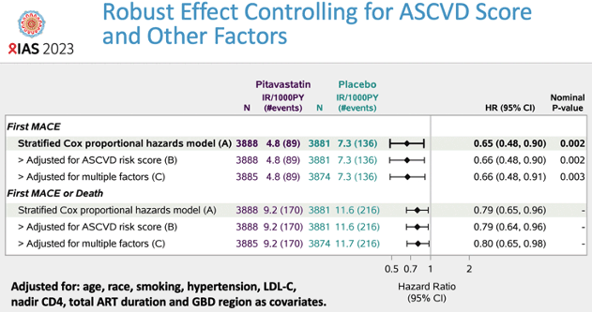
Effect Maintained after Adjusting for Risk Factors
The REPRIEVE Trial: Developing a cardiovascular prevention strategy for people living with HIV, IAS 2023. https://natap.org; Grinspoon et al, Pitavastatin to Prevent Cardiovascular Disease in HIV Infection, NEJM, 2023

Slide 15
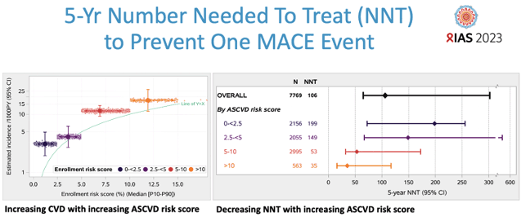
NNT = 1/ Absolute Risk Reduction
Higher baseline ASCVD score = higher absolute risk reduction in trial → lower NNT
The REPRIEVE Trial: Developing a cardiovascular prevention strategy for people living with HIV, IAS 2023. https://natap.org; Grinspoon et al, Pitavastatin to Prevent Cardiovascular Disease in HIV Infection, NEJM, 2023

Slide 16
Key Points
Primary prevention with pitavastatin lowered incidence of new major cardiovascular events by 35% in a large international cohort for PWH ages 40-75
The effect was maintained across subgroups (age, birth sex, race, baseline ASCVD risk, and other baseline Risk Factors [RFs])
Side effect profile low for pitavastatin
  Few had muscle-related symptoms (2.3% vs 1.4%), even fewer had to stop due to muscle related side effects (1.1% vs 0.5%)
  New diabetes events slightly higher in pitavastatin arm (5.3% vs 4.0%). IRR 1.25 (1.09 – 1.66)
Atherosclerotic Cardiovascular Disease = ASCVD

Slide 17
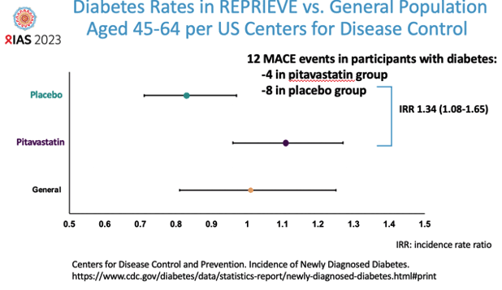
Diabetes rate increased in pitavastatin group – consistent with what was seen in prior statin studies
Not significantly above general population rate
The REPRIEVE Trial: Developing a cardiovascular prevention strategy for people living with HIV, IAS 2023. https://natap.org; Grinspoon et al, Pitavastatin to Prevent Cardiovascular Disease in HIV Infection, NEJM, 2023

Slide 18
Limitations
Does not address those under age 40yo
Await more data on potential “markers” – can we identify who is at higher/ highest risk for events?
How long should you stay on a statin????
  Does long term benefit outweigh risk over decades of therapy
Is this effect specific to the drug (pitavastatin) or to the class (statins in general)
Is any more effect to be gained by driving LDL even lower?

Slide 19
What is next for REPRIEVE?
Large contemporary international cohort
Data from sub-studies
Inflammatory markers
Biomarkers
Imaging study (plaque burden, etc.)
Data on deaths from non-CV causes (cancers, etc.)

Slide 20
Is this a practice changer?
I’d say YES!
Look holistically at ASCVD risk
Talk to your patients about benefits vs risks of statins
Don’t forget to look at other risk reducing strategies: SMOKING, hypertension control, lifestyle changes, etc.

Slide 21
Resources
National Clinician Consultation Center http://nccc.ucsf.edu/
  HIV Management
  Perinatal HIV
  HIV PrEP
  HIV PEP line
  HCV Management
  Substance Use Management
Present your case on ECHO
http://echo.unm.edu hivecho@salud.unm.edu
AETC National HIV Curriculum https://aidsetc.org/nhc
AETC National Coordinating Resource Center https://targethiv.org/library/aetc-national-coordinating-resource-center-0
HIVMA Resource Directory https://www.hivma.org/globalassets/ektron-import/hivma/hivma-resource-directory.pdf
Additional trainings scaetcecho@salud.unm.edu
www.scaetc.org
Notes:
Find additional ECHO sessions in your area: https://echo.unm.edu/locations-2/echo-hubs-superhubs-united-states/
https://hsc.unm.edu/echo/get-involved/join-an-echo/
IDEA Platform: Infectious Diseases Education & Assessment. https://idea.medicine.uw.edu/
AETC National HIV Curriculum: 6 core modules for self study; regularly updated; CME, CNE
Hepatitis C Online Curriculum: https://www.hepatitisc.uw.edu/
Hepatitis B Online Curriculum: https://www.hepatitisb.uw.edu/
National STD Curriculum: https://www.std.uw.edu/

Slide 22
