Slide 1
Project ECHO® - UNM
HIV ECHO Clinic
Ocular Findings in HIV
11 October 2023
Robert B. Avery, MD, PhD
Professor and Department of Opthamology Chair
University of New Mexico Health Sciences Center
Maritza Chavez, MSIII
University of New Mexico Health Sciences Center
Notes:
Version_ 10 2023

Slide 2
Conflict of Interest Disclosure Statement
Presenters have nothing to disclose.
This presentation was reviewed by UNMHSC and SCAETC faculty to ensure it meets Continuing Education guidelines.
This program is supported by the Health Resources and Services Administration (HRSA) of the U.S. Department of Health and Human Services (HHS) as part of an award totaling $4,205,743 with 0% financed with non-governmental sources. The contents are those of the author(s) and do not necessarily represent the official views of, nor does mention of trade names, commercial practices, or organizations imply an endorsement by HRSA, HHS, or the U.S. Government. For more information, please visit HRSA.gov. Any trade/brand names for products mentioned during this presentation are for training and identification purposes only.

Slide 3
Use of Trade/Brand Names
This program is supported by the Health Resources and Services Administration (HRSA) of the U.S. Department of Health and Human Services (HHS) as part of an award totaling $4,205,743, with 0% financed with non-governmental sources.
The views expressed do not necessarily reflect the official policies of the Department of Health and Human Services, nor does mention of trade names, commercial practices, or organizations imply endorsement by the U.S. Government. Any trade/brand names for products mentioned during this presentation are for training and identification purposes only.
Notes:
NOTE: THIS SLIDE MUST BE INCLUDED IF TRADE AND/OR BRAND NAMES FOR MEDICATIONS ARE USED IN THE PRESENTATION.
IT MAY BE DELETED IF THERE IS NO REFERENCE TO TRADE NAMES, INCLUDING PRESENTATIONS IN WHICH ONLY GENERIC MEDICATION NAMES ARE MENTIONED.
TRADE NAMES MUST BE PUT IN PARENTHESES AFTER THE GENERIC NAME THE FIRST TIME IT IS MENTIONED - E.G., FLUOXETINE (PROZAC). TRADE NAMES SHOULD ONLY BE MENTIONED FOR THE INITIAL REFERENCE AND THE GENERIC NAME ONLY SHOULD BE USED AFTER THAT. THIS APPLIES EQUALLY TO ALL MEDICATIONS OR PRODUCTS MENTIONED IN THIS PRESENTATION.

Slide 4
Unconscious Bias Disclosure
SCAETC recognizes that language is constantly evolving, and while we make every effort to avoid bias and stigmatizing terms, we acknowledge that unintentional lapses may occur in our presentations.
We value your feedback and encourage you to share any concerns related to language, images, or concepts that may be offensive or stigmatizing.
Your input will help us refine and improve our presentations, ensuring they remain inclusive and respectful to participants.

Slide 5
Learning Objectives
Recognize both common and rare ocular findings in HIV
Identify which parts of the eye are affected by which conditions.
Visualize these findings and how they manifest in persons with HIV (PWH), identifying findings that are more concerning than others
Understand treatment for ocular manifestations

Slide 6
Causes and Affected Structures
What causes ocular findings in people with HIV?
Opportunistic infections
Vascular abnormalities
Neoplasms
Neuro ophthalmic conditions
Adverse effects of medications
Affected structures:
Adnexa
Anterior segment
Posterior segment
Orbit
Neuro-ophthalmic structures.

Slide 7
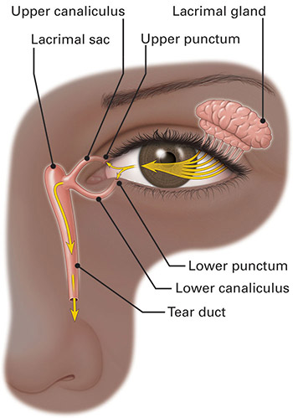
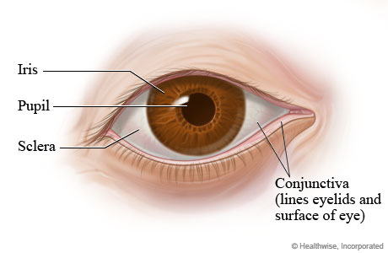
What is the Adnexa (around the eye)?
The support system of the eye!
Eyelids
Lashes
Lacrimal gland/system
Conjunctiva
1: https://www.vecteezy.com/vector-art/22464689-two-closed-eye-detail-of-face-eyelid-with-eyelashes-flat-cartoon-illustration-isolated-on-white-background 2: https://massachusetts.networkofcare.org/mh/library/article.aspx?hwid=tp9807 3: https://www.aao.org/eye-health/anatomy/tear-duct
Notes:
The adnexa helps protect they eye of debris and keeps it moist.

Slide 8
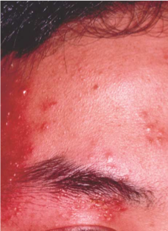
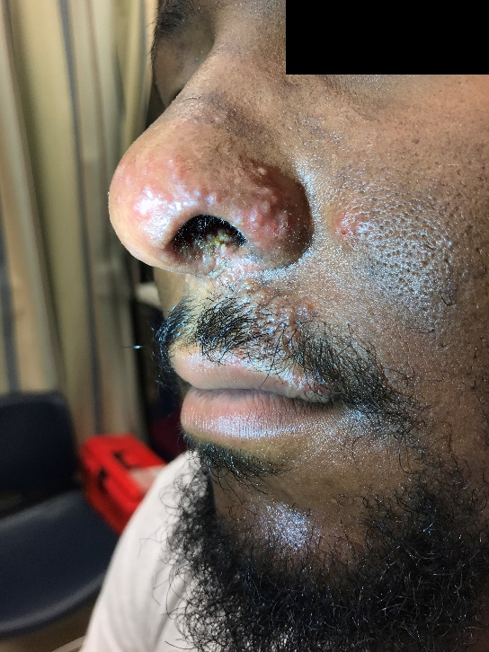
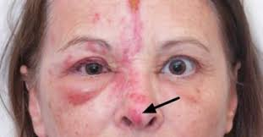
Herpes Zoster Ophthalmicus (HZO)
Involves ophthalmic division of the trigeminal nerve
Hutchinson sign = ⬆ risk of Ocular involvement
Commonly found with concurrent keratitis, scleritis, uveitis, retinitis, or encephalitis
Treatment is the same with or without ocular involvement
https://www.nejm.org/doi/full/10.1056/NEJM199807233390406 https://www.eophtha.com/posts/ocular-manifestations-of-hiv-3#google_vignette
1: https://www.nejm.org/doi/full/10.1056/NEJM1998072333904062: https://jetem.org/hutchinsons_sign/ 3: https://houstonmedicalclerkship.com/wp-content/uploads/2021/09/Hutchinson.pdf
Notes:
The Hutchinson sign is Herpes involvement on the tip of the nose. Almost directly correlates with concurrent ocular involvement. However, you may have ocular involvement without Hutchinson sign.
Initial treatment is the same whether the eye is involved or not. Treatment with acyclovir is automatically given by providers at the first sign of HZO, before sending the patient to an ophthalmologist for additional treatment.
This is not an emergent condition; patients can be scheduled to see an ophthalmologist in about a week’s time to search for and track ocular involvement.

Slide 9
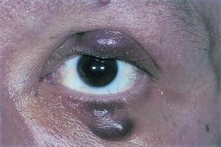
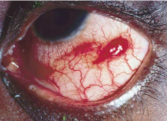
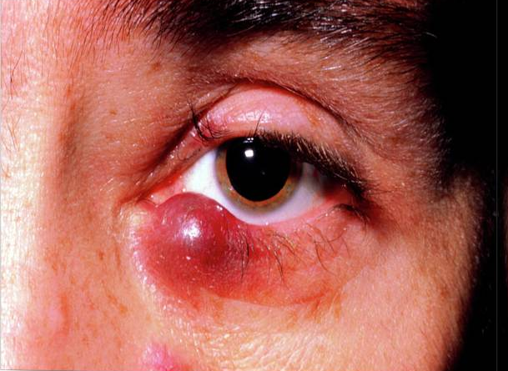
Kaposi Sarcoma
May affect conjunctiva or eyelids
Some PWH may have asymptomatic eyelid or conjunctival involvement
Often mistaken for a chalazion or subconjunctival hemorrhage
https://www.nejm.org/doi/full/10.1056/NEJM199807233390406 1: https://www.aao.org/education/image/kaposi-sarcoma-2 2: https://www.nejm.org/doi/full/10.1056/NEJM199807233390406
3: https://sciencephotogallery.com/featured/kaposis-sarcoma-on-lower-eyelid-of-man-with-aids-sue-fordscience-photo-library.html?product=canvas-print
Notes:
PWH=people with HIV
This is a relatively rare manifestation now that most patients are on HAART therapy.
For individuals that are more immunocompromised, Kaposi Sarcoma can often be mistaken for other conditions.
Treatment involves radiation therapy, excision, surgical removal, local cryotherapy, chemotherapy (especially if more systemic involvement).

Slide 10
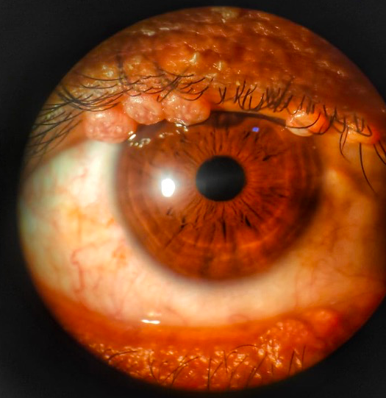
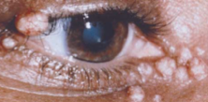
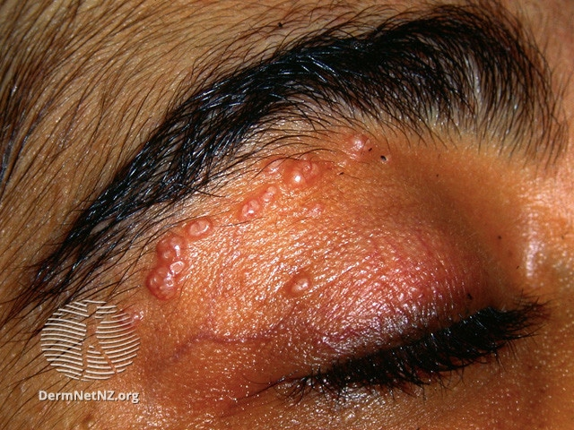
Molluscum Contagiosum
Multiple, small, painless umbilicated lesions
Can cause persistent ‘red eyes’ on the side with lesions
Treatment: cryotherapy, curettage, incision, and excision
https://www.nejm.org/doi/full/10.1056/NEJM199807233390406 1: https://www.nejm.org/doi/full/10.1056/NEJM199807233390406 2: https://www.eophtha.com/posts/ocular-manifestations-of-hiv-3#google_vignette 3: https://geekymedics.com/molluscum-contagiosum/
Notes:
Poxvirus
Can affect both skin and mucous membranes

Slide 11
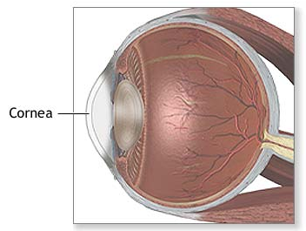
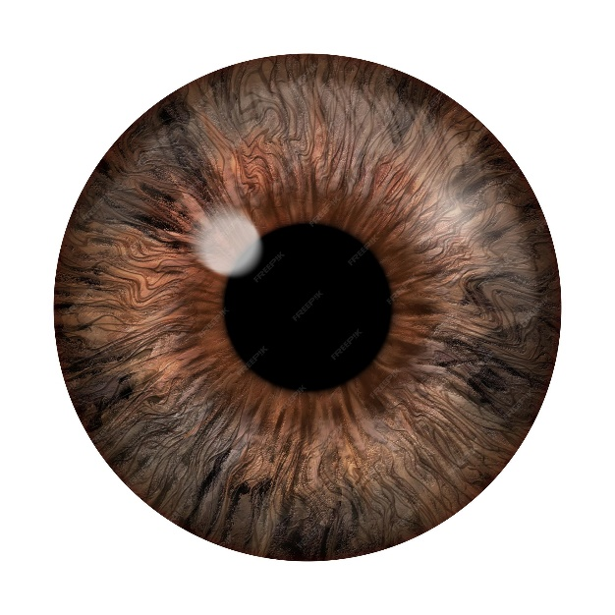
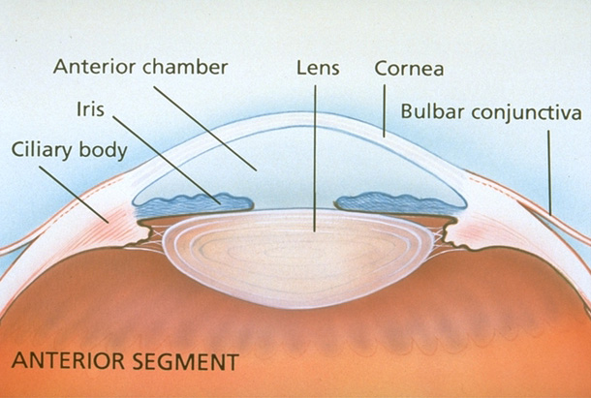
Anterior Segment (front of eye)
What is the anterior segment?
Cornea
Conjunctiva/sclera
Iris
Anterior chamber (space from lens forward)
1
2
3
1: https://medlineplus.gov/ency/imagepages/9909.htm 2: https://www.freepik.com/premium-photo/realistic-image-eye-iris-cornea-retina-with-luminous-flash-brown-eye-3d-illustration_21041023.htm 3:https://www.aao.org/education/image/anterior-segment-anatomy-2
Notes:
Aqueous humor: fluid in anterior chamber

Slide 12
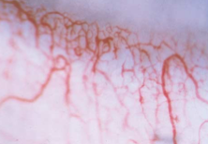
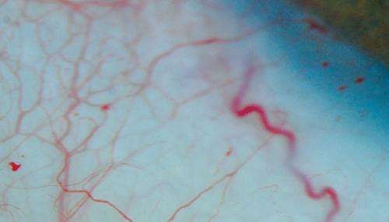
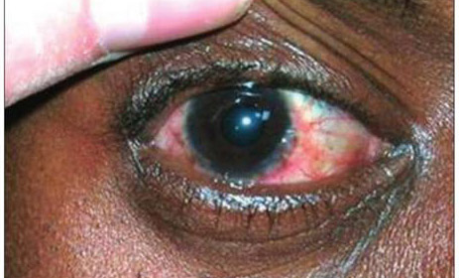
Conjunctival Microvasculopathy
Best seen with a slit-lamp biomicroscope
Asymptomatic
Changes include
segmental vascular dilatation and narrowing
microaneurysm formation
comma-shaped vascular appearing fragments
“sludging” of the blood column
https://www.nejm.org/doi/full/10.1056/NEJM199807233390406 1: https://www.nejm.org/doi/full/10.1056/NEJM199807233390406 2: https://www.pagepress.org/journals/index.php/idr/article/view/idr.2012.e25/5112 3: https://go.gale.com/ps/i.do?id=GALE%7CA330026881&sid=googleScholar&v=2.1&it=r&linkaccess=abs&issn=10166742&p=HRCA&sw=w&userGroupName=nm_p_oweb&isGeoAuthType=true&aty=geo
Notes:
This is more of just an interesting finding / disease marker.
Conjunctival microvasculopathy can both be due to HIV and many other conditions.
This is not necessarily a “problem” and there is no “ocular treatment,” just treatment of HIV.

Slide 13
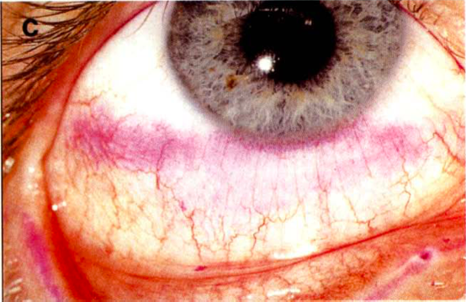
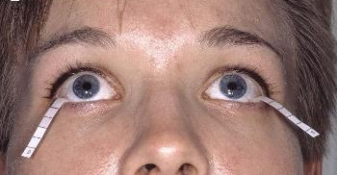
Keratoconjunctivitis Sicca (Dry Eye Disease)
Affects 10-20% of PWH
Most commonly occurs during later stages of HIV
Can be diagnosed using and interpalpebral rose-bengal staining and Schirmer’s testing
Possible causes:
HIV-mediated inflammation
Destruction of the lacrimal glands
Lagophthalmos
A decrease in blinking from encephalopathy
Easily treatable with lubricating eye drops
https://www.nejm.org/doi/full/10.1056/NEJM199807233390406 1: https://www.ajo.com/article/S0002-9394%2814%2971690-3/pdf 2: https://www.atlasophthalmology.net/photo.jsf;jsessionid=3E156910E27A3579C3620F686B937B4B?node=7258&locale=en
Notes:
PWH=people with HIV
This is also a common finding in dry environments such as living in New Mexico.
Can also cause red eyes.
Symptoms of blurry vision and feeling like there’s something in your eye.
Lacrimal glands produce tears and keep the eye lubricated.
Lagophthalmos = eyelid dysfunction, incomplete/abnormal closure of lids
Red eyes = treat with lubricating drops

Slide 14
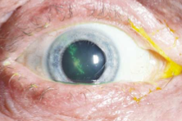
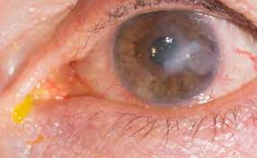
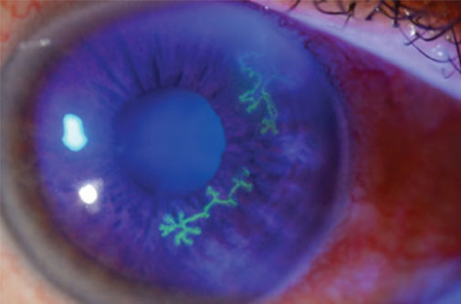
Infectious Keratitis (Corneal Infection)
Low incidence but could lead to loss of vision
Varicella zoster virus (VZV) and Herpes simplex virus (HSV) are most common
Can recur more frequently in PWH
Can be more resistant to treatment in PWH
Bacterial and fungal infectious keratitis are not more common in PWH, but they may be more severe
Candida etiology common in injection drug use
https://www.nejm.org/doi/full/10.1056/NEJM199807233390406
https://www.eophtha.com/posts/ocular-manifestations-of-hiv-3#google_vignette 1: https://www.nejm.org/doi/full/10.1056/NEJM199807233390406 2: https://www.optometrists.org/general-practice-optometry/guide-to-eye-conditions/guide-to-corneal-diseases/keratitis/ 3: https://eyesforears.net/episodes/ep02-infectiouskeratitis
Notes:
PWH=people with HIV
Suspect HZO in people with Hutchinson’s sign.
Symptoms of blurry vision and feeling like something is in your eye.
Can cause corneal scarring and raised intraocular pressure.

Slide 15
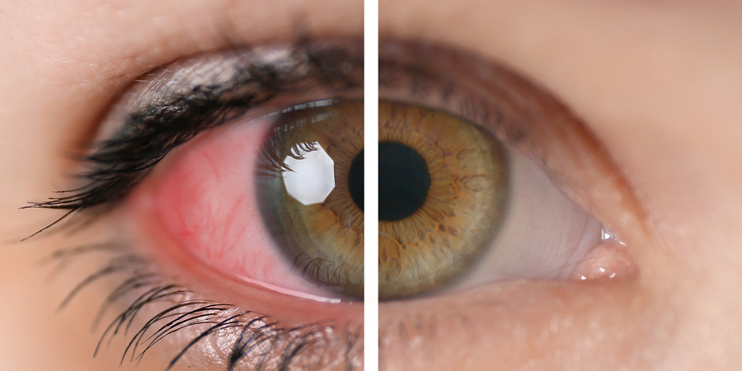
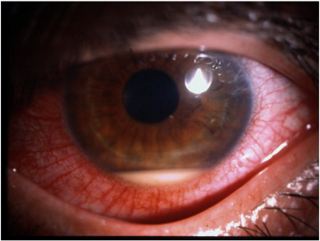
Iritis (inflammation in the front part of the eye)
Can be seen as a toxic side effect of rifabutin or cidofovir
Found as a result of infection in the back of the eye:
Cytomegalovirus (CMV) or VZV retinitis
Toxoplasmic retinochoroiditis
Syphilitic retinochoroiditis
Diagnosed by slit-lamp examination
Can have a red eye or a white ‘quiet’ eye, and can have +/- collection of white blood cells (hypopyon)
https://www.nejm.org/doi/full/10.1056/NEJM199807233390406 https://eyewiki.aao.org/Ocular_Involvement_in_HIV/AIDS#cite_note-Sellitti-10 1: https://www.aoa.org/AOA/Images/Patients/Eye%20Conditions/AnteriorUveitis_AdobeStock_248413869.jpg 2: https://ars.els-cdn.com/content/image/1-s2.0-S1568997214000184-gr3.jpg
Notes:
Rifabutin used to treat mycobacterium-avian complex. Known to cause severe hypopyon.
Cidofovir used to treat CMV retinitis.
Some other infection in the back of the eye that is spilling over into the front of the eye.
Treat the infectious cause or taper the toxic medication.
Light sensitivity, misshaped pupils.

Slide 16
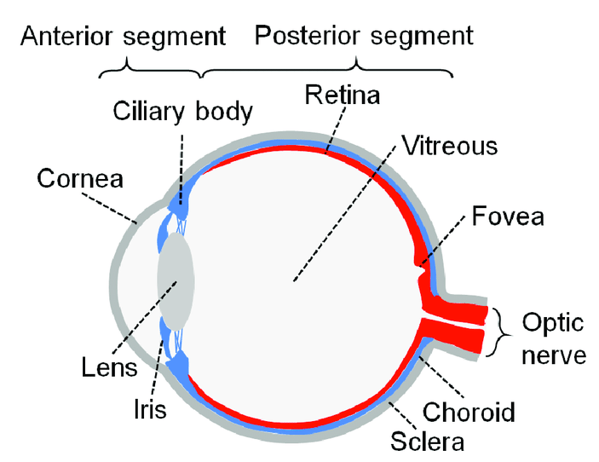
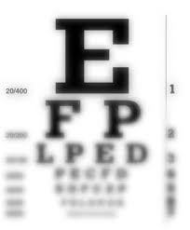
Posterior Segment Findings
What is the posterior segment (aka back of the eye)?
Retina
Choroid
Optic-nerve head
Common symptoms:
Curtain vision
Significant and new floaters
Flashing lights (photopsia)
Visual-field defects
Acute and significant decrease in visual acuity
Send to ophthalmologist or optometrist immediately!
1: https://www.researchgate.net/figure/Diagram-of-the-human-eye-The-anterior-segment-of-the-eye-contains-the-cornea-iris_fig1_321951894 2: https://jec.co.id/en/service/vitreoretina-1 3: http://www.achromatopsia.info/reduced-visual-acuity/ 4: https://www.focus-eye-clinic.com/en/retinal-surgery/retinal-detachment
Notes:
*MOST IMPORTANT SLIDE*
-VISION LOSS MAY BE IMMINENT
Before HAART it was not uncommon to go blind after HIV diagnosis.
Afferent pupillary defect has strong correlation with retinal and nerve involvement.

Slide 17
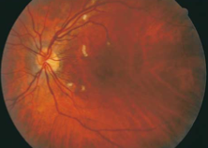
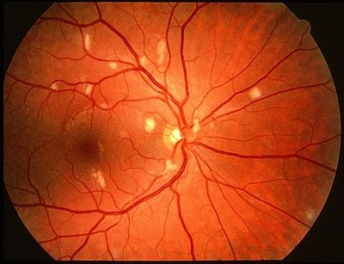
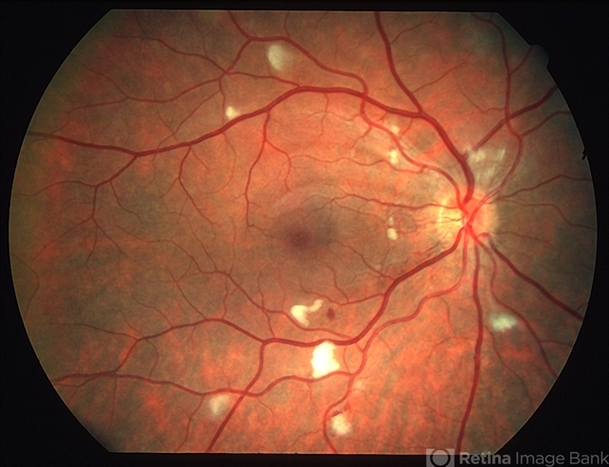
Retinal Microvasculopathy (HIV Retinopathy)
Most commonly observed manifestations:
Cotton-wool spots
Intraretinal hemorrhages
Retinal microaneurysms
Increased frequency in CD4+ T-lymphocyte counts below 100 cells per cubic millimeter
1
3
2
https://www.nejm.org/doi/full/10.1056/NEJM199807233390406 1: https://www.nejm.org/doi/full/10.1056/NEJM199807233390406 2: https://imagebank.asrs.org/file/3352/hiv-retinopathy-re 3: https://theretinainstitute.org/hiv-retinopathy
Notes:
Used to be very common before emergence of HAART treatment.
Affected people with HIV may experience decrease in contrast sensitivity and color vision.

Slide 18
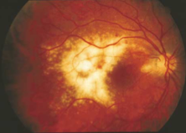
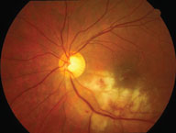
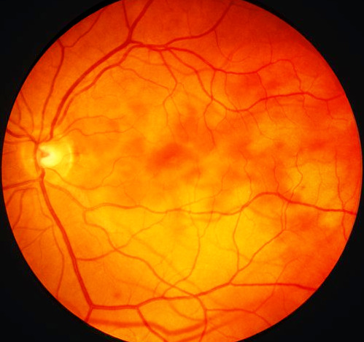
CMV Retinitis
Most often occurs when CD4+ count is below 100
Findings on fundus examination:
full-thickness retinal whitening
intraretinal hemorrhages
Optic nerve involvement in up to 5% PWH
https://www.nejm.org/doi/full/10.1056/NEJM199807233390406
https://eyewiki.aao.org/Ocular_Involvement_in_HIV/AIDS#cite_note-Sellitti-10 1: https://www.nejm.org/doi/full/10.1056/NEJM199807233390406 2: https://www.ncbi.nlm.nih.gov/books/NBK551705/figure/article-19496.image.f3/ 3: https://www.opticianonline.net/content/features/cytomegalovirus-cmv-retinitis/
Notes:
PWH=people with HIV
Not seen as often since the emergence of HAART
- decreased incidence by 80% due to HAART
High risk of retinal detatchment.

Slide 19
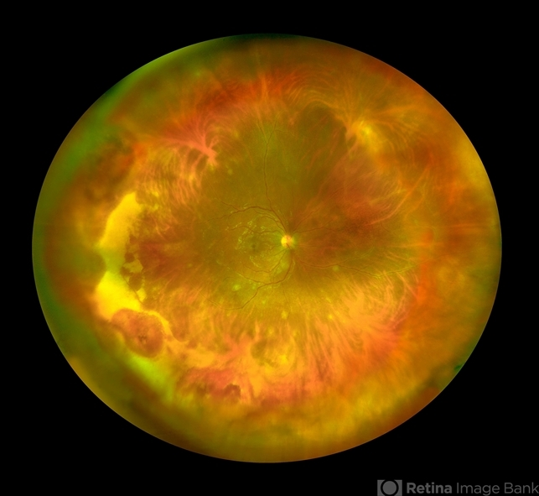
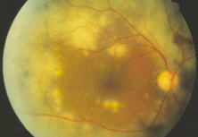
Herpetic Retinitis
Early involvement of deep retinal layers
Rapid development of multifocal lesions
High risk of bilateral eye involvement and retinal detachment
https://www.nejm.org/doi/full/10.1056/NEJM199807233390406 1: https://www.nejm.org/doi/full/10.1056/NEJM199807233390406 2: https://imagebank.asrs.org/file/28827/varicella-zoster-virus-retinitis
Notes:
Devastating and progresses rapidly.
May quickly progress to vitreous humor or anterior segment involvement.
Patients almost never have concurrent dermatologic herpetic presentation.

Slide 20
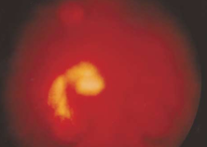
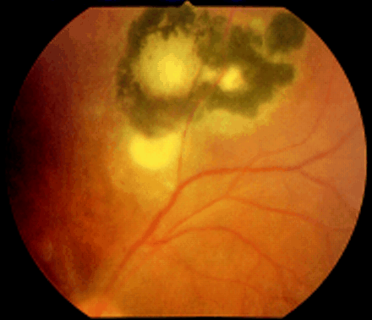
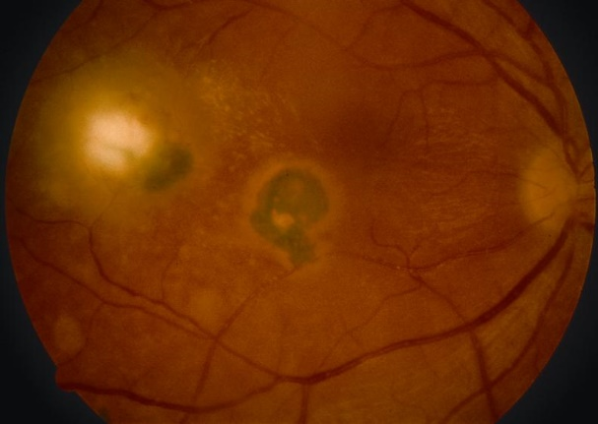
Toxoplasmic Retinochoroiditis
Ocular manifestations:
Anterior-chamber and vitreous inflammation
A relative absence of retinal hemorrhage
Pigmented chorioretinal scars
PWH are more likely to have bilateral and multifocal lesions
Can progress to central nervous system symptoms
https://www.nejm.org/doi/full/10.1056/NEJM199807233390406 1: https://www.nejm.org/doi/full/10.1056/NEJM199807233390406 2: https://bjo.bmj.com/content/86/6/636 3: https://eyewiki.aao.org/Toxoplasmosis
Notes:
PWH=people with HIV
MRI of brain to rule out CNS involvement

Slide 21
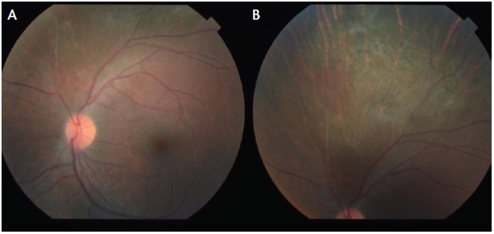
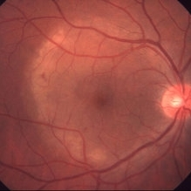
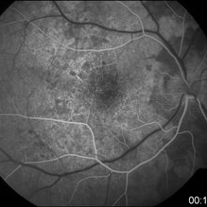
Bacterial and Fungal Retinitis
Ocular syphilis is the most common bacterial retinitis
Concurrent diffuse intraocular inflammation is common
Other microbial etiologies should be considered in people who use injection drugs or people with systemic disease
https://www.nejm.org/doi/full/10.1056/NEJM199807233390406 https://www.eophtha.com/posts/ocular-manifestations-of-hiv-3#google_vignette
https://eyewiki.aao.org/Ocular_Involvement_in_HIV/AIDS#cite_note-Sellitti-10 1: https://retinatoday.com/articles/2018-may-june/recognizing-ocular-syphilis 2,3: https://imagebank.asrs.org/discover-new/files/4/25?q=syphilis
Notes:
Diffuse intraocular inflammation: anterior uveitis, retinitis, chorioretinitis, panuveitis, optic neuropathy
Possible finding: Argyll Robertson Pupil – pupil constricts to nearby objects but not with light due to use of different neuro-pathways.
May have Jerisch-Herxheimer reaction: worsening of symptoms after antibiotic treatment

Slide 22
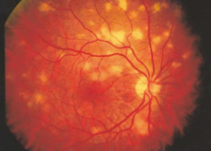
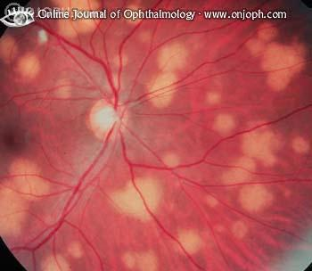
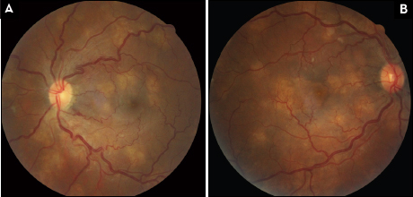
Infectious choroiditis:
Most common etiology: Pneumocystis jirovecii
Cryptococcus or M. tuberculosis (TB) have also been documented
https://www.nejm.org/doi/full/10.1056/NEJM199807233390406 1: https://www.nejm.org/doi/full/10.1056/NEJM199807233390406 2: https://www.atlasophthalmology.net/photo.jsf;jsessionid=2492BDA18B753BBB82B1BB4A25E7B8C5?node=1907&locale=en 3: https://www.retinalphysician.com/issues/2012/july-aug/a-case-of-cryptoccocal-choroiditis-in-an-hiv-infec
Notes:
Choroid = Layer of eye containing blood vessels that support the retina.

Slide 23
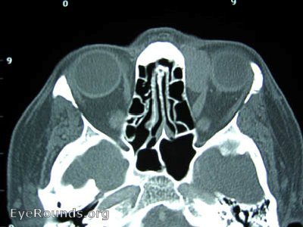
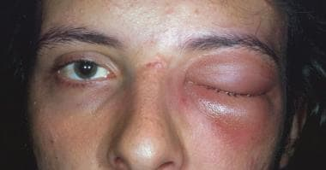
Orbit Findings
What is the orbit?
The “eye-socket” formed by the bones of the skull
Orbital findings are relatively uncommon
Findings include:
Orbital Lymphoma
Orbital Cellulitis
Most common etiology: Aspergillus
https://www.nejm.org/doi/full/10.1056/NEJM199807233390406 1: http://www.eyerounds.org/atlas/pages/orbital-lymphoma.html 2: https://emedicine.medscape.com/article/1217858-overview
Notes:
Lymphoma treatment: radiation and chemotherapy
Cellulitis: antimicrobials

Slide 24
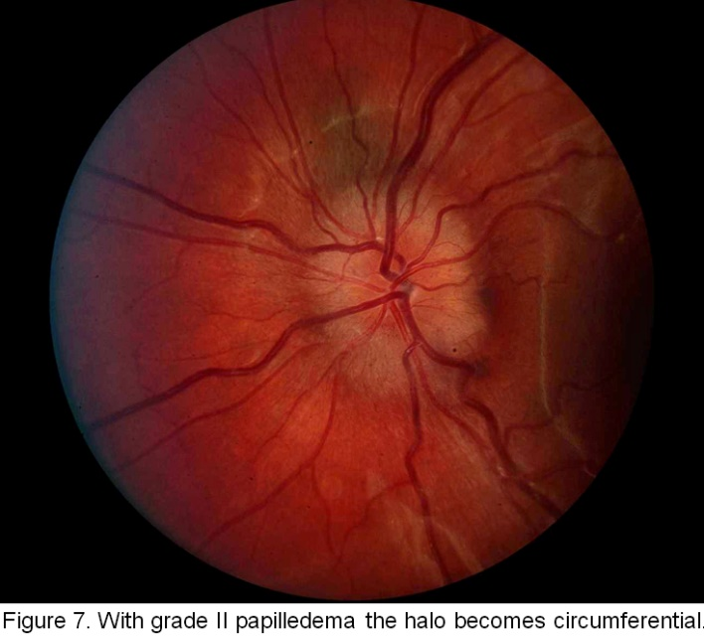
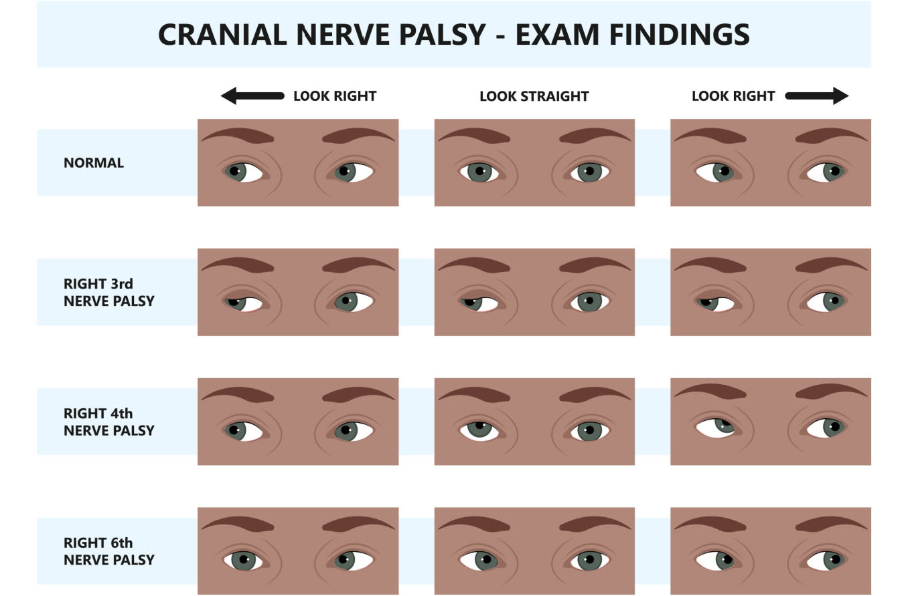
Neuro-Ophthalmic Findings
Common findings:
Ocular-motility disorders: double vision
Papilledema from elevated intracranial pressure
Cranial-nerve palsies
Visual-field defects
MRI and Ophthalmology referral
Common causes:
Cryptococcal meningitis
Meningeal and parenchymal lymphoma
Neurosyphilis
Toxoplasmosis
Secondary causes:
diffuse encephalopathies (HIV encephalopathy or progressive multifocal leukoencephalopathy)
Notes:
Not as urgent as retinal disorders but still need quick response time due to possible brain involvement.

Slide 25
Conclusion
Signs of retinal infection (curtain vision, floaters, flashes) ➡️ send to ophthalmologist/optometrist immediately
Signs of neuro-ophthalmic involvement (double vision, papilledema, visual field defects) ➡️ MRI and ophthalmology appointment ASAP
Lots of PWH have red/dry eyes ➡️ treat with lubricating eye drops
Ocular findings in HIV have many different causes: opportunistic infections, side effects from medications, the disease itself
Notes:
PWH=people with HIV

Slide 26
References
https://www.nejm.org/doi/full/10.1056/NEJM199807233390406
https://www.eophtha.com/posts/ocular-manifestations-of-hiv-3#google_vignette
https://www.ncbi.nlm.nih.gov/books/NBK441926/#:~:text=Posterior%20segment%20involvement%20in%20HIV,acuity%20or%20visual%20field%20defects
https://eyewiki.aao.org/Ocular_Involvement_in_HIV/AIDS#cite_note-Sellitti-10

Slide 27
Resources
National Clinician Consultation Center http://nccc.ucsf.edu/
HIV Management
Perinatal HIV
HIV PrEP
HIV PEP line
HCV Management
Substance Use Management
Present your case on ECHO
http://echo.unm.edu
hivecho@salud.unm.edu
ihsecho@salud.unm.edu
AETC National HIV Curriculum https://aidsetc.org/nhc
AETC National Coordinating Resource Center https://targethiv.org/library/aetc-national-coordinating-resource-center-0
HIVMA Resource Directory https://www.hivma.org/globalassets/ektron-import/hivma/hivma-resource-directory.pdf
Additional trainings scaetcecho@salud.unm.edu
www.scaetc.org
Notes:
Find additional ECHO sessions in your area: https://echo.unm.edu/locations-2/echo-hubs-superhubs-united-states/
https://hsc.unm.edu/echo/get-involved/join-an-echo/
IDEA Platform: Infectious Diseases Education & Assessment. https://idea.medicine.uw.edu/
AETC National HIV Curriculum: 6 core modules for self study; regularly updated; CME, CNE
Hepatitis C Online Curriculum: https://www.hepatitisc.uw.edu/
Hepatitis B Online Curriculum: https://www.hepatitisb.uw.edu/
National STD Curriculum: https://www.std.uw.edu/

Slide 28
SCAETC Social Media

