Slide 1
Cases in HIV for InterProfessional Students (CHIPS) SESSION 3
A Case of Amnesia:
On Remembering the Importance of Interprofessional Communication
Melanie Goebel, MD
Assistant Professor, Baylor College of Medicine
Associate Clinical Director, Houston AETC
Notes:
Version date_03 2023

Slide 2
Disclosures
Original Slide Developer: Steven Paul Woods, Psy.D.
Professor of Psychology, University of Houston
Director, TSHC Clinical Neuropsychology Service
Slide developer has no financial conflicts of interest to disclose
Speaker has no conflicts of interest to disclose
This program is supported by the Health Resources and Services Administration (HRSA) of the U.S. Department of Health and Human Services (HHS) as part of an award totaling $3,132,205, with 0% financed with non-governmental sources.
The views expressed do not necessarily reflect the official policies of the Department of Health and Human Services, nor does mention of trade names, commercial practices, or organizations imply endorsement by the U.S. Government. Any trade/brand names for products mentioned during this presentation are for training and identification purposes only.

Slide 3
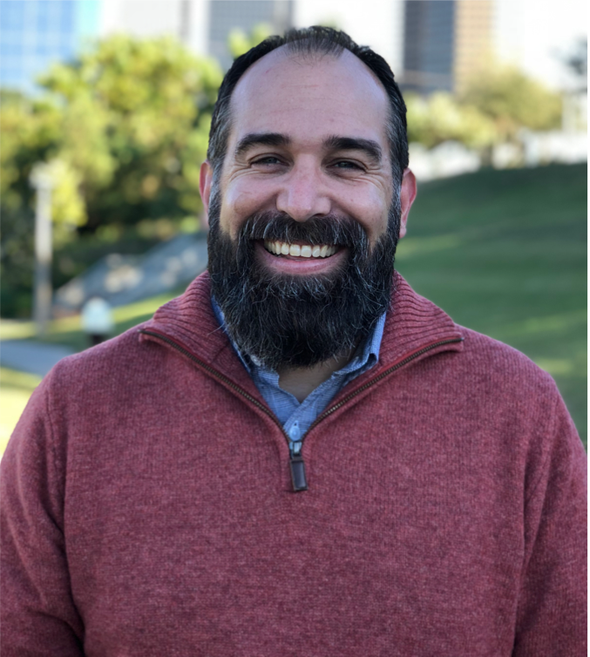
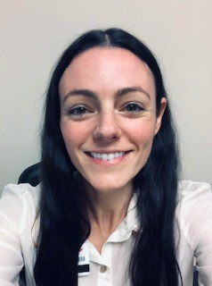
CHIPS Faculty and Collaborators
Shital Patel, MD
Assistant Professor
Infectious Diseases
Baylor College of Medicine
Melanie Goebel, MD
Assistant Professor
Infectious Diseases
Baylor College of Medicine
Steven Woods, Psy,D.
Professor
University of Houston
Department of Psychology
School of
Health Professions
Padmavathy Ramaswamy, PhD
Assistant Professor
Cizik School of Nursing
The University of Texas
Erica Yu, PhD
Associate Dean & department chair
Cizik School of Nursing
The University of Texas
Sheryl Malone-Thomas, DNP, RN, FNP-BC
Assistant Professor
Cizik School of Nursing
The University of Texas
Lis Shell, PhD, PA-C
Assistant Professor
Baylor College of Medicine
Physician Assistant Program
Amy Moss, PharmD
Clinical Pharmacist
Harris Health System
Alexa Zhao, PharmD
Clinical Assistant Professor
College of Pharmacy
University of Houston

Slide 4
Learning Objectives
Describe the relevance of brain health to multidisciplinary HIV care.
Illustrate the importance of clear, direct communication with patients, family members, and treatment team members.
Recognize how your unique expertise contributes to effective communication.

Slide 5
Session expectations for students
Respectful, collaborative discussions
Active participation from all
Focus on team-based care
Zoom logistics
Please turn on your video (if possible)
Change your “name” in zoom (Name, profession, year)
Note: this session will be recorded on zoom

Slide 6
Initial visit to neuropsychologist: patient history
33yo, Black/African American (AA) woman
Born and raised in Harris County
No history of childhood illness or learning difficulties
A/B student, enjoyed English
Dropped out after 11th grade (pregnancy)
Prior work as a rehab tech and call center operator
Currently unemployed
Lives with mother, husband, and children.
Enjoys listening to music and caring for her children
Notes:
Ms. X was referred to neuropsychology by her primary care provider to evaluate the patient’s memory symptoms

Slide 7
Ms. X’s Presenting Symptoms
Ms. X first noticed memory problems in 2018, which have remained stable since that time
Difficulties recalling details from the recent past, including conversations and instructions from her health providers
Difficulties remembering to do things in the future, such as forgetting to pick up her child after school or take a prescribed medication
No trouble recalling details from the distant past and no other cognitive symptoms

Slide 8
Ms. X’s Presenting Symptoms
Ms. X feels overwhelmed and anxious about her memory symptoms, which tends to make her problems worse
Her memory symptoms make it difficult for her to keep up with her activities of daily living (ADLs)
Household responsibilities, such as managing finances and completing chores
Health responsibilities, such as refilling and taking her medications, completing paperwork necessary for services

Slide 9
Past Medical History
Seizure Disorder (diagnosed 2018)
Both simple (e.g., staring spells) and complex seizures (i.e., focal onset with loss of awareness) that last a few minutes and are followed by a brief period of confusion
Her seizures have increased in frequency in recent months and are managed with levetiracetam 750mg bid
EEG: intermittent focal slowing and isolated focal sharp wave discharge in the left temporal lobe
Notes:
There is a family history of seizures (2 maternal aunts)
Neuroimaging
An EEG in August 2021 showed intermittent focal slowing and isolated focal sharp wave discharge in the left temporal lobe.
A brain MRI in 2021 showed increased T2/FLAIR signal and architecture abnormalities in the left hippocampus
Mesial temporal sclerosis (scarring, commonly idiopathic)
A brain MRI in 2018 and a head CT in 2021 were WNL
levetiracetam (Keppra)

Slide 10
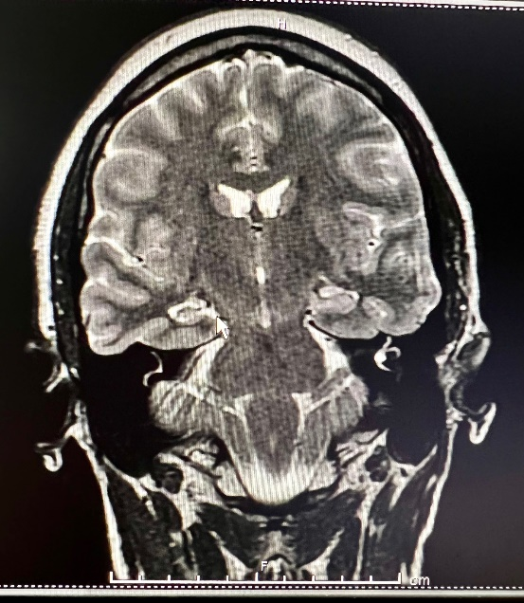
Brain imaging
MRI brain in 2021 showed increased T2/FLAIR signal and architecture abnormalities in the left hippocampus
Mesial temporal sclerosis (scarring, commonly idiopathic)
A brain MRI in 2018 and a head CT in 2021 were within normal limits (WNL)
Notes:
Neuroimaging
An EEG in August 2021 showed intermittent focal slowing and isolated focal sharp wave discharge in the left temporal lobe.
A brain MRI in 2021 showed increased T2/FLAIR signal and architecture abnormalities in the left hippocampus
Mesial temporal sclerosis (scarring, commonly idiopathic)
A brain MRI in 2018 and a head CT in 2021 were WNL (within normal limits)

Slide 11
HIV History
Diagnosed with HIV in December 2020
Behavioral risk factor: Unprotected heterosexual contact
Treated with tenofovir alafenamide, emtricitabine, bictegravir (Biktarvy®); ran out of medication several weeks ago and reports “rationing” her medication by cutting the pills in half
CD4 Count: 785 cells/millimeter
HIV-1 viral load
Current = 22,800 copies/milliliter
At diagnosis = 41,500 copies/mL
Undetectable 3 months prior to evaluation
No history of any central nervous system opportunistic infections
Notes:
CD4 Nadir = 629 (at diagnosis)
Patient had been rationing her medication by cutting pills in half
Due to memory problems, patient had forgotten to renew her eligibility paperwork for the AIDS drug assistance program (ADAP)

Slide 12
Other Medical History
Cervical dysplasia
Smoking: currently smokes cigarettes (1 pack/day)
No known history of stroke, cancer, head injuries, hypoxia
No surgical history
Most recent labs
Liver function tests, CBC, B12, thyroid, HCV antibody, and syphilis screen all normal
Notes:
CBC = complete blood count

Slide 13
Psychiatric History
Symptoms of anxiety (e.g., panic) and depression
Currently managed by psychiatry (escitalopram 20mg) and behavioral health (supportive counseling) at clinic
No history of suicidal ideation(SI)/homicidal ideation (HI), abuse, or neglect
Active cannabis use (daily)
History of cocaine use (in remission)
No treatment for substance use disorder
Notes:
SI = suicidal ideation
HI= homicidal ideation

Slide 14
Neuropsychological Test Results
Estimated Verbal IQ = Average (25-74%ile)
Attention = Average (25-74%ile)
Processing Speed = Low Average (9-24%ile)
Executive Functions = Average (25-74%ile)
Memory = Exceptionally Low (<2nd %ile)
0/12 word list items recalled at delay
<20% of details of short stories at delay
Did not benefit from Yes/No recognition
Did not respond to 2 items asking her to remember to something after 15-minutes

Slide 15
Neuropsychological Test Results
Activities of Daily Living (ADLs) = 6/14 need assistance
Shopping, chores, transport, medications
Depression = 12/15 endorsed
Sadness, reduced activity
Anxiety = 4/5 endorsed
Worry, nervousness

Slide 16
Patient Case Summary
33 y/o Black/African American woman with seizure disorder, depressive disorder, substance use disorder, and HIV who shows a markedly amnestic profile on neuropsychological evaluation

Slide 17
Breakout Rooms Icebreaker
Share your name and school
In 10 years, what do you see yourself doing? (1 sentence, 10 words or less)

Slide 18
Breakout Rooms Questions for Discussion
In this patient, what factors are facilitators or barriers to adherence to antiretroviral therapy (ART)?
How does the patient’s amnesia affect her physical and mental health?
Recall a time that you encountered a patient with memory problems. Describe.
In your role as a (physician, pharmacist, physician assistant, nurse, nurse practioner, psychologist), how can you effectively communicate with the patient?

Slide 19
Team Education & Communication
Emailed referring provider and looped in psychiatry and social worker
Described the findings and diagnosis in non-technical terms, tied directly to their care with the patient (e.g., difficulty recalling medical instructions without aids)
Patient counseling
Memory notebook or other electronic compensatory device
Single device, kept on-person at all times
Explicit prompts and reminders with detailed instructions
Involvement of mother, to the extent possible
Possible occupational therapy consult for in-home evaluation and strategizing
Notes:
Emailed referring provider and looped in psychiatry and social worker
Described the findings and diagnosis in non-technical terms, tied directly to their care with the patient (e.g., difficulty recalling medical instructions without aids)
Noted the risk of missing her memory problems, since her other basic functions and remote memory were intact
Provided some examples of how her counseling could focus on both acceptance of her memory challenges and training on how to use a memory notebook or other electronic compensatory devices
Single device, kept on-person at all times
Explicit prompts and reminders with detailed instructions
Involvement of mother, to the extent possible
Possible OT consult for in-home evaluation and strategizing

Slide 20
Team-Based Plan of Care
Problem: Major neurocognitive disorder (amnestic type) due to mesial temporal sclerosis
Team solution:
Memory devices (phone, calendar)
Treat anxiety
Refrain from driving and operating hazardous machinery
Follow up with neuropsychology in 1 year
Notes:
https://www.mededportal.org/doi/10.15766/mep_2374-8265.10295

Slide 21
Team-Based Plan of Care
Problem: Seizure disorder
Team solution:
Seen by neurology: due to concern for subclinical seizures causing memory problems, levetiracetam increased to 1500 mg bid
Plan for possible prolonged overnight EEG
Advised against marijuana use (can lower seizure threshold)
Notes:
https://www.mededportal.org/doi/10.15766/mep_2374-8265.10295

Slide 22
Team-Based Plan of Care
Problem: Substance use disorder
Team solution:
Referred to substance use counselor
Counseled patient to abstain from marijuana use
Problem: HIV with poor adherence
Team solution:
Restarted Biktarvy® (bictegravir, emtricitabine, tenofovir alafenamide)
Adherence counseling
Repeat labs in 2 months
Nursing assessments for adherence counseling at each visit
Notes:
Advised patient not to cut pills in half

Slide 23
Team-Based Plan of Care
Problem: Depressive disorder, off escitalopram for 3 months
Team solution:
Followed closely by psychiatry
Continued escitalopram
Supportive therapy provided
Nursing assessments for depression and intimate partner violence
Notes:
Per psychiatry:
Discussion reveals that she has been off her HIV and psychotropic medications for 3-4 months ("They never came in the mail like they used to"), and consequently she has been using larger quantities of cannabis ("A dime bag a day"), which could certainly contribute to her foggy memory.

Slide 24
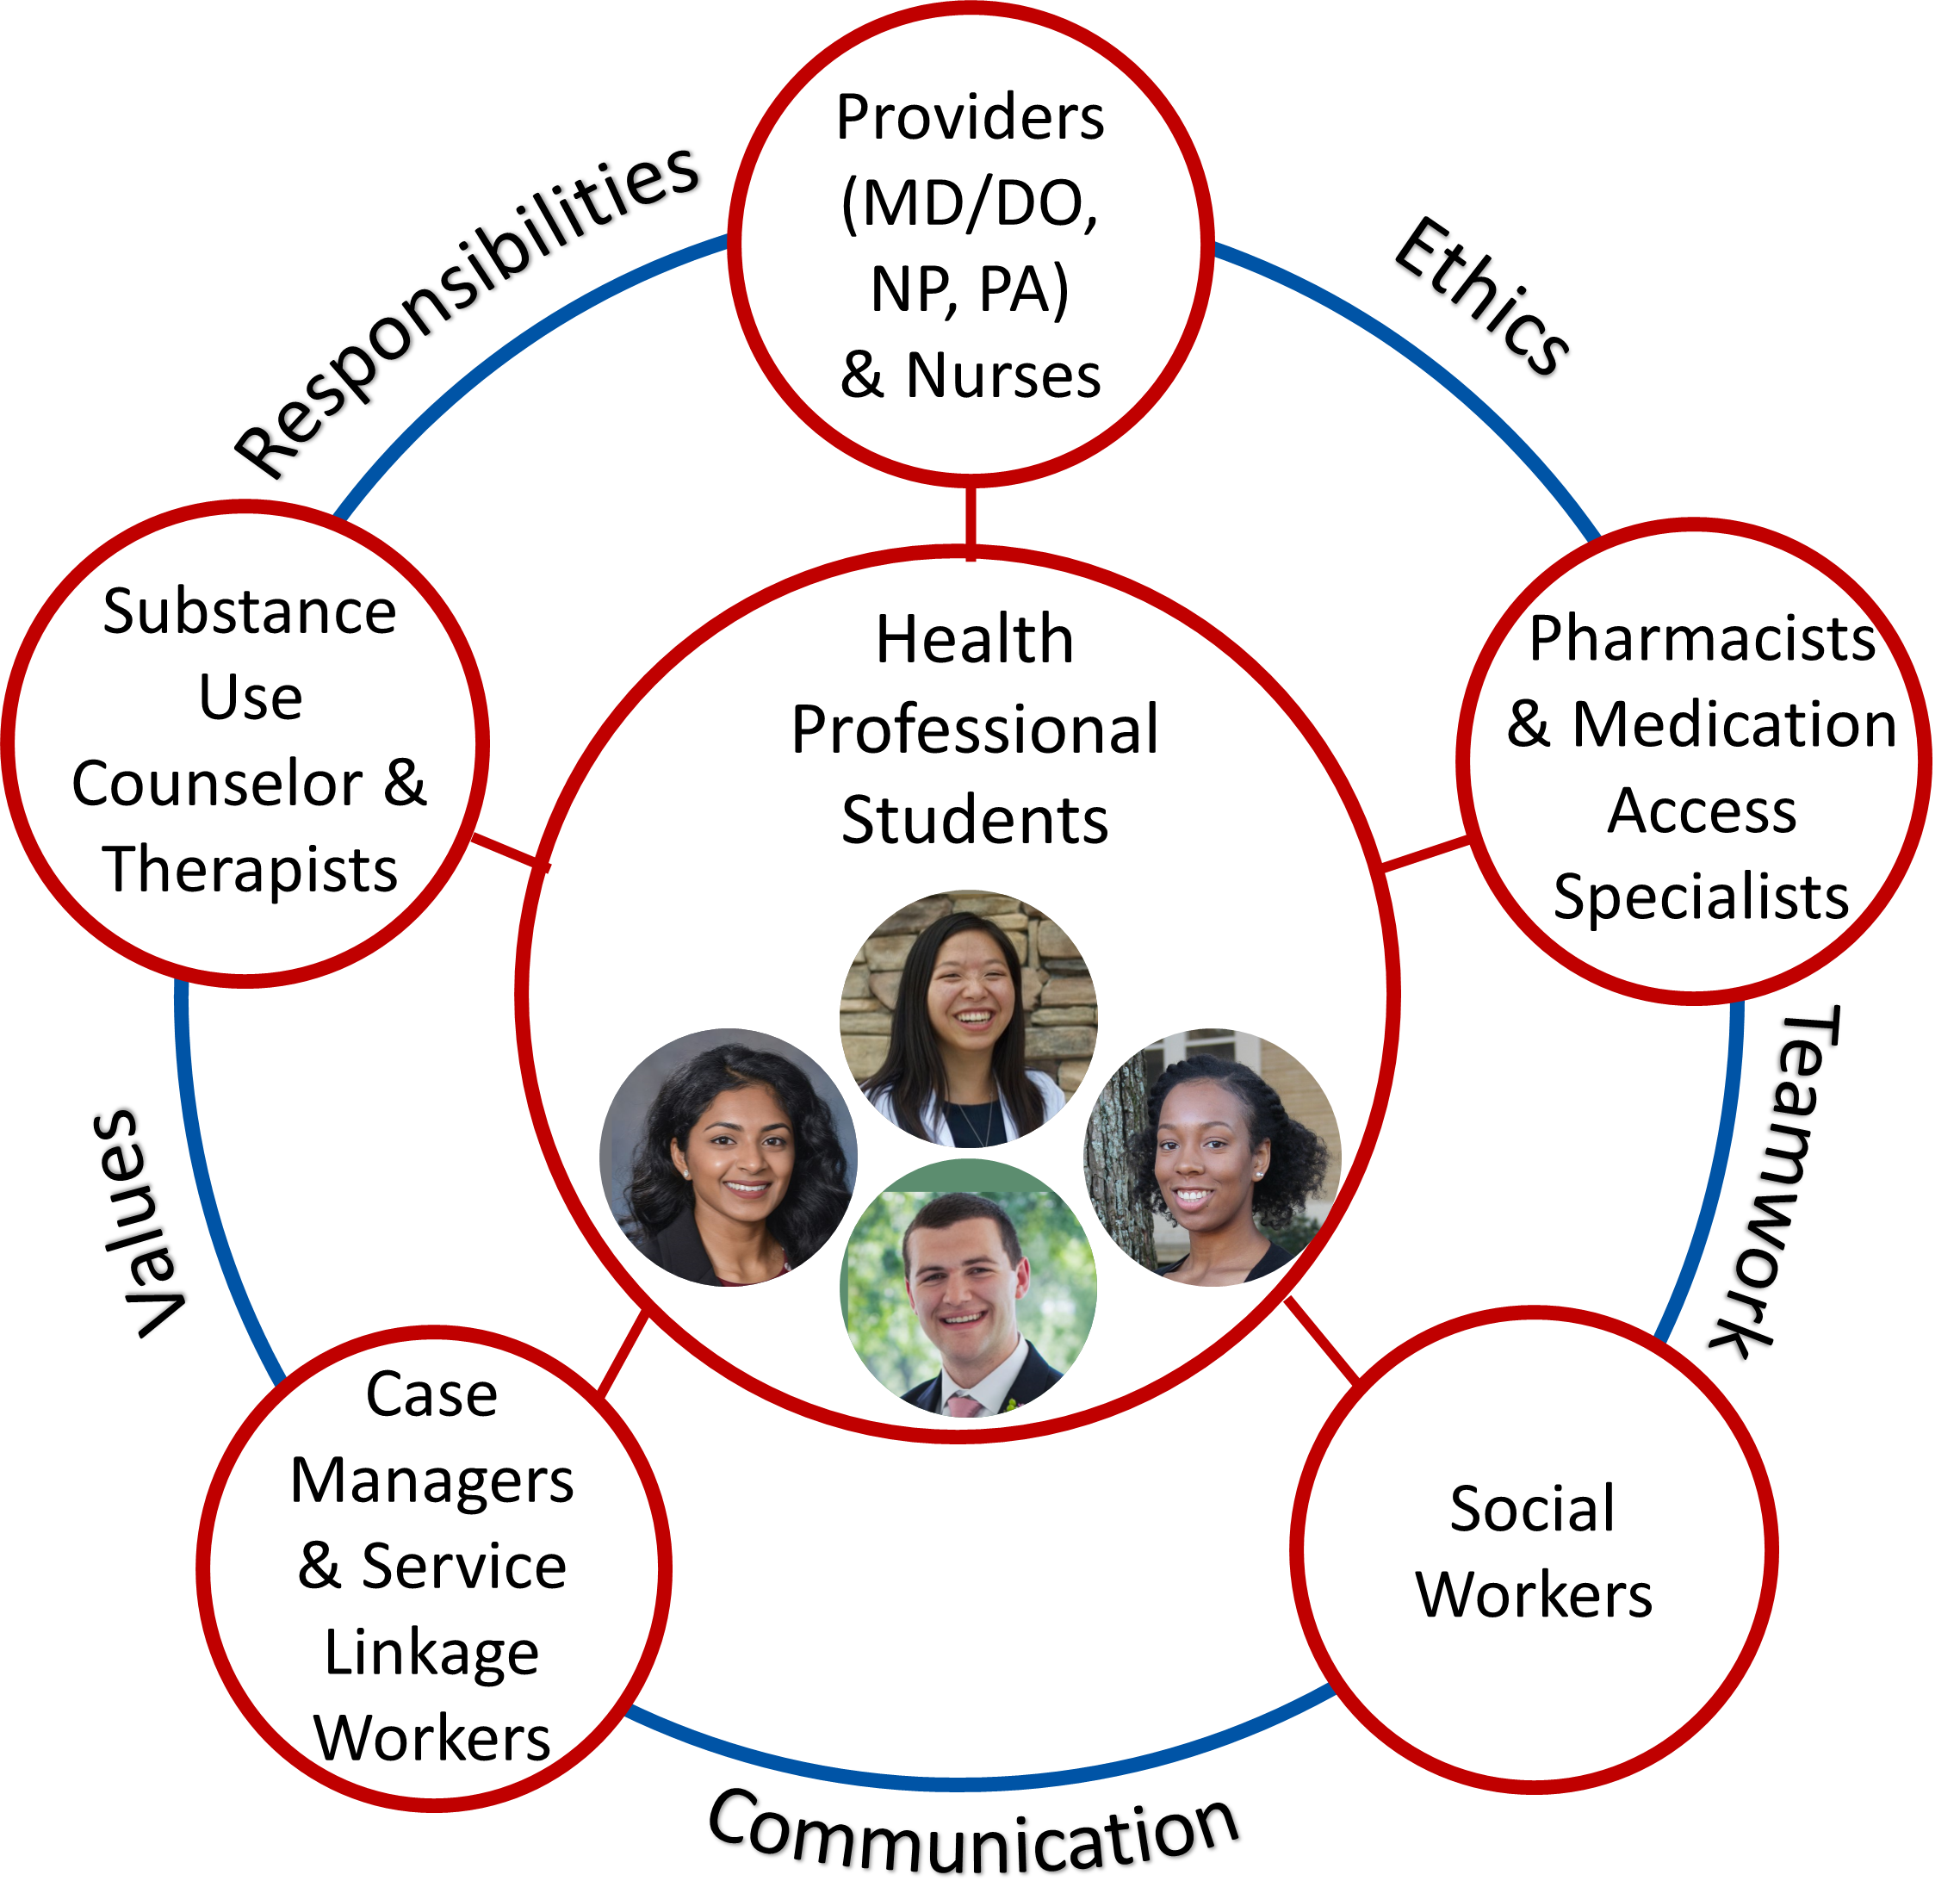
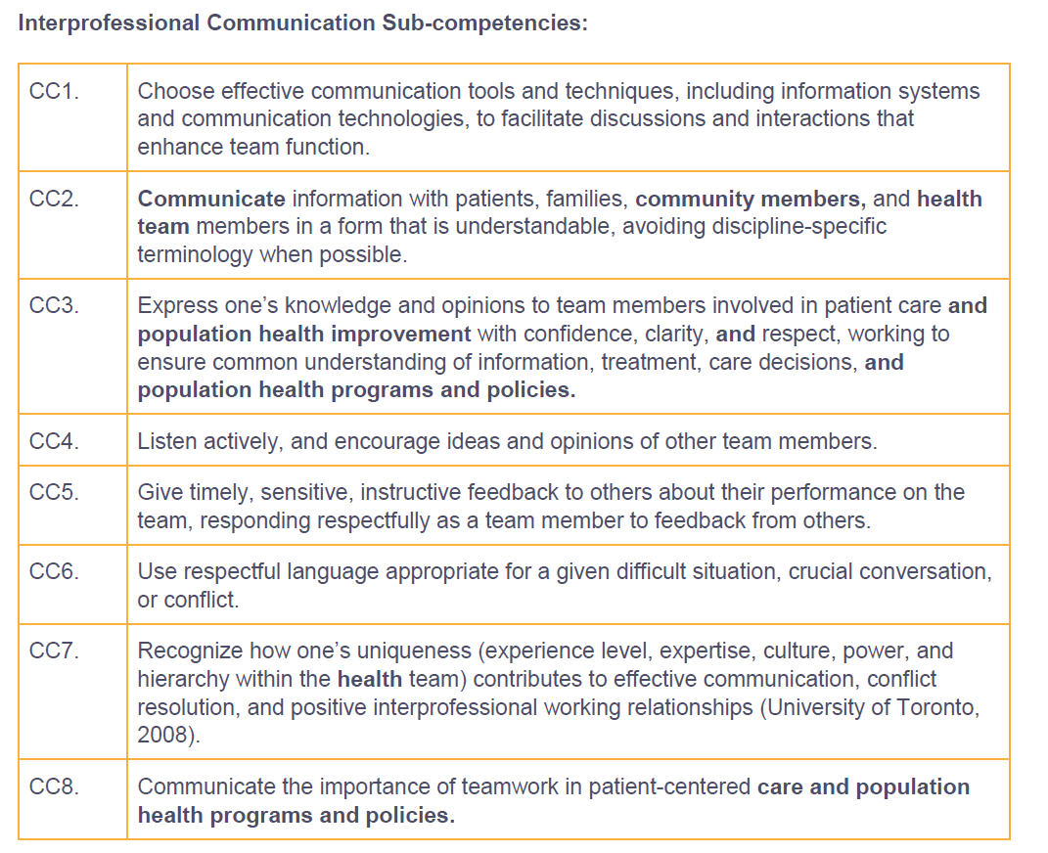
Core Competency: Interprofessional Communication
Interprofessional Education Collaborative. (2016).
Core competencies for interprofessional collaborative practice: 2016 update. Washington, DC: Interprofessional Education Collaborative.

Slide 25
Questions?
https://www.cdc.gov/stophivtogether/index.html
Notes:
https://www.gettingtozerosf.org/

Slide 26
References and Resources
http://www.interprofessionalprofessionalism.org/
Interprofessional Education Collaborative. (2016). Core competencies for interprofessional collaborative practice: 2016 update. Washington, DC: Interprofessional Education Collaborative.
Resources for HIV Medicine
National HIV Curriculum (https://www.hiv.uw.edu/)
Guidelines for the prevention and treatment of opportunistic infections in adults and adolescents with HIV: recommendations from the Centers for Disease Control and Prevention, the National Institutes of Health, and the HIV Medicine Association of the Infectious Society of America. Available at: https://clinicalinfo.hiv.gov/

Slide 28
SCAETC Social Media

Slide 29
Resources
National Clinician Consultation Center http://nccc.ucsf.edu/
HIV Management
Perinatal HIV
HIV PrEP
HIV PEP line
HCV Management
Substance Use Management
Present case on ECHO https://hsc.unm.edu/scaetc/programs-services/echo.html
AETC National HIV Curriculum https://aidsetc.org/nhc
AETC National Coordinating Resource Center https://targethiv.org/library/aetc-national-coordinating-resource-center-0
HIVMA Resource Directory https://www.hivma.org/globalassets/ektron-import/hivma/hivma-resource-directory.pdf
Additional trainings scaetcecho@salud.unm.edu
www.scaetc.org
Notes:
hivecho@salud.unm.edu https://hsc.unm.edu/scaetc/programs-services/echo.html
Find an HIV-related topic TeleECHO in your area: https://echo.unm.edu/locations-2/echo-hubs-superhubs-united-states/
IDEA Platform: Infectious Diseases Education & Assessment. https://idea.medicine.uw.edu/
AETC National HIV Curriculum: 6 core modules for self study; regularly updated; CME, CNE
Hepatitis C Online Curriculum: https://www.hepatitisc.uw.edu/
Hepatitis B Online Curriculum: https://www.hepatitisb.uw.edu/
National STD Curriculum: https://www.std.uw.edu/

