Slide 1
A Primer on the
Neuropsychology of HIV Disease
Steven Paul Woods, Psy.D.
Professor of Psychology, University of Houston
Director, Clinical Neuropsychology Service, Thomas Street Health Clinic
Adjunct Professor of Psychological Science, University of Western Australia
Notes:
Version date 4/2023
Targeted audience: medical and behavioral health providers, nurses

Slide 2

Presenter Profile
Dr. Woods is a Professor of Psychology at the University of Houston whose research focuses on cognition, everyday functioning, and health in HIV and aging. He is the founder and director of the Clinical Neuropsychology Service at Thomas Street Health Center.

Slide 3
Conflict of Interest Disclosure Statement
I receive research funding from the National Institutes of Health (NIH) and University of Houston
I receive salary support from Harris Health
I am paid as an Associate Editor for Neuropsychology and The Clinical Neuropsychologist
This program is supported by the Health Resources and Services Administration (HRSA) of the U.S. Department of Health and Human Services (HHS) as part of an award totaling $3,132,205, with 0% financed with non-governmental sources. The contents are those of the author(s) and do not necessarily represent the official views of, nor does mention of trade names, commercial practices, or organizations imply an endorsement by HRSA, HHS, or the U.S. Government. For more information, please visit HRSA.gov. Any trade/brand names for products mentioned during this presentation are for training and identification purposes only.

Slide 4
Learning Objectives
Attendees will be able to describe:
The clinical features of HIV-associated neurocognitive disorders (HAND).
Empirically-supported approaches to screening and diagnosing HAND.
Practical ways to manage encounters with persons with HAND that maximize learning and retention of health information.

Slide 5
What Is Neuropsychology?
“Clinical Neuropsychology is a specialty field within clinical psychology, dedicated to understanding the relationships between brain and behavior, particularly as these relationships can be applied to the diagnosis of brain disorder, assessment of cognitive and behavioral functioning and the design of effective treatment.”
American Psychological Association

Slide 6
What Is Neuropsychology?
Key Elements
Higher-order cognition
Emphasis on assessment & psychometrics
Evidence-based
Related Terms
Neurocognitive
Neurobehavioral
Cognitive
Related Disciplines
Neuropsychiatry
Behavioral Neurology
Physiatry
Occupational Therapy
Speech Pathology
American Psychological Association
Notes:
Higher-order cognition
Memory, executive, speed

Slide 7

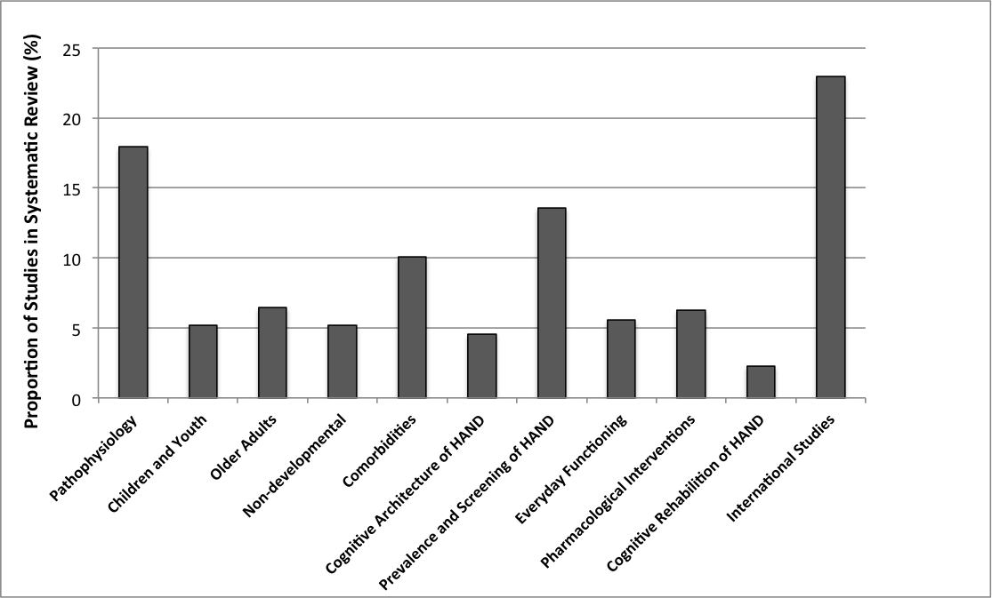
Neuropsychology of HIV
k = 446 (2015-2017)
Sheppard et al., 2019

Slide 8
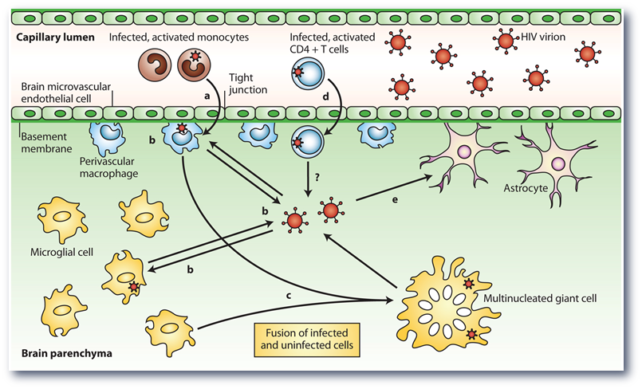
Direct and Indirect Pathways to Neuropathology in People with HIV (PWH)
Direct viral pathway
Viral proteins (e.g., Tat, gp120)
Indirect pathway
Inflammation (e.g., TNF-alpha)
Monocyte activation (e.g., MCP-1, sCD14)
Co-factors (e.g., organ disease, substance use disorders)
Ellis et al., 2009

Slide 9
Brain Pathology Occurs in a Majority of PWH
HIV encephalitis has declined in the Antiretroviral Therapy (ART) era
  Pathology is now diverse
Synaptodendritic injury
Clinical predictors of pathology
  Low nadir CD4 cell count
  High plasma RNA; No ART
  Neurocognitive impairment
Everall et al., 2009

Slide 10

HIV is Associated with Mild-to-Moderate Whole Brain Atrophy
k = 19

Slide 11
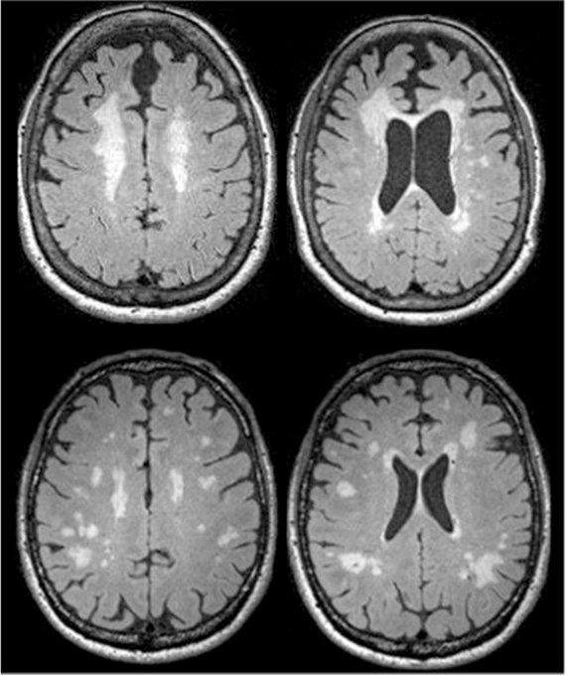
White Matter Hyperintensities are Fairly Common in HIV
White matter changes were a common feature of pre-cART HIV Associated Dementia (HAD) and are also often seen in milder forms of HAND
However, they are highly non-specific
  Comorbid conditions (e.g., hepatitis C, vascular disease)
  Demographic variables (e.g., ethnicity, age)
Watson et al., 2017

Slide 12
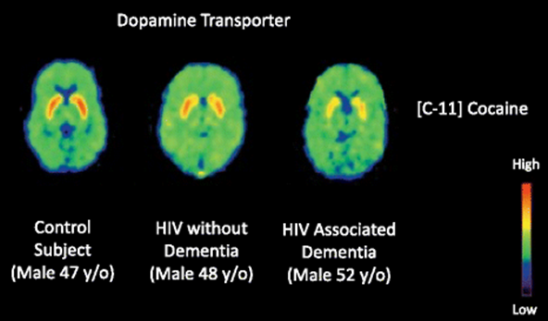
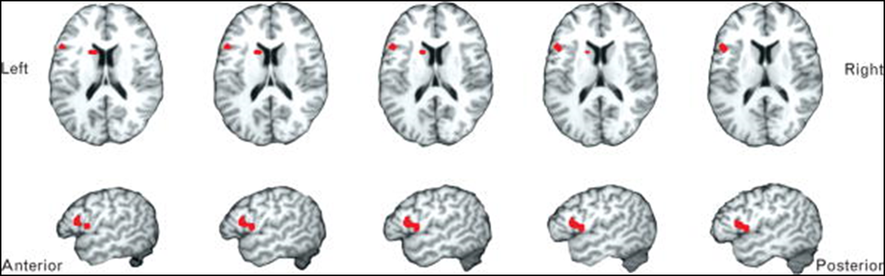
HIV-associated Neural Injury Reliably Affects
Frontal Brain Systems
Meta-analysis of 21 fMRI studies showing hyperactivation in L inferior frontal gyrus and caudate
Harezlak et al., 2011; Plessis et al., 2014; Vera et al., 2017

Slide 13
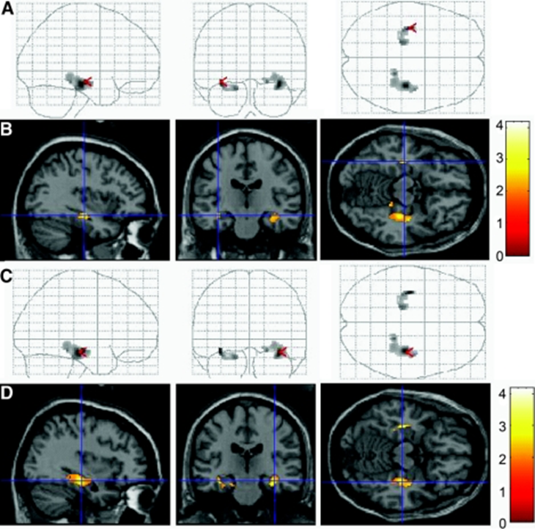
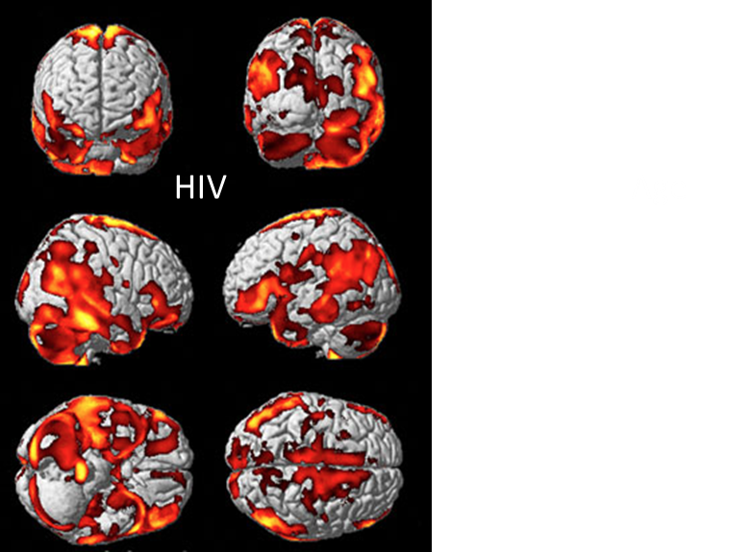
But HIV-associated Neural Injury is Not Specific to Frontal Systems
Becker et al., 2012; Maki et al., 2009

Slide 14
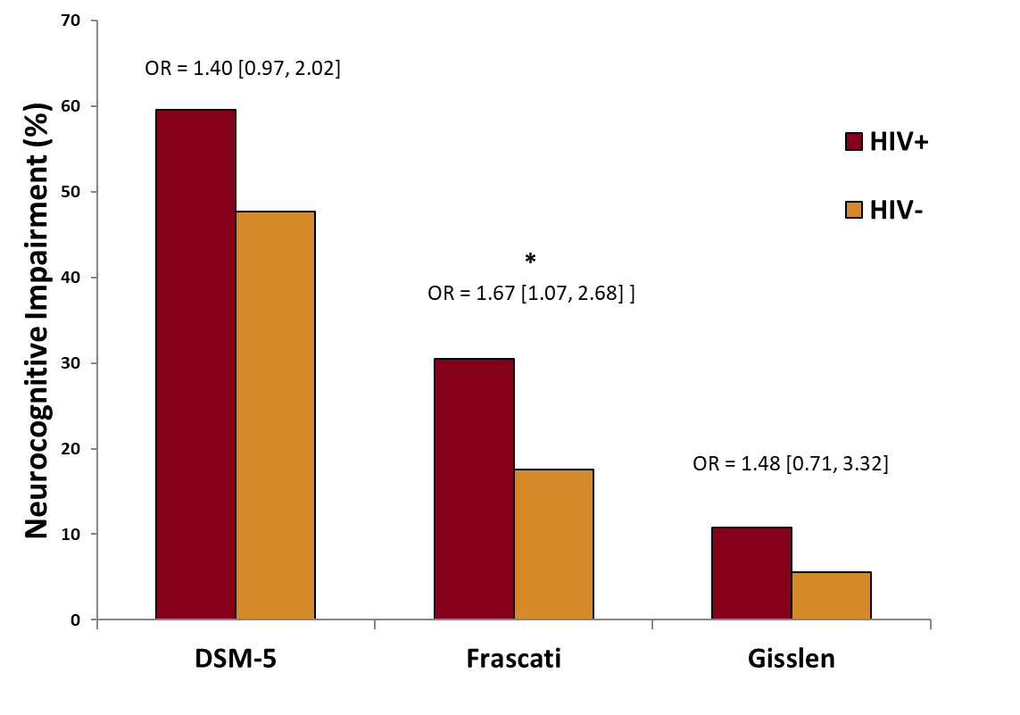
Three Primary Diagnostic Systems for HIV-associated Neurocognitive Disorders (HAND)
Tierney et al., 2017

Slide 15
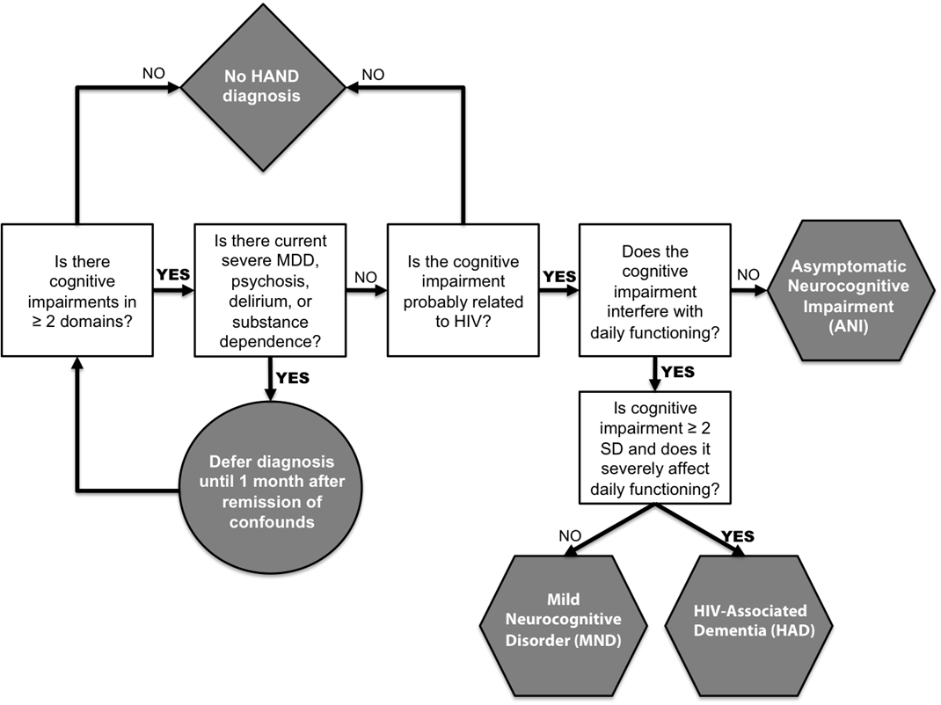

Frascati Criteria for HAND

Slide 16
Rates of HIV Dementia Declined Sharply in the cART Era
Heaton et al., 2011

Slide 17
Milder Forms of Neurocognitive Impairment Persist in the cART Era
HIV Disease Severity
* p < .05
Heaton et al., 2011

Slide 18
Approximately 30-50% of People with HIV (PWH) Have a Neurocognitive Disorder
HIV-Associated Dementia
Asymptomatic Neurocognitive Impairment
PWH Normal
PWH
Non-Demented HAND
Minor Neurocognitive Disorder
N = 1,555
Heaton et al., 2010

Slide 19
HAND is Not Invariably Progressive
Heaton et al., 2015

Slide 20
Screening for HAND is Challenging
It can be easy to miss and misdiagnose HAND in clinic
  Akin to mental health problems
  Medical comorbidities that can affect cognition are very common
  HIV disease factors don’t track well with HAND
  Report-based screening tools tend to be ineffective
  Confounded by mood and insight

Slide 21
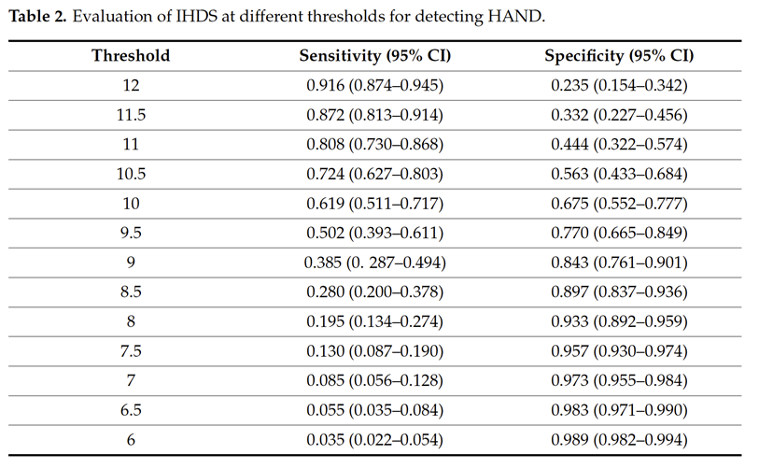


Screening for HAND is Challenging
Mini Mental Status Exam (MMSE) is largely insensitive to HAND
HIV Dementia Scale & International Hierarchic Dementia Scale (HDS)
  Includes motor and psychomotor speed
Notes:
MMSE is largely insensitive to HAND
Assesses domains not usually affected in HIV (e.g., orientation and basic language)
HIV Dementia Scale & International HDS
Includes motor and psychomotor speed
MMSE= mini mental status exam

Slide 22
Neurocognitive Domains Affected in
HIV in the ART Era
Profile suggests injury to fronto-striatal loops
Mild-moderate, “spotty” impairment
  Psychomotor speed
  Attention/white matter(WM)
  Executive functions
  Episodic memory
Spared functions
  Spatial cognition
  Praxis
  Receptive language
N = 1,555
Heaton et al., 2010

Slide 23
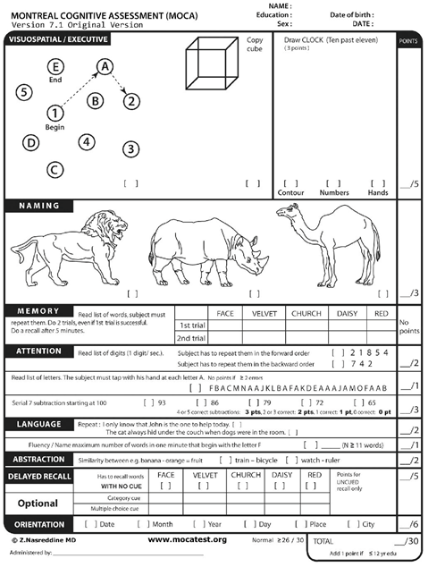
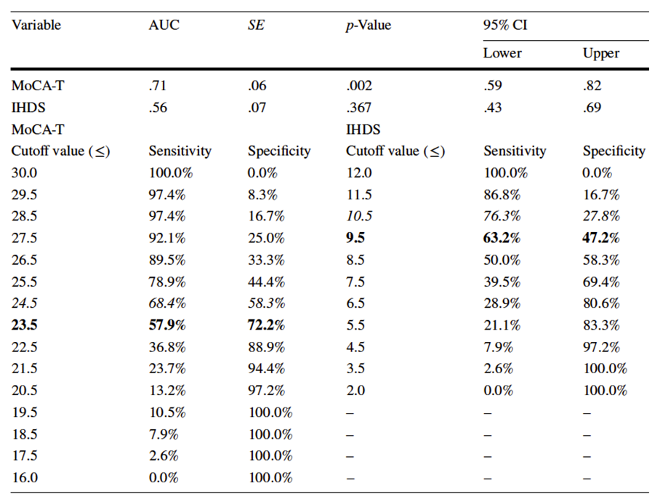



Montreal Cognitive Assessment (MoCA)

Slide 24
Limitations of Screeners for HAND
False Positive Scores
  Lower levels of education, older age
  Under-represented racial/ethnic & linguistic groups
    Average MoCA among 1,118 healthy Black/African American (AA) was 22.3 (cutpoint is 26)
False Negatives
  Ceiling effects (inverse of the above sociodemographics)
Not helpful for differentials or treatment planning
“Agnostic” rather than “diagnostic” interpretation of low scores, with a focus on their functional implications
Rossetti HC, Lacritz LH, Hynan LS, Cullum CM, Van Wright A, Weiner MF. Montreal Cognitive Assessment Performance among Community-Dwelling African Americans. Arch Clin Neuropsychol. 2017 Mar 1;32(2):238-244.

Slide 25

When In Doubt, Refer to CN
TSHC Clinical Neuropsychology (CN) Service
Detection and differential diagnosis of HAND
Establishment of baseline levels of neurocognitive functioning and monitoring of the effects of treatment and/or disease progression
Patient and provider education on HAND
Management recommendations regarding the contribution of neurocognitive impairment and other mental health disturbances to critical health behaviors (e.g., antiretroviral adherence) and activities of daily living (ADL)
Notes:
Detection and differential diagnosis of HAND that may guide treatment decisions
Establishment of baseline levels of neurocognitive functioning and monitoring of the effects of treatment and/or disease progression
Patient and provider education on HAND
Determinations and management recommendations regarding the contribution of neurocognitive impairment and other mental health disturbances (e.g., mood and substance use disorders) to critical health behaviors (e.g., antiretroviral adherence) and activities of daily living (ADL); (e.g., managing finances, vocational functioning).

Slide 26
A Variety of Co-occurring Factors Modify the Development and Expression of HAND
Demographics
  Age
  Education
  Sex
  Race/Ethnicity
Medical
  Hepatitis C
  Cardiovascular disease
  Diabetes
  Organ system disease
Neuropsychiatric
  Alcohol use
  Substance use
    Stimulants
    Cannabis?
    Opioids?
Mood disorders
  Bipolar disorder
Apathy
Sheppard et al., in press

Slide 27
The Prevalence of “Older” Adults with HIV Continues to Rise
CDC; Smit et al., 2015

Slide 28
HIV and Age Confer Additive Risk of Neurocognitive Impairment
Younger person without HIV
Older person without HIV
Younger person with HIV
Older person with HIV
R01 MH073419 (Woods), P30 MH062512 (HNRC)

Slide 29
The Alzheimer’s Disease (AD) Hypothesis of Aging and HAND
Most common cause of dementia in aging
Progressive
  Amyloid plaques and neurofibrillary tangles
    Especially in the medial temporal lobes
Neurocognitive profile
  Rapid forgetting, semantic memory failures, aphasia, dyspraxia
Shared HAND-AD risk factors
  Age*
  Apolipoprotein E gene (APOE-e4)*
  Lipid
Neuroanatomy
  Hippocampus and Medial Temporal Lobes (MTL)*
Biomarkers
  Amyloid beta*
  Tau*
Neuropathology
  Amyloid plaques *

Slide 30
No Evidence for an AD Memory Profile in Older People with HIV (PWH)
Younger person without HIV
Older person without HIV
Younger person with HIV
Older person with HIV
Scott et al., 2011

Slide 31

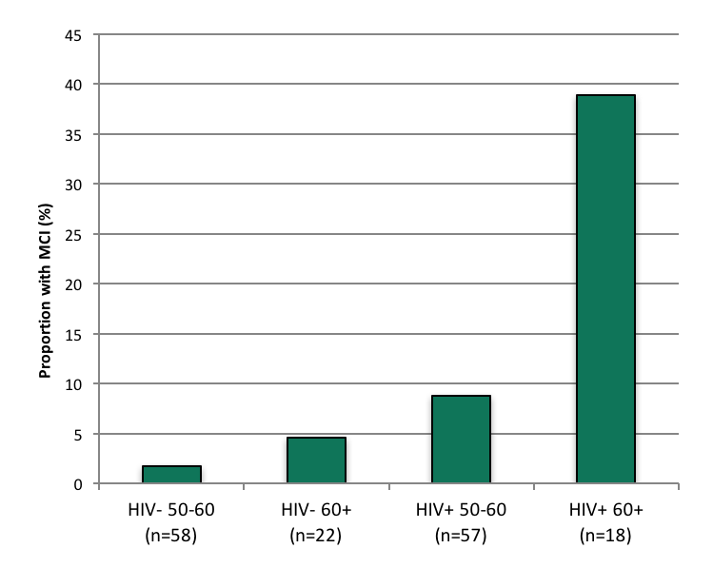
Elevated Rates of SCD and MCI in HIV Disease
Subjective Cognitive Decline (SCD)
Mild Cognitive Impairment (MCI)
**
Older person without HIV
Older person with HIV
*p < 0.01, odds ratio = 5.2
**p < 0.01, odds ratio = 6.7
Sheppard et al., 2019; Sheppard et al., 2015

Slide 32
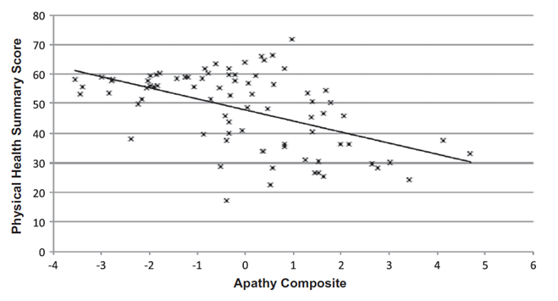

Apathy in HIV Disease: Why Care?
Person without HIV
PWH
HAND

Slide 33
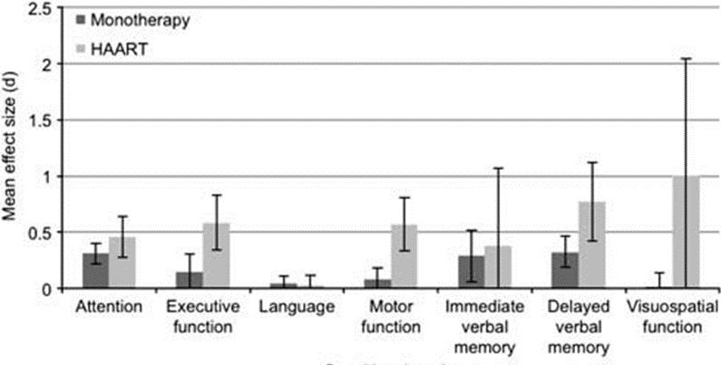
Pharmacological Approaches to
Managing HAND
Initiation of ART can improve HAND
  Especially in treatment naïve patients, younger persons and CD4 responders
  CNS penetration
Non-ART therapies have not shown much success
  Stimulants, selegiline
Al Khindi et al., 2011; Ellis et al., 2014

Slide 34
Non-Pharmacological Approaches to
Managing HAND
Positive cognitive health behaviors
  What’s good for the heart is good for the brain
    Diet, physical activity, sleep
    Minimal alcohol, avoiding tobacco and illicit drugs
  Enjoyable cognitive activity
  Enjoyable social activity

Slide 35
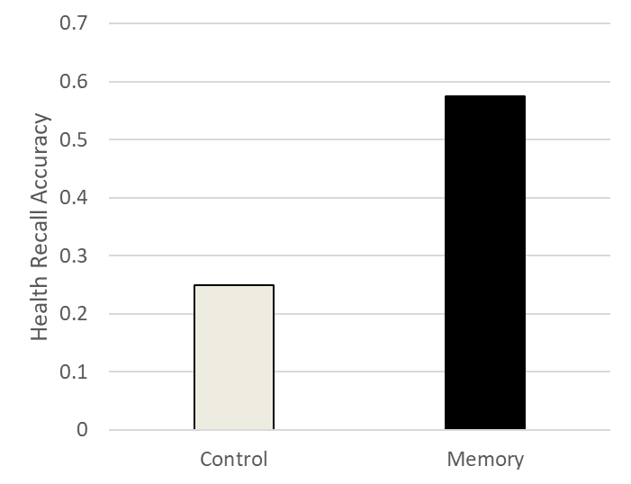

Cognitive Neurorehabilitation of HAND
Create “desirable difficulties”
  Spacing, practice
  Elaboration
  Provider teach-back
External Reminders
  Explicit
  Tied to existing (enjoyable) habits
  Require physical interaction
Avci et al., 2017; Woods et al., 2020; 2021

Slide 36
Summary of HIV-associated Neurocognitive Disorders (HAND)
HIV is neurovirulent and is associated with a high prevalence of neurocognitive disorders, even with effective systemic disease management
HAND is generally mild-to-moderate and marked by impairment consistent with injury to frontal systems
Common co-factors have a complex interplay with the expression of HAND
Rising prevalence of PWH aged 65+ may change the landscape of neuro-AIDS
Effective pharmacological, cognitive, and behavioral interventions are needed

Slide 37
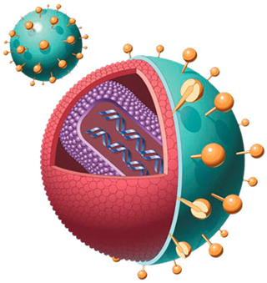

Questions?
spwoods@uh.edu

Slide 38
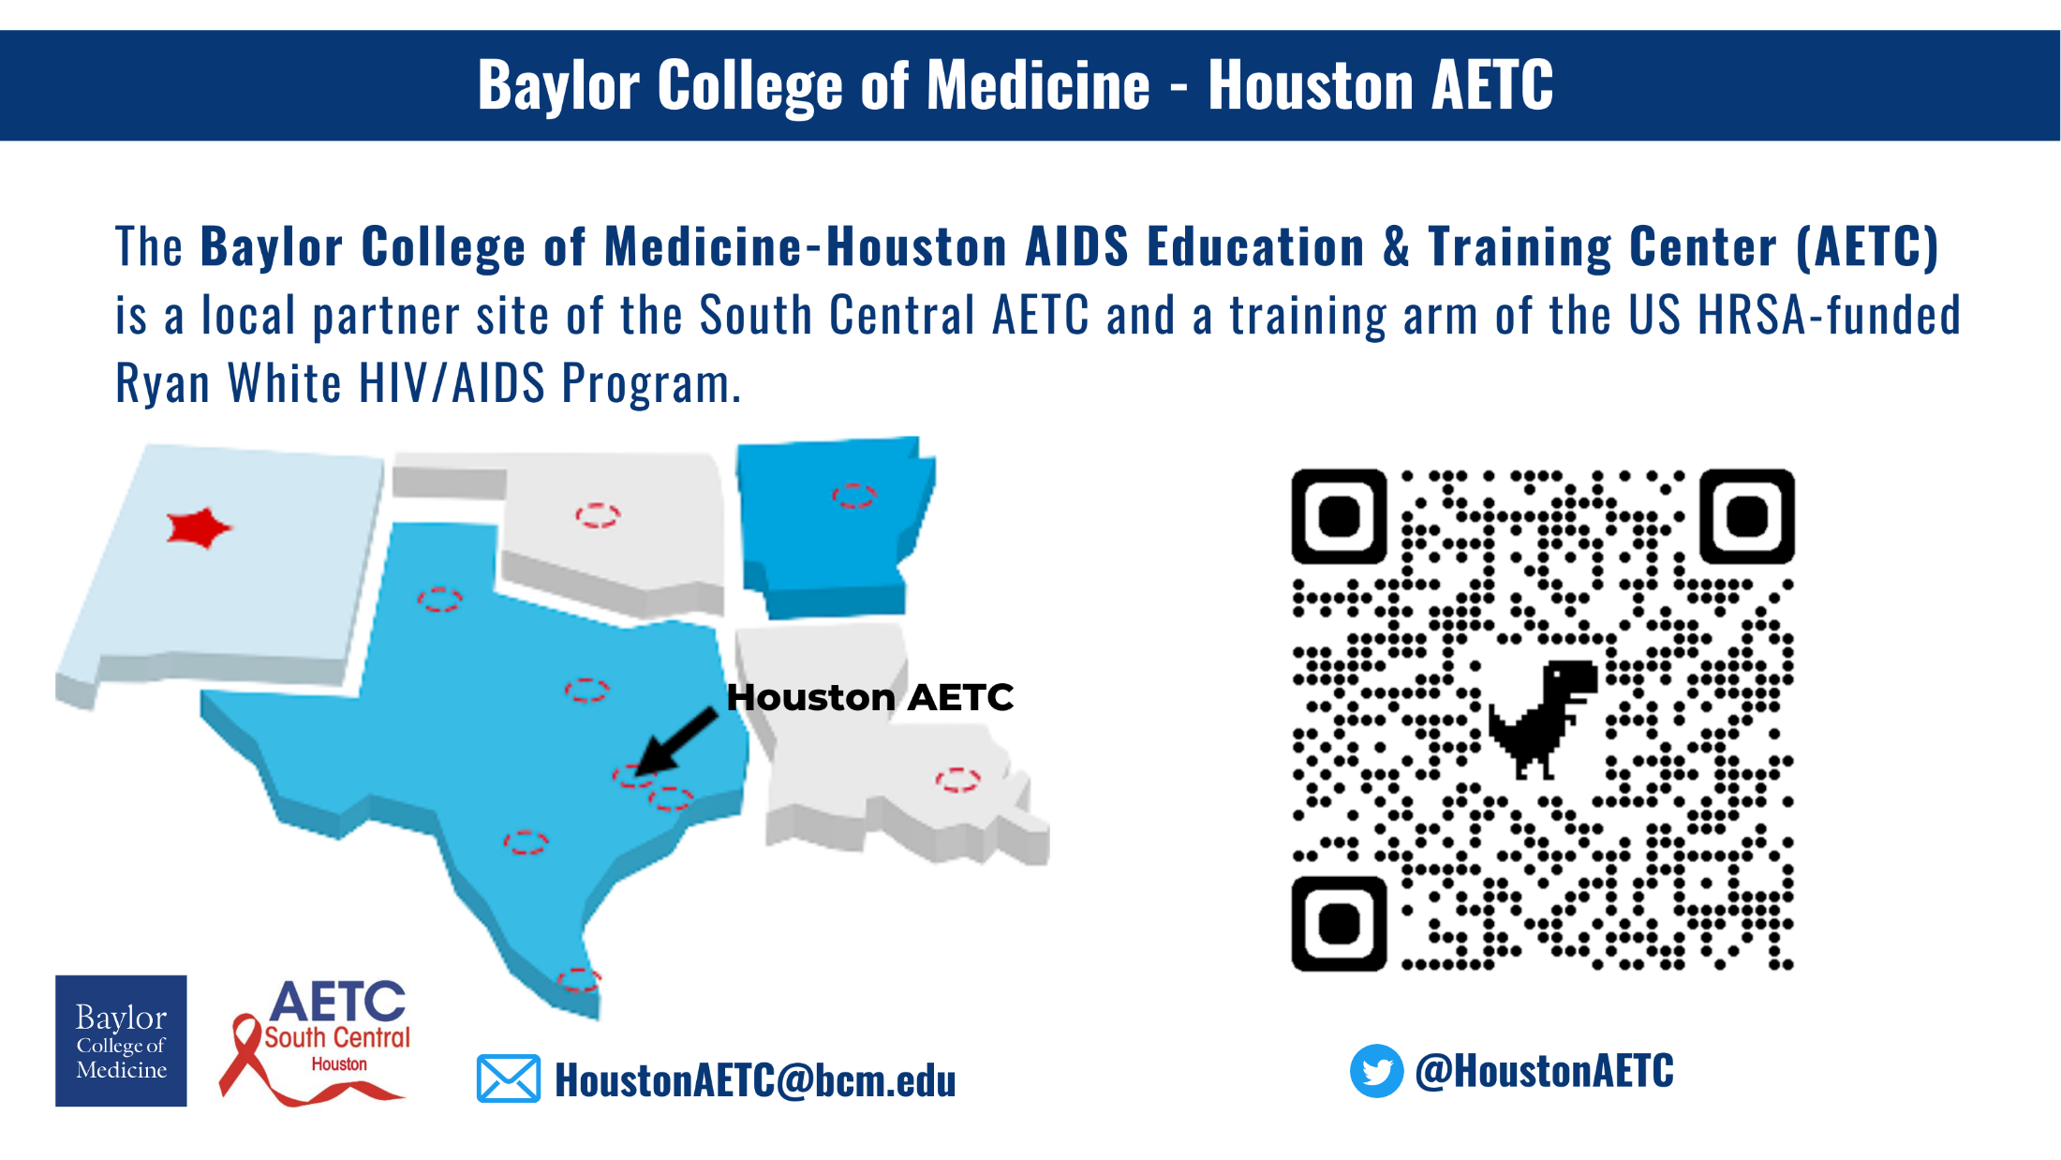

Slide 39
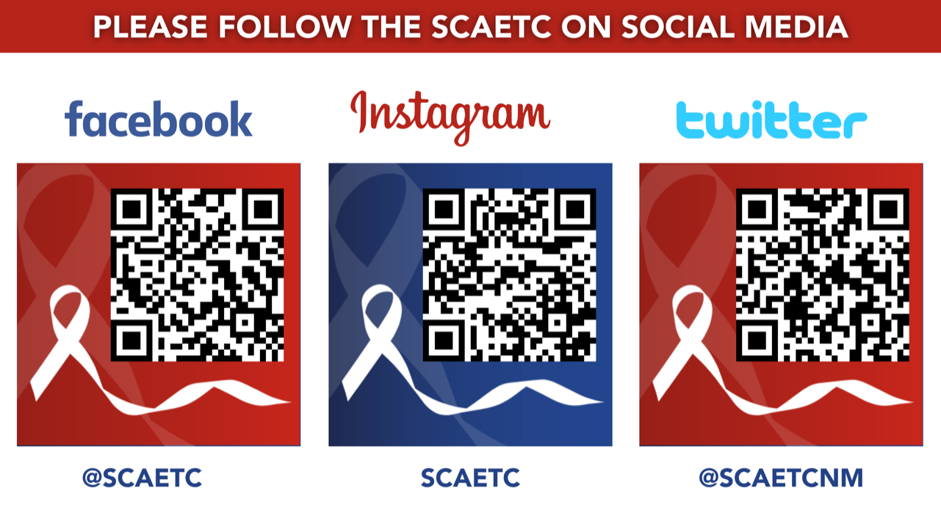
SCAETC Social Media

Slide 40
Resources
National Clinician Consultation Center http://nccc.ucsf.edu/
  HIV Management
  Perinatal HIV
  HIV PrEP
  HIV PEP line
  HCV Management
  Substance Use Management
Present case on ECHO hivecho@salud.unm.edu https://hsc.unm.edu/scaetc/programs-services/echo.html
AETC National HIV Curriculum https://aidsetc.org/nhc
AETC National Coordinating Resource Center https://targethiv.org/library/aetc-national-coordinating-resource-center-0
HIVMA Resource Directory https://www.hivma.org/globalassets/ektron-import/hivma/hivma-resource-directory.pdf
Additional trainings SCAETC scaetcecho@salud.unm.edu www.SCAETC.org
Notes:
Find an HIV-related topic TeleECHO in your area: https://echo.unm.edu/locations-2/echo-hubs-superhubs-united-states/
IDEA Platform: Infectious Diseases Education & Assessment. https://idea.medicine.uw.edu/
AETC National HIV Curriculum: 6 core modules for self study; regularly updated; CME, CNE
Hepatitis C Online Curriculum: https://www.hepatitisc.uw.edu/
Hepatitis B Online Curriculum: https://www.hepatitisb.uw.edu/
National STD Curriculum: https://www.std.uw.edu/

